Slide 1
Requirements for Smuon searches at CLIC
Outline
Signal and Background cross sections
Discriminating variables and event selection
Mass measurement method
Contributions to the errors on the masses
Table of results
Summary
M.Battaglia, J-J.Blaising

Slide 2
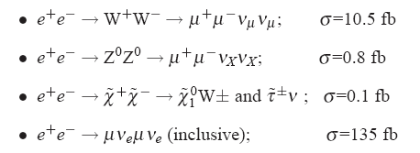
Signal and Background Cross Sections
Signal: e⁺ + e⁻ → μ̃⁺ + μ̃̄ˉ → χ⁰, μ⁺ + χ⁰, μˉ
M μ̃ = 1109 GeV, M χ⁰ = 554 GeV, σ =0.7 fb
Background:

Slide 3
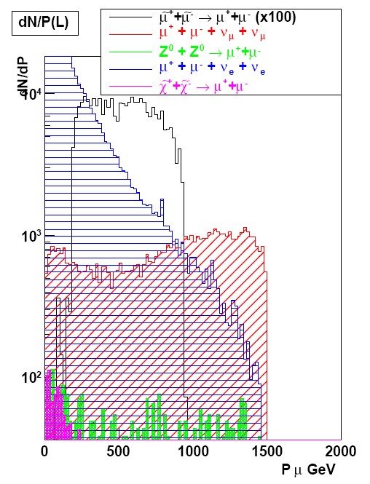
Signal and Background

Slide 4
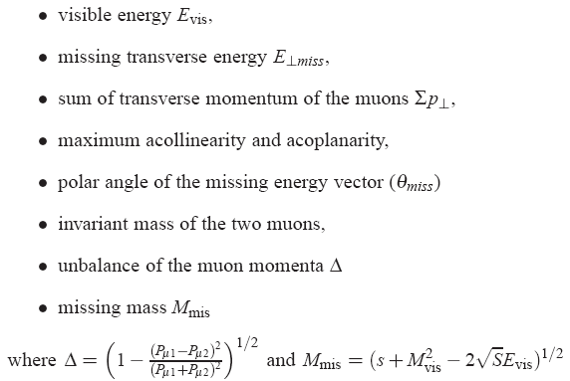
Discriminating variables

Slide 5
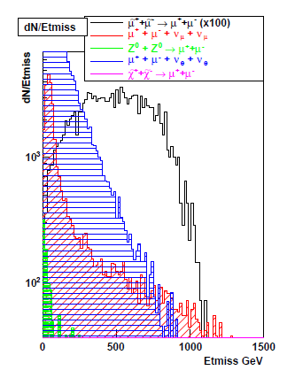
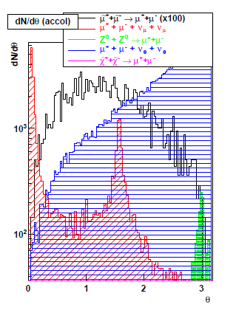
Discriminating variables
Compute normalized S/B probability for each variable, and combined probability: Prob

Slide 6
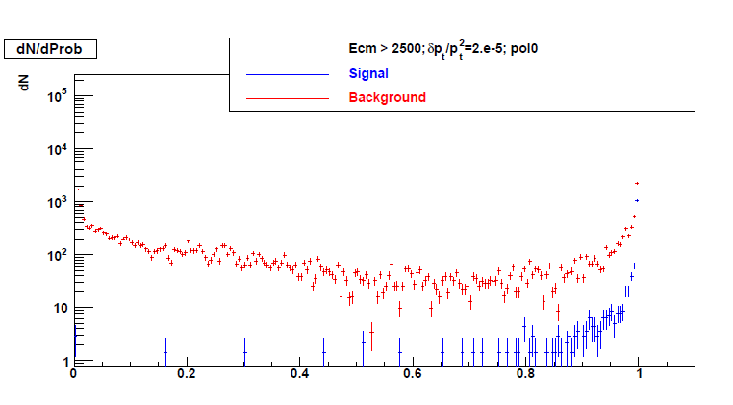
Combined Probability
Prob

Slide 7
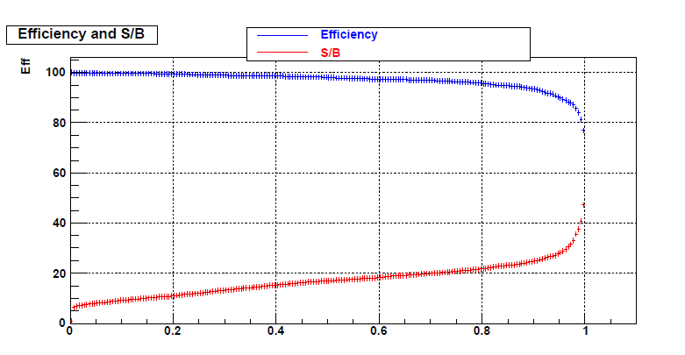
Selection Efficiency and S/B
Prob
For Prob > 0.8, the selection efficiency is 93 % and S/B ~ 20%;
Assume muon identification efficiency = 100%.

Slide 8
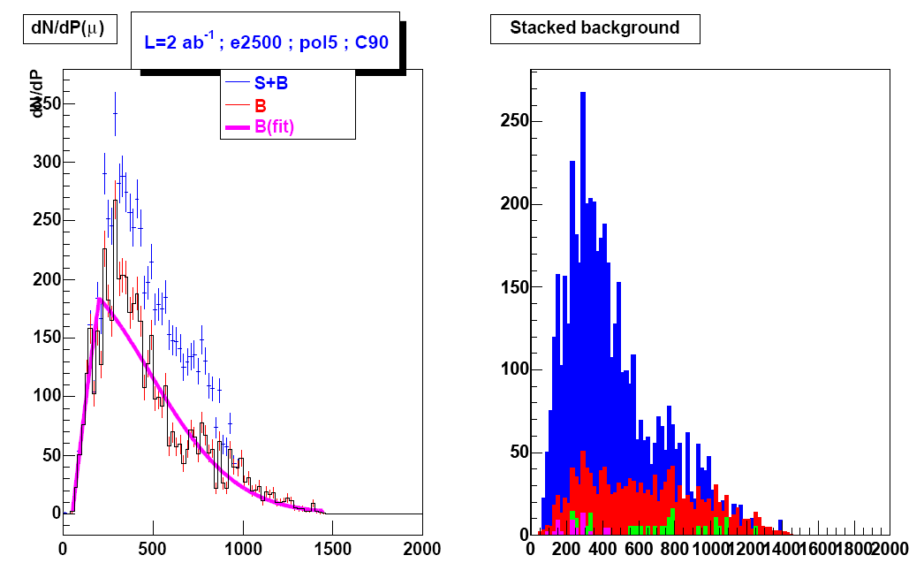
Event Selection

Slide 9
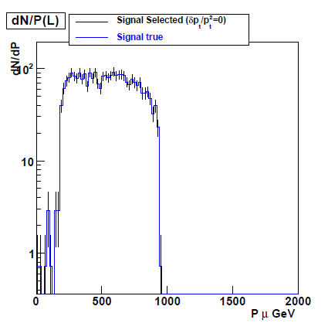
μ̃ and χ⁰ mass measurements
(1)
The μ̃ and χ⁰ masses are determined
from a 2 parameter fit to muon
momentum spectrum. The spectrum
is modeled according to eq (1);
It takes into account ISR,
Beamstrahlung and momentum
resolution effects and the correlation
between the μ̃ and the χ⁰ masses.

Slide 10
ISR and Beamstrahlung effects
The ISR contribution to the energy spread is ~ to the Linac momentum spread

Slide 11
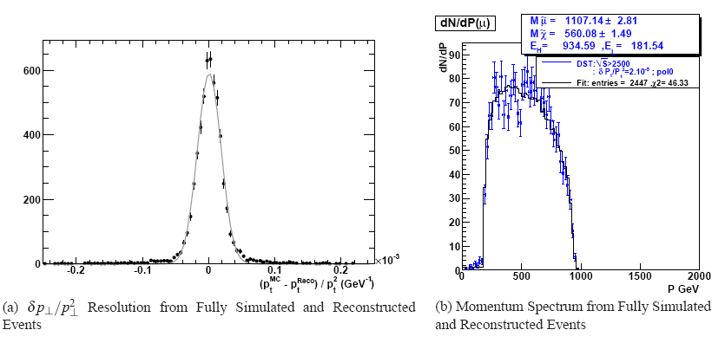
Signal fit

Slide 12
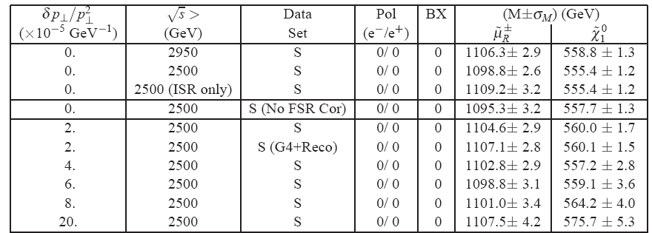
Results

Slide 13
Preliminary results
With 2 abˉ¹ of integrated luminosity
At 3 TeV, ISR and beamstrahlung are major sources to errors on the masses; it requires a good control of the luminosity spectrum.
ISR and BS are the dominant contributions to the errors on the masses as long as δpt/pt² is < 5.10̄ˉ⁵.
Work in progress on Background subtraction, beam polarisation and time stamping

