Slide 1











Track Finding in the Velo at LHCb using Graph Neural Networks
Anthony Correia
15th December 2025
Protection zone
In collaboration with

Slide 2
1
Beginner Introduction
2
Neural Network Introduction
3
Problem Formulation
4
Experimental Setup
5
Exa.TrkX Pipeline
6
From Exa.TrkX to ETX4VELO
7
Implementation in Allen
8
Optimization

Slide 3
1
Beginner Introduction
a
Particle Physics
b
LHCb Detector
c
Track Finding
d
Summary

Slide 4

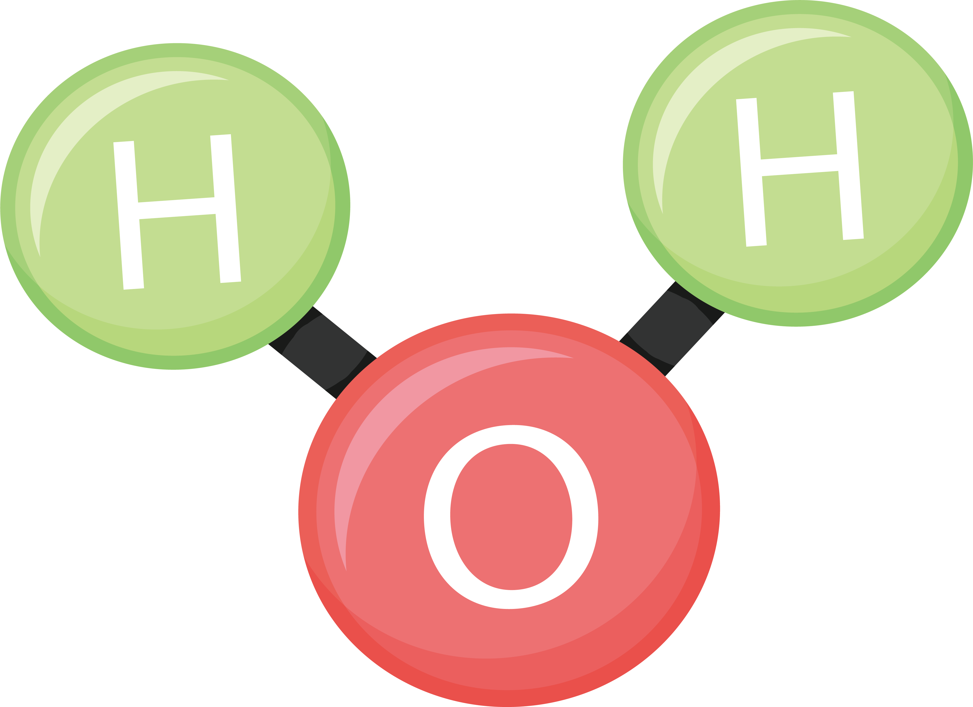

Beginner Introduction
1
a
Glass of Water
Molecule H₂0
Atom O
Nucleus O
1 atome O
+ 2 atomes H
Nucleus O
+ 8 electrons e⁻
8 protons p
+ 8 neutrons n
Not in scale!
Notes:
Particle physics: scale of protons and neutrons and below

Slide 5











































Beginner Introduction
1
a
Somes particles very unstable.
They decay really fast.
$$τ^{+}$$
$$\overline{D^{0}}$$
$$e^{−}$$
$$μ^{+}$$
$$p$$
$$n$$
…
2 ps
$$μ^{−}$$
$$τ^{−}$$
$$Σ^{−}$$
$$B^{0}$$
$$e^{+}$$
$$K^{0}$$
$$e^{−}$$
$$ν_{e}$$
$$ν_{μ}$$
$$ν_{τ}$$
$$Σ^{0}$$
$$K^{+}$$
$$\overline{K^{0}}$$
$$Σ^{+}$$
$$K^{−}$$
$$\overline{B^{0}}$$
$$\overline{ν_{e}}$$
$$\overline{ν_{μ}}$$
$$\overline{ν_{τ}}$$
$$π^{+}$$
$$B^{+}$$
$$\overline{ν_{e}}$$
$$π^{0}$$
$$B^{0}$$
$$π^{−}$$
$$B^{−}$$
$$γ$$
$$H$$
$$g$$
$$D^{0}$$
Standard Model: theory of particle physics
$$W^{−}$$
$$\overline{D^{0}}$$
$$D^{−}$$
$$W^{+}$$
$$D^{+}$$
How to study them?

Slide 6









Beginner Introduction
1
a
We produce them and detect them right away.
$$e^{−}$$
Particle "Producer"
$$π^{−}$$
$$\overline{ν_{e}}$$
$$K^{−}$$
$$\overline{D^{0}}$$
$$B^{0}$$
$$π^{+}$$
$$e^{−}$$
$$\overline{ν_{e}}$$
…
How to produce them?
Particle detector

Slide 7


Beginner Introduction
1
a
We produce them and detect them right away.
100 billions of protons
100 billions of protons
$$e^{−}$$
$$π^{−}$$
$$\overline{ν_{e}}$$
$$K^{−}$$
$$\overline{D^{0}}$$
$$B^{0}$$
$$π^{+}$$
$$e^{−}$$
Proton-proton collision
$$\overline{ν_{e}}$$
…
How to detect them?
Particle detector

Slide 8


Beginner Introduction
1
b
Tracking detector
RICH detectors
Calorimeters
Muon Chamber
Measure trajectories
Identification
Energy measurement
Identification
Collision reconstructed using computers, and saved to disk

Slide 9
Beginner Introduction
1
c
Track Finding

Slide 10






Beginner Introduction
1
d
Other LHCb subdetectors
Proton-proton collision
$$K^{+}$$
$$φ$$
$$K^{−}$$
$$e^{−}$$
$$J/ψ$$
$$e^{+}$$
Tracking detector

Slide 11
1
Beginner Introduction
2
Neural Network Introduction
3
Problem Formulation
4
Experimental Setup
5
Exa.TrkX Pipeline
6
From Exa.TrkX to ETX4VELO
7
Implementation in Allen
8
Optimization

Slide 12
2
Neural Network Introduction
a
Fitting a One-Dimensional Function
b
Multi-Layer Perceptron
c
Different Types of Neural Networks

Slide 13
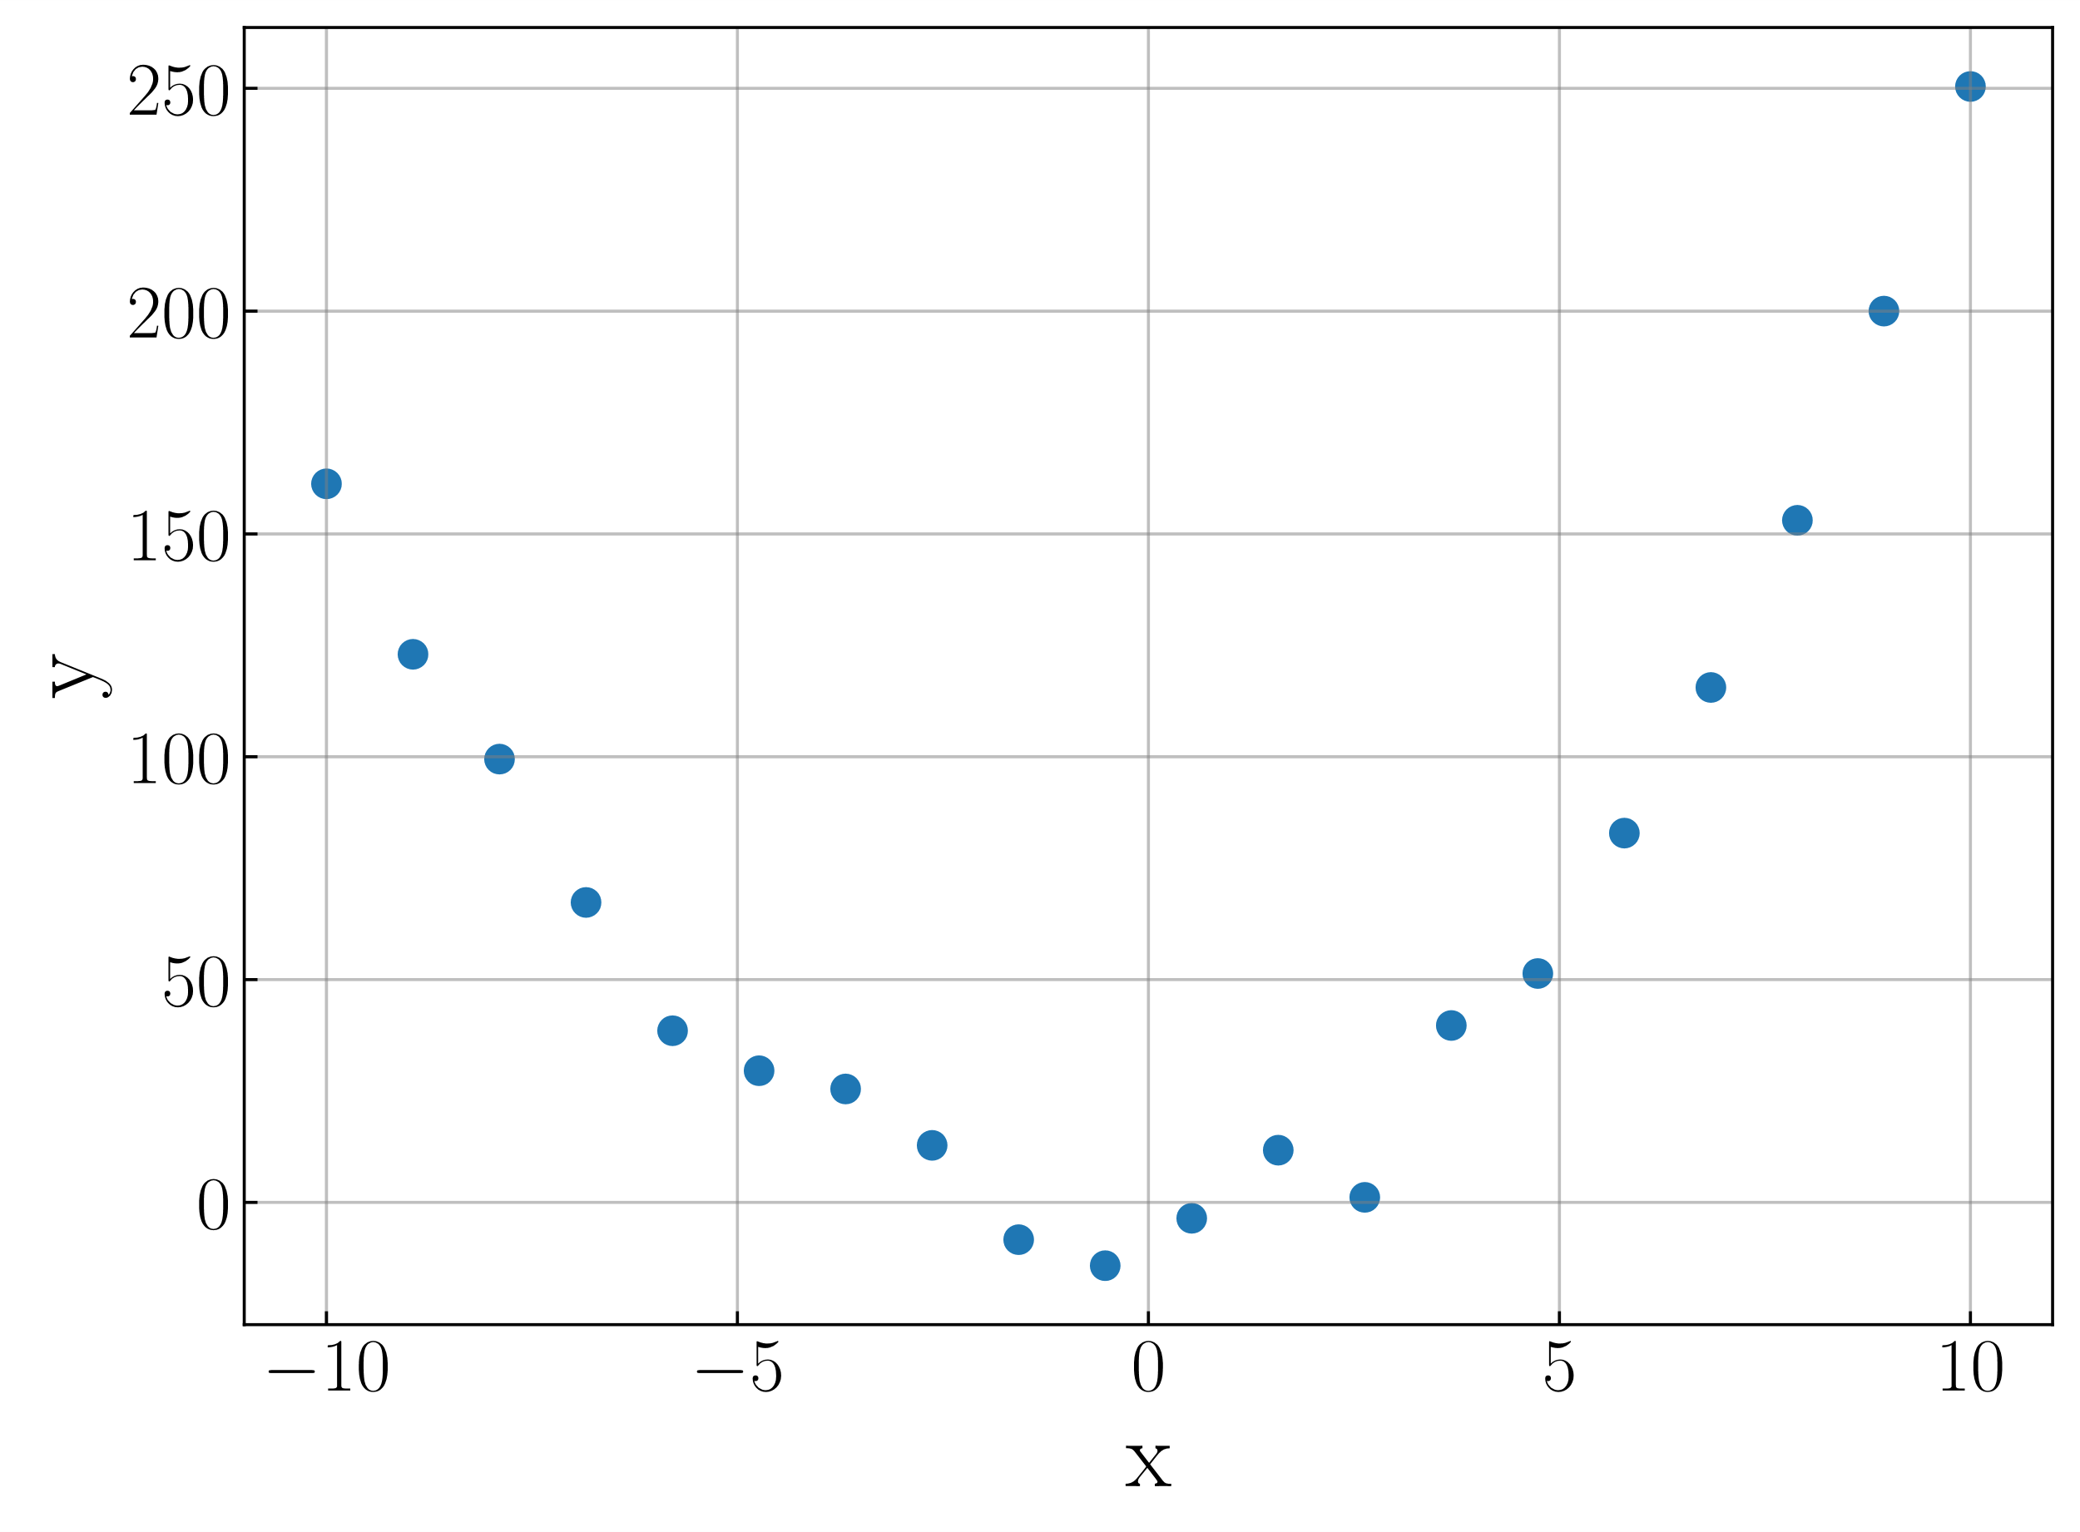
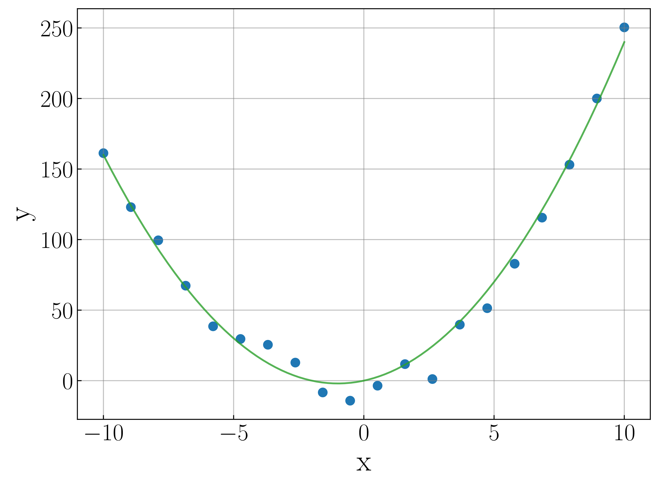


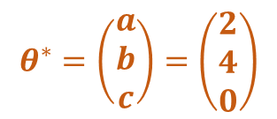

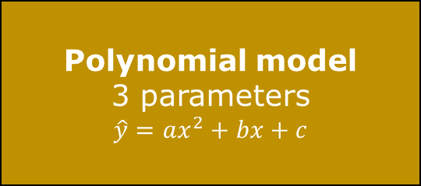

Neural Network Introduction
2
a
Regression problem: Predict $y∈ℝ$ from $x∈ℝ$
Predicted target $\hat{y}$
Target $y$
Polynomial model
3 parameters
$$\hat{y}=ax^{2}+bx+c$$
?
$$θ^{∗}=\left(\begin{aligned}a \\ b \\ c\end{aligned}\right)=\left(\begin{aligned}2 \\ 4 \\ 0\end{aligned}\right)$$
Input $x$
Input $x$
1. Model selection
Choose best model $f_{θ}$
1. Model selection
Choose best model 𝑓_𝜃
2. Training
Find optimal parameters $θ^{⋆}$
2. Training
Find optimal parameters 𝜃^⋆
3. Inference
Use the model for other examples
What if multi-dimensional data?

Slide 14
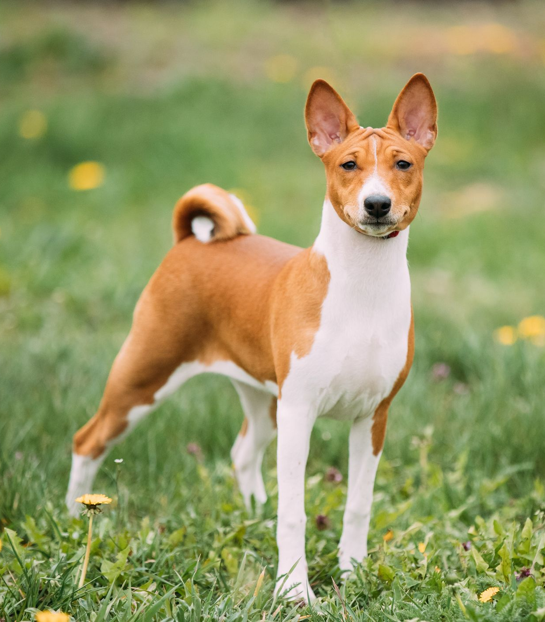

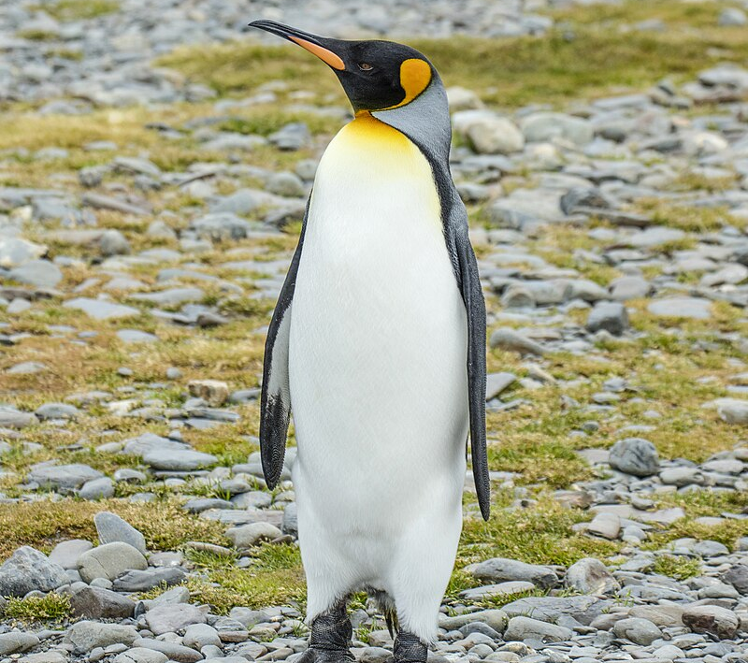


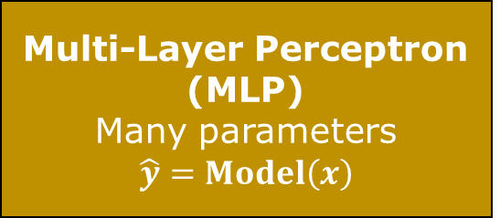

Neural Network Introduction
2
b
Binary classification problem: predict picture $→$ is this a cat
Input: vectors made of the pixel values of the picture
Output: Probability of being a cat, between $0$ (no) and $1$ (yes)
Multi-Layer Perceptron (MLP)
Many parameters
$$\hat{y}=Model\left(x\right)$$
?
0.4
0.9
0.2
$s>s_{min}=0.5$
Model Choice: Multi-Layer Perceptron (MLP) [many parameters]
Training: Needs for:
Much more data
Much more computing resource
Inference: Apply a minimum score threshold: $s>s_{min}=0.5$

Slide 15



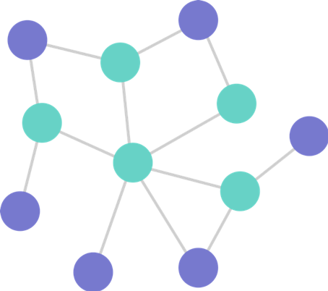

Neural Network Introduction
2
c
Input
Neural Network Model Family
Pictures
Convolutional Neural Network (CNN)
Sequences: text , audio , …
Recursive Neural Network (RNN)
Graph Neural Network (GNN)
Graph
Deep Learning Library:

Slide 16
1
Beginner Introduction
2
Neural Network Introduction
3
Problem Formulation
4
Experimental Setup
5
Exa.TrkX Pipeline
6
From Exa.TrkX to ETX4VELO
7
Implementation in Allen
8
Optimization

Slide 17
3
Problem Formulation
a
Track Finding in the Velo
b
Allen: a Fully GPU-Based Trigger
c
Motivations
Notes:
Improve physics performance.
See thesis manuscript for extensive description.
NB: this is not Exa.TrkX vs ETX4VELO

Slide 18
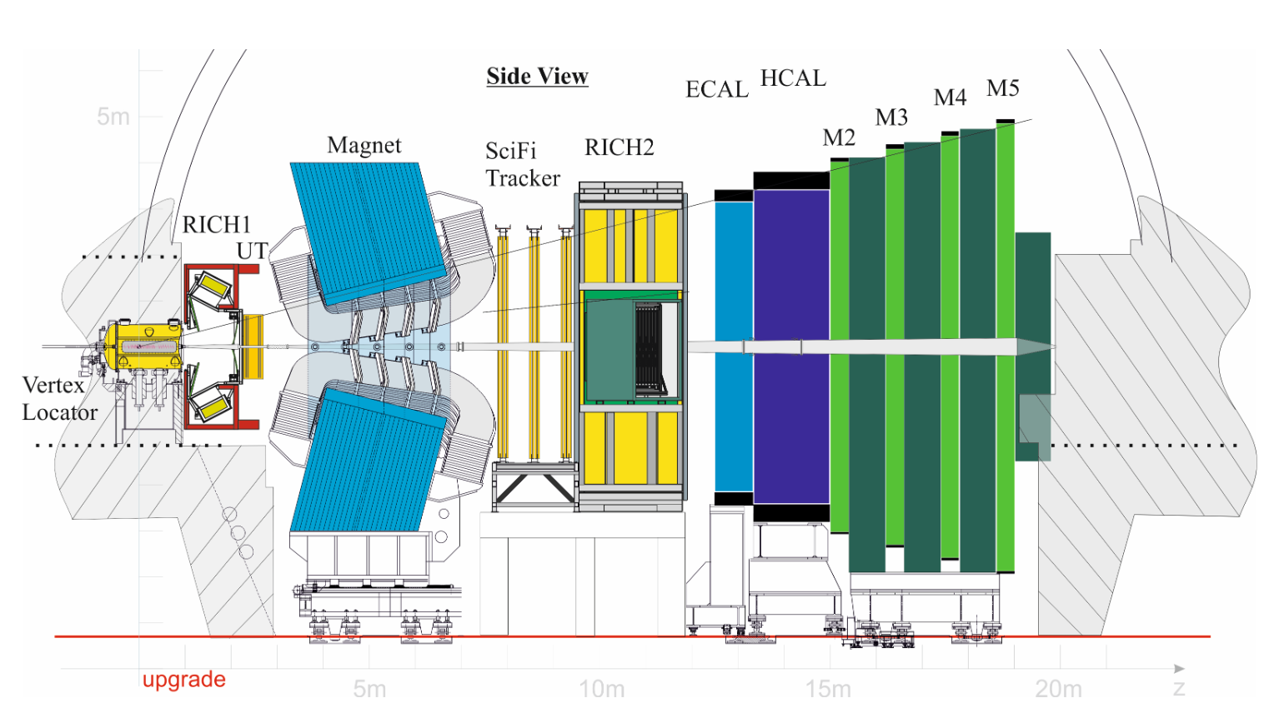

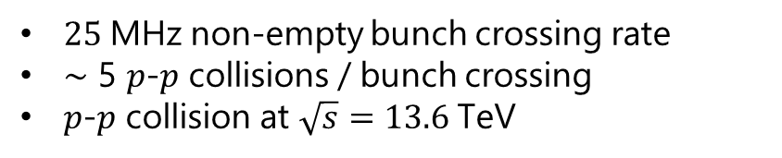

Problem Formulation
3
a
Velo
Vertex Locator
With silicon pixels
No magnetic field
UT
Upstream Tracker
With silicon strips
SciFi
With Scintillating Fibres
Magnet
$$x$$
Primary vertices
Secondary Vertices
Seeds
$$z$$
Collisions (Run 3)
$25 \text{MHz}$ non-empty bunch crossing rate
$\sim$ 5 $p$-$p$ collisions / bunch crossing
$p$-$p$ collision at $\sqrt{s}=13.6 \text{TeV}$

Slide 19
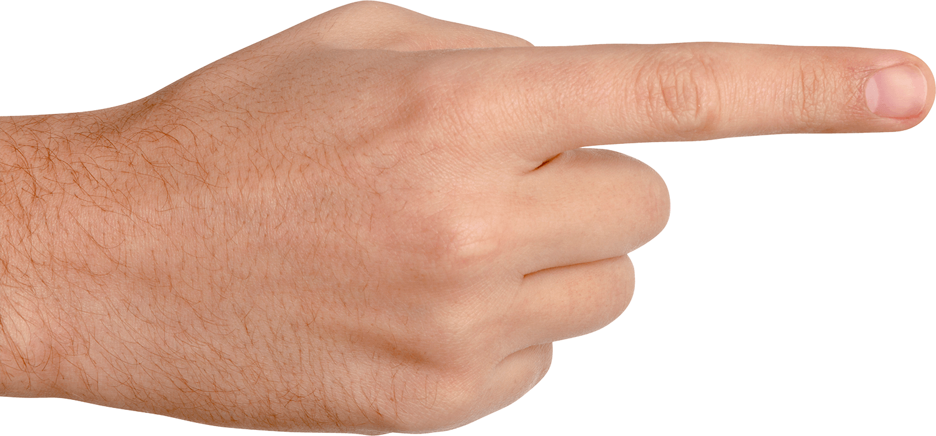



Problem Formulation
3
a
Velo
Vertex Locator
With silicon pixels
UT
Upstream Tracker
With silicon strips
SciFi
With Scintillating Fibres
Magnet stations
$$x$$
Long particle
Reconstructible in the Velo and SciFi
26 layers
$$z$$
Magnetic field $\vec{B}$
Velo-only particle
Reconstructible in the Velo only
No momentum measurement

Slide 20
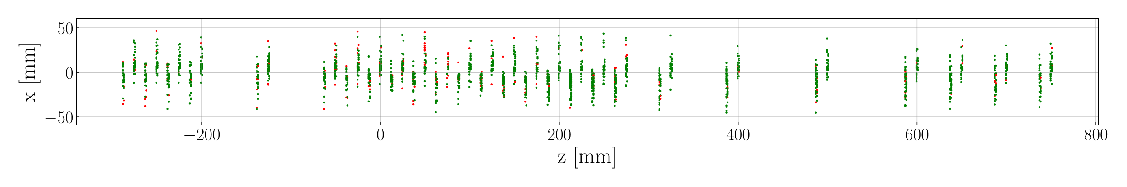
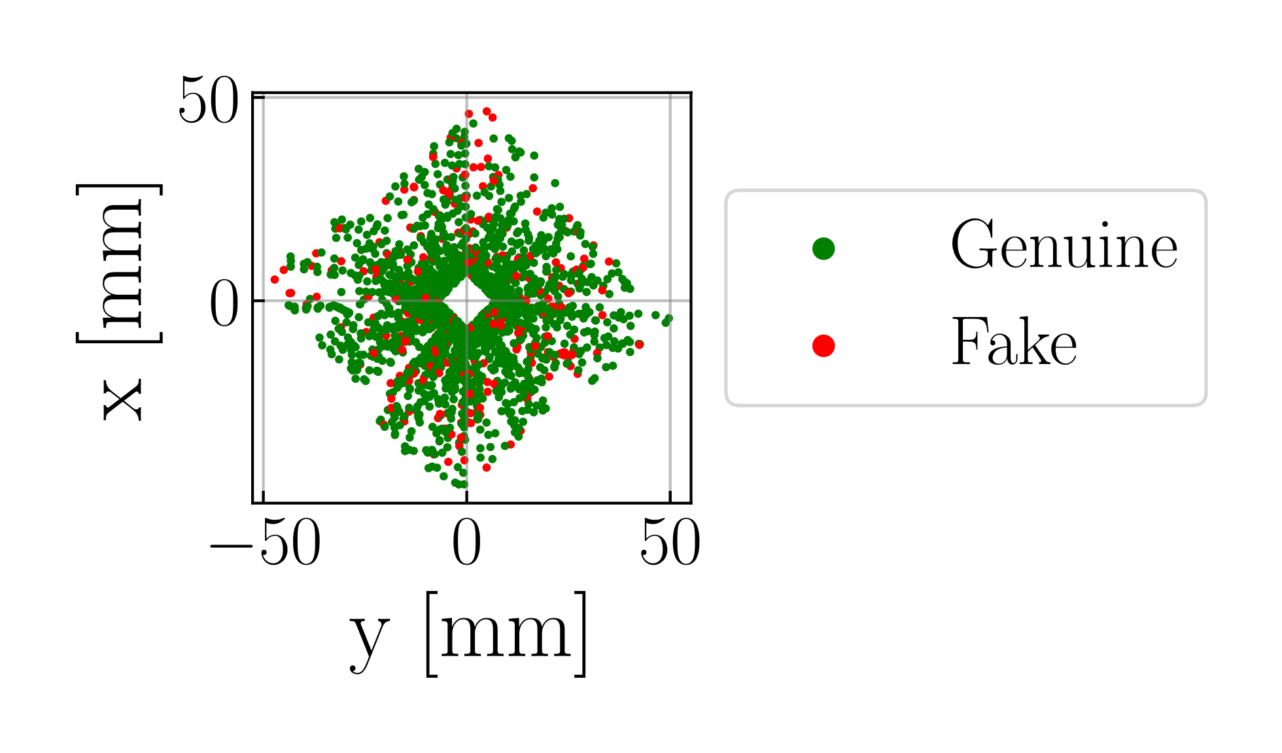
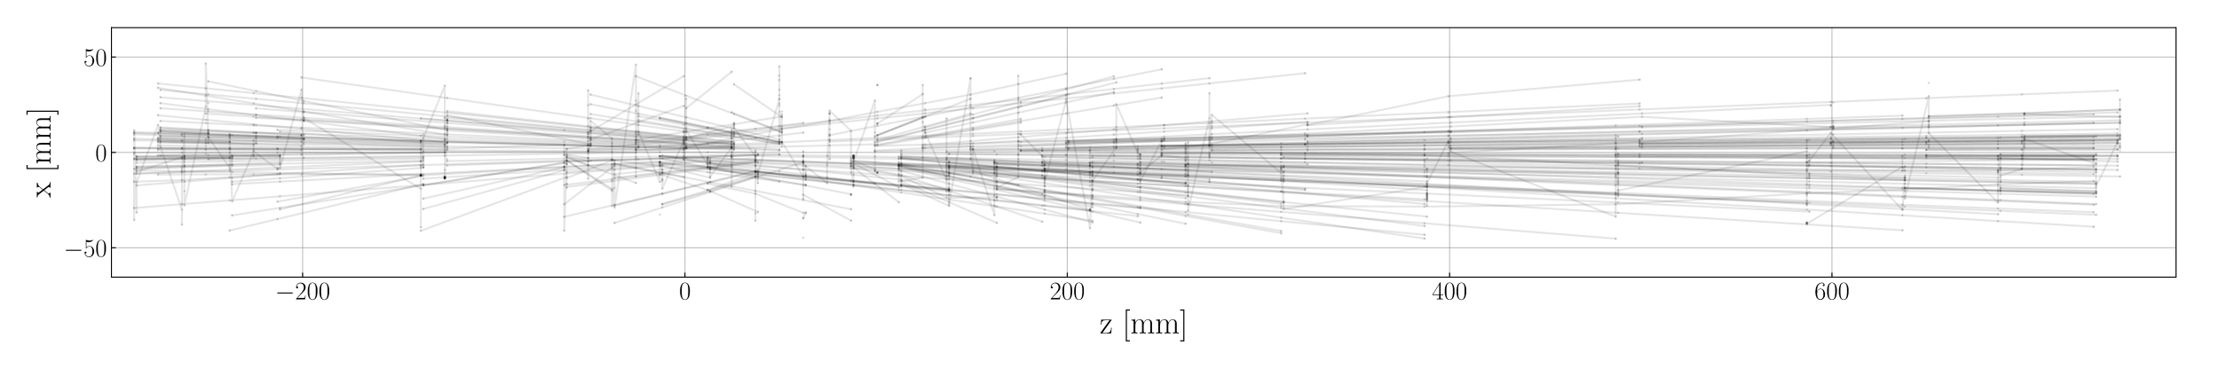
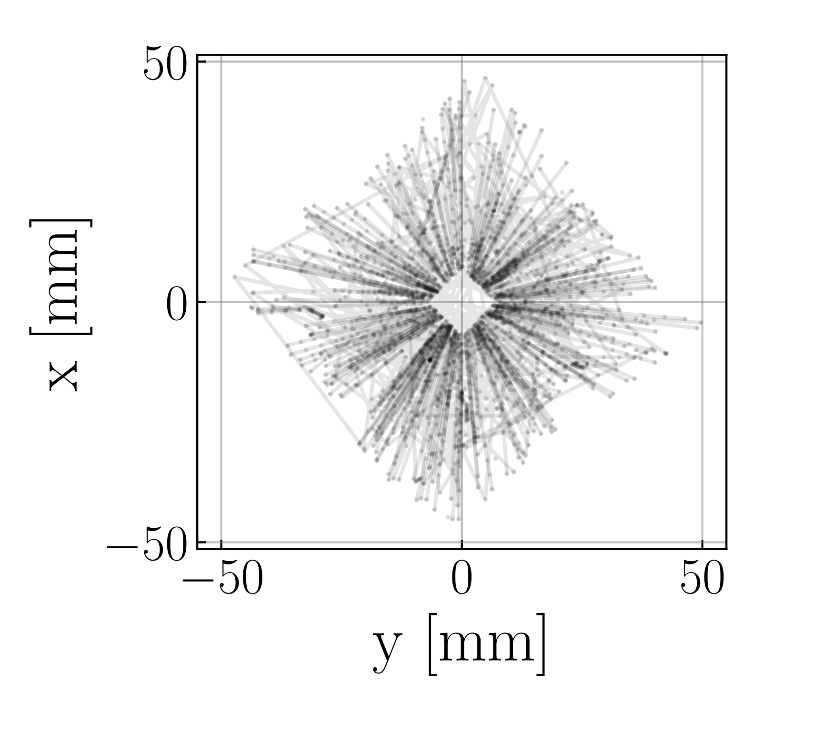
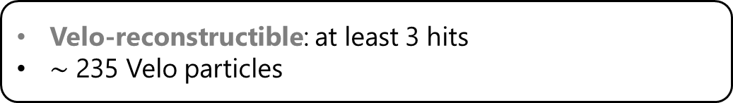
Problem Formulation
3
a
2000 hits
13% fake hits
Track Finding
Velo-reconstructible: at least 3 hits
$\sim$ 235 Velo particles

Slide 21
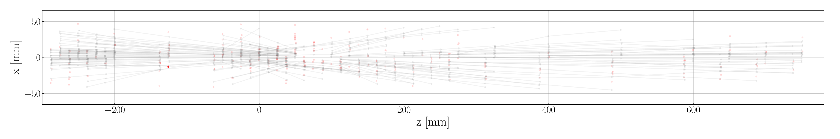
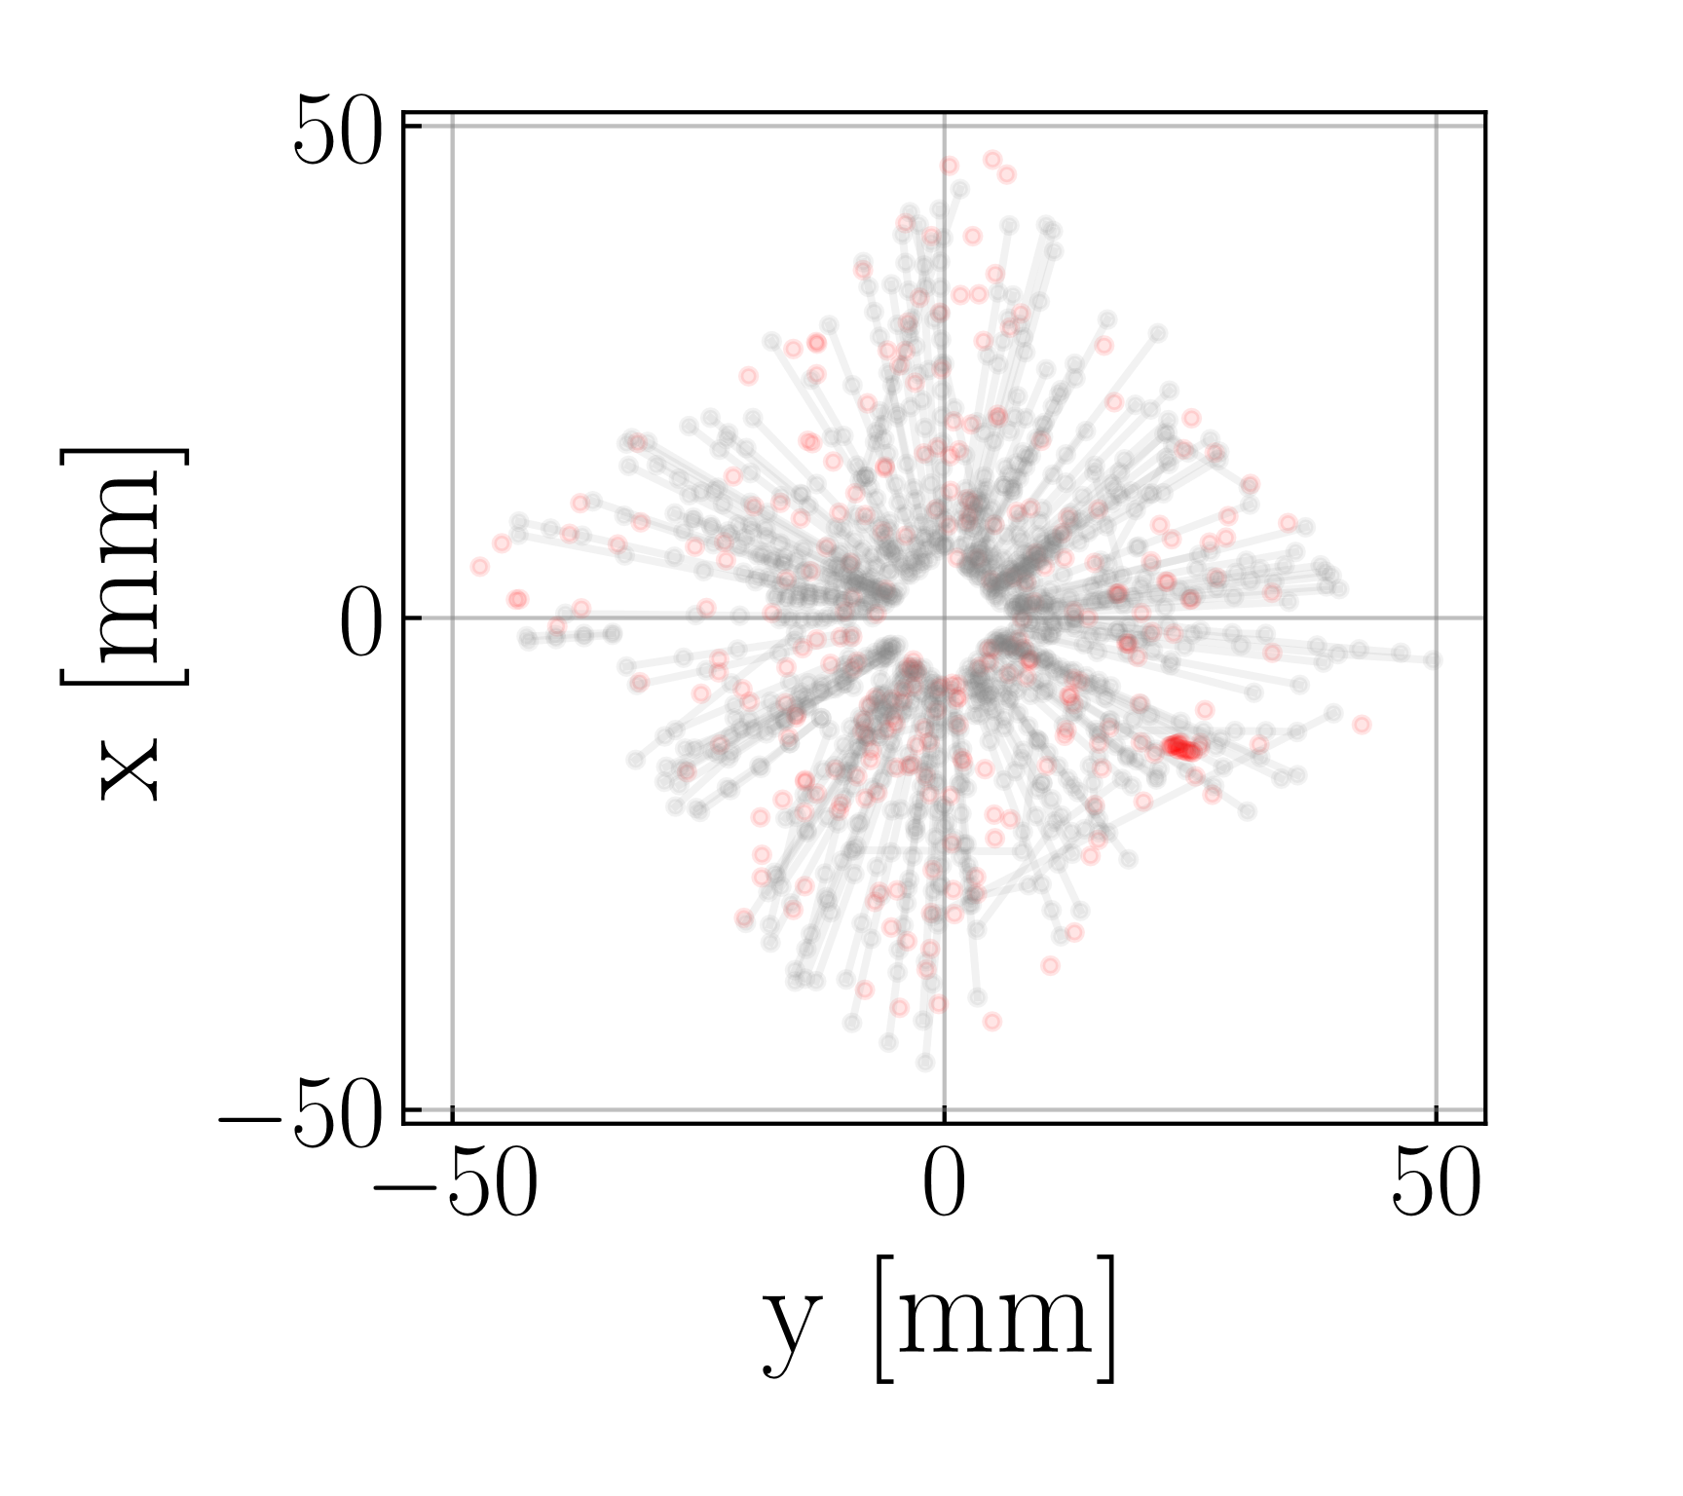
Problem Formulation
3
a
Category | Proportion | # particles / event
Velo | 100% | 235
Velo-only | 73.50% | 172

Slide 22
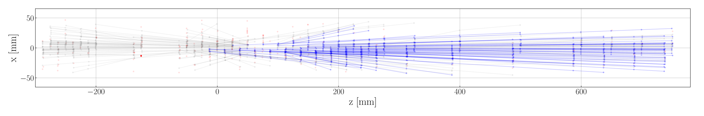
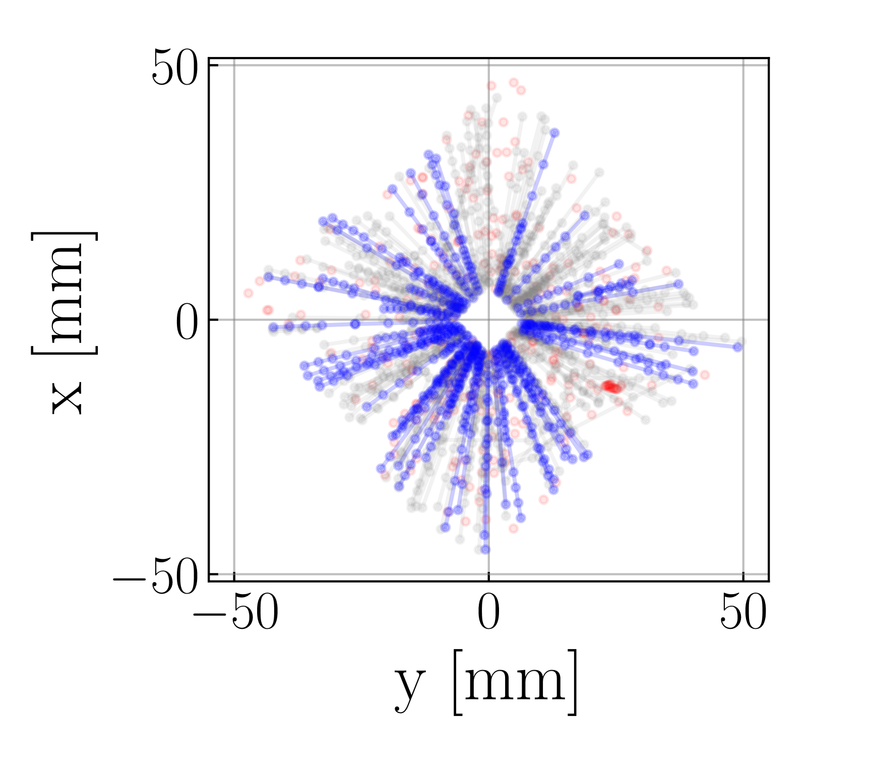
Problem Formulation
3
a
Category | Proportion | # particles / event
Velo | 100% | 235
Velo-only | 73.50% | 172
Long no electrons | 24.74% | 58

Slide 23
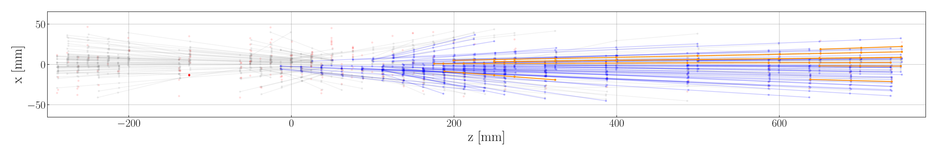
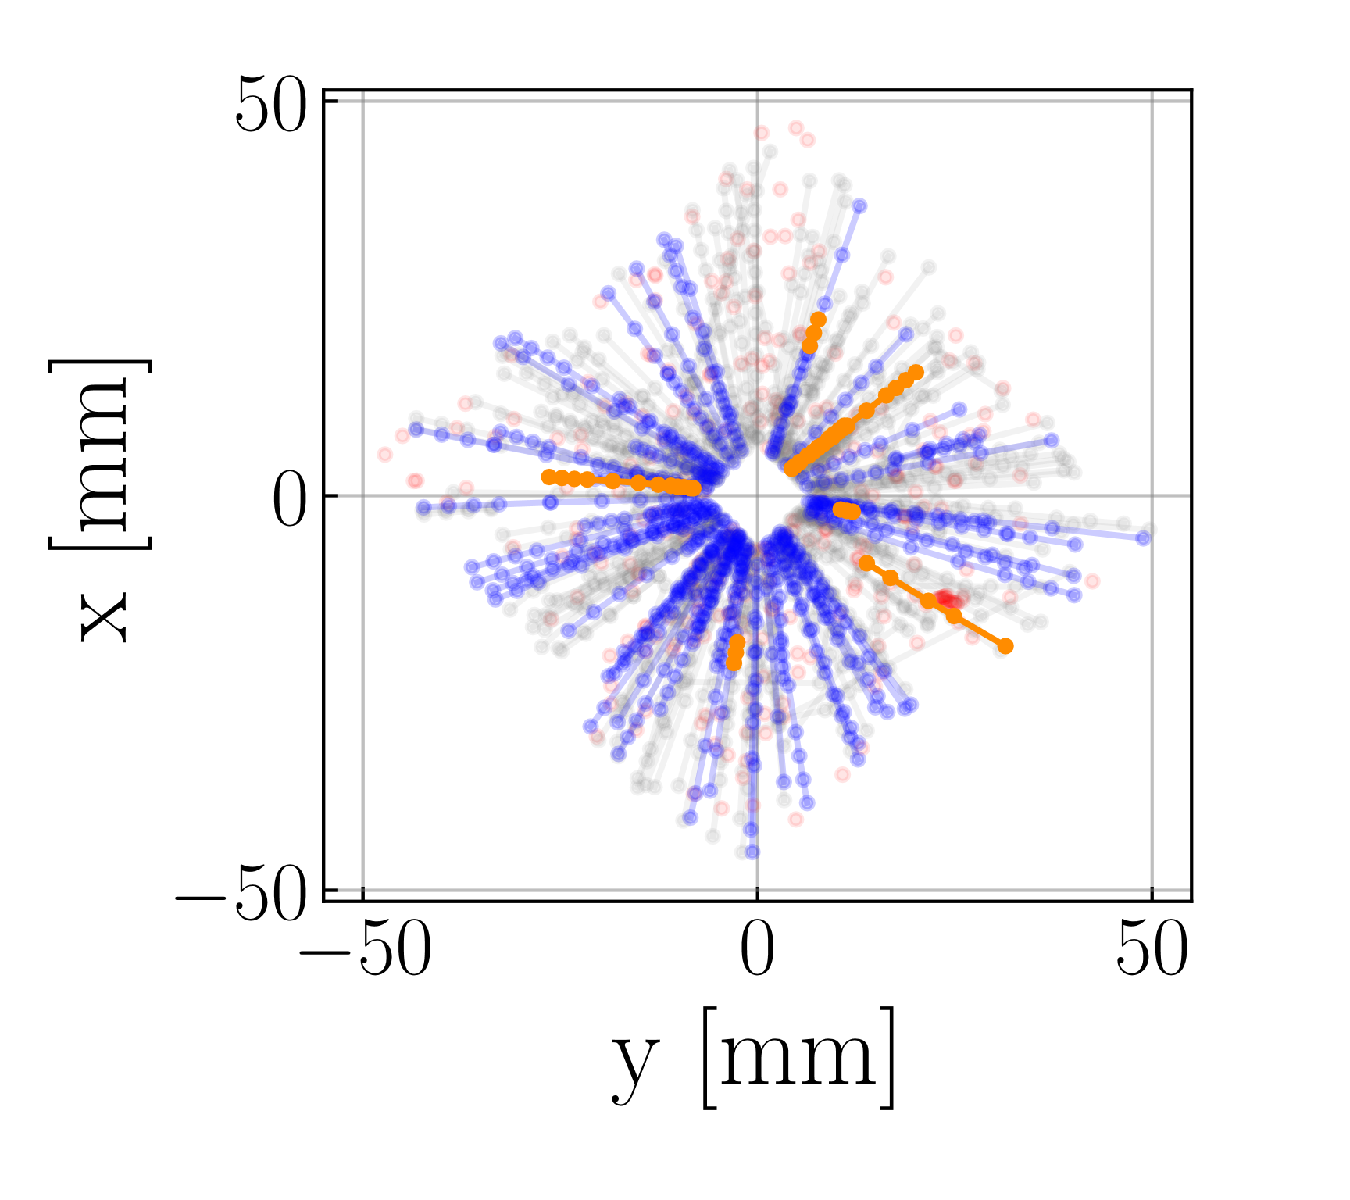
Problem Formulation
3
a
Category | Proportion | # particles / event
Velo | 100% | 235
Velo-only | 73.50% | 172
Long no electrons | 24.74% | 58
Long electrons | 1.58% | 4

Slide 24
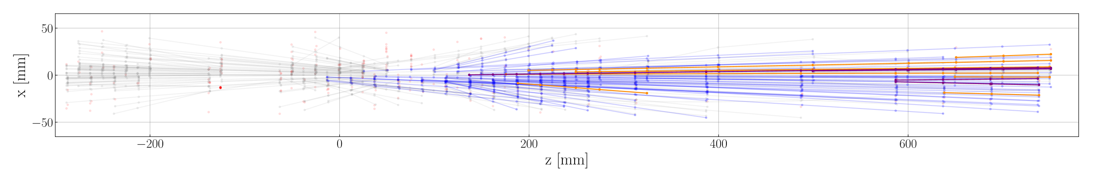
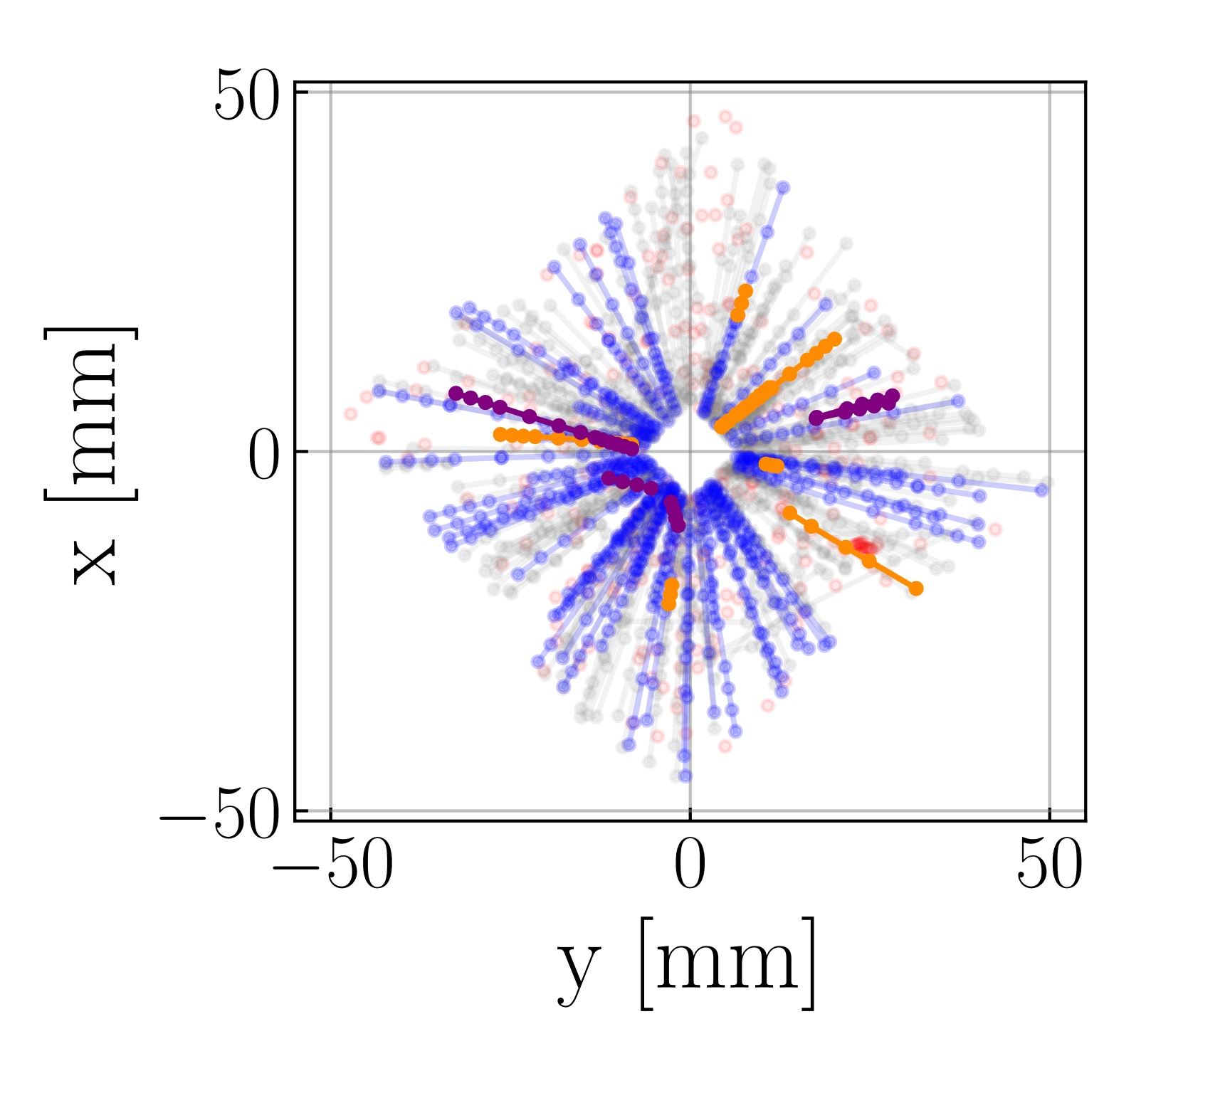
Problem Formulation
3
a
Category | Proportion | # particles / event
Velo | 100% | 235
Velo-only | 73.50% | 172
Long no electrons | 24.74% | 58
Long electrons | 1.58% | 4
Long from strange | 1.11% | 3
Notes:
Main message:
Velo-only: useful for reconstructing primary and secondary vertices
Long no electrons -> global idea of track-finding
Long electrons: different beast. Use for analyses
Long from strange: displaced vertices with weird angles, useful for physics analysis

Slide 25




Problem Formulation
3
a
Particle Trajectories
Straight lines (magnetic field negligible)
Skipped layers: 5% of Velo-reconstructible particles miss at least 1 layer
$$x$$
2
2
2
3.0
3.0
3.0
4
4
4
1
1
2.0
1
6
2.0
6
8
2.0
6
8
8
3
3
3
9
9
1.0
9
1.0
5
1.0
0
5
0
5
0
0.0
7
0.0
7
0.0
7
0.0
1.0
2.0
3.0
4.0
$$z$$
0.0
1.0
2.0
3.0
4.0
$$z$$
0.0
1.0
2.0
3.0
4.0
$$z$$

Slide 26
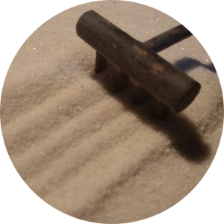
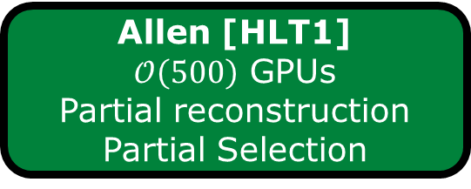
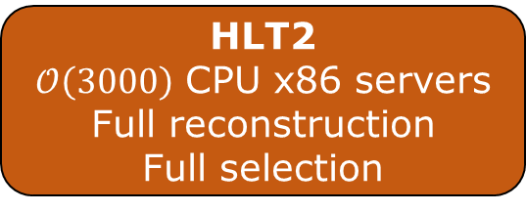
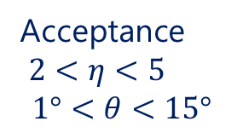
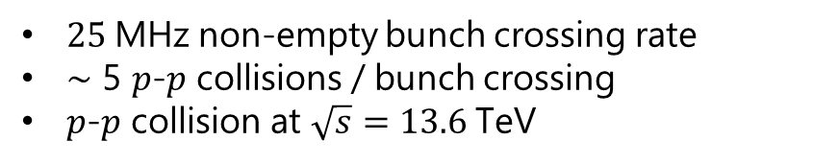
Problem Formulation
3
b
Collisions (Run 3)
$25 \text{MHz}$ non-empty bunch crossing rate
$\sim$ 5 $p$-$p$ collisions / bunch crossing
$p$-$p$ collision at $\sqrt{s}=13.6 \text{TeV}$
LHCb Subdetectors
Acceptance
$2<η<5$
$$1°<θ<15°$$
Digitization
PCIe40 boards
5 TB/s
70-200 GB/s
Allen [HLT1] $𝒪\left(500\right)$ GPUs
Partial reconstruction
Partial Selection
HLT2
$𝒪\left(3000\right)$ CPU x86 servers
Full reconstruction
Full selection
Storage buffer
10 GB/s
Notes:
68%: only reconstructed objects
26%; full events
6% calib events

Slide 27

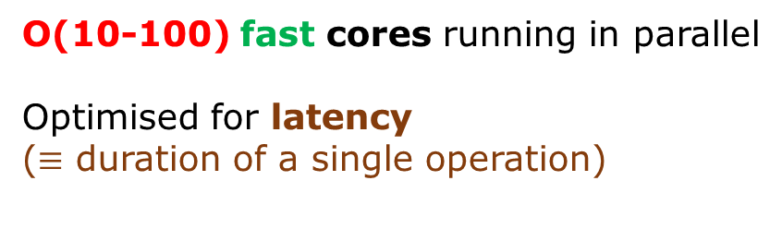
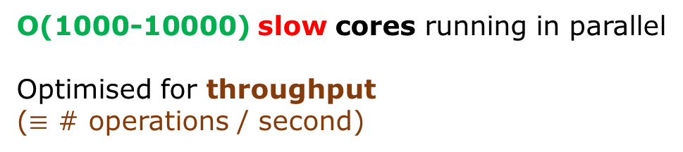
Problem Formulation
3
b
CPU
Central Processor Unit
GPU
Graphical Processor Unit
O(10-100) fast cores running in parallel
Optimised for latency
($≡$ duration of a single operation)
O(1000-10000) slow cores running in parallel
Optimised for throughput
($≡$ # operations / second)
Programming Language for NVIDIA GPUs: CUDA

Slide 28
Problem Formulation
3
b
Allen = framework
Algorithm: C++/CUDA
Sequence: Python
Sequence for "Search by Triplet" algorithm for track-finding in the Velo
initialize_event_lists
initialize_number_of_events
calculate_number_of_retina clusters_each_sensor_pair
decode_retinaclusters
velo_search_by_triplet
velo_three_hit_tracks_filter
velo_copy_track_hit_number
velo_consolidate_tracks

Slide 29
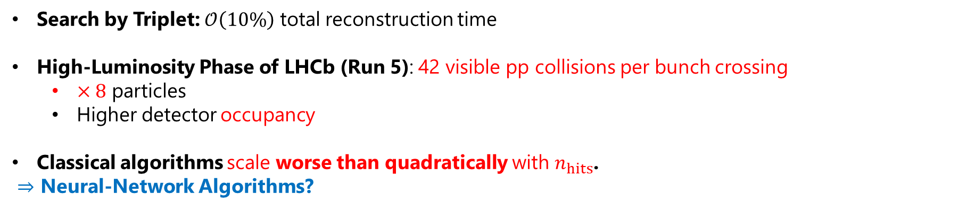
Problem Formulation
3
c
Search by Triplet: $𝒪\left(10\%\right)$ total reconstruction time
High-Luminosity Phase of LHCb (Run 5): 42 visible pp collisions per bunch crossing
$×8$ particles
Higher detector occupancy
Classical algorithms scale worse than quadratically with $n_{hits}$.
$⇒$ Neural-Network Algorithms?
Allen = optimal bench for developping neural network solution
GPU inference
Reference algorithm on GPU (Search by Triplet)
Goal: develop, optimize and evaluate a neural network-based pipeline for track-finding in the Velo

Slide 30
1
Beginner Introduction
2
Neural Network Introduction
3
Problem Formulation
4
Experimental Setup
5
Exa.TrkX Pipeline
6
From Exa.TrkX to ETX4VELO
7
Implementation in Allen
8
Optimization

Slide 31
4
Experimental Setup
a
Evaluation Setup
b
Data Acquisition
c
Performance of Search by Triplet
1. Get Data
2. Define Evaluation Procedure
3. Develop algorithm

Slide 32
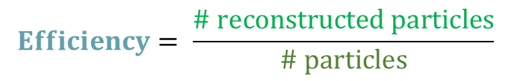
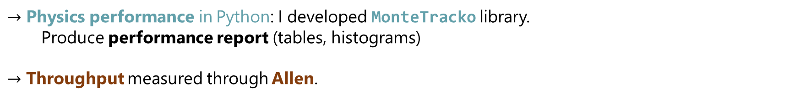
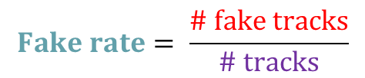
Experimental Setup
4
a
Two kinds of evaluation:
Physics performance: how well particles are recovered
Throughput: # events / second
In this presentation, 2 metrics for physics performance:
$$Efficiency= \frac{\# reconstructed particles}{\# particles}$$
$$Fake rate= \frac{\# fake tracks}{\# tracks}$$
Allen implements both physics performance and throughput evaluation.
$→$ Physics performance in Python: I developed MonteTracko library.
Produce performance report (tables, histograms)
$→$ Throughput measured through Allen.
Notes:
Main message

Slide 33
Experimental Setup
4
b
"local"
CERN grid
Simulated files in the (X)DIGI format
Table of hits
digout library
Table of hits-particles
Table of particles
In format Parquet
With LZ4 compression
digout library: from a bookkeeping path
Find the corresponding (X)DIGI files
Batch submission (HTCONDOR) : conversion of each (X)DIGI file in parallel
Notes:
Main message: digout library allows to do something laborious in a super easy way.

Slide 34
Experimental Setup
4
c
Performance of Search by Triplet on 1000 simulated events (with spillover)
Metric | Category | Search By Triplet
Efficiency | Long, no electrons | 99.35%
 | Long electrons | 97.53%
 | Long from strange | 95.21%
Fake rate |  | 2.19%
Throughput (# events / s) NVIDIA RTX 2080Ti |  | 595 kHz
Physics performance

Slide 35
1
Beginner Introduction
2
Neural Network Introduction
3
Problem Formulation
4
Experimental Setup
5
Exa.TrkX Pipeline
6
From Exa.TrkX to ETX4VELO
7
Implementation in Allen
8
Optimization

Slide 36
5
Exa.TrkX Pipeline
a
Why Graphs?
b
Pipeline Overview
c
Step 1: Embedding + FRNN
d
Step 2: GNN Edge Classifier
e
Results

Slide 37

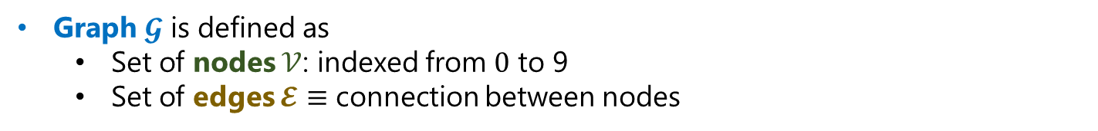
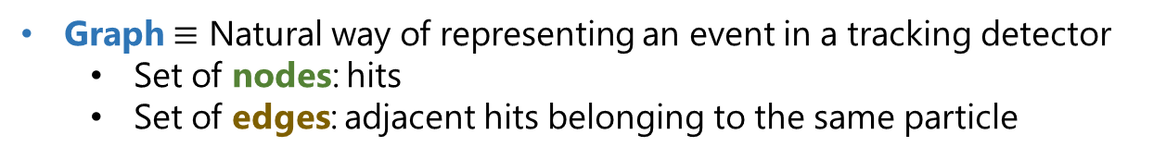
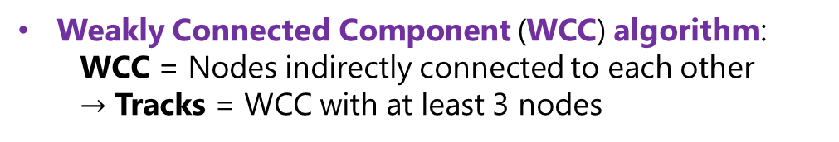

Exa.TrkX Pipeline
5
2
4
a
1
6
8
3
9
0
5
Graph $𝓖$ is defined as
Set of nodes $𝒱$: indexed from $0$ to 9
Set of edges $𝓔$ $≡$ connection between nodes
7
2
3.0
4
2.0
1
6
3
8
1.0
9
Graph $≡$ Natural way of representing an event in a tracking detector
Set of nodes: hits
Set of edges: adjacent hits belonging to the same particle
0
5
0.0
7
0.0
1.0
2.0
3.0
4.0
$$z$$
WCC algorithm
Weakly Connected Component (WCC) algorithm:
WCC = Nodes indirectly connected to each other
$→$ Tracks = WCC with at least 3 nodes
2
3.0
4
2.0
1
6
3
8
1.0
9
0
5
0.0
7
0.0
1.0
2.0
3.0
4.0
$$z$$

Slide 38


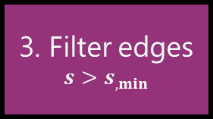


Exa.TrkX Pipeline
5
2
3.0
4
b
2.0
1
6
3
8
1.0
9
0
5
0.0
7
0.0
1.0
2.0
3.0
4.0
$$z$$
2
0.9
2
2
3.0
4
3.0
4
3.0
4
1
6
2.0
1
6
1
1
6
2
2.0
8
3,4
8
2.0
8
3
3
3
9
1.0
9
9
1.0
0
5
0
5
1.0
0
5
0.1
0.0
7
0.0
7
0.0
7
0.0
1.0
2.0
3.0
4.0
$$z$$
0.0
1.0
2.0
3.0
4.0
$$z$$
0.0
1.0
2.0
3.0
4.0
$$z$$
Rough graph
Edge scores
Filtered edges
1. Build Rough Graph
2. GNN
edge classifier
3. Filter edges
$$s>s_{, min}$$
4. WCC algo
Hits
Tracks

Slide 39
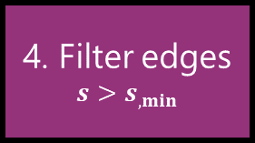
Exa.TrkX Pipeline
5
2
3.0
4
b
2.0
1
6
3
8
1.0
9
0
5
0.0
7
0.0
1.0
2.0
3.0
4.0
$$z$$
2
0.9
2
2
3.0
4
3.0
4
3.0
4
1
6
2.0
1
6
1,2
1
6
3
2.0
8
4,5
8
2.0
8
3
3
3
9
1.0
9
9
1.0
0
5
0
5
1.0
0
5
0.1
0.0
7
0.0
7
0.0
7
0.0
1.0
2.0
3.0
4.0
$$z$$
0.0
1.0
2.0
3.0
4.0
$$z$$
0.0
1.0
2.0
3.0
4.0
$$z$$
Hit embeddings
Rough graph
Edge scores
Filtered edges
1. Embedding network
2. FRNN
3. GNN
edge classifier
4. Filter edges
$$s>s_{, min}$$
5. WCC algo
Hits
Tracks
FRNN: Fixed Radius Nearest Neighbour Search
Build rough graph

Slide 40
Exa.TrkX Pipeline
5
c
Notes:
Main message:
Velo-only: useful for reconstructing primary and secondary vertices
Long no electrons -> global idea of track-finding
Long electrons: different beast. Use for analyses
Long from strange: displaced vertices with weird angles, useful for physics analysis

Slide 41

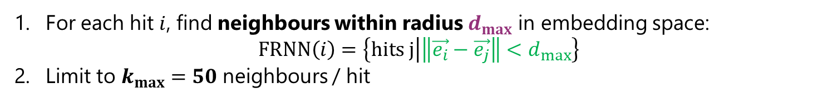
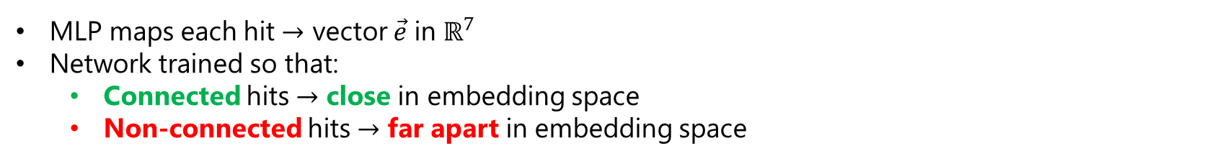


Exa.TrkX Pipeline
5
c
1
$$d_{max}$$
1
3
2
2
3
2
3
2
1
3
1
1
1
2
3
2
2
2
1
2
3
1
1
3
3
1
1
2
2
3
1
2
1
2
3
rough graph
1
3
3
Learn a $d_{emb}$-dimensional embedding
$$\vec{x}=\left(\begin{aligned}r \\ φ \\ z \\ layer\end{aligned}\right)$$
Embedding Network
(MLP)
$$\vec{e}$$
MLP maps each hit $→$ vector $\vec{e}$ in $ℝ^{7}$
Network trained so that:
Connected hits $→$ close in embedding space
Non-connected hits $→$ far apart in embedding space
2
Build candidate edges with Fixed Radius Nearest Neighbours (FRNN)
For each hit $i$, find neighbours within radius $d_{max}$ in embedding space: $FRNN\left(i\right)=\left\{hits j | \left\|\vec{e_{i}}−\vec{e_{j}}\right\|<d_{max}\right\}$
Limit to $k_{max}=50$ neighbours / hit
Add an edge to each neighbour

Slide 42

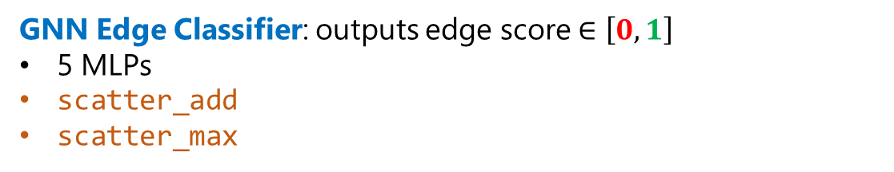


Exa.TrkX Pipeline
5
2
3.0
4
d
2.0
1
6
3
8
1.0
9
3
0
5
GNN Edge Classifier: outputs edge score $∈\left[0, 1\right]$
5 MLPs
scatter_add
scatter_max
0.0
7
0.0
1.0
2.0
3.0
4.0
$$z$$
Cylindrical Hit coordinates
GNN Edge Classifier
Edge scores $S$
Edges
2
0.9
3.0
4
2.0
1
6
3
8
1.0
9
0
5
0.1
0.0
7
0.0
1.0
2.0
3.0
4.0
$$z$$
4
Edge Filtering: $s>s_{min}=0.5$

Slide 43
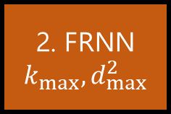
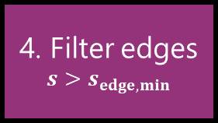
Exa.TrkX Pipeline
5
e
Hit embeddings
Rough graph
Edge scores
Filtered edges
1. Embedding network
2. FRNN
$$k_{max}, d_{max}^{2}$$
3. GNN
edge classifier
4. Filter edges
$$s>s_{edge, min}$$
5. WCC algo
Tracks
Build rough graph
Adaption of the Exa.TrkX pipeline to LHCb data by Fotis Giasemis.
Training/testing with 1000 simulated events without spillover
Metric | Category | Allen | Exa.TrkX
Efficiency | Velo no electrons | 98.25% | 93.72%
 | Long electrons | 96.55% | 64.14%
 | Long from strange | 97.74% | 88.89%
Fake rate |  | 0.88% | 7.50%

Slide 44
1
Beginner Introduction
2
Neural Network Introduction
3
Problem Formulation
4
Experimental Setup
5
Exa.TrkX Pipeline
6
From Exa.TrkX to ETX4VELO
7
Implementation in Allen
8
Optimization

Slide 45
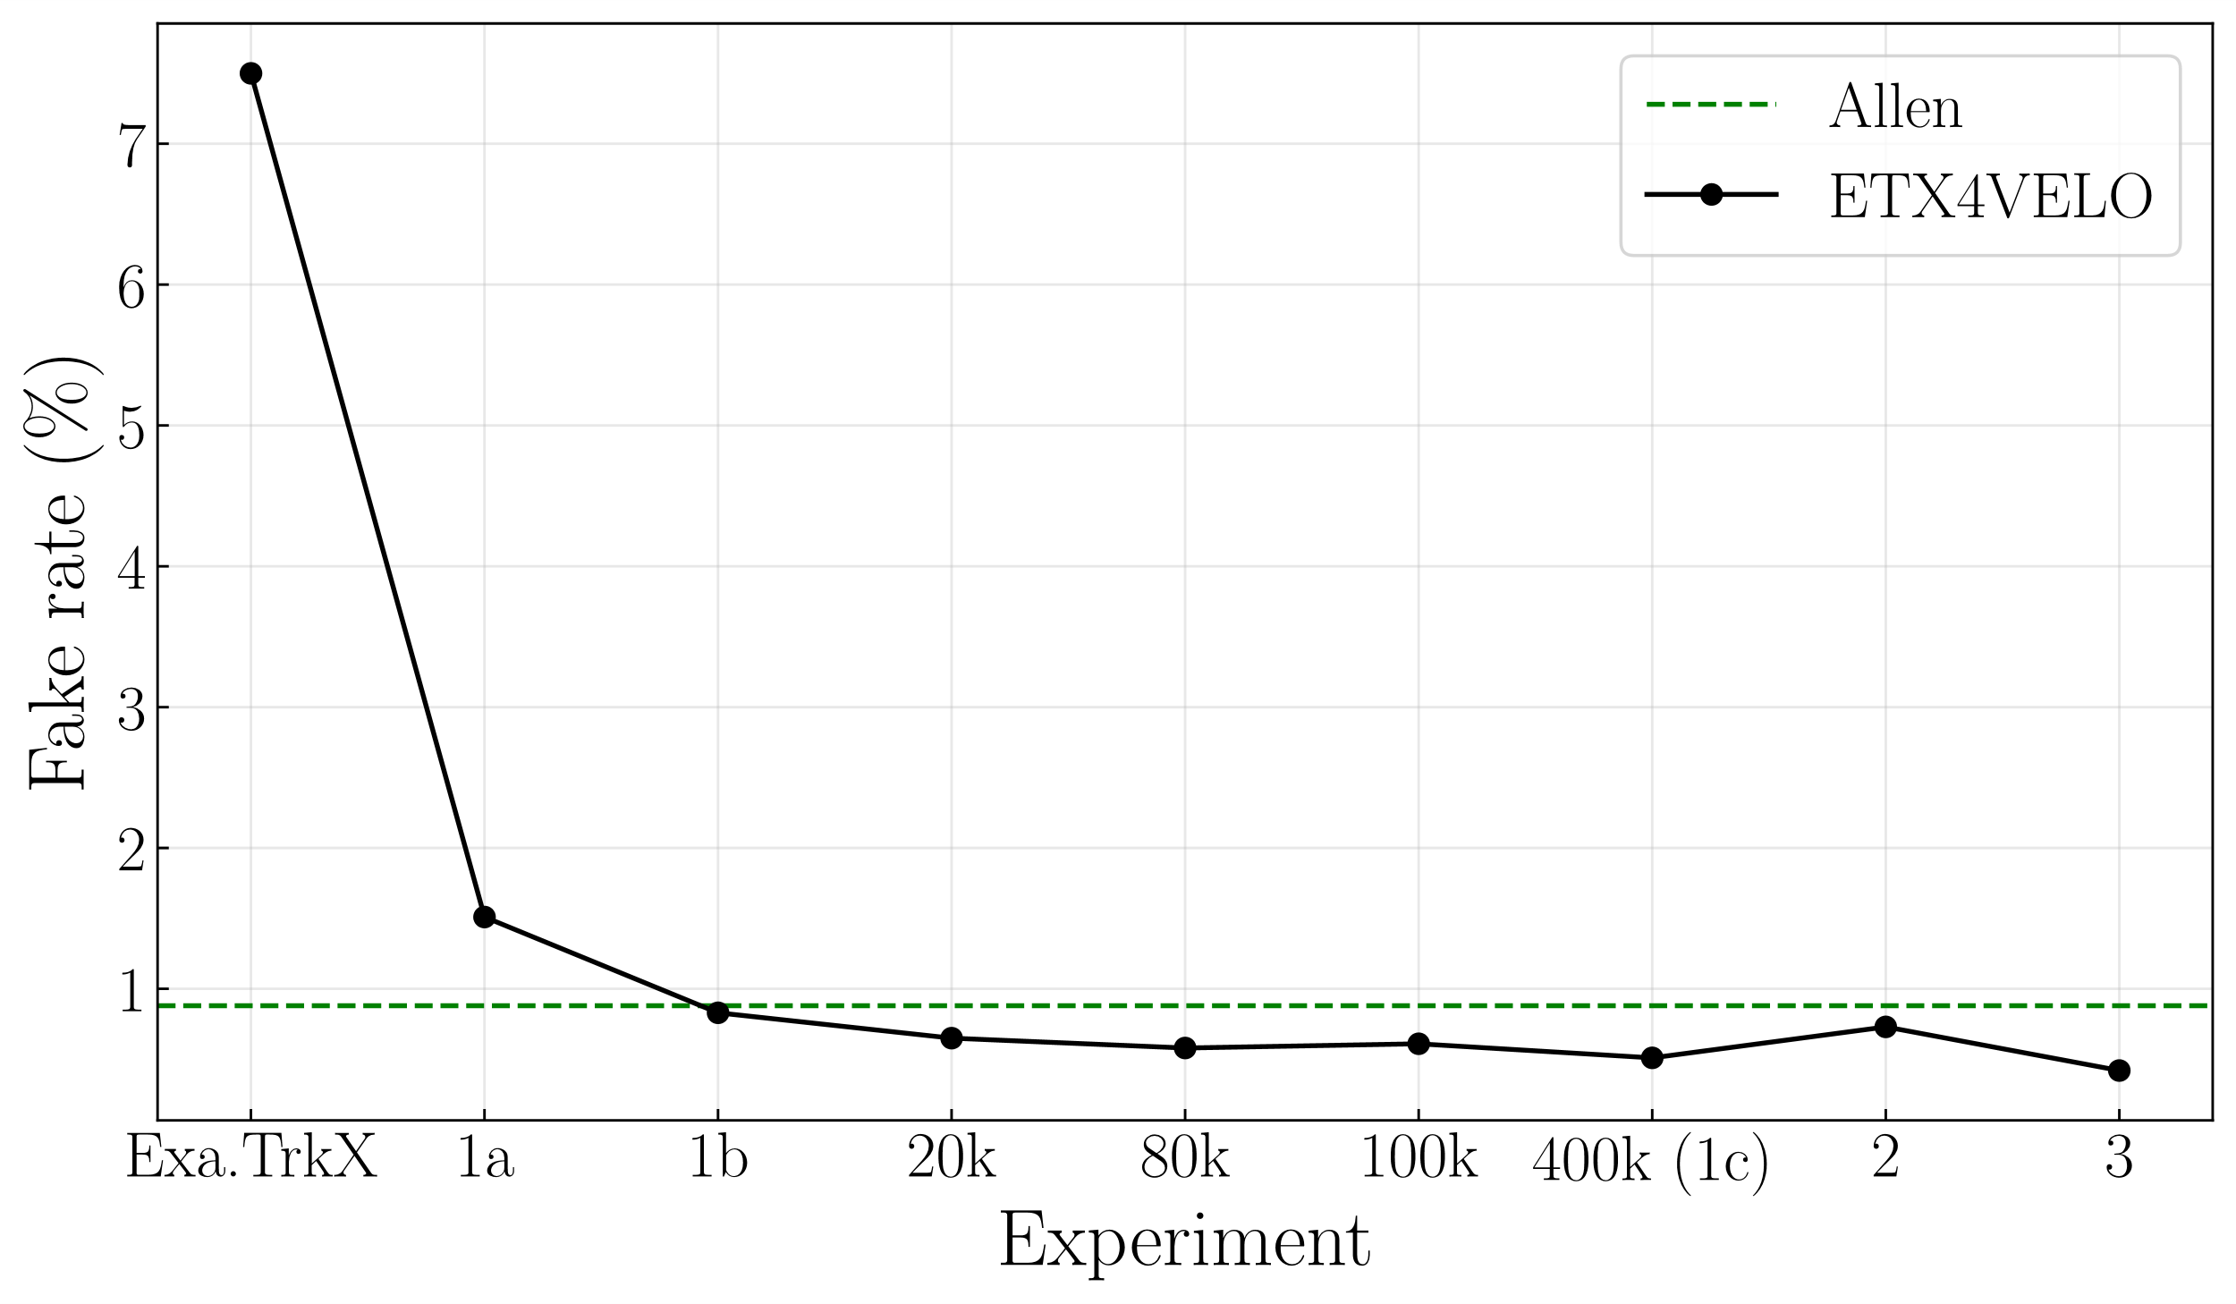
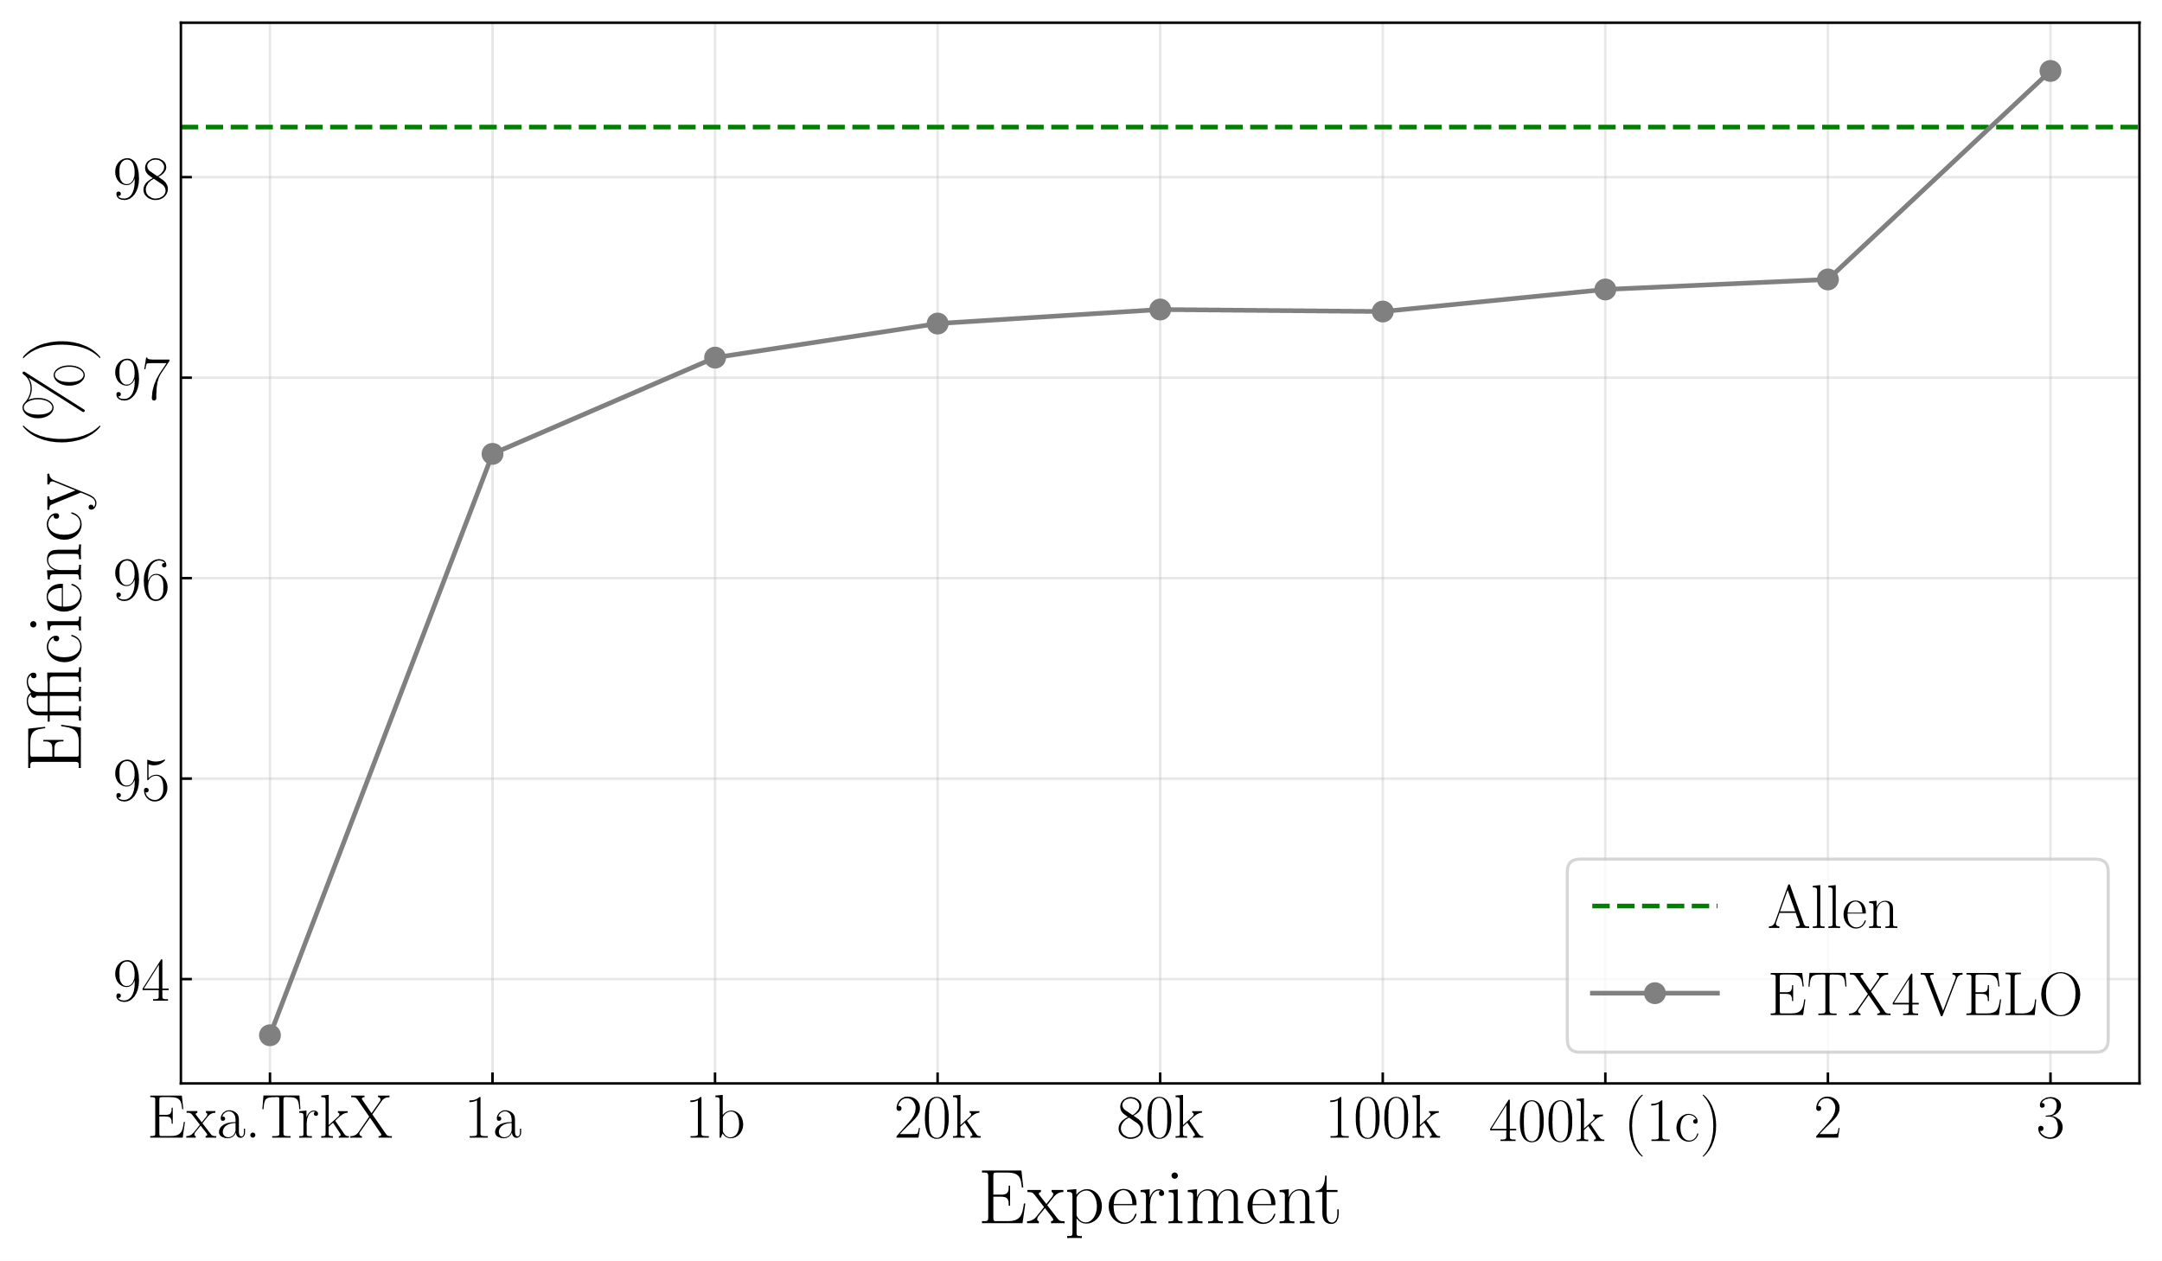
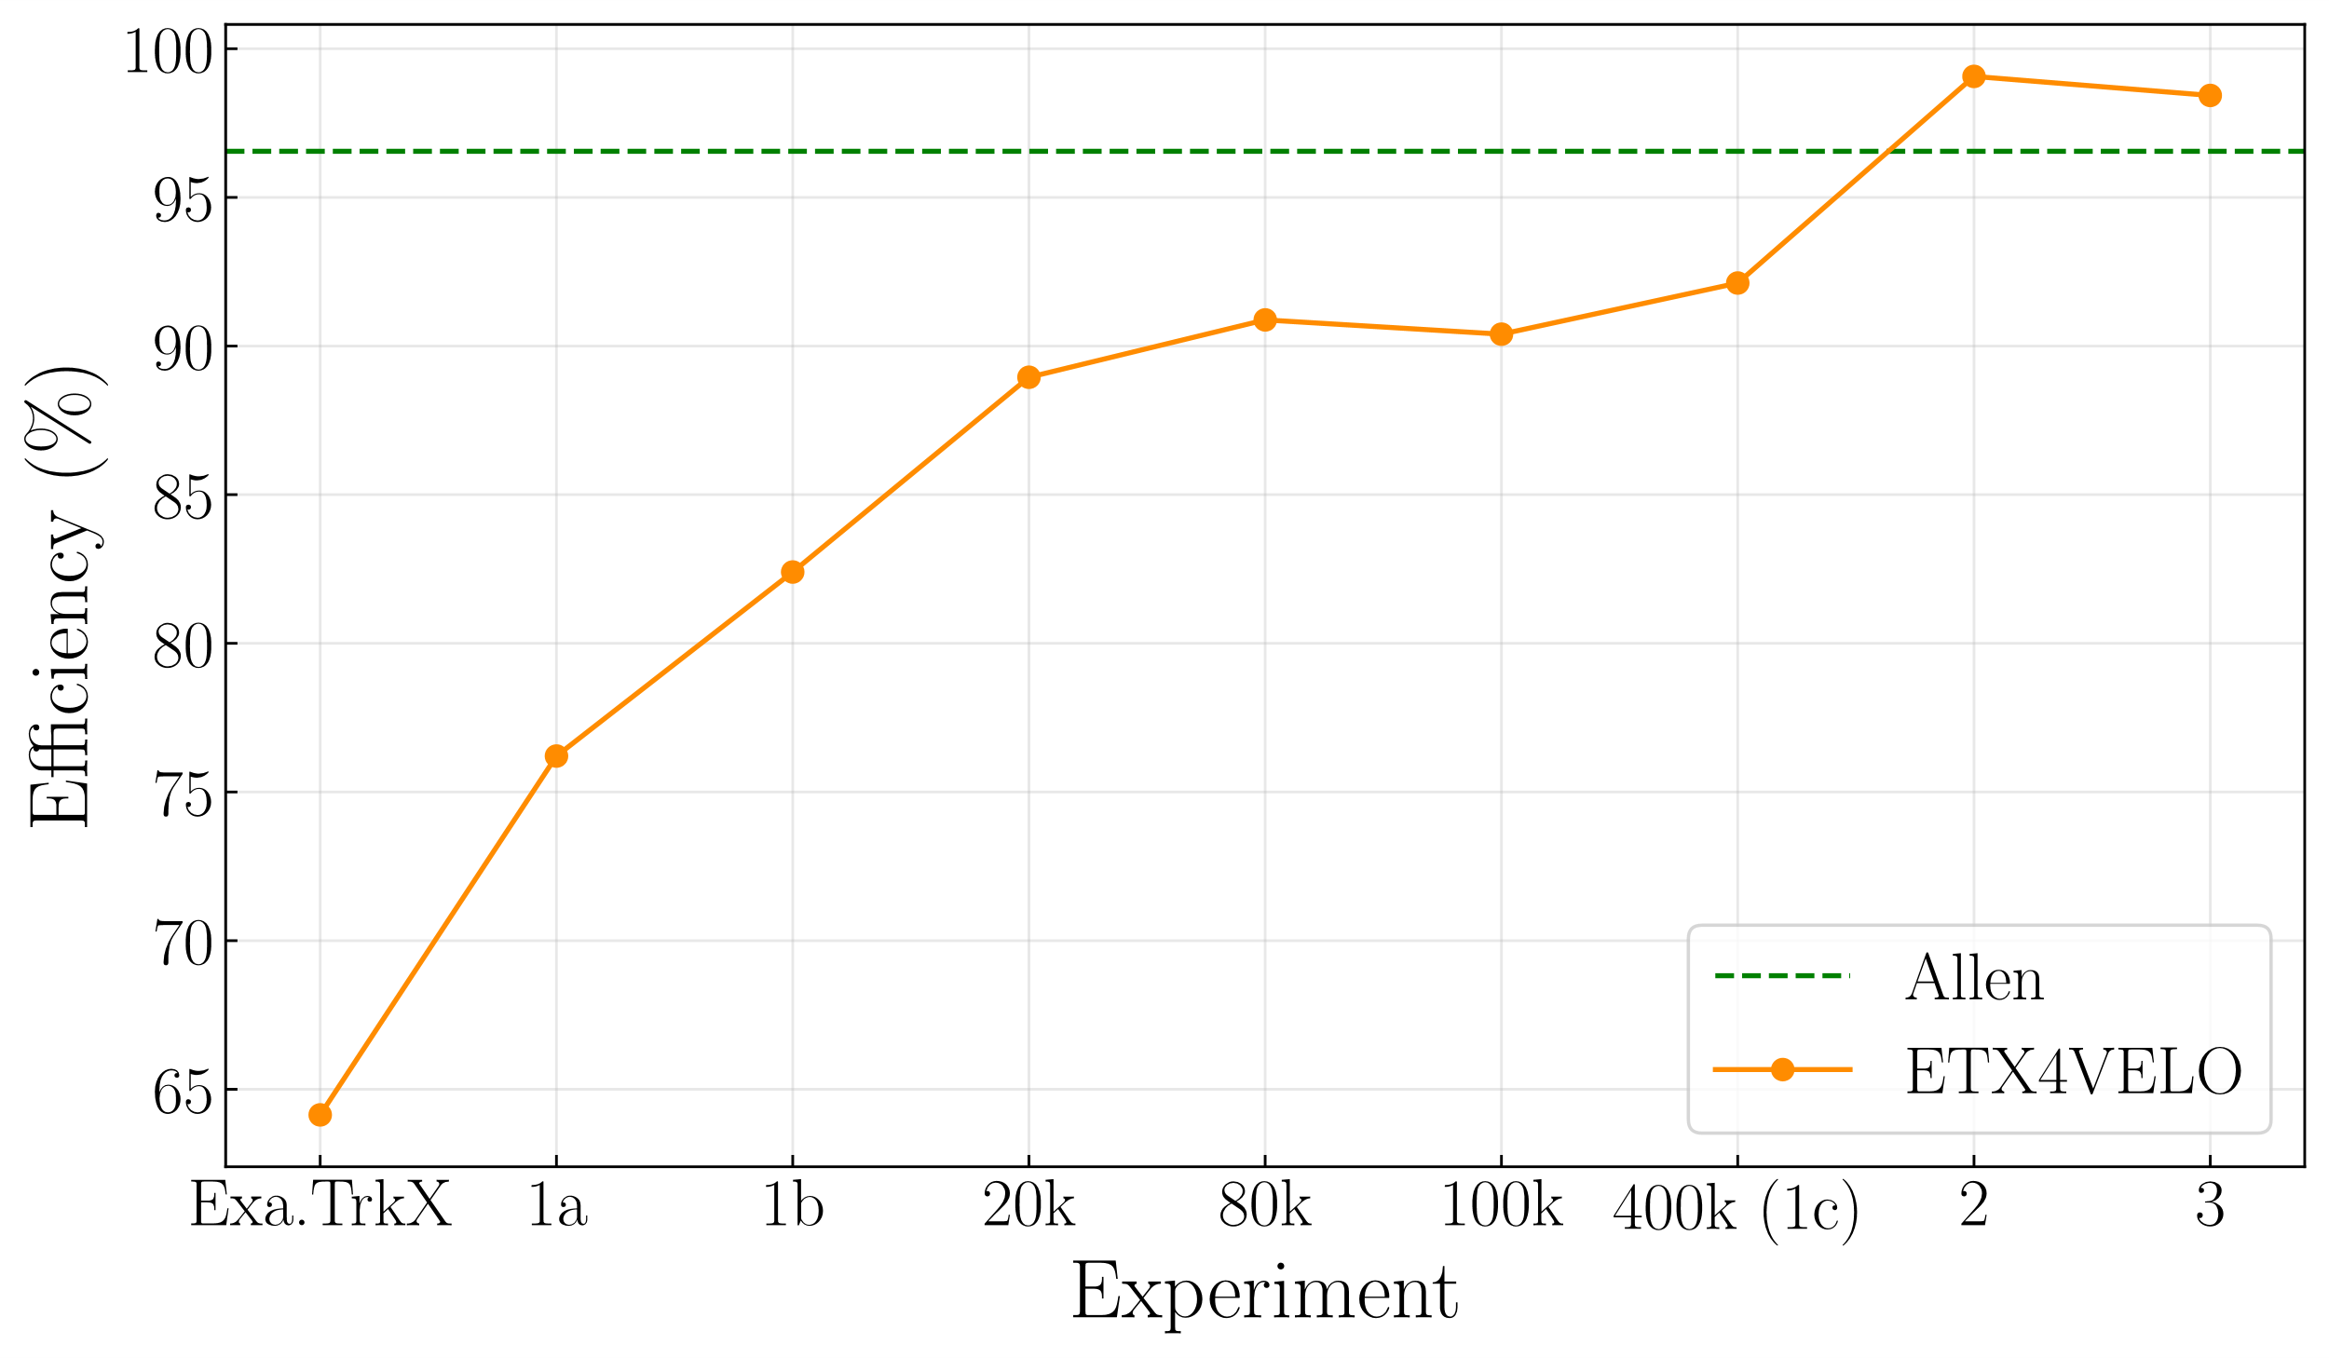

6
ETX4VELO Pipeline
a
Round 1: First Improvements
b
Round 2: Improving Long Electrons
c
Round 3: Improving long from strange
Fake rate
d
Results Without Spillover
Velo, no electrons
Long electrons
Long from strange
Notes:
Goal: Physics Performance

Slide 46


From Exa.TrkX to ETX4VELO
6
a
Remove scattered trajectories from training set.
Fit a straight 3D line to each particle
Remove particles whose Root Mean Square (RMS) distance between hits and line $>0.8 \text{mm}$ [extremely conservative]
Training with 10,000 events
Fake rate
Velo, no electrons
Long electrons
Long from strange

Slide 47





From Exa.TrkX to ETX4VELO
6
a
True edges used as target during training of the embedding network and GNN.
Exa.TrkX definition:
Connect consecutive hits ordered from origin vertex
“Bidirectional”: edges duplicated in the other direction
Problem: 13% of reconstructible particles have at least 2 hits in a layer
$⇒$ edges within the same layer
$$x$$
Exa.TrkX
2
1
1
3.0
4
3.0
4
3.0
4
2.0
1
6
0
0
6
8
2.0
3
6
8
2.0
3
8
3
9
9
1.0
2
9
1.0
2
0
5
1.0
5
5
0.0
7
0.0
7
0.0
7
0.0
1.0
2.0
3.0
4.0
$$z$$
0.0
1.0
2.0
3.0
4.0
$$z$$
0.0
1.0
2.0
3.0
4.0
$$z$$
Notes:
63% of the cases.

Slide 48





From Exa.TrkX to ETX4VELO
6
a
Problem:
edges within the same layer
Bidirectional = # edges $×$ 2
Solution:
Connect hits in adjacent layers
Only consider edges in $+z$ direction
Exa.TrkX
ETX4VELO
1
1
1
3.0
4
3.0
4
3.0
4
2.0
0
6
2.0
0
6
0
6
3
8
3
8
2.0
3
8
1.0
2
9
1.0
2
9
2
9
5
5
1.0
5
0.0
7
0.0
7
0.0
7
0.0
1.0
2.0
3.0
4.0
$$z$$
0.0
1.0
2.0
3.0
4.0
$$z$$
0.0
1.0
2.0
3.0
4.0
$$z$$

Slide 49
From Exa.TrkX to ETX4VELO
6
a
Fake rate will never be a problem from now on.
Fake rate
Velo, no electrons
Long electrons
Long from strange

Slide 50

From Exa.TrkX to ETX4VELO
6
a
Data available: 500k
Use as much data as possible! 10k $→$ 400k
Fake rate
Velo, no electrons
Long electrons
Long from strange

Slide 51




From Exa.TrkX to ETX4VELO
6
b
Low performance on long electrons.
Pipeline does not know about “electrons” $→$ problem either
Geometric: angle, production vertex
Hit-related: # hits, skipped planes, etc.

Slide 52





From Exa.TrkX to ETX4VELO
6
1
6
3
b
0
5
Shared hit
8
Shared hit: hit that belongs to $>1$ reconstructible particle
Electrons have many shared hits
Typically $e^{−}e^{+}$ pairs sharing their first hit(s)
Correspond to photon conversion in detector material $γ→e^{−}e^{+}$
Other particle categories have shared hits too!
e.g., particle crossing

Slide 53



From Exa.TrkX to ETX4VELO
6
b
Example of two particles crossing
$$x$$
$$x$$
$$x$$
3.0
2
4
7
2
4
7
2
4
7
2.0
1
6
1
6
1
3
3
6
3
1.0
0
5
0
5
0
5
8
8
WCC
algo
0.0
8
0.0
1.0
2.0
3.0
4.0
0.0
1.0
2.0
3.0
4.0
0.0
1.0
2.0
3.0
4.0
Shared hit
Shared hits belong to same WCC $→$ two particles get merged

Slide 54
From Exa.TrkX to ETX4VELO
6
b
Line graph:
Nodes = edges of the hit graph
Edges = edge-edge connection of the hit graph
3 kind of edge-edge connections
Allow to solve all kinds of shared hits
middle
left
right
0
1
1
0
1
2
1
1
2
0
2
0
1
0
0
0
0
1
1
1
1
2
1
1
0
2
2
0
2
0
1
0
0

Slide 55








From Exa.TrkX to ETX4VELO
6
b
Hit embeddings
Rough graph
Edge scores
Filtered edges
1. Embedding network
2. FRNN
$$k_{max}, d_{max}^{2}$$
3. GNN edge classifier
4. Filter Edges
$$s_{edge,min}$$
Filtered edges [$2,n_{edges}$]
Raw connections
Raw connection scores
5. Build
connections
6. Connection classifier
7. Filter connections
$$s_{conn, min}$$
8. Build tracks
Tracks
Filtered connections
Classify edge-edge connections using same GNN!
Hit coordinates: $X_{cylindrical}$
GNN
Edge scores $S_{edge}$
Edges: $I_{rough}$
Connection scores $S_{conn}$

Slide 56
From Exa.TrkX to ETX4VELO
6
b
Problem of "long electrons" immediately solved!
From there on, long electrons will never be a problem.
Fake rate
Velo, no electrons
Long electrons
Long from strange

Slide 57




From Exa.TrkX to ETX4VELO
6
c
2
3.0
4
2.0
1
6
3
8
FRNN applied to the whole space
Edges within the same layer
$20\%$ edges with $>$ 2-plane gap
We always ask “is hit in layer 0 connected to hit in layer 25?”
9
1.0
0
5
0.0
7
0.0
1.0
2.0
3.0
4.0
$$z$$
New approach: FRNN Layer by Layer
Embedding + FRNN
Apply FRNN from layer $i$ to layer $i+1$ and $i+2$
for $i∈\left\{0,…,n_{layers}−1\right\}$
2
3.0
4
2.0
1
6
3
8
Parallelizable over layers
9
1.0
0
5
0.0
7
0.0
1.0
2.0
3.0
4.0
$$z$$

Slide 58
From Exa.TrkX to ETX4VELO
6
c
Performance better everywhere
Metric | Category | Allen | ETX4VELO
Efficiency | Velo no electrons | 98.25% | 98.53%
 | Long electrons | 96.55% | 98.43%
 | Long from strange | 97.74% | 97.90%
Fake rate |  | 0.88% | 0.42%
Fake rate
Velo, no electrons
Long electrons
Long from strange

Slide 59
From Exa.TrkX to ETX4VELO
6
c
Performance better everywhere
Metric | Category | Allen | ETX4VELO
Efficiency | Velo no electrons | 98.25% | 98.53%
 | Long electrons | 96.55% | 98.43%
 | Long from strange | 97.74% | 97.90%
Fake rate |  | 0.88% | 0.42%
Throughput |  | 595 kHz | ?
Fake rate
Velo, no electrons
Long electrons
Long from strange

Slide 60
1
Beginner Introduction
2
Neural Network Introduction
3
Problem Formulation
4
Experimental Setup
5
Exa.TrkX Pipeline
6
From Exa.TrkX to ETX4VELO
7
Implementation in Allen
8
Optimization

Slide 61
7
Implementation in Allen
a
Pipeline
b
Inference Engine
c
Results
Notes:
Improve physics performance.
See thesis manuscript for extensive description.
NB: this is not Exa.TrkX vs ETX4VELO

Slide 62

Implementation in Allen
7
a
Edge-edge connections not yet implemented in Allen
$⇒$ Evaluate throughput up to WCC on hit graph
$→$ Only upperbound throughput measurement
Supplementary “Consolidate tracks” step
1. Embedding network
2. FRNN Layer by Layer
3. GNN
edge classifier
4. Filter edges
5. WCC algo
6. Consolidate tracks
Hits
Tracks in Allen format
Requires implementing custom CUDA algorithms:
FRNN Layer by Layer: apply_frnn_plane_by_plane, consolidate_target_edges, build_source_edges
Filter Edges: mask_edges, filter_edge_offsets, filter_edges, build_edge_sources
WCC algorithm: count_edges_per_target_hit, build_invert_edge_targets, apply_wcc
Consolidate tracks: cound_hits_per_label, compute_track_offsets, build_tracks, consolidate_tracks
Require inferring Neural Networks (in C++/CUDA)
Embedding
GNN

Slide 63




Implementation in Allen
7
b
How to infer a neural network in C++/CUDA?
Re-implement everything from scratch
Use LibTorch (C++ API of Torch)
Use an inference engine
Inference Engine on GPU: ONNX Runtime and TensorRT (NVIDIA)
ONNX (Open Neural Network Exchange) format
torch.onnx.export

Slide 64

Implementation in Allen
7
b
TensorRT > ONNX Runtime for deployment on NVIDIA GPU
 | ONNX Runtime | TensorRT
Open source | Yes | Only a small subset
CPU Support | Yes Different execution providers: CPU, CUDA, TensorRT, ROCm, etc. | No
Memory manageable by Allen | No | Yes, a pointer can be passed to TensorRT
Memory released after each inference | Too slow to release | Yes $→$ can be re-used by other algorithms
Documentation | Worse | Better
Implementation of scatter_add operation:
ONNX Runtime: already implemented
TensorRT: I implemented a TensorRT plugin
Throughput reported with TensorRT by default

Slide 65

Implementation in Allen
7
c
1. Embedding network
2. FRNN Layer by Layer
3. GNN
edge classifier
4. Filter edges
5. WCC algo
6. Consolidate tracks
Hits
Tracks in Allen format
Step | Throughput
0. Decode velo hits | 1100 kHz
1. Embedding Network | ?
2a. FRNN | 160 kHz
2b. Edge Consolidation | 110 kHz
3. GNN Edge Classifier | ?
4. Filter Edges 5. WCC Algo 6. Track Consolidation | Able to follow
Allen | 595 kHz
< 38 kHz
< 0.026 kHz

Slide 66
1
Beginner Introduction
2
Neural Network Introduction
3
Problem Formulation
4
Experimental Setup
5
Exa.TrkX Pipeline
6
From Exa.TrkX to ETX4VELO
7
Implementation in Allen
8
Optimization

Slide 67
8
Optimisation
a
Optimising the Embedding Network
b
Optimising the GNN
c
TensorRT vs ONNX Runtime
d
Final Performance

Slide 68

Optimisation
8
a
Changes:
Reduce # parameters of embedding network from 35k down to 251 parameters
Train on reconstructible particles with $\left|η\right|∈\left[2,5\right]$
Metric | Allen | Before | Now
Embedding throughput (events/second) | 595k | < 38k | 330k
Better physics performance and better throughput

Slide 69




Optimisation
8
Embedding Network
a
Most tracks originate towards $\left(0,0,0\right)$ $⇒$ small angles:
Polar angle $θ$: angle w.r.t. $z$-axis
Azymuthal angle $φ$: angle around $z$-axis
Build all edge-edge candidates up to 2 planes apart and compare $(Δθ,Δφ)$ to
$d^{2}$ from embedding network
Truth
$⇒$ clear correlation
$$d^{2}$$
Truth

Slide 70






Optimisation
8
b
Throughput
Step 1: Increase throughput by decreasing GNN size
Removing scatter_max, only use scatter_add,
Decreasing hit and edge encoding dimensions from $h=256$ to $h=32$
Use only edge encodings for classifications
Decreasing # graph iterations from 6 to $5$
Step 2: recover lost performance
GNN non-recursive
Use cartesian coordinates for input node features instead of cylindrical
Use the new embedding network from previous slide
Do not remove curved particles from training set, but only from the loss; Consider isolated edges as fake.
Use a different classifier for middle connections, & left/right connections
Fake rate
Long, no electrons
Long from strange
Long electrons

Slide 71

Optimisation
8
b
Metric | Category | Allen | 1a | 2e
Efficiency | Long | 99.35% | 99.37% | 99.35%
 | Long from strange | 97.53% | 97.87% | 97.43%
 | Long electrons | 95.21% | 98.71% | 98.08%
Fake rate |  | 2.19% | 0.58% | 1.01%
GNN throughput (kHz) |  | 595 | 0.026 | 0.985
$×38$ in throughput

Slide 72
Optimisation
8
c
TensorRT significantly faster than ONNX Runtime for both the embedding network and GNN.
Embedding network
GNN
Inference Engine | Throughput
ONNX Runtime | 50 kHz
TensorRT | 330 kHz
Inference Engine | Throughput
ONNX Runtime | 0.307 kHz
TensorRT | 1.004 kHz
6.1 times faster
3.3 times faster

Slide 73


Optimisation
8
d
Step | Throughput
0. Decode velo hits | 1100 kHz
1. Embedding Network | 330 kHz
2a. FRNN | 160 kHz
2b. Edge Consolidation | 110 kHz
3. GNN Edge Classifier | 1.00 kHz
6. Track Consolidation | 0.996 kHz
Allen | 595 kHz
GNN is the blottleneck of the pipeline
GNN is slow because of
scatter_add: rely on AtomicAdd
# rough edges: $×9$ w.r.t. hits
# operations

Slide 74
Conclusion & Opening
1. Get Data
2. Define Evaluation Procedure
3. From Exa.TrkX to ETX4VELO
4. Implementation in Allen
5. Optimization
 | ETX4VELO | Exa.TrkX as a Service On NVIDIA Triton server 10.1088/1748-0221/20/06/P06002
Throughput | 1000 events/s | 1.75 events/s
GPU | NVIDIA RTX 2080Ti | NVIDIA A100
# hits / event | 2k | 350k

Slide 75


Conclusion & Opening
1. Get Data
2. Define Evaluation Procedure
3. From Exa.TrkX to ETX4VELO
4. Implementation in Allen
5. Optimization
Approach | Results | Potential
Filter edges inside GNN | $×3$ throughput Loss in physics performance | Up to $×14$ (upper bound)
Quantization | $12\%$ throughput gain | $×4$ to $×16$
Reconstruction approaches without edge-edge connections | Limited loss in physics performance performance | ?
$𝒪\left(10−100\right)$ speed-up?

Slide 76
Thank you

Slide 77


Problem Formulation
3
2000 hits
13% fake hits from spillover (residuals from previous events)
a
Layer number (0 to 25)
18
19
21
22
0
1
2
3
4
5
6
7
8
9
12
14
16
17
20
10
11
13
15
23
24
25
Track Finding
1 layer
4 sensor planes
1 layer $=$ 4 sensor planes
=
P. C. Tsopelas, ‘A Silicon Pixel Detector for LHCb’, PhD Thesis, Vrije U., Amsterdam, 2016.

Slide 78


Problem Formulation
3
b
Collisions (Run 3)
$20 \text{MHz}$ non-empty bunch crossing rate
$\sim$ 5 $p$-$p$ collisions / bunch crossing
$p$-$p$ collision at $\sqrt{s}=13.6 \text{TeV}$
LHCb Subdetectors
Acceptance
$2<η<5$
$$1°<θ<15°$$
Digitization
PCIe40 boards
5 TB/s
Trigger
Rate that can be saved to disk: 10 GB/s
Trigger: reduce the data rate to save to disk.
Choose which events to discard,
Only save reconstructed objects.
Reconstruct the events,
Choose which ones to keep given the reconstruction.
$$⇒$$

Slide 79















Exa.TrkX Pipeline
5
c
GNN = 5 MLPs + an operation called scatter_add
Encoding phase: encode hits and edges in high-dimensional encoding space $h=256$
Message passing phase: $n_{iters}=6$ times, aggregate neighbour encodings and update encodings
Classification phase: Final MLP to classify edges from their hit and edge encodings
$$X_{cylindrical}$$
1. Encoding Phase
2 MLPs
Hit encodings $H_{0}$
$$I_{rough}$$
Edge encodings $E_{0}$
$$H_{k}$$
2. Message Passing Step
2 MLPs
scatter_add operation
scatter_max operation
$$H_{k+1}$$
Hit encodings $H_{n}$
$$E_{k}$$
Edge encodings $E_{n}$
$$E_{k+1}$$
Repeat $n=6$ times, for $k∈⟦0, n−1⟧$
$$\left\{H\left[I_{rough}\left[0\right]\right],H\left[I_{rough}\left[1\right]\right],E\right\}$$
3. Edge Classifier
(MLP)
Edge scores $S$
$\left[n_{rough edge}\right]$
Training uses Binary Cross Entropy (BCE) loss
Only keep edges with score $s>s_{edge, min}$

Slide 80








From Exa.TrkX to ETX4VELO
6
b
A. First hit shared: 6.5/event
B. First hits shared: 2.8/event
$$x$$
$$x$$
0
4
5
3.0
0
1
3
3
1
2
1
2
4
Shared hits
2.0
5
Shared hit
0
2
4
0
1
1.0
4
6
2
3
0.0
0.0
1.0
2.0
3.0
4.0
0.0
1.0
2.0
3.0
4.0
$$z$$
C. Last hit = first hit: 0.5/event
D. Middle hit shared: 0.4/event
E. Middle hit = first hit: 0.7/event
$$x$$
$$x$$
$$x$$
3.0
0
4
0
1
3
1
1
3
1
2
3
3
2
4
2.0
4
0
2
0
1
2
2
2
4
3
1
0
0
3
1.0
4
5
5
0.0
0.0
1.0
2.0
3.0
4.0
0.0
1.0
2.0
3.0
4.0
$$z$$
0.0
1.0
2.0
3.0
4.0
$$z$$
Shared hit
Shared hit
Shared hit

Slide 81


From Exa.TrkX to ETX4VELO
6
b
Situation C
Situation fake-C
$$x$$
$$x$$
3.0
4
3.0
3
2.0
3
2.0
0
1
0
0
1
2
0
2
2
1.0
1
2
3
1.0
1
3
4
0.0
0.0
0.0
1.0
2.0
3.0
4.0
0.0
1.0
2.0
3.0
4.0
Shared hit
Problem: Same graph!
Solution: Middle edge-edge connections
4
3
0
0
1
3
1
3
1
2
2
0
0
1
2
3
1
2
2
2
3
4
1
3

Slide 82




From Exa.TrkX to ETX4VELO
6
b
Situation B
Situation fake-B
$$x$$
$$x$$
0
0
0
3.0
1
1
3.0
0
1
2
2
1
2
4
3
4
2.0
2.0
2
3
5
3
5
Shared hit
3
4
1.0
4
1.0
0.0
0.0
0.0
1.0
2.0
3.0
4.0
$$z$$
0.0
1.0
2.0
3.0
4.0
$$z$$
Problem: Same graph!
Solution: Left edge-edge connections
0
0
1
0
1
1
1
2
0
1
2
4
2
2
3
3
1
2
5
4
3
2
3
3
5
3
4
3
Algorithm in annex
3
4

Slide 83
From Exa.TrkX to ETX4VELO
6
b
0
0
1. Connect left and right connections
0
1
1
0
1
1
2
1
1
2
1
2
2
3
3
4
2
4
0
5
2
3
3
0
1
3
5
2. Connect middle connections w.o. fork
1
0
0
3
1
2
3
4
1
3
2
4
2
1
1
4
2
3
3
2
0
5
1
2
2
0
3
3
3
4
1
5
1
1
3
4
0
3
3
2
0
3
3. Each remaining middle connnection forms a track
0
2
2
1
4
3
3
4
1
1
5
2
2
2
0
0
3
2
1
3
0
3
3
4
0
1
4
1
5
0
1
2
3
3
1
2
1
1
2
3
4
2
3
4
2
2
4
3
5
3
3
4
3

Slide 84


















From Exa.TrkX to ETX4VELO
6
b
$$X_{cylindrical}$$
1. Encoding Phase
2 MLPs
Hit encodings $H_{0}$
$$I_{rough}$$
Edge encodings $E_{0}$
$$H_{k}$$
2. Message Passing Step
2 MLPs
scatter_add operation
scatter_max operation
$$H_{k+1}$$
Hit encodings $H_{n}$
$\left[n_{hit},h\right]$
$$E_{k}$$
Edge encodings $E_{n}$
$\left[n_{edge},h\right]$
$$E_{k+1}$$
Repeat $n=6$ times
for $k∈⟦0, n−1⟧$
3. Edge Classifier
Edge scores $S$
$\left[n_{rough edge}\right]$
$$\left\{2 hits encodings,edge encoding\right\}$$
4. Filter edges
5. Build edge-edge connections
6. Connection Classifier
Connection scores $S_{conn}$
$\left[n_{raw connections}\right]$
$$\left\{3 hit encodings,2 edge encodings\right\}$$
GNN trained with double objective: Loss
$$ℒ_{GNN}=ℒ_{edges}+ℒ_{connections}$$

Slide 85
From Exa.TrkX to ETX4VELO
6
d
Training with 700k events
Metric | Category | Allen | ETX4VELO
Efficiency | Velo no electrons | 98.25% | 98.53%
 | Long electrons | 96.55% | 98.43%
 | Long from strange | 97.74% | 97.90%
Fake rate |  | 0.88% | 0.42%
Use simulation with spillover
Metric | Category | Allen | ETX4VELO
Efficiency | Velo no electrons | 98.27% | 98.38%
 | Long electrons | 96.90% | 99.31%
 | Long from strange | 97.23% | 97.01%
Fake rate |  | 2.29% | 1.56%
Throughput |  | 595 kHz | ?

Slide 86






From Exa.TrkX to ETX4VELO
6
e
Minimum edge score $s_{min,edge}$ mainly to filter edges before building edge-edge connections
Set at $s_{min,edge}=0.4$ after quick scan
Minimum connection score $s_{conn,score}$ most important
How to choose $s_{conn,min}$?
Look at connection efficiency and purity?
$$\text{Efficiency}=\frac{\# selected true}{\# true}$$
$$\text{Purity}=\frac{\# selected true}{\# selected}$$
Conn.
Conn.
Conn.
Conn.
Conn.
Conn.
No idea about final performance!

Slide 87



From Exa.TrkX to ETX4VELO
6
e
How to choose $s_{conn,min}$?
Look at efficiency and fake rate after reconstruction
$→$ Build tracks for each choice of $s_{conn,min}$
$s_{conn,min}=0.32$ where long, from strange efficiency maximised.

Slide 88





From Exa.TrkX to ETX4VELO
6
f
$k_{max}$ set to 50
How to choose $d_{max}^{2}$?
Same idea as $s_{conn,min}$? But there is the GNN after.
$⇒$ Replace GNN edge classifier and connection classifier by perfect classification
Allow to estimate best efficiency and fake rate obtainable if GNN perfect.
Also look at graph size: large graph $⇒$ small throughput
$$d_{max}^{2}=0.01$$

Slide 89

















Optimisation
8
Step 1: Increase throughput
Removing scatter_max, only use scatter_add,
b
$$X_{cylindrical}$$
1. Encoding Phase
2 MLPs
Hit encodings $H_{0}$
$$I_{rough}$$
Edge encodings $E_{0}$
$$H_{k}$$
2. Message Passing Step
2 MLPs
scatter_add operation
scatter_max operation
$$H_{k+1}$$
Hit encodings $H_{n}$
$\left[n_{hit},h\right]$
$$E_{k}$$
Edge encodings $E_{n}$
$\left[n_{edge},h\right]$
$$E_{k+1}$$
Repeat $n=6$ times
for $k∈⟦0, n−1⟧$
3. Edge Classifier
Edge scores $S$
$\left[n_{rough edge}\right]$
$$\left\{2 hits encodings,edge encoding\right\}$$
4. Filter edges
5. Build edge-edge connections
6. Connection Classifier
Connection scores $S_{conn}$
$\left[n_{raw connections}\right]$
$$\left\{3 hit encodings,2 edge encodings\right\}$$

Slide 90


Optimisation
8
Step 1: Increase throughput
Removing scatter_max, only use scatter_add,
Decreasing hit and edge encoding dimensions from $h=256$ to $h=32$
b
$$X_{cylindrical}$$
1. Encoding Phase
2 MLPs
Hit encodings $H_{0}$
$$I_{rough}$$
Edge encodings $E_{0}$
$$H_{k}$$
2. Message Passing Step
2 MLPs
scatter_add operation
$$H_{k+1}$$
Hit encodings $H_{n}$
$\left[n_{hit},h\right]$
$$E_{k}$$
Edge encodings $E_{n}$
$\left[n_{edge},h\right]$
$$E_{k+1}$$
Repeat $n=6$ times
for $k∈⟦0, n−1⟧$
3. Edge Classifier
Edge scores $S$
$\left[n_{rough edge}\right]$
$$\left\{2 hits encodings,edge encoding\right\}$$
4. Filter edges
5. Build edge-edge connections
6. Connection Classifier
Connection scores $S_{conn}$
$\left[n_{raw connections}\right]$
$$\left\{3 hit encodings,2 edge encodings\right\}$$

Slide 91

Optimisation
8
Step 1: Increase throughput
Removing scatter_max, only use scatter_add,
Decreasing hit and edge encoding dimensions from $h=256$ to $h=32$
Use only edge encodings for classifications
b
$$X_{cylindrical}$$
1. Encoding Phase
2 MLPs
Hit encodings $H_{0}$
$$I_{rough}$$
Edge encodings $E_{0}$
$$H_{k}$$
2. Message Passing Step
2 MLPs
scatter_add operation
$$H_{k+1}$$
Hit encodings $H_{n}$
$\left[n_{hit},h\right]$
$$E_{k}$$
Edge encodings $E_{n}$
$\left[n_{edge},h\right]$
$$E_{k+1}$$
Repeat $n=6$ times
for $k∈⟦0, n−1⟧$
3. Edge Classifier
Edge scores $S$
$\left[n_{rough edge}\right]$
$$\left\{2 hits encodings,edge encoding\right\}$$
4. Filter edges
5. Build edge-edge connections
6. Connection Classifier
Connection scores $S_{conn}$
$\left[n_{raw connections}\right]$
$$\left\{3 hit encodings,2 edge encodings\right\}$$

Slide 92




Optimisation
8
Step 1: Increase throughput
Removing scatter_max, only use scatter_add,
Decreasing hit and edge encoding dimensions from $h=256$ to $h=32$
Use only edge encodings for classifications
Decreasing # graph iterations from 6 to $5$
b
$$X_{cylindrical}$$
1. Encoding Phase
2 MLPs
Hit encodings $H_{0}$
$$I_{rough}$$
Edge encodings $E_{0}$
$$H_{k}$$
2. Message Passing Step
2 MLPs
scatter_add operation
$$H_{k+1}$$
Hit encodings $H_{n}$
$\left[n_{hit},h\right]$
$$E_{k}$$
Edge encodings $E_{n}$
$\left[n_{edge},h\right]$
$$E_{k+1}$$
$$5$$
Repeat $n=6$ times
for $k∈⟦0, n−1⟧$
3. Edge Classifier
(MLP)
Edge scores $S$
$\left[n_{rough edge}\right]$
$$\left\{edge encoding\right\}$$
4. Filter edges
5. Build edge-edge connections
6. Connection Classifier
(MLP)
Connection scores $S_{conn}$
$\left[n_{raw connections}\right]$
$$\left\{2 edge encodings\right\}$$

Slide 93

Optimisation
8
Step 1: Increase throughput
Removing scatter_max, only use scatter_add,
Decreasing hit and edge encoding dimensions from $h=256$ to $h=32$
Use only edge encodings for classifications
Decreasing # graph iterations from 6 to $5$
b
$$X_{cylindrical}$$
1. Encoding Phase
2 MLPs
Hit encodings $H_{0}$
$$I_{rough}$$
Edge encodings $E_{0}$
$$H_{k}$$
2. Message Passing Step
2 MLPs
scatter_add operation
$$H_{k+1}$$
Hit encodings $H_{n}$
$\left[n_{hit},h\right]$
$$E_{k}$$
Edge encodings $E_{n}$
$\left[n_{edge},h\right]$
$$E_{k+1}$$
Repeat $n=5$ times
for $k∈⟦0, n−1⟧$
3. Edge Classifier
Edge scores $S$
$\left[n_{rough edge}\right]$
$$\left\{edge encoding\right\}$$
4. Filter edges
5. Build edge-edge connections
6. Connection Classifier
Connection scores $S_{conn}$
$\left[n_{raw connections}\right]$
$$\left\{2 edge encodings\right\}$$

Slide 94



Optimisation
8
Step 1: Increase throughput
Removing scatter_max, only use scatter_add,
Decreasing hit and edge encoding dimensions from $h=256$ to $h=32$
Use only edge encodings for classifications
Decreasing # graph iterations from 6 to $5$
b
Metric | Category | Allen | (1a) $$h=256$$ | $$h=128$$ | $$h=64$$ | (1b) $$h=32$$ | (1c) Only $E$ | (1d) $$n_{iter}=5$$ (not 1c)
Efficiency | Long | 99.35% | 99.37% | 99.32% | 99.28% | 99.16% | 99.16% | 99.17%
 | Long from strange | 97.53% | 97.87% | 97.30% | 97.30% | 96.66% | 96.76% | 96.80%
 | Long electrons | 95.21% | 98.71% | 98.47% | 98.61% | 98.25% | 98.40% | 98.47%
Fake rate |  | 2.19% | 0.58% | 0.77% | 1.02% | 1.31% | 1.31% | 1.32%
GNN throughput (events/second) |  | 595k | 0.26 | 0.134 | 0.333 | 0.672 | 0.695 | 0.784
Throughput $𝓞\left({10}^{3}\right)$ below
Some performance lost but:
Low fake rate
High long electron efficiency

Slide 95

Optimisation
8
Step 2: recover lost performance
GNN non-recursive
b
$$X_{cylindrical}$$
1. Encoding Phase
2 MLPs
Hit encodings $H_{0}$
$$I_{rough}$$
Edge encodings $E_{0}$
$$H_{k}$$
2. Message Passing Step [k]
2 MLPs, different at each $k$
scatter_add operation
$$H_{k+1}$$
Hit encodings $H_{n}$
$\left[n_{hit},h\right]$
$$E_{k}$$
Edge encodings $E_{n}$
$\left[n_{edge},h\right]$
$$E_{k+1}$$
Repeat $n=5$ times
for $k∈⟦0, n−1⟧$
3. Edge Classifier
Edge scores $S$
$\left[n_{rough edge}\right]$
$$\left\{edge encoding\right\}$$
4. Filter edges
5. Build edge-edge connections
6. Connection Classifier
Connection scores $S_{conn}$
$\left[n_{raw connections}\right]$
$$\left\{2 edge encodings\right\}$$

Slide 96


Optimisation
8
Step 2: recover lost performance
GNN non-recursive
Use cartesian coordinates for input node features instead of cylindrical
b
$$X_{cartesian}$$
$$X_{cylindrical}$$
1. Encoding Phase
2 MLPs
Hit encodings $H_{0}$
$$I_{rough}$$
Edge encodings $E_{0}$
$$H_{k}$$
2. Message Passing Step [k]
2 MLPs, different at each $k$
scatter_add operation
$$H_{k+1}$$
Hit encodings $H_{n}$
$\left[n_{hit},h\right]$
$$E_{k}$$
Edge encodings $E_{n}$
$\left[n_{edge},h\right]$
$$E_{k+1}$$
Repeat $n=5$ times
for $k∈⟦0, n−1⟧$
3. Edge Classifier
Edge scores $S$
$\left[n_{rough edge}\right]$
$$\left\{edge encoding\right\}$$
4. Filter edges
5. Build edge-edge connections
6. Connection Classifier
Connection scores $S_{conn}$
$\left[n_{raw connections}\right]$
$$\left\{2 edge encodings\right\}$$

Slide 97

Optimisation
8
Step 2: recover lost performance
GNN non-recursive
Use cartesian coordinates for input node features instead of cylindrical
Use the new embedding network from previous slide
Do not remove curved particles from training set, but only from the loss
b
$$X_{cartesian}$$
1. Encoding Phase
2 MLPs
Hit encodings $H_{0}$
$$I_{rough}$$
Edge encodings $E_{0}$
$$H_{k}$$
2. Message Passing Step [k]
2 MLPs, different at each $k$
scatter_add operation
$$H_{k+1}$$
Hit encodings $H_{n}$
$\left[n_{hit},h\right]$
$$E_{k}$$
Edge encodings $E_{n}$
$\left[n_{edge},h\right]$
$$E_{k+1}$$
Repeat $n=5$ times
for $k∈⟦0, n−1⟧$
3. Edge Classifier
Edge scores $S$
$\left[n_{rough edge}\right]$
$$\left\{edge encoding\right\}$$
4. Filter edges
5. Build edge-edge connections
6. Connection Classifier
Connection scores $S_{conn}$
$\left[n_{raw connections}\right]$
$$\left\{2 edge encodings\right\}$$

Slide 98
Optimisation
8
Step 2: recover lost performance
GNN non-recursive
Use cartesian coordinates for input node features instead of cylindrical
Use the new embedding network from previous slide
Do not remove curved particles from training set, but only from the loss; Consider isolated edges as fake.
Use a different classifier for middle connections, & left/right connections
b
$$X_{cartesian}$$
1. Encoding Phase
2 MLPs
Hit encodings $H_{0}$
$$I_{rough}$$
Edge encodings $E_{0}$
$$H_{k}$$
2. Message Passing Step [k]
2 MLPs, different at each $k$
scatter_add operation
$$H_{k+1}$$
Hit encodings $H_{n}$
$\left[n_{hit},h\right]$
$$E_{k}$$
Edge encodings $E_{n}$
$\left[n_{edge},h\right]$
$$E_{k+1}$$
Repeat $n=5$ times
for $k∈⟦0, n−1⟧$
3. Edge Classifier
Edge scores $S$
$\left[n_{rough edge}\right]$
$$\left\{edge encoding\right\}$$
4. Filter edges
5. Build edge-edge connections
6. 2 connection classifiers
Connection scores $S_{conn}$
$\left[n_{raw connections}\right]$
$$\left\{2 edge encodings\right\}$$

Slide 99


Optimisation
8
Step 2: recover lost performance
GNN non-recursive
Use cartesian coordinates for input node features instead of cylindrical
Use the new embedding network from previous slide
Do not remove curved particles from training set, but only from the loss; Consider isolated edges as fake.
Use a different classifier for middle connections, & left/right connections
b
Metric | Category | Allen | (4) $$n_{iter}=5$$ (not only $E$) | (5) Non-recursive | (6) Cartesian coords. | (7) New embed. | (8) Mask curved | (9) Diff. classifier
Efficiency | Long | 99.35% | 99.17% | 99.24% | 99.25% | 99.31% | 99.32% | 99.35%
 | Long from strange | 97.53% | 96.80% | 96.96% | 97.13% | 97.46% | 97.20% | 97.43%
 | Long electrons | 95.21% | 98.47% | 98.44% | 98.27% | 98.10% | 98.30% | 98.08%
Fake rate |  | 2.19% | 1.32% | 1.15% | 1.12% | 1.02% | 1.11% | 1.01%
GNN throughput (events/second) |  | 595k | 0.784 | 0.977 | 1.084 | 0.985 | 0.985 | 0.985
Physics performance recovered.
Other change to explore: reduce $n_{iter}$ to 4

Slide 100

Opening
9
a
# edges is a bottleneck
Idea 1: 2 GNNS
1st small shallow GNN to remove most of obvious fake edges
2nd normal GNN
Idea 2: Filter edges within the GNN
Results:
Throughput $×3$
Lost in performance
Metric | Category | Allen | ETX4VELO | Pre Edge-filtering
Efficiency | Long no electrons | 99.35% | 99.35% | 99.20%
 | Long electrons | 95.21% | 98.08% | 98.15%
 | Long from strange | 97.53% | 97.43% | 96.60%
Fake rate |  | 2.19% | 1.01% | 1.06%
GNN throughput (kHz) |  | 595 | 0.985 | 2.97

Slide 101



Opening
9
a

Slide 102

Opening
9
b
Tensors and parameters in FLOAT32 (4 bits)
Quantization: Convert them to INT8 (1 bit)
Expected throughput gain:
$4×$ gain since memory / 4
$16×$ gain for matrix multiplications thanks to Tensor cores.
Quantize
INT8
Neural Network
Dequantize
INT8
FLOAT32
FLOAT32
If operation not quantizable $⇒$ Need to Dequantize/Quantize
Naive quantization of the GNN: 1.00 kHz $→$ 1.127 kHz

Slide 103








Opening
9
c
Left and right edge-edge connections used to distinguish these two cases
Situation B
Situation fake-B
$$x$$
$$x$$
0
0
3.0
0
1
3.0
0
1
1
2
4
1
2
4
2.0
2
3
2.0
2
3
5
3
5
1.0
3
4
1.0
4
0.0
0.0
0.0
1.0
2.0
3.0
4.0
$$z$$
0.0
1.0
2.0
3.0
4.0
$$z$$
Split at the last layer $⇒$ probably indistinguishable in practice
If more than one layer: no need for left & right edge-edge connections
0
0
$$x$$
3.0
0
1
3.0
0
1
3
1
2
3
1
2
5
2.0
4
2.0
5
2
2
4
3
4
6
1.0
4
1.0
5
0.0
0.0
0.0
1.0
2.0
3.0
4.0
$$z$$
0.0
1.0
2.0
3.0
4.0
$$z$$
Middle connections handle rare cases

Slide 104
Opening
9
c
2 new reconstructions algorithms
Without any connections: Only classify edges
Without left and right connections: classify edges and middle connections
Metric | Category | Allen | ETX4VELO | No connections | Left & right connections
Efficiency | Long no-electrons | 99.35% | 99.35% | 99.17% | 99.34%
 | Long no-electrons No shared hits | 99.45% | 99.46% | 99.34% | 99.45%
 | Long no-electrons With shared hits | 94.46% | 97.10% | 96.53% | 96.82%
 | Long electrons | 95.21% | 98.08% | 98.27% | 97.76%
 | Long from strange | 97.53% | 97.43% | 96.53% | 97.40%
Fake rate |  | 2.19% | 1.01% | 1.13% | 0.88%
Results
Middle connections helpful even for non-shared hit situations
Left & right connections could be discarded

