Slide 1


Status of DESIR Identification Station
Bertram Blank, Philippe Alfaurt
LP2i Bordeaux
Séminaire DESIR, 05/02/2026

Slide 2
• • • Project of an Identification station for DESIR
Identification station at the entrance of DESIR
installed at the very entrance of DESIR, before the GPIB
on the main beam line ➔ integration and optics study to be done
tape retractable to intercept the beam or leave it passing to DESIR
gate valve to separate the DESIR beam line from the tape drive
at least two independent moves for the tape:
from collection point to a (second) measurement point
from the second measurement point to the tape storage
minimum detection:
plastic scintillator coupled to SiPMs for β particles
(electrically cooled) germanium detector for γ radiation
possibility to add silicon detector for protons or α particle
need for two detection positions ?
one at collection point
one after tape transport
not sure, it is needed; should it nevertheless be foreseen?

Slide 3
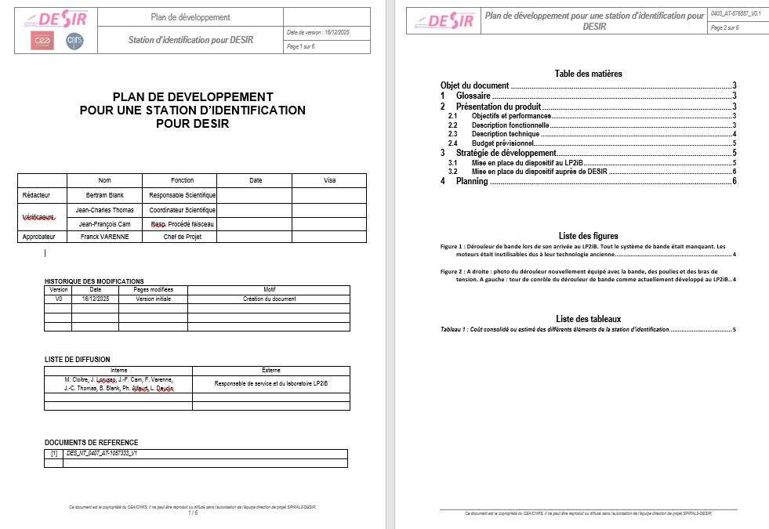
• • • Project of a development plan

Slide 4
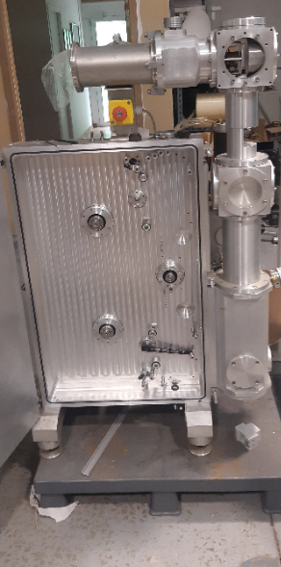
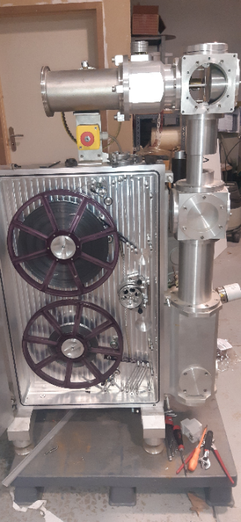
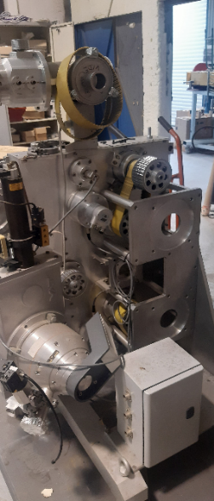
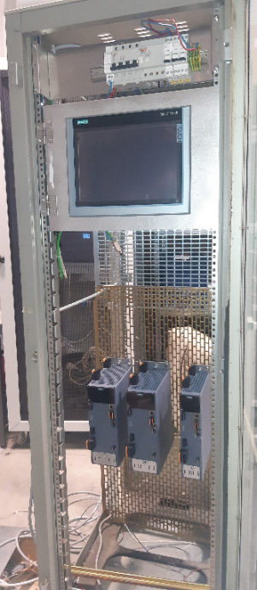
• • • Situation upon arrival at LP2iB today’s status
Upon arrival in Bordeaux….. …now equipped with new mechanics, new motors, new control system

Slide 5
• • • Present status / to-do list
wheels can be control by control system
no “coordinated” movement of the different motors yet
== difficult part
discussion on mechanical development started
dessin to do
manufacturing to be done
vacuum system to be designed and purchased
interface to DESIR control has to be thought of and worked out
detection system has to be developed
DAQ has to be implemented: two FASTER systems are available
estimated budget: 60 k€ (including vacuum system: 15 k€, no DAQ, no detectors),
25 k€ already invested
everything developed at LP2iB, delivered to DESIR,
development in 2026, installation in 2027

Slide 6











• • •
Thanks for your attention

