Slide 1

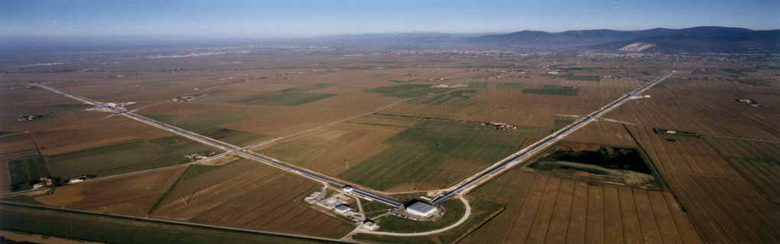

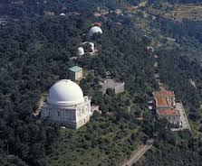
High Power Lasers and Parametric Instability Mitigation
Stéphanie Grabielle, Mourad Merzougui, Walid Chaibi, Margherita Turconi

Slide 2
Plan
ET Laser baseline design
  Besoins en R&D
R&D laser à Artemis pour ET
Instabilités Paramétriques: un frein à l’augmentation de la puissance intracavité
Techniques d’atténuation des instabilités
Programme à Artemis: atténuation active par pression de radiation
Projet en cours et plans pour le futur
Conclusion

Slide 3

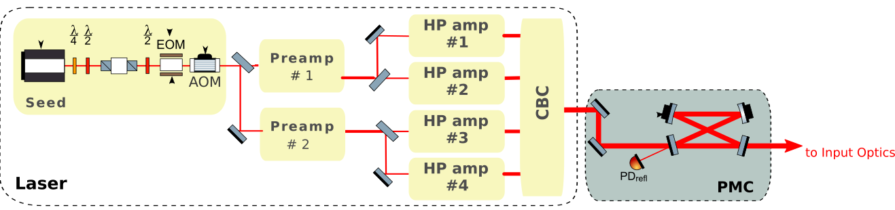
ET Lasers Baseline Design
ET-HF
1064 nm, 700 W
Laser seed ultralow noise + solid state preamplifiers + fiber amplifiers + coherent beam combination
200 W
40 W
R&D:
Démontrer la combinaison cohérente de 4 faisceaux à 200W, couplage dans PMC et prestabilization de fréquence et puissance au niveau des spécification de ET (en cours d’évaluation).
Robustesse et fiabilité des amplis fibrés à améliorer.

Slide 4
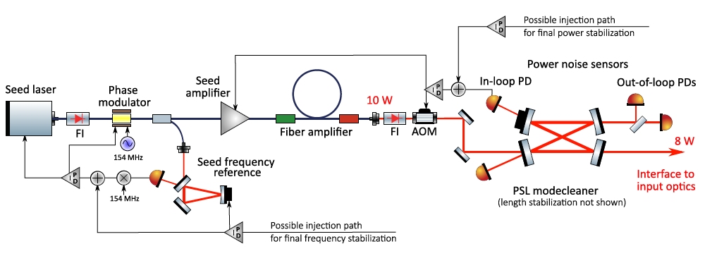
ET Lasers Baseline Design
ET-LF
1550 nm, 5 W
All commercial components:
External cavity diode laser (ECDL) + fiber amplifiers
DOI: 10.1103/PhysRevD.105.122004 (2022)
R&D
- Stabilization du laser au niveau des spécifications ET, surtout à basses fréquences <10Hz

Slide 5
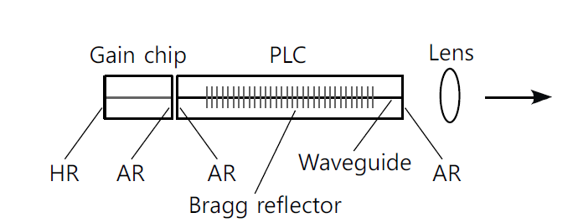
R&D laser à Artemis pour ET
Diode laser à cavité externe, un exemple:
RIO system
https://doi.org/10.1364/OE.18.022781 (2010)
Activité à Artemis :
Test de différent éléments sélectifs en fréquence: réseau, cavité Fabry-Perot.
Objectif: réduire la largeur de raie d’émission pour l’utilisation comme laser seed

Slide 6
R&D laser à Artemis pour ET
Test d’amplificateurs fibrés Tapered avec pompe injectée à l’air libre
Free space counter-propagating pumping
200 W
https://doi.org/10.1117/12.2290424 (2018)
Etude couplage bruit de phase et amplitude dans les amplis fibrés
Objectifs:
tester un autre type de technologie prometteuse par rapport à celle proposée par LZH, Hanovre (https://doi.org/10.1364/AO.401048)
Etudier la physique des amplis fibrés pour en améliorer les performances

Slide 7
R&D laser à Artemis pour ET
Test d’amplificateurs fibrés Tapered avec pompe injectée à l’air libre
Free space counter-propagating pumping
200 W
https://doi.org/10.1117/12.2290424 (2018)
Etude couplage bruit de phase et amplitude dans les amplis fibrés
Objectifs:
tester un autre type de technologie prometteuse par rapport à celle proposée par LZH, Hanovre (https://doi.org/10.1364/AO.401048)
Etudier la physique des amplis fibrés pour en améliorer les performances
Etat R&D à ARTEMIS: Financements préliminaire locaux, pas encore de résultats.

Slide 8
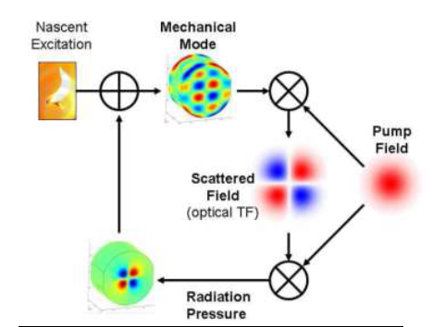


Parametric Instability (PI)
  PI is a three-mode optomechanical instability
$$ω_{m}$$
Cavity
fundamental mode ω₀
ω₁=ω₀ - $ω_{m}$
Evans et al, Phys. Lett. A, 374(4), 665-671 (2010)

Slide 9
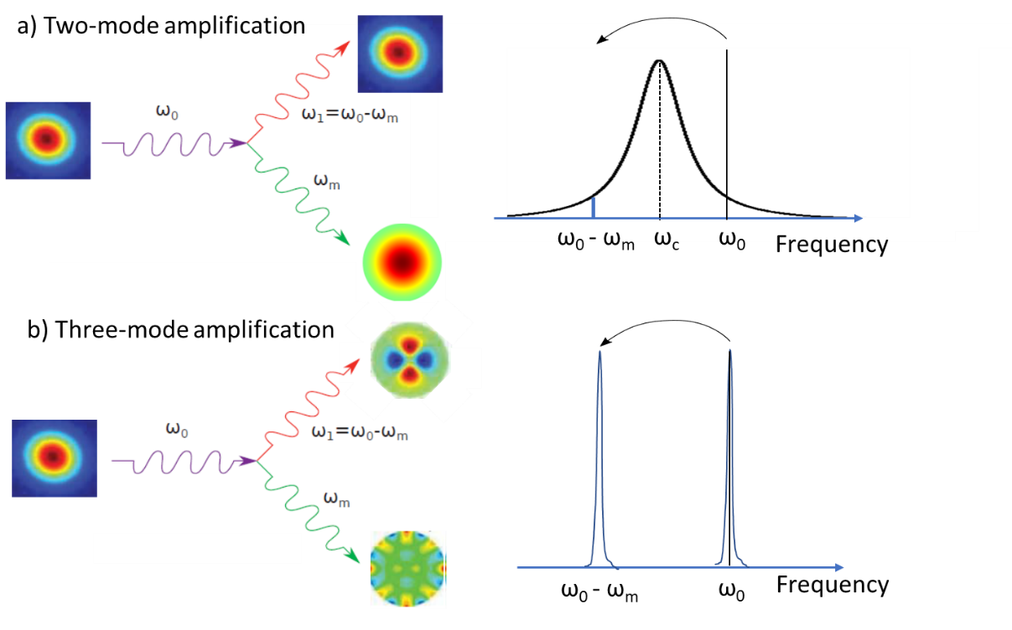
Parametric Instability (PI)
  PI is a three-mode optomechanical instability
Stokes process
$$ω_{m}$$
Cavity
fundamental mode ω₀
ω₁=ω₀ - $ω_{m}$
Evans et al, Phys. Lett. A, 374(4), 665-671 (2010)

Slide 10
Parametric Instability (PI)
  PI is a three-mode optomechanical instability
Stokes process
$$ω_{m}$$
Cavity
fundamental mode ω₀
ω₁=ω₀ - $ω_{m}$
Evans et al, Phys. Lett. A, 374(4), 665-671 (2010)
More intracavity power → more instabilities

Slide 11
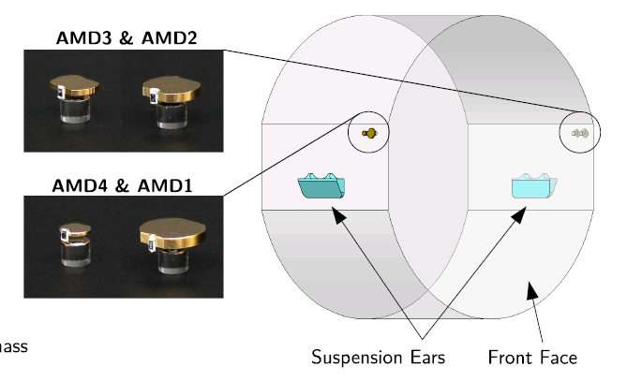
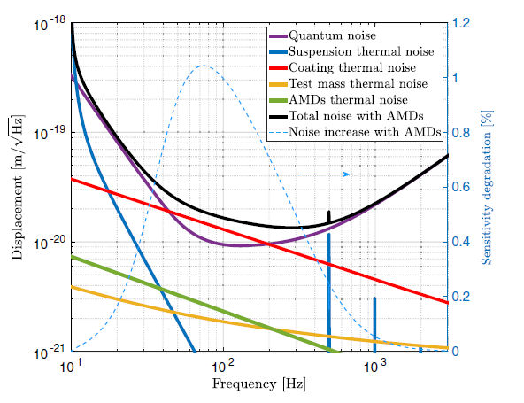
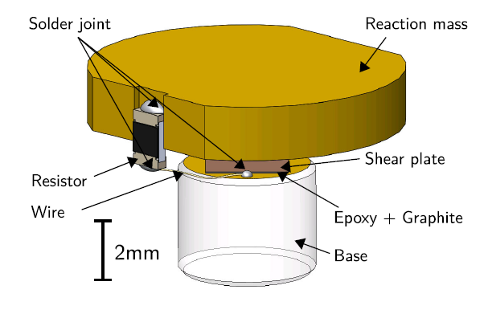
LIGO solution since O3
Passive dampers to lower the Qm factor→ decrease of the parametric gain
Mitigation strategies: Acoustic Mode Dampers
Impact: increase of thermal noise in detection BW
[S. Biscans PHYS. REV. D 100, 122003 (2019)]

Slide 12
Other Mitigation strategies
Thermal tuning of the optical mode resonance [Evans et al. PRL 114,161102 (2015)]
Active damping by Electrostatic drivers. [PRL 118, 151102 (2017)]
PI suppression through optical feedback. [DOI: https://doi.org/10.1103/PhysRevD.109.102006 (2024)]

Slide 13
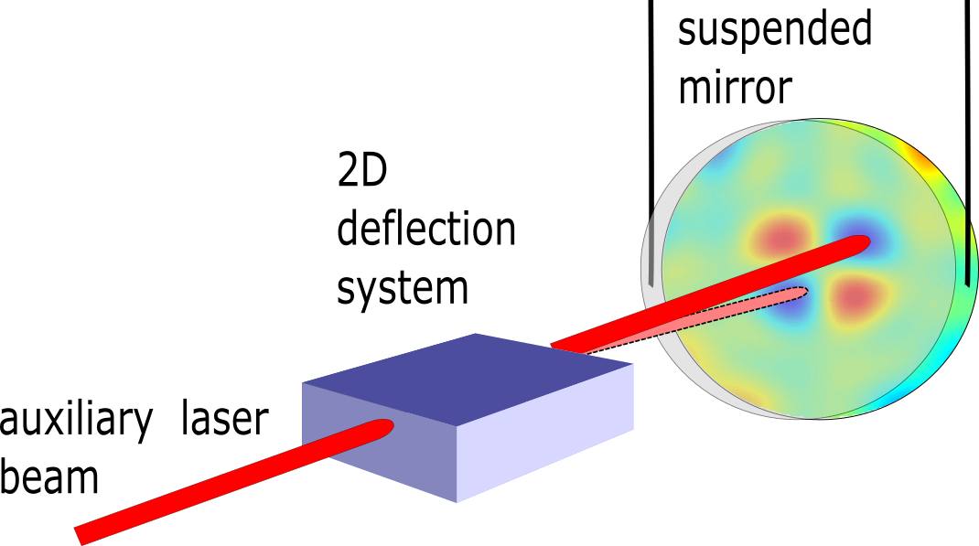
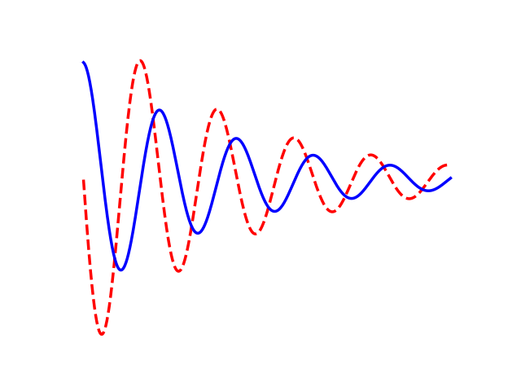
PI active mitigation by radiation pressure
        An auxiliary beam is reflected on the mirror
        The beam amplitude is modulated at the mechanical mode frequency
        A 2 D deflection system allow to apply the damping force optimizing the spatial overlap
dz
dz
Force
Time
2D deflection system based on
Acousto-Optic devices

Slide 14
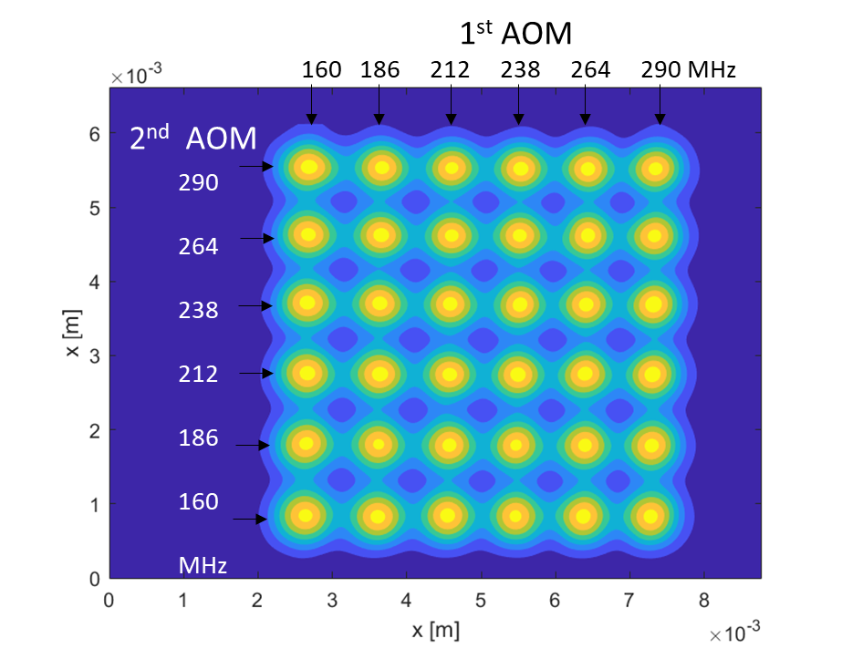
PI active mitigation by radiation pressure
        An auxiliary beam is reflected on the mirror
        The beam amplitude is modulated at the mechanical mode frequency
        A 2 D deflection system allow to apply the damping force optimizing the spatial overlap
dz
dz
Force
Time
        Expected mechanical mode frequencies 10 kHz-200 kHz → fast deflection
        Need to damp different modes → random access deflection
2D deflection system based on
Acousto-Optic devices
T. Harder et al. Optics Express Vol. 31, Issue 2, pp. 1486-1500 (2023).

Slide 15
PI: ongoing projects in Artemis
ANR JCJC SPINA 2022-2027
Develop a table–top cavity able to host PI→ to validate our mitigation strategy
Monitor the mirror modes → to be able to detect the onset of PI

Slide 16
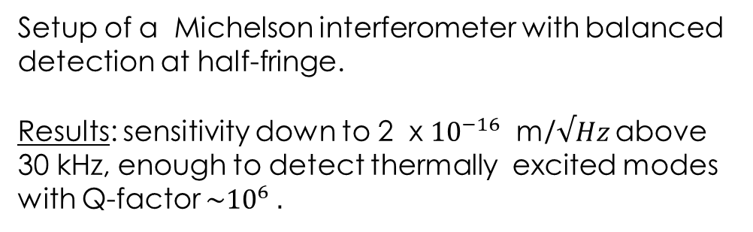
PI: ongoing projects in Artemis
ANR JCJC SPINA 2022-2027
Develop a table–top cavity able to host PI→ to validate our mitigation strategy
Monitor the mirror modes → to be able to detect the onset of PI
Setup of a Michelson interferometer with balanced detection at half-fringe.
Results: sensitivity down to 2 x ${10}^{−16}$ m/$√Hz$ above 30 kHz, enough to detect thermally excited modes with Q-factor $\sim {10}^{6} .$

Slide 17
PI: ongoing projects in Artemis
ANR JCJC SPINA 2022-2027
Develop a table–top cavity able to host PI→ to validate our mitigation strategy
Monitor the mirror modes → to be able to detect the onset of PI +
measurement of mechanical Q
Setup of a Michelson interferometer with balanced detection at half-fringe.
Results: sensitivity down to 2 x ${10}^{−16}$ m/$√Hz$ above 30 kHz, enough to detect thermally excited modes with Q-factor $\sim {10}^{6} .$
Goal: understand and measure the losses introduced by coating layers interface.
Collaboration with LMA (mirror samples with different number of coating layers) et LAUM (simulations)→ Commun internship in summer 2025.

Slide 18
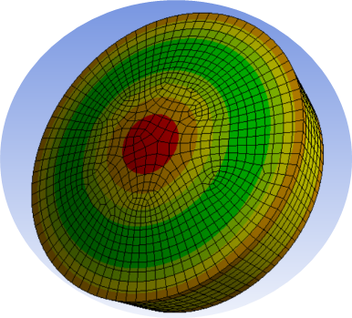
PI: future plans
Mirror’s axisymmetric mode measurement
Measurements of more complex modes with the 2D deflection system
In collaboration with LAUM and LMA : PI passive mitigation by dissipative coatings applied on the rear surface of the mirrors to reduce Q factor of the mechanical modes which potentially can trigger a parametric instability → Application ANR 2026

Slide 19
Conclusions
Le baseline design des lasers pour ET prévoit l’utilisation d’amplificateurs fibrés, les prototypes à AEI (Hanovre) doivent encore atteindre les performances requises par ET.
Notre équipe a commencé des activités R&D sur des sources diodes à cavité externe et sur les amplis fibrés.
Les instabilités parametriques doivent être contrôlées dans ET, une combinaison de technique d’atténuation peut être utilisée.
Notre équipe à Artemis travaille à un système d’atténuation actif par pression de radiation.
Collaboration LMA/LAUM/Artemis veut explorer l’idée d’une technique passive par dépôt de coatings dissipatifs sur la face arrière des miroirs.

Slide 20
Spare slides

Slide 21
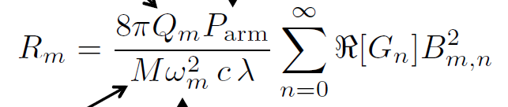
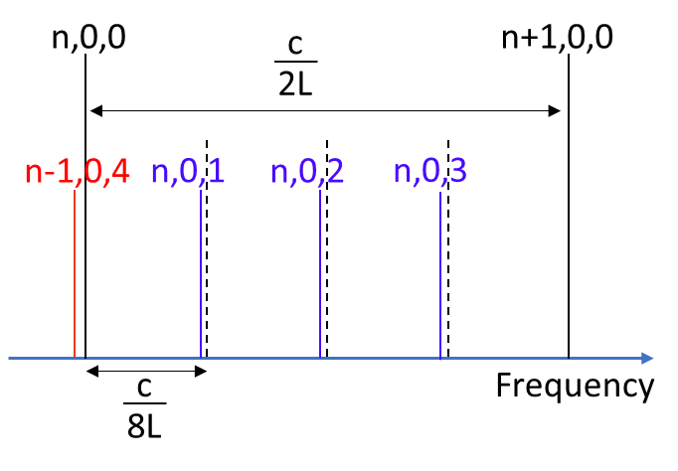
Table-top cavity hosting PI
Movable mirror: a suspended macroscopic mirror
In meter-scale stable cavities, the typical frequency difference between optical high-order modes is high (10-200 MHz) compared to the GW detectors
→ the frequency matching between optical and mechanical mode frequencies will occur for high order mechanical modes.
→ The spatial overlap might be difficult
Intracavity power
Mirror Quality Factor
Geometrical Overlap coefficient
With the n^{th} optical Mode
Gain
R
m
m
M Ω²_{m}
cav
m
,N
m
N
Mirror Mass
Choice: cavity closed to semiconfocal configuration
Mechanical
frequency
Sum over all optical modes

Slide 22
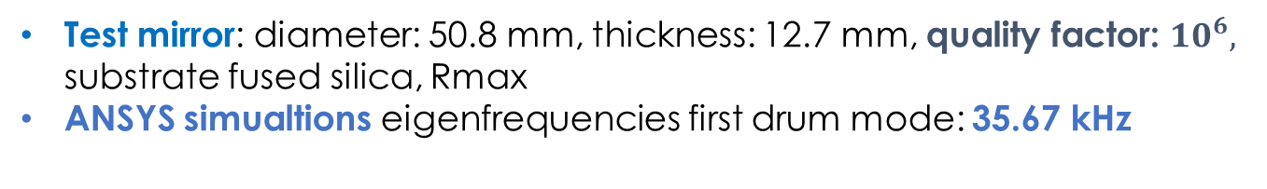
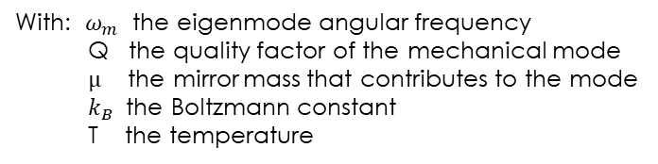
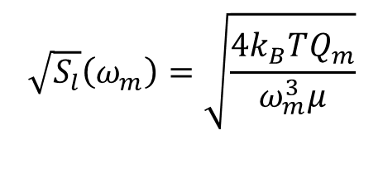
How to monitor the mirror’s modes?
Goal: measuring the thermally excited displacement of a test mirror, we start by looking for the axisymmetric (drum) modes
Test mirror: diameter: 50.8 mm, thickness: 12.7 mm, quality factor: ${10}^{6},$ substrate fused silica, Rmax
ANSYS simualtions eigenfrequencies first drum mode: 35.67 kHz
Estimation of the mirror surface displacement due to thermal excitation
$3.8×{10}^{−15}$ m/$\sqrt{\text{Hz}}$
Amplitude Spectral Density of the displacement noise:
First drum mode
$$\sqrt{S_{l}}\left(ω_{m}\right)=\sqrt{\frac{4k_{B}TQ_{m}}{ω_{m}^{3}μ}}$$
With: $ω_{m}$ the eigenmode angular frequency
Q the quality factor of the mechanical mode
$µ$ the mirror mass that contributes to the mode
$k_{B}$ the Boltzmann constant
T the temperature
Required Sensitivity of the detection: at least ${10}^{−15}m/\sqrt{Hz}$ for frequencies > 30 kHz

Slide 23
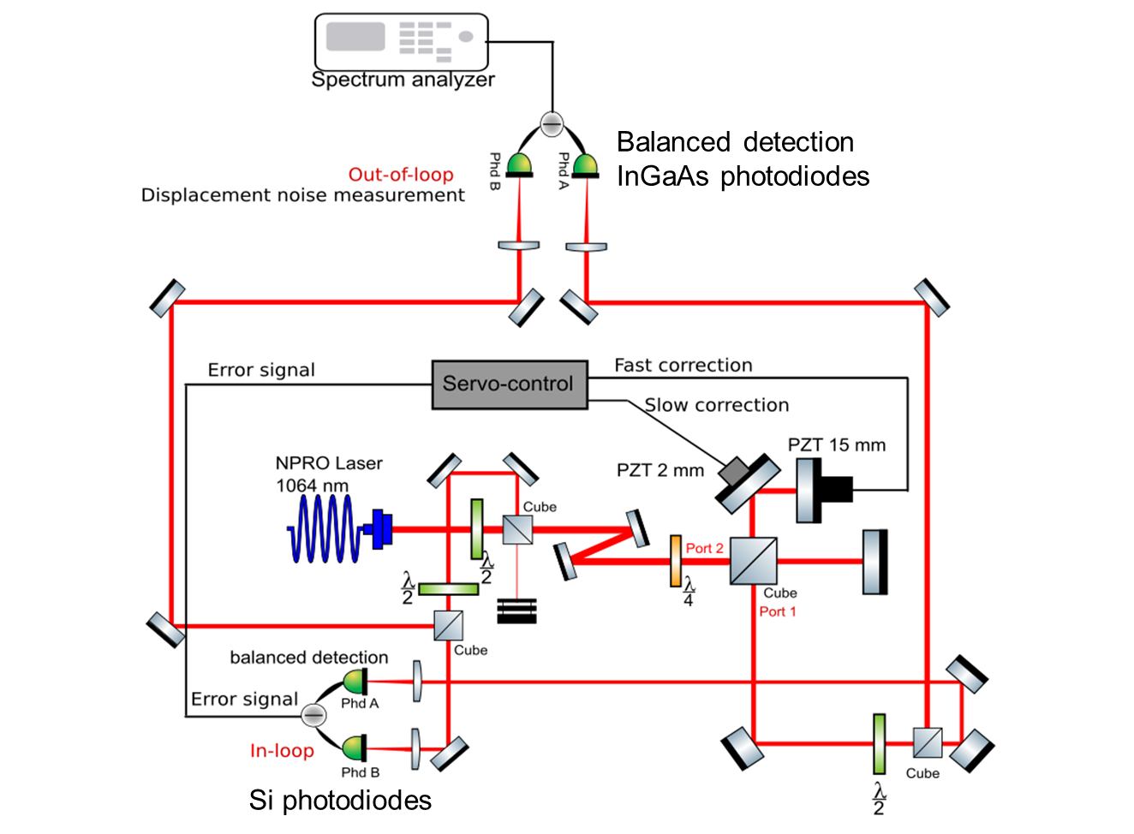
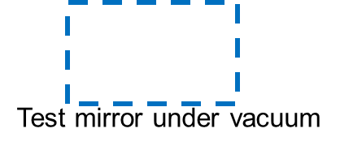
How to monitor the mirror’s modes?
Michelson interferometer with balanced detection at half-fringe

Slide 24
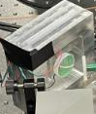
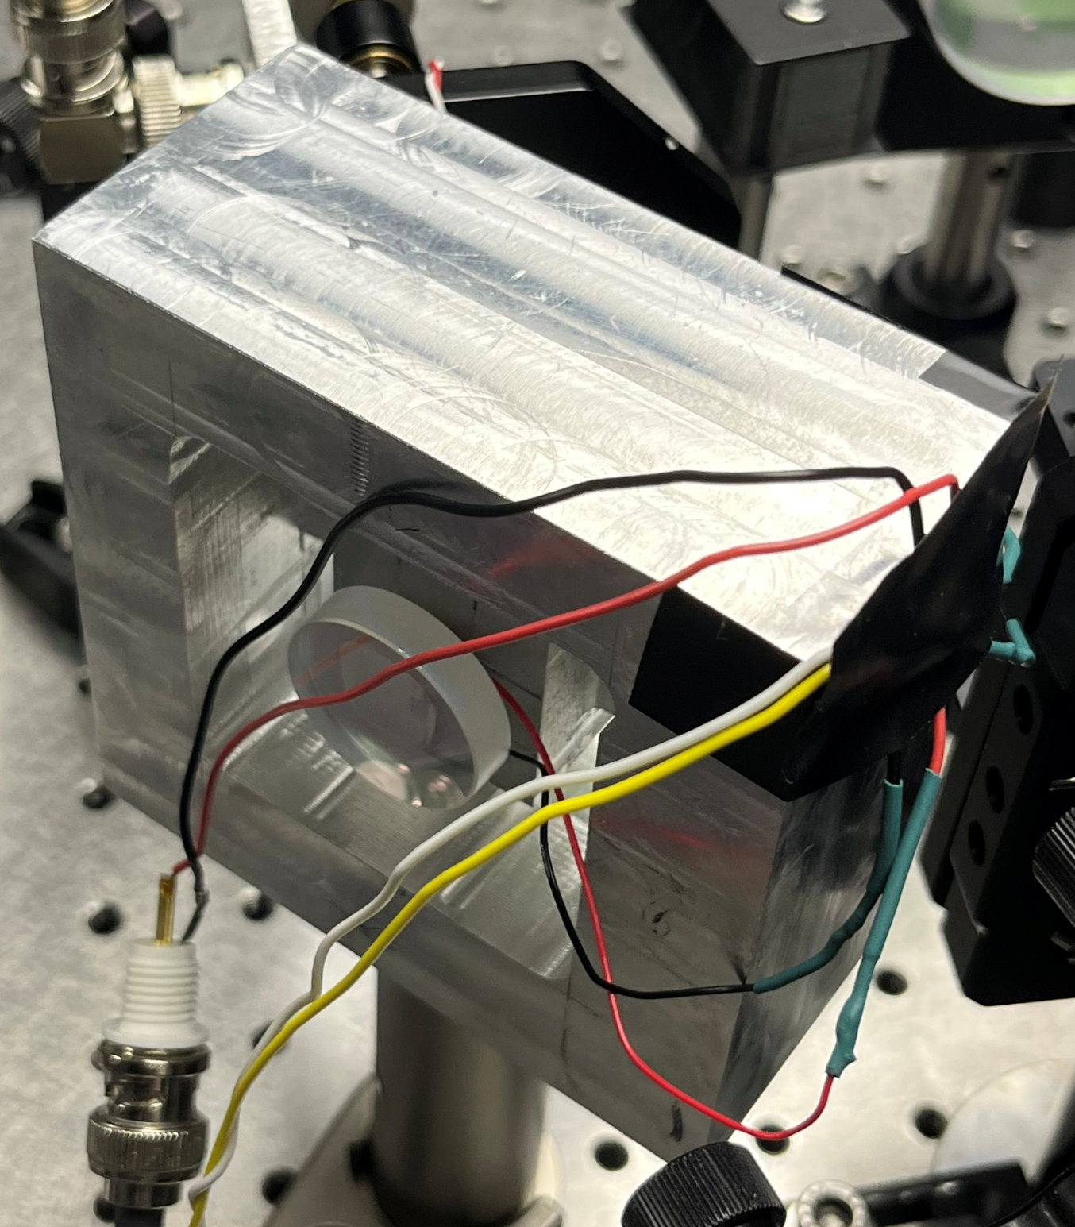
How to monitor the mirror’s modes?
Michelson interferometer with balanced detection at half-fringe
Fast piezo: specially designed mechanical mount to reduce piezo resonances

Slide 25
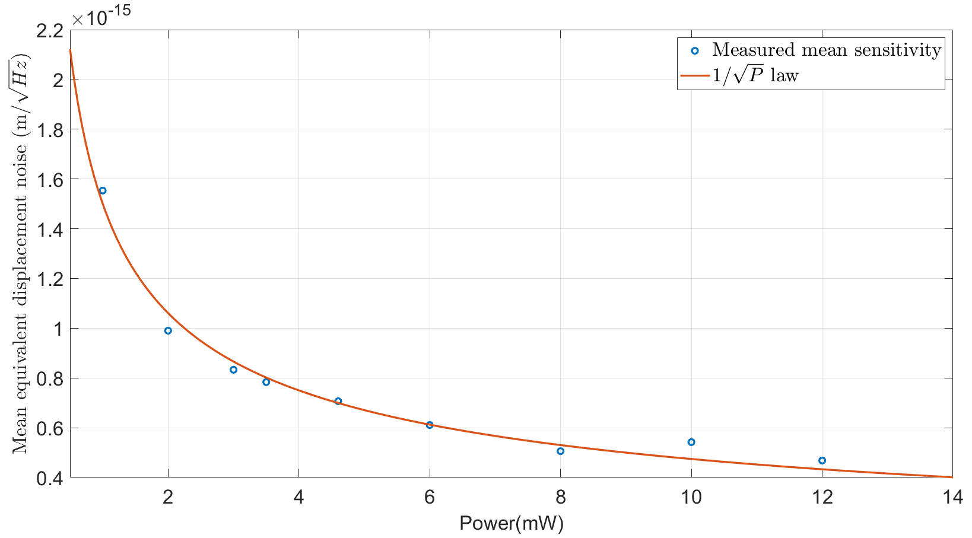
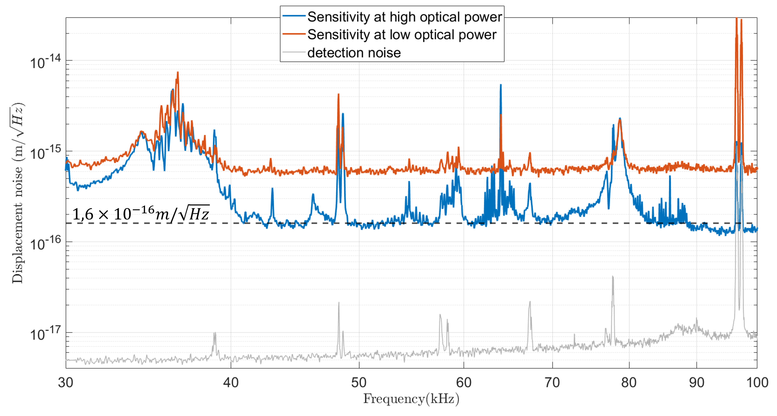

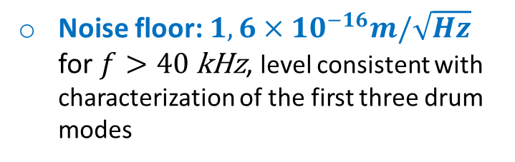

Results
Shot noise limited detection
$$P_{avg}≈4,4 mW$$
$$P_{avg}≈120 mW$$
Noise floor: ${1,6×10}^{−16}m/\sqrt{Hz}$ for $f>40 \text{kHz}$, level consistent with characterization of the first three drum modes

Slide 26
Results
Shot noise limited detection
$$P_{avg}≈4,4 mW$$
$$P_{avg}≈120 mW$$
Parasitic peaks
Parasitic peaks

Slide 27
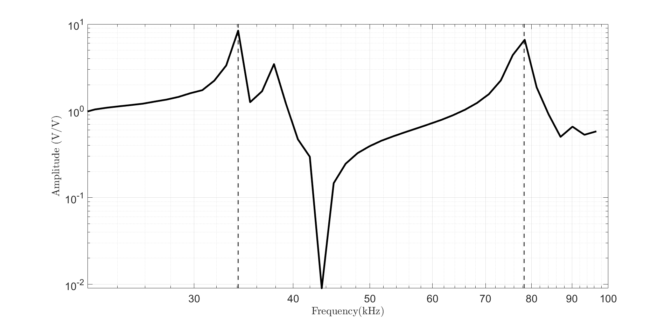
Results
Shot noise limited detection
$$P_{avg}≈4,4 mW$$
$$P_{avg}≈120 mW$$
Parasitic peaks
Parasitic peaks
Recent work on reduction of the parasitic peaks and PZT resonances:
Fast piezo first resonances
Optimized grounding
Isolation of key components
Optimized detection filters
Added electronic notch filters to the PZT correction signal

Slide 28
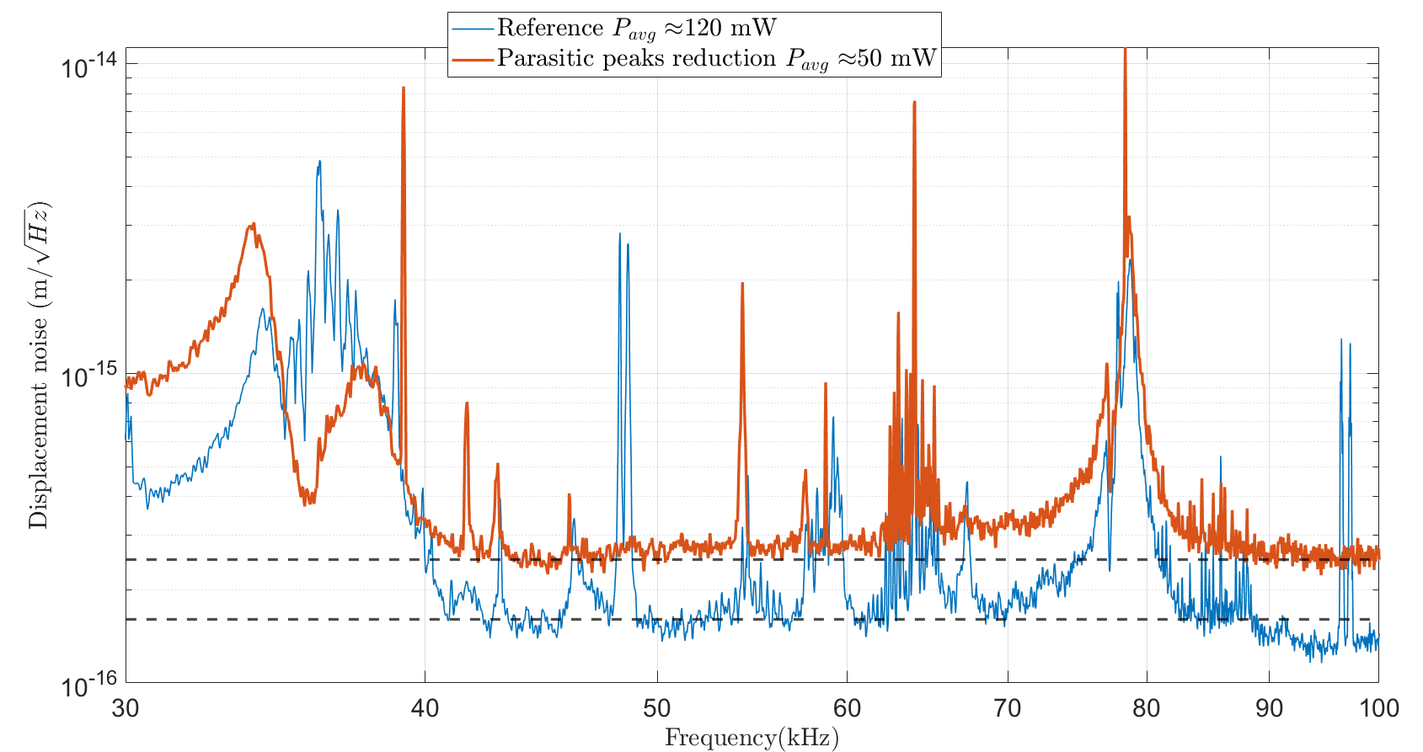
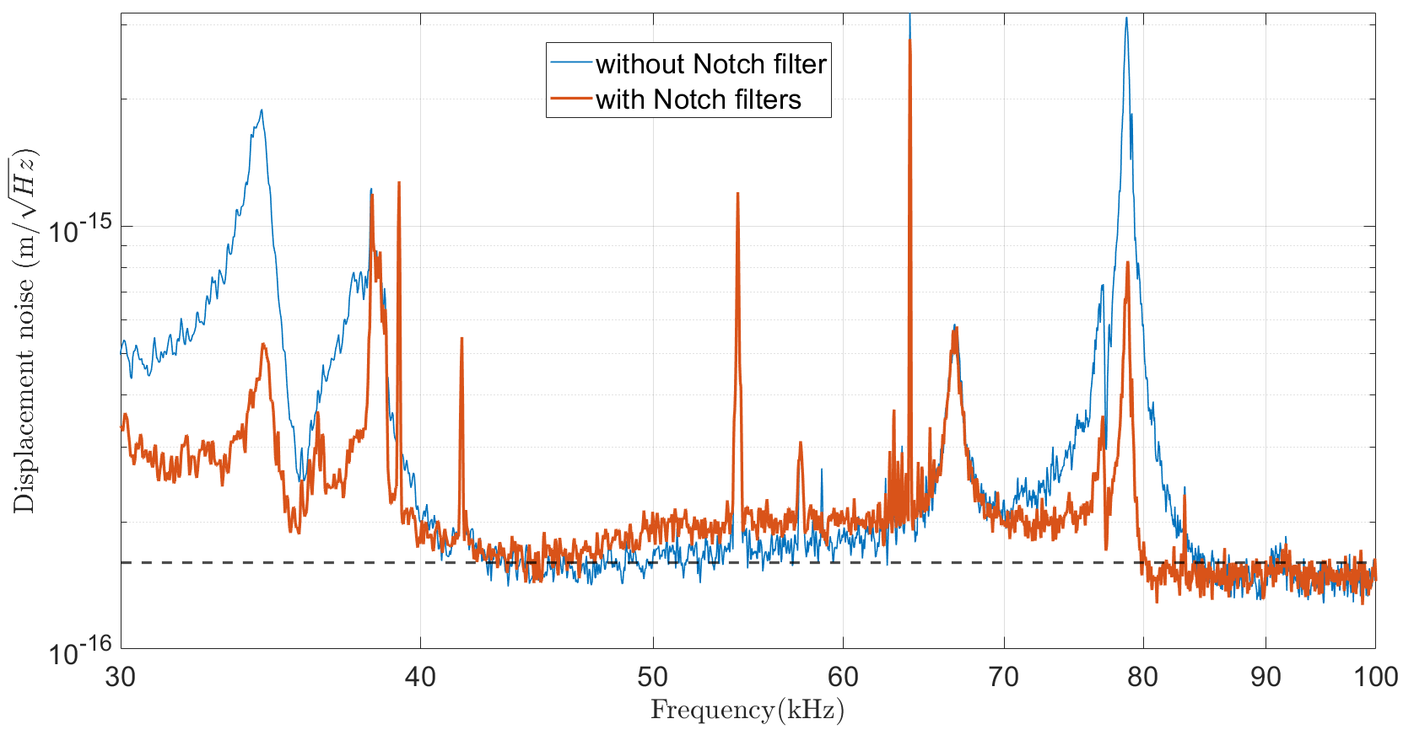

Results
Reduction of the parasitic peaks:
Reduction of the PZT resonance:
Optimized grounding
Isolation of key components
Optimized detection filters
Added electronic notch filters to the PZT correction signal
$$1,6×{10}^{−16}m/\sqrt{Hz}$$

Slide 29
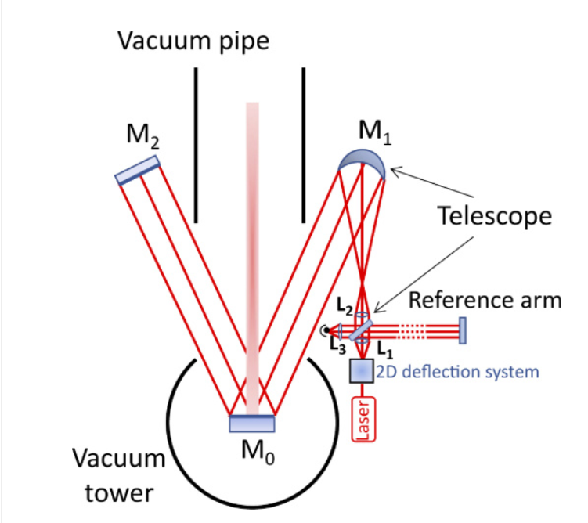
Perspectives towards implementation on a GW detector
T. Harder et al. Optics Express Vol. 31, Issue 2, pp. 1486-1500 (2023)

Slide 30
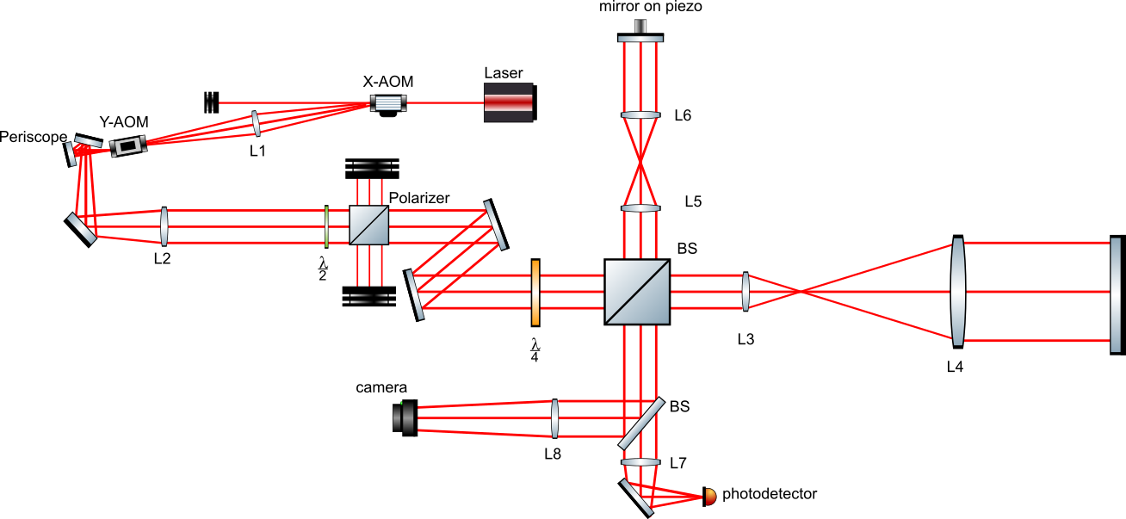
PIs observation and mitigation
Servo-control
USRP
RF-AMP
RF-AMP
L
L
vacuum
Electrostatic actuator
cavity

