Slide 1

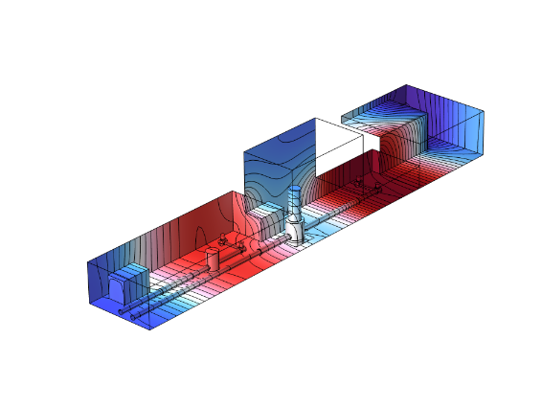
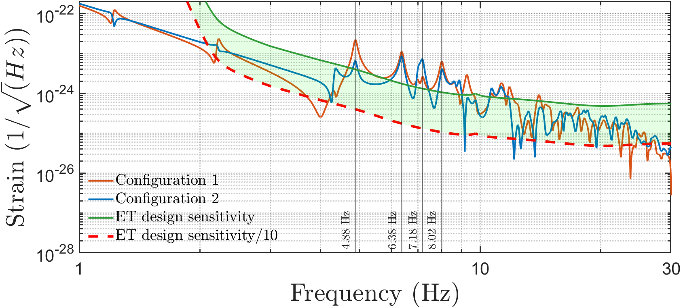
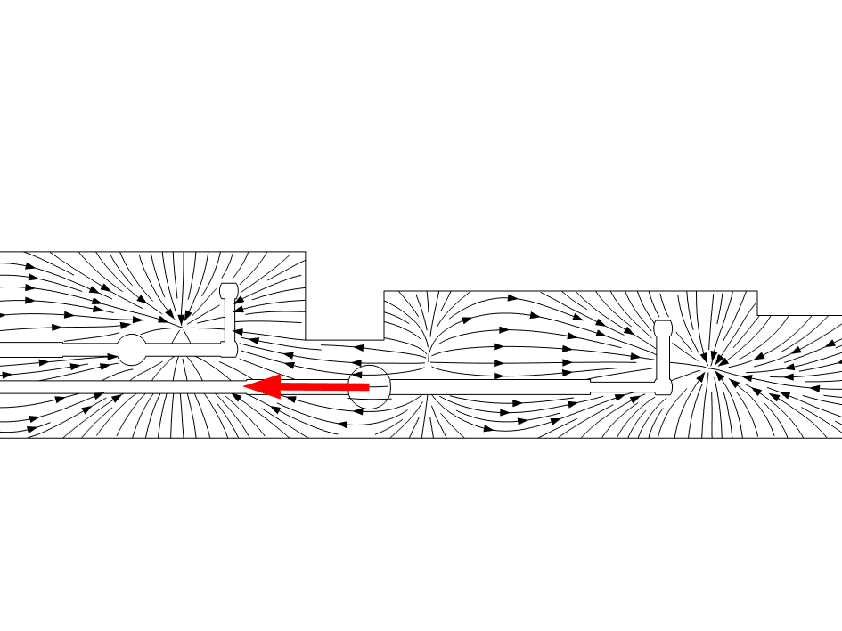
Acoustic Newtonian noise modelling in the caverns of ET
L.Maurin, F.Gautier, S.Terrien, M.Barsuglia
f5=4.8Hz
Journées ET France, 01/04/2026

Slide 2
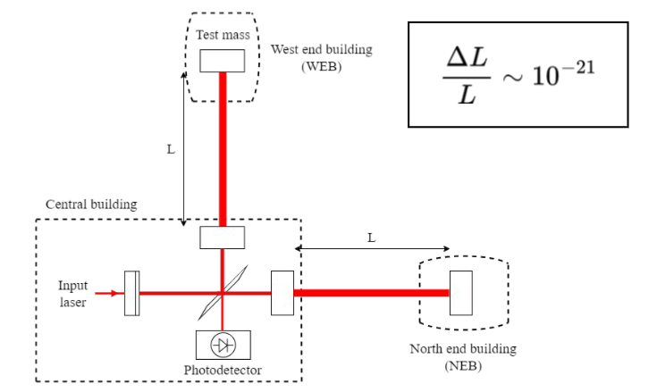
Acoustic in Gravitational Wave detectors
Coating thermo-optic noise
Substract brownian noise
Suspension Thermal noise
Vibrations or vibroacoustic coupling path
- Vibrations of technical origin contribute to Seismic noise
- Treated by superattenuator (or active control)
Radiation pressure fluctuation
Diffuse light
Residual gas
Seismic noise
Newtonian noise
Quantum noise
One possible cause of Newtonian Noise
- The pressure field variations generates change of mass density => Acoustic has a gravity counterpart
- Impossible to shield
Cause of beam jitter at Injection
Scattered or diffused light can couple with vibroacoustic
- Vibrations of optical benches, vibrations of viewport induced by structure borne sources

Slide 3
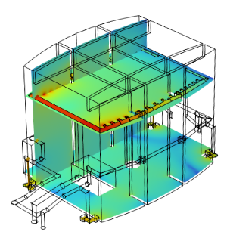
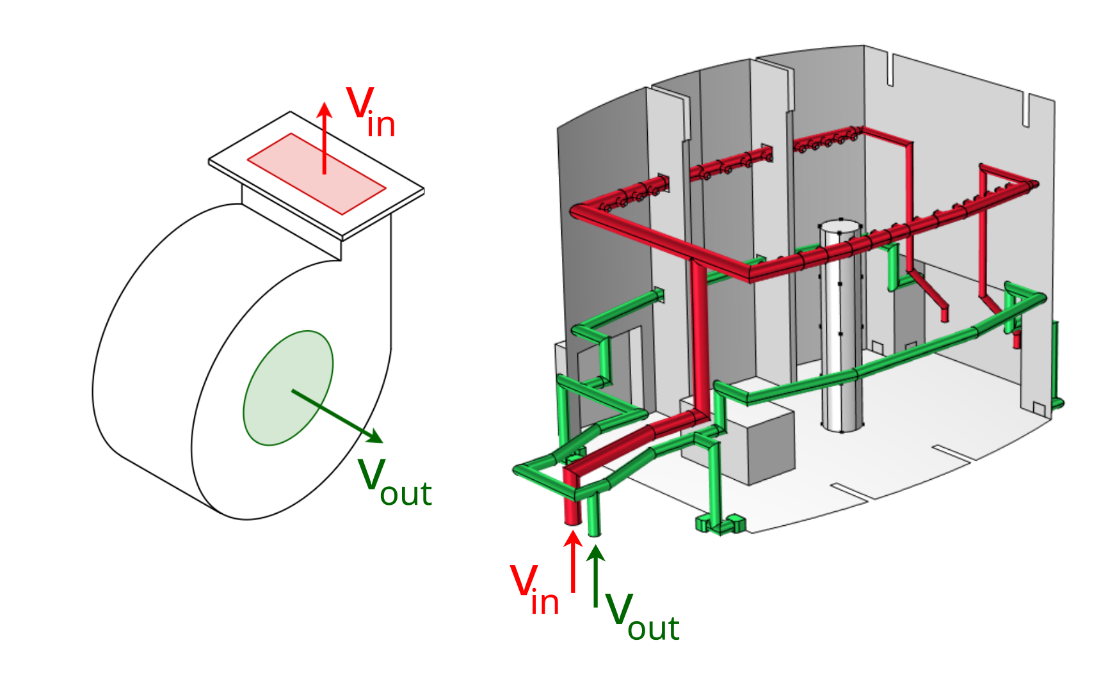
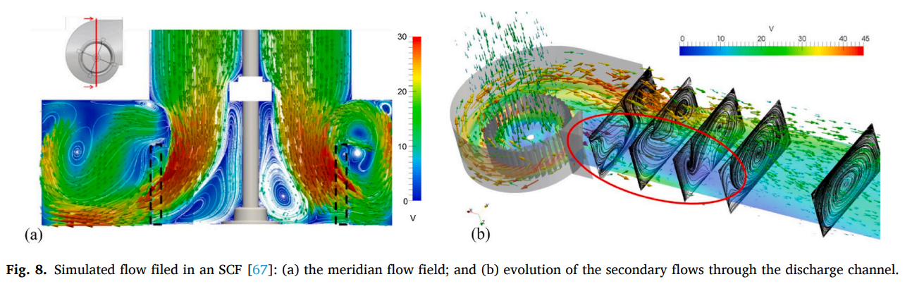
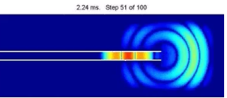
Sound generation in the experimental halls
HVAC system
heating ventilation and air conditioning
airborne source
responsible for acoustic noise
structure borne source
responsible for ground/walls vibrations
Air flow
Local turbulence
Generation of acoustic
disturbances (pressure pulsations)
Acoustic radiation by inlets/outlets
Equivalent monopolar source
Horn geometry
HEPA filter
Simulation of acoustic field
Clear modal behavior below 30Hz
Positions of inlets/outlets are key factors
Acoustic + Mechanical vibrations

Slide 4
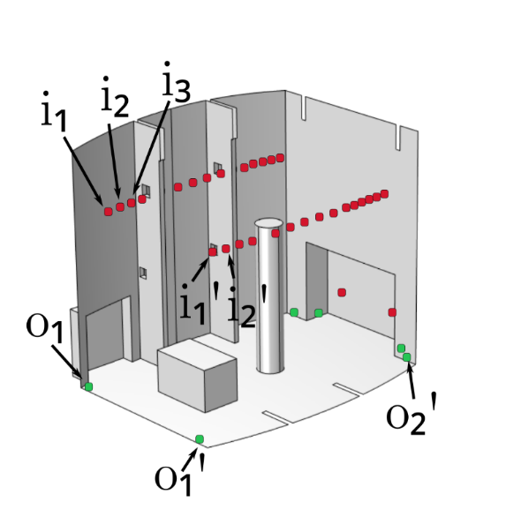
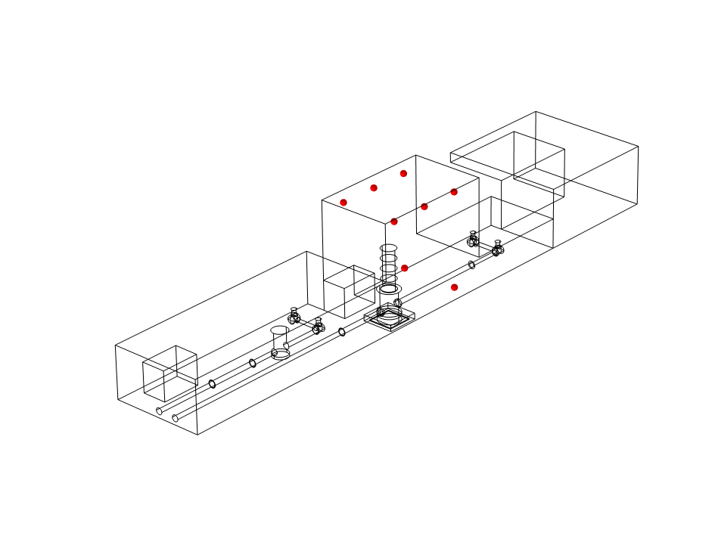
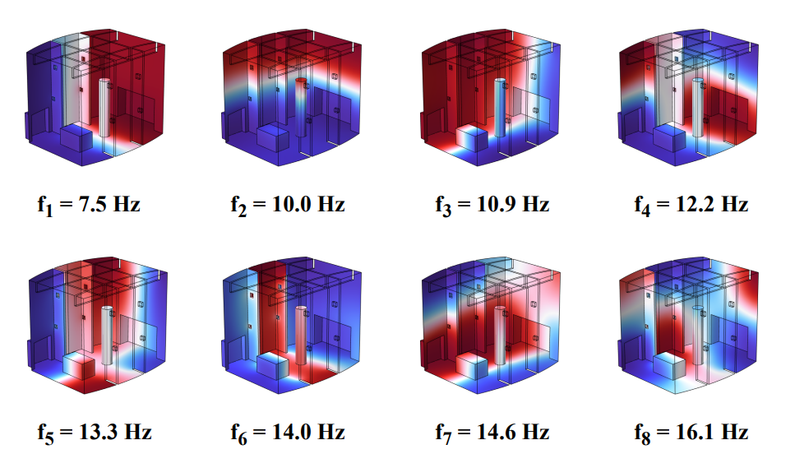
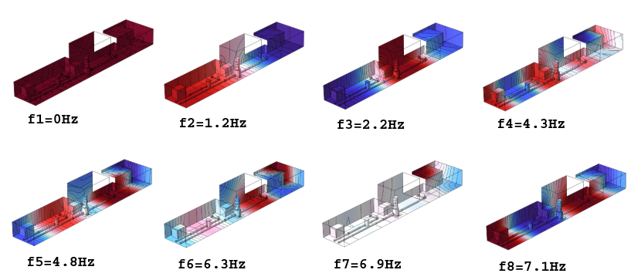
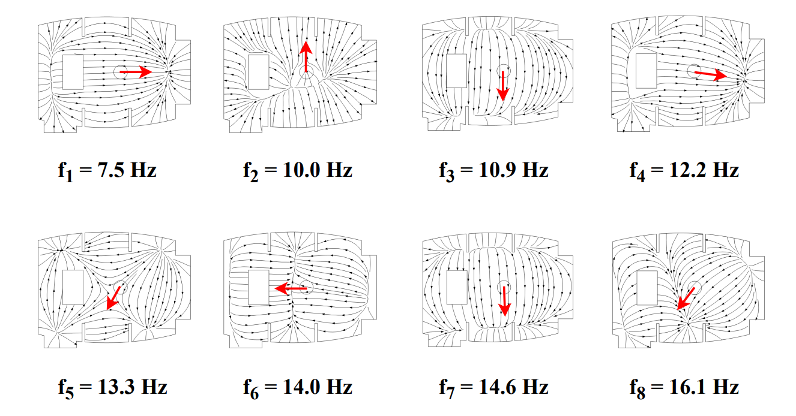
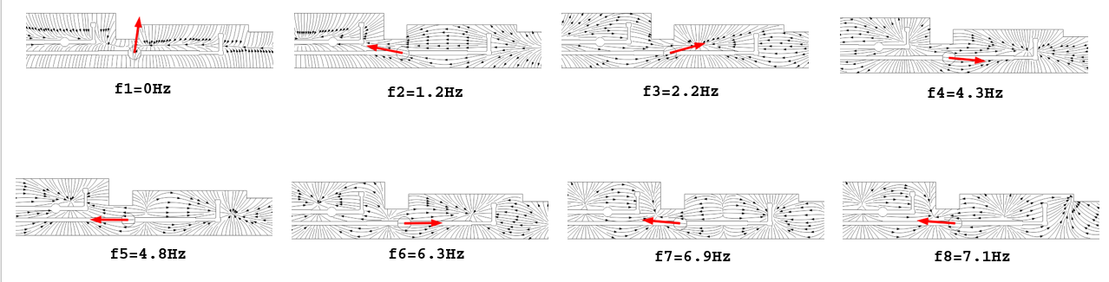
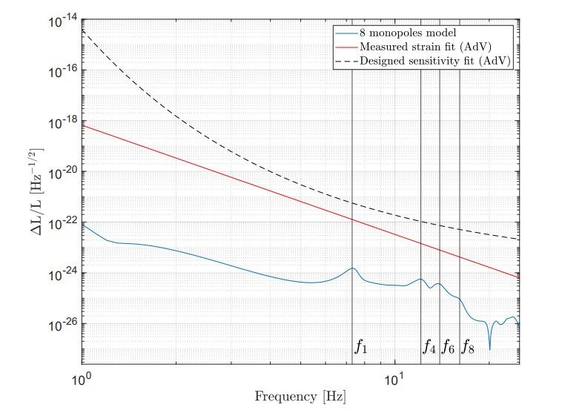
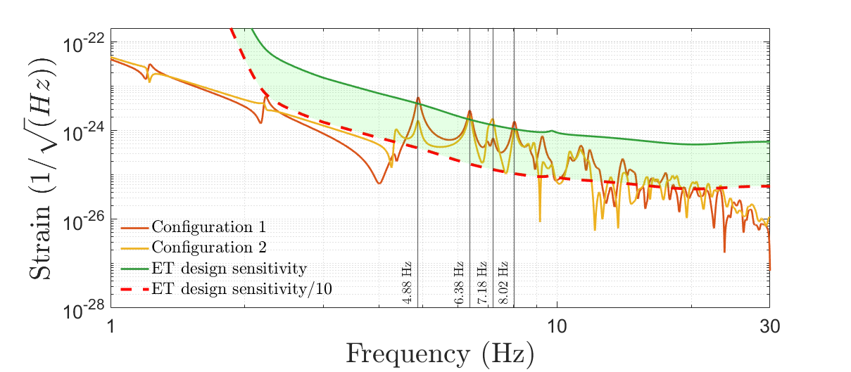
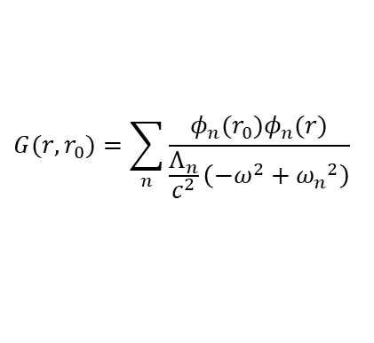
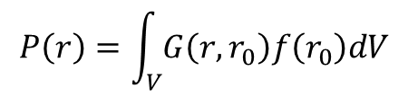
Estimation of the NN of Acoustic origin – methodology and results
Step 1 : Acoustic pressure inside a cavity
Virgo - NEB
ET- end cavern
Point sources
Pressure
$$P\left(r\right)=\int_{V}{G\left(r,r_{0}\right)f\left(r_{0}\right)dV}$$
Acoustic modes of the rigid cavity
$$G(r,r_{0})=\sum_{n}{\frac{φ_{n}(r_{0})φ_{n}(r)}{\frac{Λ_{n}}{c^{2}}\left(−ω^{2}+{ω_{n}}^{2}\right)}}$$
Step 2 : induced Gravity potential
Density
Potential
$$δΦ\left(\vec{r},ω\right)=−G\int{\frac{δρ\left(\vec{r^{′}},ω\right)}{\left|\vec{r^{′}}−\vec{r}\right|}dV\left(\vec{r^{′}}\right)}$$
$$δρ=\frac{ρ_{0}}{γp_{0}}δp$$
Step 3 : induced Gravity field
Gravity field
$$δ \vec{g}\left(\vec{r},ω\right)=−\vec{∇}δΦ(\vec{r},ω)$$

Slide 5
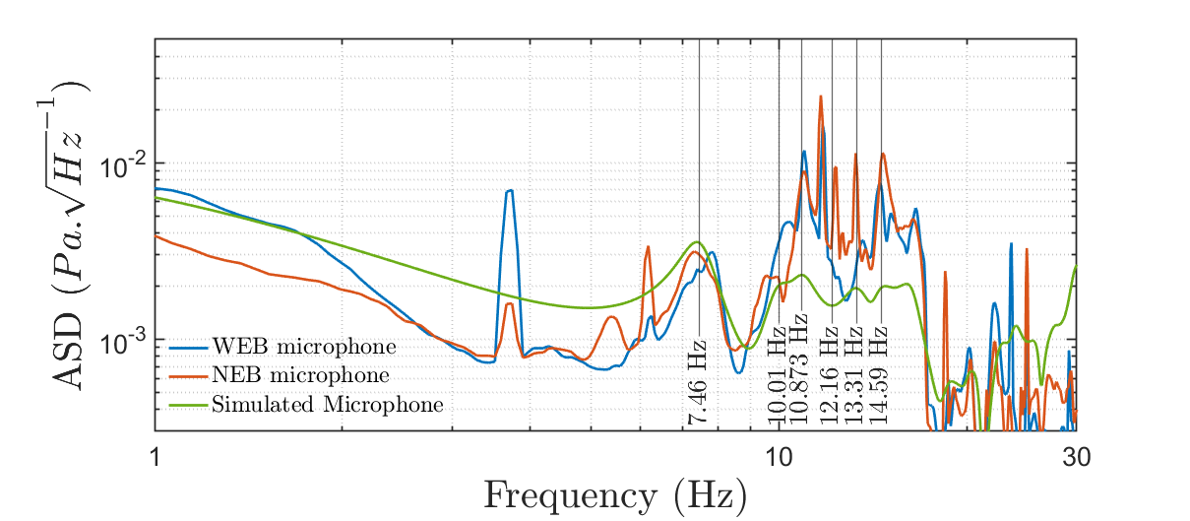
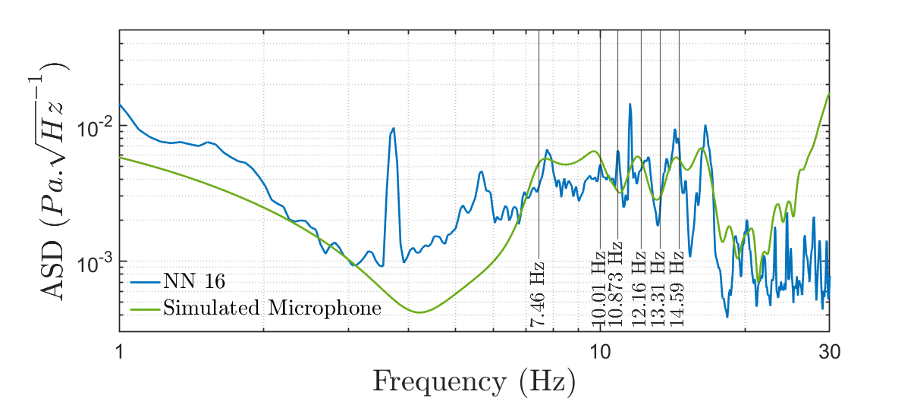
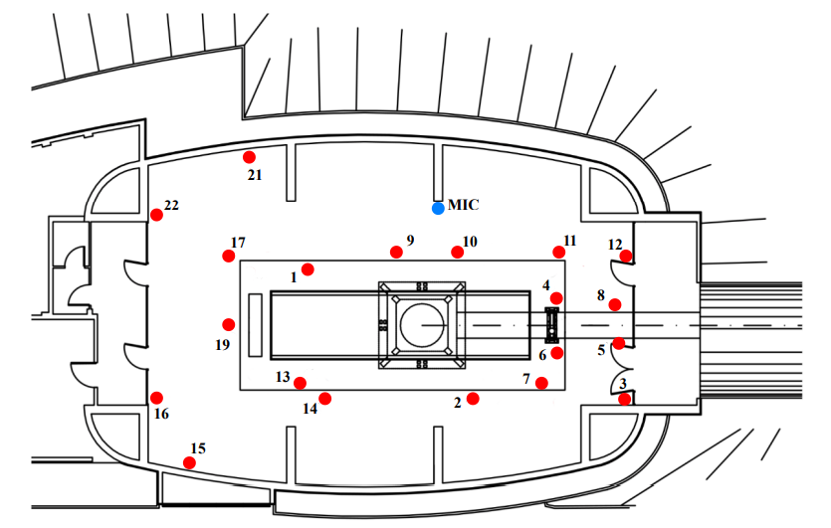
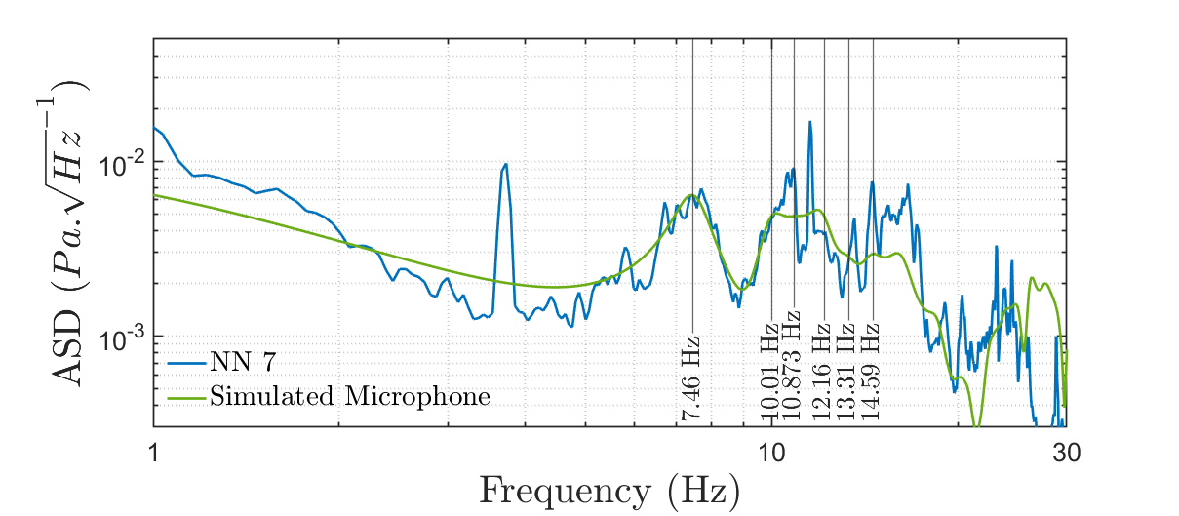
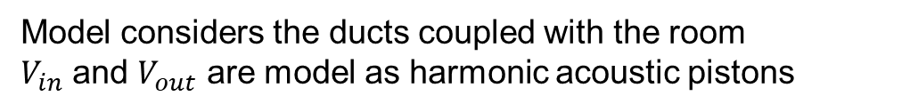
Full model
Model considers the ducts coupled with the room
$V_{in}$ and $V_{out}$ are model as harmonic acoustic pistons

Slide 6
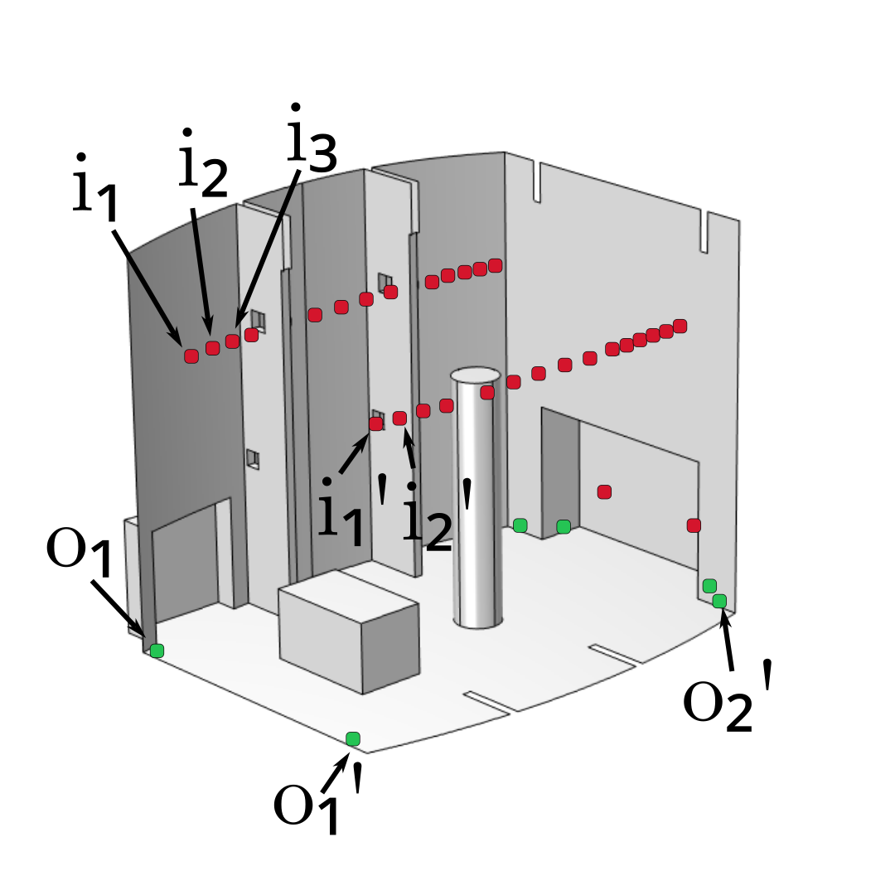
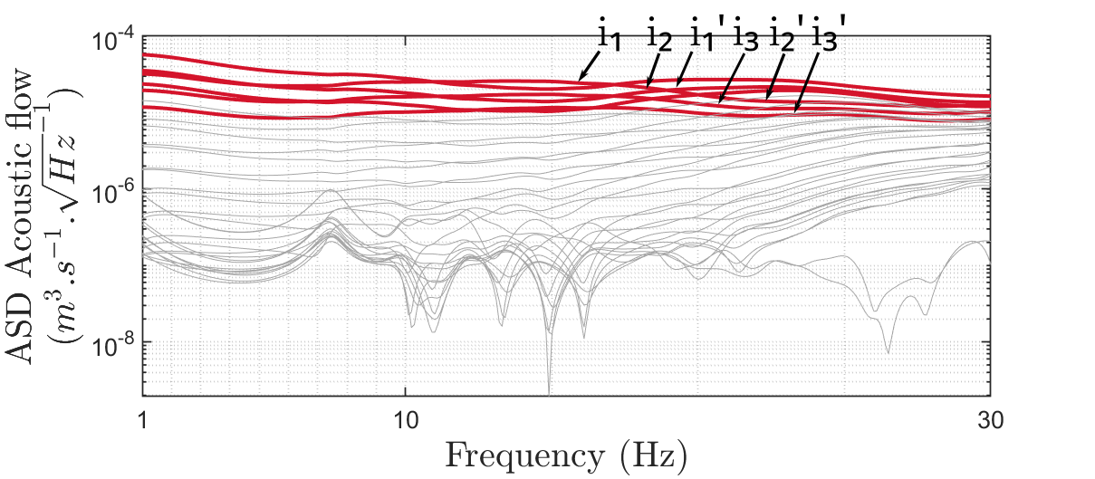
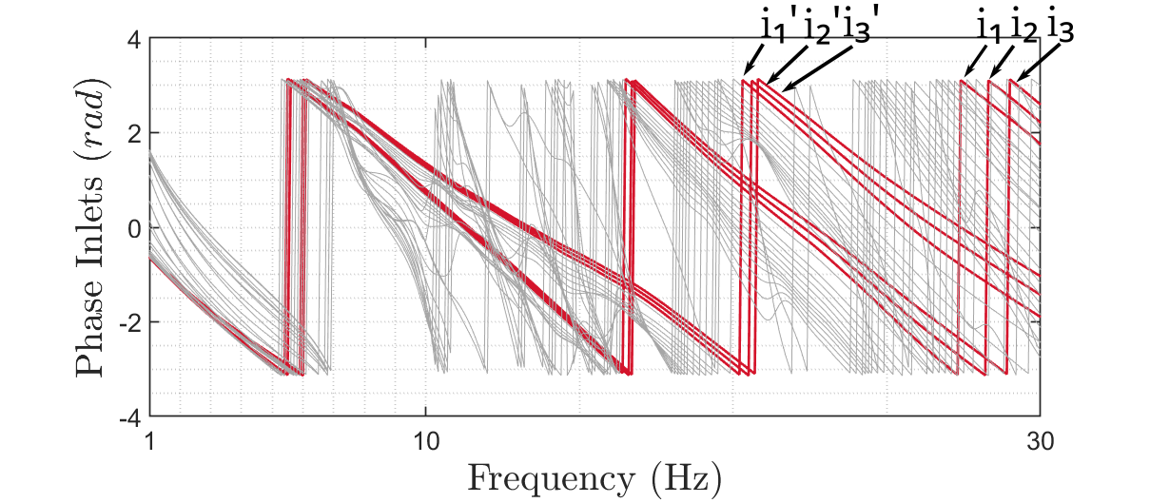
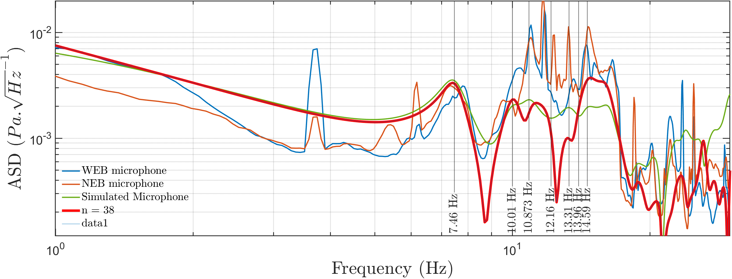
Simplified model
Inlets and Outlets are replaced by monopoles
Amplitude and phase are estimated from full model

Slide 7


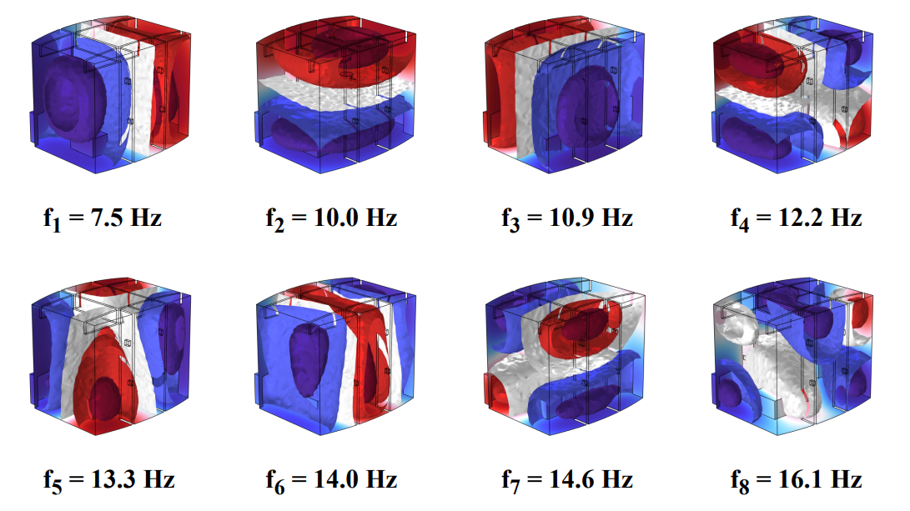
Modal and functional basis using the simplified model
Acoustic field
Potential of gravity field
Modal basis
Functional basis
$φn$ Function
$Ψn$ Function

Slide 8

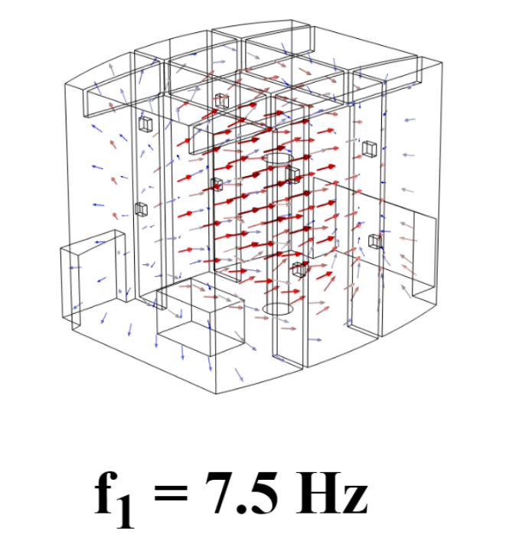
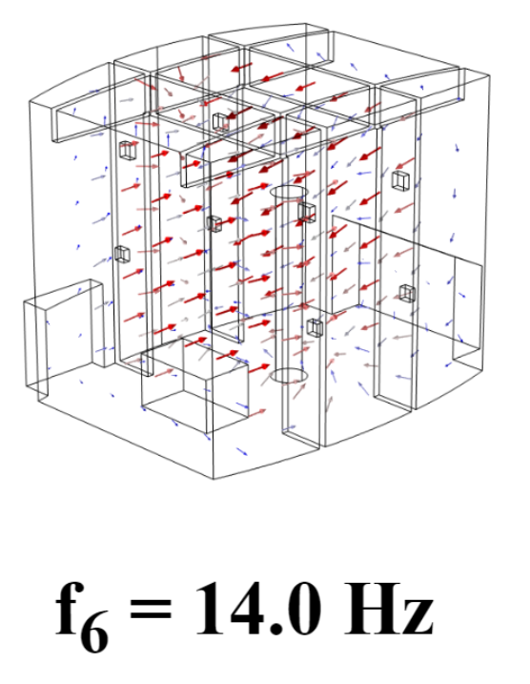

Modal and functional basis using the simplified model
Acoustic field
Gravity field
Modal basis
Gradient of Psi
$φn$ Function
$\vec{∇}Ψn$ Function

Slide 9
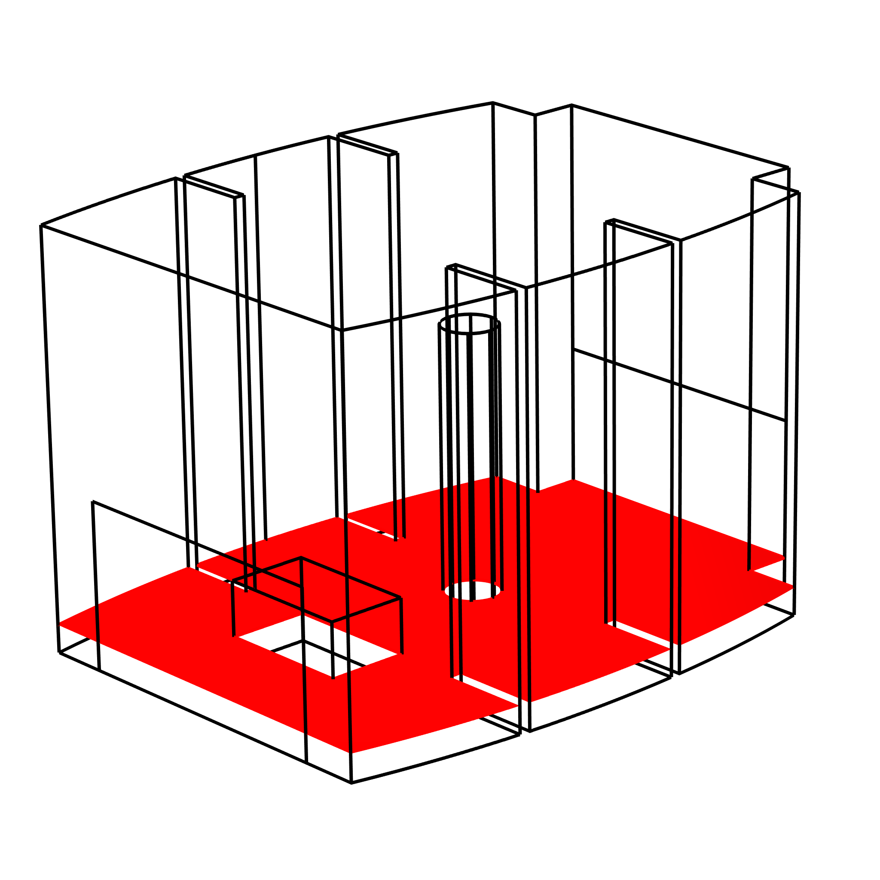
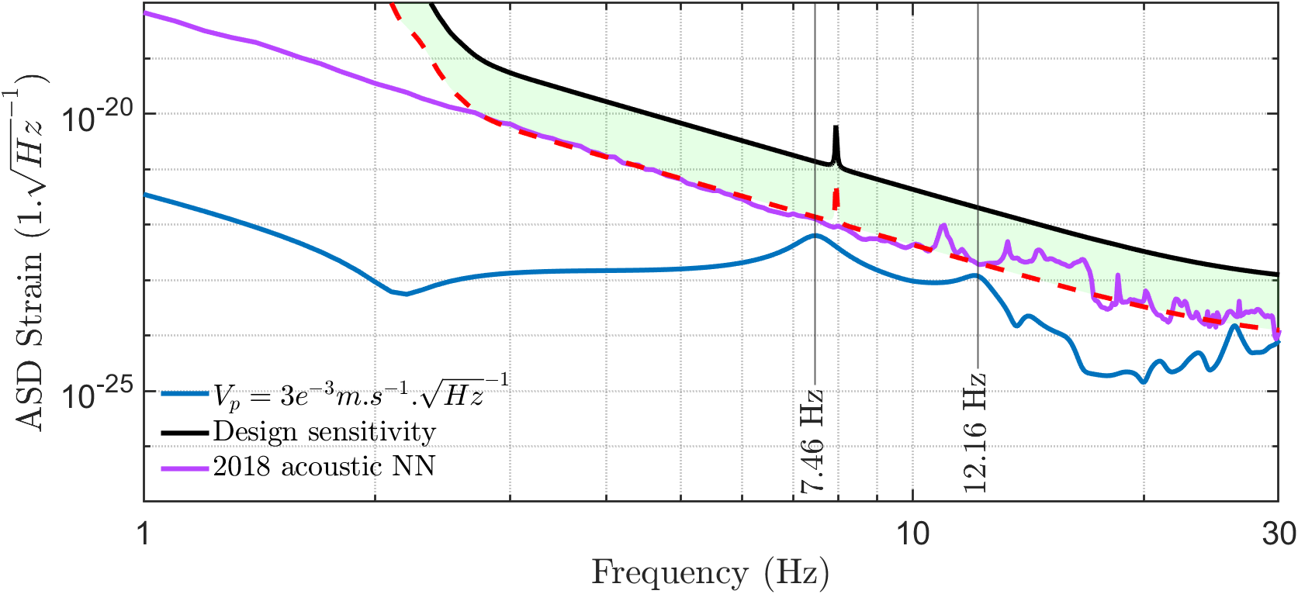
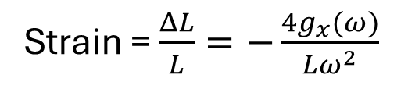
Estimating the newtonian noise from the simplified model
Strain = $\frac{ΔL}{L}=−\frac{4g_{x}(ω)}{Lω^{2}}$
What is the impact of the Newtonian noise on the suspended test mass?
z
y
x
Streamlines for the gravity field in the room in the 2D
cross-section at one meter from the ground.
NN estimate

Slide 10
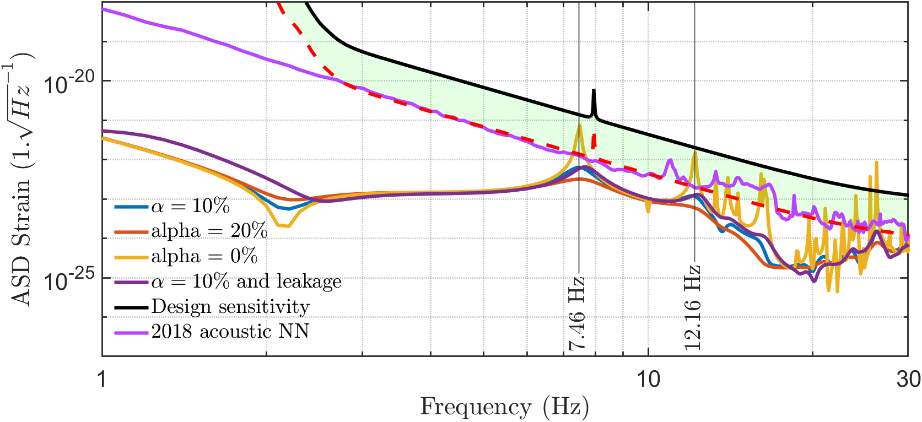
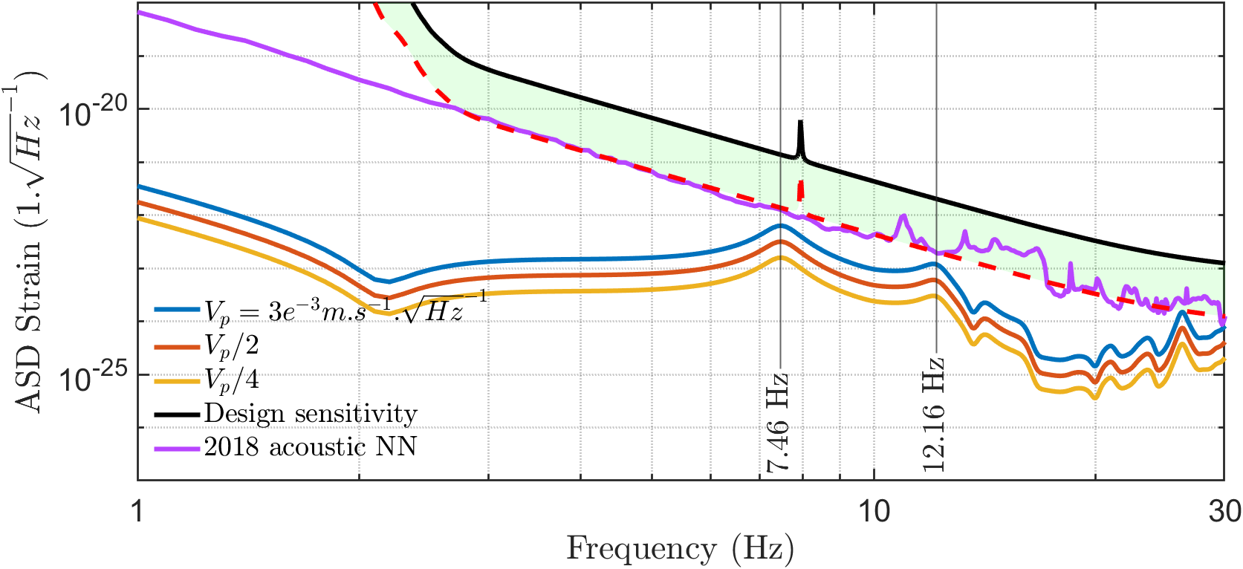
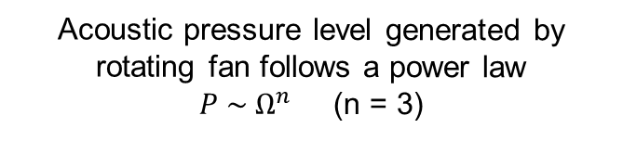
How to limit the newtonian noise
Acoustic absorption of walls
Rotation speed of Hvac
Absorption is described as a modal damping factor
Acoustic pressure level generated by rotating fan follows a power law $P \sim Ω^{n}$(n = 3)

Slide 11
What do we learn from Virgo ?
The dominant acoustic source is the HVAC
The HVAC is described by a set of equivalent monopoles where the closest to the fan are the most contributing to acoustic noise
A modal model describes properly the measured acoustic pressure field
A computation scheme is developed to estimate the newtonian noise from acoustic origin
Estimated NN is found to be lower than the current Virgo sensitivity

Slide 12
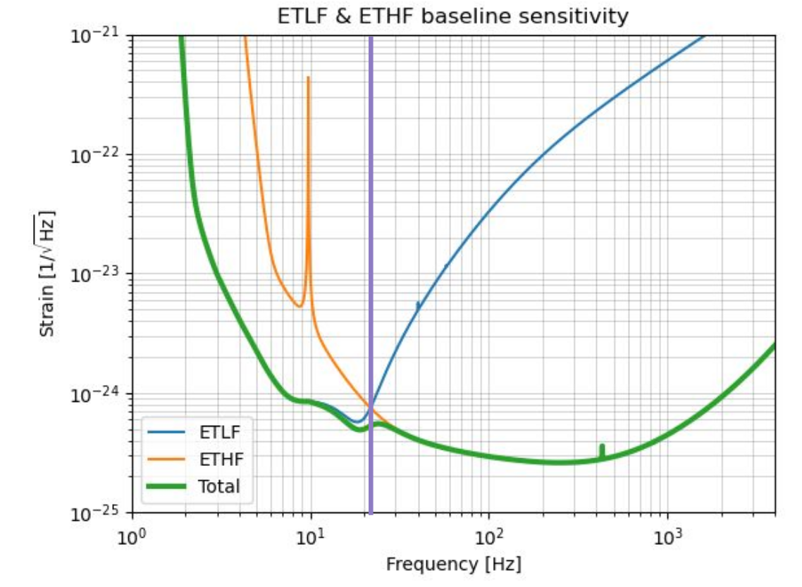
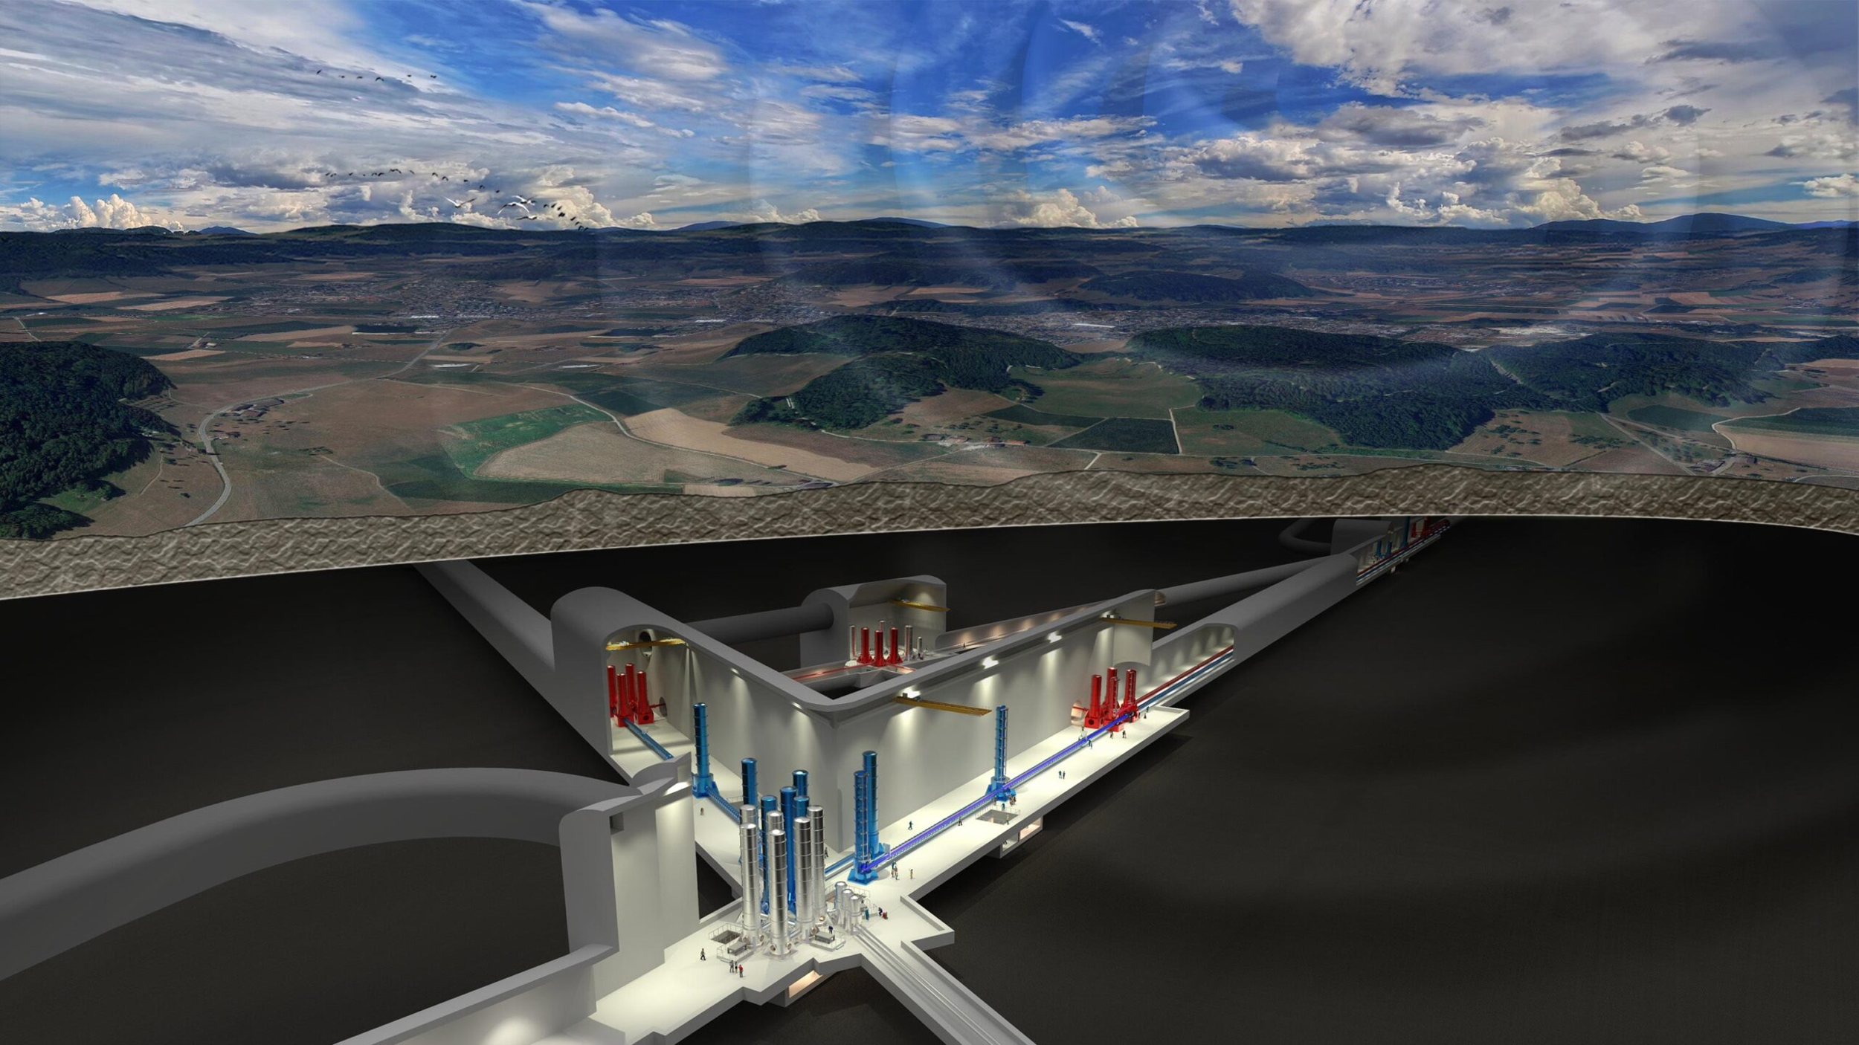
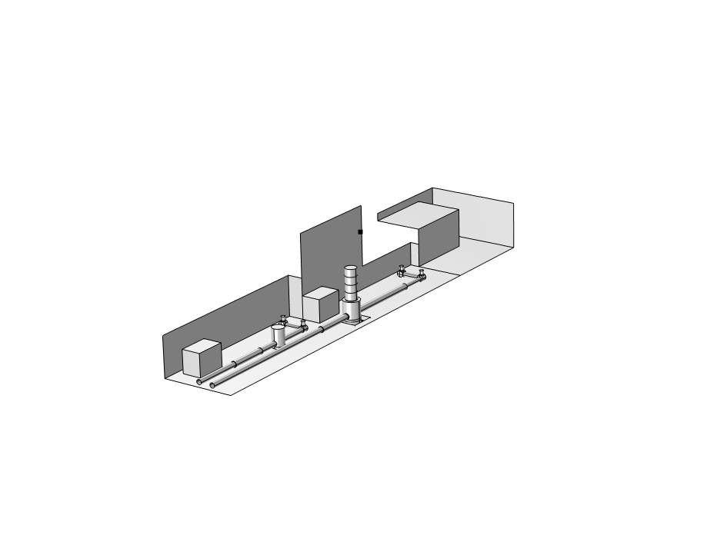
Einstein Telescope (ET) - layout and sensitivity
Artist view of ET – Triangle configuration
Credits : M. Kraan
ETLF and ET HF baseline sensitivity
Order of magnitude: 10⁻²⁴@10Hz
Geometry of an end cavern
ET design sensitivity

Slide 13
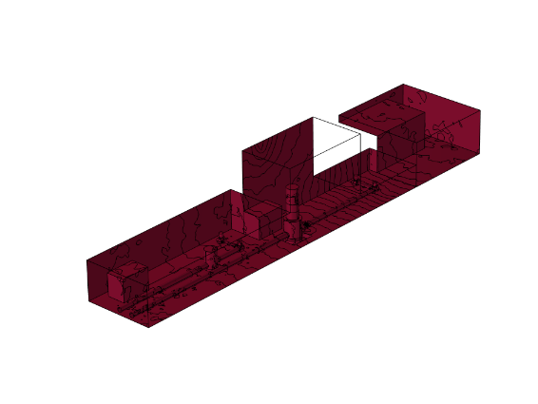
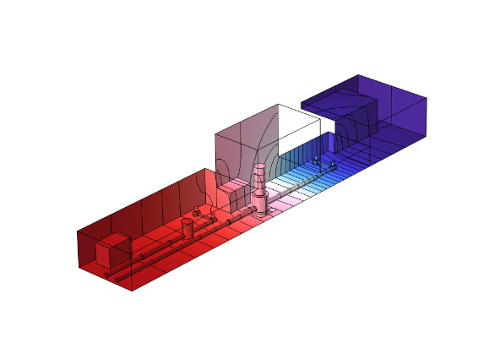
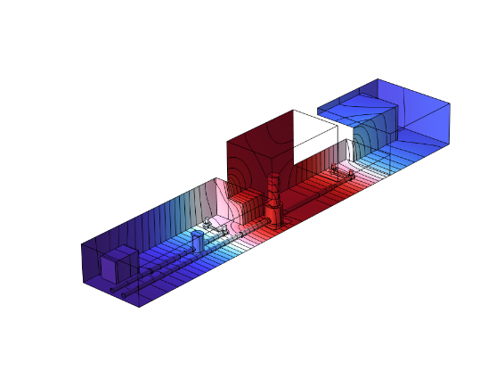
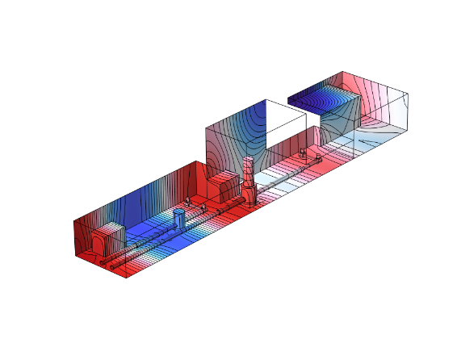
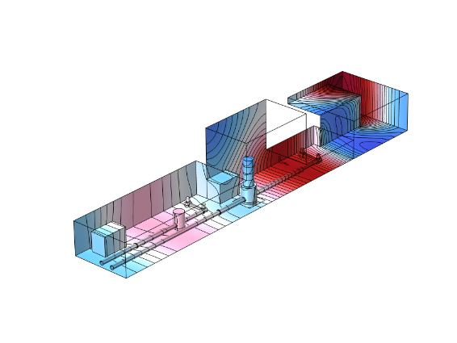
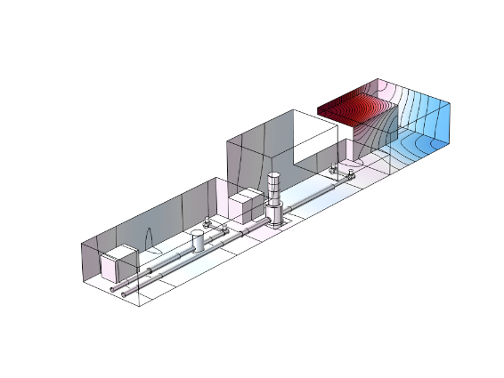
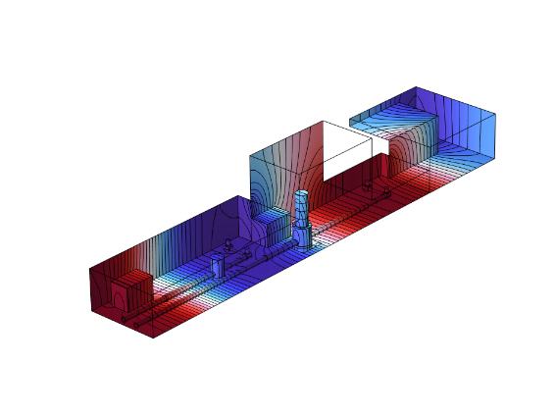
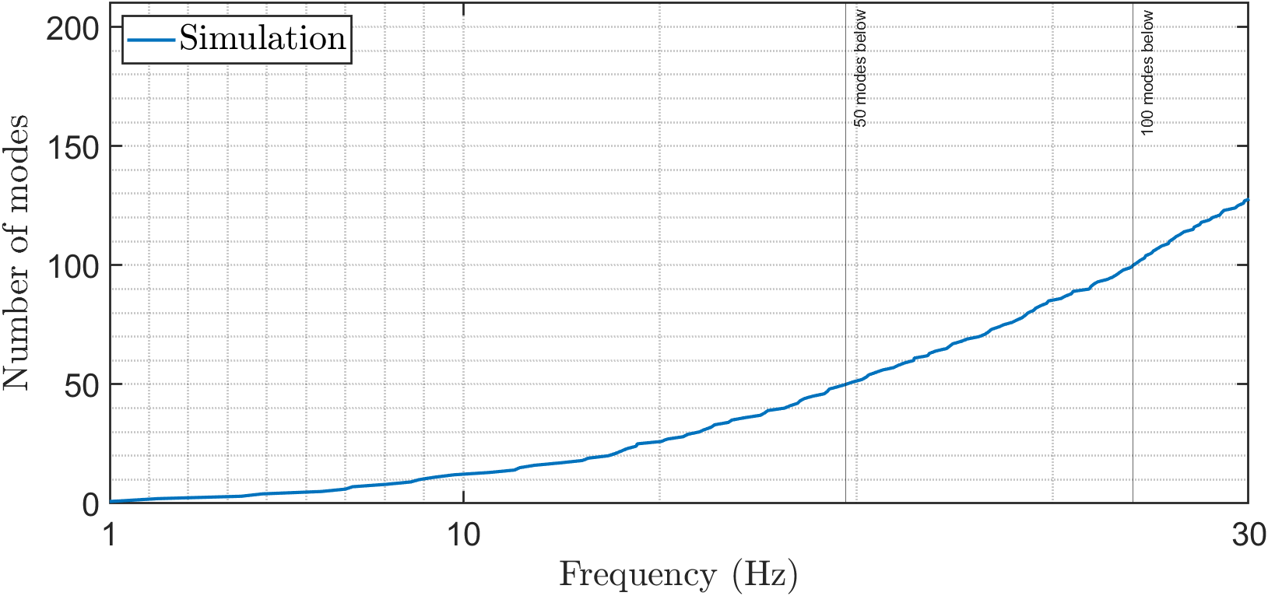
Acoustic modal basis of an end cavern
f1=0Hz
f2=1.2Hz
f3=2.2Hz
f4=4.3Hz
f5=4.8Hz
f6=6.3Hz
f7=6.9Hz
f8=7.1Hz
High acoustic modal density due to the large size of the room
Remarks
The cave is supposed airtight and disconnected from the tunnel
The sound inside tunnel is ignored, but the acoustic modal density inside is enormous

Slide 14
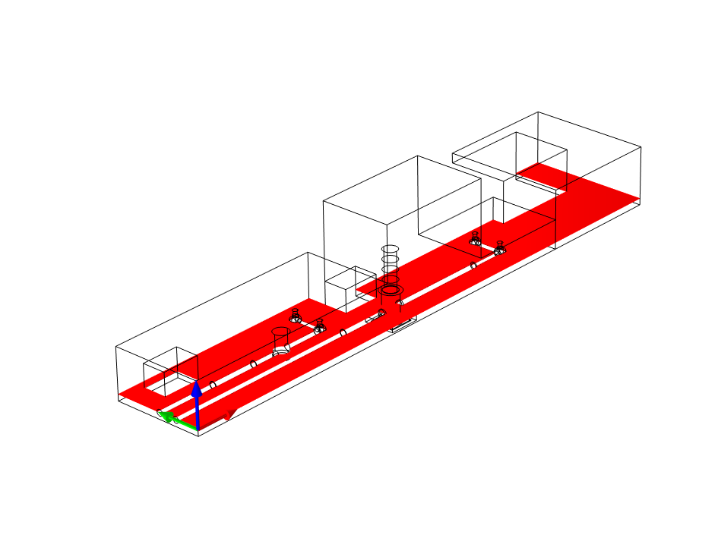
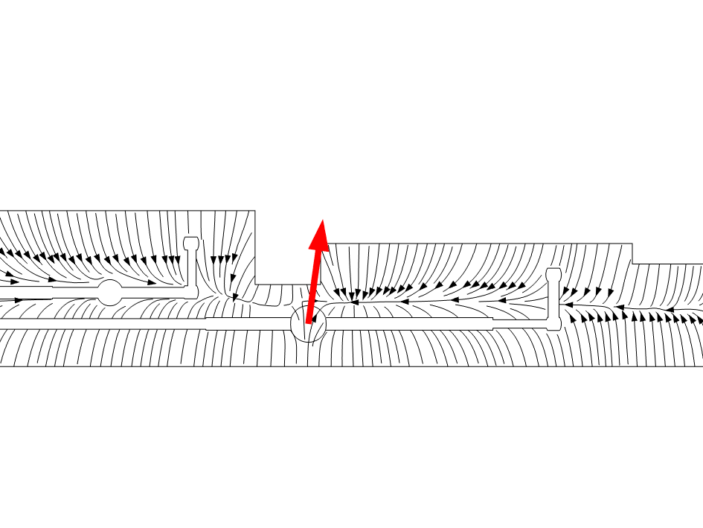
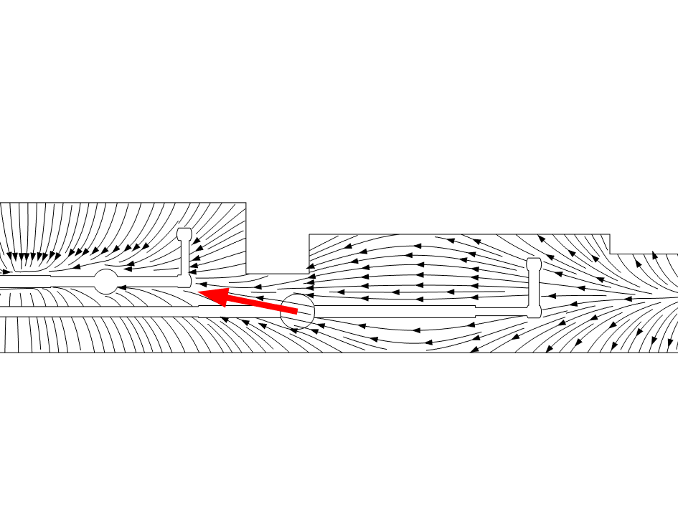





Functional basis for the gravity field
f1=0Hz
f2=1.2Hz
f3=2.2Hz
f4=4.3Hz
f5=4.8Hz
f6=6.3Hz
f7=6.9Hz
f8=7.1Hz
Numerous longitudinal modes => orientation of the NN gravity field is mostly in the laser beam direction

Slide 15




Angular filtering of the gravity functions
$$\vec{g}$$
z
Azimut Angle $θ=atan⁡(\frac{gy}{gx})$
Elevation Angle $φ=atan⁡(\frac{gz}{\sqrt{gx^{2}+gy^{2}}})$
$$φ$$
y
x
$$θ$$

Slide 16






Angular filtering of the gravity functions
4,88
6,38
6,99
7,18
9,26

Slide 17

Simulated NN of acoustic origin – effect of the inlets/outlets positions
Integration of the Virgo sources inside the ET cavern
Test of 2 configurations for the inlets/outlets
NN level reach the design sensitivity curve
6 inlets
2 outlets
Configuration 1
Configuration 2

Slide 18



Simulated NN of acoustic origin – effect of acoustic absorption
Adding acoustic absorption helps to limit NN
In practice, acoustic absorption at low frequency is very difficult to achieve
Melamine foam
Wiremesh

Slide 19


Simulated NN of acoustic origin – effect of the fan rotation speed
The fan rotation speed is the most influent parameter on the noise level (power law)
Simulations for
Virgo’s source amplitude
2 x Virgo
0.5 x Virgo
=> The methodology can be used to estimate the maximum acoustic threshold
Air flow variation

Slide 20








Identification of problematic acoustic modes
4,88
6,38
6,99
7,18
8,02
8,65
8,88
9,26
9,74
10,68
11,29
11,81

Slide 21
Identification of problematic acoustic modes
Modes with azimut angle <10°
4,88
6,38
6,99
7,18
8,02
8,65
8,88
9,26
9,74
10,68
11,29
11,81

Slide 22
How to kill NN before the construction ?
Plane of symmetry
Mirror
Even modes
(symmetric)
Mass distribution is equal on each side of mirror, NN cancels out
Odd modes
(antisymmetric)
Mass difference between each side is maximum, high NN coupling
To kill NN :
Even modes : Place sensitive equipment on antinode
Odd modes : Place Acoustic sources on node

Slide 23


Impact of tower diameter on NN
Reduction of NN coupling is expected with increase in tower diameter
=> Negligible impact below 20 Hz

Slide 24


Extension to mechanical vibration

Slide 25



ET’s preliminary design
Acoustic is currently not a design criterion

Slide 26


Concluding remarks
HVAC is necessary for the thermal stability, air cleanliness and also for the health of operators
Acoustic noise due to HVAC induces Newtonian Noise, visible by ET
Acoustic Newtonian noise must be considered as an issue in the design of Einstein Telescope’s cavern
The developped approach can give insight
on the geometry of caverns, tuning of the length for minimizing the gravity perturbation at mirror’s location
on the positions of the inlets/outlets, tuning to minimize the acoustic excitation
on the positions of the towers
on the specifications of the HVAC

Slide 28
Classification of acoustic modes for ET
4,88
6,38
6,99
7,18
8,02
10,68
Longitudinal
8,88
9,74
11,29
11,81
Transverse
8,65
9,26
Others

Slide 29
Classification of acoustic modes
Plane of symmetry
Mirror
Even modes
(symmetric)
Odd modes
(antisymmetric)

Slide 30

Classification of acoustic modes for ET
Longitudinal
Symmetrical
Asymmetrical
Symmetry Plane
4,88
6,99
6,38
8,02
7,18
10,68

Slide 31








How to reduce NN coupling
3 strategies to counter acoustic Newtonian Noise :
Positioning of sources and sensitivite equipment
Geometric optimisation of the room
Geometric optimisation of vacuum tower shape
4,88
S
T
$$0$$
$$x_{t}$$
$$x$$
$$x_{L}$$
$$x_{t}$$
$$0$$
$$x_{L}$$
$$x$$

Slide 32
















Positioning of sources and sensitive equipment
S
T
4,88
$$x$$
$$x_{L}$$
$$x_{t}$$
$$0$$
$$0$$
T
$$x_{t}$$
S
$$x_{L}$$
$$x$$
$$x_{L}$$
$$x_{t}$$
$$0$$
$$x$$
S
T
Study of 3 configurations :
Initial configuration
Source on acoustic node
Tower on acoustic antinode
$$x$$
$$x_{L}$$
$$x_{t}$$
$$0$$

Slide 33

Positioning of sources and sensitive equipment
S
T
$$x$$
$$x_{L}$$
$$x_{t}$$
$$0$$
T
S
$$x$$
$$x_{L}$$
$$x_{t}$$
$$0$$
S
T
$$x$$
$$x_{L}$$
$$x_{t}$$
$$0$$

Slide 34











Geometry of the room
S
T
$$x$$
$$x_{L}$$
$$x_{t}$$
$$0$$
$$δ=30m$$
T
T
$$x$$
$$x_{L}$$
$$x_{t}$$
$$0$$
S
Increase in length of the cavern

Slide 35

Geometry of the room
S
T
$$x$$
$$x_{L}$$
$$x_{t}$$
$$0$$
T
T
$$x$$
$$x_{L}$$
$$x_{t}$$
$$0$$
S
Increase in length of the cavern
Length increase

Slide 36



Geometry of the room
S
T
$$x$$
$$x_{L}$$
$$x_{t}$$
$$0$$
T
T
$$x$$
$$x_{L}$$
$$x_{t}$$
$$0$$
S
Increase in length of the cavern
Length increase

Slide 37

Geometry of the room
S
T
$$x$$
$$x_{L}$$
$$x_{t}$$
$$0$$
T
T
$$x$$
$$x_{L}$$
$$x_{t}$$
$$0$$
S
Increase in length of the cavern

Slide 38





Geometry of the tower
S
T
$$x$$
$$x_{L}$$
$$x_{t}$$
$$0$$

Slide 40





Room acoustic characteristics (TR60, f_{s}, α)
Concrete
Steel/wool/Steel sandwich
North End Building
Concrete + resin
AHU room
Simplified geometry of the experimental area
Experimental area
SAS
M. Falxa et al, 2018* => acoustic characterization
$$TR60=0.161\frac{V}{\sum_{i}^{n}{S_{i}α_{i} }}$$
Reverberation time
TR60 = 4.7 s
TR60 (s)
Schroeder frequency
Fs = 50 Hz
Modal acoustics if f < 50Hz
Average absorption coefficient
𝝰 = 0.097
$$F_{s}=2000\sqrt{\frac{TR60}{V}}$$
*VIR-0673A-18
Frequency (Hz)

Slide 41

Context of the study
Goal: Modeling Newtonian noise due to building acoustics
WEB map
Red and blue dot indicate microphones
Main acoustic source is an HVAC (heating ventilation and air conditioning) centrifugal fan

Slide 42



Modal basis expansion of the gravity field
Acoustic field
Potential of gravity field
$$δρ=\frac{ρ_{0}}{γp_{0}}δp$$
$$δΦ\left(\vec{r},ω\right)=−G\int{\frac{δρ\left(\vec{r^{′}},ω\right)}{\left|\vec{r^{′}}−\vec{r}\right|}dV\left(\vec{r^{′}}\right)}$$
Density fluctuation:
Potential:
Gravity field:
$$\vec{g}\left(\vec{r},ω\right)=−\vec{∇}Φ(\vec{r},ω)$$
Modal basis
Functional basis

Slide 43

Simulated NN of acoustic origin – effect of acoustic absorption
Adding acoustic absorption helps to limit NN
In practice, acoustic absorption at low frequency is very difficult to achieve
Melamine foam
Wiremesh

Slide 44





$$L+δ$$
$$L$$
$$x_{s}$$
$$x_{t}$$
$$0$$

