Slide 1

Proposal to host the 3rd France-Italy FCC workshop at Marseille
FCC France Contacts Meeting December 12th 2025
Farès Djama (CPPM)

Slide 2
Date | Venue | Participants | Talks | Fees [€]
Nov, 21st-23rd , 2022 | Lyon | 129 | 76 | 150
Nov, 4th- 6th , 2024 | Venice | 110 | 66 | 250
Nov, 25th-27th , 2026 | Marseille
Venue : l’Hexagone
On the Luminy campus, at about 200 m from CPPM.
At 50 minutes by bus from downtown or 30 minutes from closest hostels
A nice and fully equipped auditorium of 100 seat.
An exhibition hall next to the auditorium suitable for coffee and lunch breaks.
https://www.univ-amu.fr/fr/public/hexagone-coeur-de-campus-de-luminy
Closes everyday at 6:45 PM: we have to adapt for the welcome cocktail, on November 25th.
HR support from CPPM: Mme Angélique Pèpe, who has a long experience in event organisation.

Slide 3
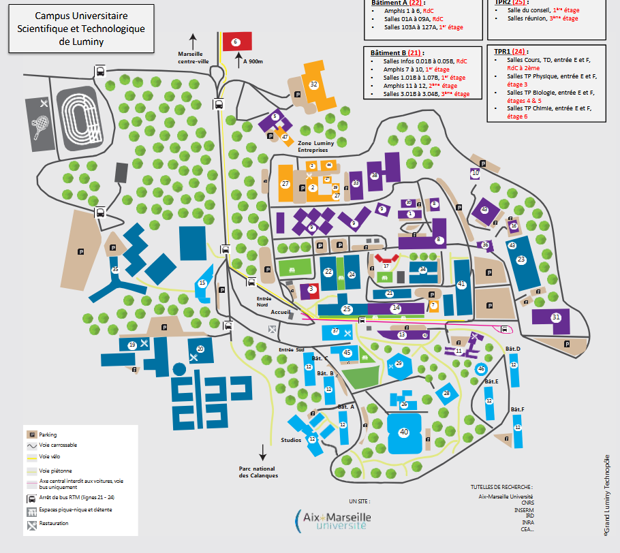
Bus stop
Luminy-Fac
24
B1
21Jet
CPPM
Main entrance
Hexagone

Slide 4
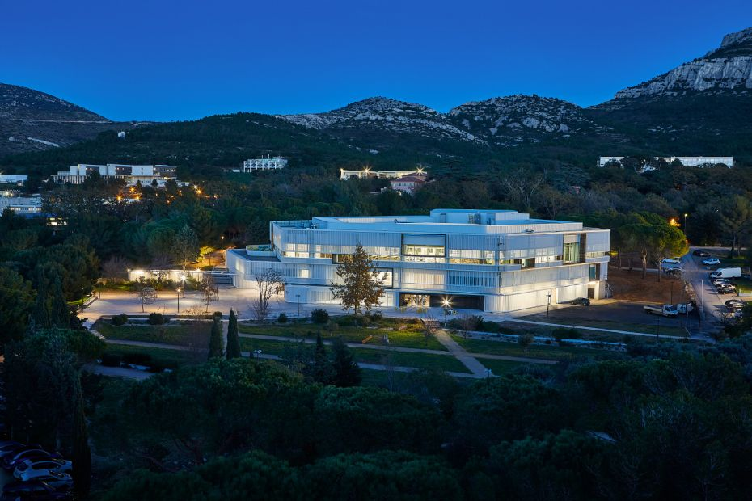

Slide 5
Other meeting rooms at Hexagone are too small.
For parallel sessions, we will use the CPPM auditorium + if necessary another room at CPPM (20 seats).
Lunches will be served in the exhibition hall, by a caterer (traiteur).
Proposal for the workshop dinner on November 26th : Les Arcenaulx https://www.les-arcenaulx.com/
A preliminary budget has been established.
We will ask for grants from IN2P3, Aix-Marseille Université and Ville de Marseille.
We will do our best to keep the fees below 200 € (includes lunches and workshop dinner).

