Slide 1
SuperNEMO
Fabrice Piquemal
Laboratoire Souterrain de Modane (CNRS/IN2P3-CEA/DSM)
et
CENBG, Université Bordeaux 1 CNRS/IN2P3
Marseille 21 avril 2010

Slide 2
Plan
Physique du neutrino et double désintégration bêta
NEMO 3
SuperNEMO

Slide 3
Double désintégration bêta sans neutrino
- Non-conservation du nombre leptonique
- Nature du neutrino : Dirac (ν ≠ν) or Majorana (ν =ν)
- Masse absolue du neutrino et hiérarchie des masses
Interaction par courant droit
Violation de CP dans le secteur leptonique
Recherche supersymétrie et nouvelles particules

Slide 4
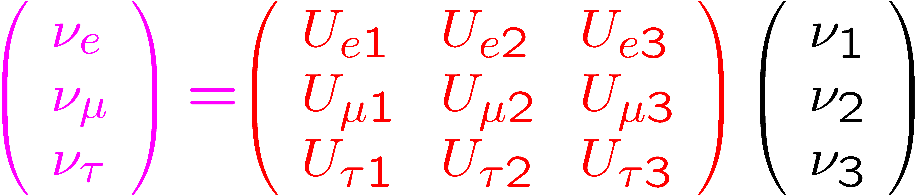
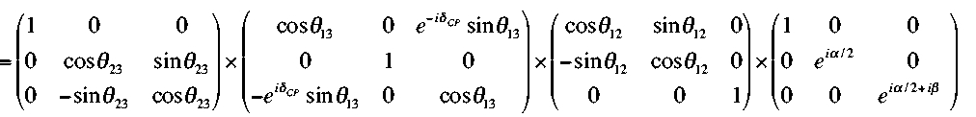
Propriétés du neutrino
Oscillations
Atmosphériques (SK)
Accélérateurs (K2K,Minos)
Réacteurs (CHOOZ)
Accélérators (JPARC)
Solaires (SNO, SK)
Réacteurs (KamLAND)
U
α,β : CP pahse Majorana
tan²θ₂₃=1.0 ± 0.3 sin²2θ₁₃ < 0.16 tan²θ₁₂=0.39 ± 0.05
δ_{CP}= CP phase de Dirac
Δm²_{atm} = Δm²₃₁ = (2.3 ± 0.2 ) 10⁻³ eV²
Δm²_{sol} = Δm²₁₂ = (7.9 ± 0.3) 10⁻⁵ eV²

Slide 5
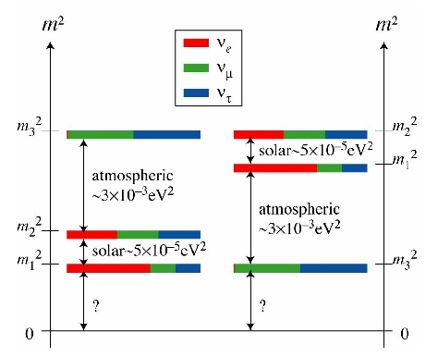
Neutrino mass
Masse absolue ?
2
2
1/2
Bêta simple m_{v} = Σ |U_{ei}| m_{i} <2.3 eV
Double bêta |<m_{ν}>| = |ΣU_{ei} m_{i}| < 0.2 - 0.8 eV
Cosmologie Σm_{i} = m₁+m₂+m₃ <~1 eV
2
Hiérarchie ?
m²
m₁²
m₂²
m₃²
?
Normale
m_{3>}>> m₂~m₁
Inversée
m₂~m₁>>m₃
Dégénérée
m₁≈m₂≈m₃» |m_{i}-m_{j}|

Slide 6
Décroissance double bêta
Bêta simple interdite (énergie)
ou fortement supprimée
Décroissance possible vers l’état fondamentale ou les états excités
ββ
ββ
ββ(2ν)
ββ(0ν)
e⁻
e⁻
e⁻
e⁻
ν
ν
ΔL =2
Processus au 2nd ordre de l’interaction faible
Déjà observé pour plusieurs noyaux
ββ(0ν) → Majorana neutrino (ν=ν)

Slide 7
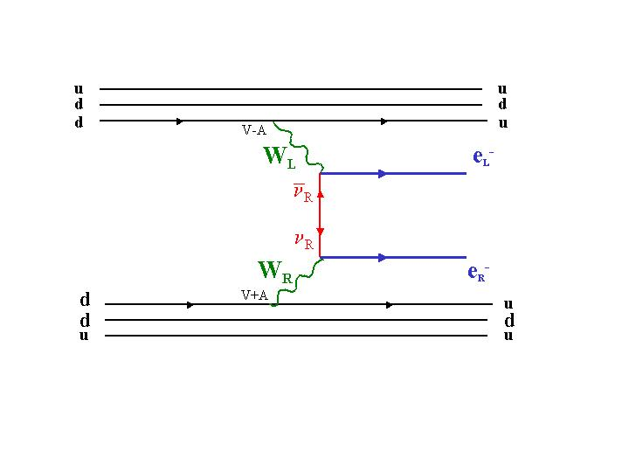
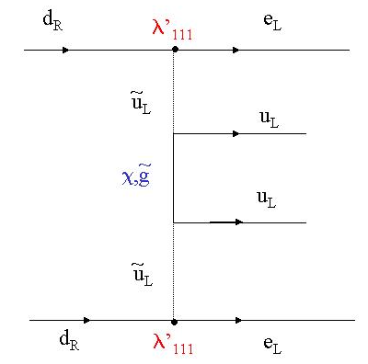
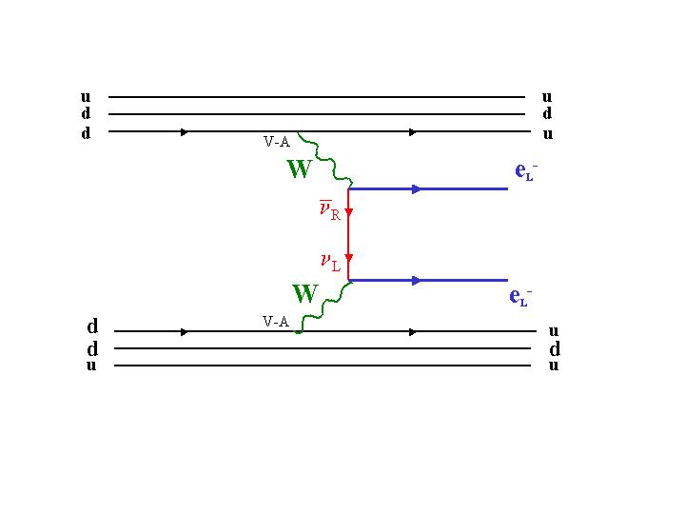
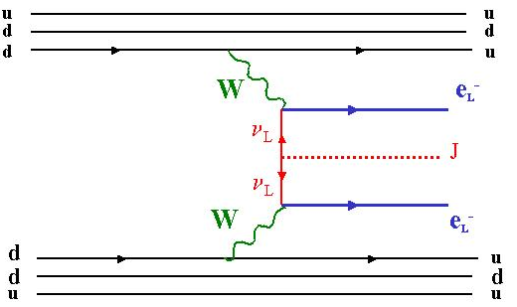
Neutrinoless Double Beta decay
(A,Z) (A,Z+2) + 2 e⁻
Découverte implique ΔL=2 and neutrino de Majorana
Processus: paramètres
Exchange neutrino léger
<m_{ν}>
Courant (V+A)
<m_{ν}>,<λ>,<η>
Emission de Majoron(s)
<g_{M}>
SUSY
λ’₁₁₁,λ’₁₁₃λ’₁₃₁,…..
Phase space factor
Nuclear matrix element
Phase space factor
Nuclear matrix element
-1
5
T_{1/2}= F(Q_{ββ},Z) |M|² <m_{ν}>²
R-parity violation T_{1/2} depends on
(λ’₁₁₁)², gluino and squarks mass
-1
T_{1/2}= F |M_{J}|² <g_{M}>²
Effective mass:
<m_{ν}>= m₁|U_{e1}|² + m₂|U_{e2}|².e^{iα1} + m₃|U_{e3}|².e^{iα2}
^{|Uei|: mixing matrix element}
^{α1 et α2: Majorana phase}
Coupling between Majoron and neutrinos

Slide 8
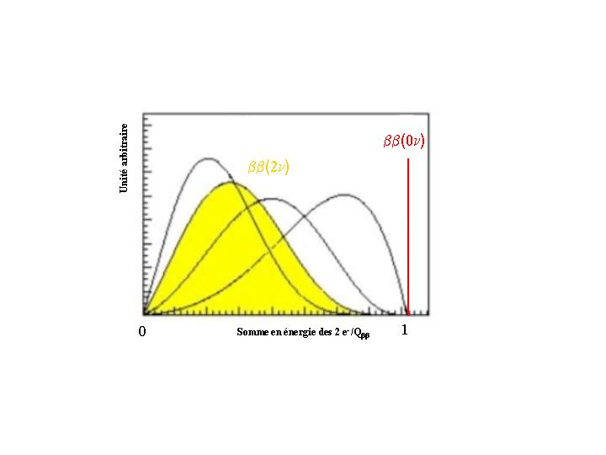
ββ(0ν) :les observables
ββ(0ν)
Arbitrary unit
ββ(2ν)
ββ(Μ)
Q_{ββ}
Electron energy sum
Summed electron energy (normalized to Q_{ββ})

Slide 9
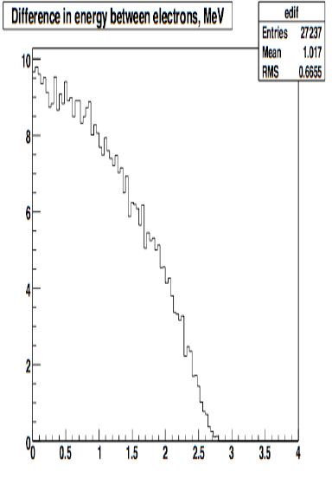
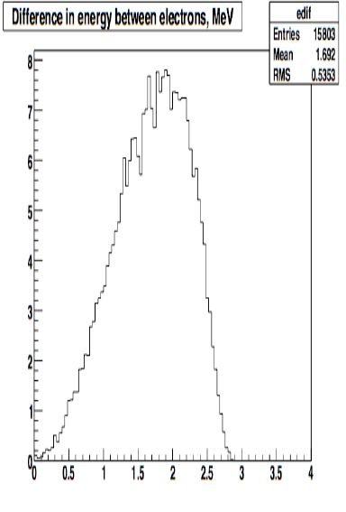
ββ(0ν): les observables
From G. Gratta
Cos θ
Energy difference
Light neutrino
exchange
Right-handed
current

Slide 10
Masse effective et oscillations de neutrinos
Klapdor
claim
Dégénéree
Dégénérée: peut être testée (~10 kg)
Hiérarchie inverse
Inversée: testée par la prochaine
génération d’expérience ββ (∼100 kg)
<m_{ν}> in eV
Hiérarchie normale
Hiérarchie normale: inaccessible
actuellement (~1 tonne)

Slide 11
Emetteurs ββ
Isotope | Q_{ββ} (MeV) | abondance isotopique (%) | G_{0ν}(an⁻¹) x 10²⁵
⁴⁸Ca | 4.271 | 0.187 | 2.44
⁷⁶Ge | 2.040 | 7.8 | 0.24
⁸²Se | 2.995 | 9.2 | 1.08
⁹⁶Zr | 3.350 | 2.8 | 2.24
¹⁰⁰Mo | 3.034 | 9.6 | 1.75
¹¹⁶Cd | 2.802 | 7.5 | 1.89
¹³⁰Te | 2.528 | 33.8 | 1.70
¹³⁶Xe | 2.479 | 8.9 | 1.81
¹⁵⁰Nd | 3.367 | 5.6 | 8.00

Slide 12
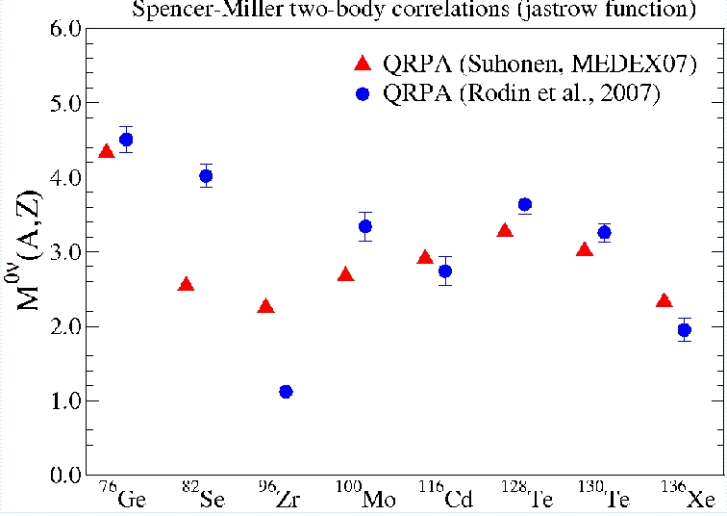
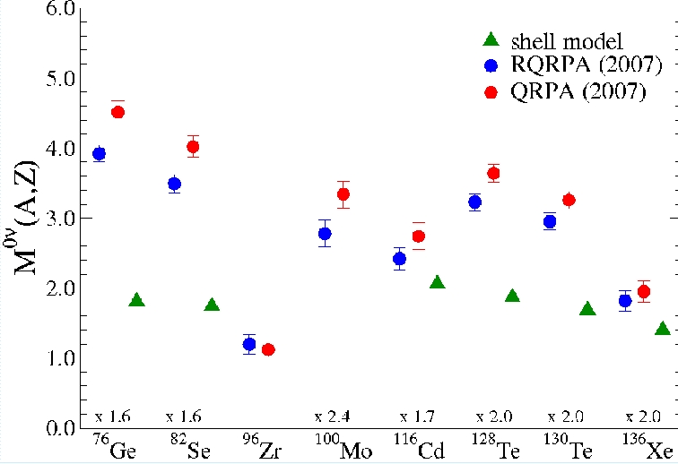
Eléments de matrice nucléaire
-1
5
T_{1/2}= F(Q_{ββ},Z) |Μ^{0ν}|² <m_{ν}>²
Shell Model - QRPA
Calculs QRPA
Des améliorations mais encore des incertitudes pour extraction de <m_{ν}>

Slide 13
Techniques expérimentales
Avec bruit de fond:
M: masse (g)
ε : efficacité »
K_{C.L.}: Confidence level
N: Avogadro number
t: temps (an)
N_{Bckg}: bruit de fond (keV⁻¹.g⁻¹.an⁻¹)
ΔE: Résolution en énergie (keV)
ε
A
M . t
(y)
ln2 . N
k_{C.L.}
> . .
N_{Bckg} . ΔE
Aucune technique ne peut optimiser tous ces paramètres
Calorimètre
Semi-conducteurs
Bolomètres
Source = détecteur
Calorimètre
Scintillateur (chargé)
Source = détecteur
Tracko-calo
Source ≠ detector
Xe TPC
Source = détecteur
β
β
β
β
β
β
β
β
ε, ΔE
ε, Μ
NBckg, choix isotope
ε,M, (N_{Bckg})

Slide 14
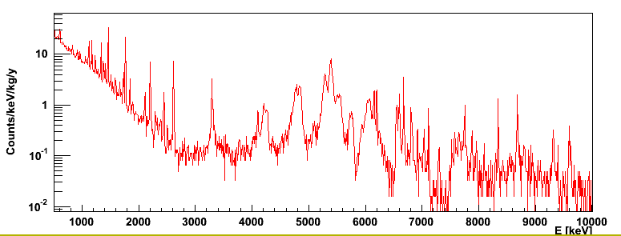
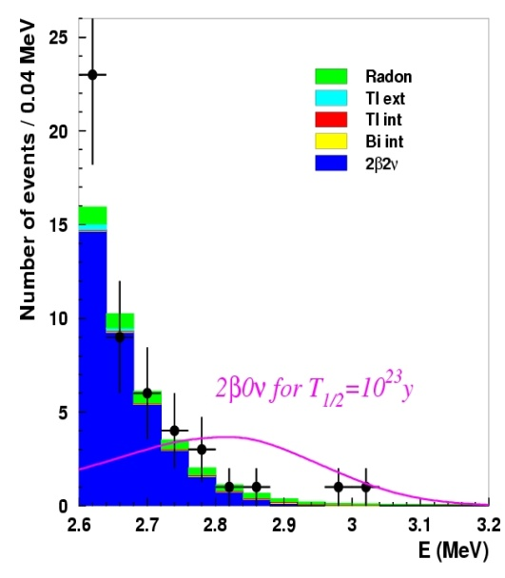
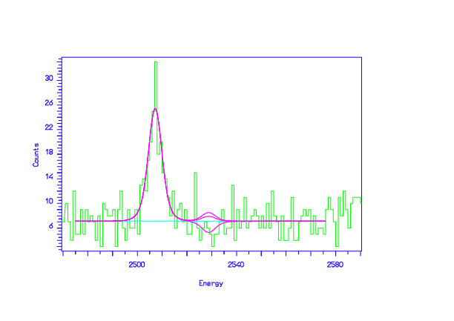
Calorimètre vs Tracko-calo
Tracko-calo
Calorimètre
Résolution en énergie
Modeste réjection des fonds
Tracko-calo
Réjection des fonds
Modeste énergie résolution
ββ(0ν)
ββ(0ν)
ββ(0ν)
keV
ββ(0ν)
keV
MeV

Slide 15
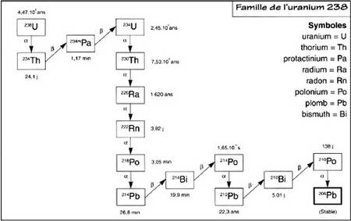
Radioactivité naturelle: principal bruit de fond
Une difficulte la radioactivite naturelle
Sélection de tous les matériaux entre 10³ et 10⁶ fois moins radioactifs
que les matériaux standard

Slide 16
Q_{ββ} et composantes de bruit de fond
Radioactivité naturelle (⁴⁰K, ⁶⁰Co,^{234m}Pa, ²¹⁴Bi and ²⁰⁸Tl externe…)
²¹⁴Bi et Radon
²⁰⁸Tl (2.6 MeV γ line) et Thoron
γ venant des réactions (n,γ) et bremstrahlung des muons
+ spécifique fonds pour les calorimètre
Contamination de surface ou de volume en émetteurs α
Production de cosmogénique
¹⁰⁰Mo
⁸²Se
¹⁵⁰Nd
⁹⁶Zr
⁷⁶Ge
¹³⁰Te
⁴⁸Ca
⁷⁶Xe
2
3
4
5
Q_{ββ} MeV
+ ββ(2ν) pour tracko-calo or calorimètre avec une modeste résolution en énergie

Slide 17
ββ(0ν) : un domaine dynamique
Experiments | Isotopes | Techniques | Main caracteristics
NEMO3 | ¹⁰⁰Mo,⁸²Se | Tracking + calorimeter | Bckg rejection, isotope choice
SuperNEMO | ⁸²Se, ¹⁵⁰Nd | Tracking + calorimeter | Bckg rejection, isotope choice
Cuoricino | ¹³⁰Te | Bolometers | Energy resolution, efficiency
CUORE | ¹³⁰Te | Bolometers | Energy resolution, efficiency
GERDA | ⁷⁶Ge | Ge diodes | Energy resolution, eficiency
Majorana | ⁷⁶Ge | Ge diodes | Energy resolution, efficiency
COBRA | ¹³⁰Te, ¹¹⁶Cd | ZnCdTe semi-conductors | Energy resolution, efficiency
EXO | ¹³⁶Xe | TPC ionisation + scintillation | Mass, efficiency, final state signature
MOON | ¹⁰⁰Mo | Tracking + calorimeter | Compactness, Bckg rejection
CANDLES | ⁴⁸Ca | CaF₂ scintillating crystals | Efficiency, Background
SNO++ | ¹⁵⁰Nd | Nd loaded liquid scintillator | Mass, efficiency
XMASS | ¹³⁶Xe | Liquid Xe | Mass, efficiency
CARVEL | ⁴⁸Ca | CaWO4 scintillating crystals | Mass, efficiency
Yangyang | ¹²⁴Sn | Sn loaded liquid scintillator | Mass, efficiency
DCBA | ¹⁵⁰Nd | Gazeous TPC | Bckg rejection, efficiency

Slide 18
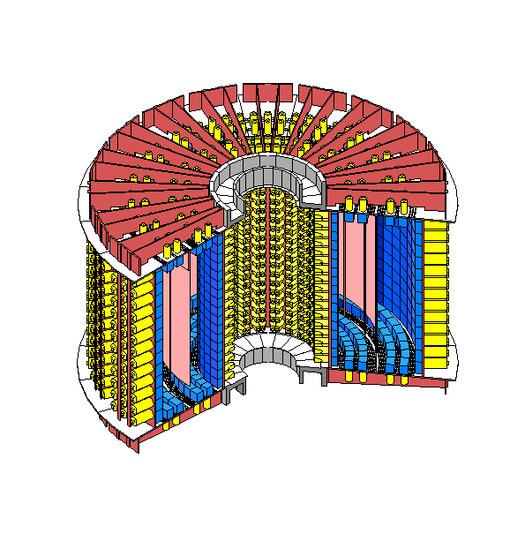
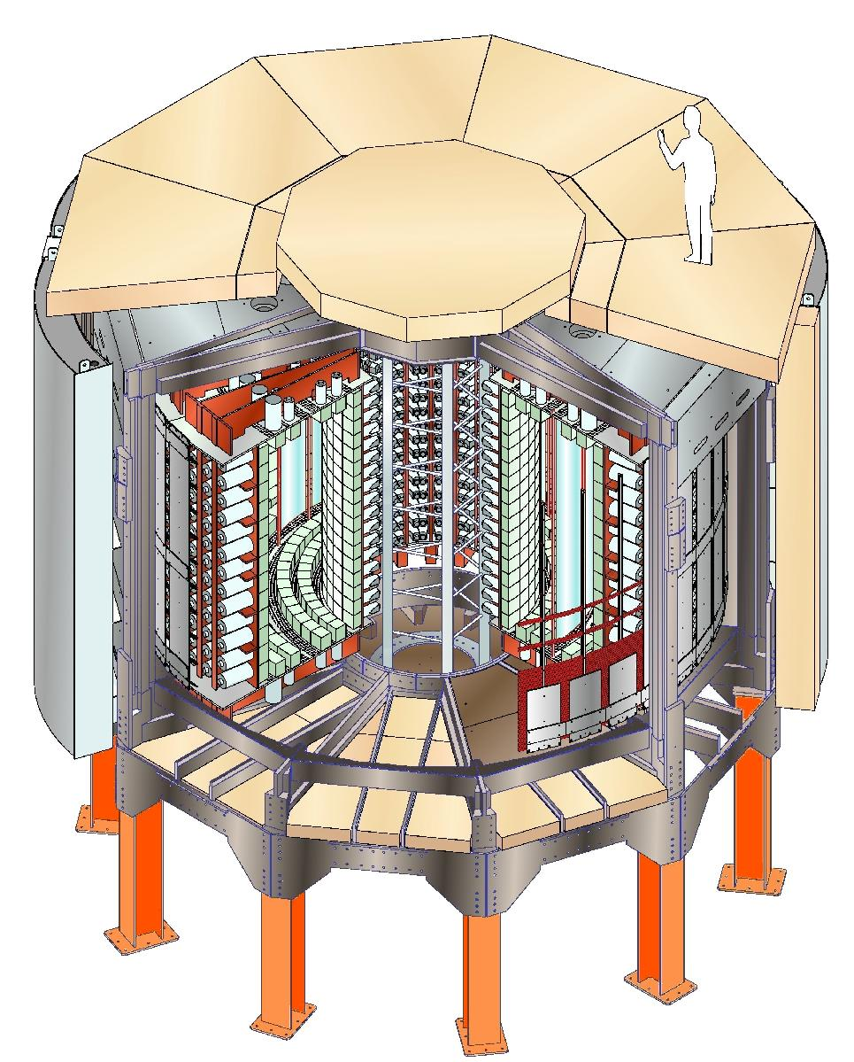
NEMO 3 detector
Fréjus Underground Laboratory : 4800 m.w.e.
Source: 10 kg of ββ isotopes
cylindrical, S = 20 m², 60 mg/cm²
Tracking detector:
drift wire chamber operating
in Geiger mode (6180 cells)
Gas: He + 4% ethyl alcohol + 1% Ar + 0.1% H₂O
Calorimeter:
1940 plastic scintillators
coupled to low radioactivity PMTs
20 sectors
3 m
Magnetic field: 25 Gauss
Gamma shield: Pure Iron (18 cm)
Neutron shield: borated water
+ Wood
B (25 G)
4 m
Background: natural radioactivity, mainly ²¹⁴Bi et ²⁰⁸Tl (γ 2.6 MeV)
Radon, neutrons (n,γ), muons, ββ(2ν)
Able to identify e⁻, e⁺, γ and α

Slide 19
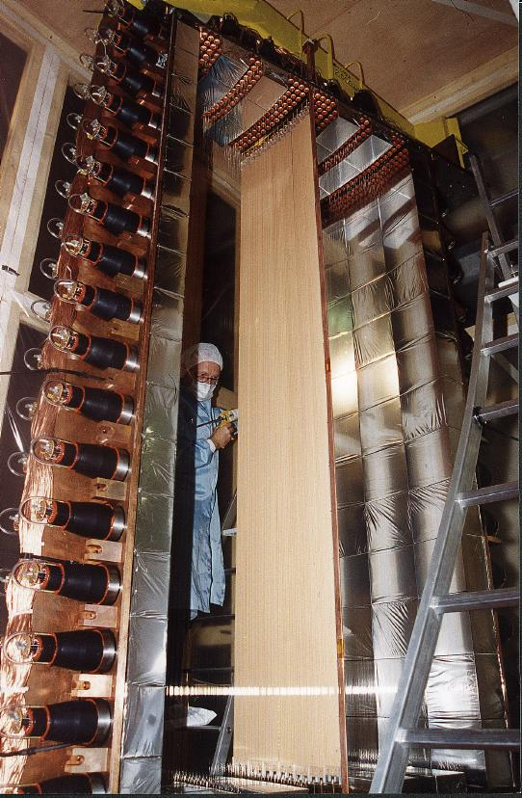
Un secteur de NEMO3
Un secteur de NEMO 3
Anneau cathodique
de la chambre à fils
PM
Tube d’étalonnage
Scintillateurs
Feuilles
Sources ββ

Slide 20
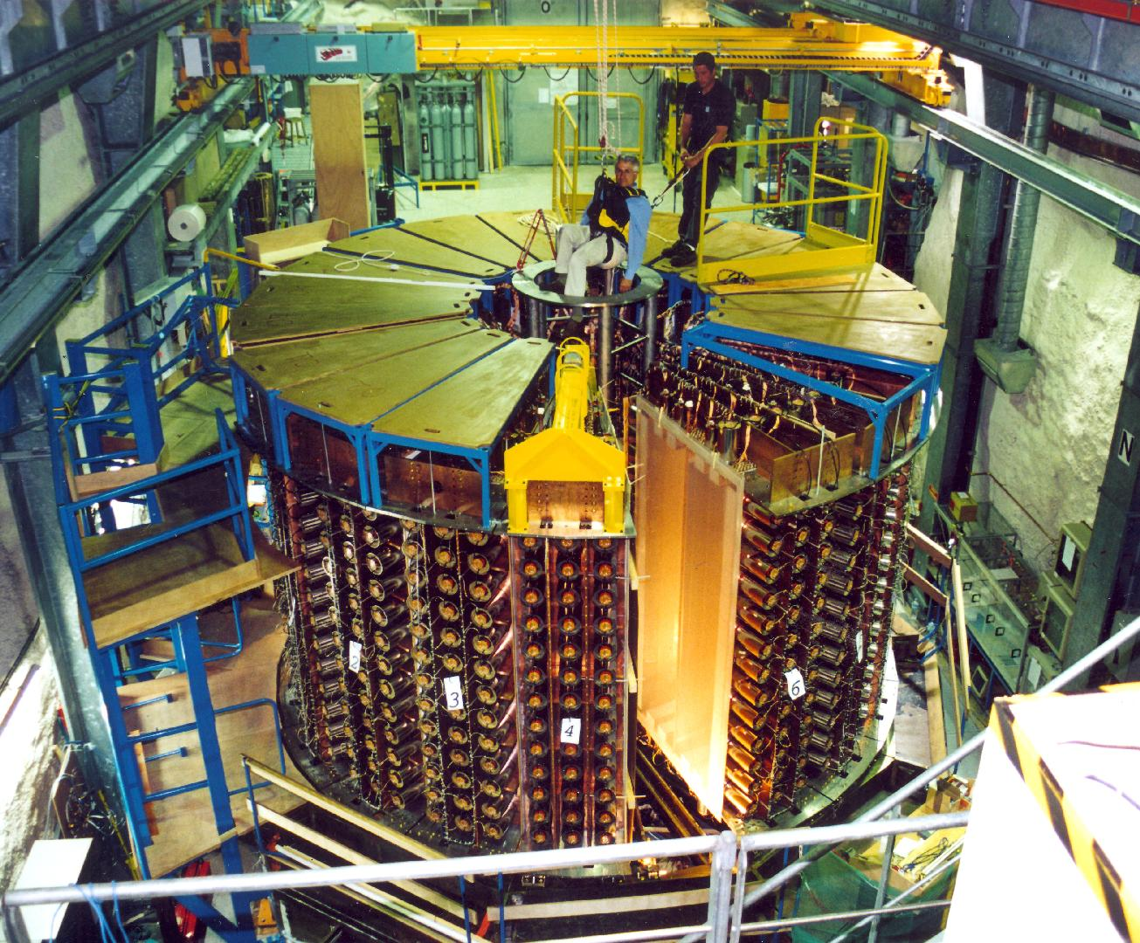
NEMO 3
NEMO 3 detector

Slide 21
NEMO 3 sources
¹⁰⁰Mo 6.914 kg
Q_{ββ} = 3034 keV
&
⁸²Se 0.932 kg
Q_{ββ} = 2995 keV
0νββ decay search
¹¹⁶Cd 405 g
Q_{ββ} = 2805 keV
⁹⁶Zr 9.4 g
Q_{ββ} = 3350 keV
¹⁵⁰Nd 37.0 g
Q_{ββ} = 3367 keV
⁴⁸Ca 7.0 g
Q_{ββ} = 4272 keV
¹³⁰Te 454 g
Q_{ββ} = 2529 keV
^{nat}Te 491 g
Cu 621 g
2νββ decay
measurement
External
background
measurement
All sources produced by centrifugation in Russia

Slide 22
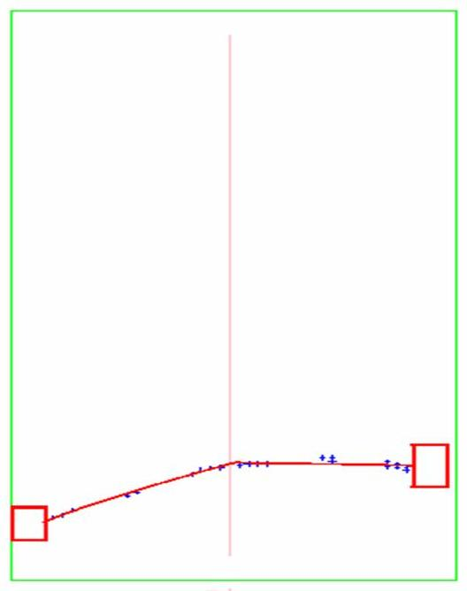
NEMO 3 ββ typical event
NEMO3 typical ββ event
Transverse view
Longitudinal view
Run Number: 2040
Event Number: 9732
Date: 2003-03-20
Vertex of the e⁻e⁻ emission
¹⁰⁰Mo foils
Scintillator
+ PMT
Vertex of the e⁻e⁻ emission
Deposited energy:
E₁ + E₂= 2088 keV
Internal hypothesis:
(Δt)_{mes} – (Δt)_{theo} = 0.22 ns
Common vertex:
(Δ vertex)⊥ = 2.1 mm
(Δ vertex)// = 5.7 mm
Criteria to select ββ events:
2 tracks with charge < 0
2 PMTs, each > 200 keV
PMT-Track association
Common vertex
Internal hypothesis TOF (external event rejection)
No other isolated PMT (γ rejection)
No delayed α track (²¹⁴Bi rejection)

Slide 23
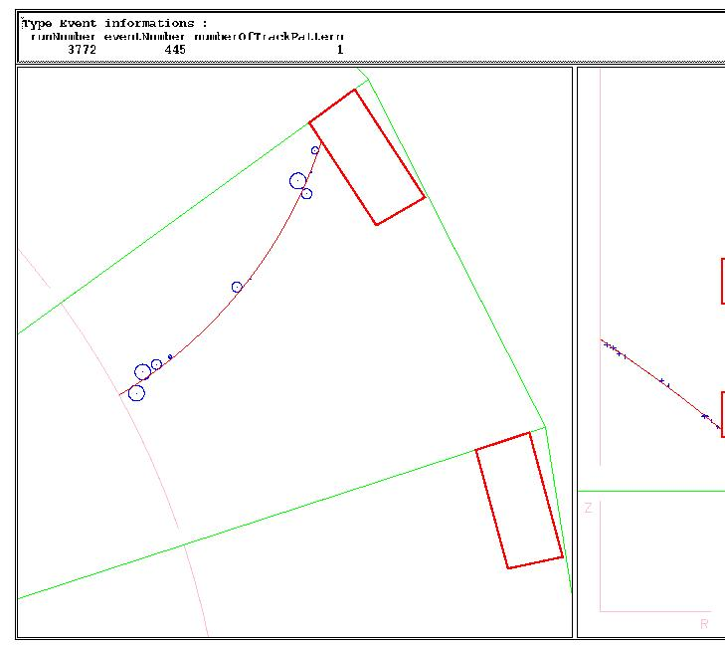
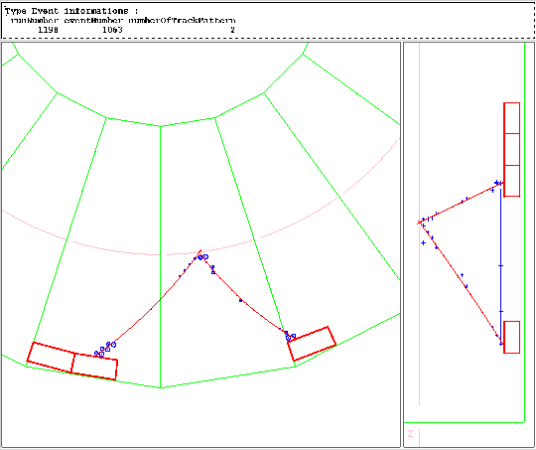
NEMO-3 can measure each component of the background
External Background ²⁰⁸Tl (PMTs)
Measured with (e⁻, γ) external events
~ 10⁻³ ββ0ν-like events year⁻¹ kg ⁻¹ with 2.8<E₁+ E₂<3.2 MeV
External Neutrons and High Energy gamma
Measured with (e⁻,e⁻)_{int} or (e⁺,e⁻) events with E₁+E₂ > 4 MeV
< 0.02 ββ0ν-like events year⁻¹ kg ⁻¹ with 2.8<E₁+ E₂<3.2 MeV
²⁰⁸Tl impurities inside the foils ~ 60 μBq/kg
Measured with (e⁻,2γ), (e⁻,3γ) events coming from the foil
~ 0.06 ββ0ν-like events year⁻¹ kg ⁻¹ with 2.8<E₁+ E₂<3.2 MeV
²¹⁴Bi impurities inside the foils
Measured with (e⁻,γ,α) events coming from the foil, dominated by radon in first period
Radon supressed since December 2004, measument in progress. Limits from Ge: A(²¹⁴Bi)< 400 μBq/kg
< 0.1 ββ0ν-like events year⁻¹ kg ⁻¹ with 2.8<E₁+ E₂<3.2 MeV
¹⁰⁰Mo ββ2ν decay T_{1/2} = 7.14 10¹⁸ y
~ 0.3 ββ0ν-like events year⁻¹ kg ⁻¹ with 2.8<E₁+E₂<3.2 MeV

Slide 24
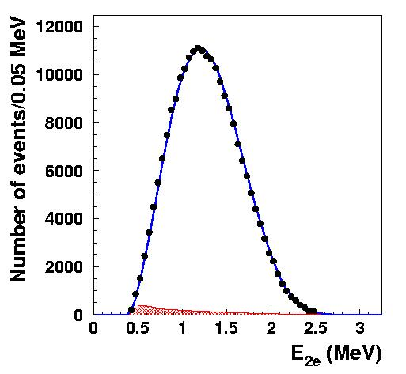
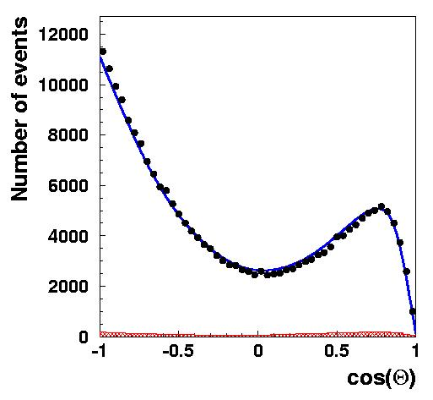
NEMO 3: ¹⁰⁰Mo ββ2ν results
Energy sum spectrum
Angular distribution
12000
10000
8000
6000
4000
2000
0
NEMO-3
219 000 events
6914 g
389 days
S/B = 40
NEMO-3
219 000 events
6914 g
389 days
S/B = 40
¹⁰⁰Mo
¹⁰⁰Mo
7.6 kg.yr
7.6 kg.yr
Data
Data
2β2ν
Monte Carlo
2β2ν
Monte Carlo
Background
subtracted
Background
subtracted
T_{1/2}(ββ2ν) = 7.11 ± 0.02 (stat) ± 0.54 (syst) × 10¹⁸ yr
Phys. Rev. Lett. 95 182302 (2005)
«ββ factory» → tool for precision test

Slide 25
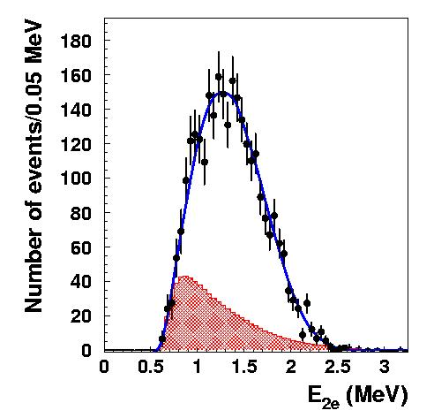
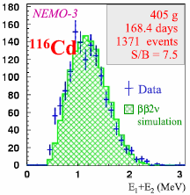
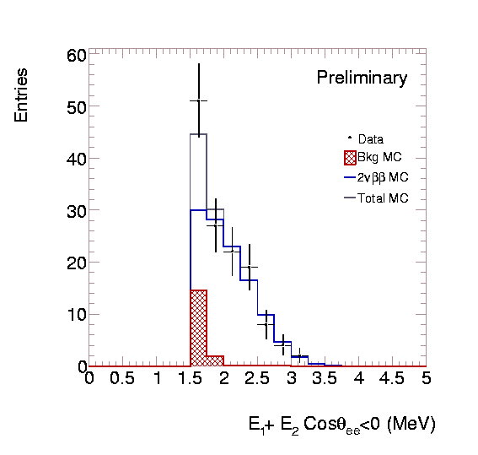
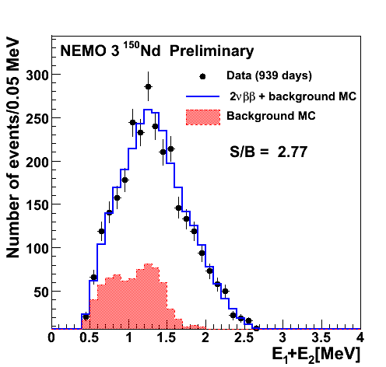
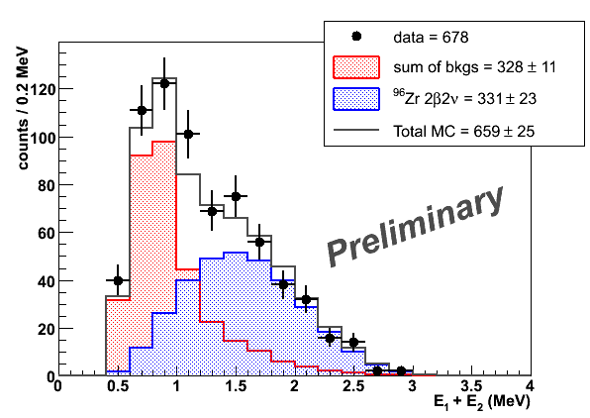
Résultats ββ(2ν) : autres isotopes
NEMO-3 ββ(2ν) autres résultats
NEMO-3
932 g,
389 days
2750 events
S/B = 4
NEMO-3
454 g,
534 days
109 events
S/B = 0.25
⁸²Se
¹³⁰Te
E₁ + E₂ (MeV)
9.6 ± 0.3 (stat) ± 1.0 (sys) 10¹⁹ a
2.8 ± 0.1 (stat) ± 0.3 (sys) 10¹⁹ a
7.6 ± 1.5 (stat) ± 0.8 (sys) 10²⁰ a
¹⁵⁰Nd
⁹⁶Zr
⁴⁸Ca
133 events
S/B 6.76
948 days
7g
925 days
S/B 1.01
9.41g
E₁ + E₂ (MeV)
9.11 ^{+0.25}_{-0.22}(stat) ± 0.63 (sys) 10¹⁸ a
2.3 ± 0.2 (stat) ± 0.3 (sys) 10¹⁹ a
4.4 ^{+0.5}_{-0.4} (stat)± 0.4 (sys) 10¹⁹ a

Slide 26
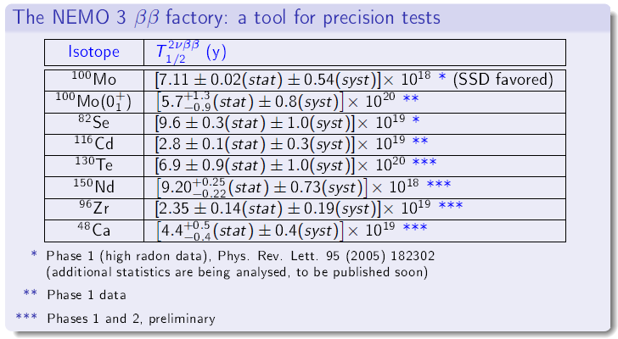
NEMO 3: ¹⁰⁰Mo ββ2ν results

Slide 27
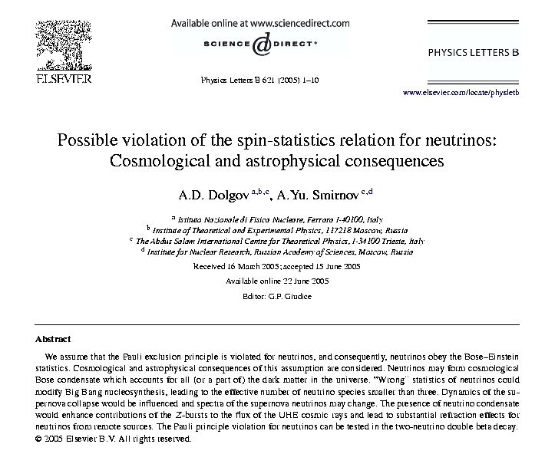
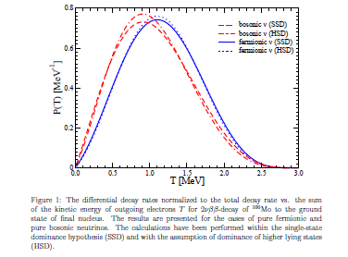
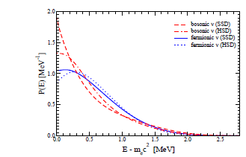
Pauli exclusion principle violated by neutrino
Proposed by Dolgov and Smirnov in 2005
Neutrino would partially obey to Bose-Einstein
Statistics and new parameter sinχ is introduced
to take this effect into account
Effects could be measured on decay rates, energy
and angular distribution in particular for ββ(2ν)
Only tracko-calo are able to do it
Results of NEMO3 used in
Nucl. Phys. B783: 90-111, 2007
sinχ <0.6
Effect on ββ(2ν)
spectrum of ¹⁰⁰Mo
Effect on single energy
spectrum of ¹⁰⁰Mo

Slide 28
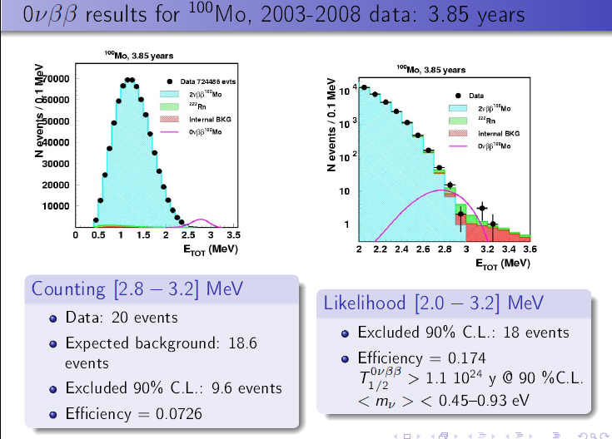

Slide 29
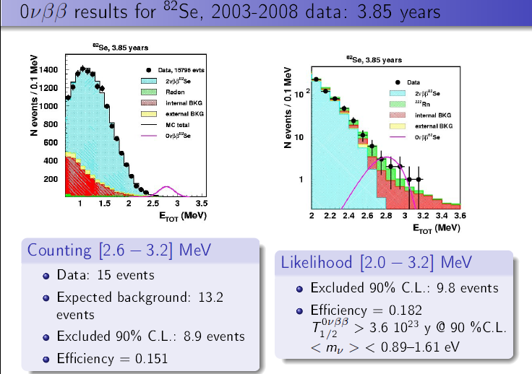
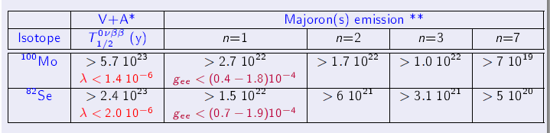

Slide 30
From NEMO-3 to SuperNEMO… challenges
T_{1/2} (ββ0ν) > ln 2 ×
N_{A}
M × ε × T_{obs}
×
A
N₉₀
NEMO-3
SuperNEMO
¹⁰⁰Mo
isotope
⁸²Se ,¹⁵⁰Nd or ⁴⁸Ca
7 kg
isotope mass M
100 kg
8 %
efficiency ε
~ 30 %
²⁰⁸Tl: < 20 μBq/kg
²¹⁴Bi: < 300 μBq/kg
internal contaminations
²⁰⁸Tl and ²¹⁴Bi in the ββ foil
²⁰⁸Tl < 2 μBq/kg
if ⁸²Se: ²¹⁴Bi < 10 μBq/kg
8% @ 3MeV
energy resolution (FWHM)
4% @ 3 MeV
T_{1/2}(ββ0ν) > 2 x 10²⁴ y
<m_{ν}> < 0.3 – 1.3 eV
T_{1/2}(ββ0ν) > 10²⁶ y
<m_{ν}> < 50 meV

Slide 31
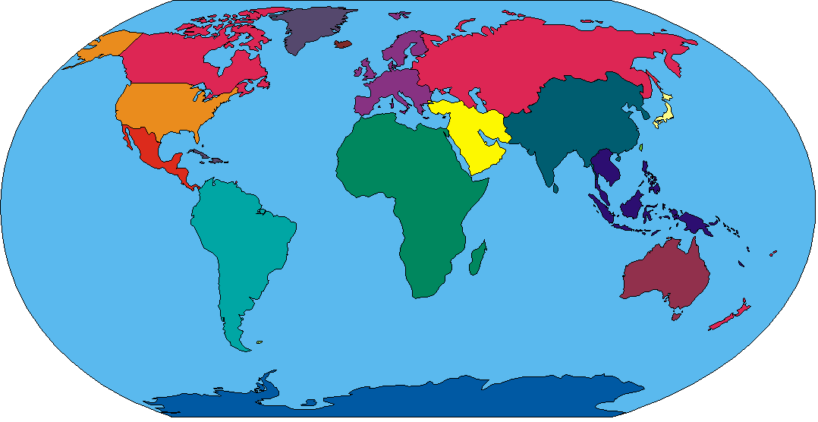
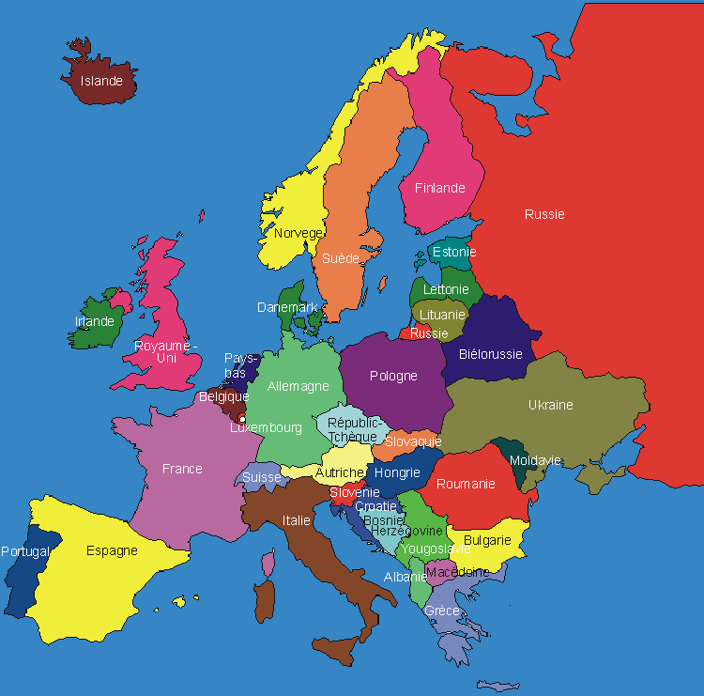
SuperNEMO collaboration
~ 80 physicists, 10 countries, 28 laboratories
South Korea
KAERI Daejong
Japan
U Saga
U Osaka
U. Fukui
U. Tokushima
KEK
USA
MHC
INL
U Texas
UK
UCL
U Manchester
Imperial College
Russia
JINR Dubna
ITEP Mosow
Ukraine
INR Kiev
France
CEN Bordeaux
IReS Strasbourg
LAL ORSAY
LPC Caen
LSCE Gif/Yvette
Slovakia
Comemius U.
Academy of sciences
Slovak technical U.
Spain
U Valencia
U Saragossa
U Barcelona
Czech Republic
Charles U Praha
IEAP Praha
Notes:
31

Slide 32
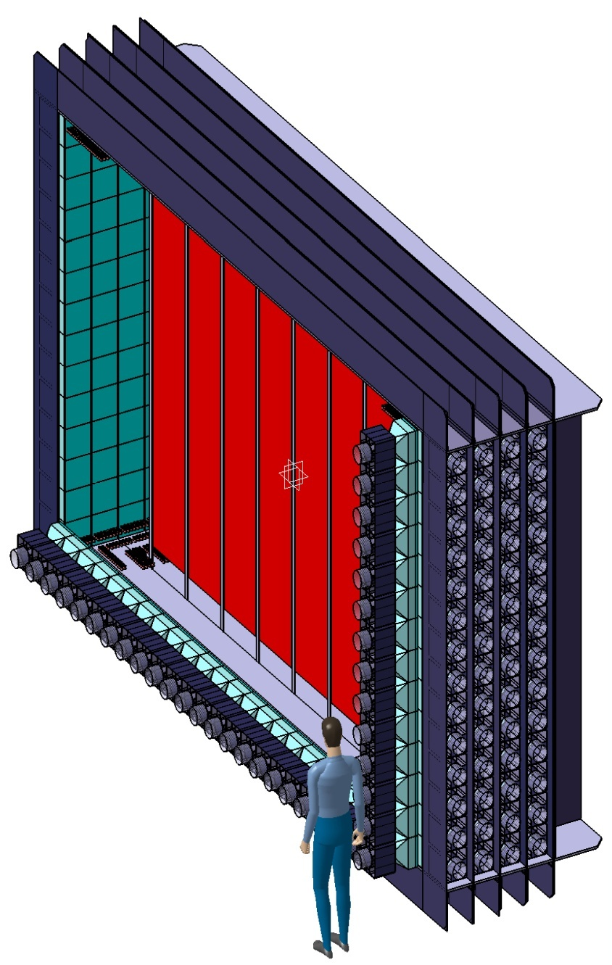
SuperNEMO conceptual design
20 modules for 100 kg
Source (40 mg/cm²) 12m²
Tracking (~2-3000 Geiger cells).
Calorimeter (600 channels)
Total:~ 40 000 – 60 000 geiger cells channels
~ 12 000 PMT
1 m
Module 0 : 7 kg of ⁸²Se
<m_{ν}> < 0.2 – 0.5 eV (1 year of data)
5 m
Top view
Notes:
32

Slide 34
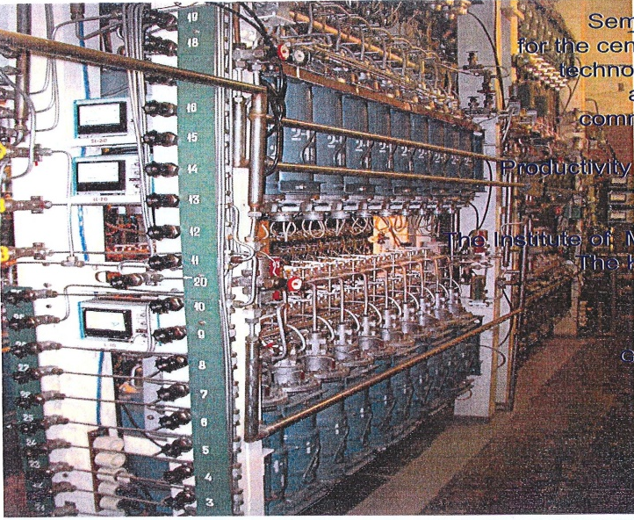
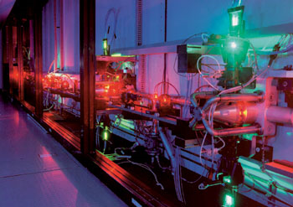
SuperNEMO Sources
Guideline: ⁸²Se
- Can be produced by centrifugation
Already 5 kg in the collaboration
(3,5 kg from ILIAS, 1 kg in NEMO3, 0,5 from ITEP)
- 2,5 kg more will be provided by Russian groups
- No problem to order 100 kg
- Several possibilities for purification
Possibility of ¹⁵⁰Nd enrichment (Q_{ββ} = 3,37 MeV No background from ²¹⁴Bi, phase space factor)
Laser isotopique separation possible in India or Russia ?
(was possible in France but facilityhas been dismantled in 2009)
Possibility to use centrifugation ?
Common investigations with SNO++ (also for purification)
⁴⁸Ca enrichment (Q_{ββ} = 4,27 MeV No background from ²¹⁴Bi, phase space factor)
- Laser isotopique separation developed in KOREA (patent)
Support of Korean government for production of 1 kg
(enr: 25%) within 3 years

Slide 35
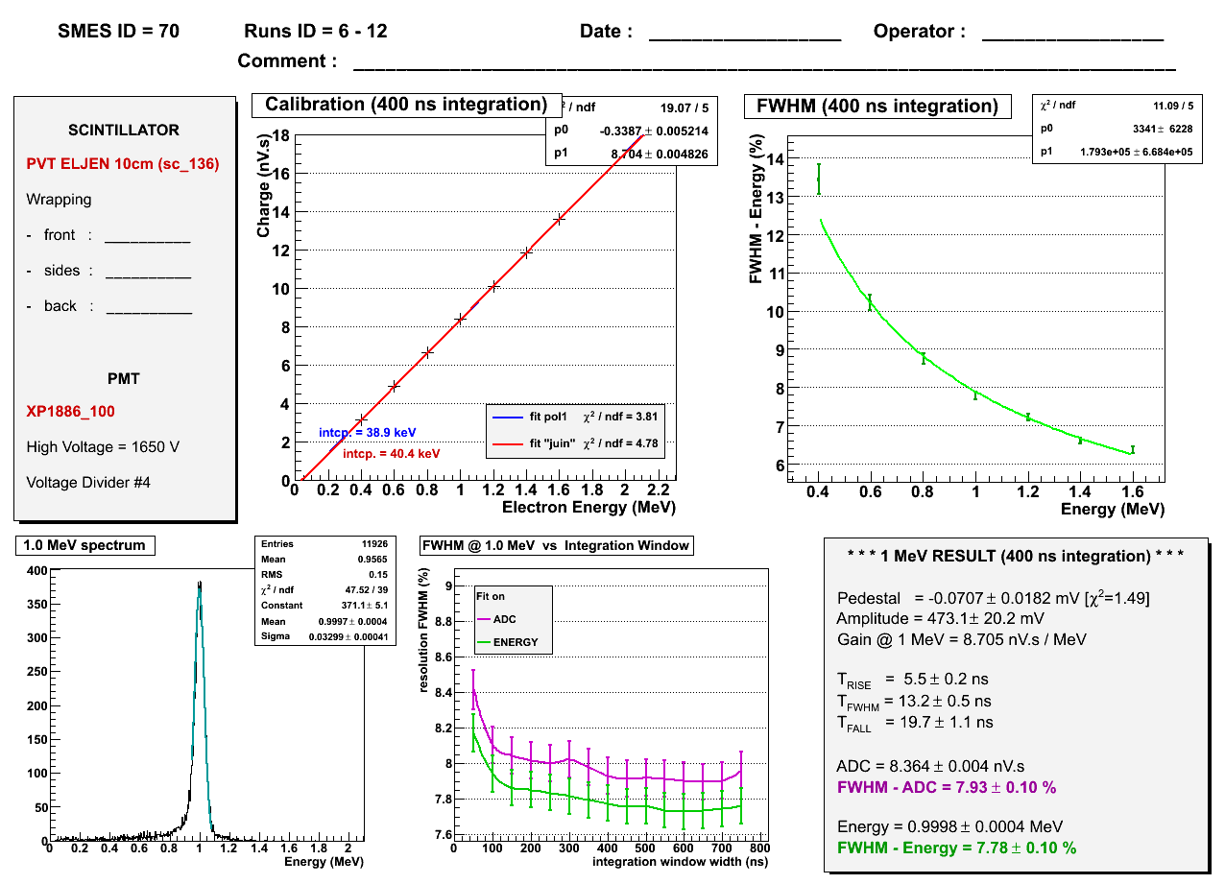
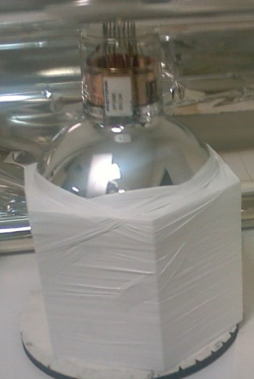
SuperNEMO Calorimeter
NEMO3
SuperNEMO
Vol: 4 l
5’’ PMT
ΔE/E ~16%
Vol: 8 l
8’’ PMT
ΔE/E 6.5 – 8 %
FWHM = 7,1 %
(7,6% before energy
loss correction)
Use of PVT instead of Polystyren, improvements of QE of PMT (8’’)
Use of Polystyren still possible

Slide 36

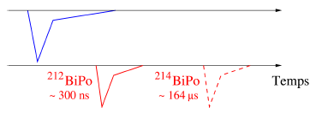
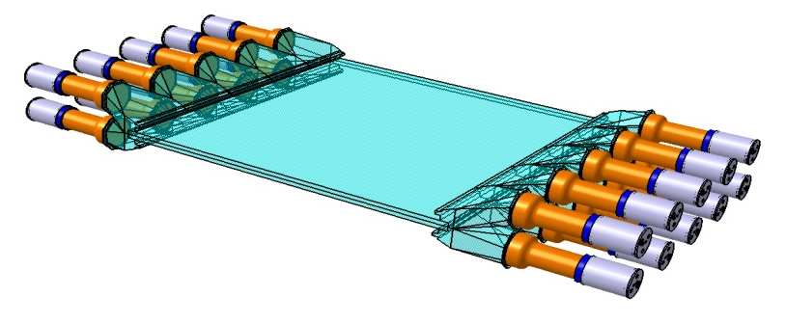
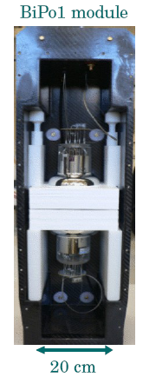
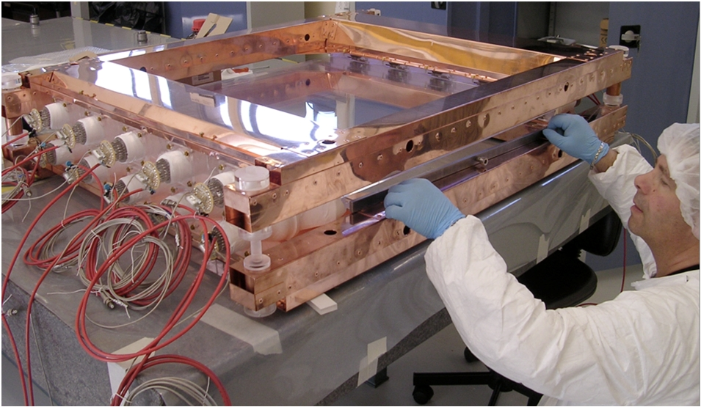
SuperNEMO… BiPo
SuperNEMO : BiPo
Objectives :to mesure ²⁰⁸Tl < 2 μBq/kg & ²¹⁴Bi < 10 μBq/kg in ββ source foil in 1 month
Principle: Detection of BiPo coïncidence : β + α retardé
²³⁸U
²¹⁴Po
²³²Th
²¹²Po
β
(164 μs)
β
(300 ns)
²¹⁴Bi
(19.9 mn)
α
²¹²Bi
(60.5 mn)
α
²¹⁰Pb
22.3 y
36%
²⁰⁸Pb
(stable)
0.021%
²¹⁰Tl
(1.3 mn)
²⁰⁸Tl
(3.1 mn)
Prototype BiPo 1
18 modules
in LSM
Prototype BiPo2
from MOON idea
0,72 m²
Data taking since July 2008

Slide 37
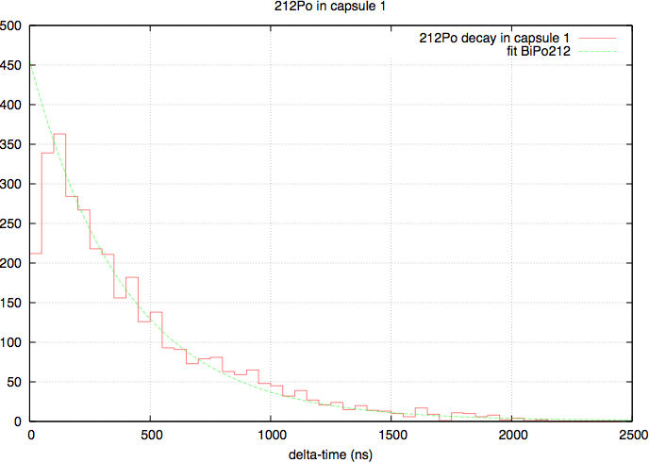
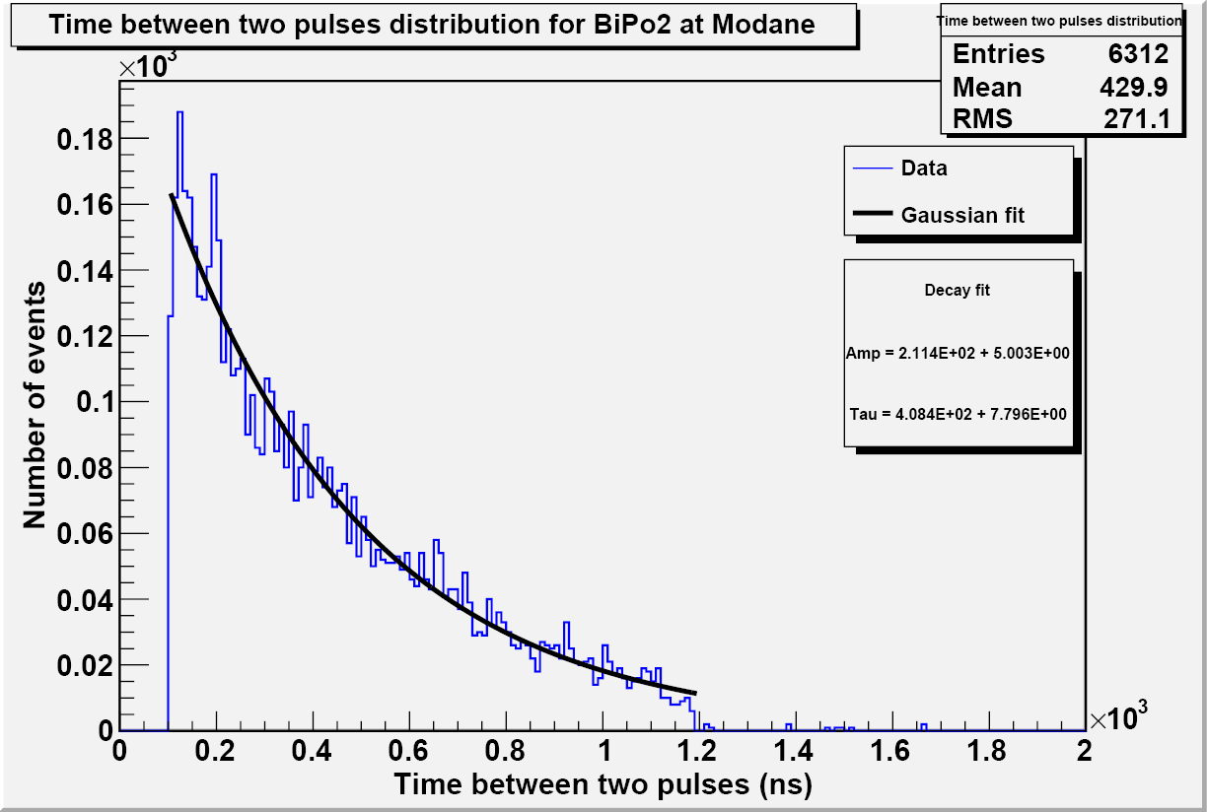
SuperNEMO BiPo results
²¹² Po decay constant measurement :
The lifetime of the ²¹²Po (299 ns) has been measured in BiPo1 (2 scintillator versions) and BiPo2 using a calibrated Aluminium foil.
T_{1/2}= 274 ± 8 ns
BiPo1
T_{1/2} = 303.4 ± 2.9 ns
The Bi-Po events measurement principle has been validated with the prototypes
BiPo2

Slide 38


SuperNEMO BiPo 1 results
2 modules composed of 2 rows of 9 scintillator pairs (face-to-face, 30×30 cm² ) coupled to 5’’PMTs.
Total number of PMT channels : 72
Surface of measurement : 0.3 x 0.3 x (18 x 2) = 3.24 m²
3 x 6 superior light lines are fixed on 3 moving supports
Maximum opening up is 200 mm for loading the source to be measured
Ways of cables 72 HV, 72 signals
Radon free Airflow
Lead (150 mm )
Wood ( 200 mm )
Pure iron ( 30 mm )
18 inferior light lines are fixed on the table

Slide 39

SuperNEMO Tracking
Wiring Robot
prototype 90 cells prototype
Wiring robot
90 cells prototype

Slide 40
Tracking 90 cells first tracks

Slide 41

SuperNEMO Radon
Strategy to reduce radon:
Tracker separated from calorimeter
Sealing of the setup → planar geometry
More radiopure materials
Monitoring of the gaz

Slide 42




SuperNEMO Radon
Bratislava, UCL : setups to measure radon emanation
of materials or gas
Prague : setup to measure
permeability of materials
CENBG, Marseille, Saga U: Electrostatic
detectors for gaz measurement
CENBG: setup to measure
radon emanation with liquid scintillator

Slide 43
SuperNEMO MC simulations

Slide 44


SuperNEMO sensitivity 100 kg 5 years
Se82
Nd150
3 candidates :
⁸²Se T_{1/2} < 10²⁶ y <m_{ν}> < 0.07 – 0.12 eV
¹⁵⁰Nd T_{1/2} < 4. 10²⁵ y <m_{ν}> < 0.05 eV
⁴⁸Ca (IE 50%) T_{1/2} < 1.9 10²⁶ y <m_{ν}> < 0.03 eV

Slide 45
<m_{ν}> current and future limits
Klapdor
claim
Limits in 2010
HM,NEMO3,
Cuoricino
Degenerated
Expected limits
2013 – 2018
CUORE,GERDA,
Majorana,
SuperNEMO,
EXO,….
Inverted hierarchy
Normal hierarchy
Use of « latest NME » for all experiments

Slide 46

SuperNEMO Module 0
SuperNEMO phase I : 2011 – 2014
A demontrator module with 7 kg of ⁸²Se (1 kg of ⁴⁸Ca ?)
Sensitivity in 1 year: ~5 10²⁴ y <m_{ν}> < 0,2 – 0,6 meV
Sensibility equivalent to GERDA I
Tracker already funded by UK
Calendar:
- Construction in labs: 2011 – 2012
- Installation, commissioning and running in LSM: 2013
- Few months to qualify the backgroud level
- Results 2014

Slide 47

SuperNEMO Demonstrator
SuperNEMO phase II: 2014 - 2018
20 modules, total 100 kg (82Se or 150Nd or 48Ca)
Contruction: 2015 – 2016
Commissioning and running: 2015 – 2020
⁸²Se Sensitivity: 53 – 145 meV
Total cost : 40 M€ (2/3 for Europe)
Running cost : ~300 k€
Degenerated
Inverted hierarchy
Normal hierarchy

Slide 48
SuperNEMO schedule summary
2009
2010
2011
2012
2013
2014
2015
NEMO3 Running
R&D SuperNEMO
TD
R
BiPo 1 and 2
running
BiPo
construction
BiPo running @ Canfranc
SuperNEMO 1st module construction
Preparation
of LSM site
SuperNEMO 1st module
running
construction of
20 modules

Slide 49
SuperNEMO summary
In case of signal, it must be confirmed on other isotope and by:
identification of electrons
measure of both angular and single energy distributions
Tracko-calo à la NEMO is the only multi-isotope detector available for such measurement
NEMO3 has been a successful experiment at the level of the best limits
and has provided data for nuclear matrix element calculations
Final sensitivity for NEMO3 : T_{1/2} > 2 10²⁴ years <m_{ν}> < 0.3 – 0.7 eV
SuperNEMO R&D has reached most of the requirements , especially on energy resolution
(limits on radiopurity to be checked)
Could be possible in the future to obtain several tens of kg of ¹⁵⁰Nd and ⁴⁸Ca
Expected sensitivity for SuperNEMO : T_{1/2} > 10²⁶ years <m_{ν}> < 50 – 120 eV
LSM extension has good chance to be done and to be able to host the next generation
of both double beta decay and dak matter experiments

Slide 50
Summary
Summary
Experiment | Isotope | Enriched isotope mass (kg) | T_{1/2} (yr) | <m_{ν}> (eV) | Start | Status
CUORE | ¹³⁰Te | 203 | 2.1 10²⁶ | 0.03 - 0.07* | 2012 | Funded
GERDA phase I phase II | ⁷⁶Ge | 17.9 40 | 3. 10²⁵ 2. 10²⁶ | 0.2 – 0.5* 0.07 – 0.2* | 2010 2012 | Funded Funded
Majorana | ⁷⁶Ge | 30 - 60 | 1.10²⁶ | 0.1 – 0.3* | 2011 | Funded
EXO-200 | ¹³⁶Xe | 200 | 6.4 10²⁵ | 0.2 - 0.7* | 2008 | Funded
SuperNEMO | ⁸²Se ¹⁵⁰Nd | 100 100 | 2. 10²⁶ 10²⁶ | 0.05- 0.09* 0.07 | 2013 | Module 0 Partially funded
CANDLES | ⁴⁸Ca | 0.5 |  | ~0.5 | 2010 | Funded
MOON II | ¹⁰⁰Mo | 120 |  | 0.09 – 0.13 | ? | R&D
DCBA | ¹⁵⁰Nd | 20 |  |  | ? | R&D
SNO++ | ¹⁵⁰Nd | 500 |  | 0.03 | ? | R&D
COBRA | 116Cd, ¹³⁰Te | 420 | ? | ? | ? | R&D
* Calculation with NME from Rodim et al., Suhonen et al., Caurier et al. PMN07

Slide 51





Modane Underground Laboratory
COMMISSARIAT À L’ÉNERGIE ATOMIQUE
4700 m.w.e
Muons flux reduced by a factor 2. 10⁶ → 4 muons/m²/day

Slide 52

LSM EXTENSION

Slide 53



LSM extension

Slide 54



SuperNEMO @ LSM
Space requirements: 32 m X 15 m
Minimum height: 13 m
Clean room : 7 m X 6 m
Electrical power : 80 kW
Free radon air : 15 mBq/m3
Water shielding
100m
55m
22,5m
14,9m

Slide 55

LSM extension
Safety galery work started in September 2009
Excavation of the extension end 2011.
In operation in 2013.
Pre-study funded by LSM and UK in 2006. Preliminary design to host SuperNEMO and EURECA
Detailed studies funded by Savoie departement and Rhone-Alpes Region
Review of project and LoI’s by an indepeandent Scientific Advisory Committee
Estimated cost : 10 M€ for civil work
3 M€ for equipment (ventilation, cooling, electrical power)
Open to international partner (contribution to scienific equipements, experiments)
Funding in progress

