Slide 1



From cosmological experiments to sensitive cryogenic detectors
-
A cool road to CMB
Congrès Des Doctorants
IPGP, 31/03/2026
Elisa Radjabou

Slide 2
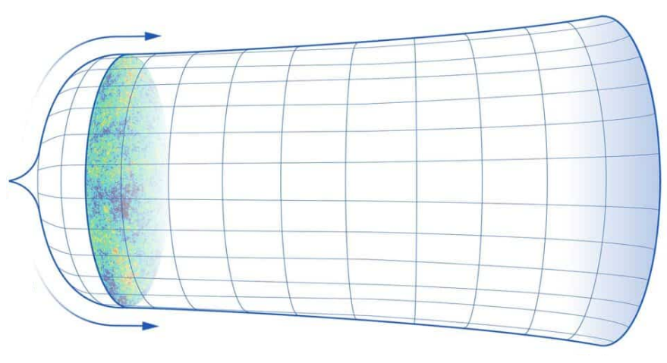
From the Big Bang to today : timeline
CMB
Today
Big Bang
History of our universe is encoded in CMB. We want to look at this relic radiation that fills all space in the observable universe
Cosmic Microwave Background : As the universe expanded, it cooled, allowing light to travel.
Pressure, density and temperature were infinite leading to exponential inflation.
time
0 y
380 000 y
few 100 million y
13,8 billion y
Notes:
density, pressure and temperature are infinite so its starts to inflate exponentially
As expansion continues temperature drops and first atoms can form
380,000 years after the Big Bang is the time when the cosmic microwave background was generated,
A few hundred million years after the Big Bang, the distribution of matter in the Universe had produced very dense knots at the intersections of the sheets and filaments that make up the cosmic web. In these knots, the density of ordinary matter was so high that the formation of stars and galaxies became possible.
axes y == pas la taille de l’univers, echelle pour montrer que
radiation made of photons (light particles), that fills all space in the observable universe

Slide 3
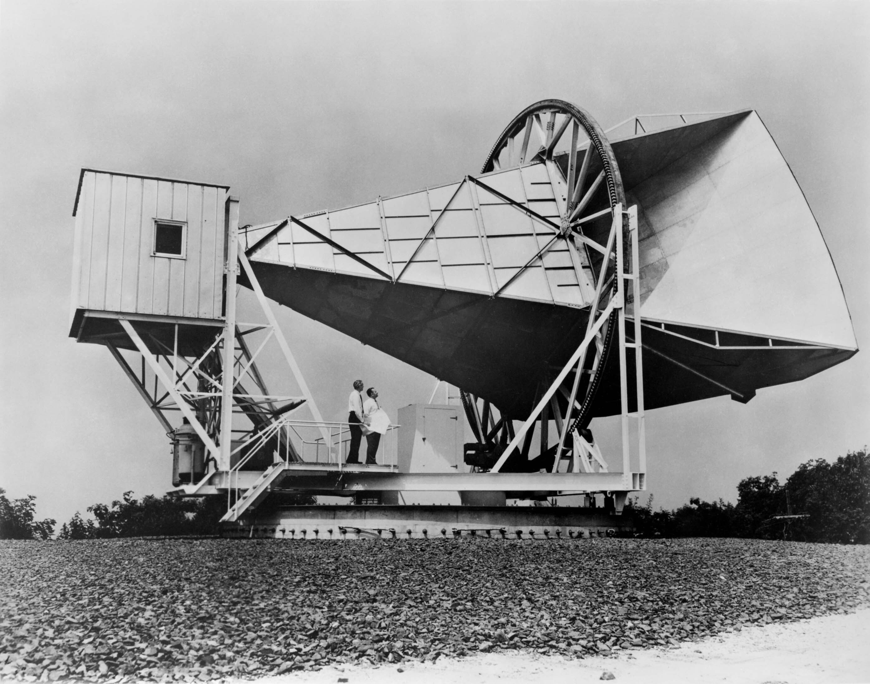
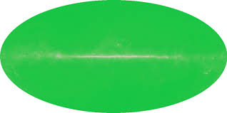
A little bit of history : Penzias and Wilson
Accidental discovery of CMB in 1964
: ~ Isotropic 2.7K blackbody spectrum
Originally built to detect radio waves reflecting off a Echo balloon satellite
They suppressed noise from the instrument and radars to discover a high residual noise…
Milky Way emission
Simulation of the entire sky Penzias and Wilson would have seen if they weren’t limited by zenith pointing
NASA/WMAP Science team
A. Penzias and R. Wilson admiring the Holmdel Horn Antenna,
New Jersey
Notes:
Penzias and Wilson
CMB looks like a homogeneous signal with no contrast enhancement

Slide 4
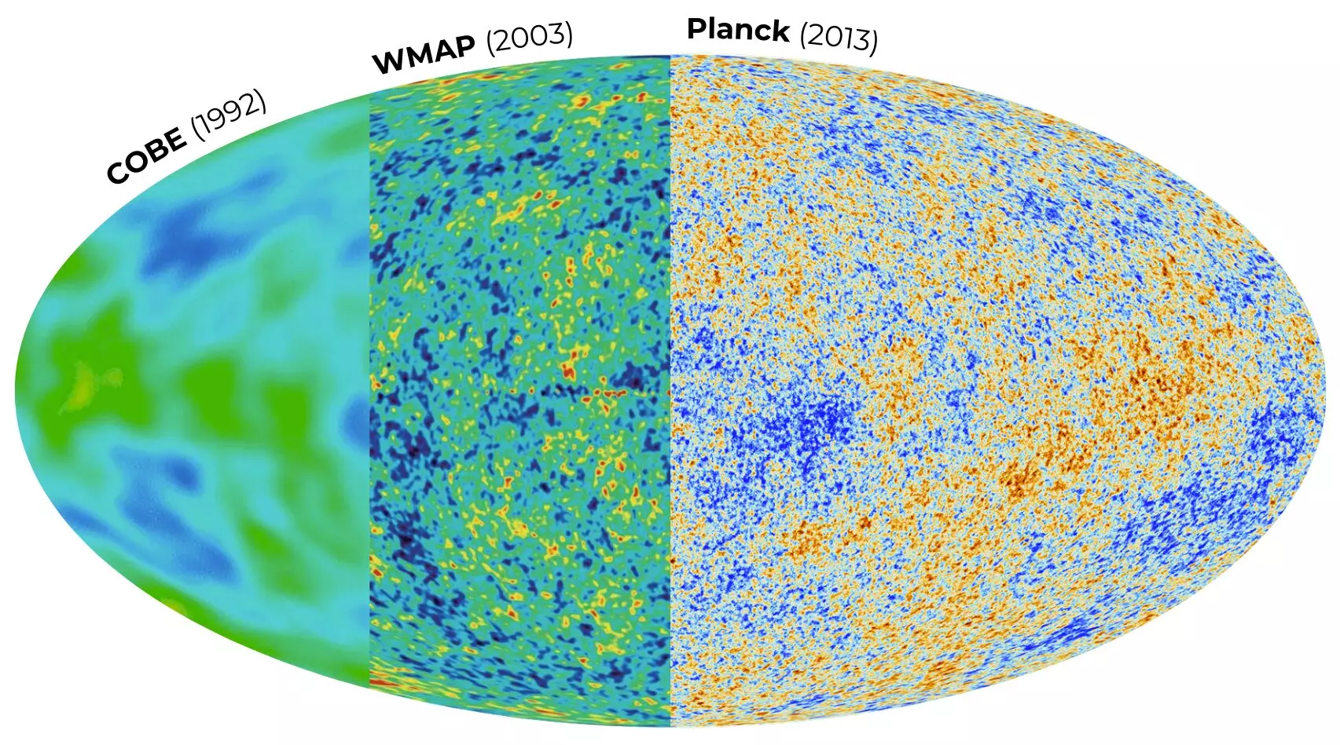
CMB anisotropies
By adding contrast to the maps we can see temperature anisotropies !
Small temperature fluctuations in the blackbody radiation
Seed of the formation of galaxies and large scale structures
Illustration of the CMB discovery history with the corresponding instrument
Bluefors website
Notes:
Since that discovery we observed from the sky rather rhan from the ground and improved our resolution and sensitivity
by adding the contrast, we see anisotropies
bluefor map : https://bluefors.com/stories/big-bang-vision-exploring-the-cosmic-microwave-background-at-simons-observatory/

Slide 5
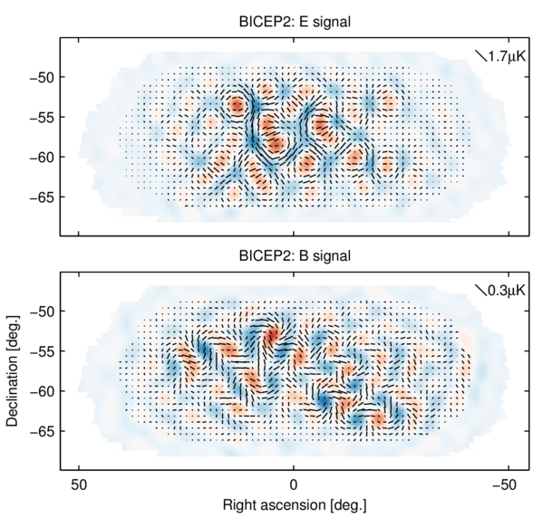
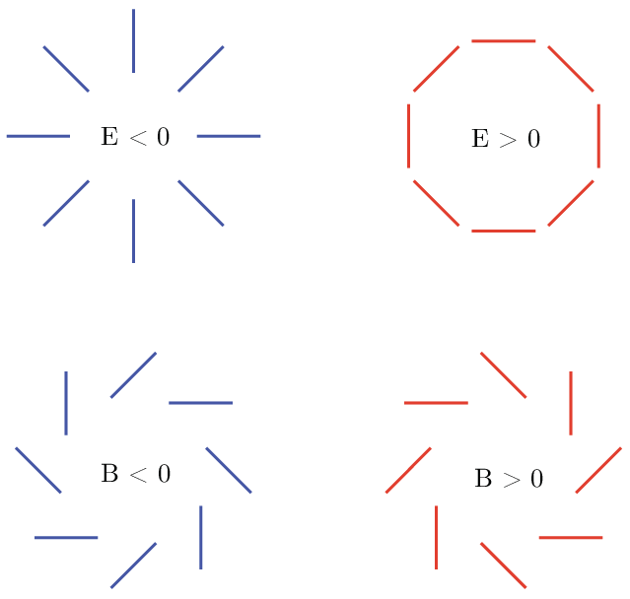
CMB polarization
CMB anisotropies can have different polarizations classified as E and B modes
E modes have extensively been observed and studied
B modes are linked to inflation and primordial gravitational waves
Notes:
A fraction of the CMB light is polarised. E and B modes are a way of describing the distribution of the orientation of the polarisation

Slide 6
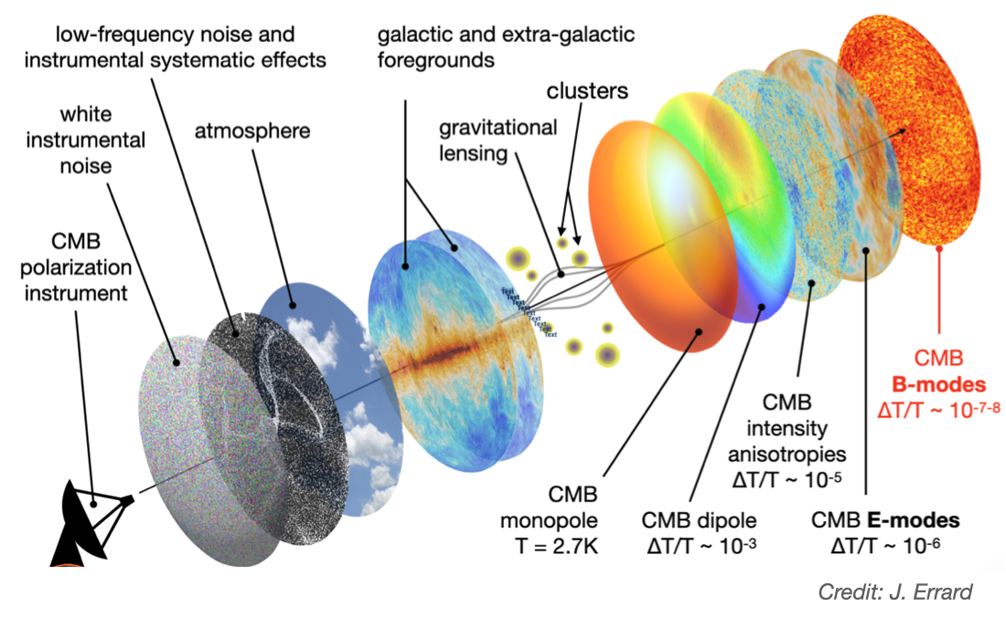
From CMB to low temperature detectors
Detector noise : my PhD
Low frequency noise : Bao TON’s PhD
galactic and non foreground
Astrophysical foreground
Goal is to detect this signal
From here
Atmospherical foreground
Notes:
galactic : synchrotron, C0 emission line, free-free, spinning dust.
Extragalctic : Effet thermiques (SZ), lensing, cosmic infrared background
froigeound astrophysique
froreground local (atmospehre + galaxies)
foreground atmospherique
Moi + bao

Slide 7
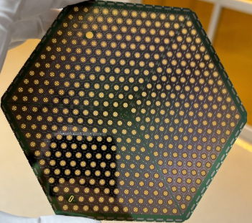
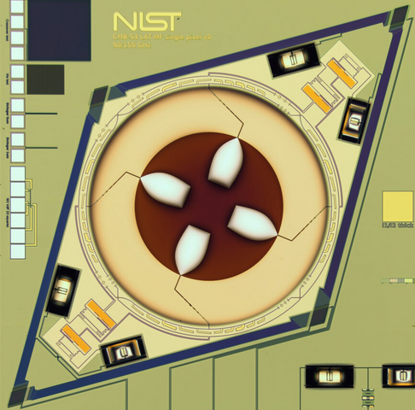
From CMB to low temperature detectors
Goal is to detect this signal
1 pixel
100 mK
My PhD : Development and characterisation of the detection chain for next generation cosmology experiments
Notes:
galactic : synchrotron, C0 emission line, free-free, spinning dust.
Extragalctic : Effet thermiques (SZ), lensing, cosmic infrared background
froigeound astrophysique
froreground local (atmospehre + galaxies)
foreground atmospherique
Moi + bao

Slide 8
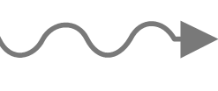
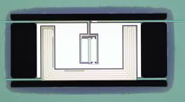
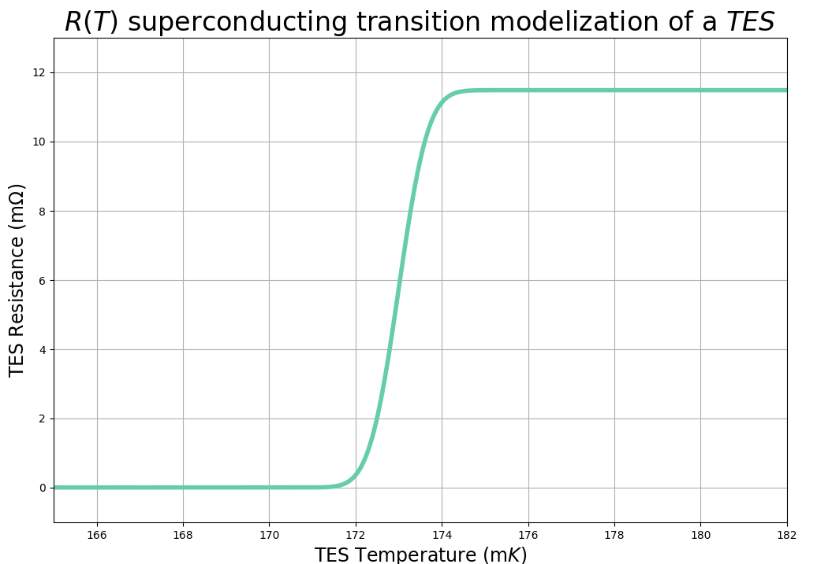
Bolometer : Transition Edge Sensor
P from CMB
C
Thermometer
G
Bath
We exploit the sharp superconducting transition to detect such a small signal, when we are at cryogenic temperatures
Normal
working point
R0,T0
Superconducting
Notes:
C absorbs the rayonnement, which is the superconductor, and R (the U in white and the thermometer ) dissipate heat proportional to that radiation

Slide 9
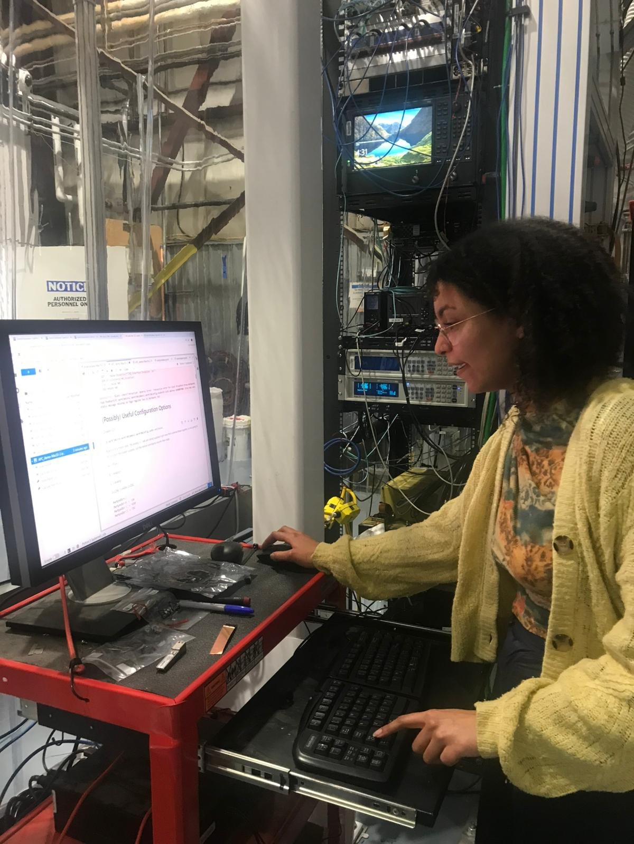
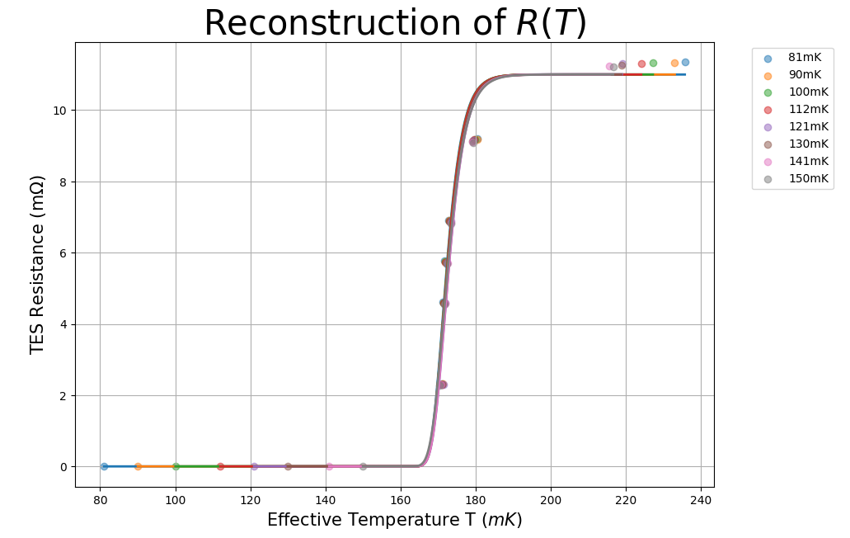
Transition Edge Sensor working point
Measured data at SLAC
(Stanford Linear Accelerator Center)

Slide 10

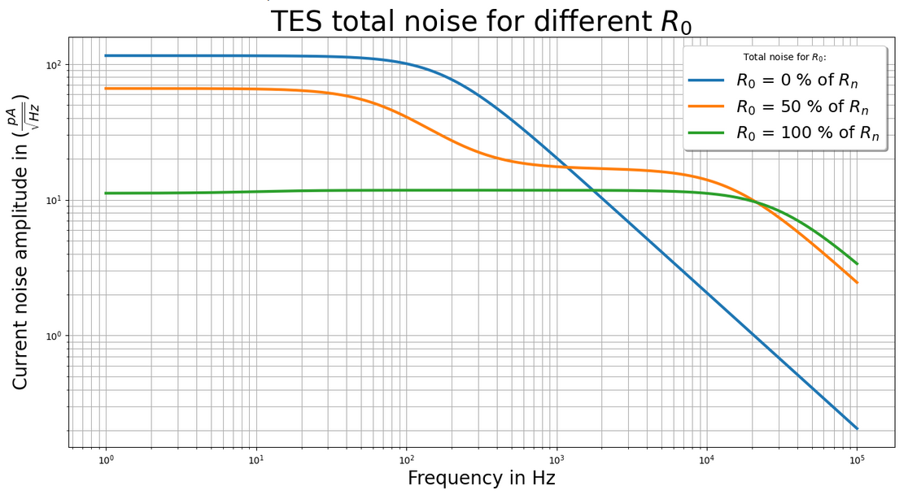


Transition Edge Sensor working point
Detector noise is very sensitive to the working point in the superconducting transition

Slide 11
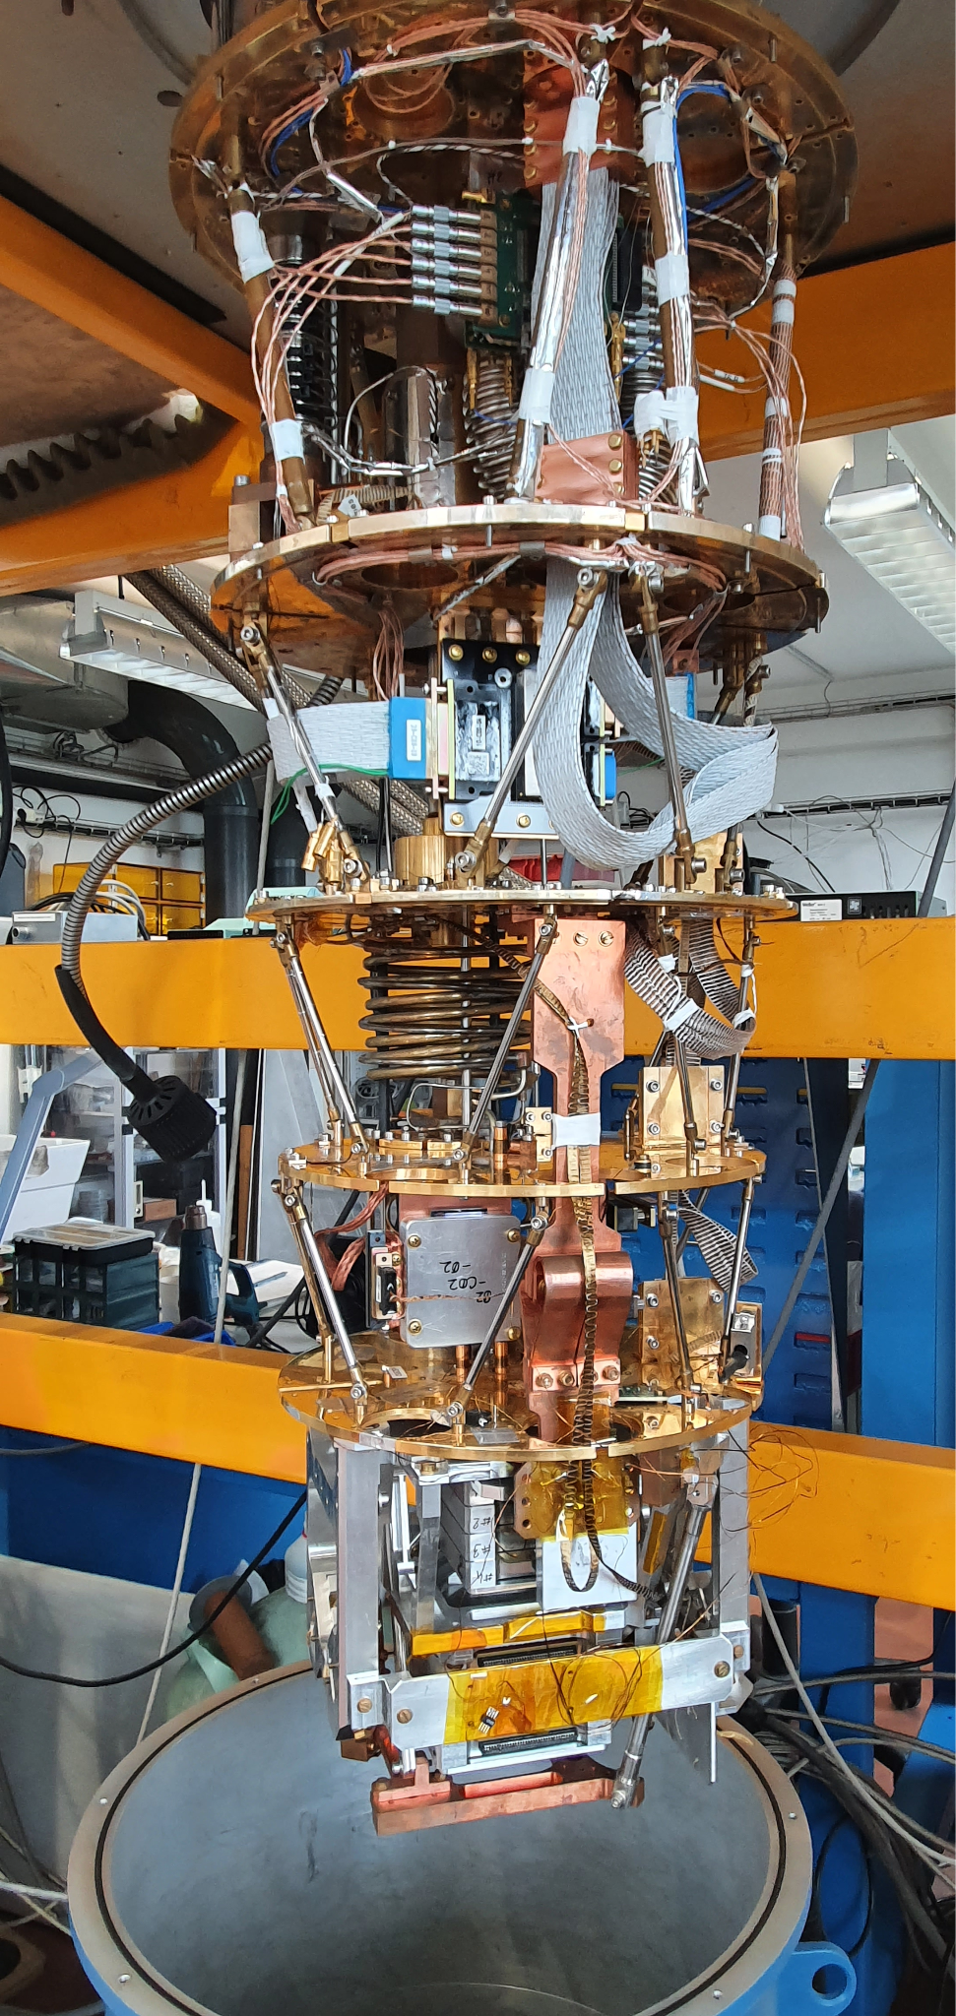
Take home messages
Instrumentation for cosmology is cool
Inflation is the most probable model, we need to detect the B modes
Characterization of detectors for next generation of cosmology experiment is necessary

Slide 12
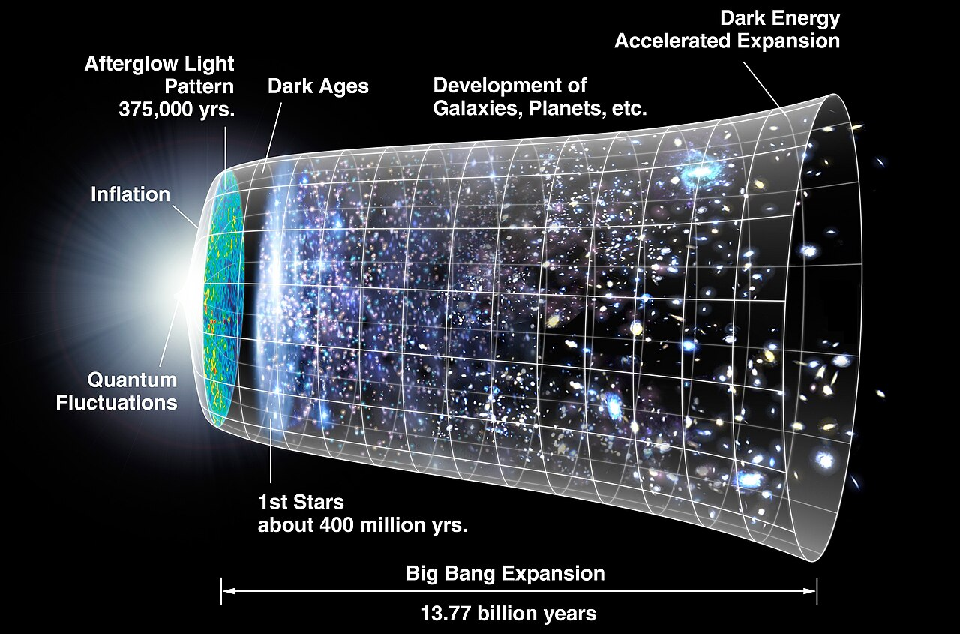
back up slides
Inflation (faster than speed of light)
Hot, dense, opaque plasma dominated by photons (amplified form of quantum fluctuations)
Recombination
380 000y after Big Bang, Universe cools down, and nucleus can catch free electrons Transparent Universe
Dark ages
Neutral and cold Universe
Reionization
Stars radiation ionises matter plasma
Millimetric observation
As the Universe expanded, CMB cooled down to T_{CMB} ~ 2,7 K

Slide 13
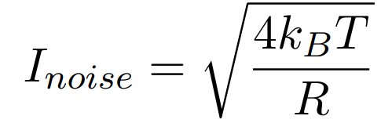
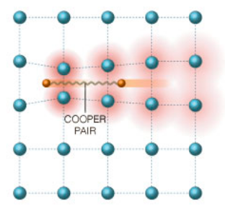
Backup slide : Cryogenic quantum detectors
Why cryogenic (near absolute zero) ?
Less thermal noise !
The temperature of the instrument is directly proportional its noise
Quantum properties of superconducting detectors !
Below its critical temperature Tc, superconductors can form Copper pairs (bound state made of two electrons) where there is no resistivity
Notes:
Cooper pairs dont’ scatter over impurities or atoms like individual electrons, they are one wave function, so zero resistance

Slide 14
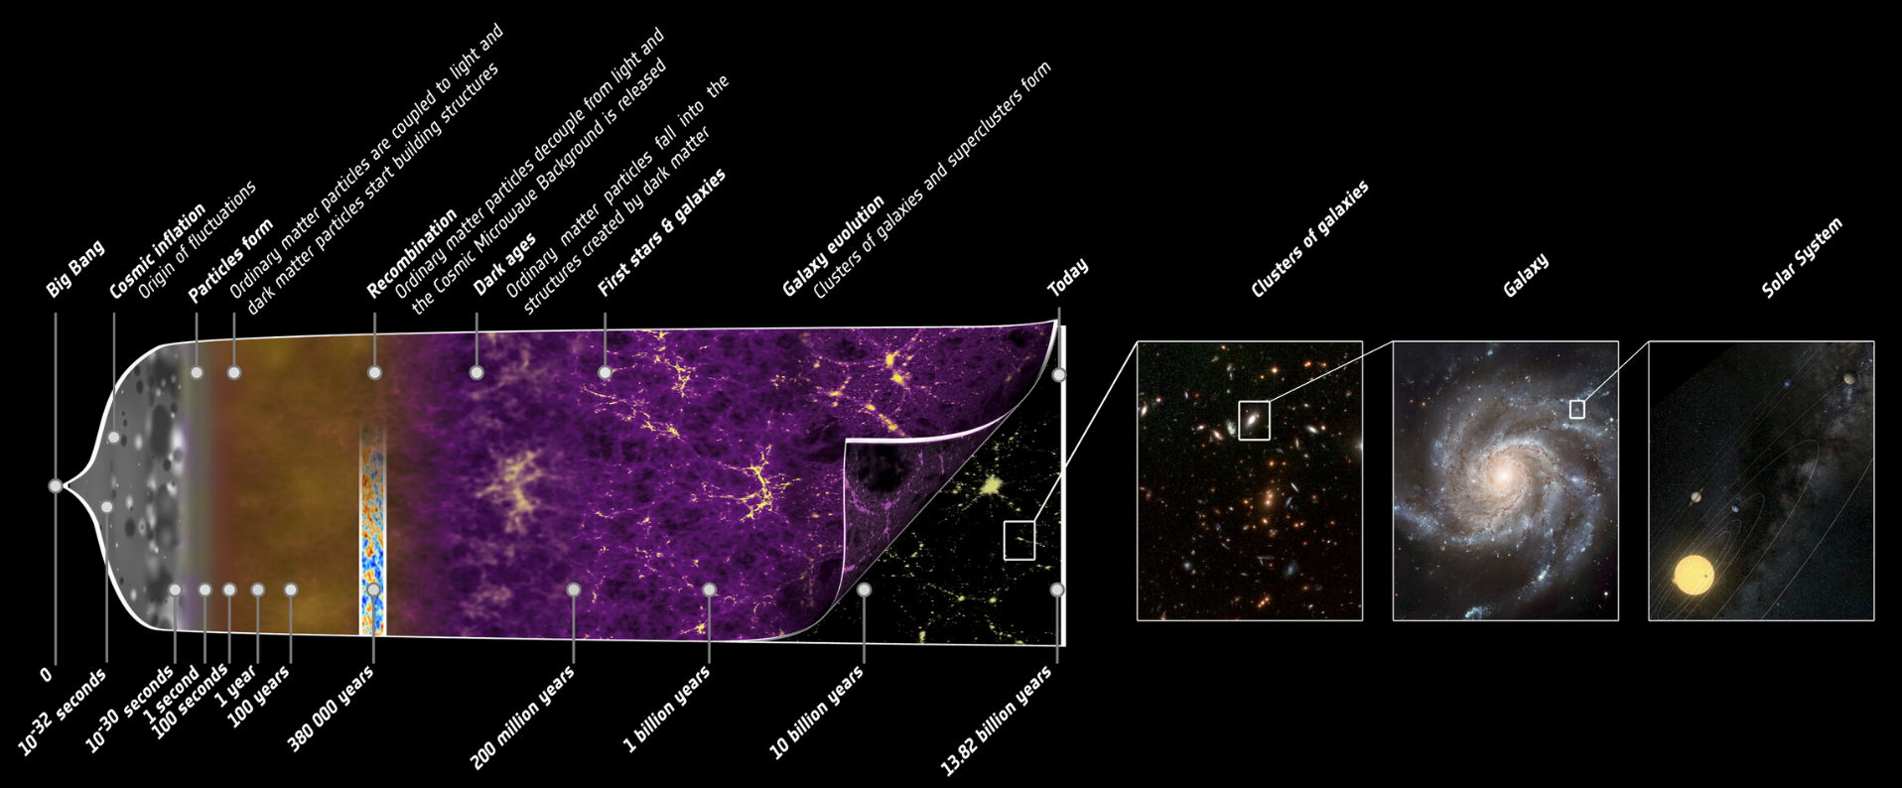
backup slide

Slide 15
Backup slide
Big Bang model :
Big Bang started with inflation : expansion that started 13.7 billion years ago
Cooled relic of the first light that could ever travel freely throughout the Universe
A radiation made of photons (light particles) that have a wavelength in the electromagnetic spectrum of microwave today (a few mm)
It fills all space in the observable universe
Notes:
The wavelength got stretched from λmax​≈966 nm because of travelling from the big bang to us

