Slide 1
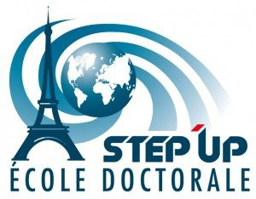



Automatic Detection of Diagnostic
Absorption Features for Mineral Identification Using
Continuous Wavelet Transform
31 March 2026
Corentin Feray
PhD advisor: Stéphane Jacquemoud (IPGP/U. Paris Cité)
PhD co-advisor: Rodolphe Marion (CEA)
2 years funded by CEA and the Académie Spatiale d’Île de France

Slide 2
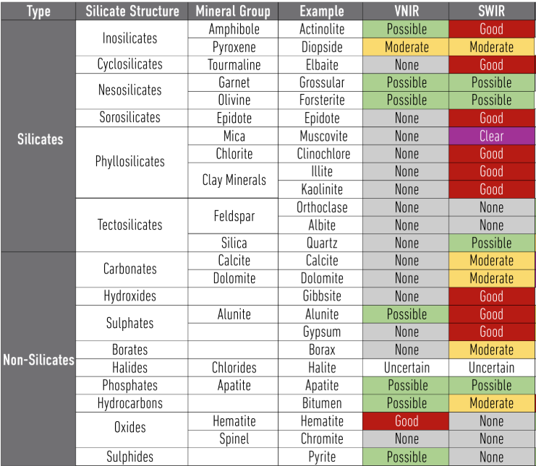
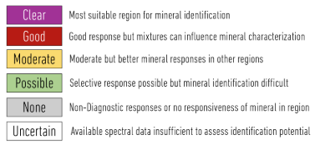
What am I looking for?
About 10 minerals of interest presenting absorptions features in the solar domain (VNIR/SWIR)
Source : Terracore
31/03/2026
Corentin Feray

Slide 3
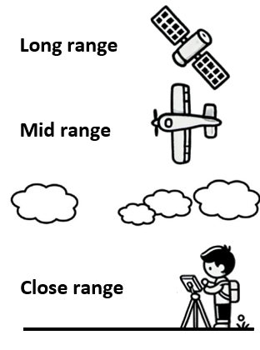
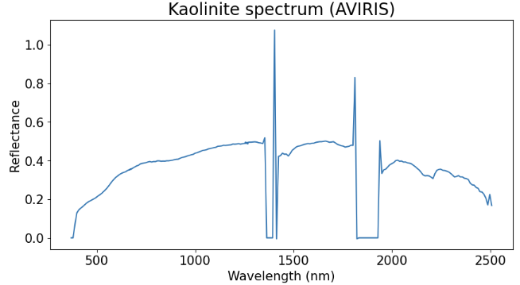
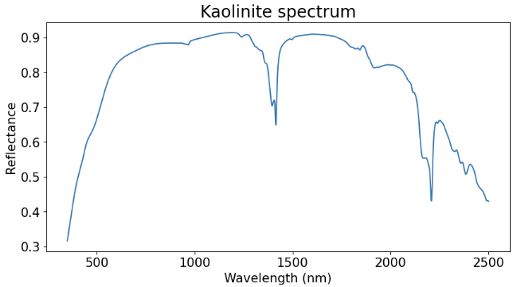
Spectroscopic data
Example of kaolinite
Absorption bands = Chemical effects
Continuum = Physical effects
31/03/2026
Corentin Feray

Slide 4
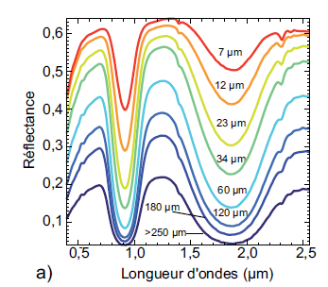
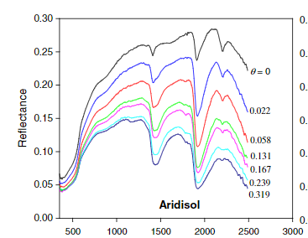
Factors affecting reflectance spectra
Acquisition chain: camera calibration, acquisition geometry …
Environmental conditions: illumination (direct/diffuse), adjacency effects …
Physical properties: grain size and shape, porosity, surface roughness (shadows) …
Chemical properties : mineralogical composition, water, organic matter, pollutant …
Average grain size [1]
Water content [2]
Wavelength (µm)
Wavelength (nm)
[1] Verpoorter (2009)
[2] Sadeghi et al. (2015)
31/03/2026
Corentin Feray

Slide 5

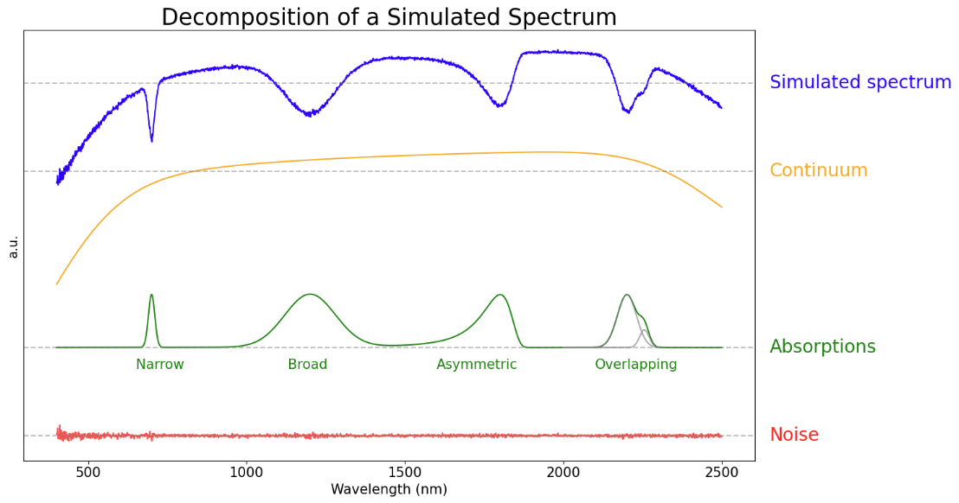
Spectral deconvolution
Objectives: reduce data dimensionality, minimize the impact of noise, mitigate correlations between parameters, and improve parameter interpretability.
Logarithm of the reflectance spectrum:
31/03/2026

Slide 6
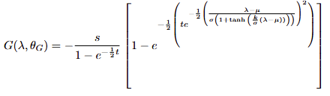
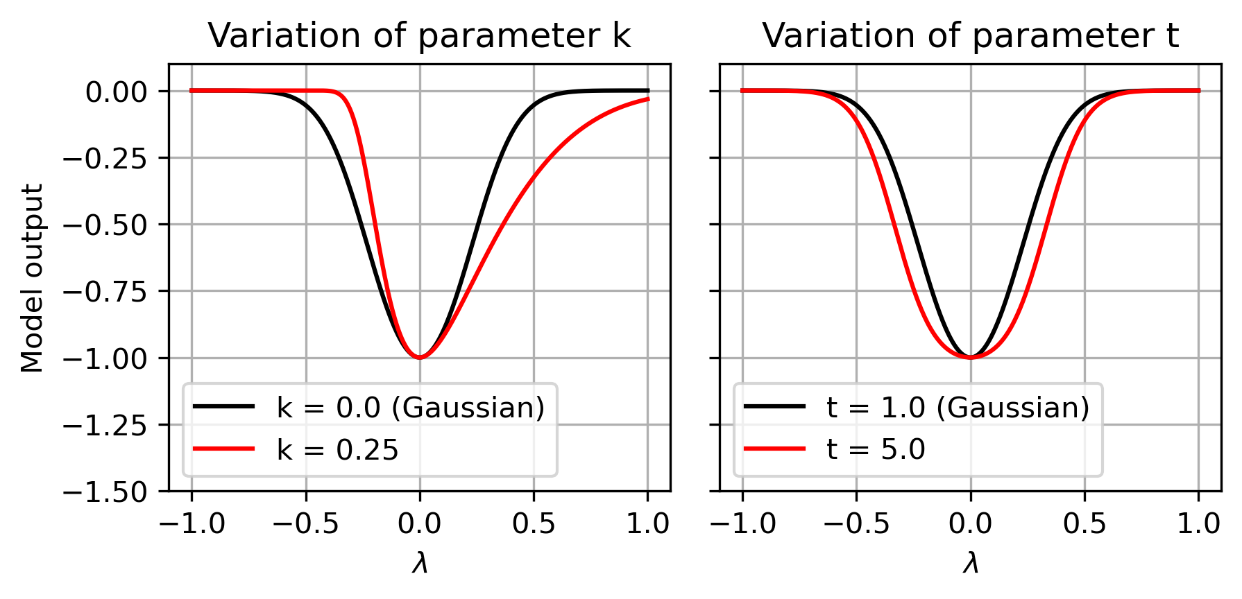
Spectral deconvolution
Absorption model: EGO (Exponential Gaussian Optimization) [3]
5 parameters:
Amplitude s
Position μ
Width σ
Asymmetry k
Flatness t
~1000 wavelengths → A few dozen parameters
8 + 5N parameters
(8 for the continuum, 5N for the absorptions)
[3] Pompilio et al. (2009)
31/03/2026

Slide 7
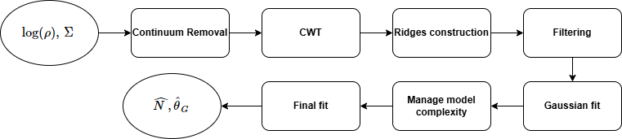
EGO Fitting Procedure
logarithm of the reflectance spectrum
associated noise covariance matrix
absorption number
estimated absorption parameters
31/03/2026

Slide 8
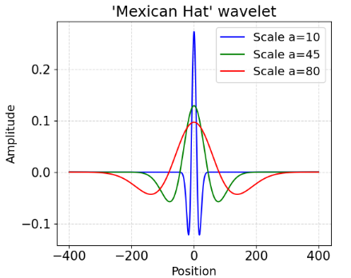


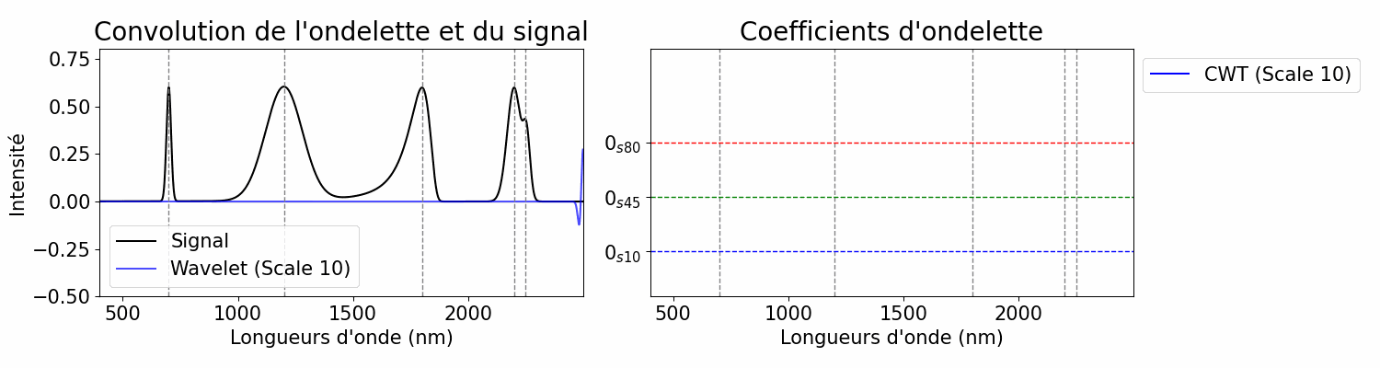
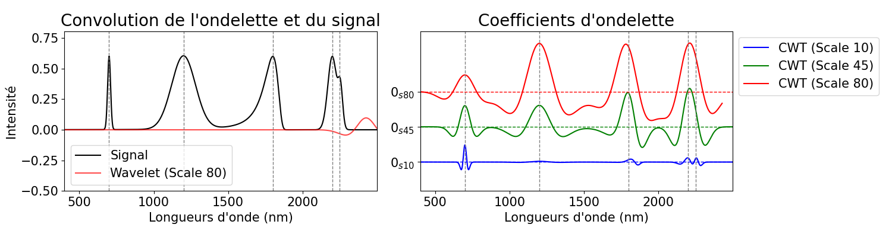
Wavelet transform
2D matrix of wavelet coefficients
Scaled and translated wavelet
Mother wavelet: Mexican Hat
f(t): signal; a: scale factor; b: translation; w(t): mother wavelet
Convolution of the wavelet and the signal
Wavelet coefficients
Intensity
Wavelength (nm)
Wavelength (nm)
31/03/2026

Slide 9
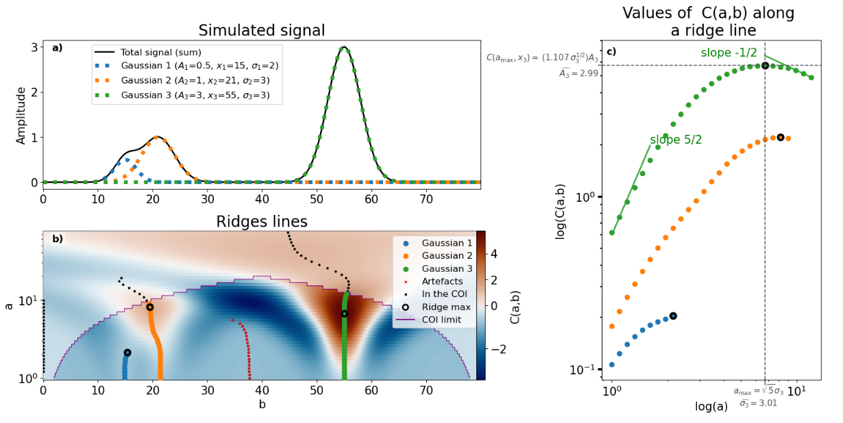
Ridge detection
31/03/2026

Slide 10
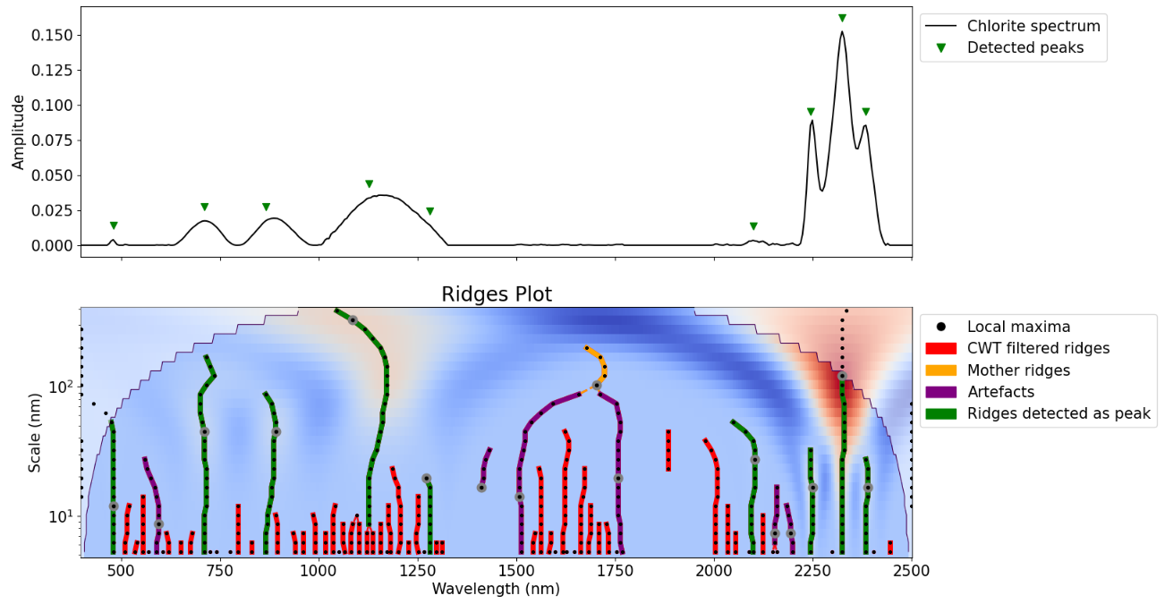
Filtering
in wavelet space
with ridge geometry
in signal space
31/03/2026

Slide 11

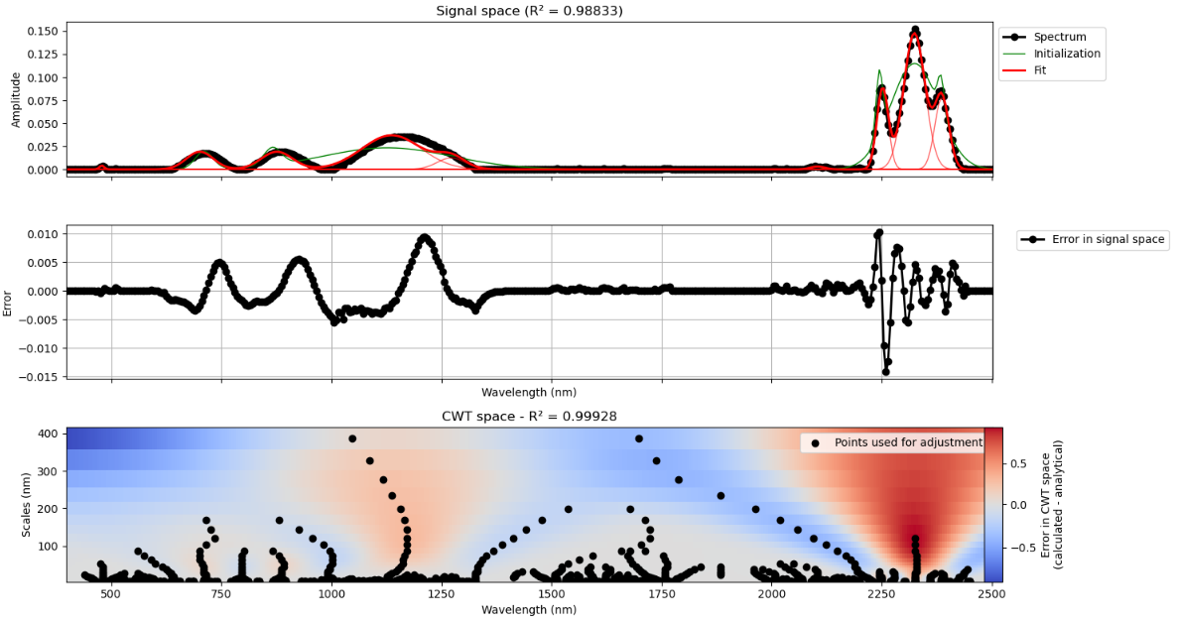
Gaussian fit
Analytical equation of the wavelet transform of a sum of gaussians:
N : gaussian number
a : cwt scale
b : cwt position
σ : gaussian width
x : gaussian position
A : gaussian amplitude
31/03/2026

Slide 12
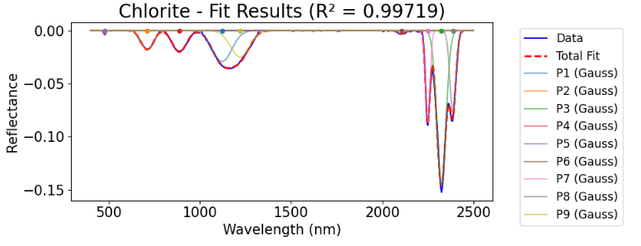
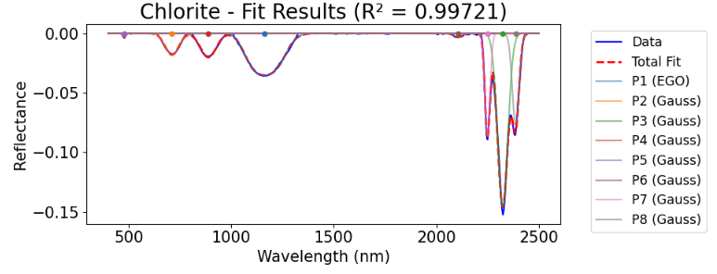
Manage model complexity
Can peaks be merged ?
Is it necessary to add a skewness or flattening parameter to the peak?
AIC comparison on local model:
2 Gaussian vs 1 EGO model
→ select EGO model if ΔAIC >3
31/03/2026

Slide 13
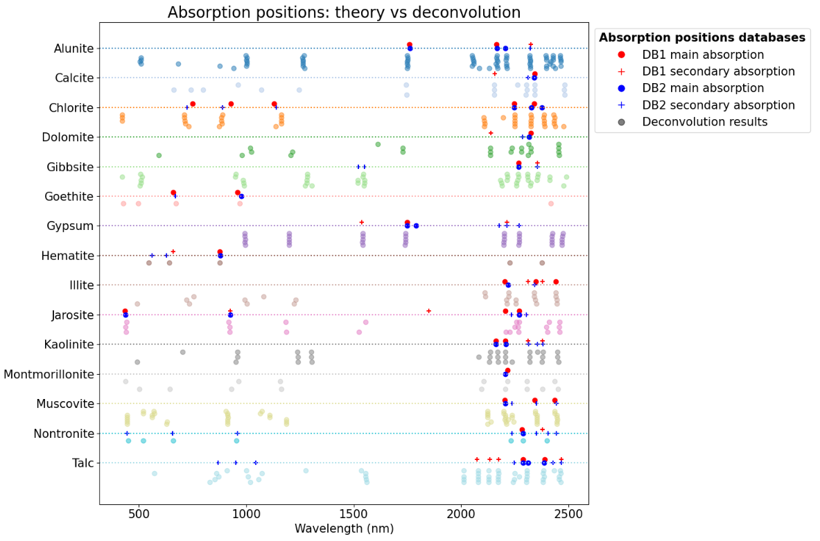
Mineral Classification
Fuzzy logic provides an interpretable decision inspired by the expertise of spectroscopists
Main absorption is always present, while secondary absorption depends on the context
31/03/2026

Slide 14
Conclusions and perspectives
Conclusions:
Algorithm applicable to different types of data
Noise taken into account
Fast (~1s per spectrum)
Overlaps handled effectively
Perspectives:
Minerals classification using fuzzy logic
Understanding and quantifying the impact of moisture content on model parameters (detection limits)
Developing robust models for mineral quantification that account for these effects
31/03/2026

Slide 15
Bibliography
[1] Verpoorter, C. (2009). Télédétection hyperspectrale et cartographie des faciès sédimentaires en zone intertidale: application à la Baie de Bourgneuf (Doctoral dissertation, Université de Nantes).
[2] Sadeghi, M., Jones, S. B., & Philpot, W. D. (2015). A linear physically-based model for remote sensing of soil moisture using short wave infrared bands. Remote Sensing of Environment, 164, 66-76.
[3] Pompilio, L., Pedrazzi, G., Cloutis, E. A., Craig, M. A., & Roush, T. L. (2010). Exponential Gaussian approach for spectral modelling: The EGO algorithm II. Band asymmetry. Icarus, 208(2), 811-823.
[4] Rialland, R. (2021). Télédétection hyperspectrale pour l’identification et la caractérisation de minéraux industriels (Doctoral dissertation, Université Paris-Saclay).
31/03/2026

