Slide 1

Squeezed-vacuum techniques for quantum noise reduction in interferometric gravitational-wave detectors Research at APC
Isander Ahrend, Matteo Barsuglia
Eleonora Capocasa, Anne Daumas, Jacques Ding, Michael Hartman, Pierre Prat
Léon Vidal, Yuhang Zhao

Slide 2
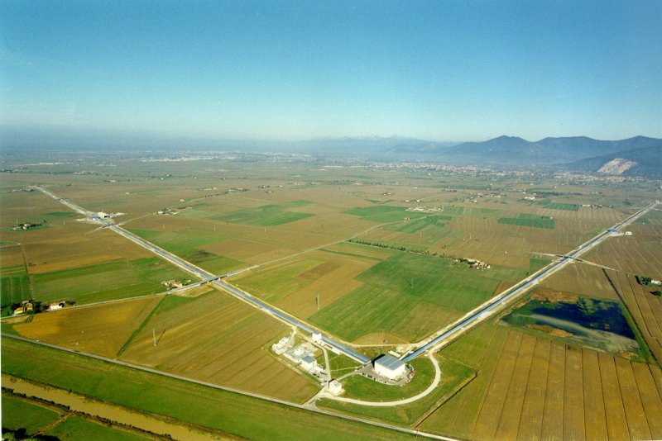
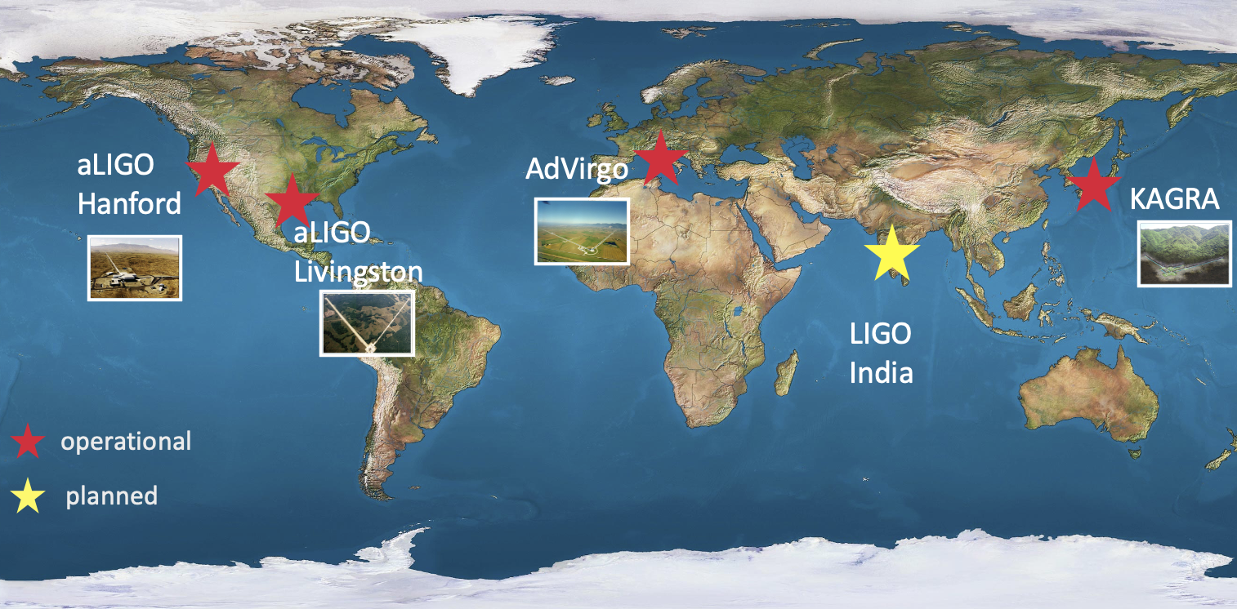
Gravitational-wave detectors

Slide 3
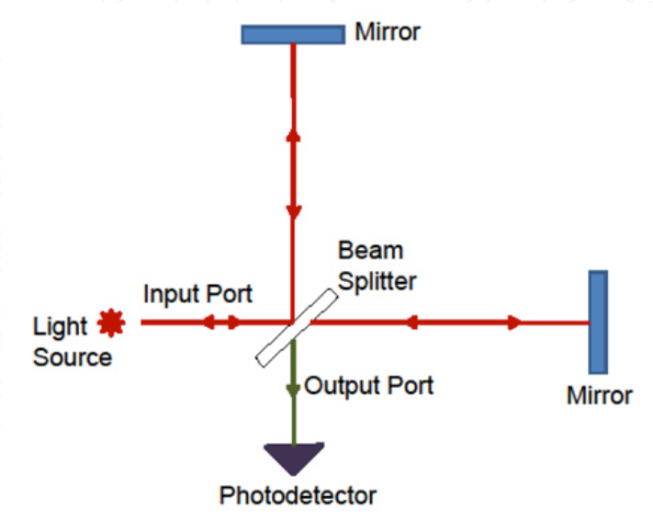
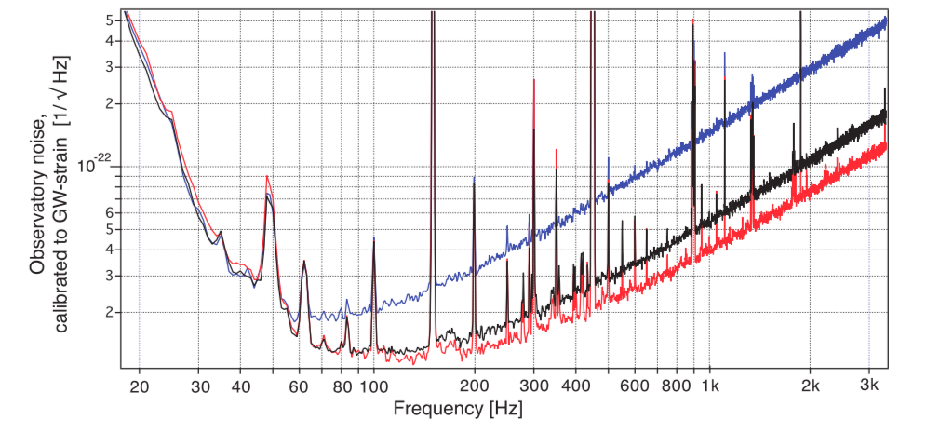
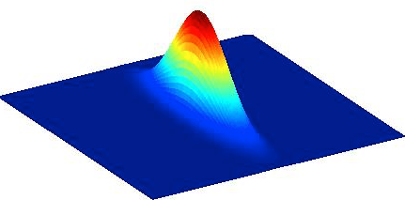
Squeezing
Quantum noise limits the sensitivity of gravitational-wave detectors (as Virgo,LIGO, KAGRA) in a large part of the spectrum
Quantum noise is given by vacuum fluctuations entering in the detector
We can reduce the effect of vacuum fluctuations using special quantum optics techniques : squeezing
Squeezing has been tested in Virgo and LIGO (+50% sources detected)
For future detectors more sophisticated squeezing sources are needed

Slide 4
APC group
Contribution on the first demonstration of frequency dependent squeezing below 100 Hz realised in a full scale prototype (2020) - https://physics.aps.org/articles/v13/s55
Contributions on the squeezing for Virgo
Developments of control techniques for squeezing
Optimization of losses in a 300-m filter cavity
2 staff, 2 PhD students, 2 post-docs, 2 engineers
10 papers published on squeezing, 1 accepted, 1 in preparation https://quantum-fresco.in2p3.fr/Publications.html
2 PhD thesis already concluded on squeezing, 2 PhD thesis on-going
1 ANR (Quantum-FRESCO)
Member of Paris Center for Quantum Technologies (PCQT) member of QuanTech InidEx Paris Cité
Various international collaborations (i.e. NAOJ-Japan, MIT-KAVLI)
Responsibilites for squeezing for Einstein Telescope and Virgo_nEXT
Our last work (published on Physical Review D):
https://arxiv.org/abs/2506.02222
Performance of multiple filter-cavity schemes for frequency-dependent squeezing in gravitational-wave detectors, Jacques Ding, Eleonora Capocasa, Isander Ahrend, Fangfei Liu, Yuhang Zhao, Matteo Barsuglia

Slide 5
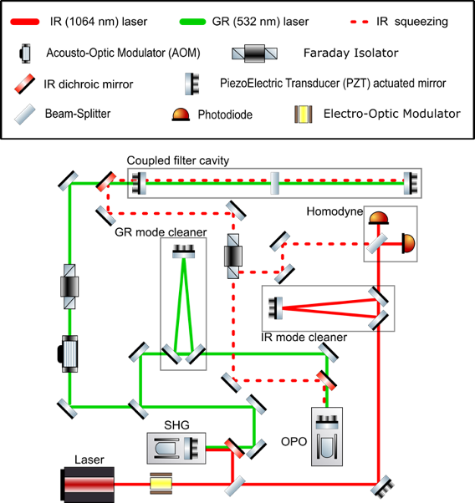
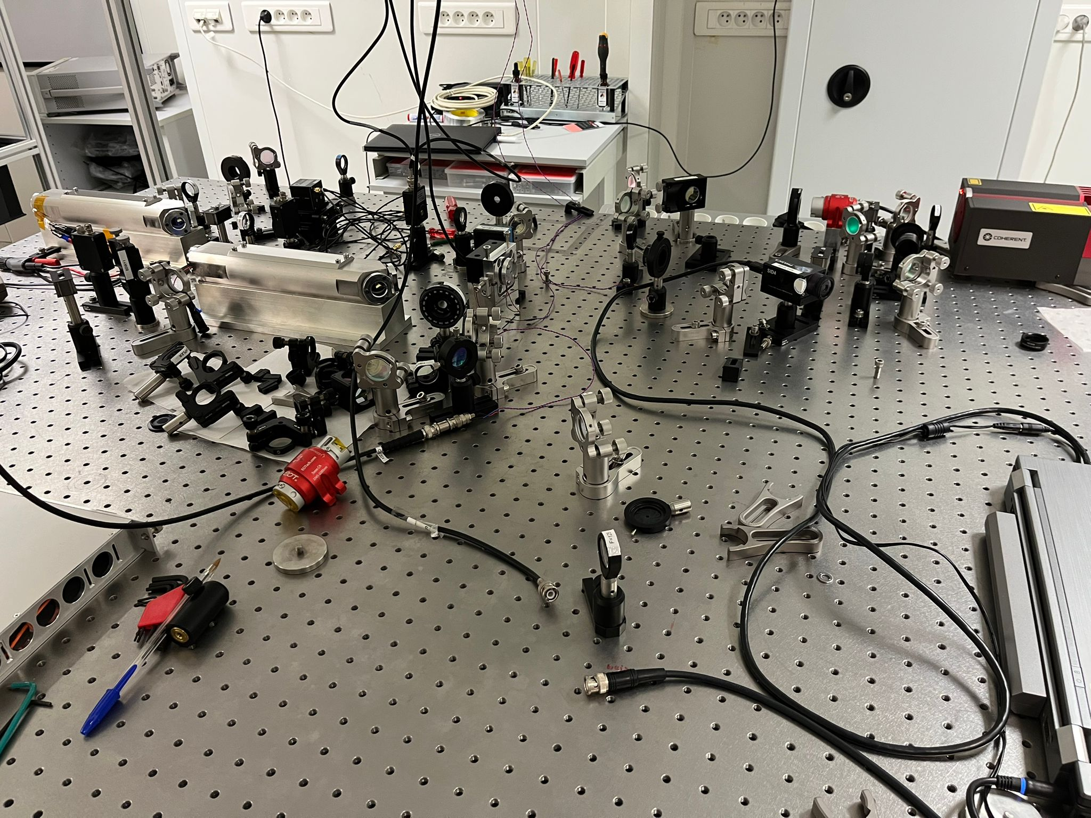
On going
Realization of a squeezed vacuum source
Table top demonstration of non-trivial rotation of the squeezing ellipse
Mimization of losses to improve squeezing
Contribution to squeezing for Virgo (O5) and Virgo_nEXT
Modeling work

