Slide 1


GATE 10
David Sarrut
CNRS - University of Lyon
CREATIS, CNRS UMR5220, Inserm U1044, INSA-Lyon, Université Lyon 1, France
On behalf of the OpenGate collaboration

Slide 2



GATE 10
Current is 10.1 (March 2026)
With Geant4 11.4
On Linux, Mac (Intel + Silicon), Windows*
With Python 3.11, 3.12, 3.13, 3.14
* No multithread, root issues, limited support

Slide 3
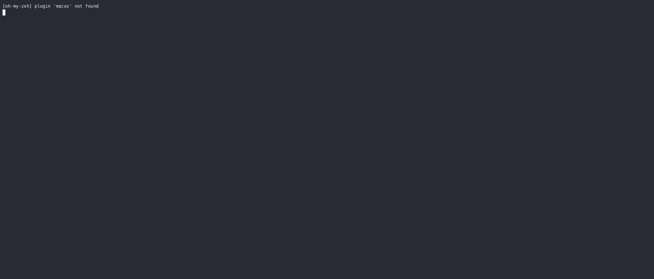

Installation
pip install opengate pip install --upgrade opengate
Take care of architectures and python versions
Install: GEANT4, ITK, QT, UPROOT, etc
Ready in few minutes
Download Geant4 data (10 min)
Download data for the tests (5 min)

Slide 4
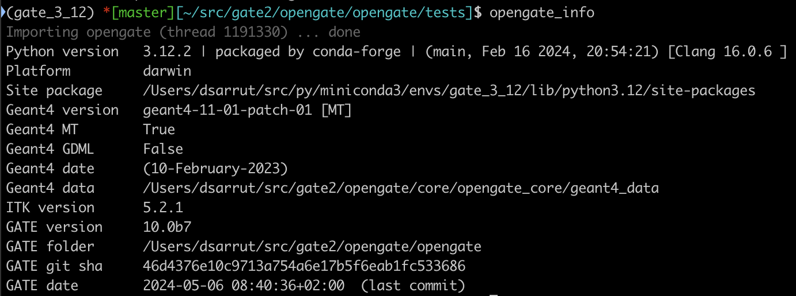

opengate_info

Slide 5
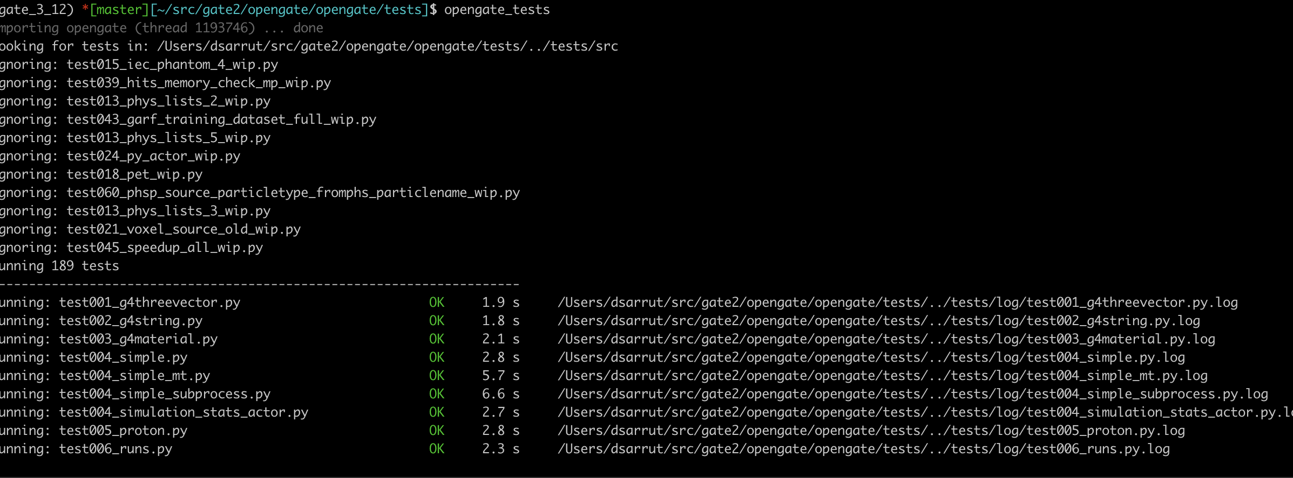

opengate_tests
March 2026 = 266 tests

Slide 6
Installation for developers
Install Qt (optional)
Download and compile Geant4 (with Qt)
Download and compile ITK
Clone opengate github repository
Compile the C++ opengate-geant4 library
Install the python part (with dependencies), with pip install –e .

Slide 7
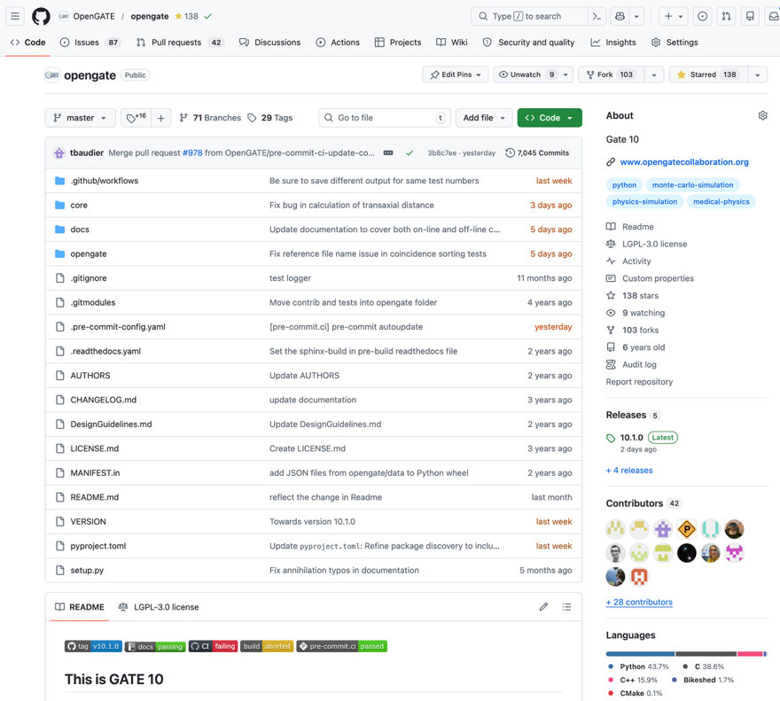

Pull Requests on github
Github statistics
Since the previous release (1 year): 70 PR merged
Pending : 39 PR
Issues: 86 are open
Contributors: 41
Code change = one PR
code + tests + doc

Slide 8
New features
Improved Digitizers
Improved DoseActor
Improved PhaseSpaceActor
Dynamic attribute: process defined step (Compton, Rayleigh etc)
Natural Filters
VRT LVS: Last Vertex Splitting
VRT FFAA: Free Flight Angular Acceptance
Additional optional Geant4 DB (LEND_GNDS2.0_ENDF.BVII.1)
Advanced test linac
Advanced test electron flash

Slide 9
Digitizers modules
HitsCollection : start with this one
Adder, Readout : “merge” hits
Blurring, SpatialBlurring : blur energy, time, position …
Efficiency : delete some hits
EnergyWindows : energy threshold and windowing
PileUp : complex pileup
Projection : create 2D image
CoincidencesSorter : group wrt time policies
DeadTime WIP
Warm thanks to Gert !
offline + online
offline + online (partly)

Slide 10
Focus on digitizers
Hits Collection
Attributes: KineticEnergy, Position …
Index | KineticEnergy | Position_X | EventID | TrackID
1 | 0.1 | 12.434 | 1 | 2
2 | 0.23 | 454.5 | 2 | 3
3 | 1.1 | 971.33 | 2 | 2
… | … | … | … | …
For PET, SPECT, CoCam, etc
Can be attached to any volume(s)
Select any attributes
Suite of modules
ROOT output
Online
C++ during the simulation
At End of Events
Offline:
Python script input=ROOT, output=ROOT
Process by chunks (memory)
Digitizer module
Index | KineticEnergy | Position_X
1 | 0.1 | 12.434
2 | 1.33 | 602.3
… | … | …
ROOT output
As a file or a new tree
or no output (memory only)

Slide 11
New features: WIP (work in progress)
More “natural” filters
EM fields
Positronium
EIC optiks
Advanced tests
…
from opengate.actors.filters import GateFilterBuilder F = GateFilterBuilder() my_filter = ( (30 * sec < F.GlobalTime) & (F.GlobalTime < 70 * sec) & (F.ParticleName == "gamma") ) # phsp phsp = sim.add_actor("PhaseSpaceActor", "phsp") phsp.attached_to = plane phsp.attributes = ["GlobalTime", "KineticEnergy", "ParticleName"] phsp.output_filename = f"{sim_name}.root" phsp.filter =my_filter

Slide 12
New features: WIP (work in progress)
Interface pytomography (updated)
Interface Castor
Interface RTK
Interface Coresi

Slide 13
Future directions

Slide 14

Future directions
Digitizers to be continued (consolidated)
Geant4-DNA/Chem/Bio with GATE (cf Nils)
Improved Multithreading (MT)
Multiprocessing (MP)
AI and ML integration
+generation of synthetic data
GPU ? Unsure
Vibe-coding … vibe-simulating?

Slide 15



Conclusion
Gate10 is 1 year
(+4 years of dev)
GATE is still GATE
Medical Physics
Open-source, community based
Python module (no time penalty)
AI ready
Contributions welcome

Slide 16
