Slide 1




GATE Activity @ DeSIs-IPHC
L. V. Garcia Garcia (lucia-victoria.garcia-garcia@iphc.cnrs.fr)
GATE Scientific Meeting 2026
Strasbourg – 1st April 2026

Slide 2


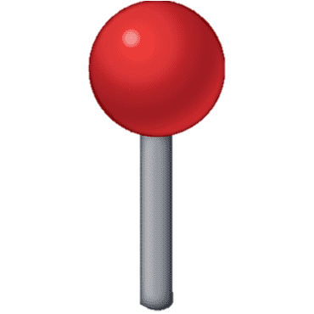

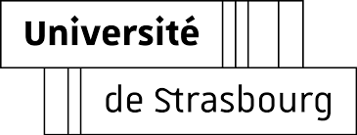
GATE @ DeSIs-IPHC
DeSIs = Dosimetry Simulation and Instrumentation
Members : 4 lecturers, 4 engineers-technicians, 1 Post-Doc, 2 PhD
Applied nuclear physics:
Radiation protection - Secondary neutron dosimetry
MC software benchmarking/intercomparison
Nuclear measurements

Slide 3
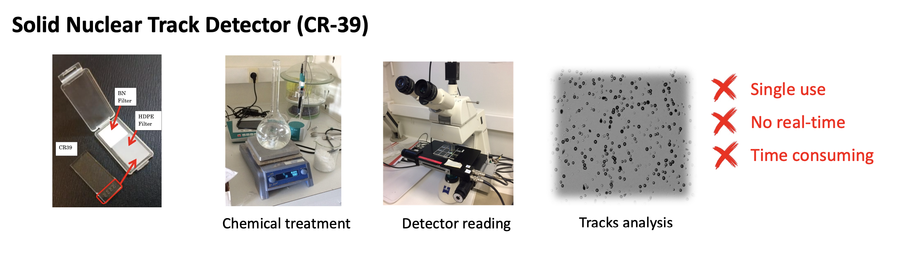

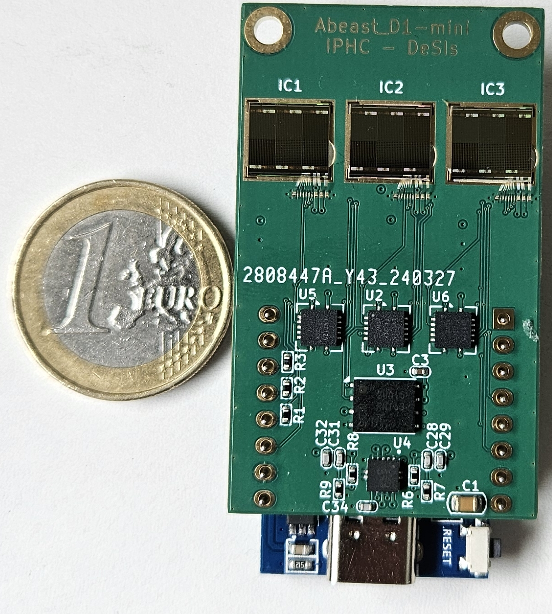
Active Neutron Detection
Neutrons are the main secondary particle radiation in particle accelerators and space dosimetry
Most current neutron detectors are based on passive methods
AlphaBeast project:
We aim to develop a CMOS sensor capable to detect Thermal and Fast neutrons on real-time → Obtain an electronic version of SSNTDs
4D monitoring
sensor network (3D - space)
real-time monitoring (1D - time)

Slide 4
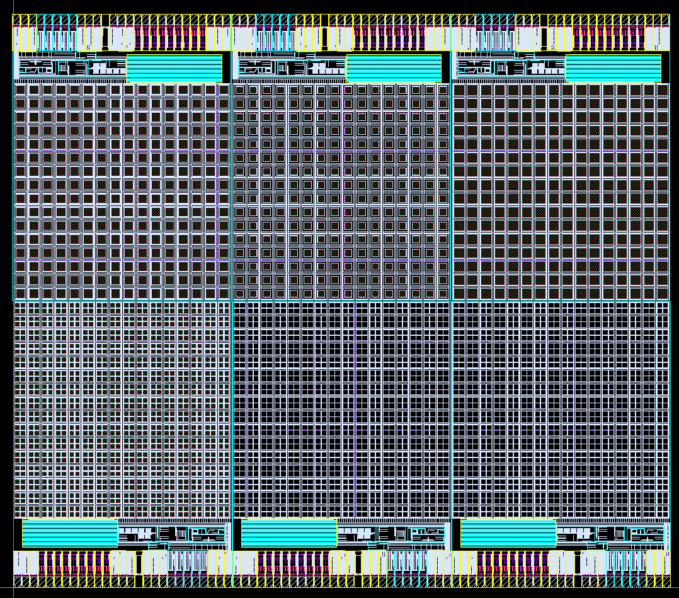
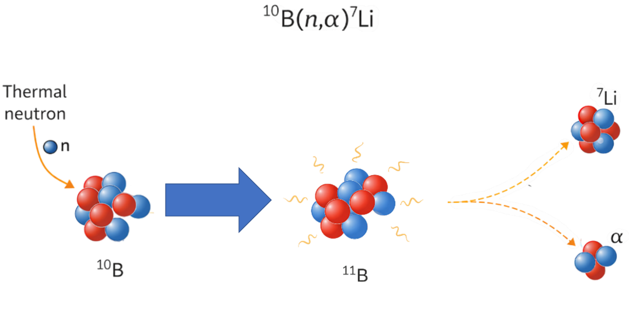
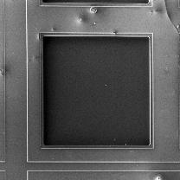

Active Neutron Detection
Thermal Neutron Detection
Epitaxial layer
¹⁰B layer
Oxide layer
Bulk
n_{th}
$$α$$
Oxide layer
Epitaxial layer
Bulk

Slide 5
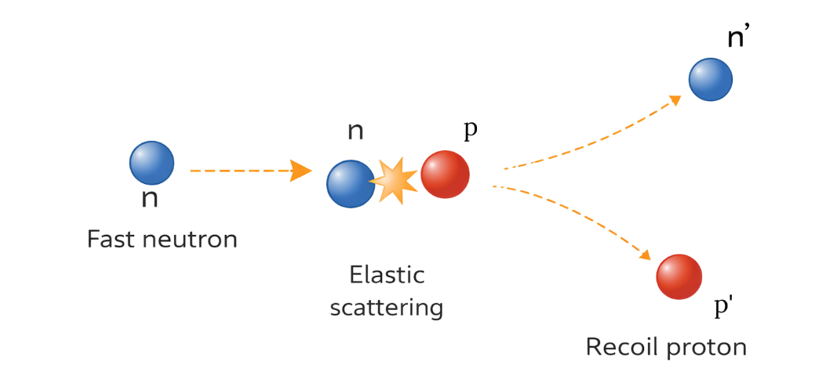
Active Neutron Detection
Fast Neutron Detection
Epitaxial layer
PE
Oxide layer
Bulk
n_{fast}
P⁺
Oxide layer
Epitaxial layer
Bulk

Slide 6
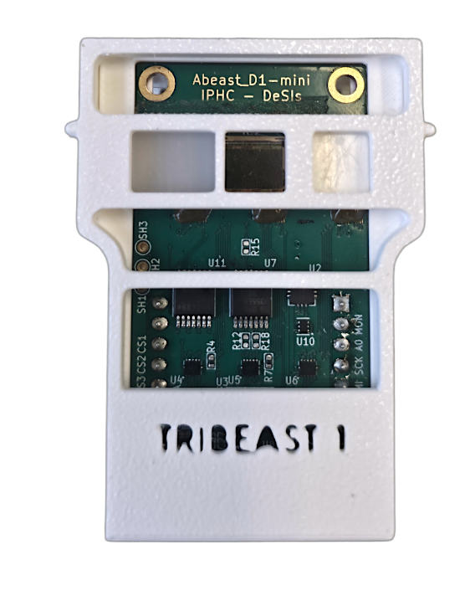
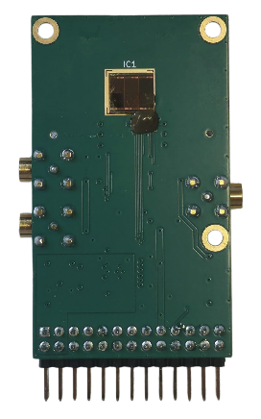
AlphaBeast Detectors
MonoBeast
Single detecting area
Extraction of both counters and analog signal [deposited energy]
TriBeast
Three detecting areas (simultaneous acquisition with Fast and thermal neutrons converter and background)
Extraction only of counter
6

Slide 7


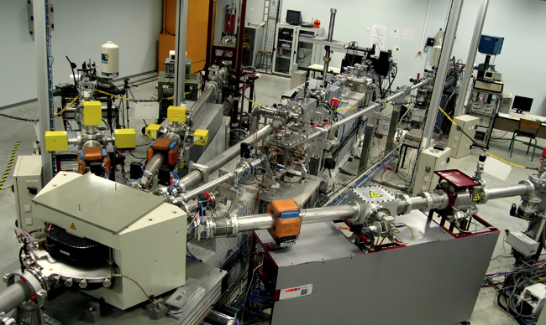
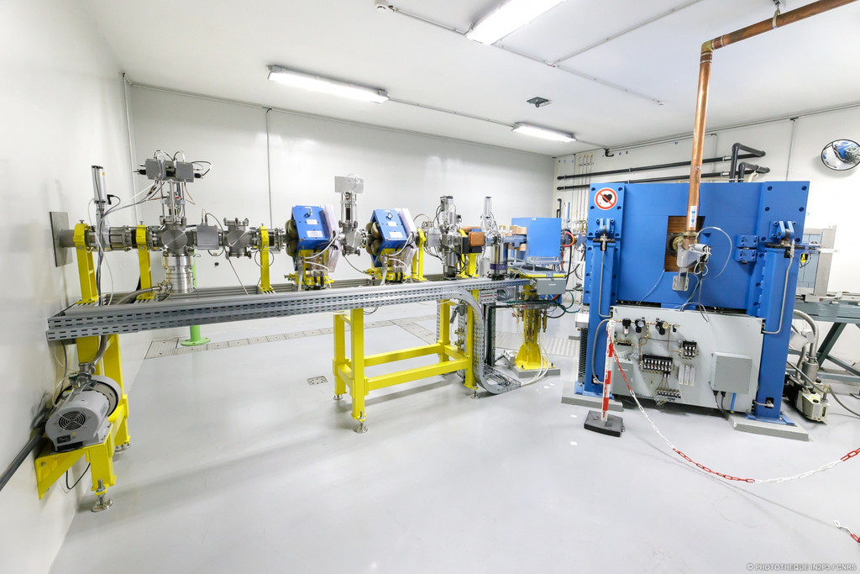
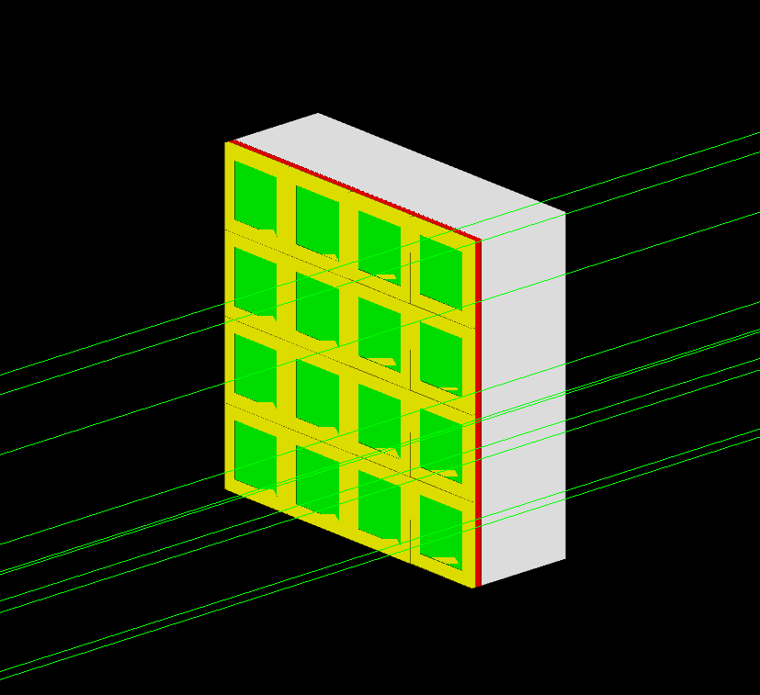
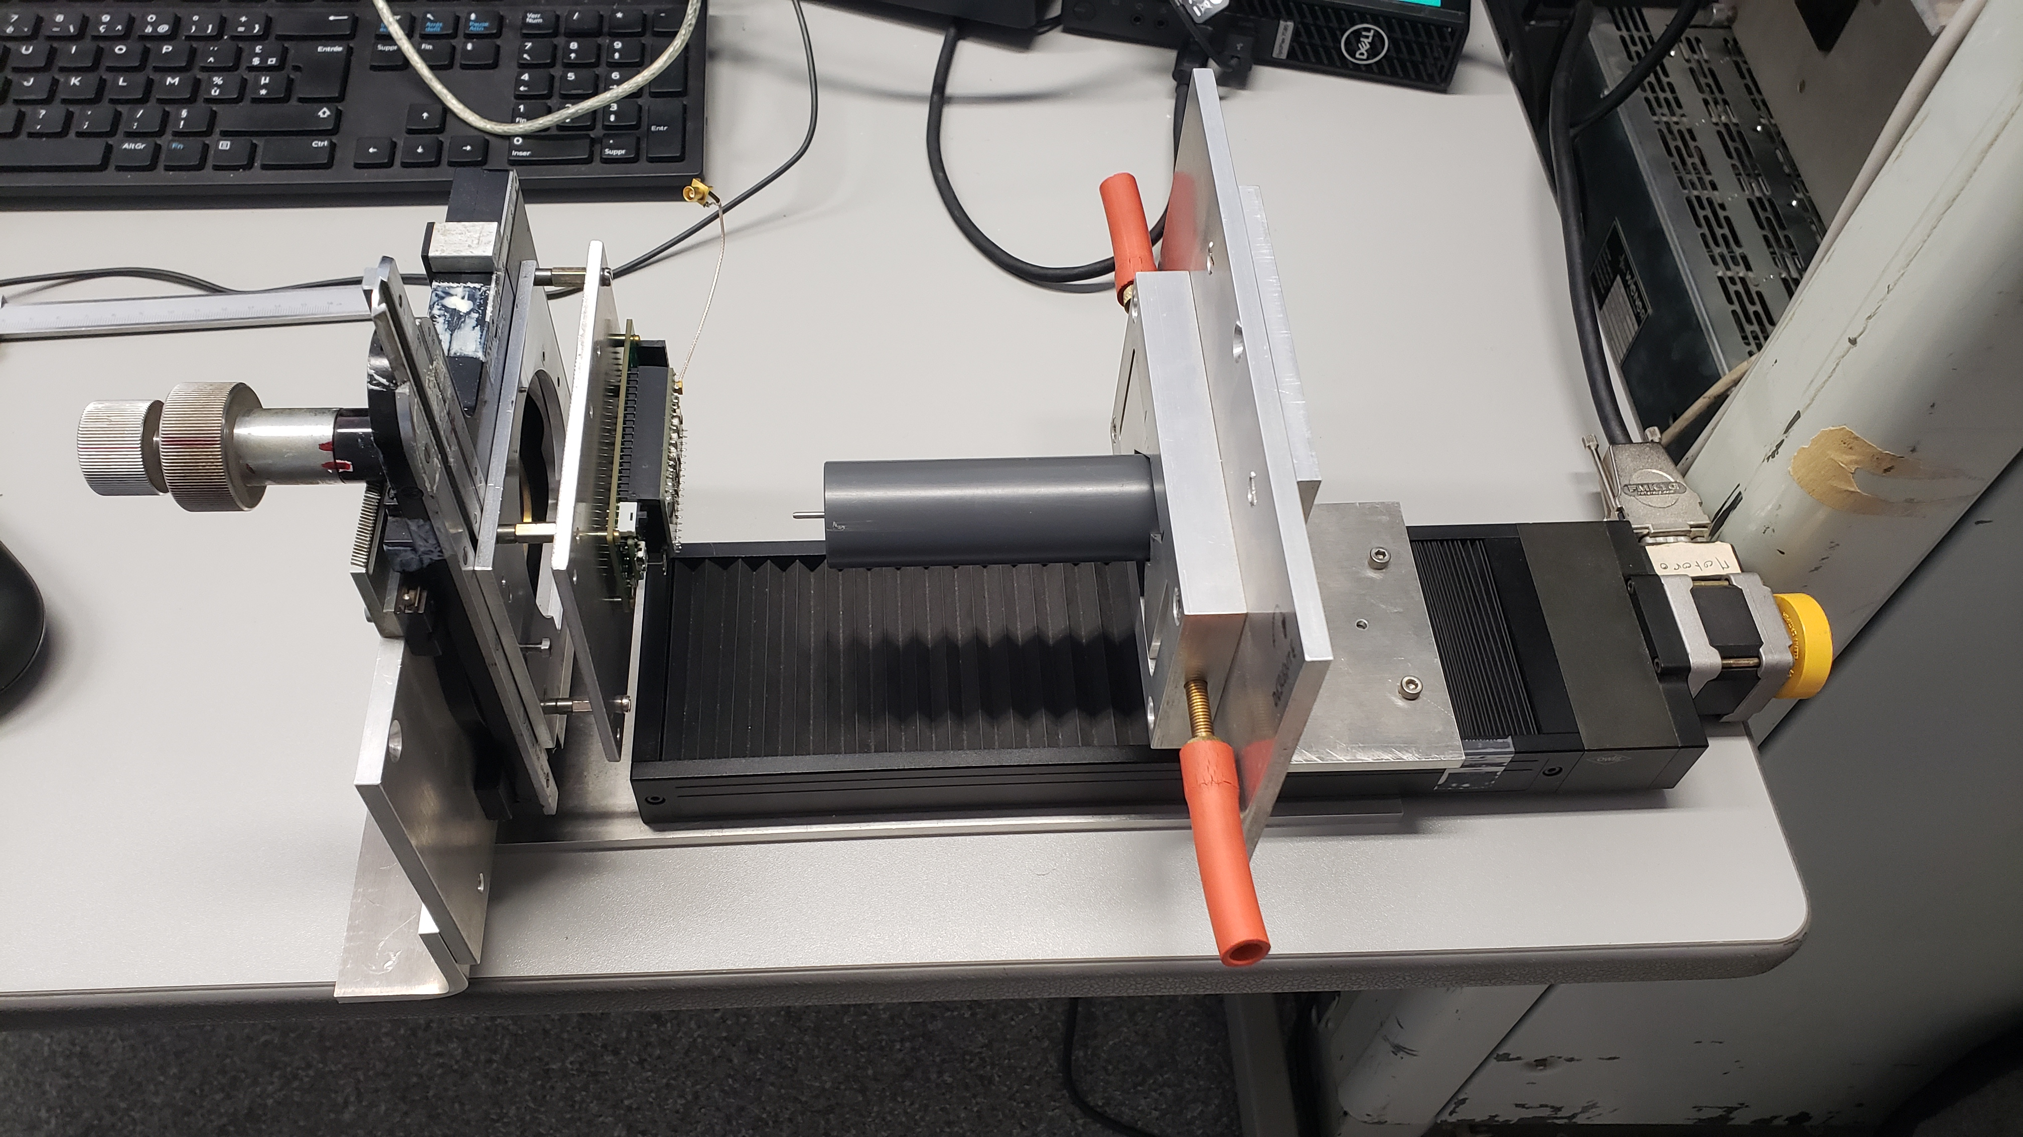

GATE in AlphaBeast Development
AlphaBeast Characterization
Calibration curve: relationship between deposited energy and ADC signal on MonoBeast
Oxide layer
AIFIRA Microbeam
CYRCE Proton Beam
Apertures
Bulk
Epitaxial layer
Calibration curve
²⁴¹Am source (E_{alpha} ≈ 5.48 MeV)

Slide 8
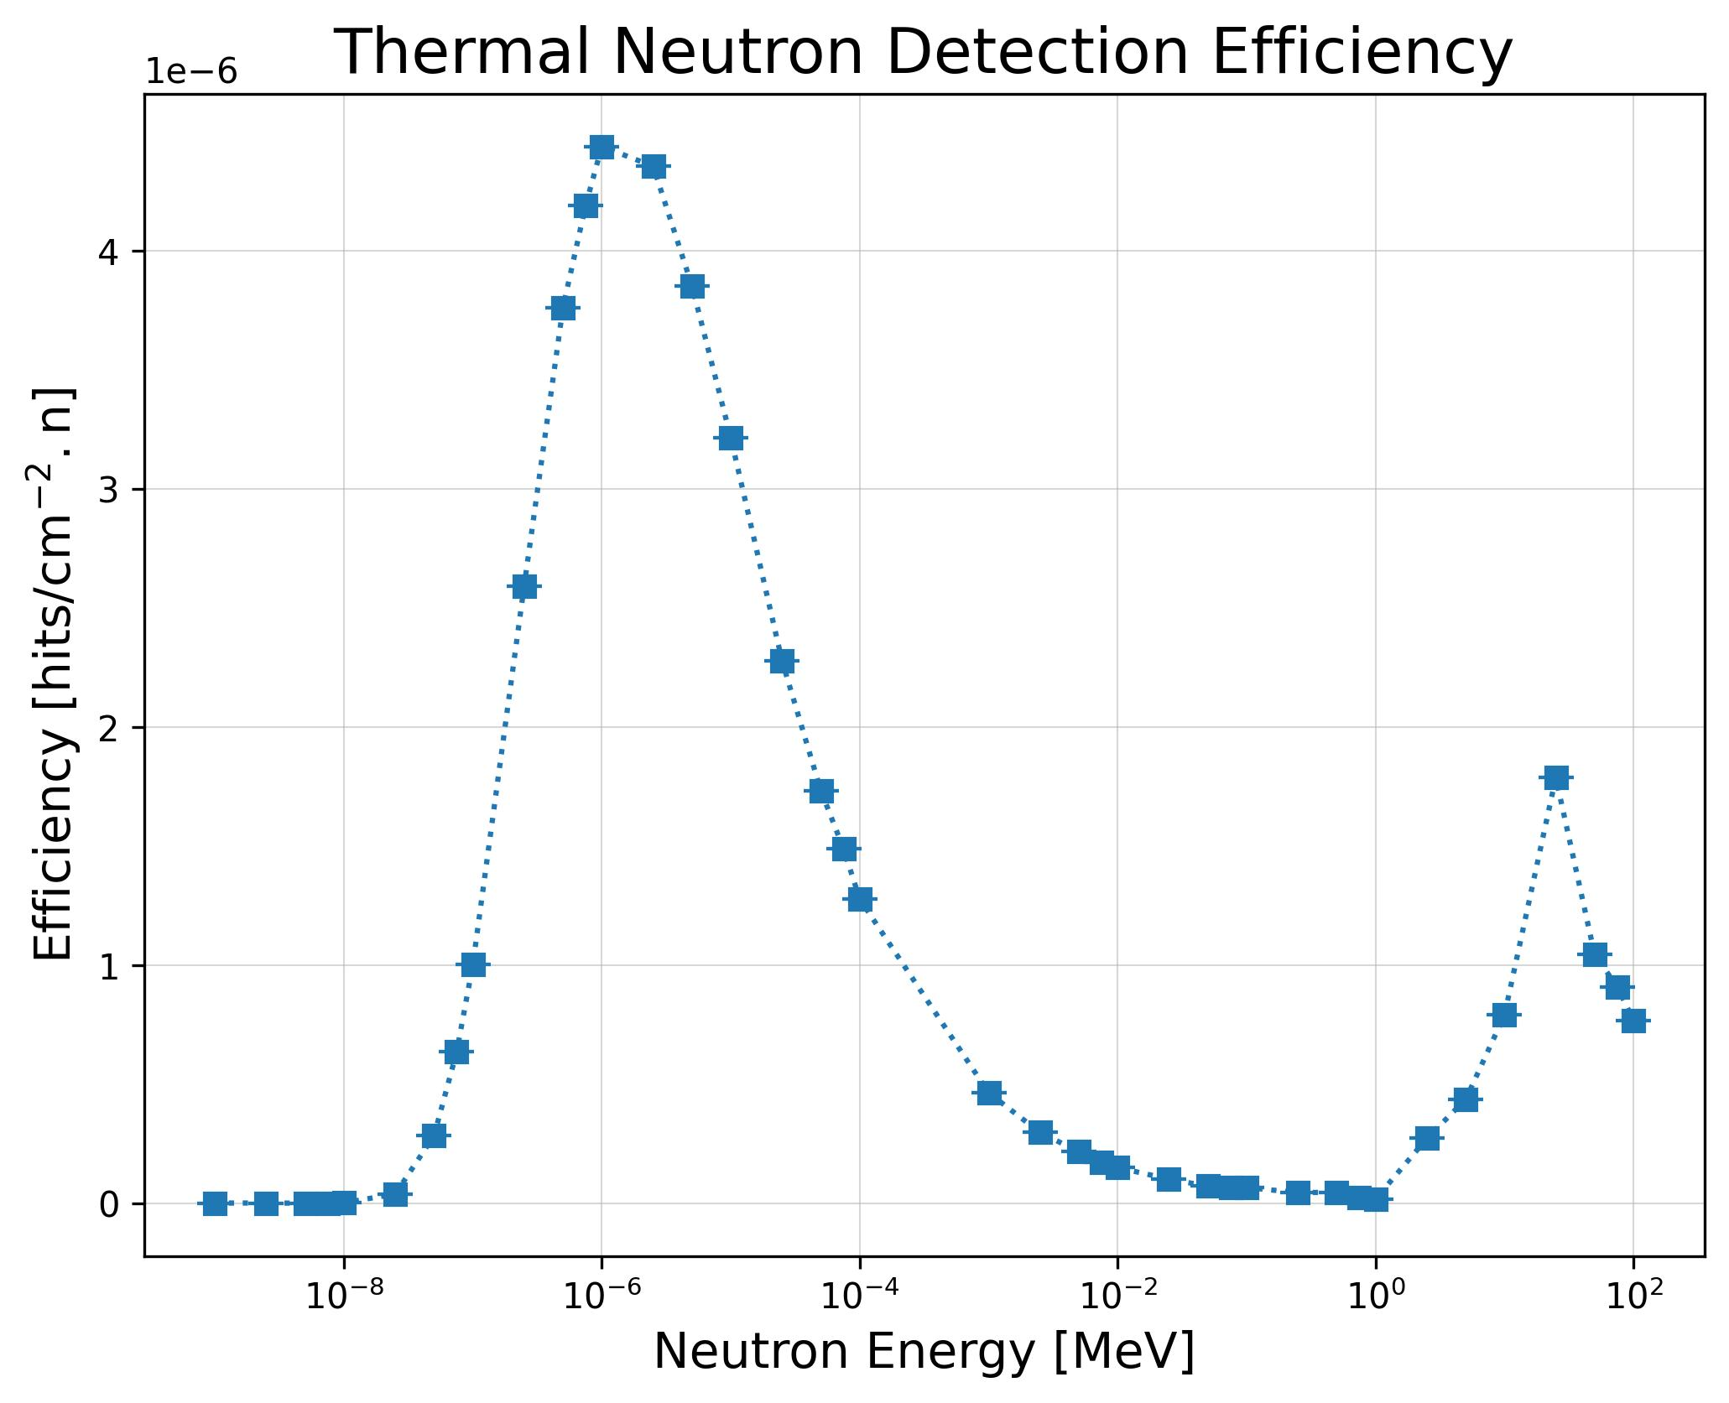
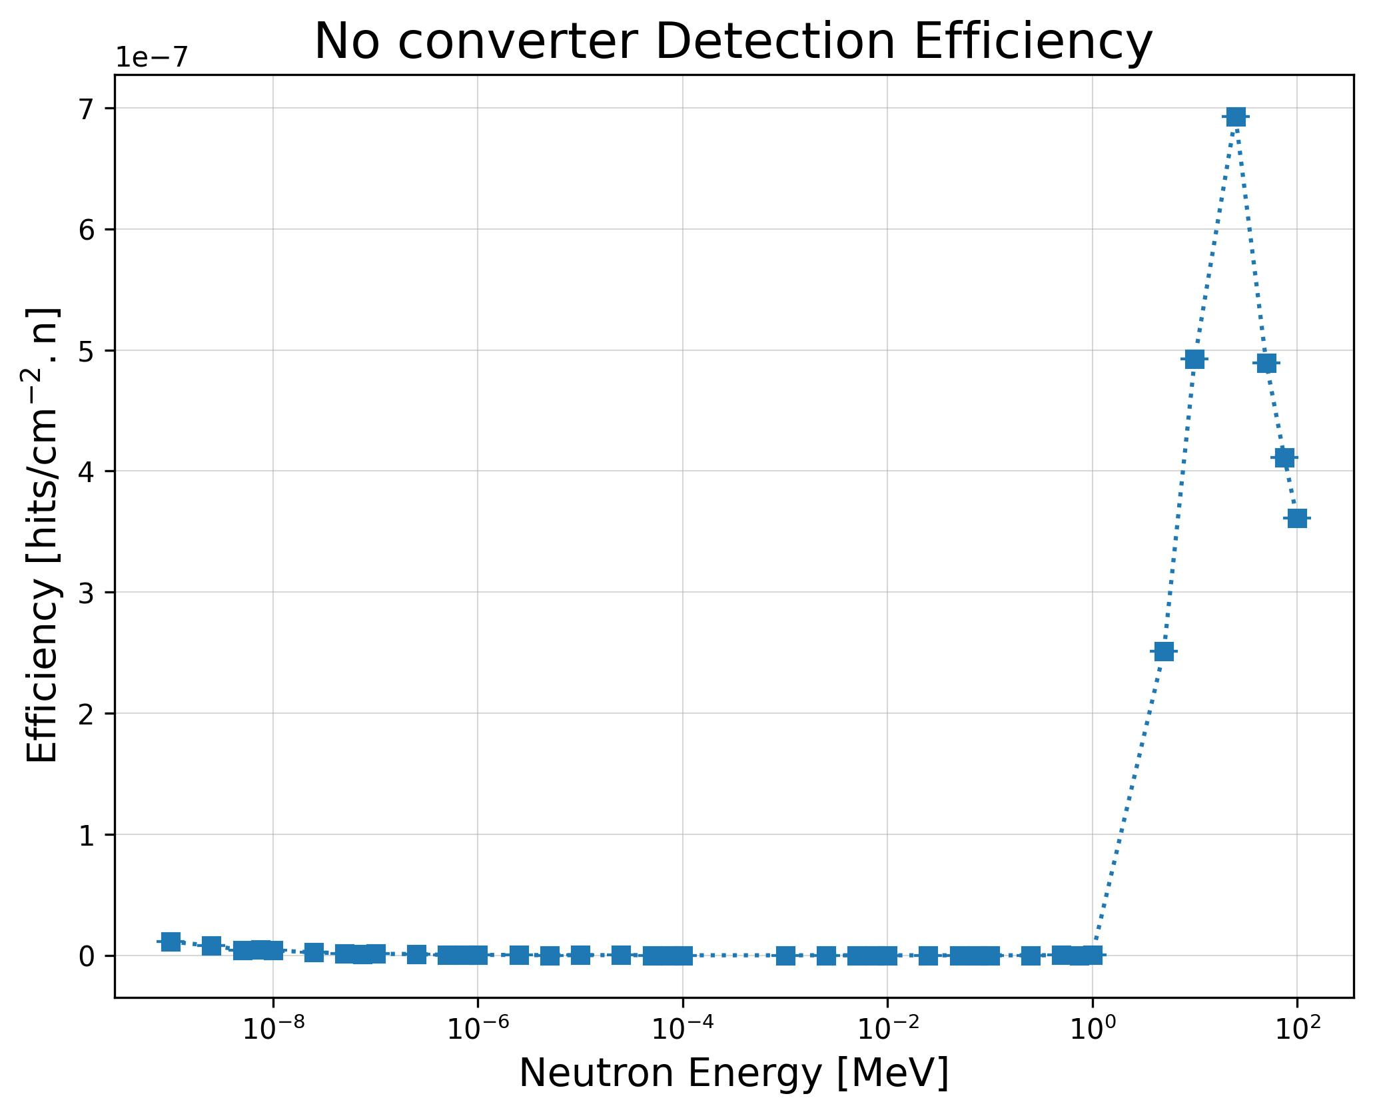
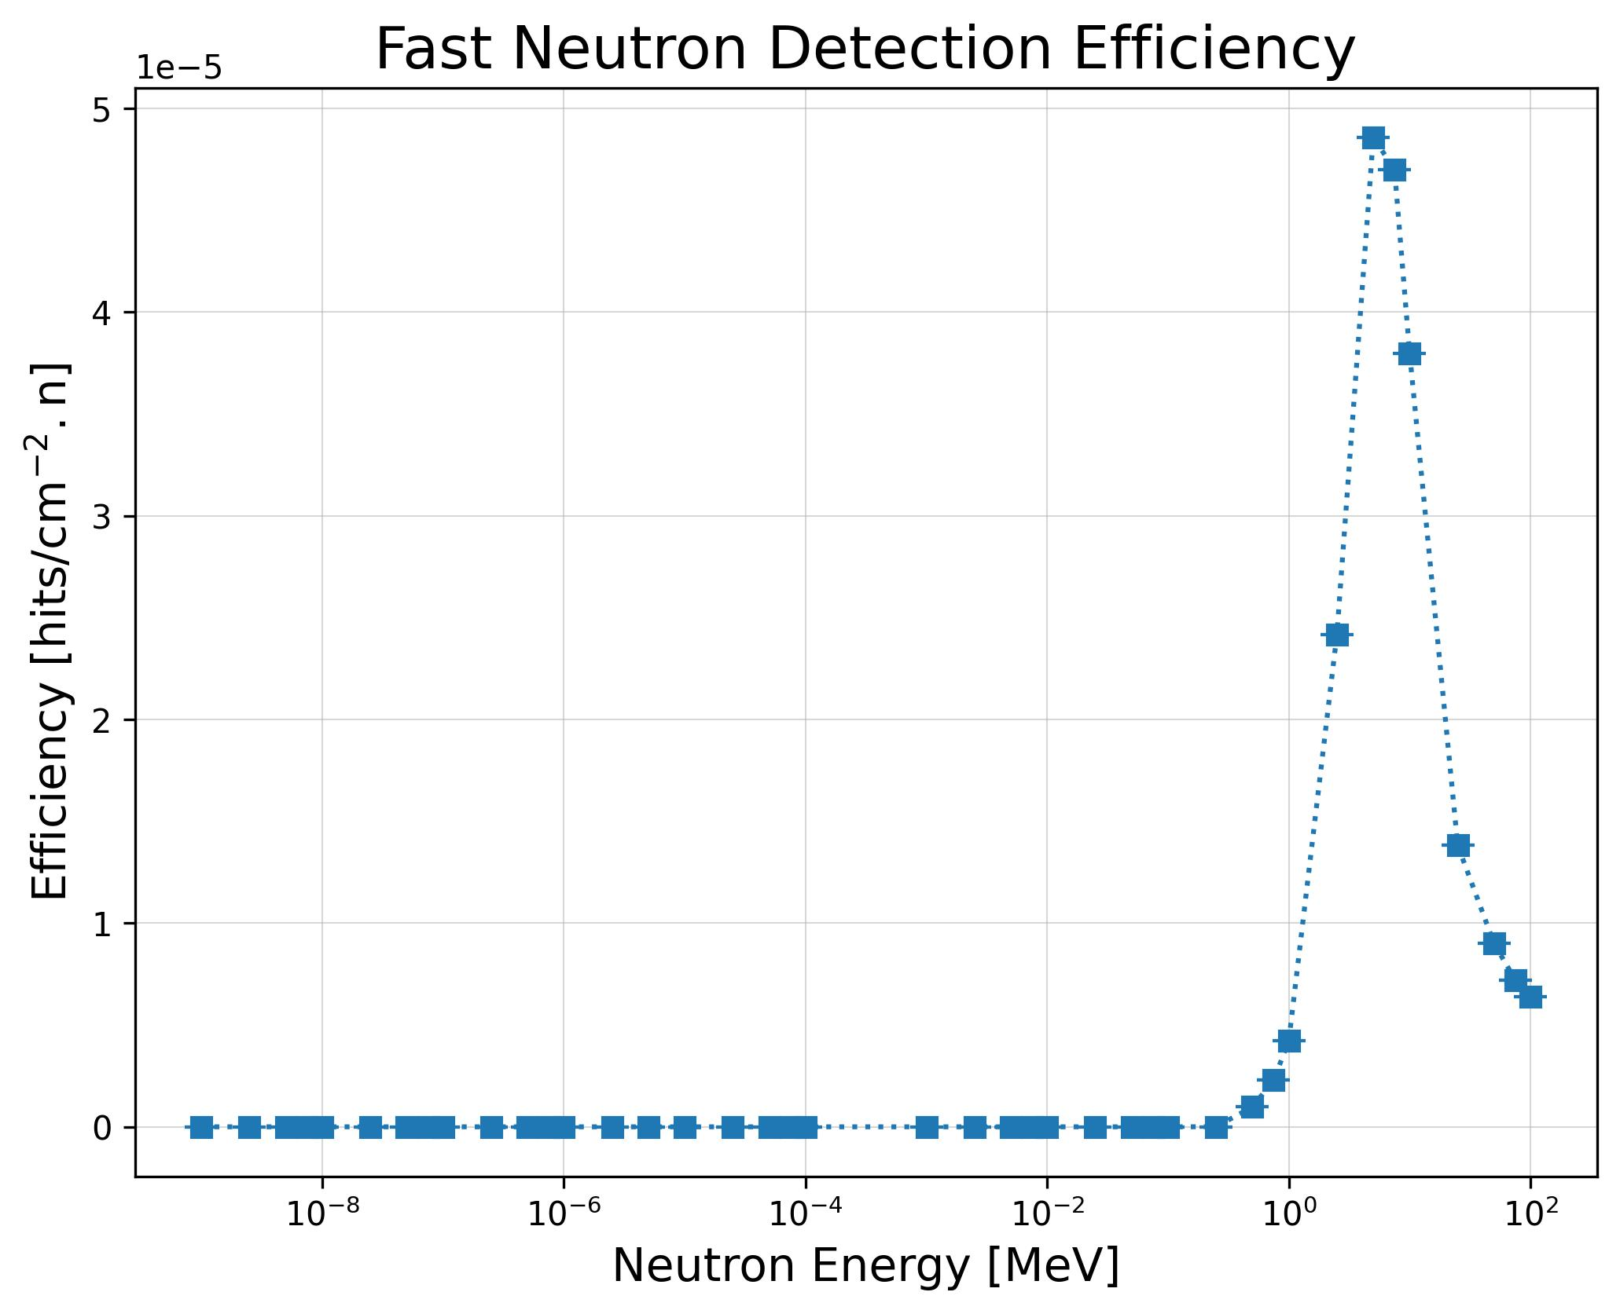
GATE in AlphaBeast Development
AlphaBeast Characterization
MC estimation of detection efficiency (hits per fluence)
Calculations of the deposited energy distribution in the epitaxial layer
Applied rejection low energy threshold (E_dep < 0.2 MeV) for electron and gamma.
Notes:
Same slides

Slide 9
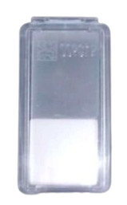
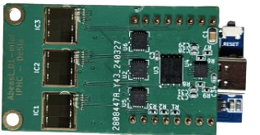
AlphaBeast Experimental Methodology
Main Goal : Test the AlphaBeast response in various accelerator facilities to evaluate neutron detection in different type of mixed fields
MC simulation of Energy deposition in detector given the experimental condition
Data acquisition with MonoBeast
Check reliability between AlphaBeast technology,
state-of-the-art methods
Data acquisition with TriBeast
Data acquisition with SSNTD

Slide 10

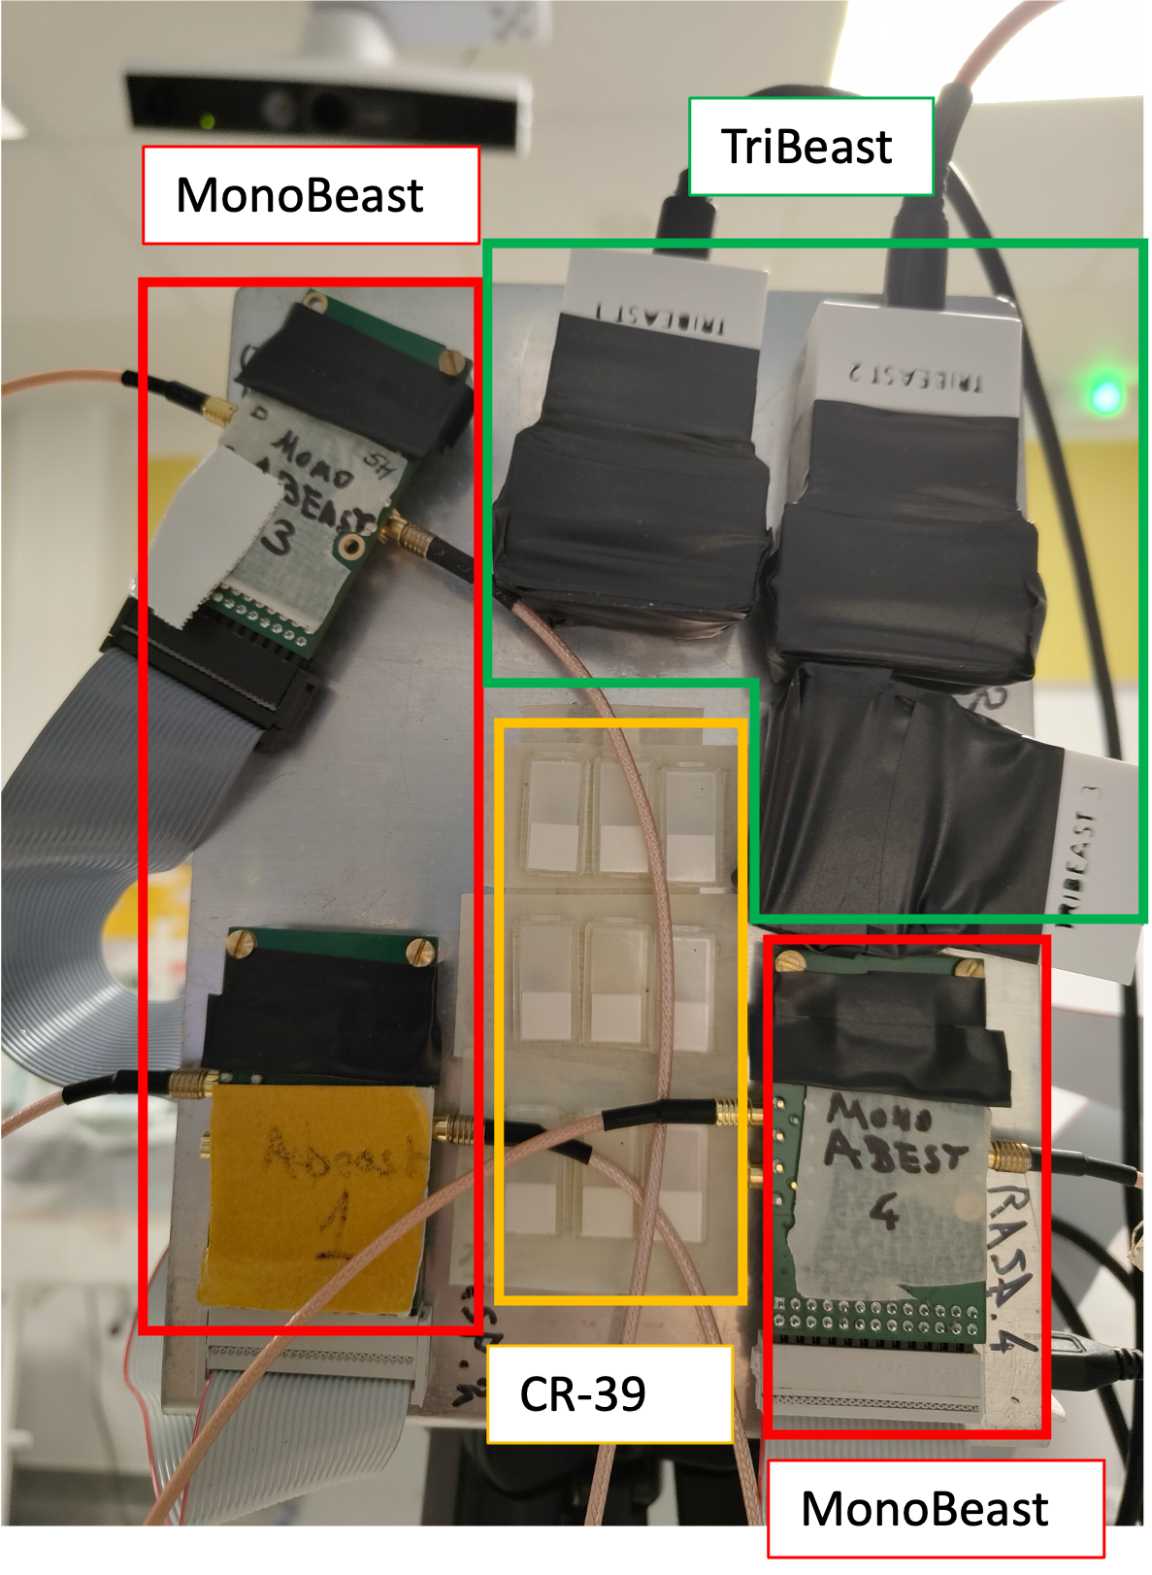
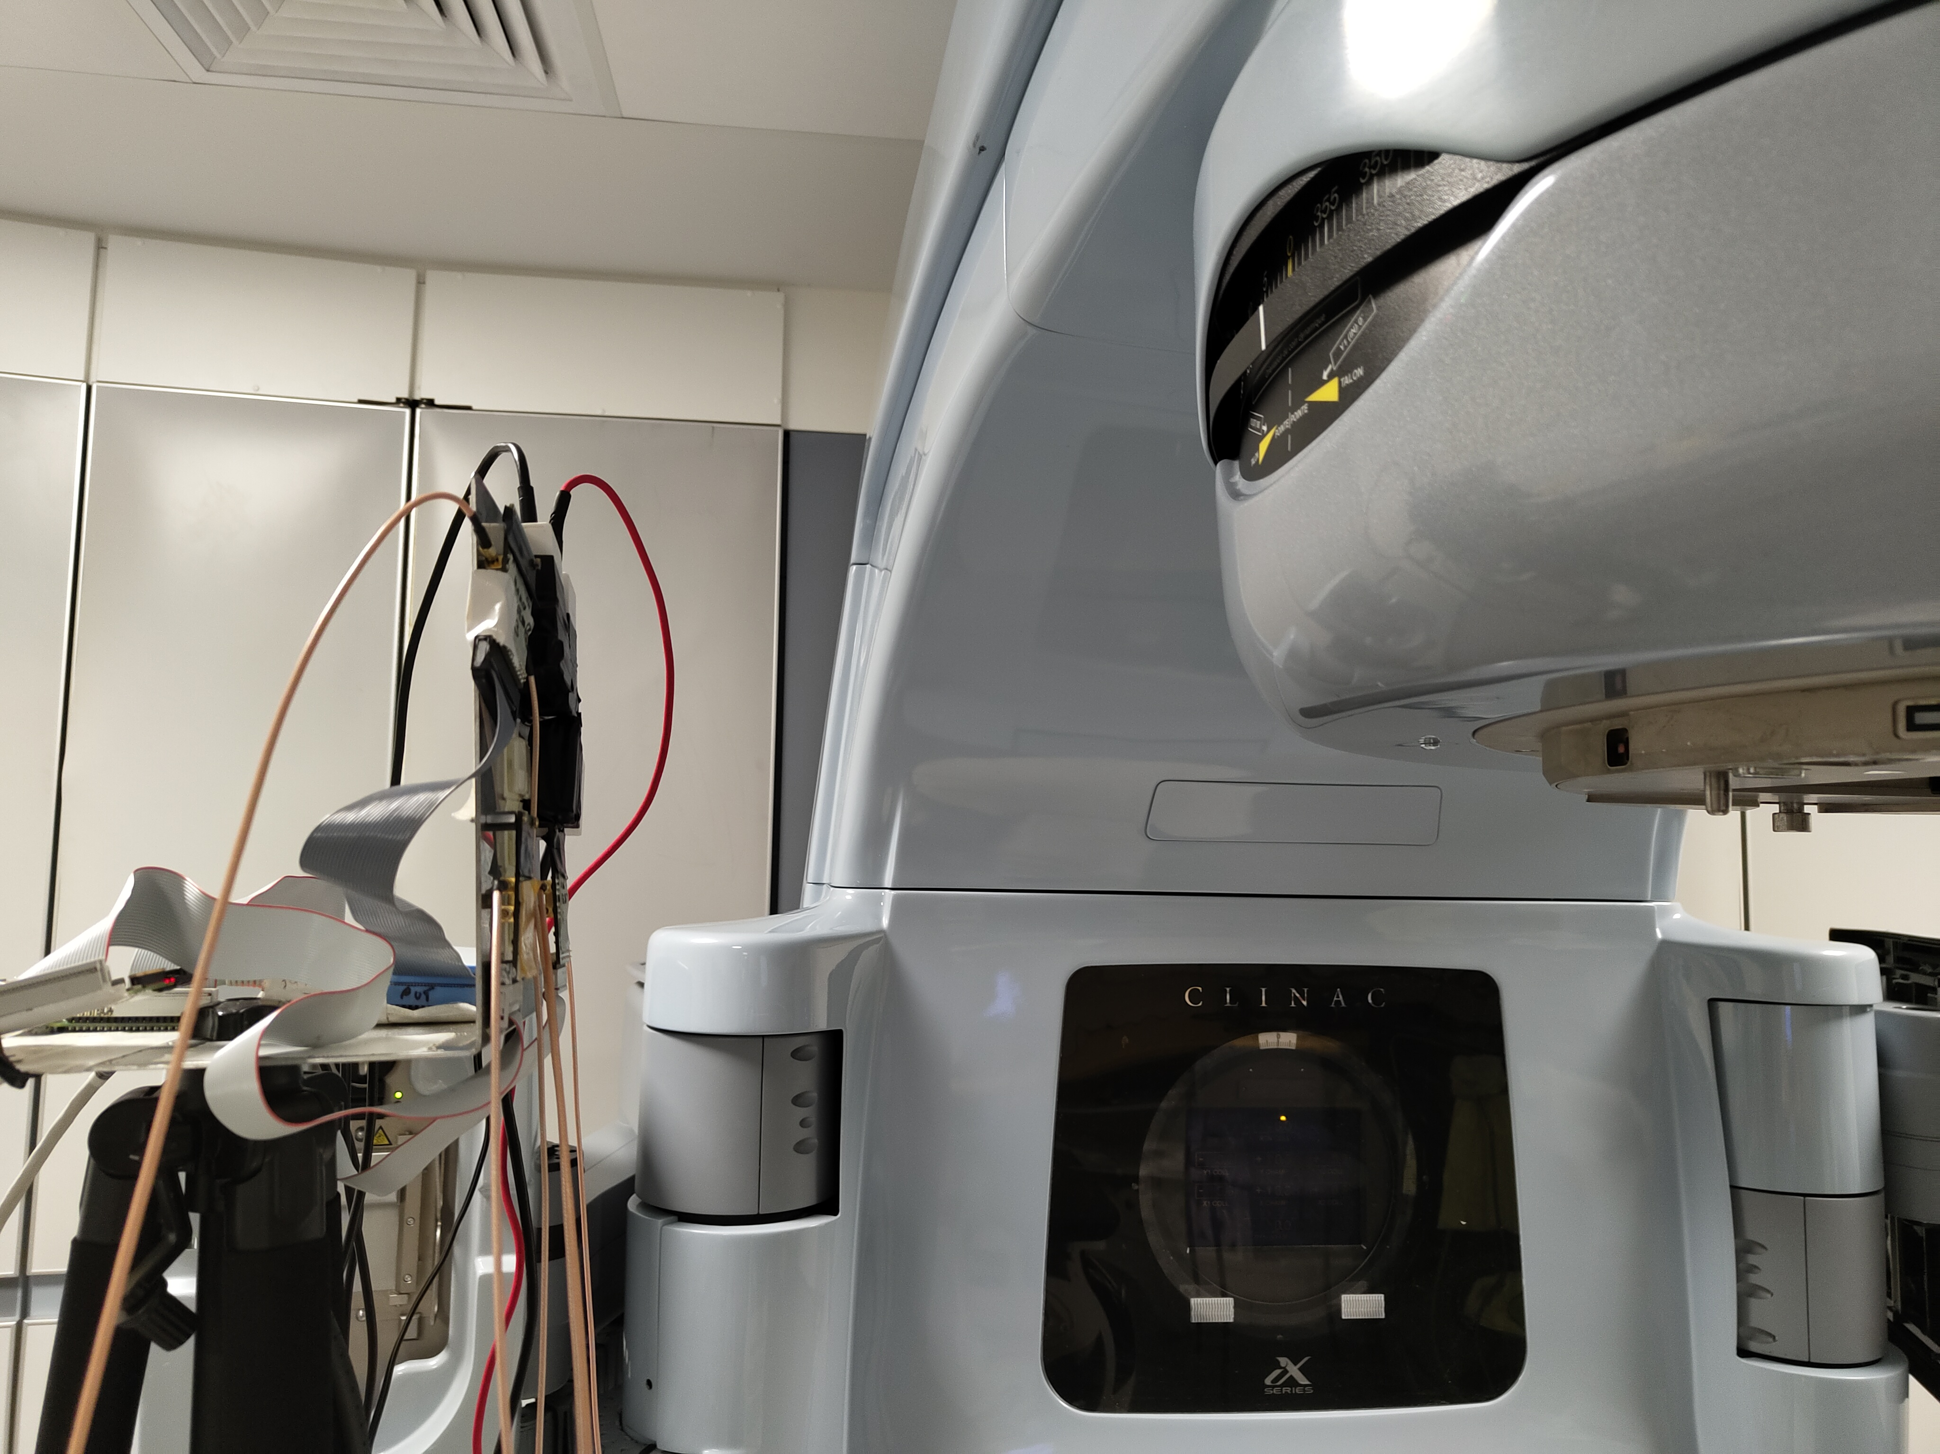
Radiation therapy room
Experimental Campaigns in Radiotherapy room
Monitoring of secondary neutron production in radiotherapy
Comparison between MC energy deposited and AlphaBeast experimental signal
15 MV run with ¹⁰B converter
33.5 cm
15 MV run with PE converter

Slide 11
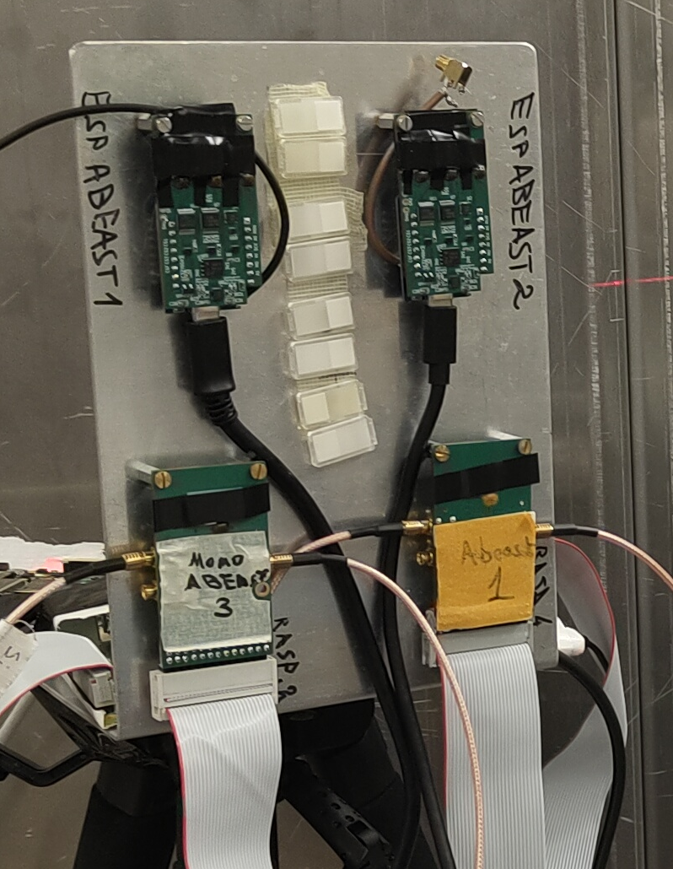
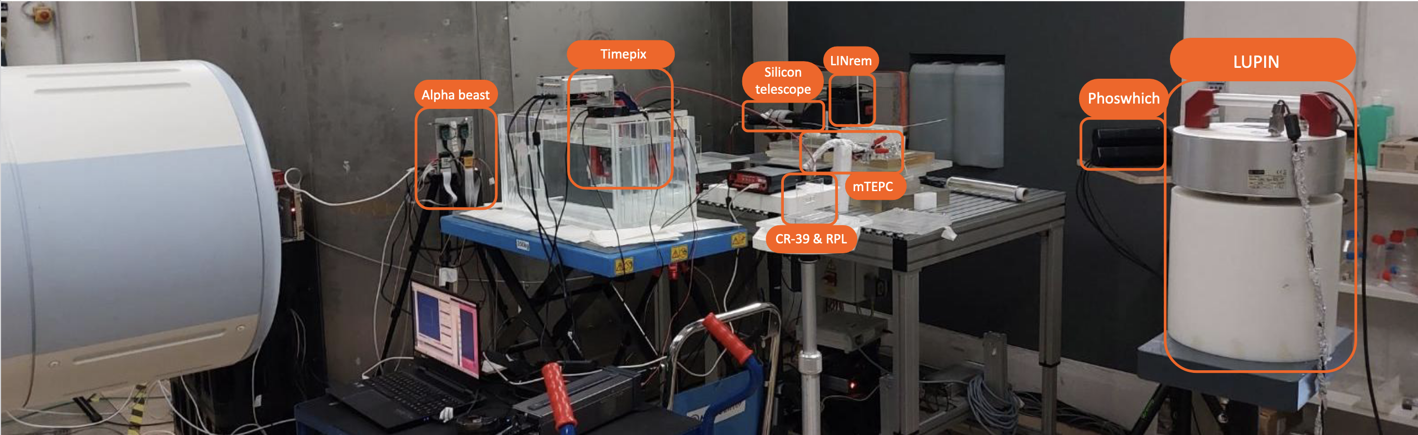


Hadrontherapy room
As part of the EURADOS WG9 members, AlphaBeast was tested in HIT alongside with other 8 neutron monitoring systems
Use of MC simulation to determine expected number counts
Comparison between FLUKA and GATE MC simulations
MonoBeast
SSNTDs
TriBeast

Slide 12
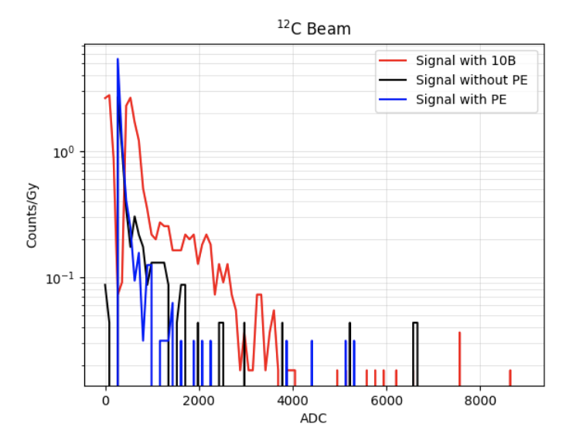
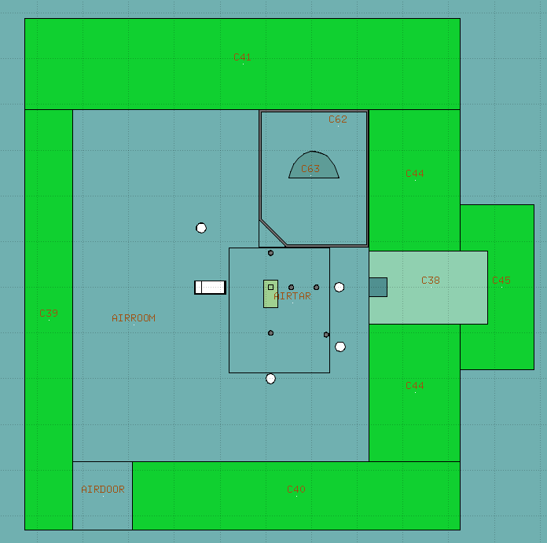
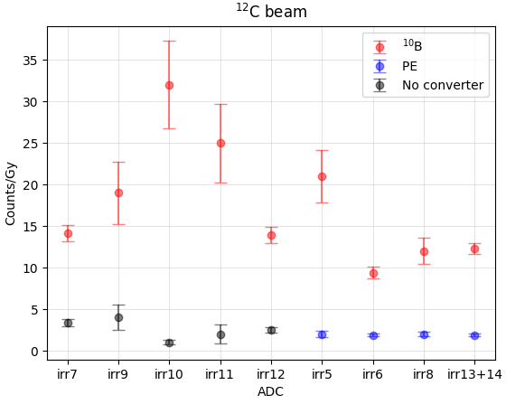
Secondary Neutron Production in Hadrontherapy
As part of the EURADOS WG9 members, AlphaBeast was tested in HIT alongside with other 8 neutron monitoring systems
Use of MC simulation to determine expected number counts
Comparison between FLUKA and GATE MC simulations

Slide 13
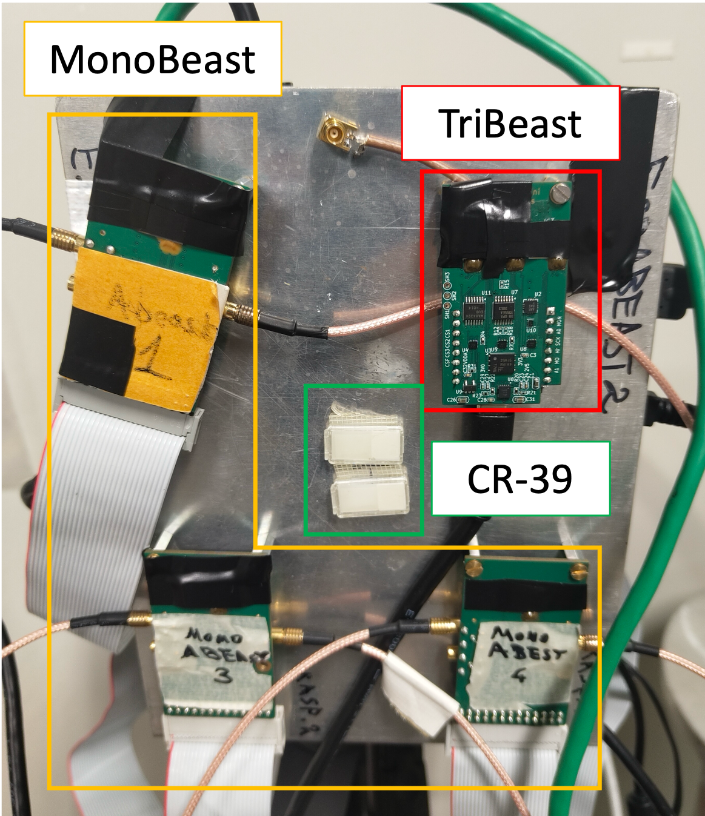

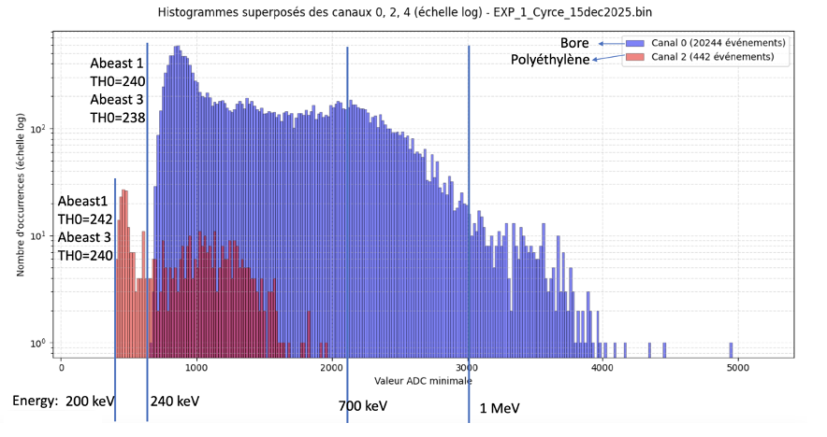
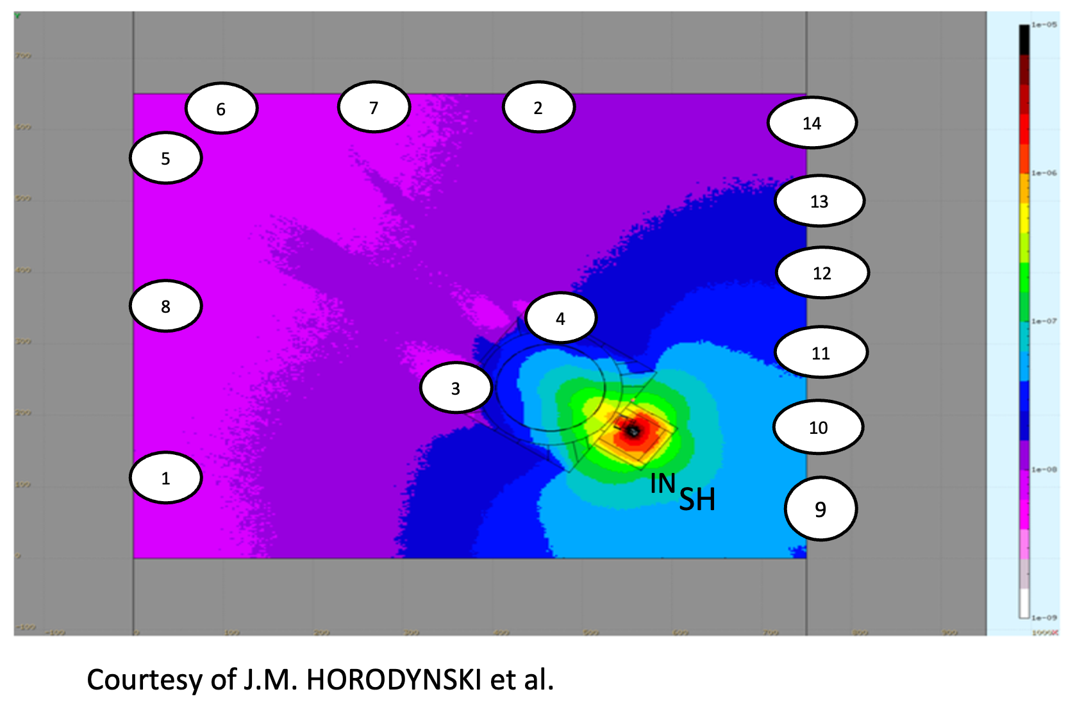
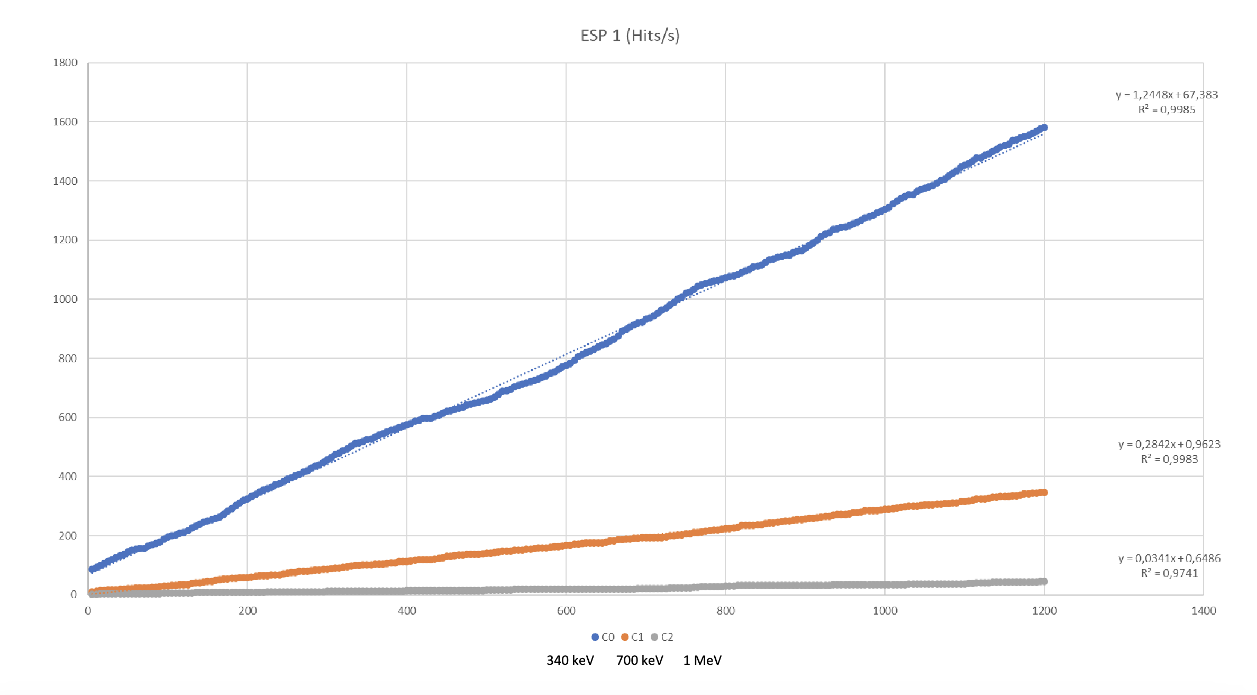
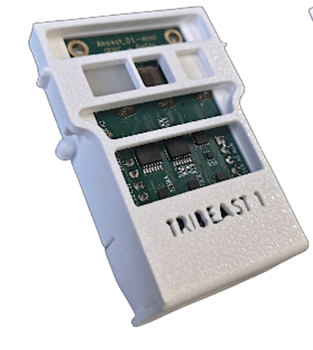


Cyclotron facility
Neutron production monitoring during CYRCE cyclotron production of ¹⁸F → activation calculations
Continuation of Simβ-AD project → neutron activation in particle accelerators
Thermal neutron online monitoring during cyclotron operation
Intercomparison between MC simulation, SSNTDs and AlphaBeast Technology

Slide 14
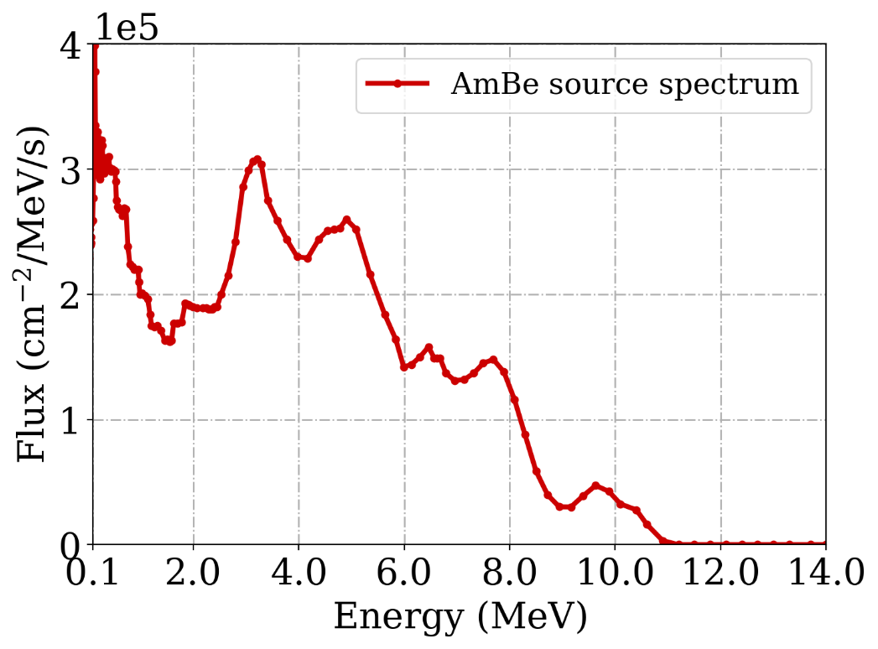
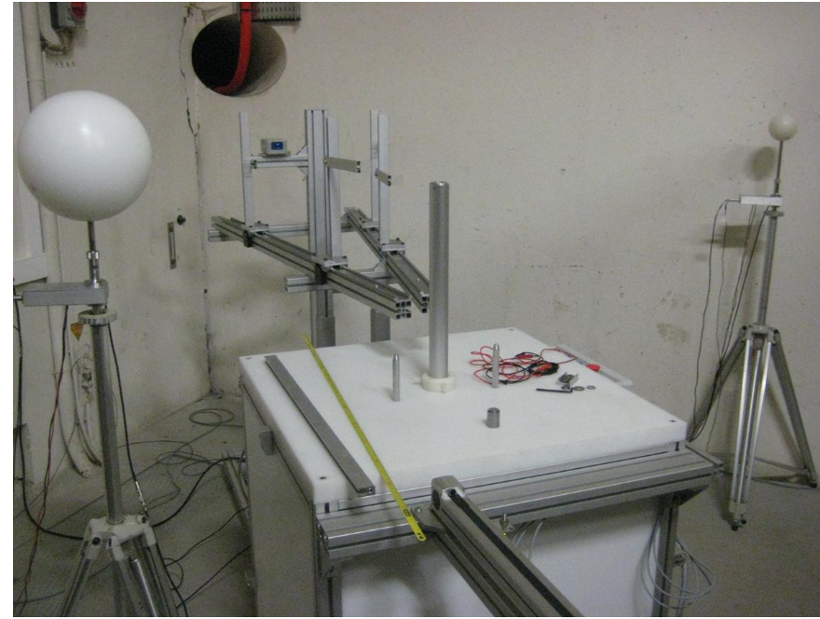
Next steps in AlphaBeast Development
Short-term goal
Continue the evaluation of the reliability of AlphaBeast technology against state-of-the-art neutron detection systems
Approach: Dedicated experimental campaign with three systems at the AmBe neutron calibration facility (IPHC) and comparison with GATE MC simulations
Ultimate Goal
Deploy a network of AlphaBeast sensors to enable real-time, 3D neutron fluence monitoring around particle accelerators (hadrontherapy, cyclotron, ...)
AmBe Neutron Calibration Facility (IPHC)
AmBe Neutron Spectrum

Slide 15

Thank you!
Any Questions?
Lucia V. Garcia
Contact: lucia-victoria.garcia-garcia@iphc.cnrs.fr

Slide 16
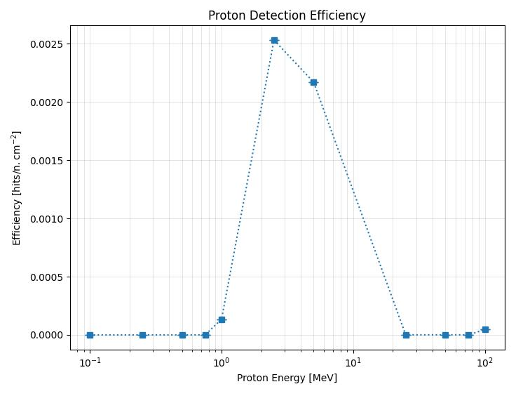
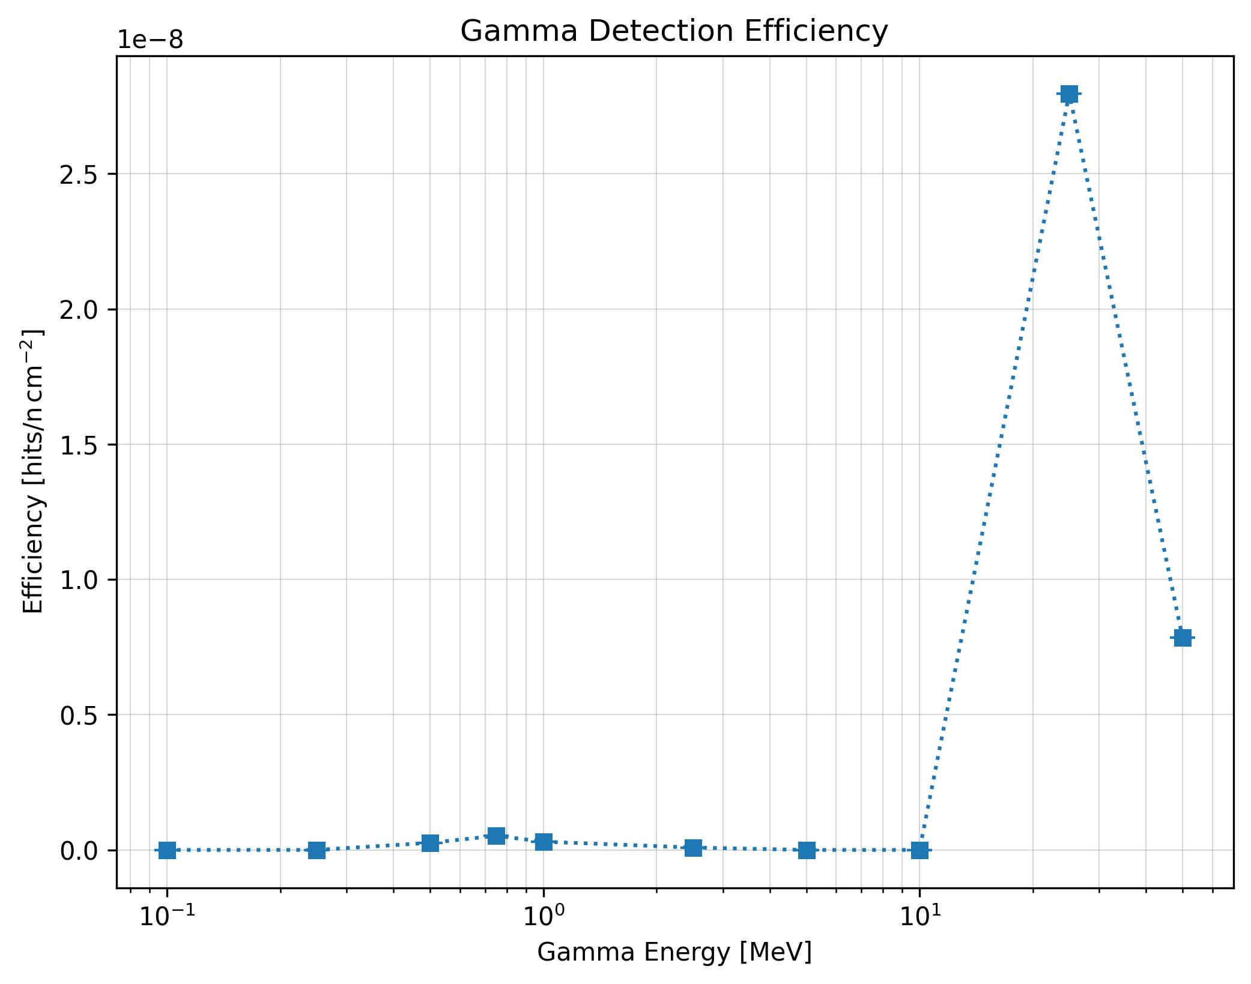
GATE in AlphaBeast Development
AlphaBeast Characterization
Determination of detection efficiency
Analysis of detection efficiency of other particle such as protons
Test the ability of AlphaBeast to detect neutron in mix fields

Slide 17
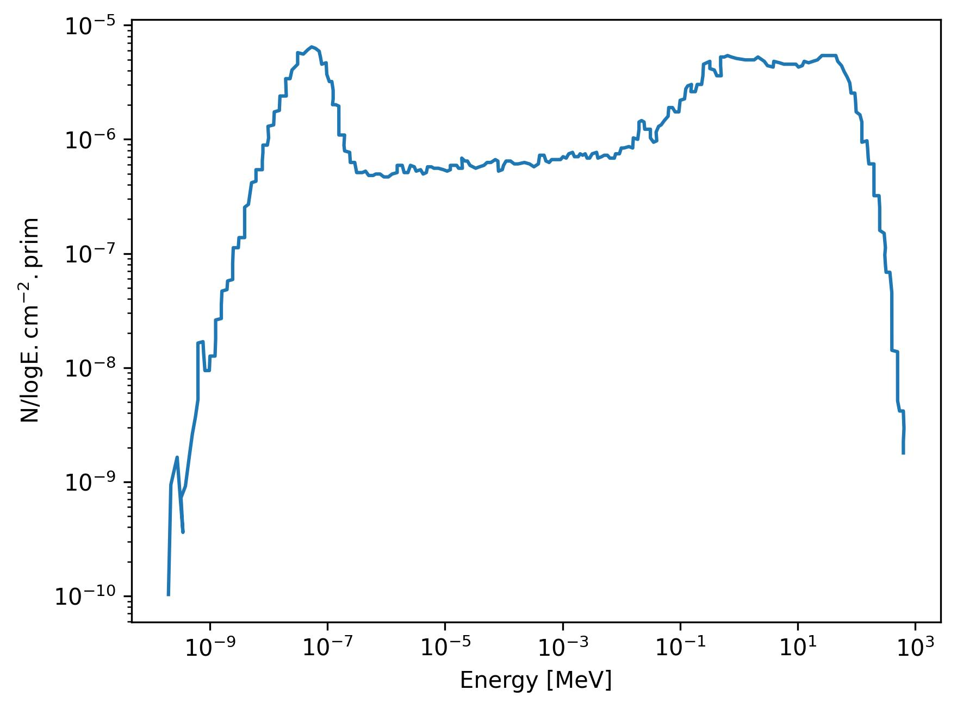
Hadrontherapy room
As part of the EURADOS WG9 members, AlphaBeast was tested in HIT alongside with other 8 neutron monitoring systems
Use of MC simulation to determine expected number counts
Comparison between FLUKA and GATE MC simulations
Add results

