Slide 1
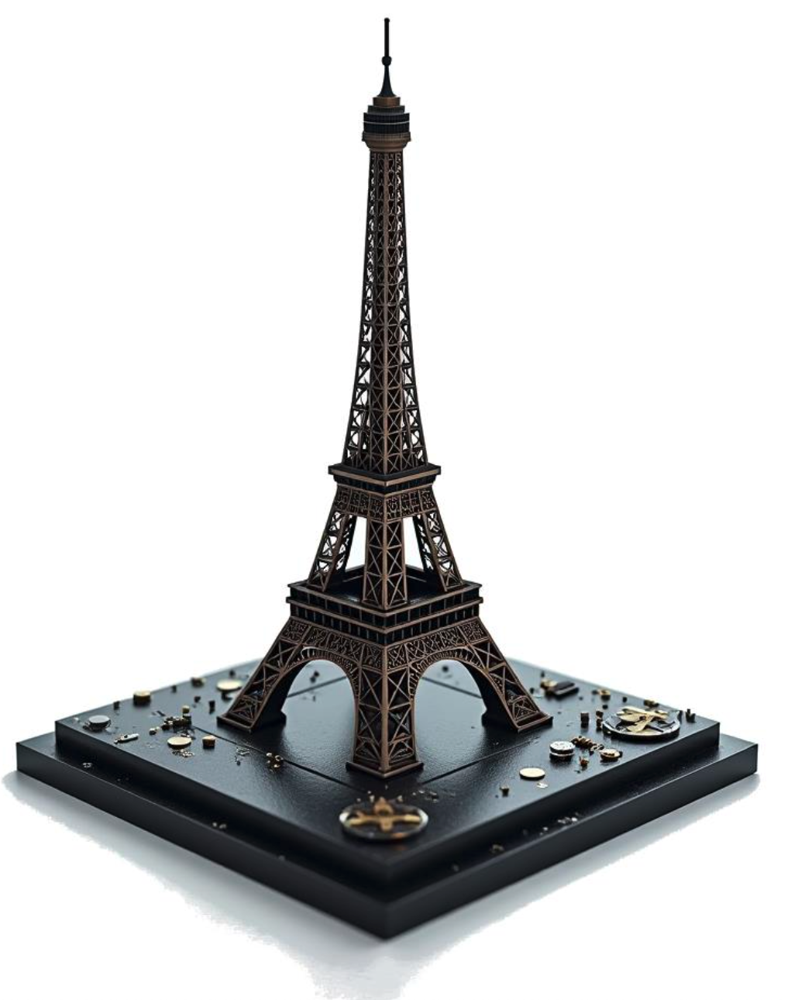



Paris cluster
Dimitris Varouchas (IJCLab)
27 Nov 2025; Paris cluster end of the year event @ LPNHE

Slide 2
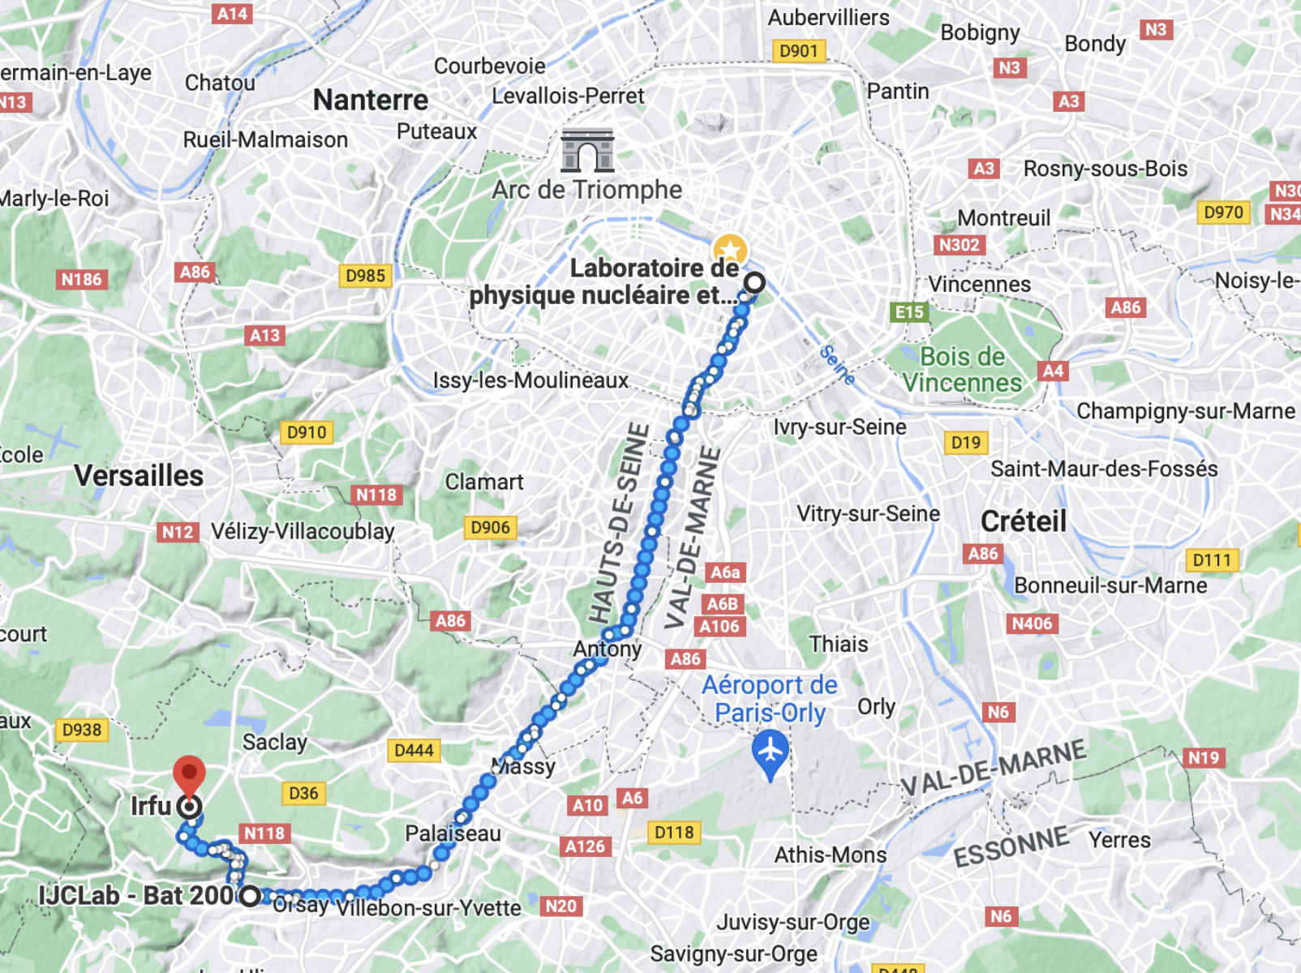


Paris cluster
City of Paris
Paris cluster: CEA-Irfu, IJCLab, LPNHE
3 ATLAS laboratories that work on ITk and are in Paris region
  LPNHE – IJCLab: 25 km
  LPNHE – CEA-Irfu: 29 km
  IJCLab – CEA-Irfu: 5 km
We work all together to deliver a big fraction of good Pixel-ITk modules to future ITk detector
Pixel module assembly and module testing cluster
Assembly + testing → production
you are here

Slide 3
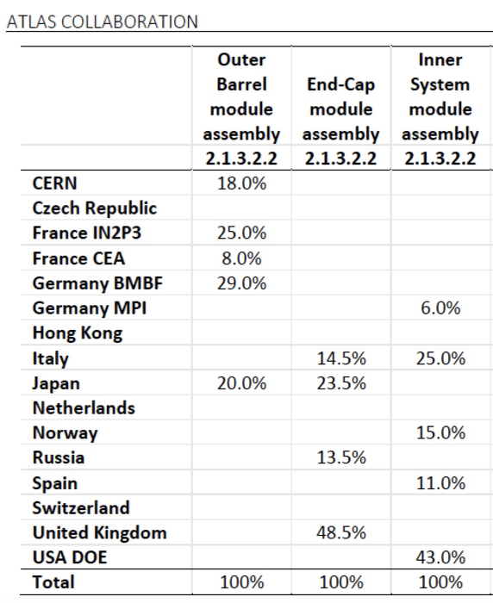
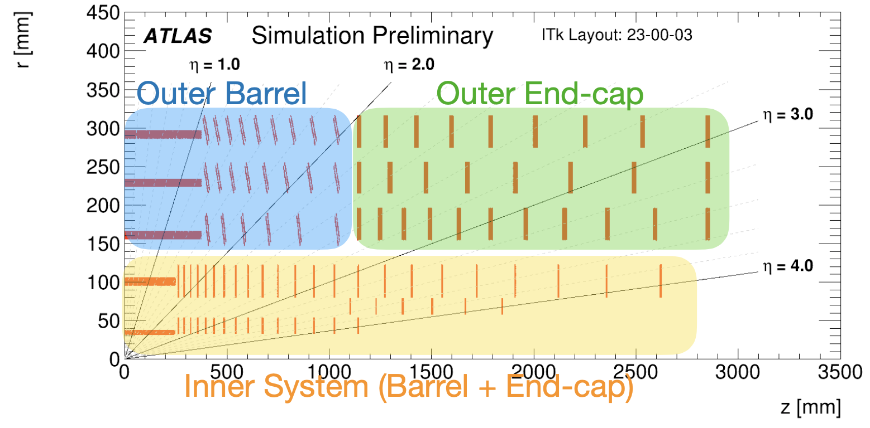
Paris cluster deliverables
Paris cluster is an ITk-Pixel modules production site
We are committed (MoU) in building 33% of the ITk-Pixel outer barrel (OB) modules
  IN2P3 (IJCLab, LPNHE) 25%, CEA-Irfu 8%
  In practise we share the tasks as evenly as possible among the 3 sites
MoU
Outer barrel has ∽4.5k installed good modules
Paris cluster share is 1/3 of outer barrel ⇒ 1.5k good modules
Taking into account the module production and loading/integration yield (∽1.5)
Paris cluster deliverable including yield: ∽2200 modules
ITk-Pixel layout
L4
L3
L2
L1
L0
In absolute numbers
  We are building the largest share of modules in OB
  Together with Japan (though they externalise), the largest share of modules in ITk-Pixel

Slide 4
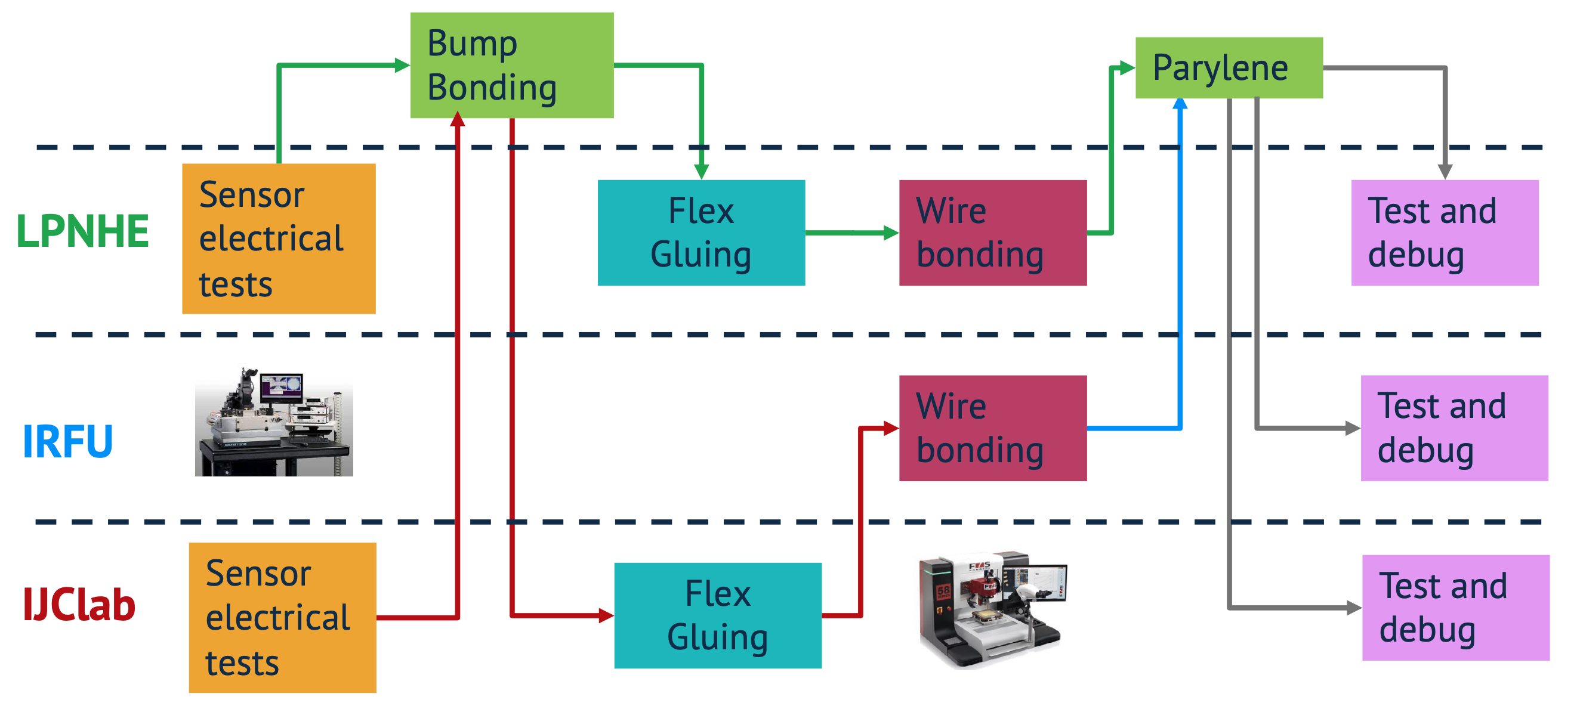

Paris cluster production diagram
- We maintain two assembly lines
  IJCLab – IRFU
  LPNHE
- And three canopy gluing and testing lines
- Parylene deposition at APS Coatings company
Parylene (@ APS)
Assembly
Bare module, PCB reception tests
Bare module + PCB Gluing
Canopy
Gluing
Canopy
Gluing
Bare module, PCB reception tests
Bare module + PCB Gluing
Canopy
Gluing

Slide 5
*Nominal* production plan
Production period: 2 years, assuming nominally 3 months off per year ⇾ 80 working weeks in total
Production started at T2 of 2025, but we are far from nominal production rate at the moment because of lack of good quality module components
With the goal of having to produce 2200 modules in Paris cluster
  Nominal production rate target: 27 modules /week

Slide 6
Paris cluster *nominal* production rates
Parylene (@ APS)
Assembly
Bare module, PCB reception tests
Bare module + PCB Gluing
Canopy
Gluing
9 modules/week
9 modules/week
9 modules/week
9 modules/week
Canopy
Gluing
27 per
week
18 modules/week
9 modules/week
9 modules/week
Bare module, PCB reception tests
Bare module + PCB Gluing
Canopy
Gluing
18 modules/week
9 modules/week
9 modules/week
Nominal share
  LPNHE: 1/3 at all steps
  IJCLAb: 2/3 up to BM+PCB gluing, then 1/3 of canopies gluing and 1/3 of testing
  CEA-Irfu: 2/3 for wire bonding, then 1/3 of canopies gluing and 1/3 of testing
Redundancy at every step
2 or 3 sites working @ every step

Slide 7
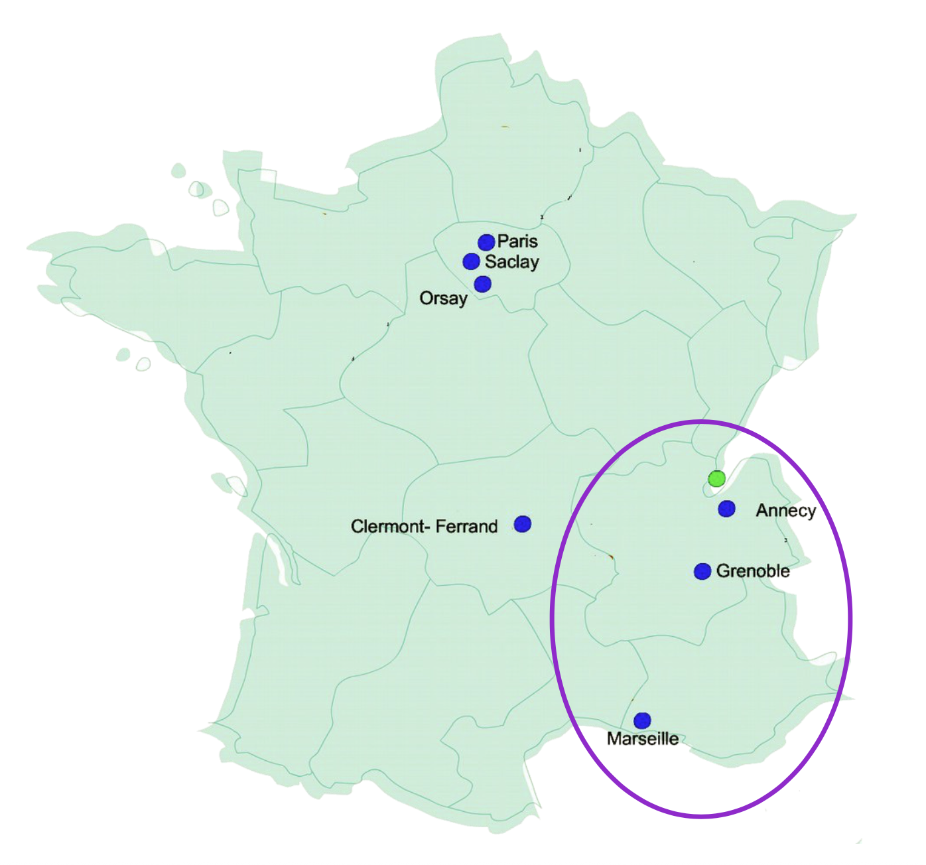

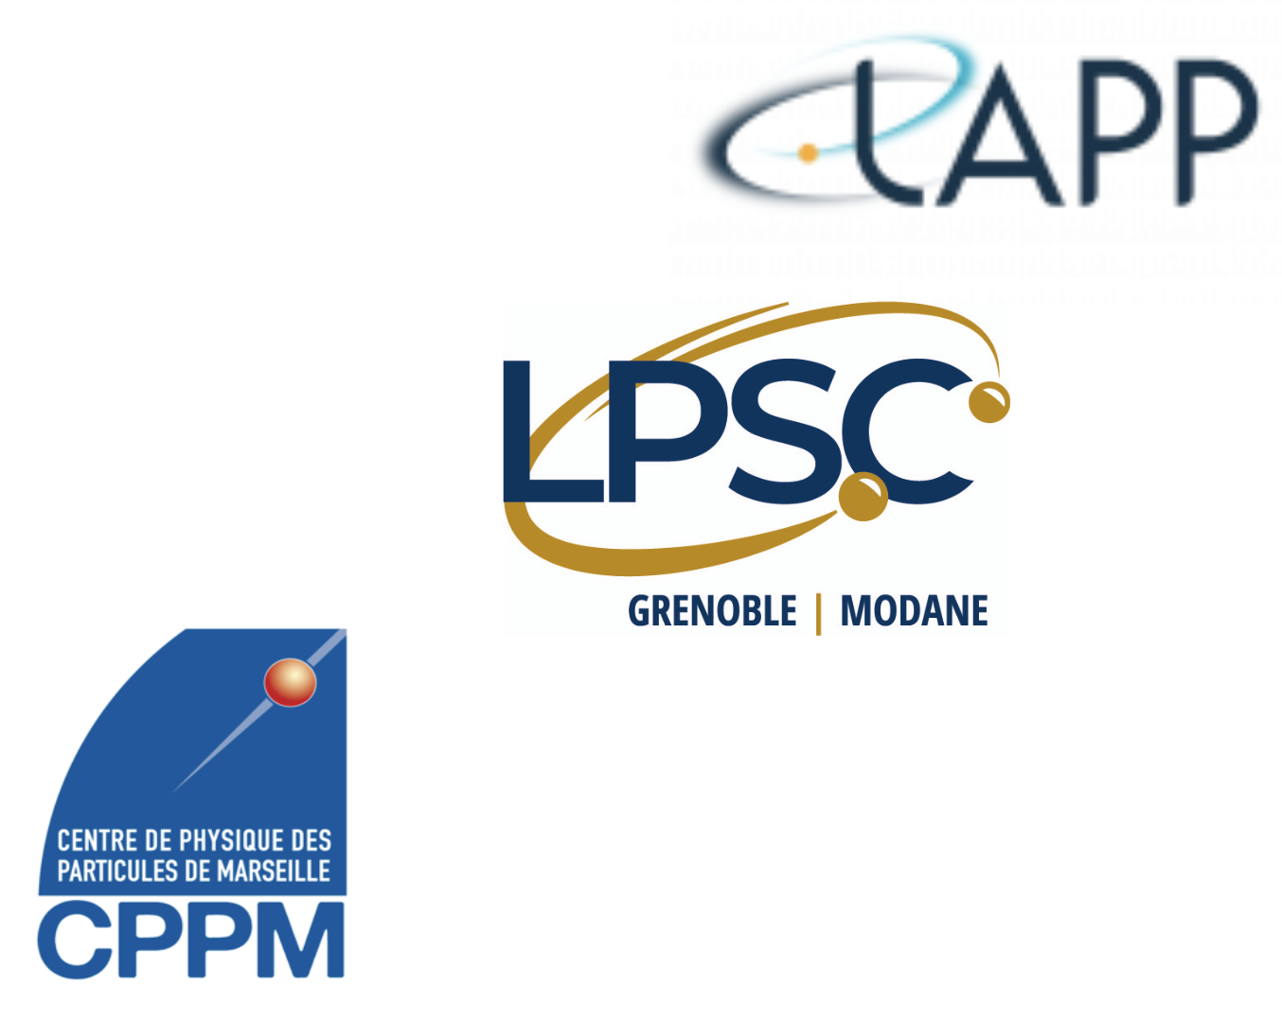
Modules following Paris production
Modules will be shipped to ALPACA cluster: CPPM (Marseille), LPSC (Grenoble), LAPP (Annecy)
These 3 other French groups will perform the cell loading and integration to local supports of our modules
Paris Cluster
Cluster

Slide 8
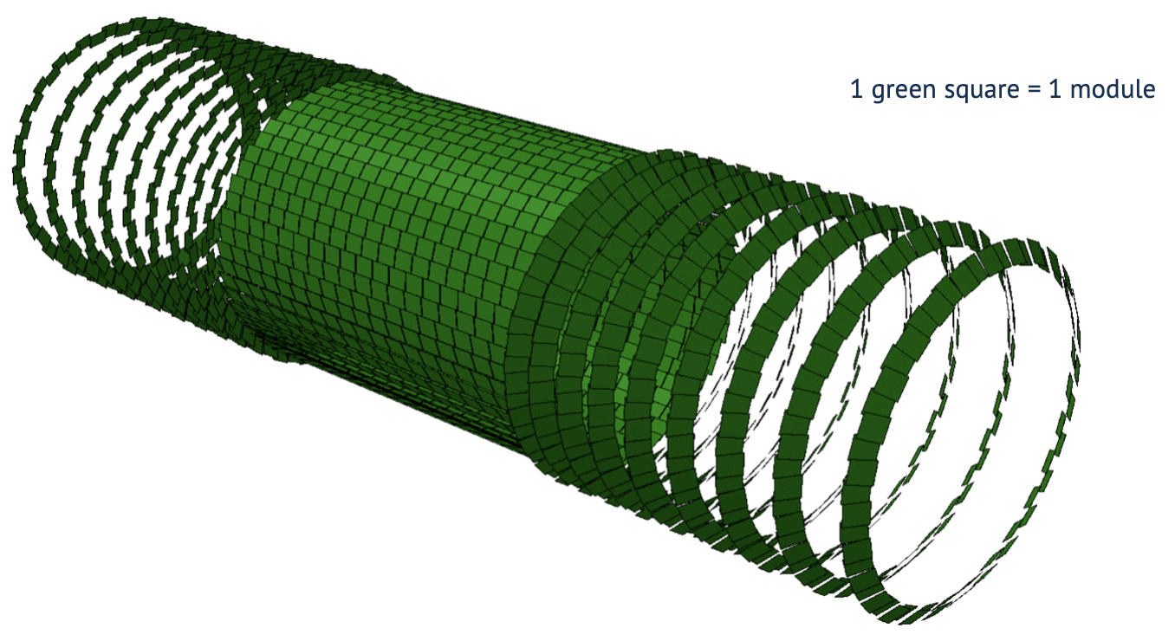
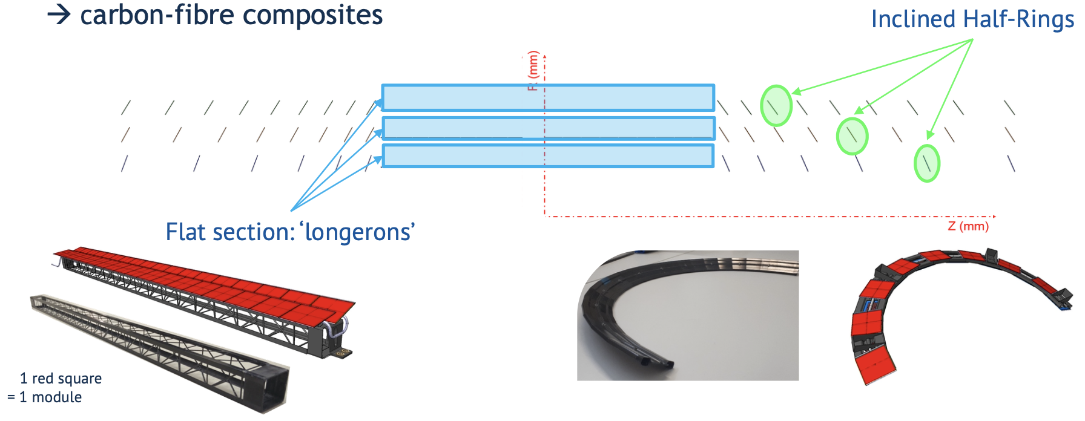
OB mechanics: local supports
This is how one layer of an ideal detector would like
Only composed by our modules, floating in the air… ☺
In practise, the modules should be mounted on supports (local supports)
And all the services (power, data transmission, cooling, sensors) have to be installed
Depending on the location of the module in the outer barrel, the local supports can be
  Longerons (central part of the detector)
  Half-rings for modules installed with an inclination

Slide 9
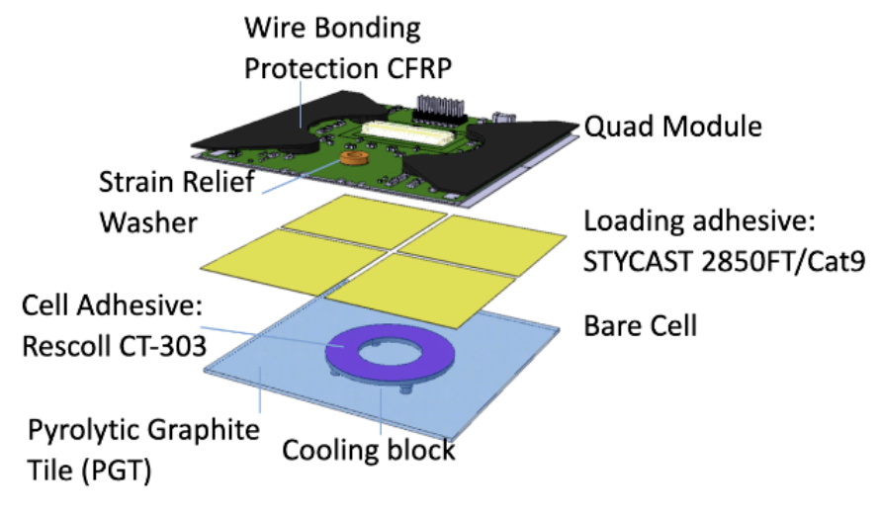
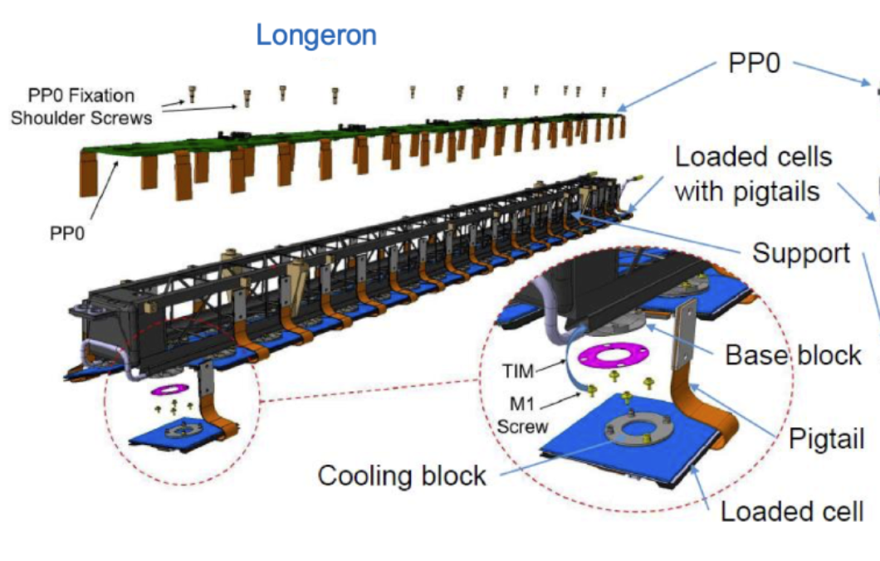
Modules following Paris production
Modules will be shipped to ALPACA cluster: CPPM (Marseille), LPSC (Grenoble), LAPP (Annecy)
These 3 other French group will perform the cell loading and integration to local supports of our modules
Cell loading: a structure with a cooling block (cell) is glued on the backside of the module (FE chip side); this explains why this side of the module has to be masked during parylene
Integration
  Loaded cells are attached to local supports
  Type-0 (PP0) services are installed
    on-detector service directly attached to the pixel modules
    Power services, Data transmission, Cooling interfaces, etc

Slide 10
Modules following Paris production
Modules will be shipped to ALPACA cluster: CPPM (Marseille), LPSC (Grenoble), LAPP (Annecy)
These 3 other French group will perform the cell loading and integration to local supports of our modules
Cell loading: a structure with a cooling block (cell) is glued on the backside of the module (FE chip side); this explains why this side of the module has to be masked during parylene
After integration
Loaded local supports are tested
And finally they are shipped to CERN for the installation in the detector
Still, long journey and tests for our modules after they leave Paris cluster

Slide 11
Paris cluster, a few facts
Undergone two joint IN2P3/IRFU reviews (2021 and 2024)
~ 30 FTEs in all 3 sites; big fraction is IT
Weekly meetings: https://indico.cern.ch/category/9094/
A pretty active mattermost group: https://mattermost.web.cern.ch/itkpariscluster/
Exchange of expertise, we try to share the work as much as possible
Common cluster Local (hosted at IJCLab) Data Base, where all members of cluster have access
Common reporting in ITk Pixel meetings as much as possible, speakers rotation is being in place
Numerous transfers of components, tools, modules, common material, etc. among the 3 sites over the years

Slide 12
Paris cluster organization chart
Paris Cluster extended committee
Max 12 pers
Giovanni, Stéphanie, Francesco
Dimitris, Lydia,
Matthias, Julien, Fred
Paris Cluster Risk Manager
(8 months rotating)
Julien + Dimitris
(among the extended committee)
Logistics
resp+ 1 ou 2 deputies
Stéphanie + Fred Déliot
(APS budget: Dimitris,
APS technique: Giovanni)
Database infrastructure
Fred Derue + Rei
Production Report
(verify yield + reporting)
Matthias + Zirui
Database software
Francesco
Assembly Line Managers
Metrology
Gluying
Wirebond
Parylene masking
Wirebond Protection
Yield
Francesco, Julien, Dimitris/Nicolas
Testing Managers
Tests analysis
X-rays
Yield
David, Matthias, Lydia/Dmytro

Slide 13
Backup

Slide 14
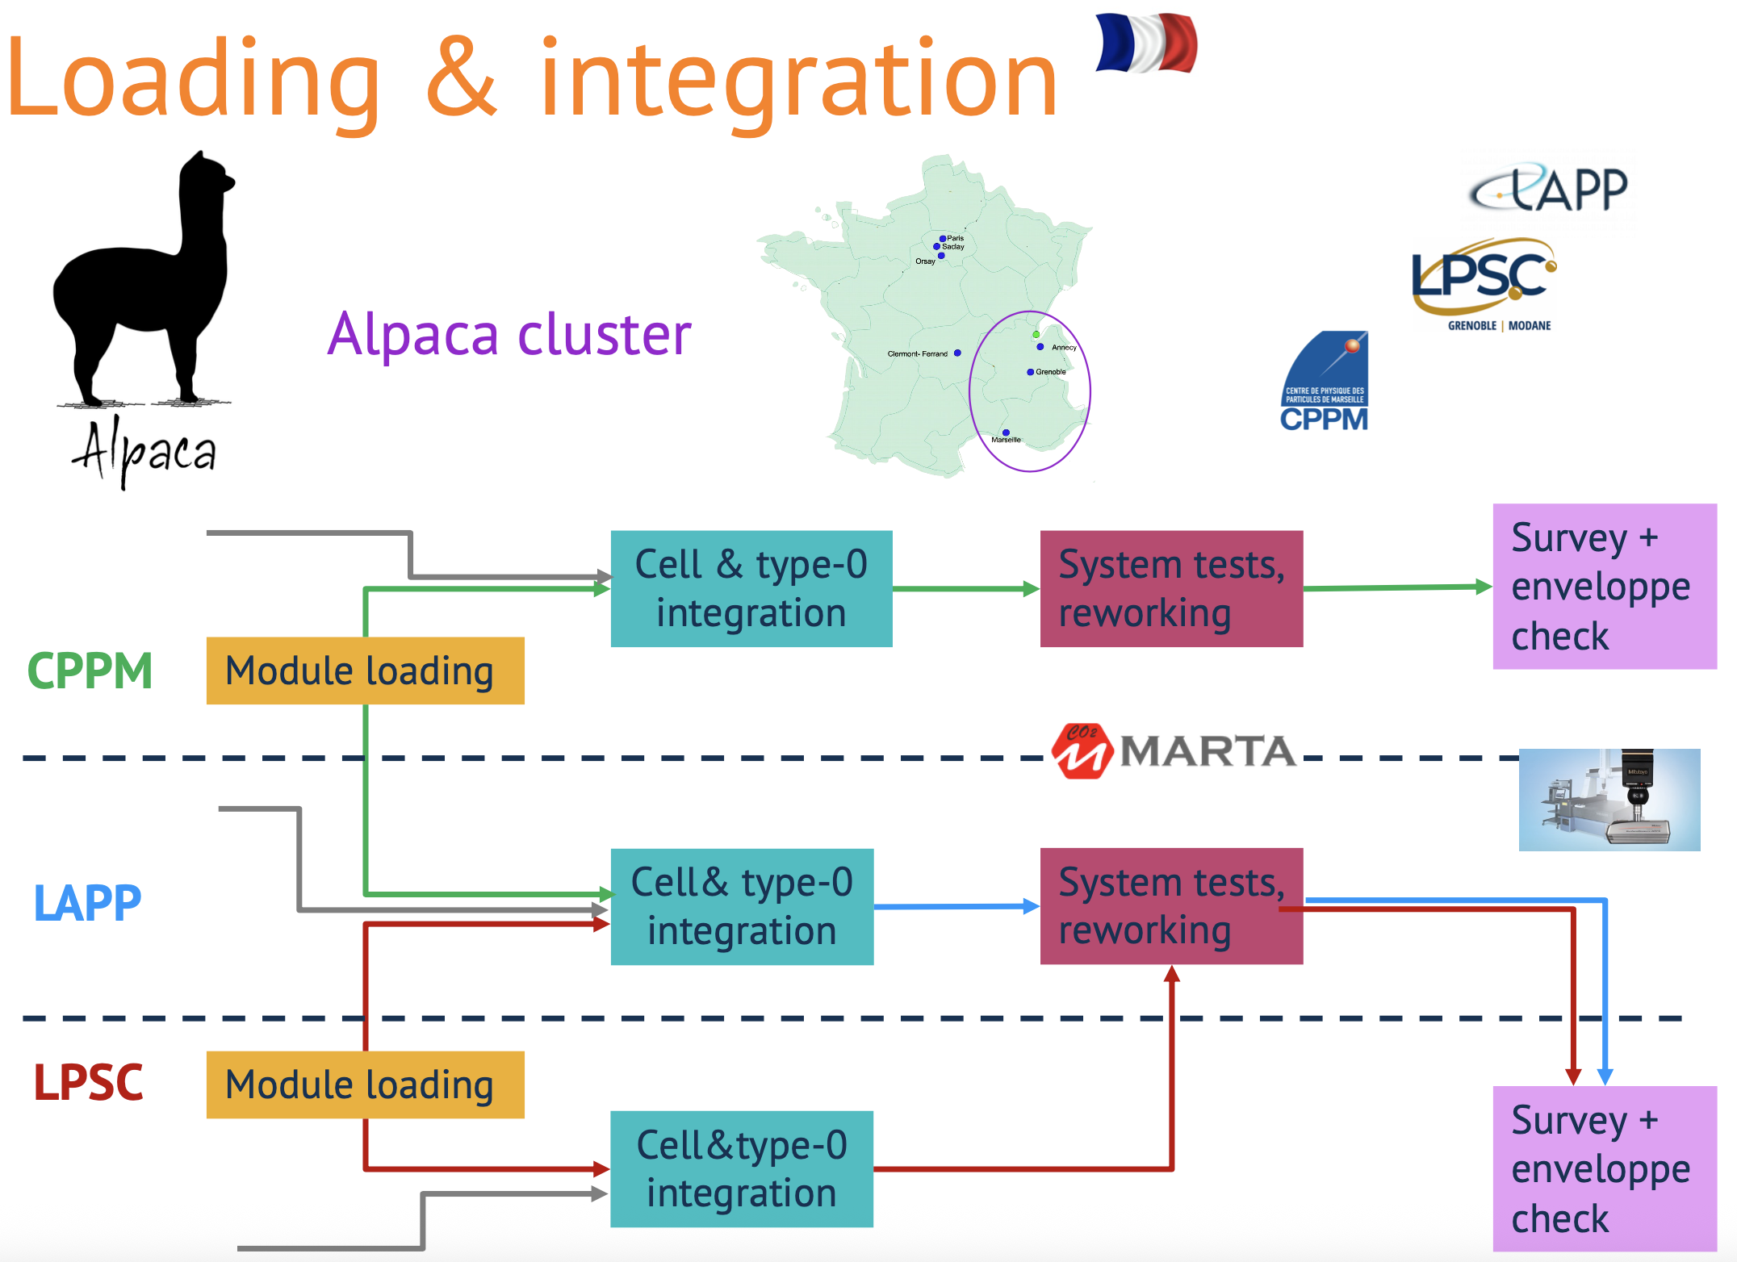
Alpaca flow

