Slide 1


CNRS Grid Institute: overview
Conseil Scientifique de l’Institut des Grilles
Vincent Breton
Crédit: Dominique Boutigny

Slide 2
A reminder on the organization of research in France
Most of the scientific research is publicly funded in France
CNRS is the largest research agency in France
  About 12.000 researchers in 8 thematic institutes (example: IN2P3)
  The large majority of CNRS researchers works in laboratories on university campuses
    Unités Mixtes de Recherche
CNRS operates a few specific units oriented towards supporting research
  Example: IN2P3 Computing Center

Slide 3
Institut des Grilles
« Unité Propre de Service » du CNRS
  Main attachment: IN2P3
  Secondary attachment to all CNRS scientific institutes
Mandate: steer up the activities and foster synergies in the field of grids and clouds
  Production grids (D. Boutigny, deputy director)
  Research grids (M. Daydé, deputy director)
  Interface between production and research grids (F. Suter, « chargé de mission »)

Slide 4
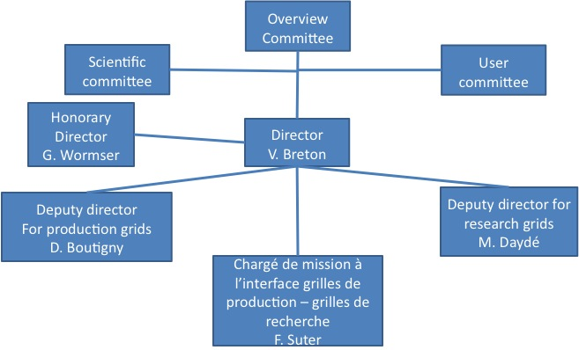
IdG management structure

Slide 5
IdG, a virtual institute
Limited staff
  Most of the 350 engineers to operate and use the grids are distributed in 30 laboratories around the country
From its creation, IdG has been acting as a
  Mediator between the laboratories and EC for european projects
  Intercessor to support requests for permanent positions in relation to grid activities
  Funding agency (equipment, travel funds)
From May 1st 2010, it has the mandate to operate the National Grid Initiative

Slide 6
The French National Grid Initiative: key dates
August 14th 2007 : Création of CNRS Institut des grilles du CNRS (IdG) under Guy Wormser initiative
End of 2008: creation of a National Steering Committee to develop a national production grid
  8 partners: CNRS, CEA, INRIA, INRA, CPU, RENATER et Ministère
Beginning of 2009: publication of the Production Grid white paper
  http://www.idgrilles.fr/IMG/pdf/livre_blanc_draft1_8FINAL.pdf
Avril 30th 2010: end of EGEE-III project
May 31st 2010: technical kick-off of France-Grilles, the French National Grid Initiative

Slide 7
French NGI: legal framework
G.I.S : Scientific Interest Group
  Popular schema different from an association
  Public and private partners can join
  See GIS creation document on SC web site
Main limitations
  No bank account
  No legal responsibility
Need for a « mandataire » => CNRS IdG
  IdG acts on behalf and represents the G.I.S

Slide 8
French NGI: mandate
Set up and operate a national Distributed Computing Infrastructure
Contribute to the European Distributed Computing Infrastructure EGI
Steer up and foster the development of user communities nationwide through all relevant means including training
Foster exchanges between research and production grids

Slide 9
French NGI: budget
French Ministry of Research has identified the creation and operation of a national production grid as a high level priority
French NGI selected among the Very Large Research Infrastructures (TGIR)
  IN2P3 computing center is also a TGIR
  Multiannual funding started in 2010 (1M€)
CNRS IdG receives and distributes ministry funding according to G.I.S policy

Slide 10
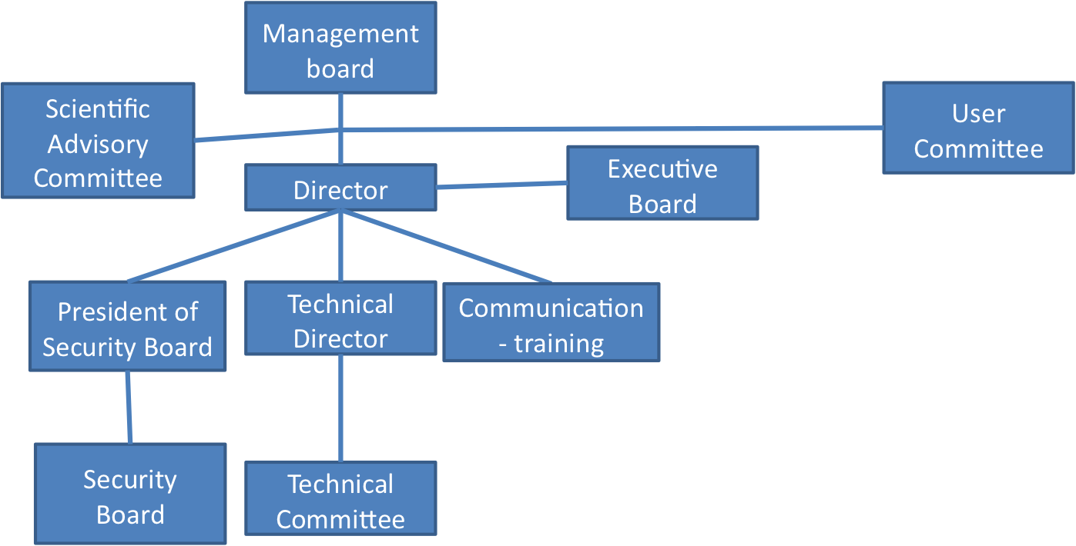

French NGI: management structure

Slide 11
French NGI: computing and storage resources
Builds upon existing production and research grids
  « EGEE » (gLite) production grid (>15000 CPUs)
  Decrypthon (DIET) production grid (500GFlops)
  CIMENT (>2000 CPUs)
  Grid5000 research grid (>5000 CPUs)
A significant part of the resources are structured into regional grids

Slide 12
Building bridges between research and production grids
Very active research community on grids and clouds
  >300 researchers at CNRS, INRIA and in universities
Community structured around the national Grid5000 research grid
Many opportunities for collaboration
More details in Michel Daydé and Frederic Suter talks

Slide 13
French NGI: resources operated with gLite
Most of these resources are integrated in LCG France, backbone of gLite operated production grid
More details in Dominique Boutigny and Fairouz Malek talks

Slide 14
French NGI: users
HEP users structured in LCG-France
Active user communities outside HEP
  CNRS was early involved in application related activities of european projects
    Leadership of NA4 in EGEE I-III
    Leadership of life and earth sciences scientific clusters in EGEE-III
  CNRS very involved in EGI-related projects to set up Virtual Research Communities
    But the projects failed
More details in Fairouz Malek and Johan Montagnat talks

Slide 15
French NGI: contribution to EGI.eu
Reminder: EGI.eu legal framework is a dutch association
  Migration to ERIC in a « close » future
The French NGI contributes to EGI.eu funding
  80.000€ in 2010
The French NGI is represented on EGI council
  French representative: M. Spiro (alternate: L. Crouzet, CEA)
  Participation to working groups

Slide 16
French NGI: involvment in EC projects
IdG acts as French partner for EC projects in the field of grids and clouds
  To reduce administrative overload (JRU)
  To increase visibility
IdG involved in 7 EC Projects starting in 2010
  Infrastructure projects(EGI-Inspire, EDGI)
  Middleware (DEGISCO, StratusLab)
  User (EPIKH, EUMedGrid-Support, SHIWA)
EC budget: 1Million euros in 2010

Slide 17
Relationship between NGIs and EGI

Slide 18
EGI-Inspire (I/II)
Duration: 48 months
Goal: federate NGIs operation in Europe and beyond
Start day: 1er Mai 2010
EC contribution to budget: 25 M€
  EC contribution to French partners: 1,64M€
French partners:
  CEA (50PM), HealthGrid (50PM)
  CNRS (450 PM): CCPM, CC-IN2P3, CREATIS, I3S, IdG, IPSL, LAL, LAPP, LPC, LPNHE, LRI, UREC

Slide 19
EGI-Inspire (II/II)
Main tasks of the French partners
  leader of task TJRA1.5 : Cyril L’Orphelin
  leader of task TSA3.4 (Life sciences): Johan Montagnat
Use of European funding
  Exclusively for hiring staff
Contact: V. Breton

Slide 20
DEGISCO, Desktop Grids for International Scientific Collaboration
Duration: 24 months (start day: 1/6/2010)
Main goal: extend EDGES desktop grid infrastructure beyond Europe
EC contribution to budget: 800k€
  EC contribution to French partners: 90415€
French partners: CNRS-LAL et HealthGrid
  Contact: Oleg Lodygensky, LAL

Slide 21
EDGI, European Desktop Grid Initiative
Duration: 24 months (start day: 1/6/2010)
Main goal: interoperability of desktop grids with ARC, UNICORE and CLOUDS
EC contribution to budget: 2300k€
  EC contribution to French partners: 211300€
French partner: CNRS-LAL
  Contact: Oleg Lodygensky, LAL

Slide 22
EUMedGrid-Support
Duration: 24 months (start day: 1/1/2010)
Main goal: develop grid adoption in Mediterranean countries
EC contribution to budget: 740k€
  EC contribution to French partners: 50k€
French partners: CNRS (IdG et LPSC) and HealthGrid
  Contact: Vincent Breton et Fairouz Malek

Slide 23
GISELA - Grid Initiatives for e-Science Virtual Communities in Europe and Latin America
Duration: 24 months (start day: 1/7/2010)
Main goal: long-term sustainability of grid infrastructure in Latine America
EC contribution to budget: 850k€
  EC contribution to French partners: 47810€
French partners: CNRS (CPPM, IPGP)
  Contact: Elie Aslanidès

Slide 24
SHIWA
Duration: 24 months (start day: 1/7/2010)
Main goal: deployment of workflow engines on Distributed Computing Infrastructures
  Application to medical imaging
EC contribution to project budget:1,8M€
  EC contribution to French partners: 294,5k€
French partners: CNRS (I3S, CREATIS)
  Contact: Johan Montagnat

Slide 25
StratusLab: Enhancing Grid Infrastructures with Virtualization and Cloud Technologies
Duration: 24 months (start day: 1/6/2010)
Main goal: cloud and virtualization technologies to simplify and optimize the use of Distributed Computing Infrastructures
EC contribution to budget: 2300k€
  EC contribution to French partners: 470k€
French partners: CNRS (LAL, IBCP)
  Project coordinator: Cal Loomis

Slide 26
Training
http://www.france-grilles.fr
virginie.dutruel@cc.in2p3.fr
Goal: train users and system administrators
Significant funding in 2010
  Institut des Grilles: 40k€
  Involvment in EPIKH Marie Curie network
One national contact point: Virginie Dutruel
  To express needs
  To find help for organizing tutorials

Slide 27
Bilateral collaborations with Asia
Framework
  International Associated Laboratories
  EC projects (EGEE, EUAsiaGrid)
Highlights:
  Scientific collaboration with Korea
    creation of an active VO soon to be extended to Japan
    Joint patents on potetial drugs
  Scientific collaboration with Vietnam
    Installation of 4 grid nodes in Hanoi
    Deployment of life sciences applications

Slide 28
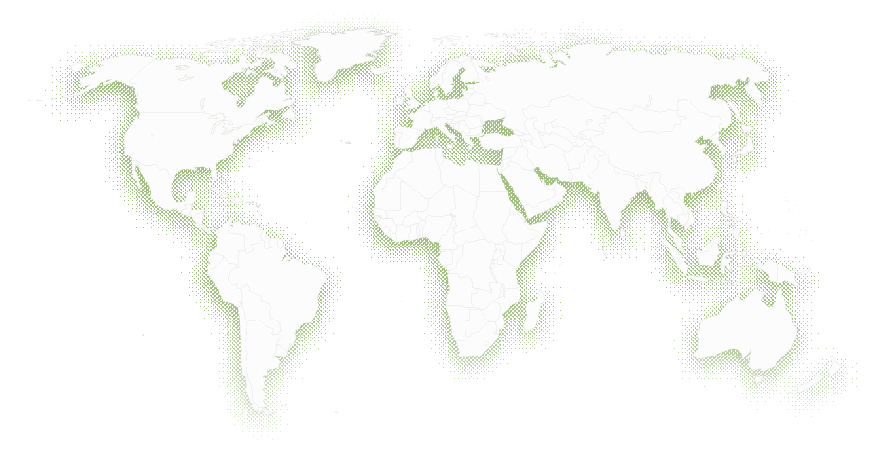
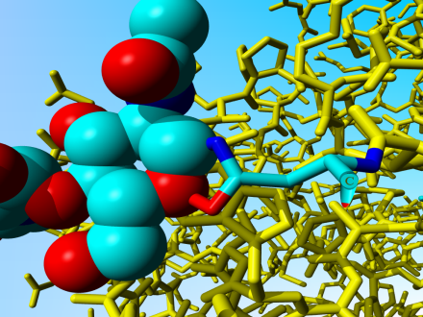
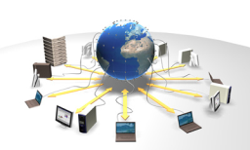
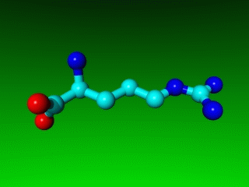
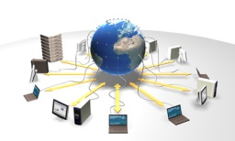
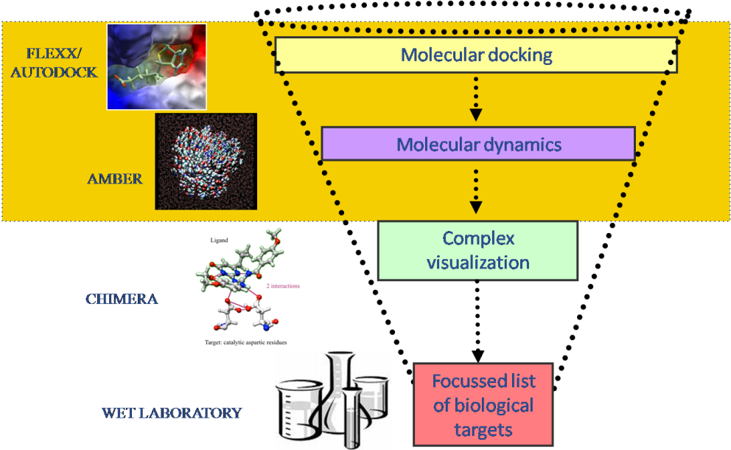
Discovering new drugs in Vietnam
PDB database
> 50.000 3D structures
including biological targets
for cancer, malaria, AIDS...
Question: are these products potentially
active against cancer, malaria, AIDS ?
Local DataBase of
Natural chemical products extracted from local biodiversity
Hanoï
INPC
Answer: focussed list of biological targets on which the compound is most active in silico
28

Slide 29
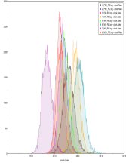
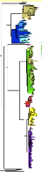
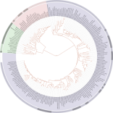
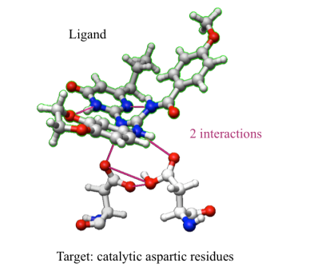
Monitoring the evolution of influenza viruses
Daily download
NCBI
International
database of influenza
genome sequences
Grid DataBase
Grid DataBase
Local database
of influenza genome sequences
Grid DB parsing
Phylogenetic analysis
Virtual screening
New candidate drugs
Daily updated data
on virus evolution
29

