Slide 1
Prospects for ³⁹Ca beam production with TULIP at SPIRAL1
ACCLAIM MORA kickoff meeting

Slide 2
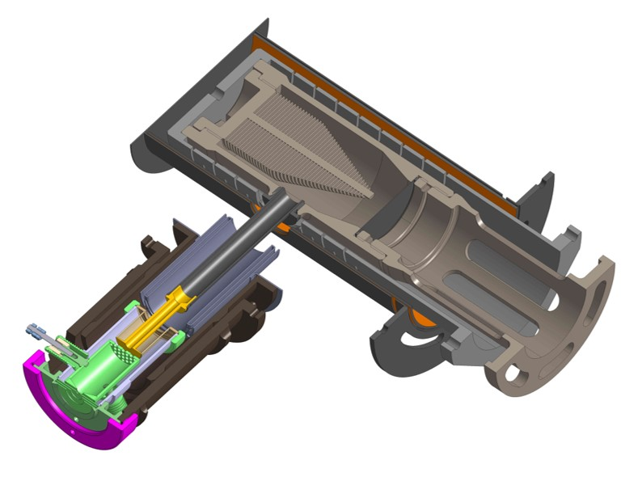
Production history
05/2019 : ⁴⁰Ca²⁰⁺ 95 AMeV at 700W (^{38m}K experiment)
In-target production ³⁹Ca : 1.3e6 pps/W ≈ 1e9 pps (SigmaSIRA EPAXV2)
Observed : none
04/2023 : ⁵⁰Cr²³⁺ 72 AMeV at 19W (⁴⁸Cr study)
In-target production ³⁹Ca : 5.5e5 pps (SigmaSIRA EPAXV2)
Observed : none
Problem with production/release/detection ?
Target
Cavity
Window
Radioactive beam
Cathode
Primary beam
Anode
Standard FEBIAD Target Ion-Source System (TISS)

Slide 3
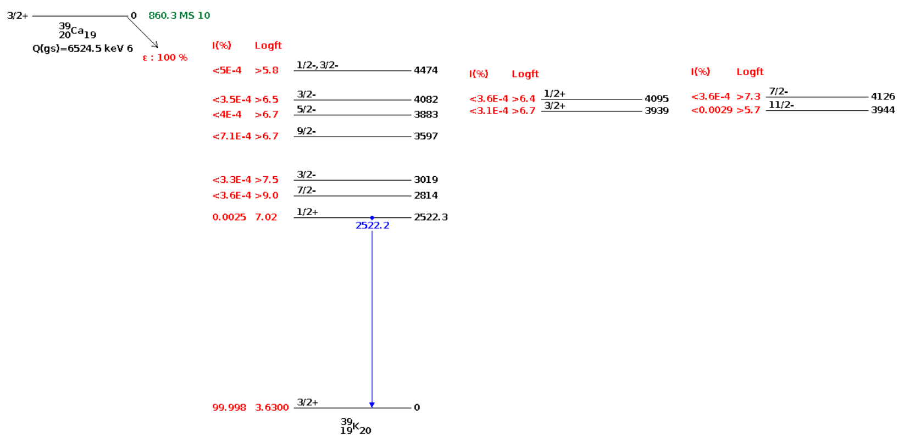
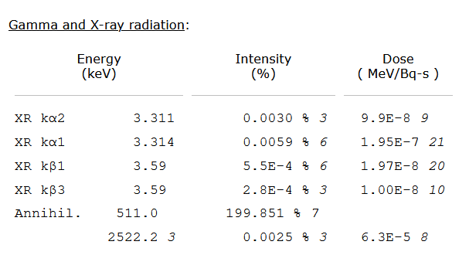
Decay & detection
EffGe(511KeV) ≈ 1% at the closest in IBE
Should we have seen ³⁹Ca if 1% atom-to-ion efficiency ?
1E7pps -> 2E5 cps in faster
Impossible to miss
5E3pps -> 100 cps in faster
Difficult to miss
Not a detection problem

Slide 4
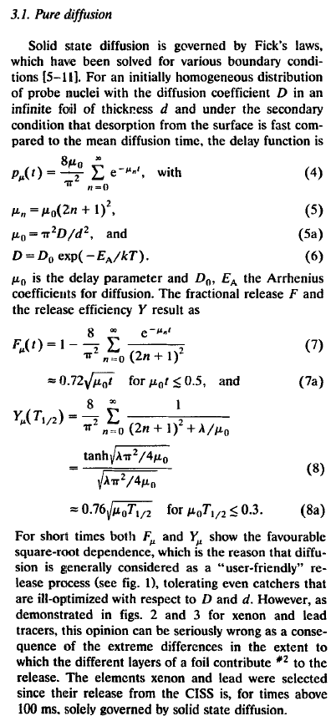
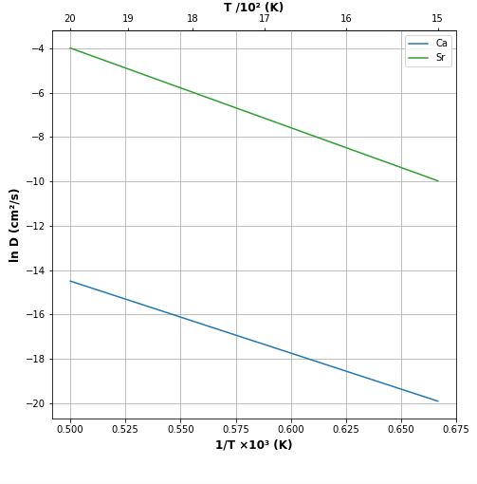
Diffusion (graphite)
Extracted from A. Ribet database
Sr in graphite. No data for Ca in C. As Sr has a larger radius than Ca, diffusion of Ca in C is expected to be larger than diffusion of Sr.
T_{1/2,diff} = 7E-3 to 3 s in 0.5mm graphite
Diffusion of Ca in Ti.
T_{1/2,diff} = 1 to 100 s in 20µm Ti
To be calculated in Nb, Ta for sustainability at high temperature
Tfus (Ti)
Probably not a diffusion problem in graphite
Targets: TRIUMF ISAC : (Ta) and TiC. CERN ISOLDE: Ti rods & foils, Ta foils
Kirchner, NIMB 1992

Slide 5
Diffusion (metals)
Ta, Nb, Ti have similar lattice parameter and atomic radius
We can assume that:
D_{Ca-in-Ta} ≈ D_{Ca-in-Nb} ≈ D_{Ca-in-Ti} << D_{Ca-in-gr}
Also :
D_{Ca-in-Mo} << D_{Ca-in-Nb}<< D_{Ca-in-Zr}
?
?
Diffusion could be a problem in refractory metals
Source : Handbook of Self-diffusion and impurity diffusion in pure metals. G. Neumann and Cornelis Tuijn, Elsevier

Slide 6
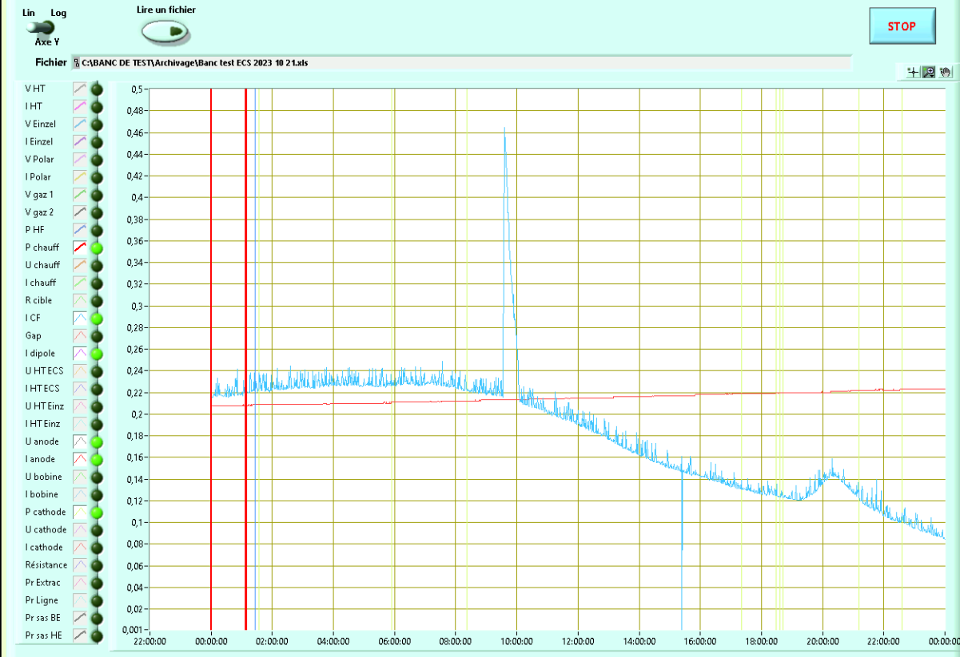
Effusion (graphite)
Test production stable Ca ions
Max 230nA of 40Ca observed for a ≈ 6E19 atoms sample. Very low, can be explained by :
Very low efficiency (No apparent reason)
Issue with experiment (target at 1240°C before the starting source)
Very slow release (T1/2 = 2 months!)
Target and cavity not hot enough (target at 1240-1750 °C during test)
Ca too sticky. Ca output doubled with CF4 injection at 1500 °C
Ca oxidized before starting the vacuum (CaO melting point 2570°C) or carbonized next to the target (CaC₂ melting point 2300°C) -> to be investigated with HSC
Effusion is quite possibly the limiting factor in graphite but to needs to be investigated

Slide 7
Effusion (metals)
Sticking time on refractory metals
Calculation at 2073 K
Values from
B. Eichler and H. Robbach, Adsorption von Metallen auf metallische oberflächen und Möglichkeiten ihrer Nutzung in der Kernchemie, vol. 527, 1984
➔ Low sticking time(<10-4 s) of Ca on refractory metals (typically 10000 contacts in a standard graphite cavity, and could also be reduced)
z
y
Effusion should not be limiting in a metal cavity
Ca
x

Slide 8
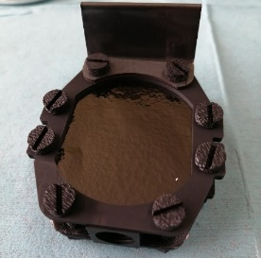
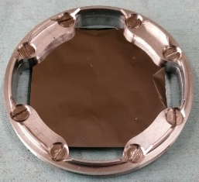
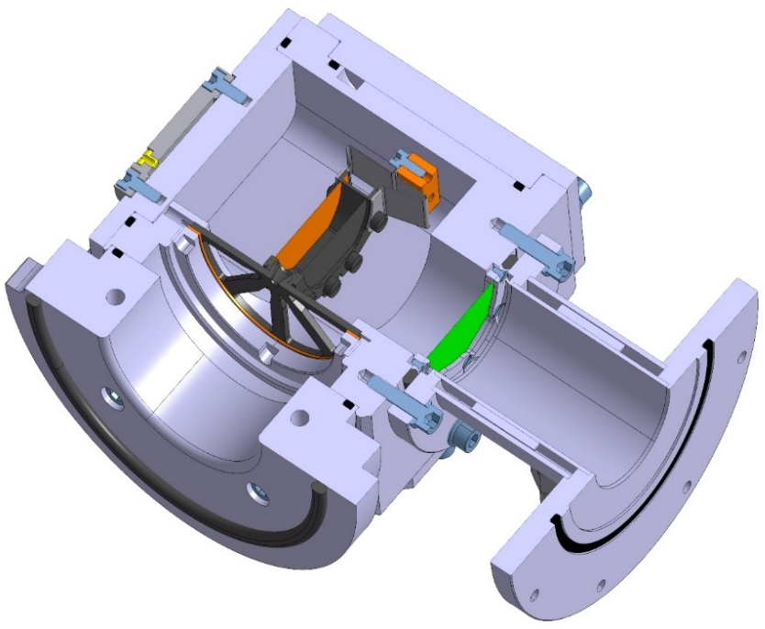
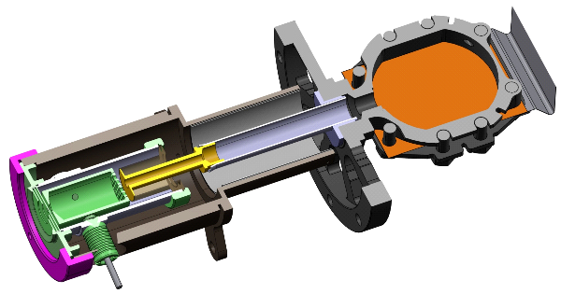

TULIP
On-line test in 2023: production of ⁷⁴⁻⁷⁸Rb⁺ ions (≈10%)
Recent on-line test (09/2025)
At least 100pps of 74Rb (65ms)
Release time in the ms range
July 2023
graphite window
TULIP cavity
Mo-Ni-Mo target
(fusion-evaporation)
Graphite catcher
TULIP FEBIAD
60 mm
²⁰Ne Primary beam
Radioactive ion beam
Tested offline in 2024-2025
Calibrated Ar leak : Eff_{Ar} > 6% (stable) and up to 17%
Ag, In, Sn tracers : Eff = 9-15%
For Ca, FEBIAD > SIS, but thick target required

Slide 9
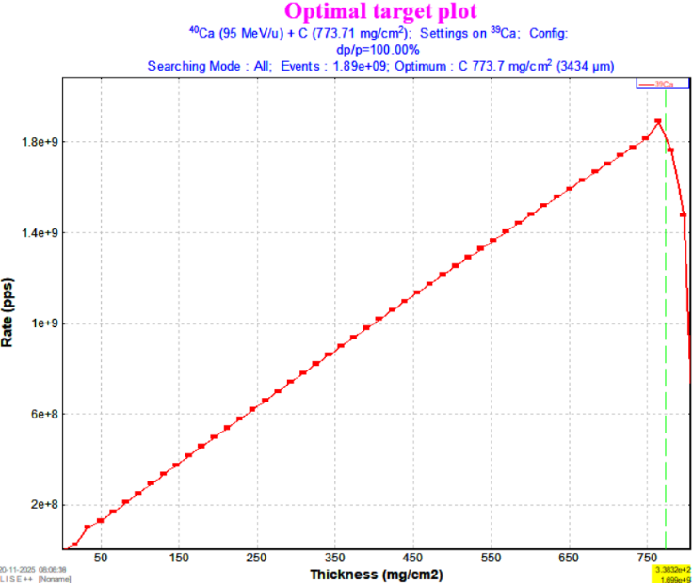
Implantation
Optimum ¹²C target thickness to maximize ³⁹Ca fragment out of target:
For a graphite cavity closed with the target
774 mg/cm2 = 3.44 mm at « normal » 2.253 g/cm³ graphite density
4.36 mm at graphite density of usual targets (1.775 g/cm³)
For a Ta cavity closed with a 7 µm Ta window
758 mg/cm2 = 3.36 mm at « normal » 2.253 g/cm³ graphite density
4.27 mm at graphite density of usual targets (1.775 g/cm³)
Small range (and production) difference

Slide 10
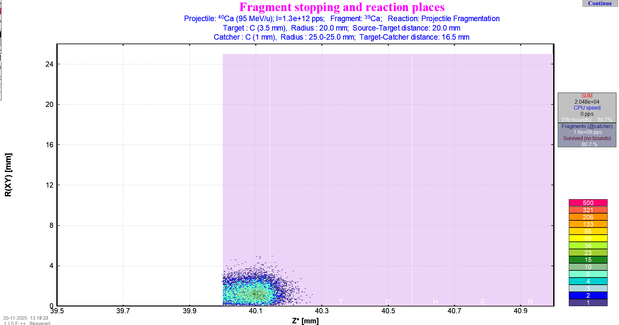
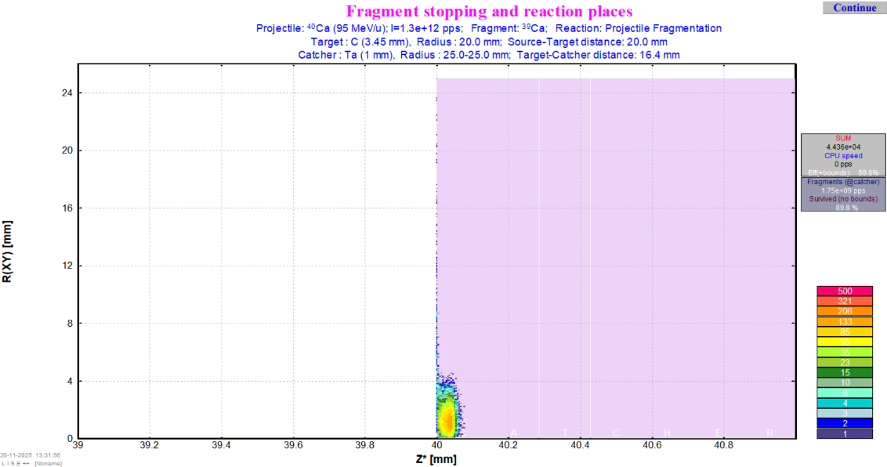
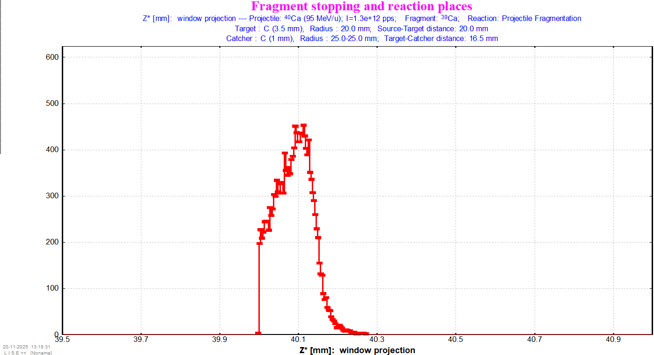
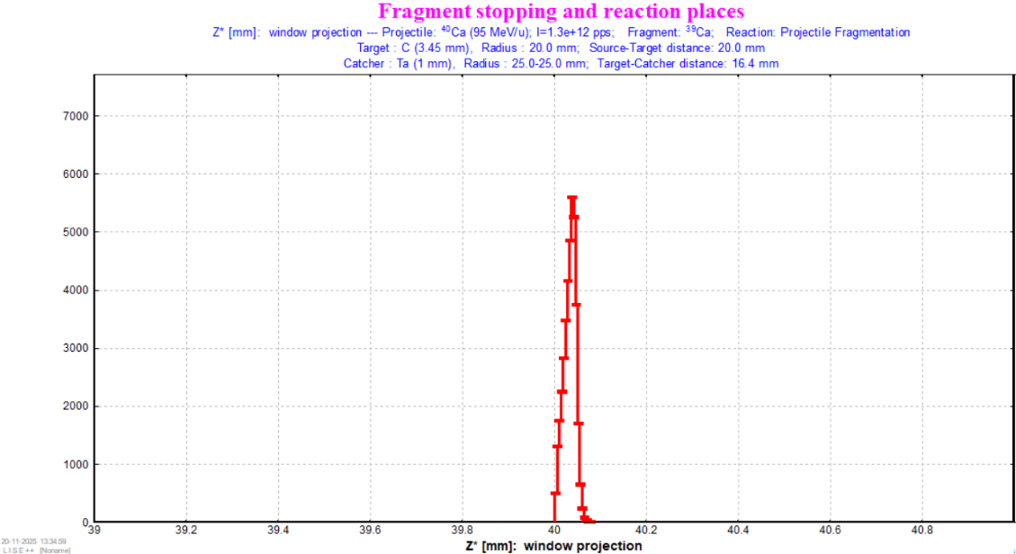
Implantation
Stopped in graphite
Stopped in Ta

Slide 11
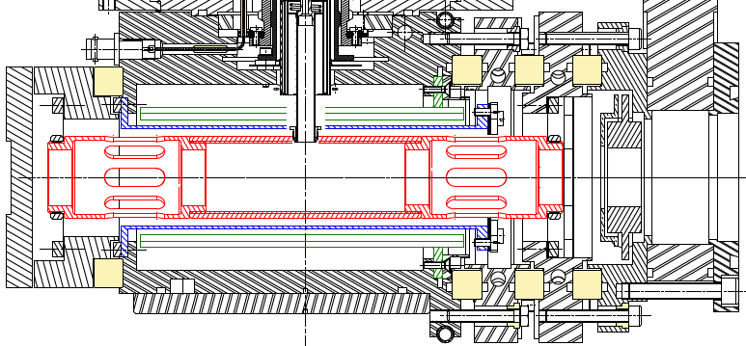
TISS concept

Slide 12
TISS concept
TARGET
Cavity
Catcher
entrance window

Slide 13
Conclusion
Ca beams are limited by release in current TISS -> new design
A full graphite system could be effusion limited
A full metal system could be diffusion limited
Limiting the implantation depth and cavity volume/surface is possible -> same as for TULIP
We received first applications for the master/PhD thesis

