Slide 1

Report on the AGATA experiment number 22.97:
Probing nucleon–nucleon correlations in the ⁴⁸Ca +
²⁰⁸Pb system below the Coulomb barrier
M. Del Fabbro¹, T. Mijatović¹,L. Corradi², S. Szilner¹, L. Busak¹, J. Diklić¹, I. Gašparić¹, D. Jelavić Malenica¹, I. Lihtar¹, L. Palada¹, M. Sigmund¹, N. Soić¹, I. Tišma¹,N. Vukman¹, G. Andreetta², M. Balogh², D. Brugnara², G. de Angelis², A. Ertoprak², E. Fioretto², A. Goasduﬀ², B. Gongora², A. Gottardo², A. Gozzelino², T. Marchi², D.R. Napoli², J. Pellumaj², R.M. Pérez-Vidal², M.Sedlak², A. M. Stefanini², J. J. Valiente-Dobón², L. Zago², I. Zanon²,
P. Aguilera³, D. Bazzacco³, J. Benito Garcia³, S. Carollo³, R. Escudeiro³, F. Galtarossa³, S.M. Lenzi³, R. Menegazzo³, D. Mengoni³, G. Montagnoli³, S. Pigliapoco³, E. Pilotto³, M. Polettini³, F. Recchia³, K. Rezynkina³,
G. Pollarolo⁴, R. Depalo⁵, Md.S. Laskar⁵, M. Milin⁶, D. Ackermann⁷, A. Utepov⁷, M. Siciliano⁸, M. Rocchini⁹, A. Gadea¹⁰
¹RBI, Zagreb, Croatia; ²INFN-LNL, Italy; ³INFN and Universitá di Padova, Italy; ⁴INFN and Universitá di Torino, Italy; ⁵Universitá degli Studi di Milano, Italy; ⁶University of Zagreb, Croatia; ⁷GANIL, France; ⁸Argonne National Laboratory, USA; ⁹INFN Firenze, Italy; ¹⁰IFC-CSIC, Spain.
ACC meeting - AGATA Week 2026

Slide 2
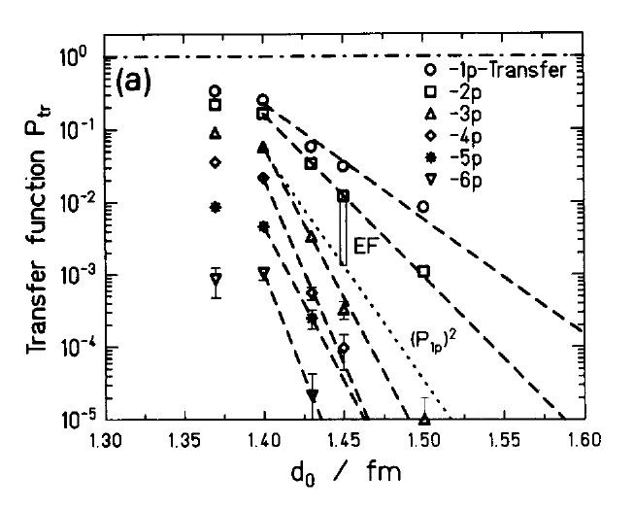
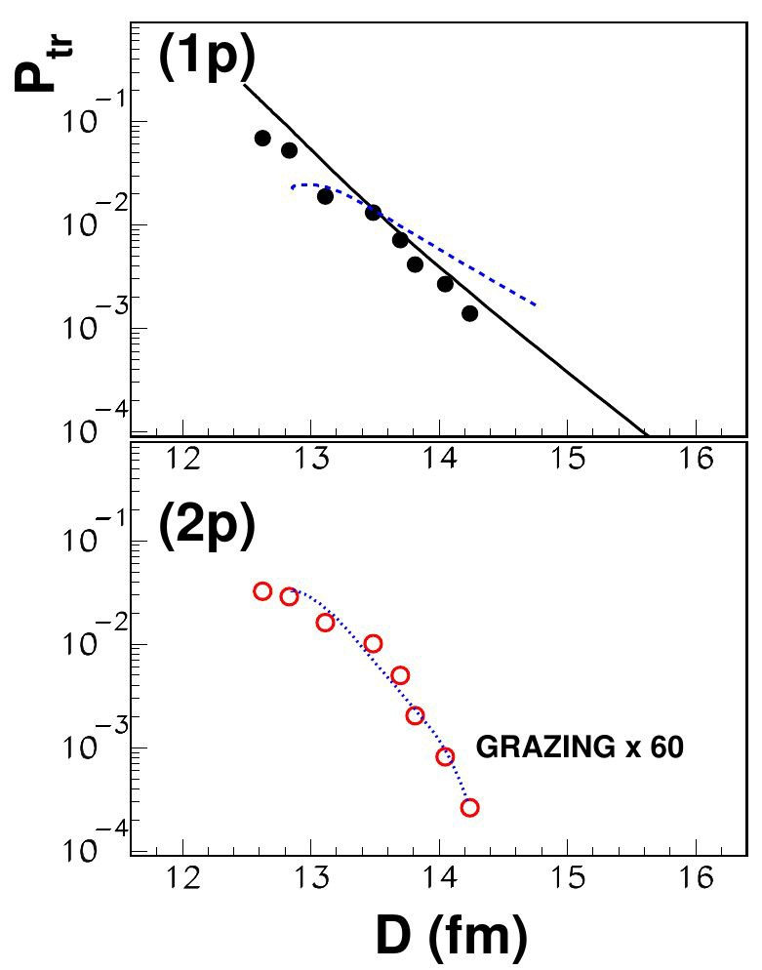

MNT and pair transfers
Two-particle transfer processes are an ideal tool to study the dynamical aspects of pairing correlations
MNT: in selected cases simultaneous comparison of ±nn, ±pp and ±np pairs
Enhancement Factor:
the ratio of the cross section to model predictions using uncorrelated states
GRAZING calculation (independent nucleon transfer) is underpredicting experimental results for -2p channel by a factor 60
60_{Ni +} 116_{Sn}
208_{Pb +} 144_{Sm}
J. Speer et al., PLB 259 (1991) 4
L. Corradi et al., Phys. Lett. B 834 (2022) 137477

Slide 3
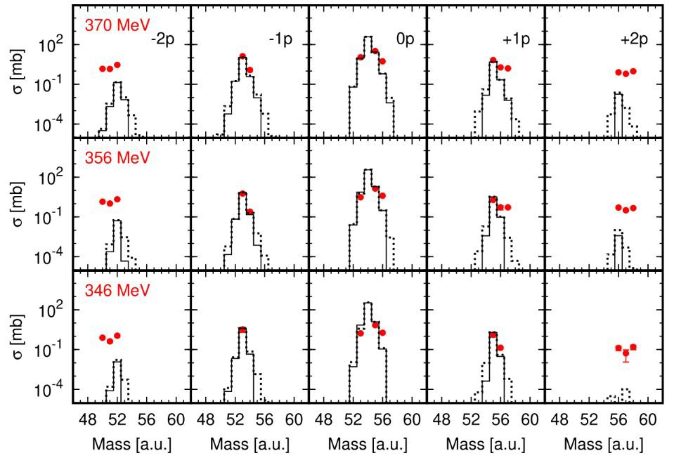
MNT reactions below the Coulomb barrier
Measurement at energies below the Coulomb barrier results in: very narrow TKEL-value distributions: no secondary eﬀects and allow to probe nucleon-nucleon correlations as close as possible to the ground to ground states.
Proton pair transfer studies so far performed mostly above the Coulomb barrier
For the ⁹²Mo + ⁵⁴Fe system the GRAZING cross section calculation well reproduce ±1n and
±1p but underestimate the experimental cross section for the transfer of ±2n and ±2p even below the barrier
T. Mijatović Phys. Lett. B 872 (2026) 140085

Slide 4
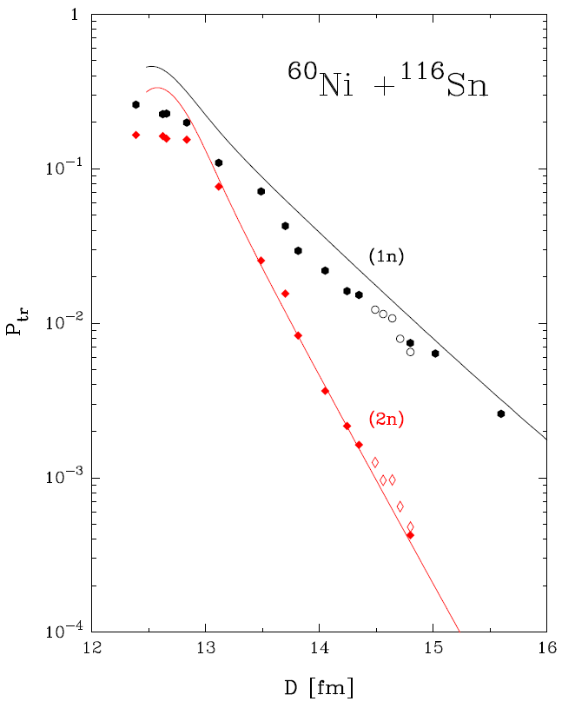
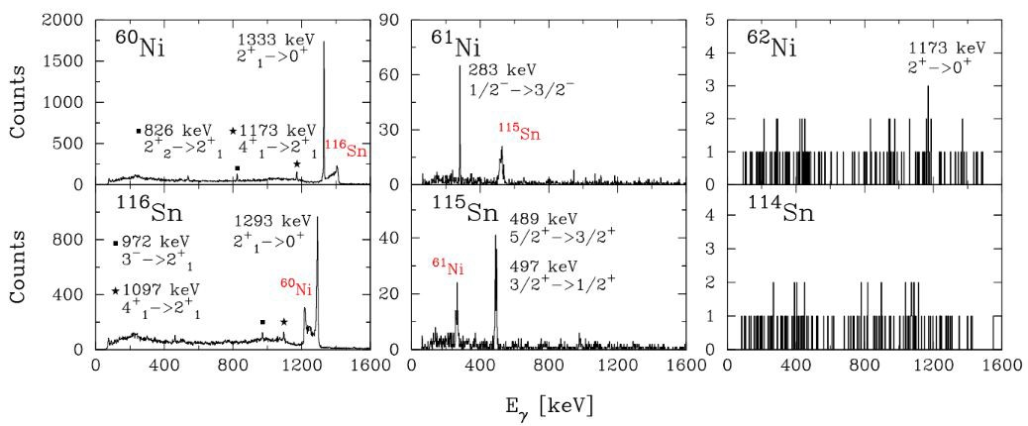
MNT and pair transfers
The information from the 𝛾-spectrometer AGATA allow us to extract both the intensities of the excited states population and, using also the information measured with PRISMA, the intensities of the ground-state populations.
Microscopic calculations: PRISMA+AGATA experiment
D. Montanari PHYSICAL REVIEW C 93, 054623 (2016)
D. Montanari PHYSICAL REVIEW C 93, 054623 (2016)

Slide 5
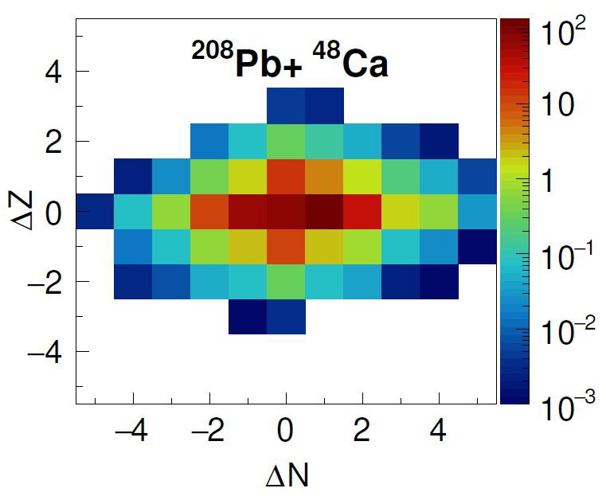
⁴⁸Ca+²⁰⁸Pb: motivation
The ⁴⁸Ca + ²⁰⁸Pb system provides a very interesting opportunity to investigate addition and removal of neutron and proton pairs, starting from closed shell configuration in Z and N for both reaction partners
The GRAZING calculation predicts a quite symmetric population of n and p transfer channels
The use of closed-shell nuclei will simplify the calculations
New information for p stripping and pickup channels
Possibility to investigate correlations simultaneously for a complete set of transfer channels
Total cross section GRAZING code calculations

Slide 6
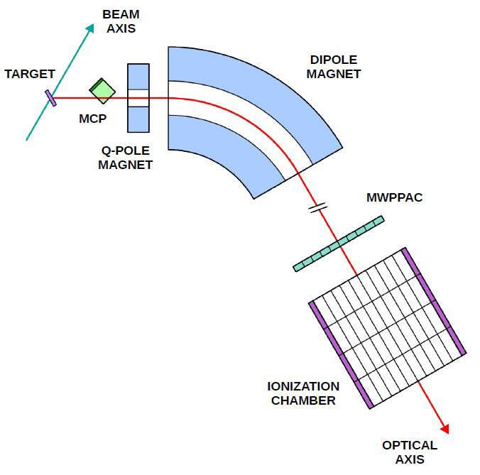
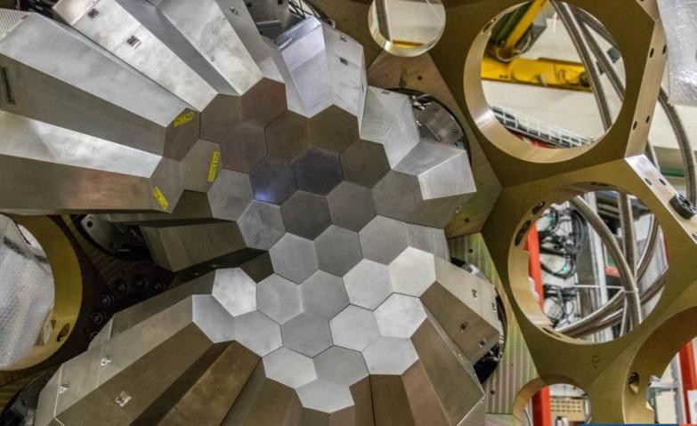
Experimental Set-up
²⁰⁸Pb beam:
  Elab = 1000 MeV
  Elab = 960 MeV
  Elab = 900 MeV
Detectors:
MCP - entrance x, y, ToF
MWPPAC - focal plane x, y, ToF
IC - E, ∆E
PRISMA at 25◦, AGATA
opposite to PRISMA
34 operational AGATA crystals
PRISMA
Magnets:
quadrupole
dipole
⁴⁸Ca target: 400 µg/cm²
+ 20 µg/cm² C

Slide 7
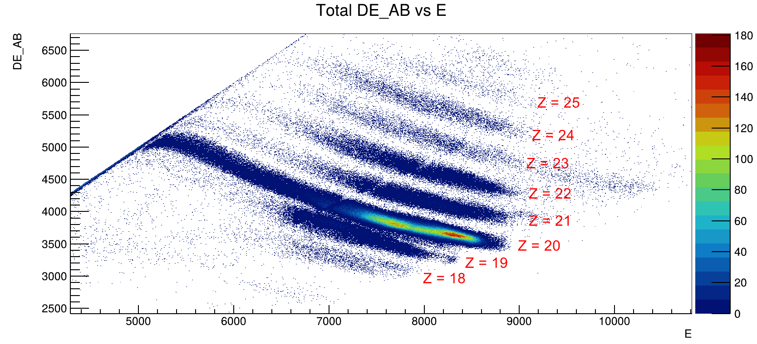
Z identification
Using the information on the ΔE-E provided by the PRISMA Ionization Chamber (IC) is possible to identify the atomic number (Z) of the detected ions.
A clear separation of the diﬀerent Z has been obtained with a good resolution
E = 960 MeV

Slide 8
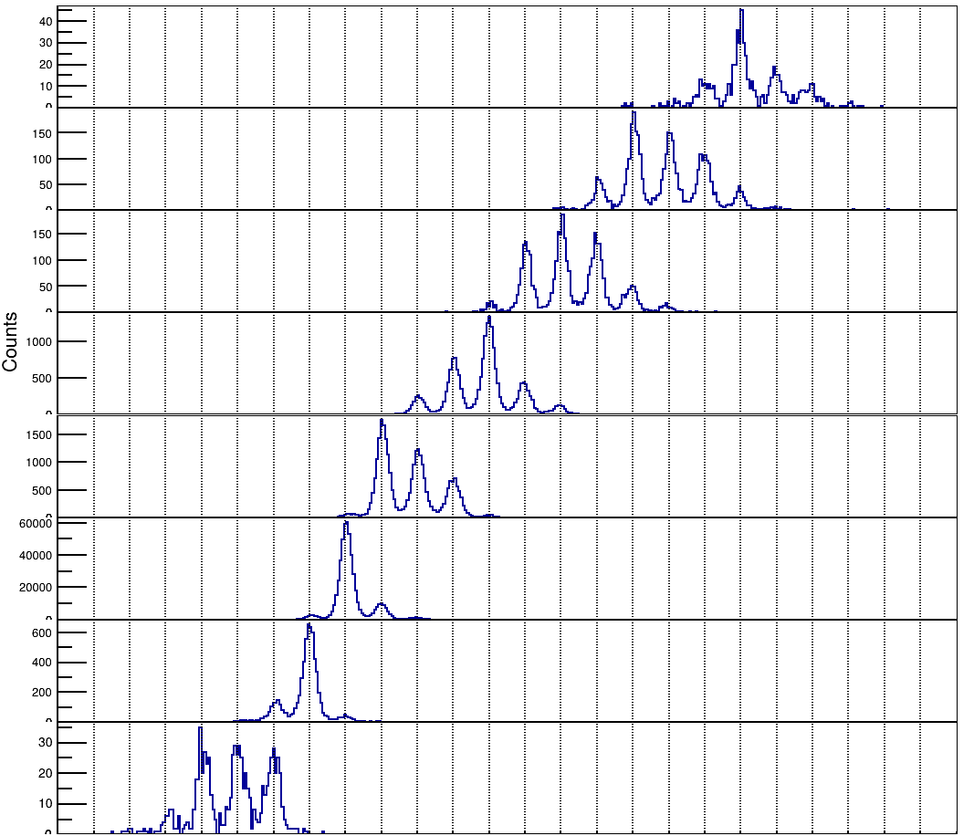
Mass identification
E = 960 MeV
Z = 25
Up to five proton
pick-up channels were observed, as well as proton stripping down to -2
Z = 24
Z = 23
Z = 22
Z = 21
Clear separation of multiple transfer channels and good mass resolution
Z = 20
Z = 19
Z = 18

Slide 9
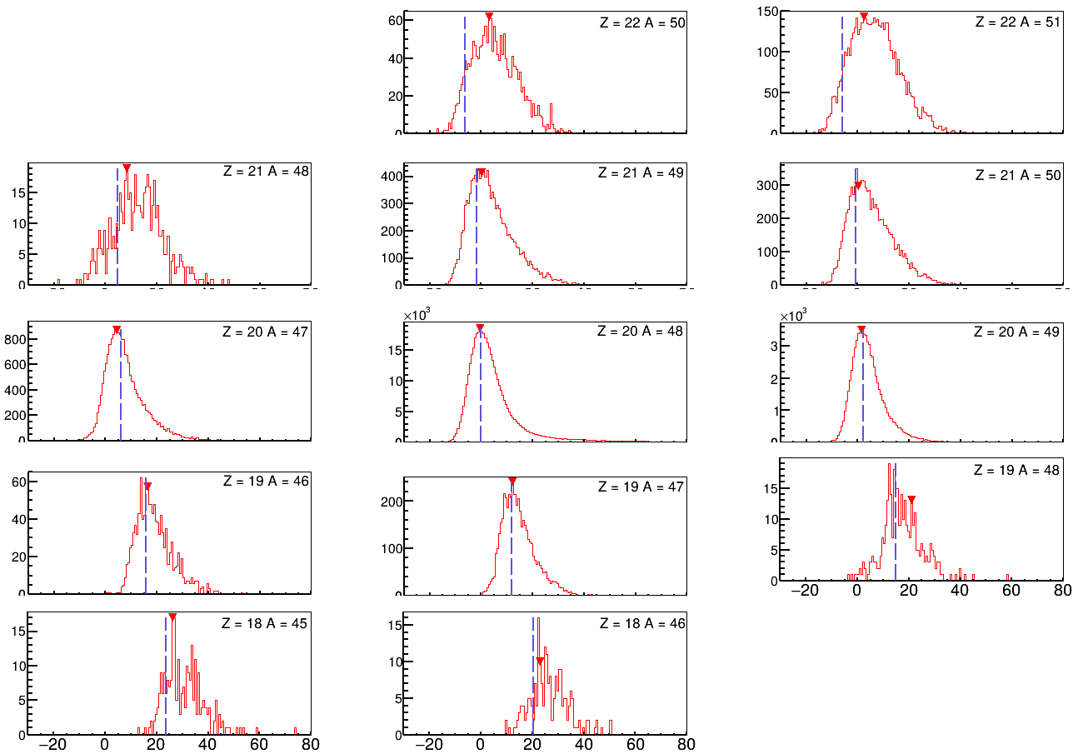
TKEL distribution
The Total kinetic energy loss (TKEL) distribution, reconstructed assuming a binary reaction and imposing the conservation of momentum, for the reaction channels in which one neutron or proton have been transferred are centred around the ground-to-ground-state transitions.
As more nucleons are transferred, a tail toward larger energy losses starts to develop, indicating that secondary processes may contribute.
E = 960 MeV
x10³
TKEL (MeV)
11/11

Slide 10
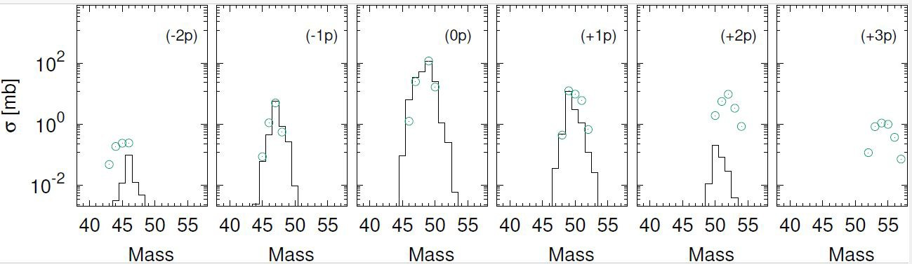
Comparison with GRAZING
E = 960 MeV
Preliminary
Comparison of the experimental yields and total cross section with the GRAZING calculation
There is a good agreement as long 1 proton, 1 neutron and 2 neutrons are transferred but ±2p channels are underestimated. A more detailed analysis of the TKEL and gamma spectra will help to better understand the origin of this underestimation

Slide 11
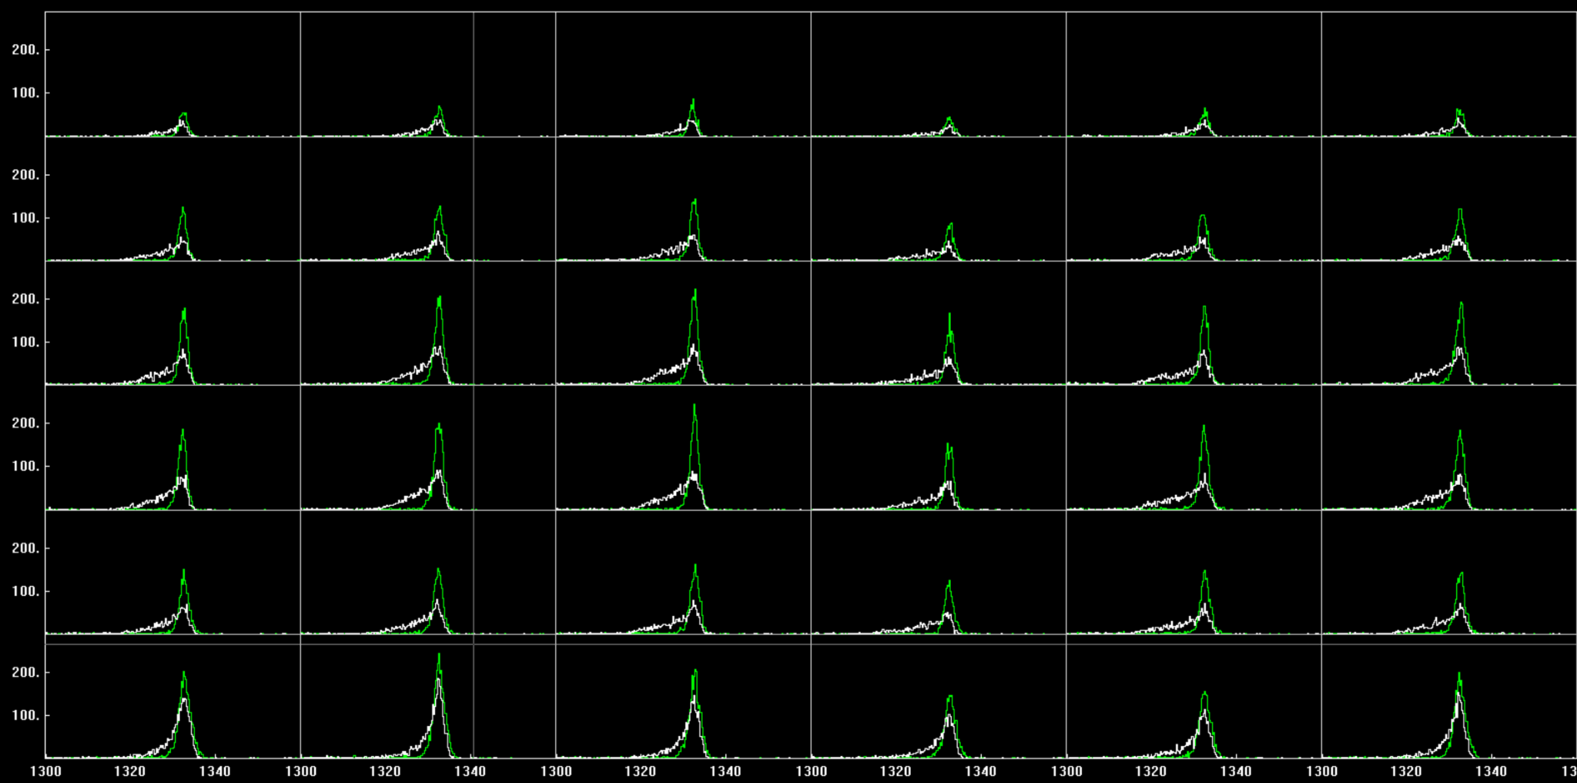
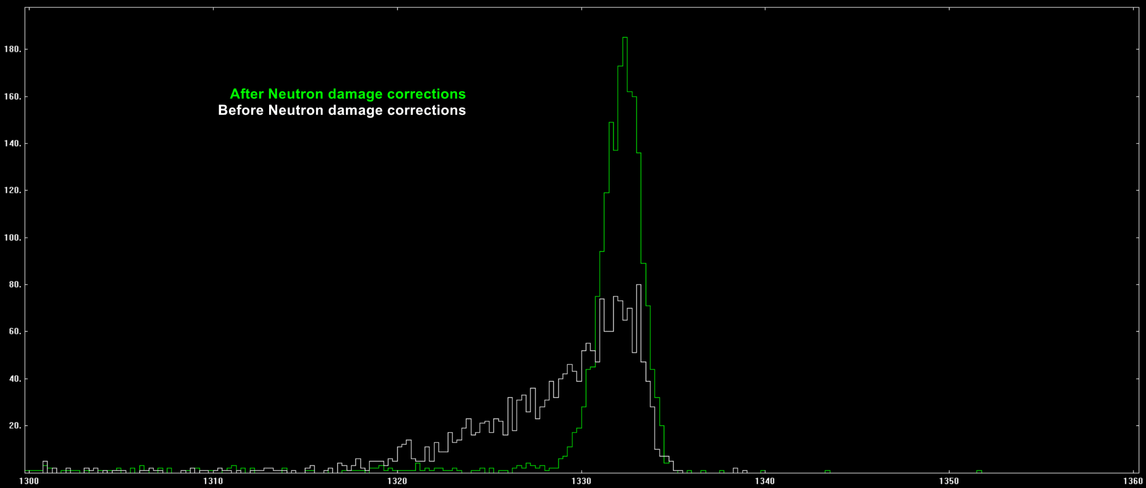
Neutron damage correction
Neutron Damage (ND) from fast neutrons ( E > 1 MeV ) in HPGe detectors causes charge trapping and therefore energy resolution degradation
The typical effect of this neutron damages is a left tail on the peaks.
The objective is obtain the λ_{e,h} (inverse electron / hole trap density) parameters that yield the best possible correction and therefore energy resolution
Crystal 06A

Slide 12
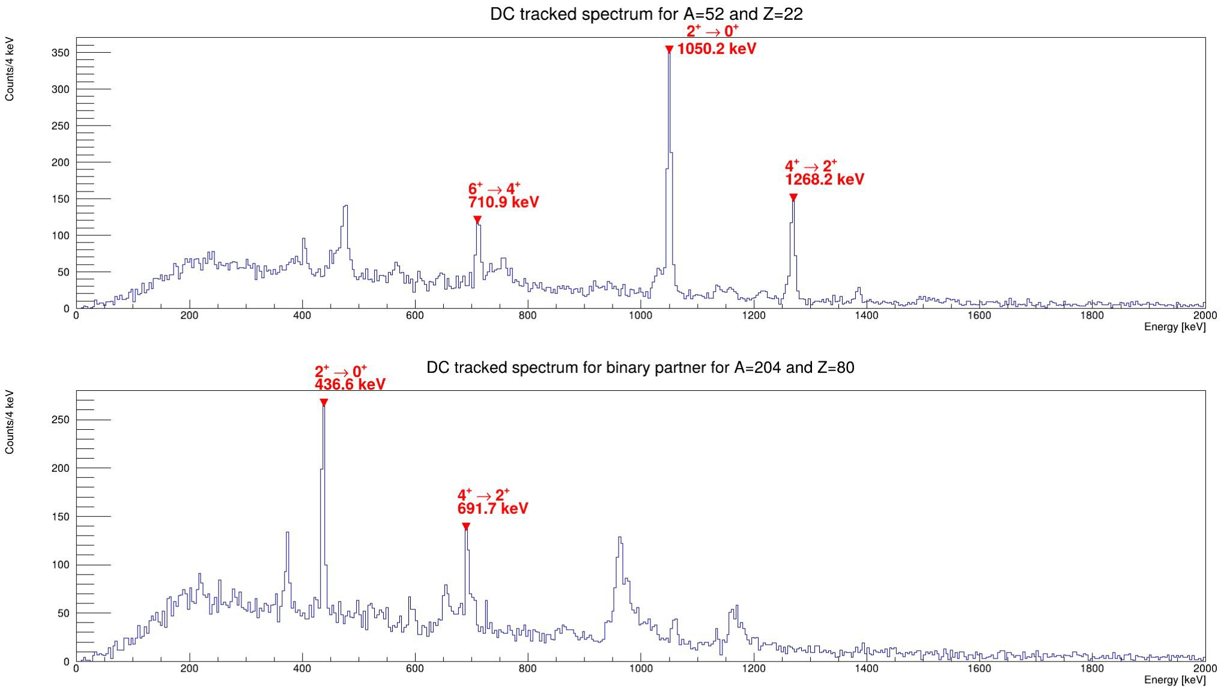
AGATA - PRISMA Coincidence Spectra
52_{Ti}
204_{Hg}
main γ lines identified for the strongest channels. For example, for ⁵²Ti (pick-up of 1 alpha particle) and the binary partner ²⁰⁴Hg the most intense transitions are clearly recognizable.

Slide 13
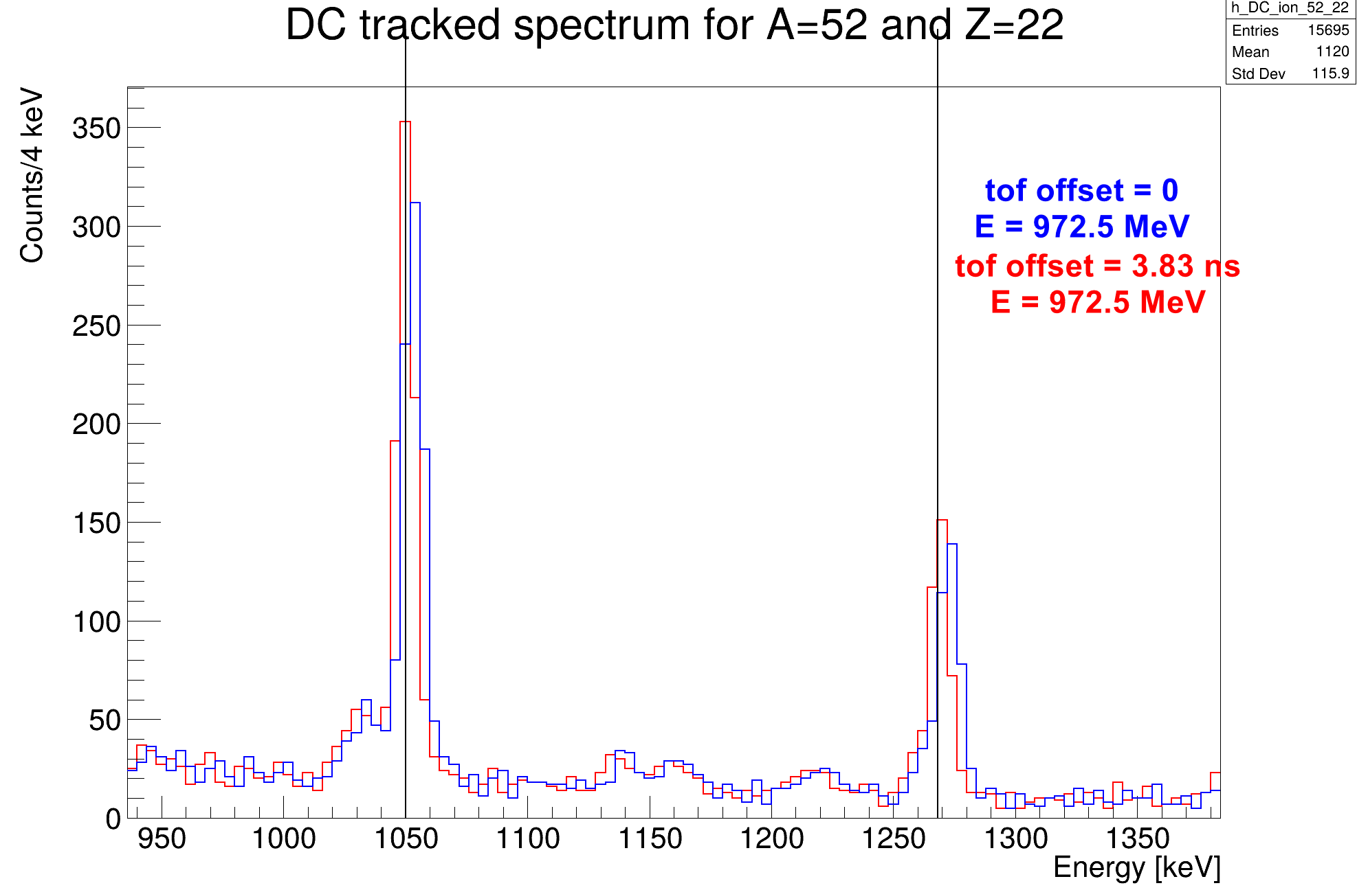
Doppler correction Optimisation
1050.2 keV
Tof offset = 0 ns
Tof offset = 4.6 ns
1268.2 keV
The value of the ToF offset and the beam energy has been adjusted to optimise the Doppler correction for the gamma spectra

Slide 14
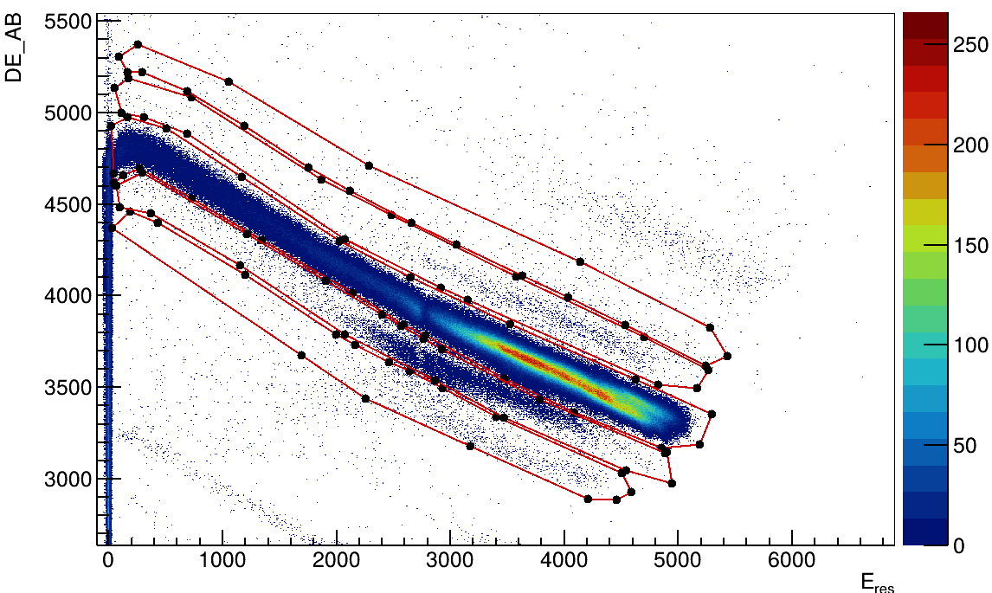
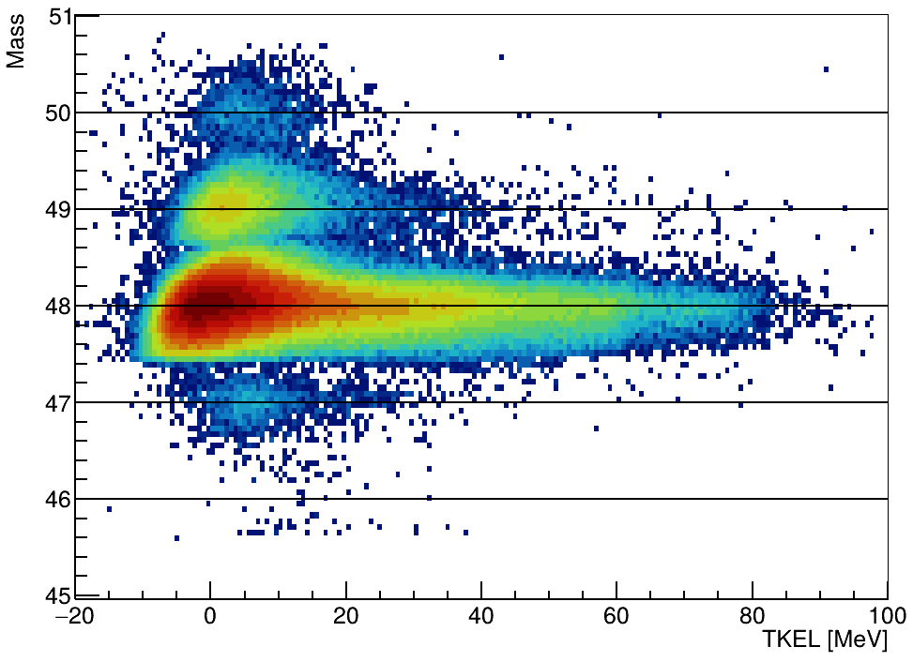
Energy 900 MeV analysis
The same system has been measured also at the beam energy of 900 MeV
(below the Coulomb barrier).
Z = 22
Z = 21
Z = 20
Z = 19
Z = 20
Z = 18

Slide 15
Summary
MNT reactions below the Coulomb barrier
We measured ⁴⁸Ca + ²⁰⁸Pb system around the Coulomb barrier
Z and q identification
Good mass resolution obtained
Q-value calculation
Comparison with GRAZING
AGATA spectra in coincidence with PRISMA for each transfer channel
Doppler correction optimisation
Transfer probability for +1,2n and for +1,2p transfer for two energies (900 MeV and 960 MeV) is ongoing
The 2p channels are under predicted by theory, detailed analysis of the TKEL and gamma spectra will help to give some insight on this underestimation
Results need to be compared also with the highest energy (1000 MeV)

Slide 16



Thank you for your attention!
UIP-2025-02-8168

Slide 17
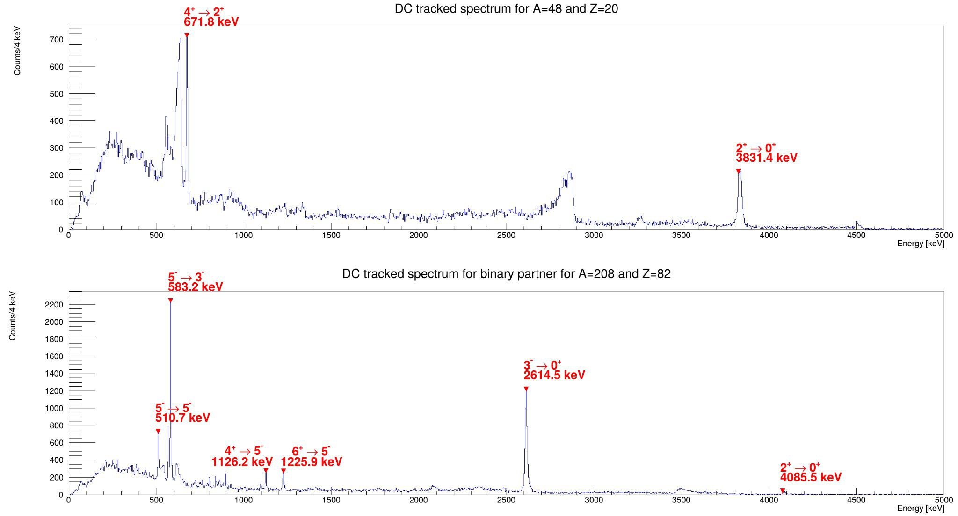
AGATA - PRISMA Coincidence Spectra
48_{Ca}
208_{Pb}
main γ lines identified for the strongest channels. For example, for ⁴⁸Ca and the binary partner ²⁰⁸Pb the most intense transitions are clearly recognizable.

Slide 18
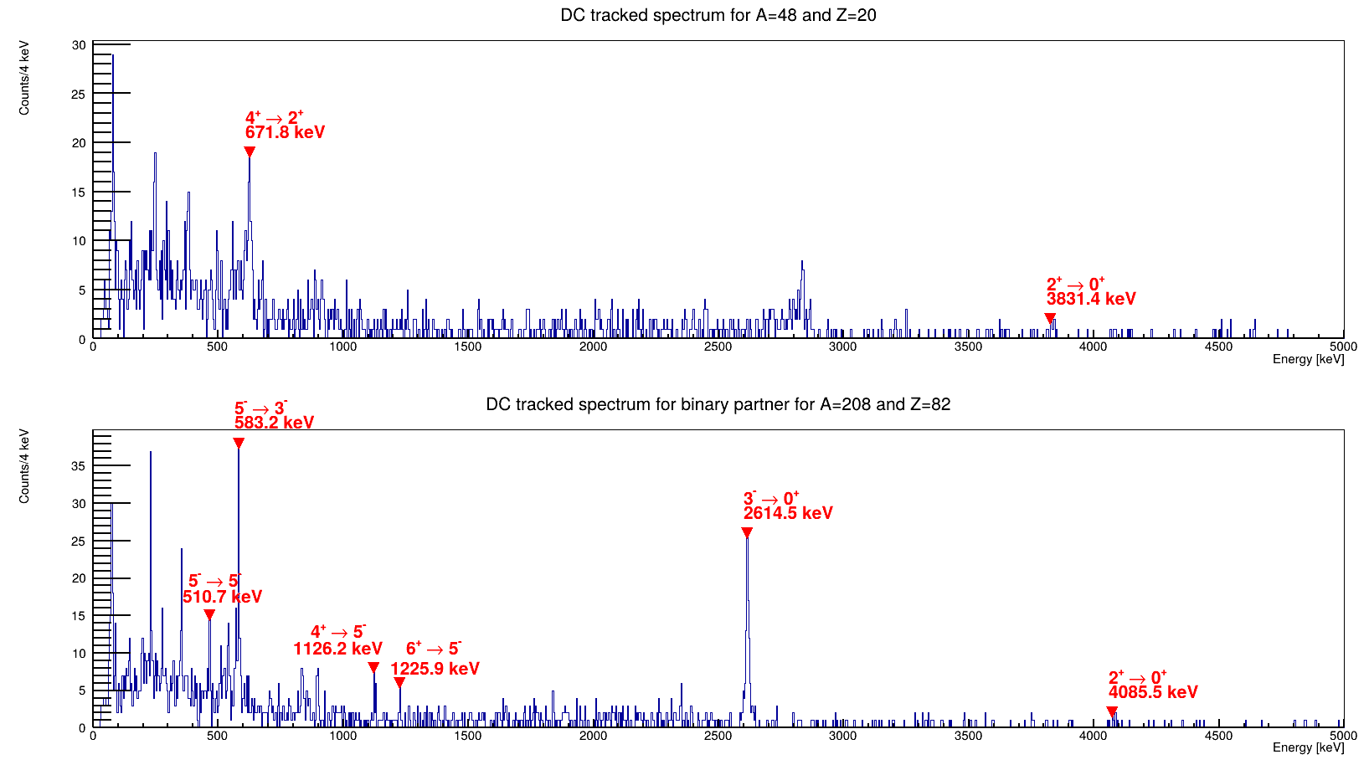
AGATA - PRISMA Coincidence Spectra
48_{Ca}
208_{Pb}
main γ lines identified for the strongest channels. For example, for ⁴⁸Ca and the binary partner ²⁰⁸Pb the most intense transitions are clearly recognisable for the beam energy of 900 MeV.

Slide 19
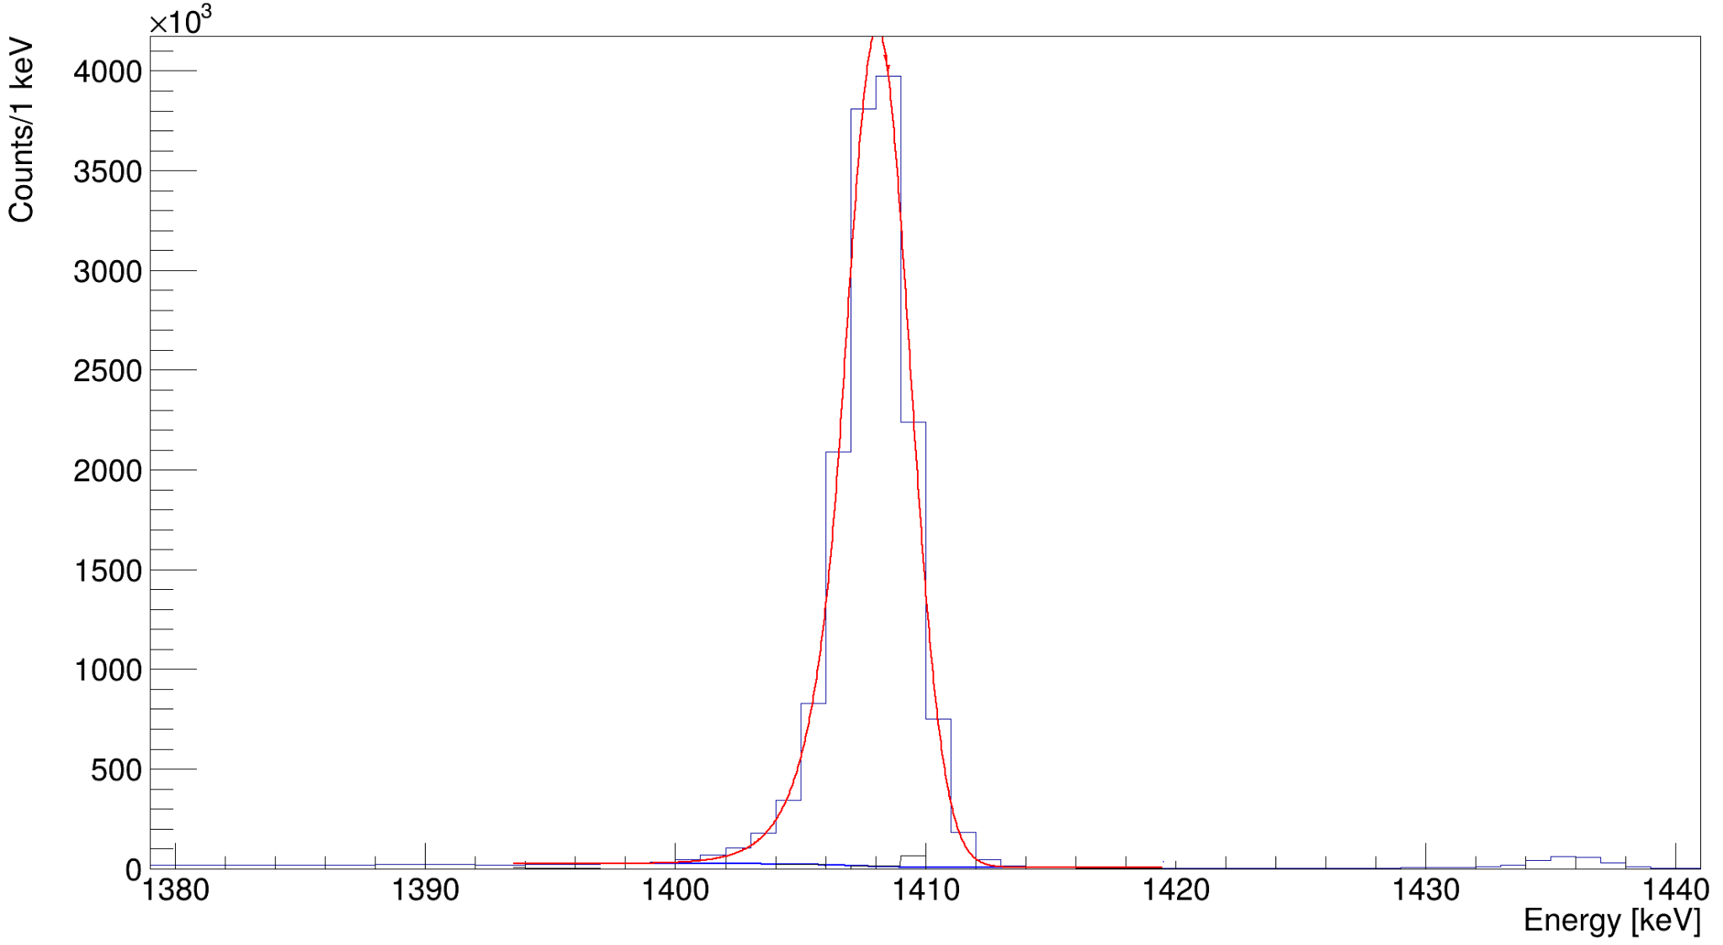
¹⁵²Eu Energy Spectra
Fit Parameters:
Energy = 1408.07 ± 0.01
FWHM = 3.06 ± 0.01

Slide 20
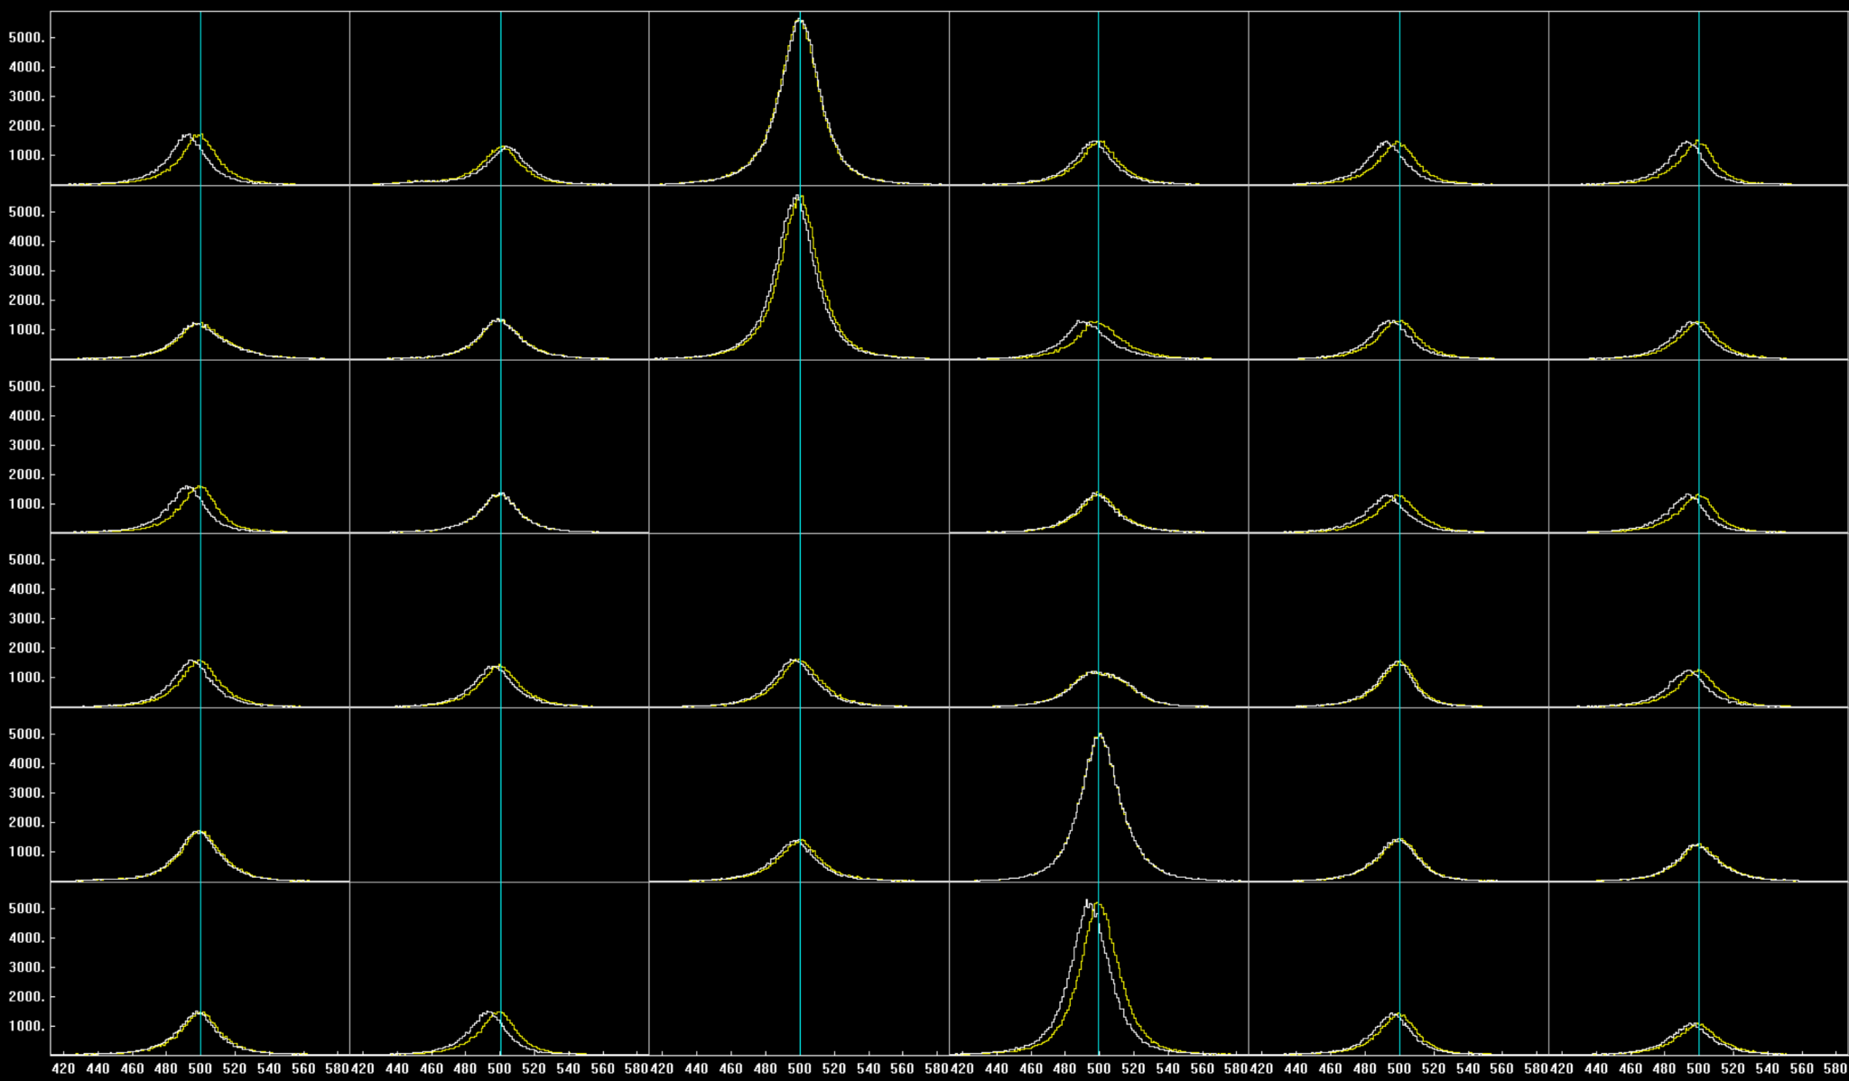
Time alignment of the cores
Crystal 06A
Global Time alignment consist in aligne the time difference of each crystal with all the others at the same value.
This is important to reduce random coincidences.

Slide 21
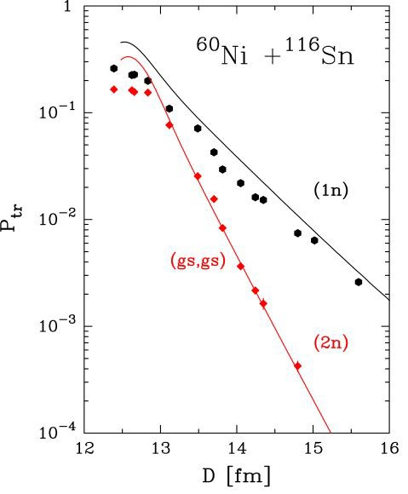
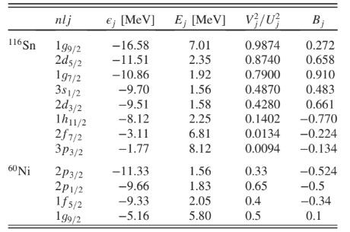
Microscopic calculation ¹¹⁶Sn+⁶⁰Ni
The calculations are performed in a distorted wave Born approximation (DWBA) by using for the wave functions of relative motion their CWKB. For the one-neutron transfer channel, the inclusive cross section is simply obtained by summing up all the contributions coming from the single particle transitions. For the two-neutron transfer channel, we included only the ground to ground state transition in the successive approximation.
For nickel, the spectroscopic factors are obtained from literature while for tin they are not well known experimentally and, therefore has been calculated them via a BCS transformation

Slide 22
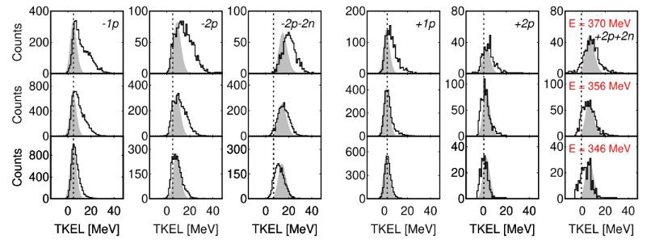
MNT reactions below the Coulomb barrier
Measurement at energies below the Coulomb barrier results in: very narrow TKEL-value distributions: no secondary eﬀects and allow to probe nucleon-nucleon correlations as close as possible to the ground to ground states.
Proton pair transfer studies so far performed mostly above the Coulomb barrier
For the ⁹²Mo + ⁵⁴Fe system, below the barrier, all TKEL distributions become narrower, reflecting a transition to predominantly direct processes.
T. Mijatović Phys. Lett. B 872 (2026) 140085

Slide 23
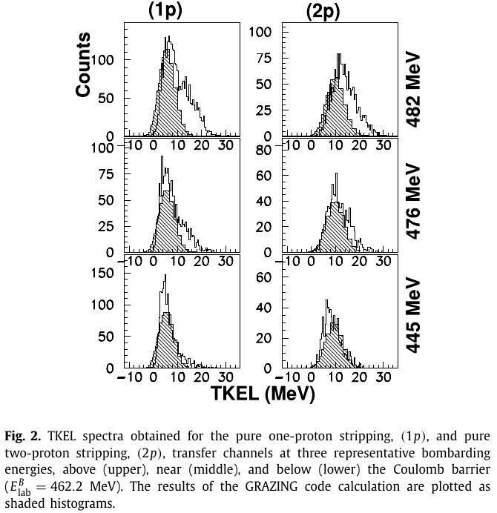
Proton transfer channels: ¹¹⁶Sn+⁶⁰Ni
More data needed for p transfer channels in diﬀerent systems
We propose to study n-rich system and both p stripping and pickup channels
GRAZING calculation (independent nucleon transfer) is underpredicting experimental results for -2p channel by a factor 60
L. Corradi et al., Phys. Lett. B 834 (2022) 137477

Slide 24
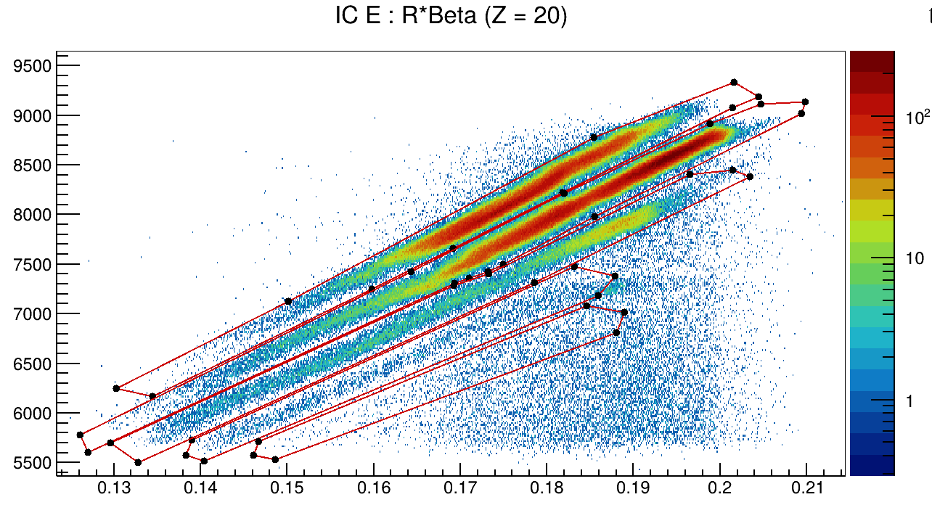
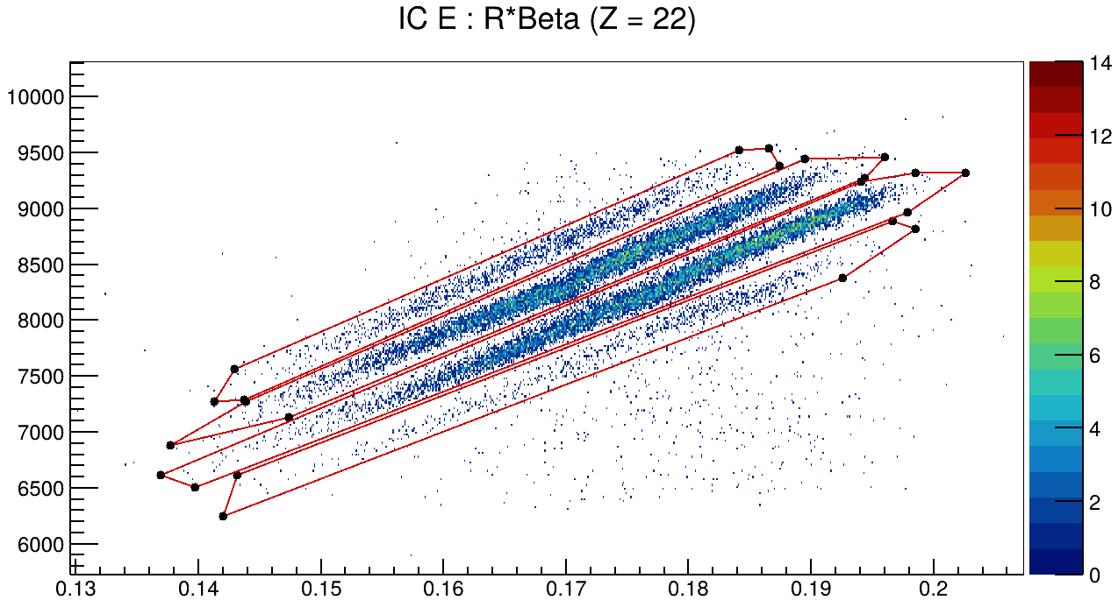
Atomic charge state identification
The atomic charge state (q) can be recognized from the relation between the total energy
obtained from the IC (E_{IC}) and the product of the curvature radius and the ions speed (Rβ) From the E_{IC} vs Rβ matrix the diﬀerent charge states can be identified for each value of Z.
q = 20
q = 19
q = 22
q = 21
q = 20
q = 18
q = 19
q = 16
q = 17

Slide 25
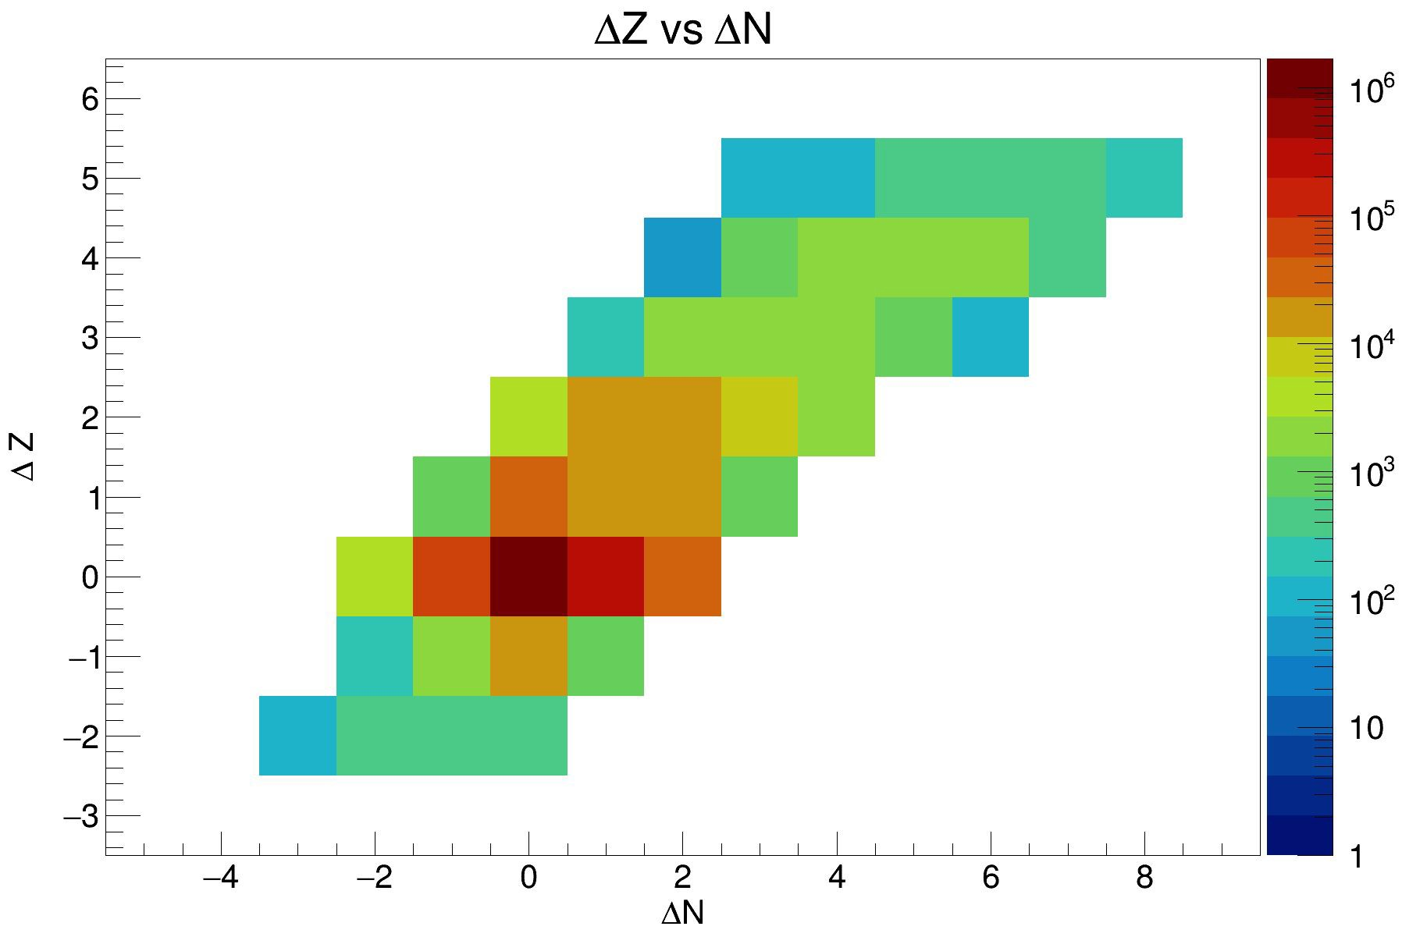
Mass identification
Up to five proton
pick-up channels were observed, as well as proton stripping down to -2
For neutrons the observed channels are up to eight neutron pick-up, as well as stripping down to -3

Slide 26
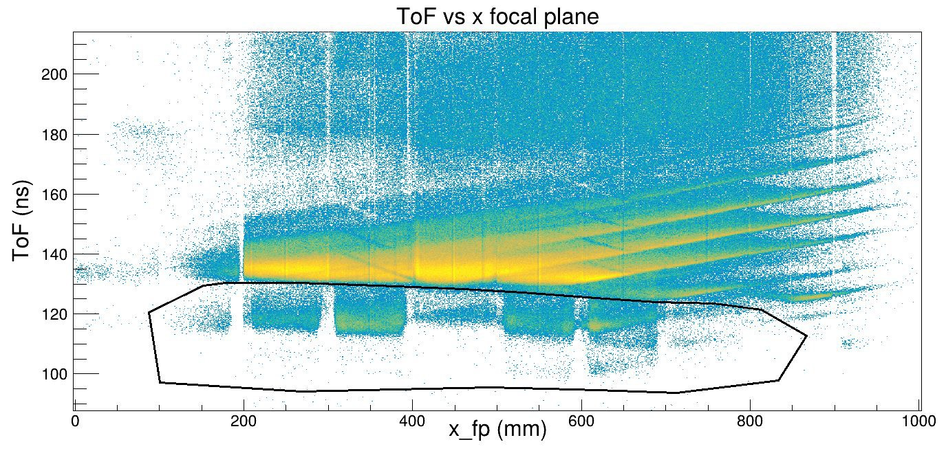
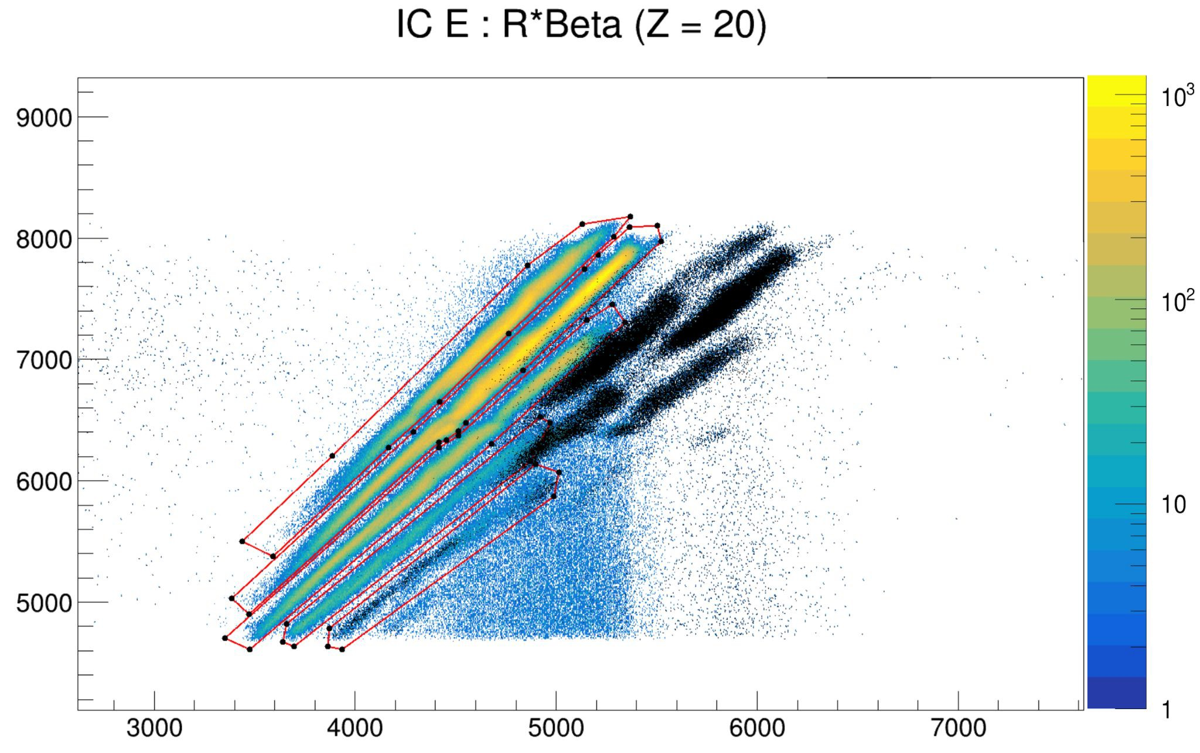
Atomic charge state identification
Charge state identification using E_{IC} vs Rβ.
Repetitions in the time of flight spectrum can be seen in the E_{IC} vs Rβ spectra
q = 20
q = 19
q = 18
q = 17
q = 16

Slide 27
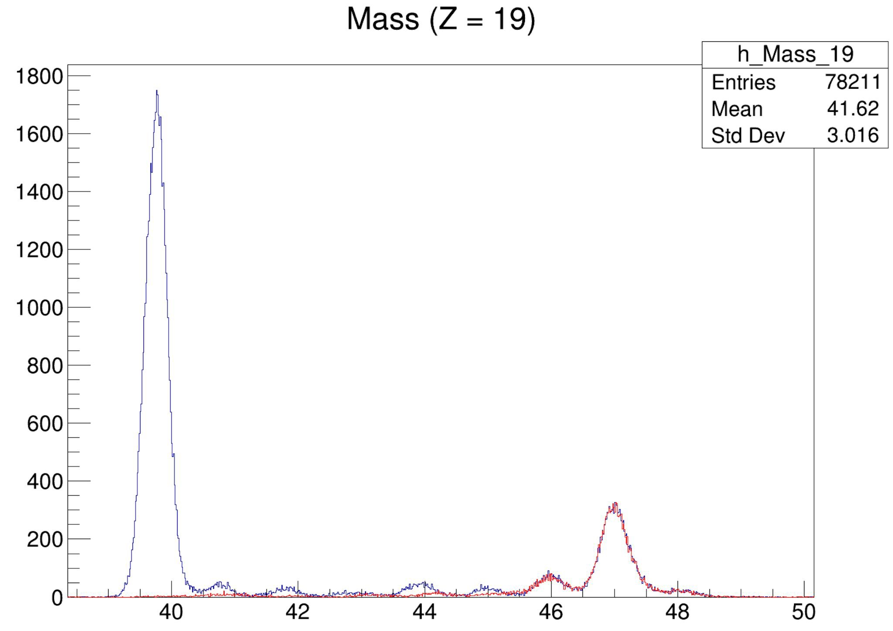
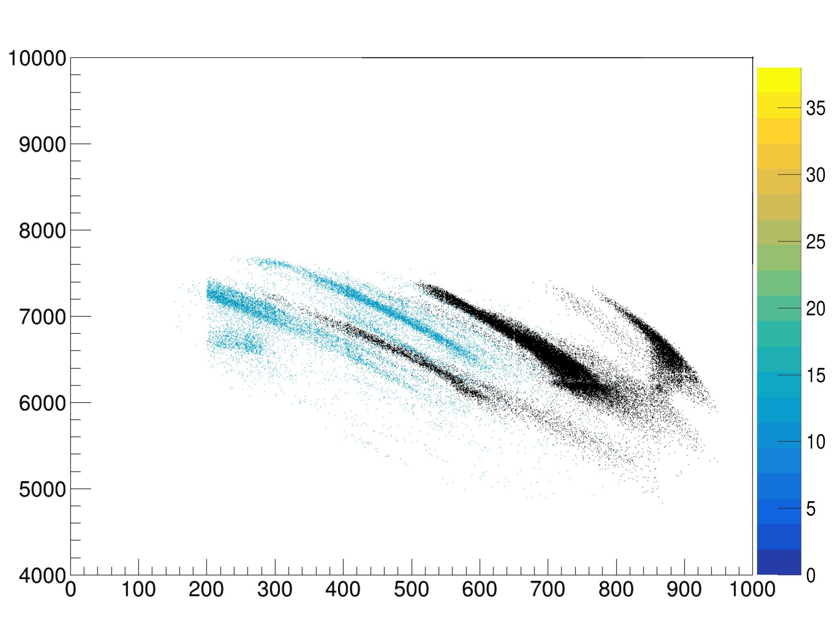
Mass contaminant
Presence of contaminant in mass spectra for Z = 19 and Z = 18
The reason is still not clear, most likely be caused by the presence of ³⁹K in the target
Contaminant at mass ≈ 39
IC_E vs Rβ IC_E vs X_fp
Z = 19
q = 19
The contaminant can be removed thanks to the Energy vs x focal plane spectrum where there is good separation between contaminant and Ca-like events
q = 18
contaminant
X_fp (mm)
19/11

Slide 28
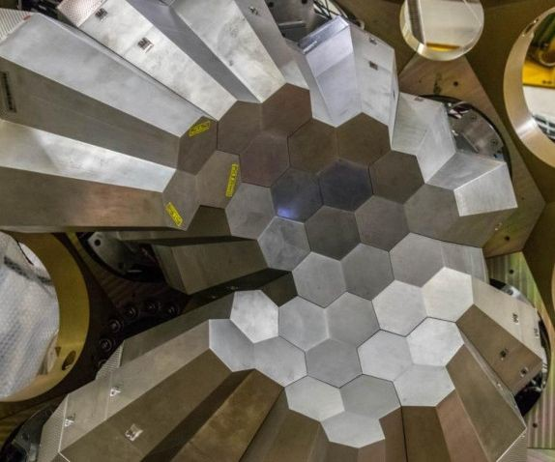
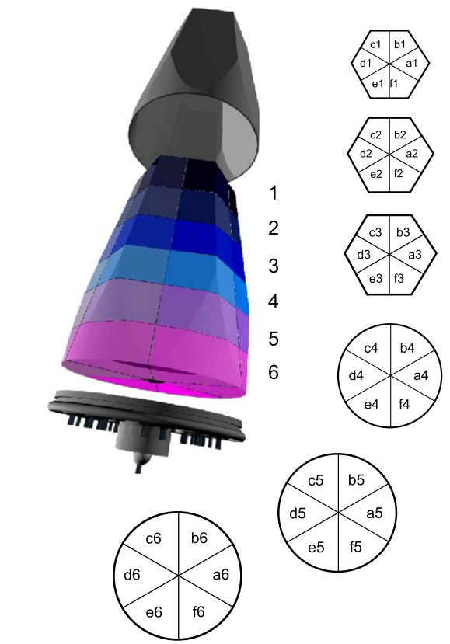
The 𝛾-spectrometer AGATA
34 High Purity Germanium (HPGe) crystals
Each crystal is segmented longitudinally and radially in 6 sections for a total of 36 sections
Very precise estimation of the position of interaction of the photons (within 4 mm)
Tracking algorithms to reconstruct the events from 𝛾-rays Compton scattering
S. Akkoyun et al. Nucl. Instrum. Methods Phys. Res. A 668 (2012), p. 26
J.J. Valiente-Dobon et al., Nucl. Inst. Meth. Phys. Res. A 1049, 168040 (2023)

Slide 29
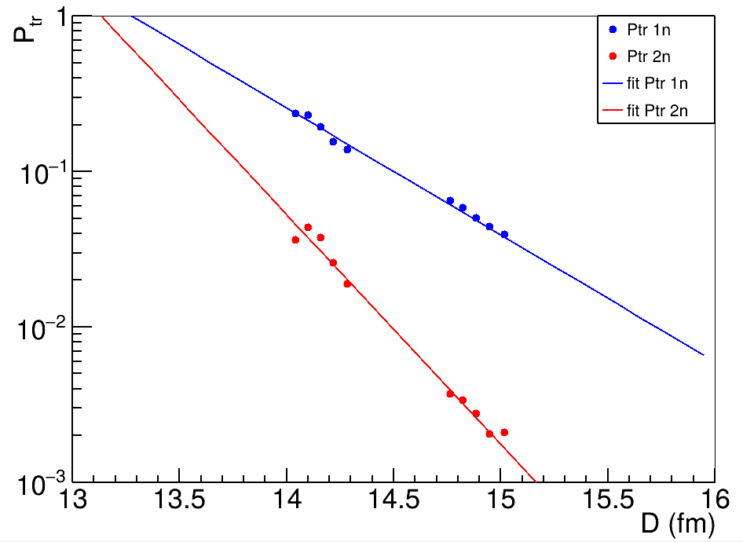
Transfer Probability
The transfer probability (Ptr) for the 1n (and 2n) transfer has been obtained as the ratio between the number of events for the 1n (and 2n) transfer and the number of events in the elastic+inelastic channel.
The Ptr has been extracted for the energies of 960 MeV and 900 MeV
The Ptr for the two energies are in good agreement and the data for the transfer of 2n are well reproduced by the square of the fit for the transfer of 1n
Preliminary
Results

