Slide 1





Spectroscopy and fission studies in inverse kinematics: ²⁰⁸Pb + ⁹Be with AGATA and PRISMA
Report on EXP_009 (LNL 22.23)
Filippo Angelini
GSI
AGATA Collaboration Council Meeting
Warsaw, 8th September 2026

Slide 2
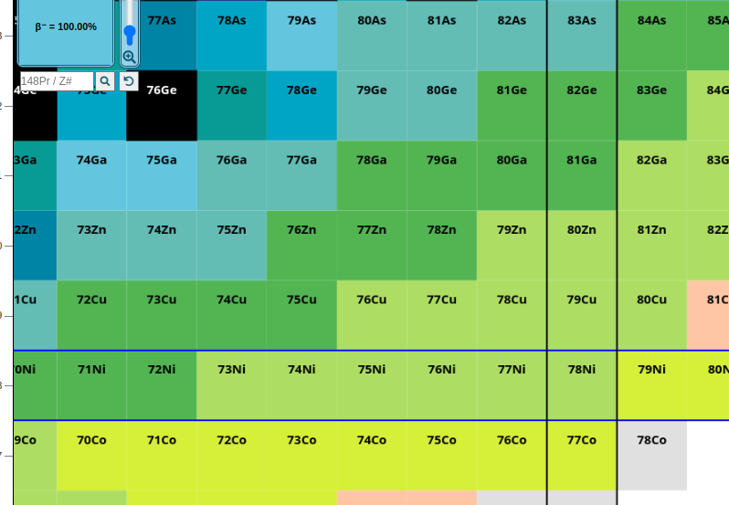
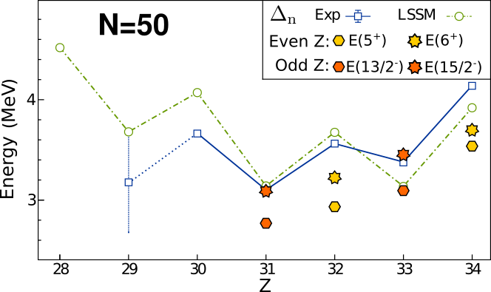
Evolution of N = 50 shell gap
Decrease in the N=50 energy gap towards ⁷⁸Ni: compatible behaviour with two different methods
Mass measurements: decrease of gap up to ⁸¹Ga
Re-increase measured for ⁸⁰Zn
2. "Spectroscopic" gap estimated from energy of lowest core-breaking
neutron excitations in N=50 isotones
S. Baruah et al., Phys. Rev. Lett. 101, 262501 (2008)
J. Hakala et al., Phys. Rev. Lett. 101, 052502 (2008)​
Δ n = BE(Z,N=51)+BE(Z,N=49)-2⋅BE(Z,N=50) Mass gap
5⁺,6⁺,7⁺ states in even Z, 13/2⁻, 15/2⁻ in odd Z
In ⁸⁰Zn J≥5 cannot be reached only by valence protons
1p-1h neutron excitations
J. Dudouet et al, Phys. Rev. C 100, 011301(R) (2019)​
Spectroscopy of ⁸⁰Zn​
Fission populates medium-high spins
T. Rzaca-Urban et al., Phys. Rev. C76, 027302 (2007)
<number>

Slide 3
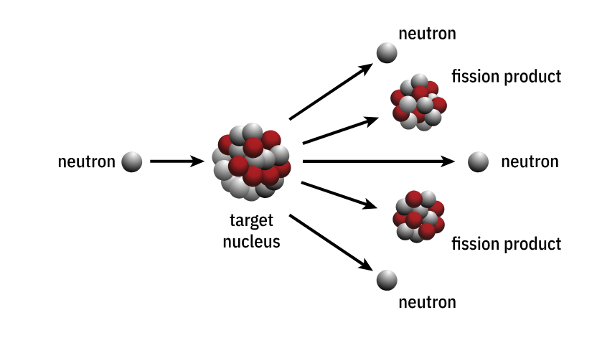
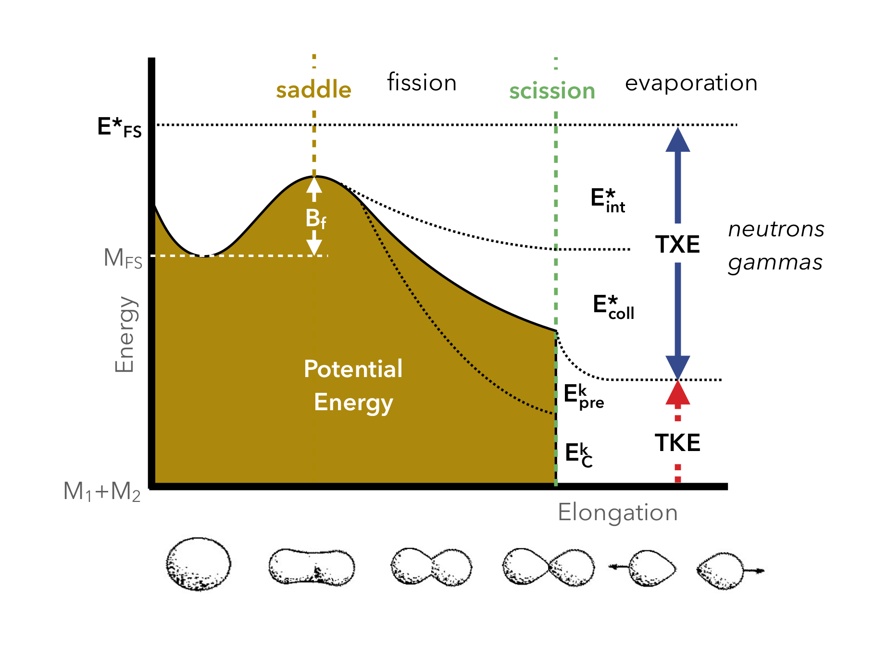
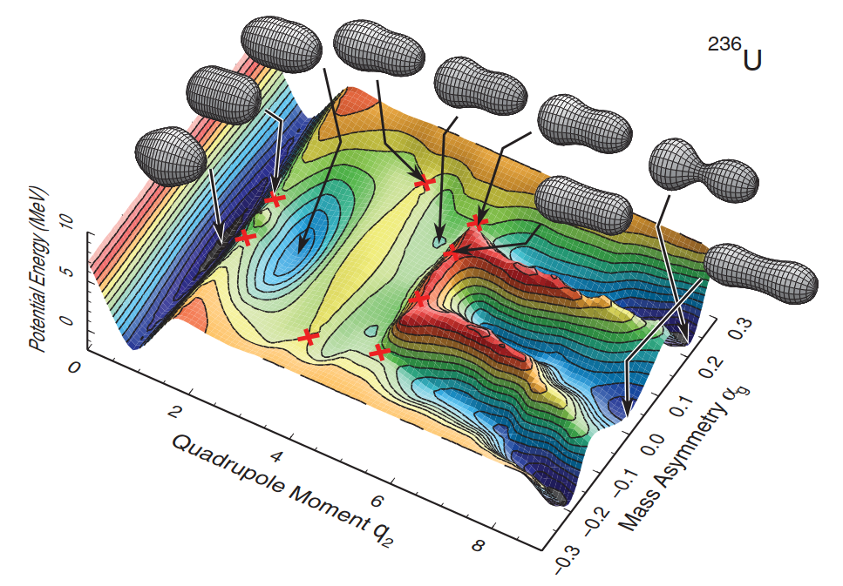
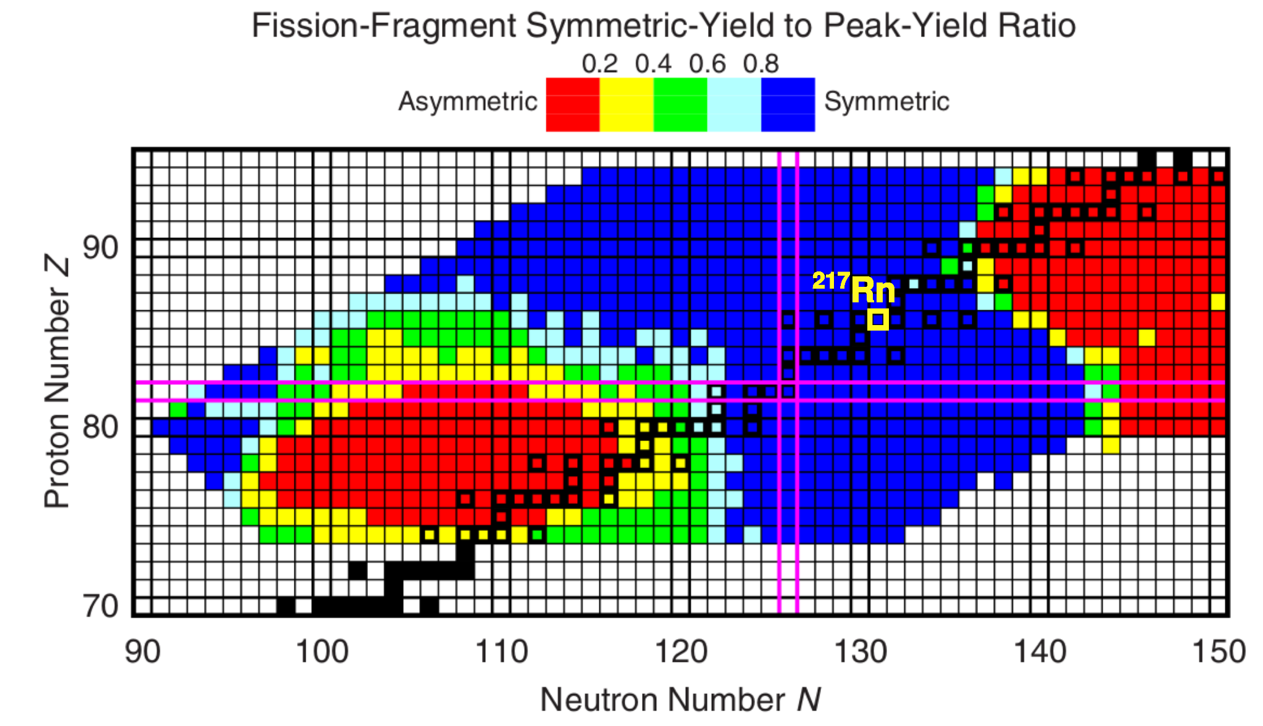
Fission dynamics: ²¹⁷Rn
Fission fragment
Fission: splitting of heavy nucleus into two fragments
Deformation until saddle point
Coulomb repulsion of fragments -> scission
Fragments share Total Excitation (TXE) and Kinetic Energy (TKE)
Neutron evaporation ν (pre- and post-scission)
Compound
nucleus
n
Liquid drop model could not reproduce data: added nuclear shell effects
(Deformed) nuclear shell closures impact on the isotopic yield distributions: multiple fission modes
For ²¹⁷Rn, symmetric fission is expected at low E*
Shell effects should be small and washed out by high E*, but no study was done.
T. Ishikawa et al., Phys. Rev. C 86, 024610 (2012)
²⁰⁸Pb + ⁹Be fusion-fission to study fission observables from ²¹⁷Rn
P. Möller and J. Randrup, Phys. Rev. C 91, 044316 (2015)
<number>

Slide 4
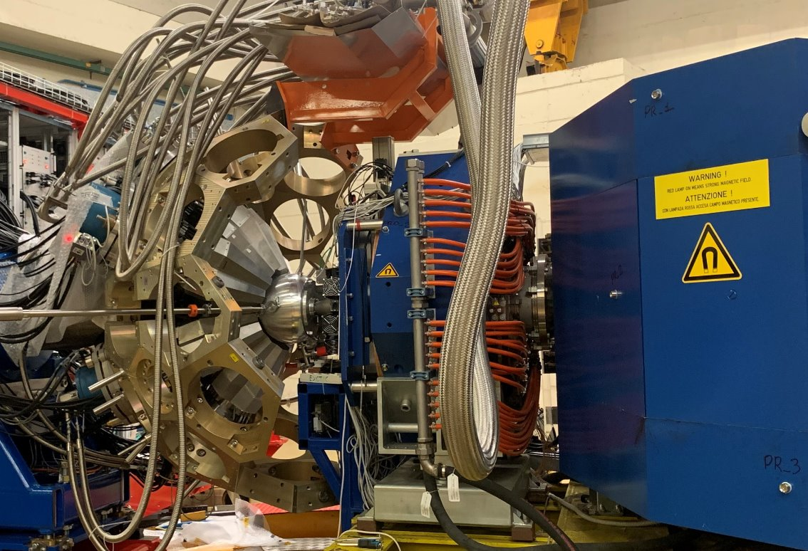
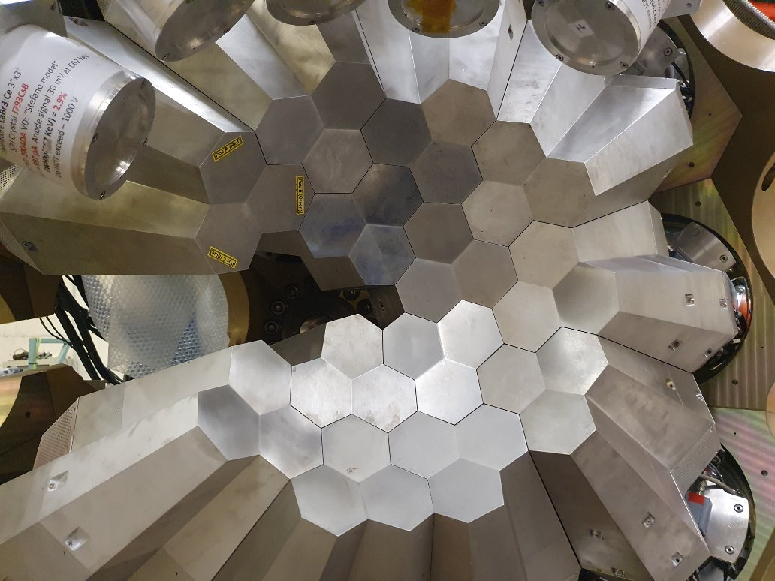
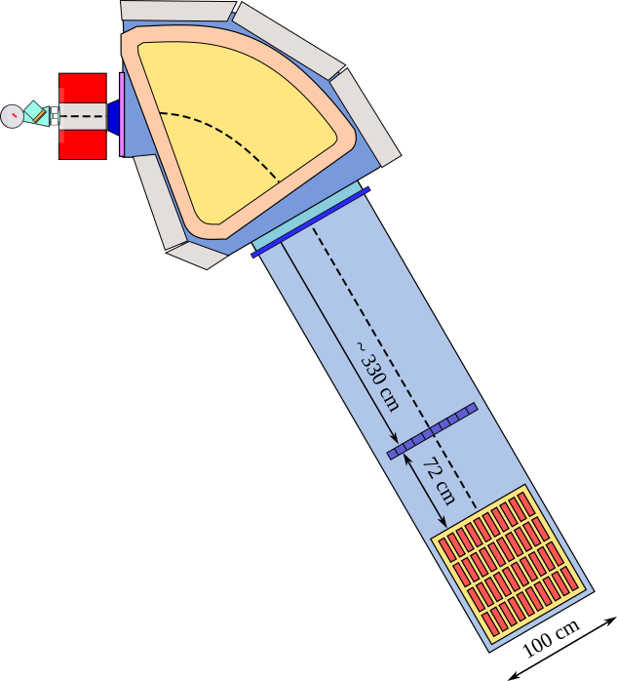
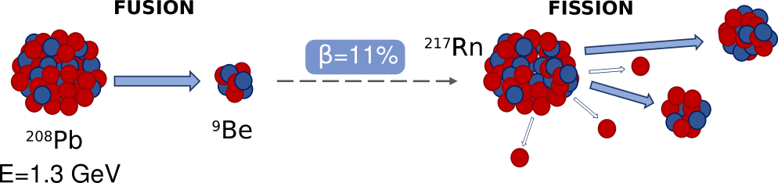
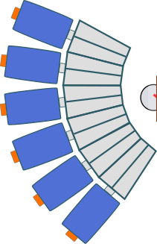
²⁰⁸Pb+⁹Be inverse kinematics fusion-fission
Exp. 22.23, december 2022
First ever experiment measuring inverse-kinematics fission at INFN-LNL (Italy) with AGATA + PRISMA
Isotopic identification of fission fragments with PRISMA at 20°-23°
Measurement of de-excitation ɣ rays with AGATA
Doppler correction of ɣ rays with AGATA + PRISMA
Spectroscopy of N=50 nuclei
Fission dynamics of ²¹⁷Rn
PRISMA: Large acceptance magnetic spectrometer
AGATA:
Advanced GAmma-ray Tracking Array
CN: ²¹⁷Rn with E_{ex} = 33.0 MeV, J = 15.6 ħ
<number>

Slide 5
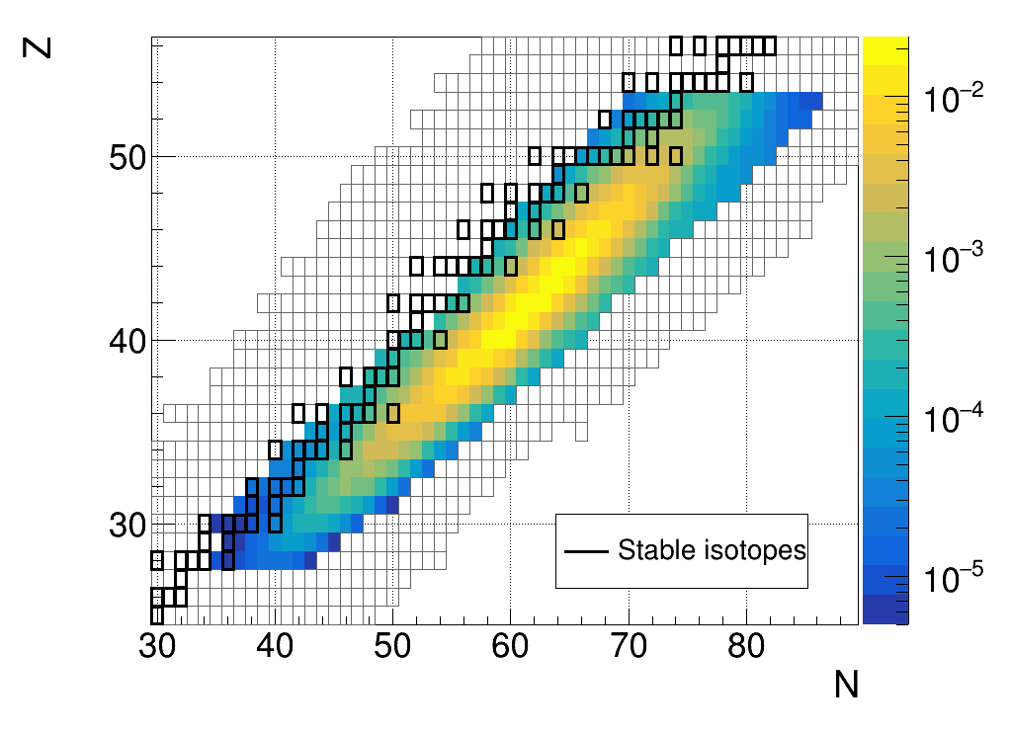
Previous year and current status
Last year's status:
Global identification of fragments
New transitions for nuclei with Z=29-32, N=40-50
Extract fission yields for ²¹⁷Rn fission
This year's to do list:
Comparison of fission observables with models (GEF)
<number>

Slide 6
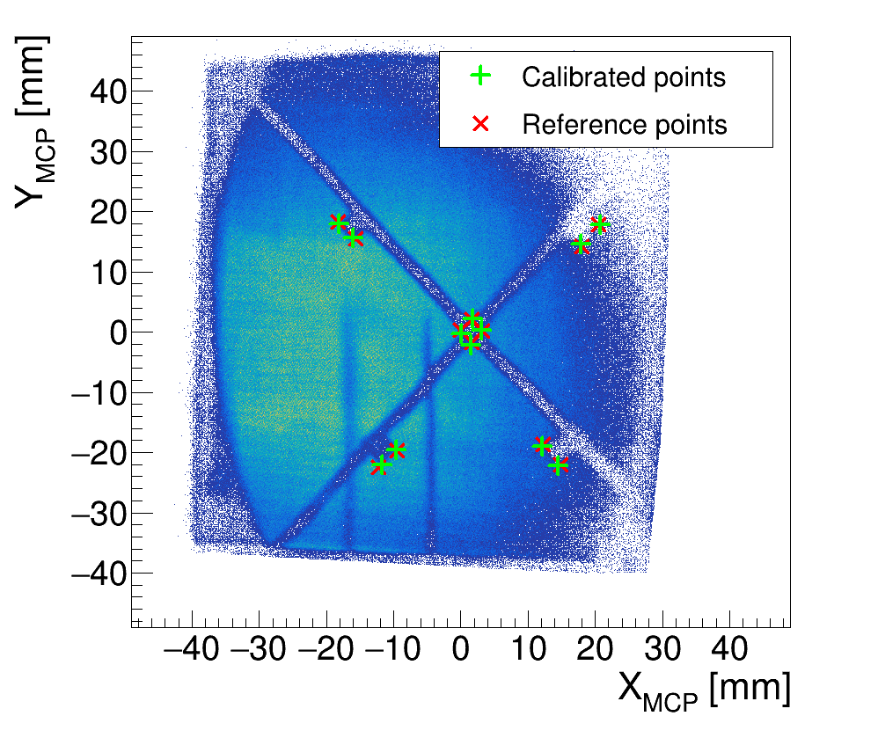
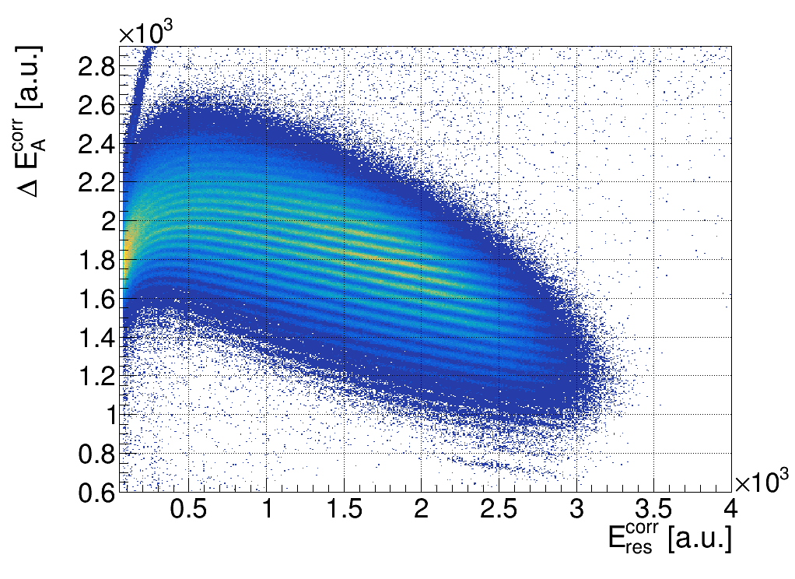
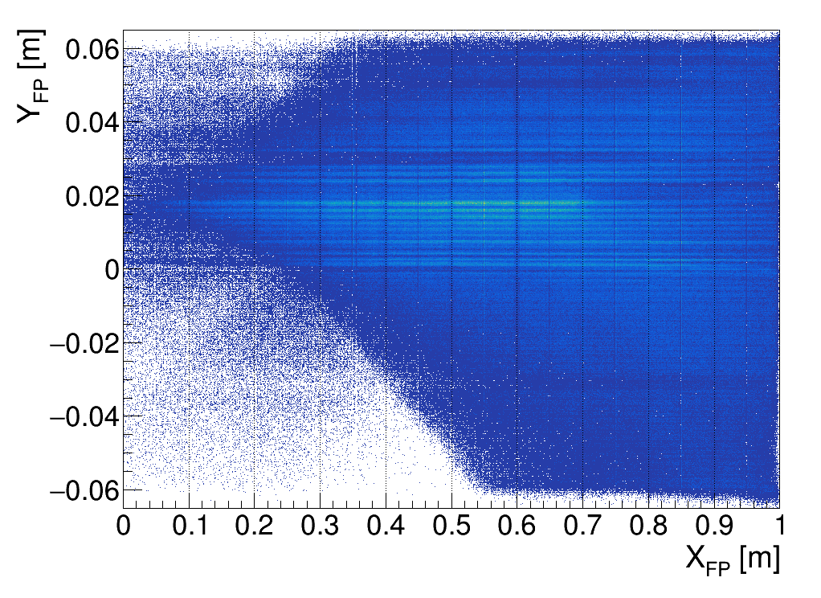
PRISMA spectrometer
Functions:
Trajectory reconstruction
Velocity measurement
A,Z identification
Dipole
MWPPAC
Micro Channel Plate (MCP)
Entrance detector
X,Y measurement de
Time signal (ToF delayed stop)
A
B
C
D
Ionization Chamber
(IC)
10x4 pads (Energy)
dE vs Eres to discriminate Z
Quadrupole
Ionization chamber
Target
MCP
S. Szilner, C.A. Ur et al., Phys. Rev. C 76, 024604 (2007)
Multi-Wire Parallel Plate Avalanche Counter
(MWPPAC) - "Focal Plane" detector
10 independent sections
X,Y measurement
Time signal (ToF start)
<number>

Slide 7
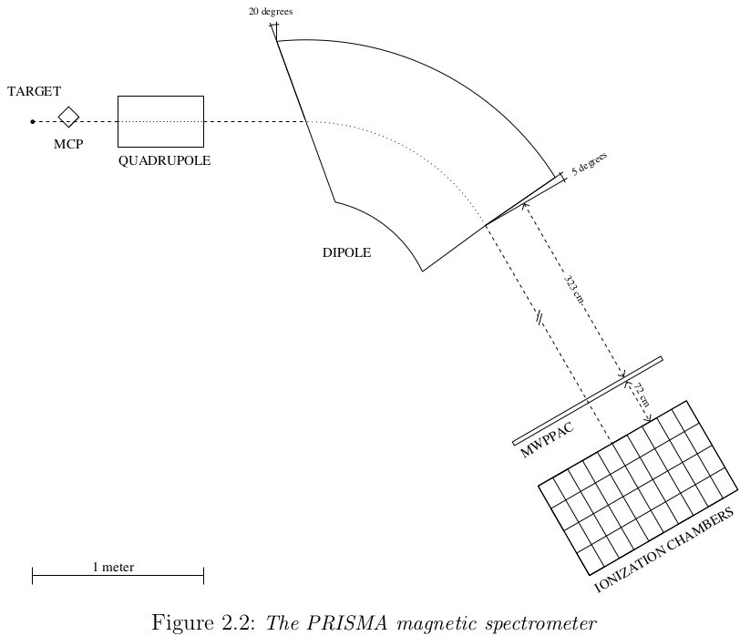
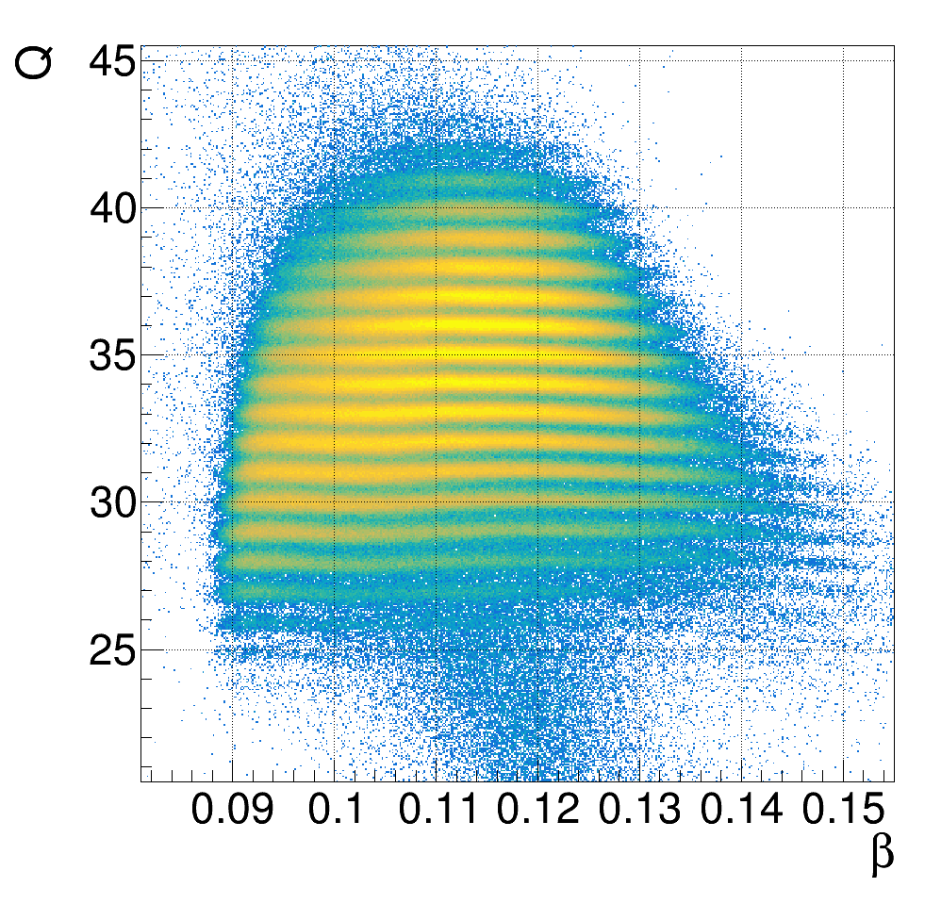
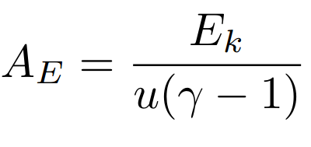
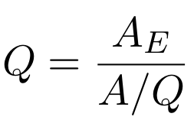
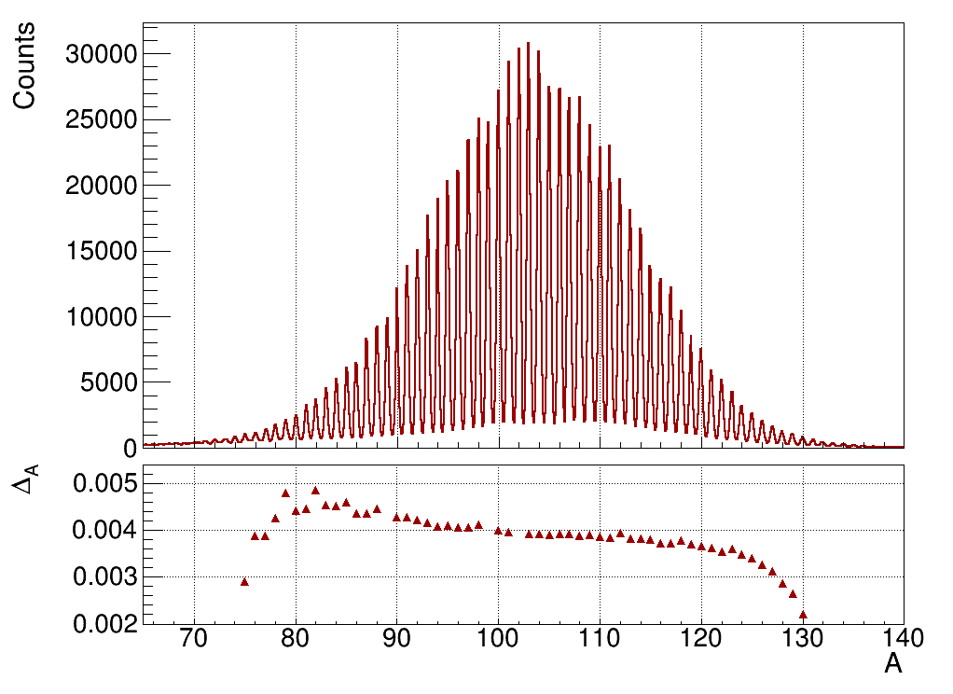

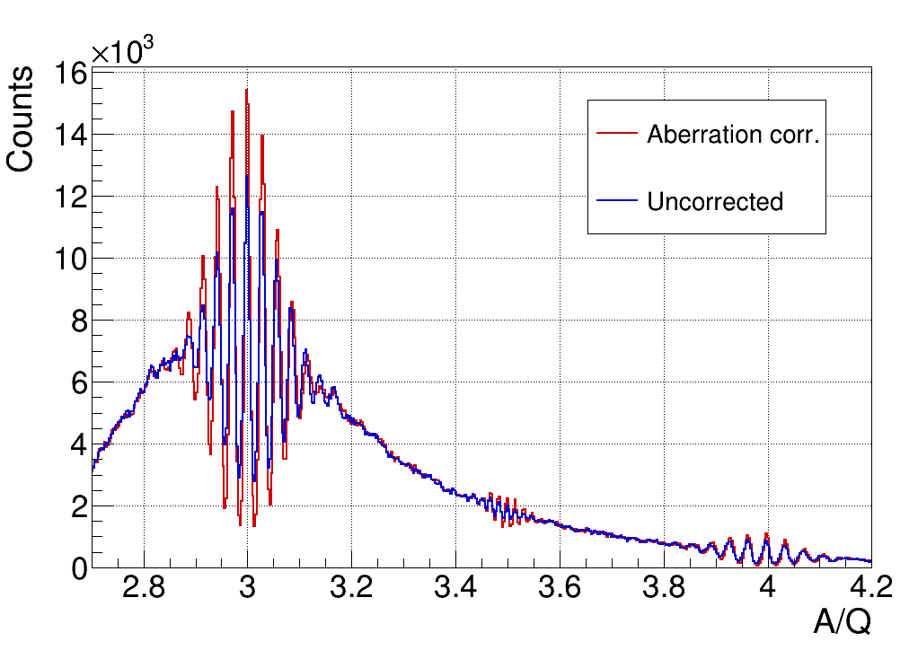
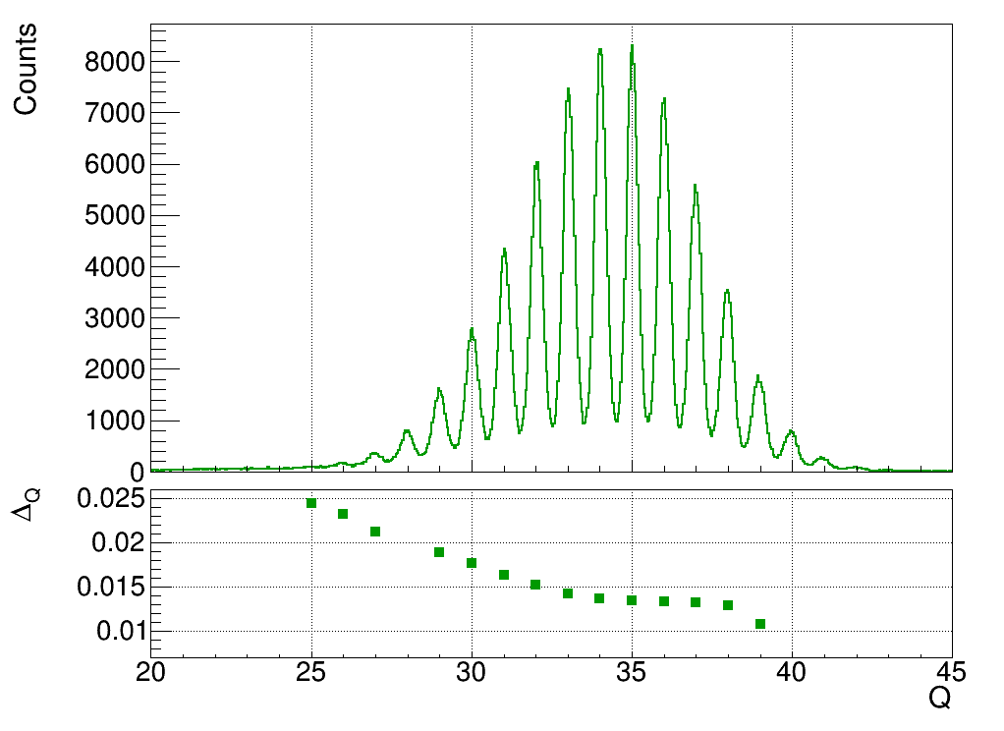
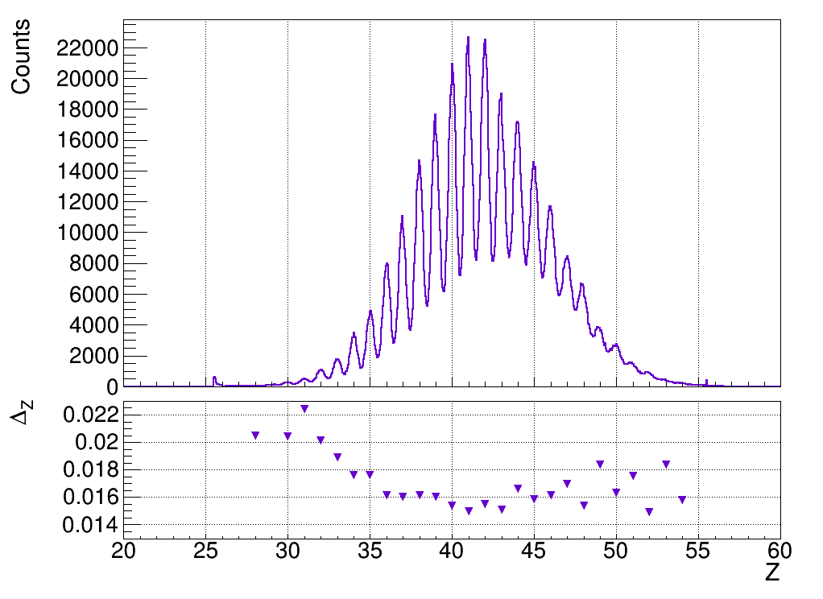
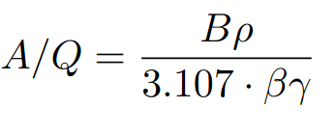
PRISMA identification
(X,Y)
X_{MCP,} Y_{MCP,} X_{FP}
Trajectory
reconstruction
X
Bρ, L
Correction of aberrations against positions at the MCP and PPAC
ΔA/A ~ 1/250
Charge State Q
Atomic number Z
Mass A
ΔQ/Q ~ 1/60
ΔZ/Z ~ 1/60
<number>

Slide 8
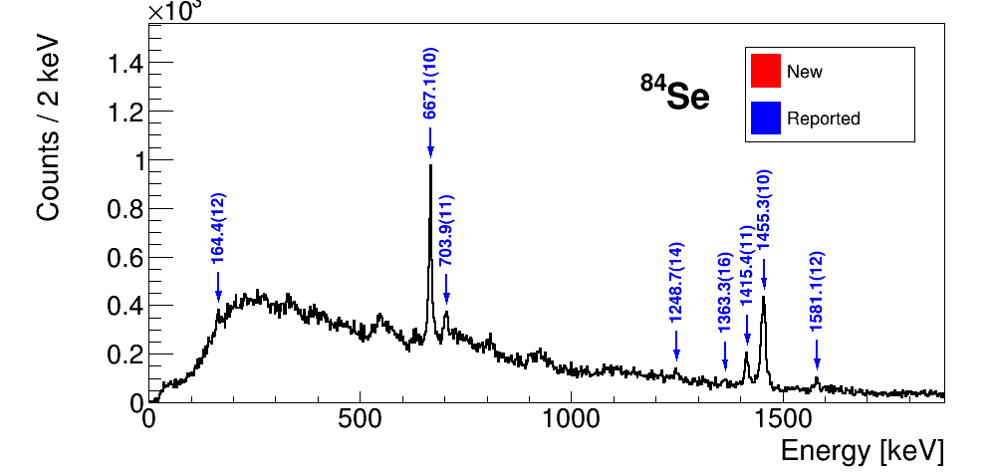
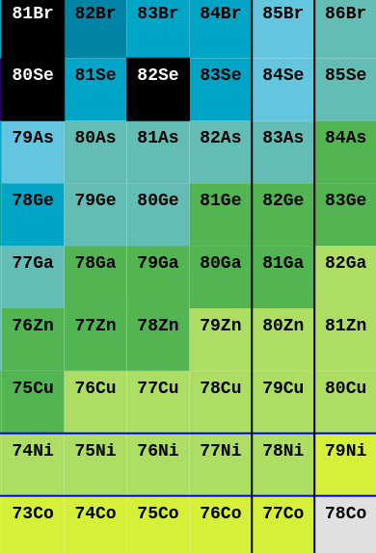
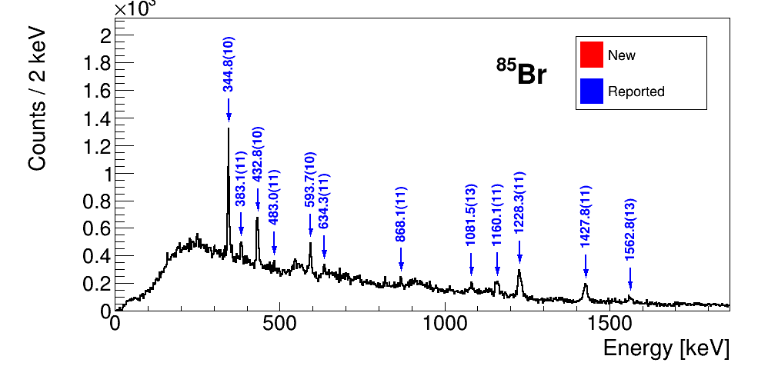
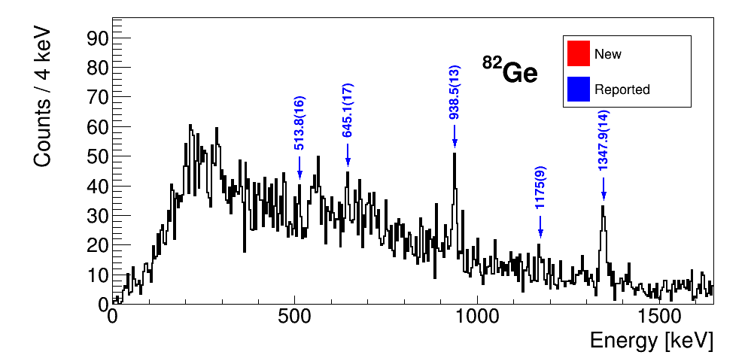
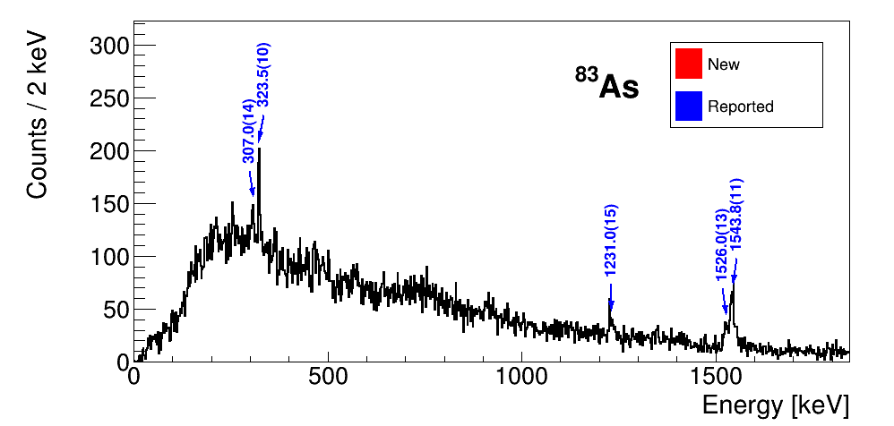
Gamma-ray spectroscopy: N=50 isotones
Z=28
Technical issues with trigger:
not enough statistics to see lightest N=50 nuclei
N=50
Core-breaking n excitations (~gap size)
<number>

Slide 9
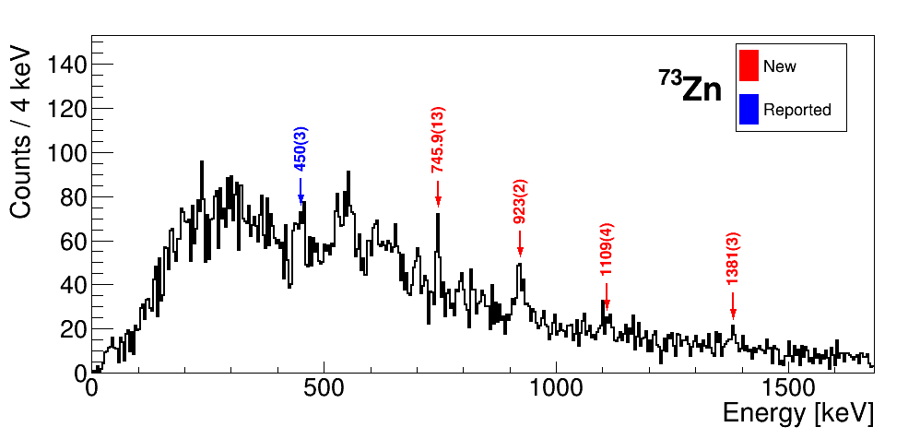
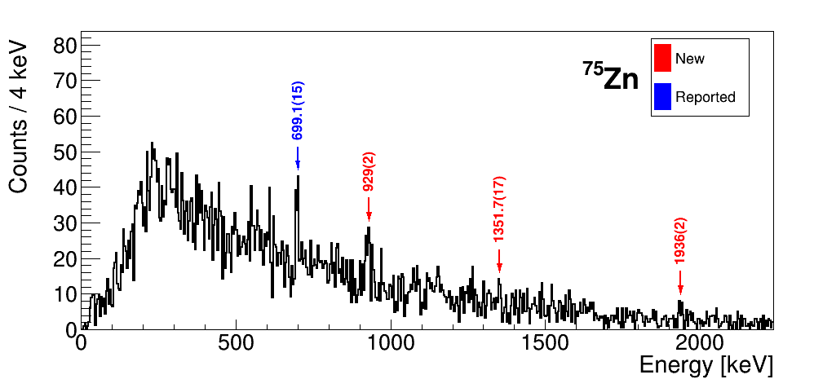
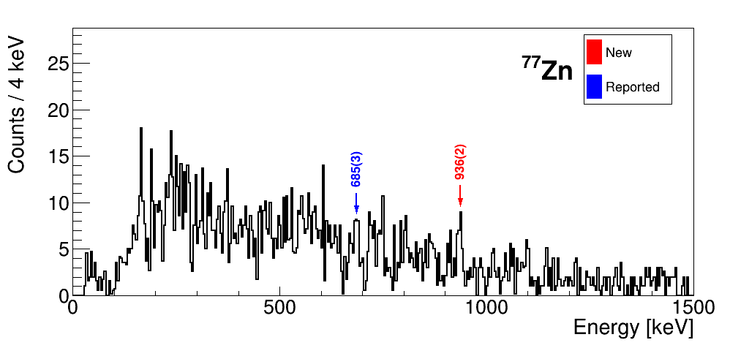
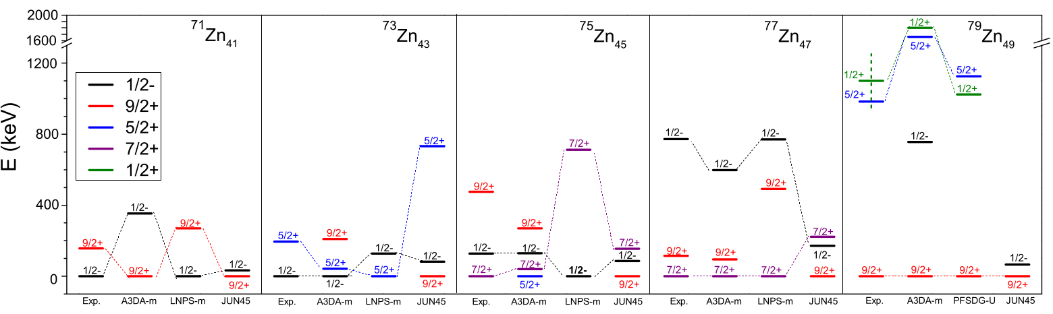
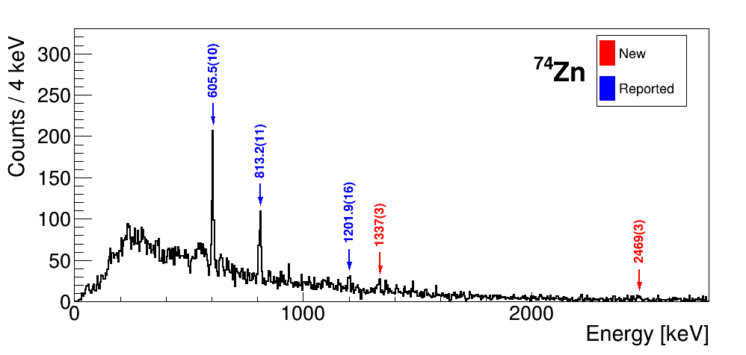
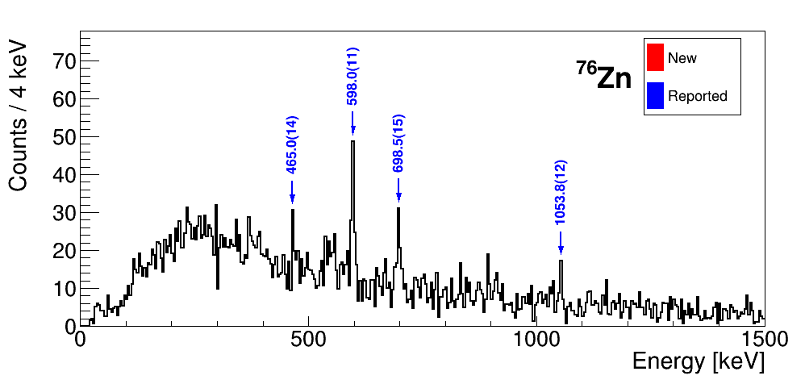
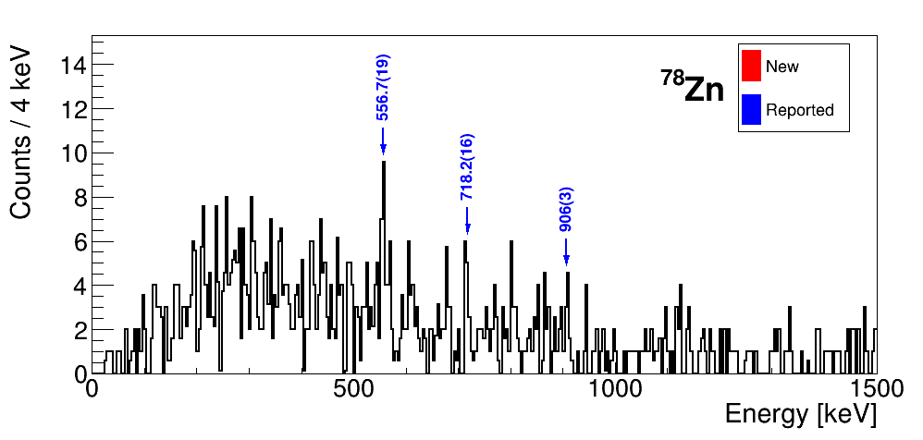
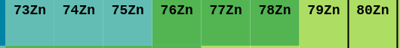
Gamma-ray spectroscopy: Zn isotopes
C. Wraith et al., PLB 771, 385–391 (2017).
New transitions in Zn isotopes
Zn isotopic chain is poorly reproduced by models
Experimental inputs needed
Z=30
N=50
<number>

Slide 10
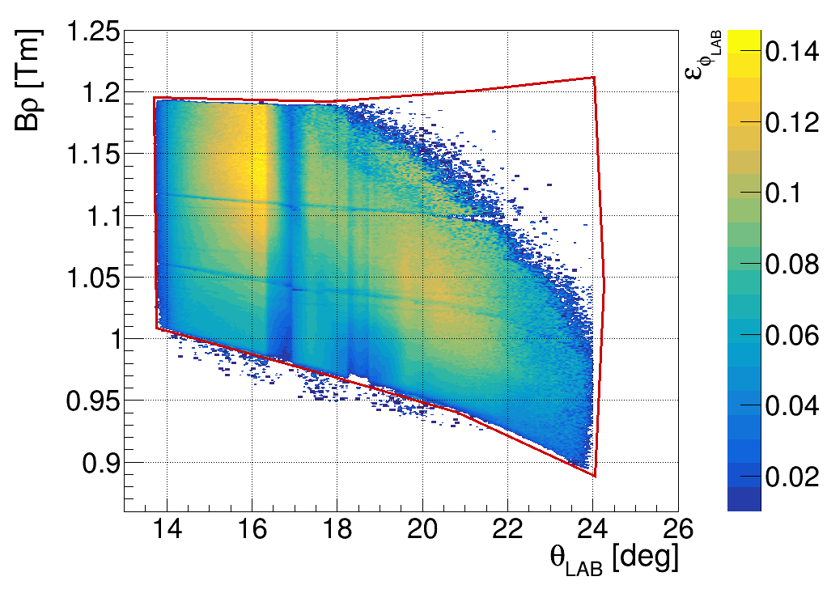
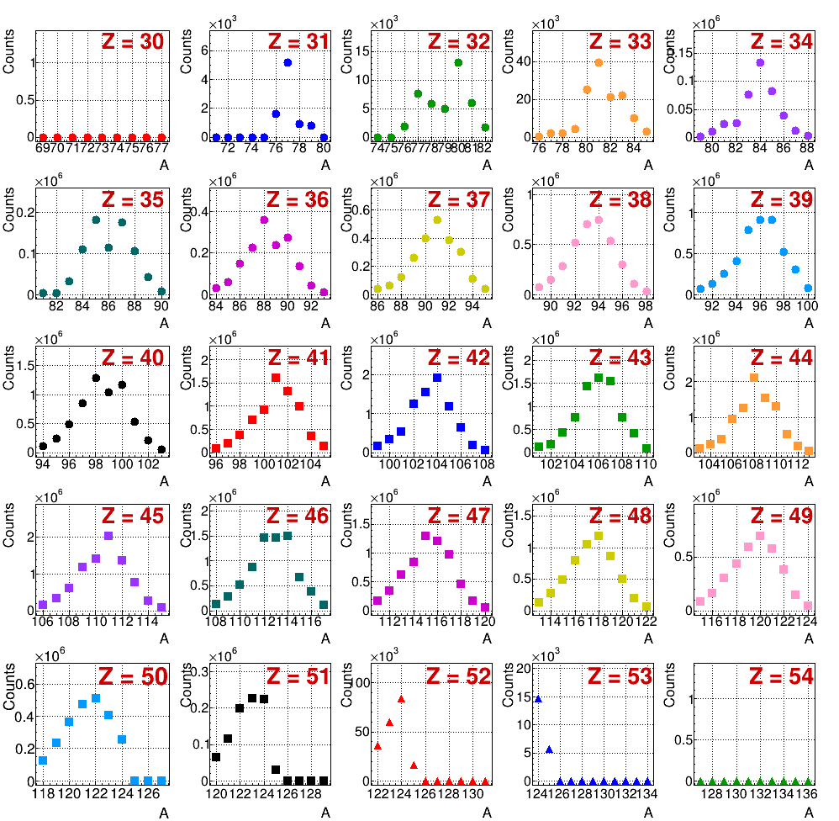
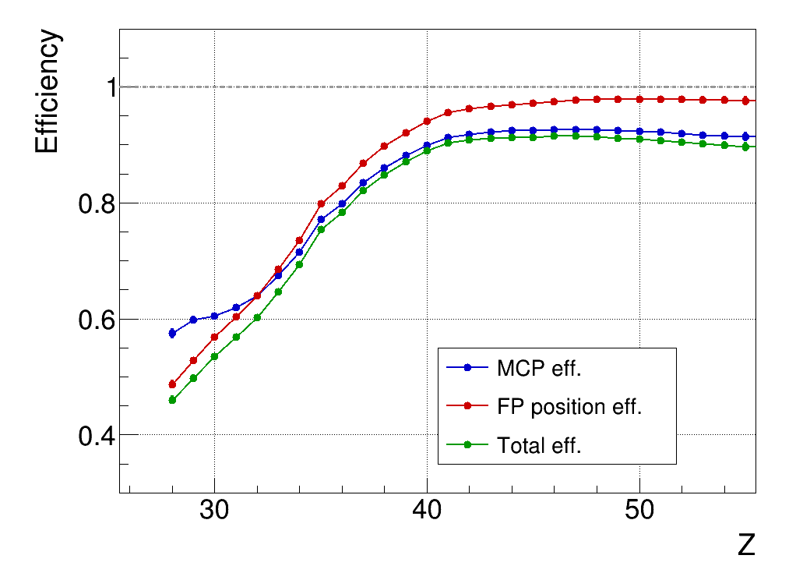
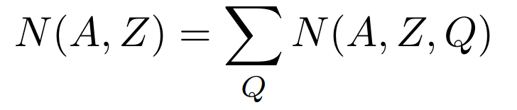
Fission yields
PRISMA acceptance
Isotopic yields
From PRISMA identification:
Correct the distributions by acceptance and detection efficiency (derived from data)
Charge states are not complete over the measurement window:
Reconstruction of Q
Detector efficiencies
Isotopic yields: sum over Qs for each (A,Z)
<number>

Slide 11
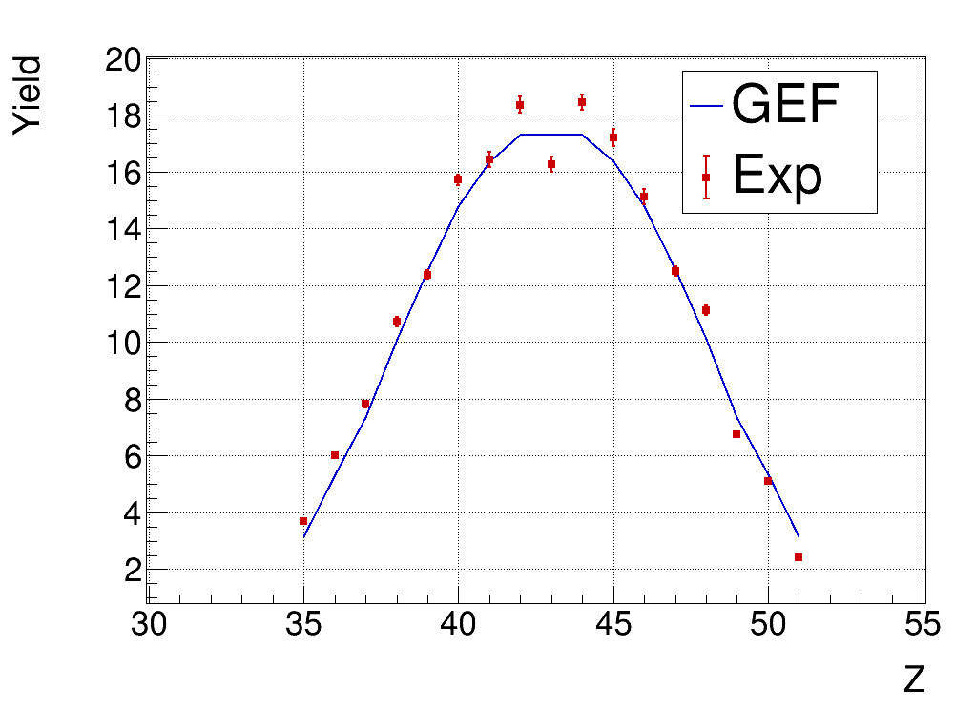
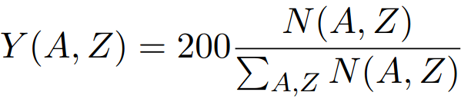
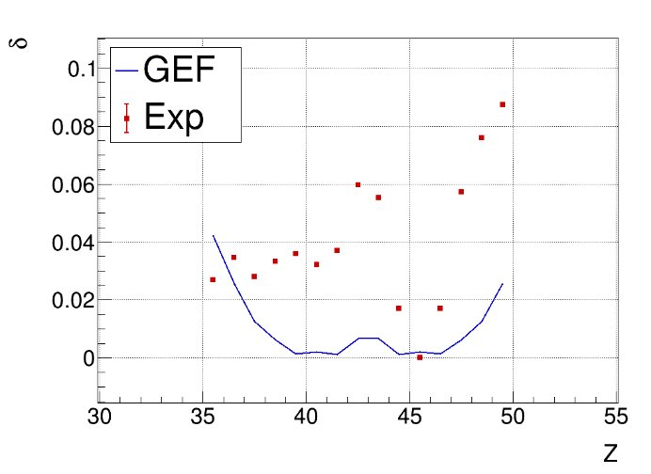
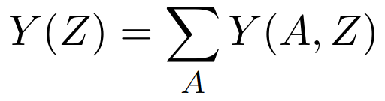
Exp vs GEF - Even-odd effects
K.-H. Schmidt et al., NDS 131, 107–221 (2016)
GEF: Phenomenological model for the prediction of fission observables
Element yields
Isotopic yields
Even-Odd effects
Larger staggering than calculated
Less excitation energy for FF, larger n evaporation?
<number>

Slide 12
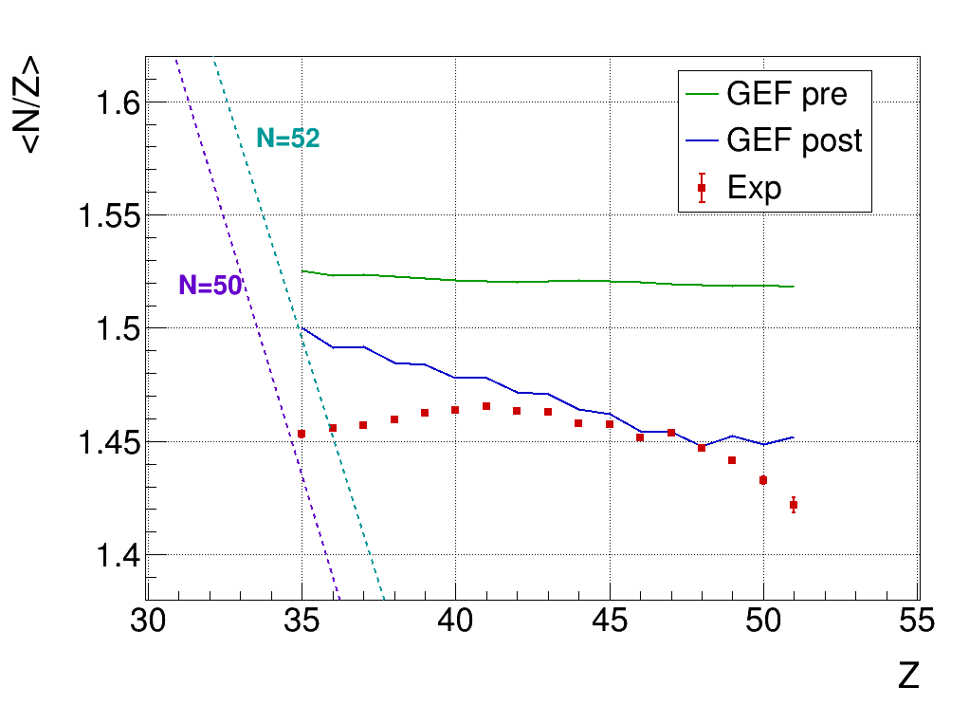

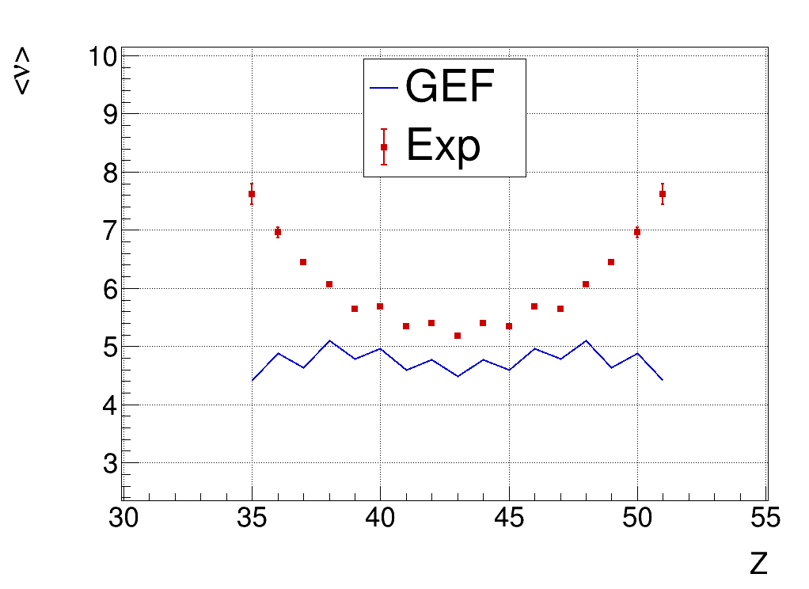
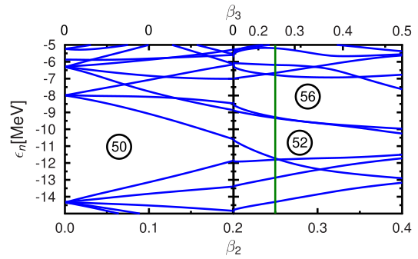
Exp vs GEF - Neutron evaporation and N/Z
Total neutron evaporation
Average neutron excess
~1 extra n for all Z
Far from symmetry, large discrepancy
Higher evaporation
Large deviation towards
Z~35-36
Preferred configuation after evaporation. N=52?
N=52 Octupole deformed shell closure
<number>
G. Scamps and C. Simenel, Phys. Rev. C 100, 041602(R) (2019)

Slide 13
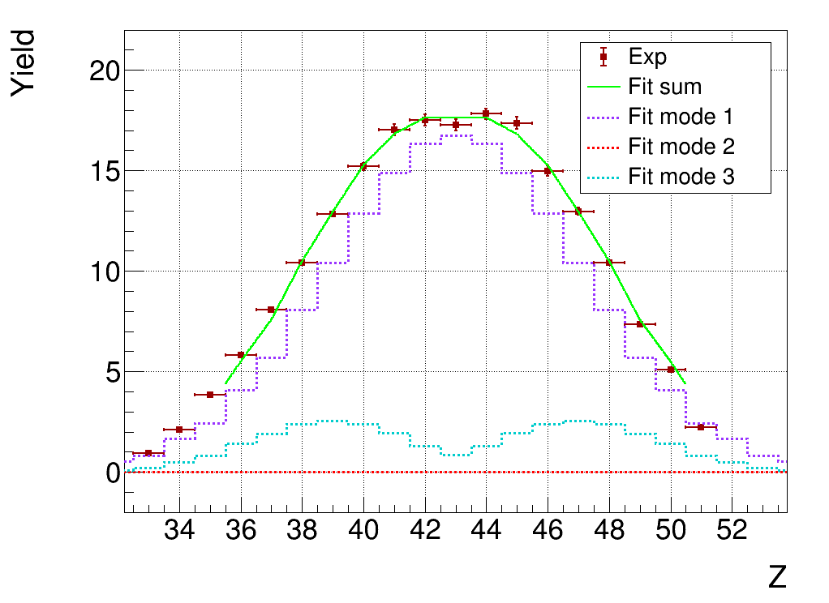
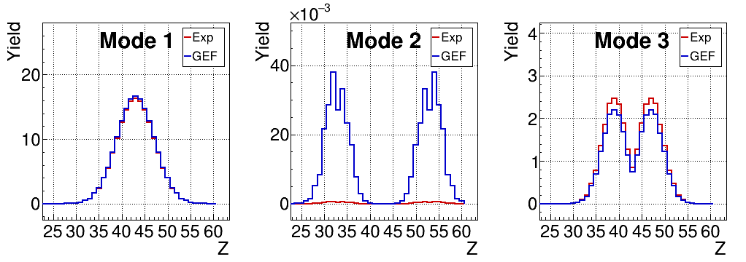
Exp vs GEF - Fission modes
Fission modes
84.5%
<0.01%
15.5%
Super-Long
(symmetric)
Standard II
(asymmetric)
Sub-Pb mode
(asymmetric)
Deviations from model:
Treatment of shell effects can be improved
<number>

Slide 14
Summary and perspectives
Gamma spectroscopy in the region of ⁷⁸Ni
Measured new transitions for Zn and Cu isotopes
More exotic channels cannot be studied -> Lifetime measurement with ²³⁸U beam @ LNL exp. 25.022 (A. Gottardo’s talk)
Study of ²¹⁷Rn fission
Extraction yields with uncertainty
Compared several observables to GEF -> Shell effects not well reproduced
-> Double check with second prisma setting @ 23° (limited acceptance)
-> Study of energy balance (velocities, TKE)
<number>

