Slide 1
Neutron damage studies of capsule A601
Chris Everett, University of Liverpool
Agata week 2026, HIL Warsaw

Slide 2
History of A601
  A601 (formerly A501) was part of the DEGAS setup.
  Returned to Mirion for repair after going high leakage.
  Relative efficiency was reduced to lower-than-acceptable levels by the reprocessing, and was rejected.
  Purchased by the University of Liverpool in 2023 for neutron damage studies.

Slide 3
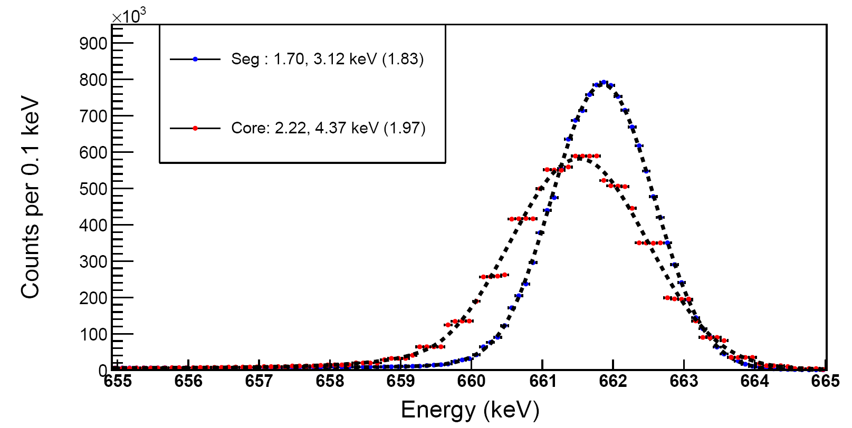
As a baseline – A601 before irradiation.
Whole detector sum-of-segment and core responses

Slide 4
Where we left off last time (AGATA Week 2024, Milan)
  A601 was characterised while undamaged, and ready for neutron irradiation.
  The plan was to use the High Flux – Accelerator Driven Neutron Facility (HF-ADNeF) in Birmingham to induce high-energy neutron damage.
  A601 would be kept cold, driven to the facility, and irradiated 3 times over the course of a week, with analogue & simple digital measurements taken between runs, returning to Liverpool for full characterisation at the end of each set.
  The detector would have been irradiated to a x 10^{b}, where a = 2.5, 5.0, 7.5 and b = 7, 8, 9. This would have been three trips to the site.

Slide 5
What actually happened…
  Birmingham suffered a series of delays/shutdowns which kept pushing back our visits.
  At the end of 2025, an alternative was sought – and we ended up using the Americium-Beryllium neutron generator already at Liverpool, which we had previously assumed was not powerful enough for our goals.
  Simulations showed the AmBe source would be suitable for this work. As such, it has been used for 2 irradiations and is actively irradiating A601 for a third time during this presentation.
  Characterisations using the new 2-axis, collimated Cs-137 source scanning table at Liverpool were performed.

Slide 6
Simulations & Setup

Slide 7
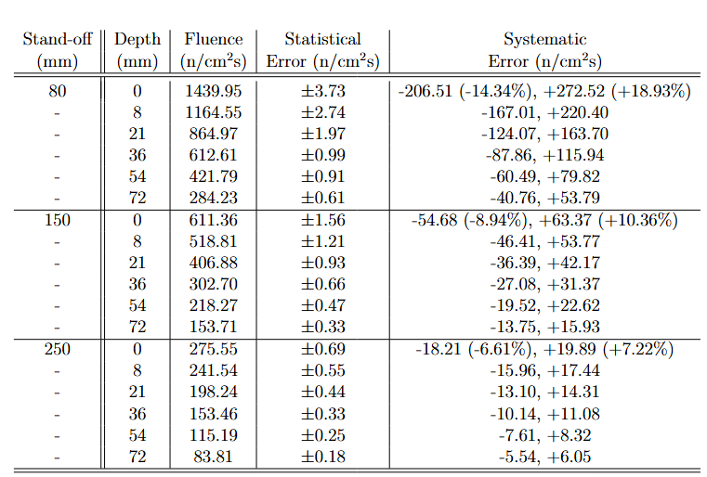
Simulations of AmBe and A601
  MCNP simulations were performed with an HPGe detector volume of similar geometry to A601 in front of the 1 Ci AmBe source at Liverpool. This simulation of the AmBe source has been fully validated.
  Average neutron fluences per cm² in 0.015 keV energy bins were determined for the front face of each ring for three source-detector distances. Fluences listed are for E_{n} > 200 keV.
  Systematic uncertainties arise from issues in accurate determination of the source-detector stand off. An uncertainty of +/- 10 mm defines the presented values.
  Uncertainties due to timings are found to be 3-4 orders of magnitude lower than those caused by placement issues.
MCNP Simulations by Nerys Davies @ University of Liverpool

Slide 8
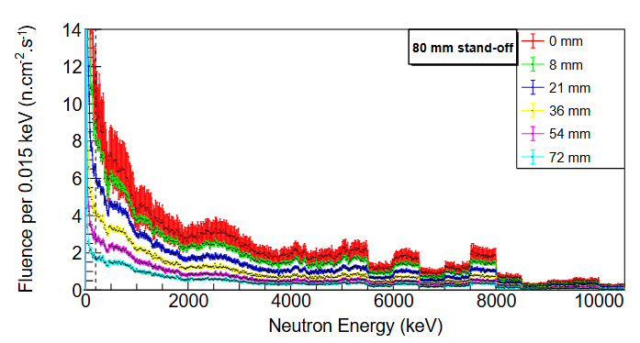


Simulated neutron energy spectra from Americium-Beryllium @ 1Ci
Neutron energy determined by which state ¹²C is produced in.
Breakup of excited ⁹Be nuclei produces neutrons of energies < 1MeV
y-axis limit imposed to show structure at high energy.
Dashed line @ 200 keV

Slide 9
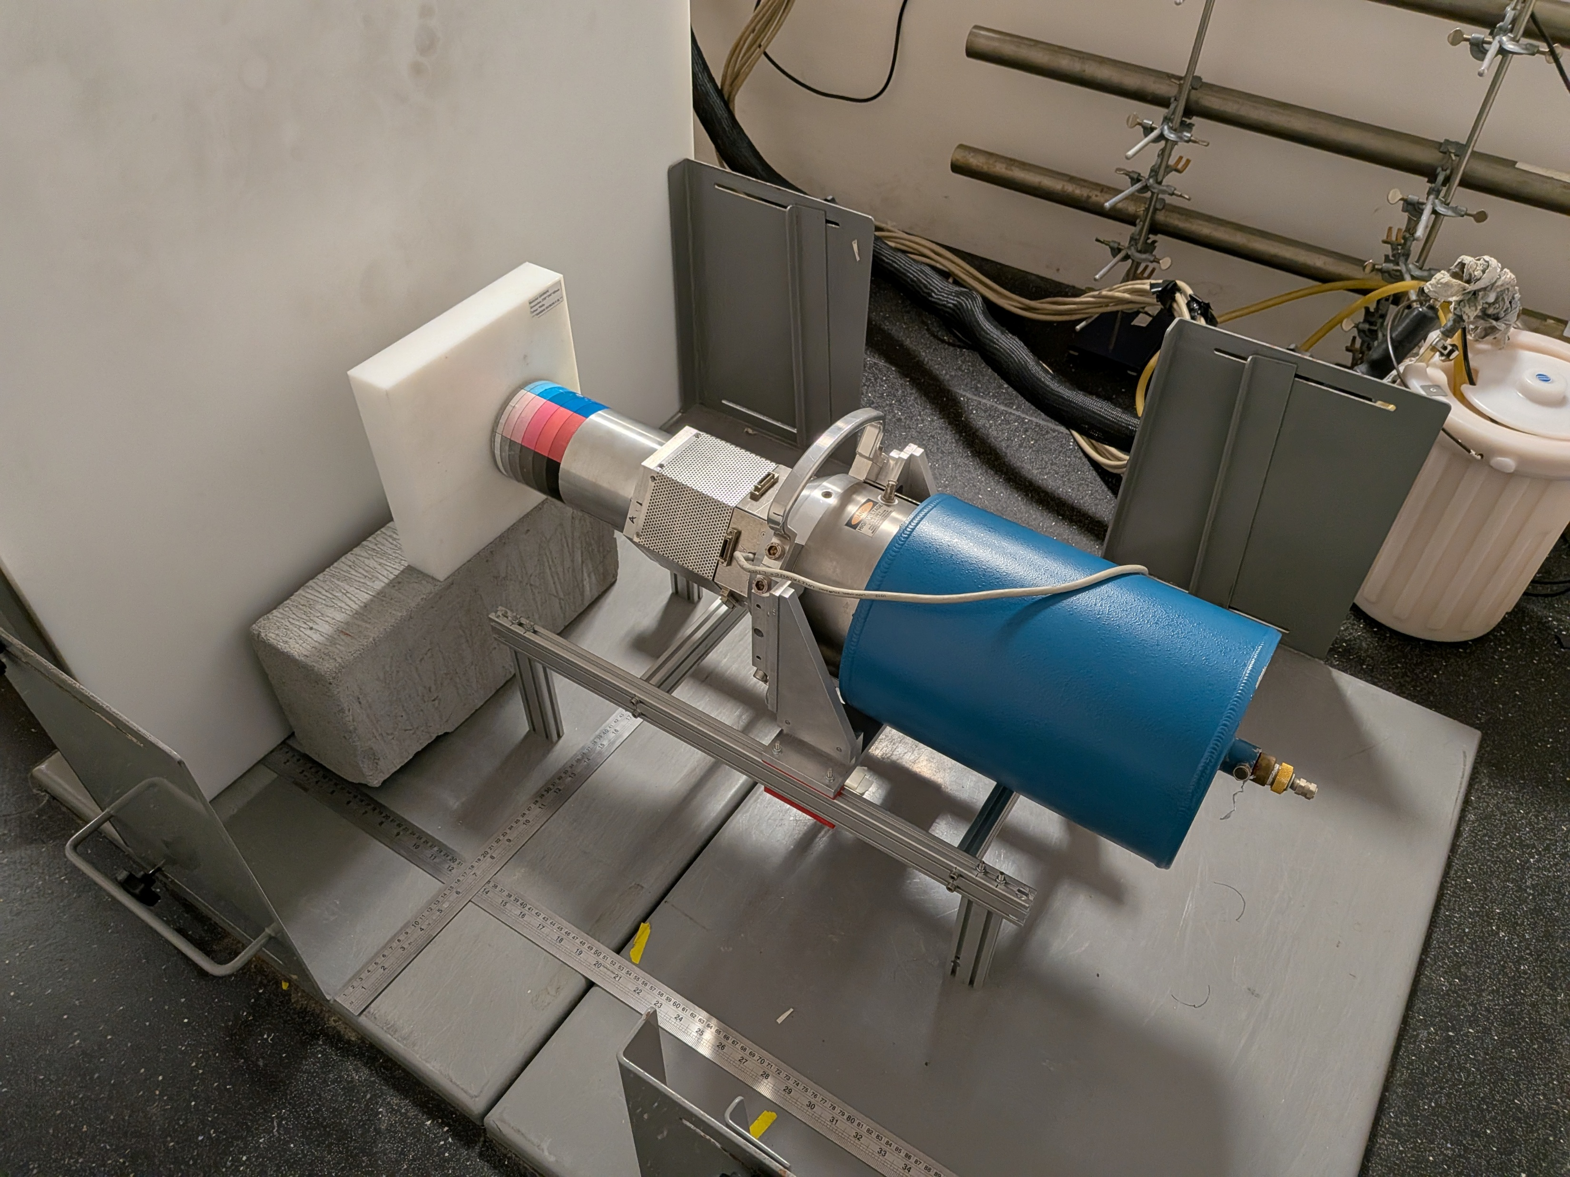
Boronated plastic moderators
(Removed for run)
Cadmium thermal
neutron shield
behind this.
(Remained for run)
AmBe source
Behind both.
A601
Cryostat
Tooling assembly
to raise A601
to the height of
the AmBe source
A601 in 250 mm
Source – detector position

Slide 10
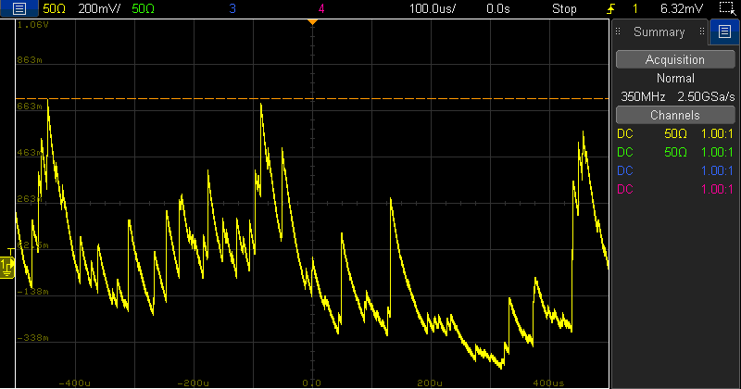
Gammas seen on the core contact from neutron interactions

Slide 11
Irradiations & Results

Slide 12
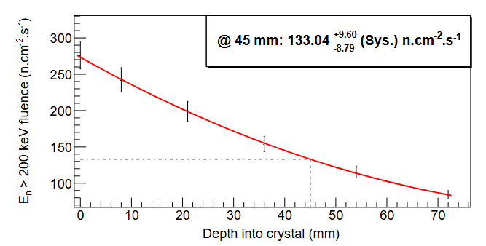
Irradiation 1 – March ‘26
  Irradiation 1 took the central depth of the detector to a flux of 1x10⁸ n.cm⁻², at a 250 mm source-detector distance.
  The fluence at this depth was determined by interpolating the values returned by the MCNP simulation.
  752101 seconds, or 8.7 days was needed to reach the target flux, but lab accessibility issues led to a 9 day irradiation.

Slide 13
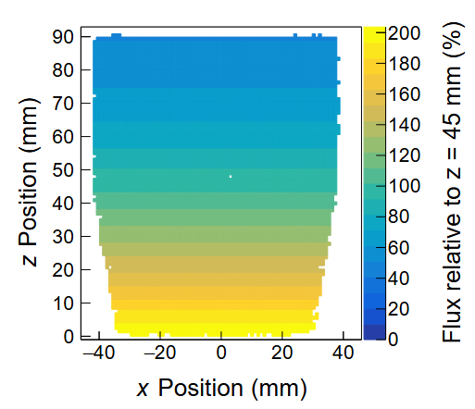
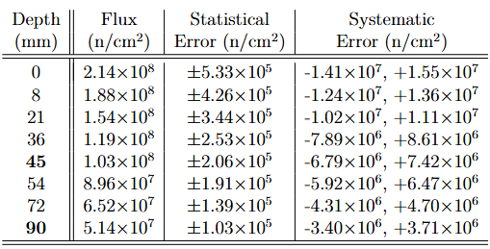
Irradiation 1 – to 1x10⁸ n.cm⁻²
Bold values obtained via interpolation/extrapolation of simulated results. Statistical errors on these points are assumed to be 0.02% of flux values, in keeping with the simulated results.

Slide 14
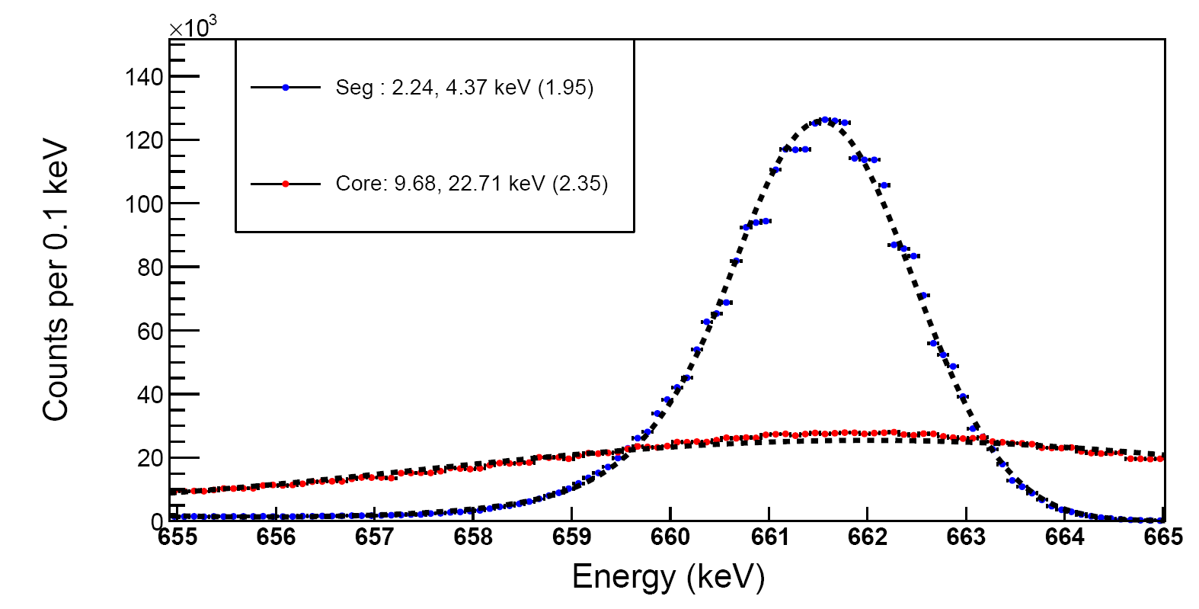
Poor core resolution caused by baseline oscillation induced by HV power supply – not the irradiation!
Whole detector sum-of-segment and core responses
Segment FWHM is still good and the response is Gaussian.

Slide 15
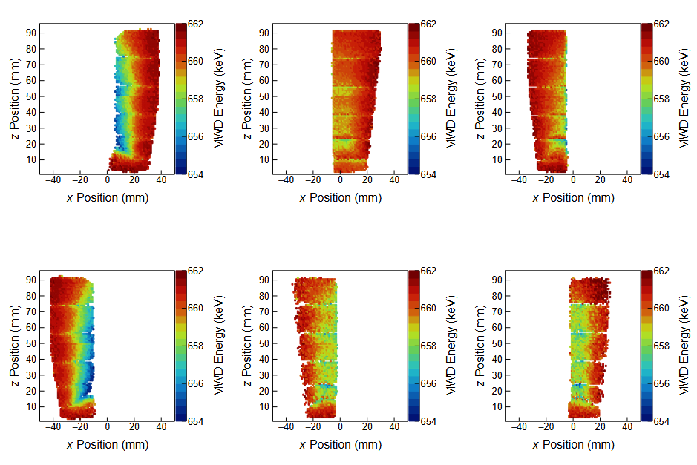
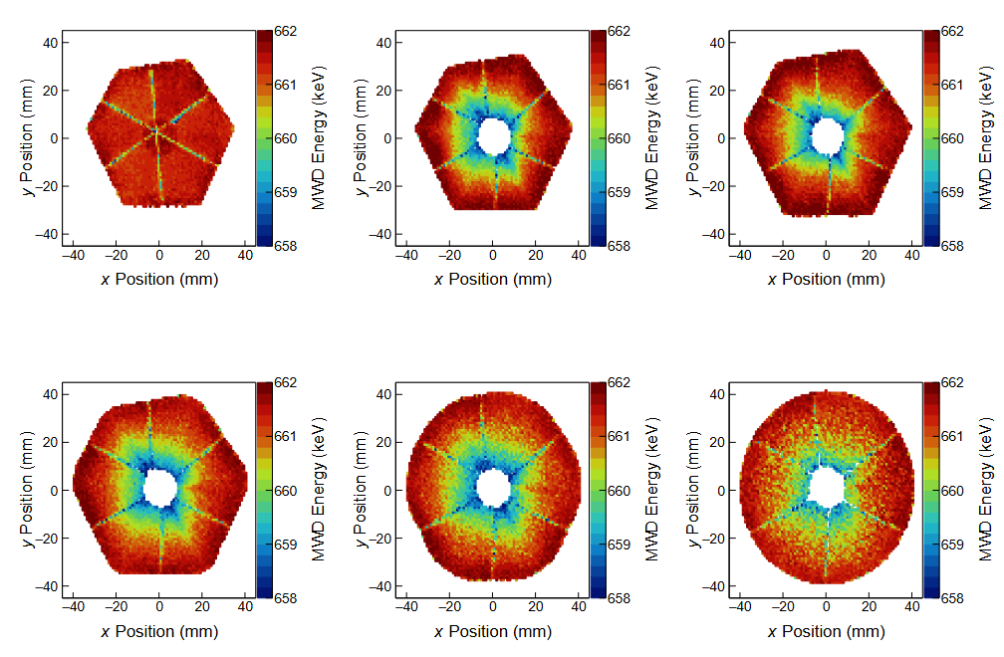
Sectors A-C
Rings 1-3
Average Fold-1 segment full-peak energy per 1mm² scan position
Sectors D-F
Rings 4-6

Slide 16
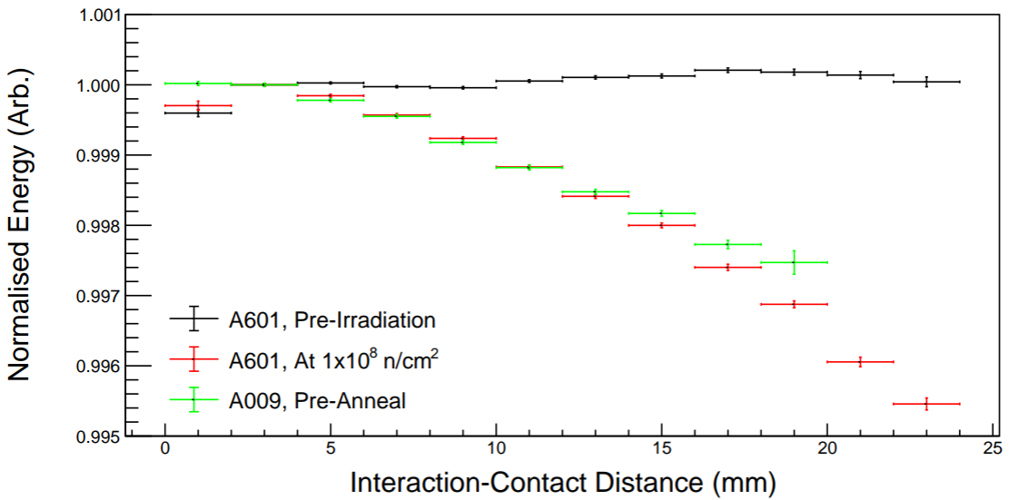
(March 2020)
Whole detector segment response to 661.7 keV gammas
Losses of ~ 3 keV

Slide 17
Overview – irradiation 1
  The first irradiation brought neutron-damage induced energy losses in A601 to a similar level to those seen in A009 when it was characterised in 2020.
  No energy loss is seen on core signals at this stage, and a reduction of energy of <1% is seen on segment signals.
  Energy losses are found to be linear through the central volume of the germanium.
  F2 is found to have the worst energy loss, with ~0.16 keV/mm.

Slide 18
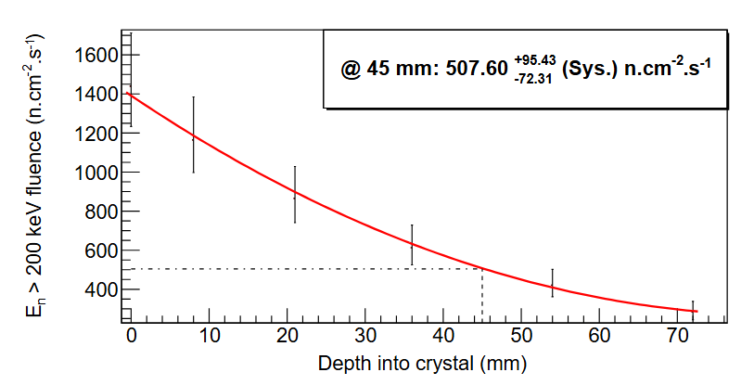
Irradiation 2 – May to June ‘26
  Irradiation 2 took the central depth of the detector to a flux of 1x10⁹ n.cm⁻², at an 80 mm source-detector distance.
  The fluence at this depth was again determined by interpolating the values returned by the MCNP simulation.
  Less the irradiation already done, the time determined to reach this level was 20.65 days, but again because of accessibility, it was left for 21 days.

Slide 19
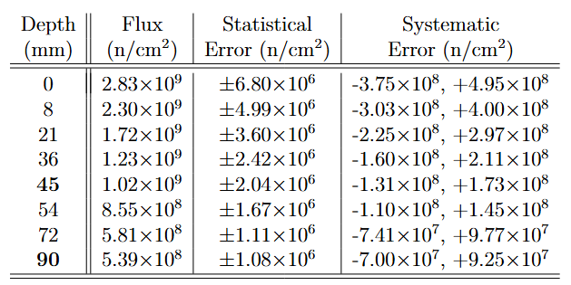
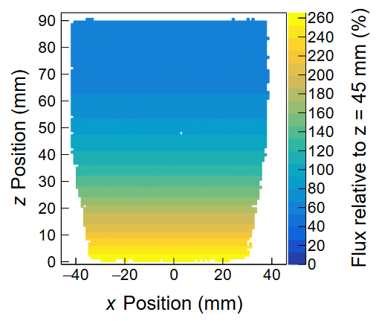
Irradiation 2 – to 1x10⁹ n.cm⁻²

Slide 20
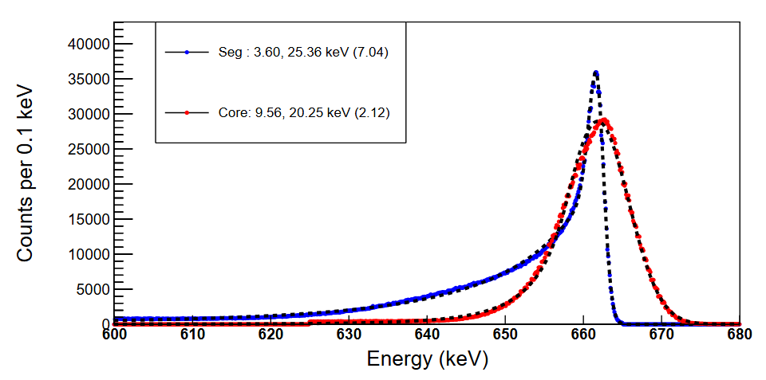
Core resolution issue fixed by swapping back to NIM HV supply.
Whole detector sum-of-segment and core responses
Segment FWHM is still relatively good – but the response is clearly not Gaussian.
Distributions modelled with Crystal Ball functions

Slide 21
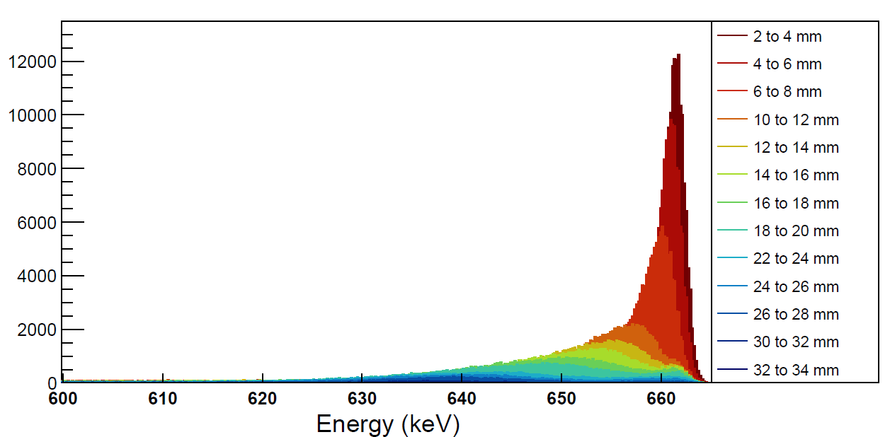
Whole detector Fold-1 segment response split into interaction-contact distance
Energy losses are so great in the central and near-core regions of the detector that the spreading of the peaks is huge, and the individual spectra resolutions are very poor.
These effects mean that when summed to form whole segment or detector responses they do not reach the “Half-max” height of the peak, and thus do not contribute to the FWHM.
This structure from inclusion of Ring 1 events

Slide 22
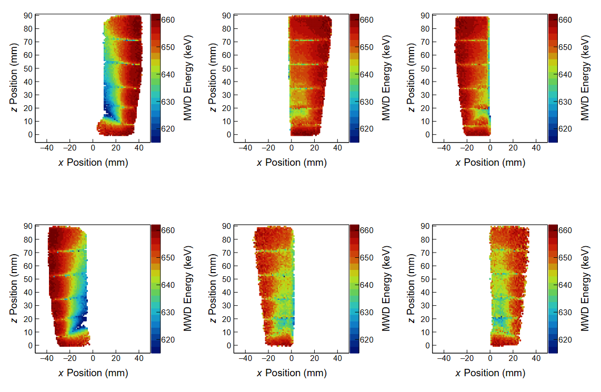
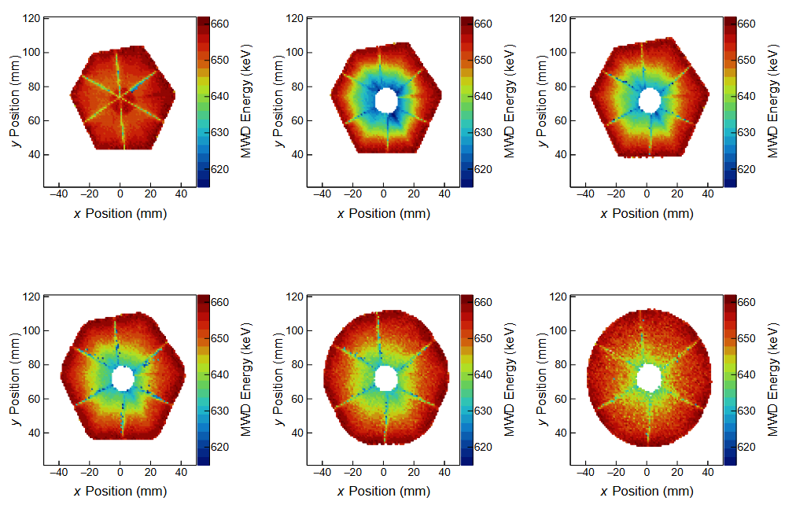
Sectors A-C
Rings 1-3
Average Fold-1 segment full-peak energy per 1mm² scan position
Sectors D-F
Rings 4-6

Slide 23
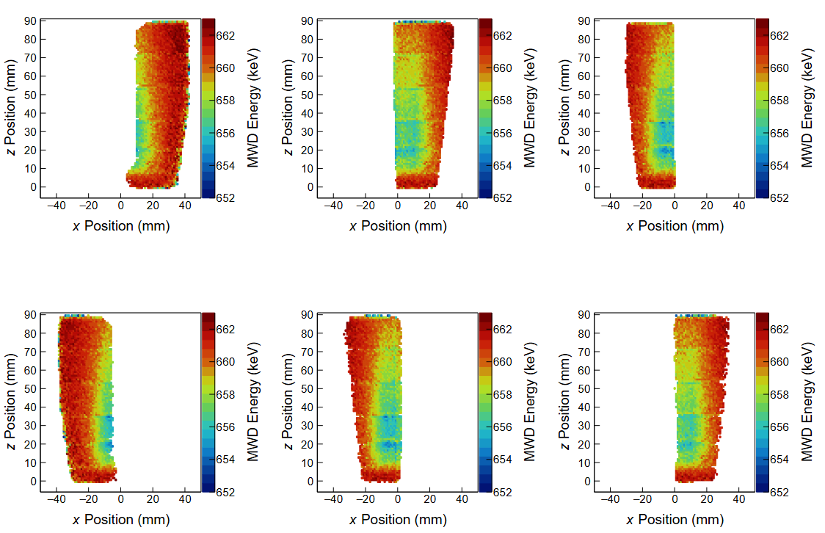
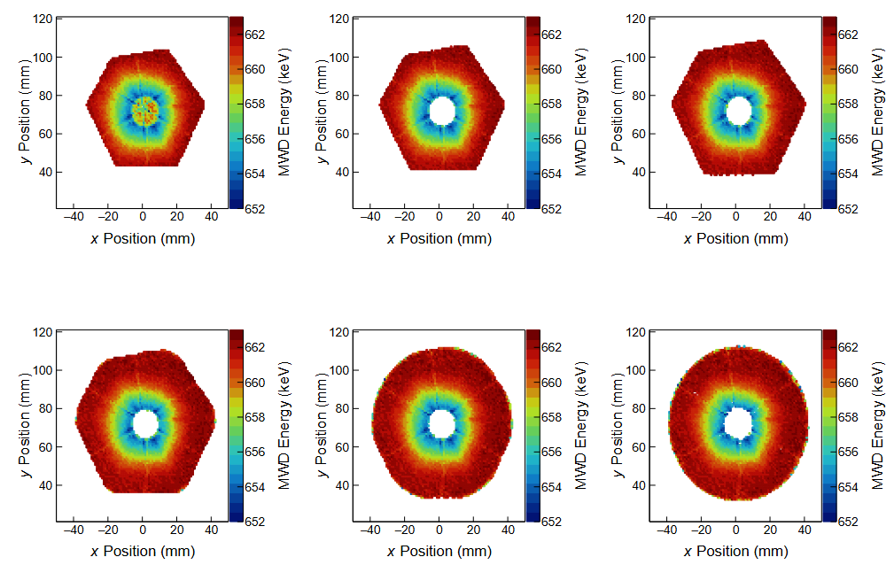
Sectors A-C
Rings 1-3
Average Fold-1 core full-peak energy per 1mm² scan position
Sectors D-F
Rings 4-6

Slide 24
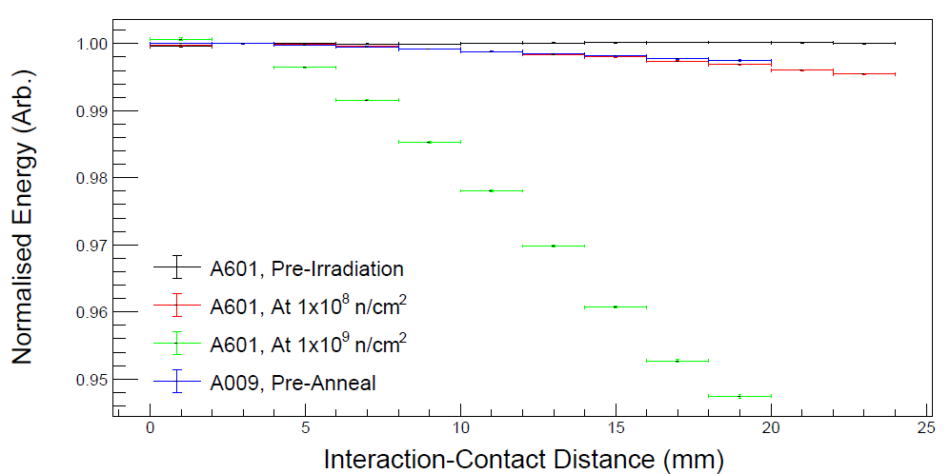
(March 2020)
Whole detector segment response to 661.7 keV gammas
Losses of ~ 35 keV

Slide 25
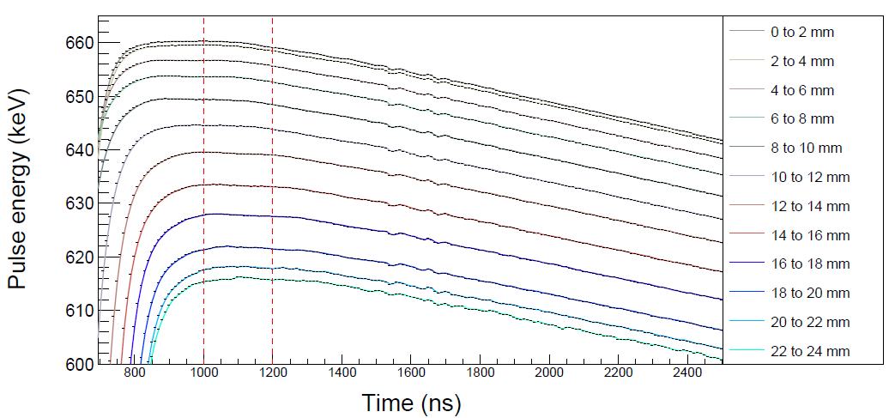
End of signal traces for Segment F2
Each pulse normalised to the height of the 2-4 mm trace.

Slide 26
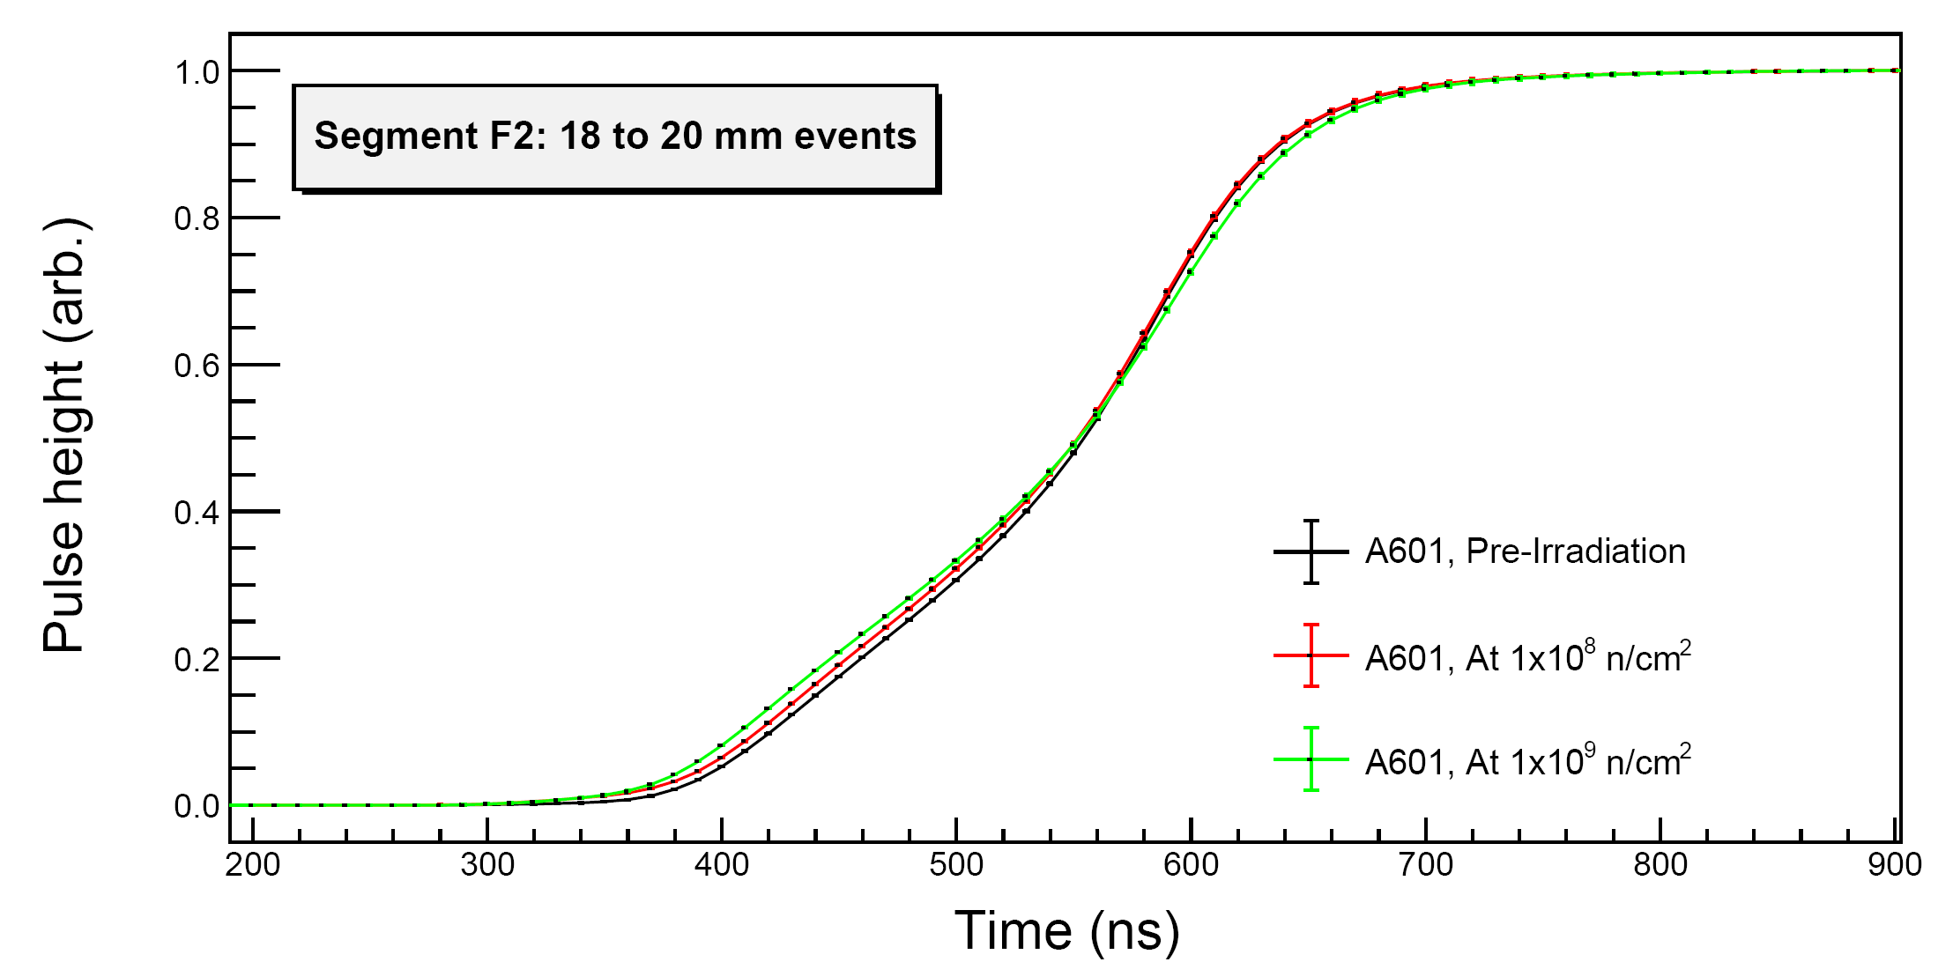
Each pulse normalised to itself.

Slide 27
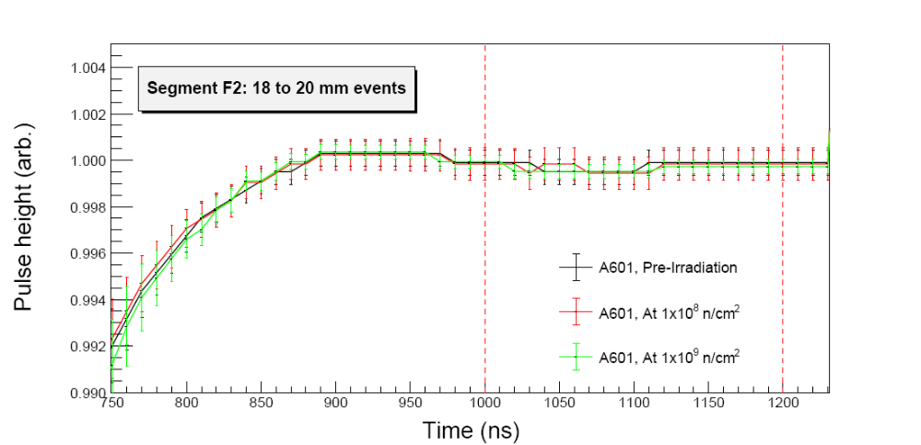
< Pulse height averaging window >

Slide 28
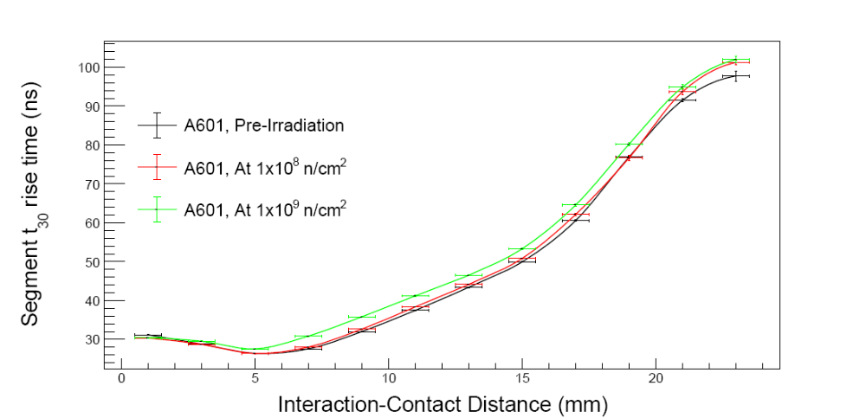
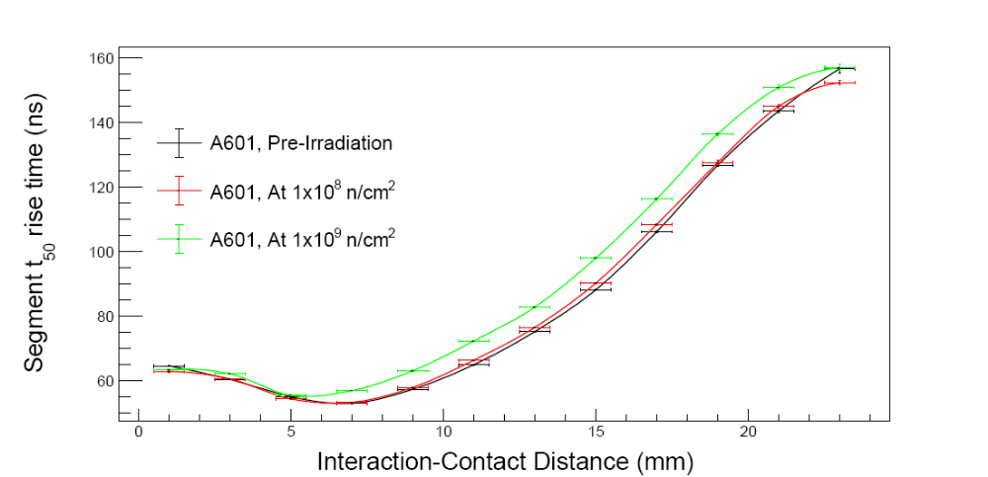
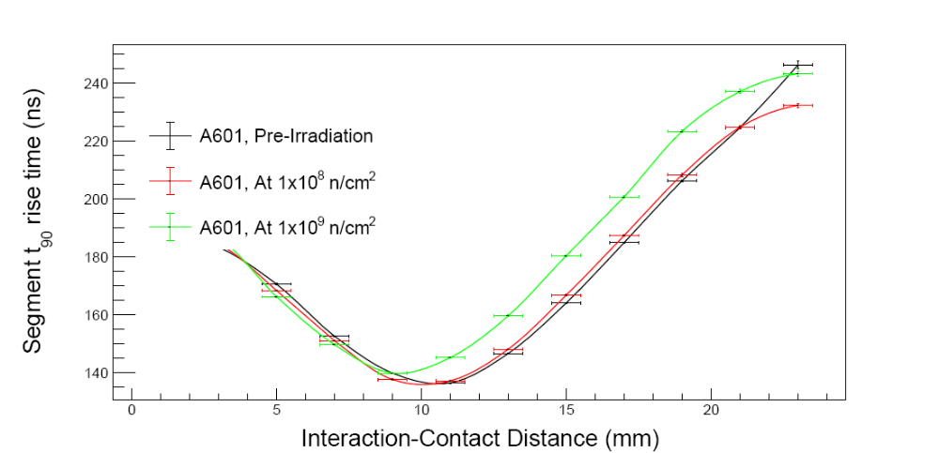
Extrapolated rise times normalised to t₁₀ for segment F2

Slide 29
Overview – irradiation 2
  Losses are now seen on core signals originating close to the borehole, implying a disturbance of the electron charge cloud by hole signals rather than direct trapping.
  Energy loss is still worst on F2, with a value of 2.1 keV/mm being measured, as much as 5% total on near-core events.
  Signal traces originating in near-core locations appear to be slowed, and this pattern is seen in all segments, not just those in which charge carriers move through the slower lattice indices.
  No ballistic deficit is seen on the ends of traces – implying de-trapping is occurring very slowly if at all, and a longer shaping time may not recover lost energy.

Slide 30
Irradiation 3 – August to September ‘26
  Irradiation 3 was still originally planned to be a one-off at Birmingham, to get to 10x10¹⁰ n.cm⁻². The results from the second irradiation implied that another order of magnitude of damage may prove fatal for the detector, however.
  So, this irradiation is instead to 2x10⁹ n.cm⁻², doubling the damage already done. This is being performed in the 80 mm stand off distance through 23 days of irradiation, and is ongoing as I speak. To be completed 17th September @ 1.45pm (BST). This brings us to a total of
    In only 53 days!
    This would have taken 92 milliseconds at Birmingham.

Slide 31
The Future

Slide 32
Ongoing and to come
  After reaching 2x10⁹ n.cm⁻², the detector will then be characterised again, as before.
  After this, it will be allowed to thermal cycle to room temperature for a week, allowing the potential for:
      Trap sites to migrate and worsening, non-linear energy losses?
      Partial annealing and recovery of performance?
  There are conflicting opinions on which of these effects may occur. Some papers indicate worsening resolution, some report improvement. The same characterisation suite will occur after cooling back to LN2 temperatures.
  Finish implementation of ADL grid search with singles scanning table data – how much does the alteration of signal rise times at high neutron damage levels affect position resolution?

Slide 33
Beyond this
The detector will be returned to Mirion for annealing. This was originally part of my plans, but the delays in irradiation mean this is no longer achievable in the time I have left on my PhD.
Characterisation should be repeated once returned to see how performance has been recovered. This will be after completion of my PhD, but will almost certainly be my responsibility (to collect the data at least) anyway.
A similar measurement suite could be performed on SIGMA as a comparison dataset.

Slide 34
Thank you for listening

