Slide 1
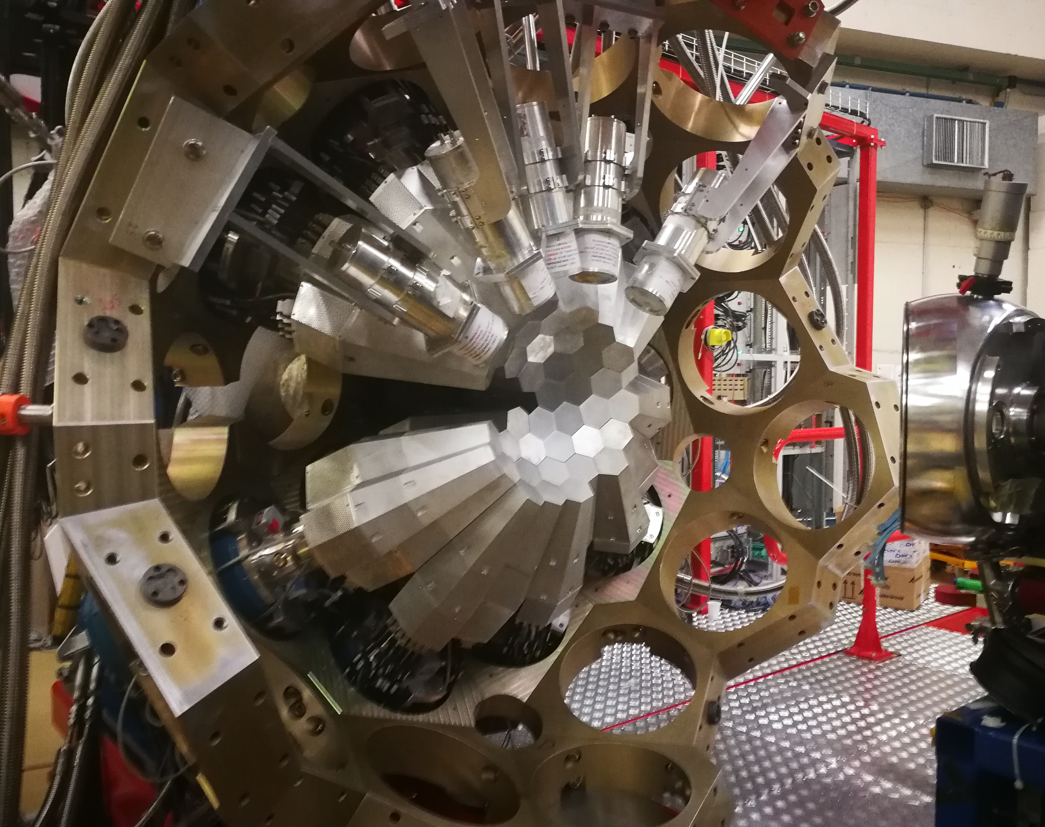


Trigger(s) for the ZD campaign
Alain Goasduff (INFN LNL)
26th AGATA Week meeting
7-11 September 2026
HIL - Warsaw

Slide 2
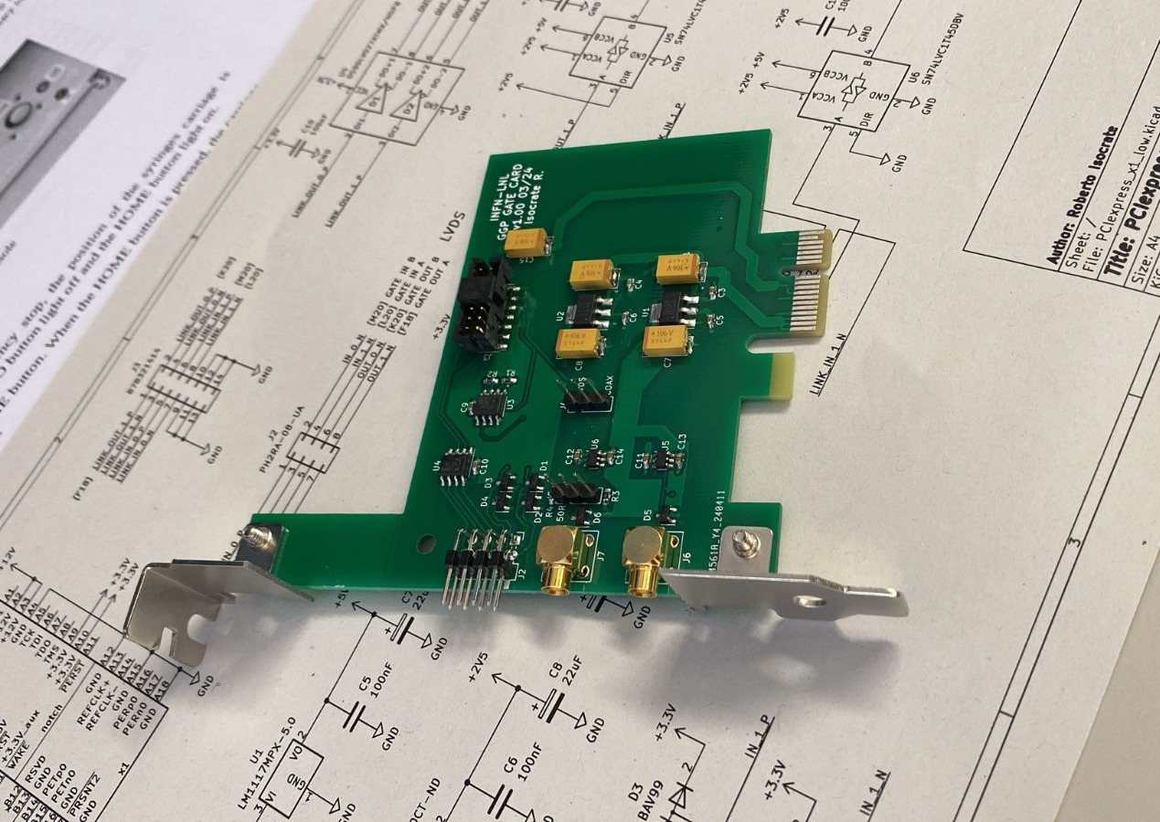
Low level hardware trigger system using external gate on AGATA

Slide 3
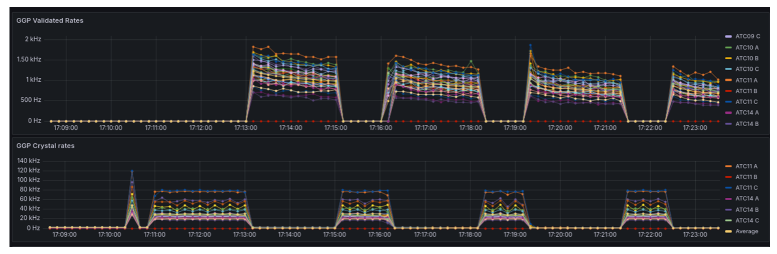
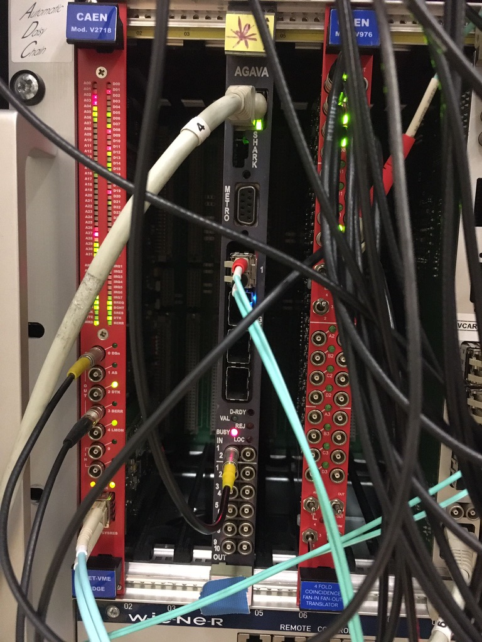
Low level external gate application
Beam-on / Beam-off measurement for decay spectroscopy
External gate from ancillary detectors by-passing the AGAVA
PRISMA (1 trigger channel)
SPIDER (56 trigger channels)
EUCLIDES (55 trigger channels)
SAURON (32 trigger channels)
CAEN VX2740 – Ethernet readout 64ch
1 Trigger output / board
V2495 used as FIFO for the logical GATE
Signal sent directly to the GGP FPGA to act at the local trigger level
SPIDER (1 trigger channel) @ 1kHz
EUCLIDES (2 trigger channels) @ 20 kHz
SAURON (2 trigger channels) @ 40 kHz
Courtesy of D. Bazzaco – R. Isocrate

Slide 4

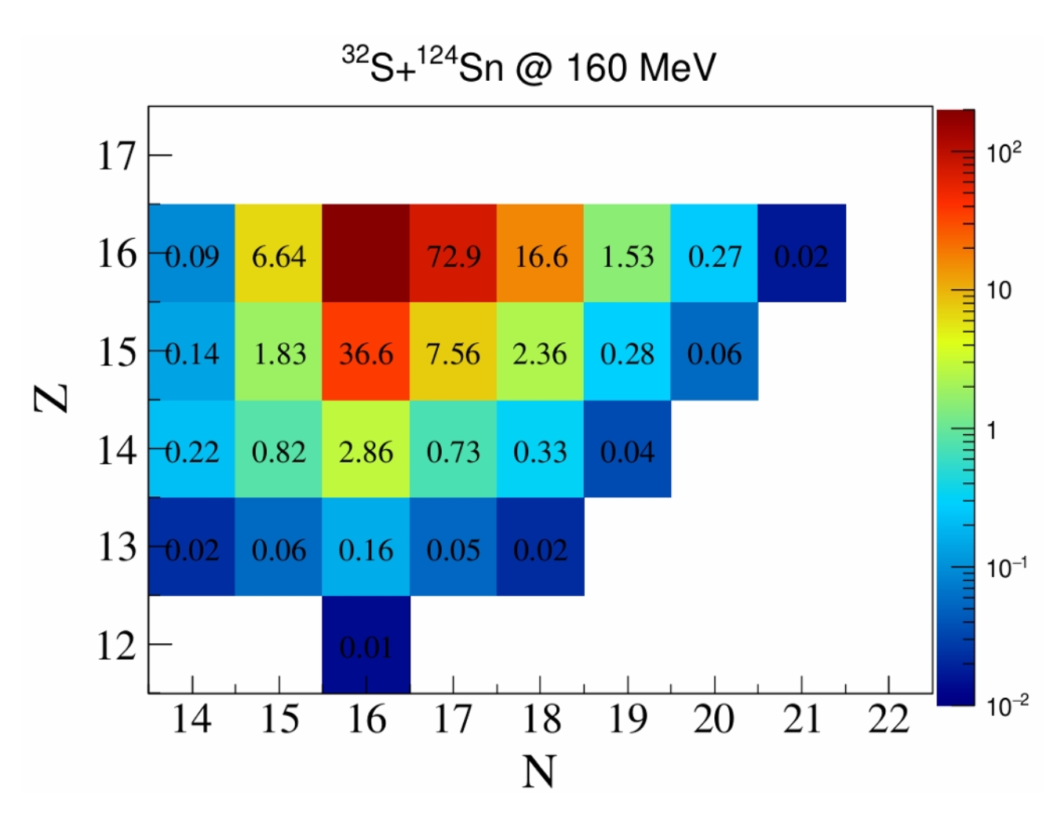
TP Commissioning experiment
Analysis done by
Eleonora Caleffi – University of Camerino
Three trigger systems tested:
Original AGATA TP (used since the AGATA-D phase) “LNL TP”
Fully digital system based on the reconstruction of the events using a CPU and the Timestamp difference
EXOGAM2 TP or “GANIL TP”
FPGA based but using an analog-like approach with logical gate overlap
Hardware Gate “HwGATE”
Based on the sumbus board developped for GANIL. Allows to inject a logical signal directly in the GGP FPGA to act at the local level trigger (before event generation)
MNT reaction experiment (³²S+¹²⁴Sn @ 160 MeV)
Setup composed of PRISMA + AGATA

Slide 5
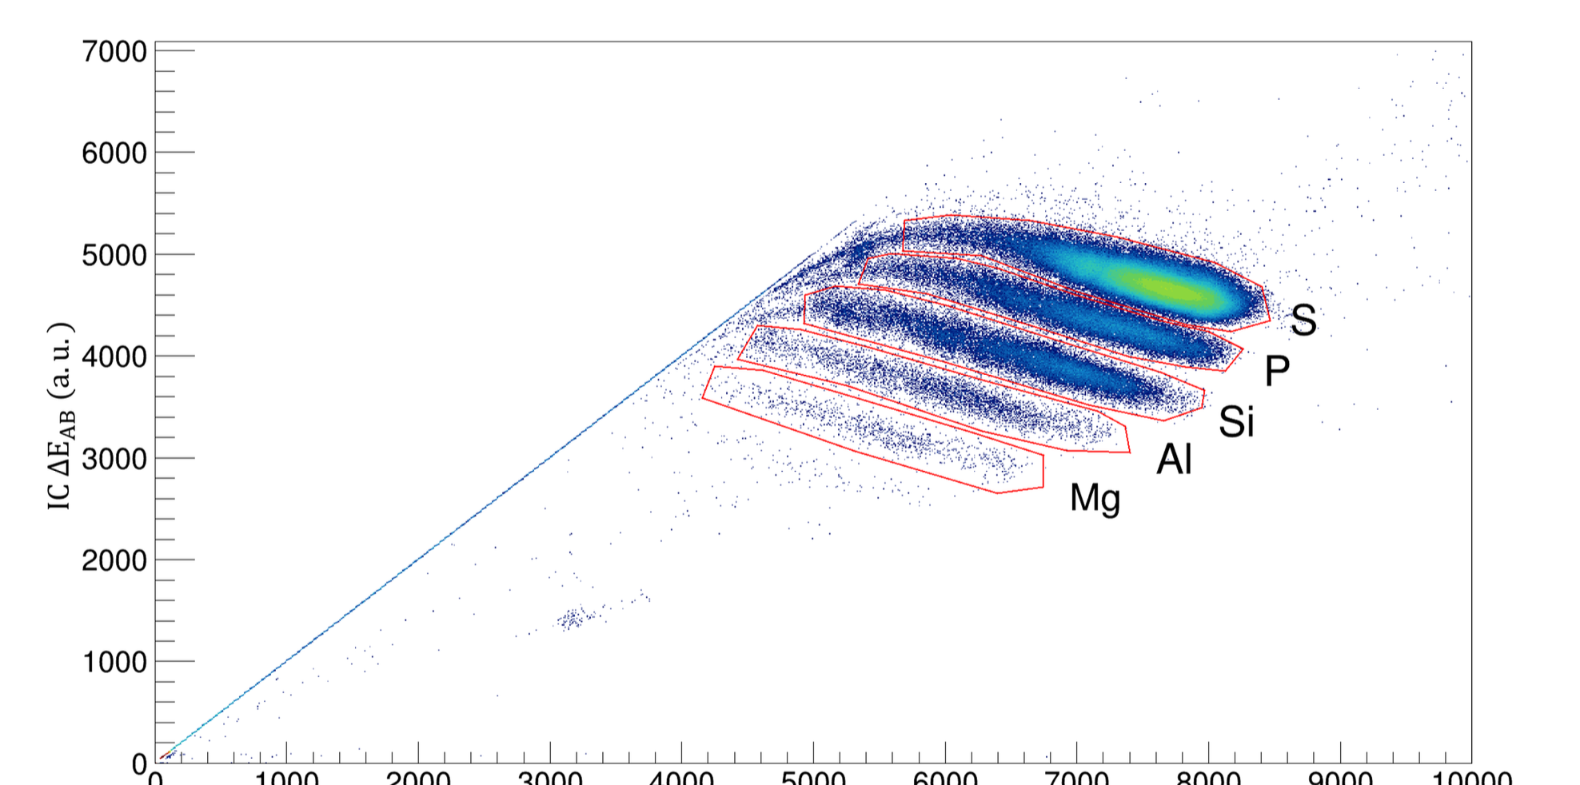
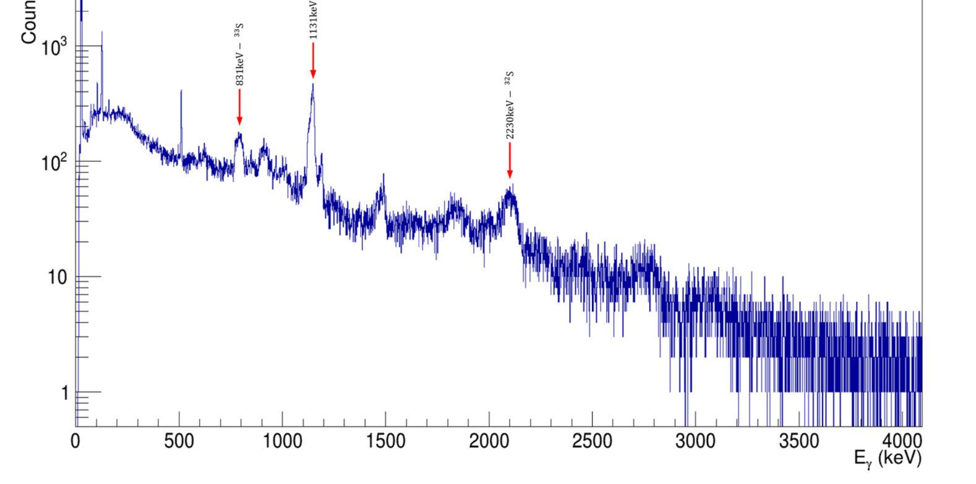
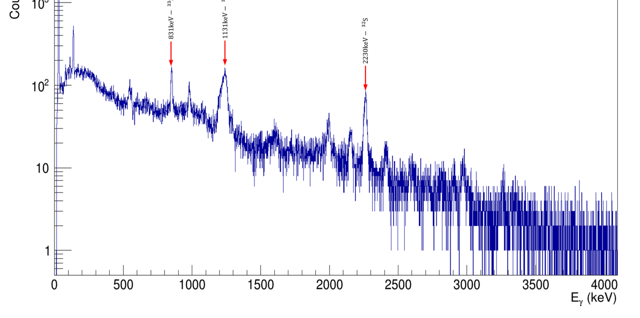
Event selection and analysis approach
Important parameters to get out of the PRISMA Analysis:
Z-identification
Recoil velocity vector determination for the Doppler correction
We can define the ratio between the number of ions in the S-region over the number of gamma-rays detected for the ³²⁻³³S

Slide 6
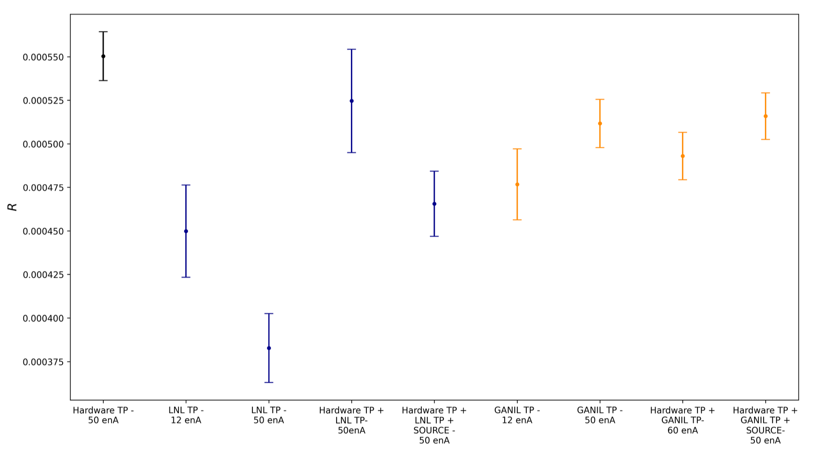

Slide 7
Conclusion for the TP commissioning
LNL TP
exhibits a strong dependence on the trigger rate reaching the TP
Could be used in conjunction of the hardware gate for second level event selection based on fold in the gamma-particle coincidences
The new GANIL TP Firmware:
Clearly performs better than the previous FW version with more consistent behaviour
Strong dependence of the results in function of the “TP Delay” parameter (not shown here but observed during source test
No clear dependence of the validation perfomances in function of the rate
Hardware GATE:
Bypassing the AGAVA for the ancillary coincidence requirement reduce drastically the overall deadtime of the system in particular when using large number of ancillary channels not integrated in the GTS!
In the case of PRISMA no improvement on this part since AGAVA is still included in the VME readout for the timestamping of the events

Slide 8
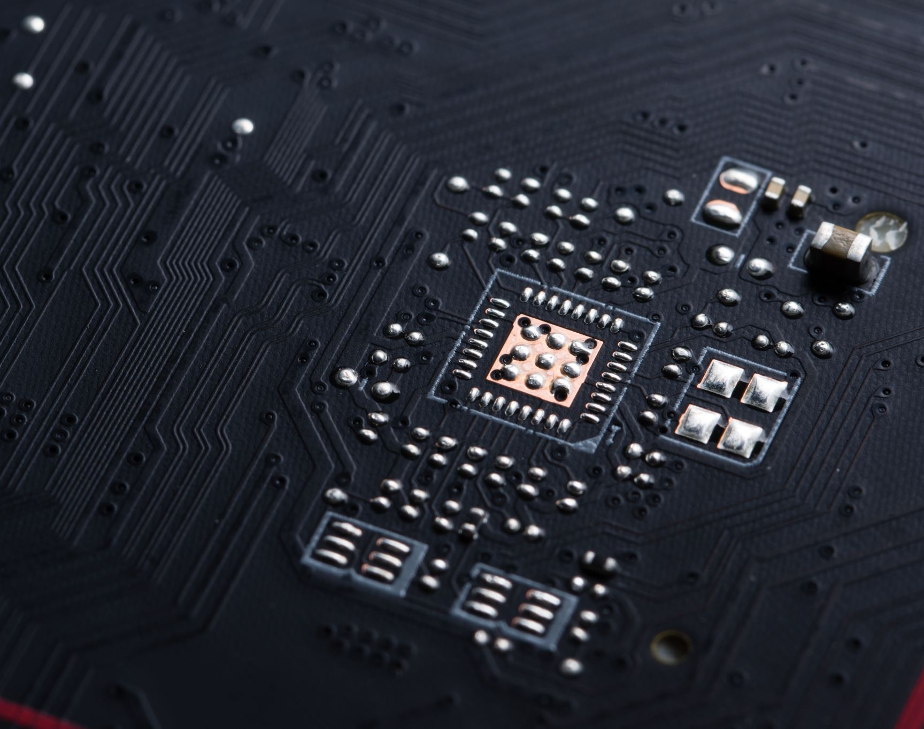
V2 Electronics and Trigger processor

Slide 9
Test benches for the V2 at LNL
Crystal ATC07-C dedicated to the V2 characterization
Dedicated small GTS tree (ROOT+FIFO+AGAVA+V2)
VivadoLab for quick debug / flash of PACE FPGA
FULL TS AGAVA | Time from GTS alignment [min] | Last 2 bytes V2 | Last 2 bytes AGAVA | DeltaTS
0x6C53CEA25 | 4.8 | 0x17 | 0x25 | 0xE
0x81DDA37DA | 5.8 | 0xCC | 0xDA | 0xE
0x970128220 | 6.7 | 0x12 | 0x20 | 0xE
0xA6FBC114B | 7.5 | 0x3D | 0x4B | 0xE
0x2D23055EC8 | 32 | 0xBA | 0xC8 | 0xE
0x5522E25068 | 60 | 0x5A | 0x68 | 0xE
0x64F5DA786E | 72 | 0x60 | 0x6E | 0xE
0x8BAD600B42 | 99 | 0x34 | 0x42 | 0xE
0x11BF289937C | 203 | 0x6E | 0x7C | 0xE
0x2210807EA3E | 390 | 0x30 | 0x3E | 0xE
0x60C698ACCE4 | 1108 | 0xD6 | 0xE4 | 0xE
0x77F9D0AD00E | 1374 | 0x00 | 0x0E | 0xE

Slide 10
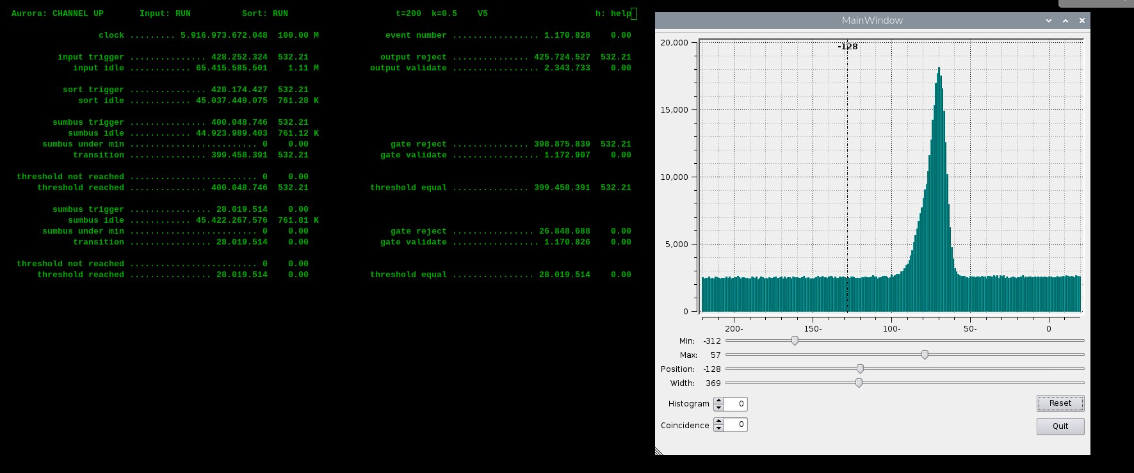
Trigger Processor integration
Online PRISMA-V2 Coincidences with in-beam data
“LNL TP”
Hardware gate to be tested!

Slide 11
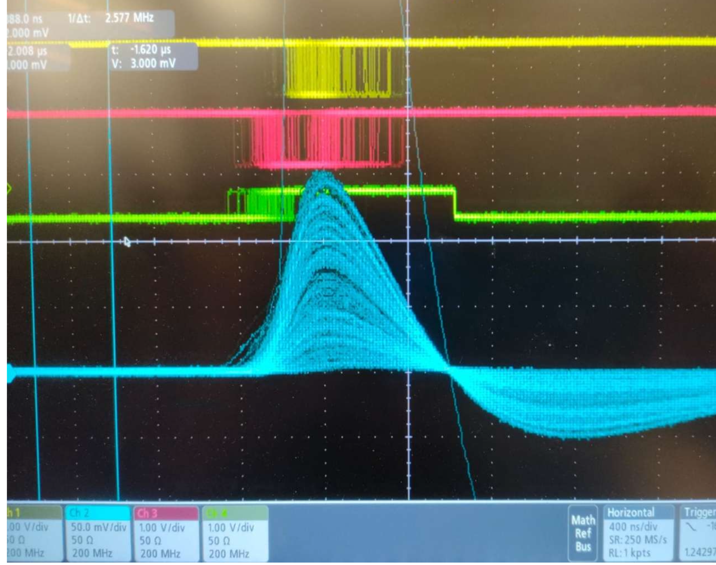
Hardware fold determination

Slide 12
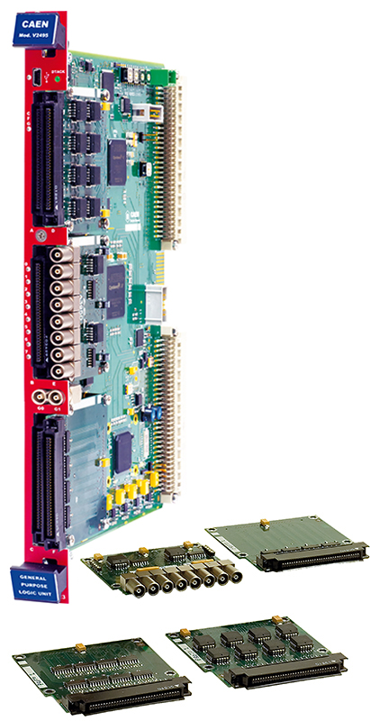
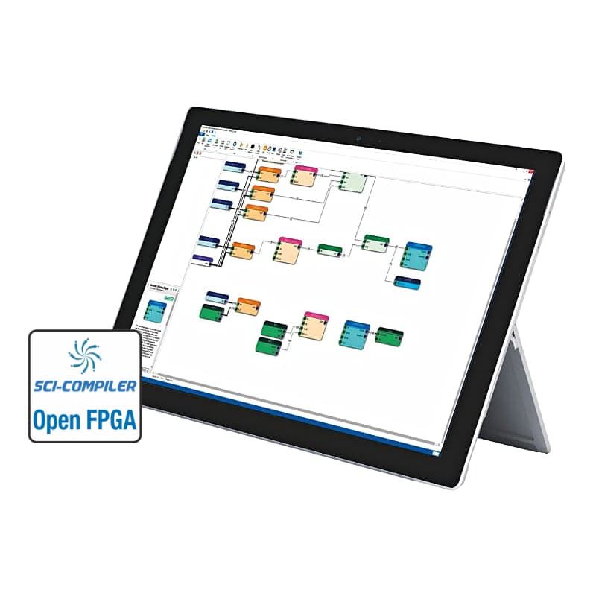
AGATA GAMMA-OR
Slow control of DigiOpt-12 Core board fine trigger threshold:
--corethreshold arg adc: Set value of LE trigger threshold (0..127) for core board
--coremodtreshold arg adc: modify value of LE trigger threshold for core board
In the present configuration of the V2495:
  up to 64 cores – all the material available to go to 128 cores
  Selectable trigger output (TTL/NIM)
  Dedicated scaler for individual channels
  Possibility to enable/disable channels
  Selection of the rising/falling edge of individual signals
  Adjustable delay and width of the output
  Selectable individual inspection
To be done:
  Fold conditions and output

Slide 13
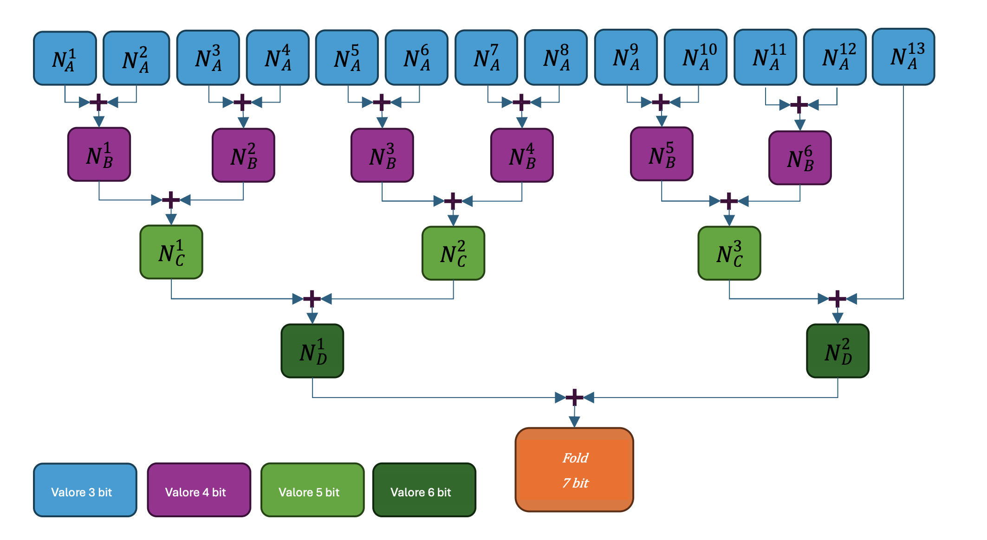
Fold determination
Development made by
Andrea Arcangeli
New FW developped for the V2495
Up to 91 input channels
Determination of the fold performed in tree like structure
Output signal can combine several fold conditions with configurable down-scaling

Slide 14
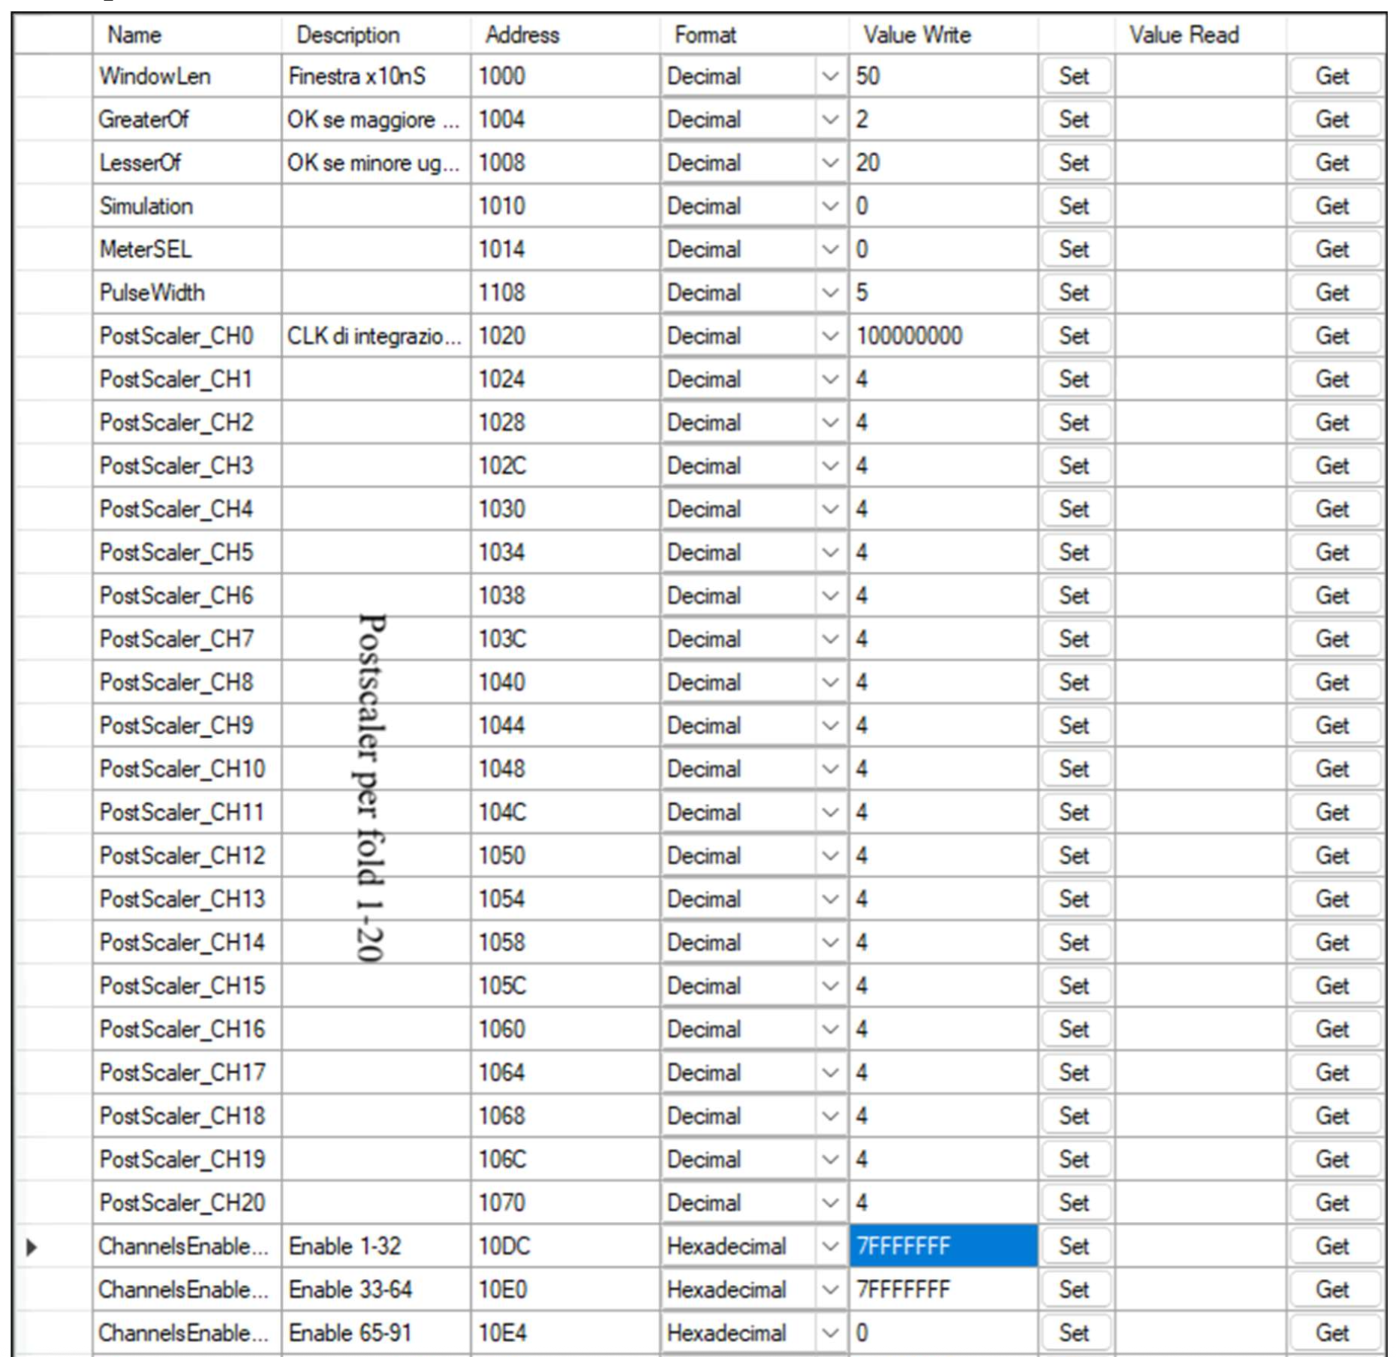
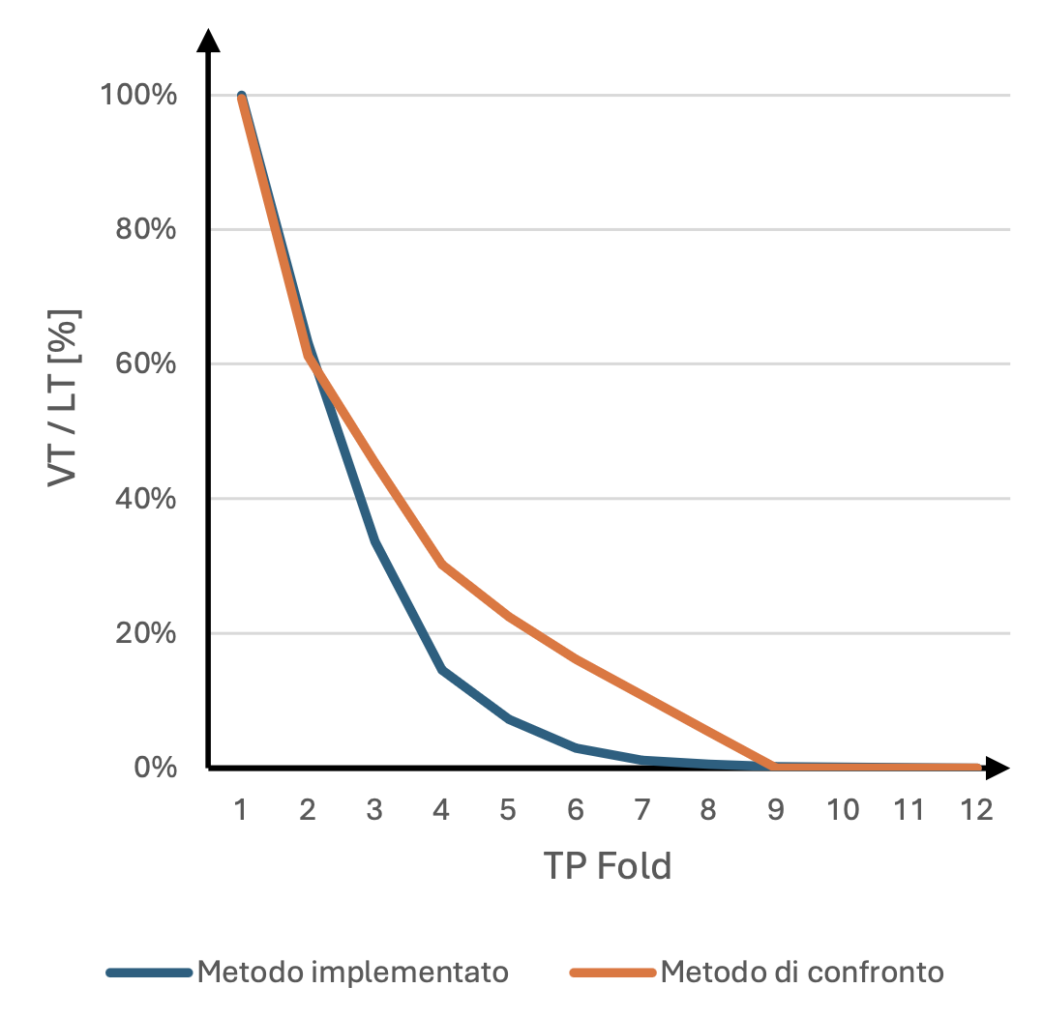
Source test
Firmware tested with the ⁶⁰Co and ¹⁵²Eu
Hardware fold
LNL TP

Slide 15

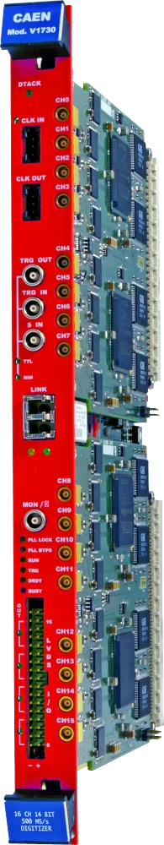

PARIS trigger system
Within PARIS collaboration FPGA fold determination for CAEN Dig1 digitizers:
  8 Fast Trigger outputs per board (common for 2 channels)
  CAEN DPP-PSD firmware modified to have the duration of the signal proportionnal to the number of channels
  (8 ns = 1 channel ; 16 ns = 2 channels)
Production on-going
Courtesy of S. Brambilla & S. Riboldi

Slide 16
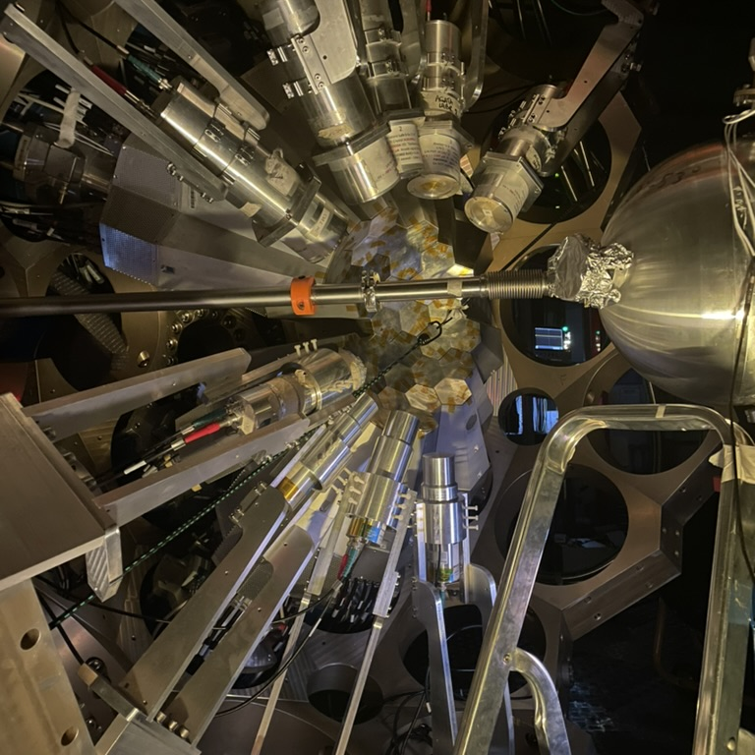
Thank you
Alain.goasduff@lnl.infn.it
https://web.infn.it/gamma/
https://www.agata.org

