Slide 1
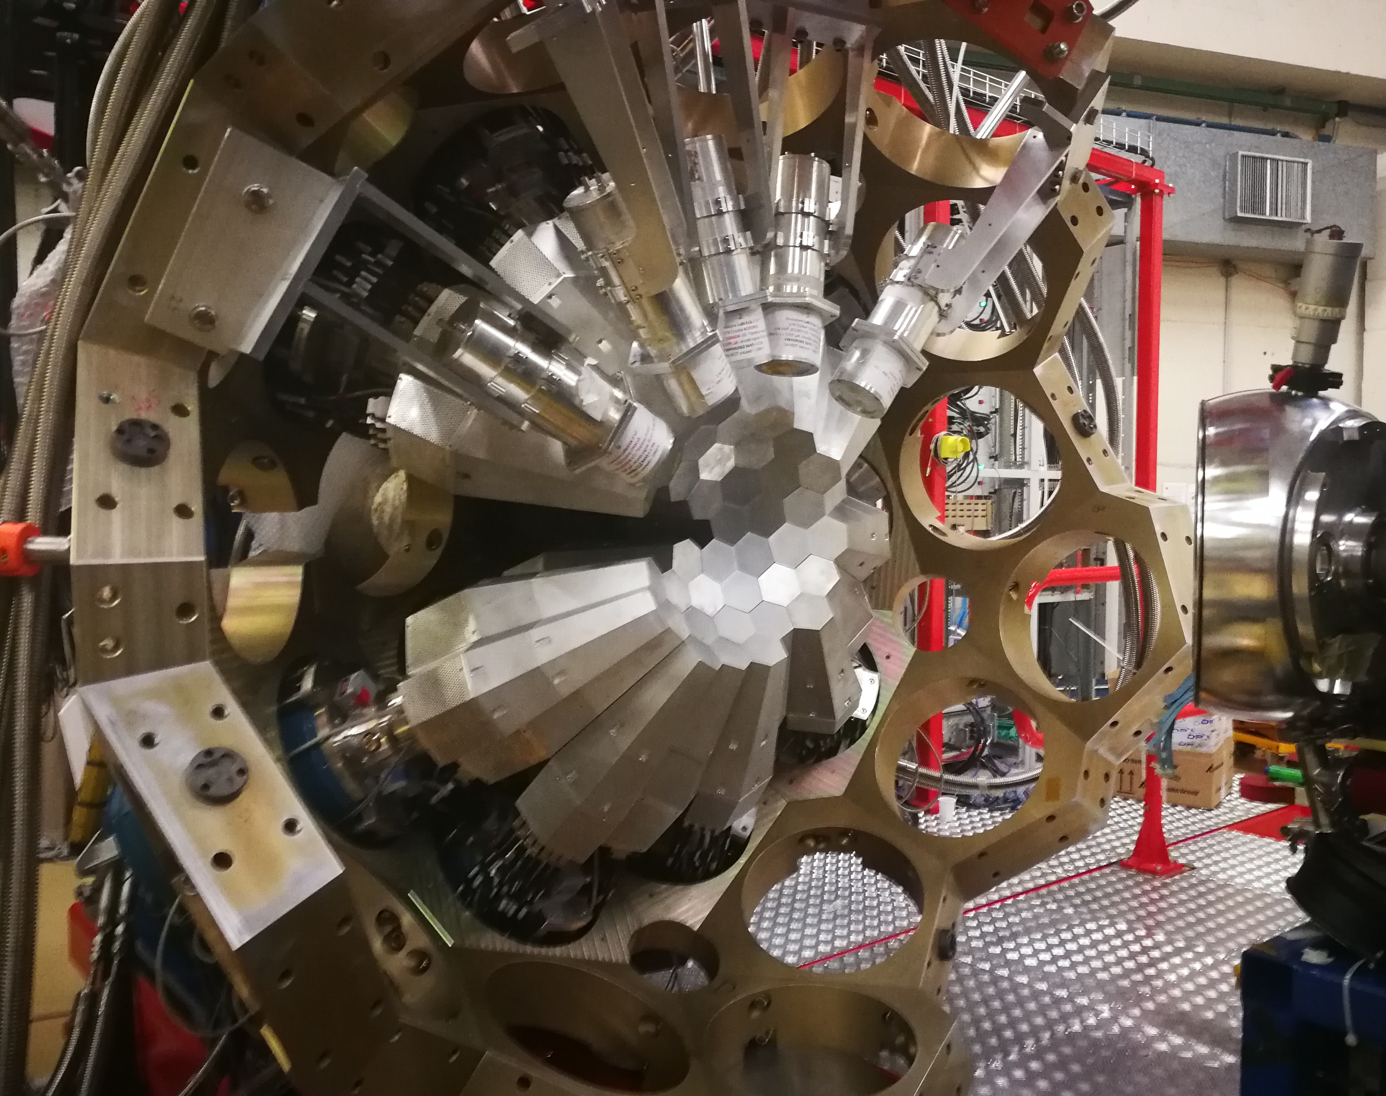


CAEN digitizer test
Alain Goasduff (INFN LNL)
26th AGATA Week meeting
7-11 September 2026
HIL - Warsaw

Slide 2
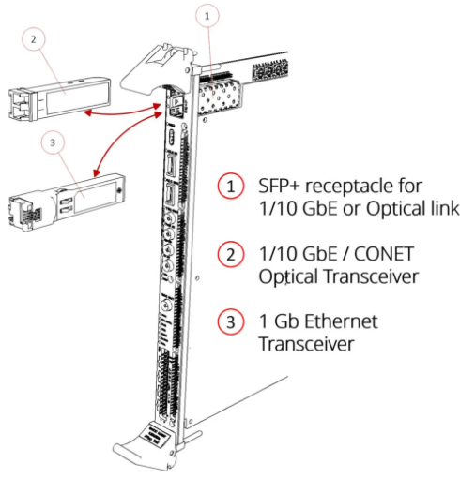
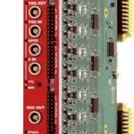

Hardware configuration
Readout with the VX2740 / VX2745
High resolution 16-bit ADC
125 MSps
Differential inputs V_{pp} = 2V
New FW development in collaboration with CAEN
Digitizers used for the silicon detectors @ LNL
25 boards available from the NUMEN collaboration (LNS)

Slide 3
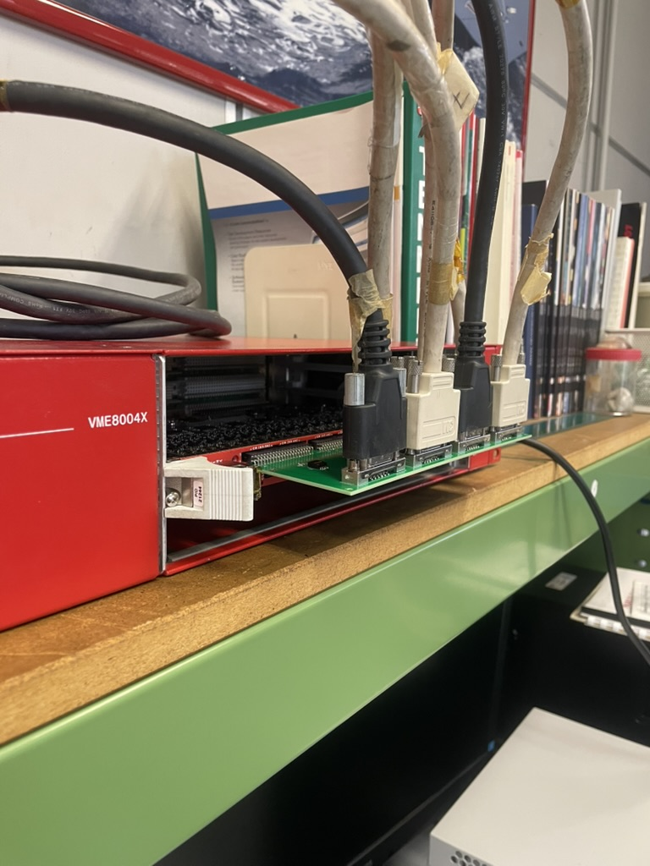
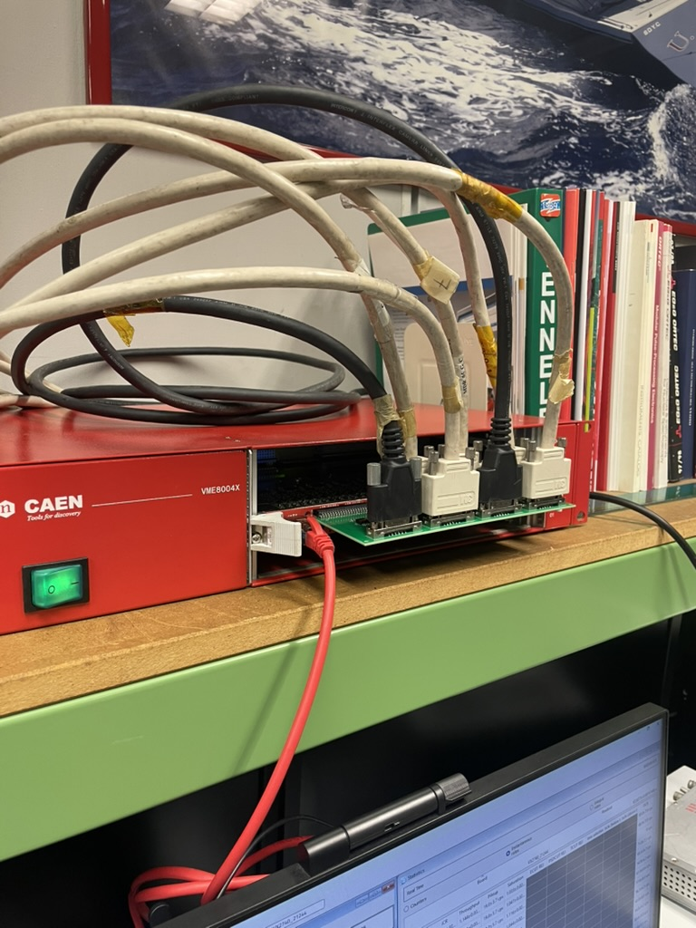
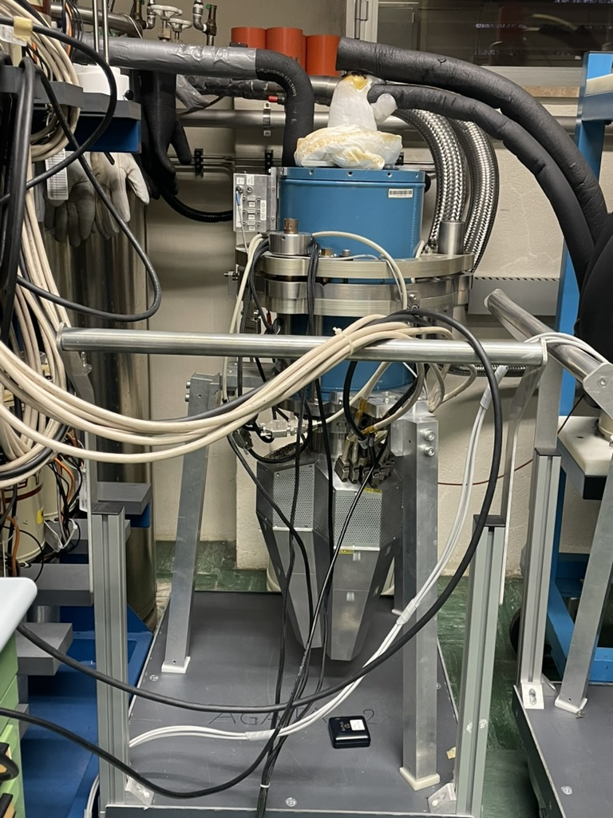

Electronics for detector test bench

Slide 4
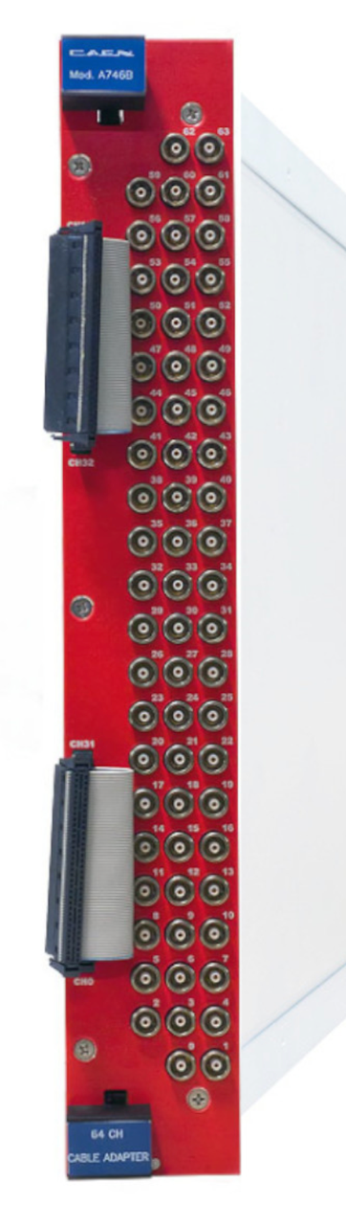
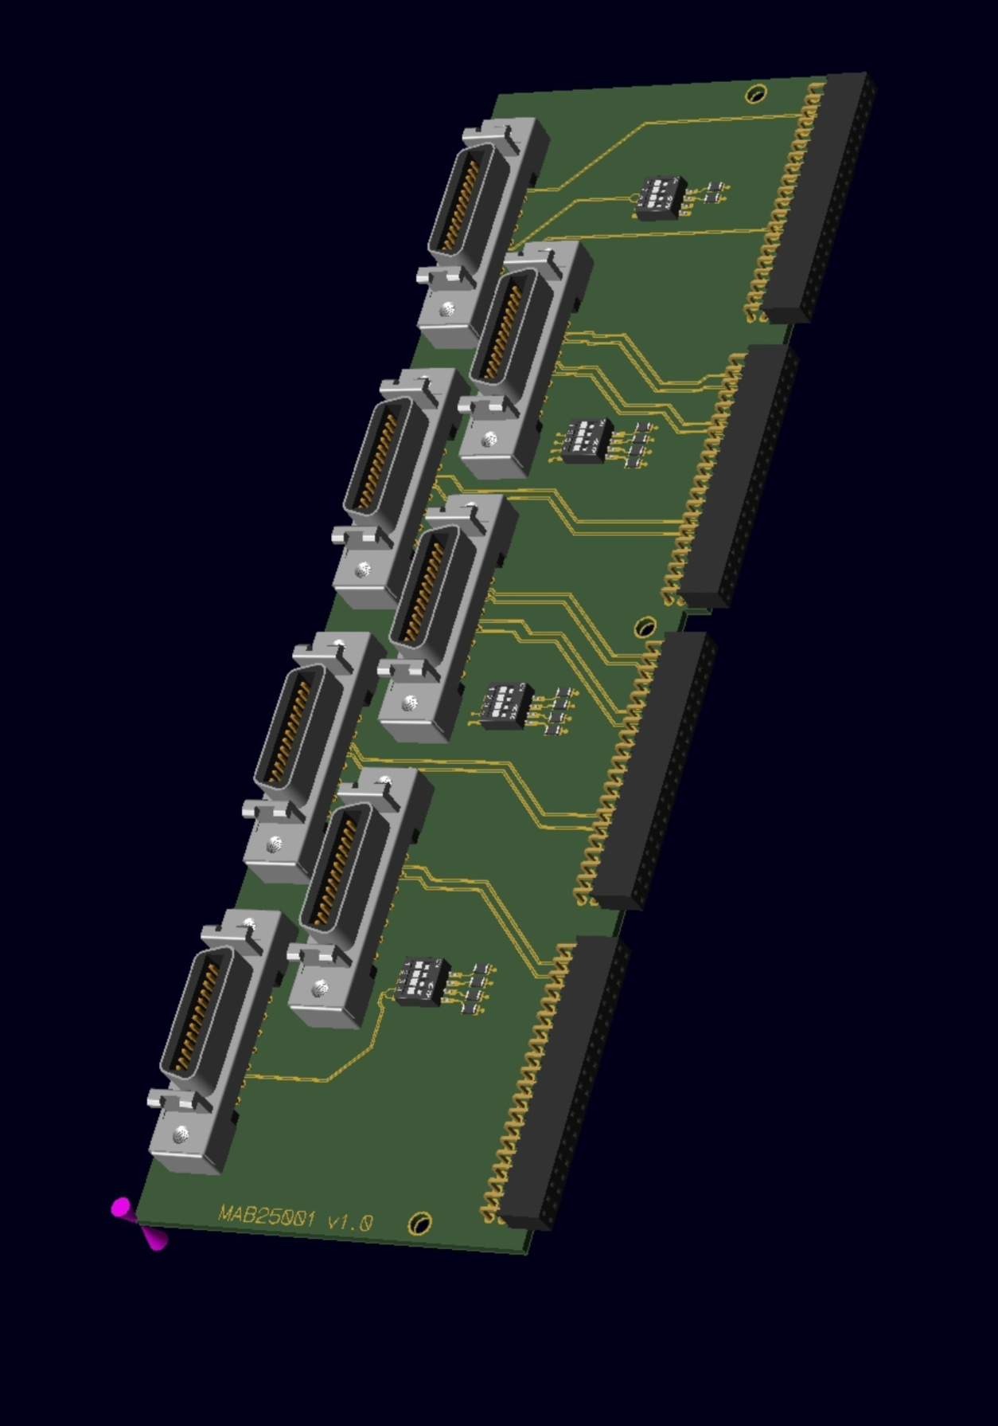
Adapters for the MDR cables to VX2740
Prototype made for the detector test bench and 4U VME crate
  Cable at 90 degrees from the PCB
  Weight on the Digitizer connectors
  Mapping identical to the V1 electronics
  Control of the pre-amp fast reset
  1 detector x board
New revision of the geometry:
  2U VME mechanics
  Kapton connectors to the digitizers
  Prototype order in progress
  One AGATA Crystal = 3 VME units
  With one crate we have 7 crystals
Courtesy of M. Nicoletto

Slide 5
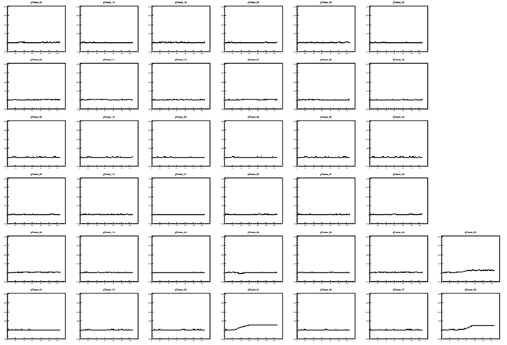
Electronics for detector test bench
Different trigger modes available:
Individual trigger for each channels (core/segments)
Common master trigger (AGATA like operation)

Slide 6
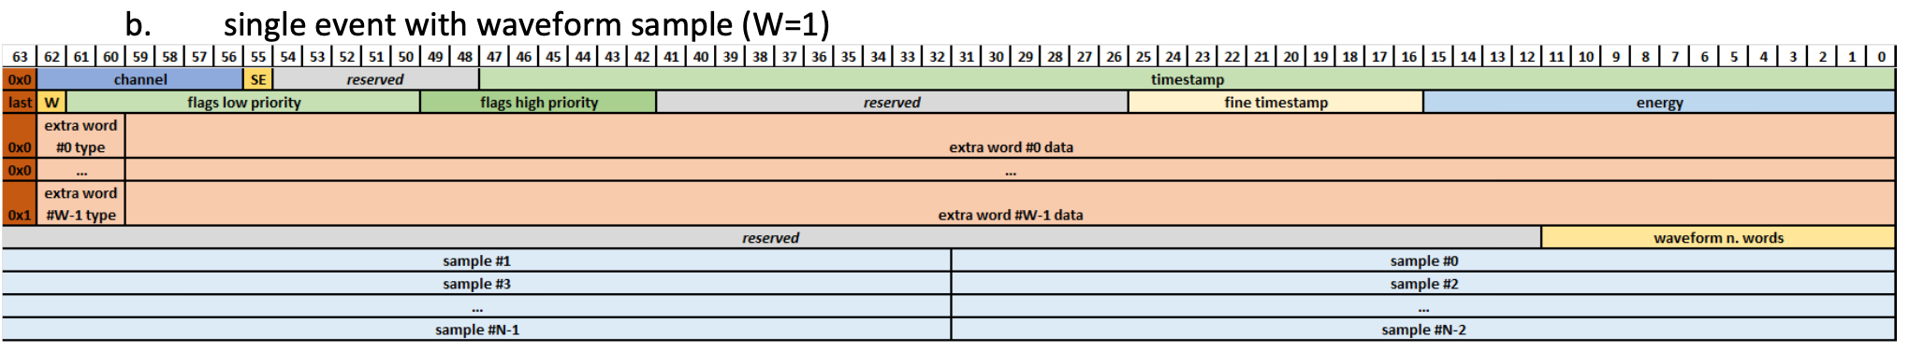
Data bandwidth
In the CAEN raw data:
  Aggregate header: 64 bits
  Size of the single channel sub-event = 2358 bits
  For 38 channels we are at ~ 89668 bits → 10.9 kB / event
With 1 Gbps up to 10 kHz of validation (in case of perfectly stable conditions)
Old data frame already modified for the ancillary detectors to have
4 analog samples / 64 bit

Slide 7

Test bench for the CAEN digitizers
Digitizers included in the acquisition chain for the last AGATA+PRISMA experiments (ATC14)
Readout on a single servers using the AGATA-net (172.16.1.0/24)
External coincidence with PRISMA (“Hardware trigger mode”)
Readout using XDAQ modified actors:
  On-line resampling (from 125 MSps down to 100 MSps)
  Writing data as in AGATA short traces format (“cdat” – but not compressed)

Slide 8
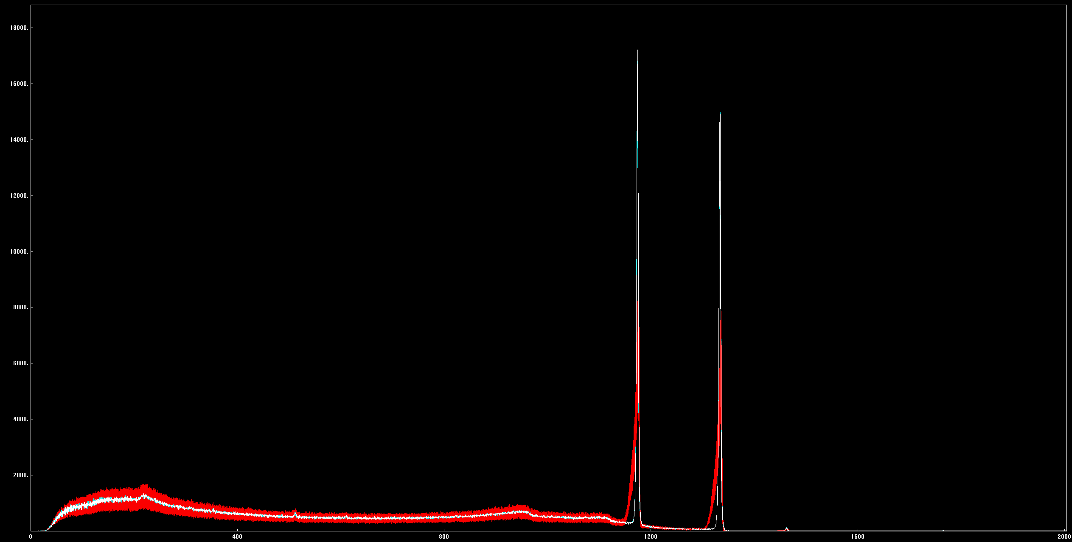
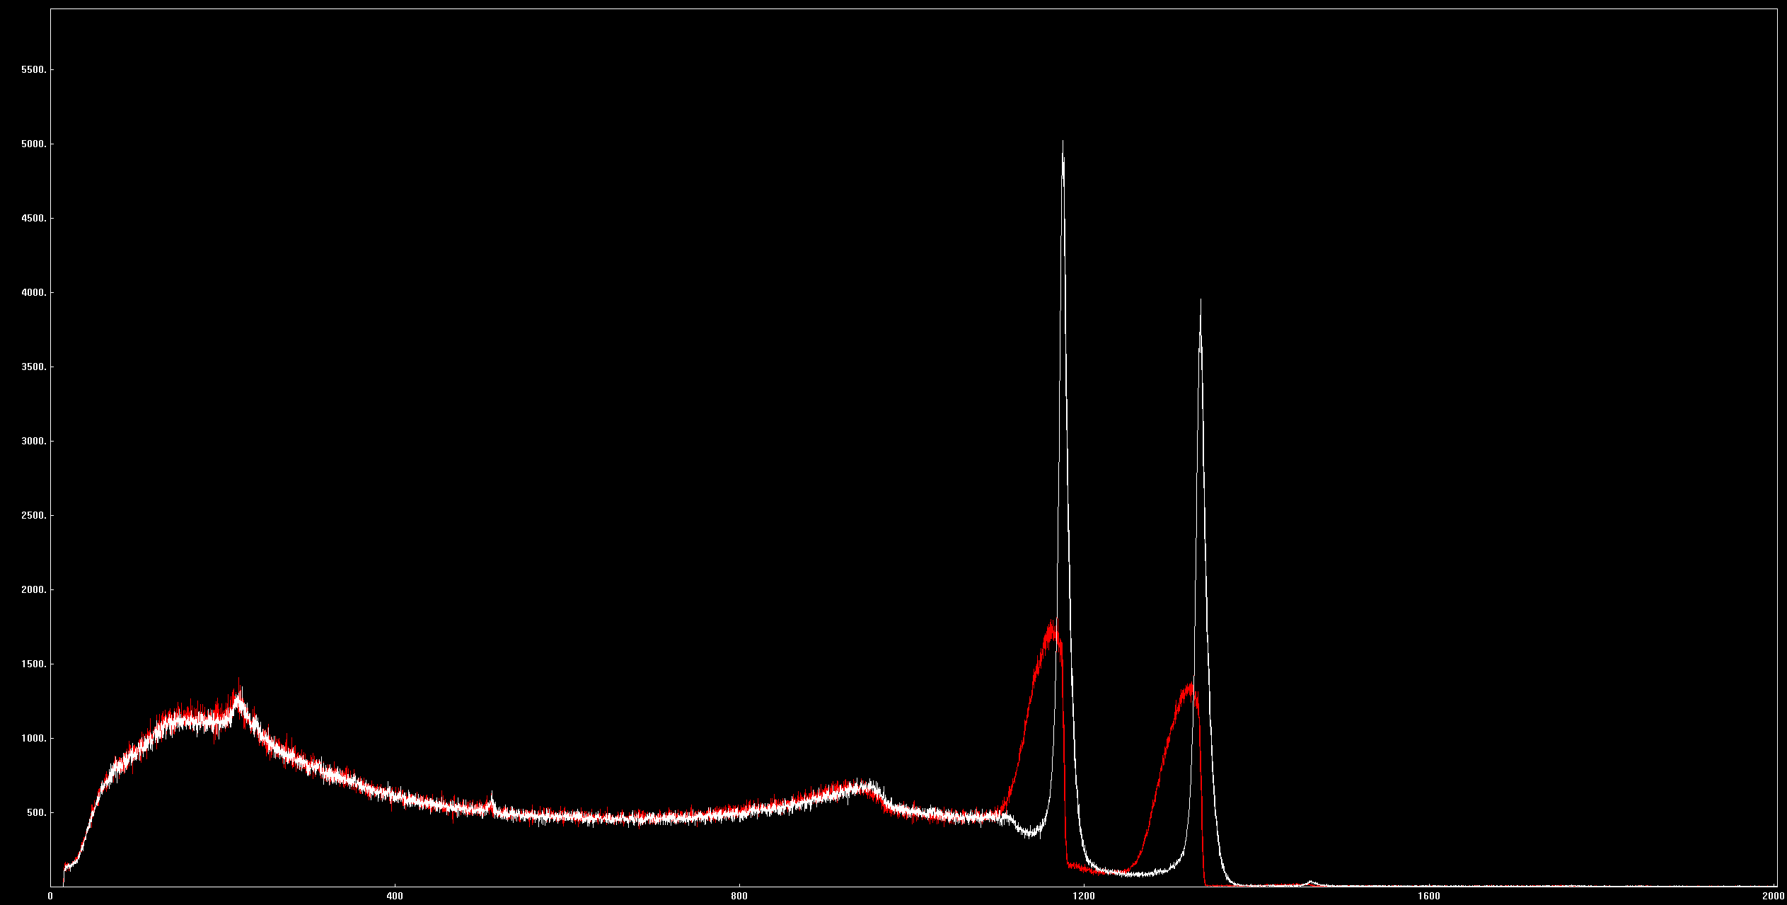
Source test
Core Response
Before Neutron Damage Correction
 | 14A | 14C
Prod. centroid | 8107 (ch) | 7593 (ch)
Prod. FWHM | 57.0 (ch) | 55.6 (ch)
Prep. FWHM | 8.7 keV | 8.7 keV
Core before ND | 8.4 keV | 8.7 keV
Core after ND | 3.6 keV | 4.0 keV
Sum-segments before ND | 46.1 keV | 60.2 keV
Sum-segments after ND | 12.3 keV | 11.6 keV
Sum of Segments
Before Neutron Damage Correction

Slide 9
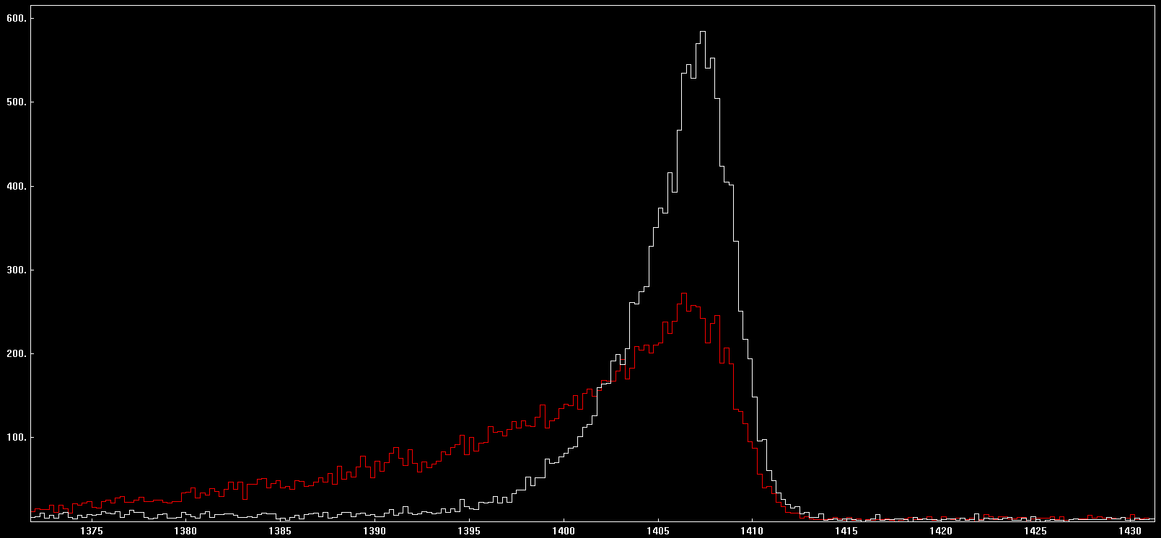
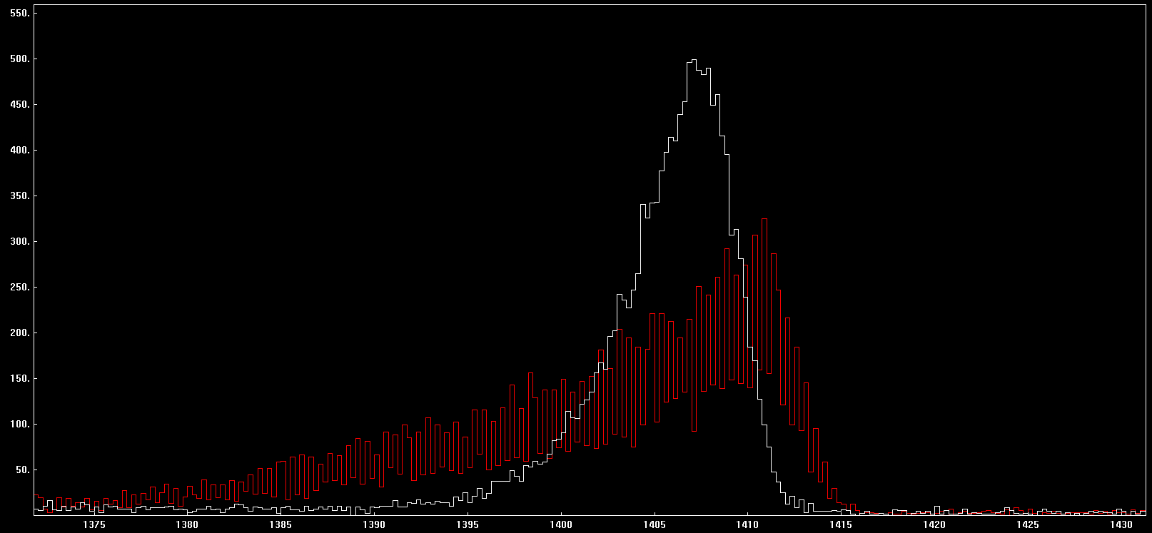
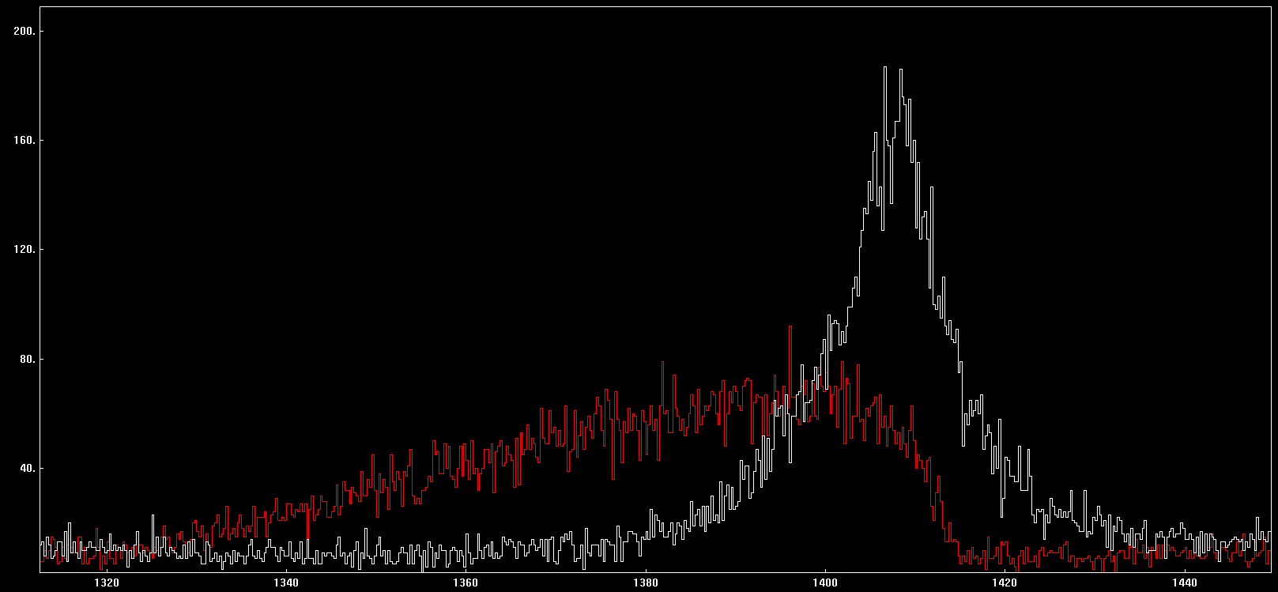
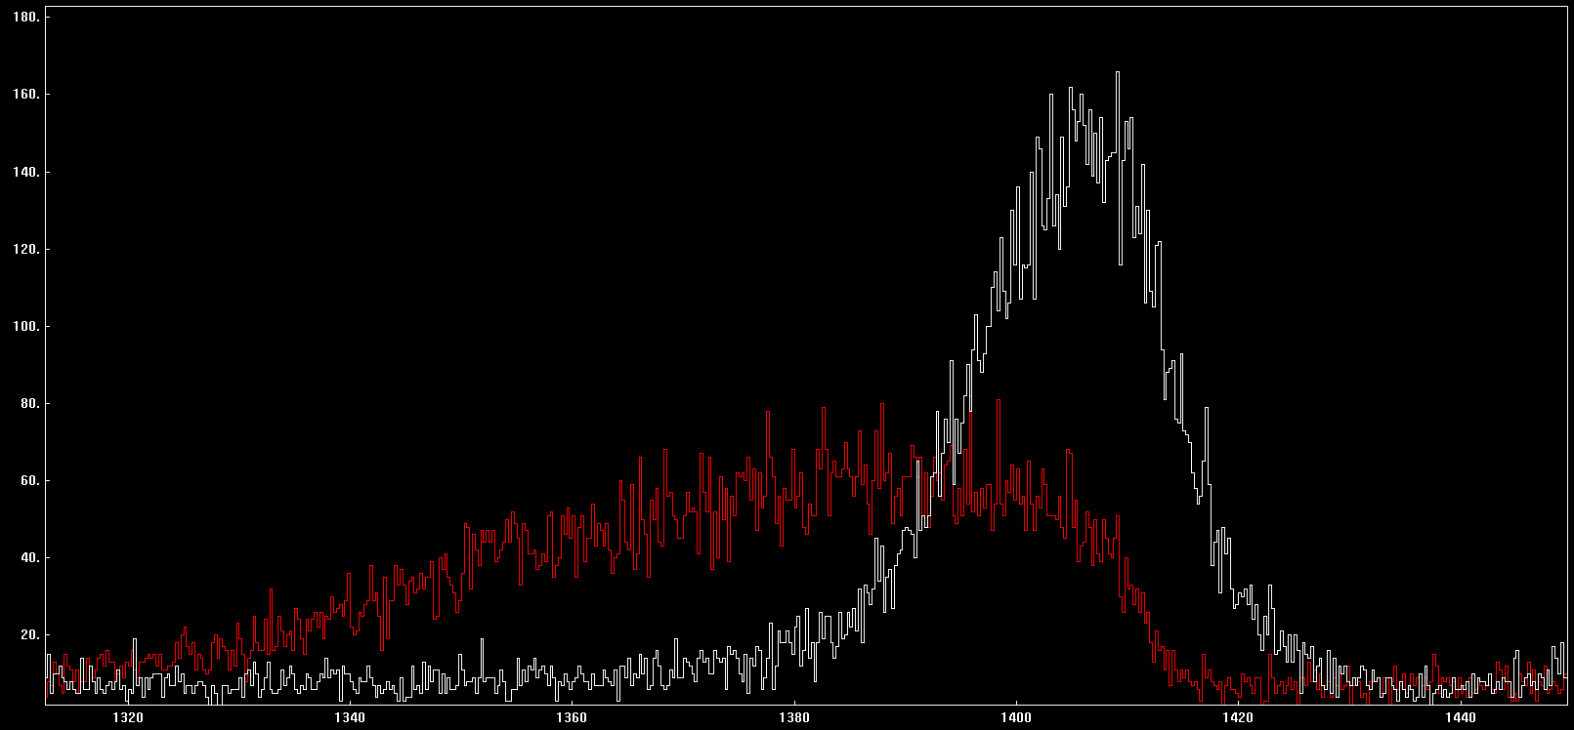
Source test
05A PostPSA Core
14A PostPSA Core
Preprocessing Output
Preprocessing Output
05A PostPSA Sum of Seg.
14A PostPSA Sum of Seg.
Preprocessing Output
Preprocessing Output

Slide 10
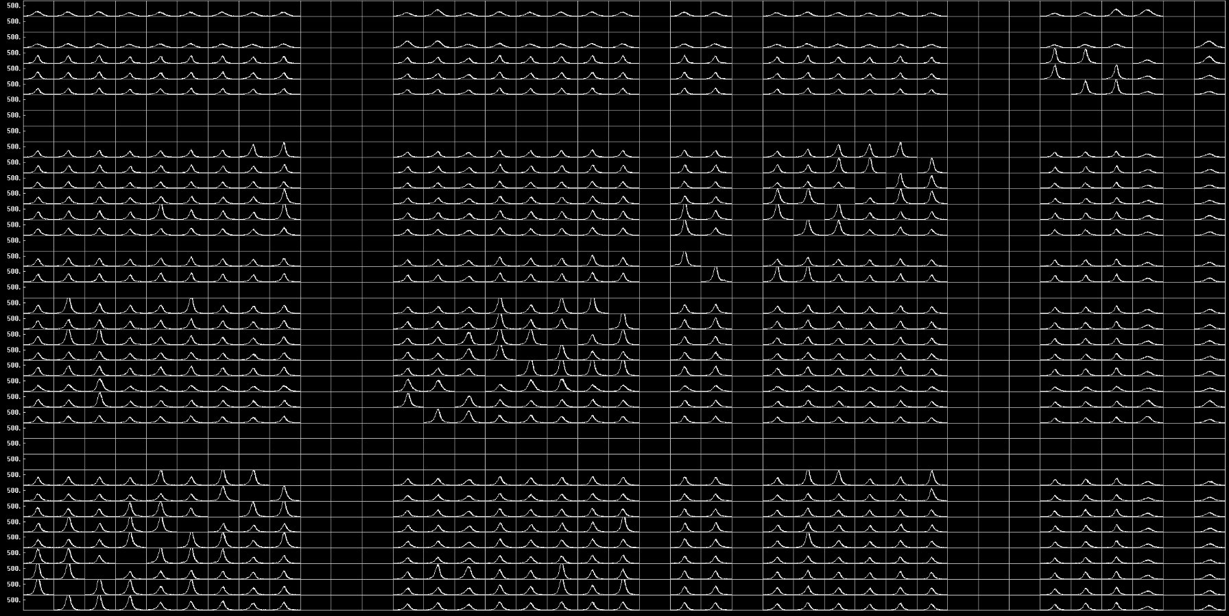
Source test – Global Time Alignment

Slide 11
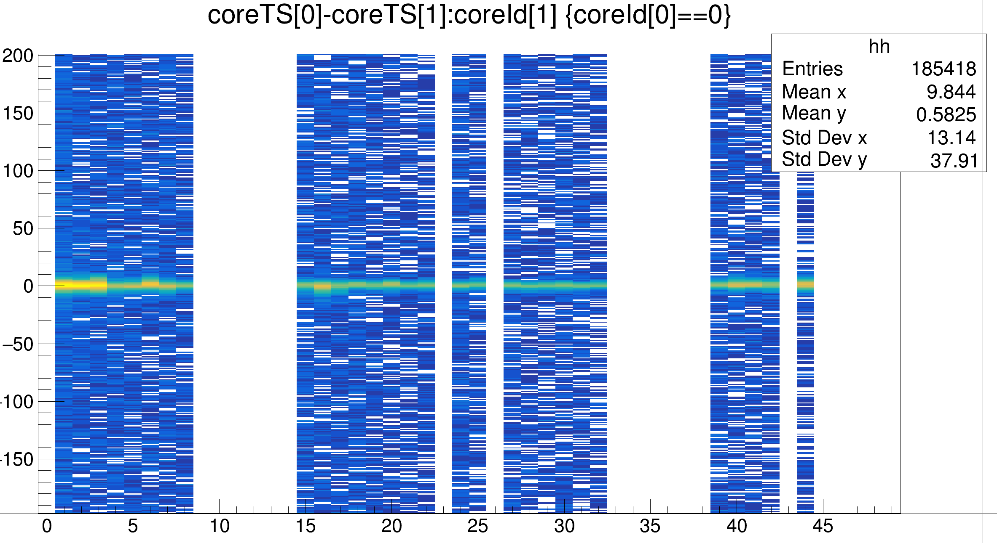
Source test – Time Alignment
Full pre-processing of the GGP and CAEN data
+ merging of the data from the two chain
+ AGAPRO TreeBuilder

Slide 12
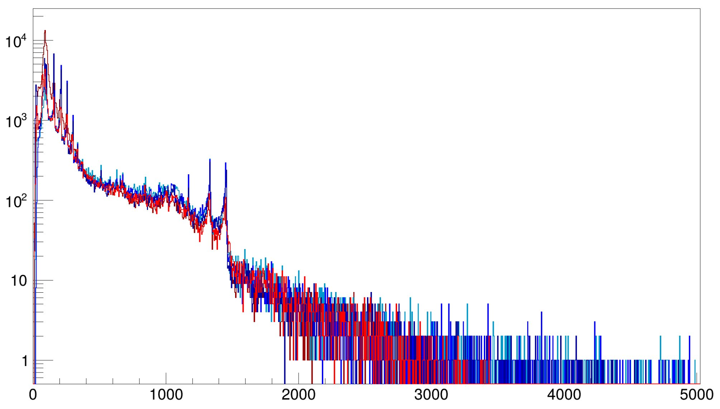
In-beam test
13C
Using AGATA digitizer:
13B
13A
Using CAEN digitizer:
14A
14C
Hardware coincidences AGATA-PRISMA on CAEN and GGP
Recoil velocity vector determine from PRISMA
Gamma first interaction position determined from PSA

Slide 13
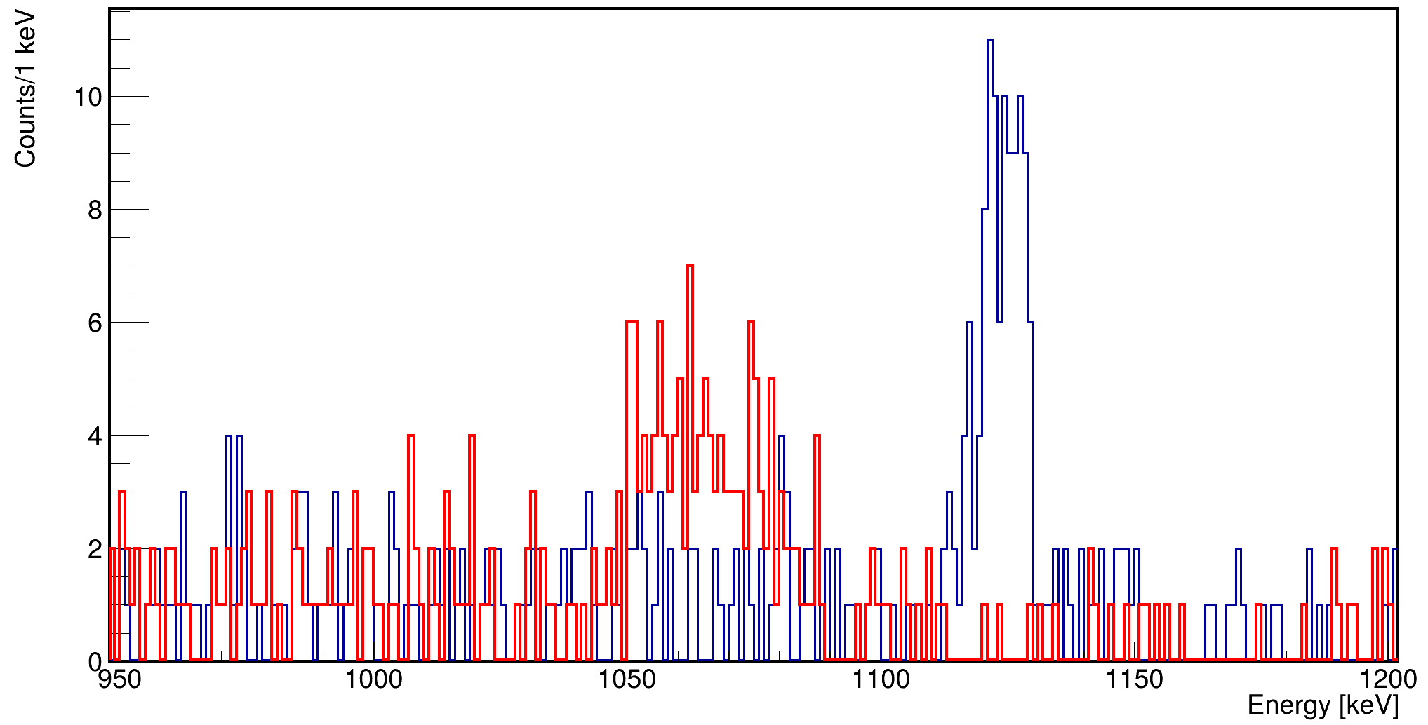
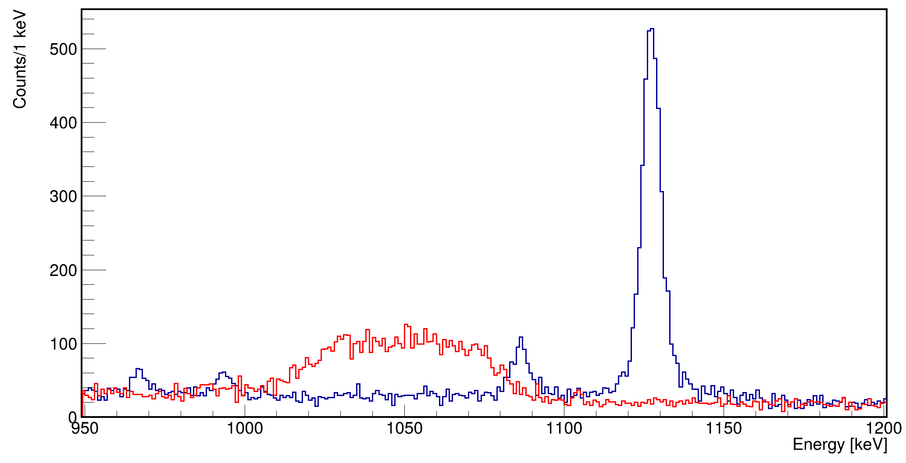
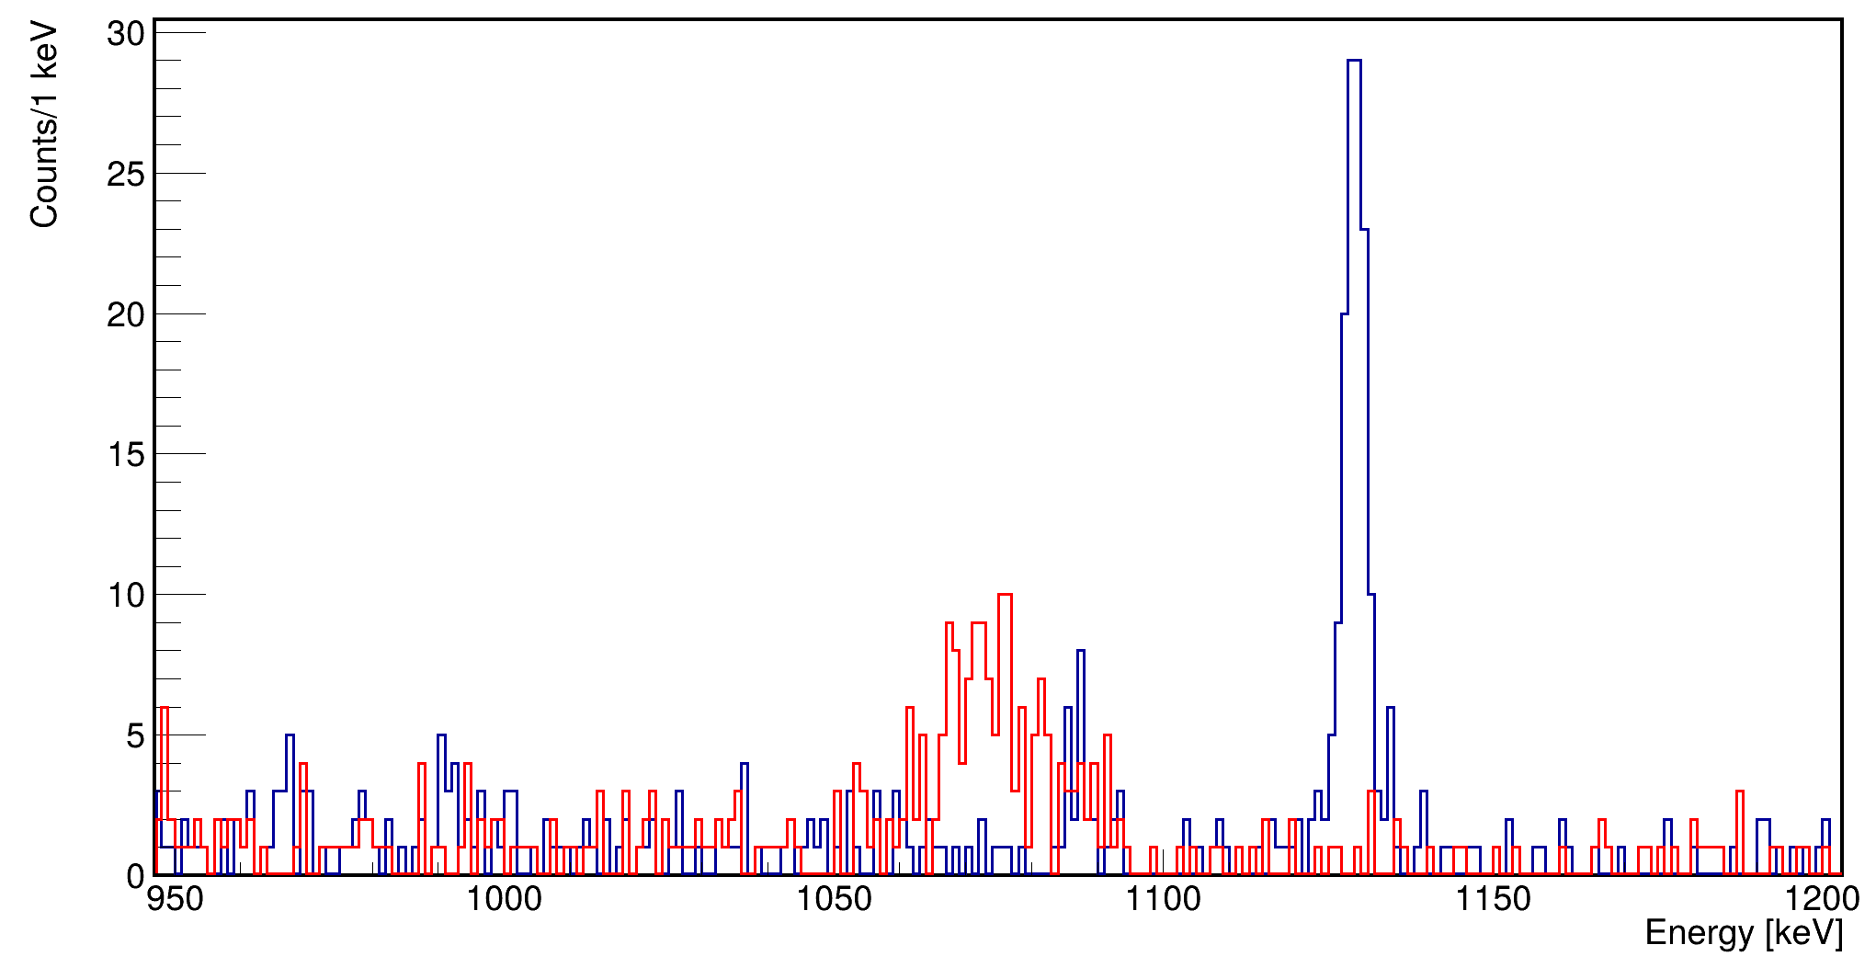
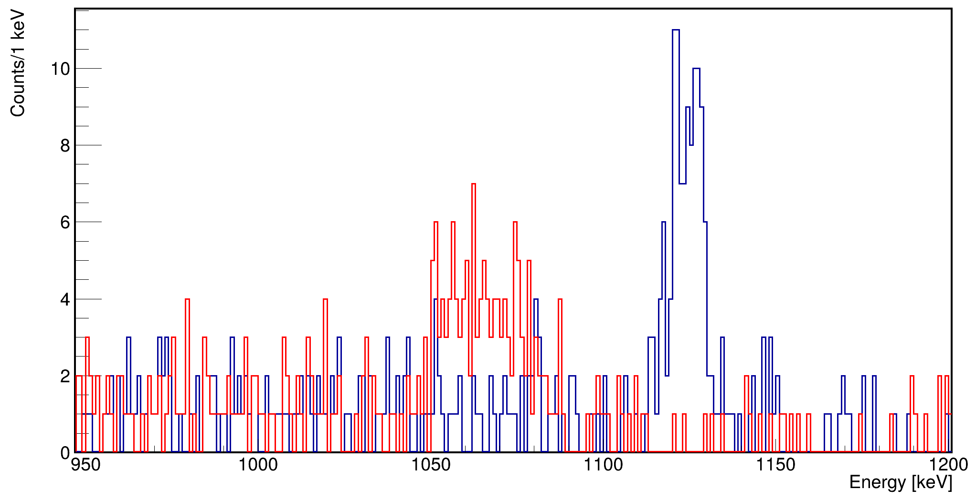
Doppler Comparison
05A
All Crystals
13A
14A

Slide 14
Important points raised
Comparable peak intensities to crystals on AGATA digitizers in producer spectra
Energy binning results in defective cross talk – pre-existing cross-talk file used to proceed through this test
PostPSA peak intensities show ~5-10% loss in efficiency at current stage – loss may occur as early as preprocessing so hopefully this can be resolved simultaneously with xtalk

Slide 15

Disponibility for the next campaign
Collaboration with the NUMEN experiment (INFN – LNS)
  25 boards guarantee
  Few additionnal boards in function of their disponibility
Transport to LNL by the end of Septembre
Installation of a test bench in hall 2 with the good detector (e.g. ATC13)
One of the LNL digitizer used for the preliminary test will be send to IJCLab for the integration in DCOD

Slide 16
Roadmap
Production of the adapter MDR→VX2740 (INFN PD): on-going
Full characterization of the chain with a good detector (INFN LNL)
DAQ Integration in DCOD
  Based on the CAEN library
  XDAQ readout and data unpacking code sent to IJCLab
  VX2740 Board from LNL will be sent to Orsay
New channel integration in the Topology Manager:
  Limited number of files to manage (no GTS integration)
  Only mapping of Digitizer IP to Crystal ID necessary
  possibility to set the IP address of the board to “172.17.3.CrystalID”
  Slow Control of the board and configuration of the board done in the GGP way (basicInit.sh / shaping.sh)
Board monitoring done on the individual boards using the embedded linux (already done)

Slide 17
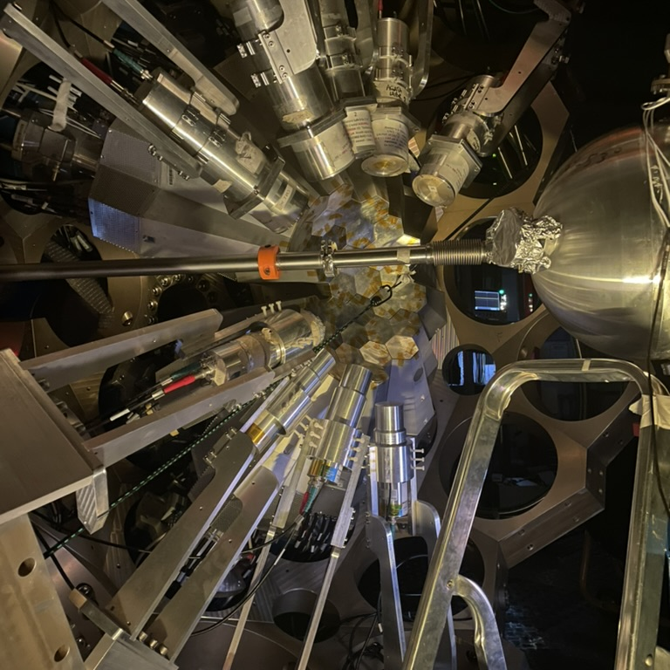
Thank you
Alain.goasduff@lnl.infn.it
https://web.infn.it/gamma/
https://www.agata.org

