Slide 1
AGATA Project
150 Gbps Bay and STARE Status
N. Karkour et al.

Slide 2
Outline
  STARE STATUS Hardware and Firmware
  When did the 12 link Bay idea germinate
  Why do we need this Bay
  12 Link Bay functionalities
  From 12 link to 150 Gbps Bay qualification

Slide 3
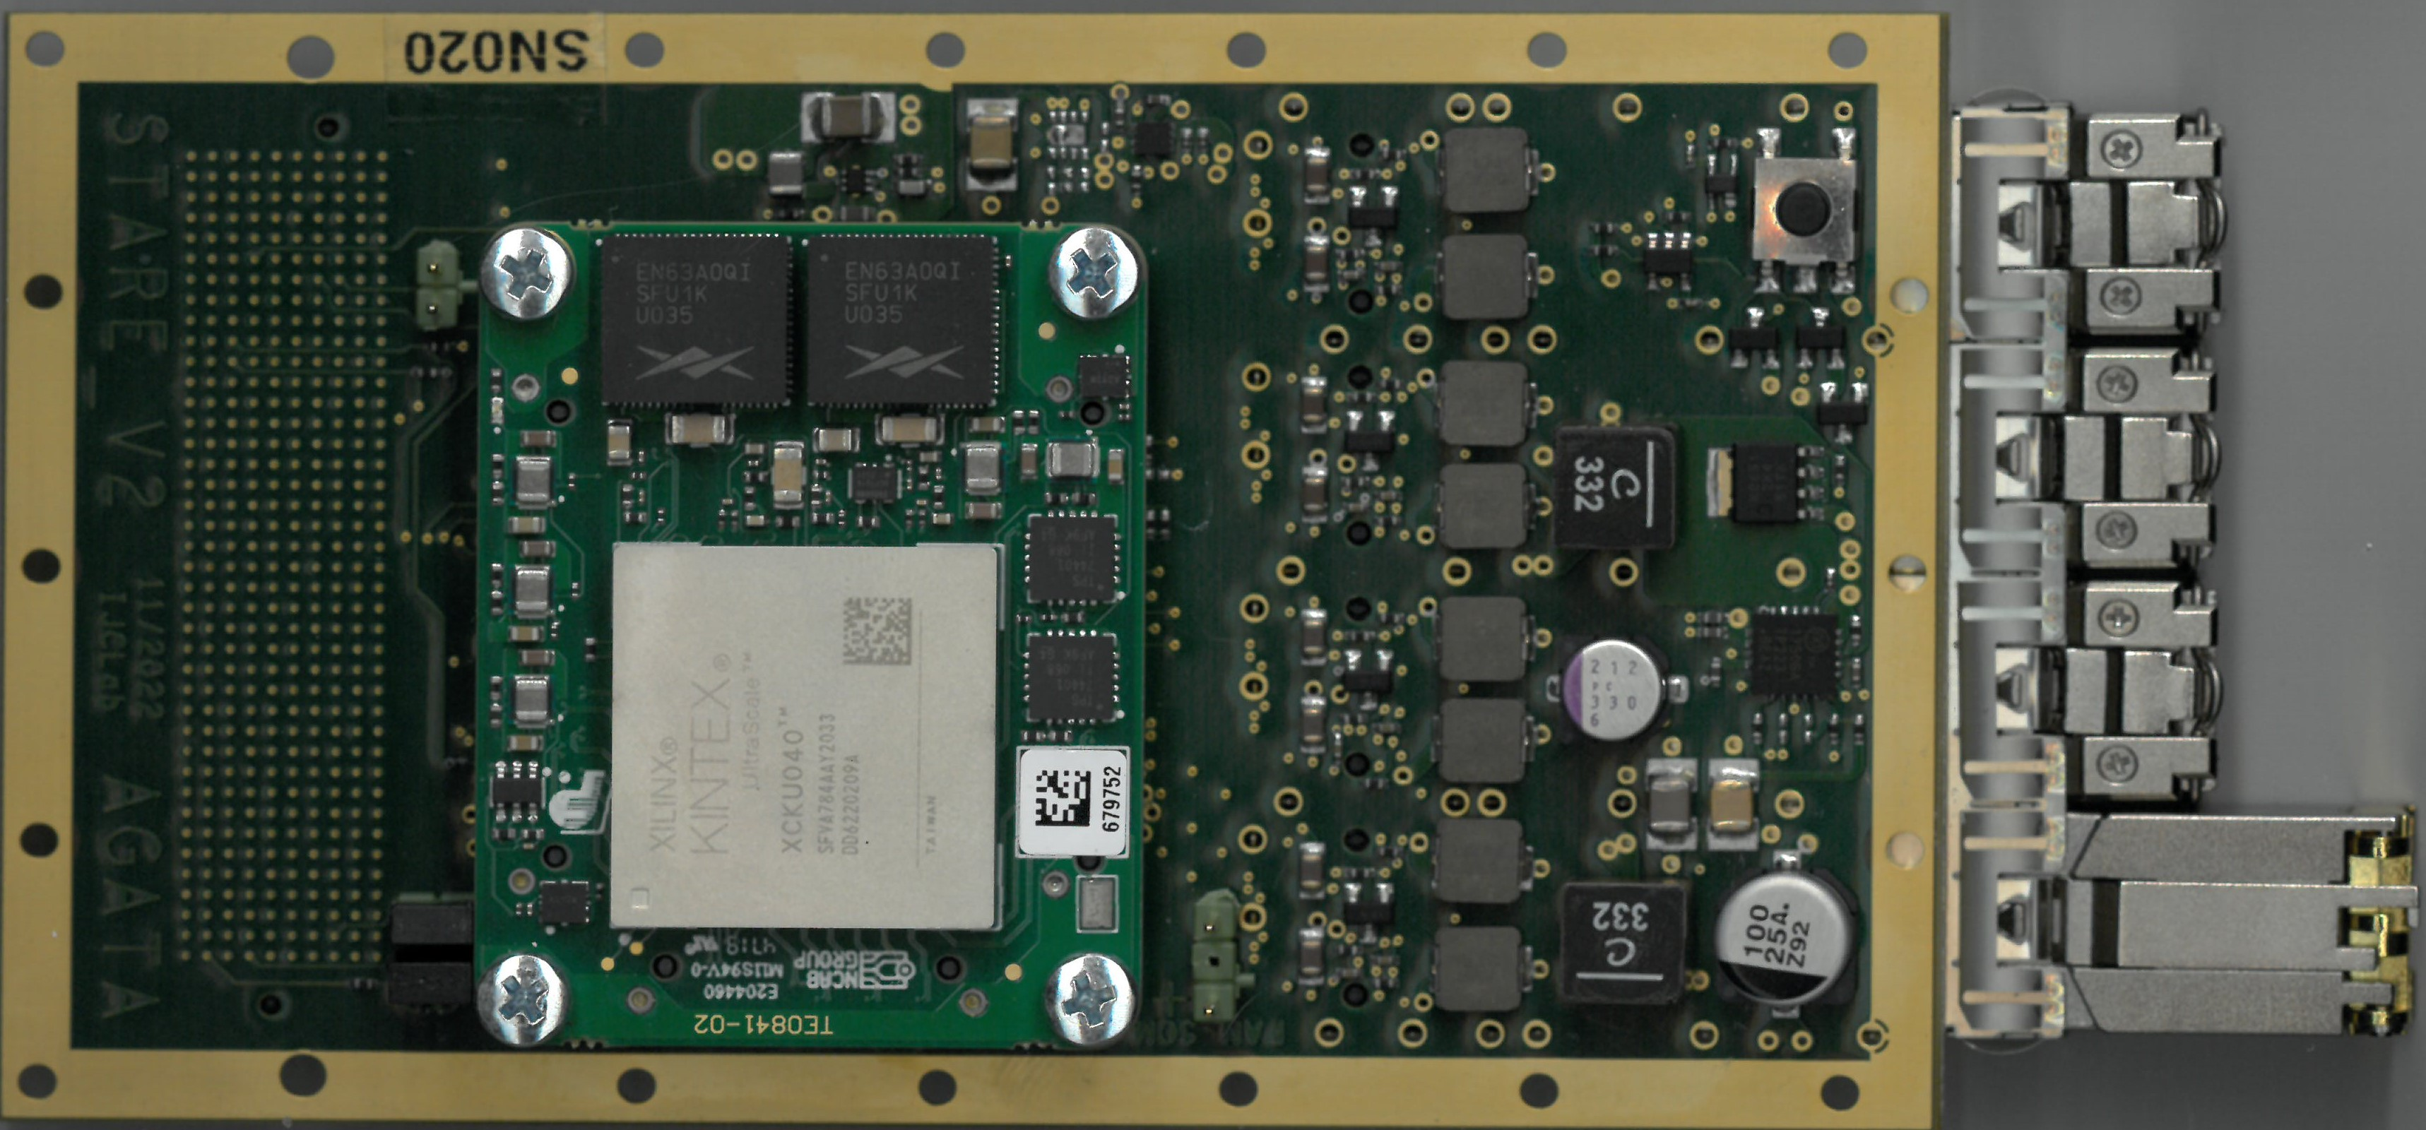
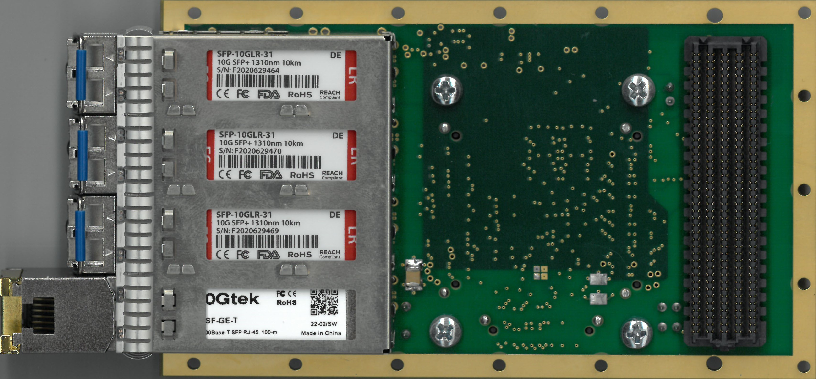
STARE for AGATA : readout UDP 10Gbps
IJCLab Orsay
INFN & U. Milano
STARE
IFIC Valence
Input data rate from pre-processing : 4 x 10 Gbps serial (AURORA)
Network Bandwidth up to 4 x 10 Gbp (UDP)
FMC vita 57.2
Spare LVDS I/O with the pre-processing
Full clock management inside the SOM and the FMC carrier.
1 Gbps IPBus for slow control (use 1*10Gbps network link)

Slide 4
Data processing (1 * 10Gb/s)
Aurora interface
Data manger
Spliter
UDP interface
(David Zidler – Zurich)
10 Gb/s
Aurora
64 bit
@156,25 Mhz
64 bit
@156,25 Mhz
10 Gb/s
Ethernet SFP
One event of X KB
Y packets of 8 KB
Standalone
data generator
Data check
_ Slow control
_ EEPROM
_ Clock manager
_ Spare LVDS link
Generators available (compute by Ipbus, independant, rate ajustable, random trigger) :
_ byteANDpackage_counter : data can be checked by SQM ; size of event 8 Bytes -> 256 MBytes
_ 2 Rams of 8KB : can be fill by Ipbus

Slide 5
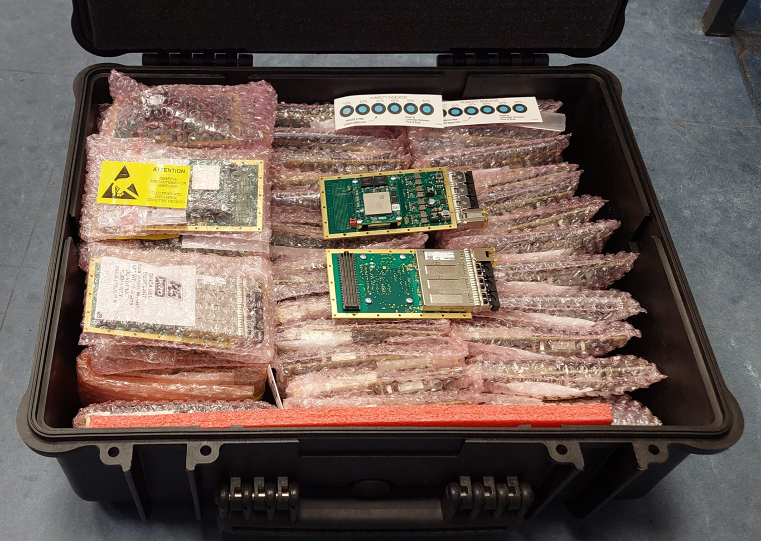
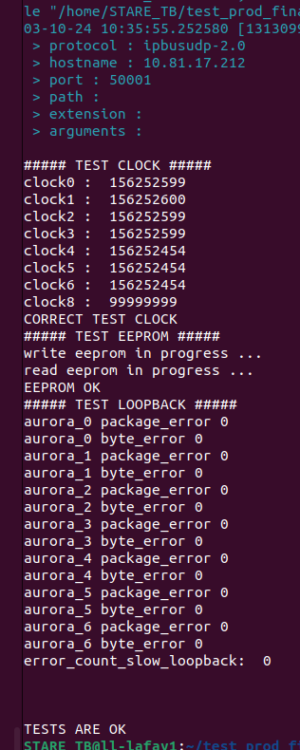
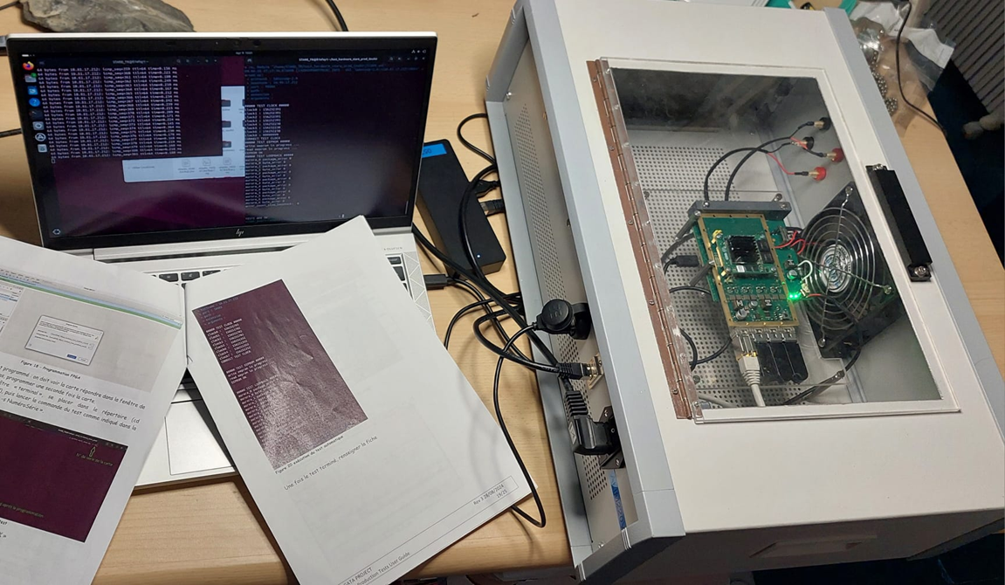
Production
Manufacturer : STAE (Savigny-sur-Orges)
140 Stare produced (10 Pre-production)
  64 (+10 Pre-production) delivered at Orsay (+1 not_OK)
  61 ready to be delivered (+ 4 not_OK)
  Multiple upgraded SOM modules lead to issues (full production purchased)
testbench developped at IJCLab :
Assembled STARE board is validated by the manufacturer before delivery
_ shortcut test
_ STARE-interface board (covers 99 % of the STARE)
_ optical loopback (SFP)
_ dedicated computer, control by Ipbus, log file
_ configure MAC address

Slide 6
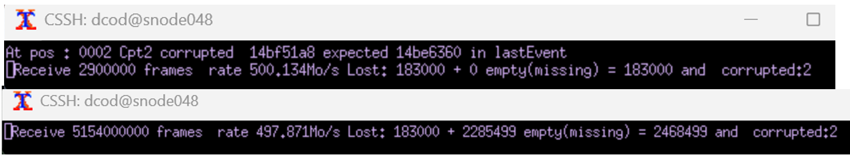
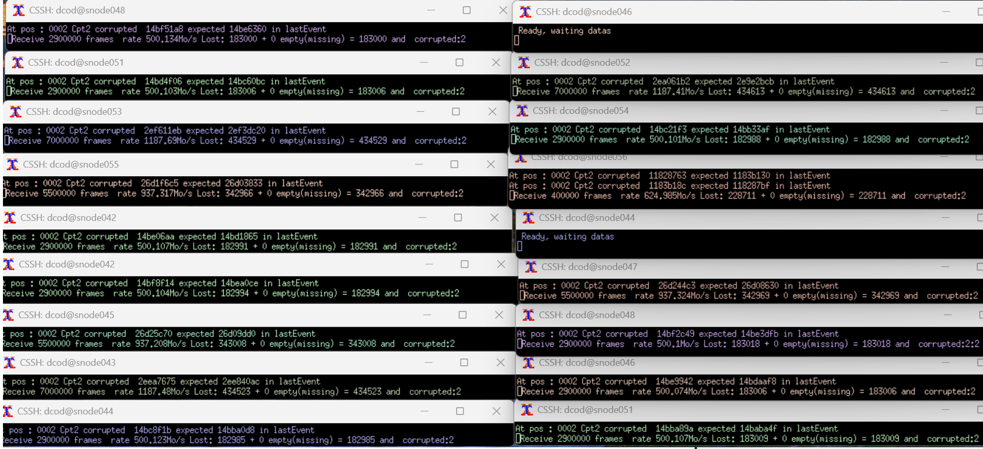
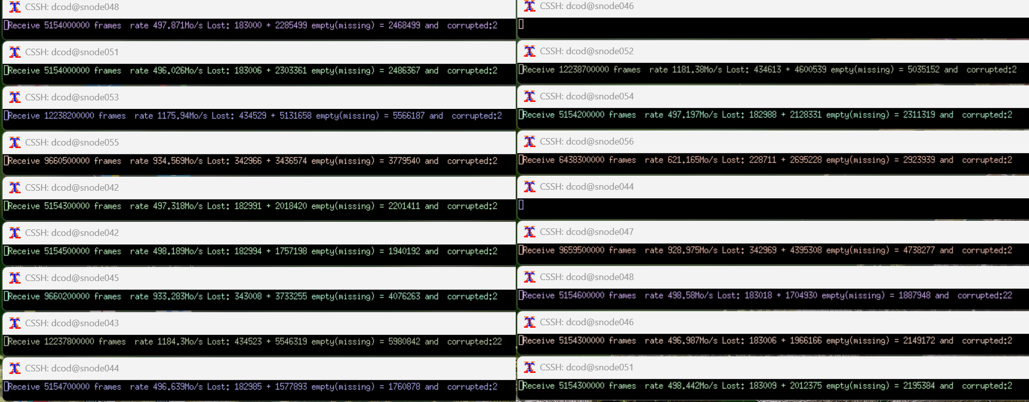
Tests – 80Gbps between buldings 104 and 206
Commande : SQM :
3*9,5 Gbit/s 3*1187 MB/s
3*7,5 Gbit/s 3*937 MB/s
9*4 Gbit/s 9*500 MB/s
1*5 Gbit/s 1*625 MB/s
Total = 80 Gbit/s 9997 MB/s (=79,98 Gbit/s)
Commande : SQM :
3*9,5 Gbit/s 3*1187 MB/s
3*7,5 Gbit/s 3*937 MB/s
9*4 Gbit/s 9*500 MB/s
1*5 Gbit/s 1*625 MB/s
Total = 80 Gbit/s 9997 MB/s (=79,98 Gbit/s)
Commande : SQM :
3*9,5 Gbit/s 3*1187 MB/s
3*7,5 Gbit/s 3*937 MB/s
9*4 Gbit/s 9*500 MB/s
1*5 Gbit/s 1*625 MB/s
Total = 80 Gbit/s 9997 MB/s (=79,98 Gbit/s)
After 24h no data loss, no data corrupted
To check (done FW upgrade): les empty (missing) makes network saturation (found and fixed data filtering while ping command with >512 bytes See Guillaume slides) ?

Slide 7
Firmware Upgrade
Simulation generator :
  _IDLE frame simulation
  _ random trigger (rate manageable)
  _ change RAM data simulation < 25ms (40 Hz)
Monitoring (via ipbus) :
  _ count incoming event and outgoing packets
  _ clock monitoring
  _ power supply monitoring
UDP Transfer issues (hidden problem hard to check) :
  _ incoming data to stare is not properly managed : this function has been removed to preserve network functionalities (arp, ping)

Slide 8
When did the idea germinate
Slow Control for PACE
Slow Control for STARE
STARE Firmware and IPbus
Slow Control for Digiopts
PACE Firmware and Ipbus
DECOD SQM RUDP etc.
Topology Manager for STARE PACE
IJCLab Orsay
INFN & U. Milano
SCOPE Monitoring
STARE
Topology Manager for STARE standalone
Topology Manager for STARE Emulateur
IFIC Valence

Slide 9
When did the idea germinate
Total number of cristals is 120
Topology Manager configuration is not easy
  Needs test benches for several types of HW and SW developpement
  Stare alone for the STARE firmware development
  Stare with PACE for HW and FW tests and qualification of the V2 electronics
  Stare emulation software to check for DAQ improvements and new programs validation.
  Online monitoring link to see
  Each board type has its own scripts to setup reset load save recall etc…
Must validate all software packages before installation in Legnaro
Must test in standalone
We need to validate the RUDP along with UDP and compare using multiple STAREs

Slide 10
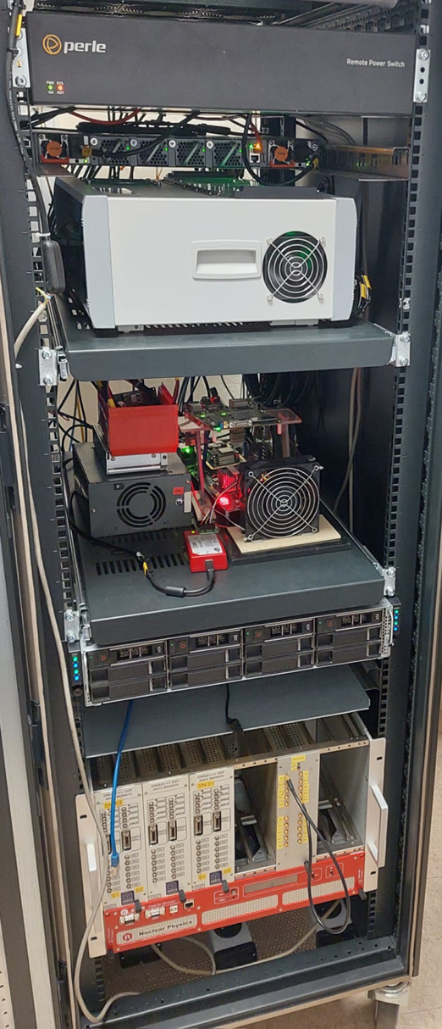
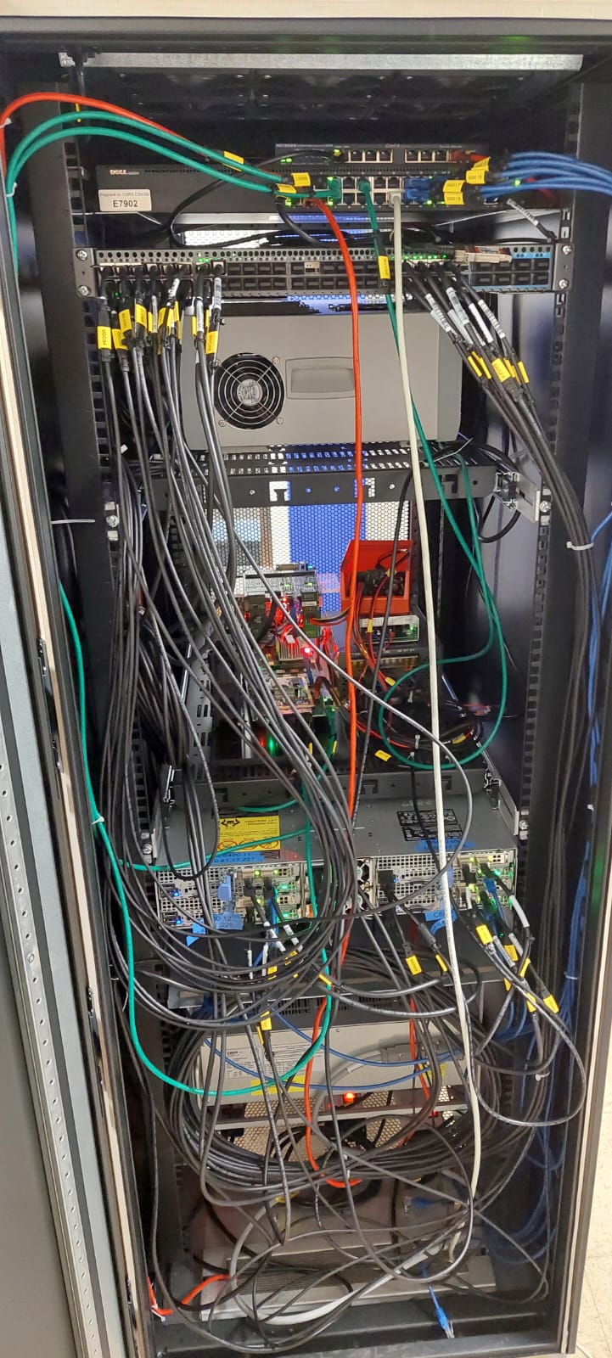
AGATA crystal simulator using STARE
Power Switch for remote control
A new Bay to be designed to house all the STARE facilities
New PACE crate with cooling, Fans, PS mechanics to fix the backplane and up to 38 channels. Plus 3 Stare links
12 links Stare bench
100 Gbps switches
Power switch
4 DAQ servers up to 8 STARE emulators
Cristal emulator (pulser + faninfanout + single_diff)
Total of 23 links @ 10 Gbps each (230 Gbps).
100 Gpbs fibre between 104 and 206 (200 Gbps as an upgrade)
100 Gbps Optical Switche
STARE 12 links
PACE Test Bench (in a crate *)
Pizza boxes
(4 DAQ servers C6400)
Cristal emulator *
* Missing some parts

Slide 11
12 Link Bay functionalities
We propose to simulate 38 High resolution low noise pulses to the PACE board and analyse the data contents
Validate the Slow Control using multiple cristal configuration
Validate the AGATA monitoring system in order to see continuous triggered signals.
We need to validate the DAQ software and make it more reliable.
All this development is done is parallel
All this cannot be done with a simple test bench

Slide 12
12 Link Bay functionalities
We can make parallel development (We can test firmware development on one stare and test Topology manager on other STAREs, or Slow control on one or 2 STARE and firmware on PACE in parallel
Topology Manager configuration can be qualified using STARE, STARE with PACE and STARE emulator
We can validate SC TM and DECOD before installation in Legnaro (Completely Crucial for the ongoing physics experiments to start quickly)
Remember Legnaro 2009 and GSI 2012 plus beginning of GANIL phase in 2014

Slide 13
First Full qualification
This test was done in Orsay with the STARE Dream Team (IP2I IPHC and IJCLAB).
Several tests were made on March 2026 to stamp the use or not of the RUDP inside the STARE for data quality insurance.
Several configurations were programmed by the Topology Manager to transfer data at different rates and different use (soft emulator, AGATA events, and monitoring).
Start with 18 links and go up to 24 (plus 6 soft emulators from the C6400)
18 links come from 12 link crate, 1 stare Tb and 1 PACE STARE module.
The DAQ box @ Bat. 206 connected to a 100 Gbps link to qualify reliability .

Slide 14
First Full qualification
Test 1
18 Stare links @5kHz (AGATA plus PSA)
SQM->SQM2ADF->PreProcessing->PSA->BasicAFC
Launch OK (11:10 AM) on all 18 links.
After a few minutes, link 06C loses packets (received on snode053). Backpressure from the PSA is suspected.
Swapping 06C (snode053) and 06B (snode043): the problem reappears on 06C on snode043 --> confirms the PSA is too slow depending on the frame selected for crystal 06C.
Apart from this problem related to the test data, the acquisition works correctly for 45 minutes

Slide 15
First Full qualification
TEST2
18 Stare links + 6 soft emulator links @5kHz
SQM->SQM2ADF->PreProcessing->PSA->BasicAFC . Topology: 18 links, 6 emulators, Stare, PSA
Launch OK (12:00 PM) on all 18 + 6 links.
The topology ran for 2 hours and 15 minutes. Losses occurred on two crystals, 06C and 12C. 06C is known to cause problems (replaced with 05C), and 12C exceeded the PSA output buffer size (the buffer was increased from 8 to 32 MB).
Souhir's monitoring test: it didn't work for the software emulators because the python3-redis module wasn't installed on the machines.
After installing python3-redis, the 18+6 topology was restarted at 20 kHz with monitoring enabled (Back Pressure management Nicolas Talk).

Slide 16
First Full qualification
Test 3 - 4:44 PM
18 Stare links + 6 soft emulator links @20kHz and above SQM->SQM2ADF->BlackHole
Preprocessing and PSA are removed to increase throughput.
The Stare links are then increased to 50kHz: no packet loss for 10 minutes.
We increased the Stare speed to 4800 Mbps (approximately 73 kHz): packet loss occurred after a few minutes (we were at 95 Gbps on the 100 Gbps link). This problem will need to be diagnosed once we have network monitoring.
6:05 PM: For the night, we used a Stare random number generator at 50 kHz (x18) + 6 software emulators at 20 kHz. SQM->SQM2ADF->BlackHole
After 15 hours of operation, there were no packet losses on the Stare links, but some losses on the software links. This could be due to a different network packet transmission profile between the software emulators and the Stare. The software emulator stores several hundred frames in a buffer and sends them all at 10 Gbps, then adjusts the pause duration to achieve the desired count rate. The Stare sends packets on the UDP link frame by frame with a variable interval between each frame to achieve the desired count rate.

Slide 17
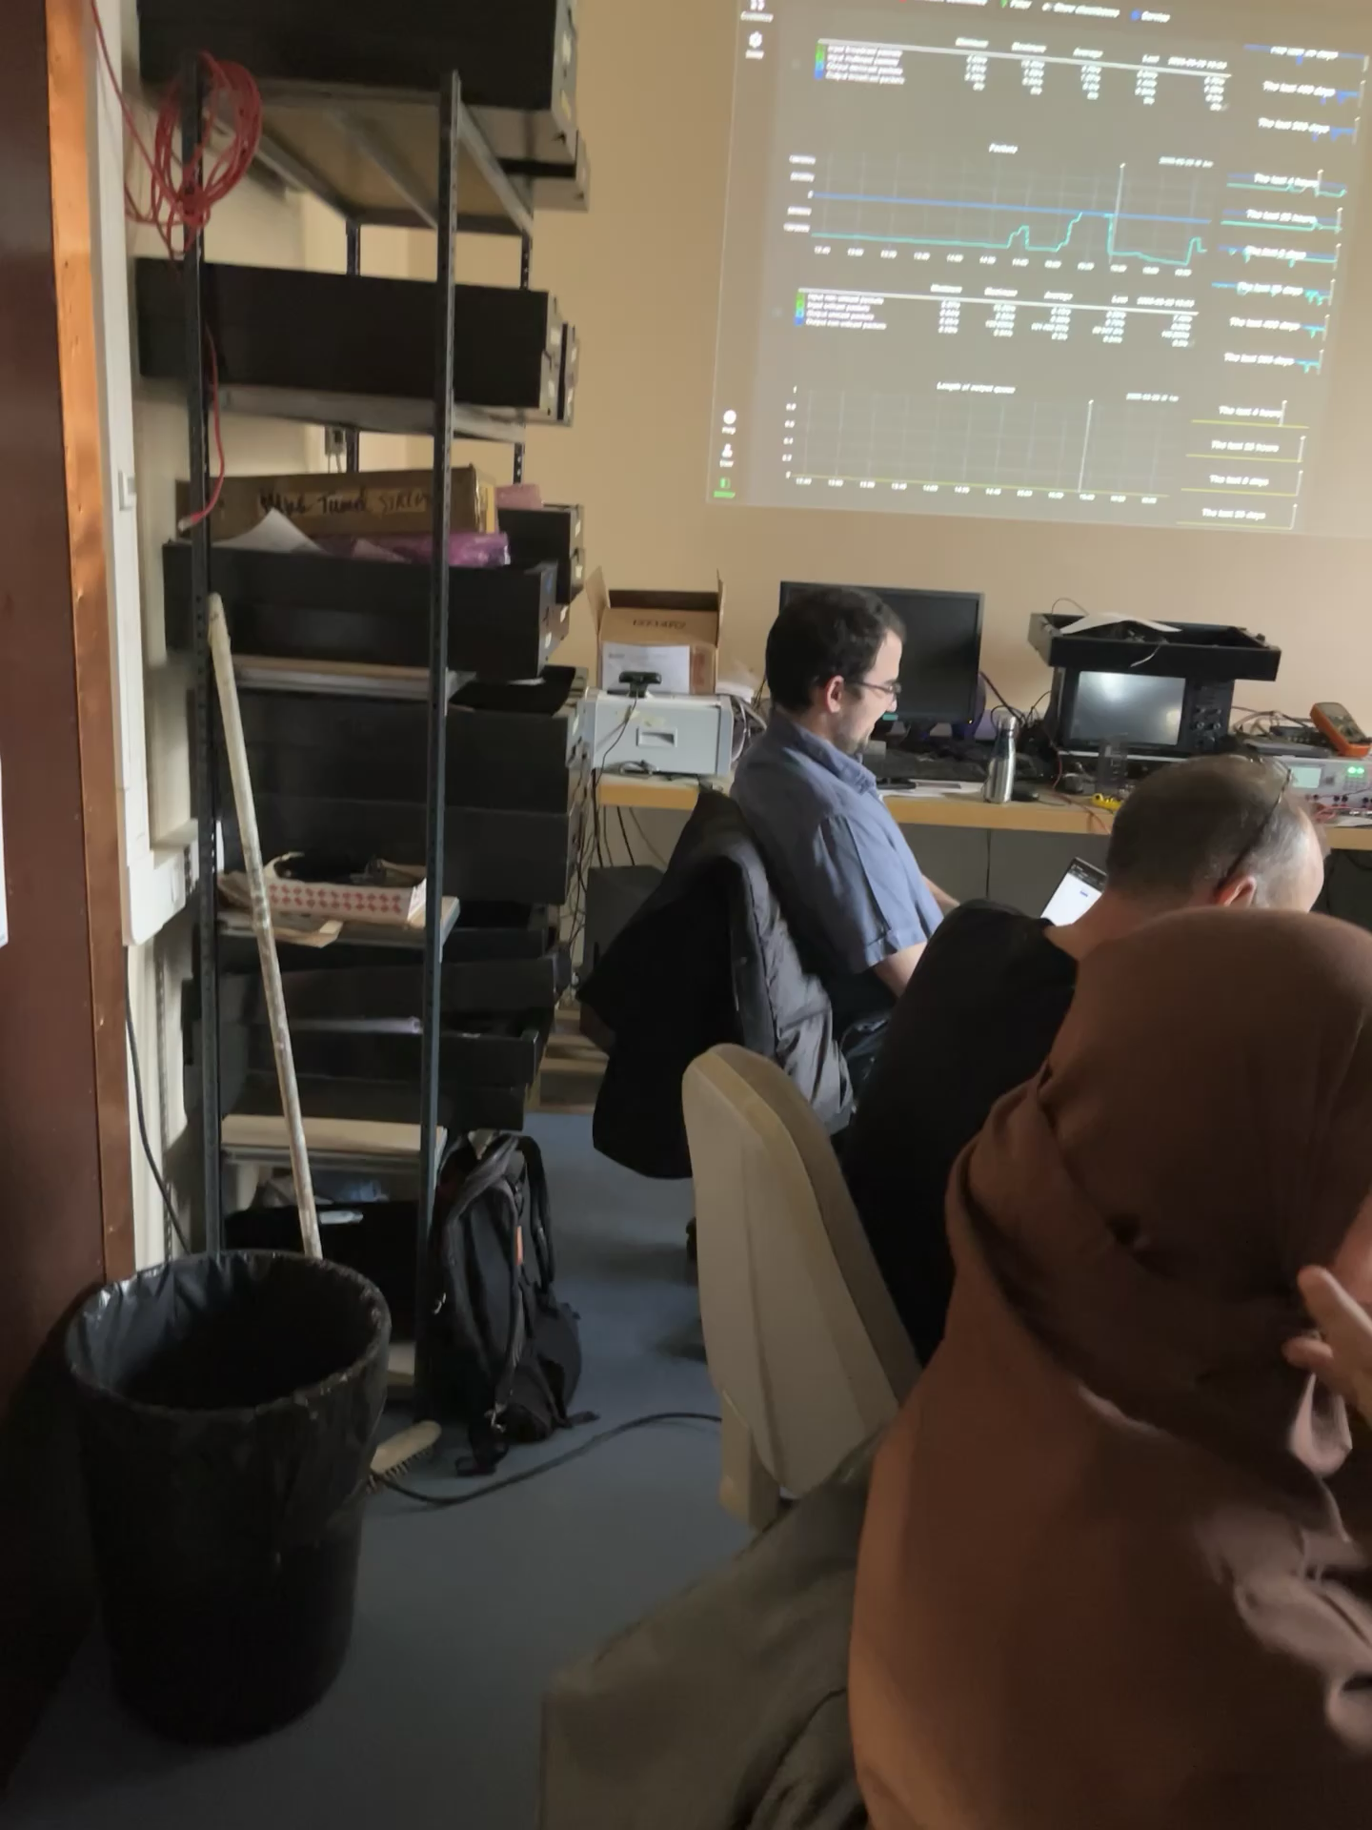
First Full qualification
Thanks to Xavier, Nico, Souhir, Patrick, Mathias, Guillaume, Olivier et Christian le DreamTeam Stare

Slide 18
conclusion
What is Still needed?
we have a preliminary very primitive PACE STARE couple to test the STARE readout. It needs to be a complete V2 electronics crate with water cooling system to be as close as possible to the Legnaro V2 electronics installed now.
We need a High resolution low noise pulser to simulate detector preamplifier signals to the DIGIopt12 boards board and analyse the data contents of the PACE board and compare to Legnaro tests.
We can have a scope of 48 channels for the AGATA monitoring system in order to see continuous triggered signals.
We will develop the CAEN backup solution software in Orsay. We will get a board from Alain and we will provide all the necessary material (pulser, cables, crate, PC etc…). 1 Gbps and 10 Gbps interfaces will be tested as the STARE qualification tests.

Slide 19
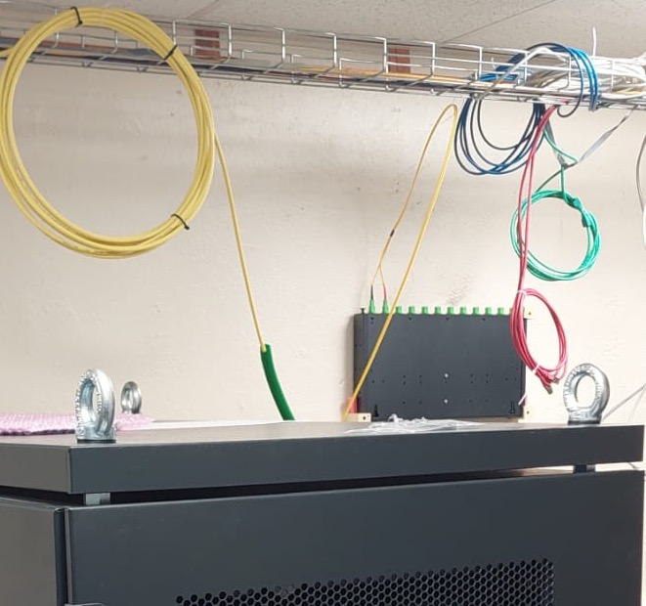
conclusion
Conclusion :
STARE Readout was qualified up to 73 kHz /crystal using 24 links in parallel @ 100 Gbps link going from 104 to 206.
This confirms that RUDP is not needed because if RUDP is activated the readout speed goes down to 6 Gbps (at max). While normal UDP can go up to 7 Gbps without any losses.
Server and Switch configurations are mandatory to insure no packet loss.
Monitoring was tested but when used a readout link is taken off. Hence a second 100 Gbps link is needed for monitoring.
Next is to build a second crate of 12 links for monitoring in order not to change the Topology manager every time we need to test a readout link.

Slide 20
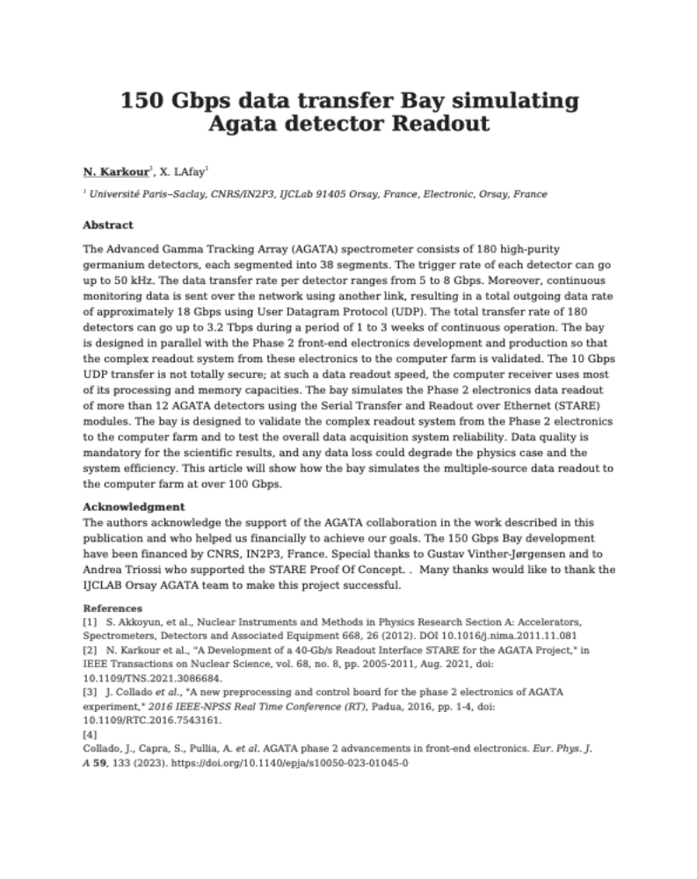
Highlights
An IEEE abstract is written for the 2026 NSS Nuclear Physics Symposium

Slide 21
MERCI

