Slide 1
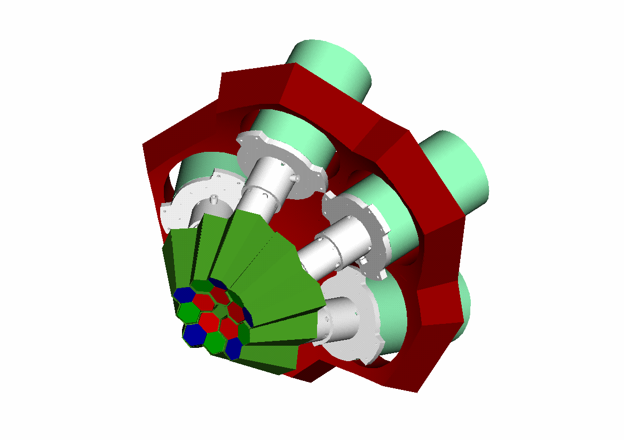


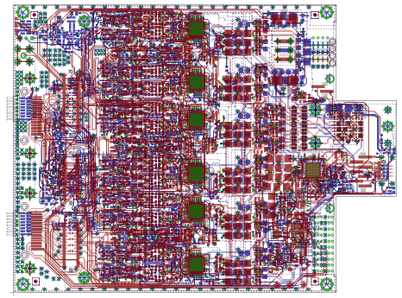

INFN - Milano University of Milano
Department of Physics
Digitizers (DIGI-OPT12) Status, Advancements and Production on v3.7.1
Alberto Pullia
26th AGATA Week 7-11 September, 2026 Warsaw, Poland

Slide 2
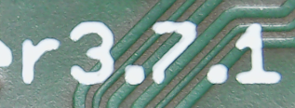
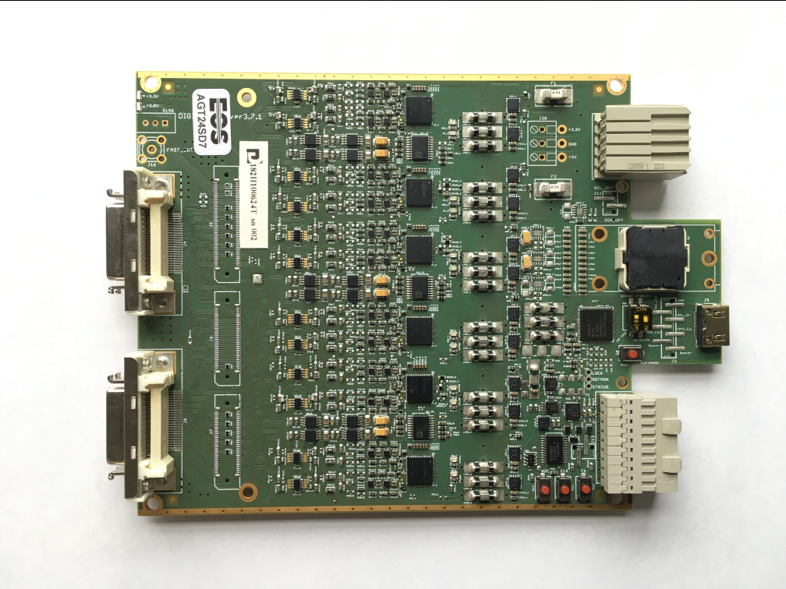
DIGI-OPT12 v3.7.1 – production status
ADC32J44
Segment cards v3.7.1 22 realized - 22 tested 9 under construction
• Core cards v3.7.1 13 realized - 11 tested 3 under construction
First bunch of v3.7.1 cards delivered in March 2025
• Production yield: 90.9%
• Yield after repairs: 100%

Slide 3
v3.7.1 cards map – ownership
Card ID | Card Type | Owner | Country
AGT25S00 | segment | INFN | Italy
AGT25S01 | segment | INFN | Italy
AGT25S02 | segment | INFN | Italy
AGT25S03 | segment | INFN | Italy
AGT25S04 | segment | INFN | Italy
AGT25S05 | segment | INFN | Italy
AGT25S06 | segment | INFN | Italy
AGT25S07 | segment | GSI | Germany
AGT25S08 | segment | GSI | Germany
AGT25S09 | segment | GSI | Germany
AGT25S10 | Segment | GSI | Germany
AGT25S11 | segment | GSI | Germany
AGT25S12 | segment | GSI | Germany
AGT25S13 | segment | GSI | Germany
AGT25S14 | segment | GSI | Germany
AGT25S15 | segment | GSI | Germany
AGT25S16 | segment | GSI | Germany
AGT25S17 | segment | IFJ PAN | Poland
AGT25S18 | segment | IFJ PAN | Poland
AGT25S19 | segment | IFJ PAN | Poland
AGT25S20 | segment | INFN | Italy
AGT25S21 | segment | INFN | Italy
Card ID | Card Type | Owner | Country
AGT25C00 | core | INFN | Italy
AGT25C01 | core | INFN | Italy
AGT25C02 | core | INFN | Italy
AGT25C03 | core | INFN | Italy
AGT25C04 | core | INFN | Italy
AGT25C05 | core | INFN | Italy
AGT25C06 | core | GSI | Germany
AGT25C07 | core | GSI | Germany
AGT25C08 | core | GSI | Germany
AGT25C09 | core | GSI | Germany
AGT25C10 | core | Uni Warsaw | Poland
Core and Segment Cards under Construction
Card ID | Card Type | Owner | Country
AGT26C00-02 | core - n. 3 | GANIL | France
AGT26S00-08 | segment - n. 9 | GANIL | France

Slide 4
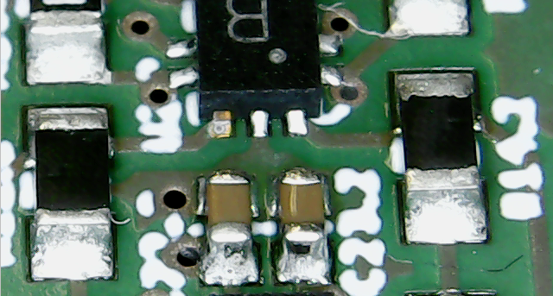
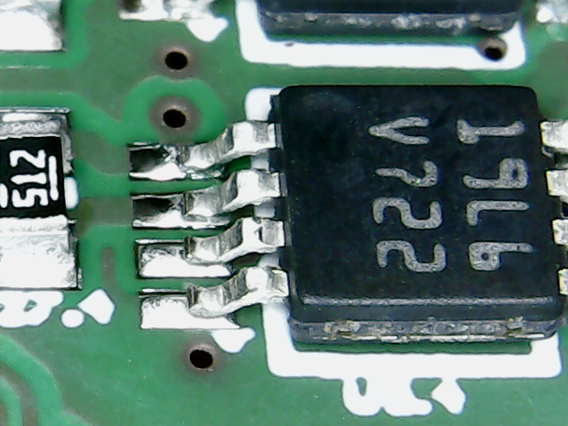
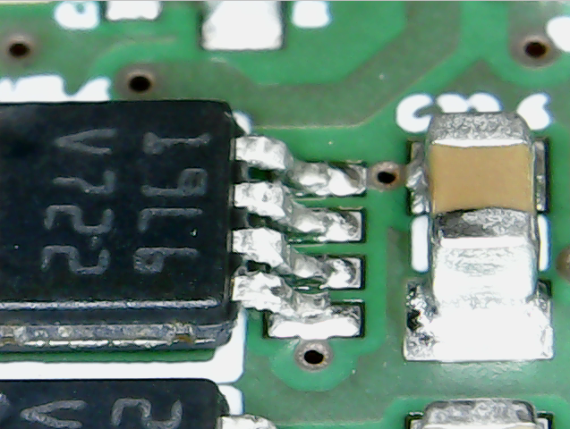
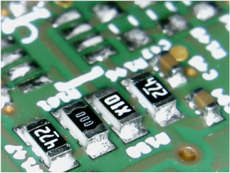
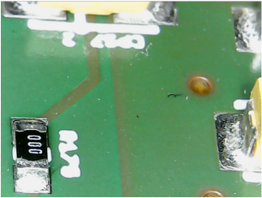
Issues in v3.7.1 cards
3 mm
1.3 mm
Critical jumper shorts PS
3 mm
Components installed by mistake (AGT25S12)
All issues fixed after a thorough inspection

Slide 5
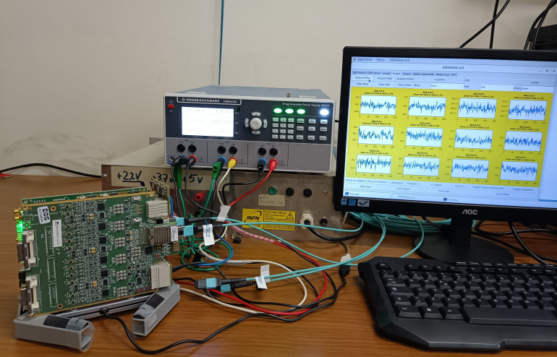
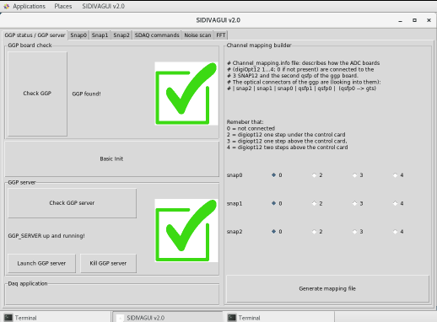
DIGI-OPT12 v3.7.1 – Milano test-bench for acceptance
GUI - Graphical User Interface
thanks to Stefano Capra and Dino Bazzacco
Test-bench is based on GGP, and uses an optical link

Slide 6
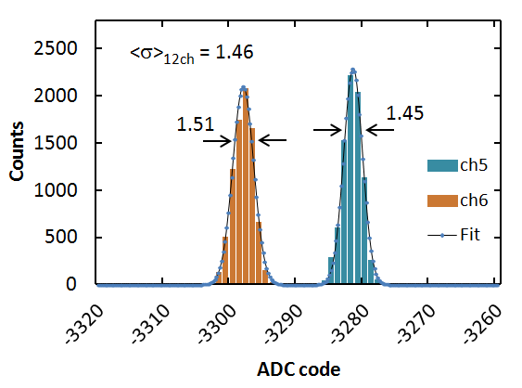
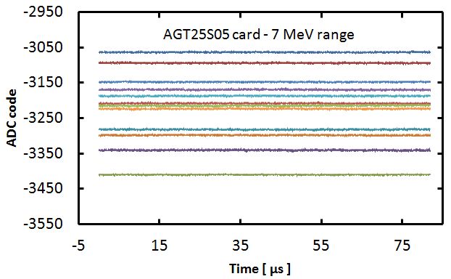
Noise performance – Milano testbench – no detector
12 chs of v3.7.1 card w LTC6247 opamps
DIGI-OPT12 | Opamp | Energy Range | Noise [LSB rms] | ENOB
v3.6.x | AD8030 “standard” | 7 MeV | 2.27 | 11.03
 |  | 20 MeV | 1.43 | 11.69
 | LTC6247 | 7 MeV | 1.63 | 11.50
 |  | 20 MeV | 1.35 | 11.77
v3.7.1 | AD8030 “standard” | 7 MeV | 1.73 | 11.42
 |  | 20 MeV | 1.42 | 11.70
 | LTC6247 | 7 MeV | 1.46 | 11.66
 |  | 20 MeV | 1.35 | 11.77
Earlier generation
J
Latest generation
J

Slide 7
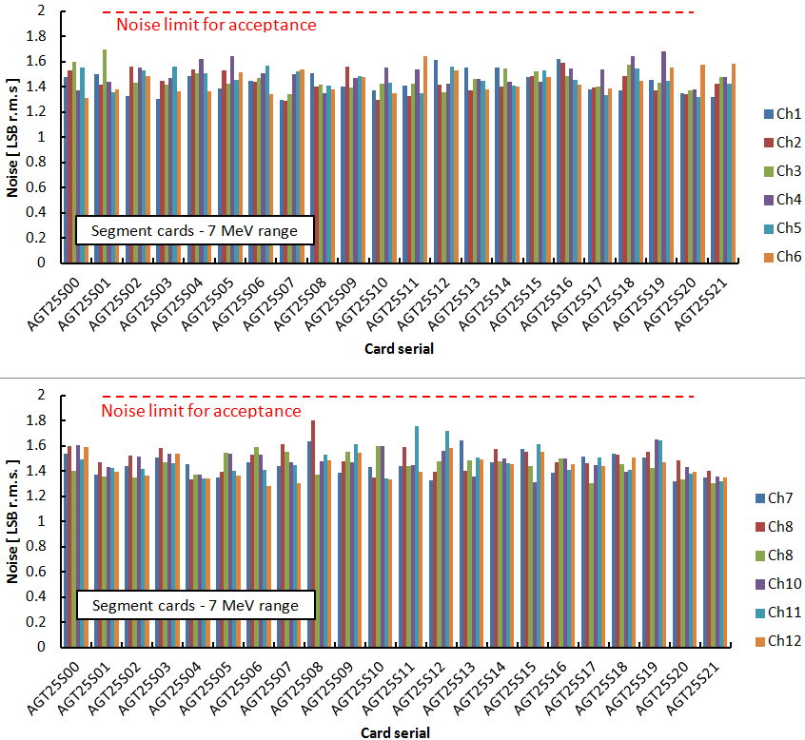
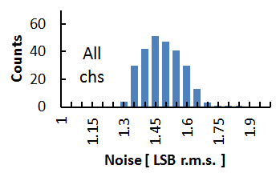
Noise statistics of v3.7.1 segment cards – 7 MeV range
Ch10 ok
Noise limit
LSB r.m.s. | ENOB
1.15 | 12.01
1.3 | 11.83
1.45 | 11.67
1.6 | 11.53
1.75 | 11.40
Ch10 ok
Mean value
1.46 LSB r.m.s.
ENOB = 11.66
178 µV r.m.s.

Slide 8
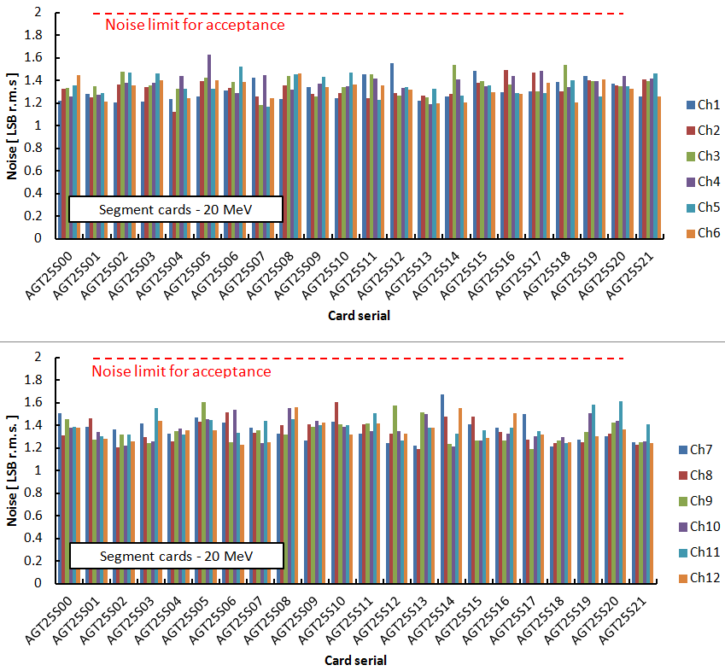
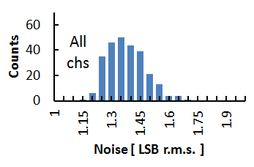
Noise statistics of v3.7.1 segment cards – 20 MeV range
Ch10 ok
Noise limit
LSB r.m.s. | ENOB
1.15 | 12.01
1.3 | 11.83
1.45 | 11.67
1.6 | 11.53
1.75 | 11.40
Ch10 ok
Mean value
1.35 LSB r.m.s.
ENOB = 11.77
165 µV r.m.s.

Slide 9
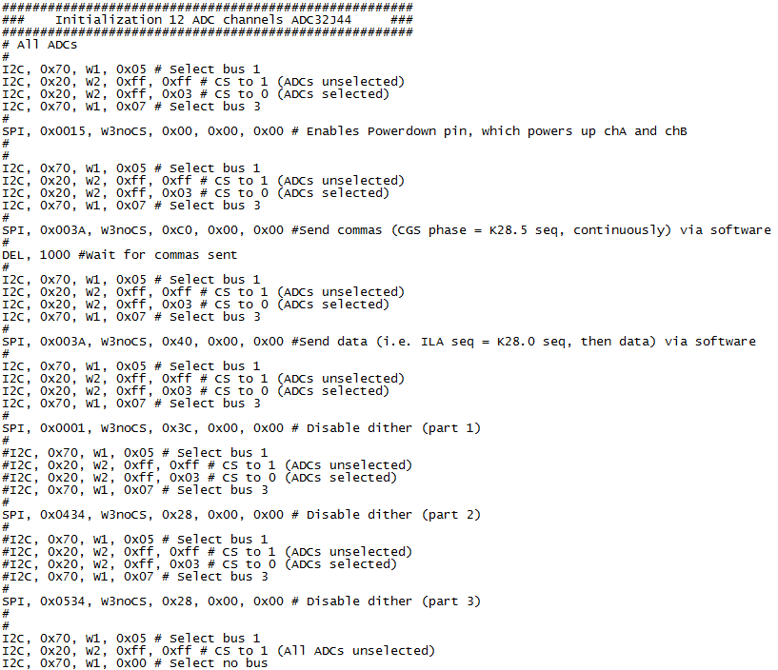
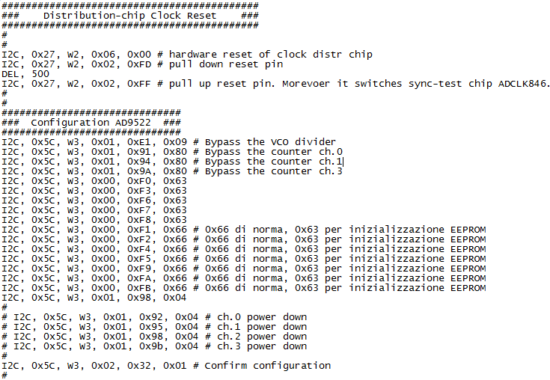
Initialization script for v3.7.x
Mini-HDMI
L
J
J

Slide 10
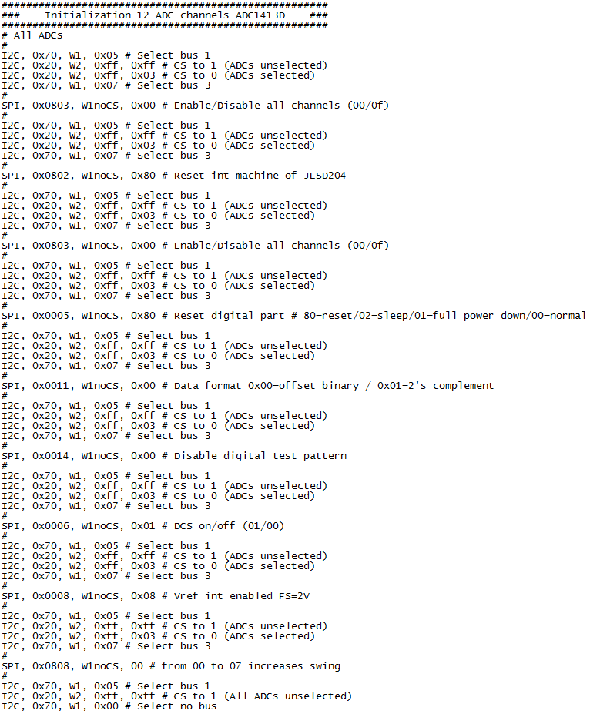
Initialization script for v3.6.x
Mini-HDMI
L
J
J

Slide 11
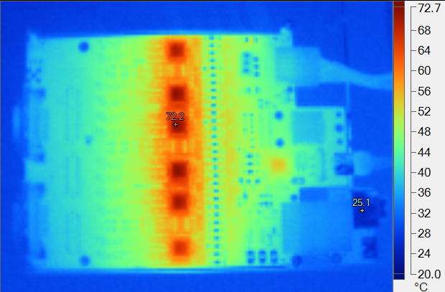
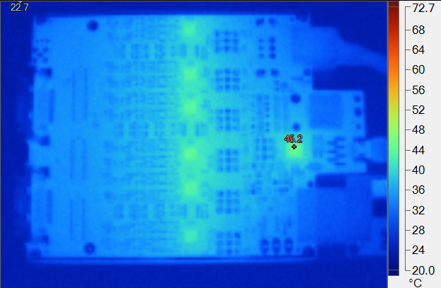
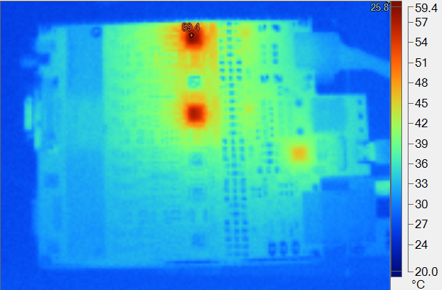
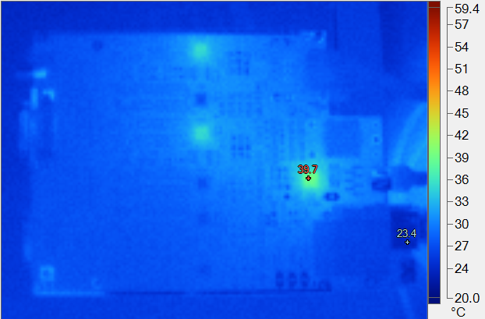
Thermal images
Segment card v3.6.x
Segment card v3.7.1
P = 8.6 W
P = 3.3 W
Core card v3.6.x
Core card v3.7.1
P = 3.4 W
P = 1.6 W

Slide 12
Summary
Production yield is currently 90.9 / 100% (22 segm. cards, 11 core cards)
Noise well below the acceptance limit of 2 LSB r.m.s. even in 7 MeV range
Noise distribution homogeneous over the full set of channels
Mini-HDMI connector for diagnostics only, should not be used in AGATA because contacts are notoriously unreliable
4 wire slow control of cards in AGATA through 40-pin press-fit connector (GGP) or JTAG (v2 Electronics) - using mini-HDMI is a technical error

Slide 13
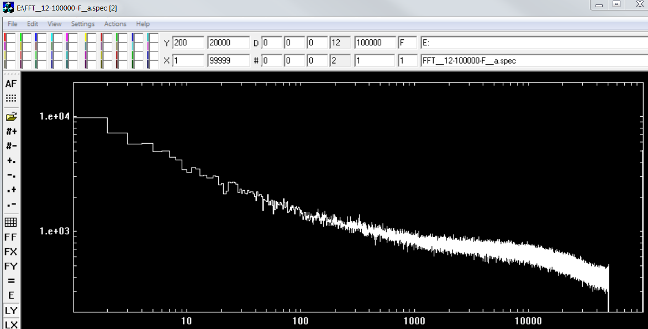
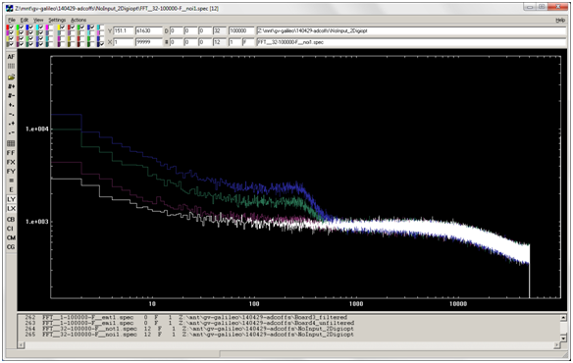
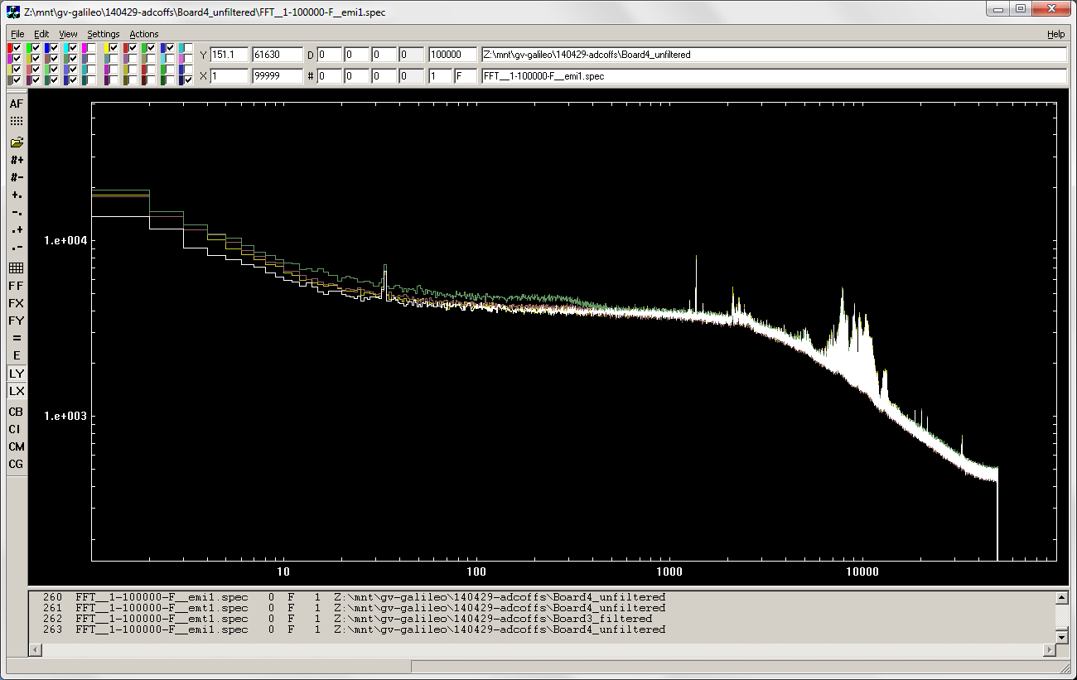
Noise spectral density
New generation
(v3.7.x – AD8030)
without detector
no change vs offset
kHz
Previous generation
(v3.6.x – AD8030)
(4)
with detector
(3)
(2)
(1)
Offsets
without detector
(1) 127 (middle)
(2) 140
(3) 160
(1) 180
kHz
Courtesy of D. Bazzacco

