Slide 1
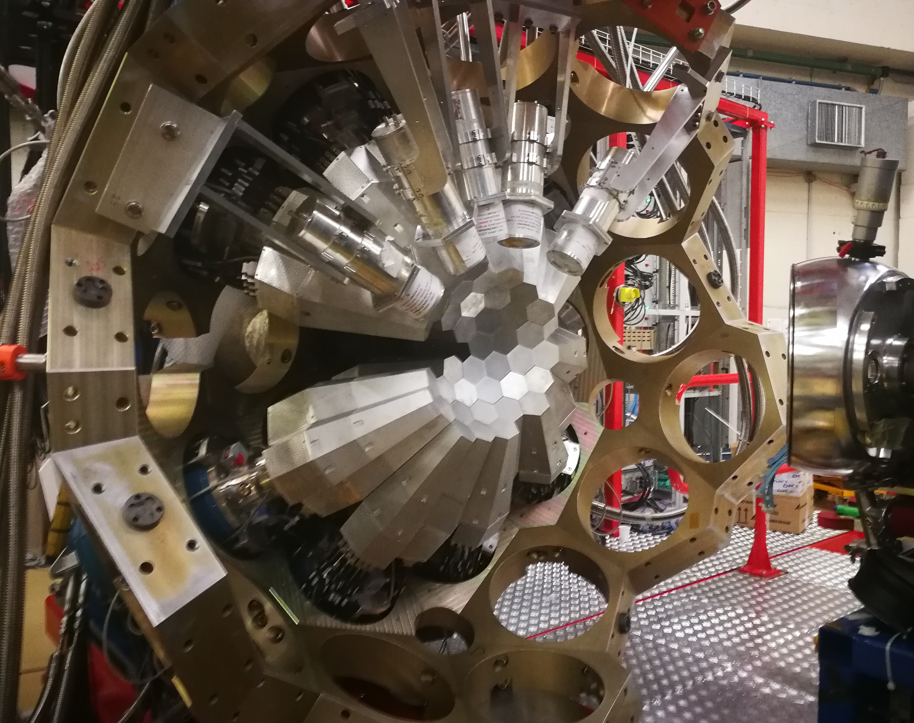


The LNL campaign: technical aspects
Alain Goasduff (INFN LNL)
26th AGATA Week meeting
7-11 September 2026
HIL - Warsaw

Slide 2
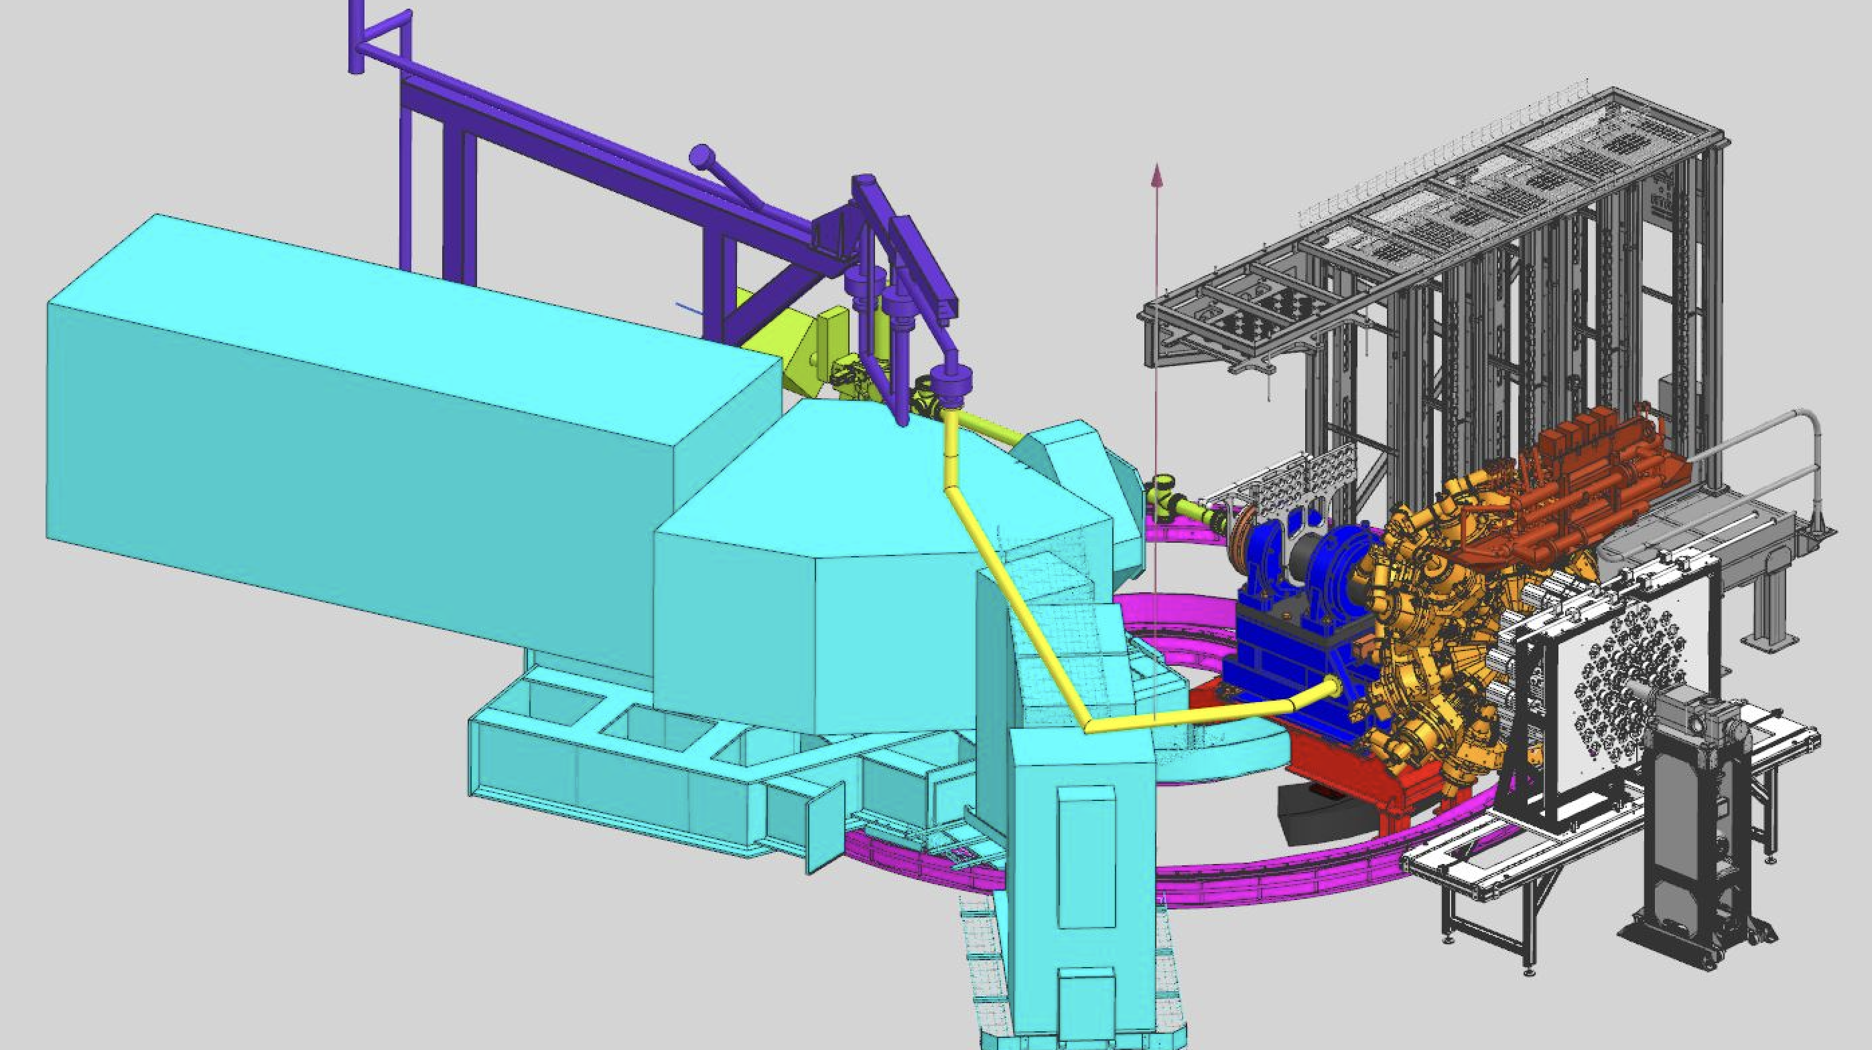
Zero-Degree configuration

Slide 3
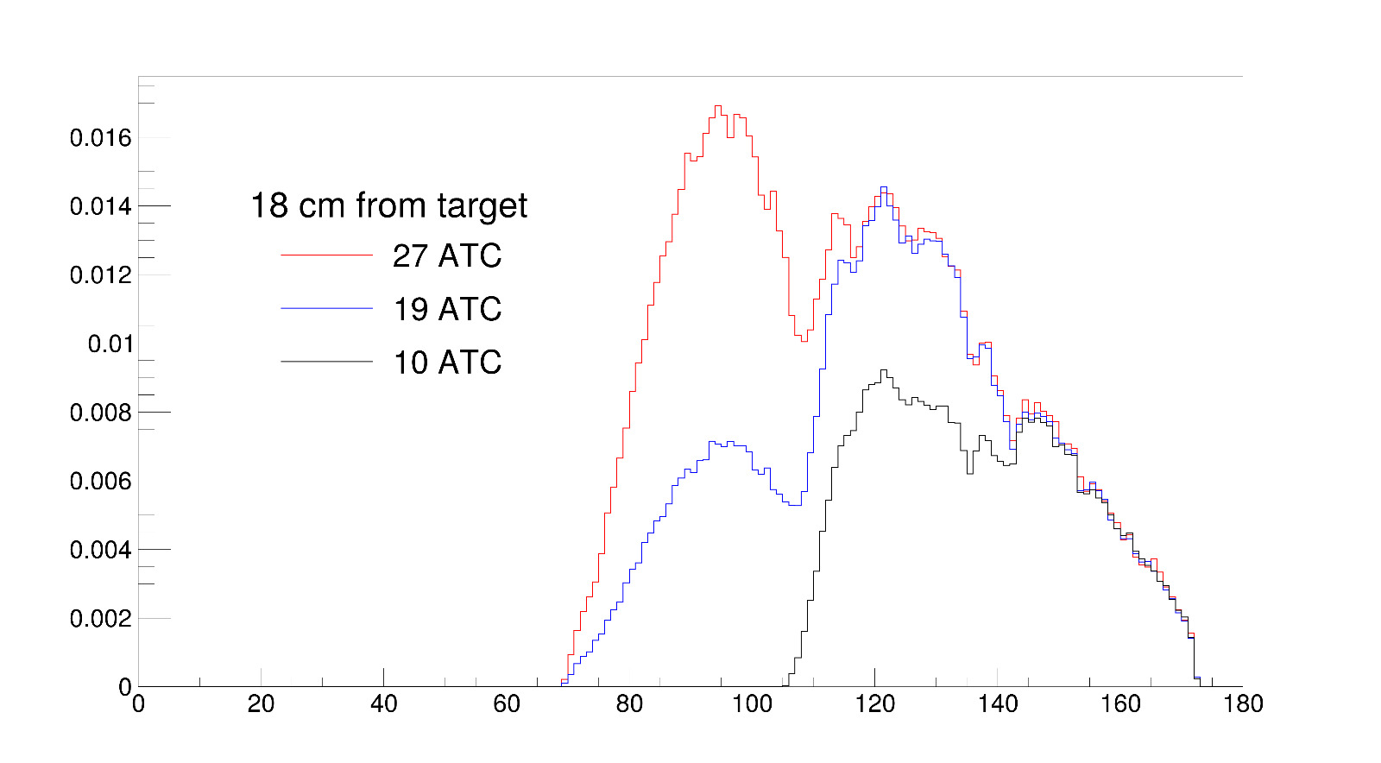
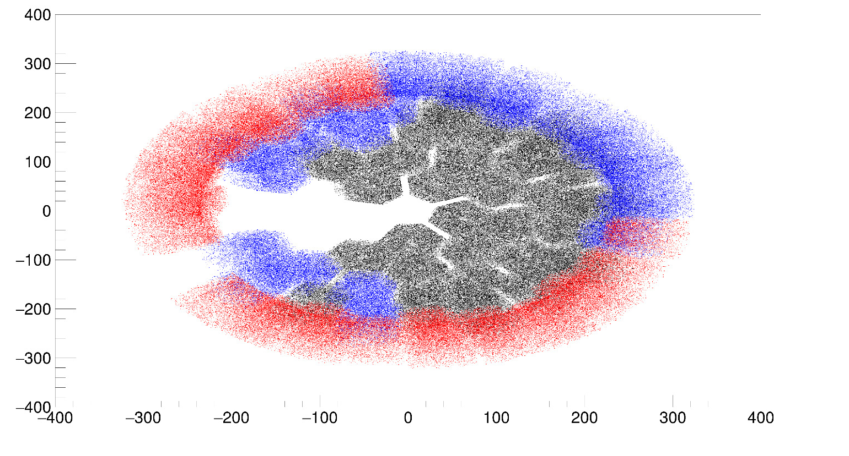
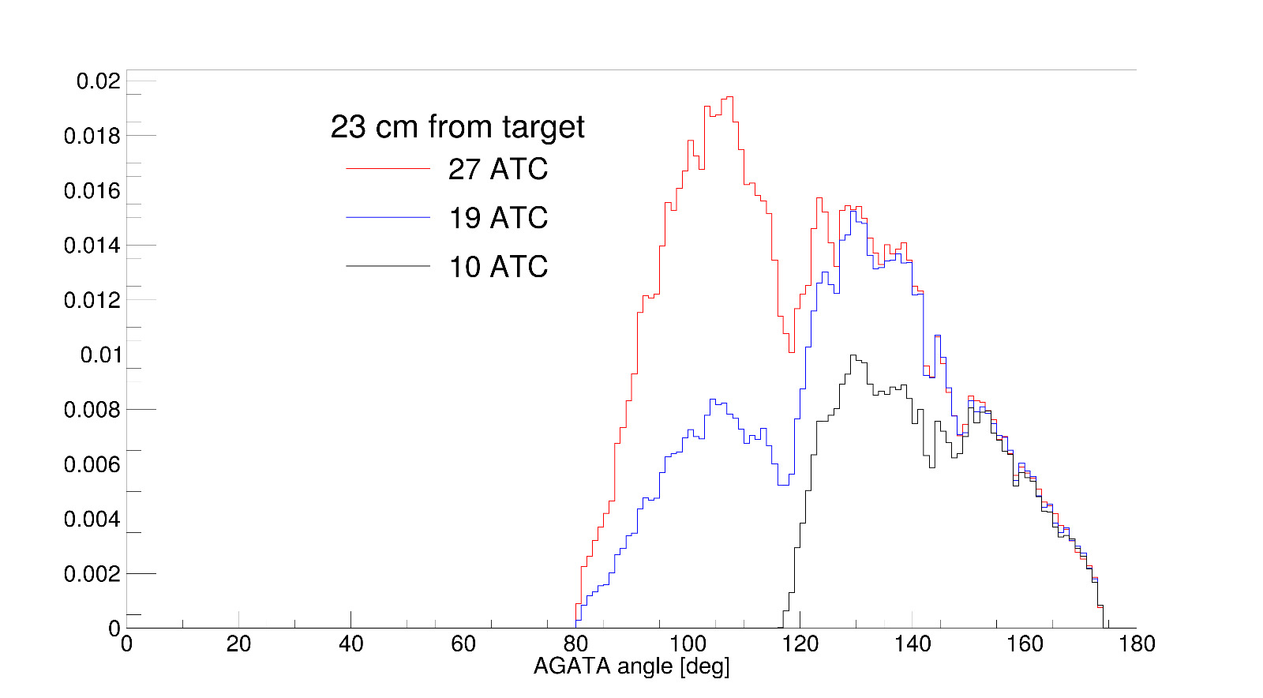
AGATA Configuration
10 ATC: All covered by the V1 electronics:
GTS + TP + Hardware gate
19 ATC: V1 electronics + temporary commercial solution
GTS for synchronization + Hardware gate
27 ATC: AGATA V1 + V2
GTS + TP + Hardware gate
Courtesy of L. Zago

Slide 4
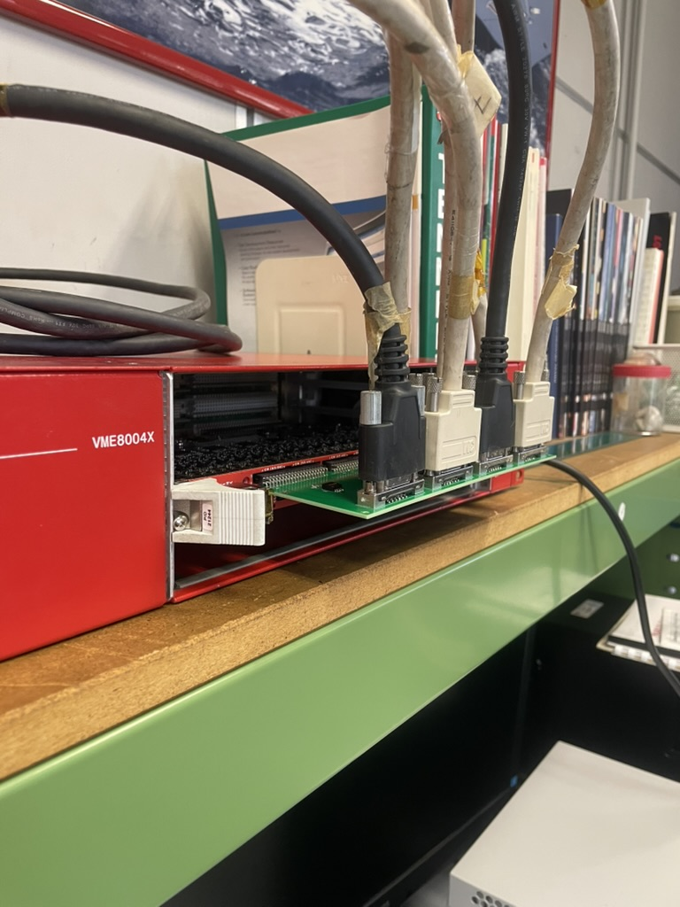
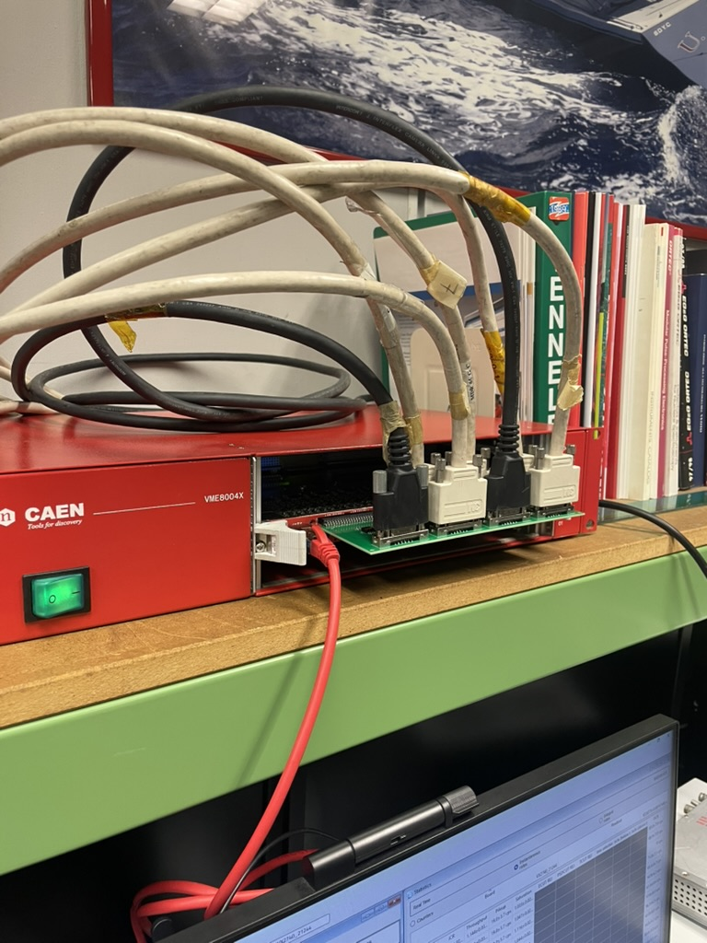
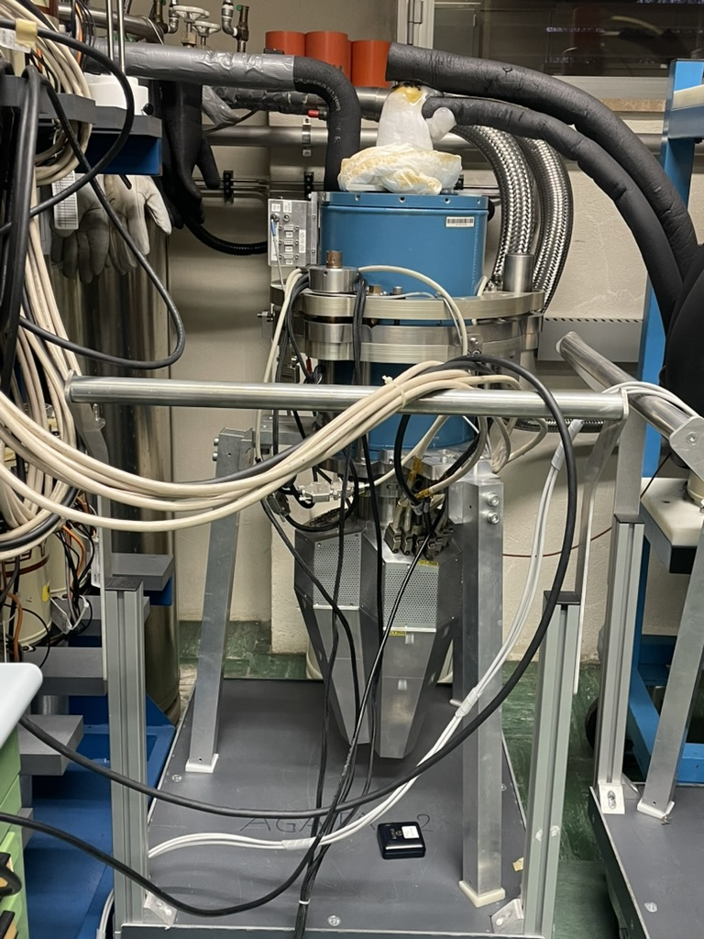


Electronics for detector test bench

Slide 5
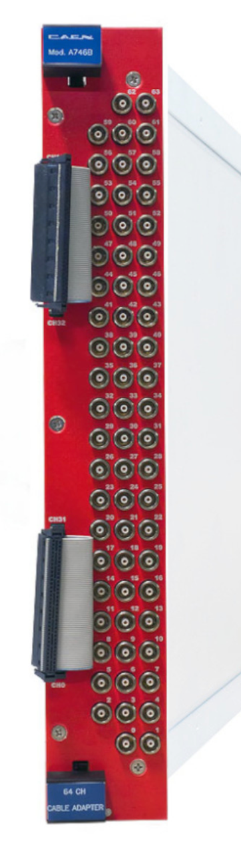
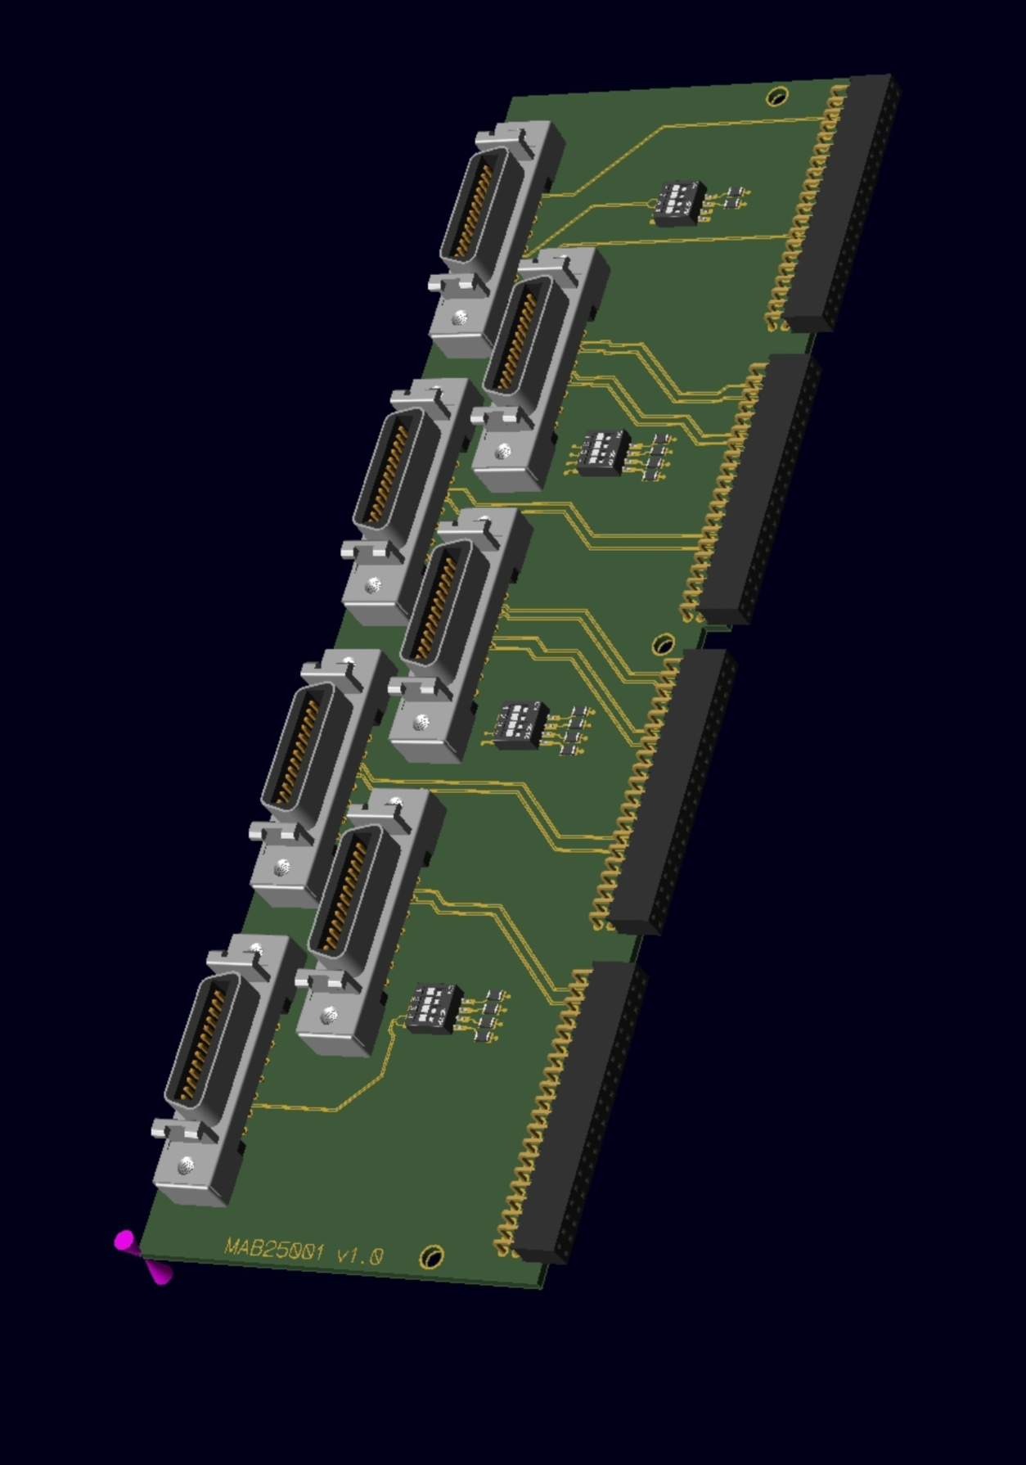
Adapters for the MDR cables to VX2740
Prototype made for the detector test bench and 4U VME crate
  Cable at 90 degrees from the PCB
  Weight on the Digitizer connectors
  Mapping identical to the V1 electronics
  Control of the pre-amp fast reset
  1 detector x board
New revision of the geometry:
  2U VME mechanics
  Kapton connectors to the digitizers
  Prototype order in progress
Courtesy of M. Nicoletto

Slide 6
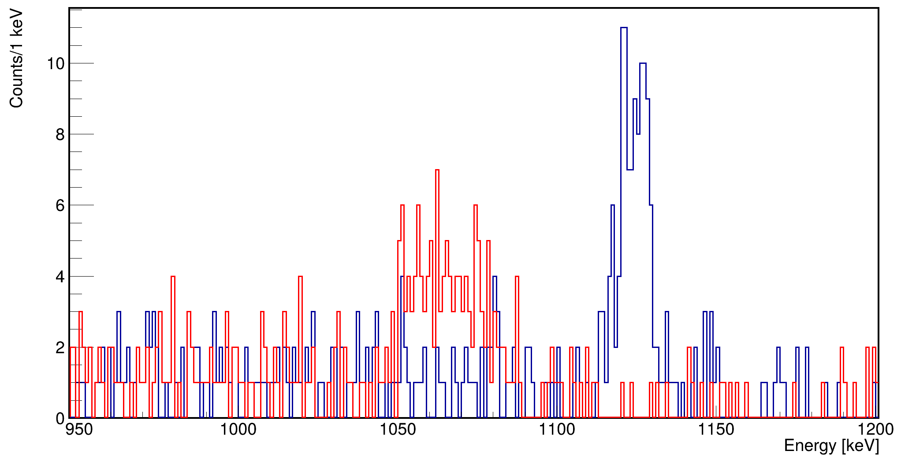
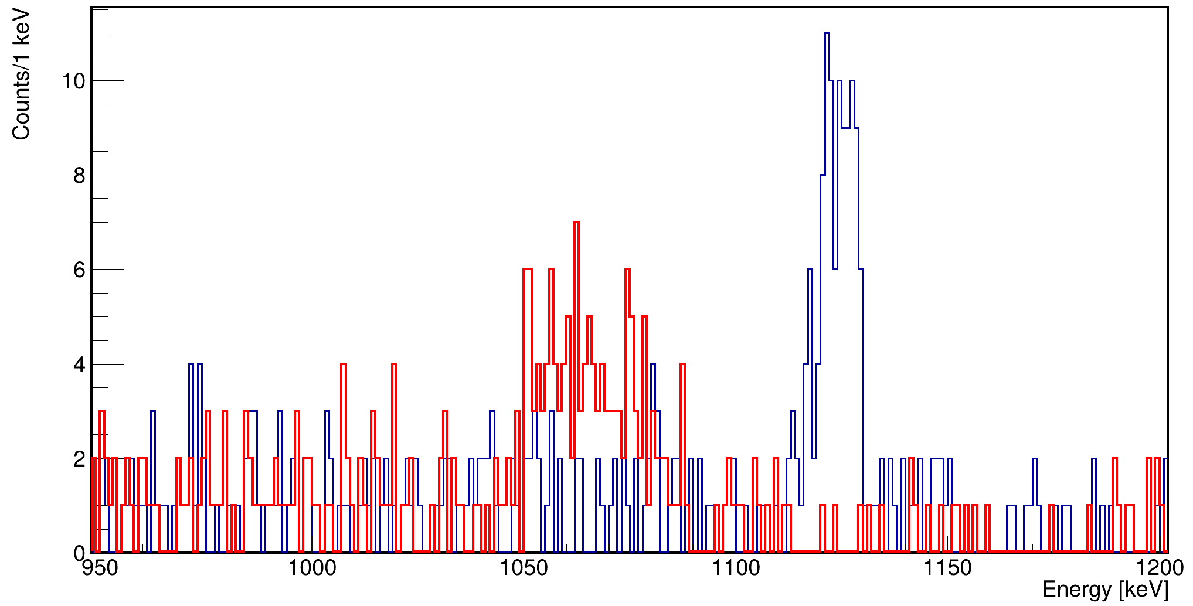
In-beam test of the backup solution
Tested during the last experiment using ATC14
(ATC mounted for more than 2 years)
Comparison with V1 electronics
ATC14A (CAEN chain)
ATC05A (GGP chain)
Courtesy of B. Greaves

Slide 7
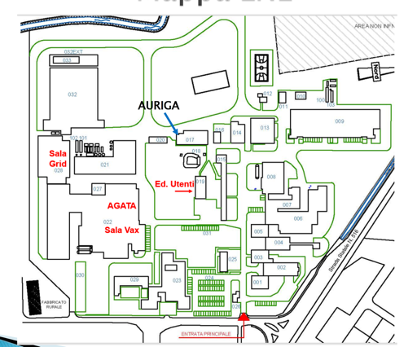
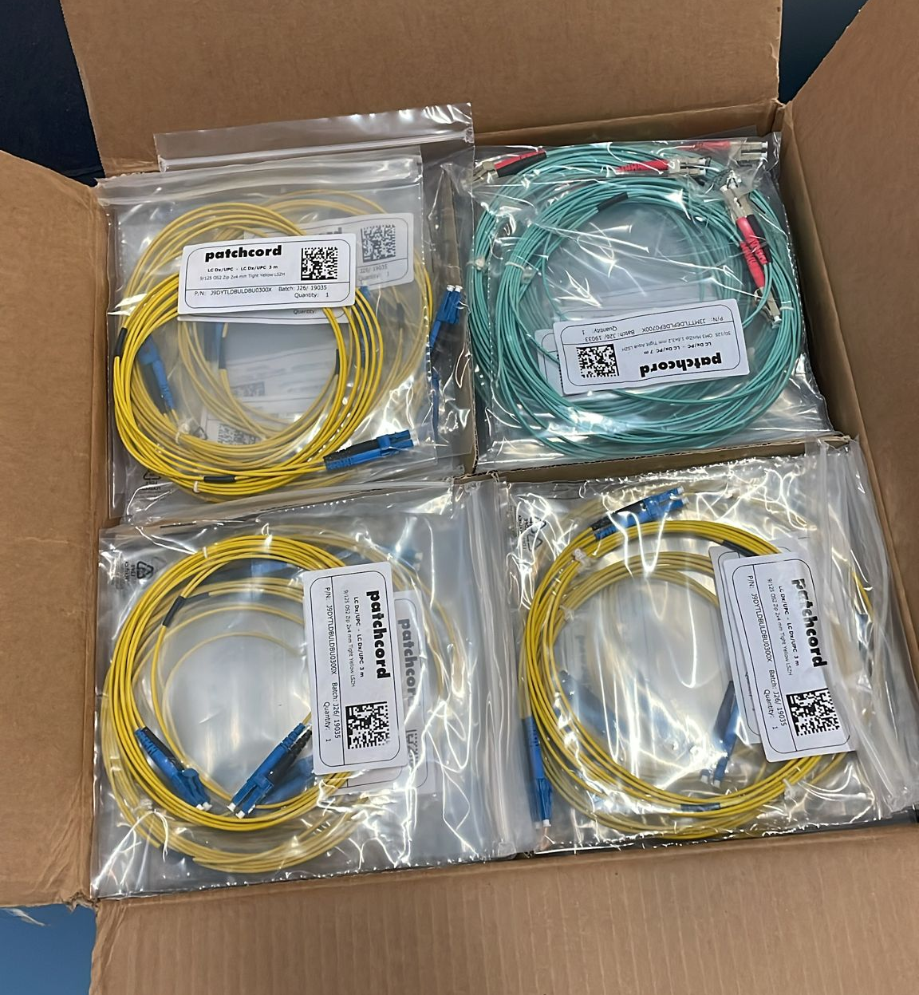
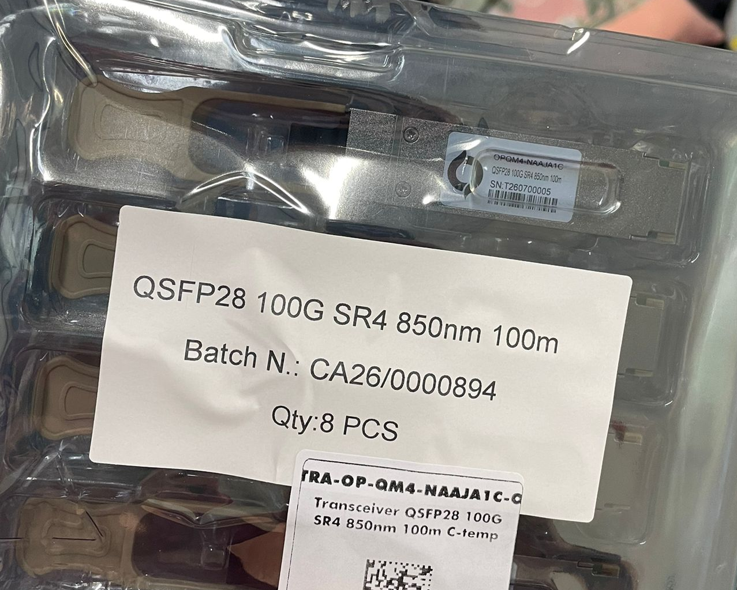
Network infrastructure for the V2 and commercial eletronics
10Gbps – 100 Gbps networks
fibers / transceivers
Switches at LNL
Connection between VAX and Data center tested

Slide 8
Update of the DAQ box
Migration of the GGP anodes to more Debian13
  Compilation of the GGP driver (Readout and comunication with the GGP)
  Compilation of the GGP server (Slow control of the GGP)
  Readout test
  EPICS and GTS server compilation
  GTS alignment test
Distributed computing resources (VAX + New data center)
Not done for the V1 but already done for the V2!
Courtesy of G. Baulieu

Slide 9

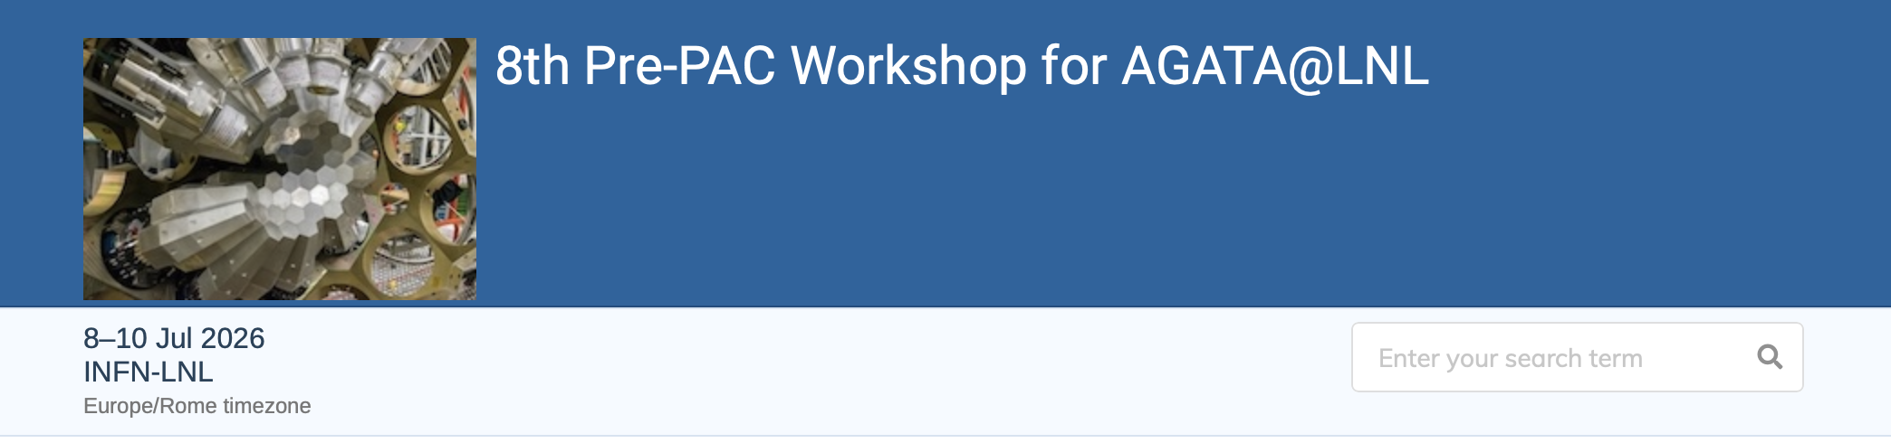
Pre-PAC for the LNL ZD campaign
Pre-evaluation of projects for the ZD campaign at a dedicated workshop (April 2023):
  42 projects + 4 umbrella proposals, including 13 for SPES beams and 7 for gas targets
Stable beams from Tandem – ALPI – PIAVE
  First call for AGATA at zero degrees
  PAC meeting in December 2026 or January 2027 (TBD)
In the current call, we have received 52 new projects and 2 resubmissions, for a total request of almost 500 beam days (more than the remaining duration of the campaign!)

Slide 10
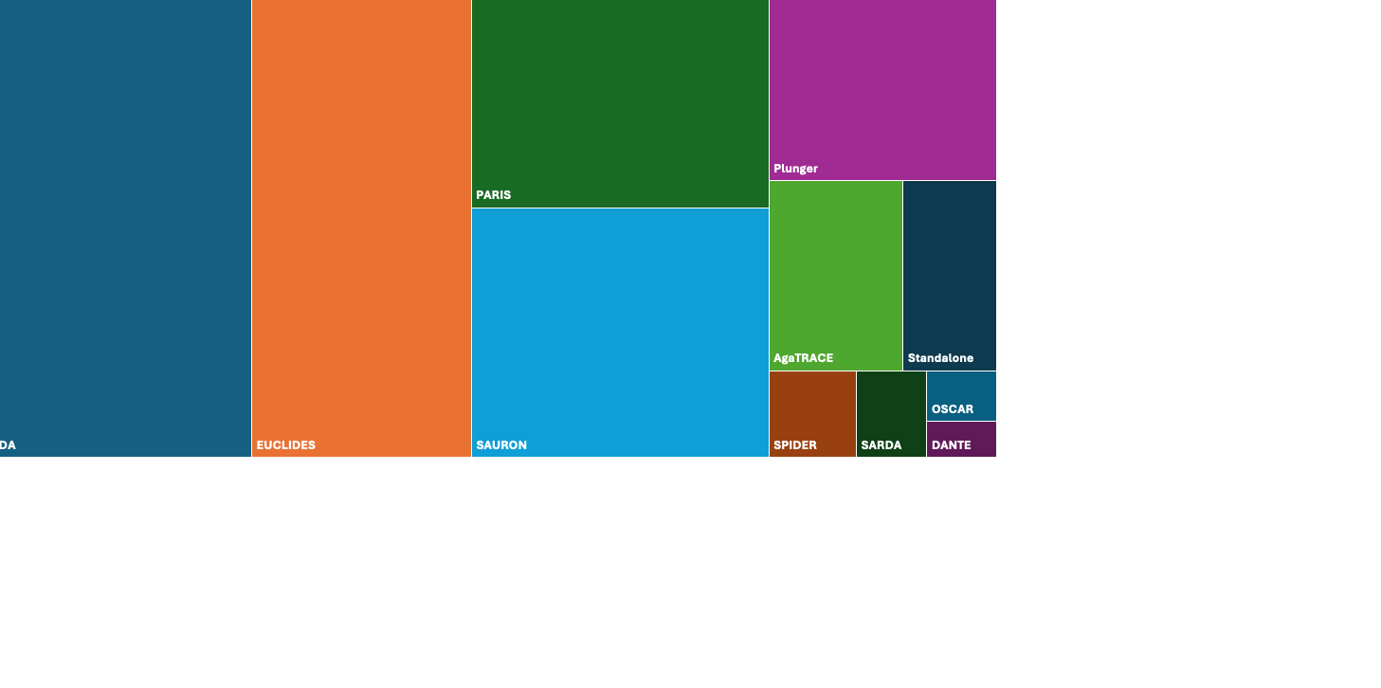
Pre-PAC ancillary detector request

Slide 11
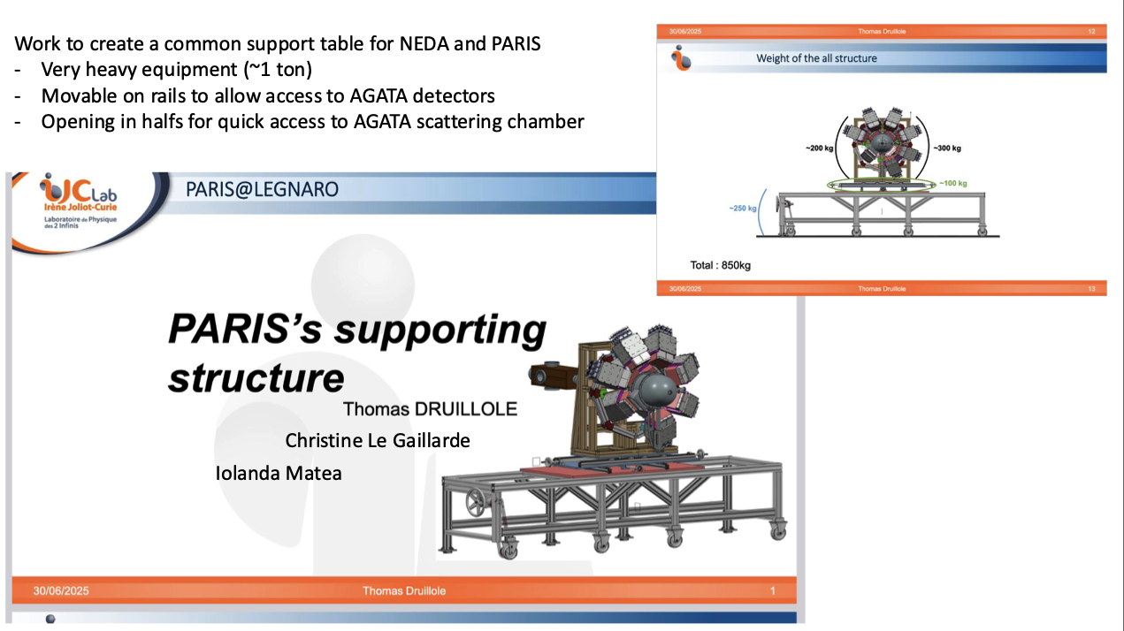
Deliveries to LNL:
NEDA detctors: First week of Octobre
NEDA/PARIS support: Mid November

Slide 12
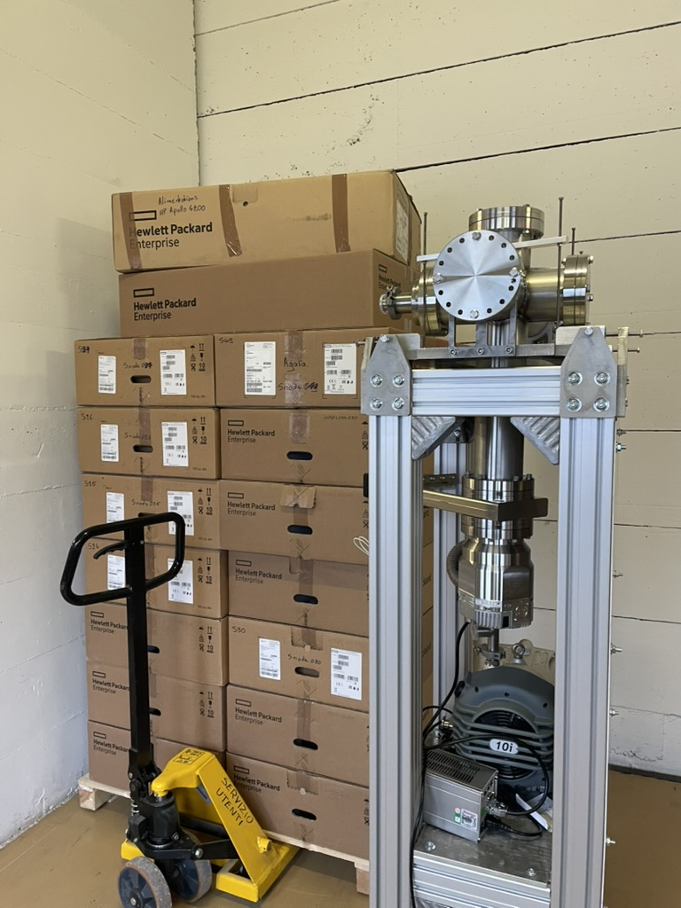
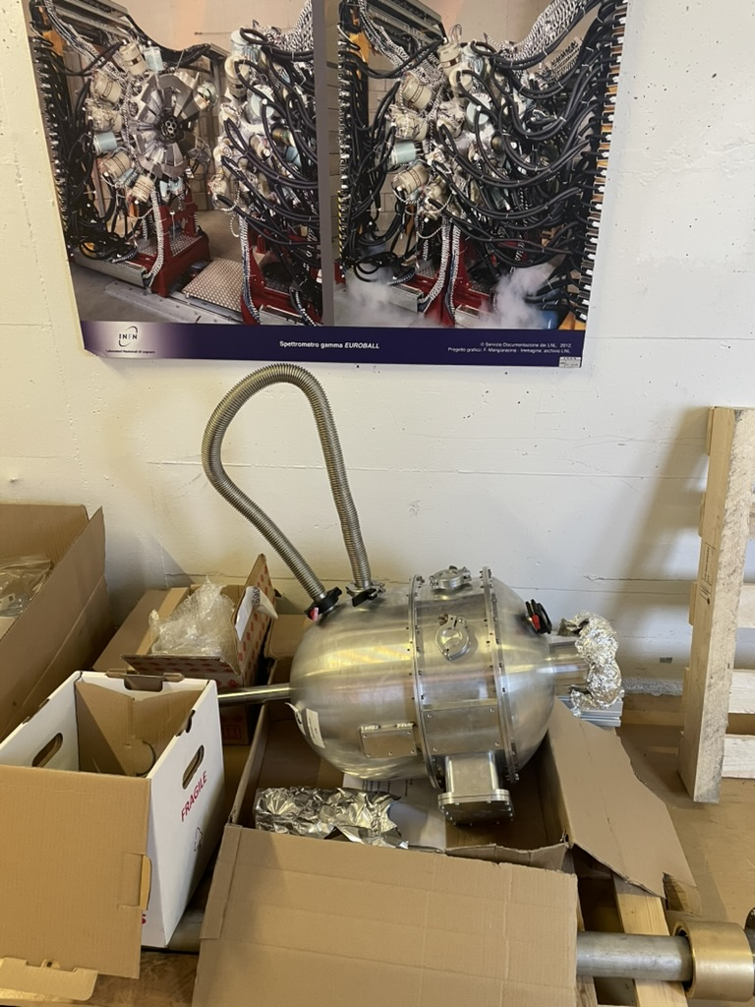
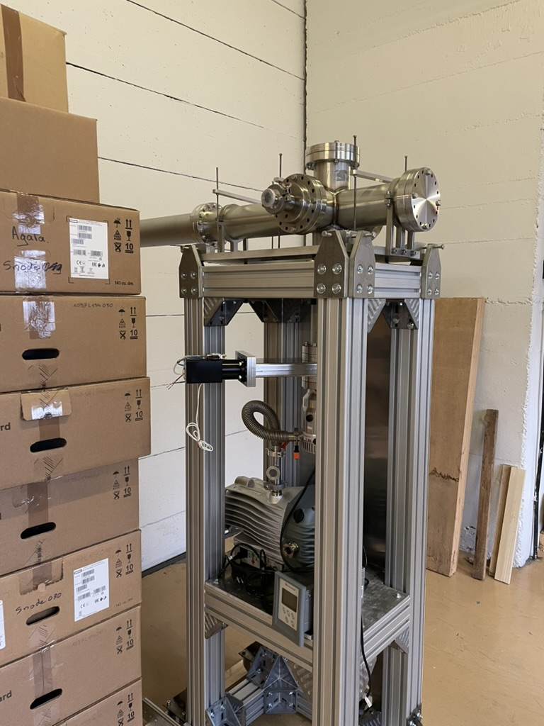
Reaction chamber

Slide 13
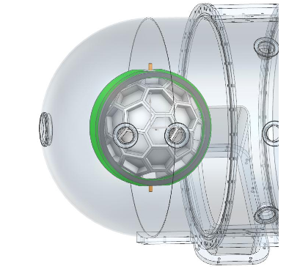
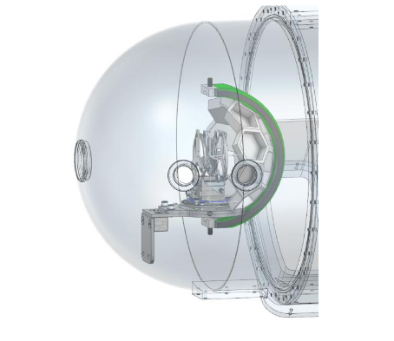
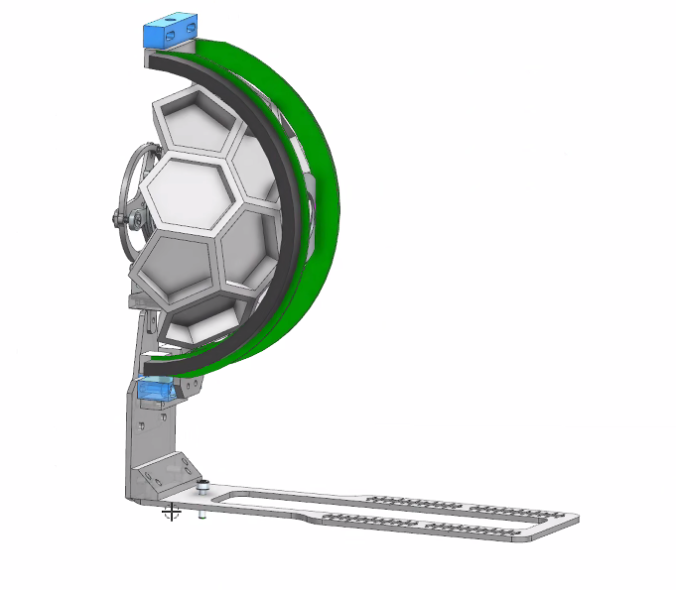
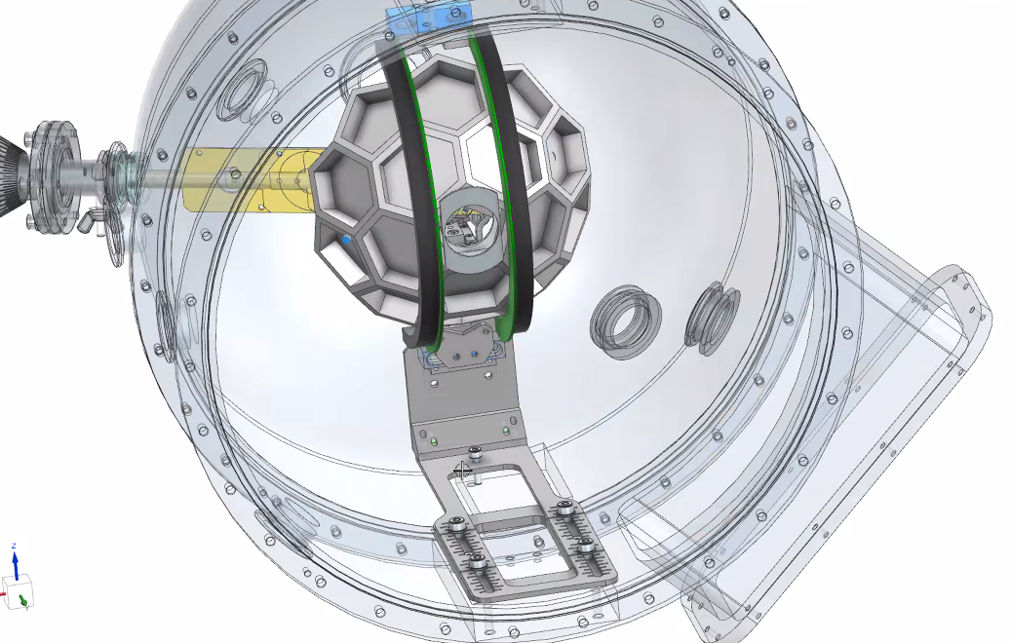
EUCLIDES integration in the new reaction chamber
EUCLIDES standard configuration
4π configuration
EUCLIDES with plunger
Forward rings only
Courtesy of F. Galtarossa – N. Bez

Slide 14
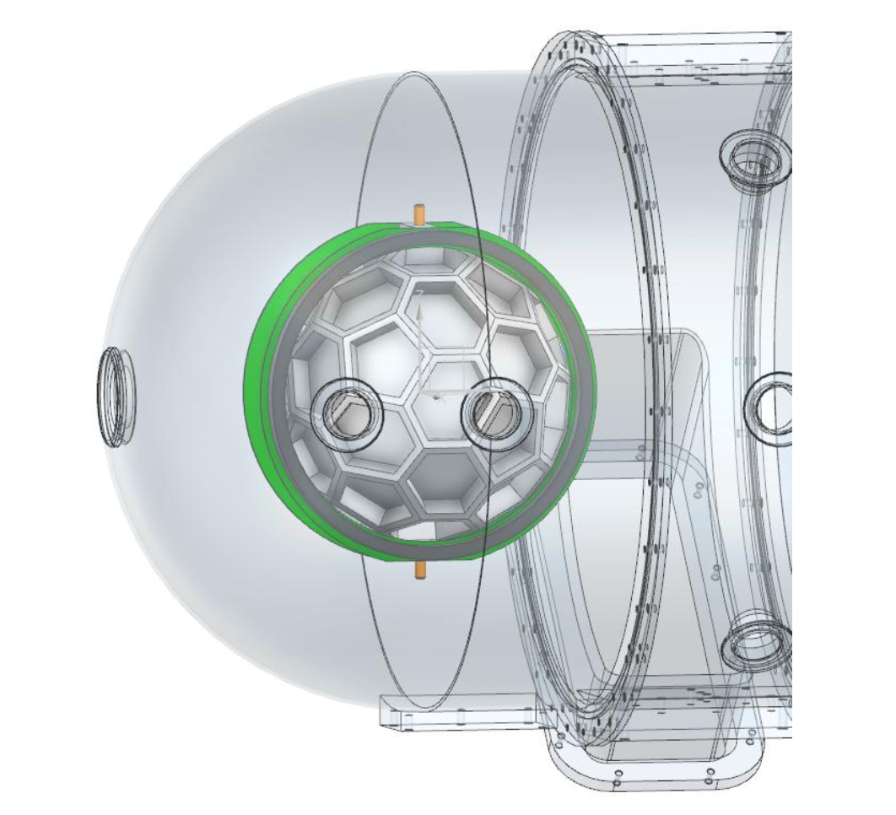
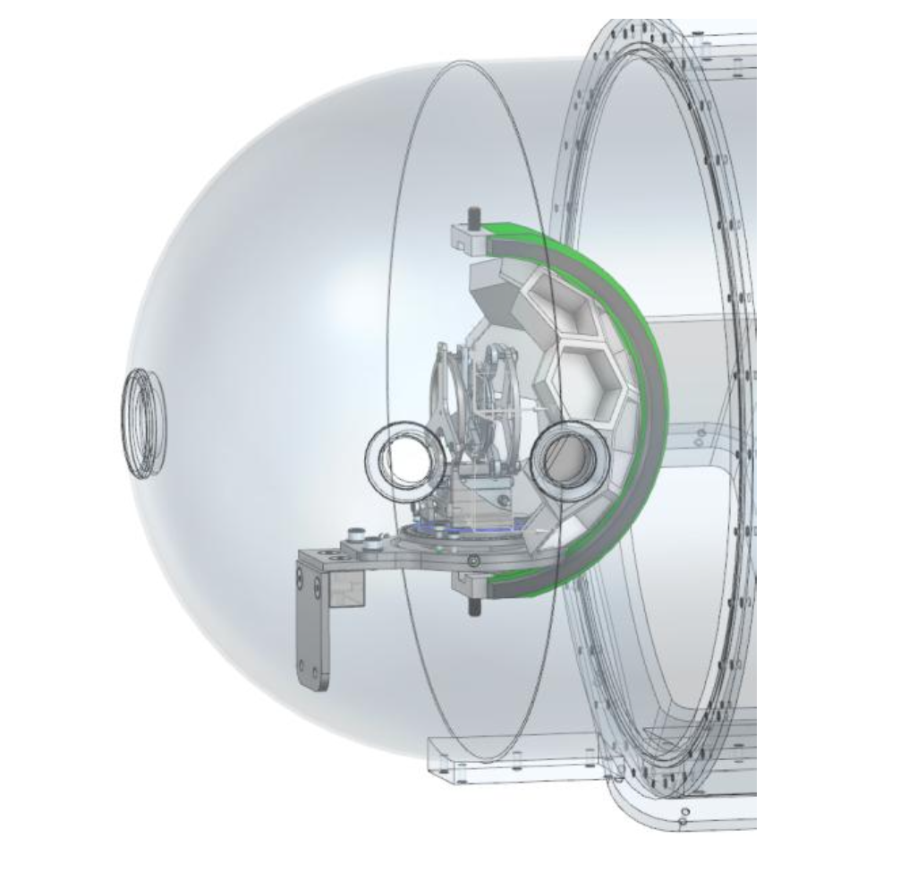
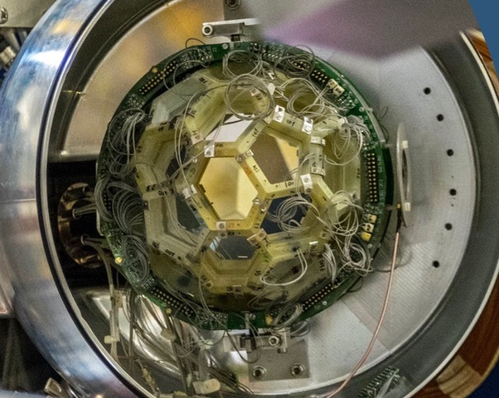
Ancillaries – Silicon detectors
Ancillaries most requested for the ZD campaign:
  EUCLIDES
    Detectors installed on the array have been tested with the alpha sources
    New vacuum flange under designed (PD)
    New detector PCB for easier cable management in the new chamber under design (FI)
    Pre-amplifiers will be the ones used on GALILEO
    New HV boards delivered at LNL for individual biasing of all detector layers
    Design of the mechanical support (PD)
    Production of the mechanical support
  SAURON
    Detectors tests from 14/07 onwards and re-bonding in necessary
    2 spares will be requested at INFN
    Design of the mechanical support (PD)
    Production of the mechanical support

Slide 15
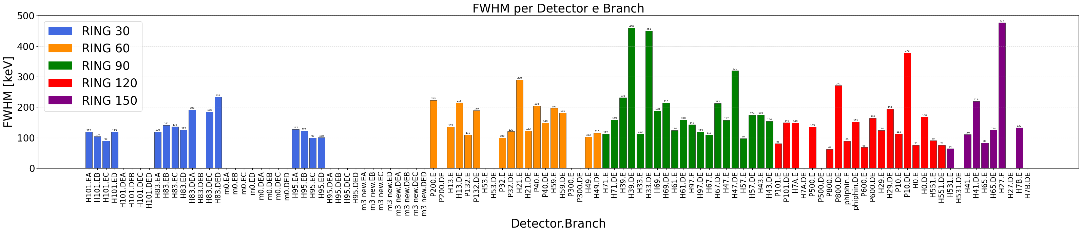
Source test Euclides units – LNL June 26
RING30 Multi-Hex detectors available at the lab, to be re-tested
Depending on the ongoing test => Possible procurement of extra spares
5 repaired Multi-Pent dets delivered and under commissioning, former leakage current drift disappeared
New PBC under design for a more robust connector plug
Courtesy of F. Simioni

Slide 16
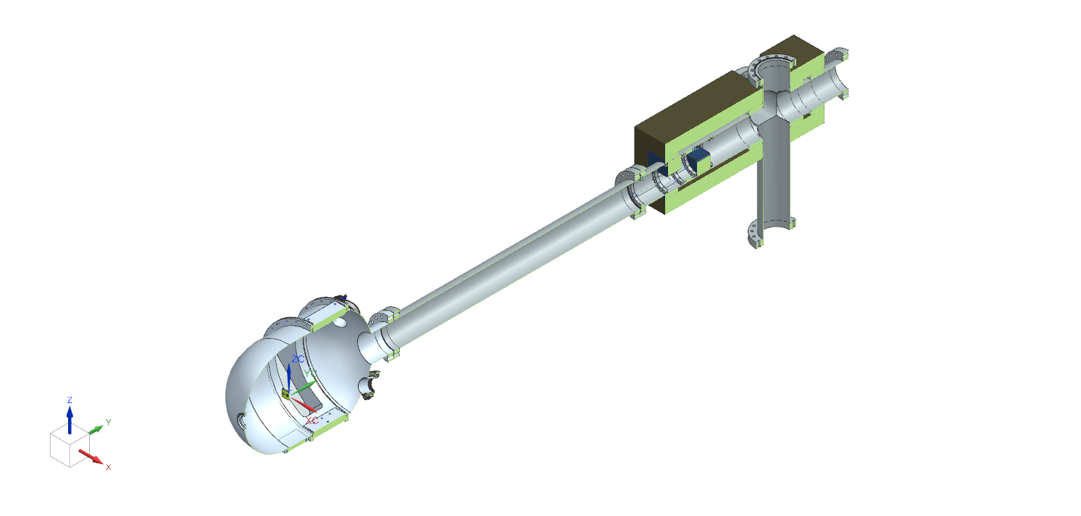
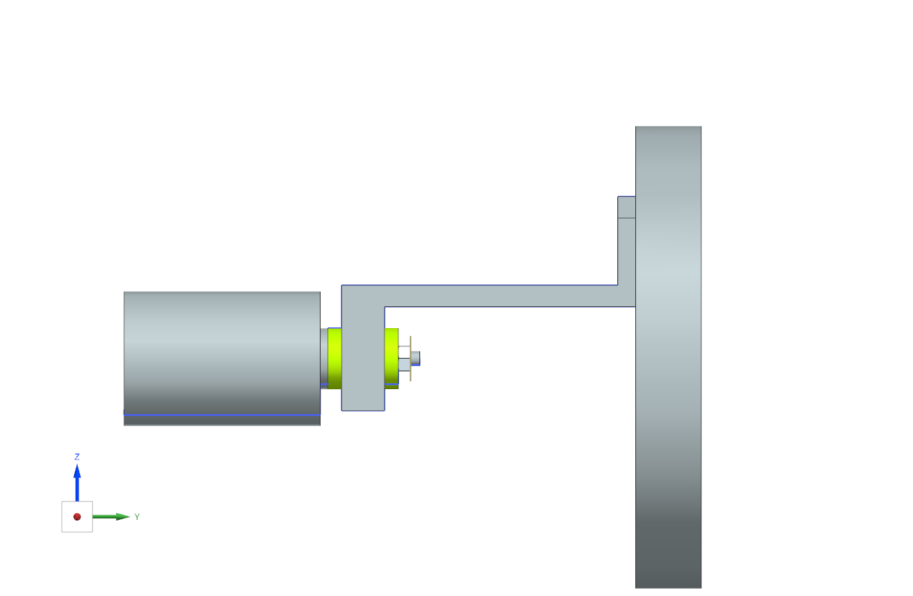
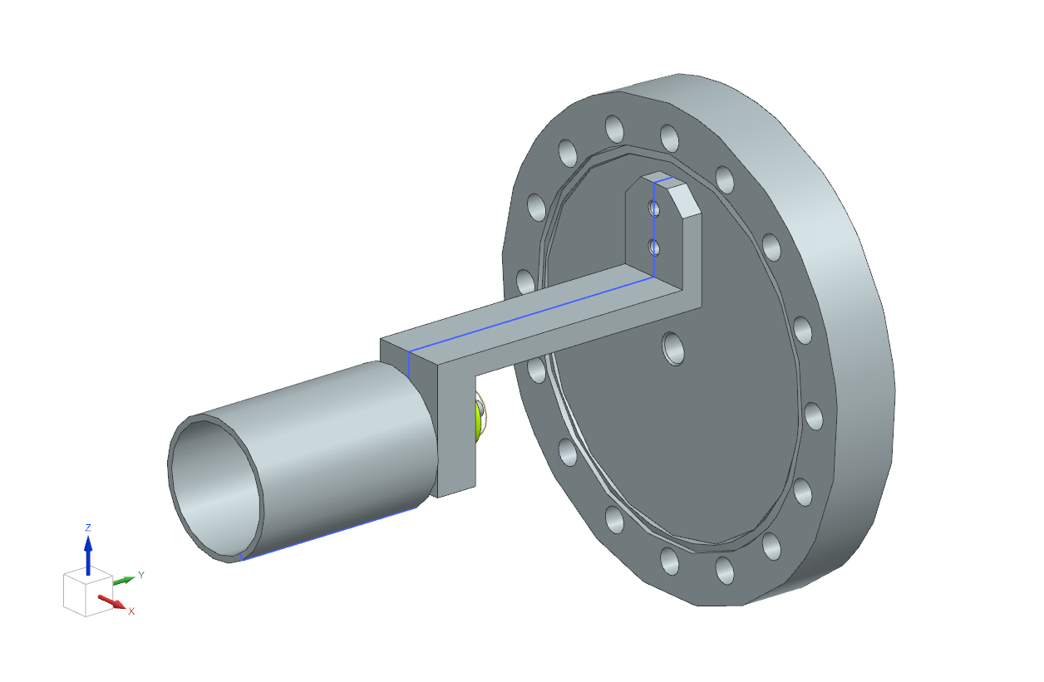
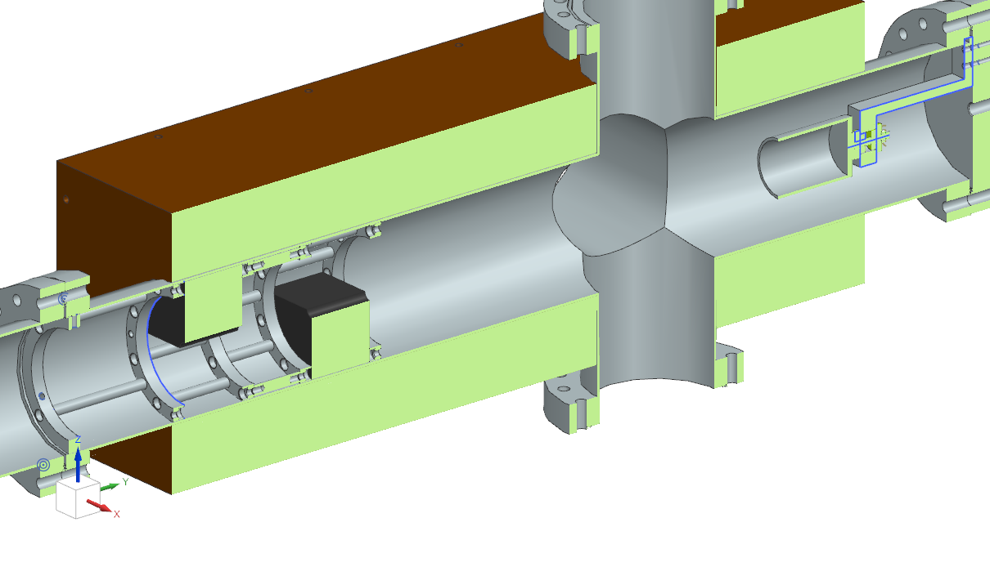
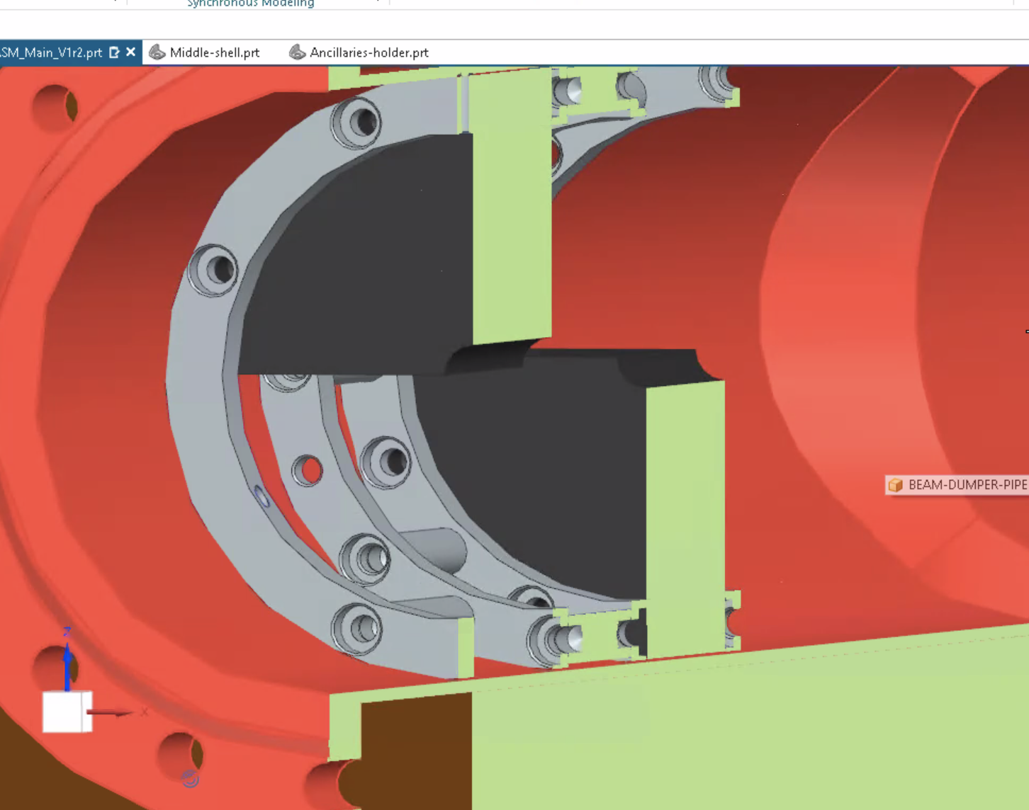
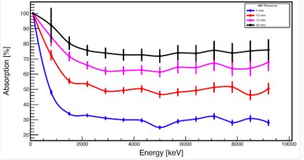
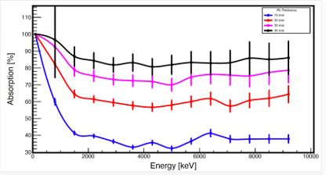
AGATA Zero-Deg Configuration: downstream and beam dump
2281
Details of the beam-dump chamber:
It is a 4-way cross to allow location of a pumping system
Beam-dump cup located on end flange
Feedthroughs for signals
PEEK insulation
End-flange closed using flat Viton CF o-ring for easy removal
Shielding:
  Externally 50 mm Pb
  Internally at the entrance of the chamber, two blocks of W alloy to shield from backward scattering radiation
  W blocks are detached to help vacuum and have a hole (10 mm) to allow beam entering.
  Absorbs approx. 98% or radiation up to 4-5 MeV
CUP
Courtesy of G. Benzoni

Slide 17
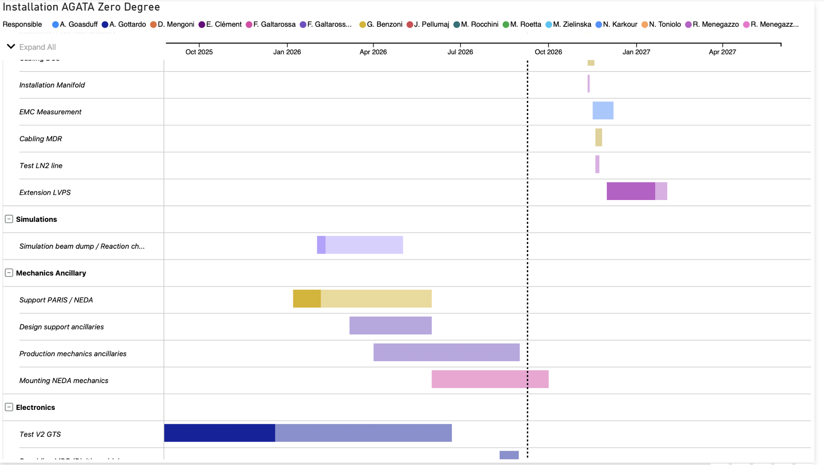
Installation planning
Important milestones:
Sept. 2026
Copy to the GRID
Removing
Oct. 2026
all detectors in hall 2
Mid-Nov. installation of the honeycomb
Dec. installation of the first detectors on the array
Jan. source commissioning
Feb. in-beam commissioning

Slide 18
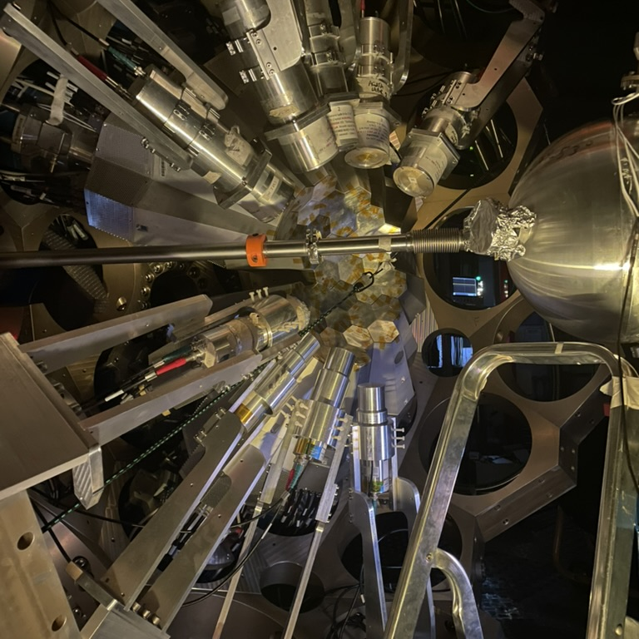
Thank you
Alain.goasduff@lnl.infn.it
https://web.infn.it/gamma/
https://www.agata.org

