Slide 1

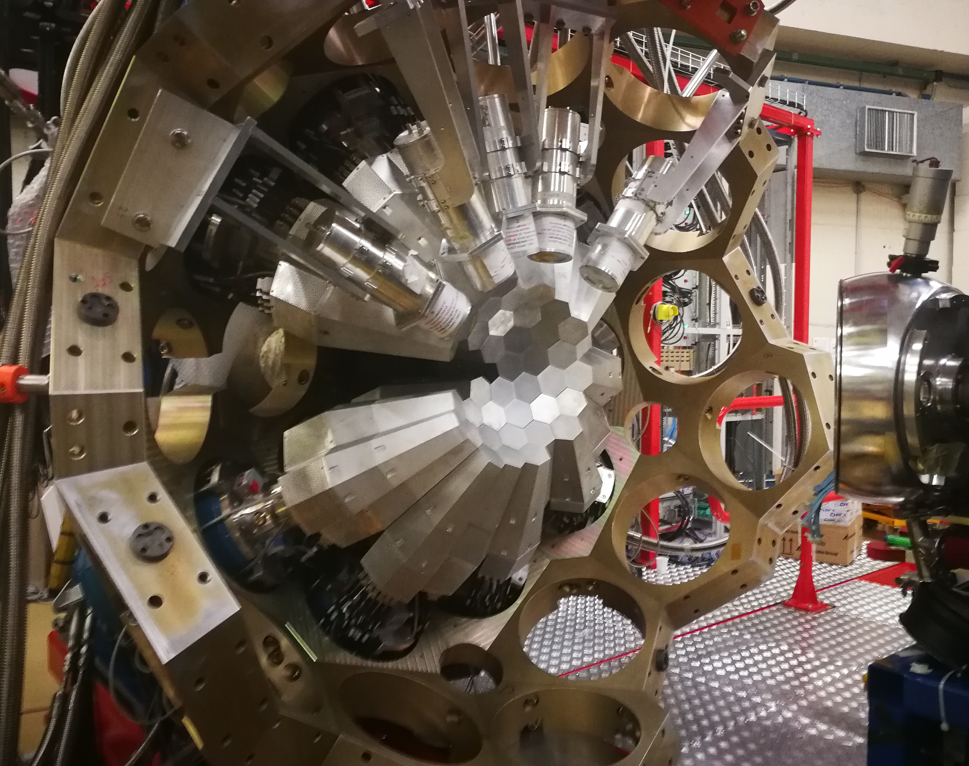

The LNL campaign: physics campaigns
Alain Goasduff (INFN LNL)
26th AGATA Week meeting
7-11 September 2026
HIL - Warsaw

Slide 2
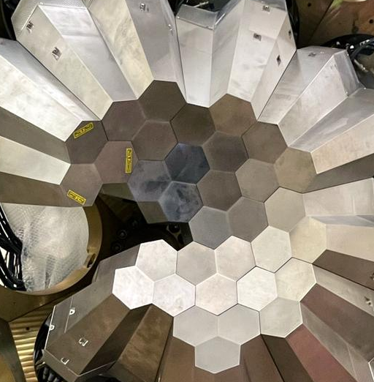
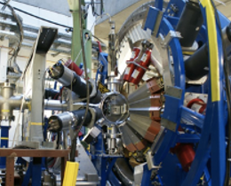
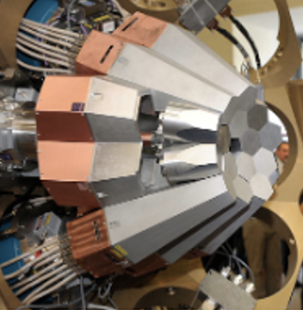
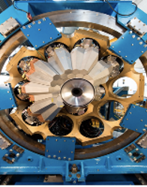
The AGATA Timeline
Local project manager
J.J. Valiente-Dobón – A. Goasduff
Scientific coordinator
M. Zielinska
AGATA@GSI
2009
2014
2029-203X
PHASE 2
2011
2021
AGATA@LNL
AGATA@GANIL
AGATA@GANIL

Slide 3
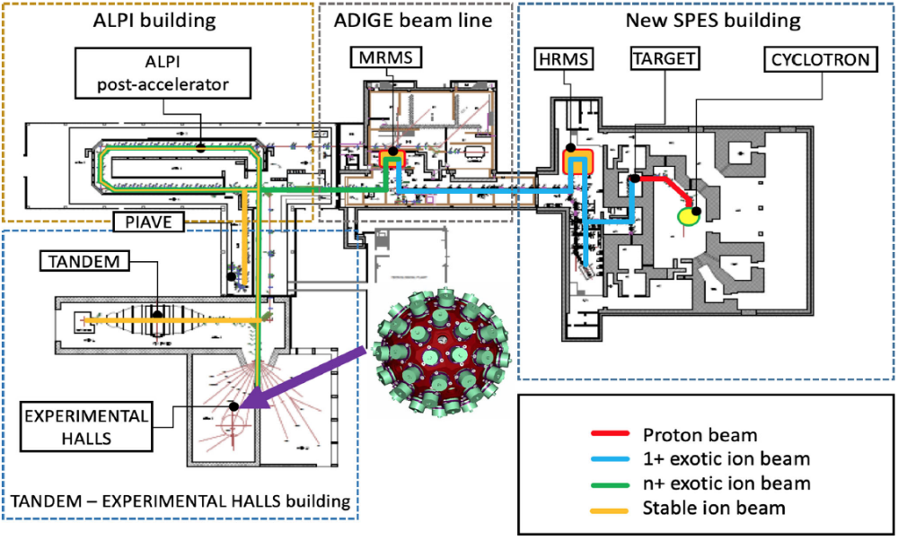
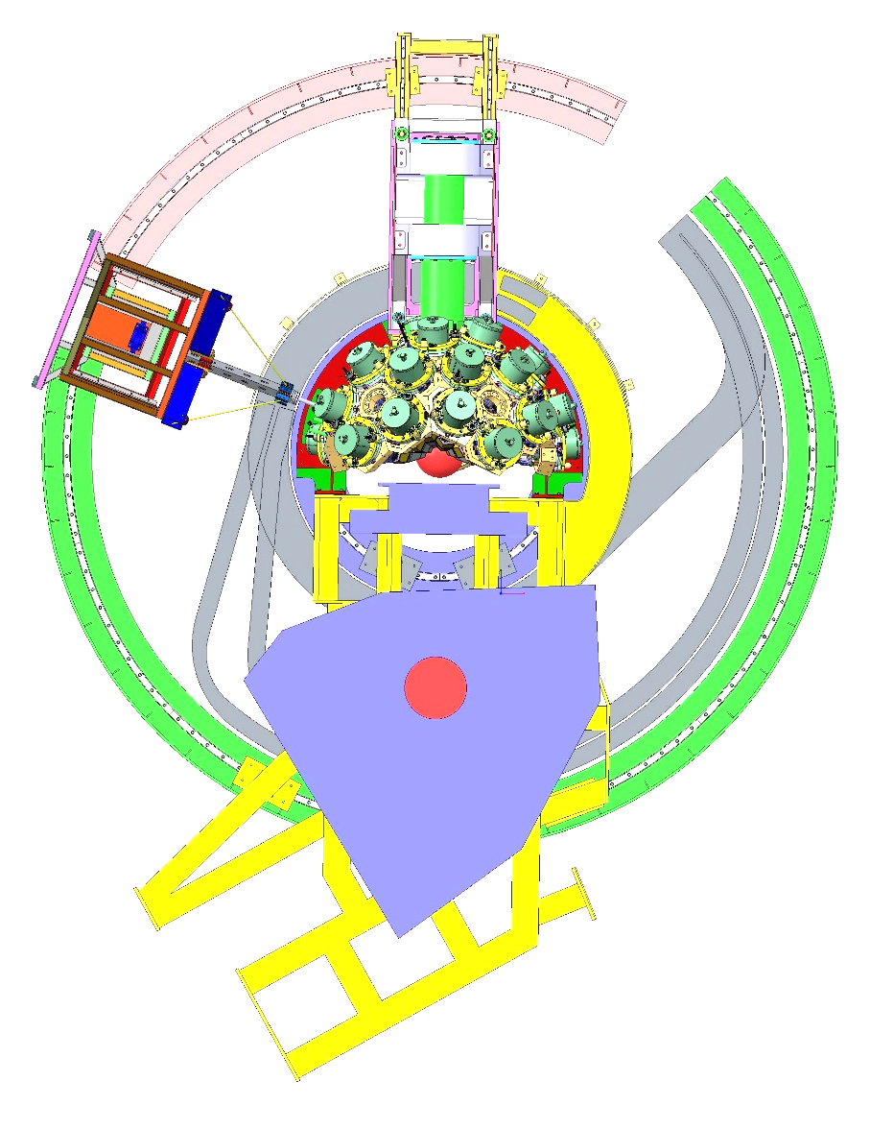
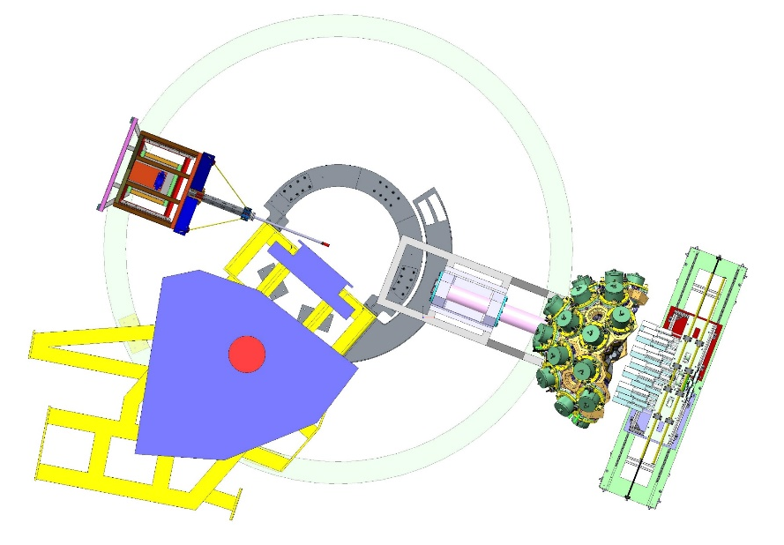
AGATA @ LNL:
2021 - 2028
Two configurations:
2021 – July 2026: AGATA coupled to PRISMA
July-2026 – mid-2028: AGATA at “zero-degree”
AGATA coupled with PRISMA
Current configuration
NEDA
AGATA zero degrees

Slide 4
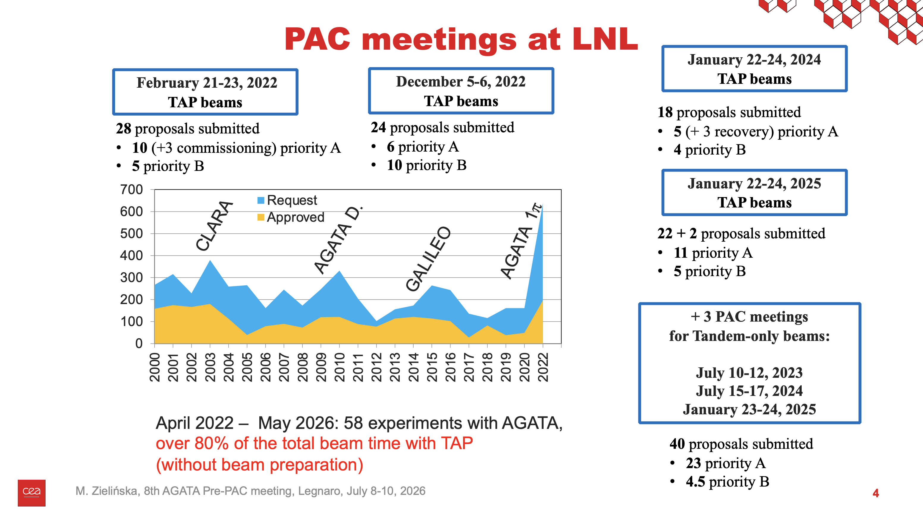

Slide 5
Brief summary of the campaign so far
Since April 2022, 65 experiments folder
created:
  12 commissioning and test experiments
  53 in-beam experiment performed

Slide 6
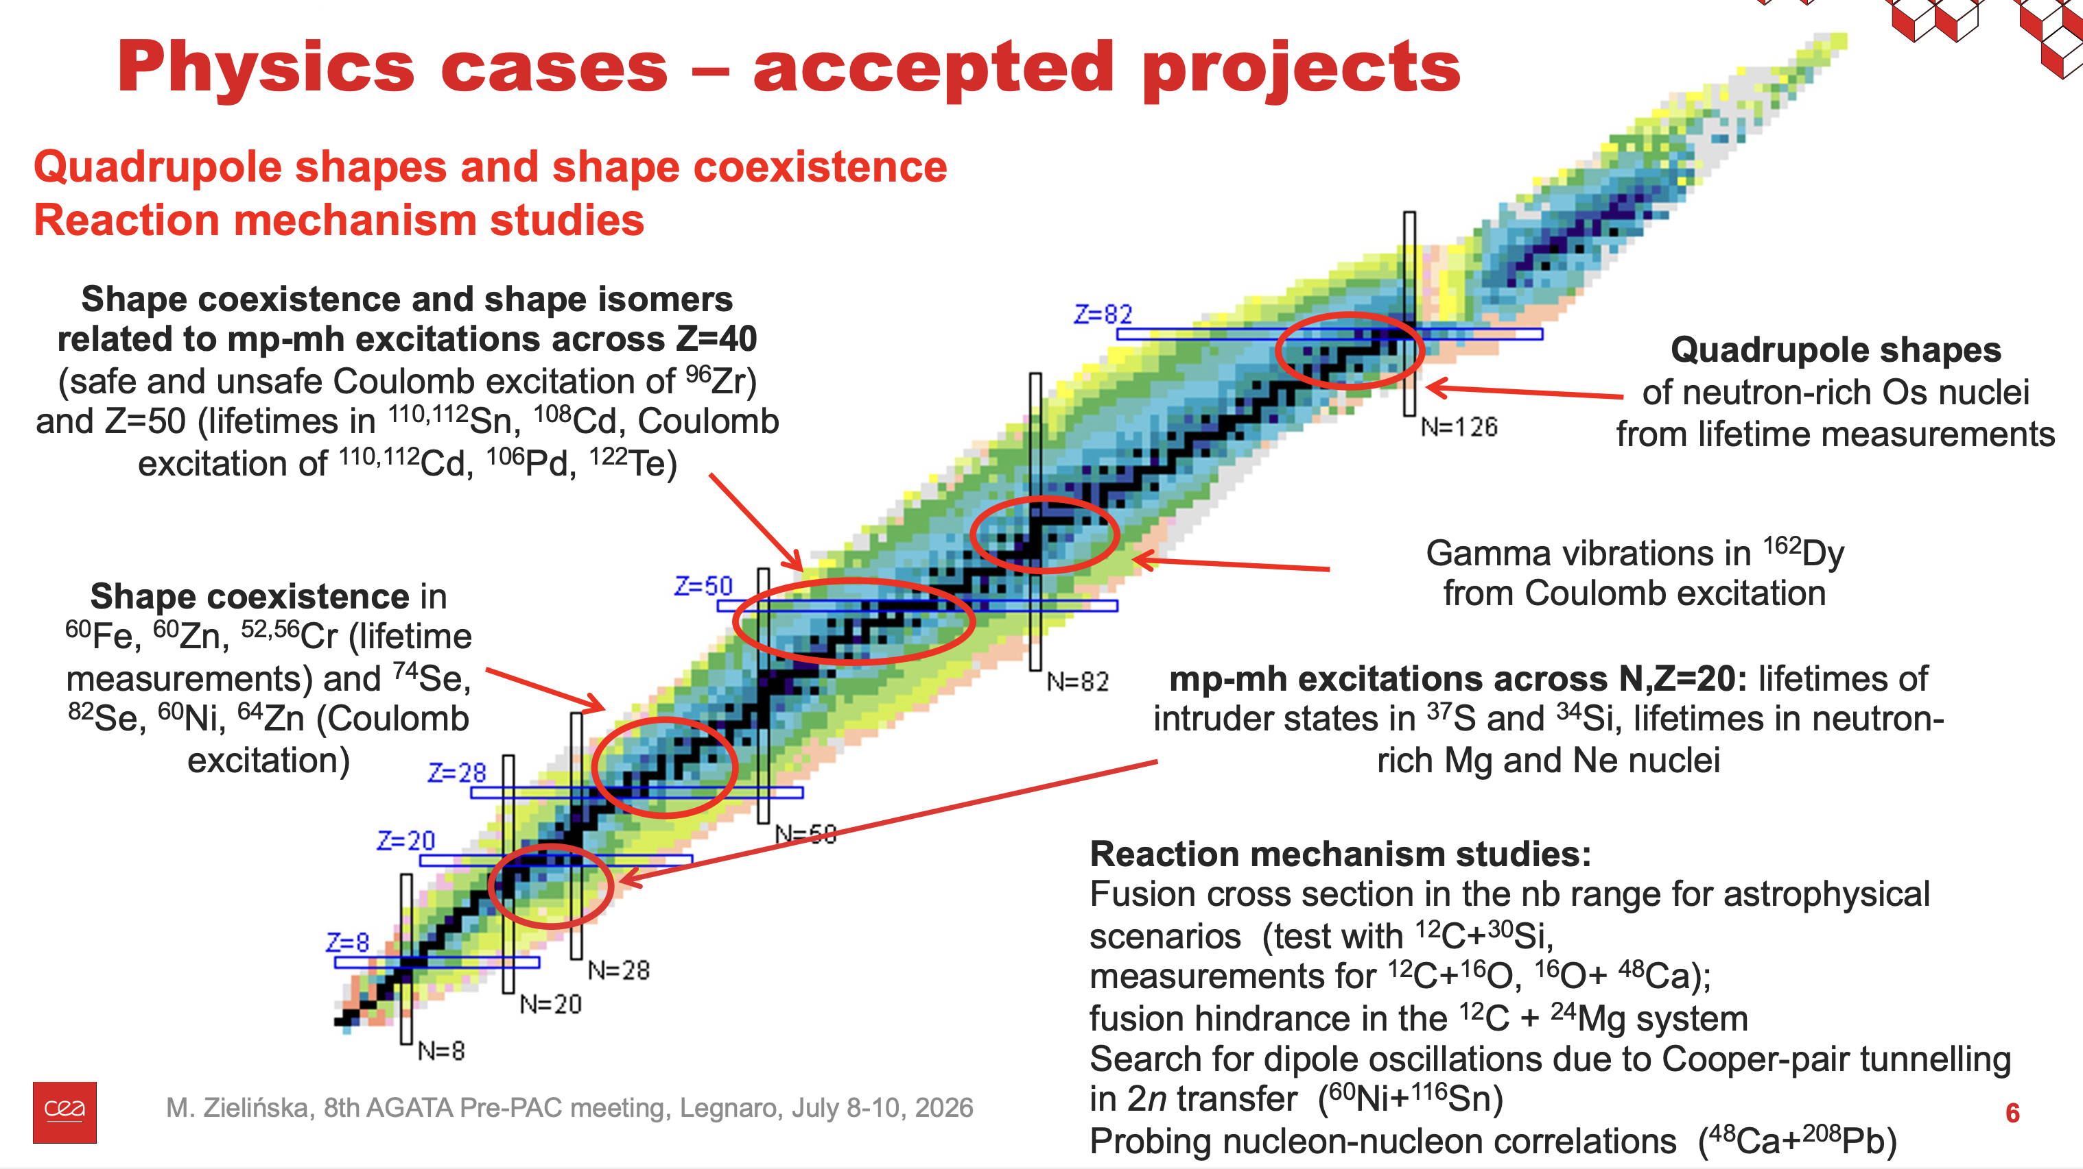

Slide 7
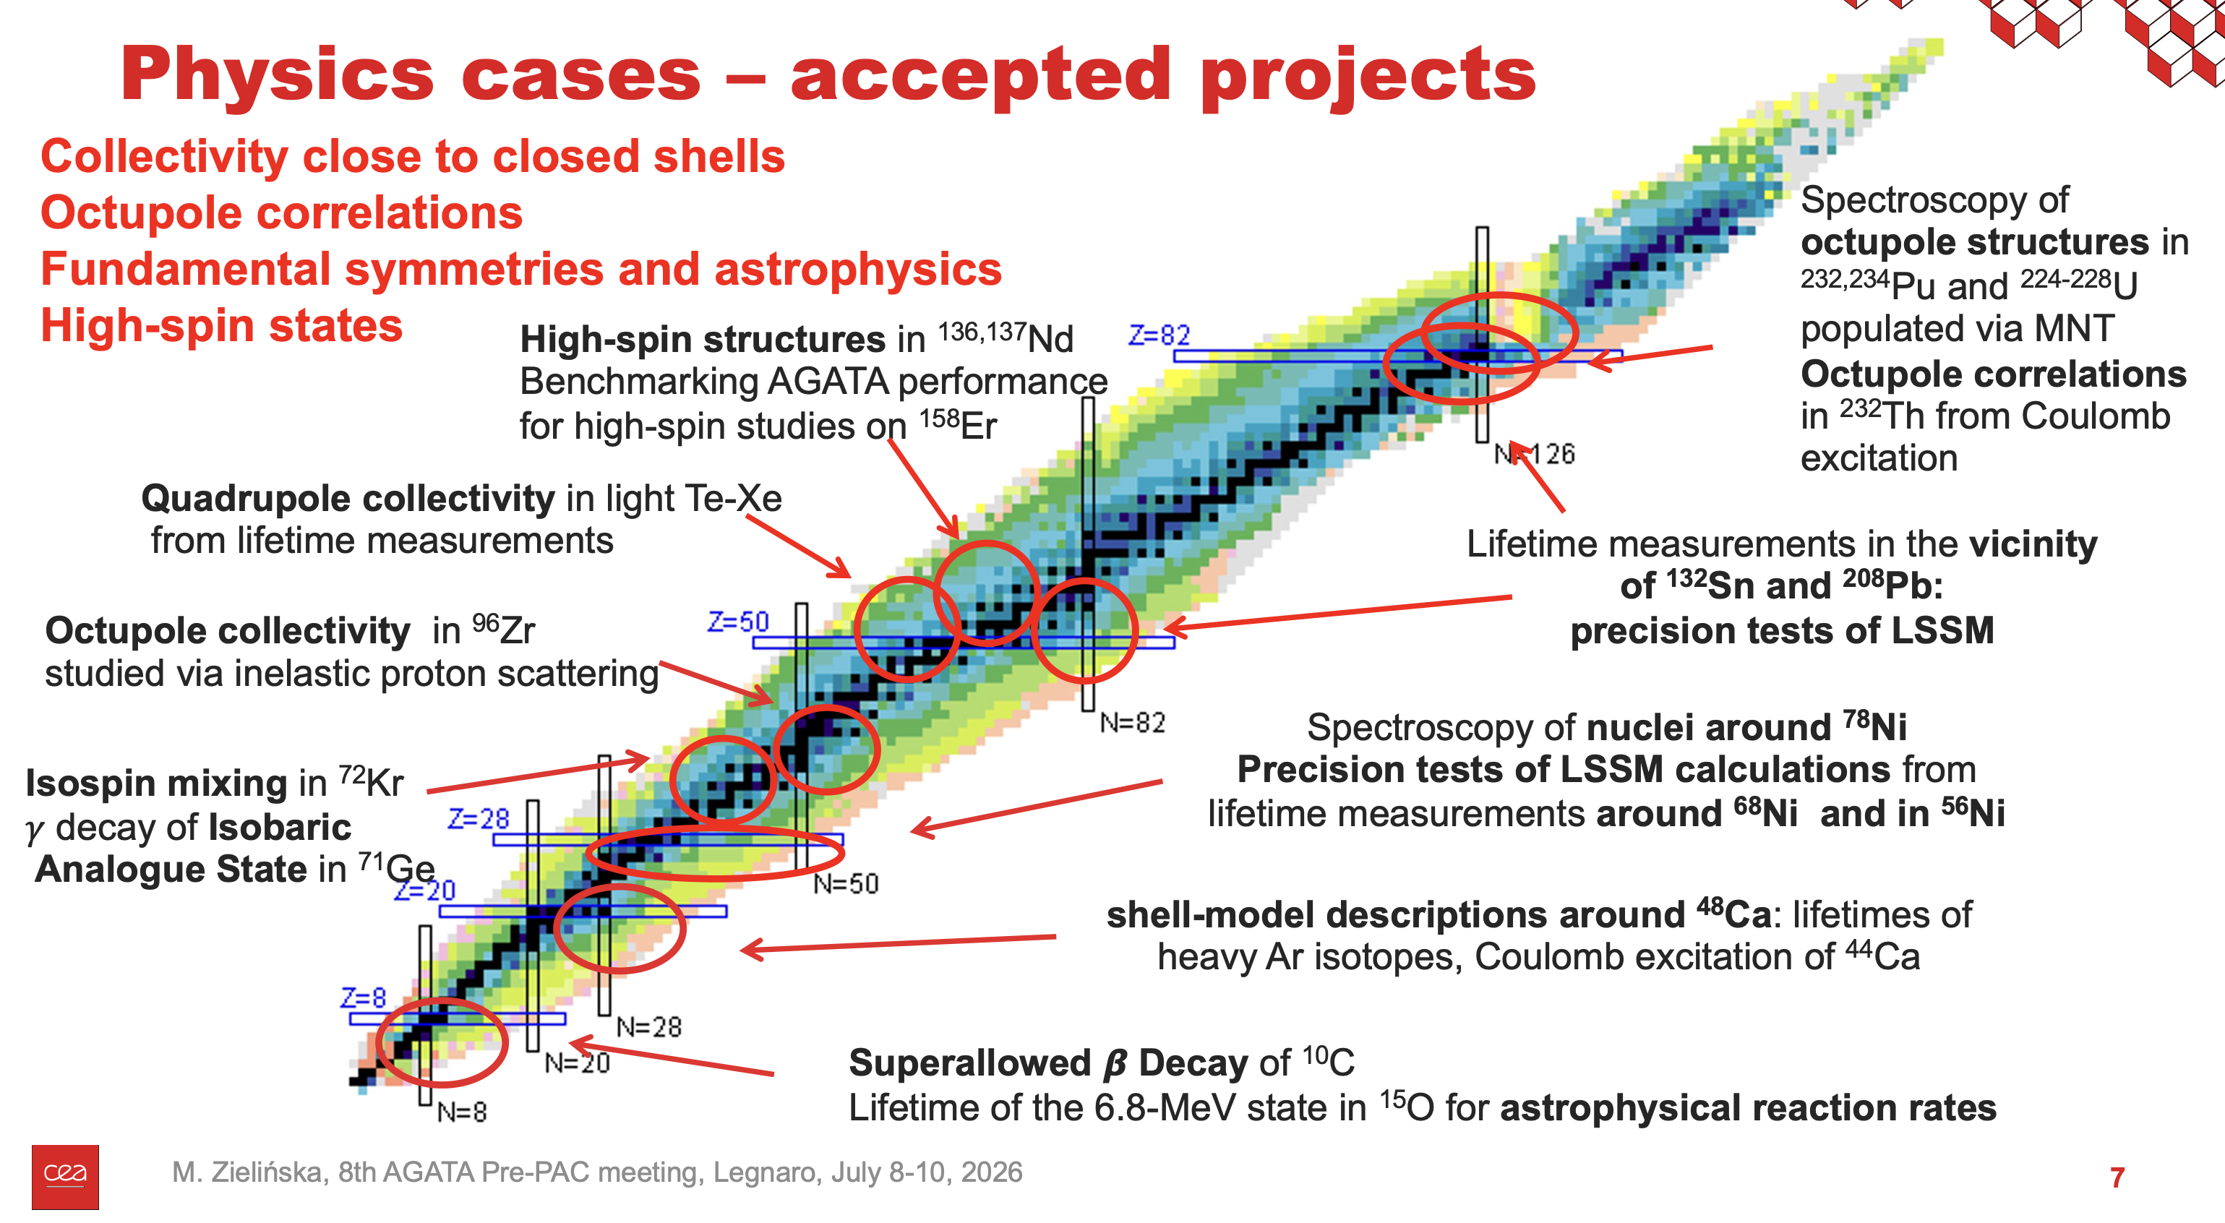

Slide 8
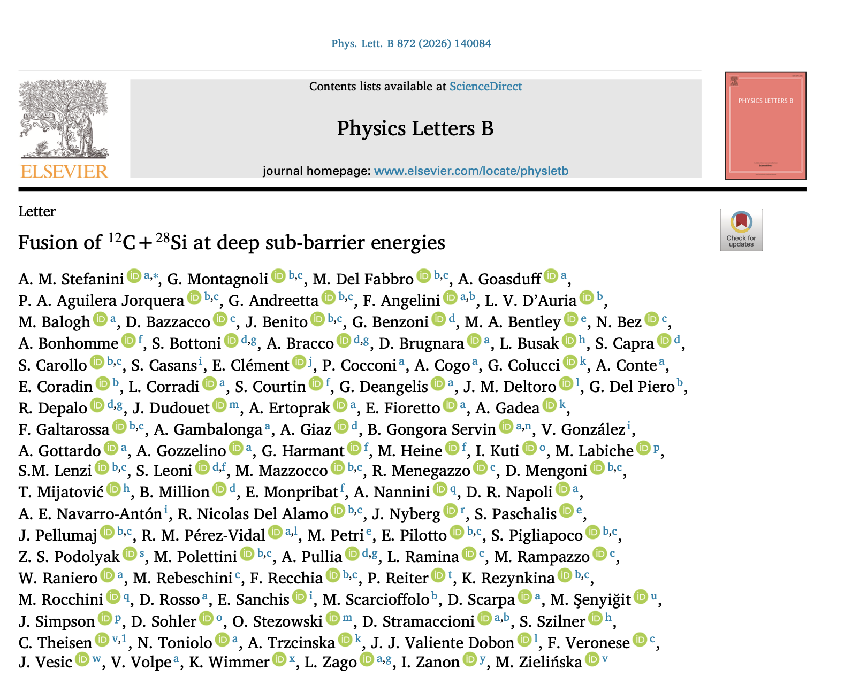
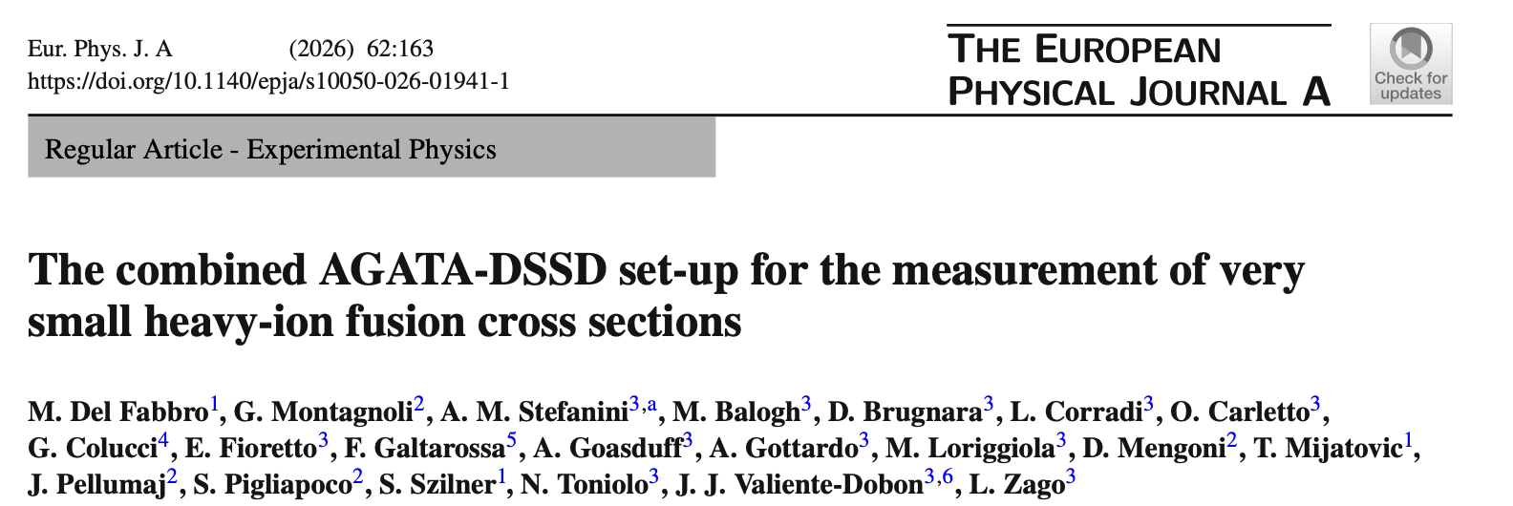
News since the last AGATA week
First publications from the campaign are coming out
AGATA used for sub-barrier reaction cross-section measurements
2 physics papers under review
4 PhD theses completed
  (+3 expected by the end of the year)
Several Master's and Bachelor's theses

Slide 9
News since the last AGATA week
EXOTIC beams succesfully delivered to AGATA
  Intensities up to 10⁵ pps at the AGATA target position
  Three experiments performed using TANDEM primary beams
  See talks of S. Bottoni and A. Togni
²³⁸U beam delivered on AGATA
  Delays due to the consequences of the heatwave on the laboratory infrastructure
  → Beam time reduced from 2 down to 1 month
  1 experiment + Merging of the 2 nuclear reaction studies performed
  See talk of A. Gottardo

Slide 10
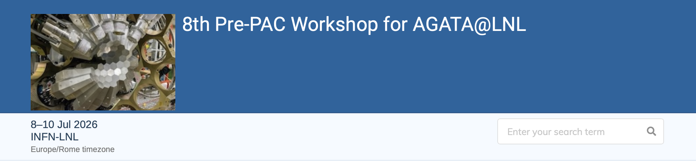
Pre-PAC for the LNL ZD campaign
Pre-evaluation of projects for the ZD campaign at a dedicated workshop (April 2023):
  42 projects + 4 umbrella proposals, including 13 for SPES beams and 7 for gas targets
Stable beams from Tandem – ALPI – PIAVE
  First call for AGATA at zero degrees
  PAC meeting in December 2026 or January 2027 (TBD)
In the current call, we have received 52 new projects and 2 resubmissions, for a total request of almost 400 beam days (more than the remaining duration of the campaign!)

Slide 11
Planning for the next physics campaign
 | Jan. | Feb. | Mar. | Apr. | May | Jun. | Jul. | Aug. | Sept. | Oct. | Nov. | Dec.
2025 |  | TANDEM |  |  |  | TANDEM |  |  |  | TANDEM
2026 | TANDEM |  |  | TANDEM/PIAVE-ALPI |  |  |  | MOVE TO 0 DEG
2027 |  | NEDA |  |  |  |  |  |  |  | NEDA
2028 |  | PARIS |  |  |  |  |  |  |  | AGATA@GANIL

Slide 12
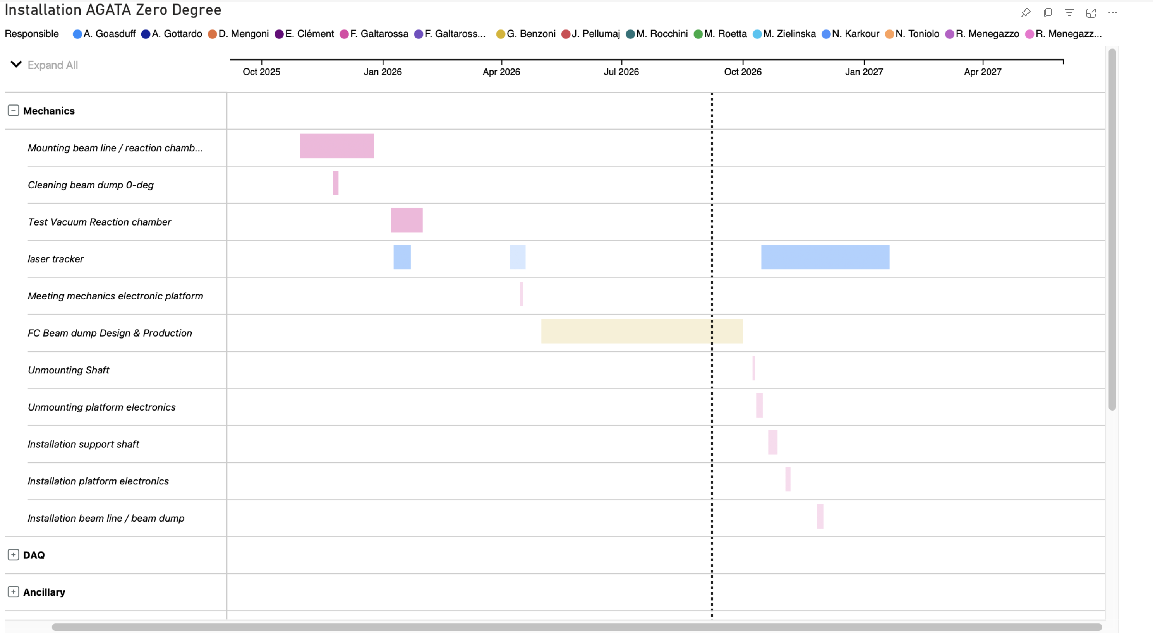
Details of the configuration change
Task 1: Infrastructure: Roberto Menegazzo & Walter Raniero
Task 2: AGATA Mechanics: Franco Galtarossa & Marco Mazzocco
Task 3: Experimentation mechanics: Giovanna Benzoni
Task 4: Safety and Quality: Daniela Benini, Luca de Ruvo
Task 5: Computing and network infrastructures: Michele Gulmini, Marco Roetta
Task 6: Surveyor: Daniele Scarpa
Task 7: Detectors: Walter Raniero, Davide Rosso
Task 8a: DAQ: Alain Goasduff, Nicola Toniolo
Task 8b: Electronics: Andrea Gottardo & Jaime Benito
Task 9: Complementary instrumentation: Daniele Mengoni & Kseniia Rezynkina
Task 10: Performance: Fabio Crespi, Simone Bottoni
Task 11: Exploitation: Daniele Brugnara & Marco Rocchini
Task 12: Data Analysis: Francesco Recchia
Task 13: Logistics: Paolo Cocconi
Task 14: Documentation, data base and procurement: Vincenzo Volpe
Task 15: Public exposure of AGATA activities: Andrea Gozzelino

Slide 13
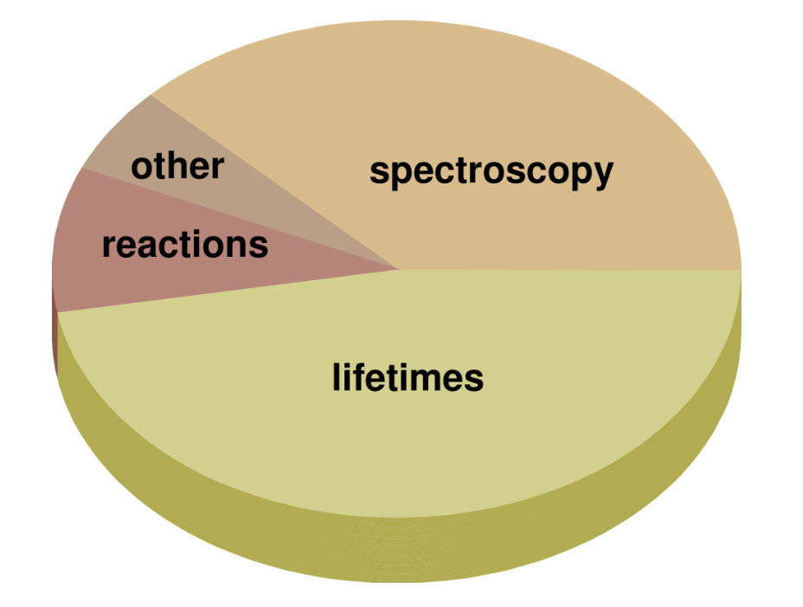
Pre-PAC results
About 50% of the projects request NEDA
About 25% request PARIS
About 25% request neither detector
A similar number of lifetime-measurement experiments (plunger and DSAM) and pure spectroscopy experiments, together with some reaction studies
Multiple experiments interested in using gas-implanted targets (in particular ³He)

Slide 14
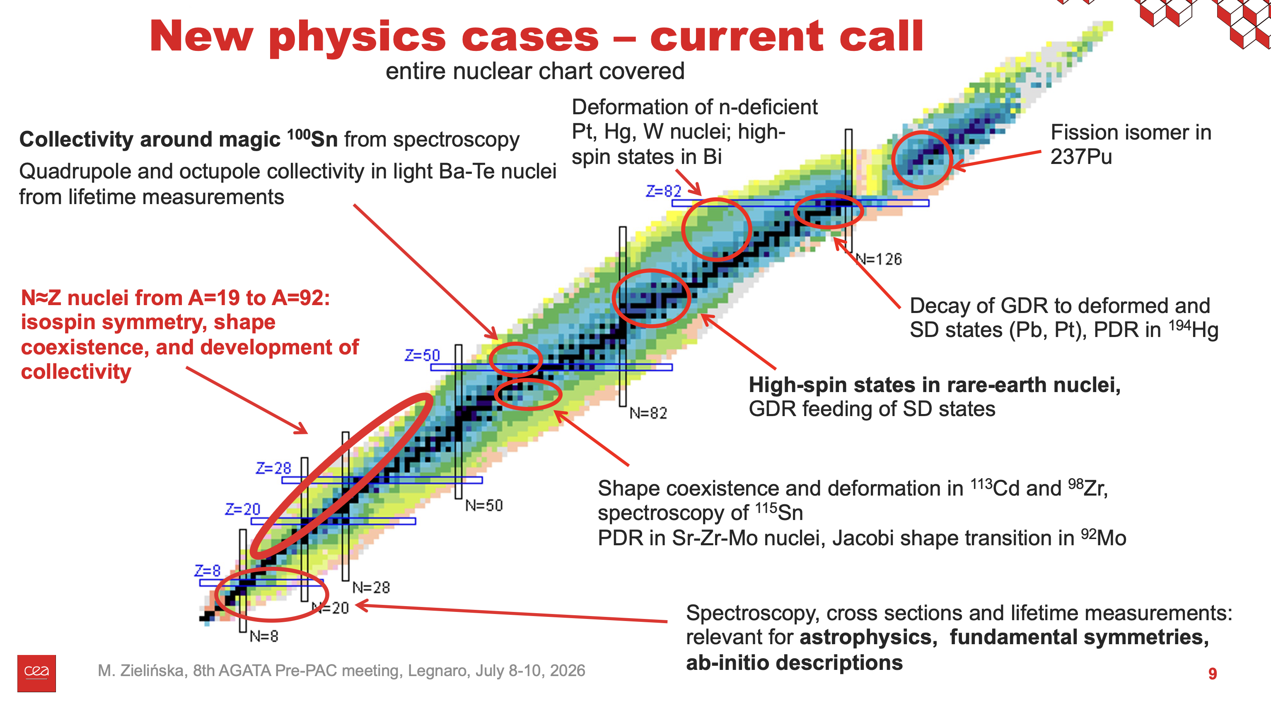

Slide 15
Conclusions
So far, we have had a very successful campaign
The zero-degree campaign will be divided into two sub-campaigns:
  First sub-campaign with NEDA
  Second sub-campaign with PARIS
Preparations for both are ongoing in parallel
Strong collaboration with well-established and well-documented procedures for data analysis

Slide 16
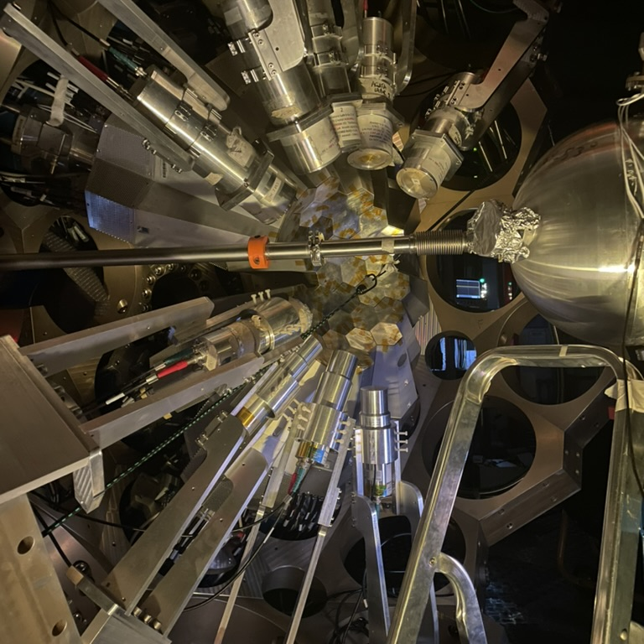
Thank you
Alain.goasduff@lnl.infn.it
https://web.infn.it/gamma/
https://www.agata.org

