Slide 1
AGATA Project
EMC Grounding monitoring and both 0° @Legnaro and GANIL Installation
N. Karkour et al.

Slide 2
Outline
  EMC report on HV (April 2026 visit to Legnaro)
  HV modules discussion @ CAEN Italie
  EMC grounding considerations for Legnaro 0°
  EMC Grounding considerations for GANIL 2028 installations
  Conclusions

Slide 3
EMC Development Plan
Long traces and Scope signal monitoring is crucial.
Monitoring MUST be made physically on the signals and without generating noise
We need detailed and synchronised monitoring (LVPS HV and CSP)
Low Voltage Power supplies for Preamps.
High Voltage Power supplies for detector biaising (Discussion started with CAEN).

Slide 4
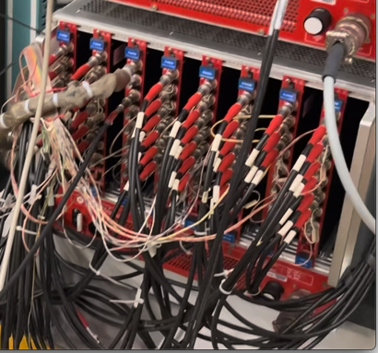
EMC @ LNL April 2026
HV Qualification
The AGATA HV output baseline EMC test is based on several steps (using externally shielded and normal 30 m HV cable):
An HV decoupler is lent gently by the CAEN company to check for ripple voltage signals.
The needed HV output is connected to the Decoupler.
The HV baseline signal is analysed on the scope using Vp-p and FFT frequency analysis.
The HV is then plugged into the detector and the core output preamplifier baseline spectra using long trace is recorded and plotted.
Figure 1 AGATA High Voltage crate

Slide 5
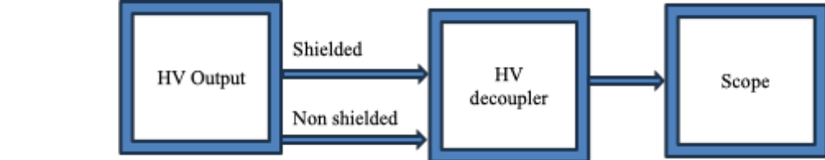
EMC @ LNL April 2026
HV Scheme tests

Slide 6
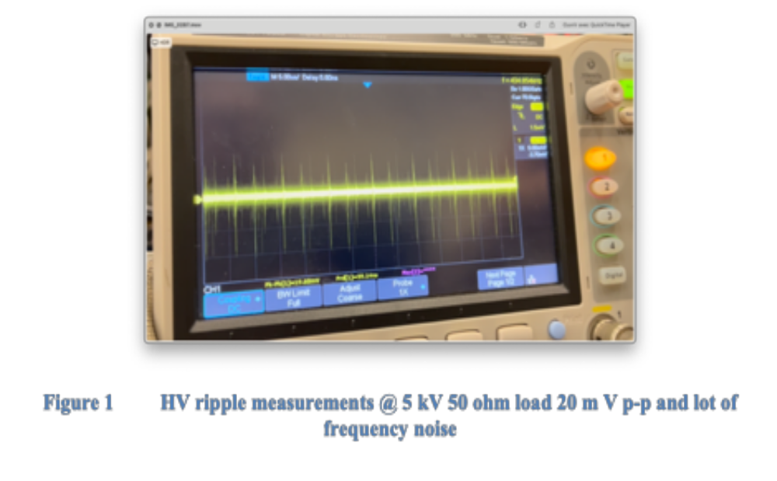
EMC @ LNL April 2026
The HV decoupler has its limitations in frequency cutoff @ 6 and 8 MHz.
Hig frequency signals level is reduced.
Test of the noise @ 0V and the results are the same.
The following tests were made @0V without the HV decoupler.
The 50 ohm load is taken out because in reality the HV is a high impedance .

Slide 7
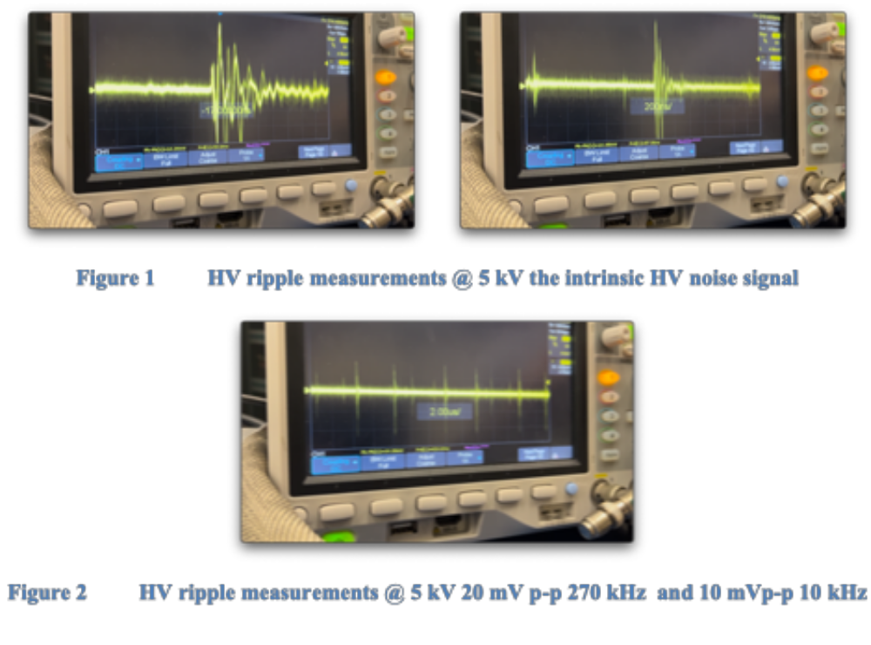
EMC @ LNL April 2026
Shielded 20 cm Decoupler Cable
Instrinsic HV Noise

Slide 8
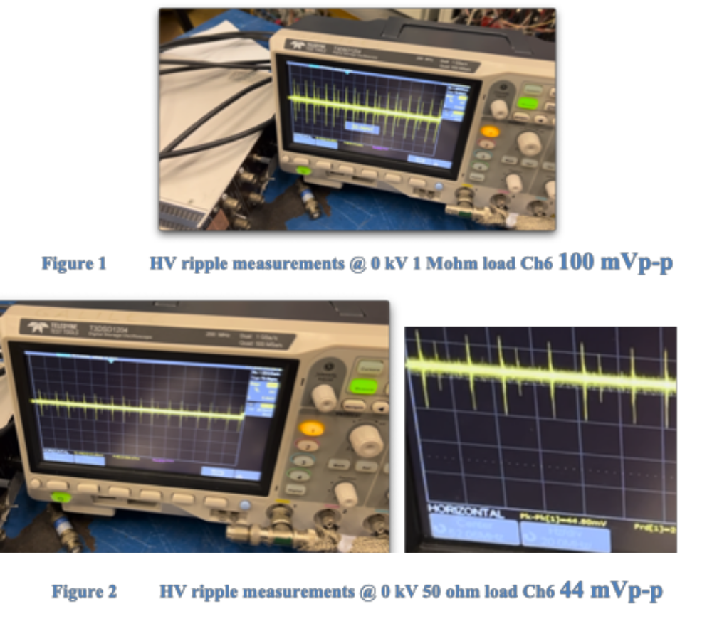
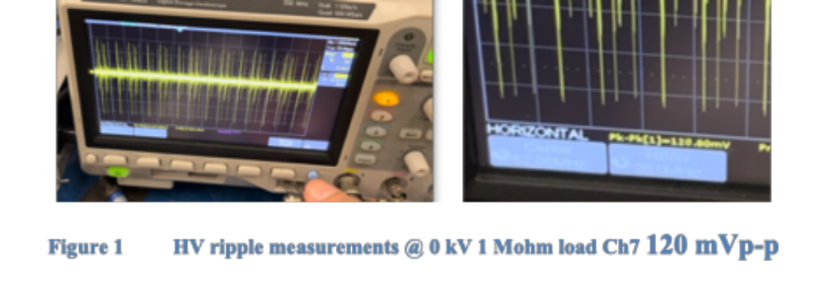
EMC @ LNL April 2026
0 kV 1 Mohm load direct connection to scope
The HV decoupler has its limitations in frequency cutoff @ 6 and 8 MHz.
High frequency signals level is reduced.
Taking off the decoupler and setting th HV to 0 V or 10 V to be compatible with the scope input @ 1 Mohm.

Slide 9
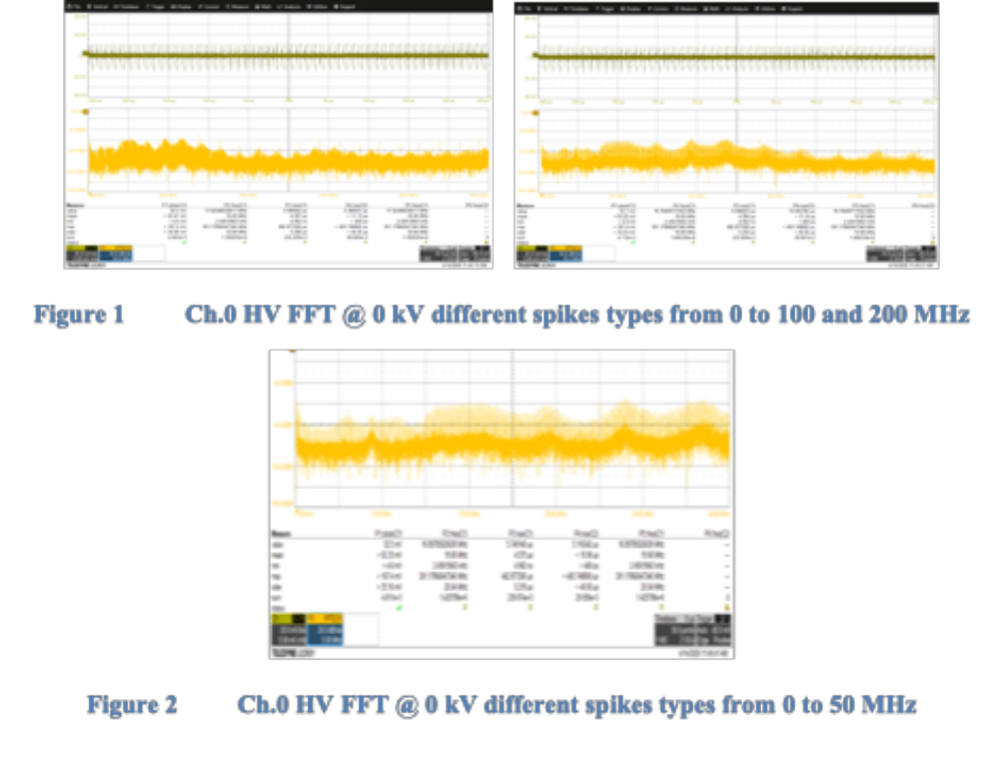
EMC @ LNL April 2026
FFT

Slide 10
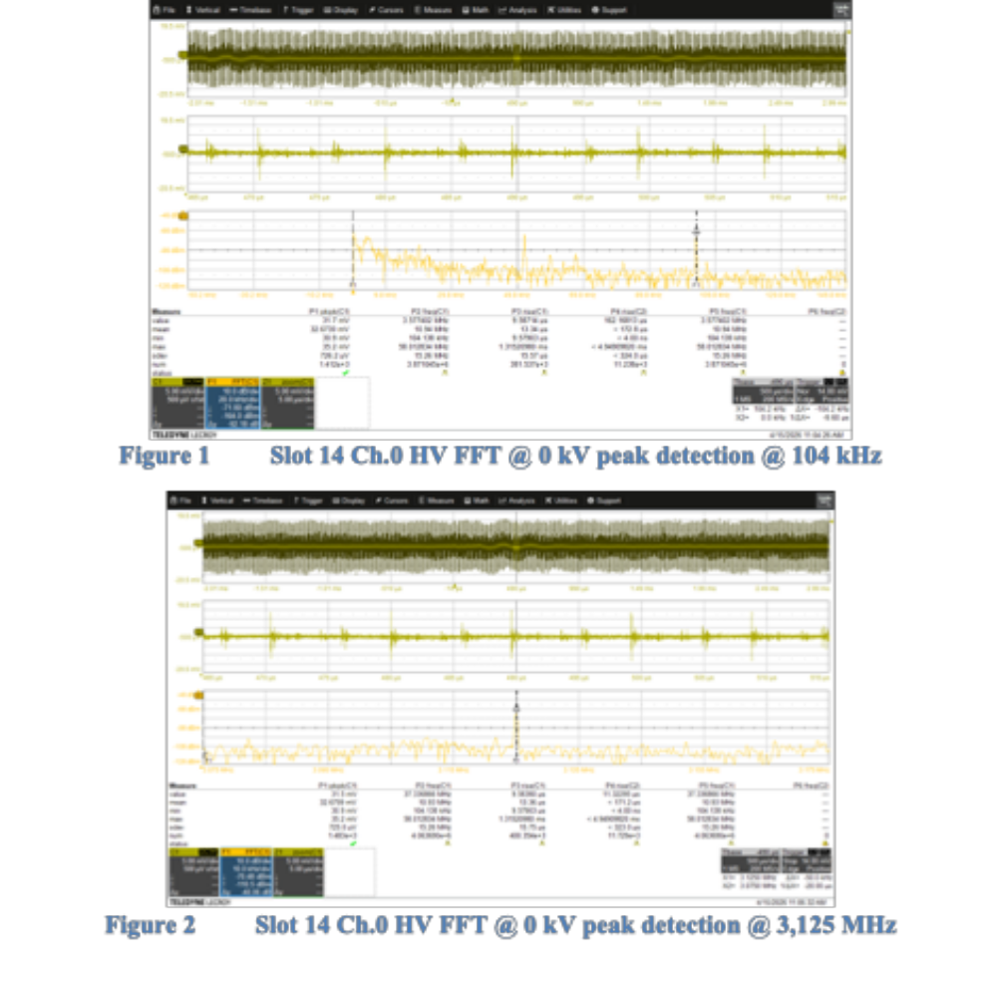
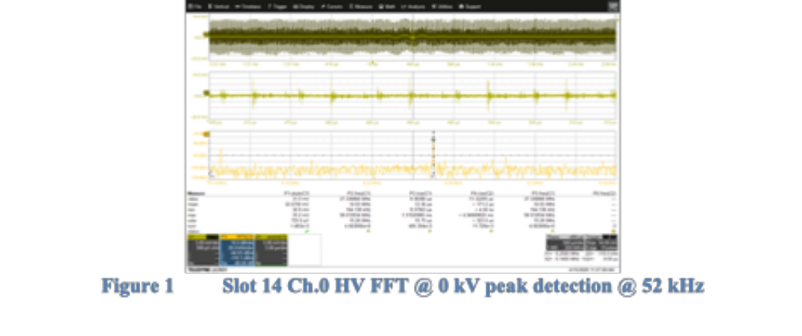
EMC @ LNL April 2026
Most significant noise frequency selected .
104 kHz.
3,125 MHz.
52 kHz.
Huge bump from 3 to 5 kHz

Slide 11
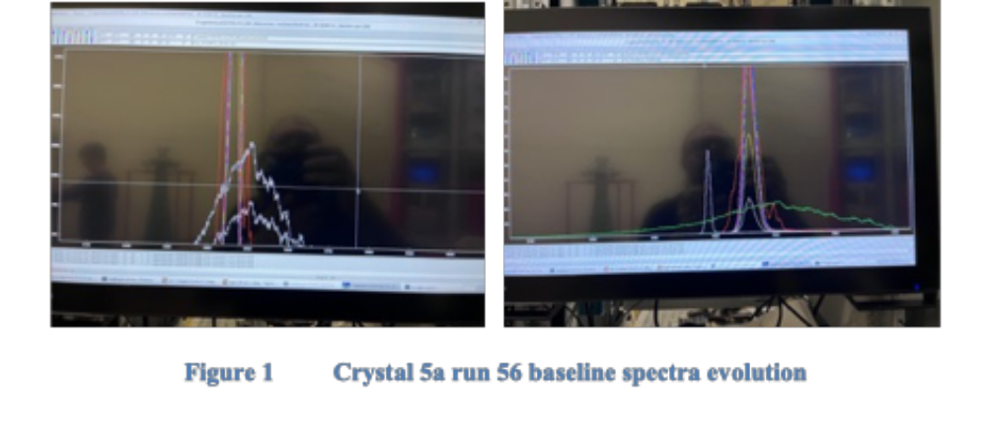
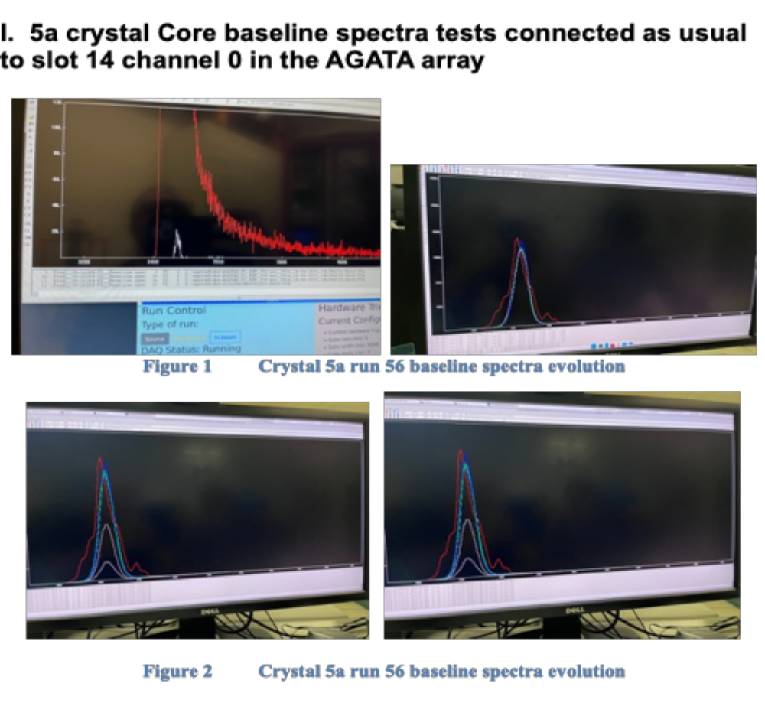
EMC @ LNL April 2026

Slide 12
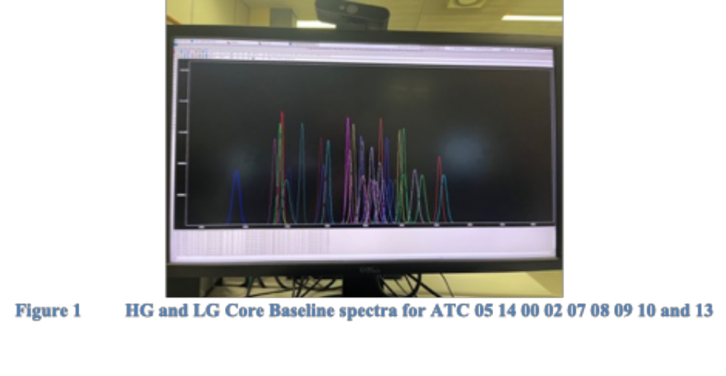
EMC @ LNL April 2026

Slide 13
EMC LVPS meeting with IRFU
IRFU meeting Held on Monday 11th of May 2026.
Present : A. Lotode, T. Joanem, M. ZIELINSKA, and N. Karkour
It was agreed to have an online monitoring on the LVPS modules output during operation.
An LVPS adapter to be installed so the LVPS can be checked one by one.
Monitoring to be made before each experiment on each ATC
Sometimes the LVPS should turn off and on and the crystal baseline spectra goes to normal condition.

Slide 14
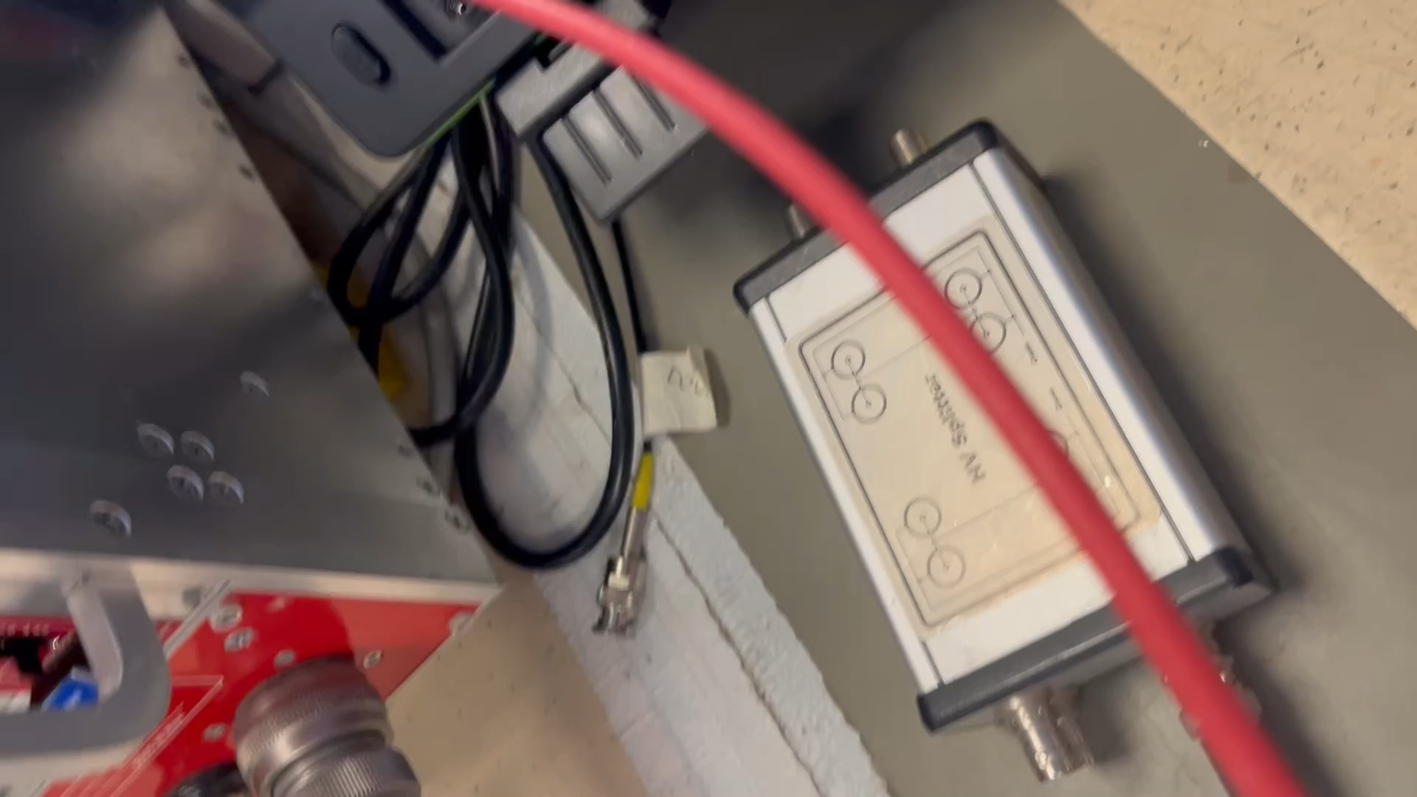
HV module tests @ CAEN Italy

Slide 15
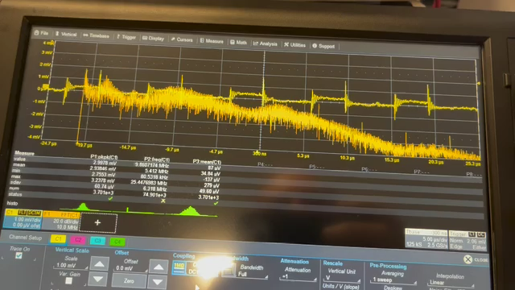
HV module tests @ CAEN Italy
HV Ripple measufred @ CAEN Vpp = 3 mV 30 to 40 dB less than the LNL HV (75 to 250 mV) ripple

Slide 16
Conclusion
The HV modules in CAEN are more recent need to compare with LNL ones at CAEN.
A HV module to be sent to CAEN in september after shutdown to compare noise @ CAEN.
Actions to be taken depends on the comparison results @ CAEN. (lot of possible solutions : can we modify the actual HV modules? Check new HV modules in LNL and compare in LNL with the actual ones to find the issue source).
Check the LVPS modules in LNL with the adapter
First recommendation is to develop an automatic Baseline spectrum and define which tolerance is acceptable in measuring the FWHM of the core baseline.

Slide 17
EMC @ LNL 0°
Future visits to Legnaro
For the Agata Installation at zero degrees The EMC must be taken into consideration..
NeedFew meetings to discuss with the mechanical engineers and infrastructure group.
1 or 2 EMC campaigns to be realized prior to the AGATA Experiments.
New recommendations to the AGATA experiments should be taken in considerations (no painting on adjacent mechanics copper plate under the electronics , HV bays and the detector area .

Slide 18
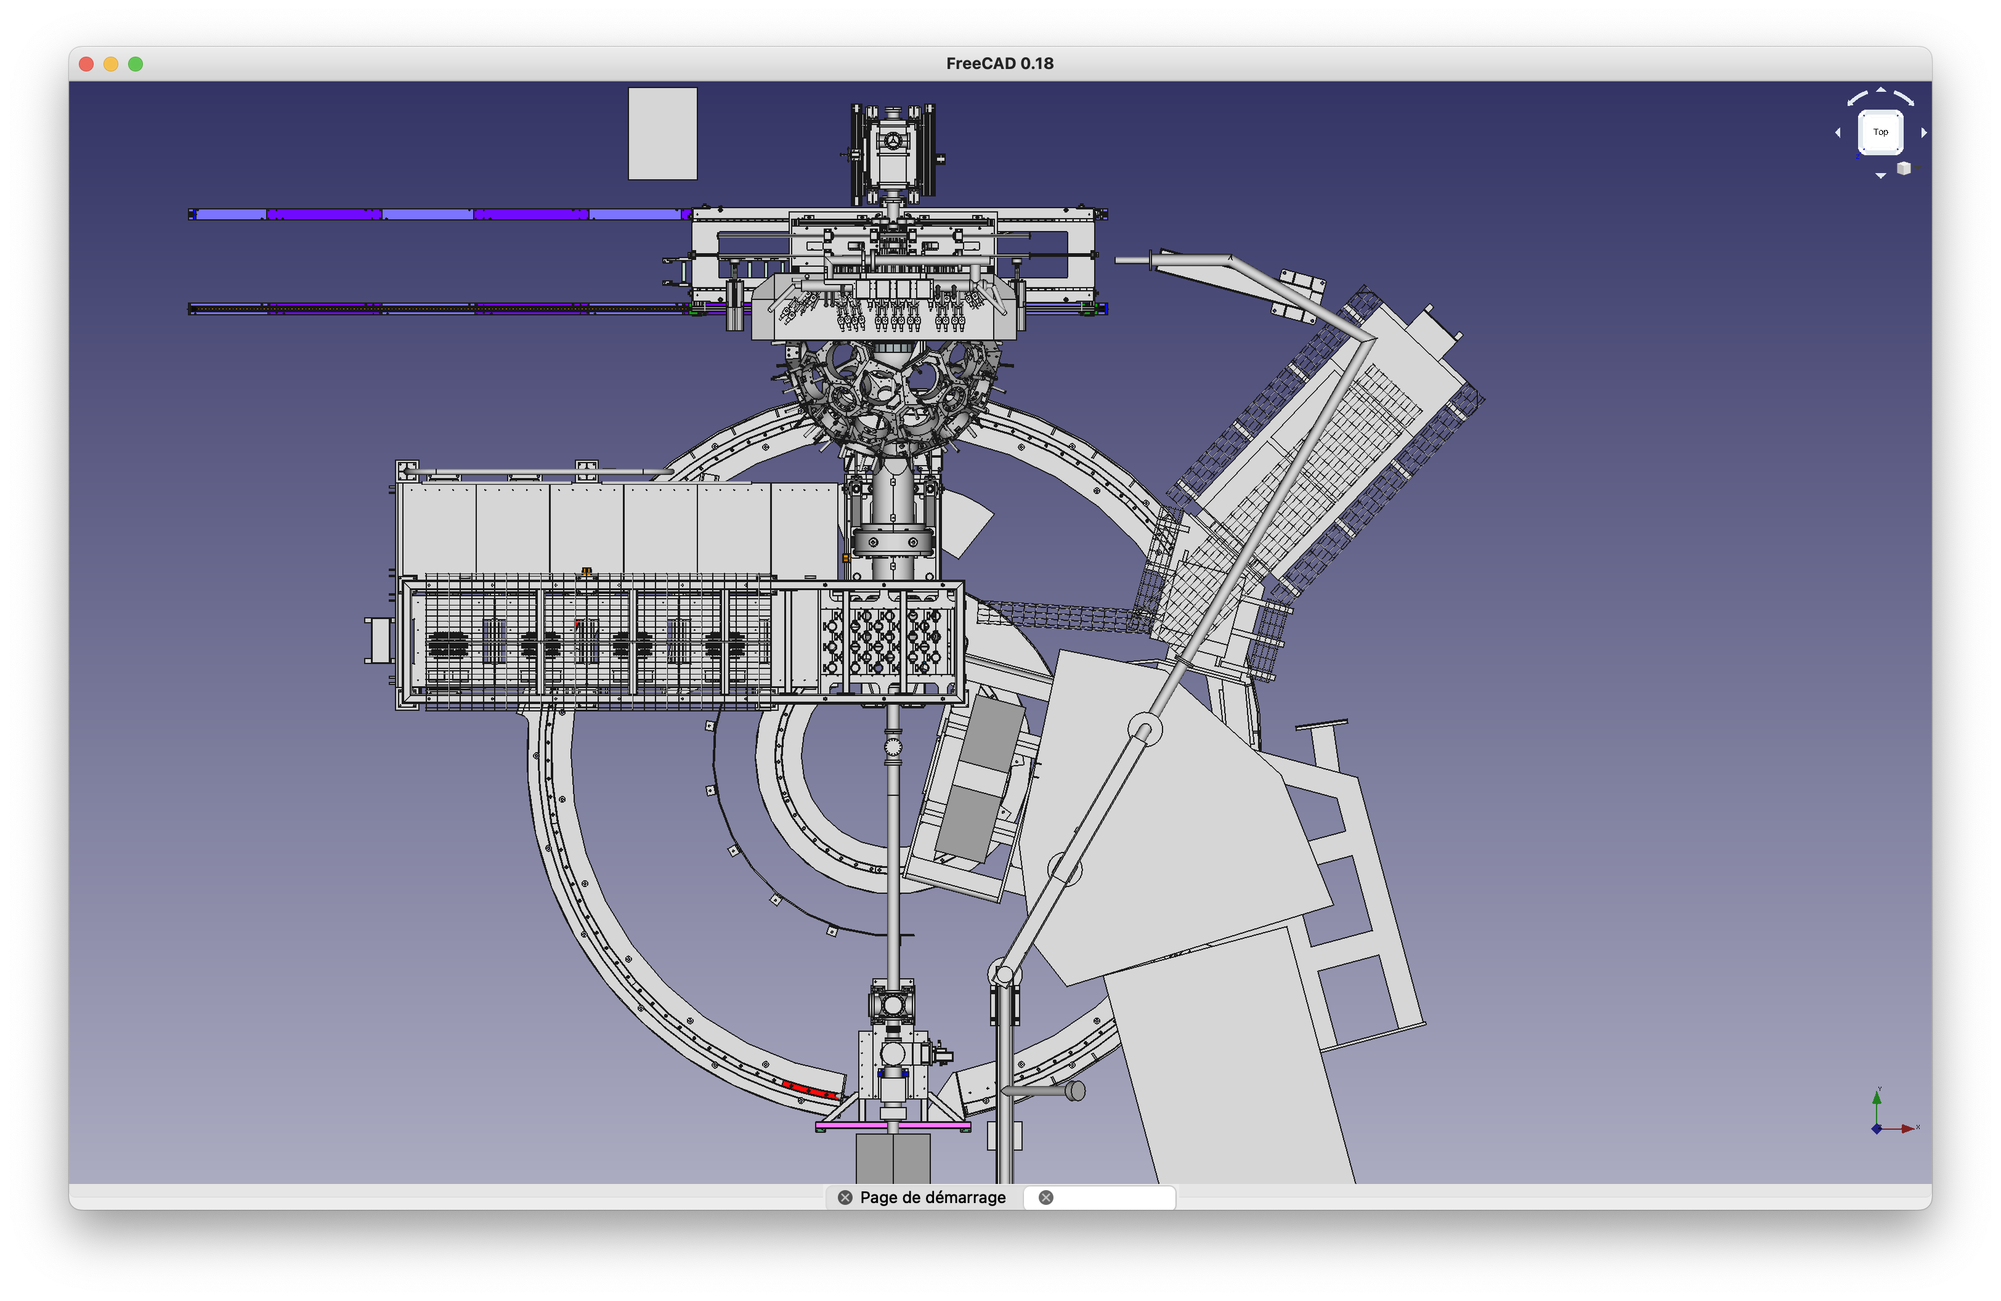
EMC @ Legnaro 0°
3 d step file Agata overview

Slide 19
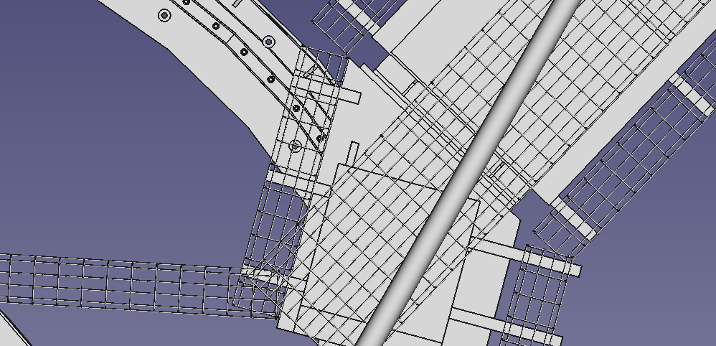
EMC @ Legnaro 0°
Preliminary report from the step file sent in July 2026 (prior to holidays)
Need fully metallic cable tray large enough to house all cables and well screwed with no painting to the mechanics. It is essential that ALL AGATA cabling does not fly in the air it must be stuck to the cable tray and attached to have the lowest electromagnetic field generated by the cable itself and amplifying the electromagnetic noise in the area.

Slide 20
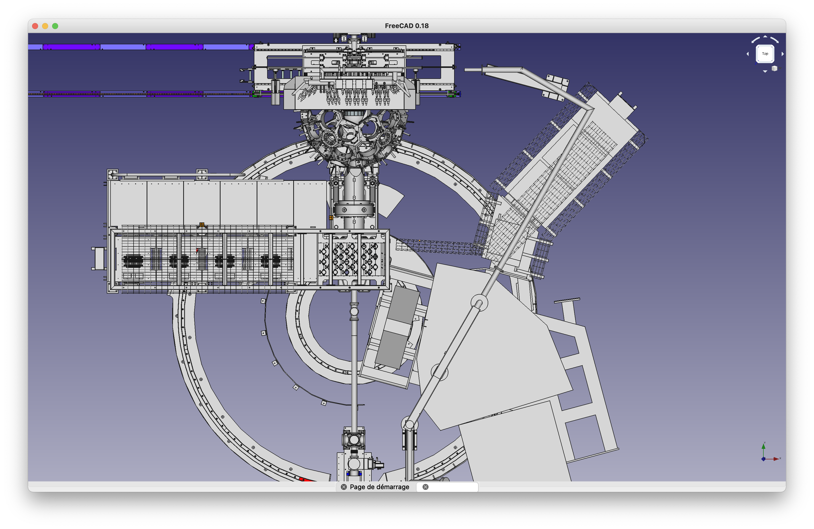
EMC @ Legnaro 0°
Preliminary report from the step file sent in July 2026 (prior to holidays)
Copper plates on the floor between the electronic bays and the honey combe plus the Nutron wall and especially with the HV bays on the right hand side.
The copper plates must be connected to the bays mechanically with no paintings (as in GANIL).

Slide 21
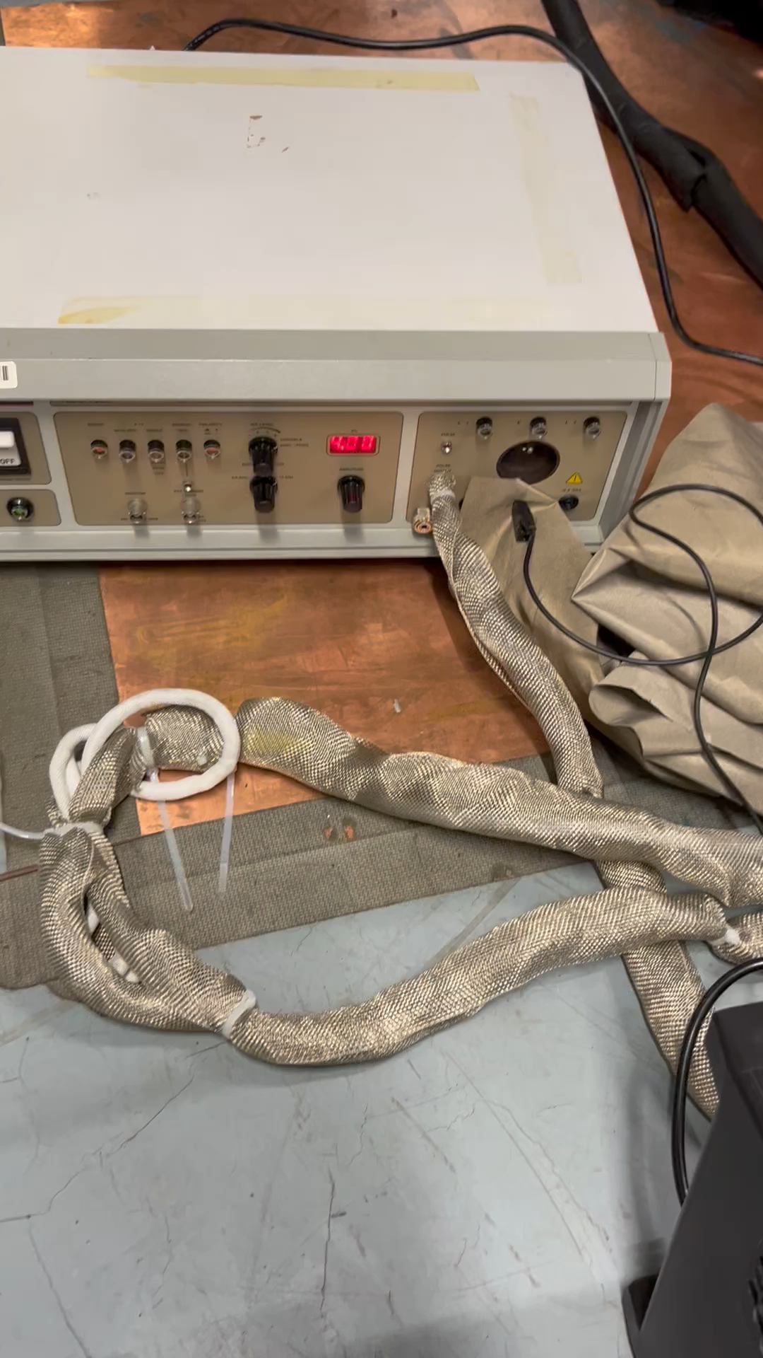
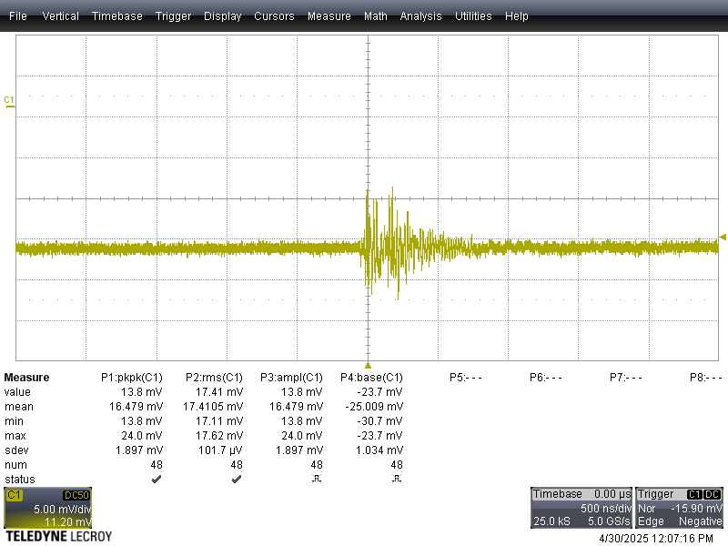
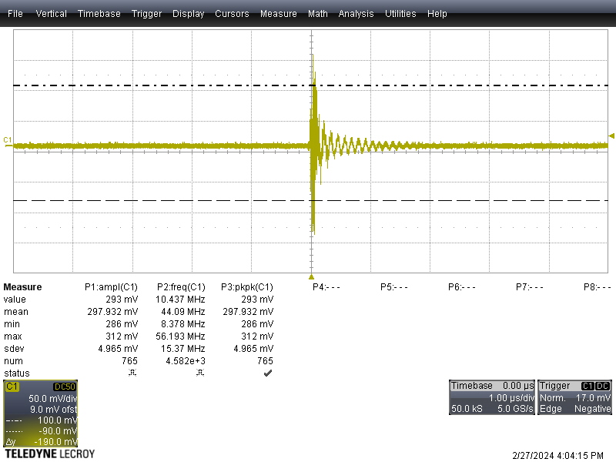
EMC @ Legnaro 0°
Examples for qualified EMC @ SIRIUS GANIL -106 dB
EMC Before copper plate -76 dB
EMC After copper plate -106 dB

Slide 22
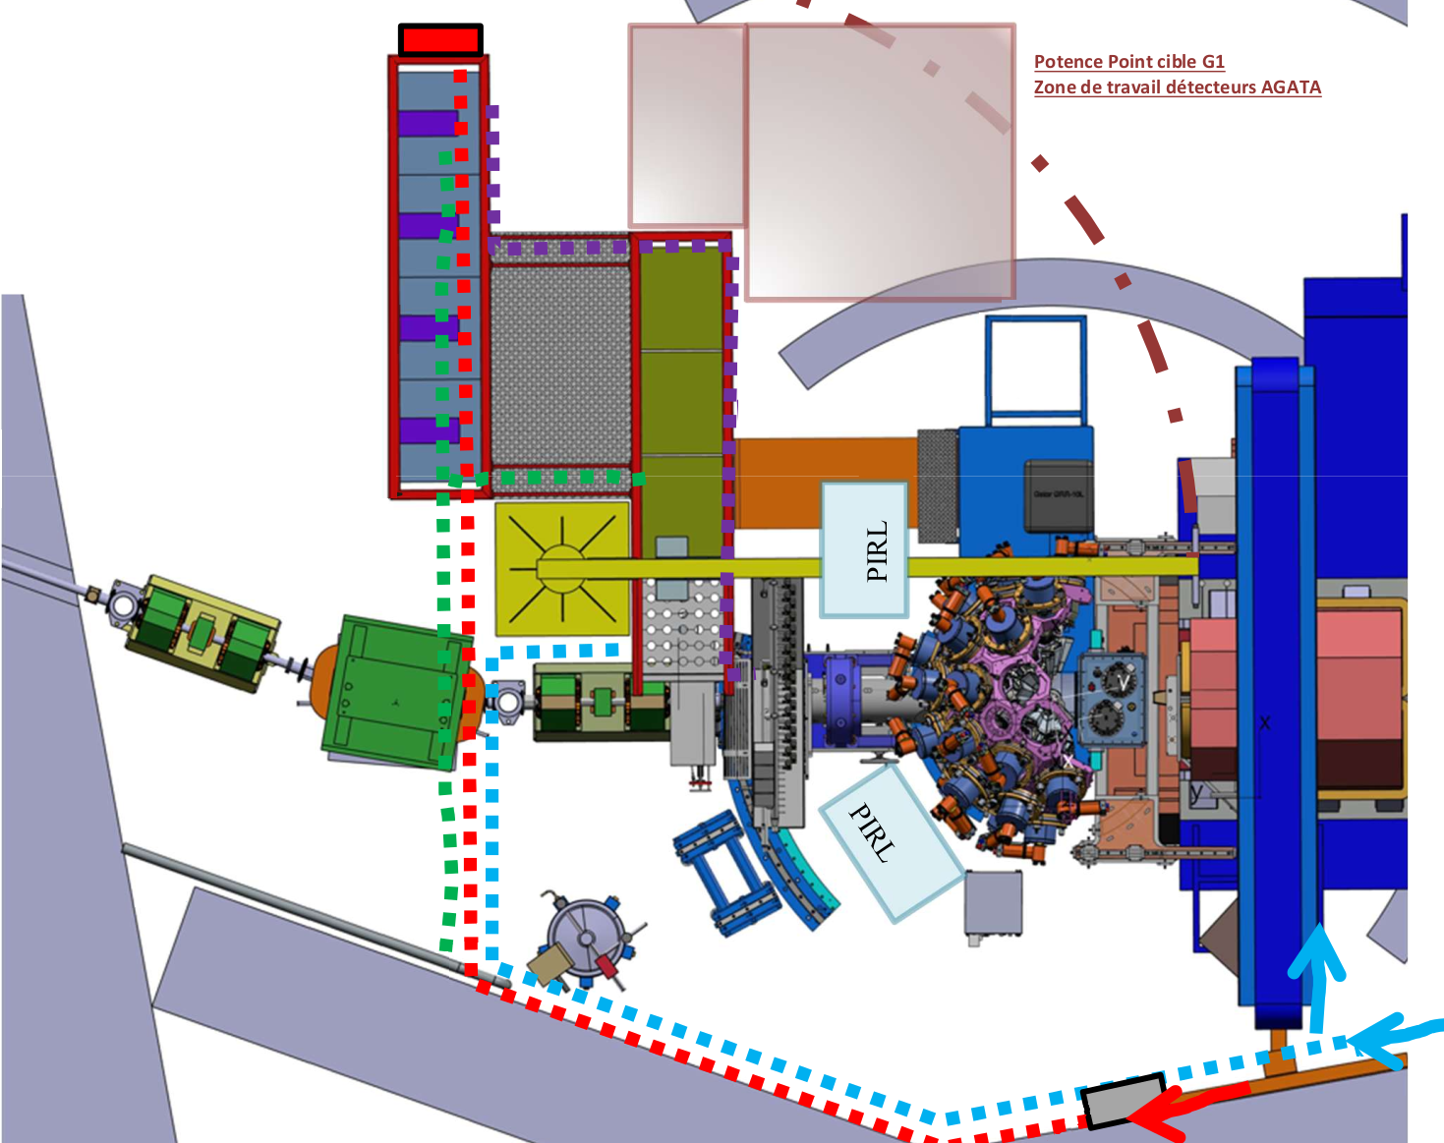
EMC @ GANIL 2028
DSS (LVPS, HVPS, autofill)
Digit + preproc.

Slide 23
EMC @ GANIL 2028
EMC meeting notes 20th of April 2026
Copper plates under all bays surface (LVPS, digitisers, Autofill).
These plates are to be connected to the internal bay mechanical structure without painting. (no painting on the bay when contact to the copper plates).
Copper plate on the ground to connect the bays to the target mechanics and infrastructure plus the cable trays (several screws evry 40 cm), and to all the AGATA honey comb and shaft
Few meetings to discuss with the mechanical engineers and infrastructure group.
More discussion when the Autofill is installed and all the infrastructure is installed.
2 or more EMC campaigns to be realized prior to the AGATA installation.

Slide 24
MERCI

