Slide 1



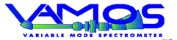

GANIL campaign preparation
Johan GOUPIL
AGATA WEEK
Warsaw (Poland) - 11 September 2026

Slide 2
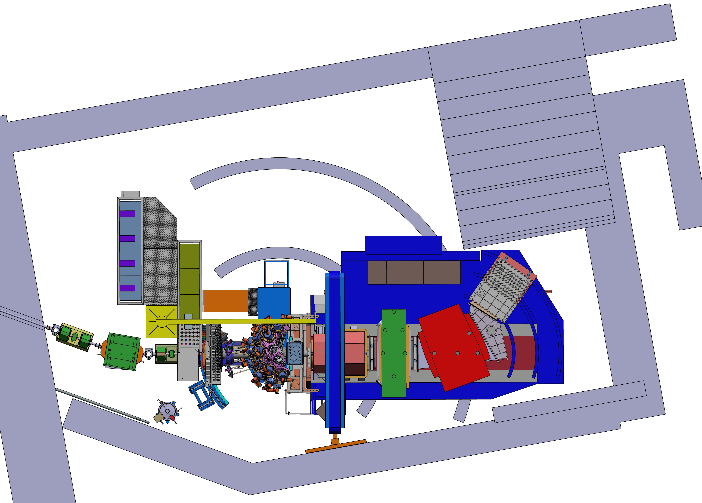
An overview on…
Mechanical integration in the G1 hall:
New « telescope detector »
Reaction chamber & access
Infrastructure:
Electronics platform placement
Cable routing
Water cooling
LN2 Autofill
Preprocessing / DAQ Room
Detector preparation and repository areas
The VAMOS-GRIT-AGATA campaign:
VAMOS improvements
Data management plan
Host agreement
Timeline ?

Slide 3
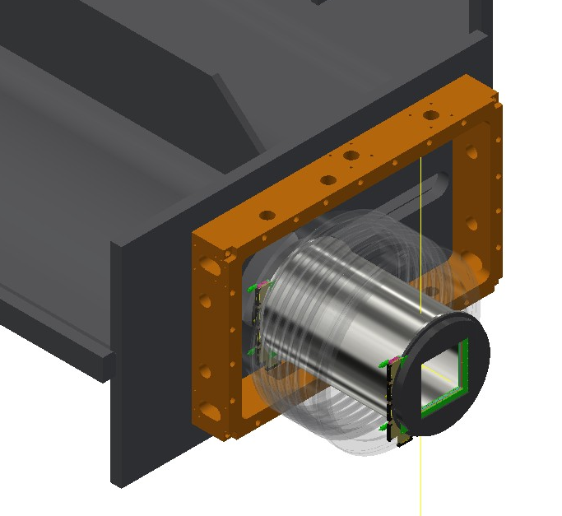

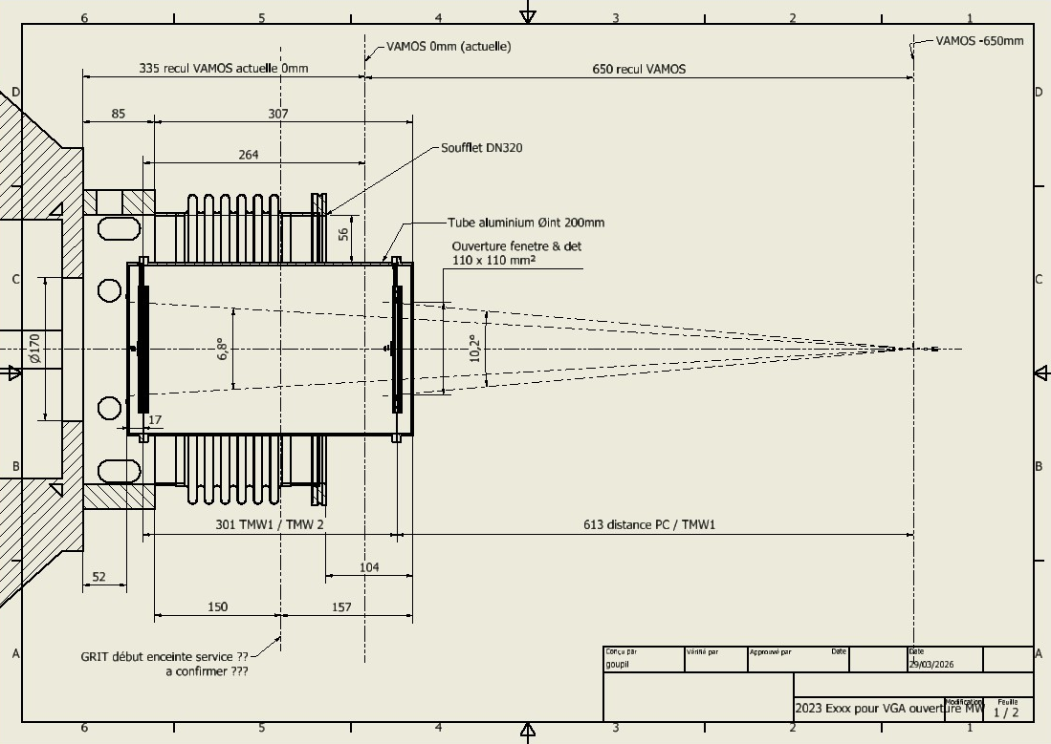
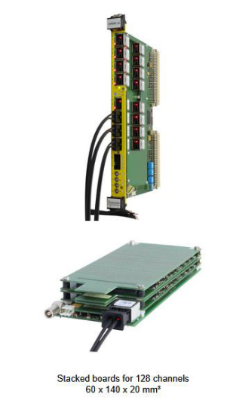
Mechanics : VAMOS : New « telescope » detector
GRIT / VAMOS Interface: bellows DN320
A low-pressure gas detector telescope (Dual Position Sensitive Multi-Wire Proportional Counter) is to be developed for target interaction reconstruction and time-of-flight measurements.
Due to its localization after GRIT (600mm) , a large opening of 110 mm × 110 mm and ~ 300 mm in length is required.
CAD design made by GANIL (VAMOS Teams) => End 2026
Electronics Front End :
MMR Mesytec :
3

Slide 4
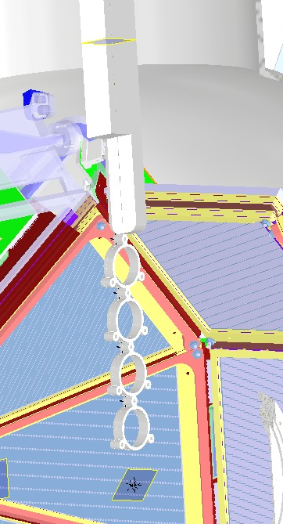
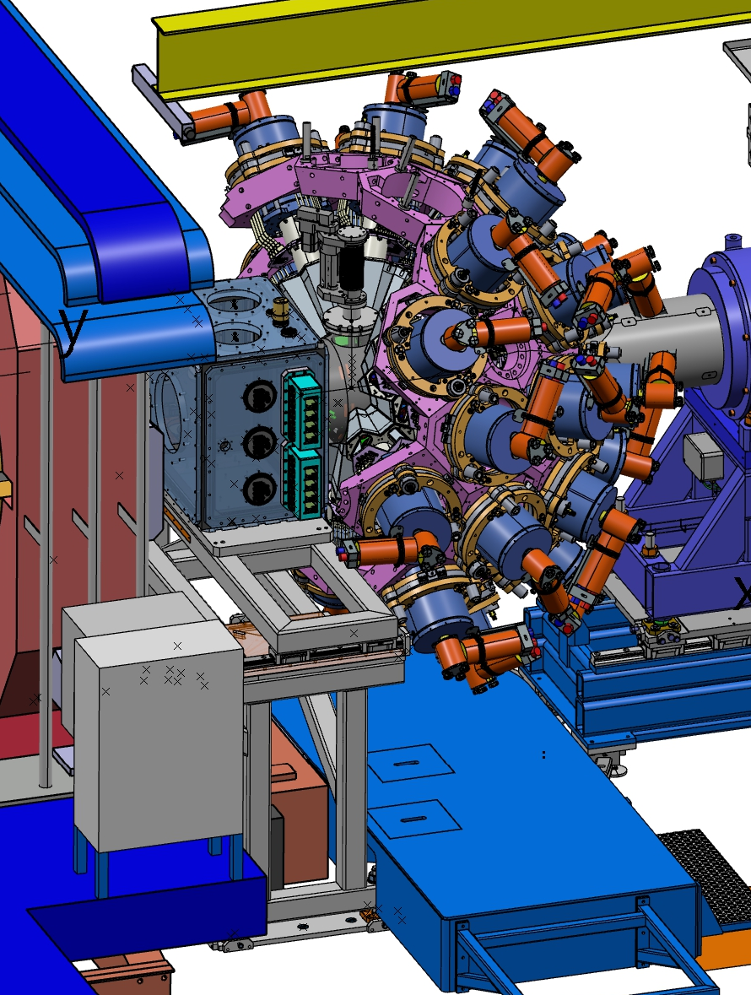
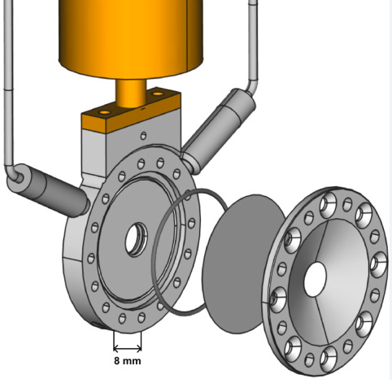

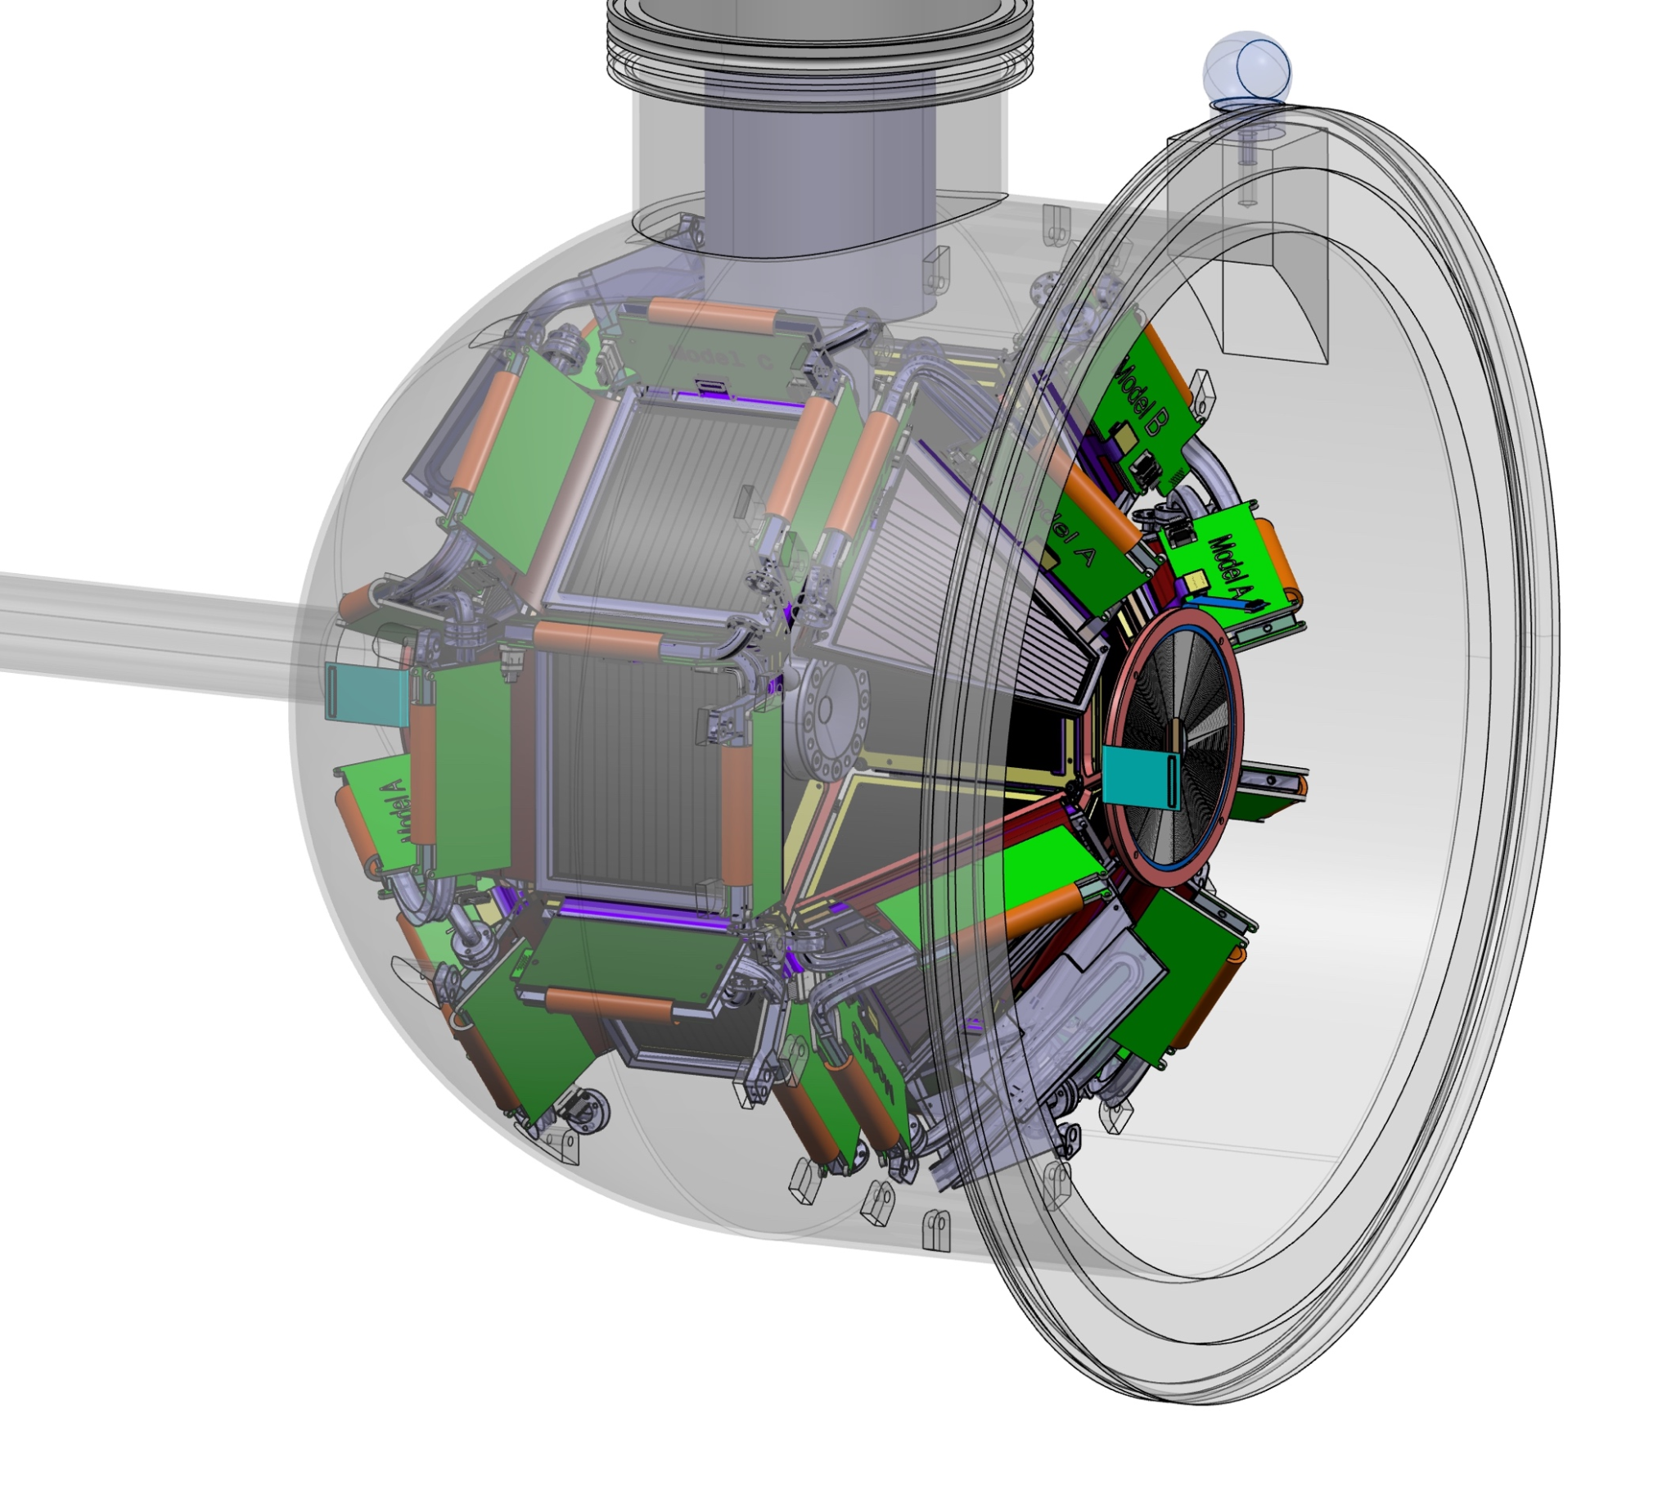
Mechanics: Reaction chamber and targets
Vacuum chamber design by GRIT collaboration:
Main reaction chamber with GRIT
Second chamber with all utilities
Target integration: (inside AGATA honeycomb)
Access from top of main chamber
⇨ 2 ATC moved to the side
Integration of cryogenic ³He target (ATRACT) or solid Target
Target handling:
Exploit G1 crane + step ladder placed on GRIT chamber support structure
Centered via DN160 flange
Angular alignment via ~1mm groove
Motorized vertical alignment
See GRIT or ATRACT presentation
4

Slide 5
Mechanics: Reaction chamber and targets
Under discussion :
Installation, positioning, and survey alignment of the two target loaders (both collaborations with GANIL mechanical group, and surveying teams).
Special case for ATRACT: Target with a small diameter and operates at 4K.
GRIT & ATRACT equipments: PLC racks for both facilities, GRIT chiller, ATRACT cryogenic compressor, vacuum pumps, and GRIT data acquisition system
5

Slide 6
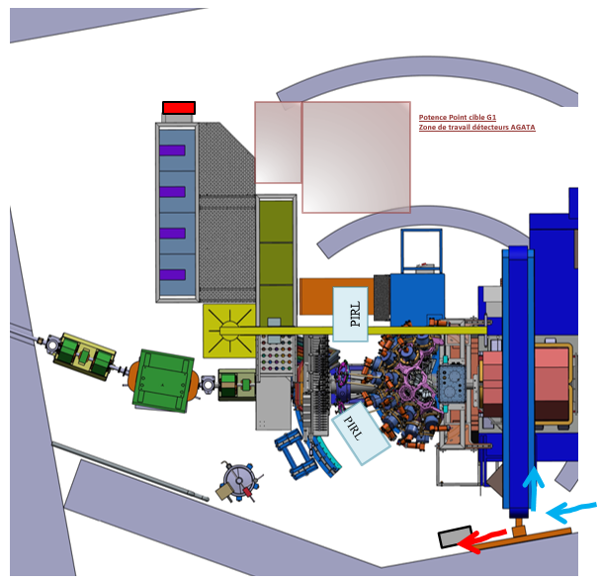

Infrastructure: Electronics platform placement
Front-end electronics:
3 racks for digitizers (from 1st campaign)
✅ position OK for 10m-long MDR cables, with optimized ATC - digitizer mapping.
Detector Support System:
2 racks for LVPS modules
1 rack for LN2 Autofill system
1 rack for (new) HVPS modules or others system (provided by GANIL)
Cable length should be ok ?
Under discussion : reuse existing LEGNARO C&C cables C&C or deploy news ones.
DSS (LVPS, HVPS, autofill)
Digit + preproc.
EMC:
  ⇨ Racks on a fixed stainless steel platform (unpainted), allowing cable routing underneath (~30 cm above ground)
  Copper links between the electronics platform and VAMOS, GRIT.
  Copper surface under AGATA rails and the electronics platform.
  EMC : conductive shielding gaskets already planned
  Awaiting a full system analysis by Nabil KARKOUR.
6

Slide 7
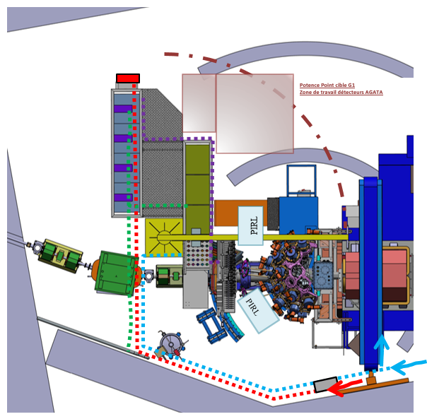
Infrastructure: Cable routing
Water cooling for digitizers:
2×3 branch lines (in/out), 3 flow valves for the 3 racks. To be mounted on the floor. Reusing water distribution (manifold) mounted directly on the racks
Network cables: to be implemented overhead (~2.3 m above racks).
Power cables: overhead cable routing.
Electrical protection & distribution cabinet:
Includes UPS backup for Autofill system.
LVPS cables: routed under racks
Large working area for manipulation, alignment, and preparation before handling
Power cables
Network cables
Water cooling
7

Slide 8
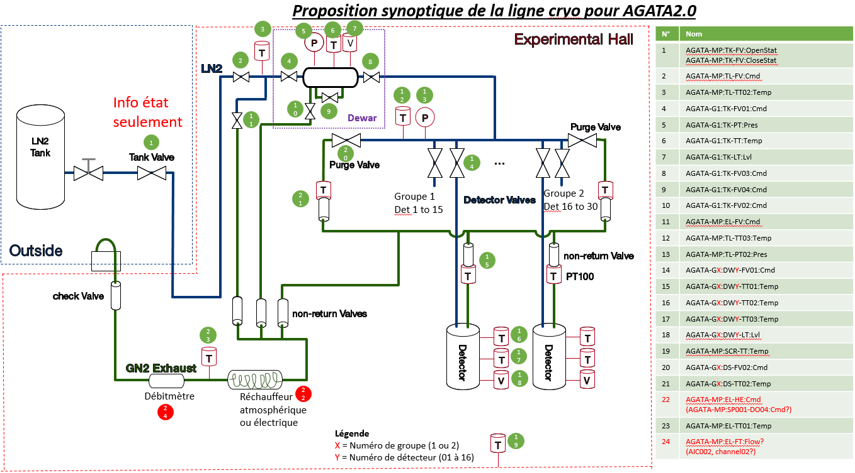
Infrastructure: LN₂ autofill
Proposed cryogenic configuration:
Single 200l Dewar retained as phase separator, pressure control, ….
Dewar control to be implemented in the PLC
Under discussion: New system for gas evacuation, designed and provided by GANIL (including gas heating and exhaust line) + flowmeter
Courtesy of Tom JOANNEM
8

Slide 9
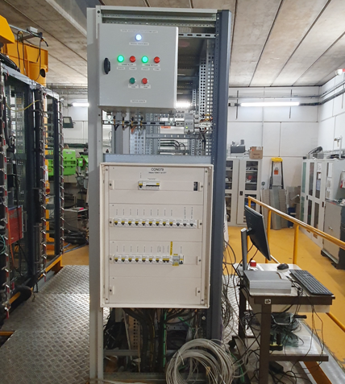
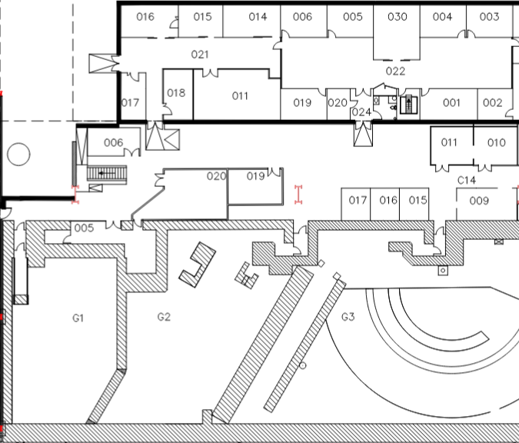
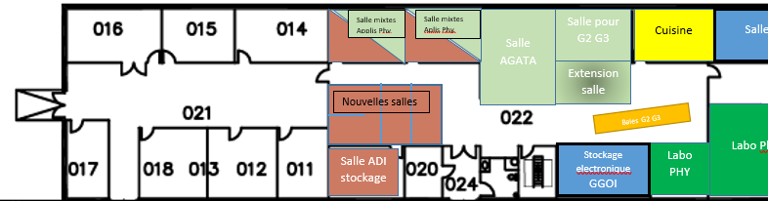
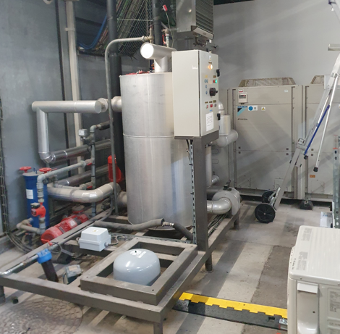
Infrastructure: Water cooling (digitizers)
For the digitizers, the water cooling system from the first campaign will be reused. (BAE nord, C14 aisle)
(operating conditions: ~15–20°C, ~4.5 bar)
Chiller currently used by VAMOS rack acquisition.
System update and validation required for the new campaign (especially if we use it for the data center—see the slide regarding the data center)
TraceTek water leak monitoring system:
automatic valve shut-off + manual reset
ACQ
VAMOS
9

Slide 10
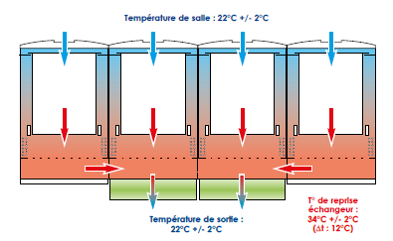
Infrastructure: DAQ room
POWER : HTC farm (15kW) + storage (~5kW)
⇨ room 019 ?? (to be confirm)
Cold aisle layout between two rack rows for server handling
1 or 2 Water cooling doors for each racks (on the back side)
Under discussion : localization, integration room 19?
GANIL IT & cooling group are involed with supplier !!!
ACQ
VAMOS
10

Slide 11
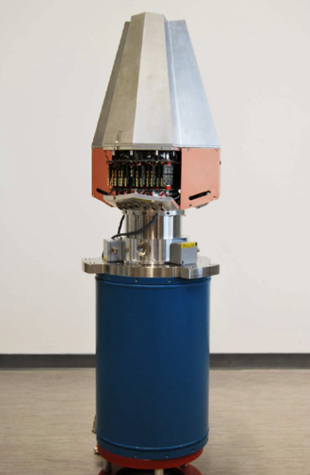
Infrastructure: ATC preparation/repository area
Detector preparation room: Still handled by Laurent Menager
Rooms 015-016:
LN₂ infrastructure already available.
(Update of the utilities to be done).
Room 006 & 005 + external area.
(meeting rooms, working offices)
ACQ
AGATA
GRIT
ACQ
VAMOS
Acquisition rooms:
Room 020 for VAMOS (room refurbishment done in 2025)
Room 030 for AGATA/GRIT(room refurbishment in 2027/2028)
11

Slide 12
Infrastructure: VAMOS improvements
a lot of actions in VAMOS & G1 to improve usability and make it reliable for the new AGATA campaign
Surveyor : adding geodesic points and updating the 3D link
Refurbishment: Electronics Front-End for Drift Chamber (Mesytec MMR)
Rearrangement of the room
(desk, extractor hood, tools)
Refurbishment: Motor and mechanics of the plastic finger (to stop the primary beam)
Refurbishment: General Low Voltage Panel (schematics, circuit breakers to accommodate power for the VGA projet)
Refurbishment: VAMOS Gas Regulation (Vacuum Connection & PLC) – Upgrading from old Schneider to SIEMENS
New Dual Position Sensitive Multi-Wire Proportional Counter (tracking, ToF )
Refurbishment of all C&C VAMOS/G1 PLCs: Replacing old Schneider systems with SIEMENS
New evacuation
system for LN2 gas exhaust
Residual Gas Analyzer (RGA)
12

Slide 13
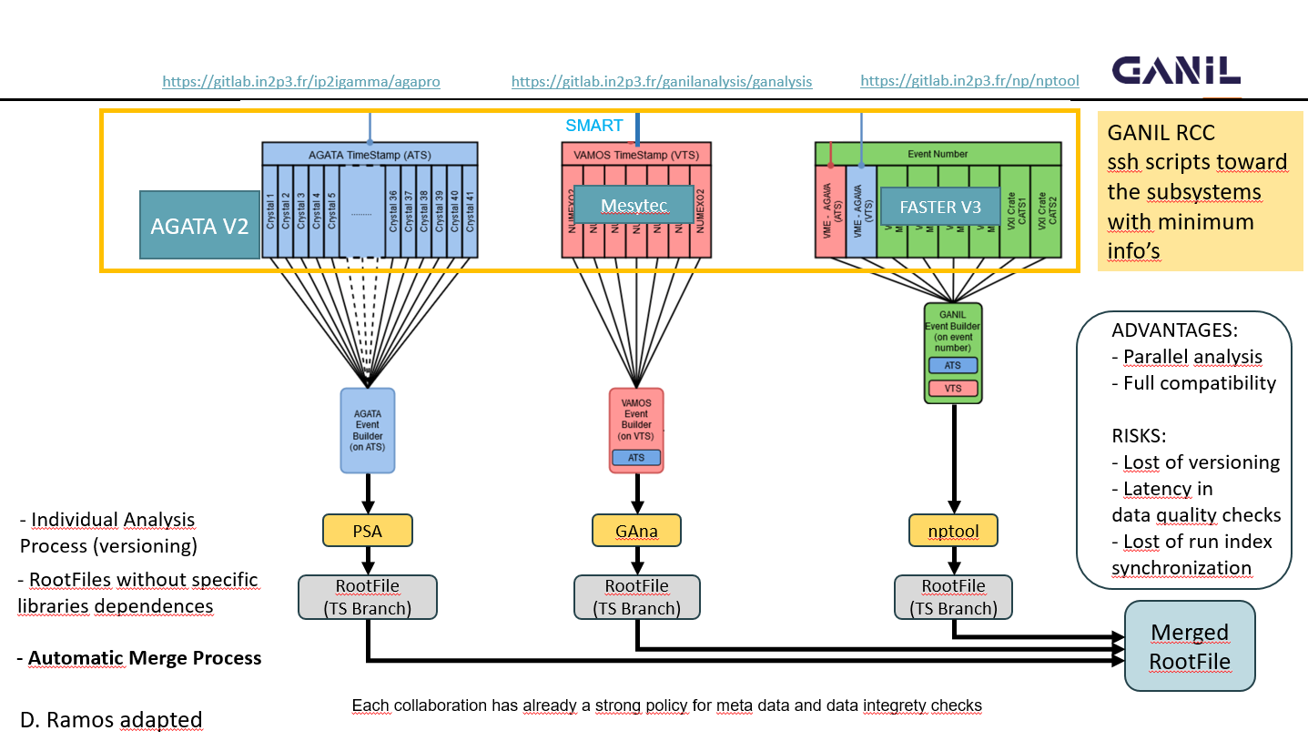
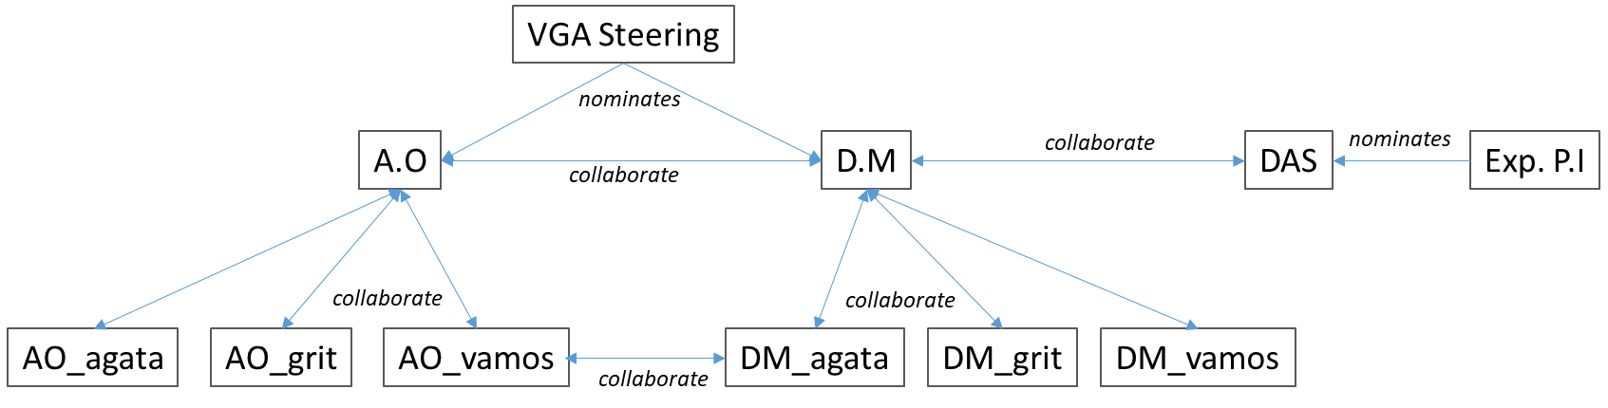
The campaign: Data Management Plan
Common Data Management Plan defined by the DM responsibles of the three collaborations
(A. Lemasson, A. Matta, J. Dudouet):
Data flow: each sub-system uses its dedicated software suites for detector control, calibration, simulation, and physics analysis. Global event merge done at the reconstructed data level.
Focus on the reproducibility of the analysis and the simulation activity
⇨open source software, well documented, clear workflow provided
Definition of the figures of:
- Data Manager
- Analysis Officer
- Dataset Analysis Spokesperson
The data flow organigram is defined as :
13
Courstesy E. Clement

Slide 14

The campaign: Host Laboratory Agreement
Draft of the Host Laboratory Agreement for the VAMOS-GRIT-AGATA campaign at GANIL.
Definition of the allocation of the GANIL Hosting Lab installation funds for both AGATA and GRIT, as well as of the operational costs pertinent to AGATA and GRIT collaborations
Beam time: - 2 weeks for in-beam commissioning
- 50% CYCLO beam time (~ 100 UT/y), subject to PAC approval and non-commercial users rules
Common VAMOS-GRIT-AGATA Data Management Plan drafted
The overall GANIL budget is estimated between 2026 and 2031 to 730k€ (~10% contingencies).
The breakdown structure is the following:
    462 k€ for AGATA items
    124 k€ for GRIT items
    112 k€ for VAMOS items
    29 k€ for ATRACT items
14

Slide 15
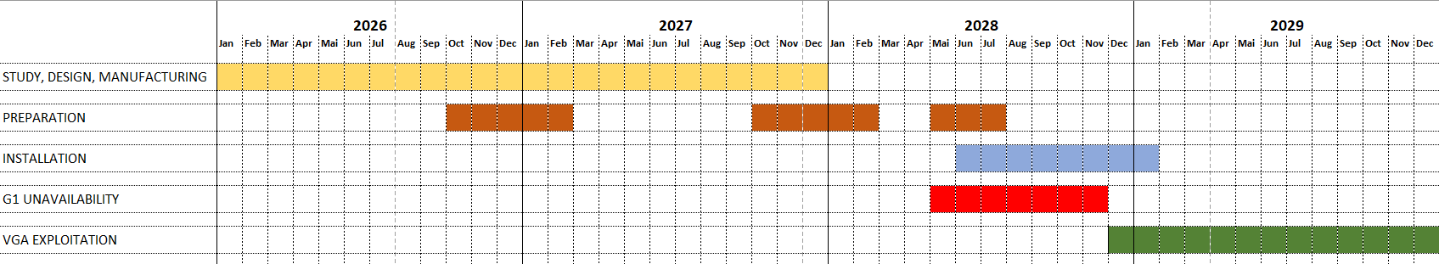
A timeline ?
Validation of mechanical designs by the end of the 1st semester of 2026
Manufacturing of all mechanical components by the end of 2027 (Storage at GANIL until spring 2028)
Data center validation (location, racks, cooling systems, electrical connections) => Ongoing
Commissioning data center scheduled for late 2027 or the end of 1st semester 2028 (under discussion with the GANIL IT group)
Last G1 experiments in spring 2028 (February to April)
1 Autofill + 2 LVPS racks (Saclay) delivered in May 2028, installed by June/July 2028
AGATA mechanical structure and detectors, Delivery start from June 2028
AGATA Commissioning setup by end 2028 - beginning 2029
Commissioning cryogenic target in 2028 (to be discussed)
15

Slide 16
Merci pour votre attention

Slide 17
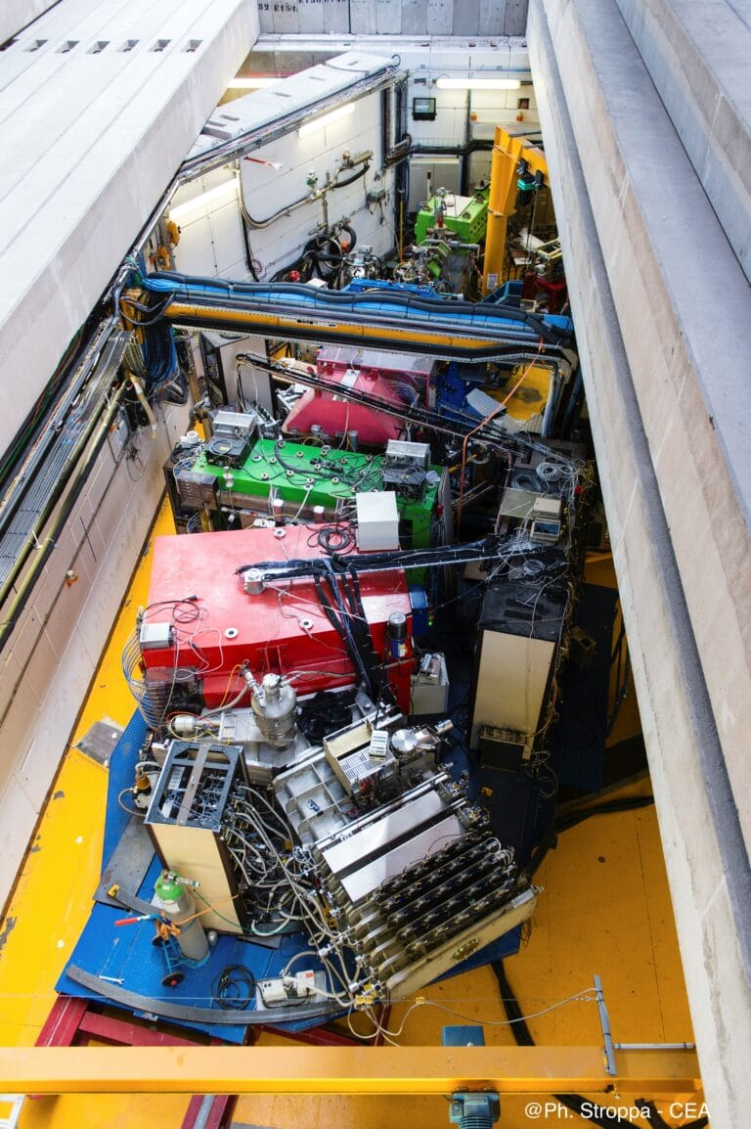
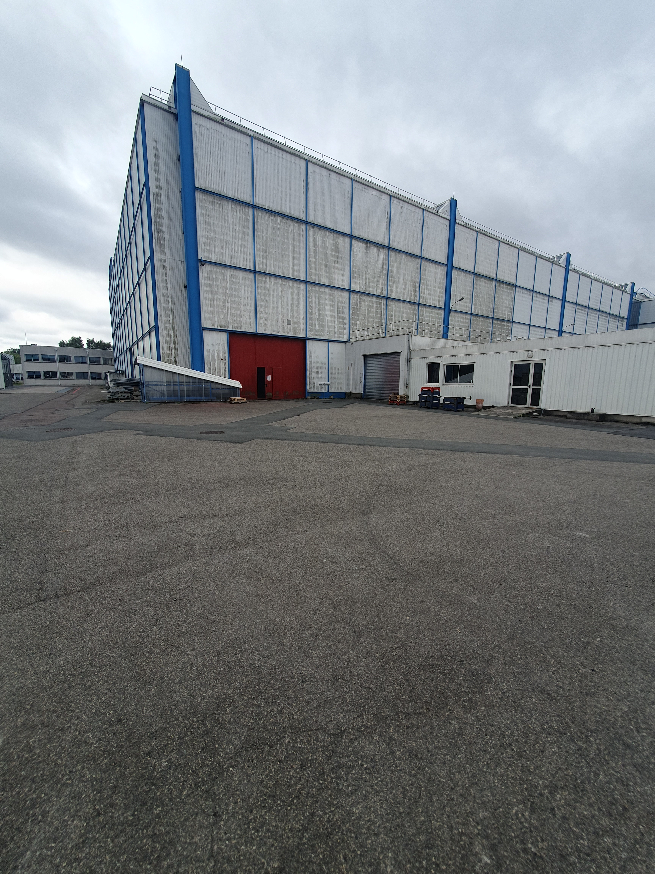
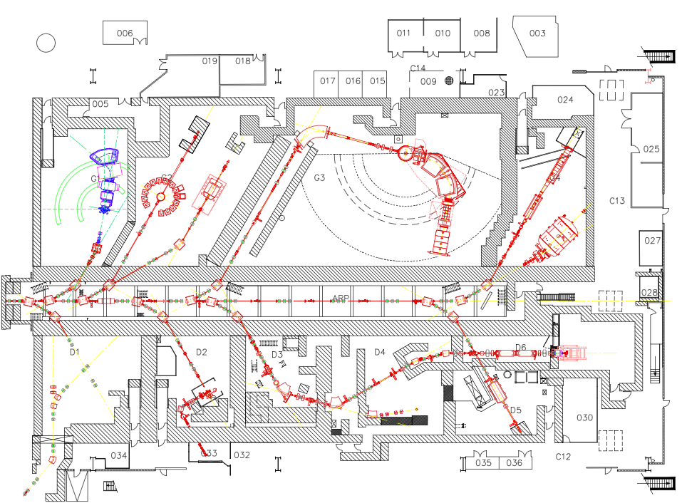
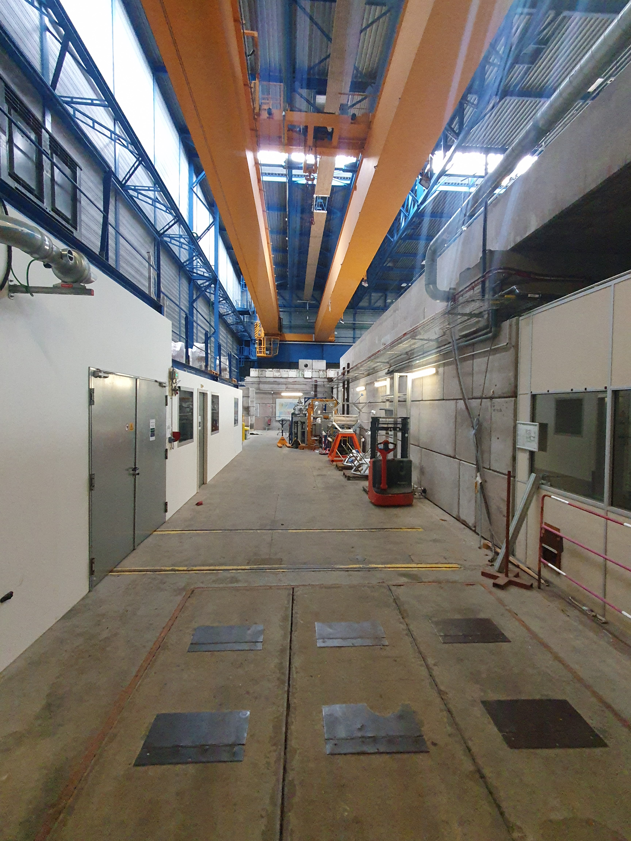
Infrastructure: GANIL LIFTING FACILITIES
Pillar jib carne (500 kg) around target
Huge area for the truck, with experimental access via the red door.
After removing the roof concrete beam,
full access to G1/VAMOS.
Area for moving the truck back and lifting the heavy part with an overhead crane (30t with 2 trolleys).
17

Slide 18
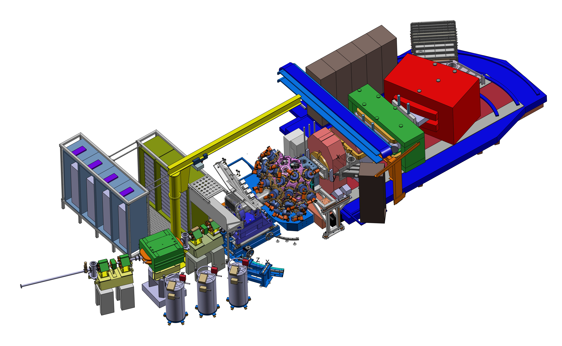
Mechanical integration of AGATA@GANIL
Preparation of the VAMOS-GRIT-AGATA campaign
Objective: mounting AGATA 2π (i.e., 30 ATC) for a 0° campaign (in priority) with GRIT and VAMOS.
Challenge: Very limited available space in G1 hall.
Installation of two rails for AGATA shaft rotation from 0° to 28°
At 28°, AGATA can be retracted, providing an access
to mount the target chamber (~550mm clearance)
Manual translation and rotation of the AGATA structure
Motorized rotation AGATA Detectors around beam axis
limited headroom in G1 and also under the pillar jib crane
18
Now, moving along the beam line…

Slide 19
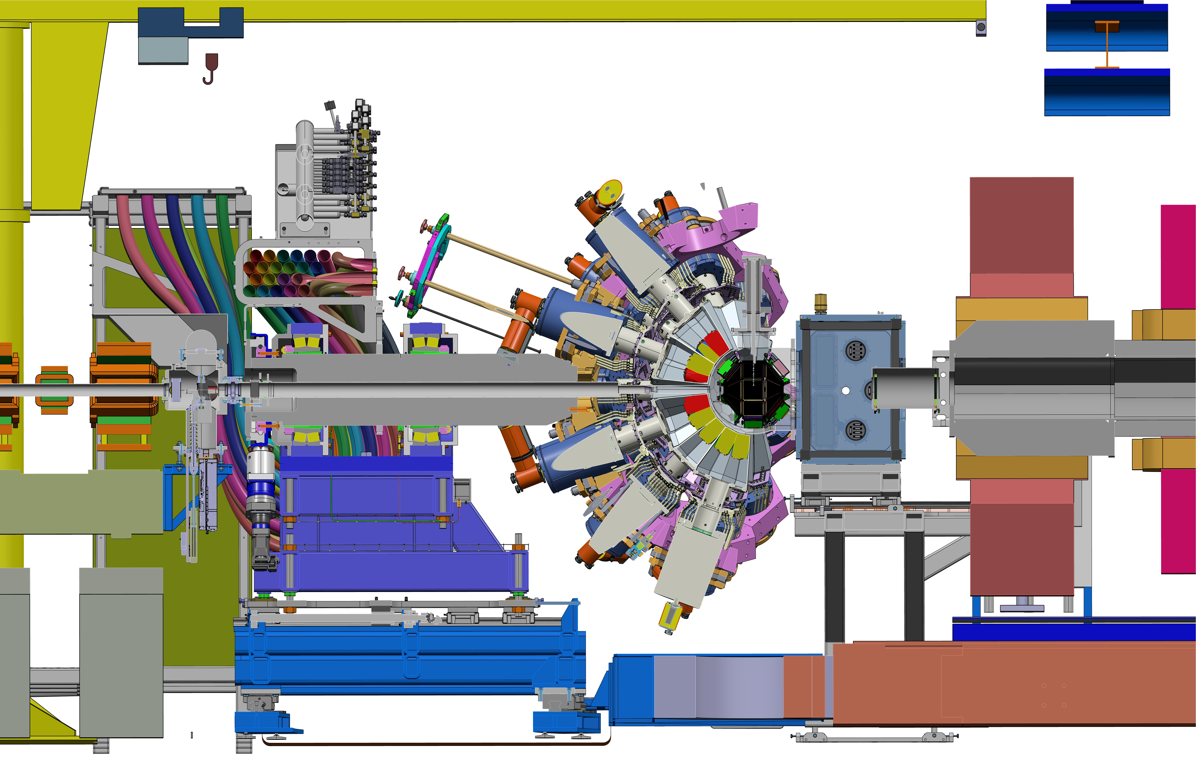
Mechanics: Diagnostic box
Newly designed diagnostic box, fitting within the tight geometric constraint (~375 mm):
Includes profilers, FC, turbo pump + additional flange for tracking detector;
Closed by isolating valve, connected with a bellow on the AGATA side.
The design is complete, to be validated with the survey and alignment engineers.
19

Slide 20
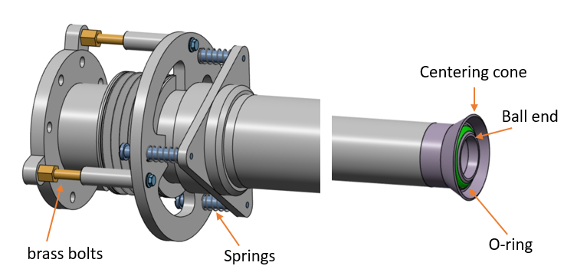
Mechanics: Beam pipe
For the 0° configuration, a 2.58m beam pipe passes through the AGATA support.
⇨ Manual access only from the diagnostic box side for vacuum sealing.
New clamp mechanism (designed by P. Gangnant, to be manufactured by the end of the 1st semester 2026):
Diagnostic box side: three brass lead screws push the pipe towards the scattering chamber
Scattering chamber side: the O-ring is compressed ensuring vacuum sealing, guided
by the ~2mm clearance along the AGATA axis
20

Slide 21
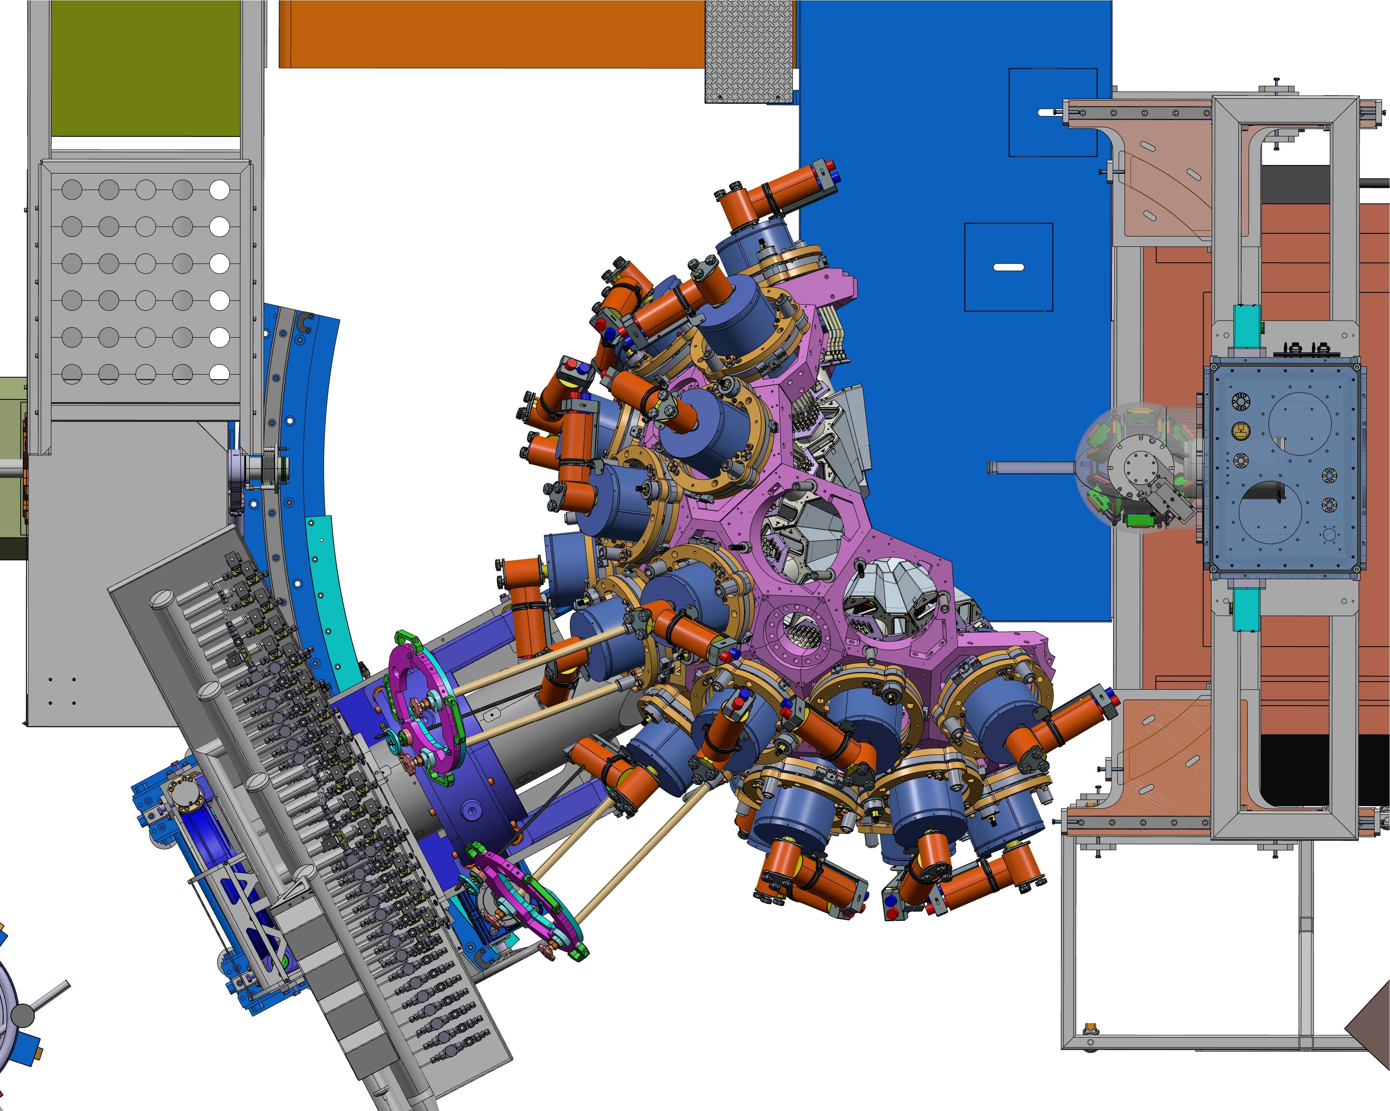
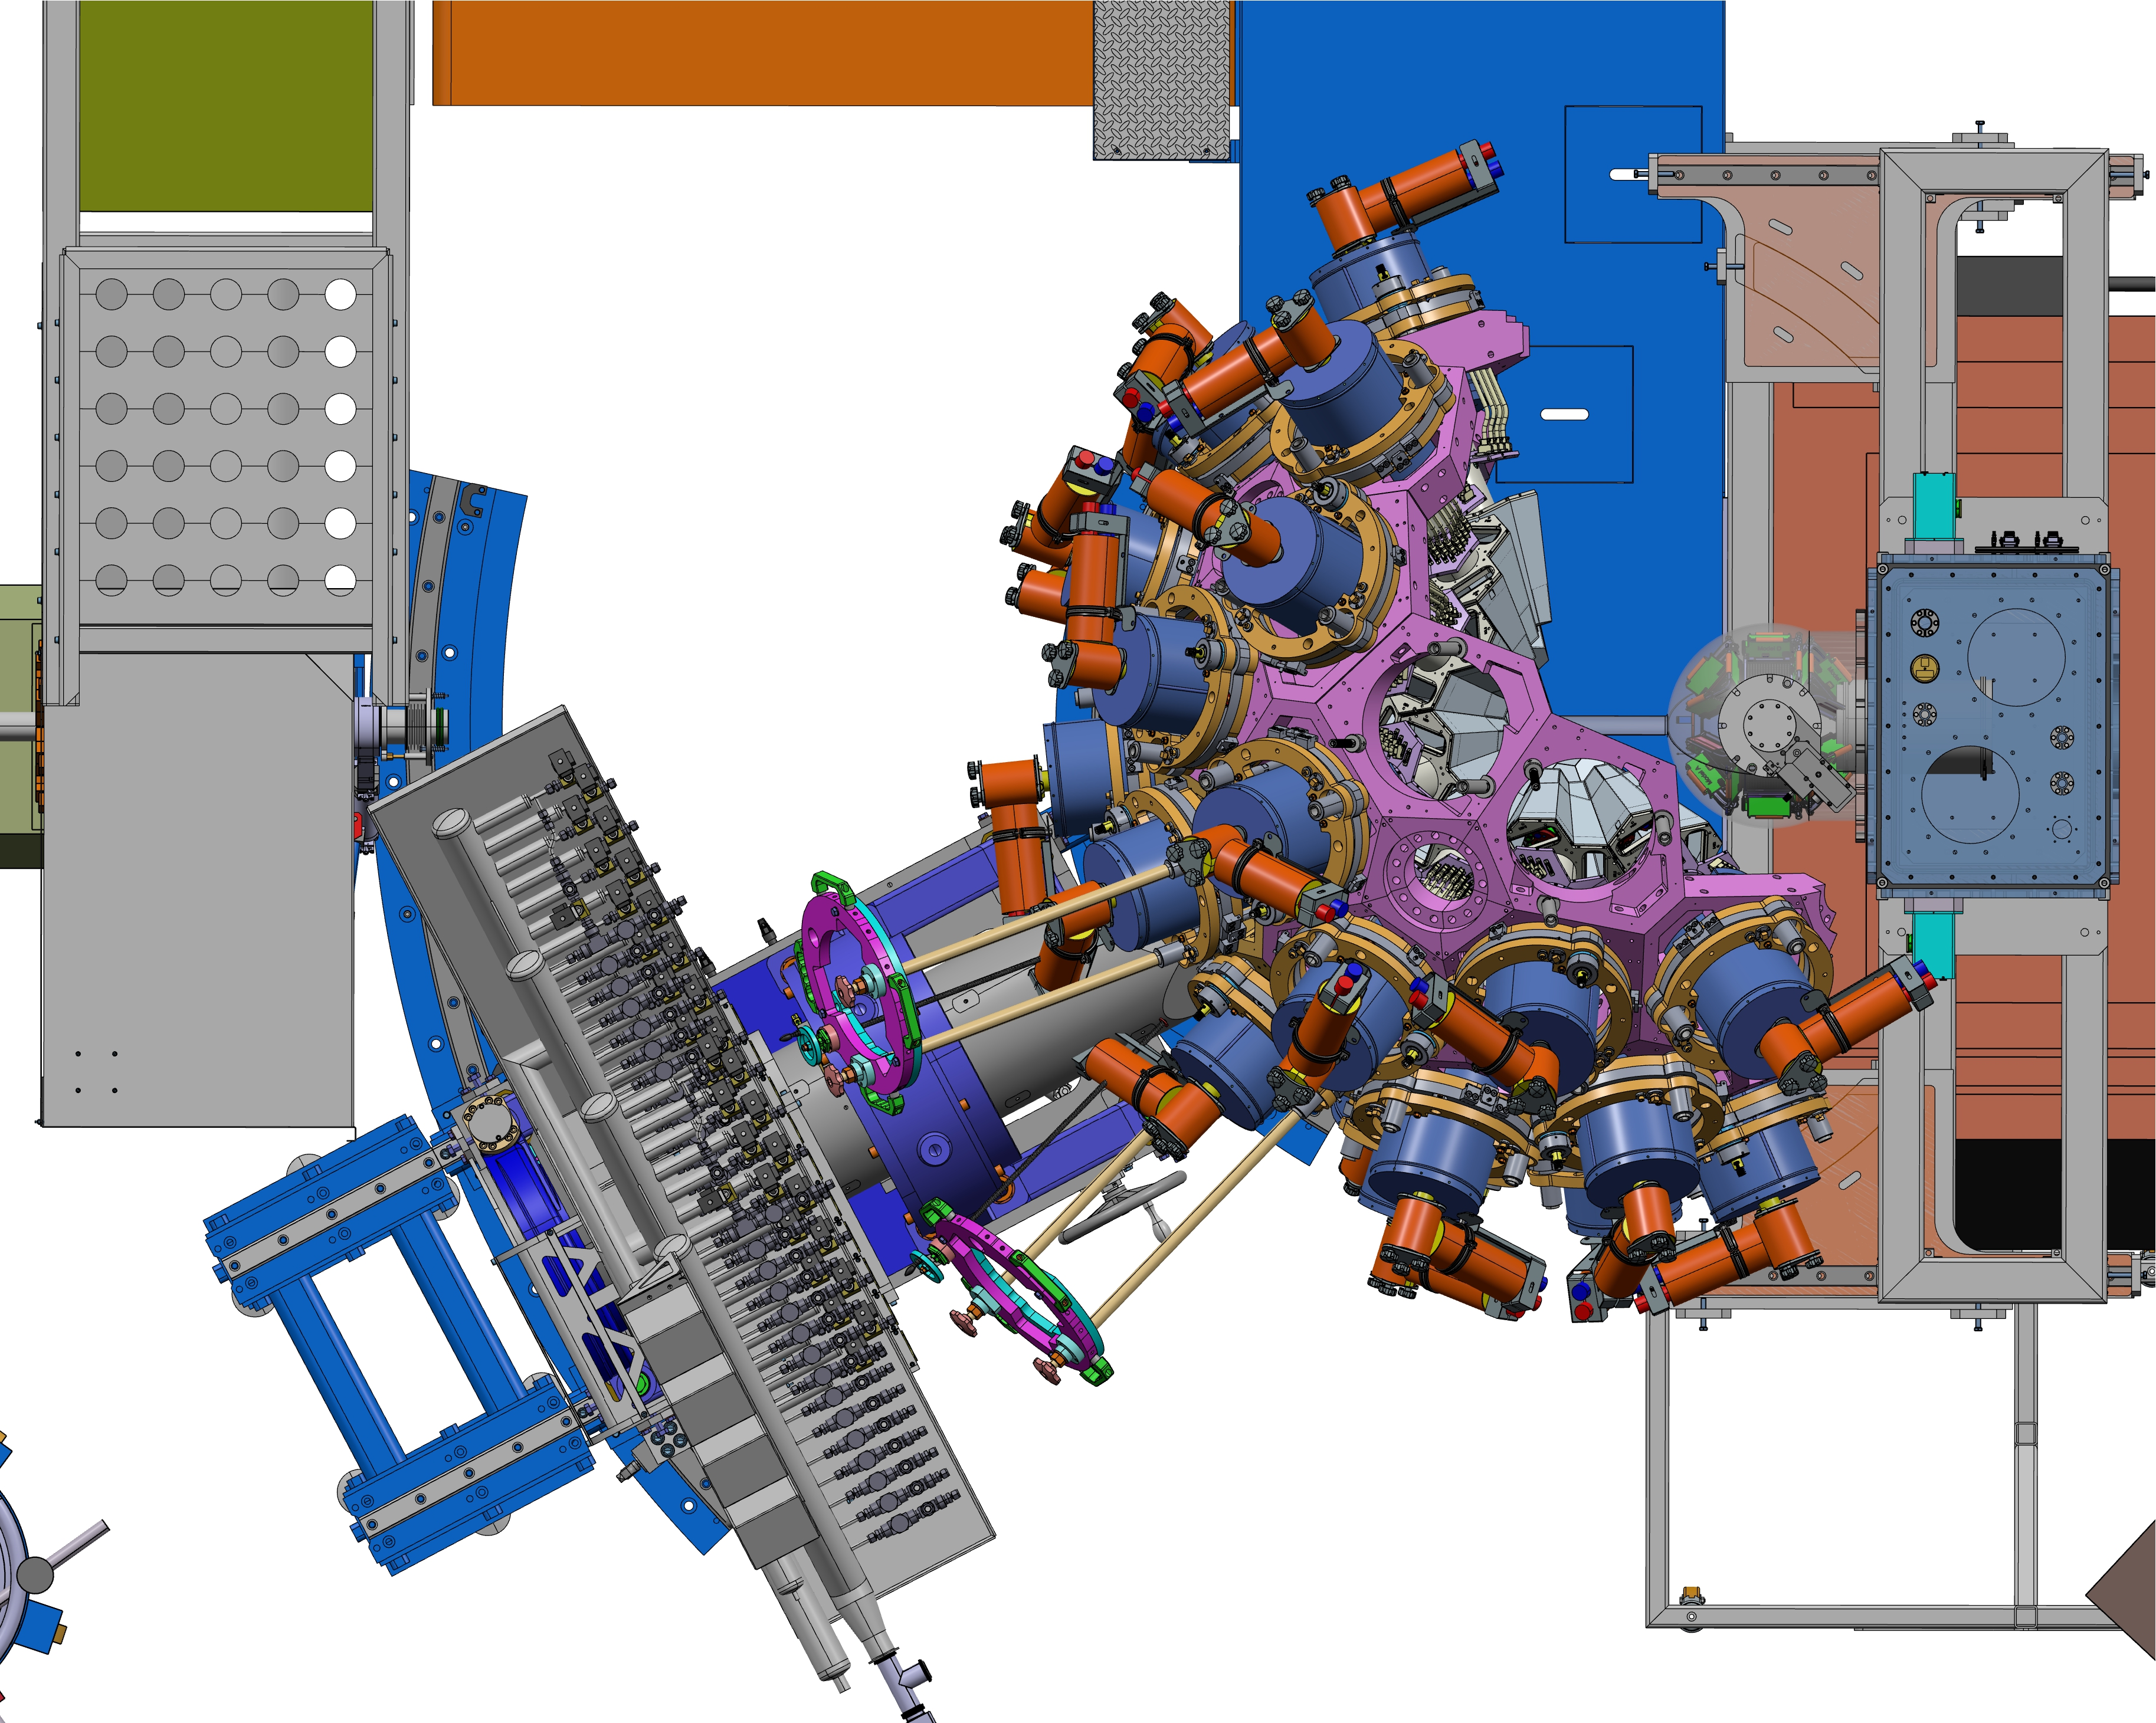
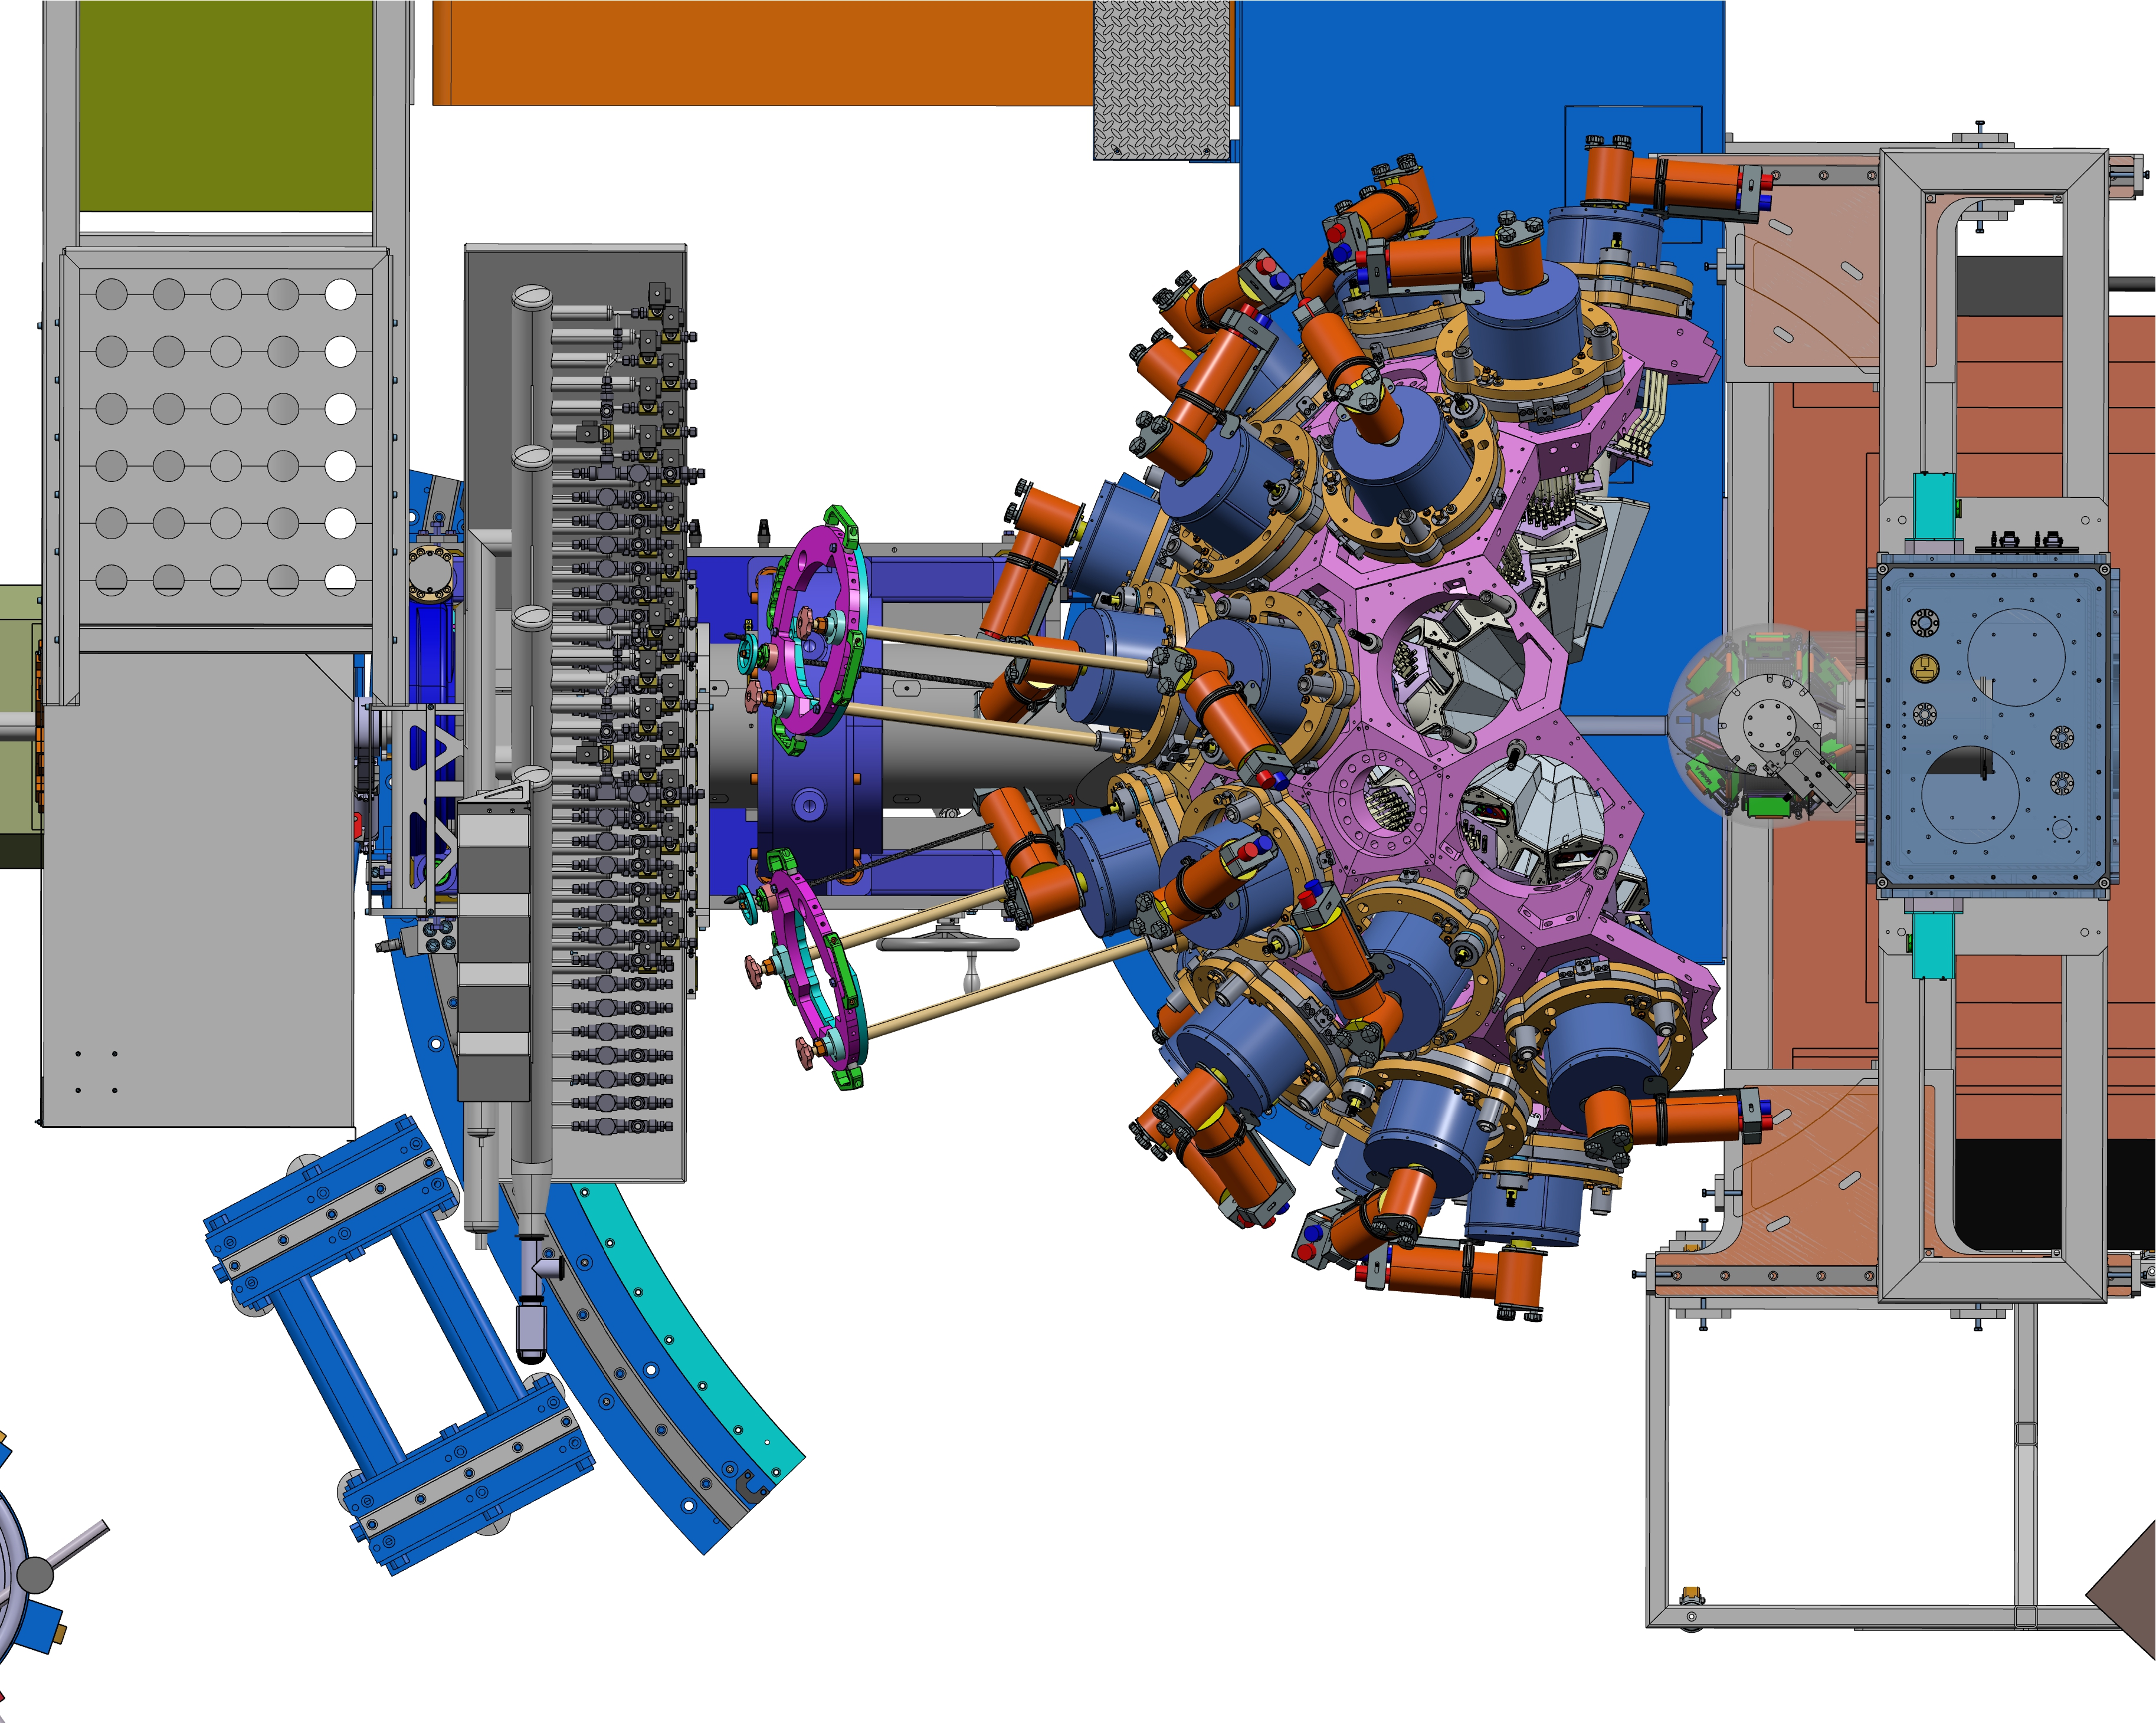
Mechanics: accessing the target area
AGATA :
28° (honeycomb rotation OK)
-500mm
Vacuum pipe installation possible
GRIT :
=> Full access
AGATA :
28° (honeycomb rotation NOK)
0mm
Vacuum pipe installation possible
GRIT :
max rear position, Target access
AGATA :
0° (honeycomb rotation OK)
0mm
GRIT :
max rear position, target access limited
21

Slide 22
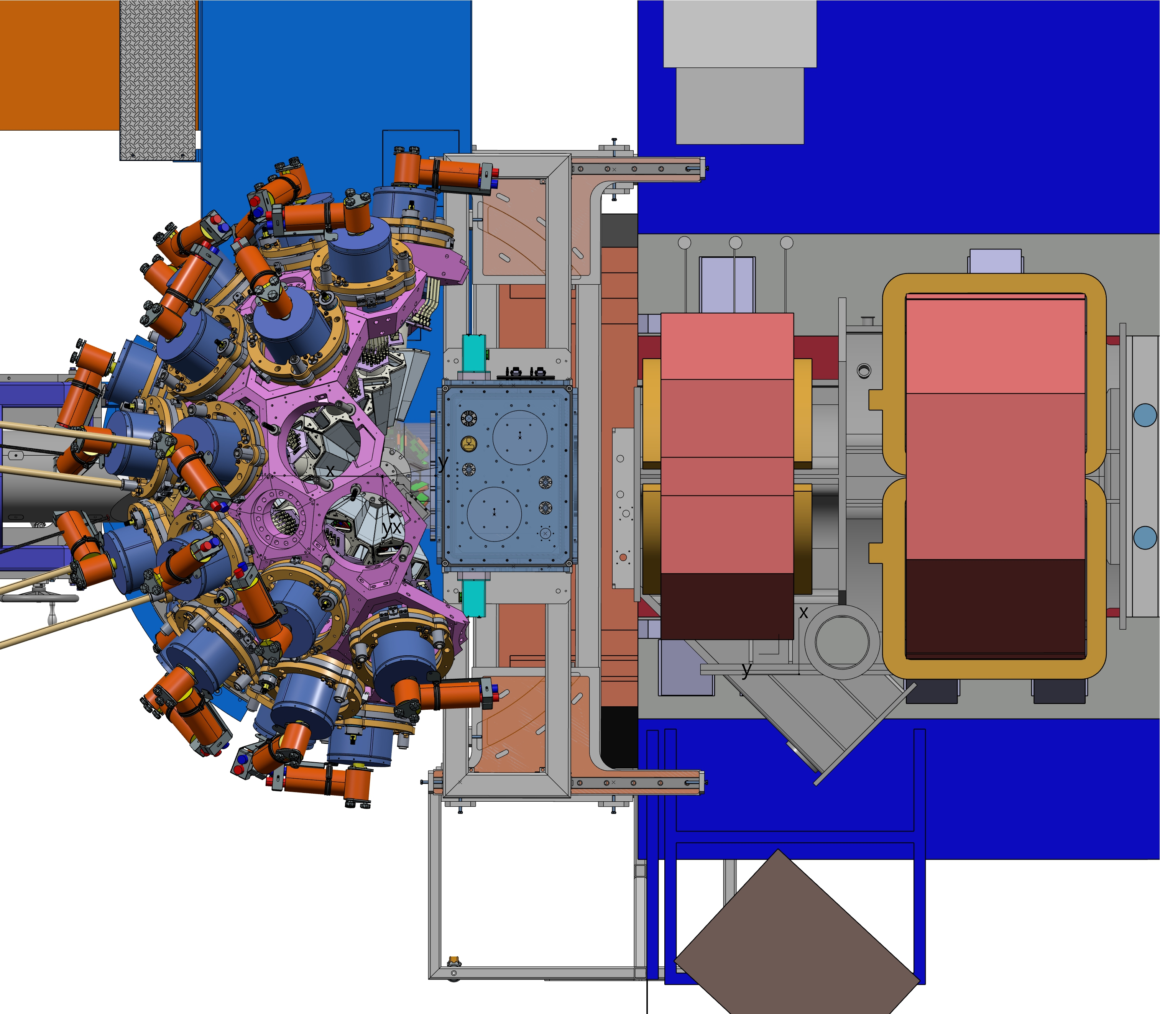
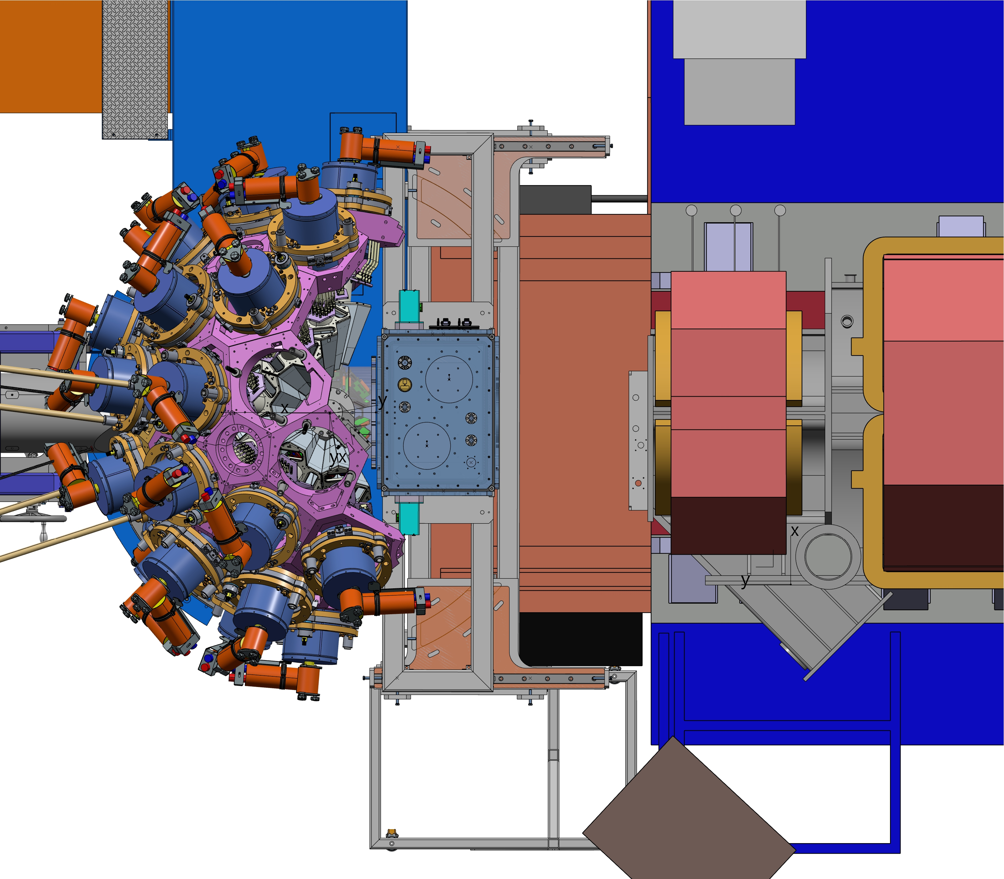
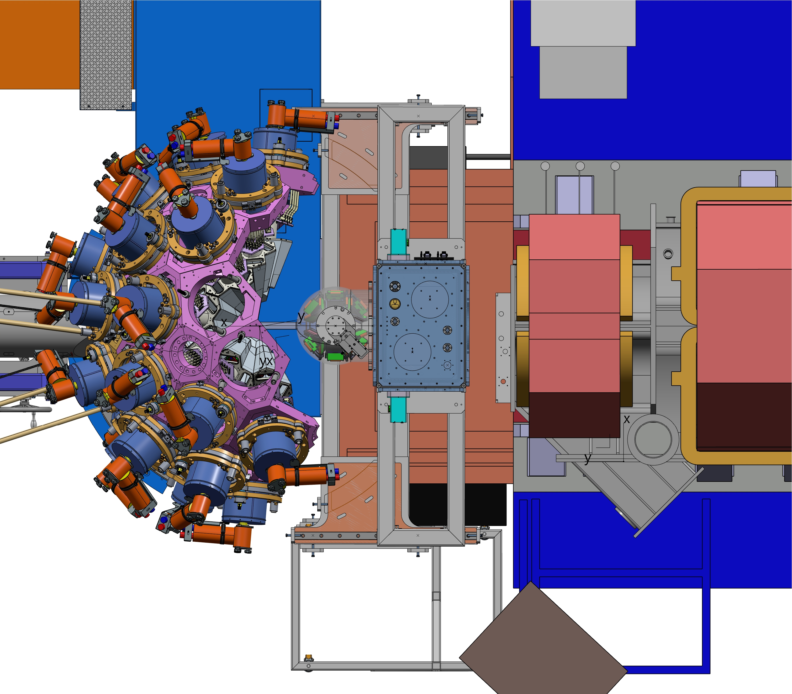
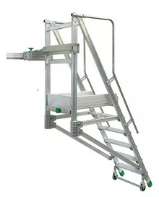
Mechanics: accessing the target area
AGATA : 0°, 0mm (honeycomb rotation NOK)
GRIT : 0mm
VAMOS : 0°, 650mm
(bellow interface VAMOS / GRIT not included)
AGATA : 0°, 0mm (honeycomb rotation NOK)
GRIT : 0mm
VAMOS : 1100mm (max rear position, for
detector access not in this picture !)
AGATA : 0°, 0mm (honeycomb rotation OK)
GRIT : 450mm (max rear position, target access limited, ..)
VAMOS : 1100mm (max rear position)
EXPERIMENTAL SETUP
GRIT access :
Specialized
step ladder ??
22

