Slide 1

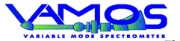


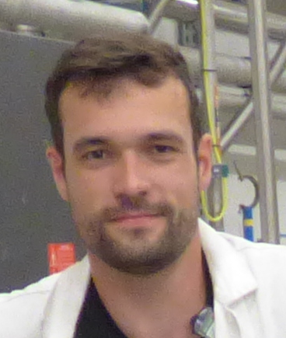
AGATA/GANIL
Mechanical design
Guillaume BRUNET
AGATA WEEK
Warsaw (Poland) - 11 September 2026

Slide 2
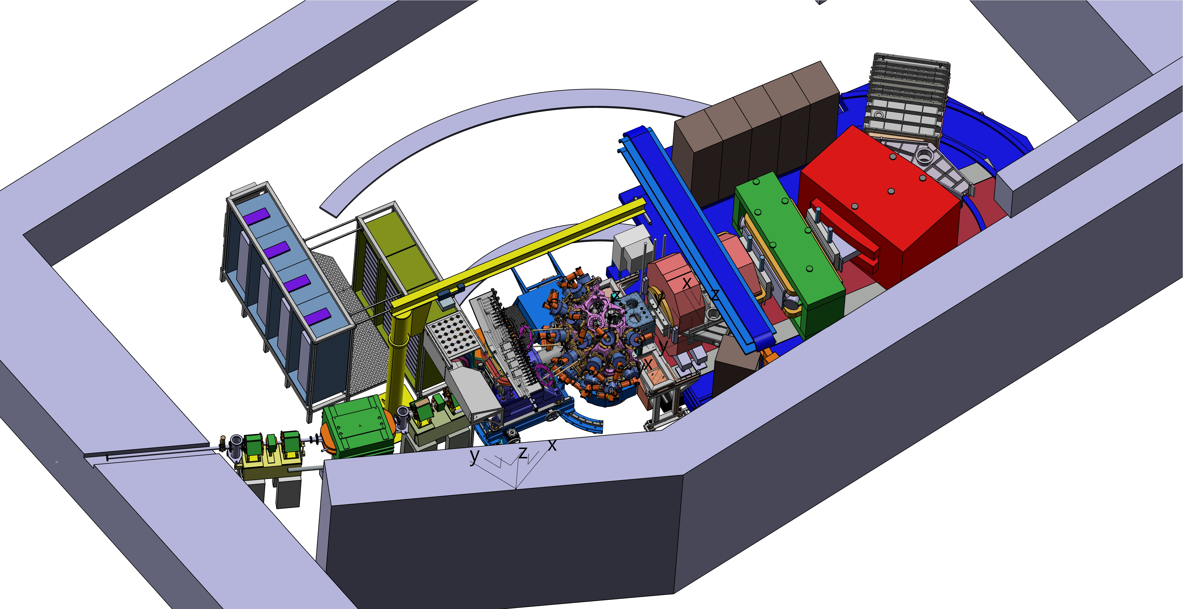
GLOBAL OVERVIEW
Mechanical integration in the G1 hall:
Mechanical installation
Detectors position update
Movements : AGATA rotation
Movements : GRIT & VAMOS
Movements : AGATA honeycomb
New diagnostic box
Beam pipe VAMOS
Beam pipe GRIT
Mechanical interface : GRIT / VAMOS
Racks disposition
Cables management
Detectors handling
LN2 Distribution
Where we at ?
Beam
Guillaume BRUNET, AGATA WEEK, Varsaw, 11 September 2026

Slide 3

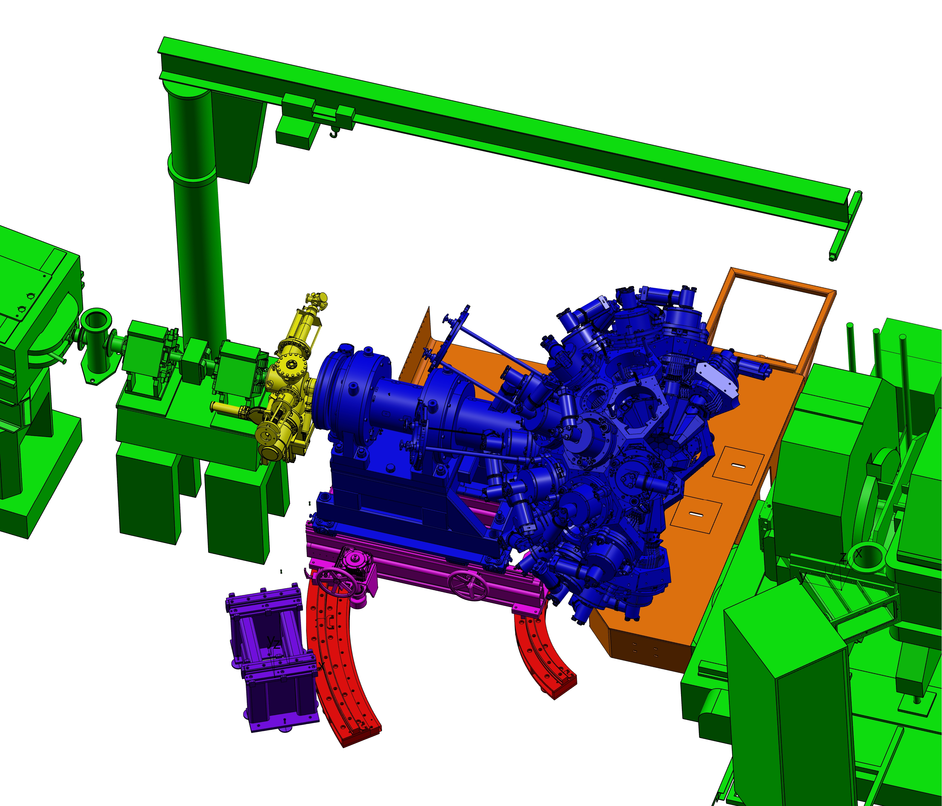
Mechanical installation
Standard AGATA 2Pi setup
New diagnostics vacuum chamber
Rotating structure (curve rails) on the ground (0 to +28°)
New Rotating (0° to +28°) and Linear (0 mm to 150 mm) systems with 2 Hand Wheels
Original Vamos/G1 setup ( beam tube modifcation)
Moving back chassis ( - 500 mm)
New Vamos platform (GRIT / AGATA access)
Beam
Guillaume BRUNET, AGATA WEEK, Varsaw, 11 September 2026

Slide 4
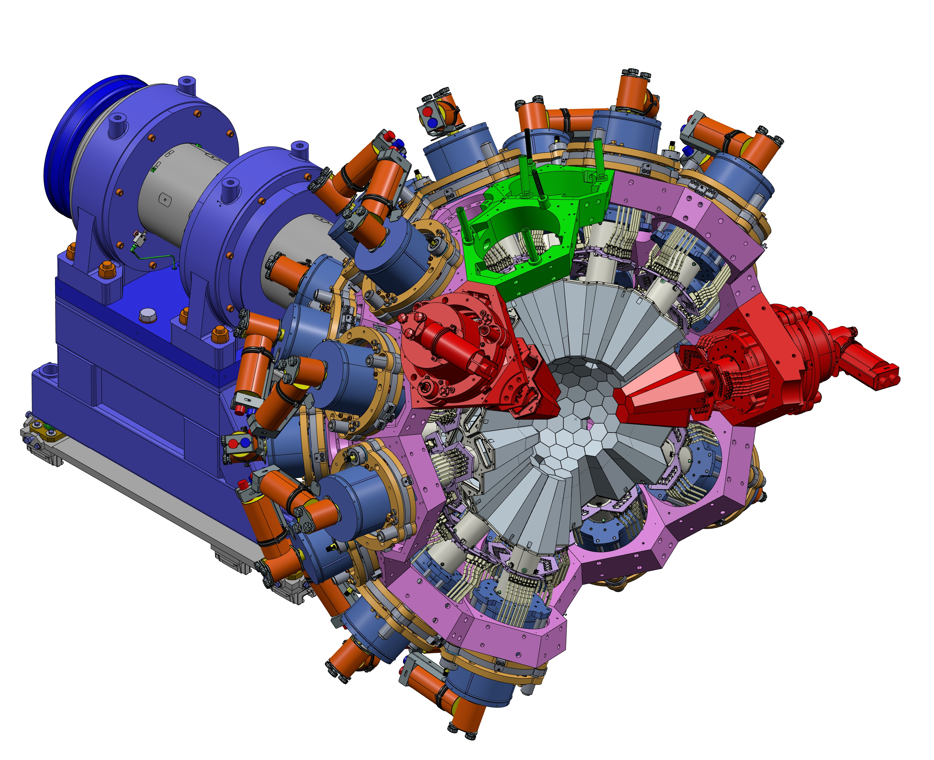
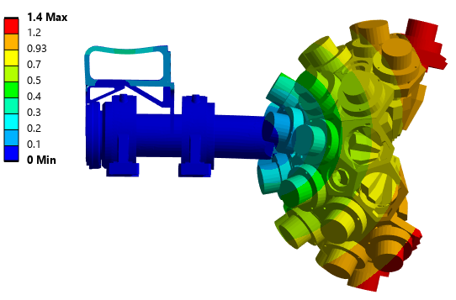
Detectors position update
GRIT needed some space on the top of the honeycomb for the targets loaders (the vacuum external part).
Change of 2 detectors position (from green position to red).
=> Mechanical integrity of the honeycomb simulations was carried out by Richard Smith and validated!
Richard Smith : Report #/version: 1098-ph5-meng-fea-0001 v3.0
Guillaume BRUNET, AGATA WEEK, Varsaw, 11 September 2026

Slide 5
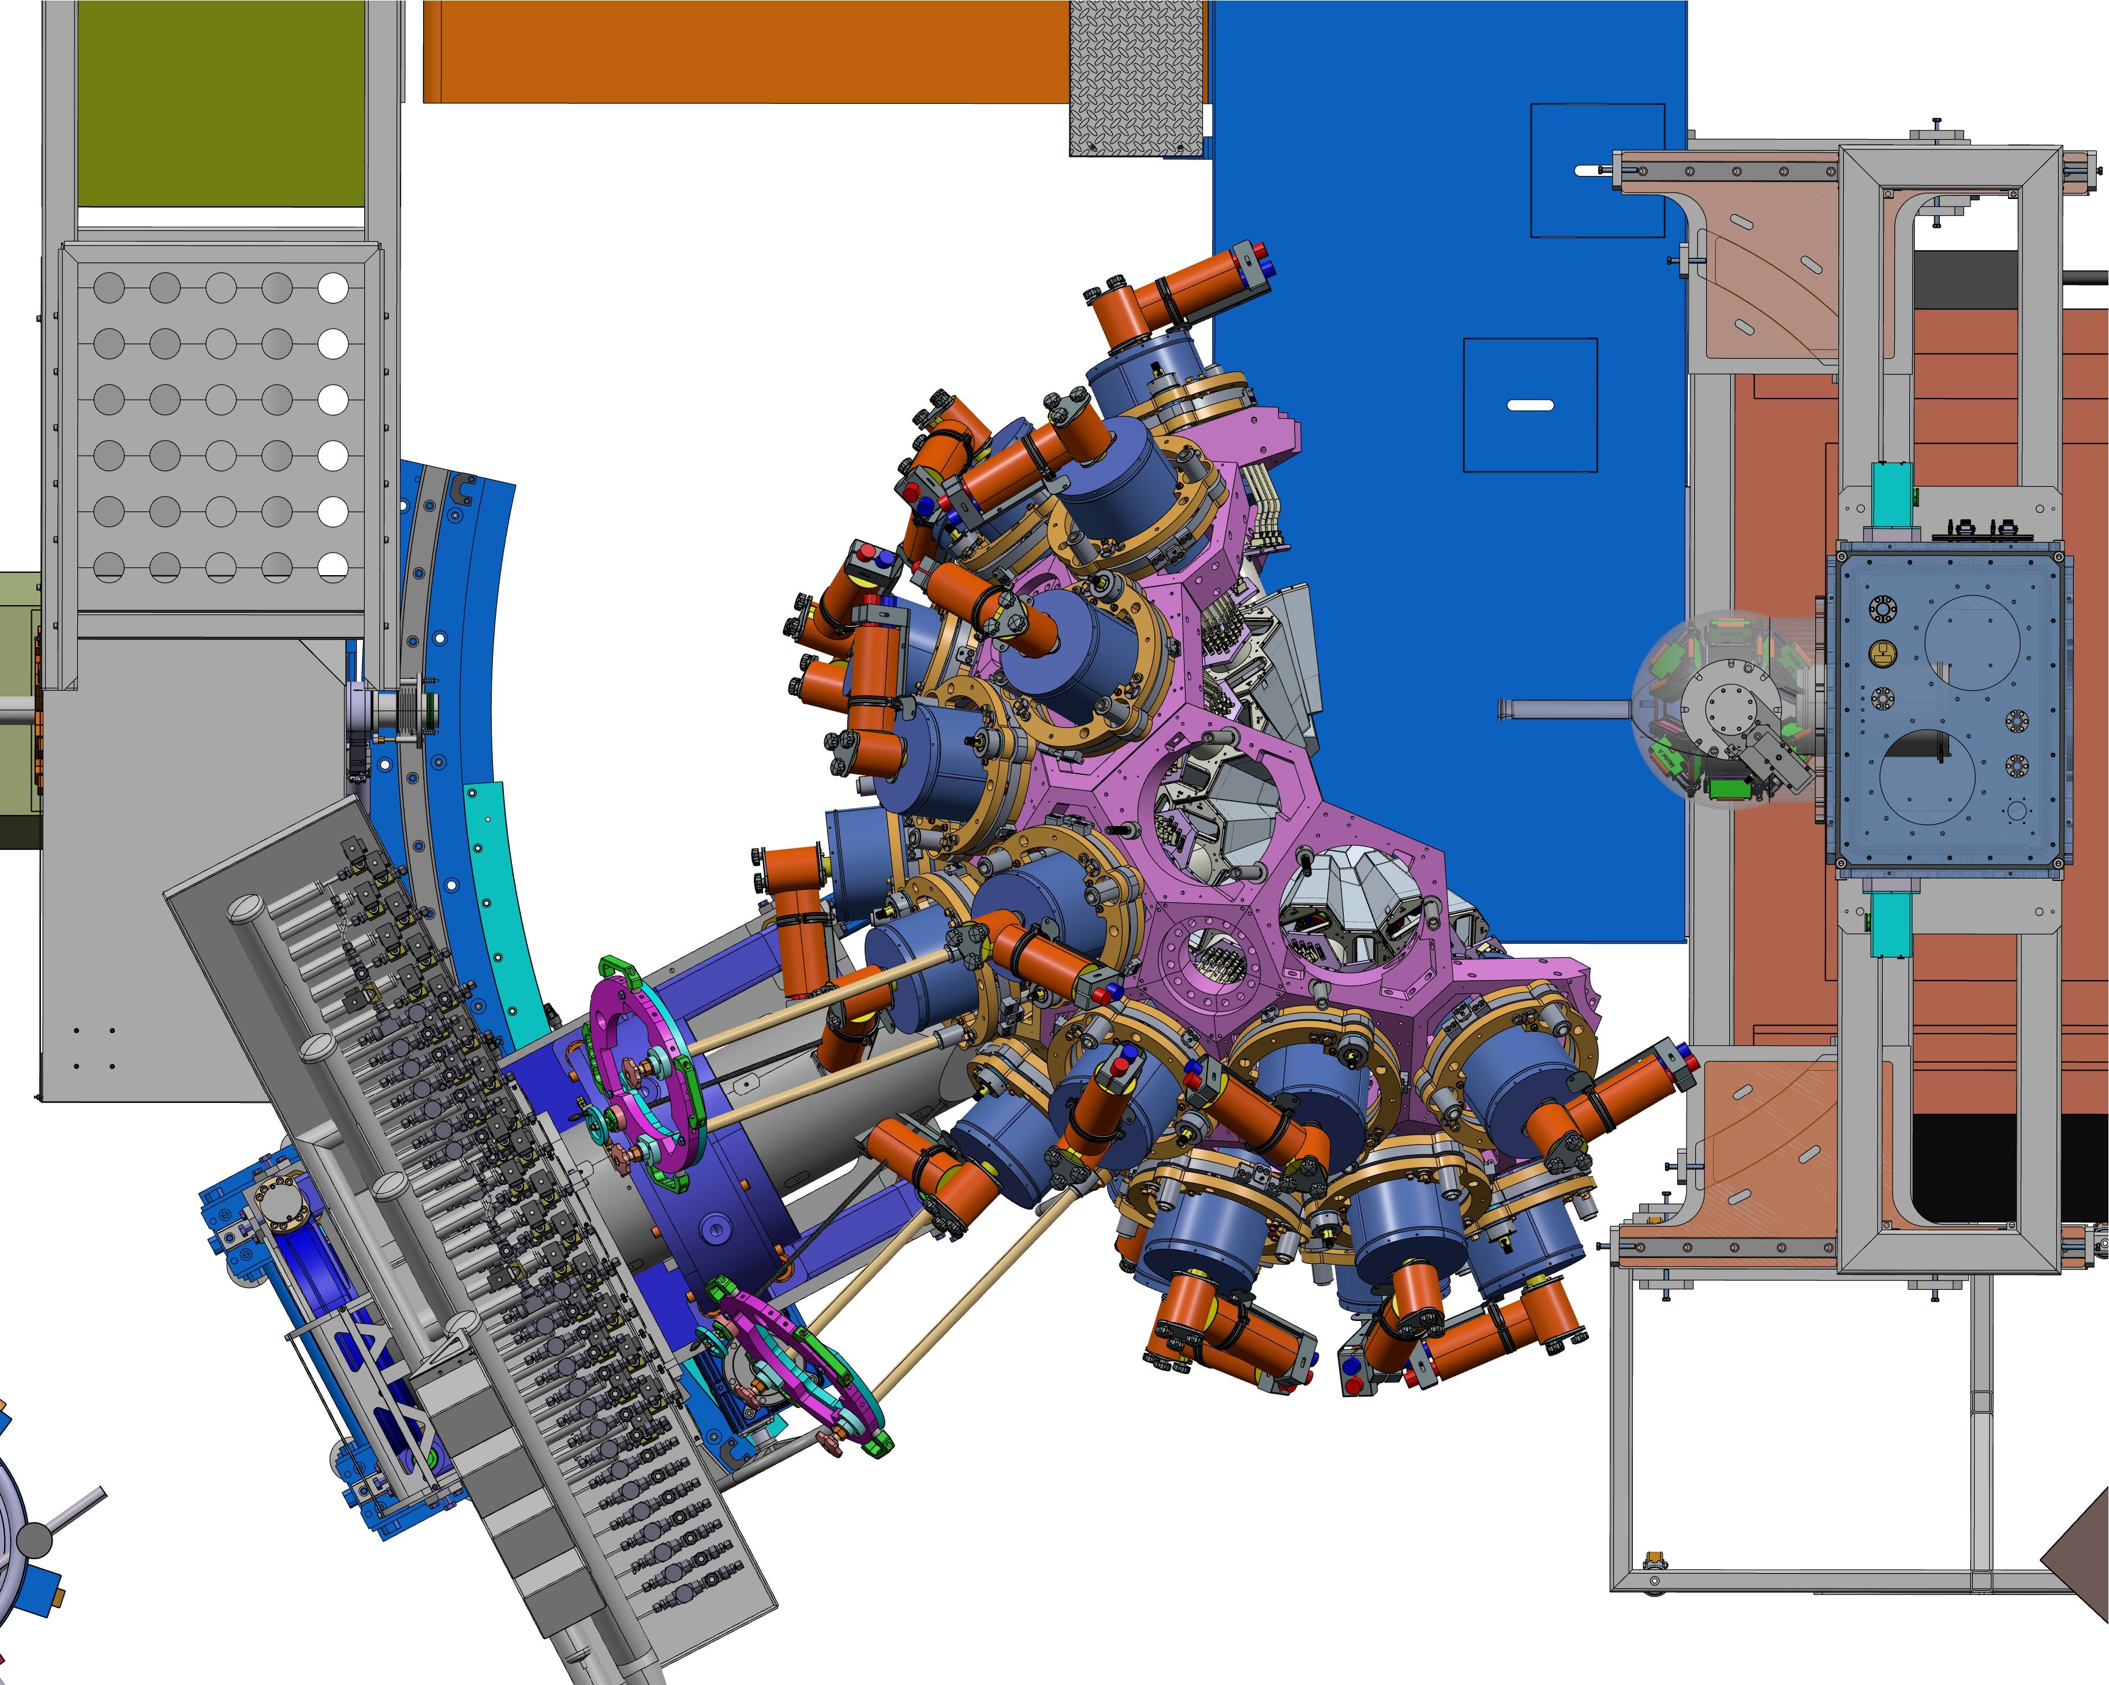
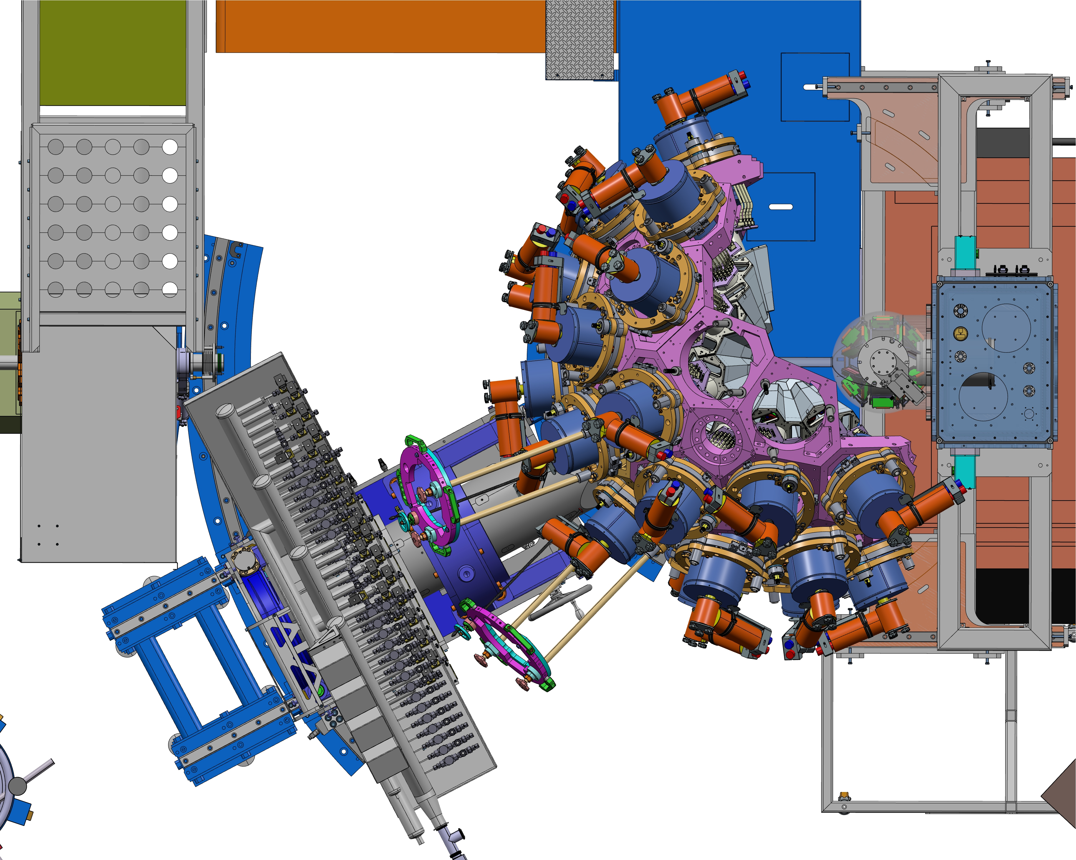
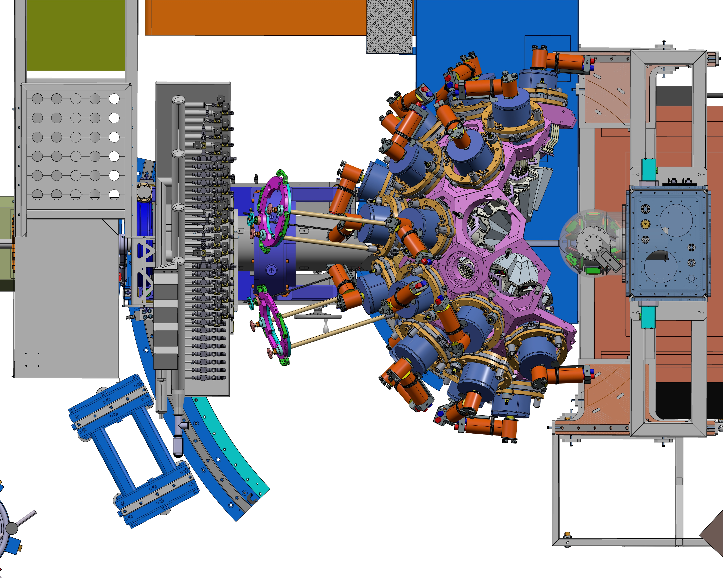
Movements : AGATA rotation (0 to 28°)
AGATA :
28°
-500mm
Vacuum pipe installation possible
GRIT :
=> Full access
AGATA :
28°
0mm
Vacuum pipe installation possible
GRIT :
max rear position, Target access
AGATA : EXPERIMENTAL POSITION
0°
0mm
GRIT :
max rear position, target access limited
Guillaume BRUNET, AGATA WEEK, Varsaw, 11 September 2026

Slide 6


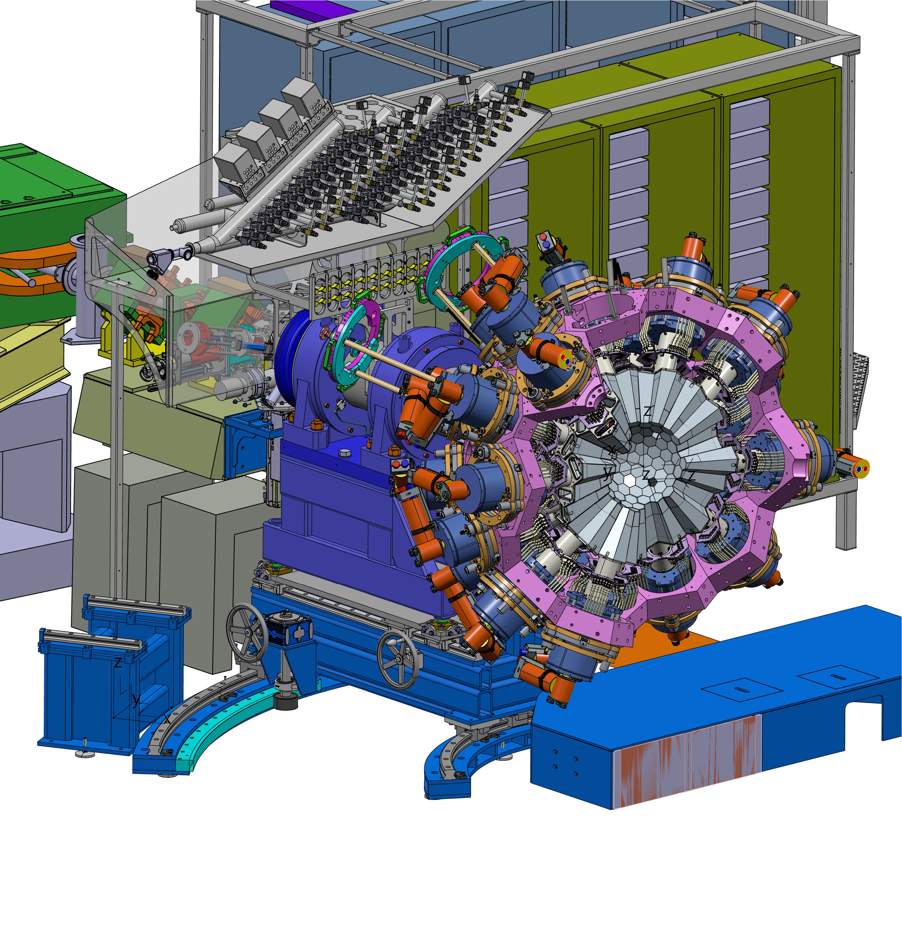

Movements : AGATA honeycomb (±90°)
LN2 manifold & cable tray rotate with the shaft if we want to remove a detector (± 90°)
Note: Cable management is not included in the pictures!
Movements : GRIT & VAMOS linear translations
Homeycomb : + 90°
Homeycomb : - 90°
AGATA 0° to 28° : ☑
Honeycomb : 0° (Home position)
AGATA 0° : ☑ AGATA ≠ 0°: ☒
Guillaume BRUNET, AGATA WEEK, Varsaw, 11 September 2026

Slide 7
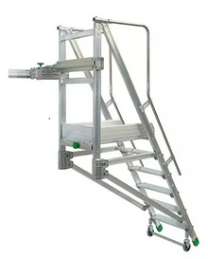
Movements : GRIT & VAMOS (Linear translations)
AGATA : 0°, 0mm
GRIT : 0mm
VAMOS : 0°, 650mm
(bellow interface VAMOS / GRIT not included)
AGATA : 0°, 0mm
GRIT : 0mm
VAMOS : 1100mm (max rear position,
detector not in the picture !)
AGATA : 0°, 0mm =
GRIT : 450mm (max rear position, target access limited, ..)
VAMOS : 1100mm (max rear position)
EXPERIMENTAL SETUP
GRIT access :
Specialized
step ladder ??
Guillaume BRUNET, AGATA WEEK, Varsaw, 11 September 2026

Slide 8
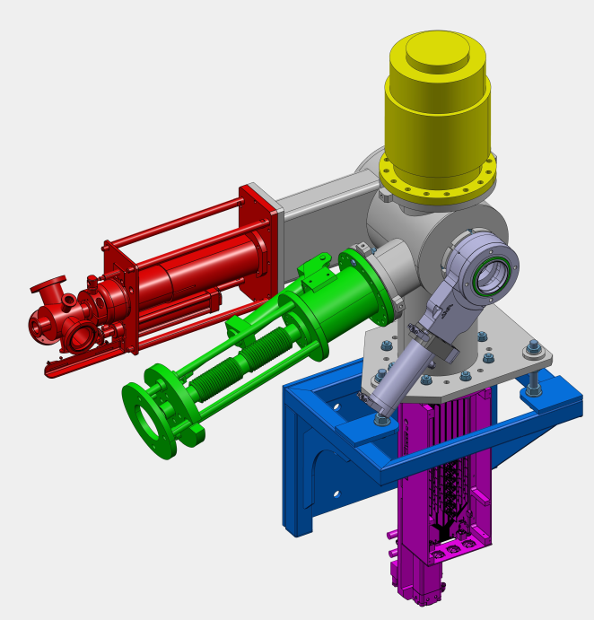
New Diagnostic box
Newly designed diagnostic box,
fitting within the tight geometric constraint (~375 mm)
All equipments on the same side to
give room for the cables
  RED : Profiler (new design)
  GREEN : Faraday Cup
  YELLOW : Turbo pump DN160
  BLUE : Mechanical support
  PINK : Free Flange (DN160 for a detector ?)
Valve AGATA beam line side DN100
Guillaume BRUNET, AGATA WEEK, Varsaw, 11 September 2026

Slide 9
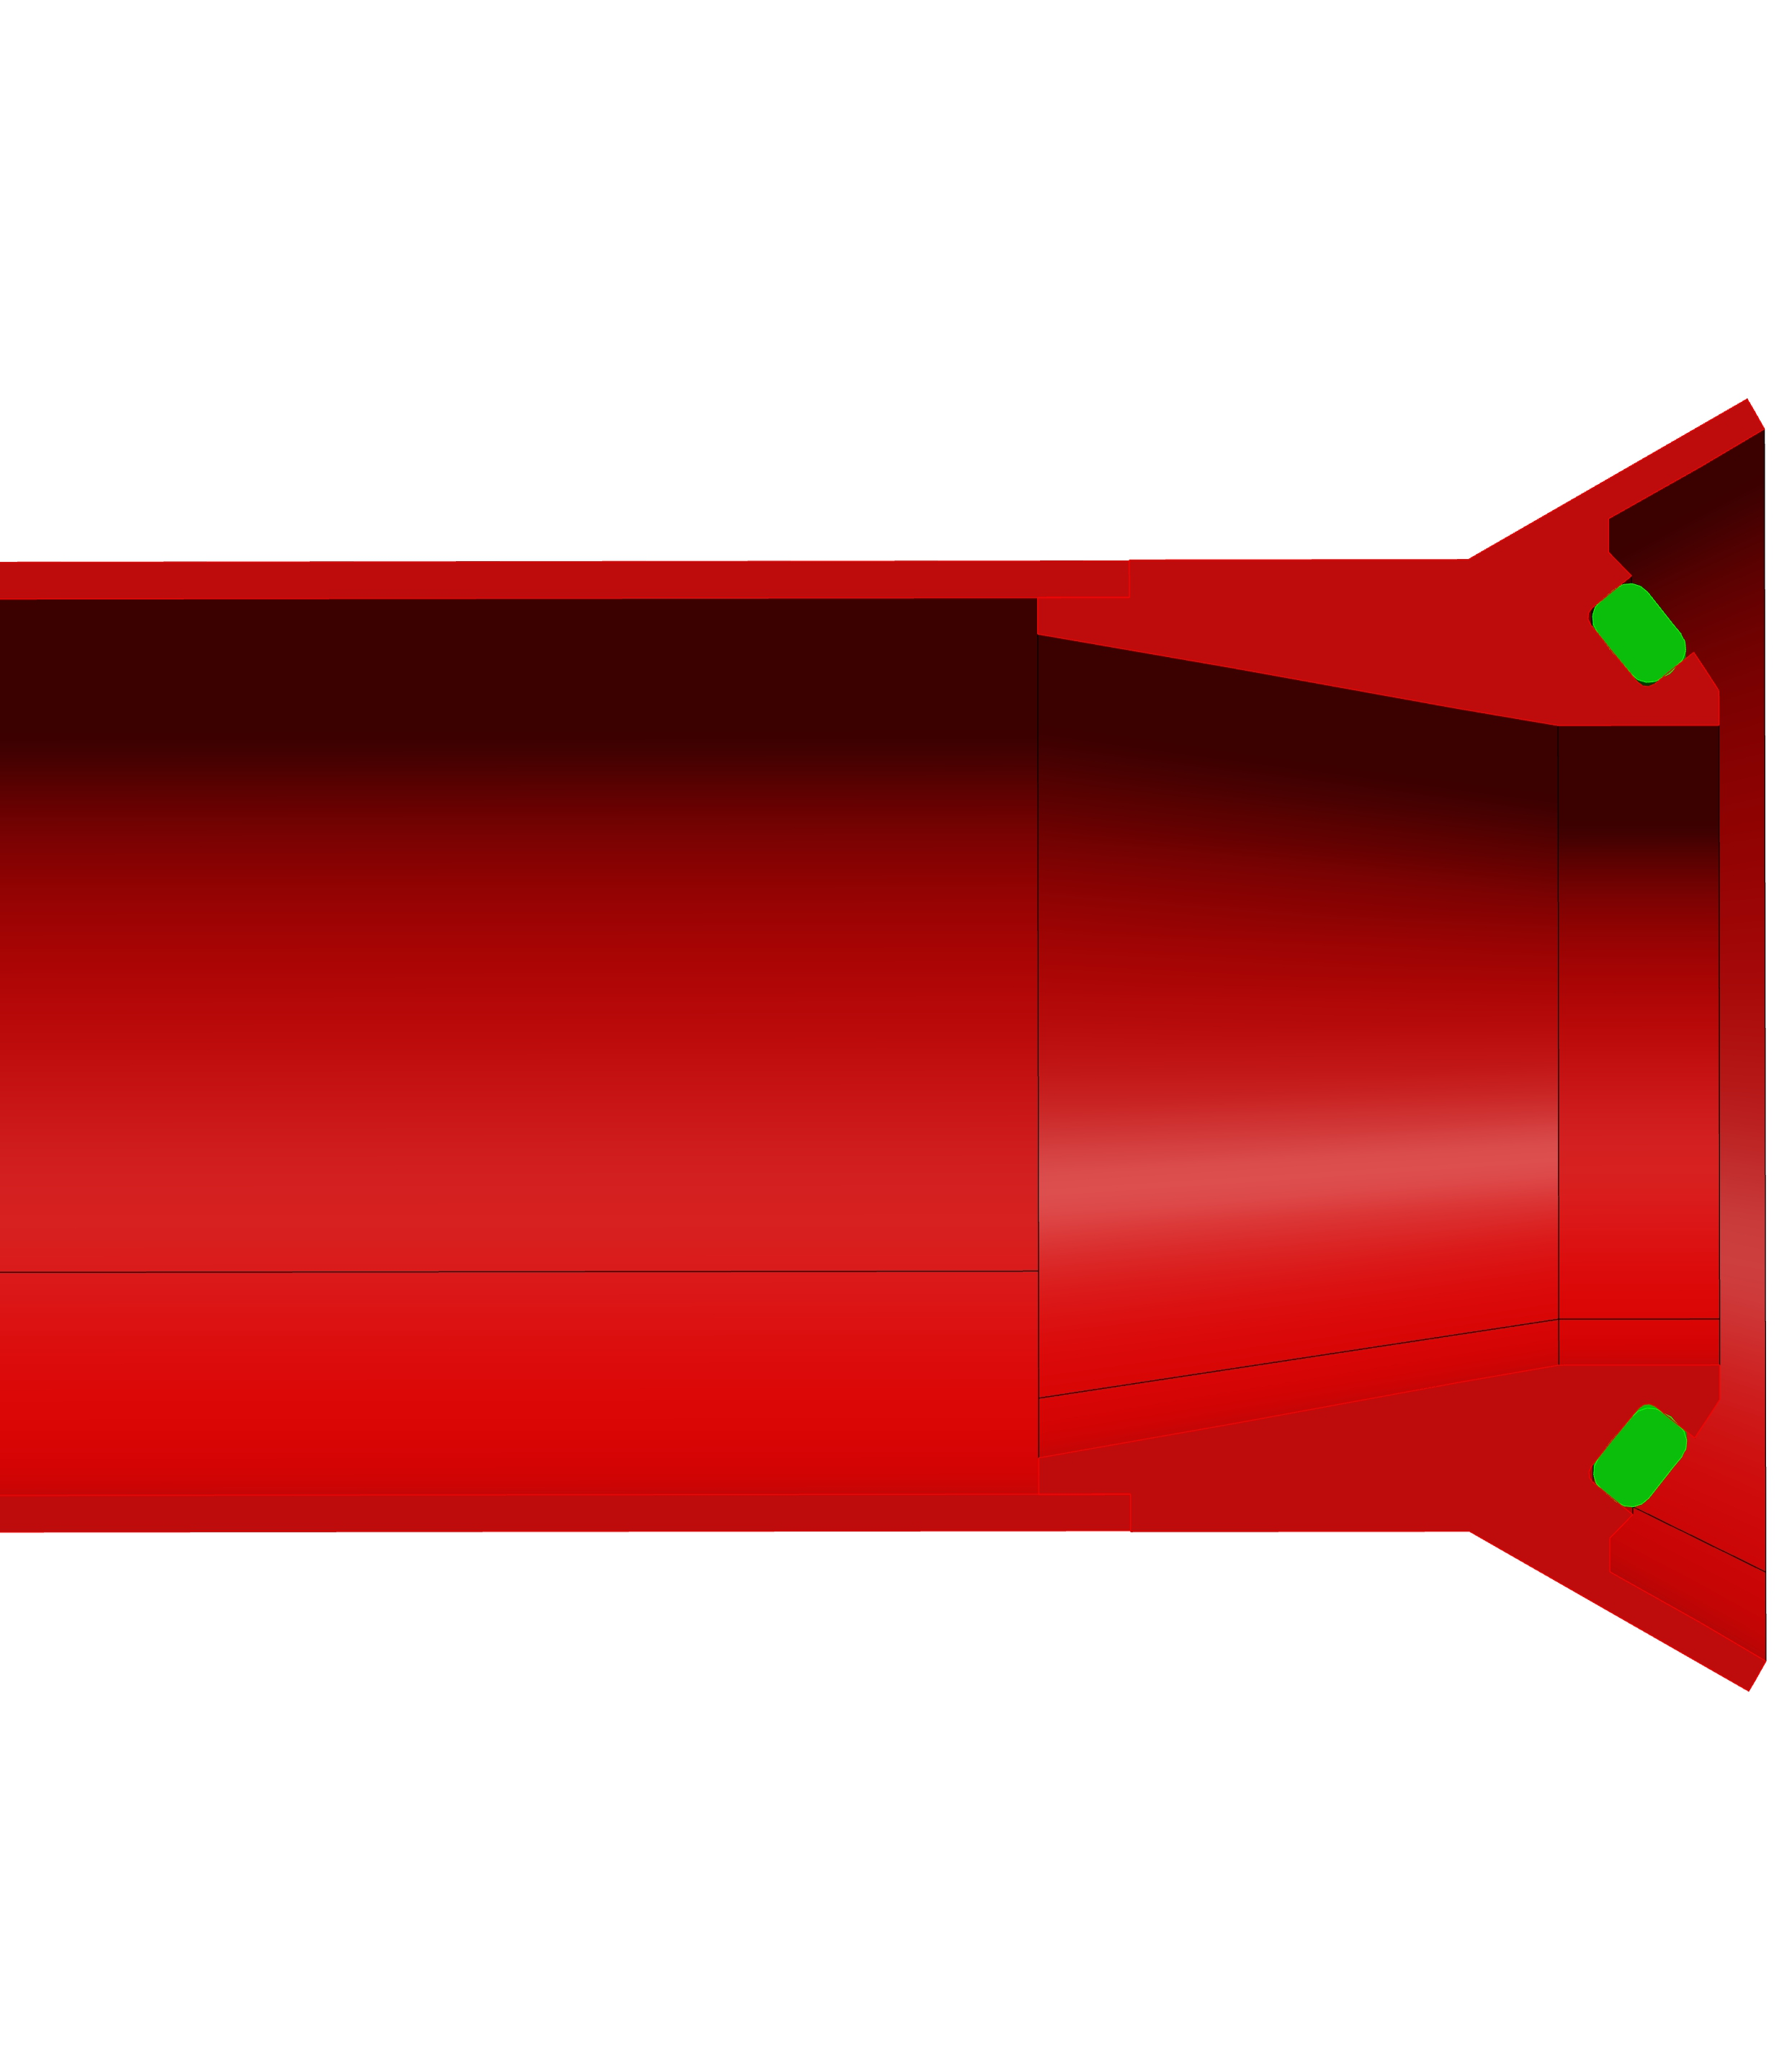
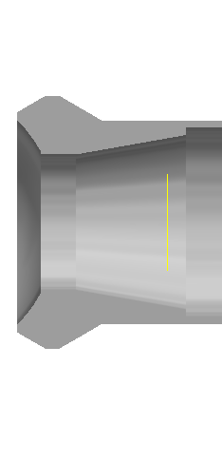
Beam pipe VAMOS (lenght : 2 m)
Connection without a clamp inside the AGATA honeycomb
The blue bellows is mounted on the valve diagnostic box.
The red spherical flange and pipe slide along the bellows and are pressed against the GRIT vacuum chamber.
(no clamp => no access).
To press it onto the GRIT pipe, we use the three screws around the bellows, which compress the three springs.
(Difficult access between DB and AGATA : 3 cm !!!!)
Internal dimensions validated by GANIL’s optical engineer (Bertrand Jacquot)
A prototype is currently being manufactured (expected completion: end of 2026).
Next steps: Mounting validation, spring force testing, and vacuum leak checks.
Centering cone
Ball end
New
Diagnostic
Box
GRIT beam
pipe
O-ring
2 mm Clearance with shaft
Springs (x3)
Brass bolds
Guillaume BRUNET, AGATA WEEK, Varsaw, 11 September 2026

Slide 10
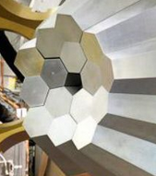
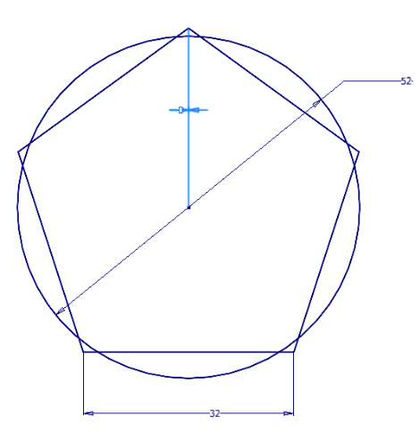
Beam pipe GRIT (lenght : 300mm)
Machining directly with the GRIT reaction chamber => See GRIT presentation
Major contraint for mounting GRIT on setup position:
The five AGATA detectors around the beam pipe must be retracted to insert or remove the spherical flange of GRIT ( ~ 15 mm)
Centering cone of
GRIT beam line
Ø52
GRIT beam pipe
Central
Pentagon AGATA
Guillaume BRUNET, AGATA WEEK, Varsaw, 11 September 2026

Slide 11
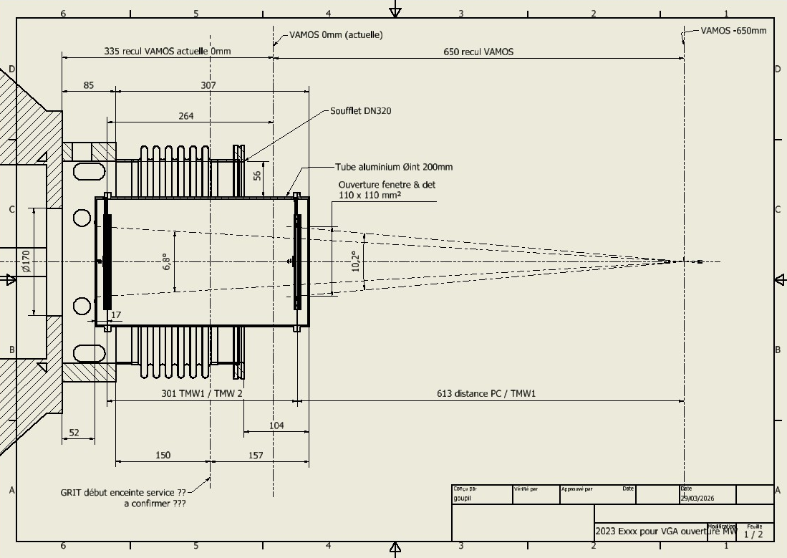

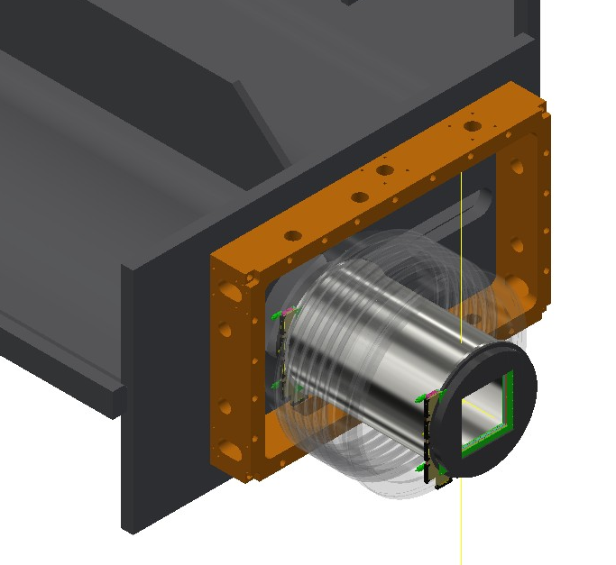
Mechanical interface: between GRIT and VAMOS
GRIT / VAMOS Interface (~ 150mm) : bellows DN320 with dimensions dictated by the detector size.
Guillaume BRUNET, AGATA WEEK, Varsaw, 11 September 2026

Slide 12
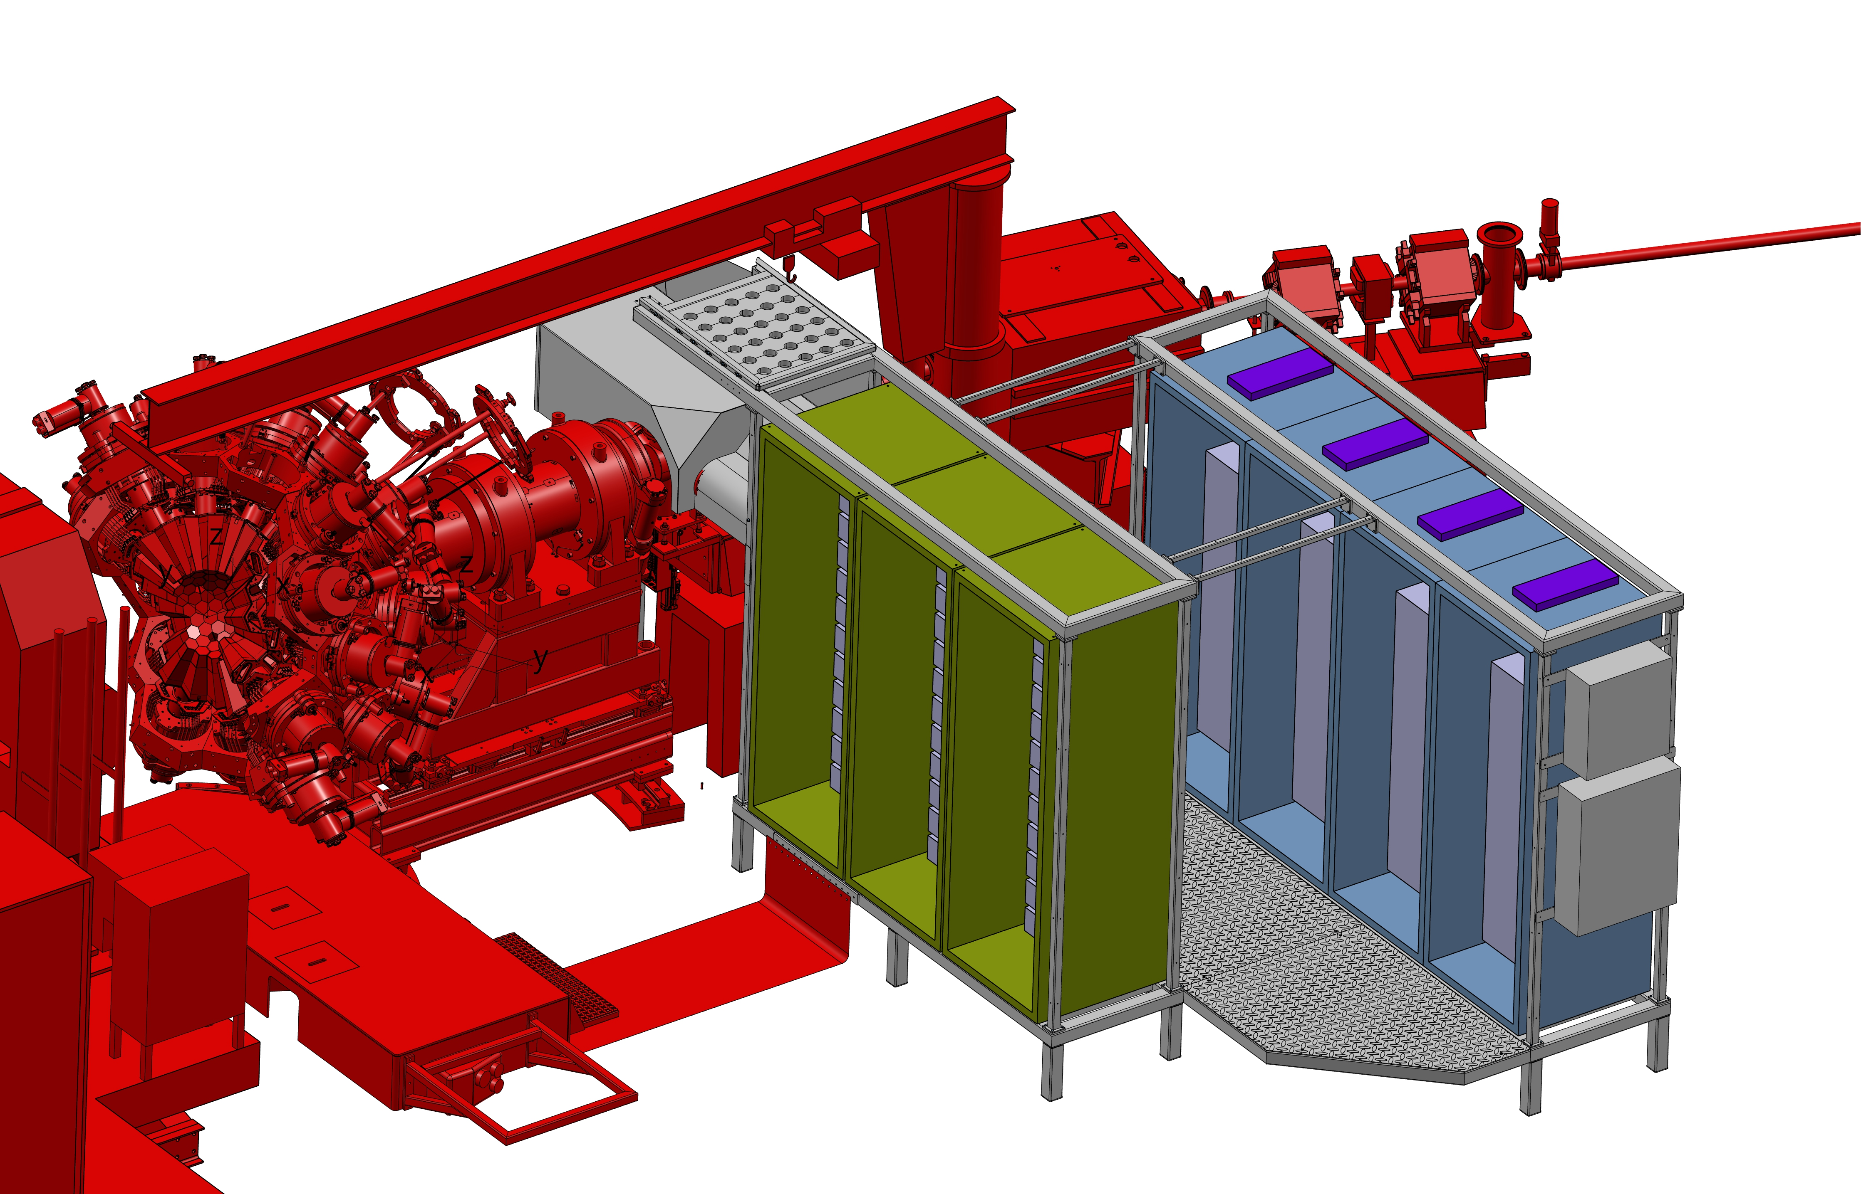
Racks disposition
Cable management challenges:
  Strict localization of the platform : Due to the 2 rotations (Honeycomb and AGATA) and the length of the MDR cables => high difficulties in managing the cables in this constrained area
New fixed platform in stainless steel (unpainted):
  2 rows:
  4 racks for LVPS, Autofill, and other devices.
  3 racks for digitizers.
  Various cables routed on the top and underneath (30 cm available above ground).
EMC:
  Copper links between the electronics platform and VAMOS, GRIT.
  Copper surface under AGATA rails and the electronics platform.
  EMC : conductive shielding gaskets already planned
  Awaiting a full system analysis by Nabil KARKOUR.
LVPS
DIGITIZERS
Autofil
HV, …
Guillaume BRUNET, AGATA WEEK, Varsaw, 11 September 2026

Slide 13
Cables management challenges
Looped cables to absorb rotation along beam axis (±90°) and target axis (0° to +28°)
Volume under the grid racks is available for cables.
The cables are clamped :
  On the grid and with the support for bending (above the AGATA shaft).
  On the racks (at the far ends).
Guillaume BRUNET, AGATA WEEK, Varsaw, 11 September 2026

Slide 14
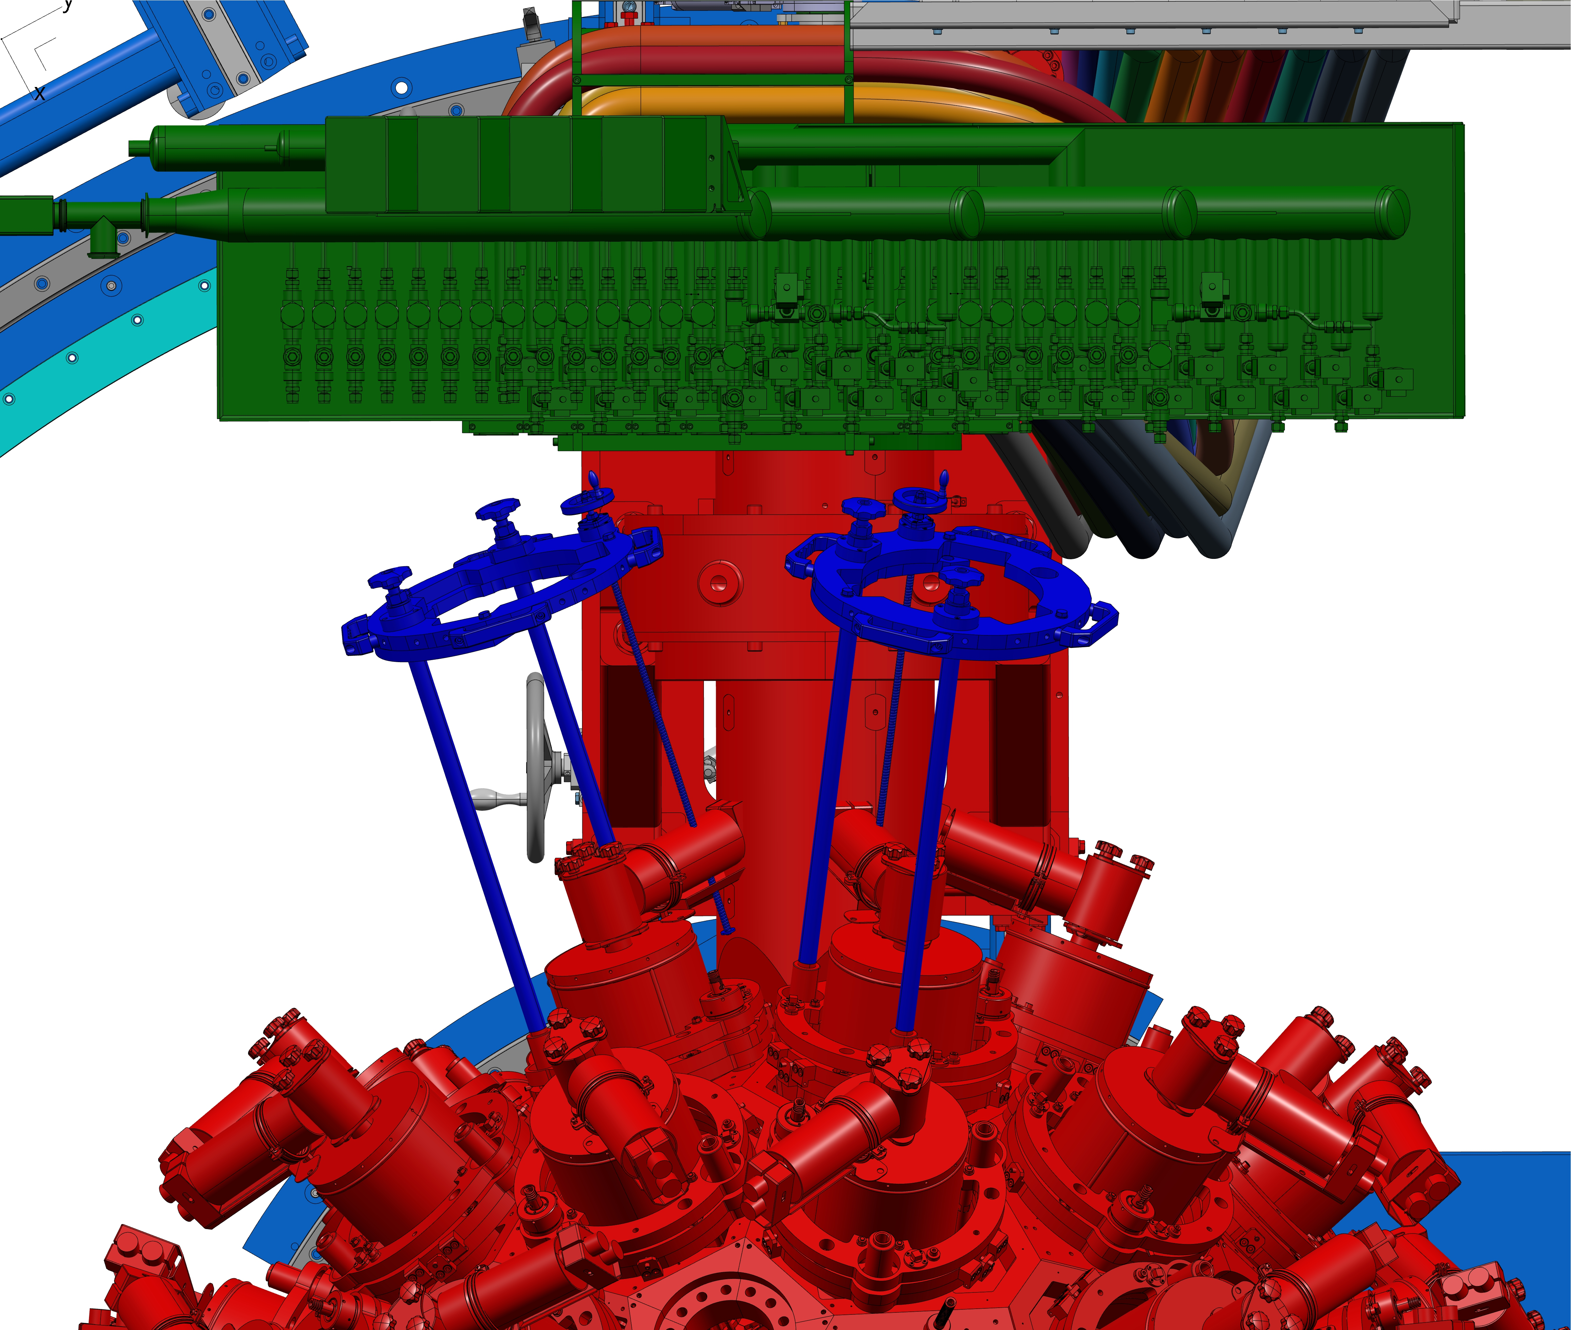
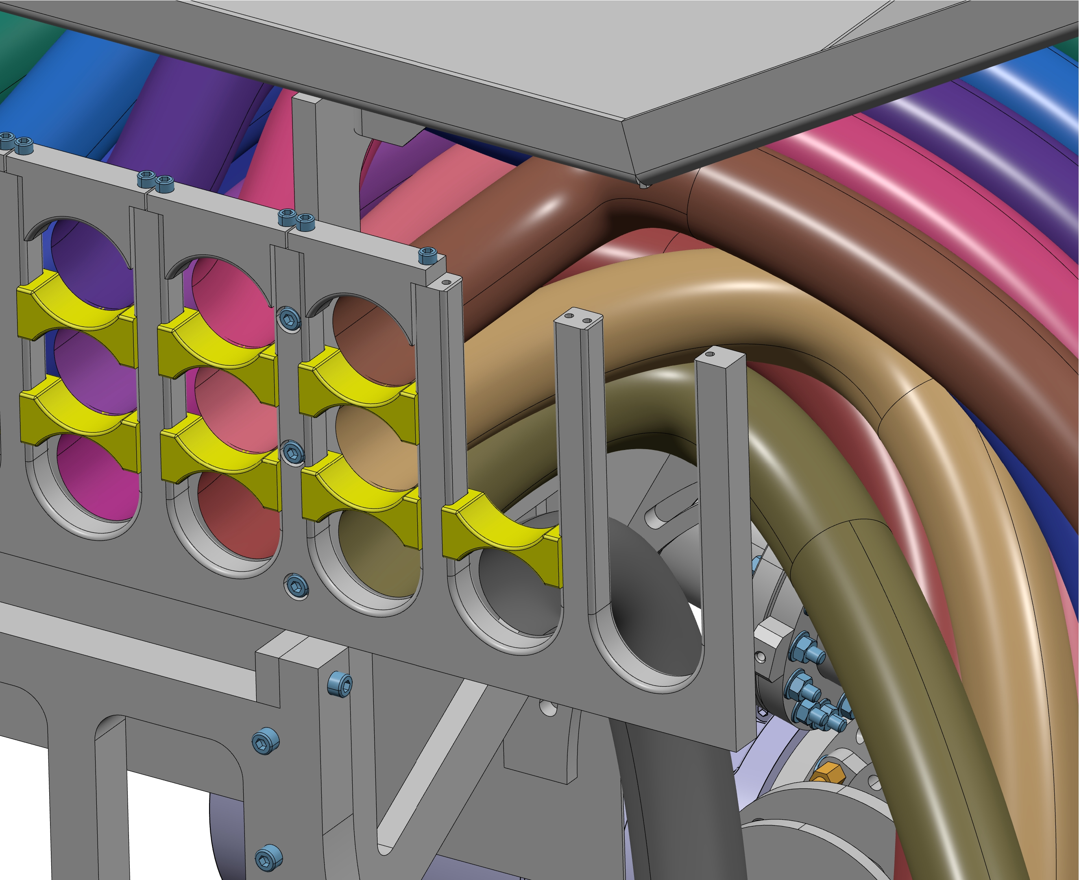
Detectors handling
100mm
Current Handling fixture
Two most complicated detectors to handle are the top central ones in front of the grid cable
Mandatory to remove 6 cables for the left one, 9 to 12 for the right one
Removing the cable spacer (yellow) and U shaped terminal (for fixation)
Guillaume BRUNET, AGATA WEEK, Varsaw, 11 September 2026

Slide 15
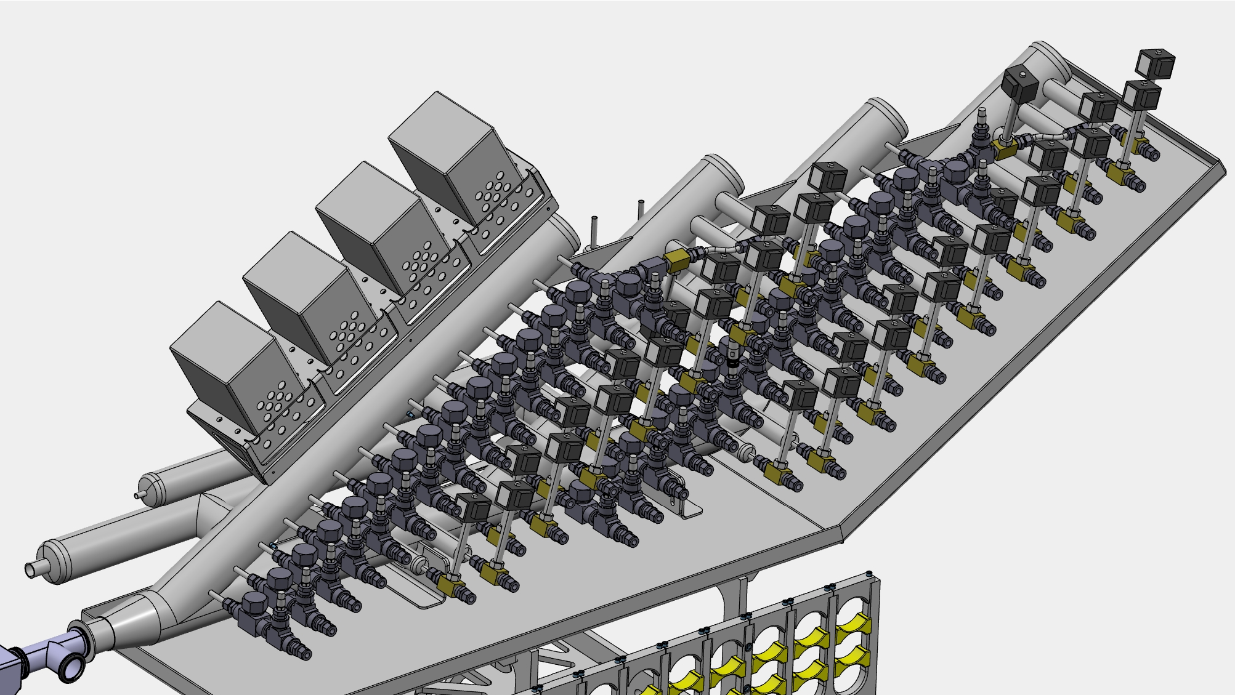
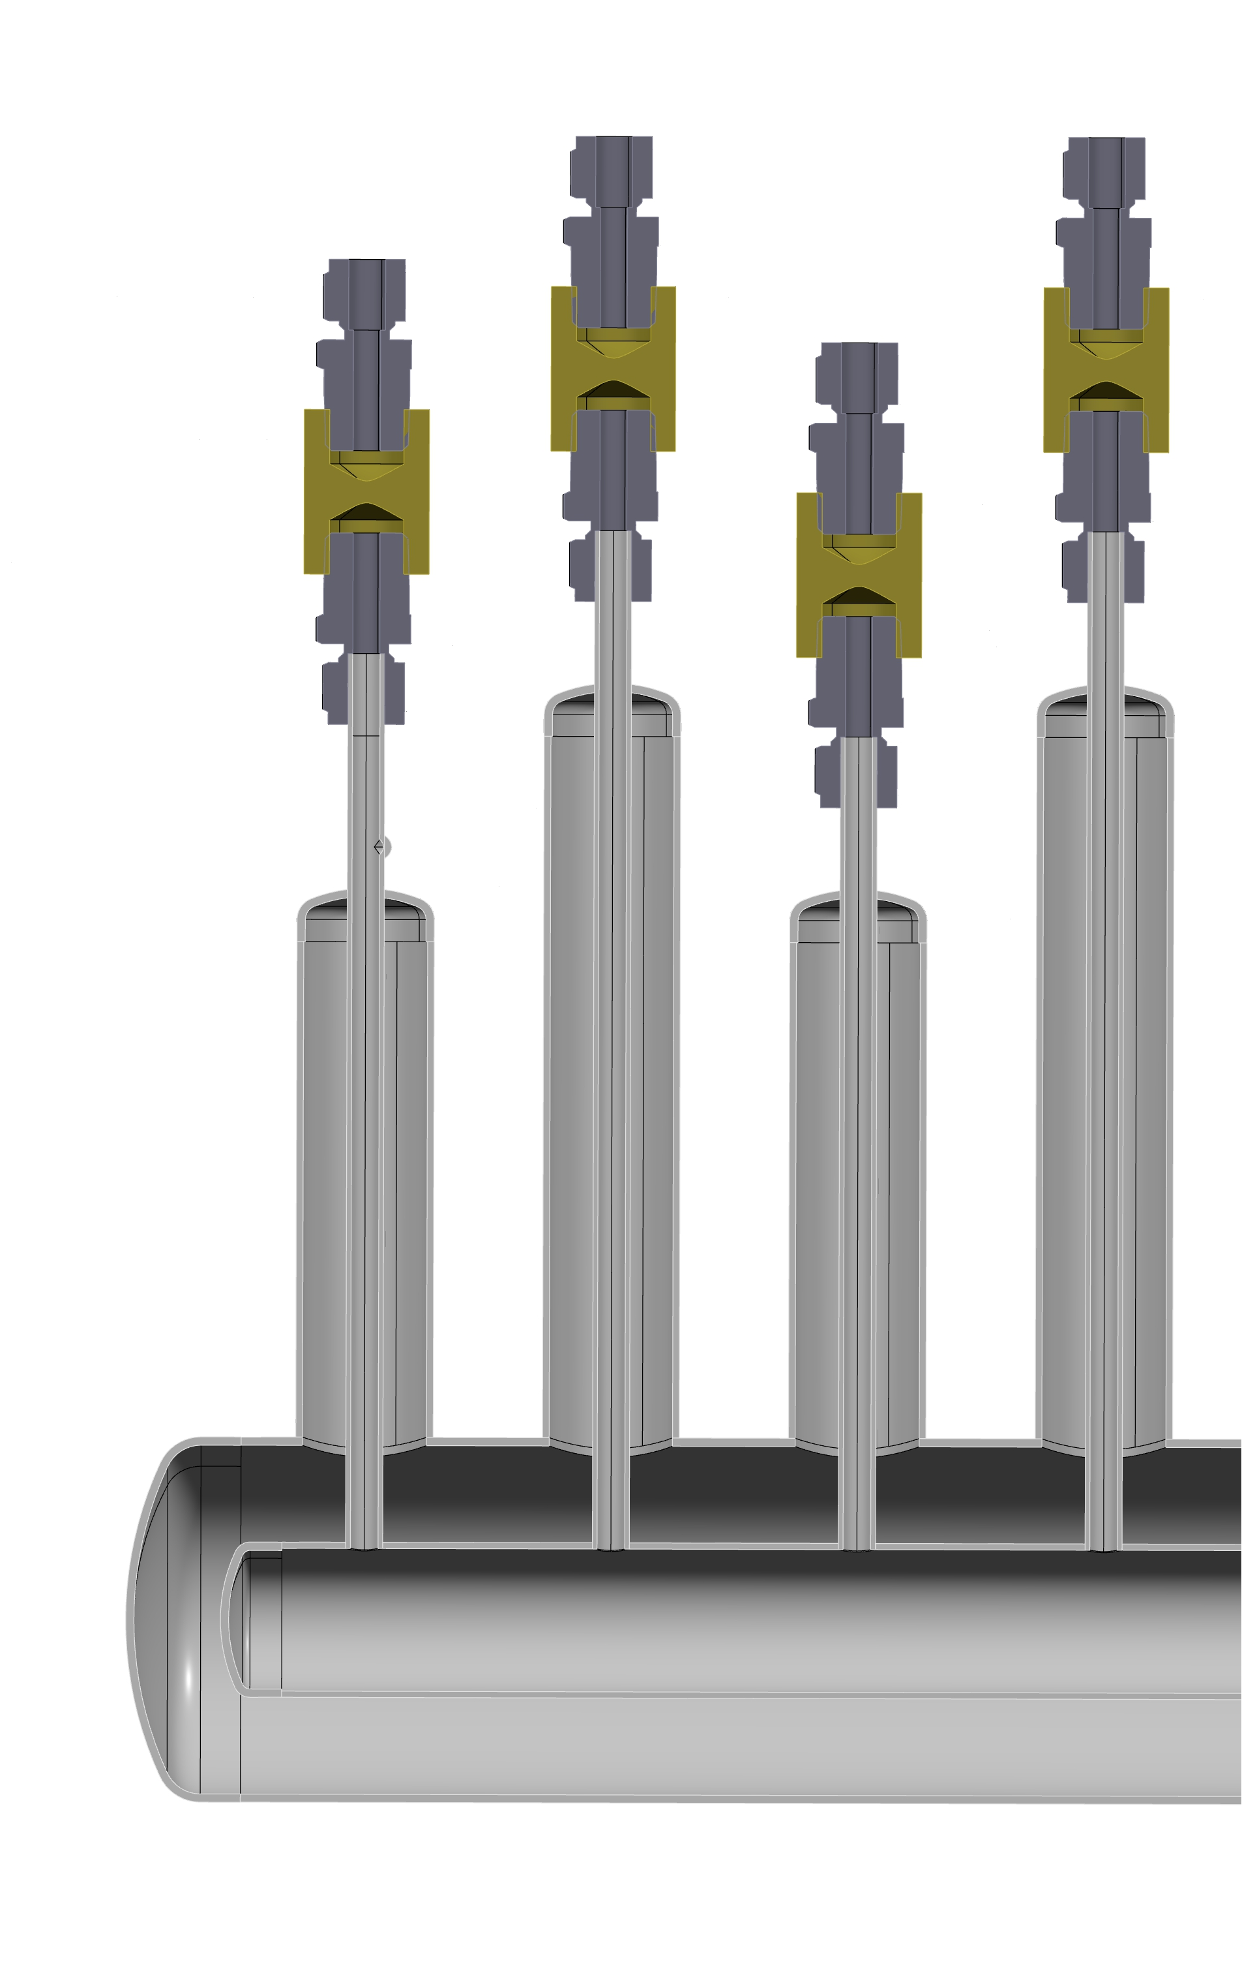
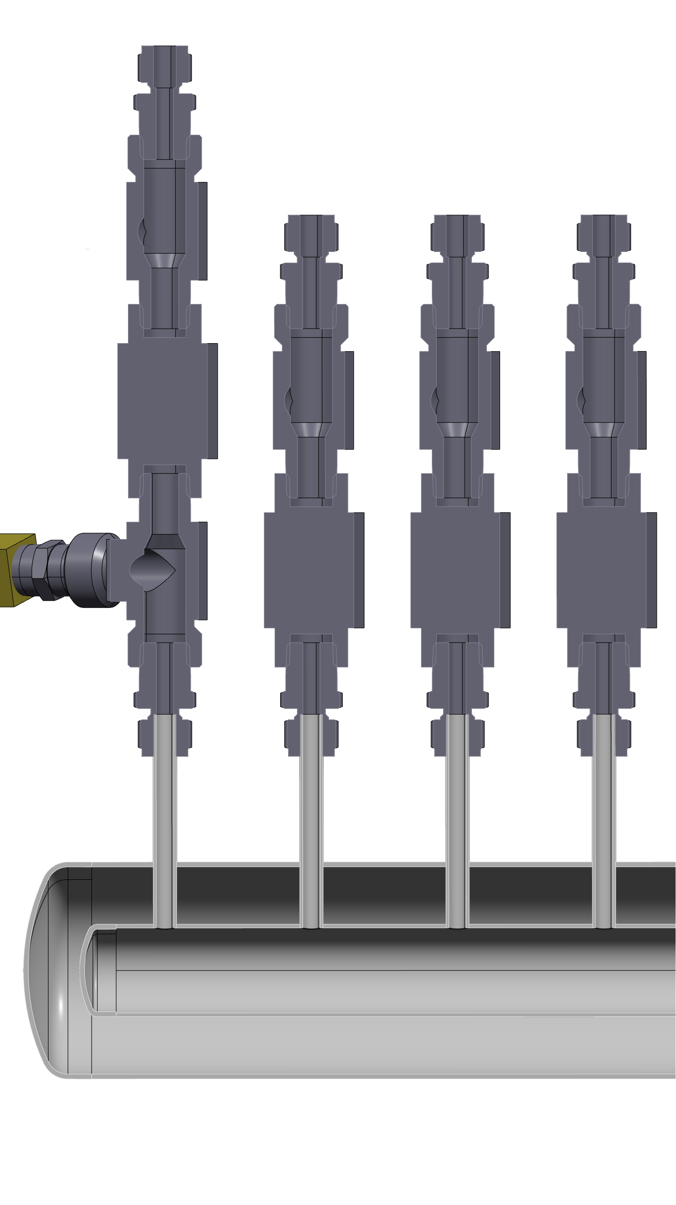
LN2 Distribution
2000mm
Outlet (gas) with T°, no-return valve
700mm
Inlet (with Cryo valve)
On one side: Tied to the AGATA shaft.
On the end shaft side (enter beam): Fixed with screws.
Angled liquid nitrogen (LN2) delivery (limited headroom in G1 and also under the pillar jib crane, 80mm with the hook)
Like Legnaro: Patch box for (C&C) mounted on this distribution
Inlet and Oulet are insulated with vacuum and MLI
The detectors must only be filled when the honeycomb is at 0°
Guillaume BRUNET, AGATA WEEK, Varsaw, 11 September 2026

Slide 16
Where we at ?
78% of the 78 mechanical drawings are done
All mechanical drawing have to be done before the end of august 2026
All part have to go to manufacturing before the end of 2026
A prototype of the beam pipe is in manufacturing and is meant to be used with GRIT
Guillaume BRUNET, AGATA WEEK, Varsaw, 11 September 2026

Slide 17
Thank you for your attention

Slide 18
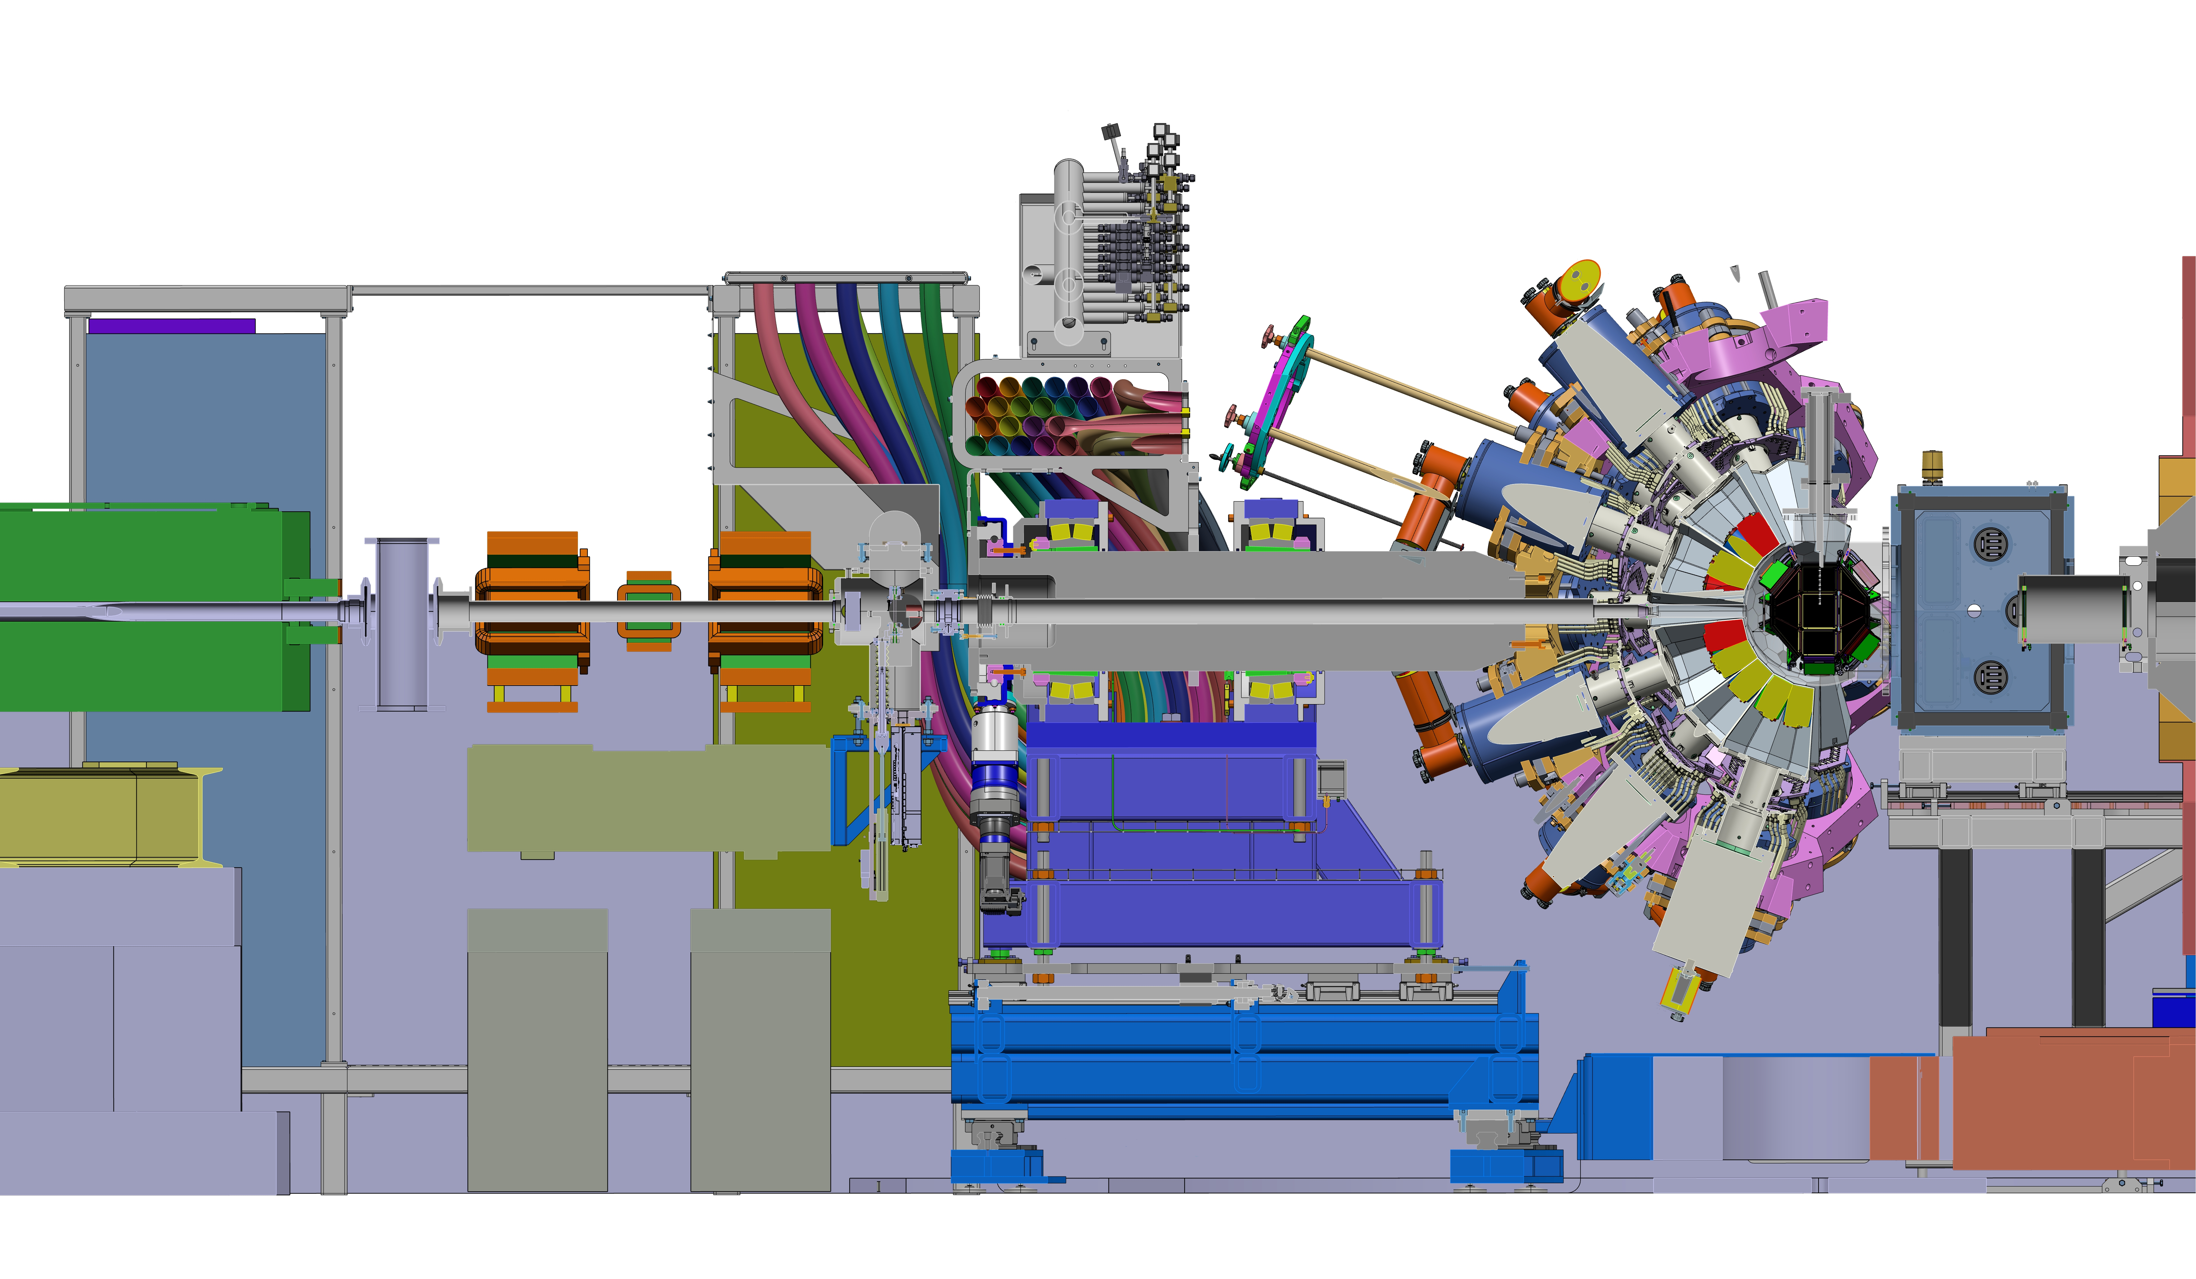
Some distances on beam line
pillar jib crane (with hook)
400mm
80mm
3330mm
30mm
4000mm
2070mm
600mm
2600mm
900mm
Guillaume BRUNET, AGATA WEEK, Varsaw, 11 September 2026

Slide 19
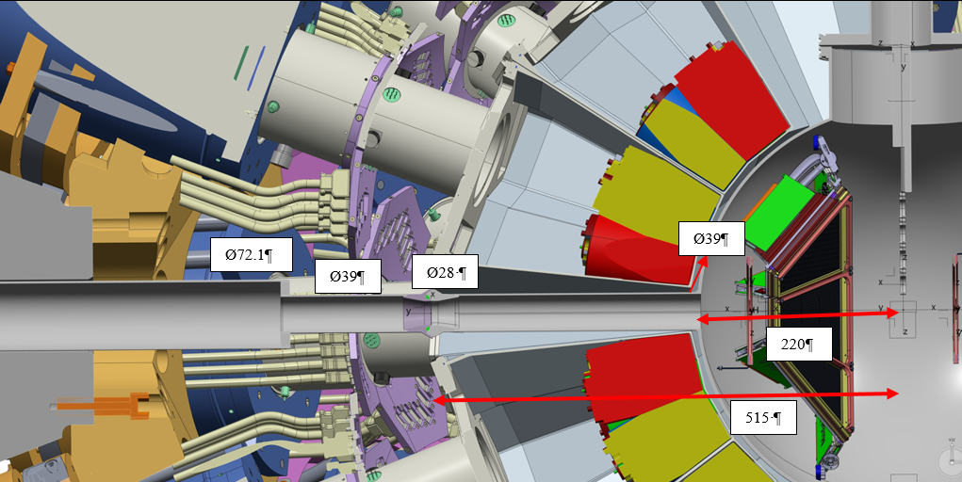
Beam pipe : connection without clamp inside AGATA honeycomb
Guillaume BRUNET, AGATA WEEK, Varsaw, 11 September 2026

Slide 20
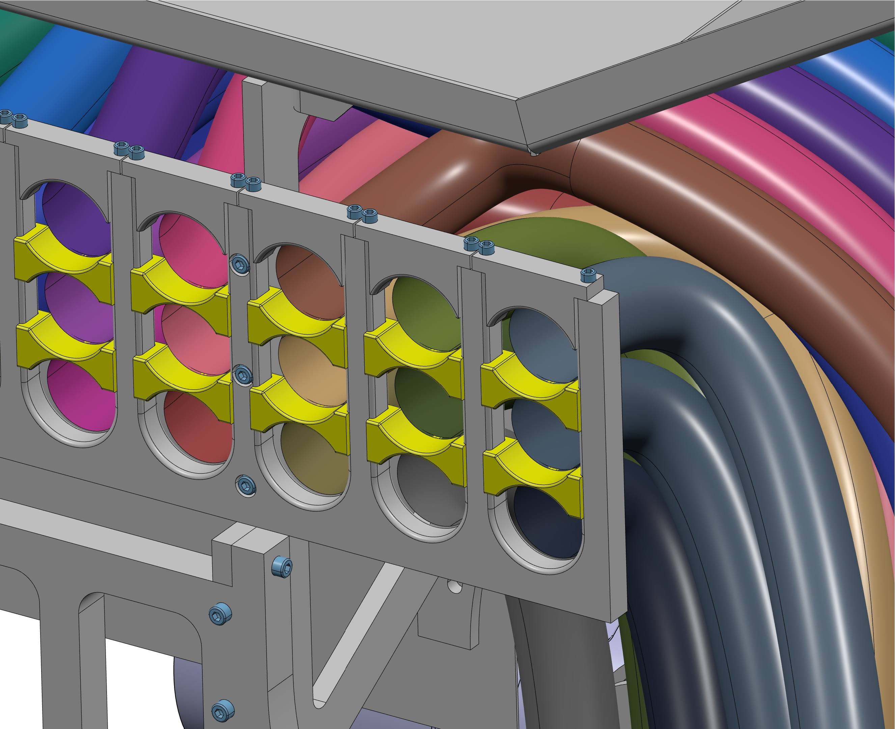
Cables removal
Mandatory to remove :
6 cables for the left one,
9 to 12 for the right one
Removing the cable spacer (yellow) and U-shaped terminal (for fixation)
Guillaume BRUNET, AGATA WEEK, Varsaw, 11 September 2026

Slide 21
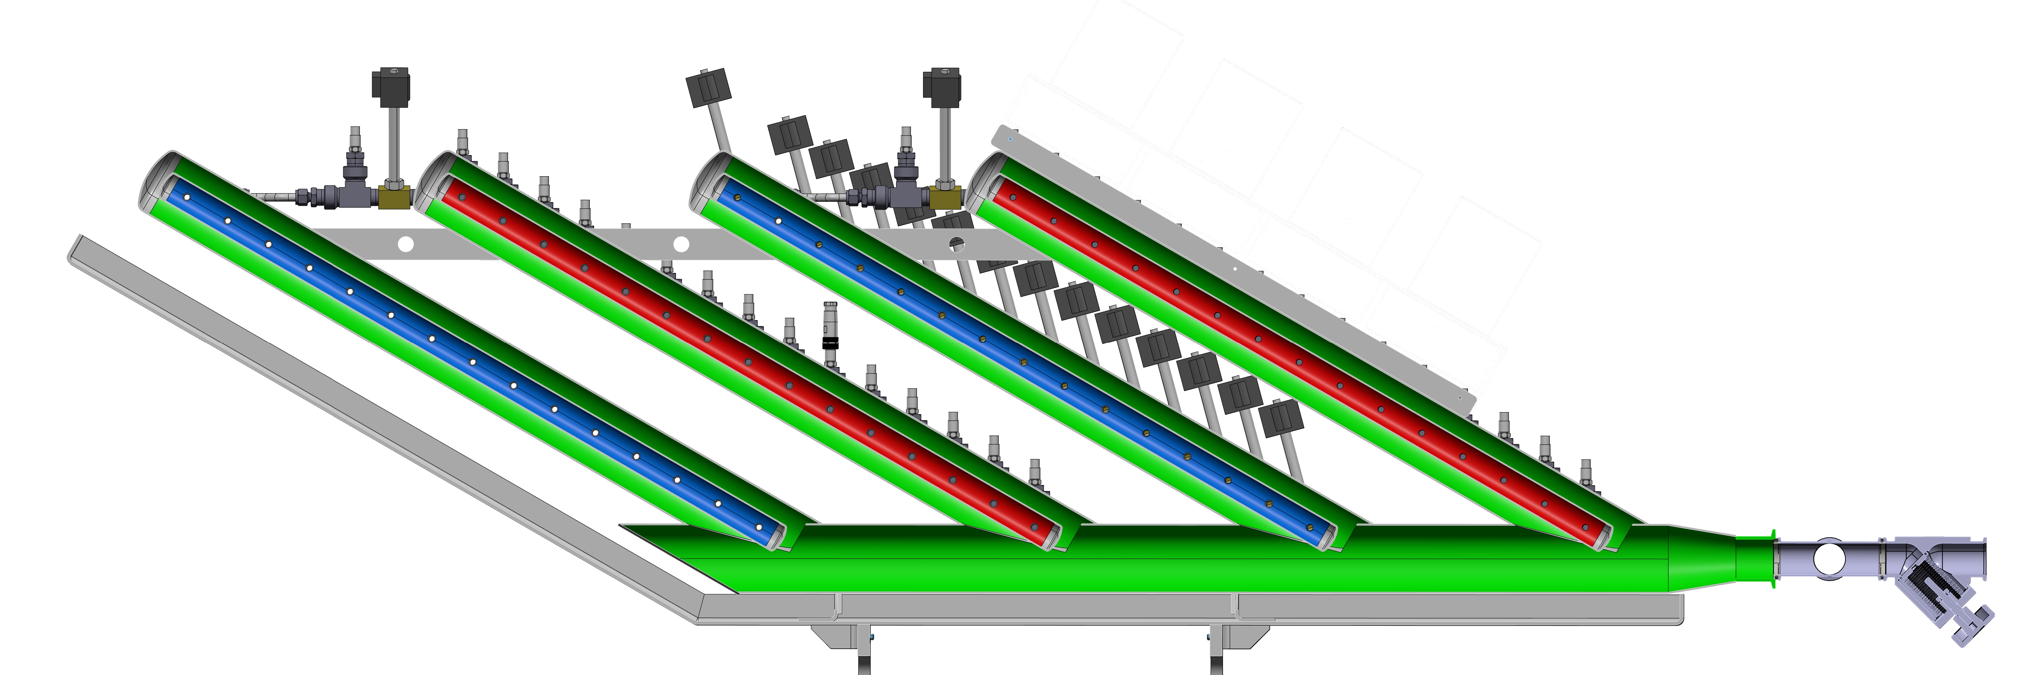
LN2 Distribution insulation
2000mm
Inlet
Outlet
Vacuum insulation
700mm
Inlet and outlet are insulated with Multi-Layer Insulation (MLI) and vacuum.
Same components as the current distribution are used (cryogenic valves, sensors, etc.)
Guillaume BRUNET, AGATA WEEK, Varsaw, 11 September 2026

