Slide 1
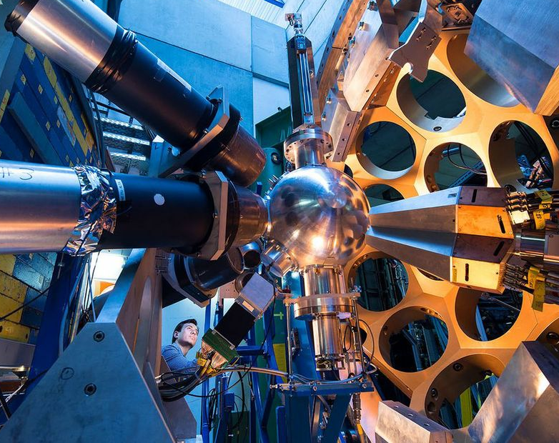
AGATA Zero-Deg Updates
G.Benzoni, M.Benettoni, M.Bolognesi, F.Camera , M.Ciemała, S.Coelli, T.Druillole, C.Le Gaillard, F. Galtarossa, A. Goasduff, A.Maj, L.Manara, I.Matea, R.Menegazzo, L.Ramina, M.Rampazzo, M.Scarcioffolo, D.Scarpa, R.Smith, B. Sowicki, F.Veronese, J.J.Valiente-Dobon
INFN-Mi, INFN-Pd, INFN-LNL, STFC (UK), IJCLab (Fr), IFJ-Pan (Pl)
The 26th AGATA week and ACC meeting 7-11 Sept. 2026 HIL - Warsaw

Slide 2
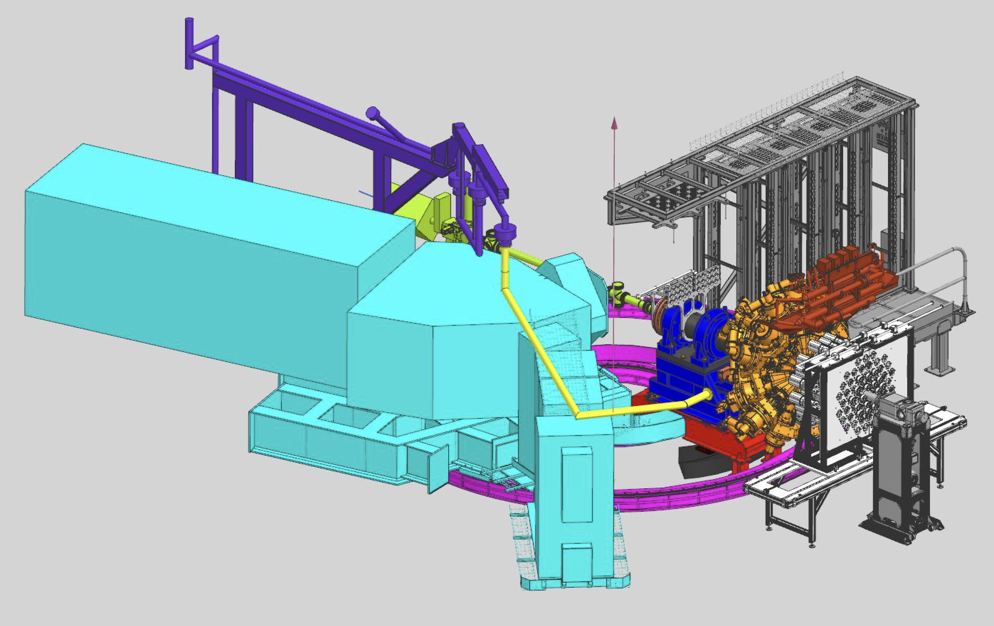
Zero-Degree configuration

Slide 3
Pre-PAC ancillary detector request
Stolen from A. Goasduff

Slide 4

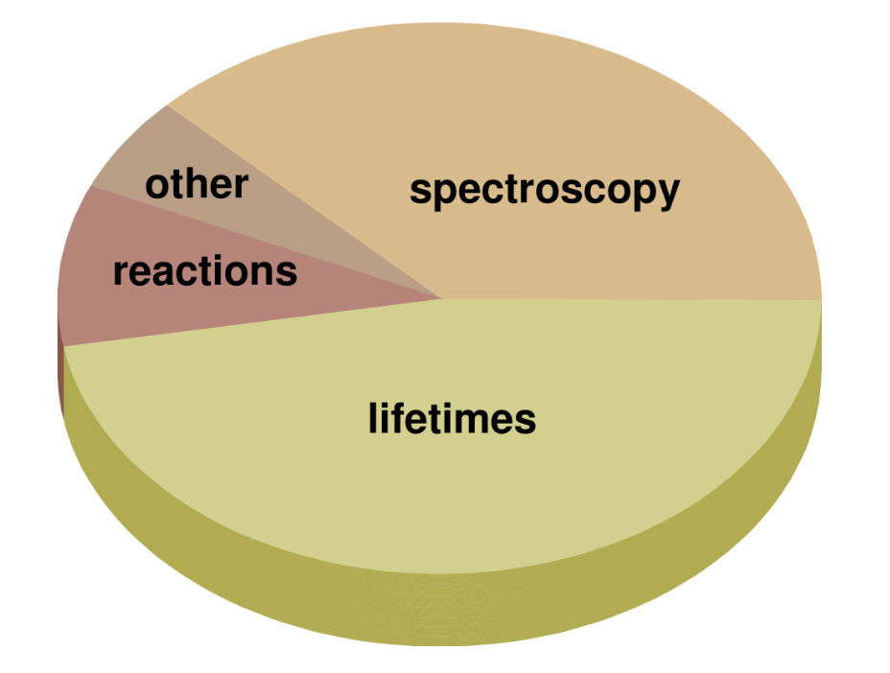
Pre-PAC results
About 50% of the projects request NEDA
About 25% request PARIS
About 25% request neither detector
A similar number of lifetime-measurement experiments (plunger and DSAM) and pure spectroscopy experiments, together with some reaction studies
Multiple experiments interested in using gas-implanted targets (in particular ³He)

Slide 5
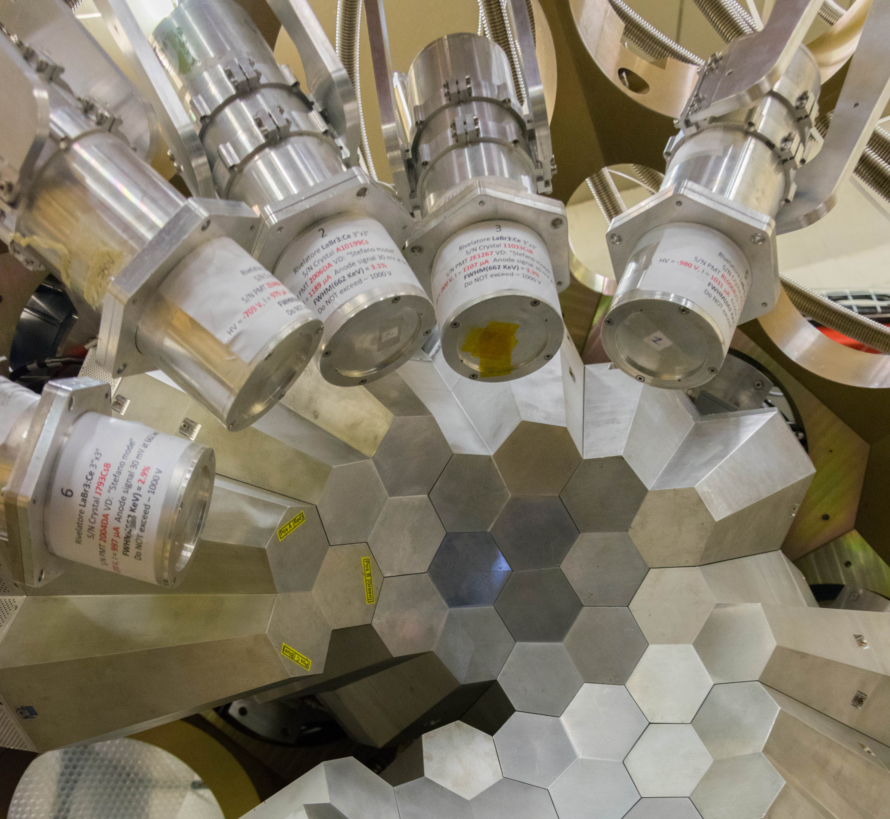
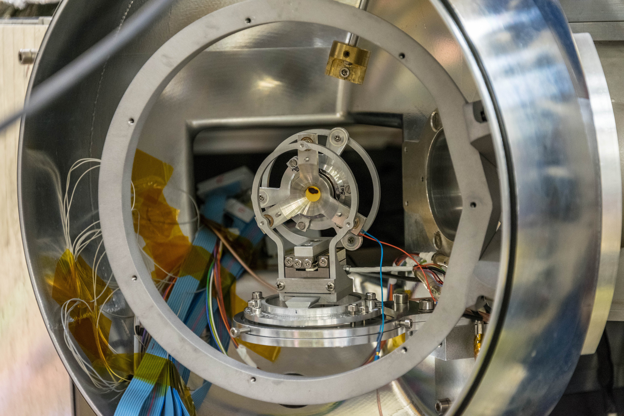
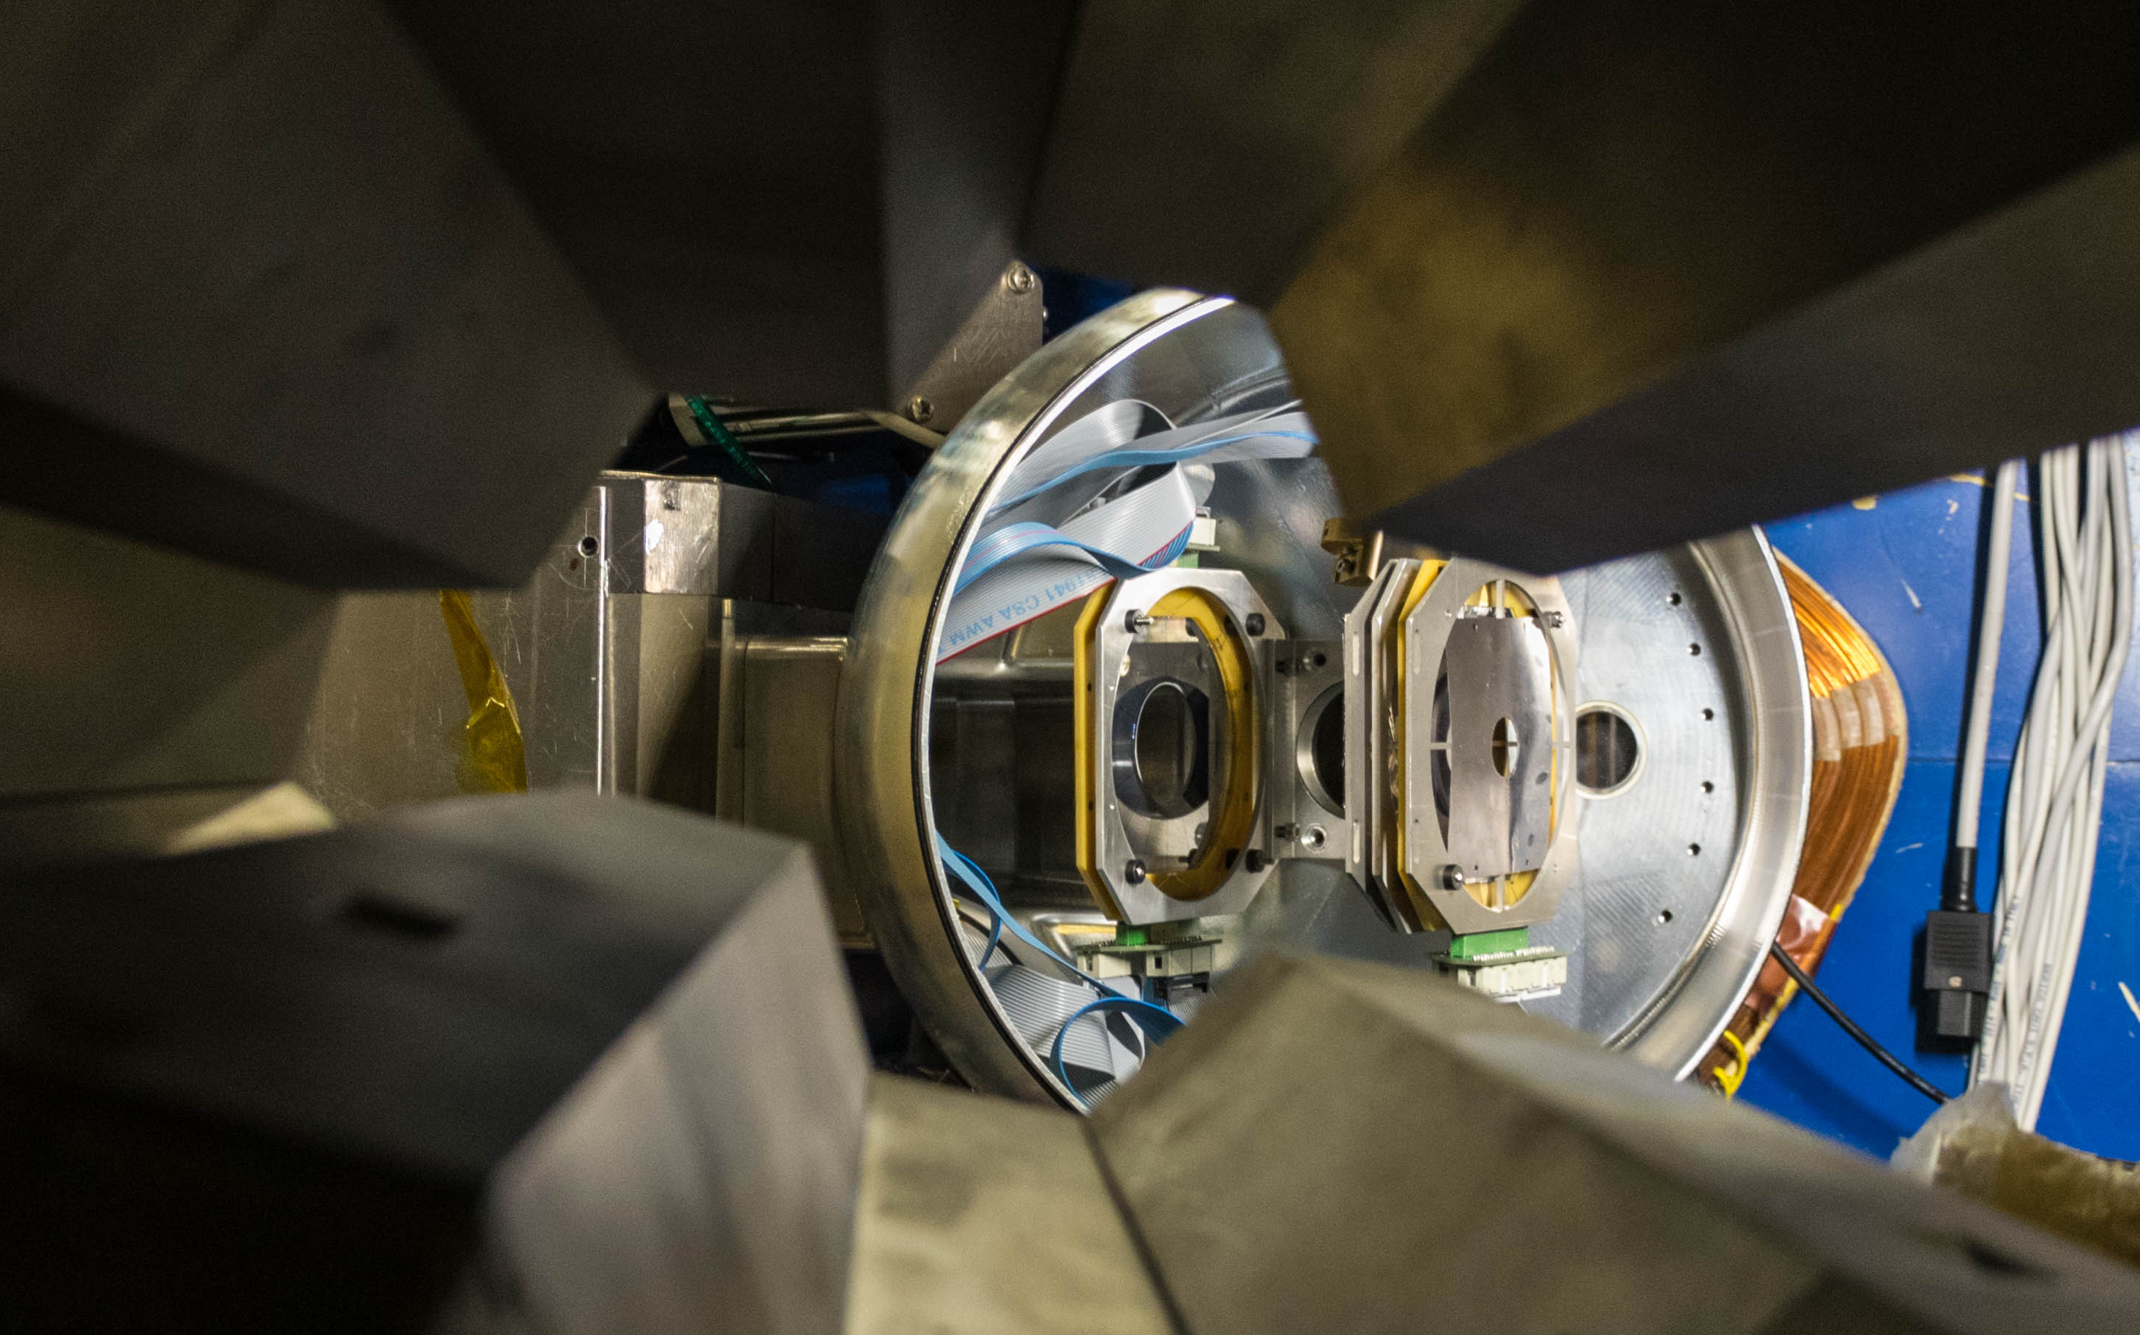
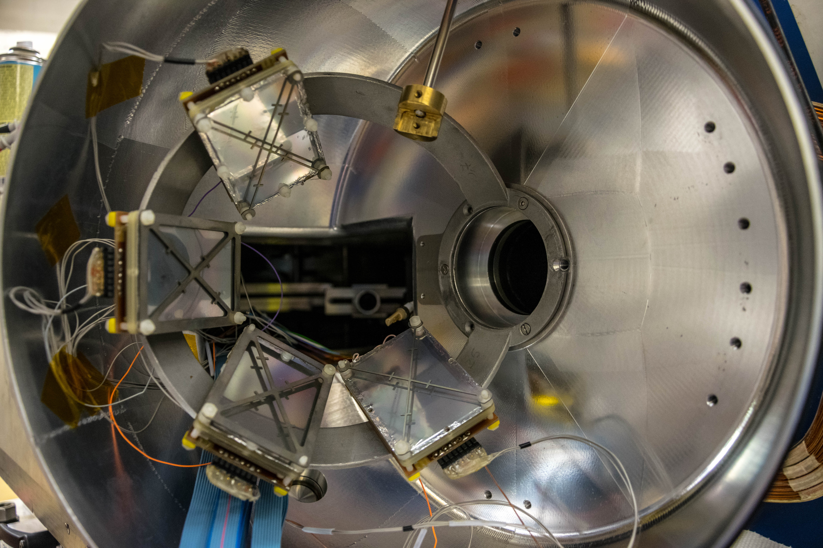
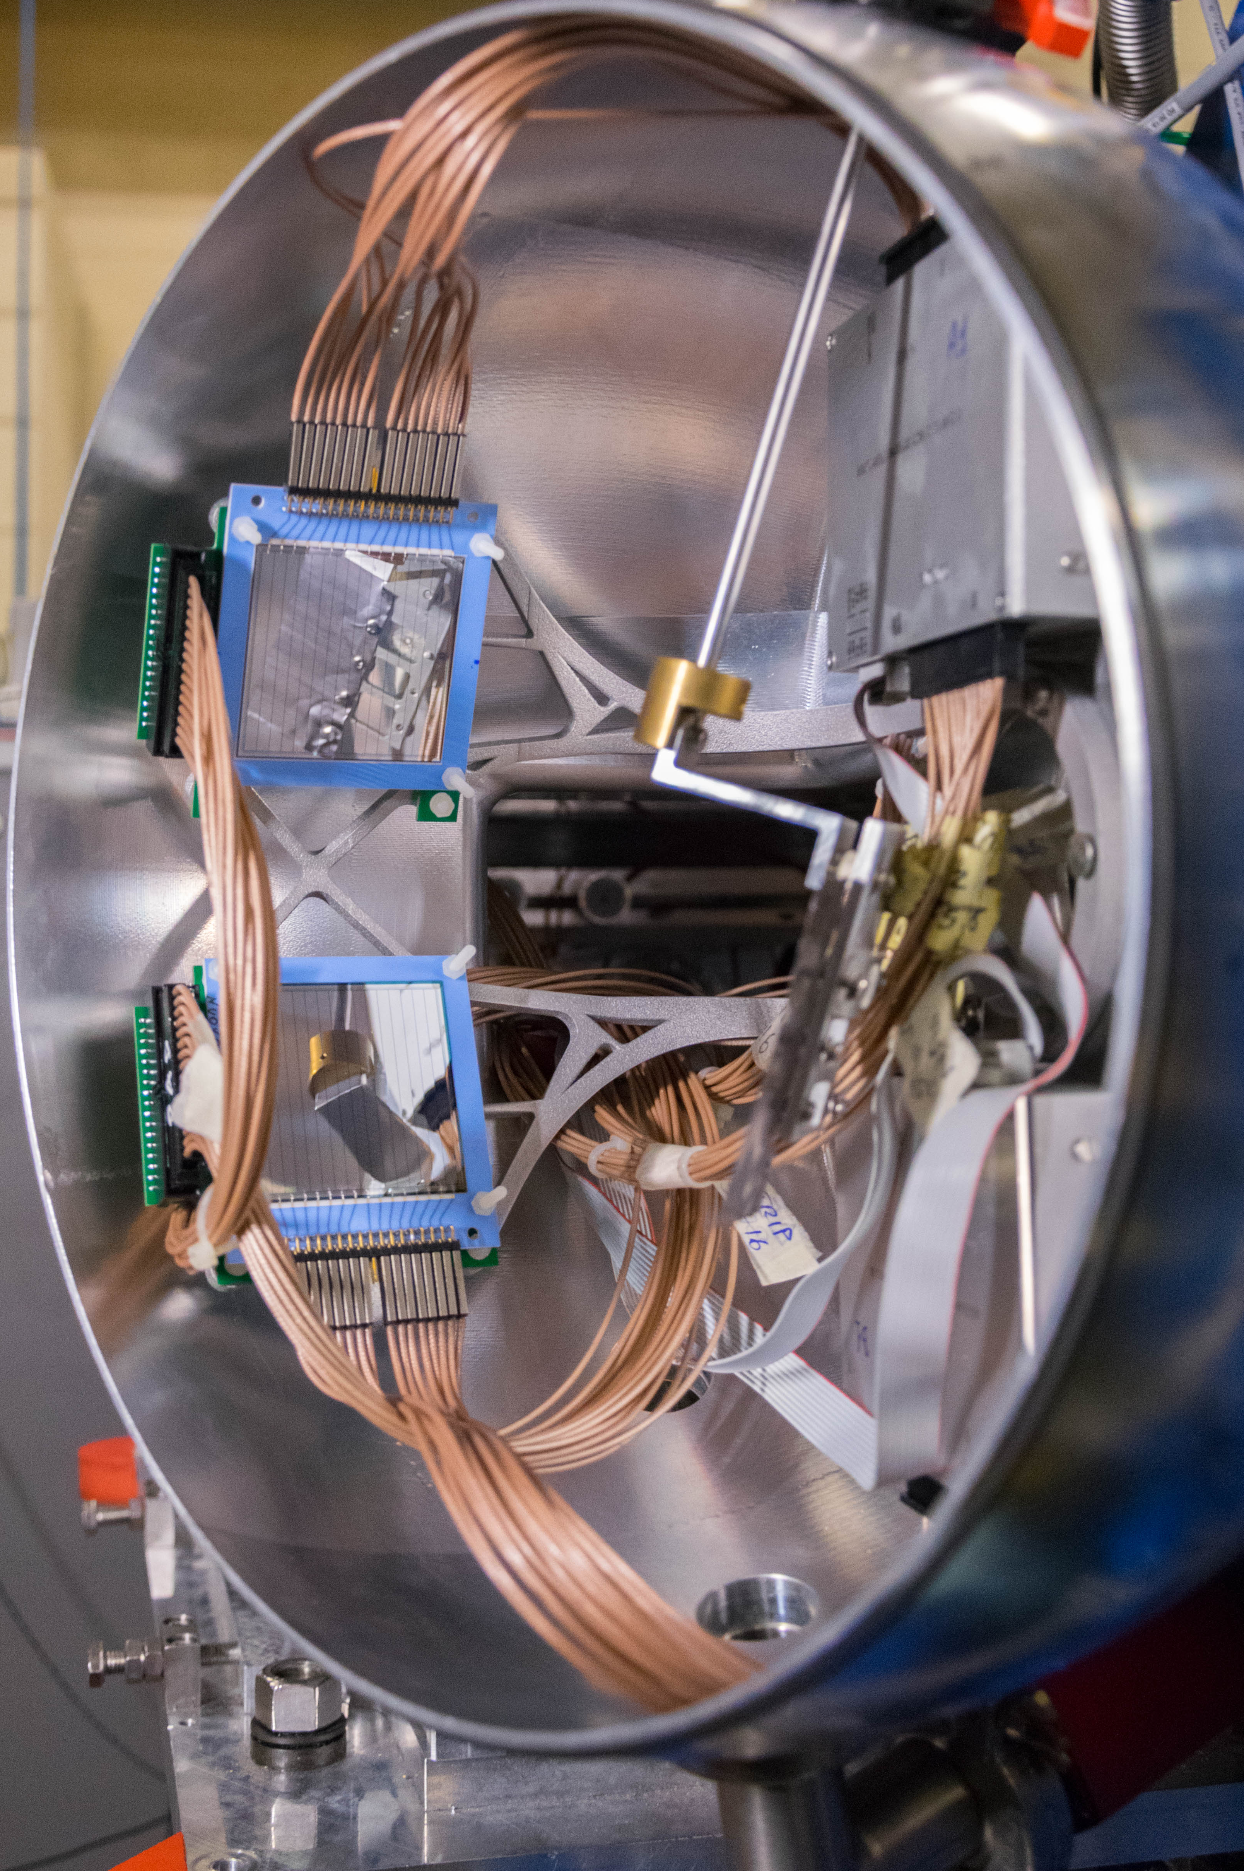
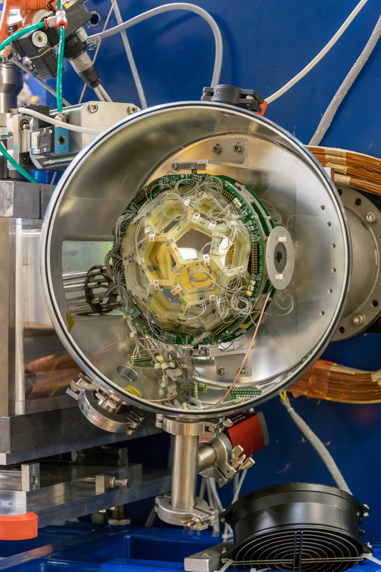
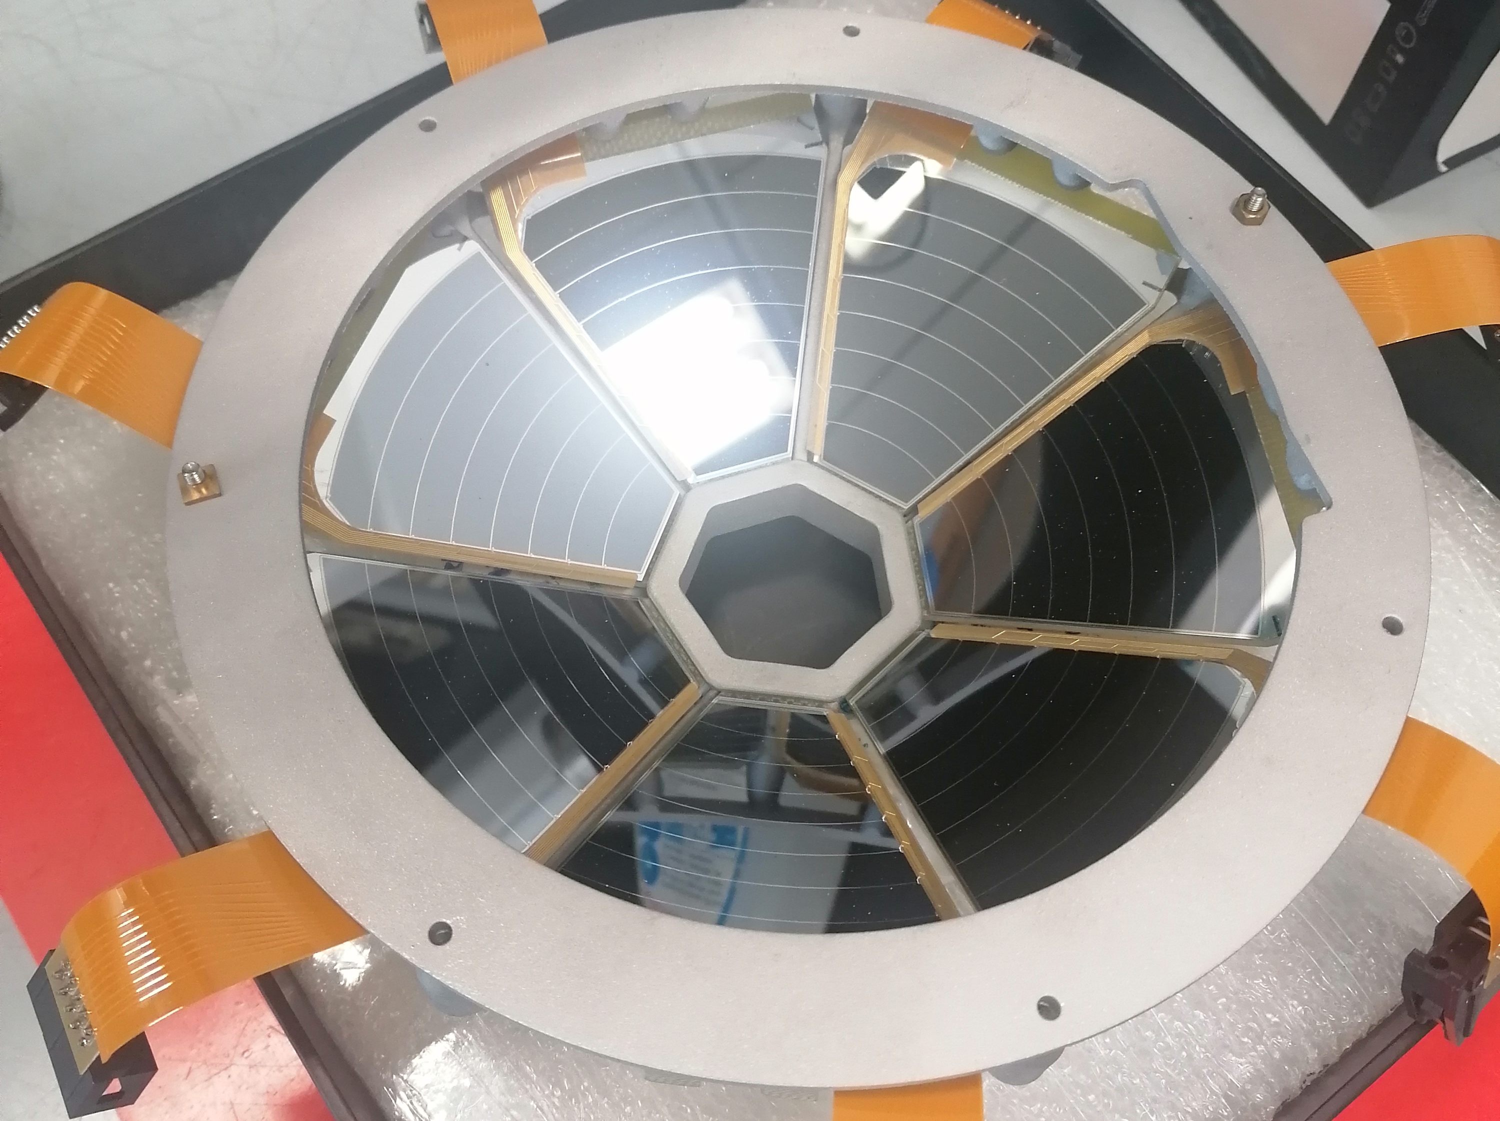
AGATA Zero-Deg Configuration: multi-purpose chamber: A wealth of Complementary detectors
Heavy ions:
  PRISMA
  SPIDER
  DANTE
  OSCAR
Light charged particles:
  SPIDER
  EUCLIDES
  SAURON
  AGATRACE
Lifetimes
  Plungers
Scintillators
  LaBr₃(Ce)
  PARIS
  NEDA
Courtesy of M. Balogh, A. Goasduff

Slide 6
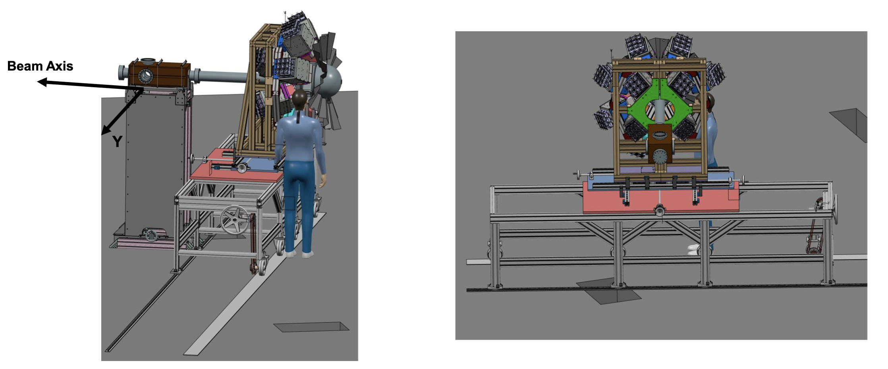
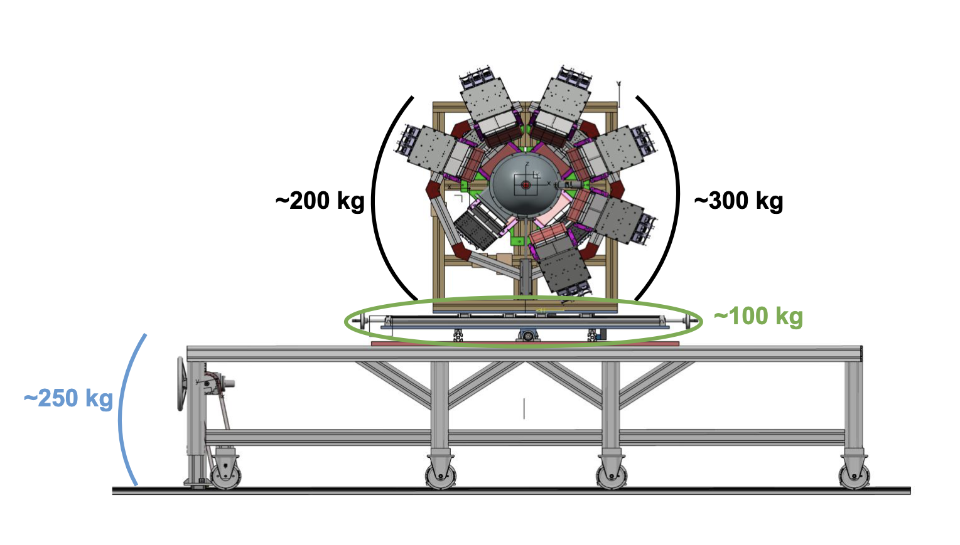
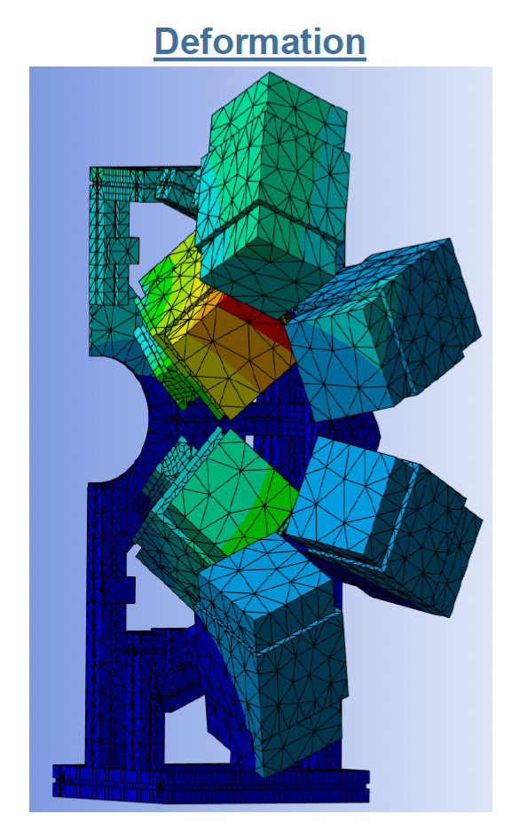
PARIS support structure
Holding 10 PARIS clusters (10x9 phoswich dets.)
2 rings at forward angles:
  6 clusters at 60 degrees
  4 clusters at 15 degrees
  Average distance Ta-Phoswich 300 mm
  Very bulky equipment (total weight ~ 200 kg)
  Stress evaluation shows deformations below 0.4 mm
PARIS portal opens in the halves to provide access to scattering chamber
Sharing support moving table with NEDA
Interchange platform specific for each array (different heights)
Table able to retract to a «parking» position to allow operations in the chamber and on AGATA detectors

Slide 7
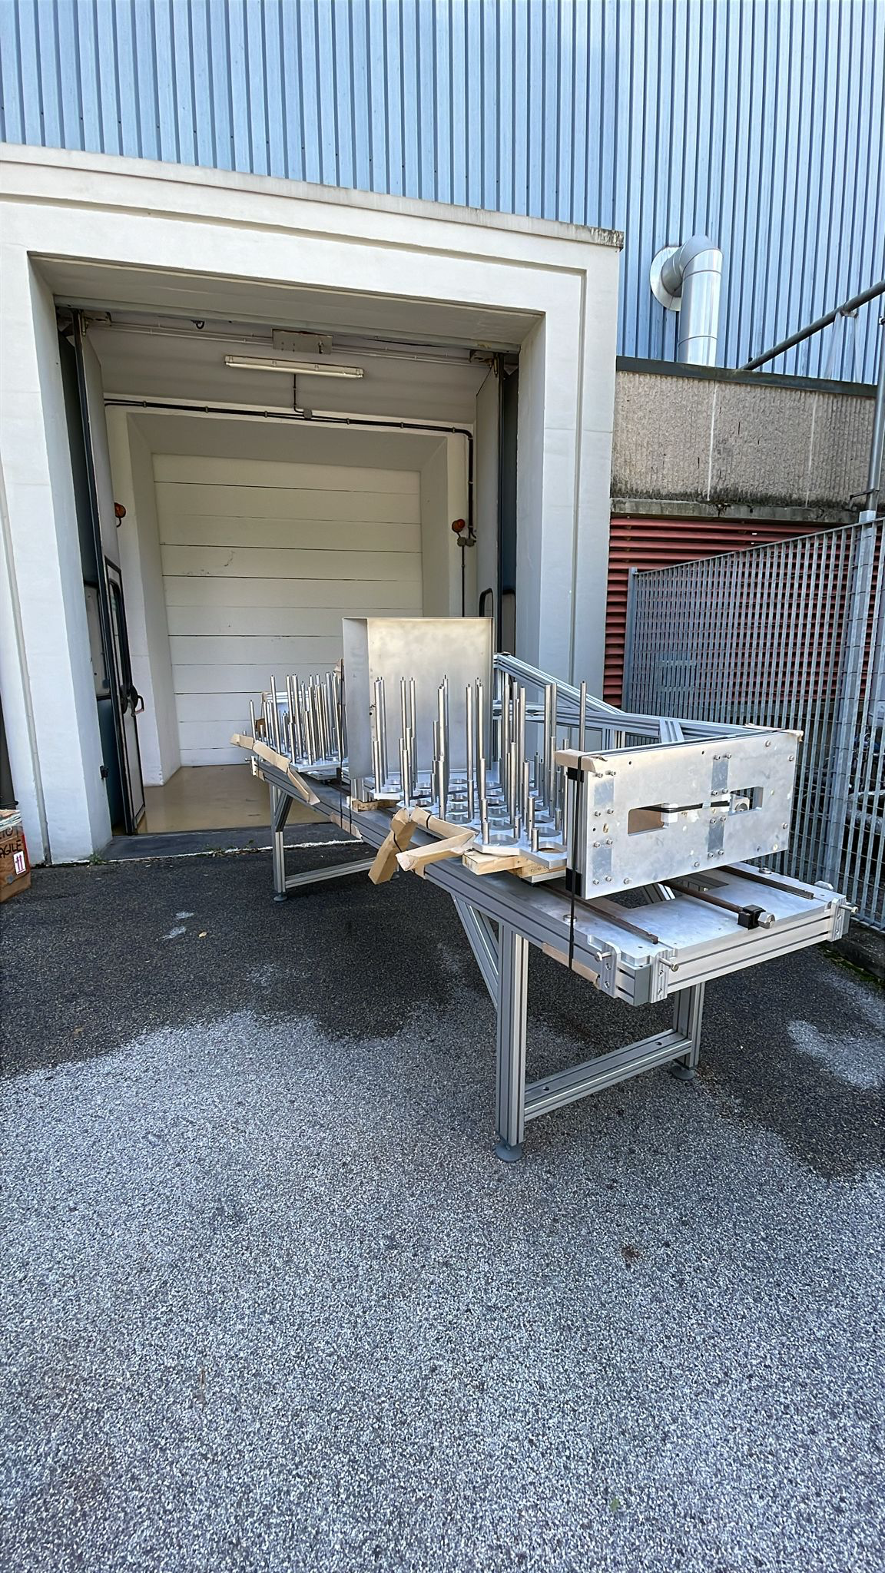
Zero degree campaign “bulky” ancillaries: NEDA
NEDA Neutron Detector Array
54 liquid scintillator cells
50 cm from the target
Neutron discimination:
  PSA
  Time of flight
Digital electronics compatible with AGATA
DAQ integration is on-going
J.J. Valiente Dobón, Nucl. Inst. Meth. A 927 (2019) 81
NEDA support structure already @ LNL
interchange platform to adapt to new table already produced
Courtesy A.Goasduff

Slide 8
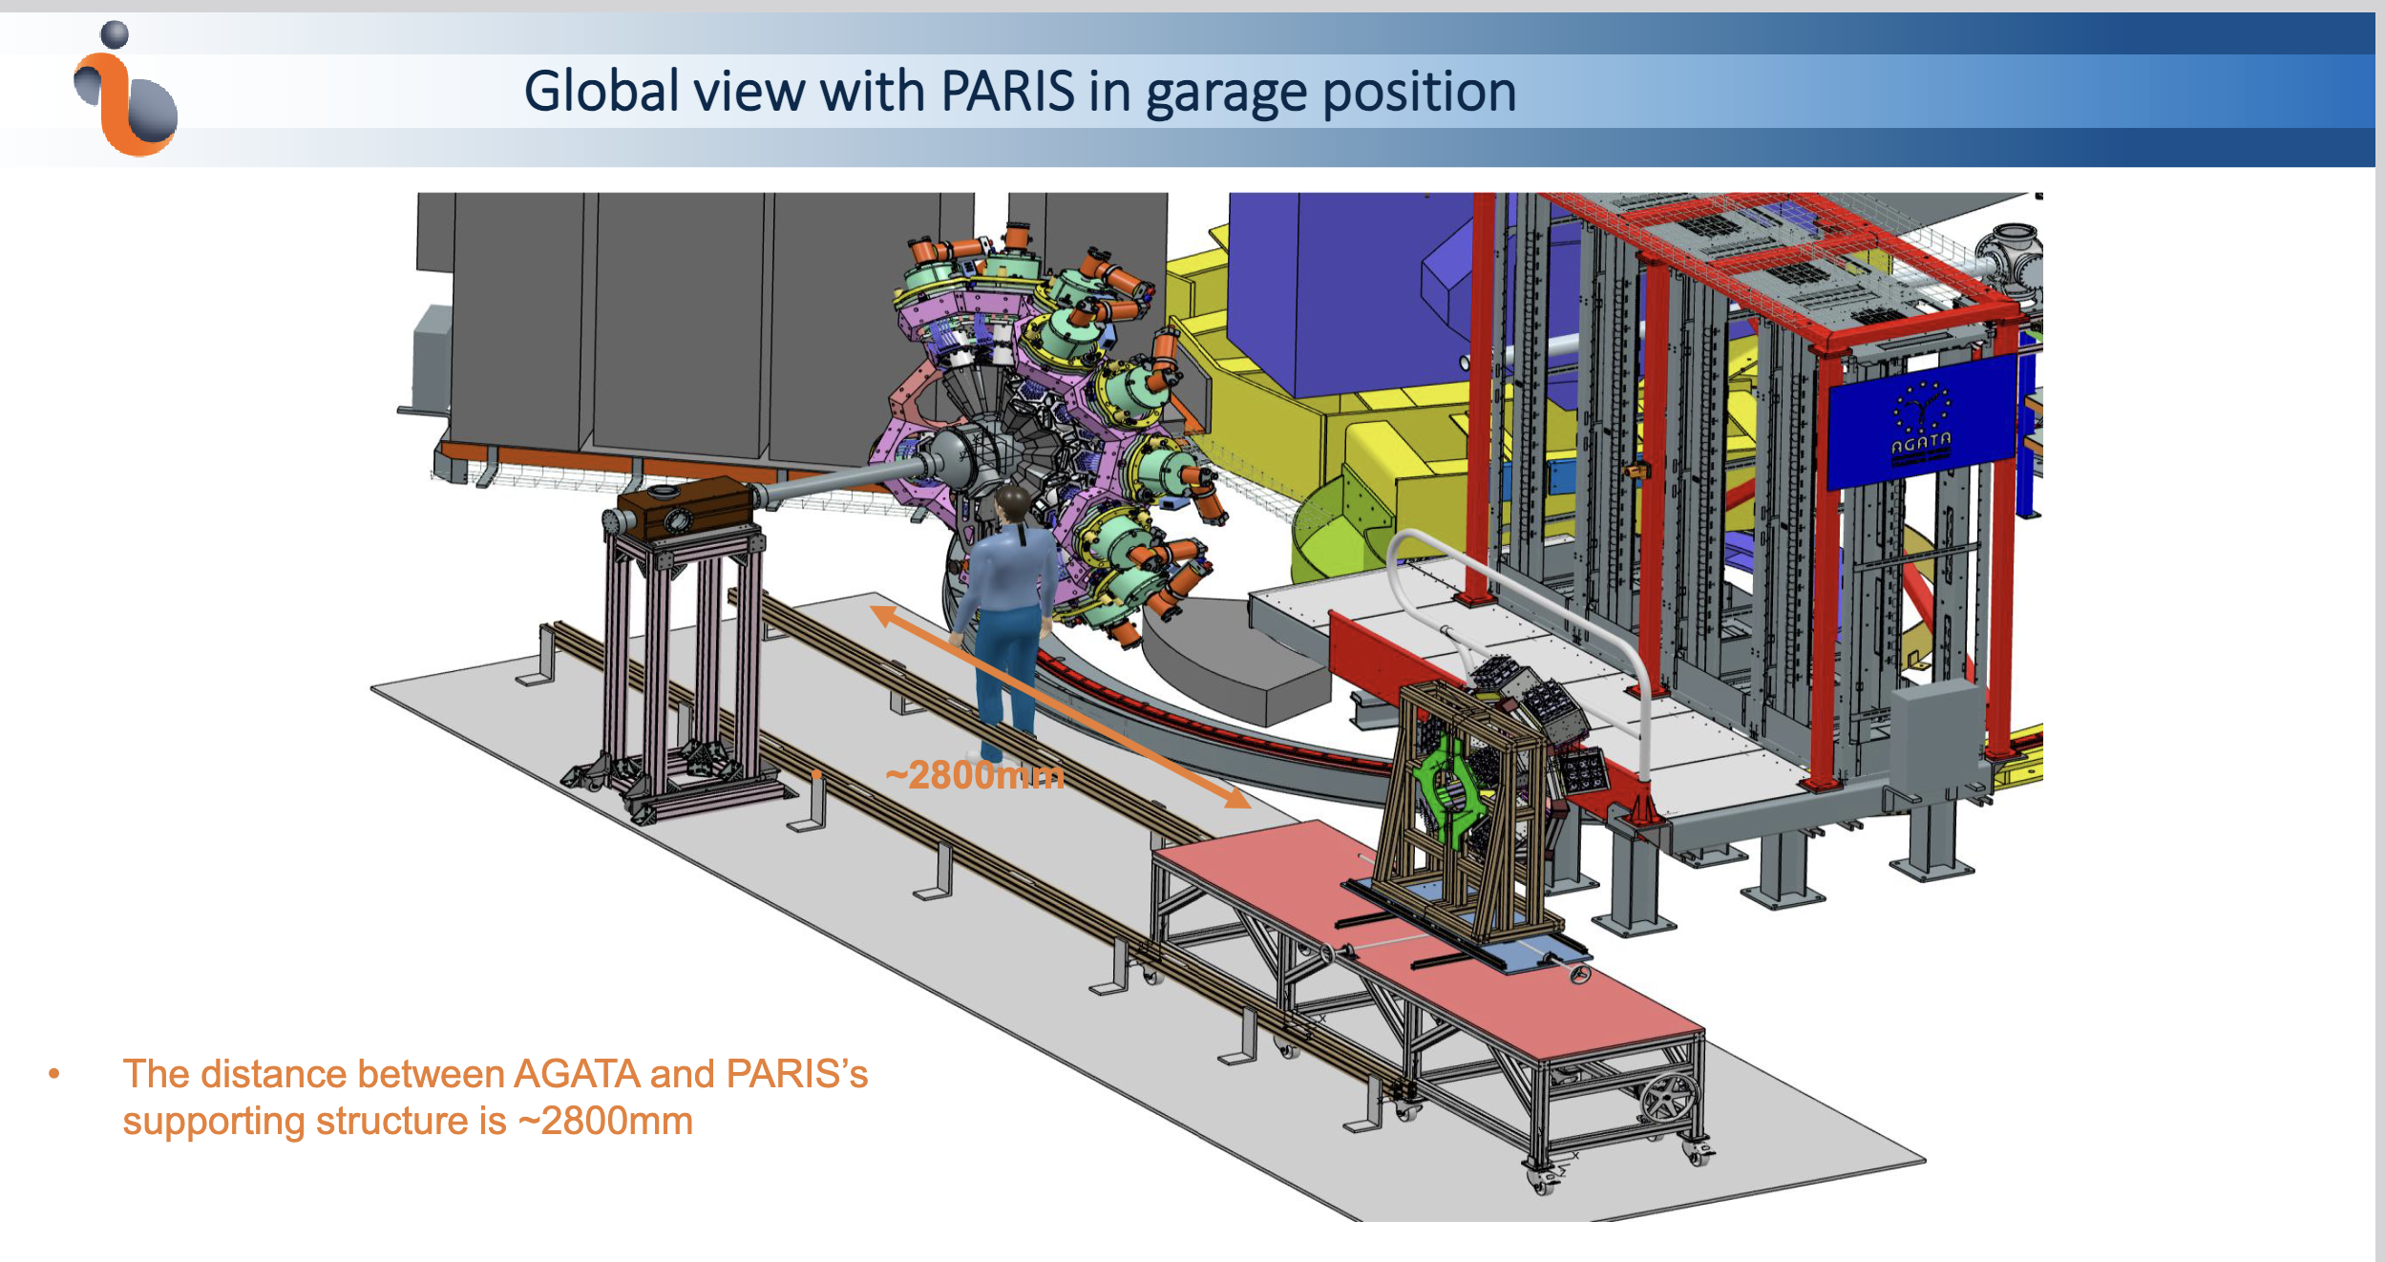

Slide 9
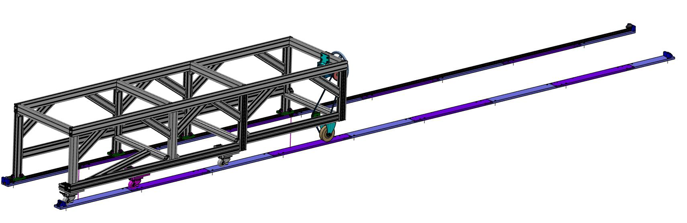
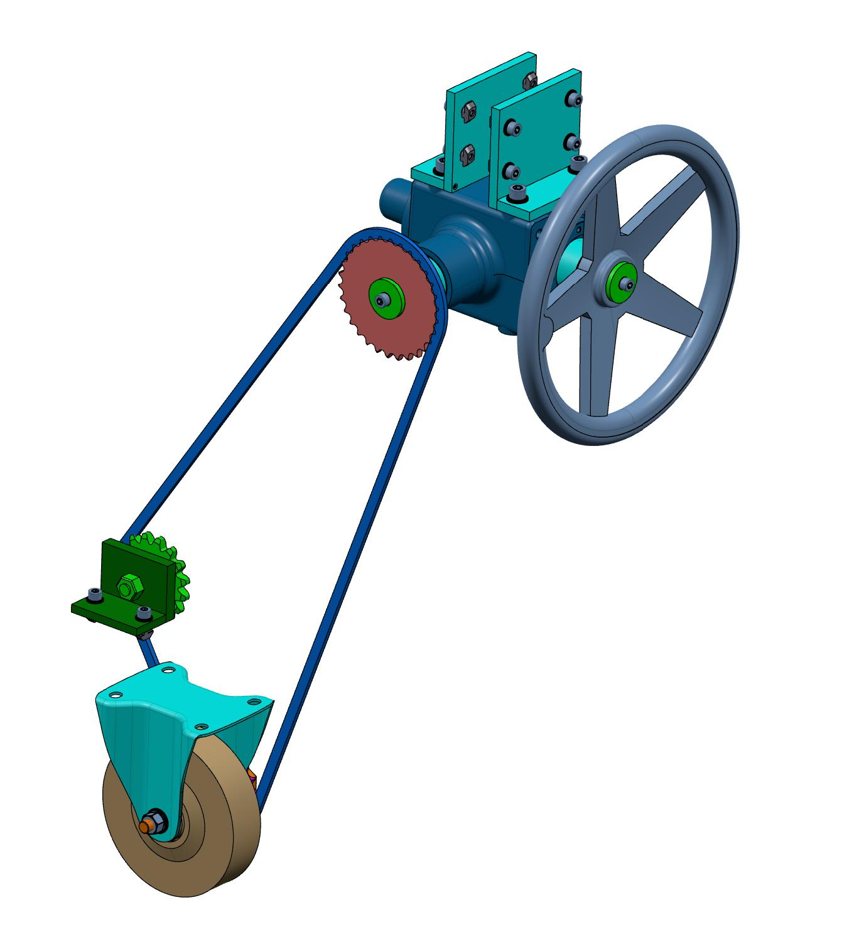
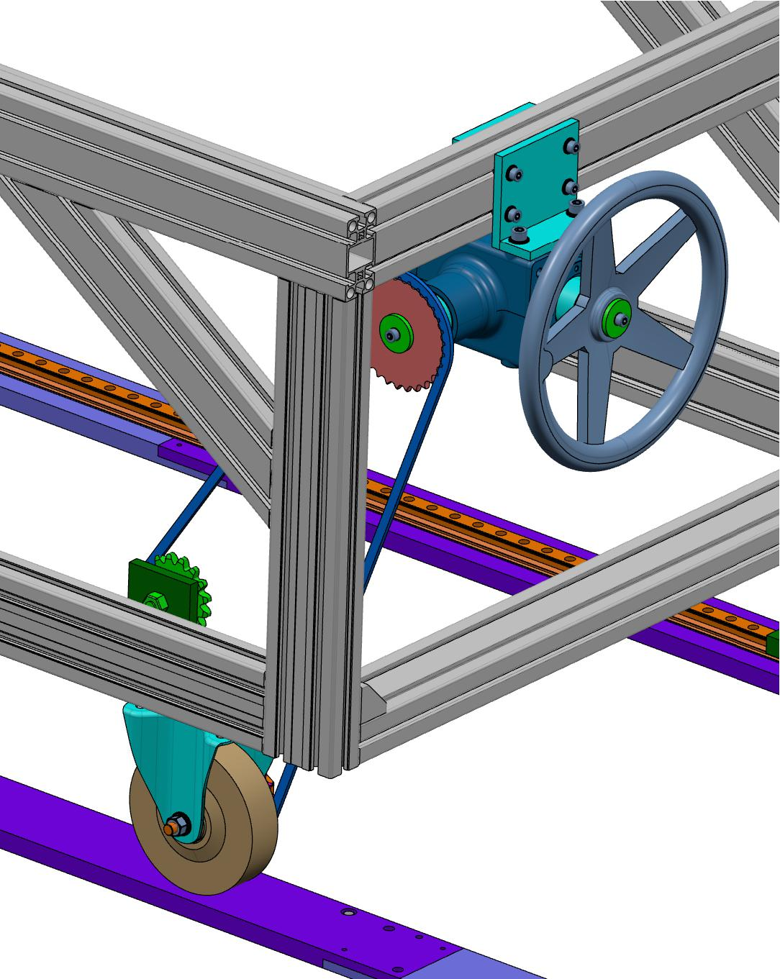
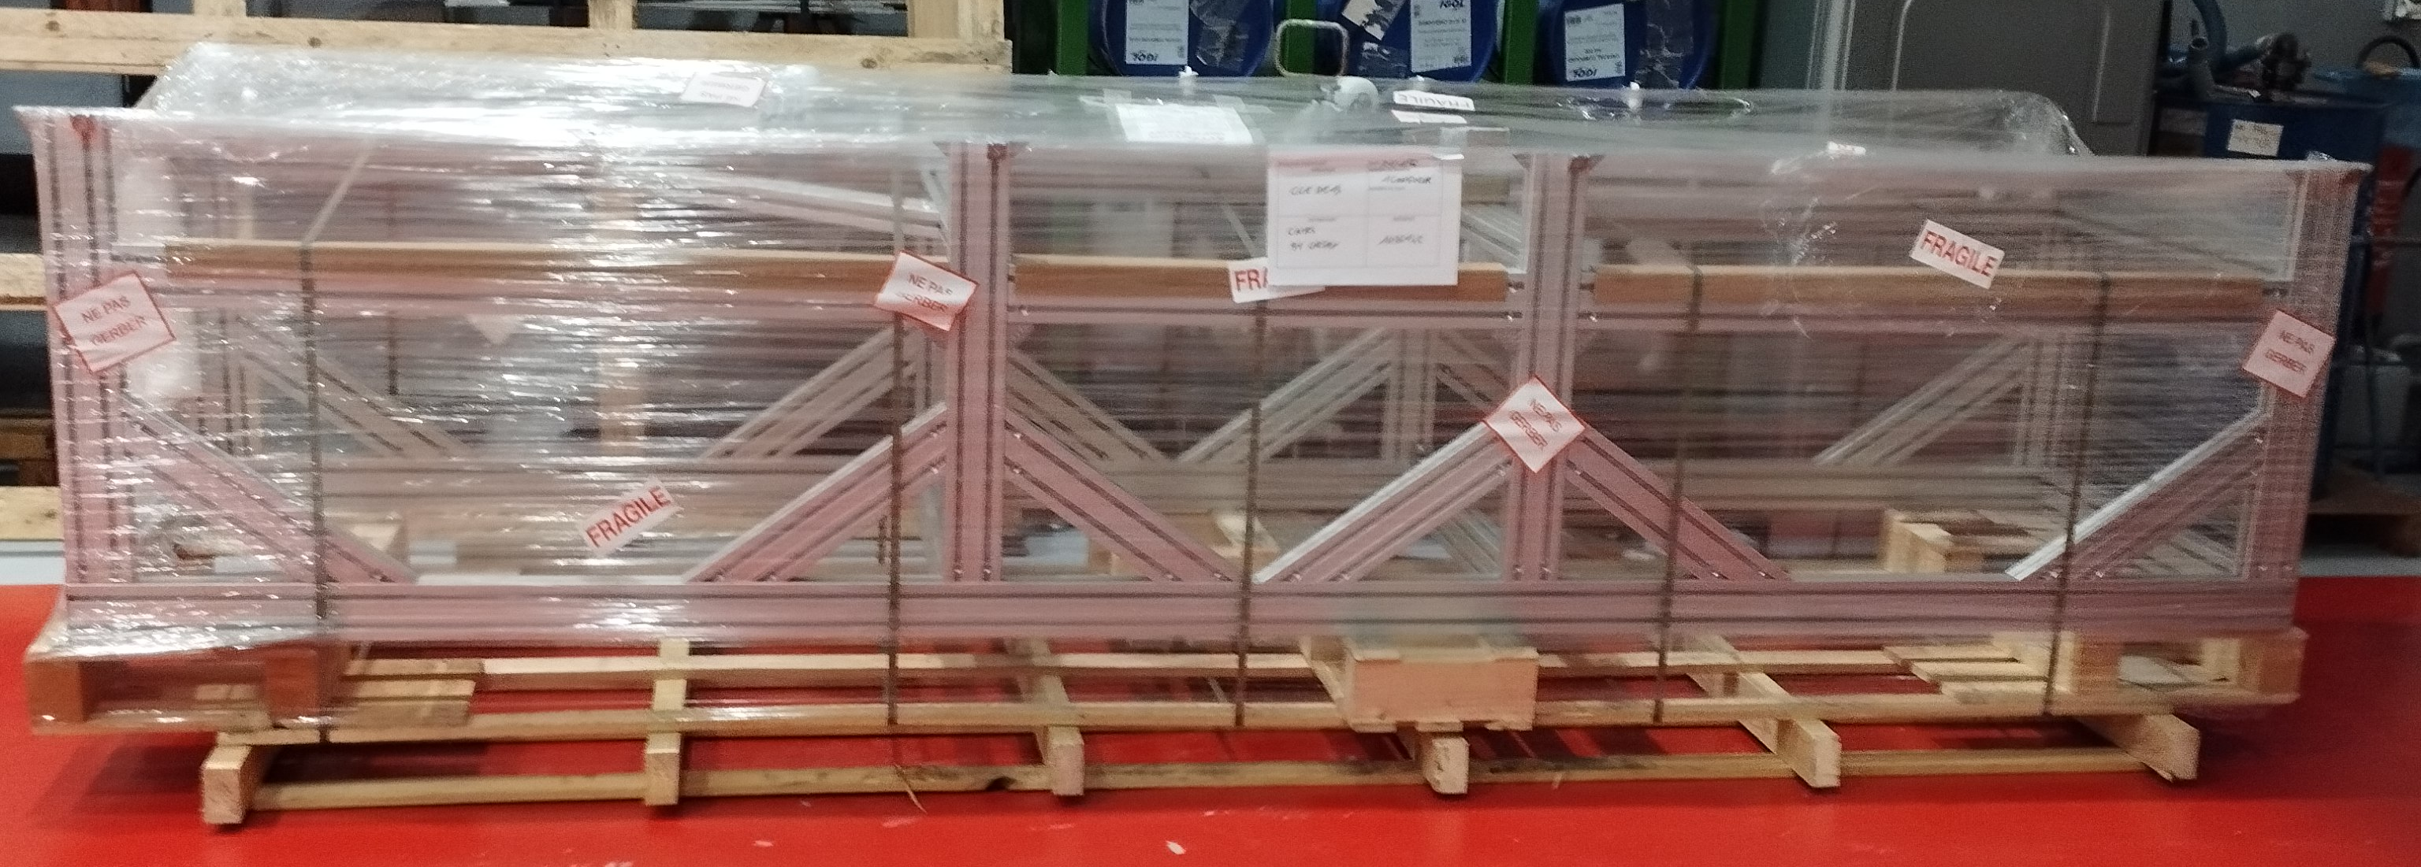
PARIS@LEGNARO
Progress report
Movement control mechanisms
Running plates for the rails
Bosch Rexroth table
Running plates for the wheels
Handwheel
Positioning shaft
Angle drive
Gear
Positioning shaft
Chain
Wheel

Slide 10
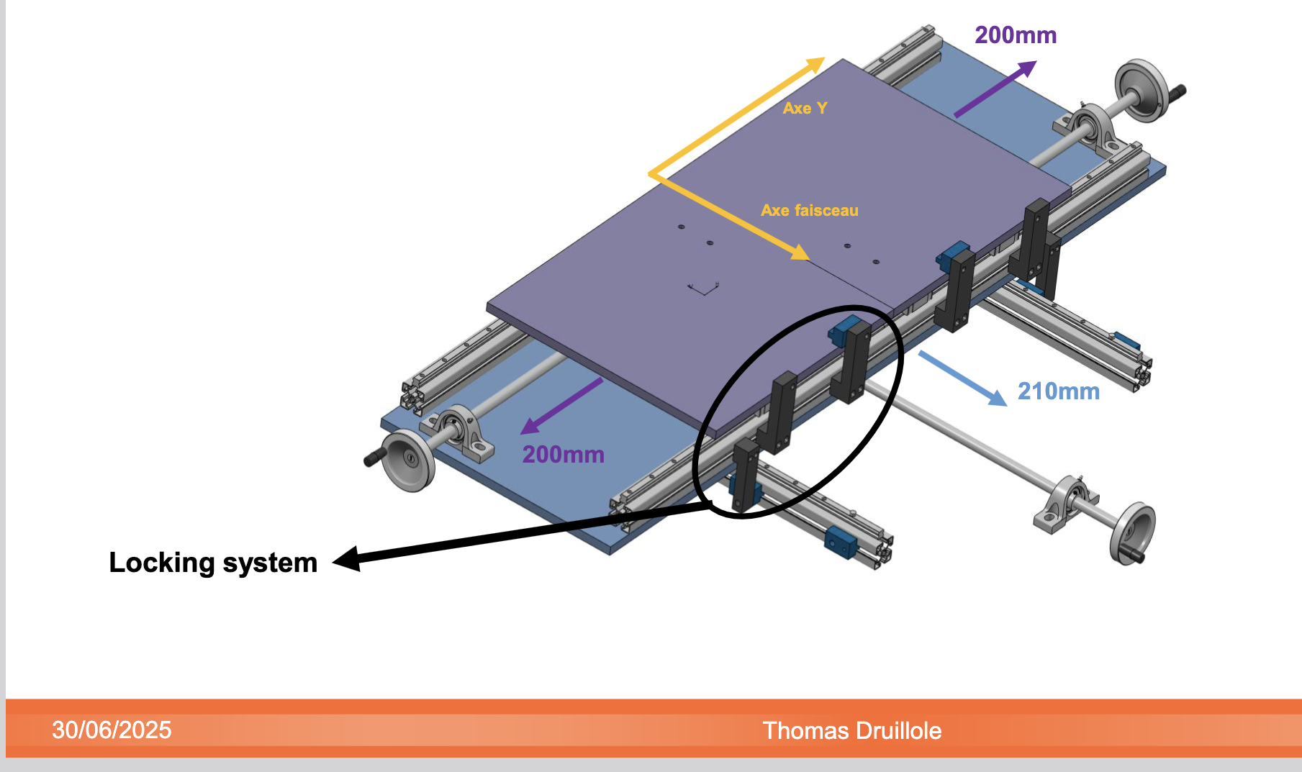
PARIS@LEGNARO
Progress report
Movement control mechanisms
Running plates for the rails
Bosch Rexroth table
Running plates for the wheels
Positioning shaft
Positioning shaft

Slide 11
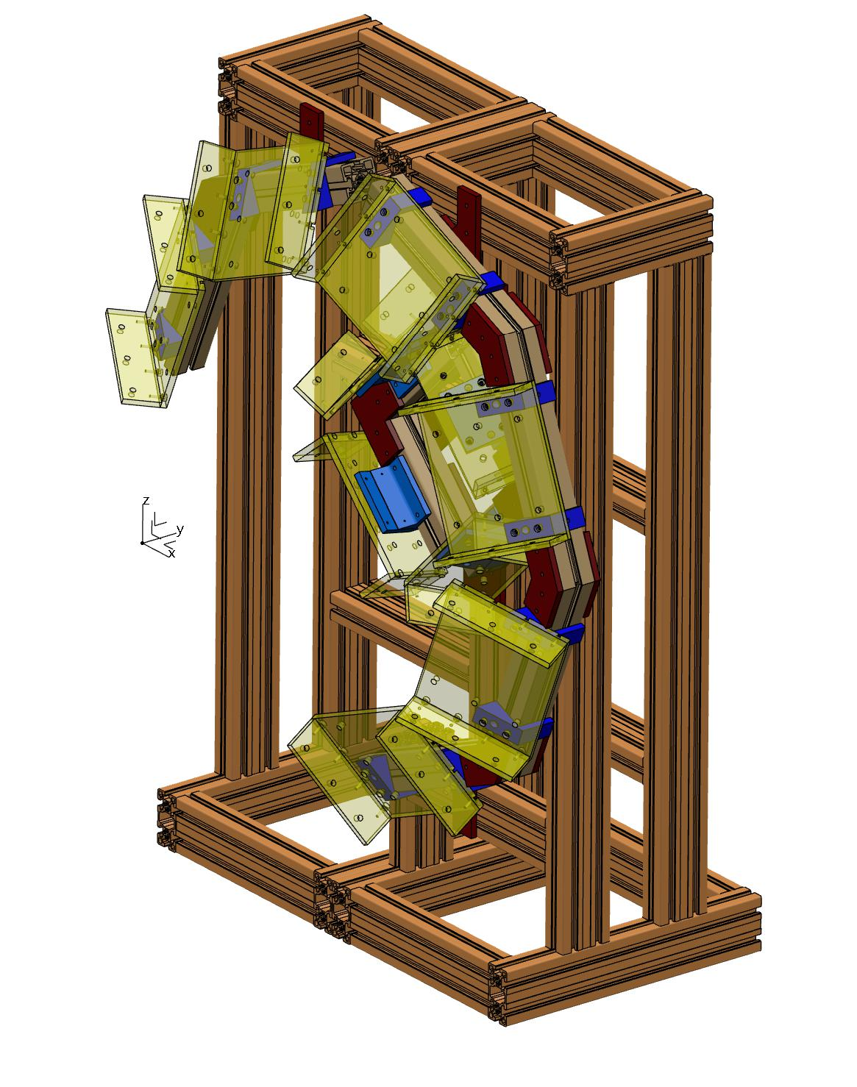
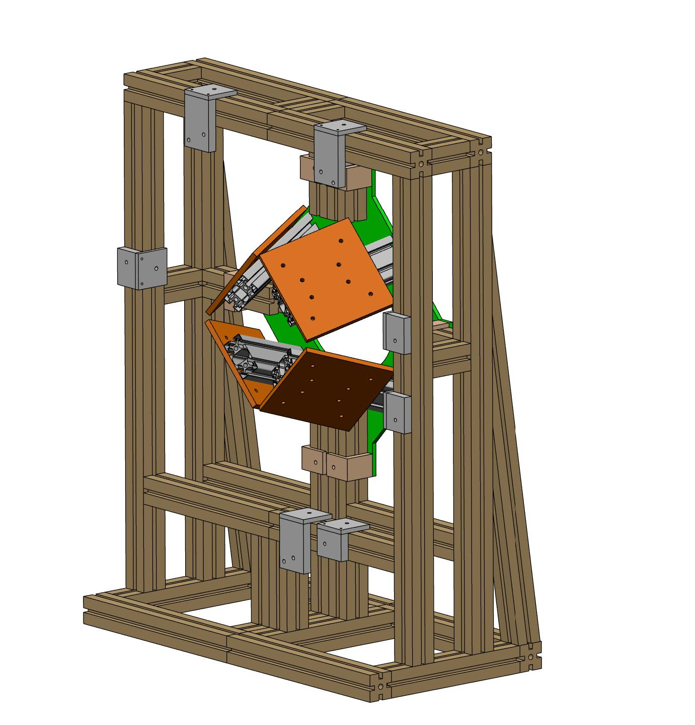
PARIS@LEGNARO
New support in aluminium profile
Upper support in aluminium profile
Bosch Rexroth aluminium profile 45x90
Manufactured parts (Krakow)
Cluster support in aluminium profile
Bosch Rexroth aluminium profile 60 x 60
Old support in aluminium profile 45x45

Slide 12
PARIS@LEGNARO
New support in aluminium profile
Upper support in aluminium profile
Bosch Rexroth aluminium profile 45x90
Table and rails to arrive to LNL latest end of October
PARIS support structure to be delivered second half of 2027
Manufactured parts (Krakow)
Cluster support in aluminium profile
Bosch Rexroth aluminium profile 60 x 60
Old support in aluminium profile 45x45

Slide 13
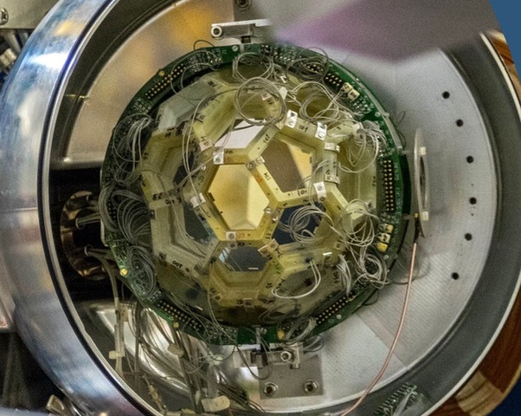
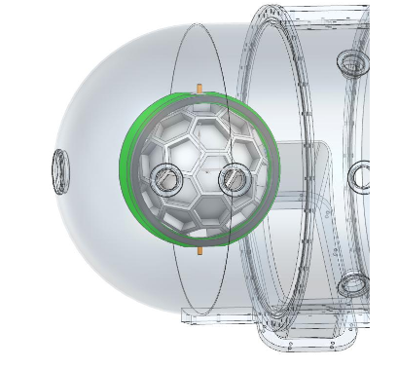
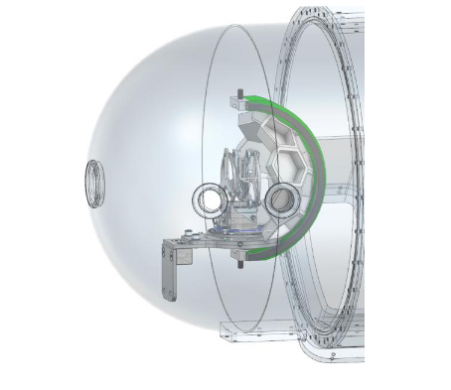
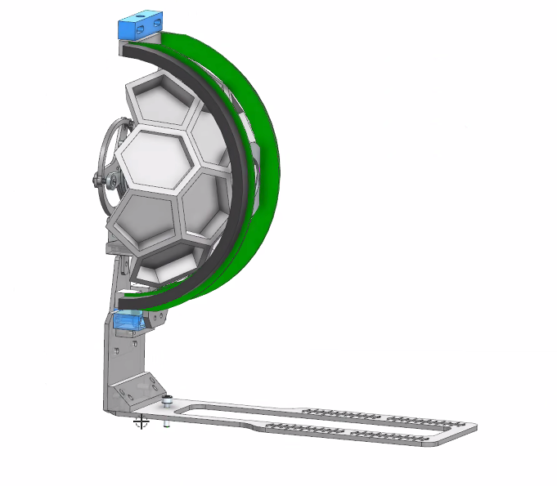
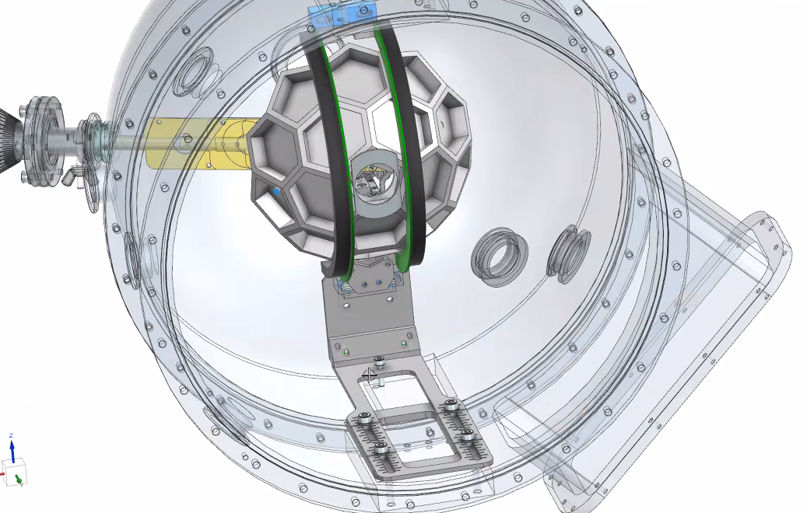
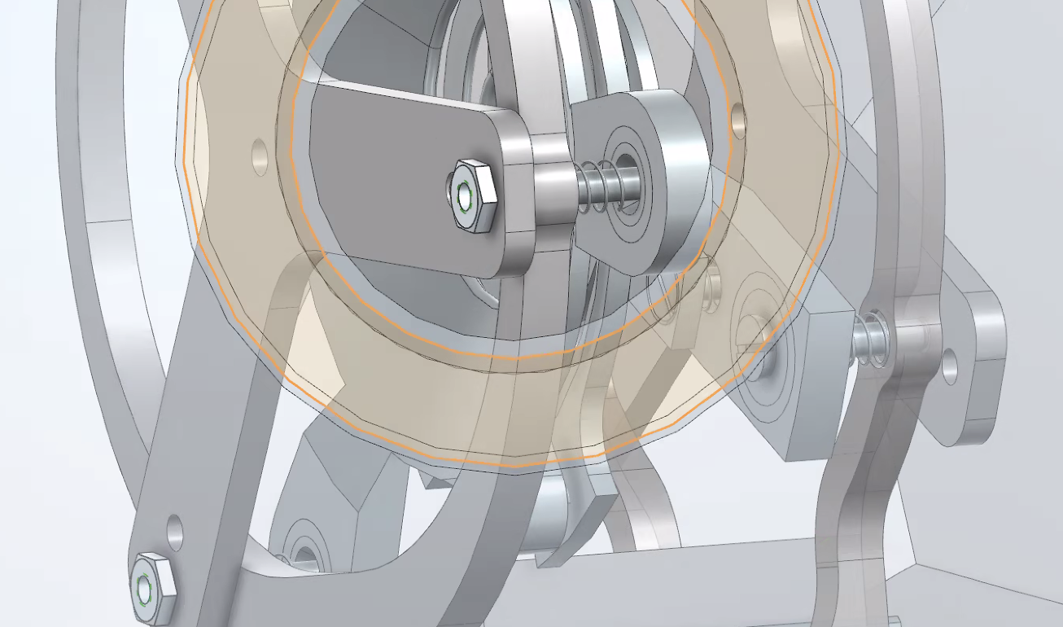
EUCLIDES integration in the new reaction chamber
EUCLIDES standard configuration
4π configuration
EUCLIDES with plunger
Forward rings only
Holding structure allows decentering the device by +/-15 mm using marked rails
Regulations in 3D are included
EUCLIDES and the plunger can be regulated independently
We need to define a procedure for beam focussing
when plunger is inserted since videocamera is
partially shadowed
Courtesy of F. Galtarossa – N. Bez

Slide 14
EUCLIDES integration in the new reaction chamber
EUCLIDES standard configuration
4π configuration
EUCLIDES with plunger
Forward rings only
intended to be common for all Si-based detectors
Holding structure allows decentering the device by +/-15 mm using marked rails
Regulations in 3D are included
EUCLIDES and the plunger can be regulated independently
We need to define a procedure for beam focussing
when plunger is inserted since videocamera is
partially shadowed
Courtesy of F. Galtarossa – N. Bez

Slide 15
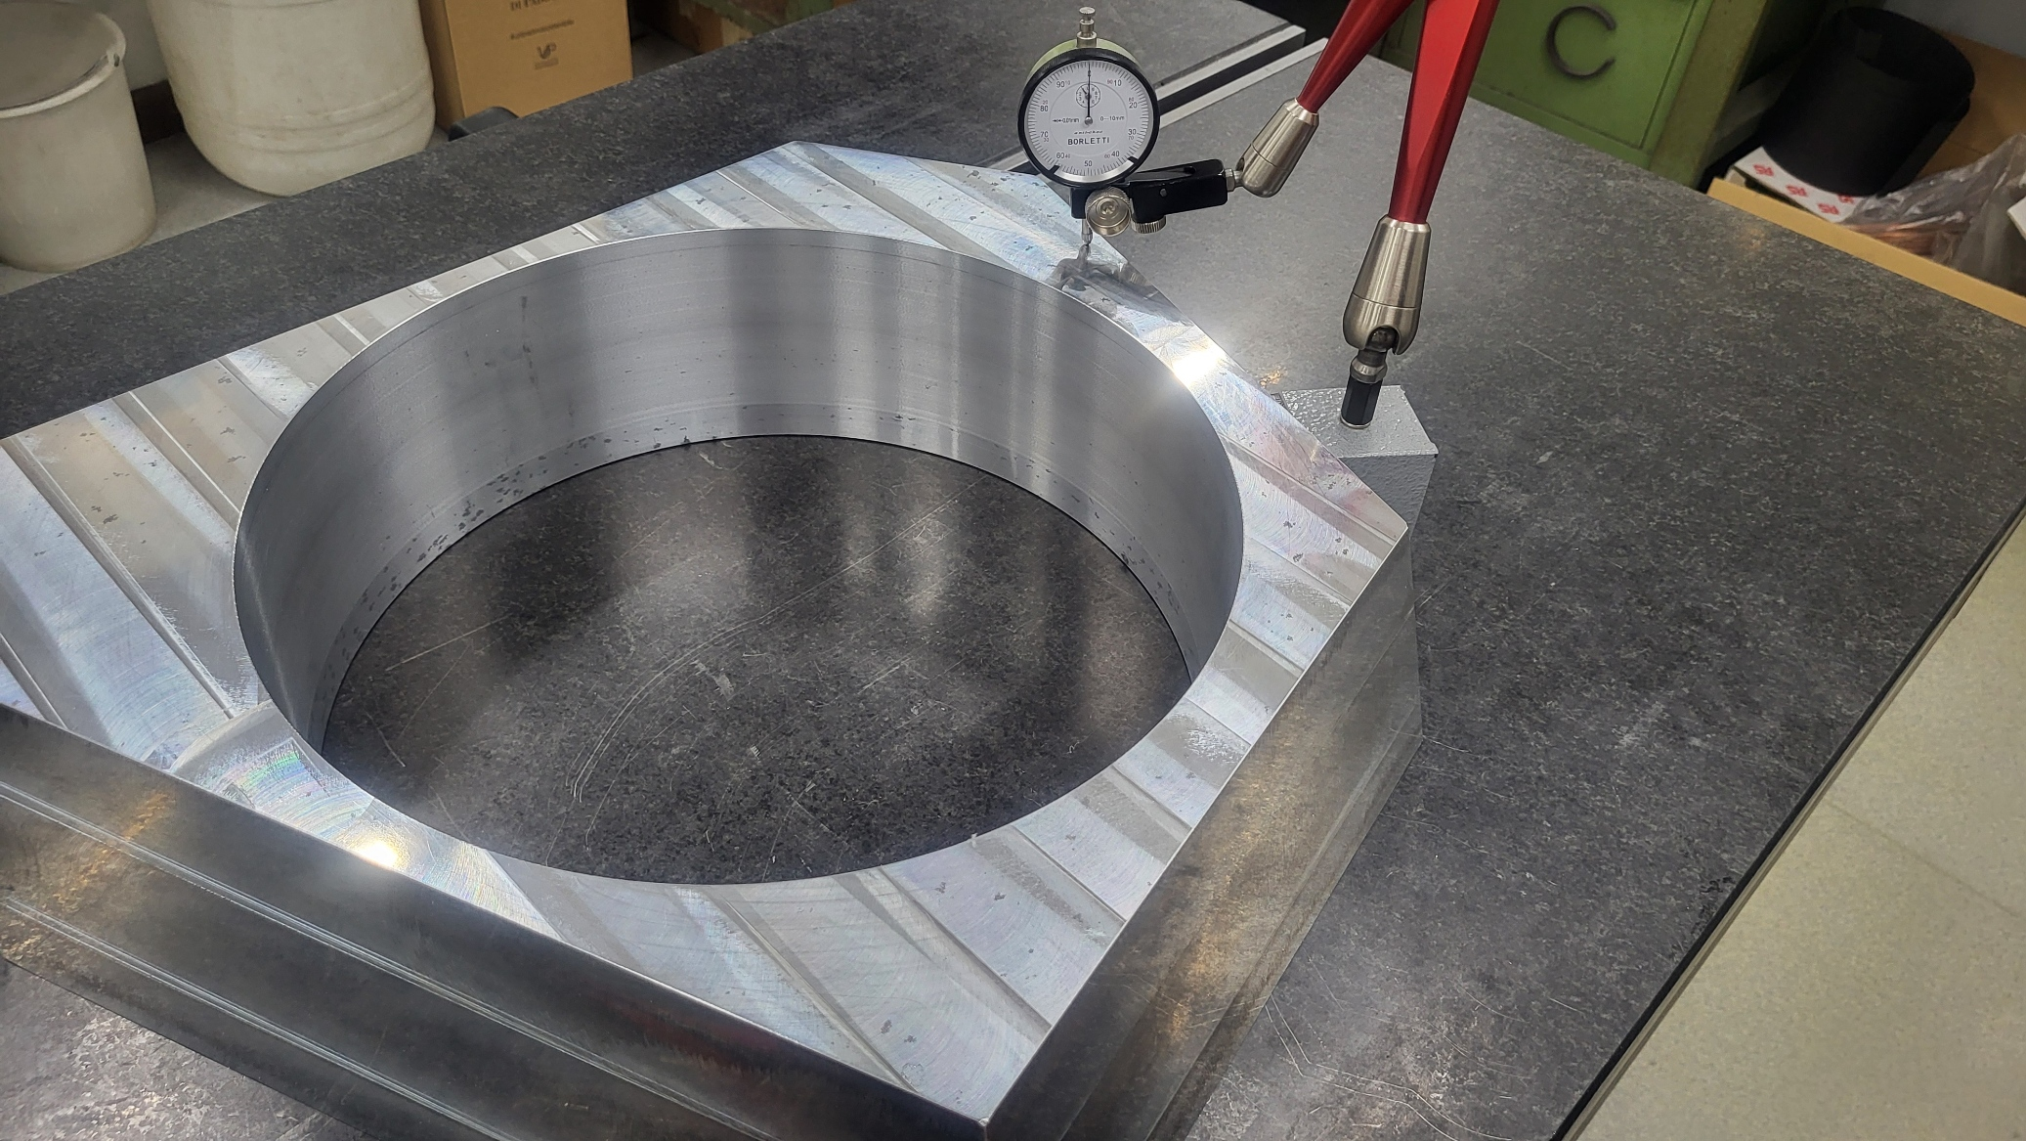
Production of new honeycomb
- The alloy previously used (ACP 6000) is now not easy to procure
Alloy 7021 has been proposed as alternative
RS: One of the reasons why the previous material (ACP 6000) was selected was its minimal distortion after heavy machining. As we are removing a lot of material from the flange, we need to ensure that the flange maintains its shape post machining.
Production of one prototipe flange in new alloy in LNL and Pd workshops
Good performances of the prototype;
  Confirmed tolerances, planarity and parallelism of the reference surfaces
New material approved for the production of new flanges

Slide 16
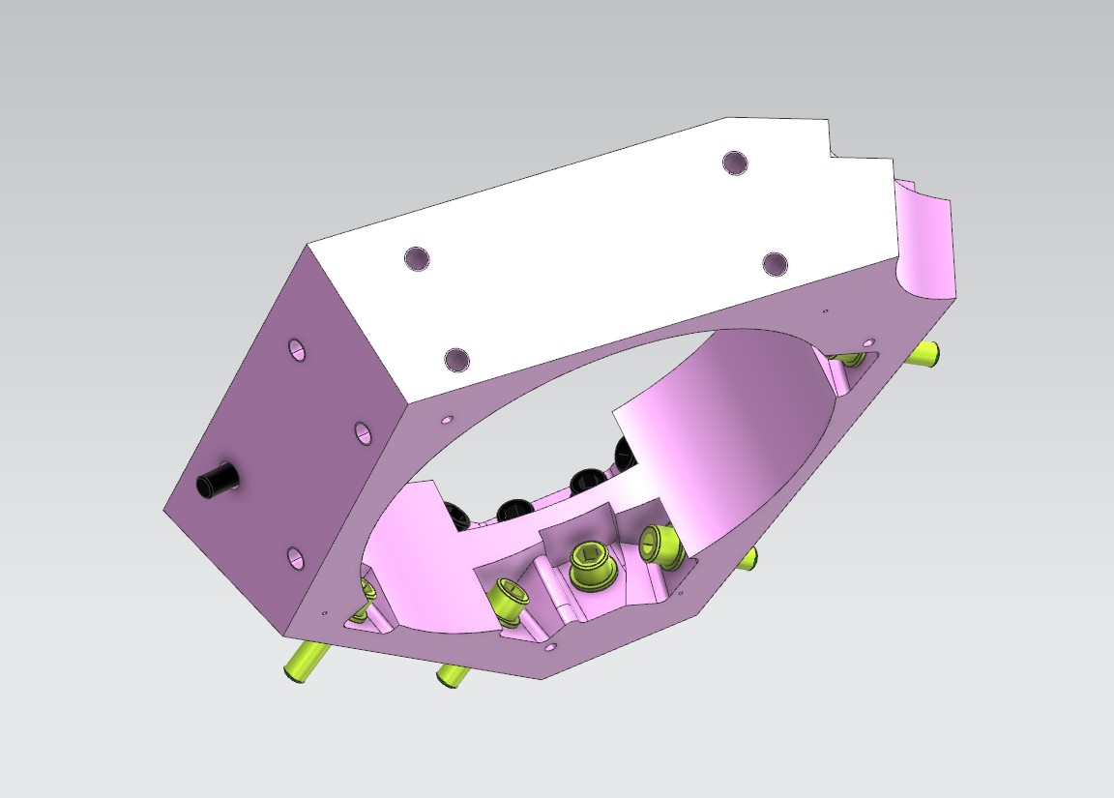
Production of new honeycomb
- The alloy previously used (ACP 6000) is now not easy to procure
Alloy 7021 has been proposed as alternative
RS: One of the reasons why the previous material (ACP 6000) was selected was its minimal distortion after heavy machining. As we are removing a lot of material from the flange, we need to ensure that the flange maintains its shape post machining.
Production of one prototipe flange in new alloy in LNL and Pd workshops
Good performances of the prototype;
  Confirmed tolerances, planarity and parallelism of the refernce surfaces
New material approved for the production of new flanges
During production a modification of the design has been proposed, with additional pockets that facilitate holding the piece while machining the central hole
This modification does not alter the honeycomb stability
Machine time at LNL and Pd workshops has been booked for the production of the new honeycomb in 2027
Awaiting feedback from collaboration

Slide 17
Thank you
The 26th AGATA week and ACC meeting 7-11 Sept. 2026 HIL - Warsaw

