Slide 1


Status of Detector Array Infrastructure
26th AGATA Week – Infrastructure Group
Walter Raniero & Roberto Menegazzo
INFN-LNL / INFN-PD

Slide 2

OUTLINE
Status of Detector Agata Array Infrastructure 2025/2026
Detector Agata Array Infrastructure for ATCs > 15
Mechanics for Detector Infrastructure
New ATC laser alignment 2.0
summary
W. Raniero – AGATA Week 2026

Slide 3
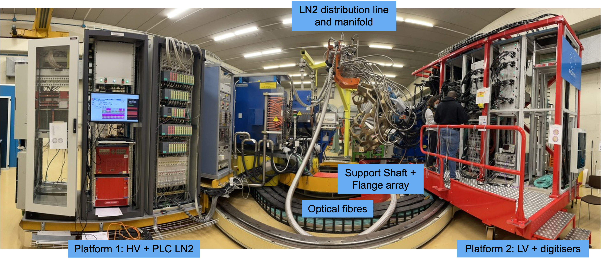
Detector Array Infrastructure Status 2025/2026
Detector and Autofill LN2 it’s ok up to 16 ATCs
W. Raniero – AGATA Week 2026

Slide 4
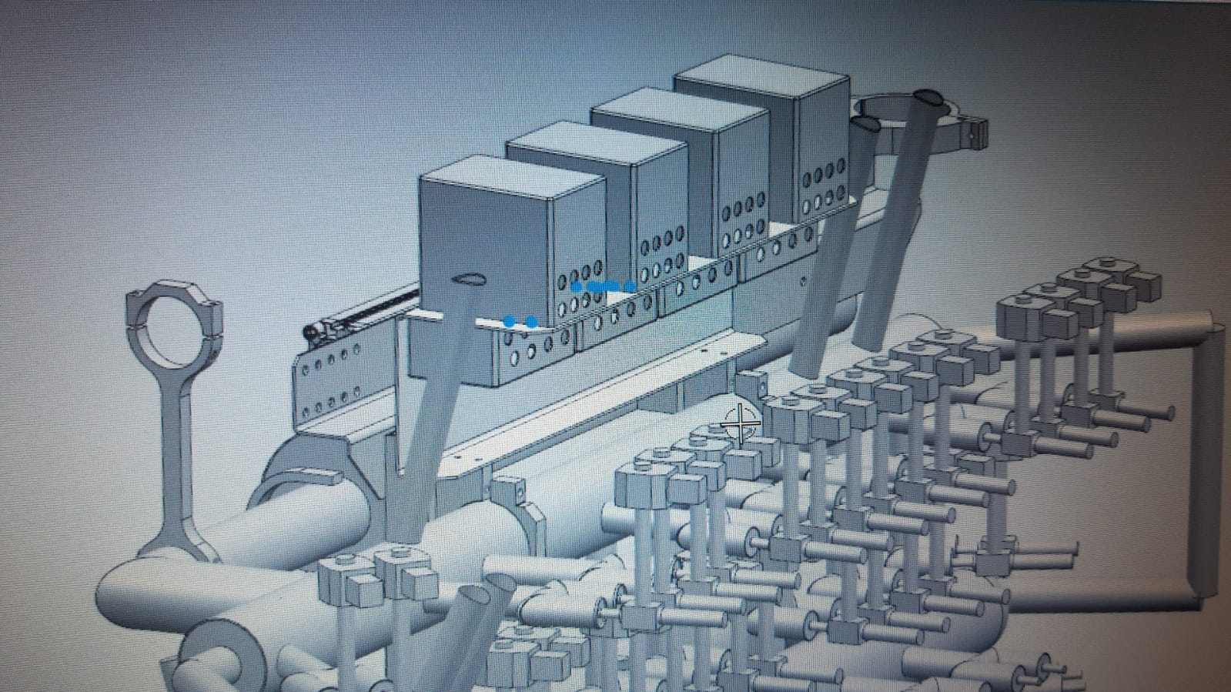
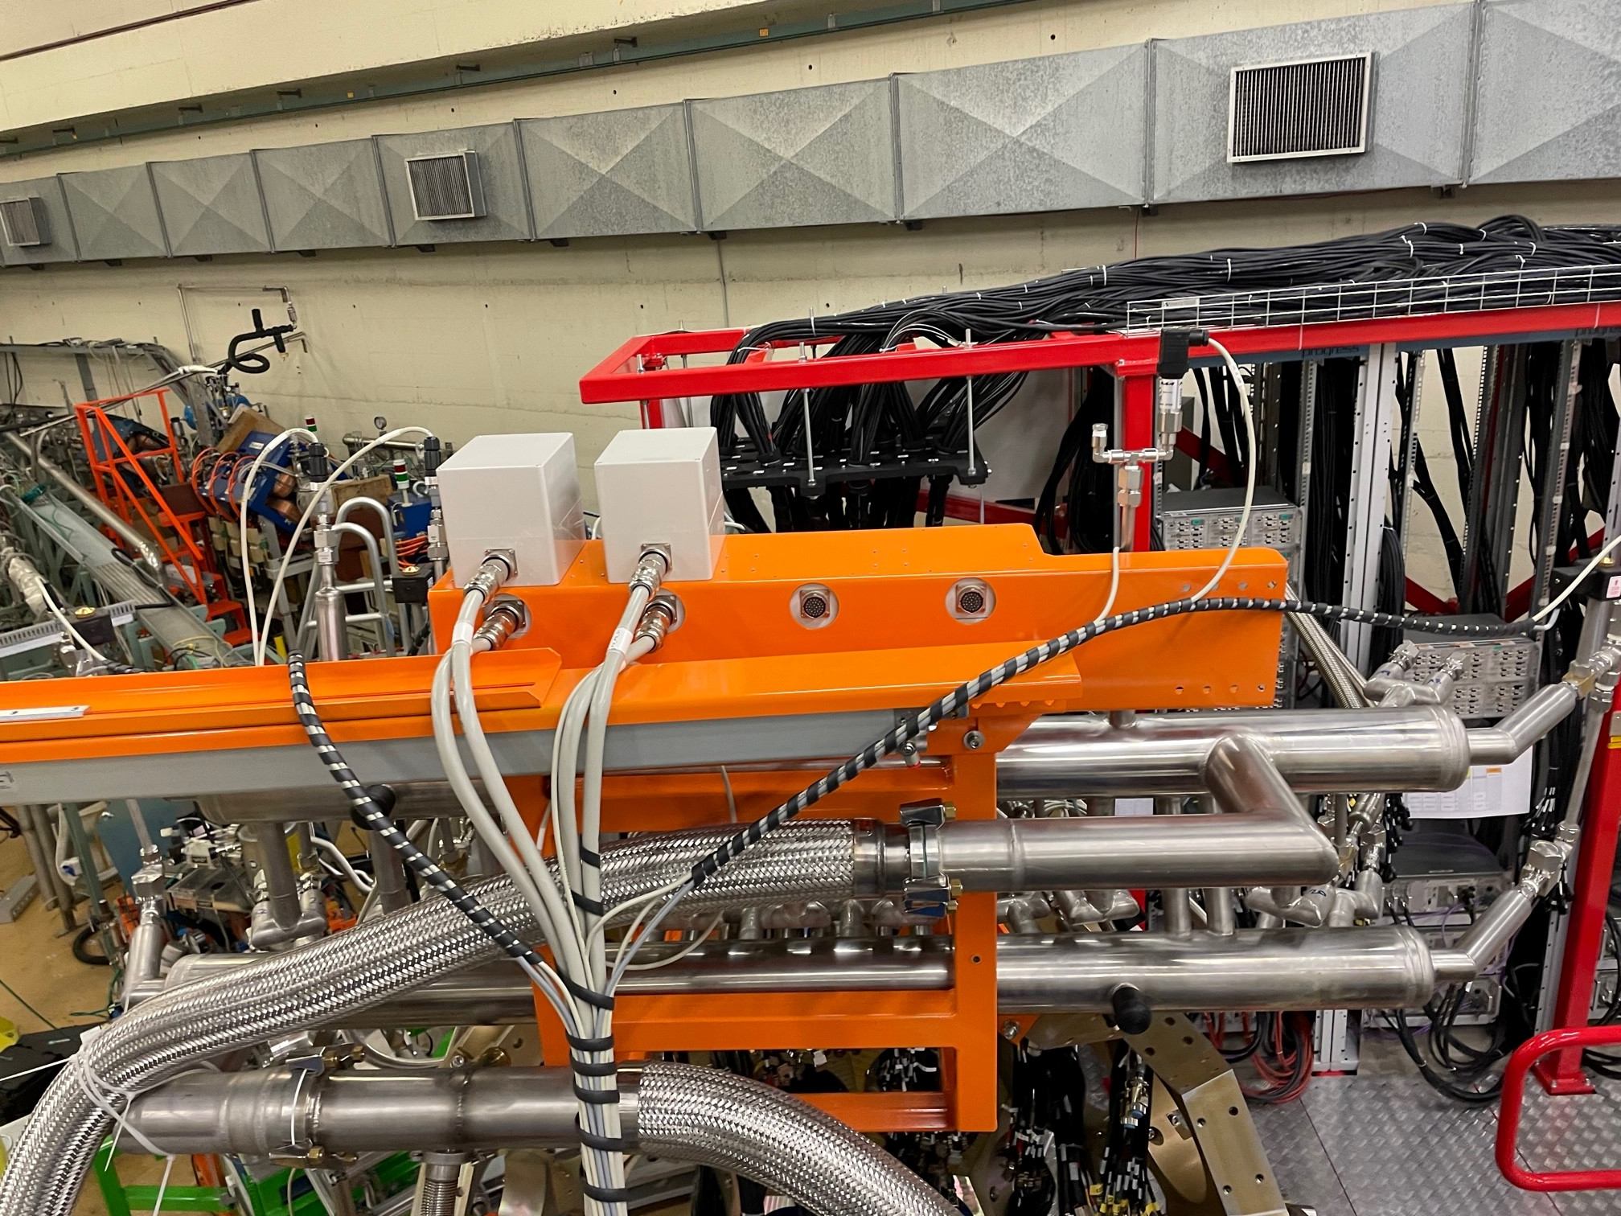
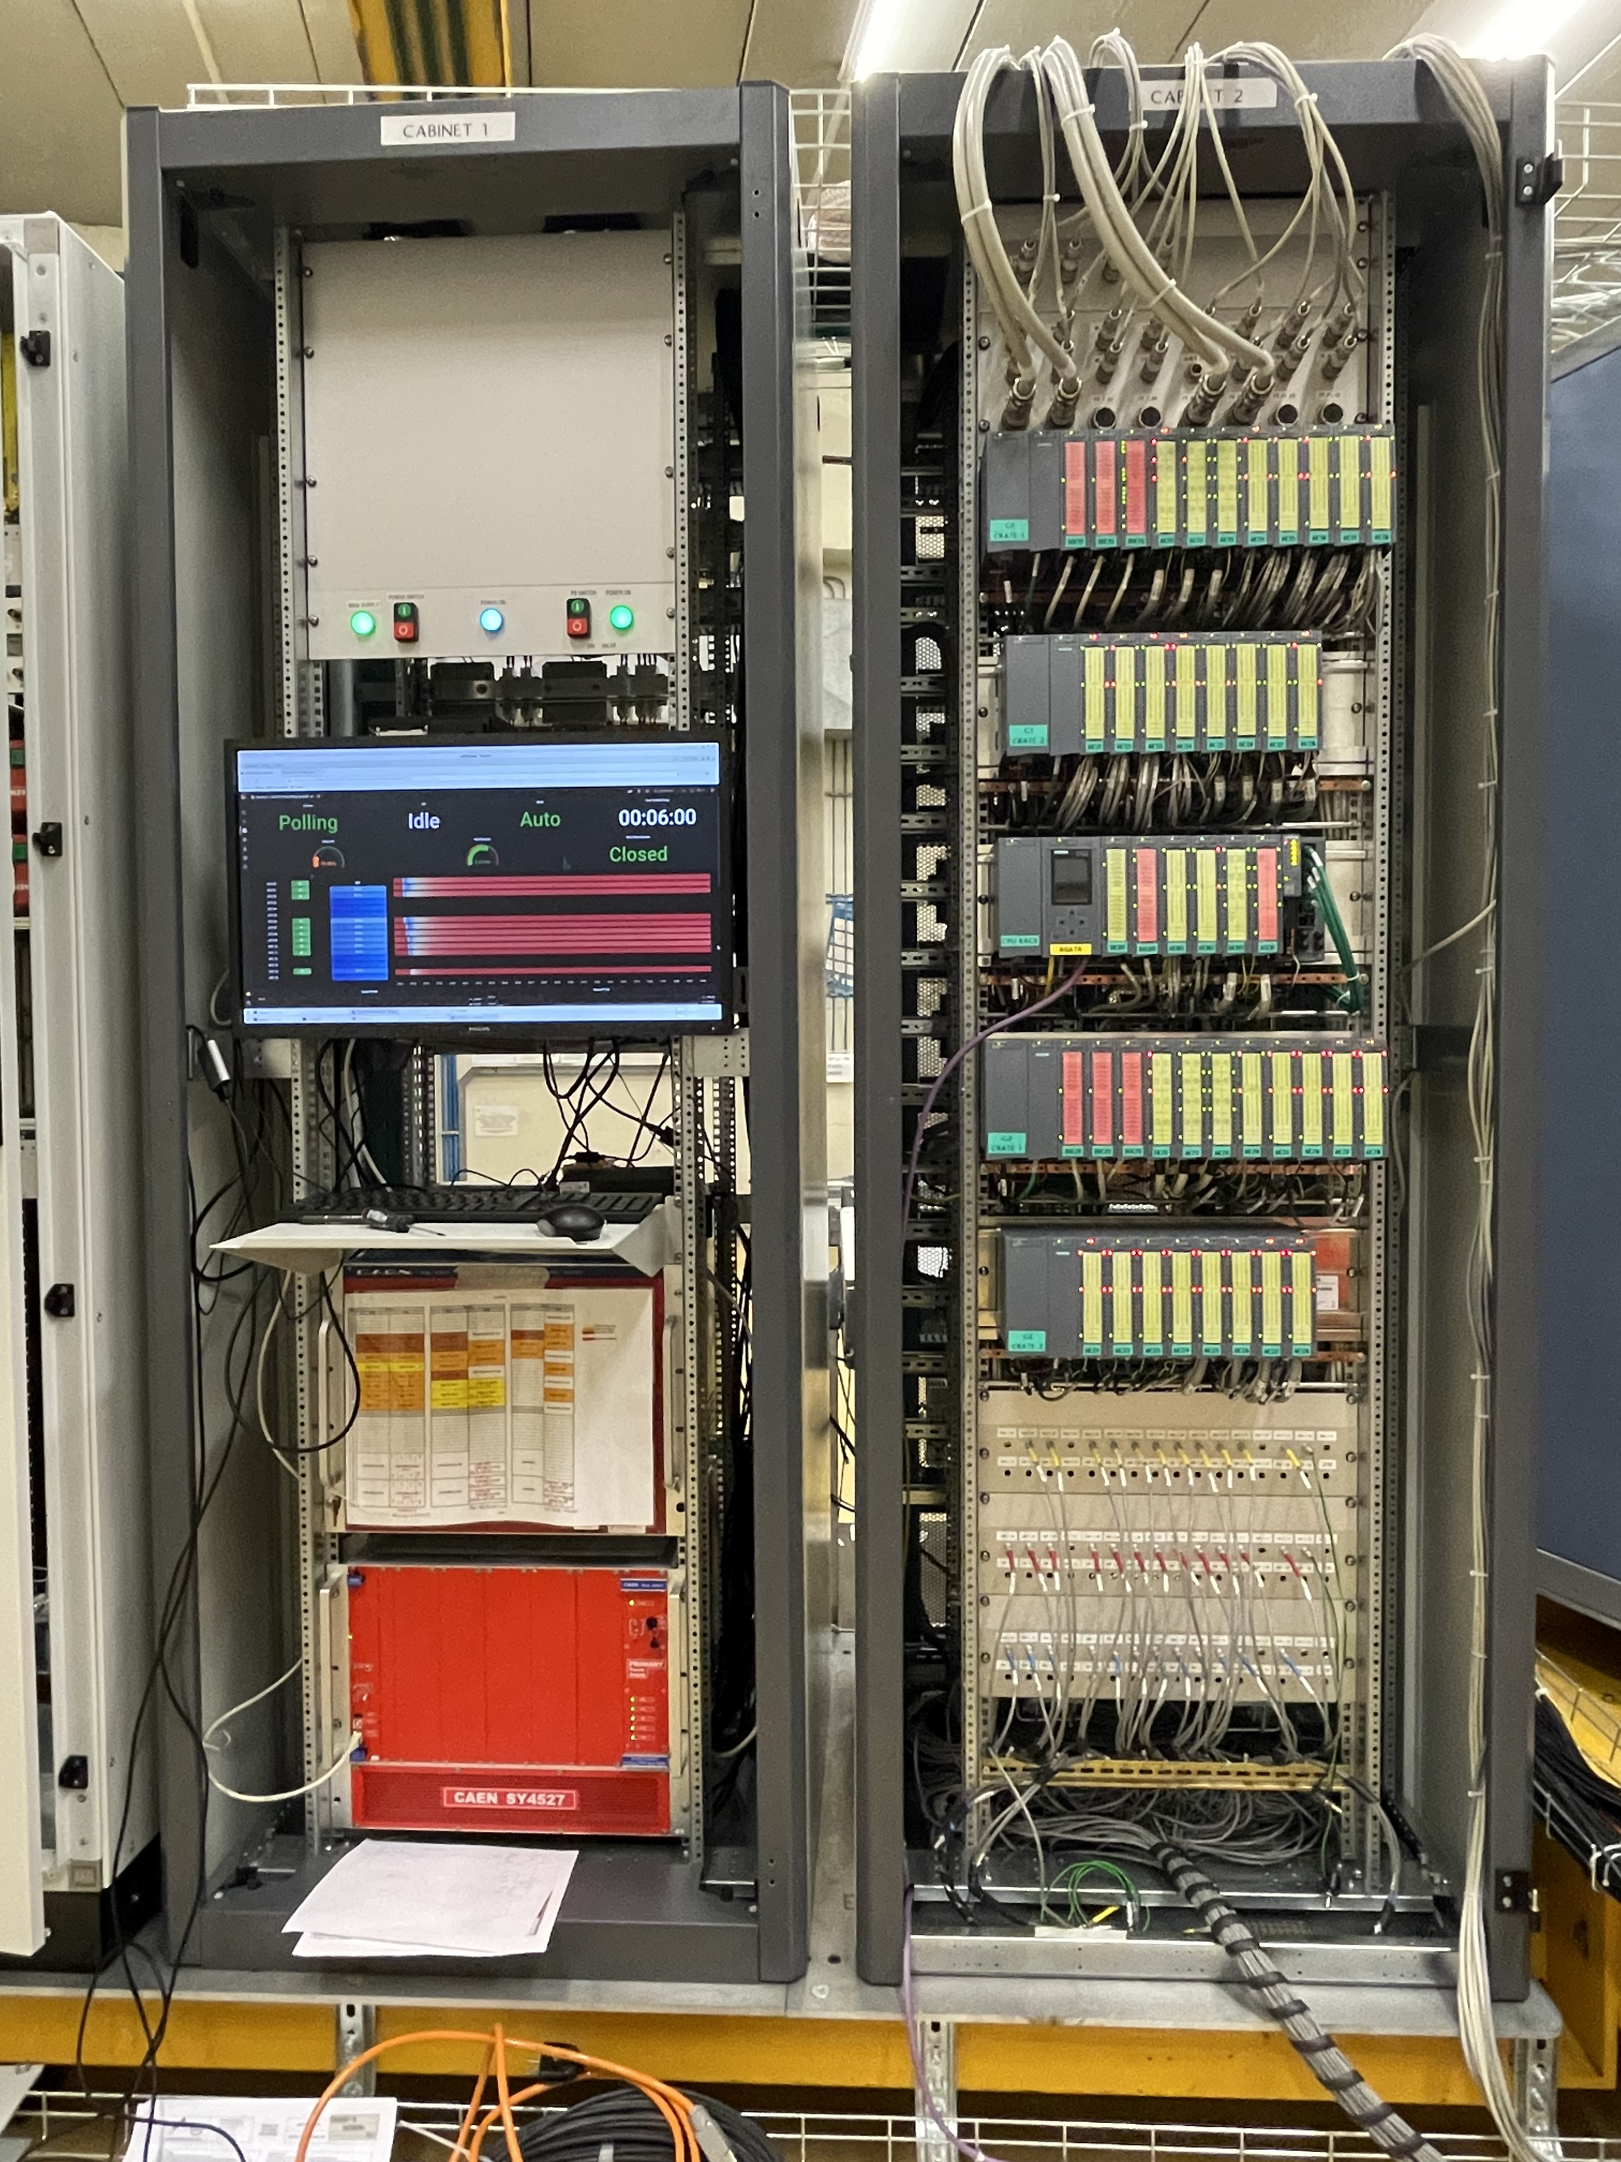
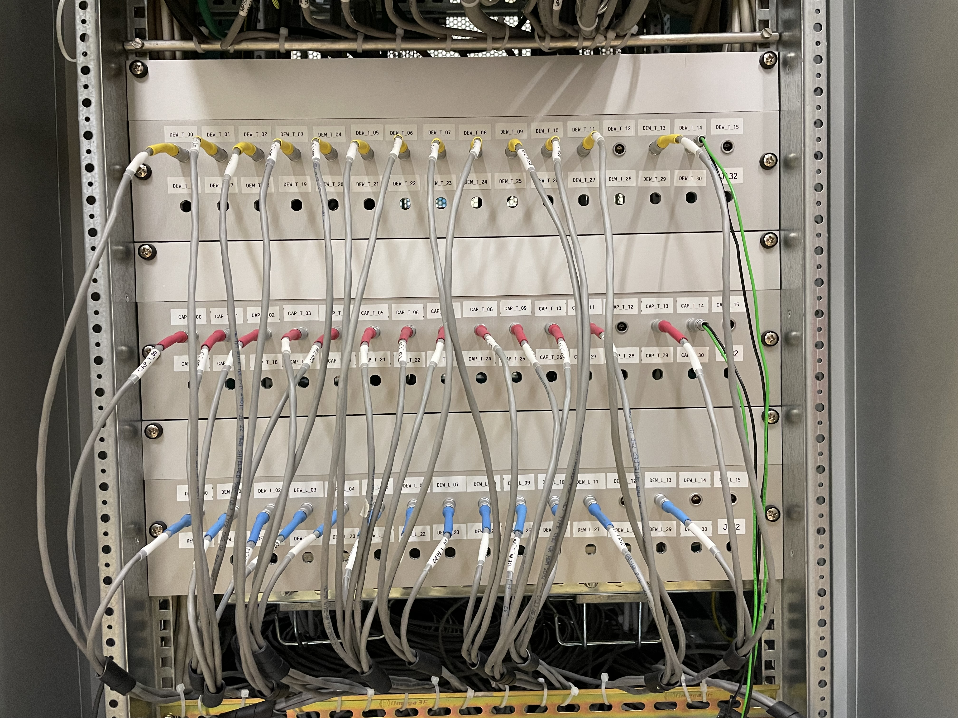
Detector Array Infrastructure Status 2025/2026
Autofill LN2
Description | Available for ATC at 2026 | Number for 2 π (ATC>15) | Note
patch panel on Autofill rack to manifold | 4 + 2 boxes | 4+4 boxes | custom made
patch panel on Autofill to patch box | 15 | 30 | PT dewar, PT capsule, LN2 red-out (15 to be installed)
PT100 cable det. | 30 x 2 (dew+caps) | 30 | (15 to be installed)
PT100 cable valve | 15 | 30 | (15 to be installed)
LN2 level cable | 15 | 30 | (15 to be installed)
Valve power cable | 15 | 37 | (15 to be installed)
Cryogenic valve | 15 | 37 | Being purchased
No returne valve | 15 | 37 | Being purchased
PT 100 on return valve | 15 | 36 | Being purchased
Bayonets | 15 | 30 | Upgrade in progress
Designed and produced at LNL
Cabling to PLC (DSS)
Software for ATC >16
W. Raniero – AGATA Week 2026

Slide 5
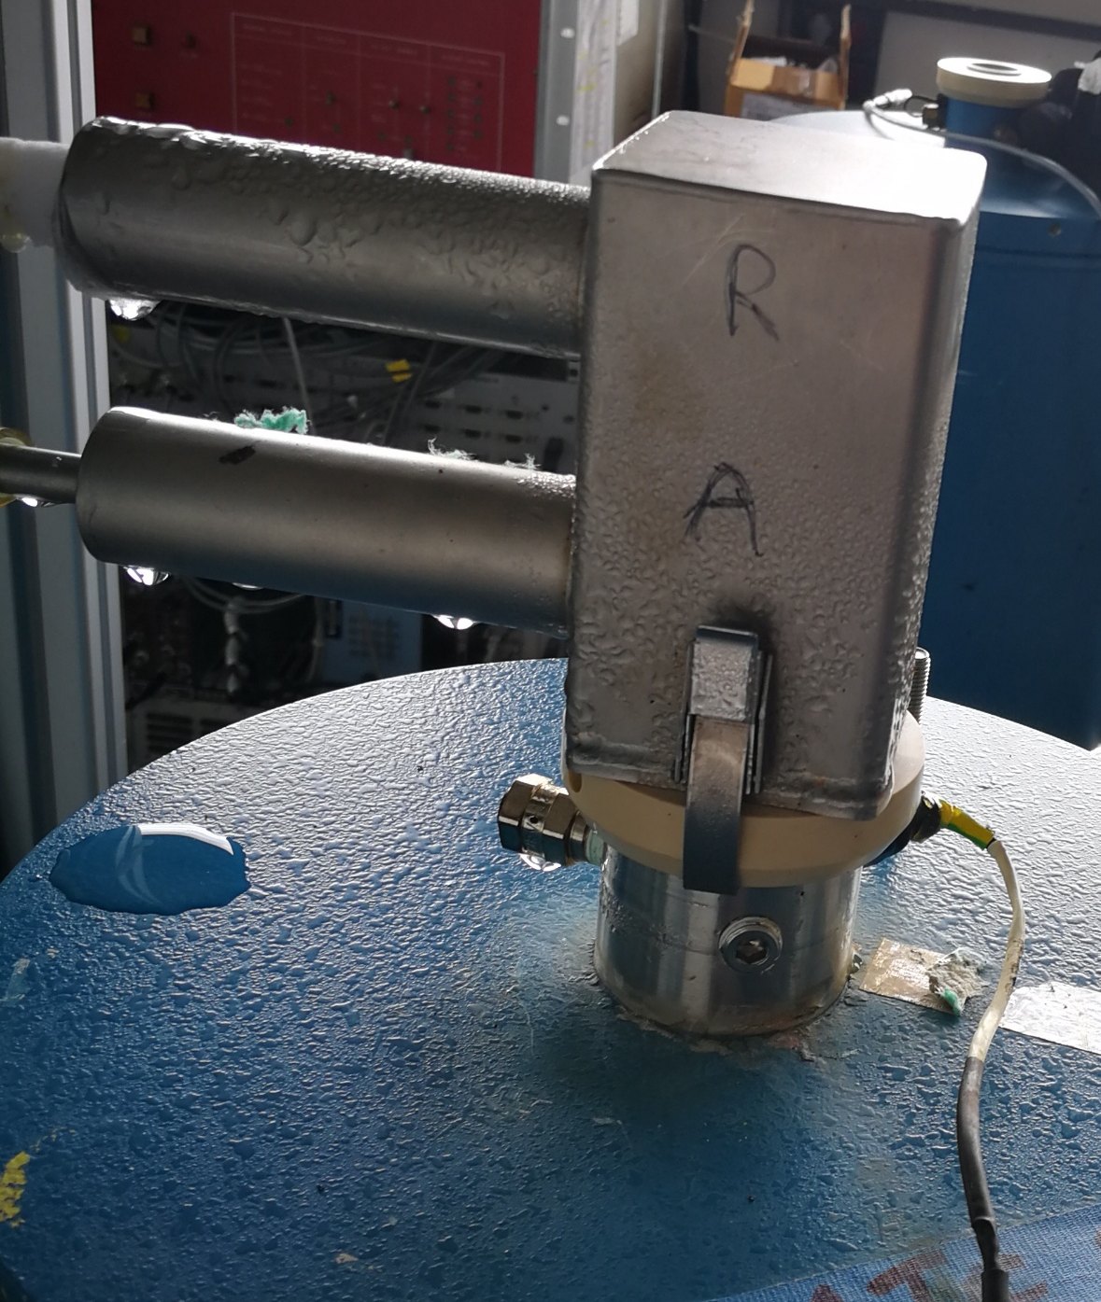
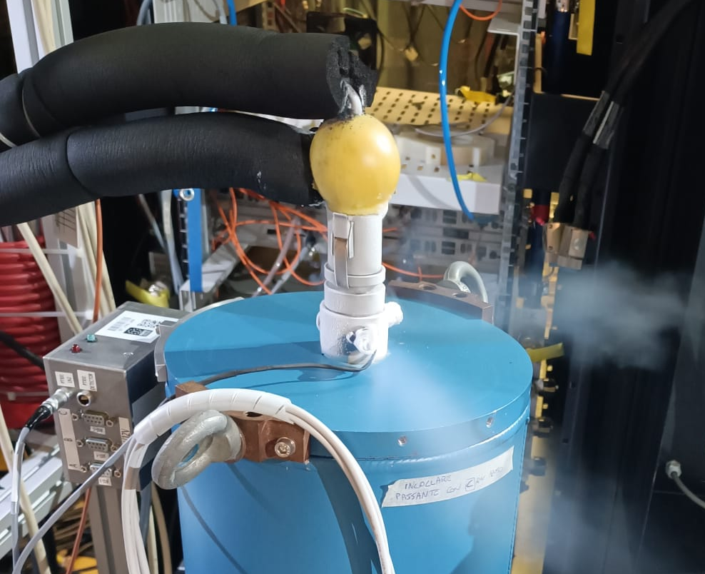
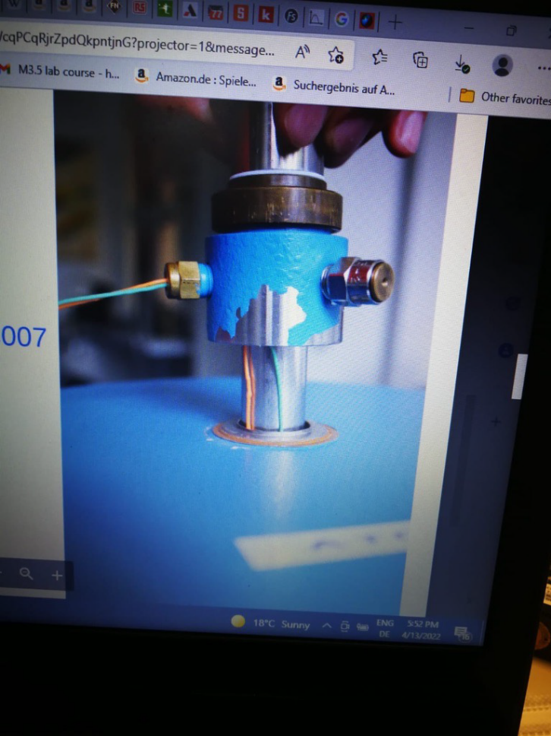
ATC installation issues and future plans
LN2 leak during the filling on AGATA array (filling LN2 pressure <2bar)
pressure Relieve Valve to be replace. tbd. Detector group
Capacitive level read out for LN2. The out cable is glued and with overpressure there is a LN2 leak.
Maintenance needed /new design tbd. detector group
A new design phase is being initiated for bayonet couplings to be connected to AGATA’s flexible metallic LN2 transfer lines.
W. Raniero – AGATA Week 2026

Slide 6
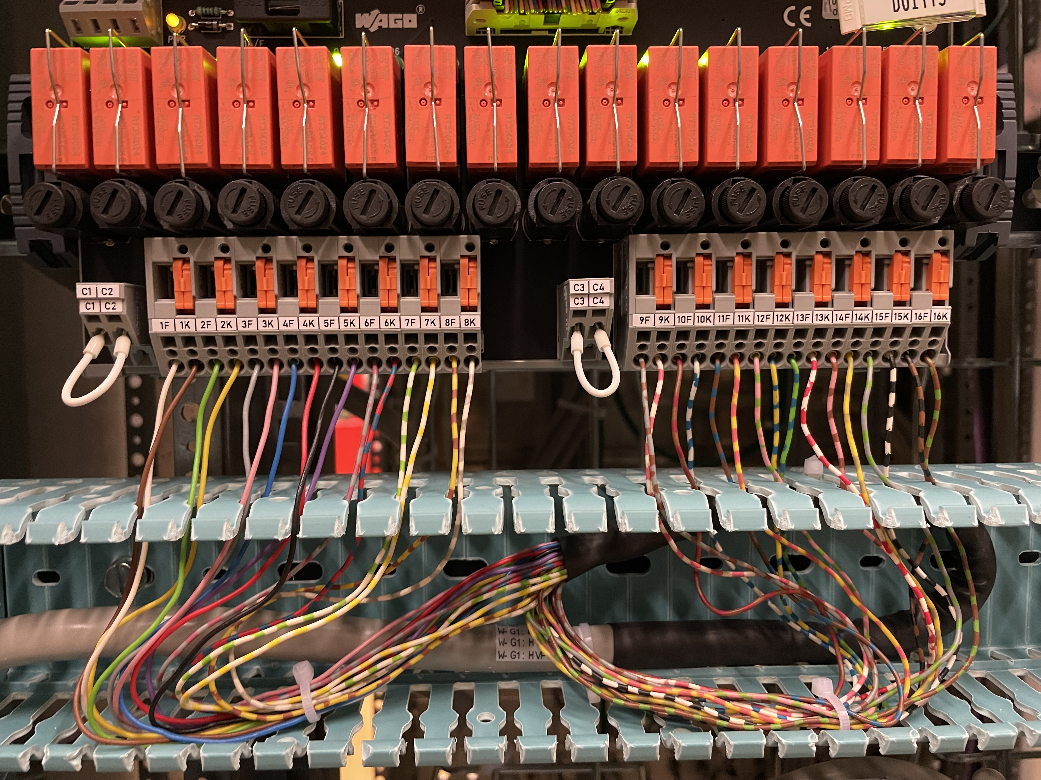
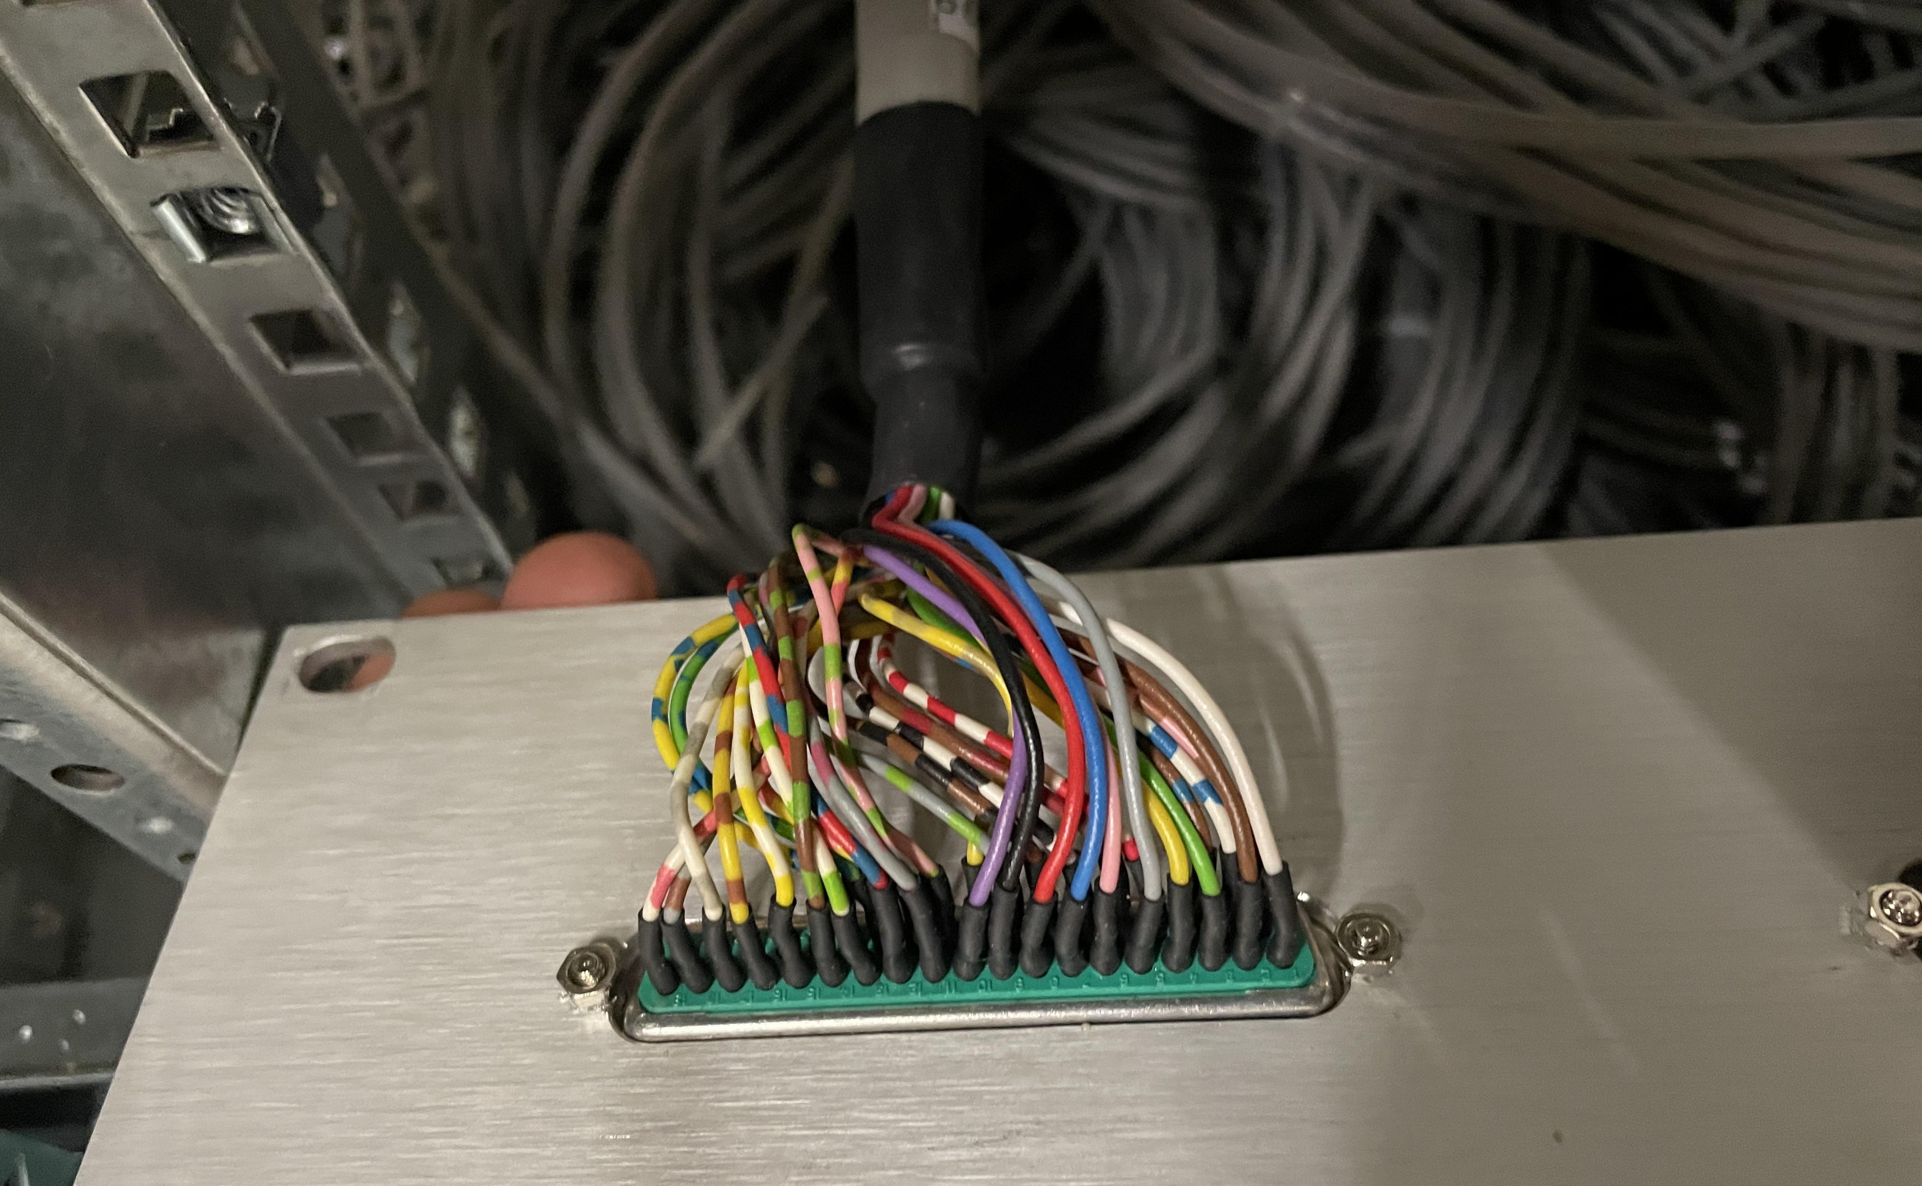
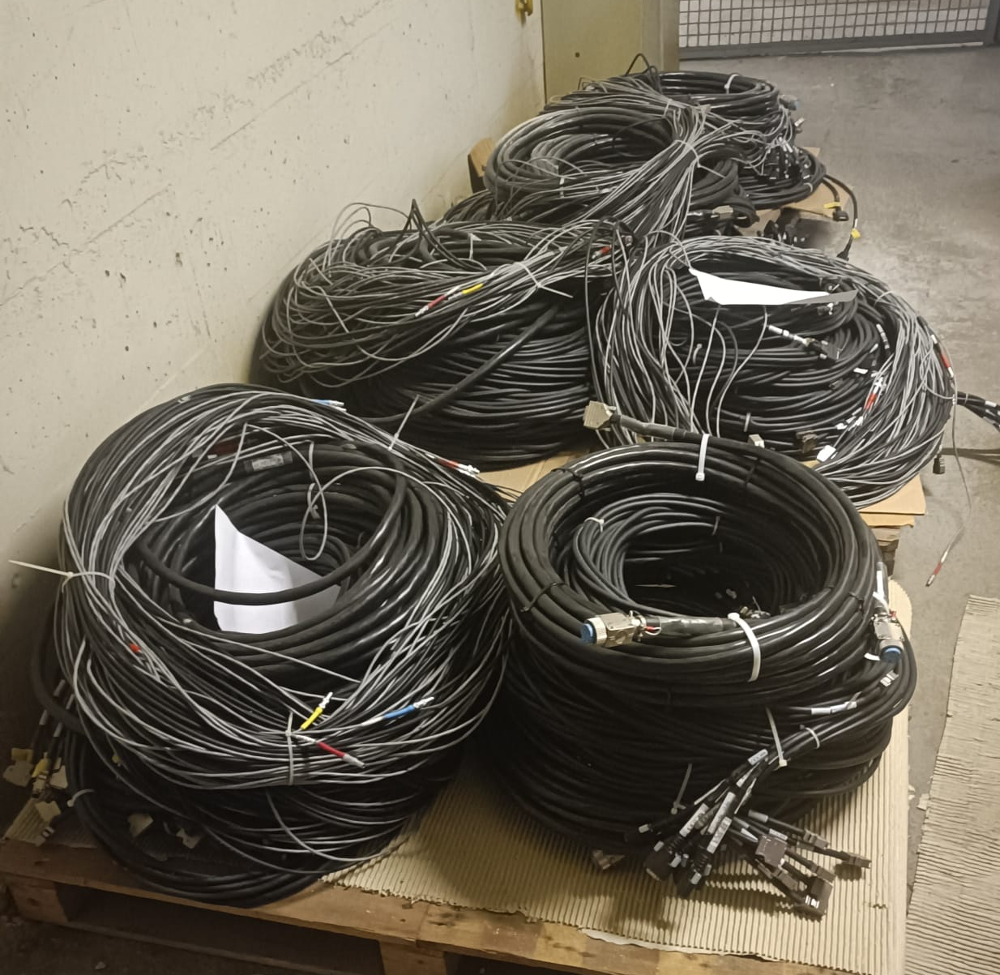
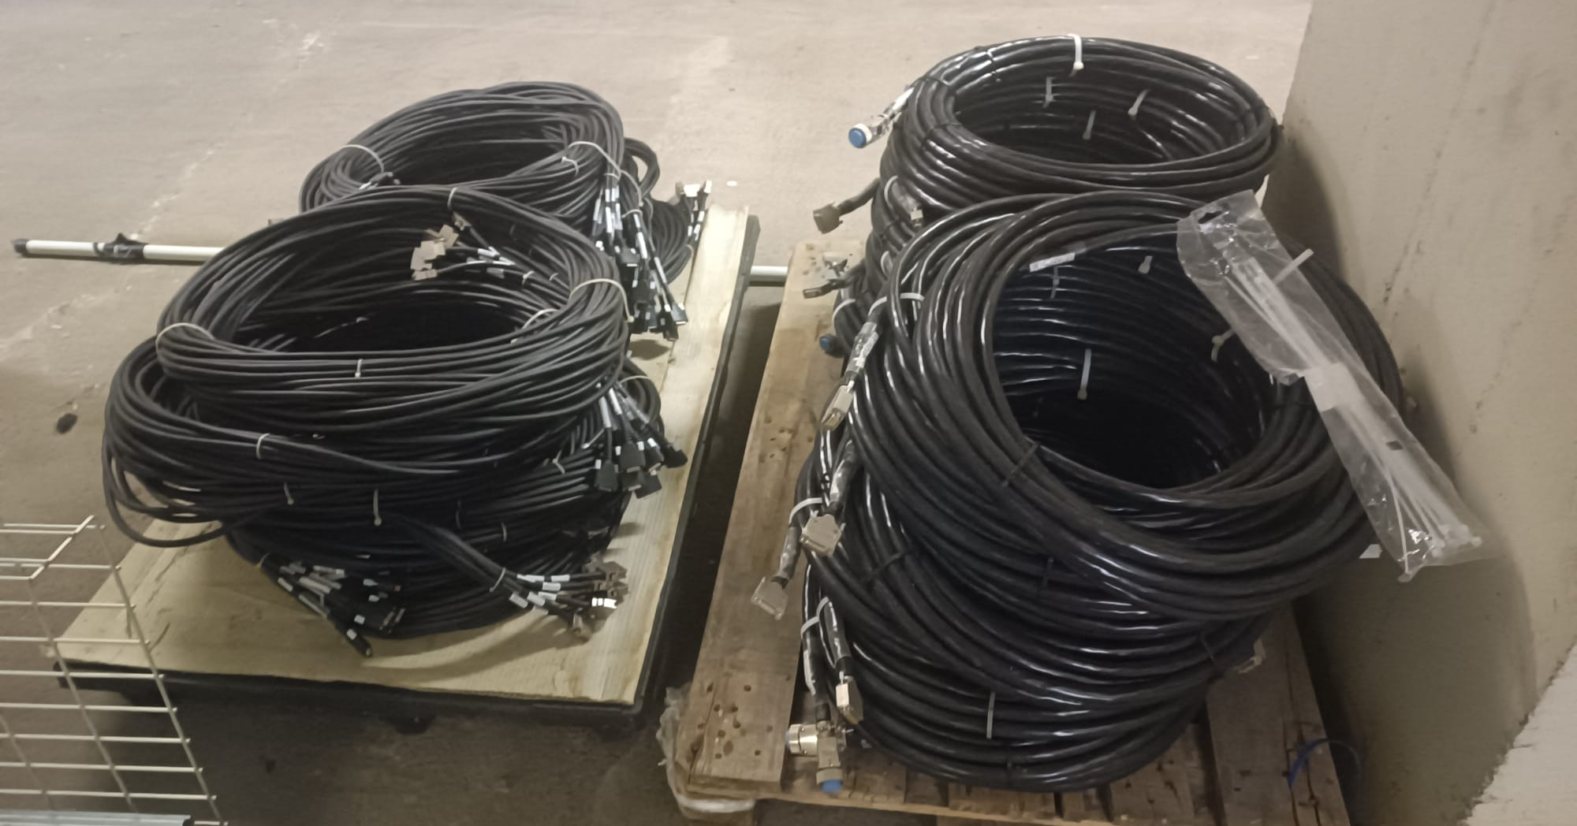
Detector Array Infrastructure Status 2025/2026
HV system
Description | Available at 2026 | Number for 2 π (ATC>15) | Note
CAEN SY4527 | 3 | 2 | HV crate
CAEN A1560HDPE | 18 | 12 | HV Boards (8 ch)
SHV cable | 45 | 90 | 45 (already available)
BSD cables | 1 | 2 | PLC to HV system
HV Bias Shutdown cabling
Digitizer
Description | Available for ATC at 2026 | Number for 2 π (ATC>15) | Note
MDR cable | 315 | 630 | 315 (available)
W. Raniero – AGATA Week 2026

Slide 7
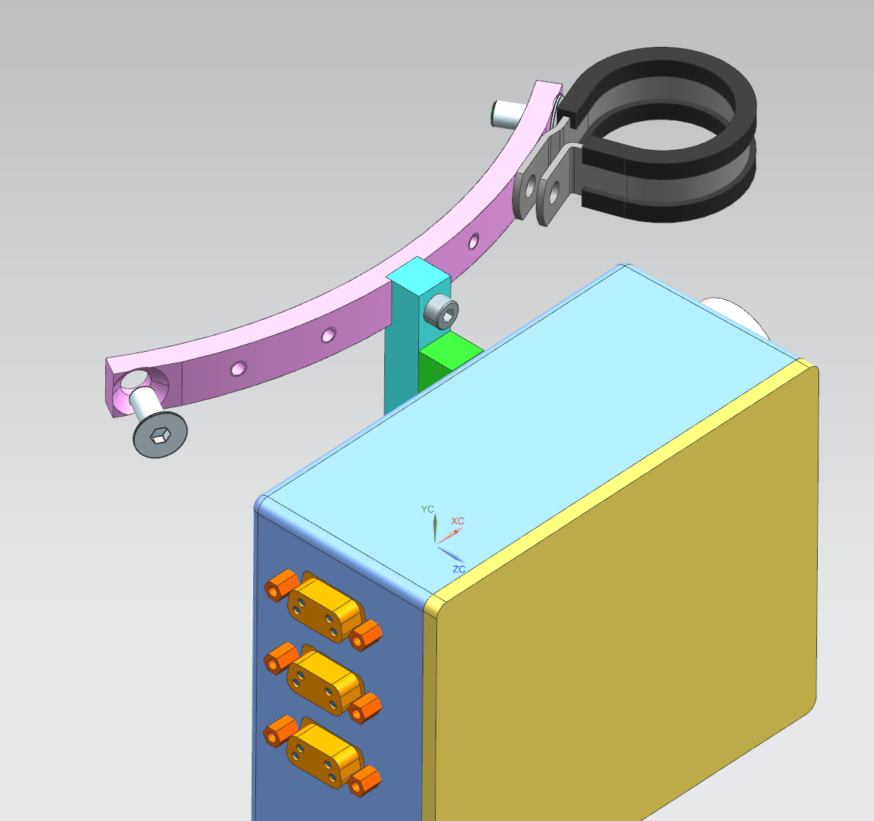
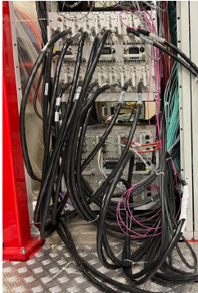
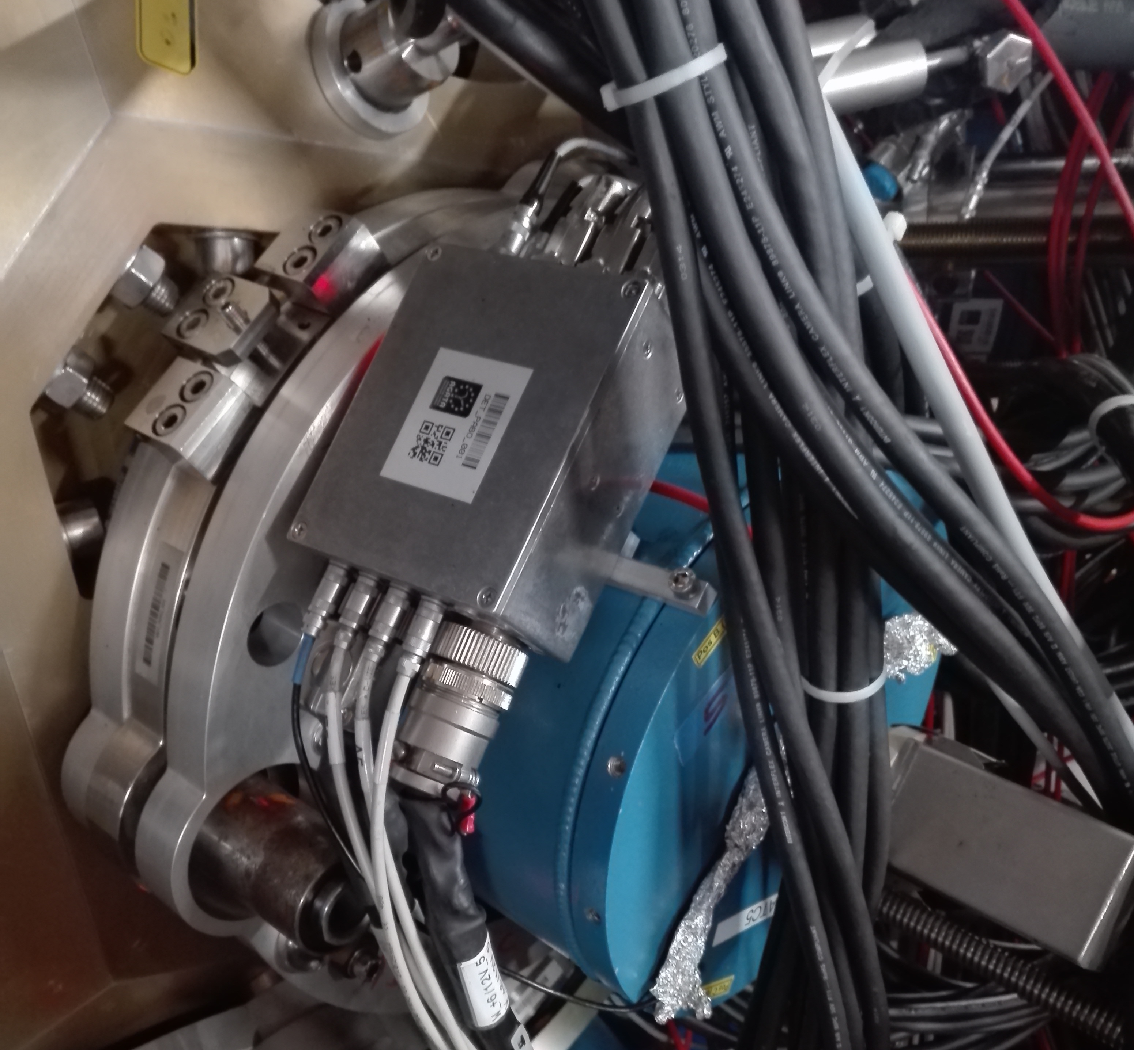
Detector Array Infrastructure Status 2025/2026
LVPS
Description | Available for 15 ATC at 2026 | Number for 2 π | Note
AXIS LVPS New (2025) system (8ch) | 4 | 4
Digitizer 48V cable | 45 | 90 | (45 already availble)
±6/12V cable set | 15 | 30 | (20 Already available)
LN2 cards | 20 | 30 | (20 purchased)
Patch box + 3 mech. part | 20 (LNL) | 30 | 20 set mech. part have been made 35 patch boxes will be purchased
Description | Available for 15 ATC at 2026 | Number for 2 π | Note
Detector legs | 18 (set) | 30 | 1 set = 3 legs from CTT
Detector legs adapter | 22 (set) | 30 | 1 set = 3 adapters IKP
Detector holding ring | 30 | 30
Detector Patch Box
New heat exchanger to prevent corrosion of Al plates and pipes (digitizer)
W. Raniero – AGATA Week 2026

Slide 8
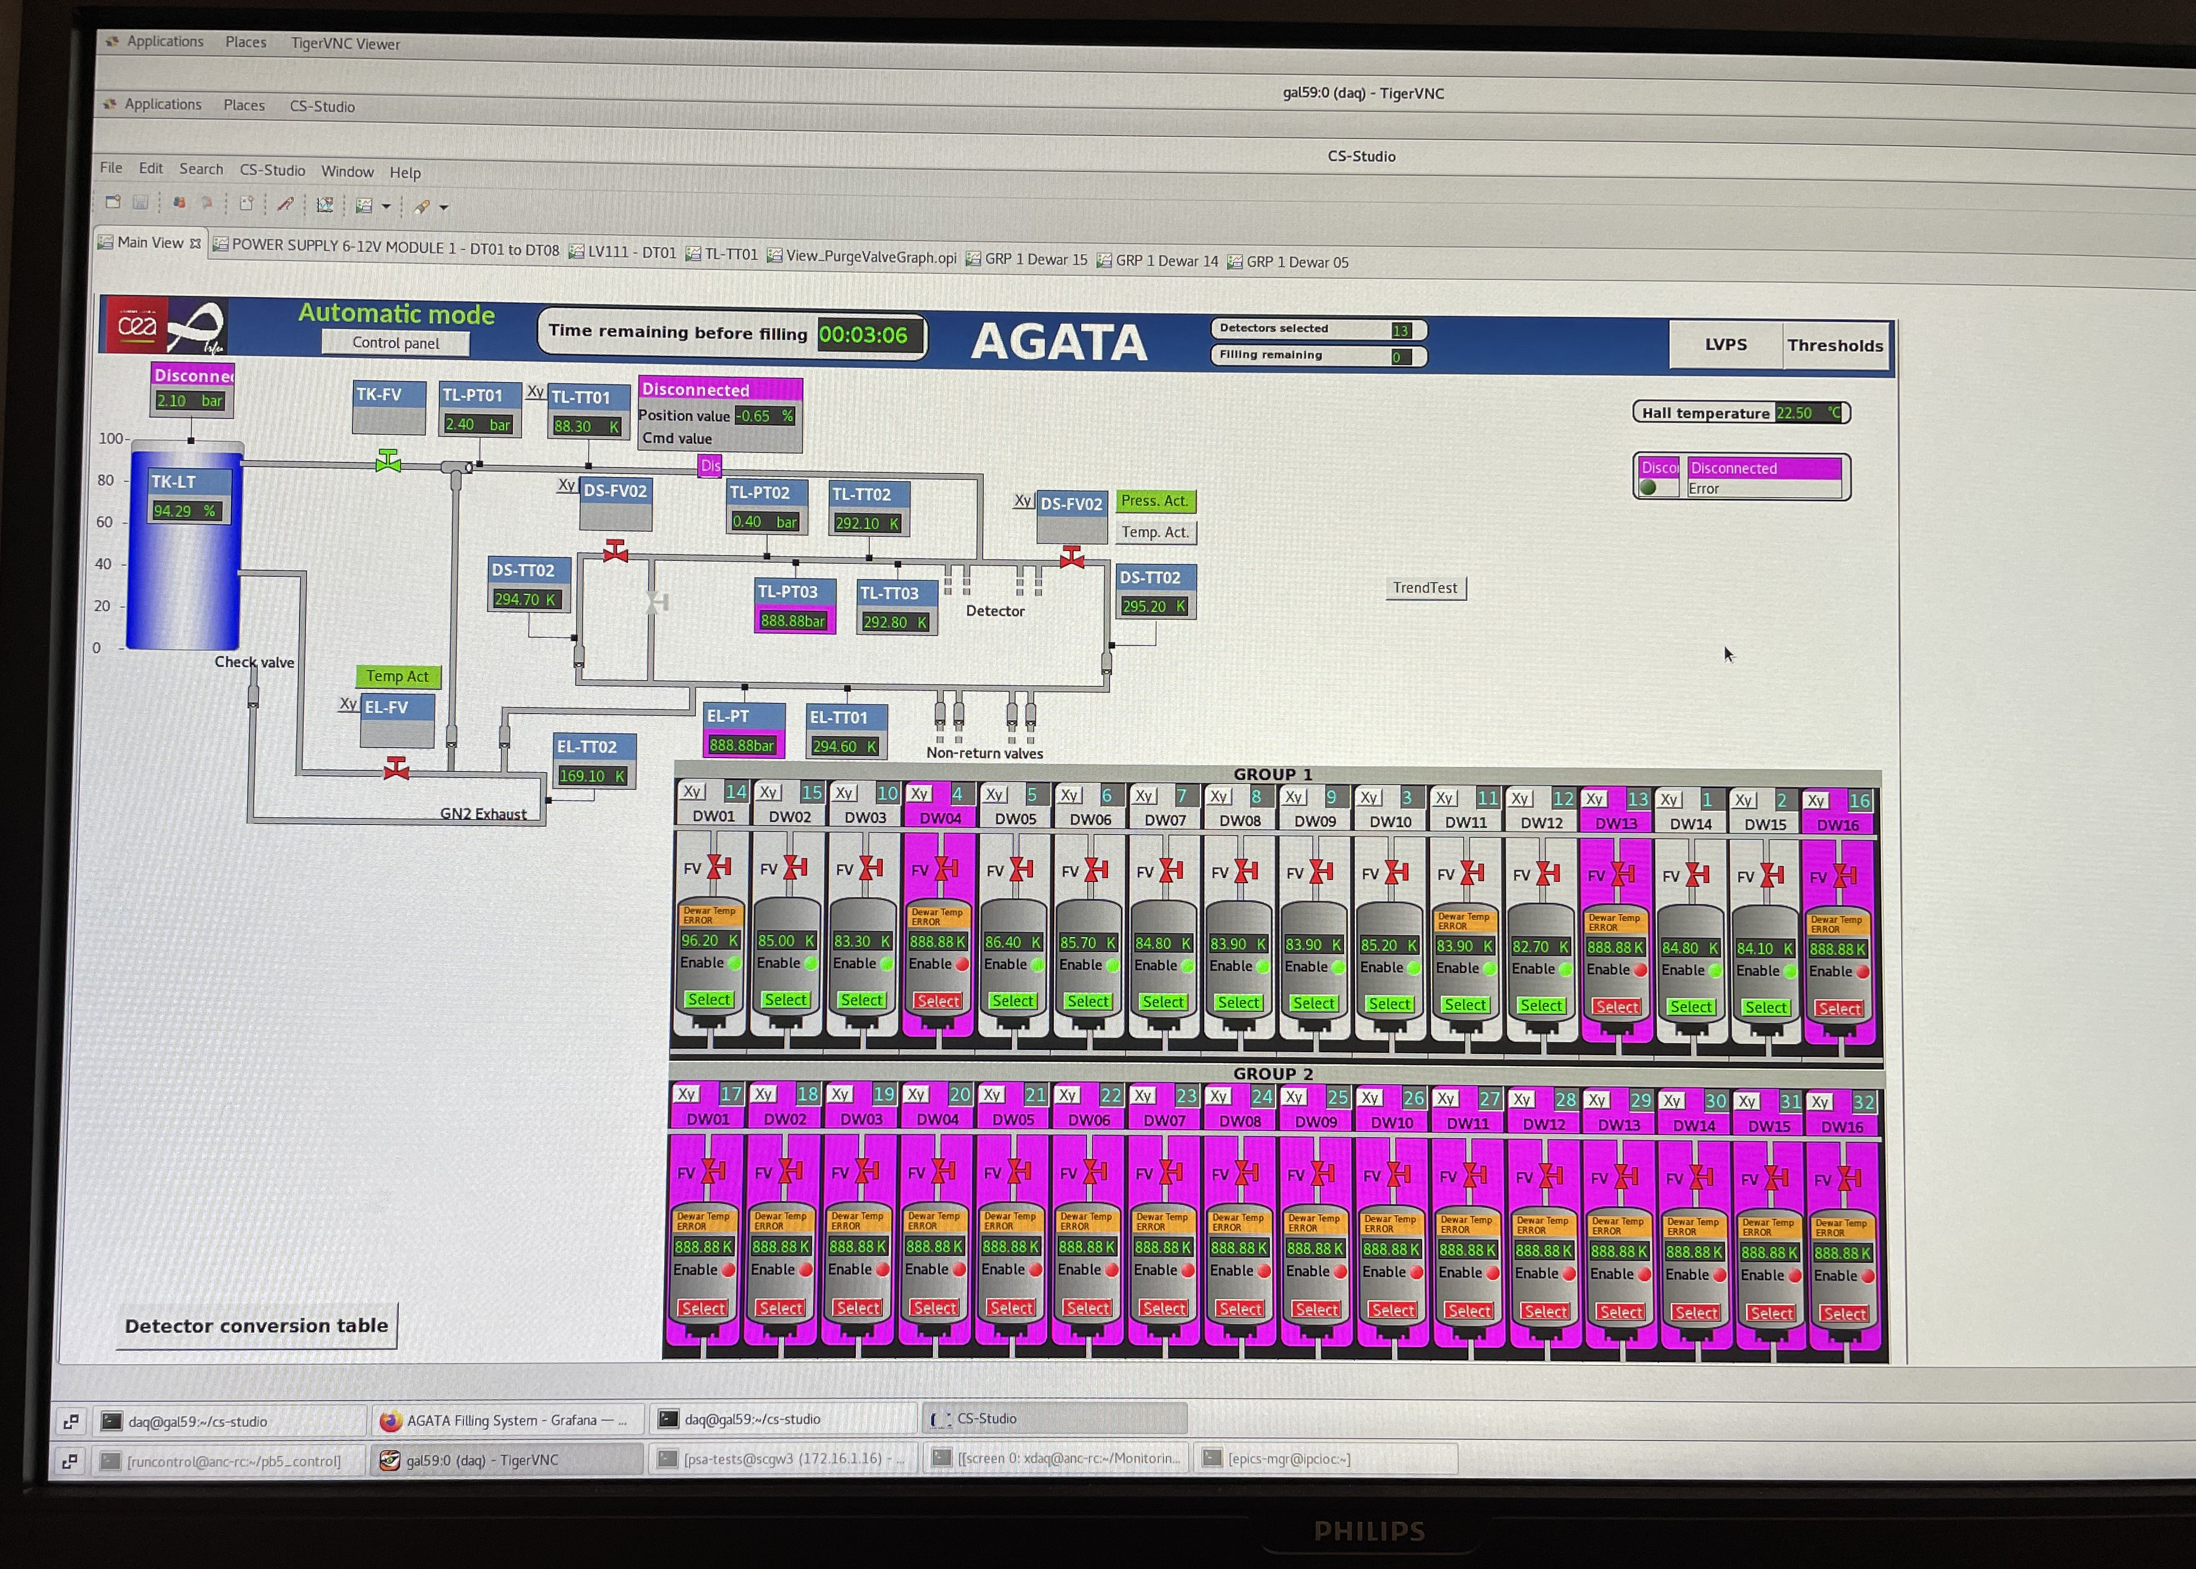
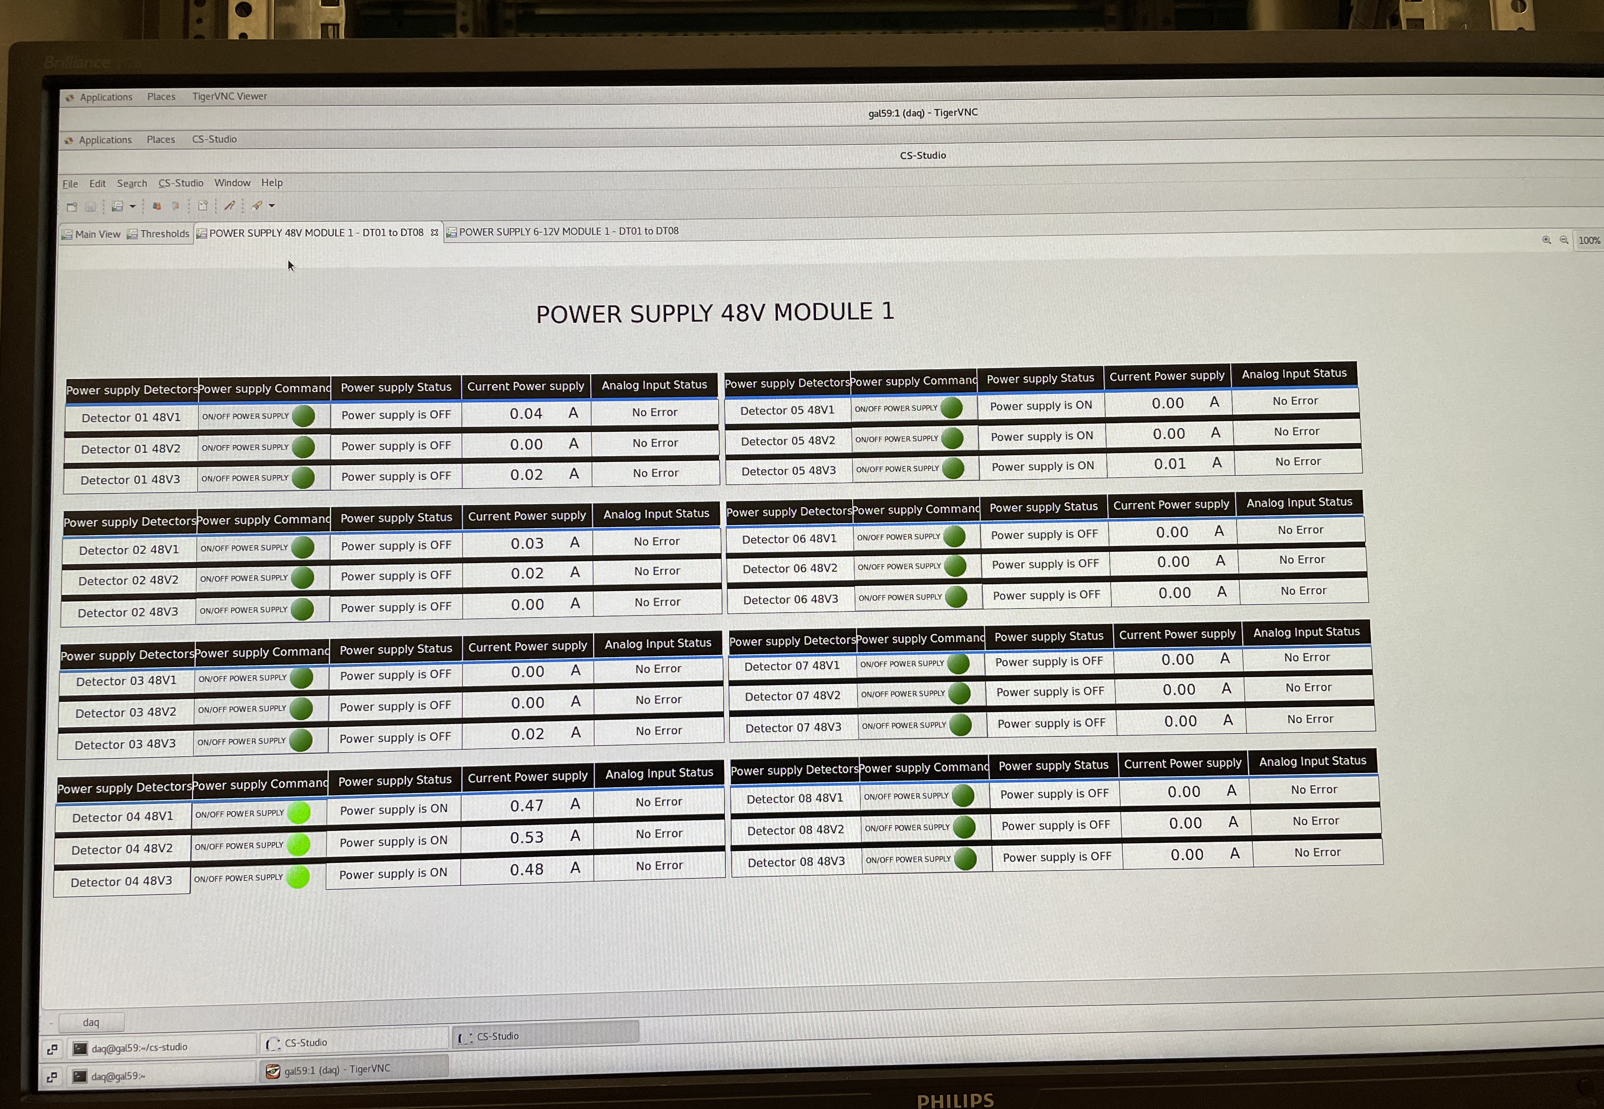
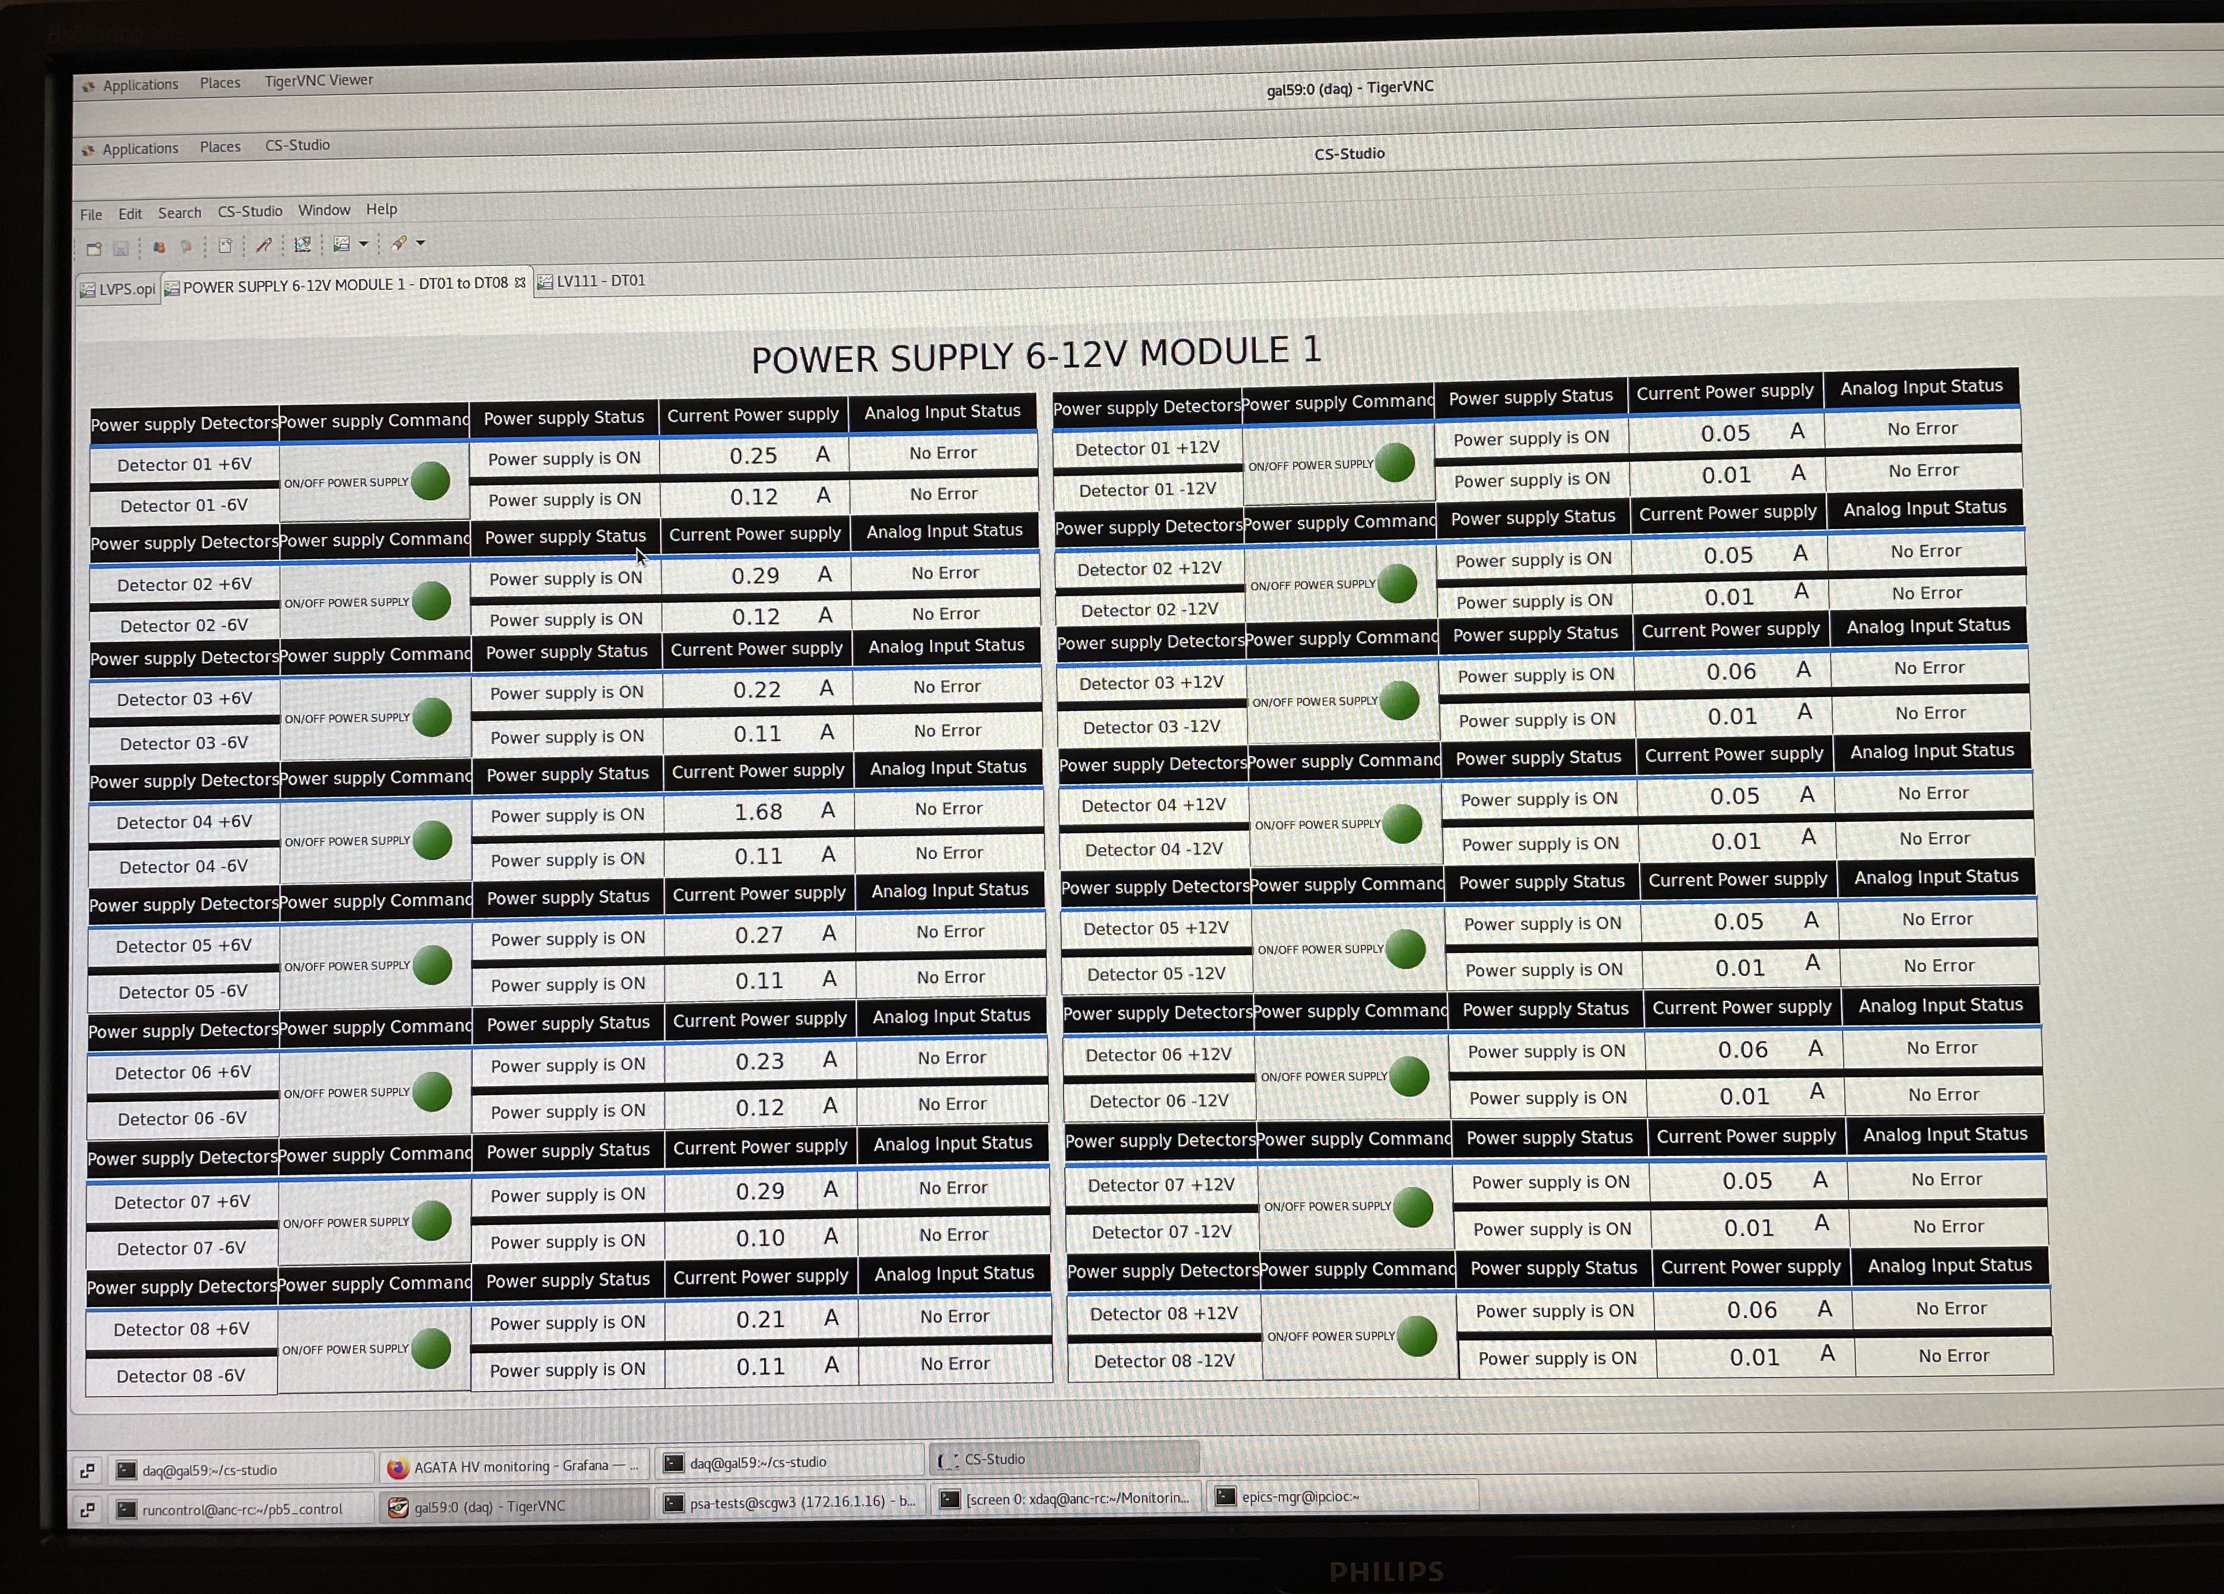
Detector Array Infrastructure Status 2025/2026
LN2 control
LVPS control
LN2 software issue:
an emergency fill of an ATC shortly before the scheduled filling time causes the other ATCs to skip their filling cycle
W. Raniero – AGATA Week 2026

Slide 9
Mechanics for Detector Infrastructure
W. Raniero – AGATA Week 2026

Slide 10
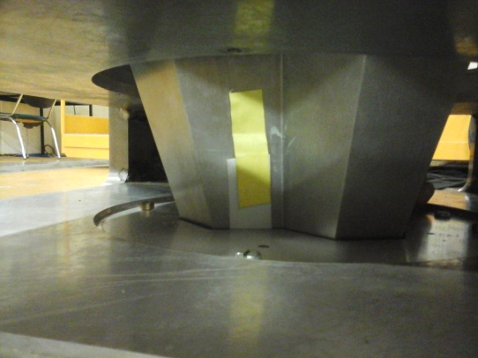
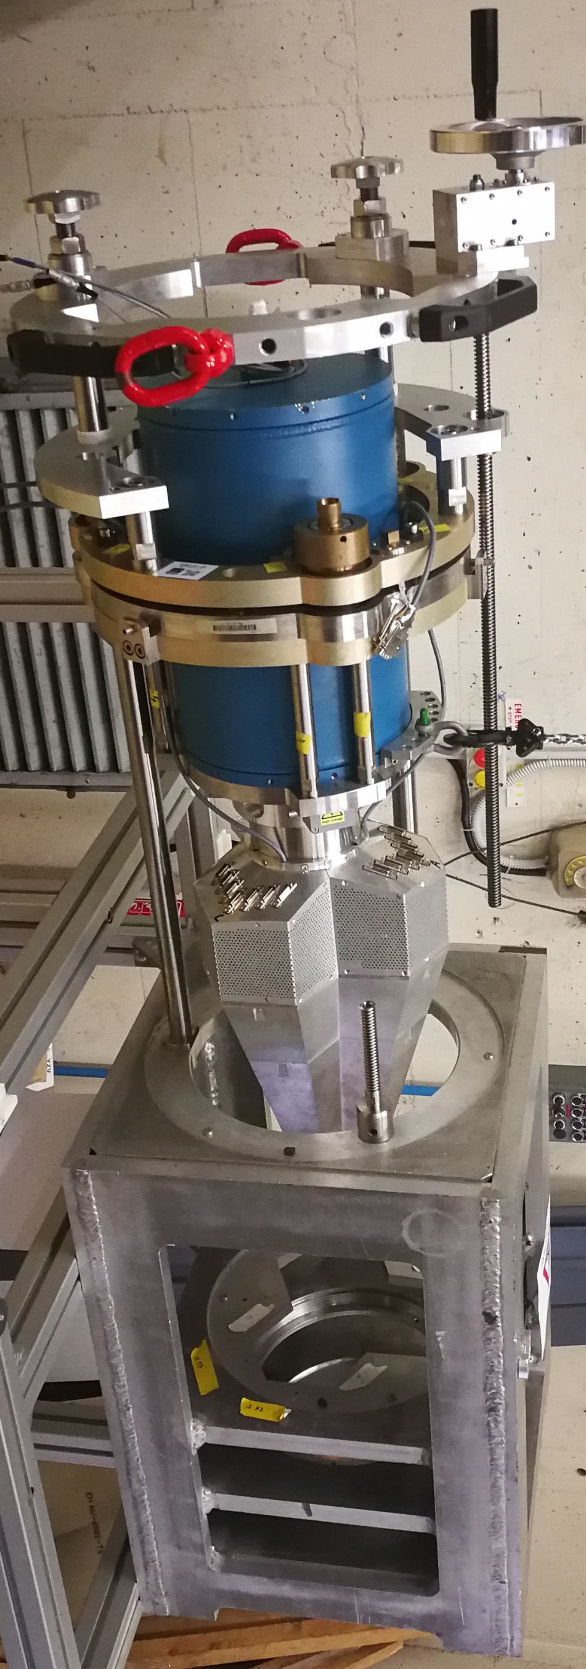
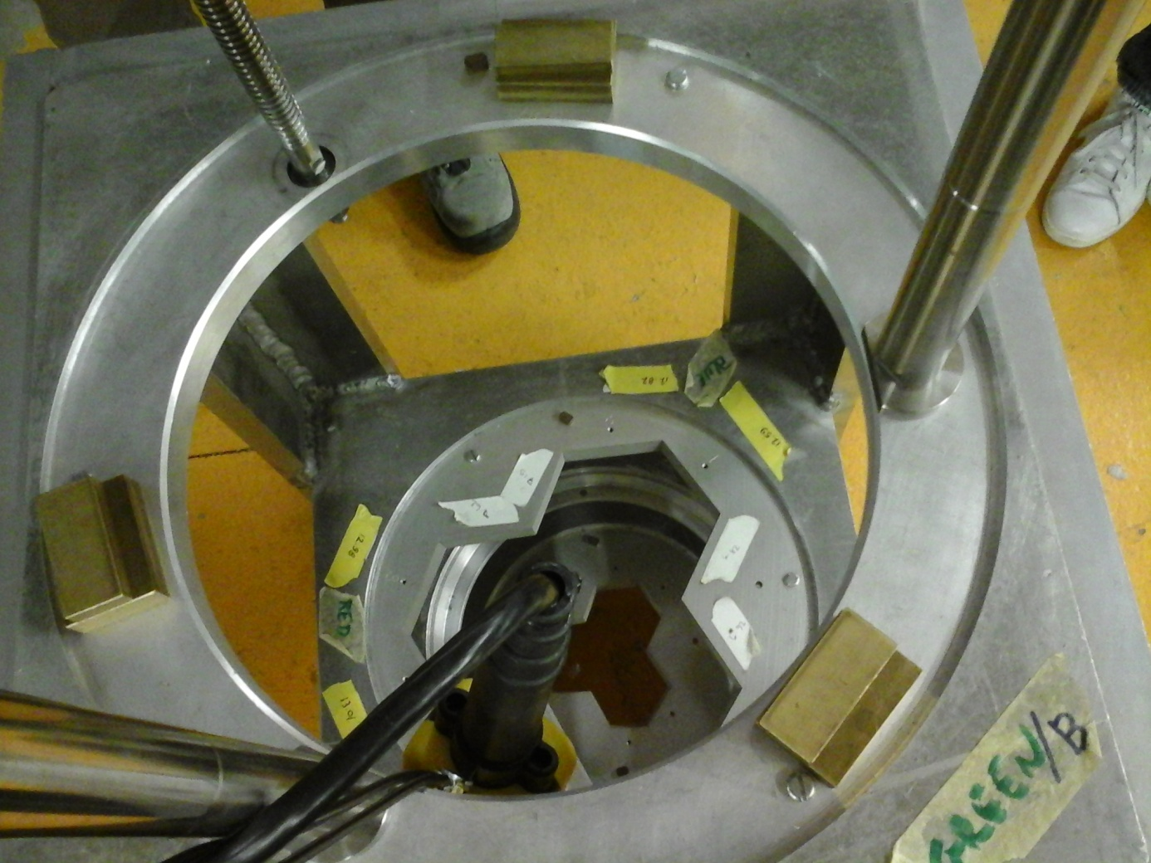
Jig Alignment @ LNL-INFN : ver_0.0
Fixed aluminum masks that may damage the ATC end cap.
Time-consuming iterative alignment process using spacers.
W. Raniero – AGATA Week 2026

Slide 11
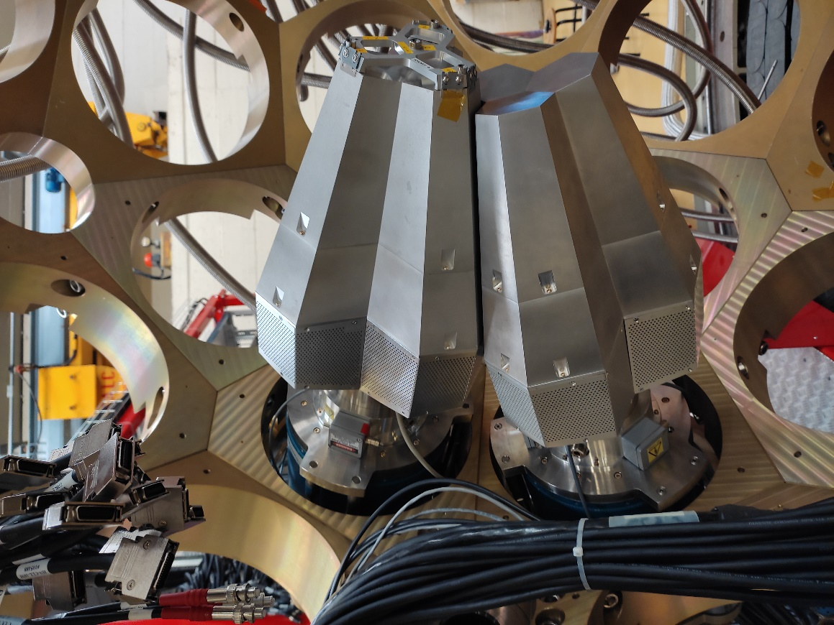
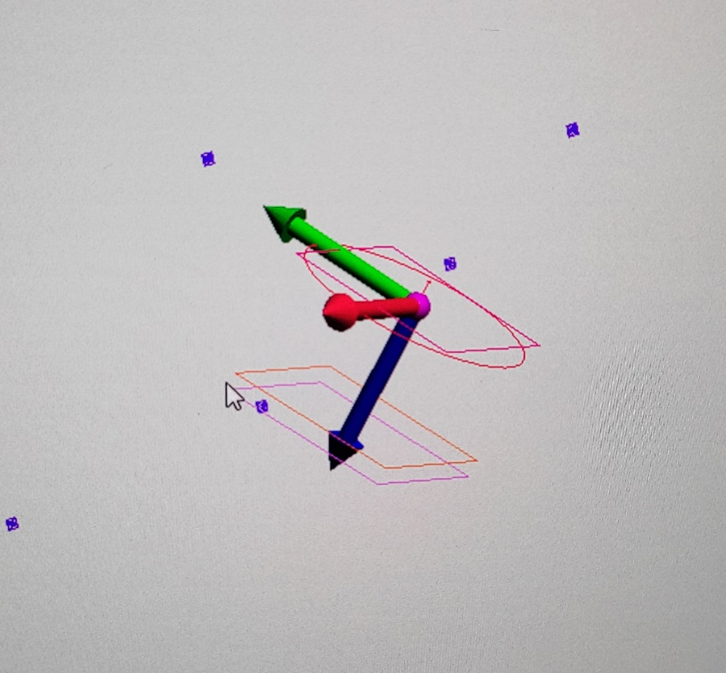
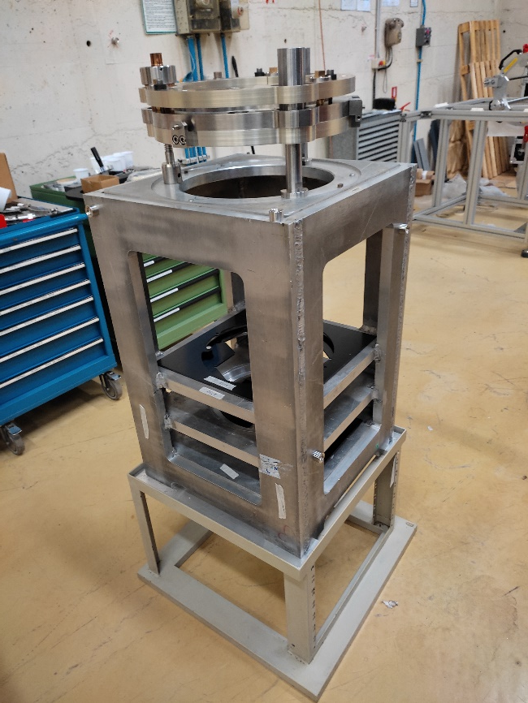
Jig Alignment @ LNL-INFN: ver_1.0
Laser Tracker assistance on setting Z (insertion in Honeycomb) coordinate JIG 1.0
Rotation made on JIG mask system
JIG ref plane
Reference in Laser software
ATC ref plane
179.5 mm
W. Raniero – AGATA Week 2026

Slide 12
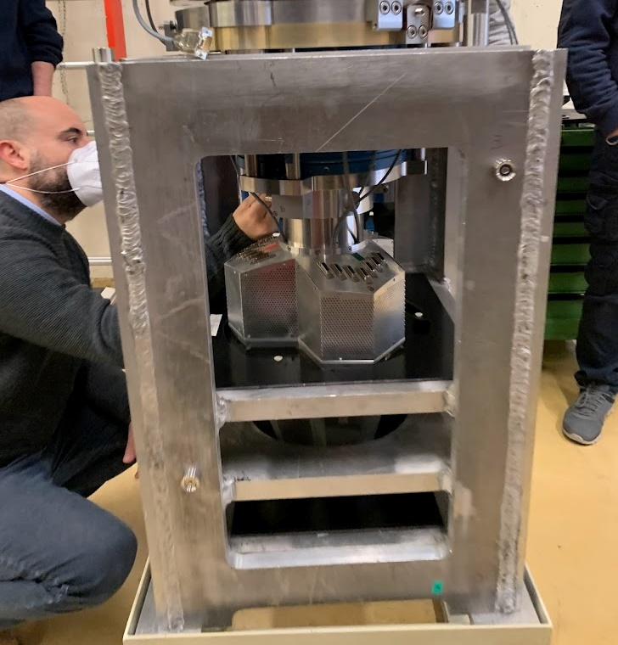
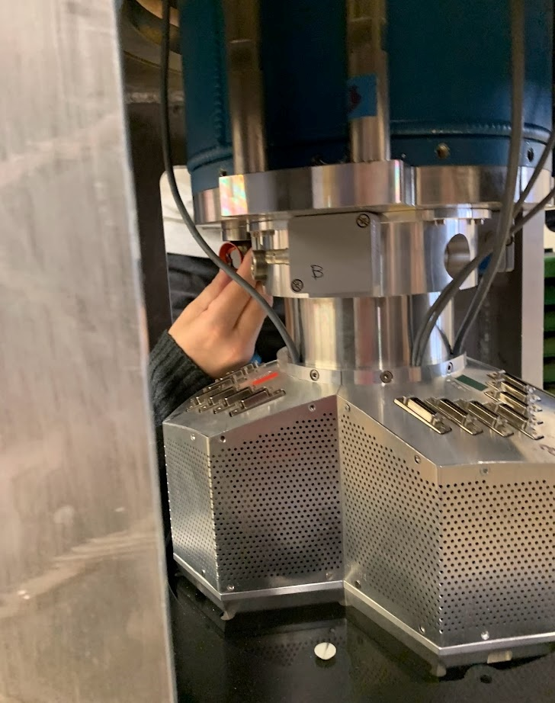
Jig Alignment @ LNL-INFN: ver_1.0
Lateral position set with new mask
Level and height set with laser tracker
Mask
W. Raniero – AGATA Week 2026

Slide 13
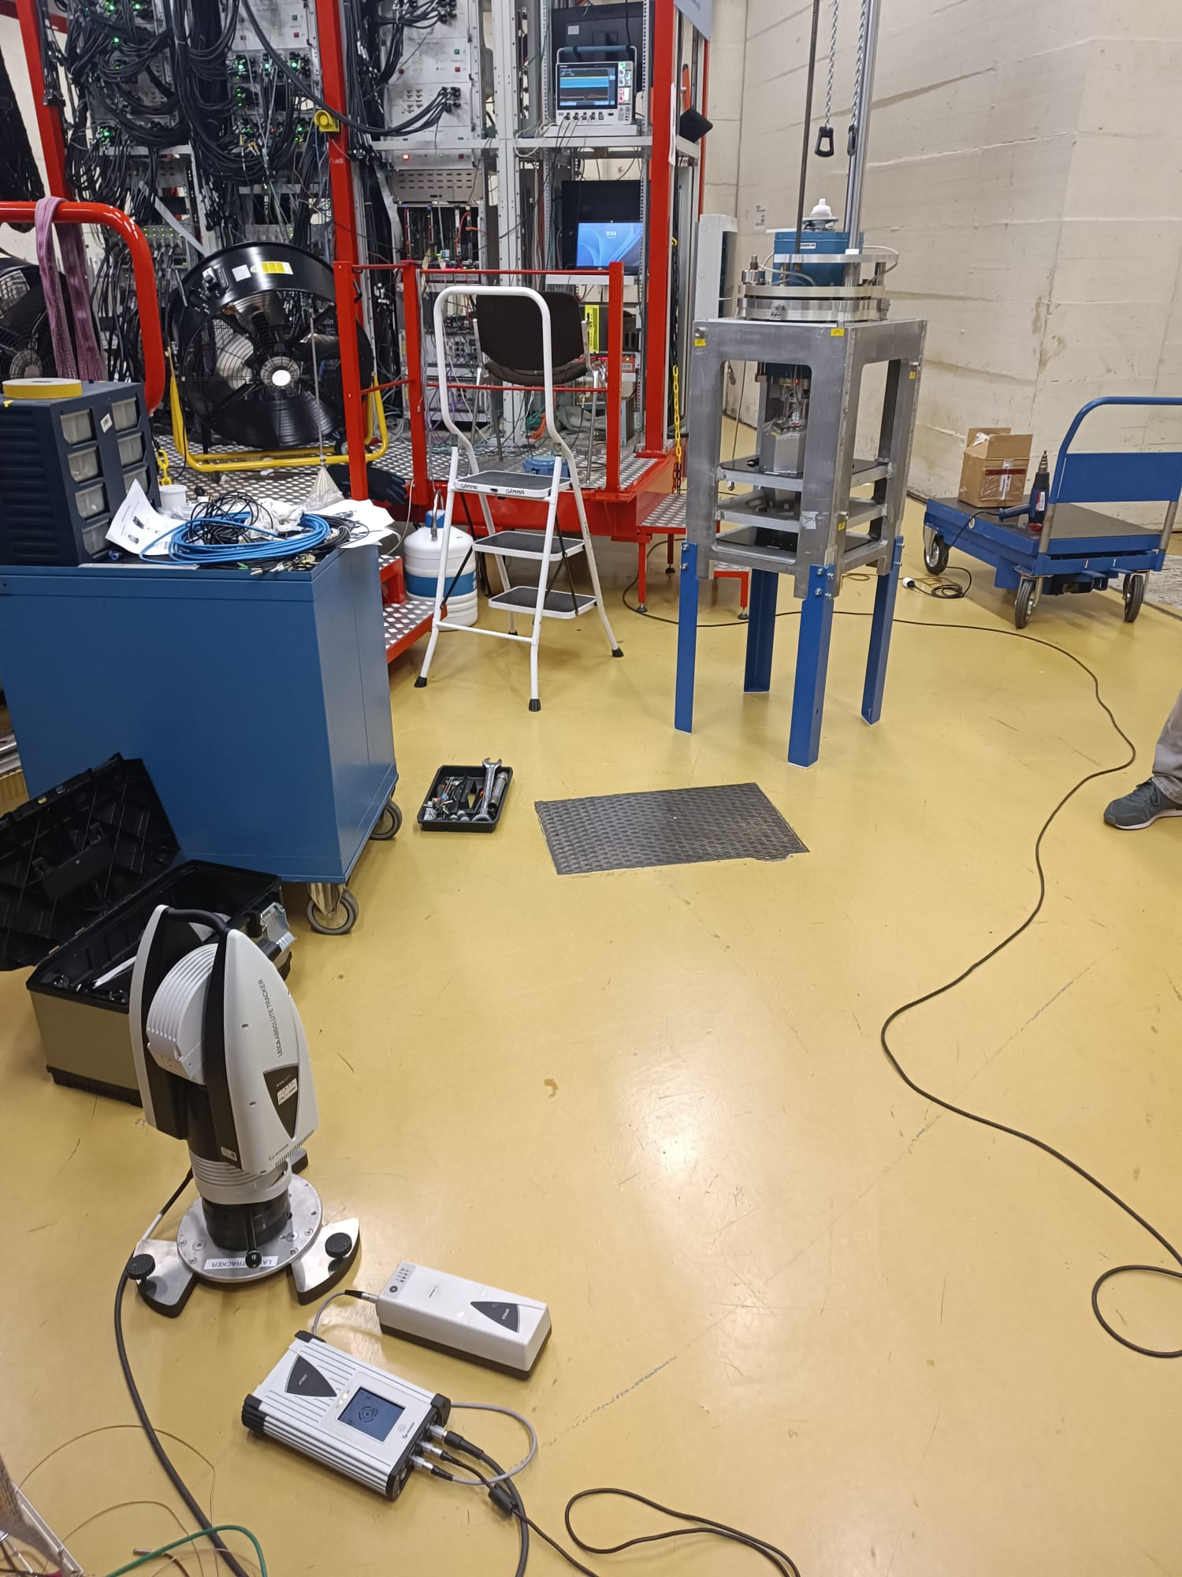
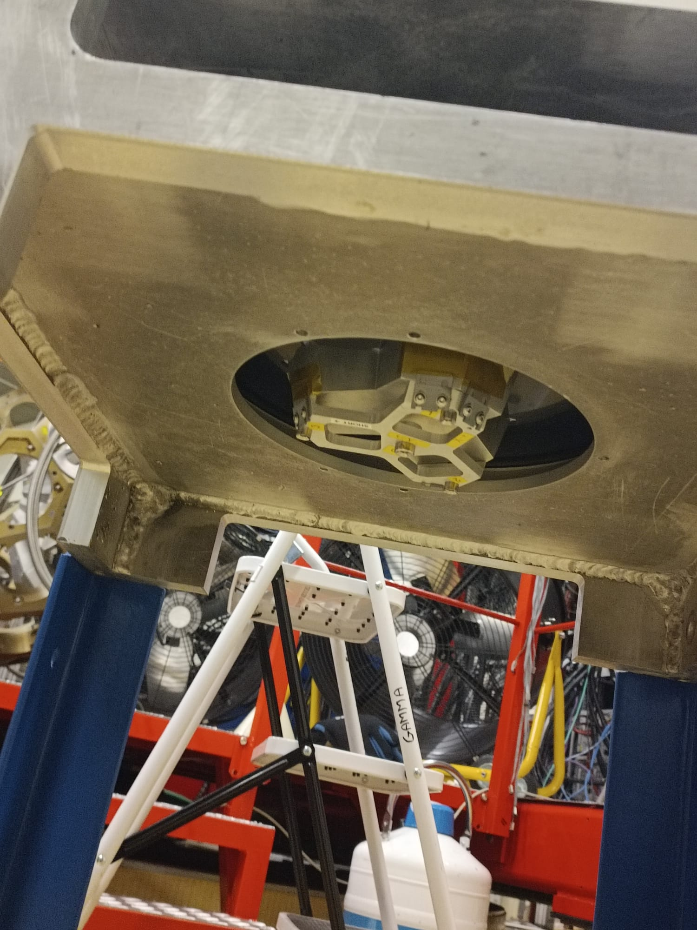
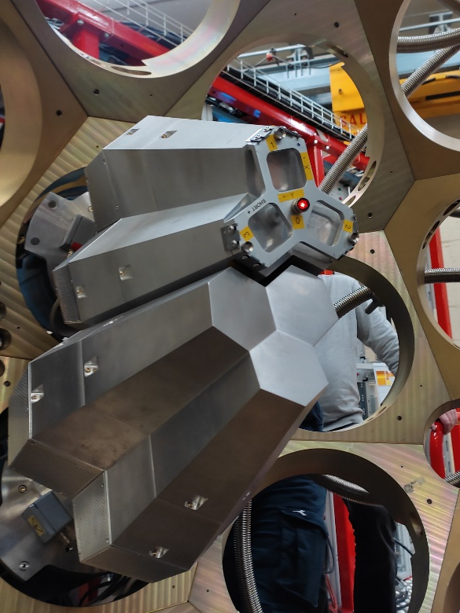
Jig Alignment @ LNL-INFN: ver_2.0
Laser Tracker assistance on insertion and angle wit JIG 2.0 with alignment tool as for the AGATA Honeycomb
ACT in Honeycomb
JIG 2.0 from below
New LT stand for ground operation
courtesy D. Scarpa
W. Raniero – AGATA Week 2026

Slide 14
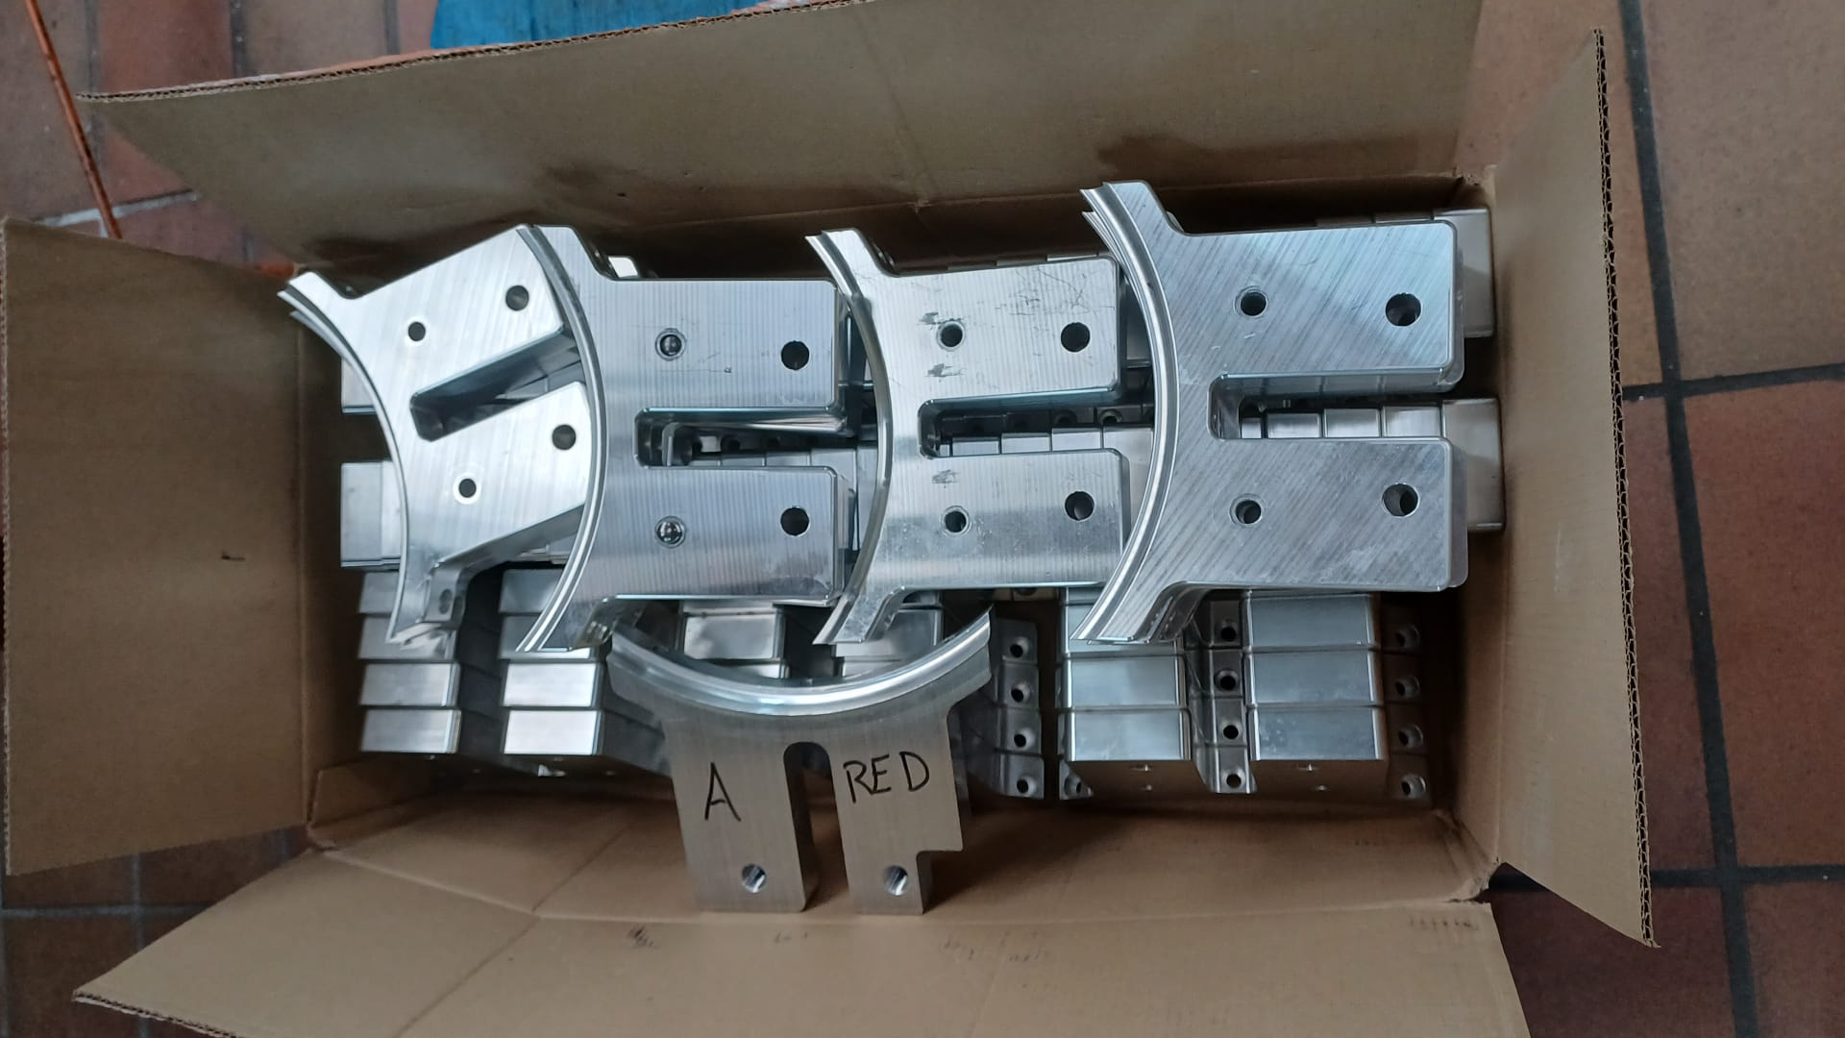
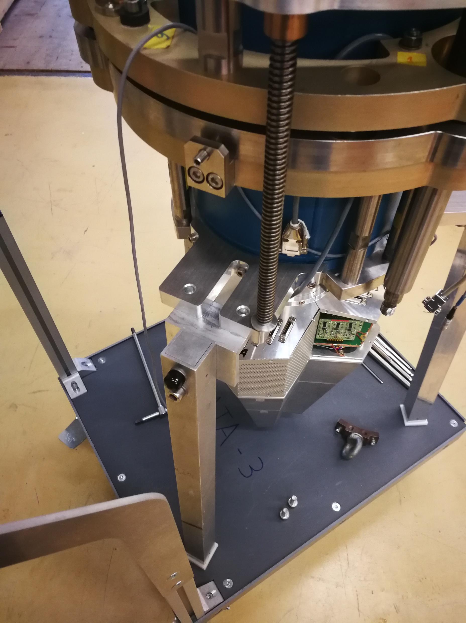
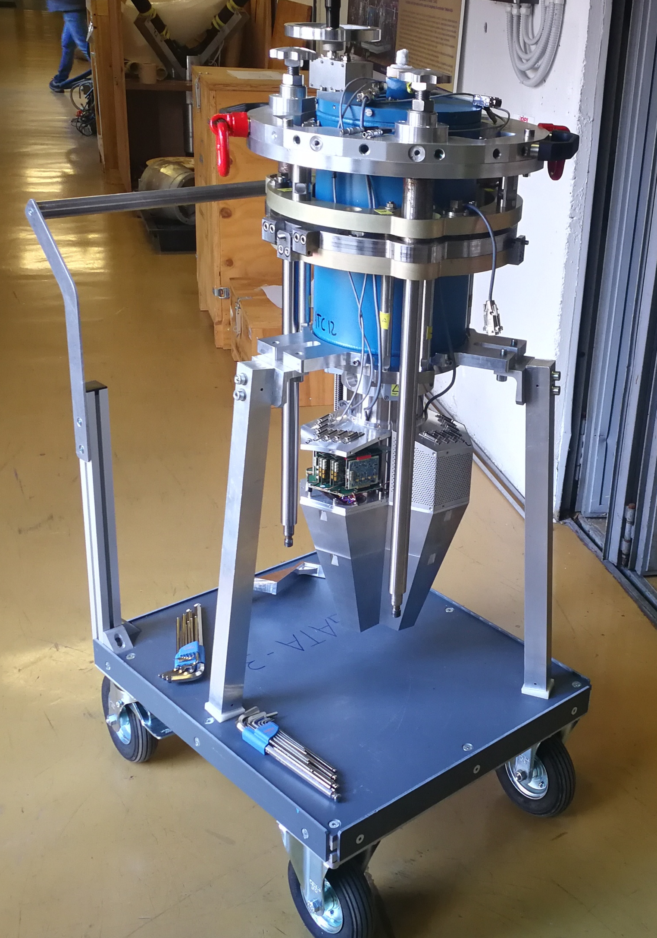
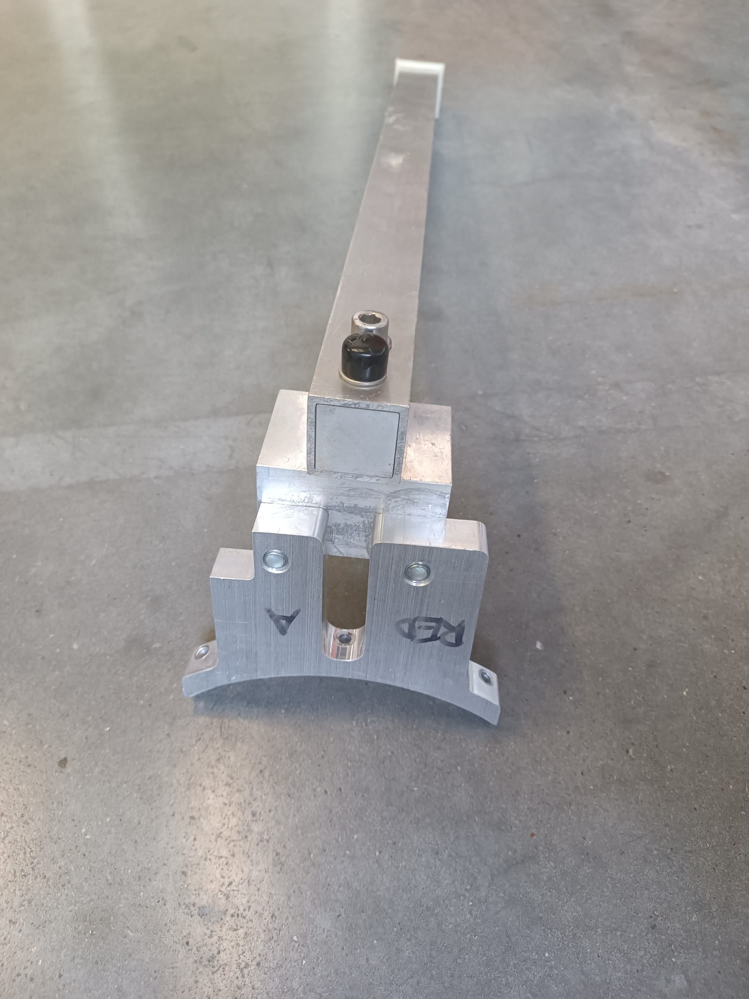
ATC Legs
46 Adapter legs
(IKP) 2026
The legs and adapter are available for all 18 ATCs at LNL (11 on the frame and 7 in the lab)
W. Raniero – AGATA Week 2026

Slide 15
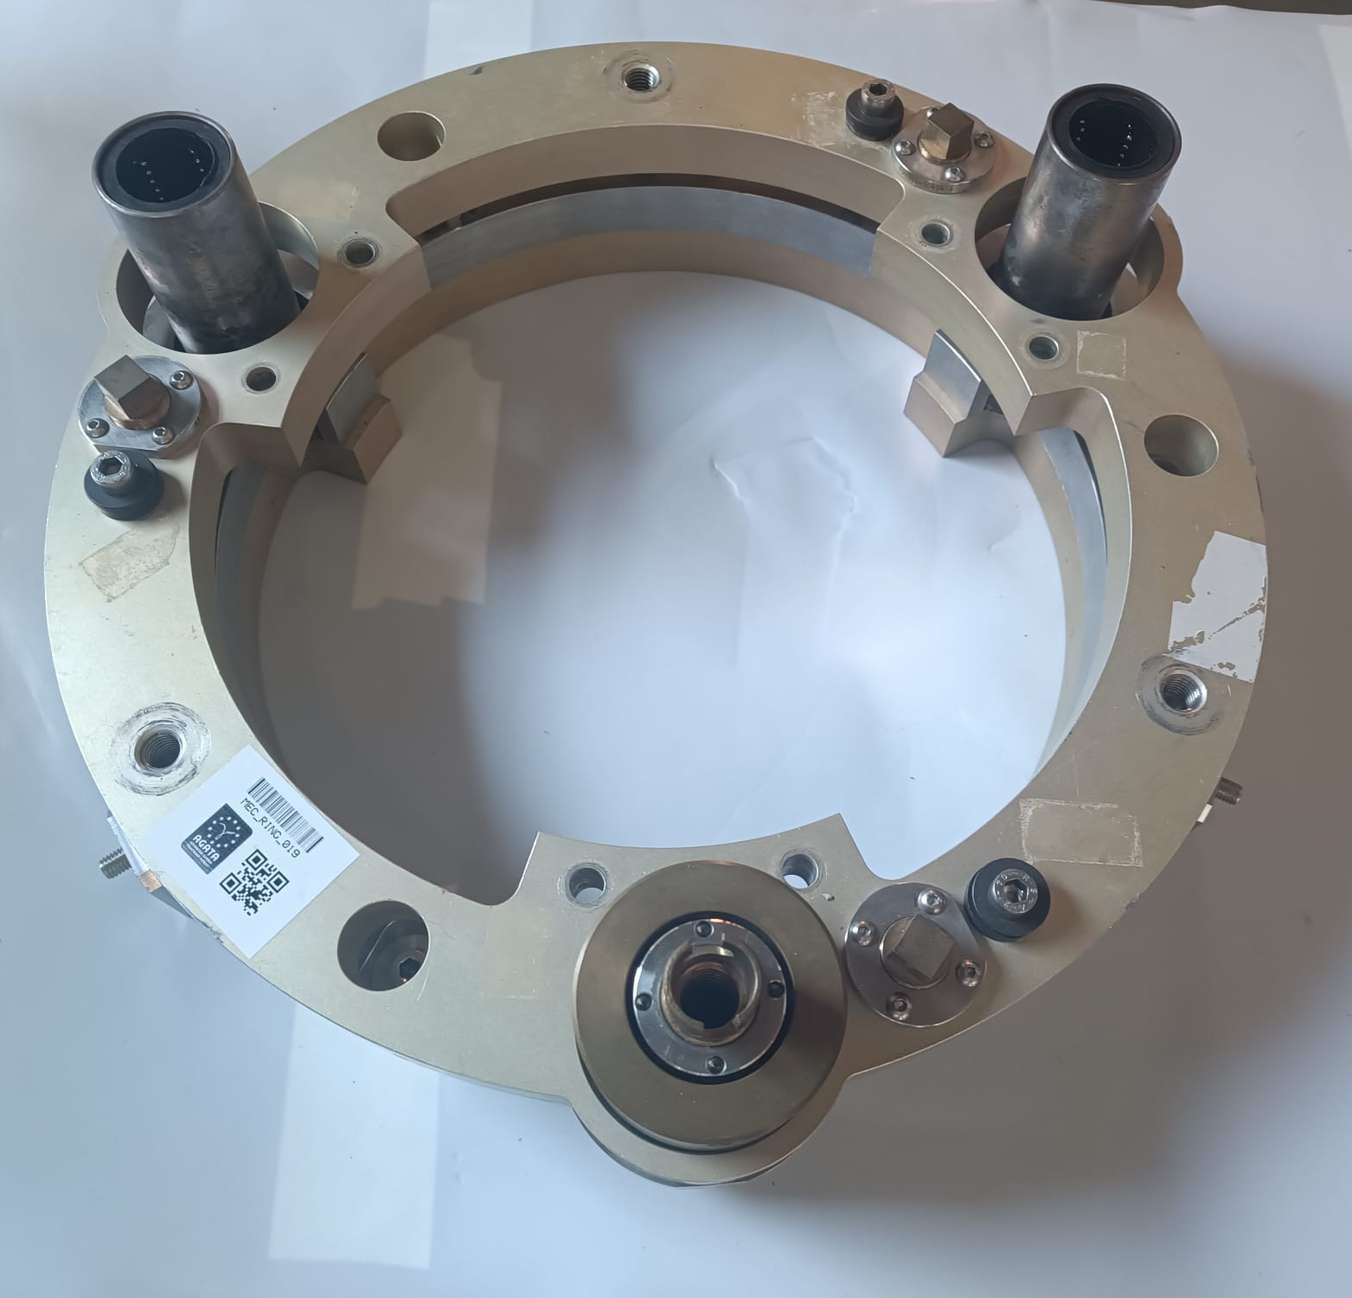
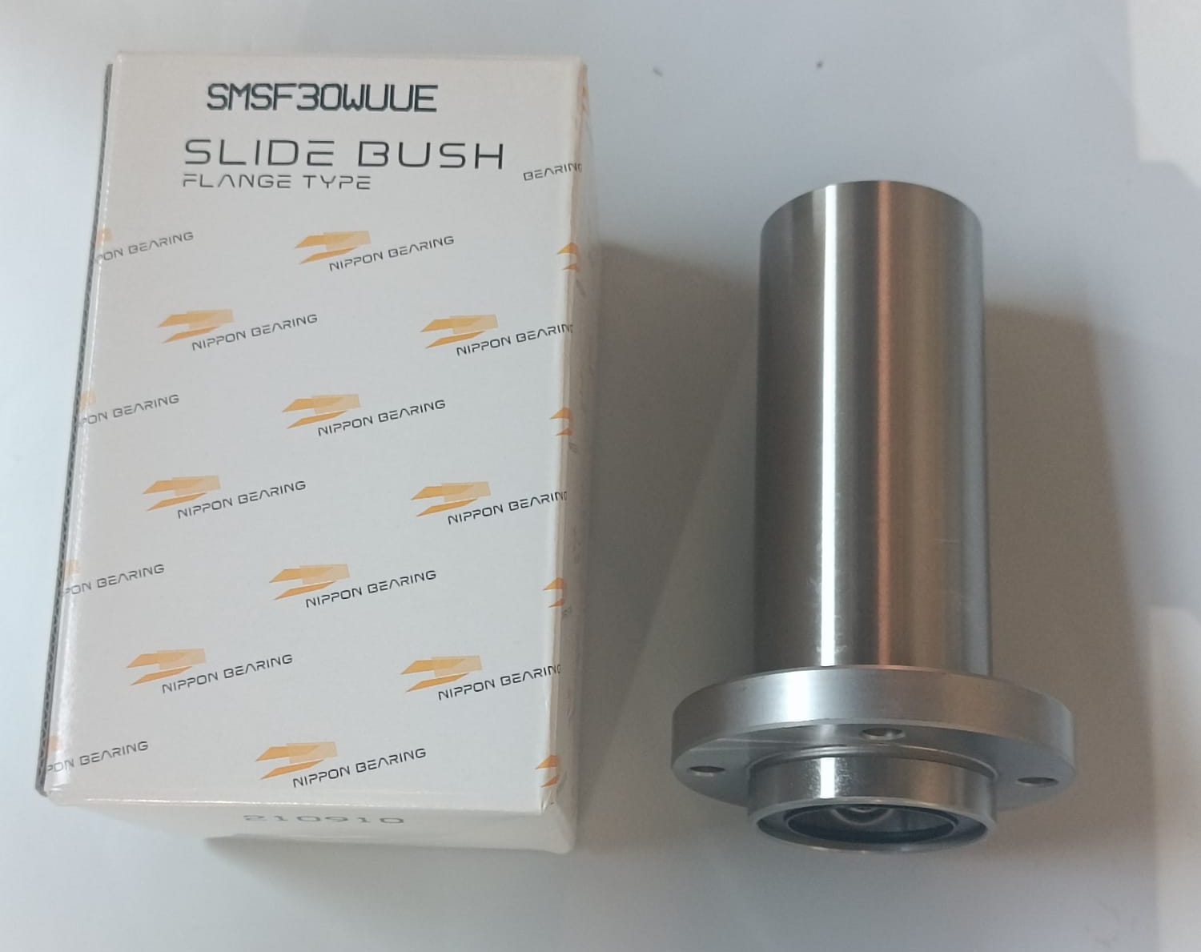
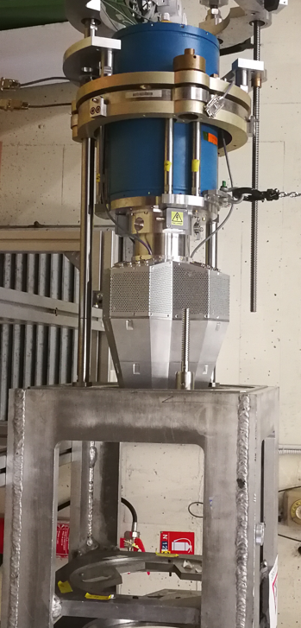
Linear SLIDE BUSH
Slide bushes were purchased to ensure the availability of 3 dedicated sets, one for each detector ring.
W. Raniero – AGATA Week 2026

Slide 16
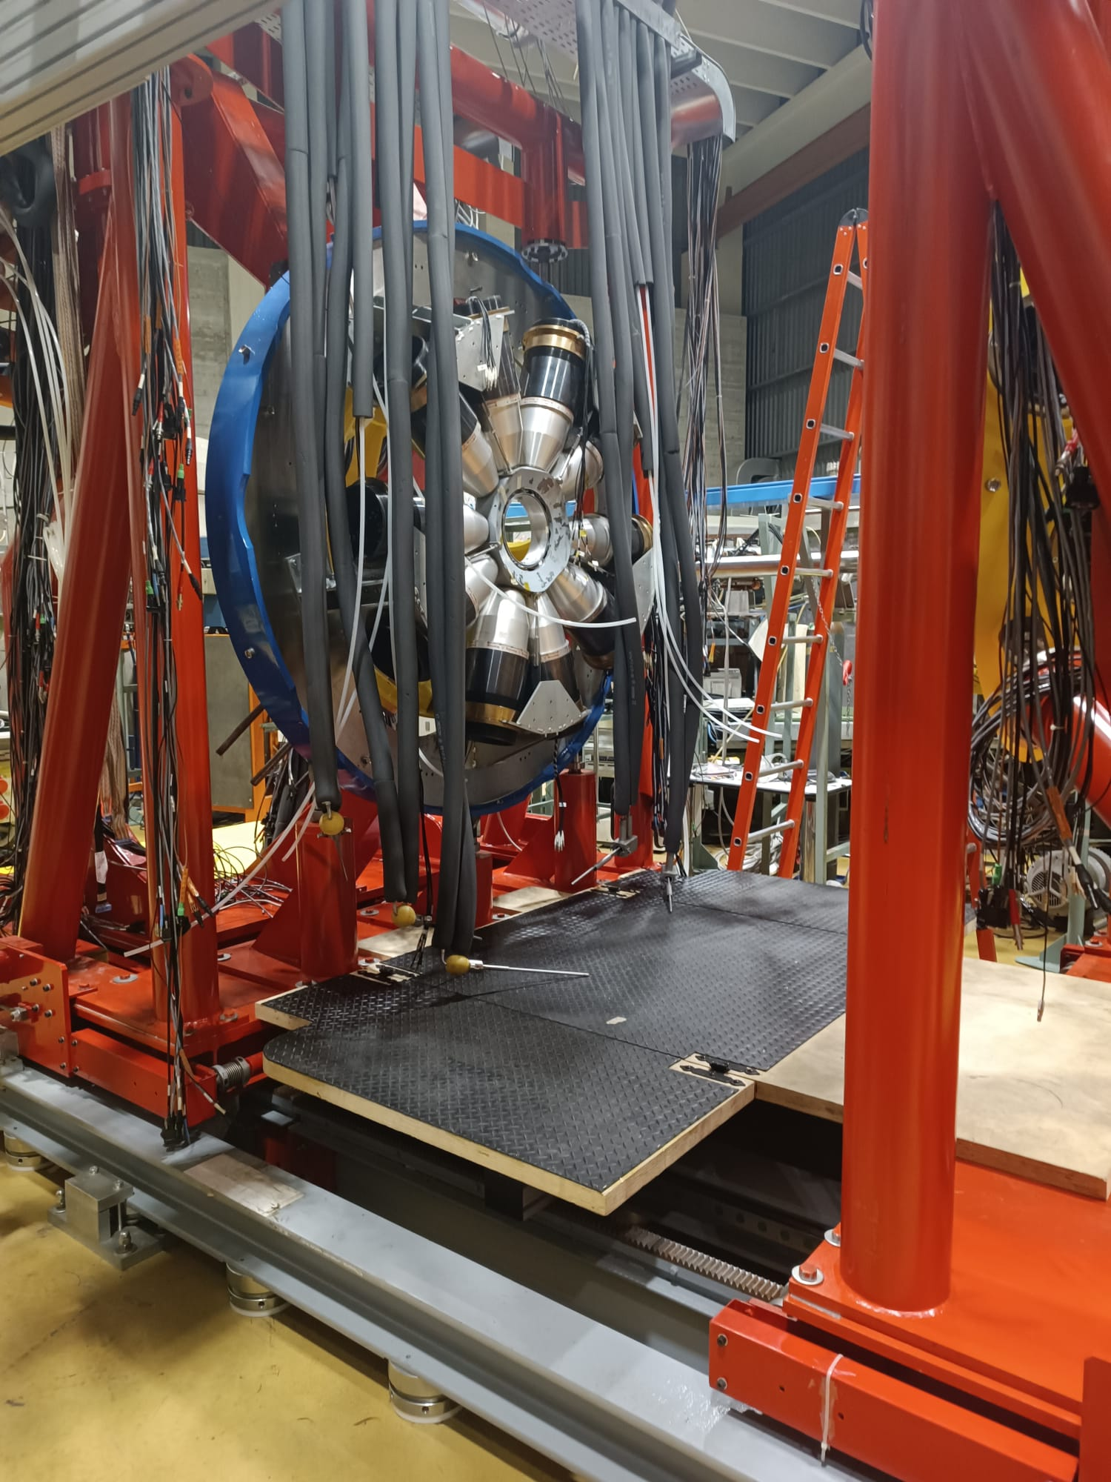
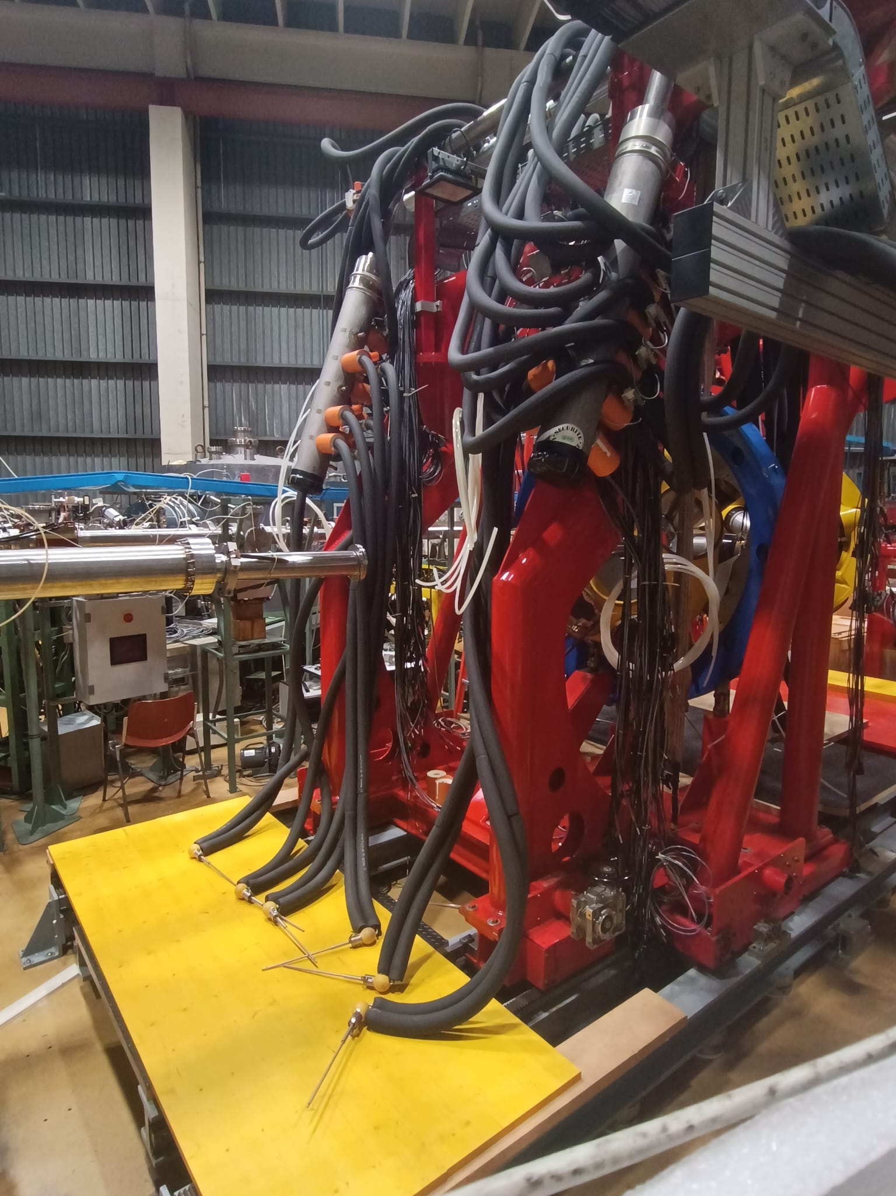
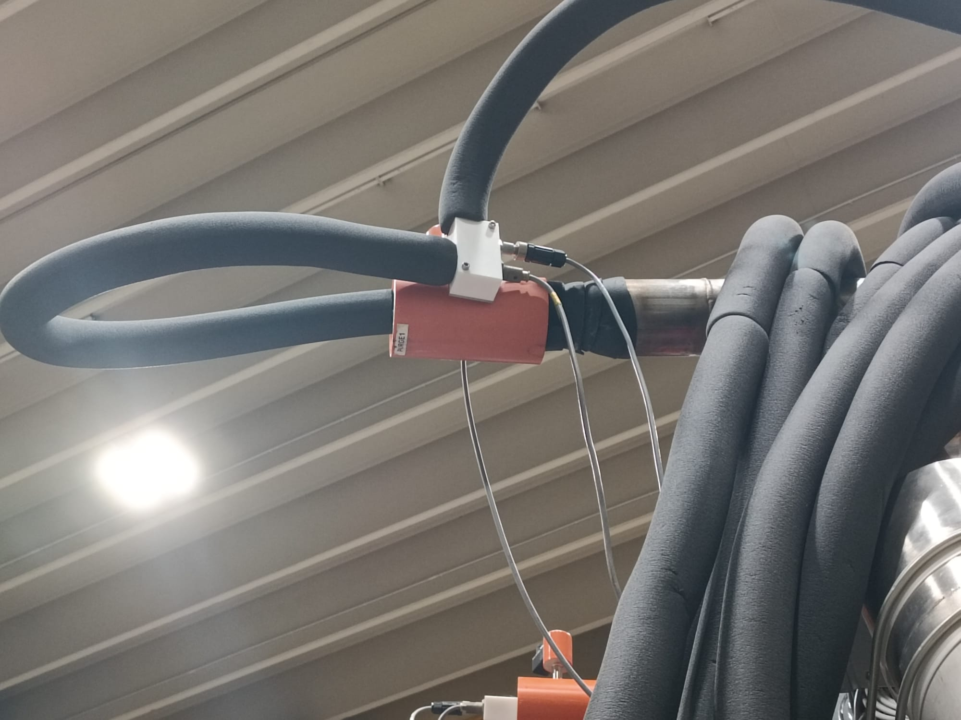
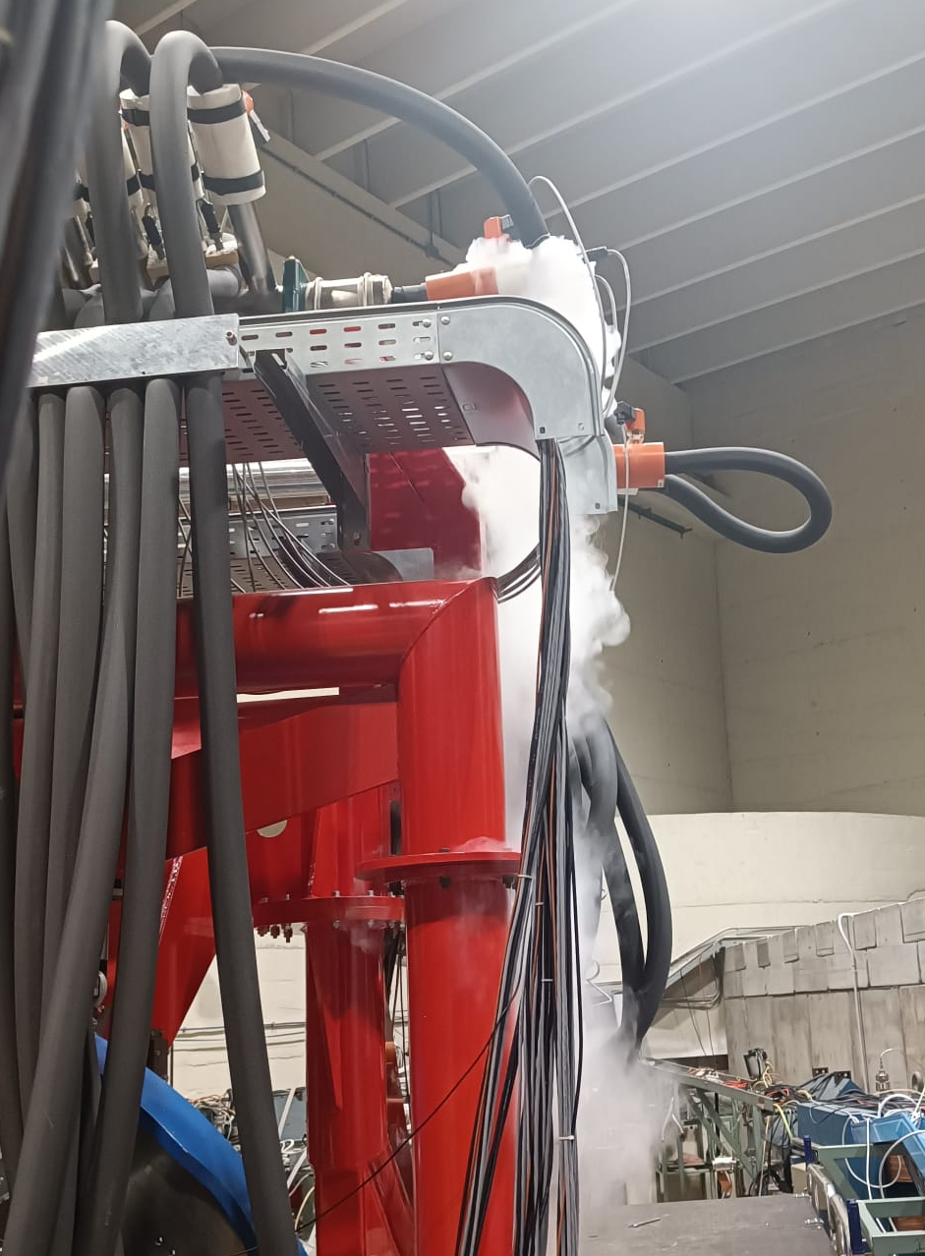
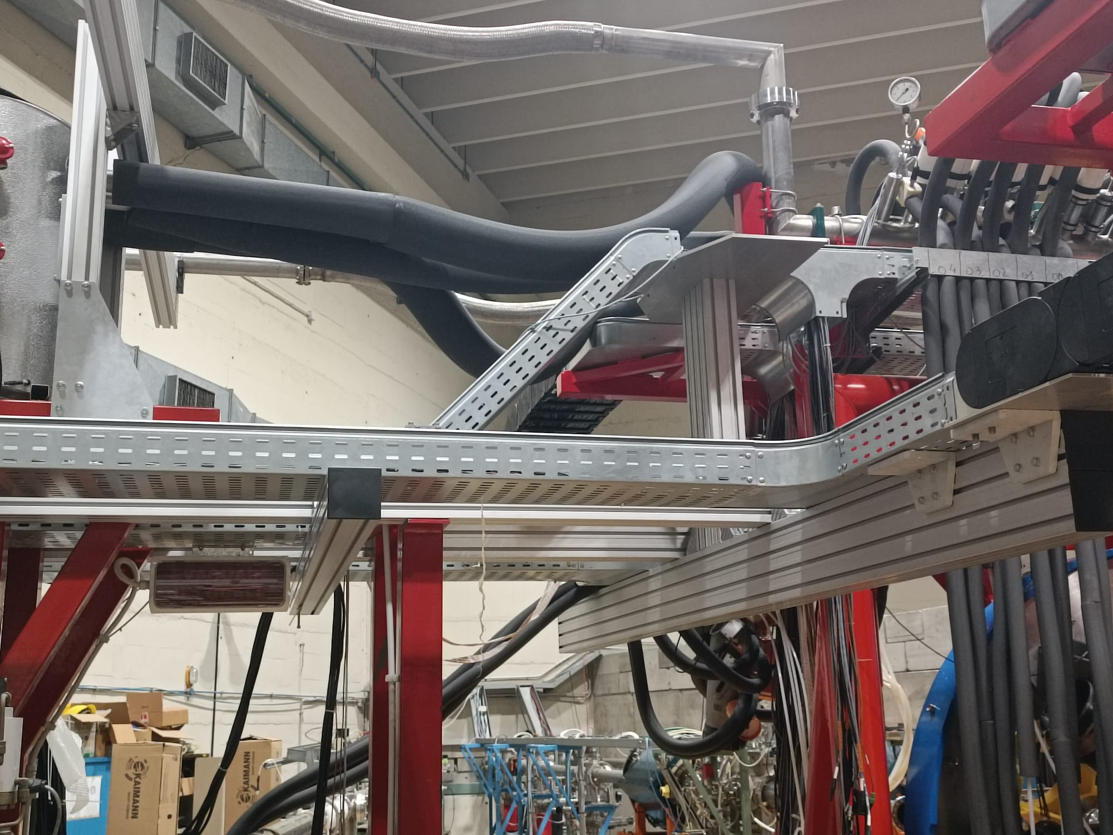
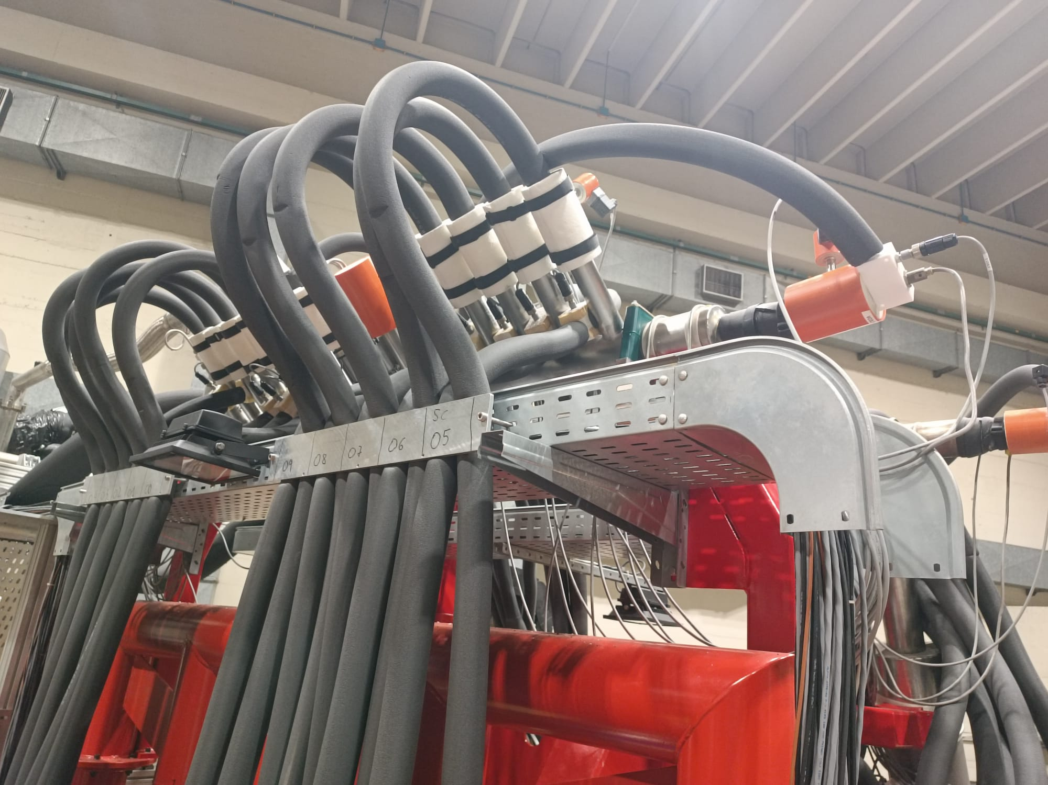
Galileo filling LN2 system
Galileo system: host up 14 ATCs
Maintenance: valves, insulated pipes, purge valves, PT 100
W. Raniero – AGATA Week 2026

Slide 17
Summary
The infrastructure is ready for up to 15 ATCs; further work is ongoing to support more than 15 ATCs.
The infrastructure materials required for 2π coverage are already available.
Detector-ring installation has been improved, ensuring more reliable alignment (x-y-z- rotation) between the JIG and the AGATA array using a laser alignment tool (JIG v2.0).
W. Raniero – AGATA Week 2026

Slide 18
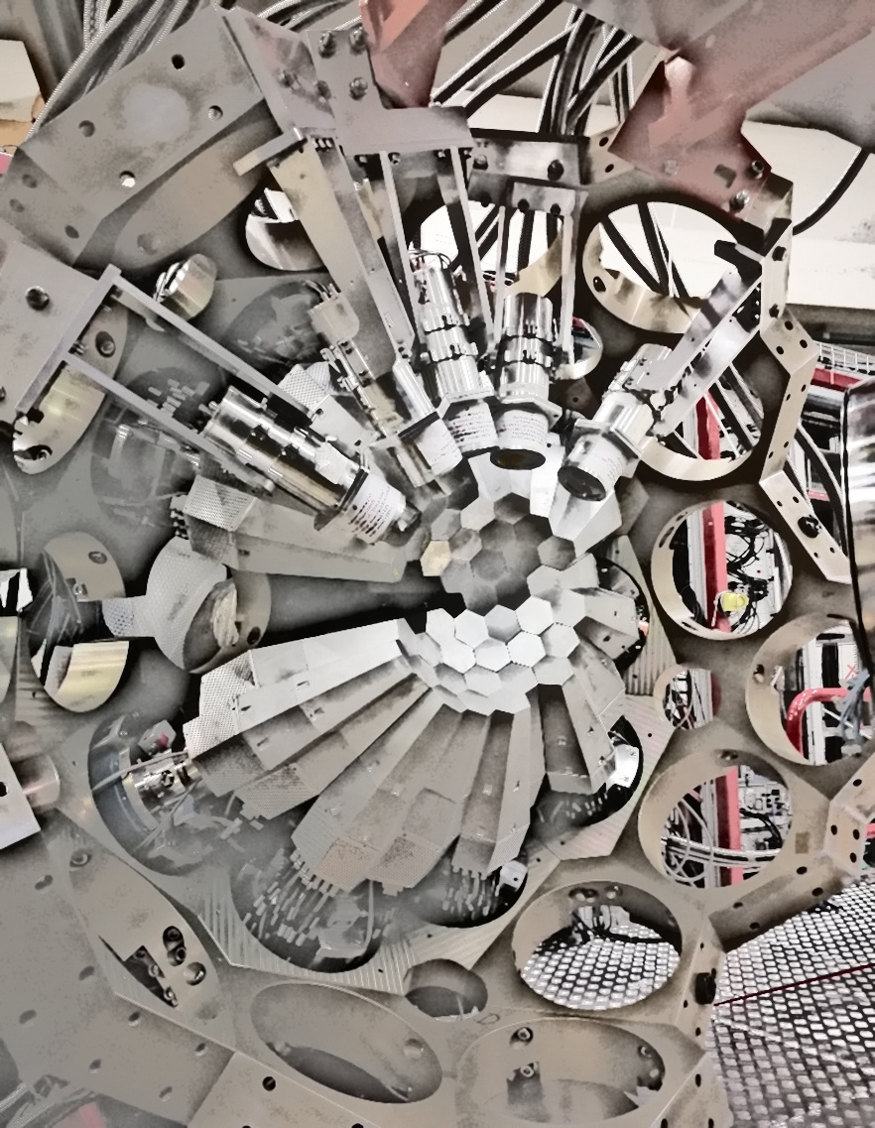
Thank you !!
W. Raniero – AGATA Week 2026

Slide 19
Status of Detector Array Infrastructure
26th AGATA Week – Infrastructure Group
Walter Raniero & Roberto Menegazzo
INFN-LNL / INFN-PD

