Slide 1
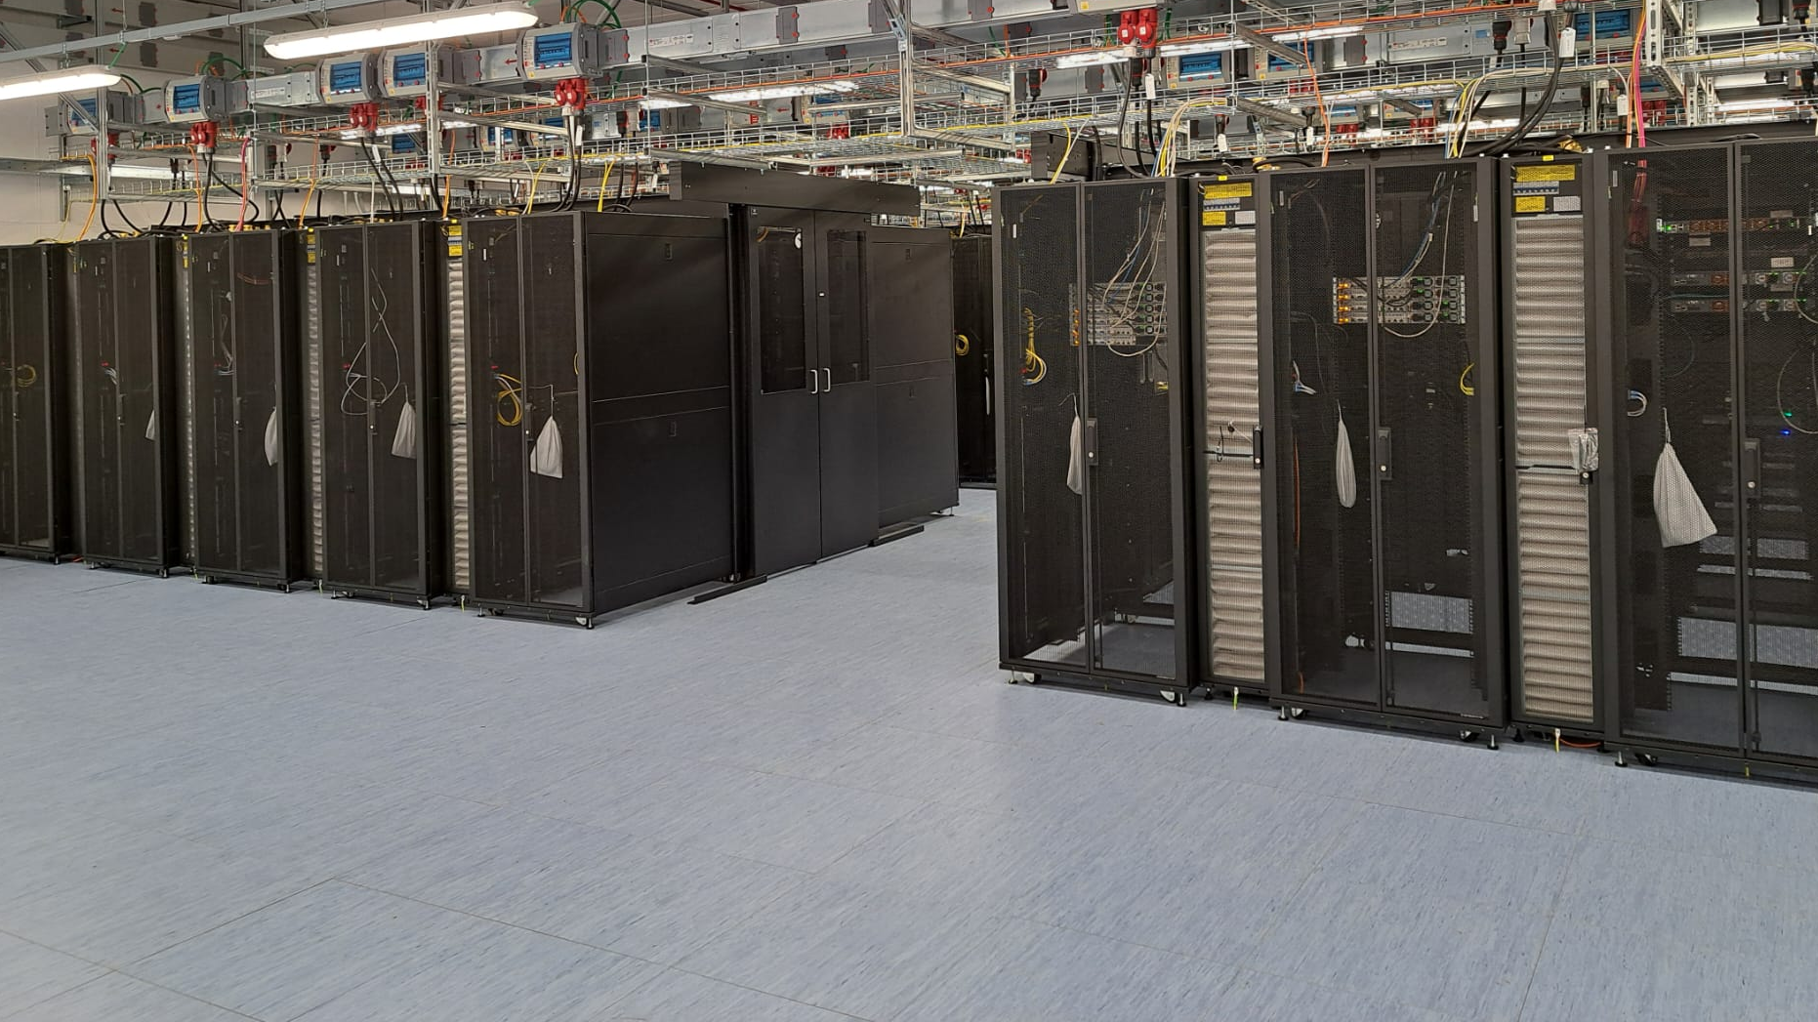

LNL DAQ Infrastructure
Alain Goasduff (INFN LNL)

Slide 2
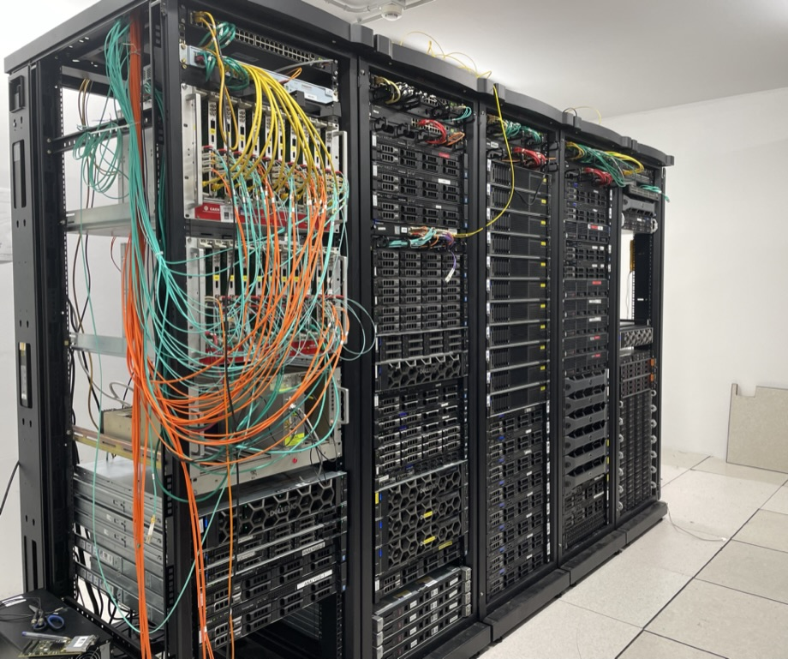
Current situation
Two sites at LNL
VAX + new CC

Slide 3
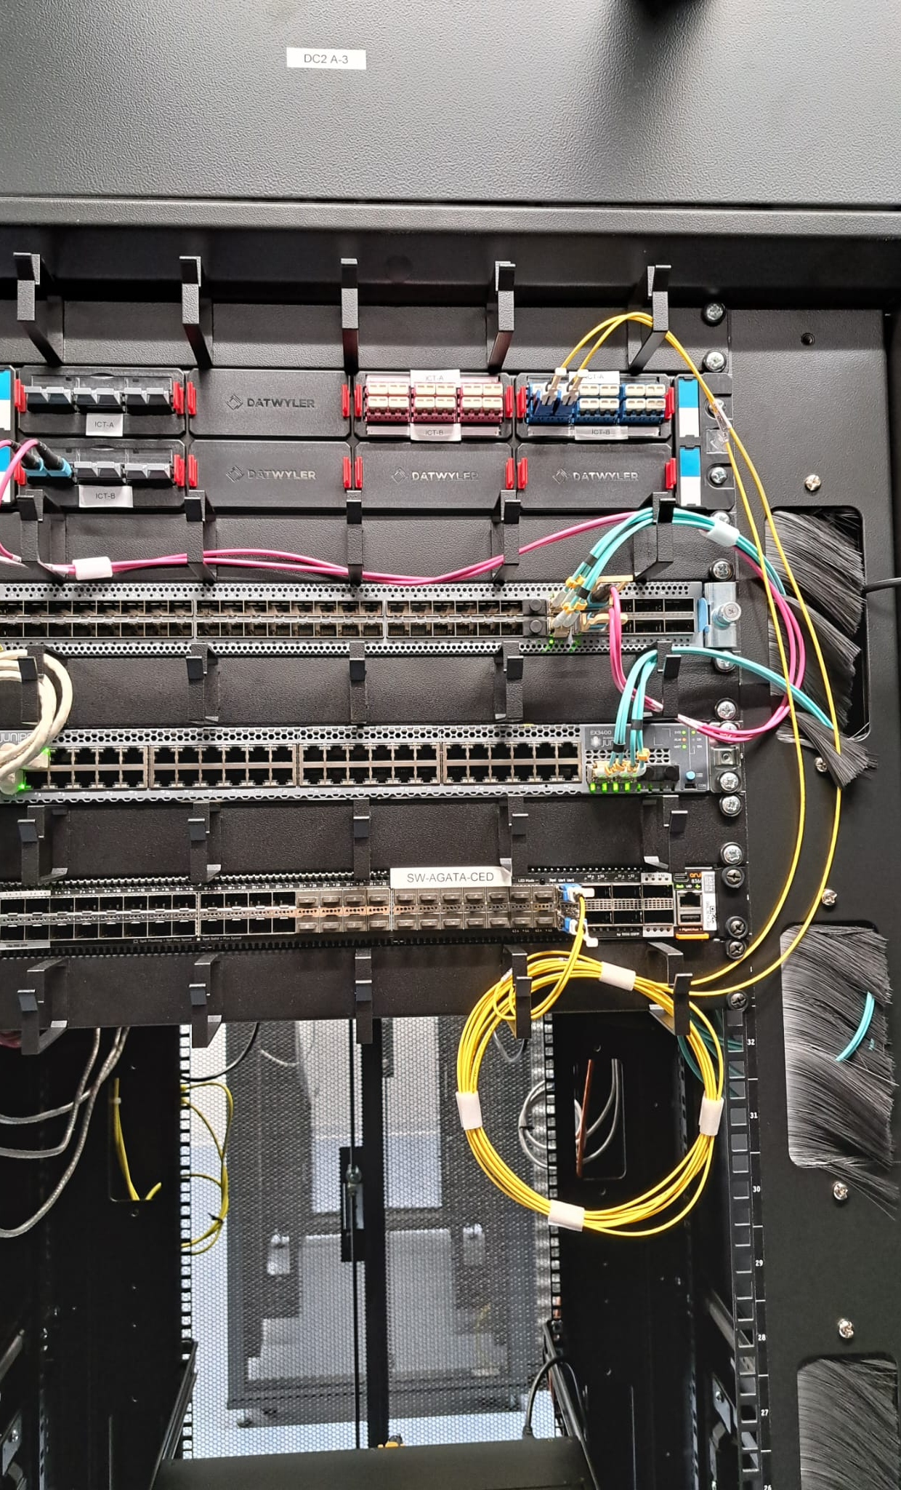
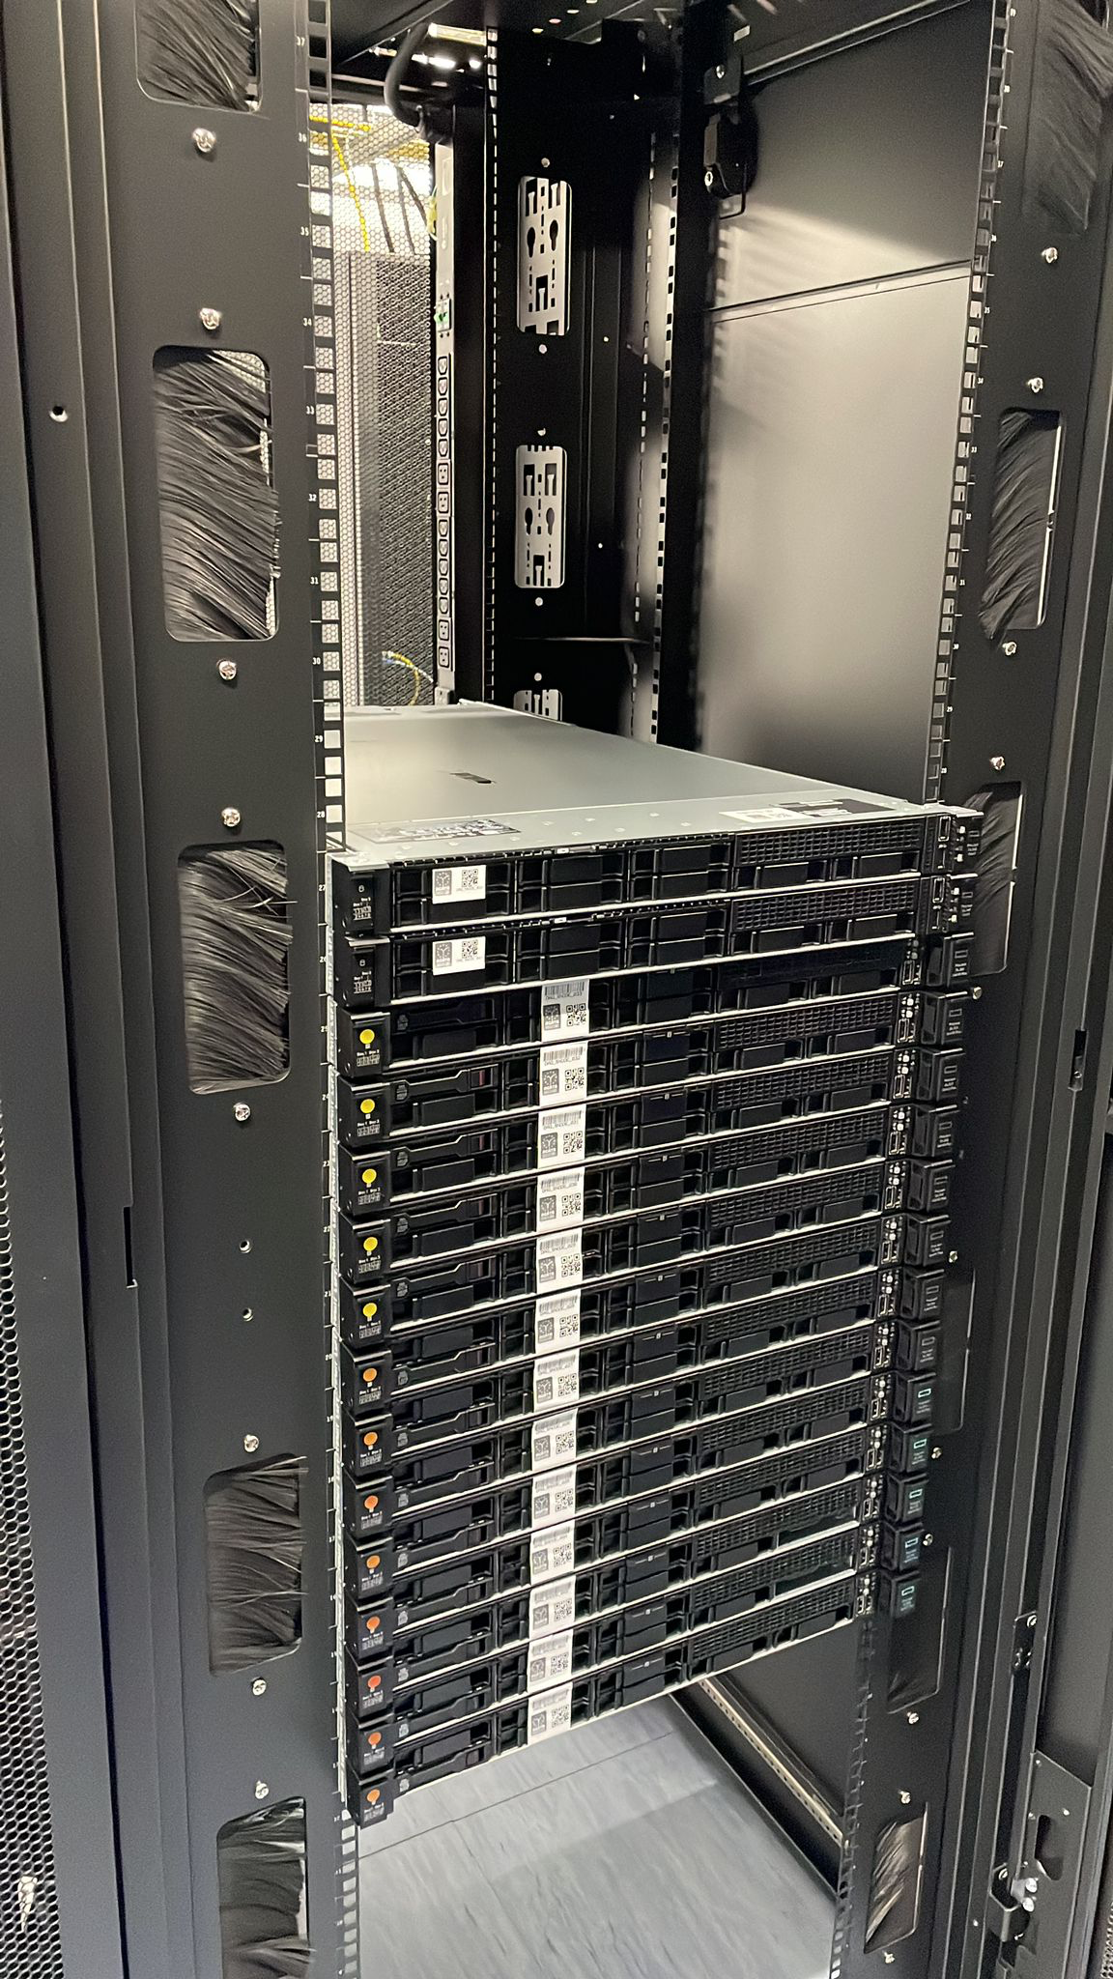
Network extension to the CC
AGATA Services already extended (172.16.0.0/16),
Moving the ancillary servers out of VAX (Fall 2026)
  Ancillary event building
  Run Control server
  Ancillary disk servers
Installed the V2 servers (Spring 2026):
  Connected 2 servers
  Data transfer test

Slide 4
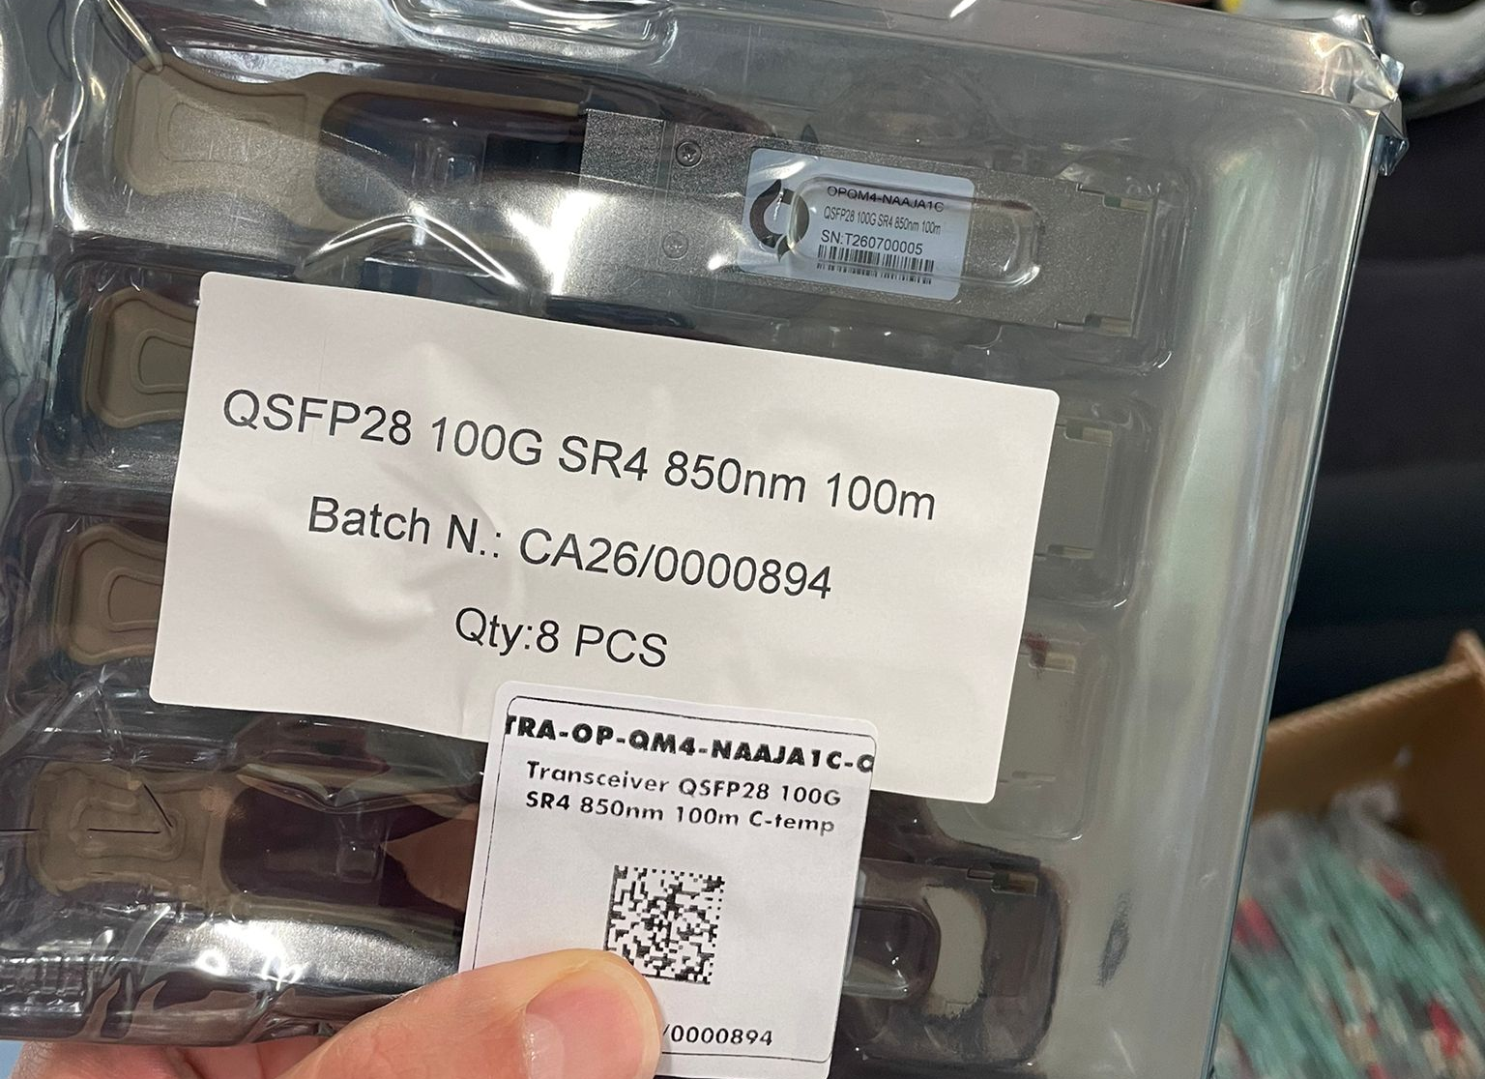
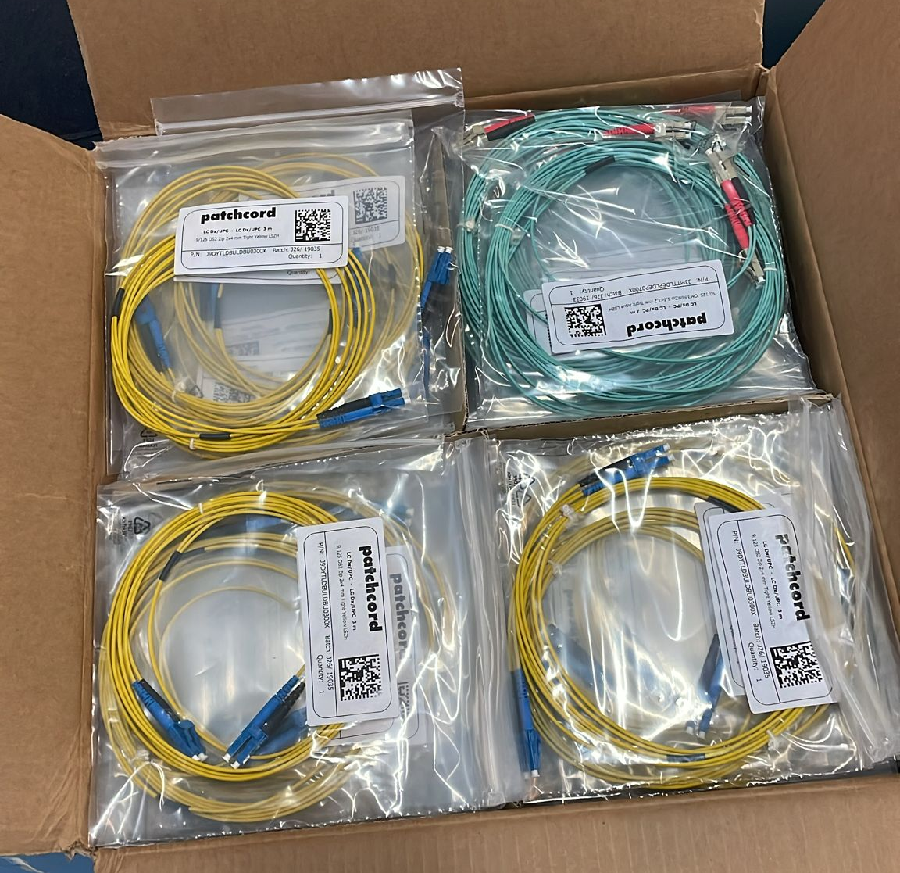
V2 installation
LVPS delivered at LNL
4x 100Gbps link installed between the experimental hall and VAX (MTP-MTP OM4)

Slide 5
V2 / Temporary solution
Similar network infrastructure
Ethernet connection 10 Gbps with identical 1310 nm fibre and trasceivers

