Slide 1
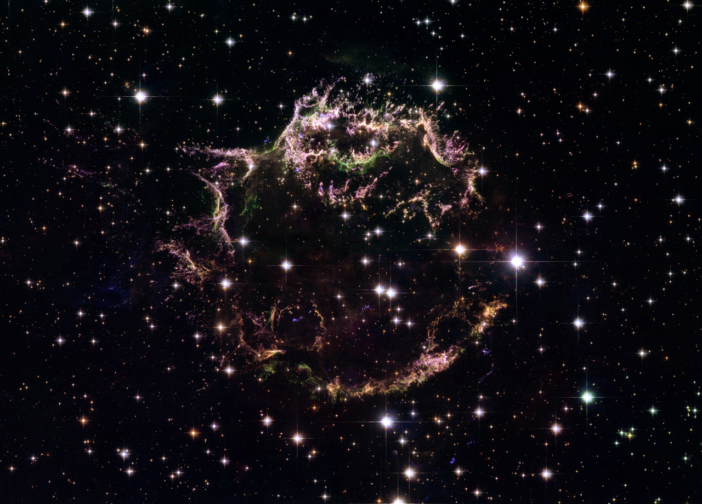


Does the Bohm (Hillas) limit determine
the maximum energy of shock-accelerated cosmic rays?
a sequel to
Cosmic ray acceleration and transport with magnetic mirroring
by
Tony Bell, James Matthews, Andrew Taylor, Gwenael Giacinti
Cassiopeia A, the brightest (extra-solar) radio source in the sky
http://hubblesite.org/newscenter/archive/releases/2006/30/image/a/format/xlarge_web/

Slide 2
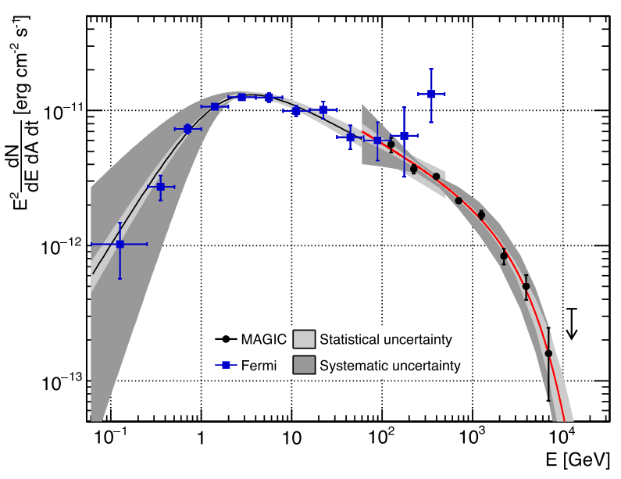
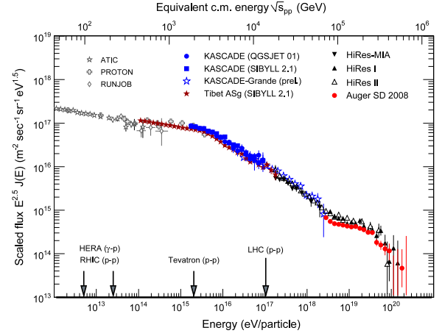
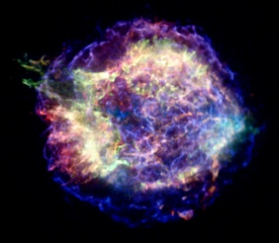
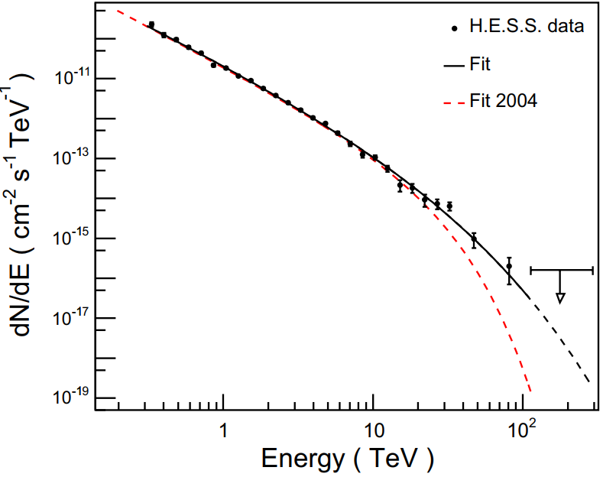
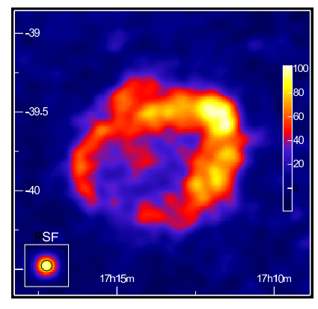
Galactic CR acceleration
where/what are the Pevatrons?
Ahnen et al 2017 (Fermi, MAGIC )
x-ray
knee
Cas A
from Blumer et al 2009
H.E.S.S. (2017)
RX J1713.7–3946
10TeV
1PeV
100TeV

Slide 3
YOUNG SNR CANDIDATES

Slide 4
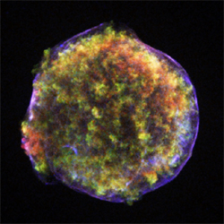
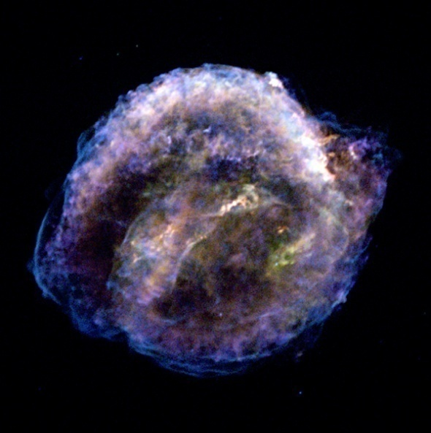
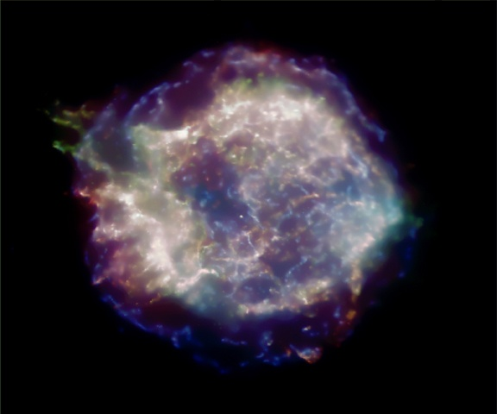
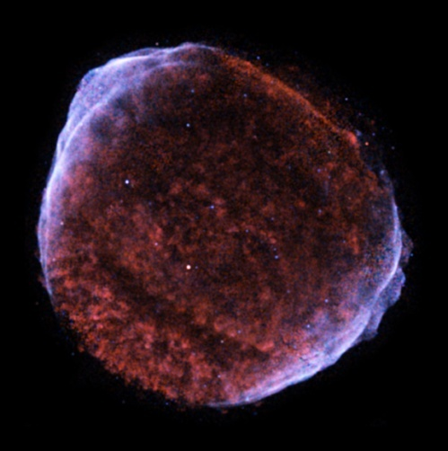
Historical shell supernova remnants
Tycho 1572AD
Kepler 1604AD
Radius, R = 2-10pc
Present velocity = 5000-7000 km s⁻¹
Mean velocity, R/t = 6000-10000 km s⁻¹
TeV electrons in 100μG field
SN1006
Cas A 1680AD
Chandra observations (x-ray)
NASA/CXC/Rutgers/
J.Hughes et al.
NASA/CXC/Rutgers/
J.Warren & J.Hughes et al.
NASA/CXC/NCSU/
S.Reynolds et al.
NASA/CXC/MIT/UMass Amherst/
M.D.Stage et al.

Slide 5





Hillas/Bohm limit for Cas A
Maximum CR energy for protons (in eV) $\text{e}=uBR$
$$u=5000 \text{kms}\text{−1}$$
$B=500$ μG
(Völk, Berezhko & Ksenofontov, 2005)
ε = 13PeV
$$R=1.7 \text{pc}$$

Slide 6
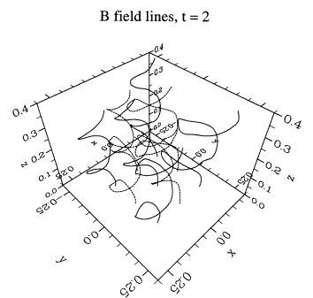






Bohm diffusion falls short of Hillas limit
CR current
Diffusive shock acceleration
upstream
shock
downstream
$$u_{shock}$$
$$u_{downstream}$$
assume Bohm diffusion
$$r_{g}$$
$$mean free path \sim { r}_{g}$$
magnetic field turbulent on scale of gyroradius
Maximum energy
Lagage & Cesarsky (1983)

Slide 7
Hillas/Bohm limit for Cas A
Maximum CR energy for protons (in eV) $\text{e}=uBR$
$$u=5000 \text{kms}\text{−1}$$
$B=500$ μG
(Völk, Berezhko & Ksenofontov, 2005)
ε = 13PeV
$$R=1.7 \text{pc}$$
ε ∼ 2PeV
after Lagage & Cesarsky
Two likely problems with magnetic field
1) localised to shock
2) structured on scale smaller than PeV proton Larmor radius

Slide 8
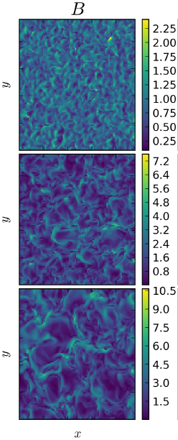
Escaping cosmic rays generate their own magnetic field
Magnetic field grows ahead of shock
Idealised supernova remnant
X
X
time
shock
CR
precursor
CHANDRA
Cas A
upstream
precursor
downstream
X
Shock
Matthews et al 2017

Slide 9

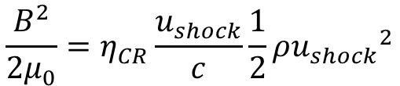
Saturation magnetic field amplification looks promising
CR current
Growth requires
1) Tension in field line less than driving jxB force
2) CR Larmor greater than spatial scale of turbulence
$$\frac{B^{2}}{{2μ}_{0}}=η_{CR}\frac{u_{shock}}{c}\frac{1}{2}ρ{u_{shock}}^{2}$$
Fraction of energy going into CR
Amplifies B by 100x
Saturates by growing to Larmor scale
Problem is the growth rate
Zirakashvili & Ptuskin 2008; Bell et al 2013
$$E_{max}=230 n_{e}^{1/2}u_{7}^{2}R_{pc} TeV$$
density
expansion velocity
radius

Slide 10
WHAT ARE THE POSSIBLE SOLUTIONS?

Slide 11

Look beyond middle-aged SNR
Very young SNR eg SN1987a
Stellar clusters: lots of SN, strong winds, large B, bubble termination shocks
Galactic centre
$$E_{max}=230 n_{e}^{1/2}u_{7}^{2}R_{pc} TeV$$
Try an alternative solution:
mirror-dominated shock acceleration (MDSA)

Slide 12
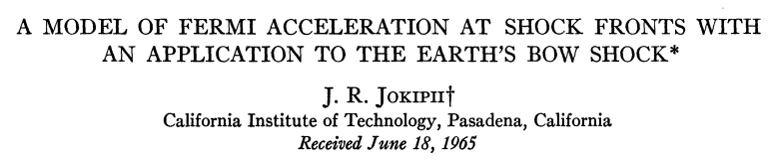
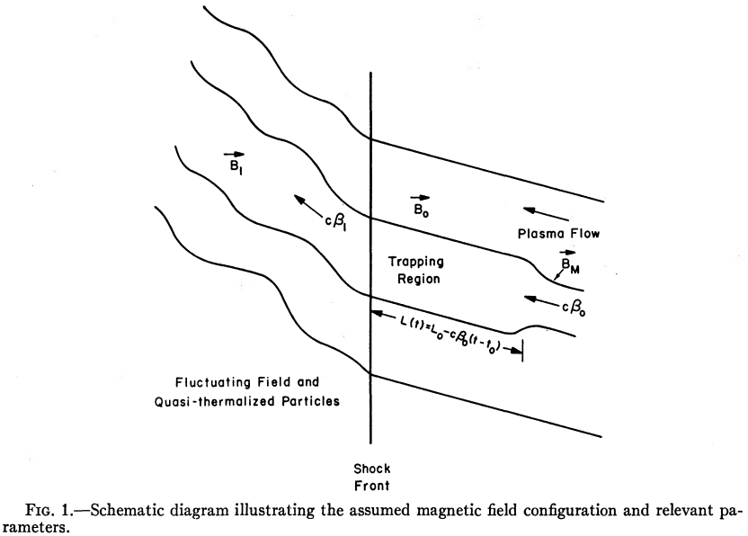
Alternative strategy: can we reach Hillas limit using mirrors?
Larmor radius << scalelength
CR constrained to field lines
† Randy Jokipii
(1939-2022)
Refer to this as mirror-dominated shock acceleration (MDSA)

Slide 13
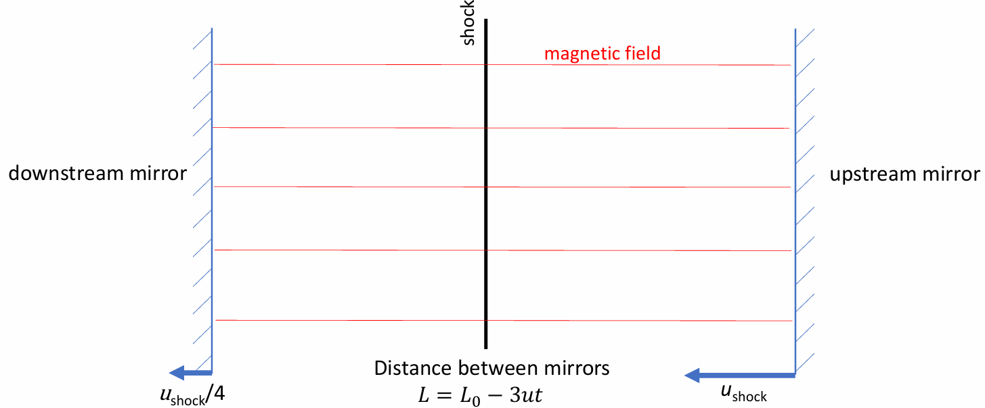
Idealised mirror-shock acceleration
Perfect reflection between mirrors increase parallel momentum
Perpendicular momentum is constant
Energy increases only by small multiple
Jokipii (1966): need scattering by magnetic fluctuations or shock interaction

Slide 14
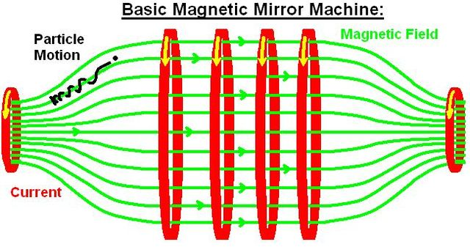
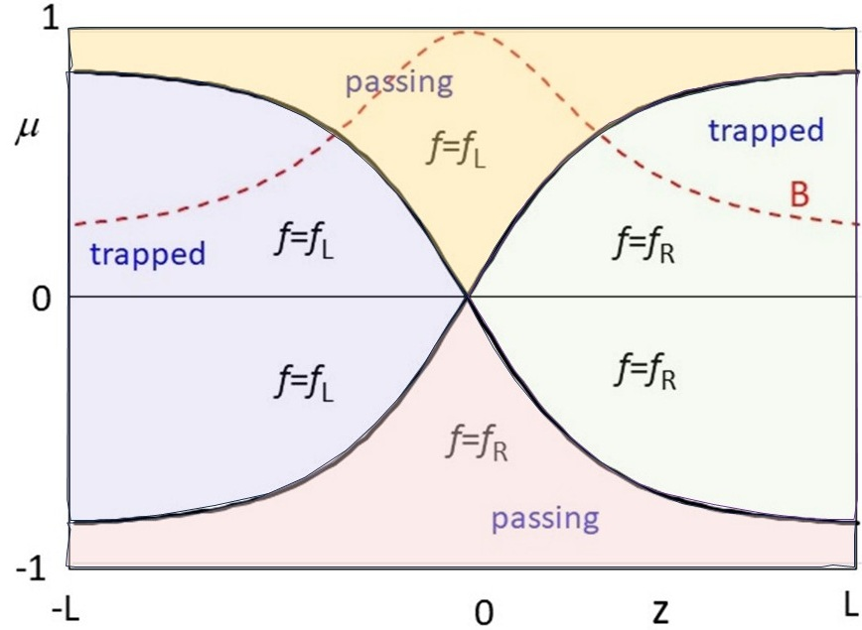

Passing and trapped particles
at a single mirror
$$μ=\frac{v_{z}}{v}$$

Slide 15
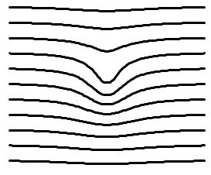
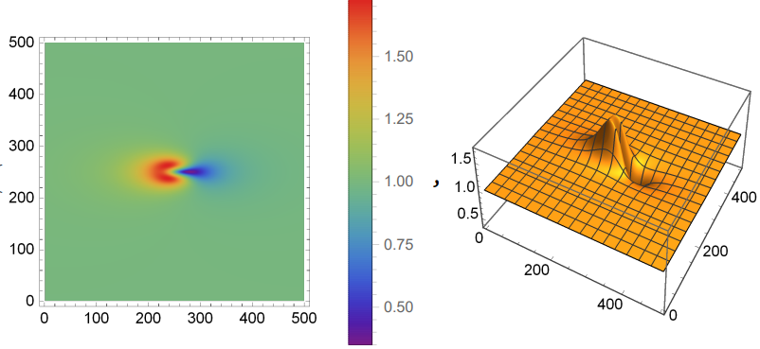
Mirrors do not have to look like mirrors
Magnetic field lines
CR density n_{CR}
|B|
Magnetic field
Injection boundary

Slide 16
VLASOV-FOKKER-PLANCK SIMULATIONS (VFP)

Slide 17




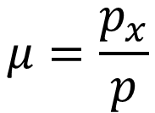
VFP modelling in the limit of small Larmor radius
$$μ=\frac{p_{x}}{p}$$
Mirror term
Vlasov equation for transport along a field line, neglecting cross-field drifts
Equation for evolution of coefficients
b is local unit vector in direction of magnetic field

Slide 18
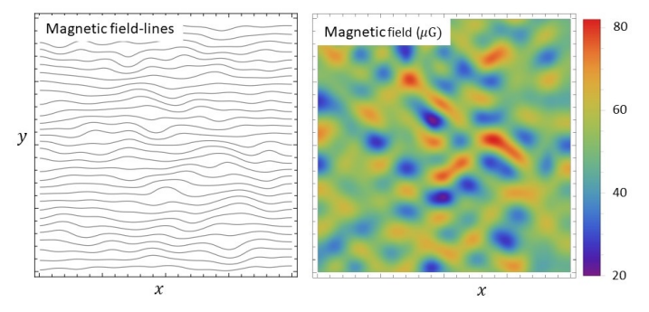
Solve VFP equation for mono-energetic CR in (x,y) plane with B_{z} =0
Computational box 1.7parsec square
Mean field is 50 μG
CR energy notionally 1 PeV
Initialise with CR at left-hand boundary
Free escape at right-hand boundary
Periodic boundary condition in vertical direction

Slide 19
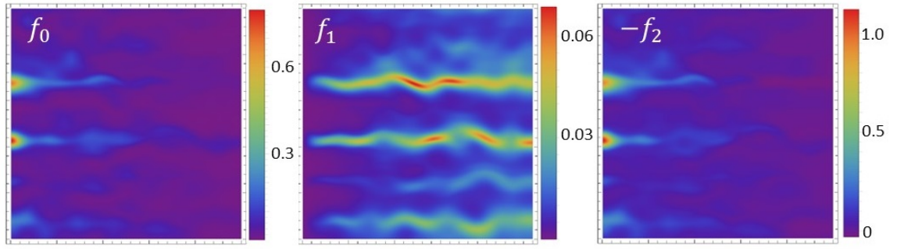
Reference calculation
Angular scattering time is 100 Larmor gyration times
After 50 years
CR density
CR current
Magnetic field with wiggles
CR trapped by mirroring
Weak currents along B

Slide 20
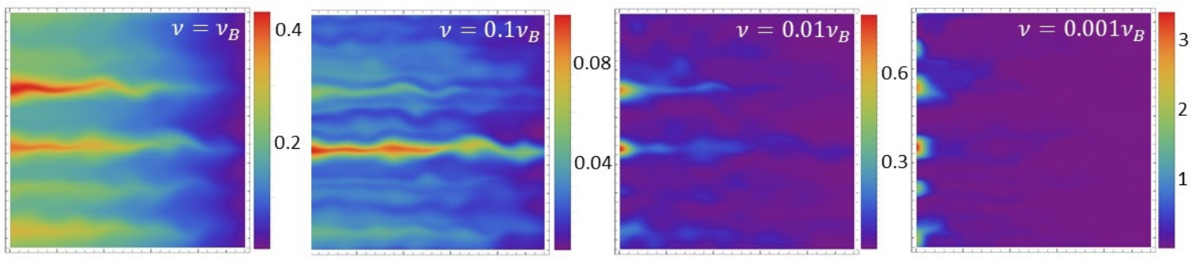

Vary the level of angular scattering (same B )
Bohm scattering
$$mfp \sim Larmor radius$$
Reference parameters
Negligible scattering
Scattering stops
CR escaping
CR unconfined
Neither scattering nor mirrors
stop CR escaping
through RH boundary
Strong trapping of some CR

Slide 21
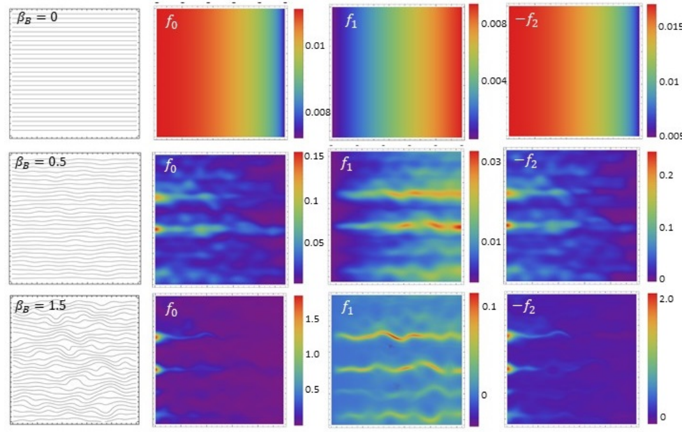
Vary amplitude of magnetic field fluctuations (same $ν={0.01ν}_{B}$)
Uniform magnetic field
Diffusive escape
Large diffusion coefficient
Reduce fluctuations by half
Still get mirroring
Increase fluctuations by half
Strong trapping

Slide 22
For details of VFP calculation
Bell, Matthews, Taylor, Giacinti (2025)

Slide 23
PARTICLE MODEL
CR acceleration by shock advancing into a mirror
No scattering

Slide 24
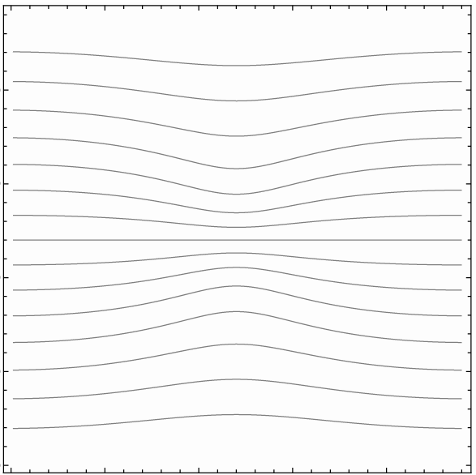
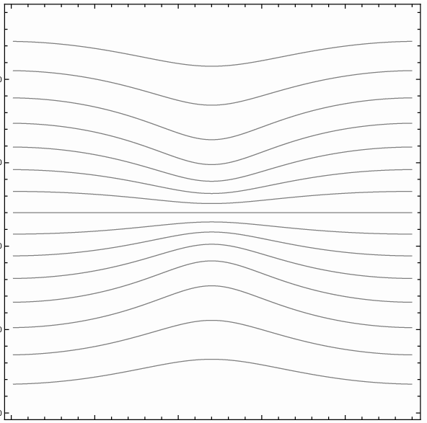
Standard mirror in background uniform field B₀=5μG
Magnetic field lines
In cylindrical geometry
Mirror field with peak
B_{mirror}=20μG
Magnetic field lines
In cylindrical geometry
Mirror field with peak
B_{mirror}=50μG

Slide 25
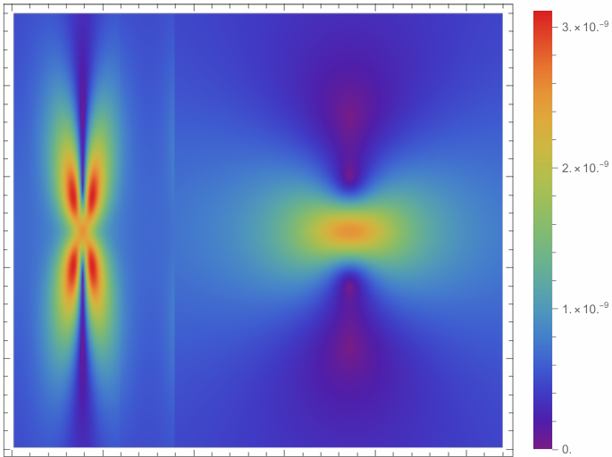
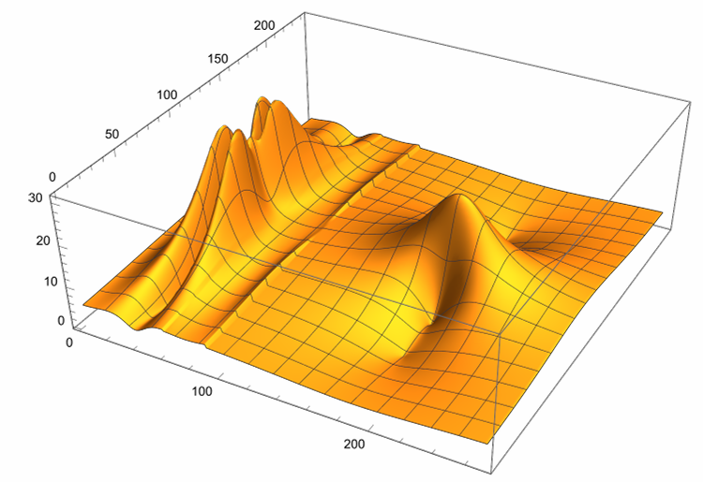
Magnitude of magnetic field
20μG mirror in parallel (θ=0º) 5μG uniform background
downstream
upstream
10,000 kms⁻¹
same data
20μG mirror
compressed mirror
μG
2.4parsec
shock

Slide 26
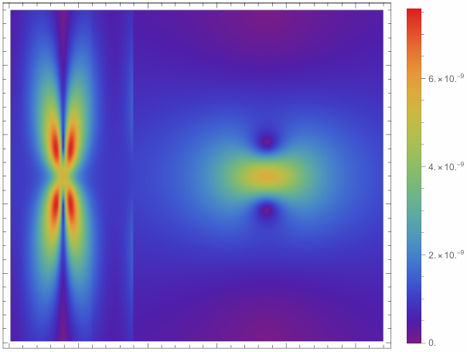
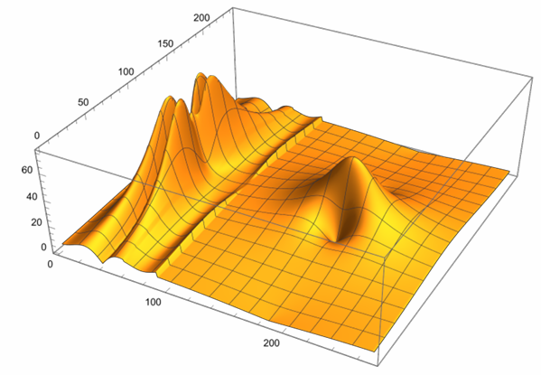
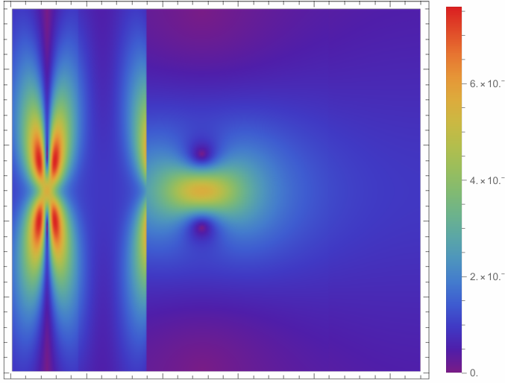
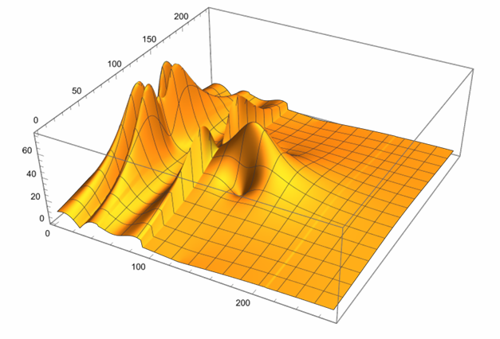
Mirror flows into shock
50μG mirror
shock
t = 0
50μG mirror
shock
t = 150 years

Slide 27
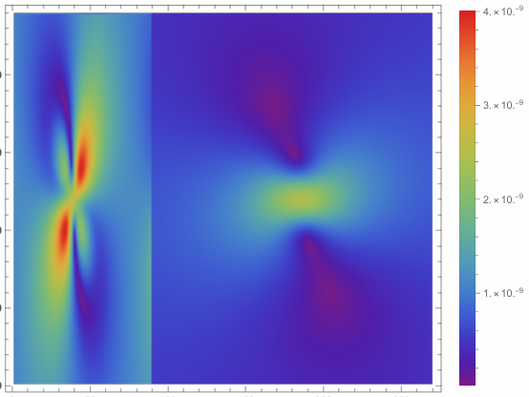
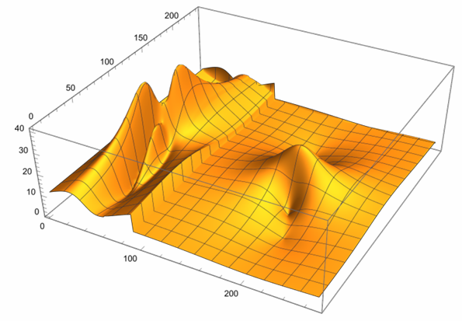
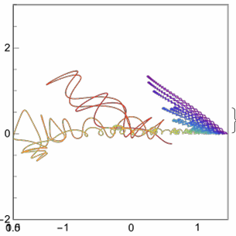
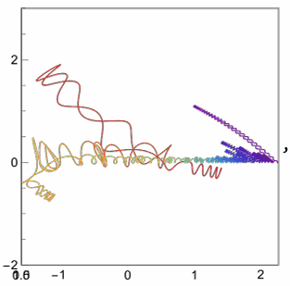
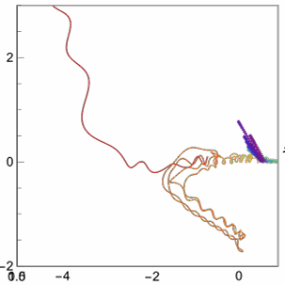
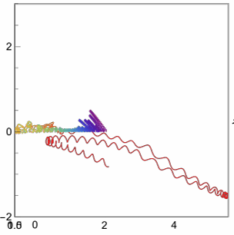
300,000 particles injected at random positions with energy 100TeV, followed for 300year
20μG mirror in parallel 5μG uniform background tilted at 30degrees (θ=30º)
3
20μG mirror
-3
-1.125
parsec
4.5
Some trajectories of CR accelerated beyond 1PeV, colour-coded by energy
x,z scales are different
upstream
upstream
upstream
upstream
parsec
parsec
parsec
parsec
downstream
downstream
downstream
downstream
parsec
parsec
parsec
parsec

Slide 28
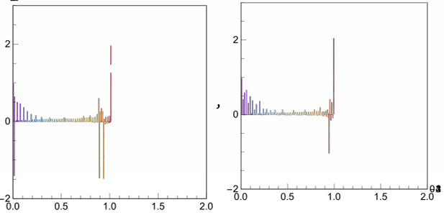
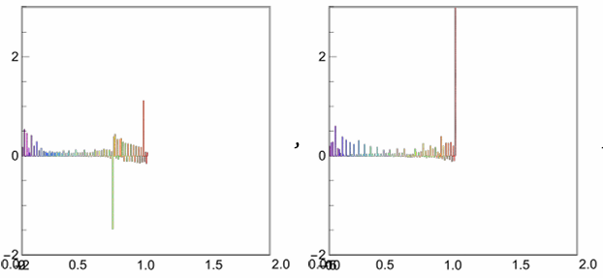
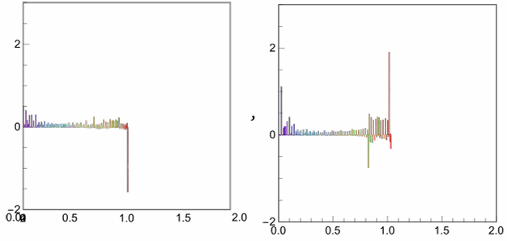
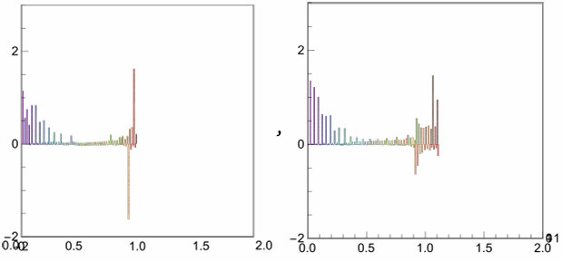
Sample trajectories: distance from shock (vertical) versus log of energy gain (horizontal)
All these reach 1PeV (just)
upstream
downstream
distance from shock in parsec
Horizontal axis: log₁₀ (local rest-frame energy/100TeV)

Slide 29
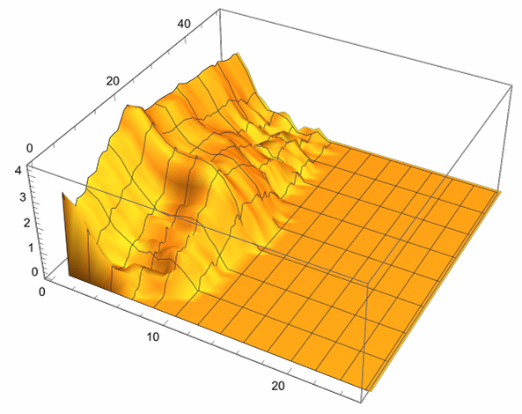
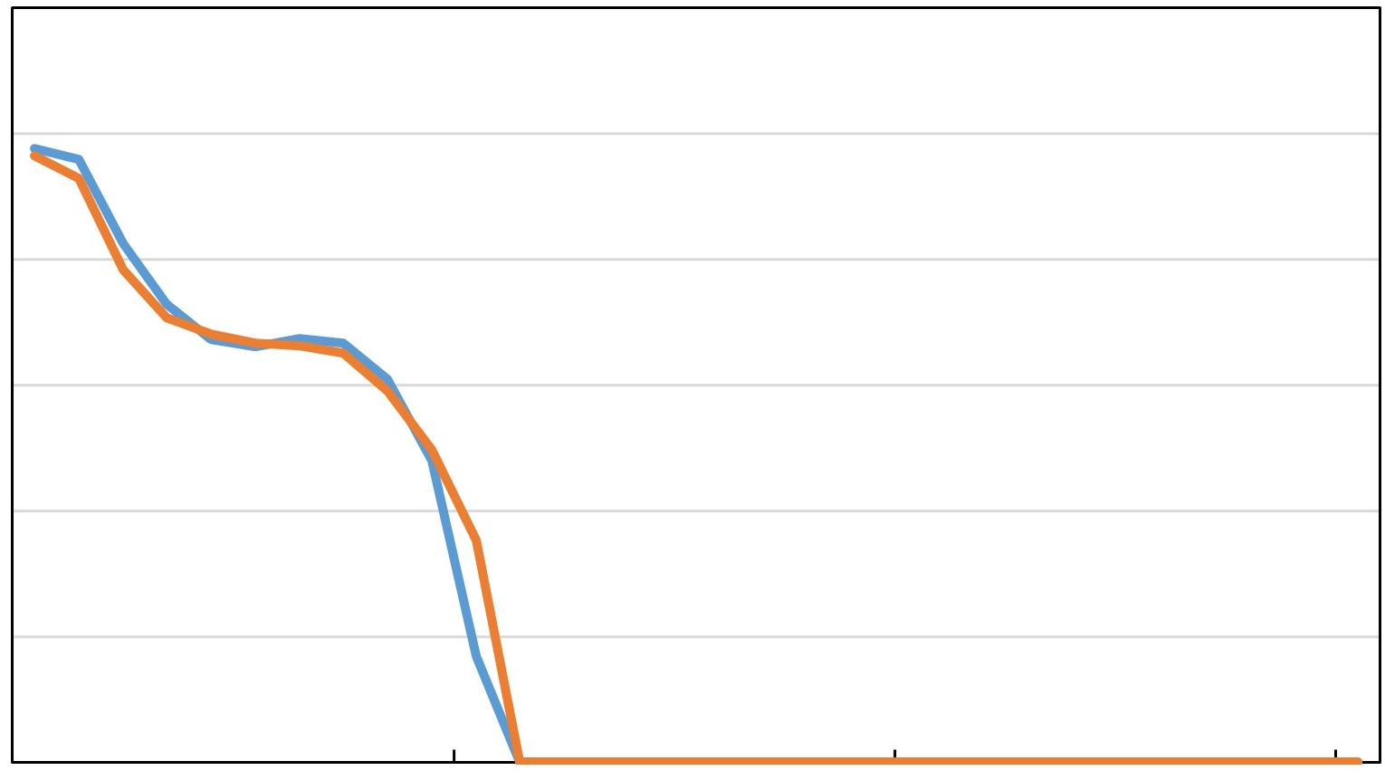


Spectrum after 300 years
6
distance from shock (pc)
1
0
εf (ε)
-6
10⁻²
log(εf (ε))
shock
10⁻⁴
100TeV
100TeV
1PeV
10PeV
1PeV
10PeV

Slide 30
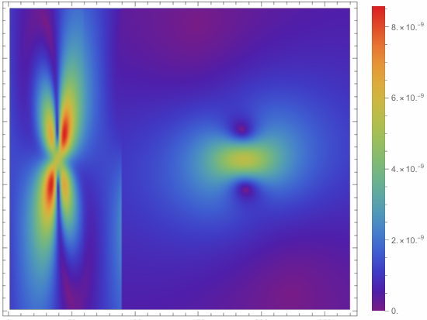
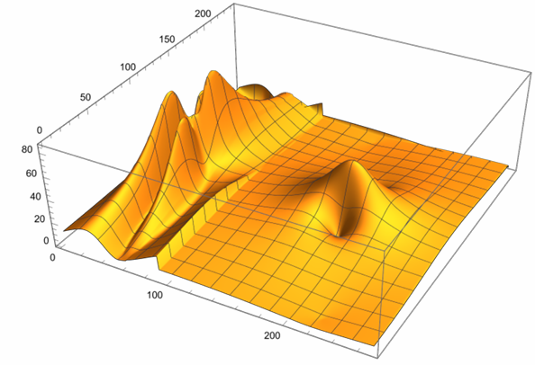
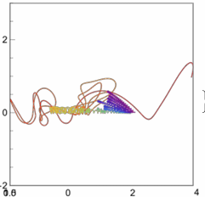
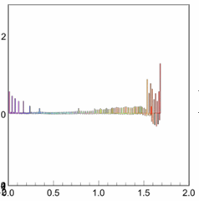
300,000 particles injected at random positions with energy 100TeV, followed for 300year
50μG mirror in parallel 5μG uniform background tilted at 30degrees (θ=30º)
3
50μG mirror
-3
-1.125
parsec
4.5
Trajectory of CR accelerated reaching 5PeV, colour-coded by energy
x,z scales are different
parsec
distance from
shock in parsec
parsec
log₁₀ (local rest-frame energy/100TeV)

Slide 31
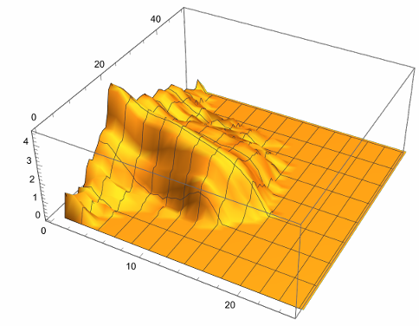

Spectrum after 300 years
50μG mirror
6
distance from shock (pc)
downstream
0
1
εf (ε)
-6
10⁻²
upstream
log(εf (ε))
10⁻⁴
100TeV
1PeV
100TeV
1PeV
10PeV
10PeV

Slide 32

Increase radius to 10pc, time to 1000 year (like SN1006)
Average expansion velocity = 10,000 kms⁻¹
Today: closer to 5000 kms⁻¹
Same geometry but expanded by 3.3x
downstream
upstream
10,000 kms⁻¹
uniform background at 30º
(θ=30º)
20μG mirror
compressed mirror
8parsec
shock

Slide 33




mirror at 8pc, follow for 1000 year
background field tilted at 30degrees (θ=30º)
20μG mirror
parsec
distance from
shock in parsec
CR reaching 3PeV
parsec
log₁₀ (local rest-frame energy/100TeV)
20
1
distance from shock (pc)
0
εf (ε)
-20
10⁻²
downstream
100TeV
10⁻⁴
upstream
1PeV
100TeV
1PeV
10PeV
10PeV

Slide 34




mirror at 8pc, follow for 1000 year
background field tilted at 30degrees (θ=30º)
50μG mirror
parsec
distance from
shock in parsec
CR reaching 15PeV
CR reaching 15PeV
parsec
log₁₀ (local rest-frame energy/100TeV)
20
20
distance from shock (pc)
1
distance from shock (pc)
0
0
εf (ε)
-20
-20
10⁻²
upstream
downstream
100TeV
100TeV
10⁻⁴
1PeV
1PeV
10PeV
100TeV
1PeV
10PeV
10PeV
100PeV

Slide 35




Parallel shock (θ=0º) after 300year
20muG mirror
6
1
distance from shock (pc)
εf (ε)
0
-6
10⁻²
upstream
downstream
10⁻⁴
100TeV
1PeV
Magnetic field lines
In cylindrical geometry
10PeV
100TeV
1PeV
10PeV
100PeV
6
50muG mirror
distance from shock (pc)
downstream
0
1
εf (ε)
-6
upstream
10⁻²
100TeV
10⁻⁴
1PeV
10PeV
100TeV
1PeV
10PeV
100PeV

Slide 36




Oblique shock after 300 year
(θ=60º)
20muG mirror
6
downstream
distance from shock (pc)
1
0
εf (ε)
-6
upstream
10⁻²
20muG mirror
100TeV
10⁻⁴
1PeV
10PeV
100TeV
1PeV
10PeV
100PeV
downstream
50muG mirror
1
6
distance from shock (pc)
εf (ε)
0
upstream
-6
50muG mirror
10⁻²
10⁻⁴
100TeV
1PeV
100TeV
1PeV
10PeV
100PeV
10PeV

Slide 37




20μG
50μG
1.8PeV
Hillas
Hillas
4.5PeV
Compendium of spectra
300yr, 0º
The red line is a fiducial energy
representing the Hillas limit
Hillas
Hillas
1.8PeV
4.5PeV
300yr, 30º
where
Hillas
1.8PeV
Hillas
4.5PeV
Energy spectrum turns over at
300yr, 60º
6PeV
15PeV
Hillas
1000yr, 30º

Slide 38
Conclusions
Mirror-dominated shock acceleration (MDSA) can accelerate CR to
MDSA energy determined by peaks in magnetic field
DSA energy determined by average magnetic field
Advantage of MDSA: don’t need magnetic field amplification
Disadvantage of MDSA: need pre-existing mirror(s) in surrounding medium
DSA with magnetic field amplification works well up 100TeV
MDSA probably better at PeV and beyond
MDSA, and therefore PeV acceleration, more likely where medium is already non-uniform on a parsec scale

