Slide 1
Stable and radioactive beam development at GANIL
Recent progress and ongoing work
Pierre Chauveau for the Target & Ion-source group

Slide 2
Introduction/Outline
Stable beams: ECR ion sources
  Progress on stable beams
  Source monitoring
Radioactive beams: focus on SPIRAL1
  Types of TISS
  Recent progress and on-going work
Conclusion
S3 facility
1+ laser source
S3-LEB
Cyclotron facility
N+ sources
ECR4, ECR4M
SPIRAL1 facility
1+ and N+ sources
TISS, PHEONIX V2
LINAC facility
SILHI (ECR 1+)
PHOENIX V3 (ECR N+)

Slide 3
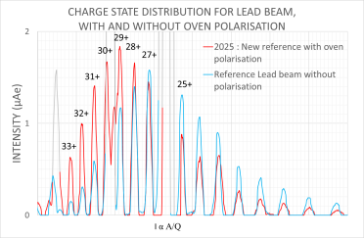
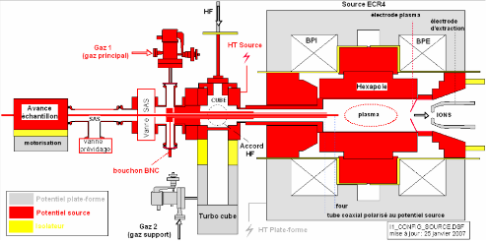
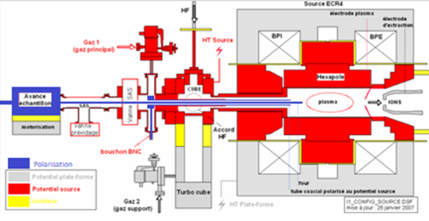
Stable beams: improving the rates (1/2)
Coax + oven at HV ground
March 2025
experiment
High Voltage : 20.6kV
Drain current : 1.96mA
RF power : 342W
O₂ support gas : 2.95V
Oven : 0.710A
Bias : 0V
Coax + oven at HV + bias
High Voltage : 20.6kV
Drain current : 2.21mA
RF power : 294W
O₂ support gas : 2.75V
Oven : 0.930A
Bias : -100V
 | 2007 | 2025
Average intensity of ²⁰⁶Pb³¹⁺ (µAe) | 0.6 | 1.1
Transport up to FC | 28% | 45%
Consumption (µg/h) | 65 | 27
Now used for every stable beam requiring an oven.
Slide credit: M. Dubois

Slide 4
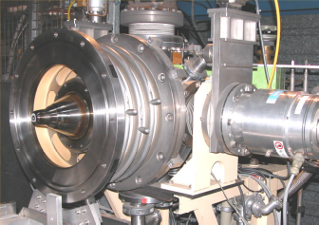
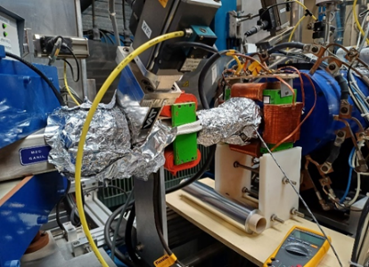
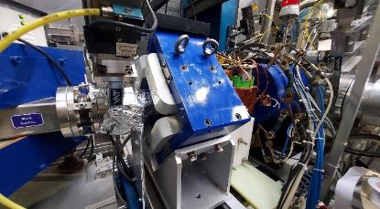
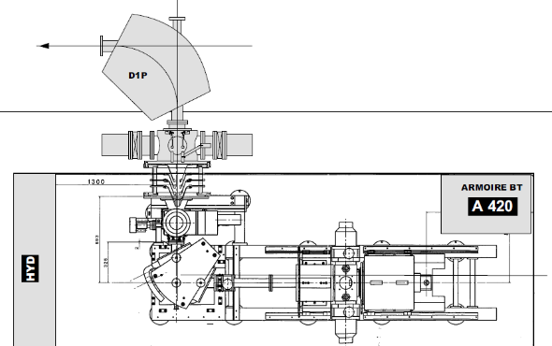
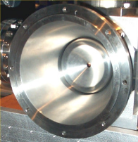
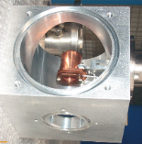
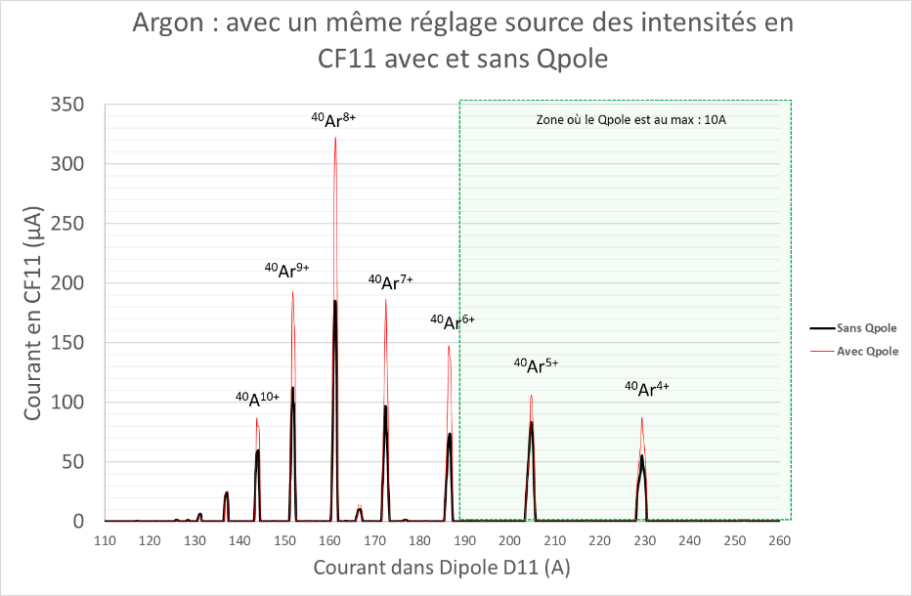
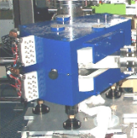
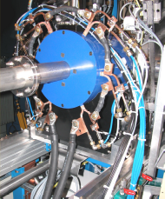
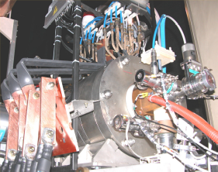
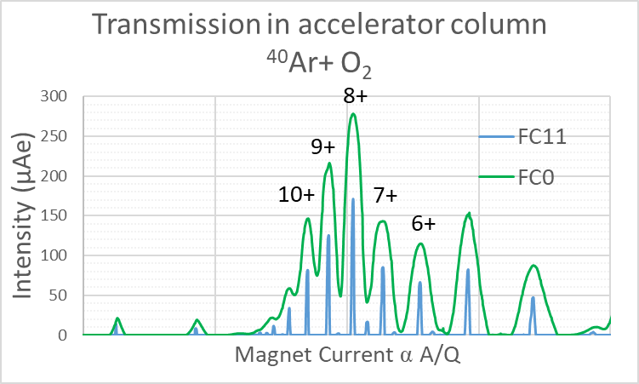
Stable beams: improving the rates (2/2)
Before
After
Faraday Cup
(FC11)
Acceleration column (80kV)
Magnet
Collimator
Installation of a Qpole
Transport Evaluation on Injector 1
Source to FC0 | 75%
FC0 to FC11 | 55 to 60%
2024 tests
Faraday cup
(FC0)
Mass
separator
Ion source
(25kV)
+30% to 60% increased rate in FC11
Qpole permanently installed in I1
Solenoid
Slide credit: M. Dubois

Slide 5
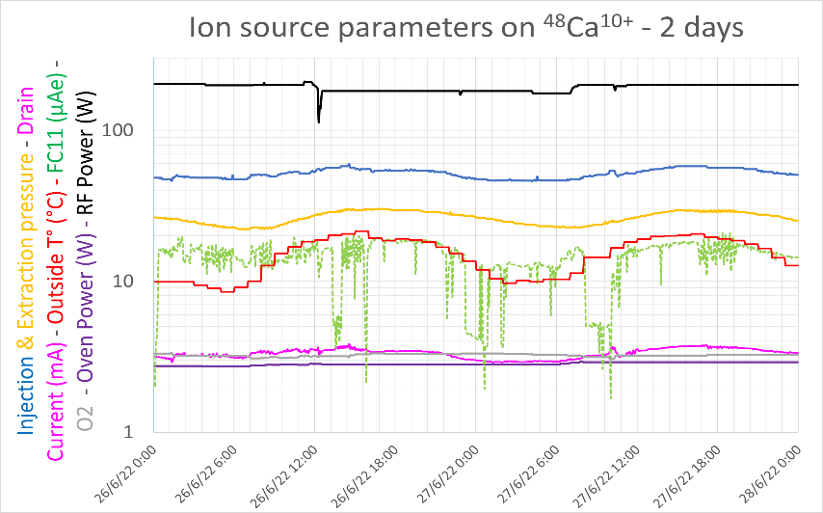
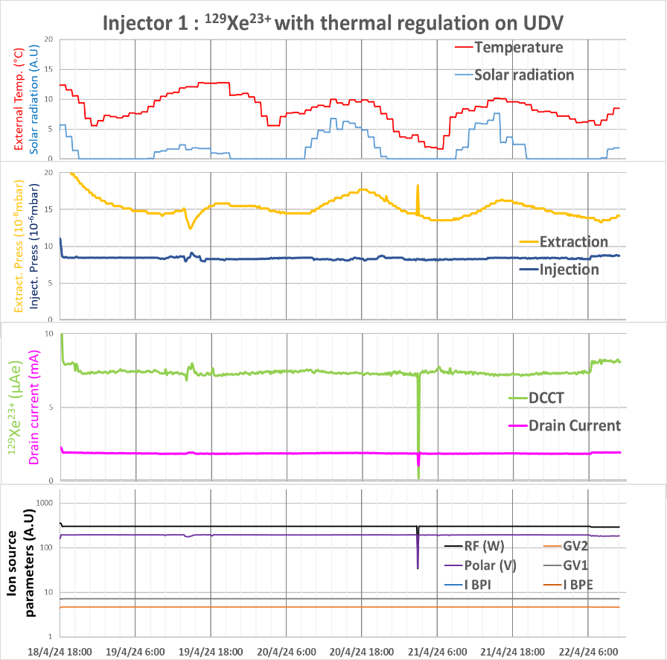
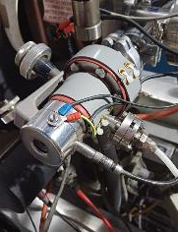
Stable beams: improving the stability
(2022)
(2024)
15 parameters modifications in 2 days to stabilize the output
Intensity variation : 40%
<5% output variation over 4 days
Gaz valve regulated at 40°C
No source tuning during operation
From 2-3 source retuning/day to once every few days
Less rate variation in between source retuning (typically <10%)
Now used for every beam
Slide credit: M. Dubois

Slide 6
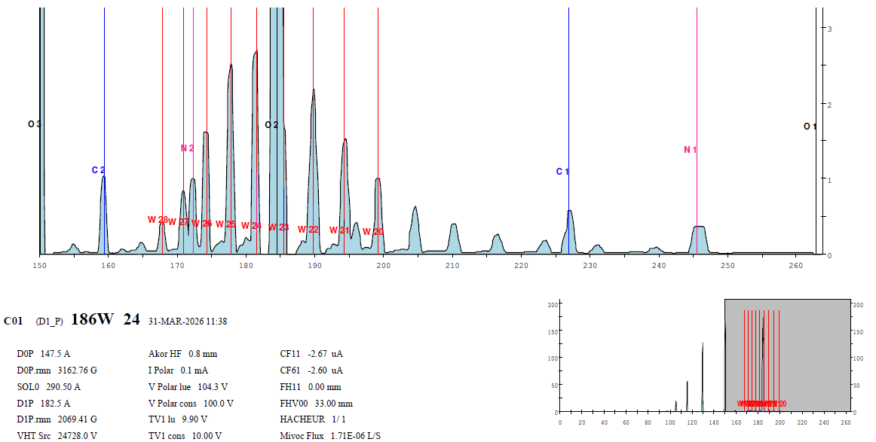
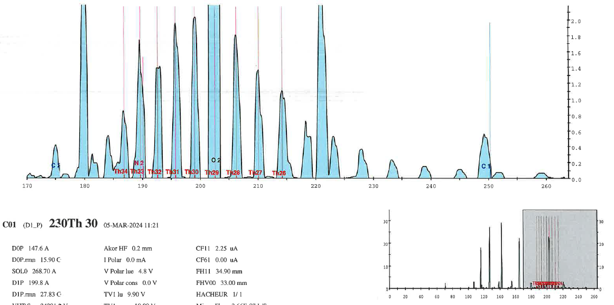
Stable beams: new beams
186W24+ at 5.1 MeV/u, E900_24 (C. Schmitt)
232Th30+ at 6.1 MeV/u, E849_21 (D. Ramos)
Images credit: M. Dubois

Slide 7
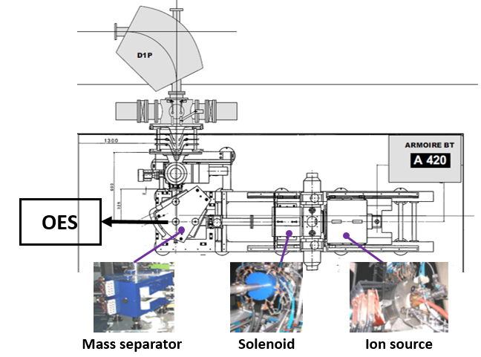
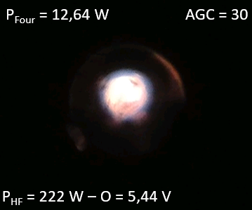
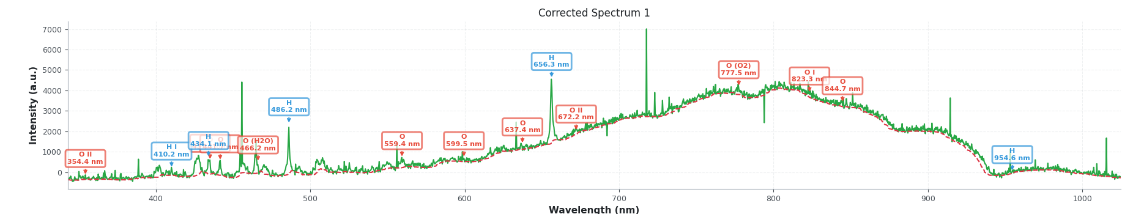
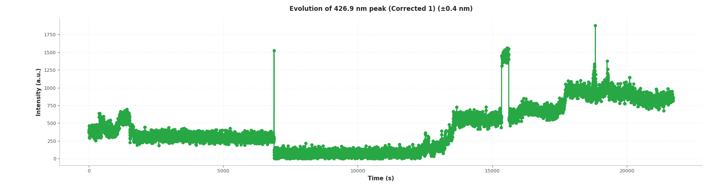
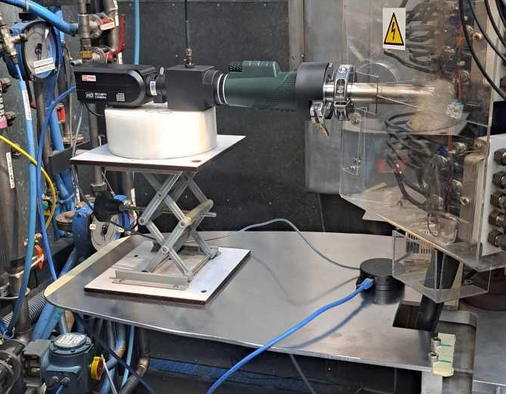
Stable beams: monitoring the source
17/03/26 16h50
Temps d’intégration = 2 s Temps d’intervalle = 2 s
P_{HF}=222 W, O=5.44 V, P_{four}=12,64 W
Monitoring the source plasma through the viewport on the first dipole of I1: camera CCD + spectrometer
Optical electron spectroscopy
  Non intrusive
  Identification of contaminants, outgassing
  Time evolution of several species/charge states (observing instabilities)
  Plasma diagnostics (ne, Te)
Program developped by A. Ribet for operation.
Images credit: A. Ribet

Slide 8
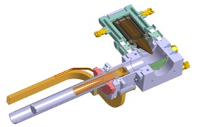
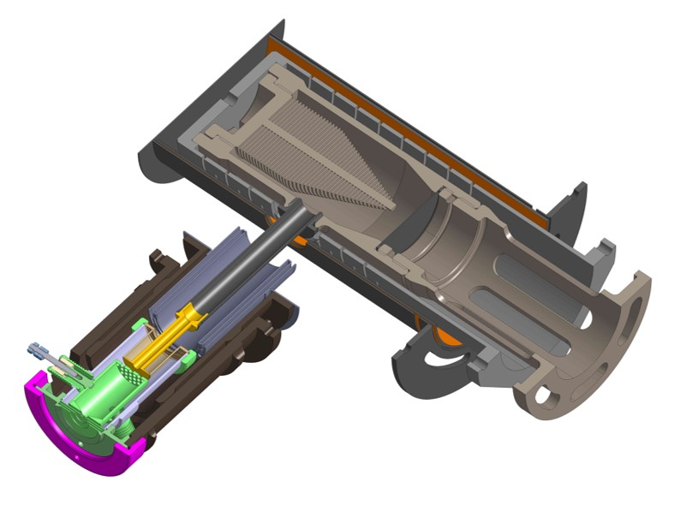
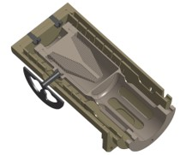
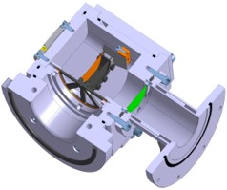
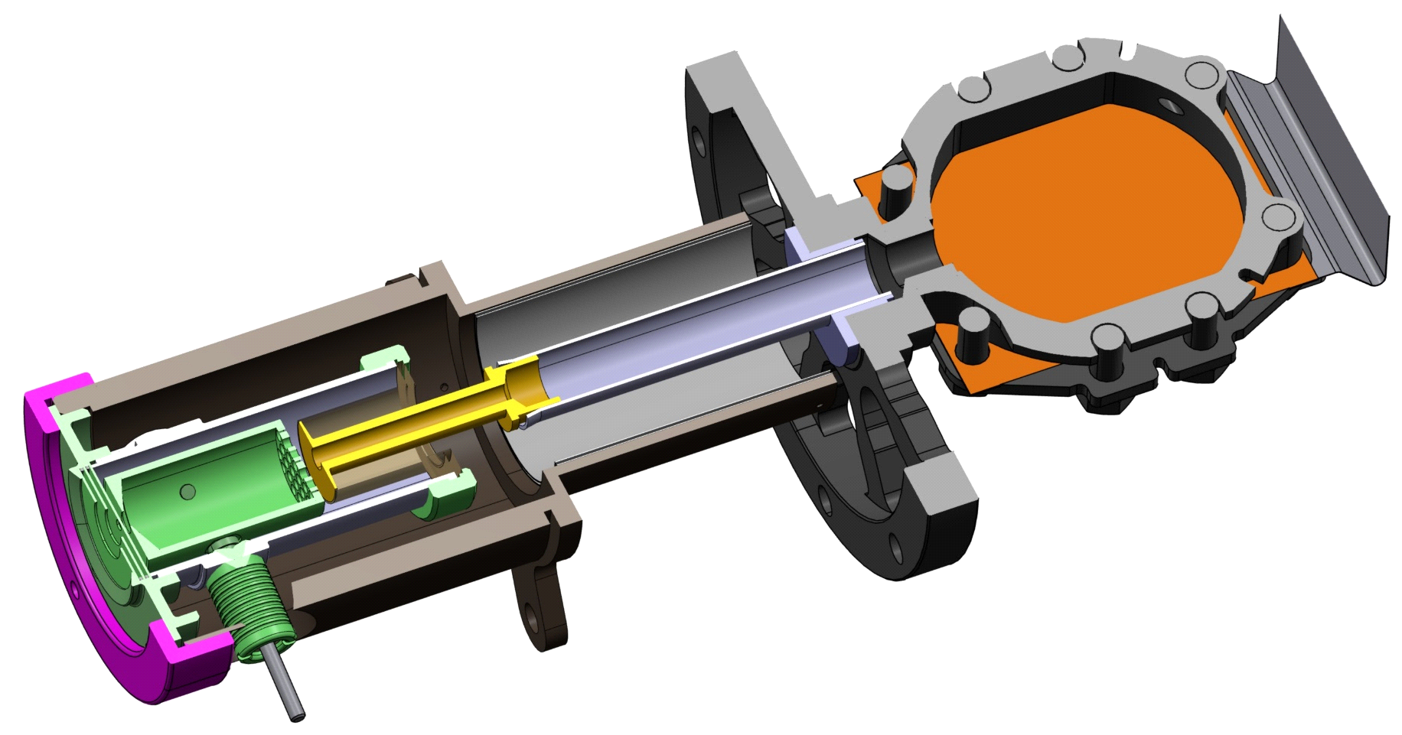
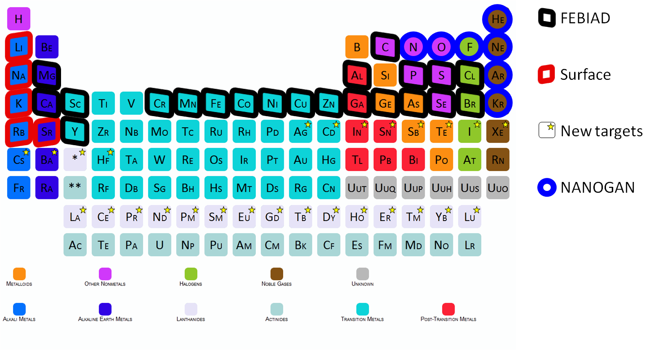
Radioactive beams: types of TISSs
The ISOL technique
 | ECR | SIS | FEBIAD
Thick target
Thin target (TULIP)
Primary beam
Target/stopper
Ion source
Advantages
Intensity (directly N+ beam)
Purity (gases only)
Disadvantages
Lower charge states (and energy)
Gases only
Advantages
Intensity (high efficiency for most alkali)
Purity (low ionisation energies only)
Disadvantages
Only alkali
Advantages
Broadband
Disadvantages
Non selective
Separator
N+
1+
1+
TISS
To user/
acceleration
58 primary beams from ¹²C to ²³⁸U
Thick targets: C, Nb (in development)
Thin targets: C, Ni
3 ion sources: ECR, SIS, FEBIAD
Nanogan
For gaz
FEBIAD
For condensable
MonoNaKe
For alkali
Advantages
Intensity (high efficiency for most alkali)
Purity (low ionisation energies only)
Fast release
Disadvantages
Only alkali
Low in-target production
Advantages
Broadband
Fast release
Disadvantages
Non selective
Low in-target production
1+
1+
TULIP(-FEBIAD)
For neutron-deficient isotopes
TULIP
For alkaline

Slide 9
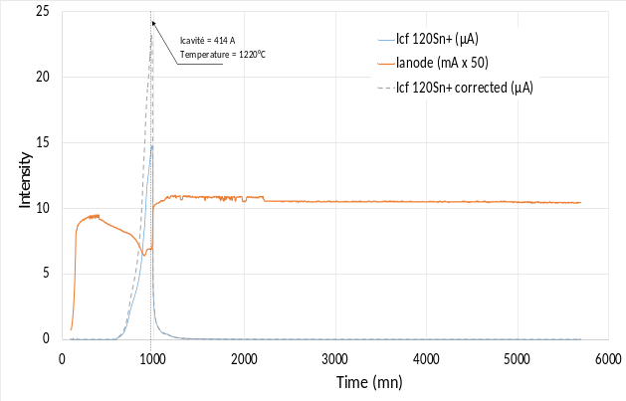
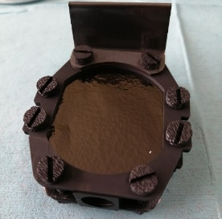
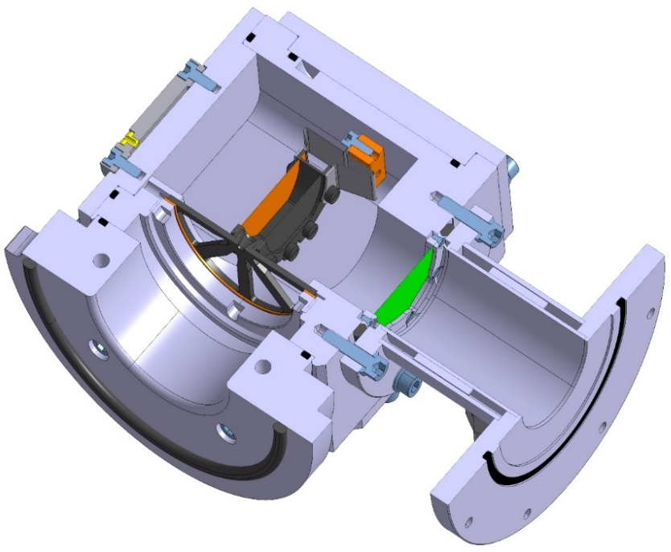
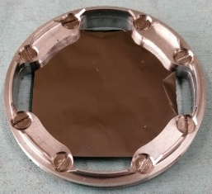
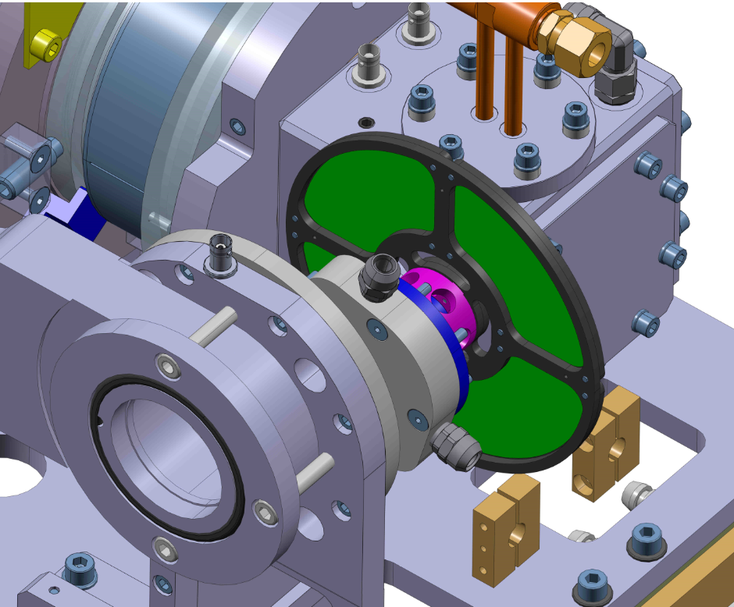
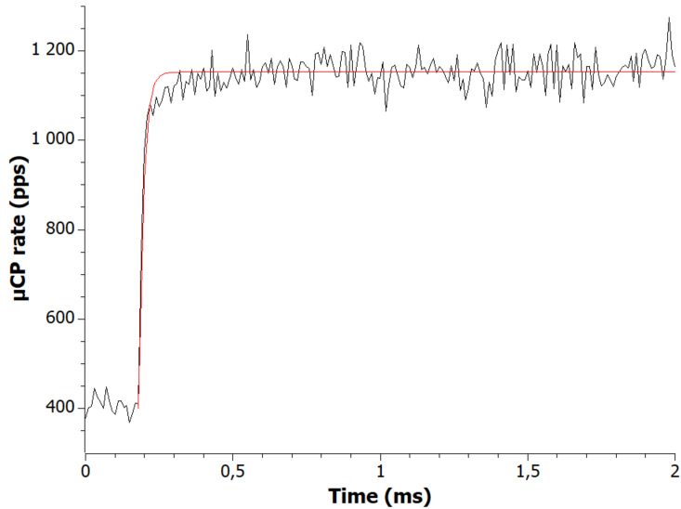
Radioactive beams: the TULIP TISSs
TULIP SIS
Proof of principle with Rb isotopes
Several experiments (2022,2023,2024)
Improved rate for 74Rb (T_{1/2} = 65ms)
TULIP FEBIAD
Fully tested offline
Efficiency measurement with tracers (Ar, Ag, Sn, In, Eff≈9-15%)
First online test in 04/2026 aiming to produce Sn isotopes: Ag/Pd isotopes seen but no Sn
Rotating target (increased beam power)
Simple and radiation hard
Water wheel/magnetic coupling
Works but rotation speed limited by eddy currents
TULIP cavity
Mo-Ni-Mo target
(fusion-evaporation)
graphite window
Graphite catcher
60 mm
²⁰Ne Primary beam
Radioactive ion beam
Beam ON
11,2 µs
⁷⁴Rb⁺ (T1/2=64,5 ms)
x ~25 ?
Beam OFF
I²⁰Ne = 0,9 p.µA, T_{cavity} ~ 1500°C
x ~20
Beam chopper 50 ms ON/10 ms OFF
Slide credit: P. Jardin

Slide 10
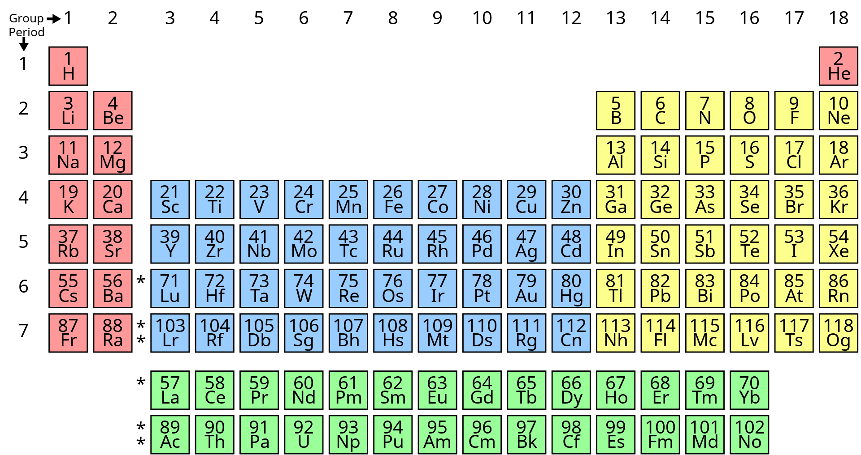
Radioactive beams: The FEBIAD TISS
Objective: production of radioactive metallic ions
58Ni @ 74.5AMeV ≈600W
Isotope | HL | measured rate (pps)
59Cu | 82 s | 5.03E+05
58Cu | 3.205 s | 1.60E+05
57Ni | 35.6 h | 2.52E+07
56Ni | 6.081 d | 1.99E+06
58Co | 70.883 d | 9.40E+07
57Co | 271.8 d | 2.21E+08
56Co | 77.236 d | 1.11E+08
55Co | 17.53 h | 2.33E+07
54mCo | 1.48 min | 2.39E+05
53Fe | 8.51 min | 7.80E+06
53mFe | 2.54 min | 2.39E+06
52Fe | 8.273 h | 4.80E+06
52mFe | 45.9 s | 6.47E+04
57Mn | 85.4 s | 4.10E+04
56Mn | 2.5788 h | 1.09E+06
52Mn | 5.591 d | 1.19E+08
52mMn | 21.4 min | 3.10E+07
51Mn | 45.84 min | 3.90E+07
50mMn | 1.75 min | 1.80E+06
129Xe @ 50AMeV ≈200W
Isotope | HL | measured rate (pps)
117Xe | 61 s | 8.72E+03
117I | 2.22 min | 3.41E+05
117Te | 62 min | 1.64E+05
117Sb | 2.8 h | 7.42E+05
109Sn | 18.1 min | 4.30E+04
117In | 43.2 min | 1.05E+04
109In | 4.159 h | 7.00E+05
109mIn | 1.34 min | 3.33E+04
109mPd | 4.694 min | 8.86E+02
Before 2023
July 2024 (58Ni)
April 2023 (50Cr)
50Cr @ 72AMeV ≈25W
Isotope | HL | measured rate (pps)
49Cr | 42.3 min | 5E+05
48Cr | 21.56 h | 3E+05
September 2024 (129Xe)
Since 2021
Irradiated with ⁴⁸Ca (2021), ³⁶Ar, ⁸⁴Kr (2022), ⁵⁰Cr (2023), ⁵⁸Ni (2024),¹²⁹Xe (2024)
100+ radioactive isotopes/isomers seen, including around 60 at post-accelerable intensities (>1E5pps).
^{48,49}Cr produced for the first time in 2023
Fe/Co/Ni beams produced for the first time in 07/2024
« Heavy » ions produced in 09/2024
Ongoing work
Investigation into the Ti contamination for the ⁴⁸Cr beam
Investigation into the production of a ⁴⁴Ti beam in batch mode
Online experiment (09/25, 07/26, XX/27?): post-acceleration and purification of 56Ni
⁵⁶(Fe,Co,Ni)¹⁵⁺
at ≈ 16AMeV
⁵⁶Fe^{≤26+}
⁵⁶Co^{≤27+}
⁵⁶Ni^{≤28+}
⁵⁶X²⁷⁺
Stripper foil
⁵⁶X²⁶⁺
⁵⁶Ni²⁸⁺

Slide 11
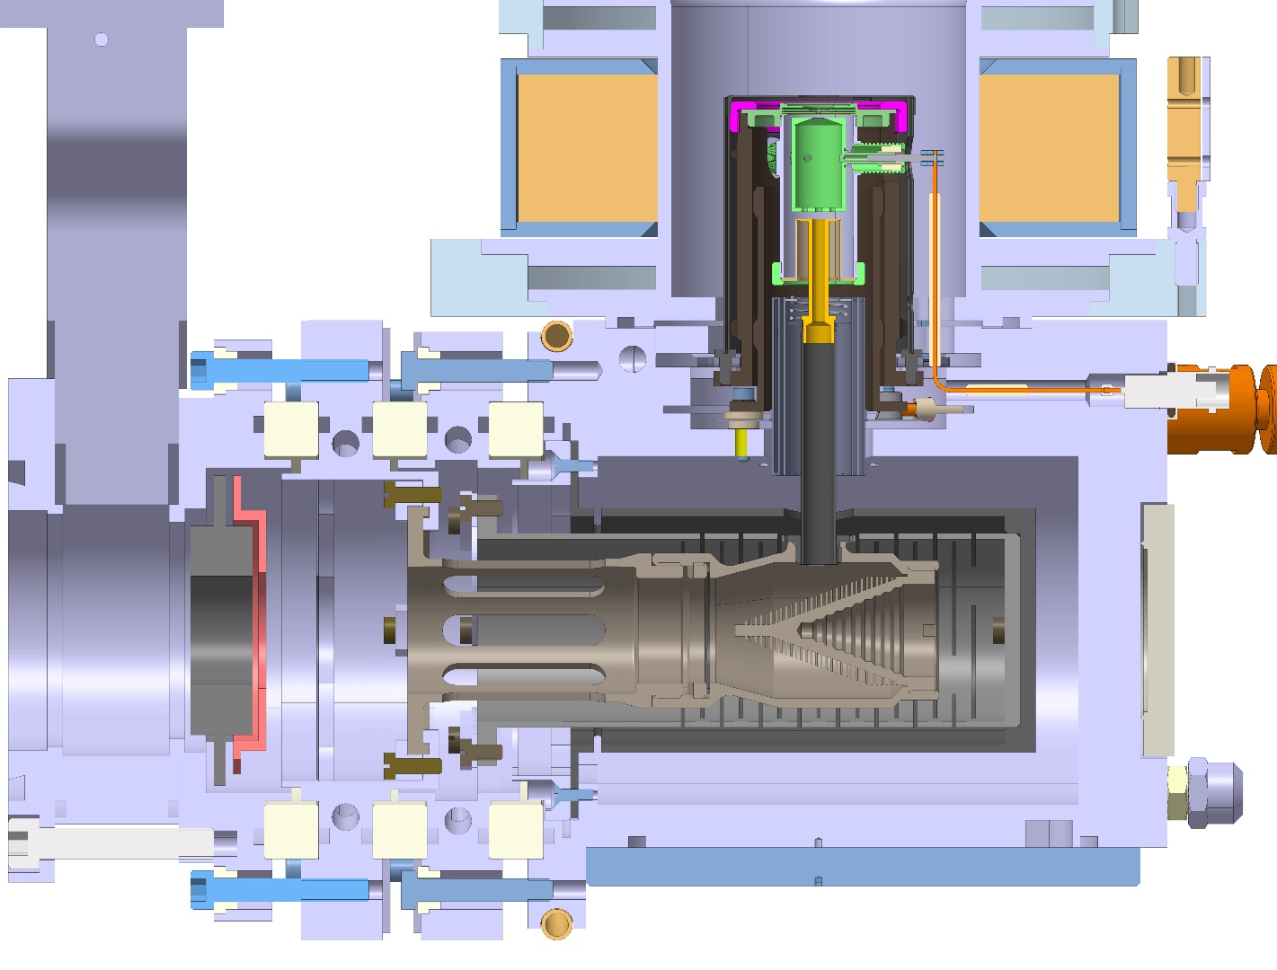
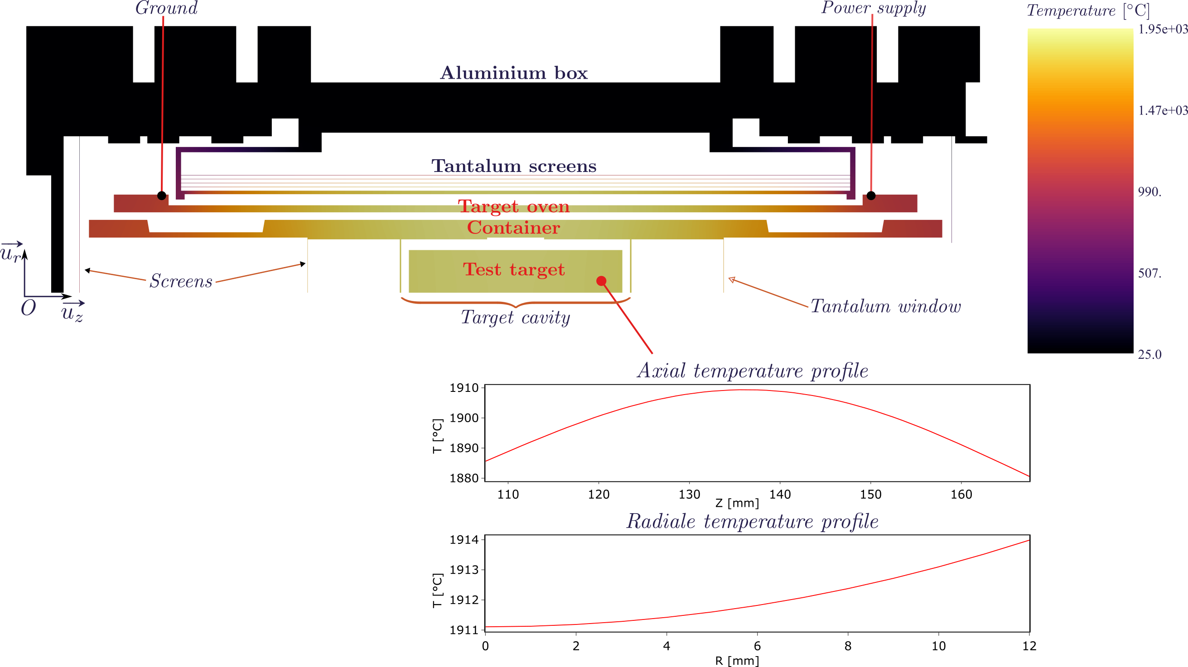
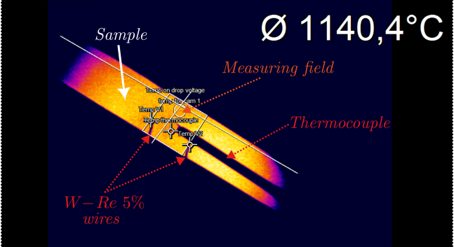
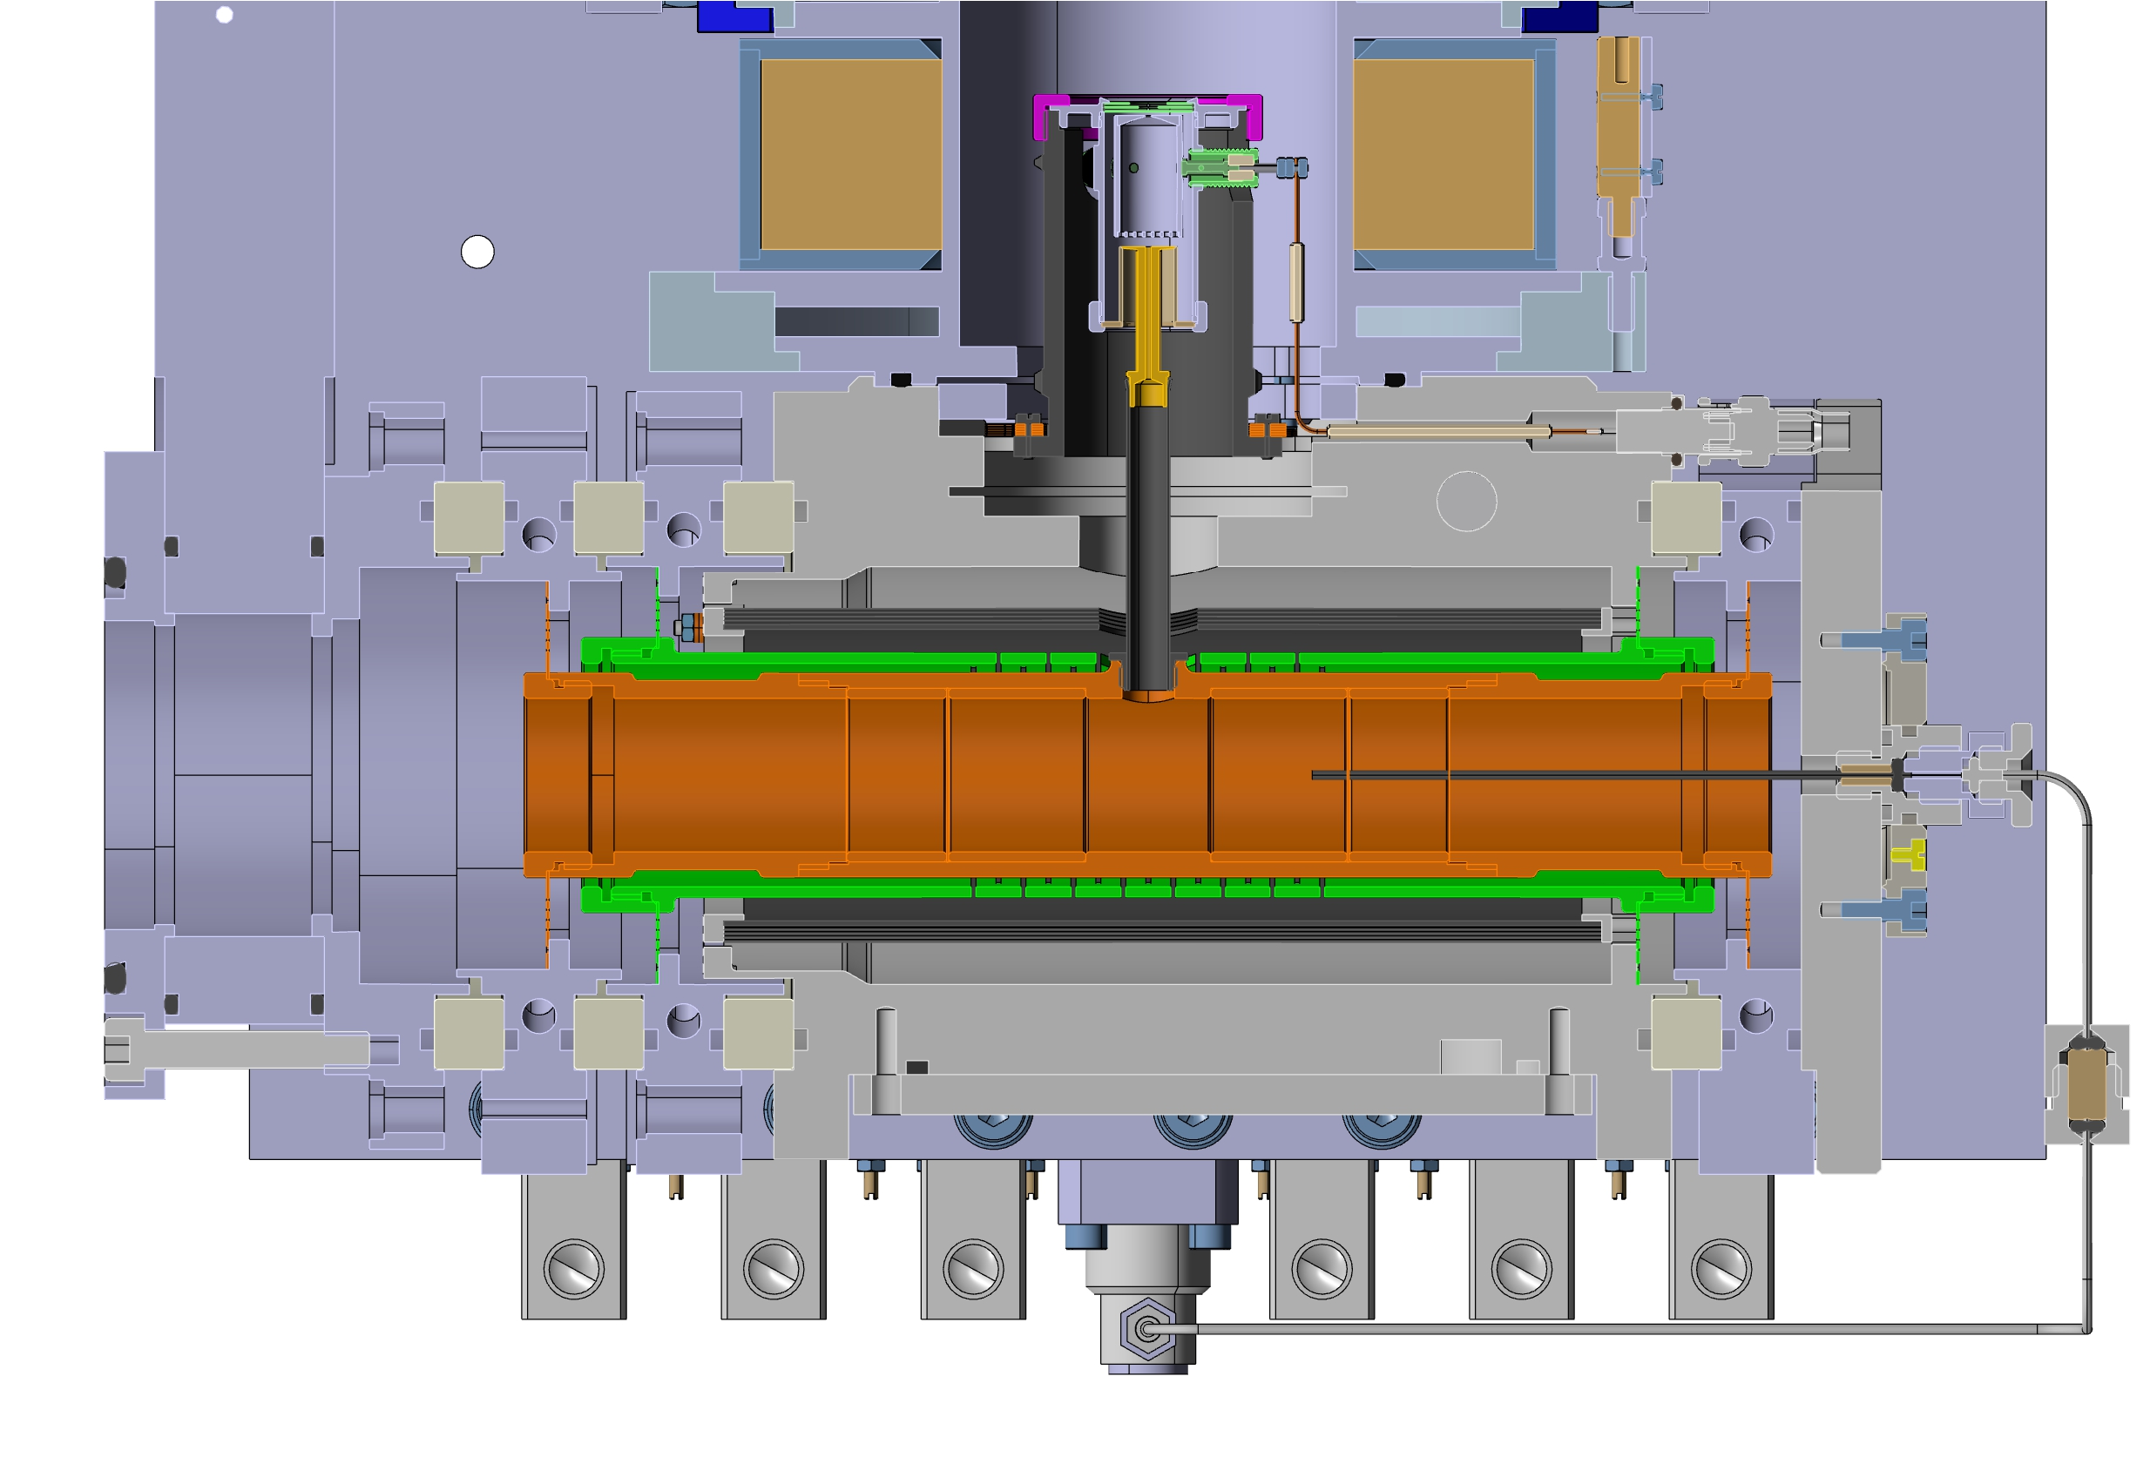
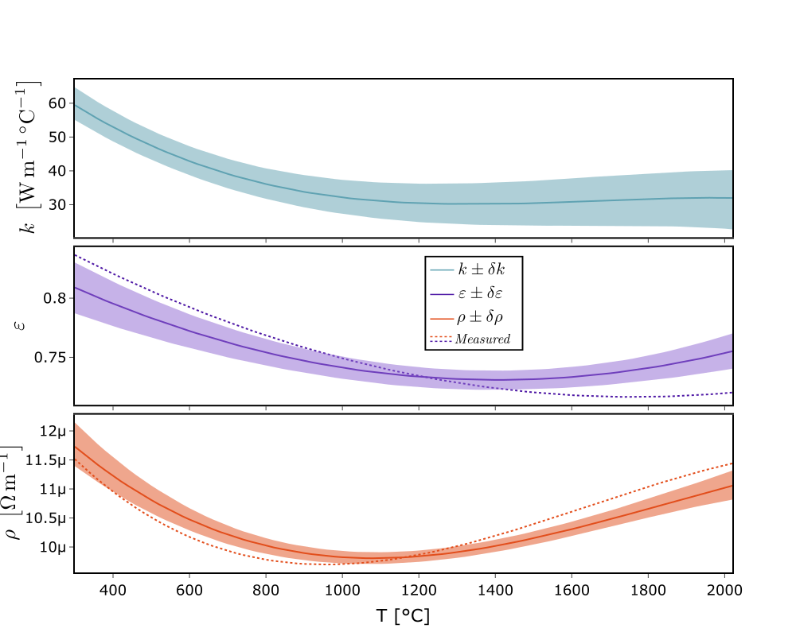
Radioactive beams: Towards a new target cavity
New target design to optimize the release of Fe-Co-Ni isotopes (and others)
Gathering material data ✅
Building a parametric model for simulations ✅
Optimizing the geometry for high and homogeneous temperature ✅
Mechanical design 🔄
Building and testing ❌
Images credit: E. Le Villain

Slide 12
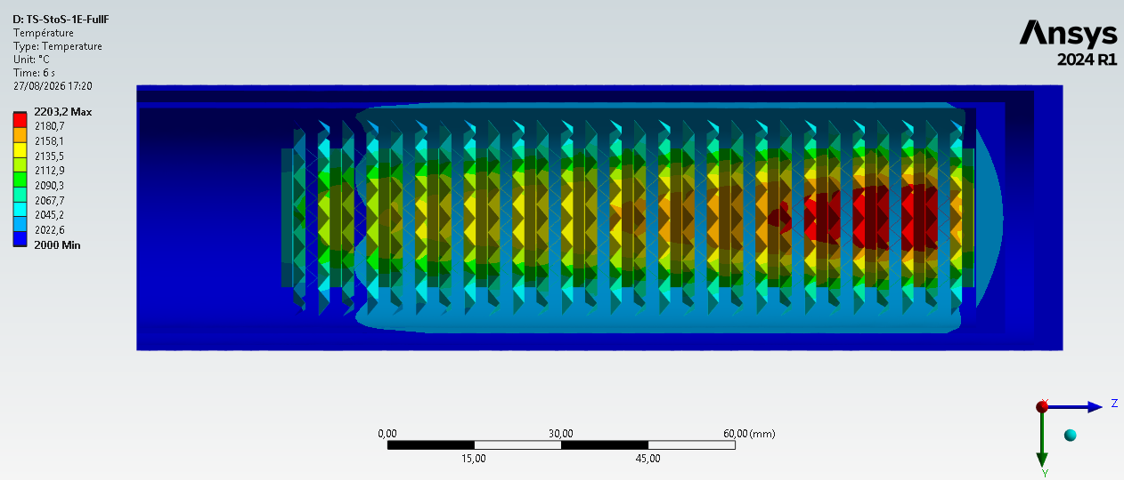
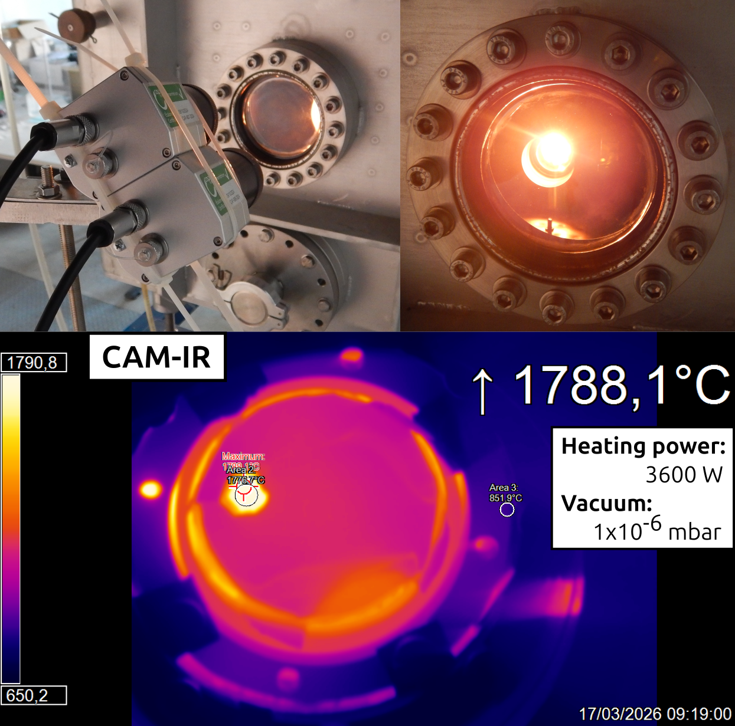
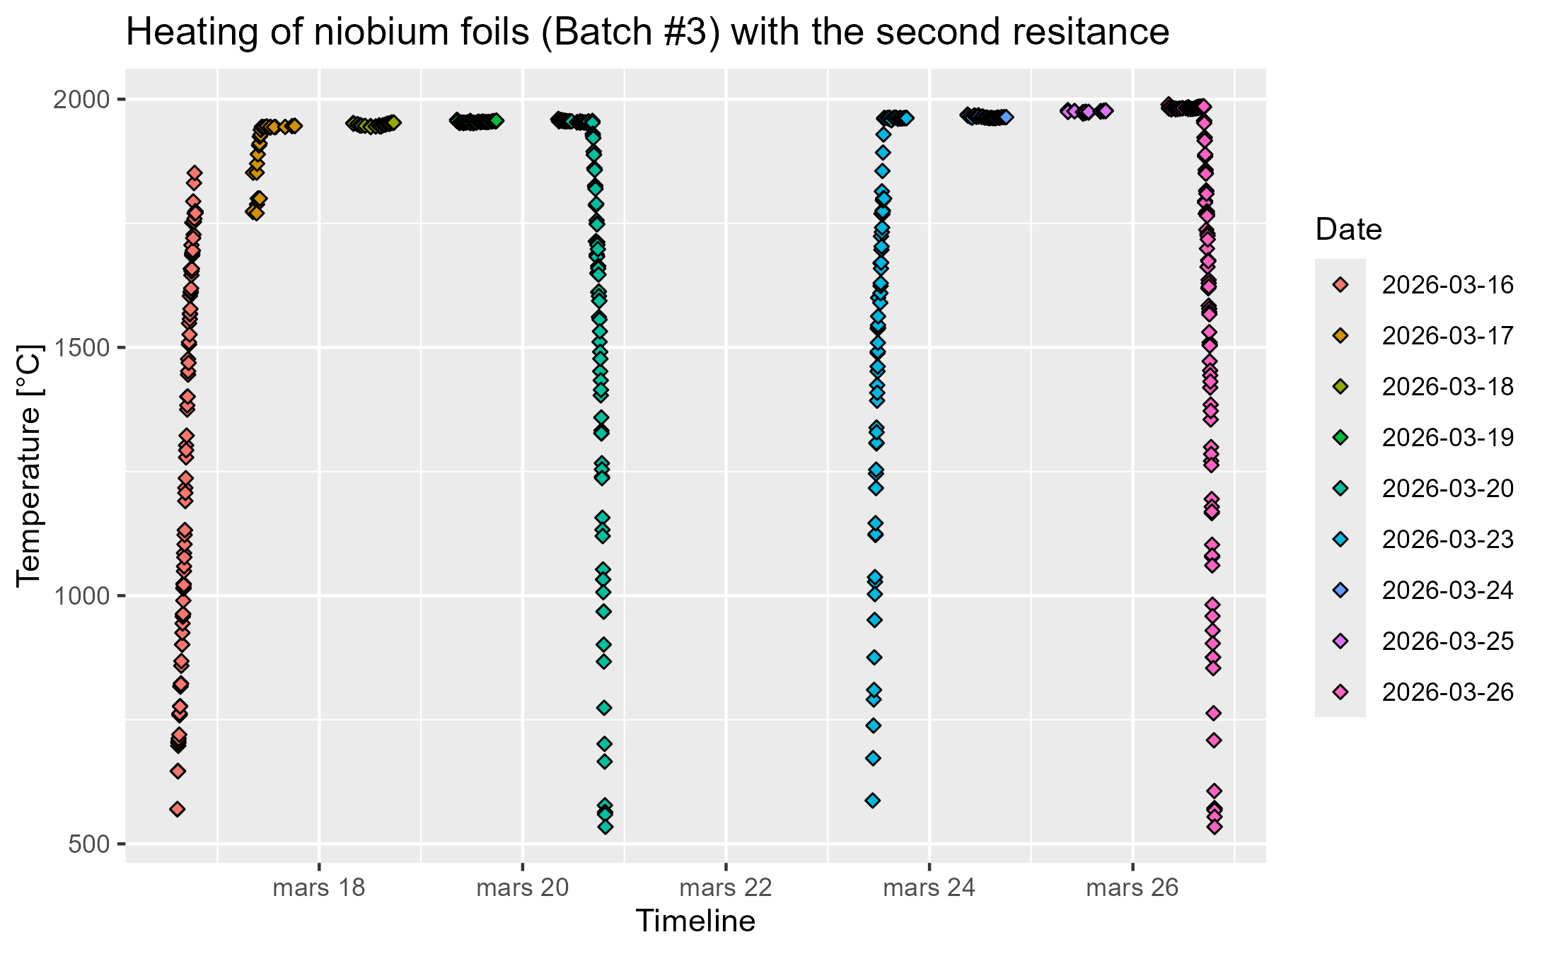
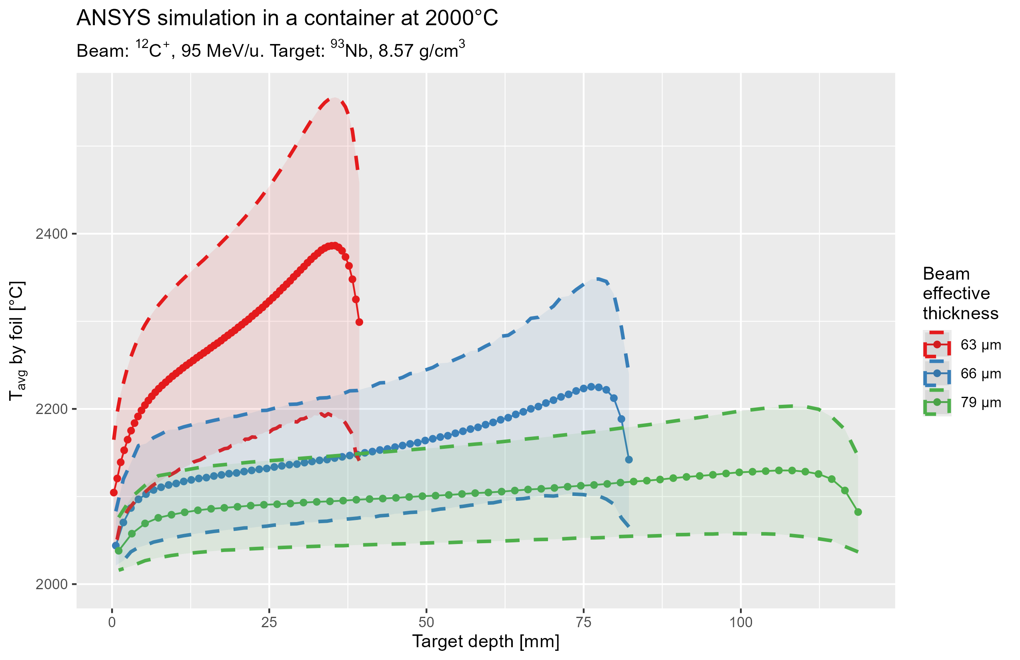
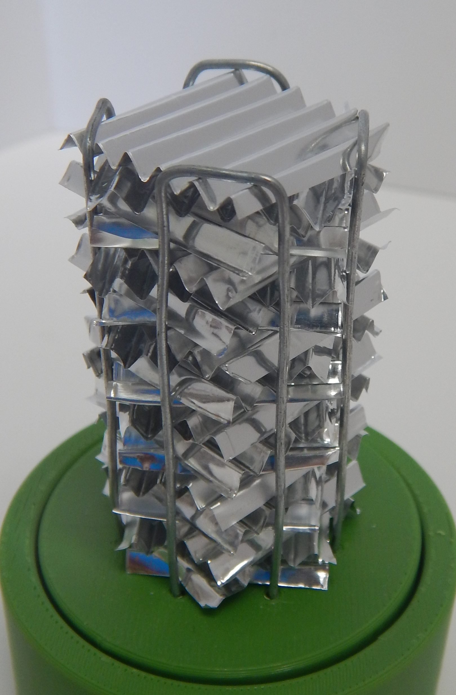
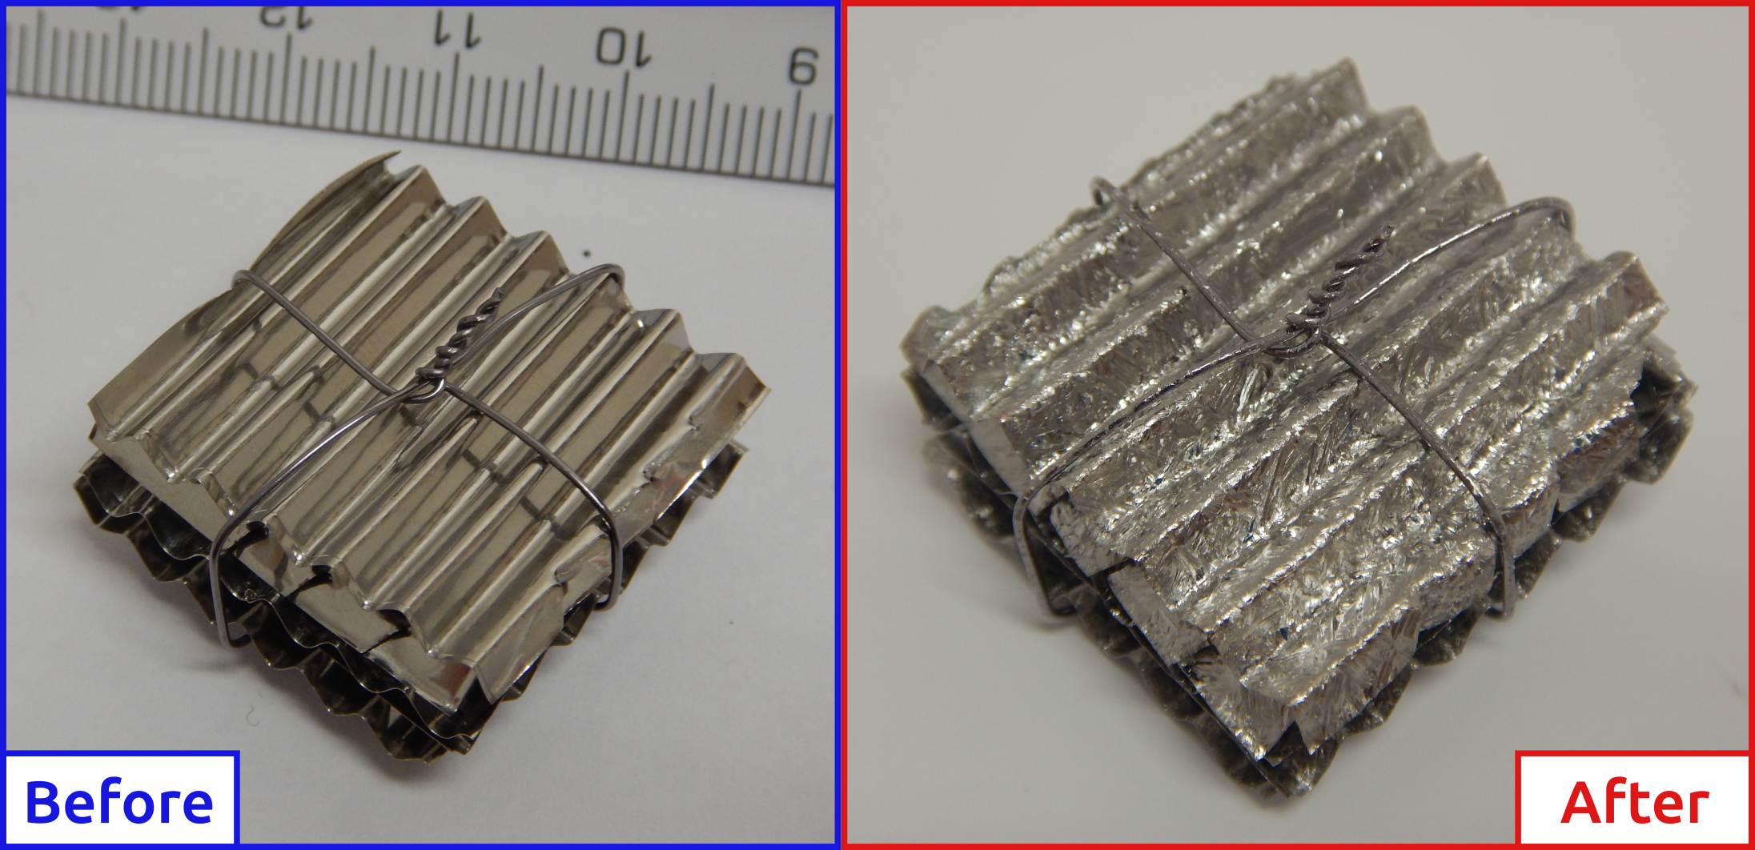
Radioactive beams: Towards a new target material
New target material to improve the production rate of many isotopes
Production calculations : GANIL beams → graphite VS Carbon beam → new material (<Nb) ✅
Investigating and chosing materials (Nb, ZrO²) ✅
Testing material properties ✅
Designing and simulating a target 🔄
Building and testing ❌
Images credit: S. Hurier

Slide 13
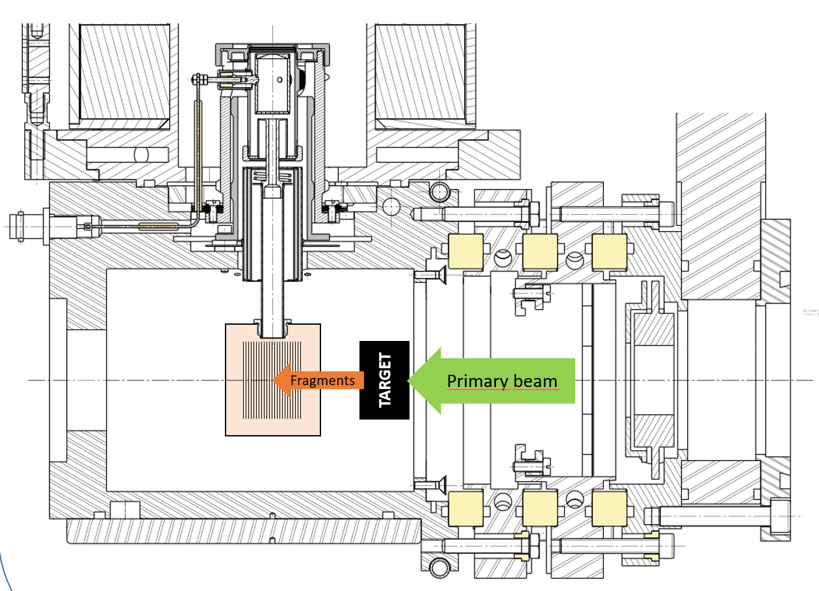
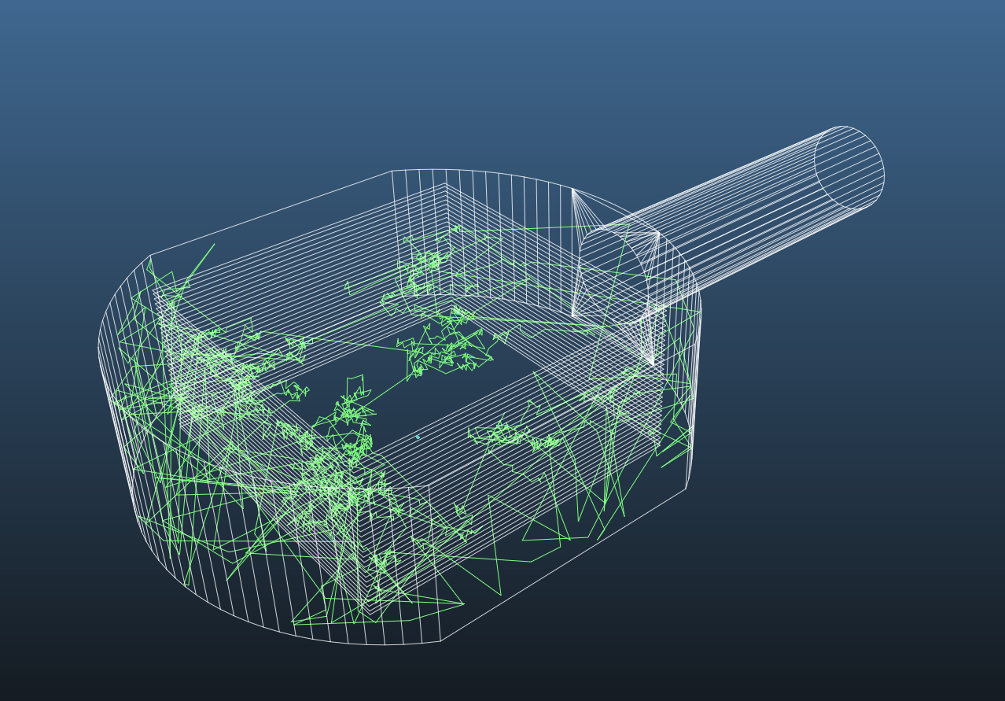

Radioactive beams: 39Ca for the MORA project
New TISS for intense 39Ca beams
Preliminary investigation
  production method (fragmentation) ✅
  Target/catcher materials (several choices) ✅
  Diffusion/effusion 🔄
  Ionization 🔄
Offline Ca ionisation tests (MonoNake + Re ionizer/FEBIAD) 🔄
Cavity design and thermal simulations ❌
Mechanical design, assembly and test ❌
Images credit: C. Pfeffer

Slide 14

Takeway messages
Stable beams
Improved rate and stability on most beams
New tool for source monitoring
Radioactive beams
Many beams produced in the recent years … but wether they are expoitable or not depends on the experiment
Many ongoing developments: new beams with existing TISSs & new TISSs
Beam requests
Estimating the feasibility requires the minimum rate, the energy and the maximum contamination
Crucial for radioactive beams
Contact us
pierre.chauveau@ganil.fr
pascal.jardin@ganil.fr
mickael.dubois@ganil.fr
pierre.delahaye@ganil.fr
chartbeams-spiral1@ganil.fr

Slide 15
Thank you for your attention

