Slide 1
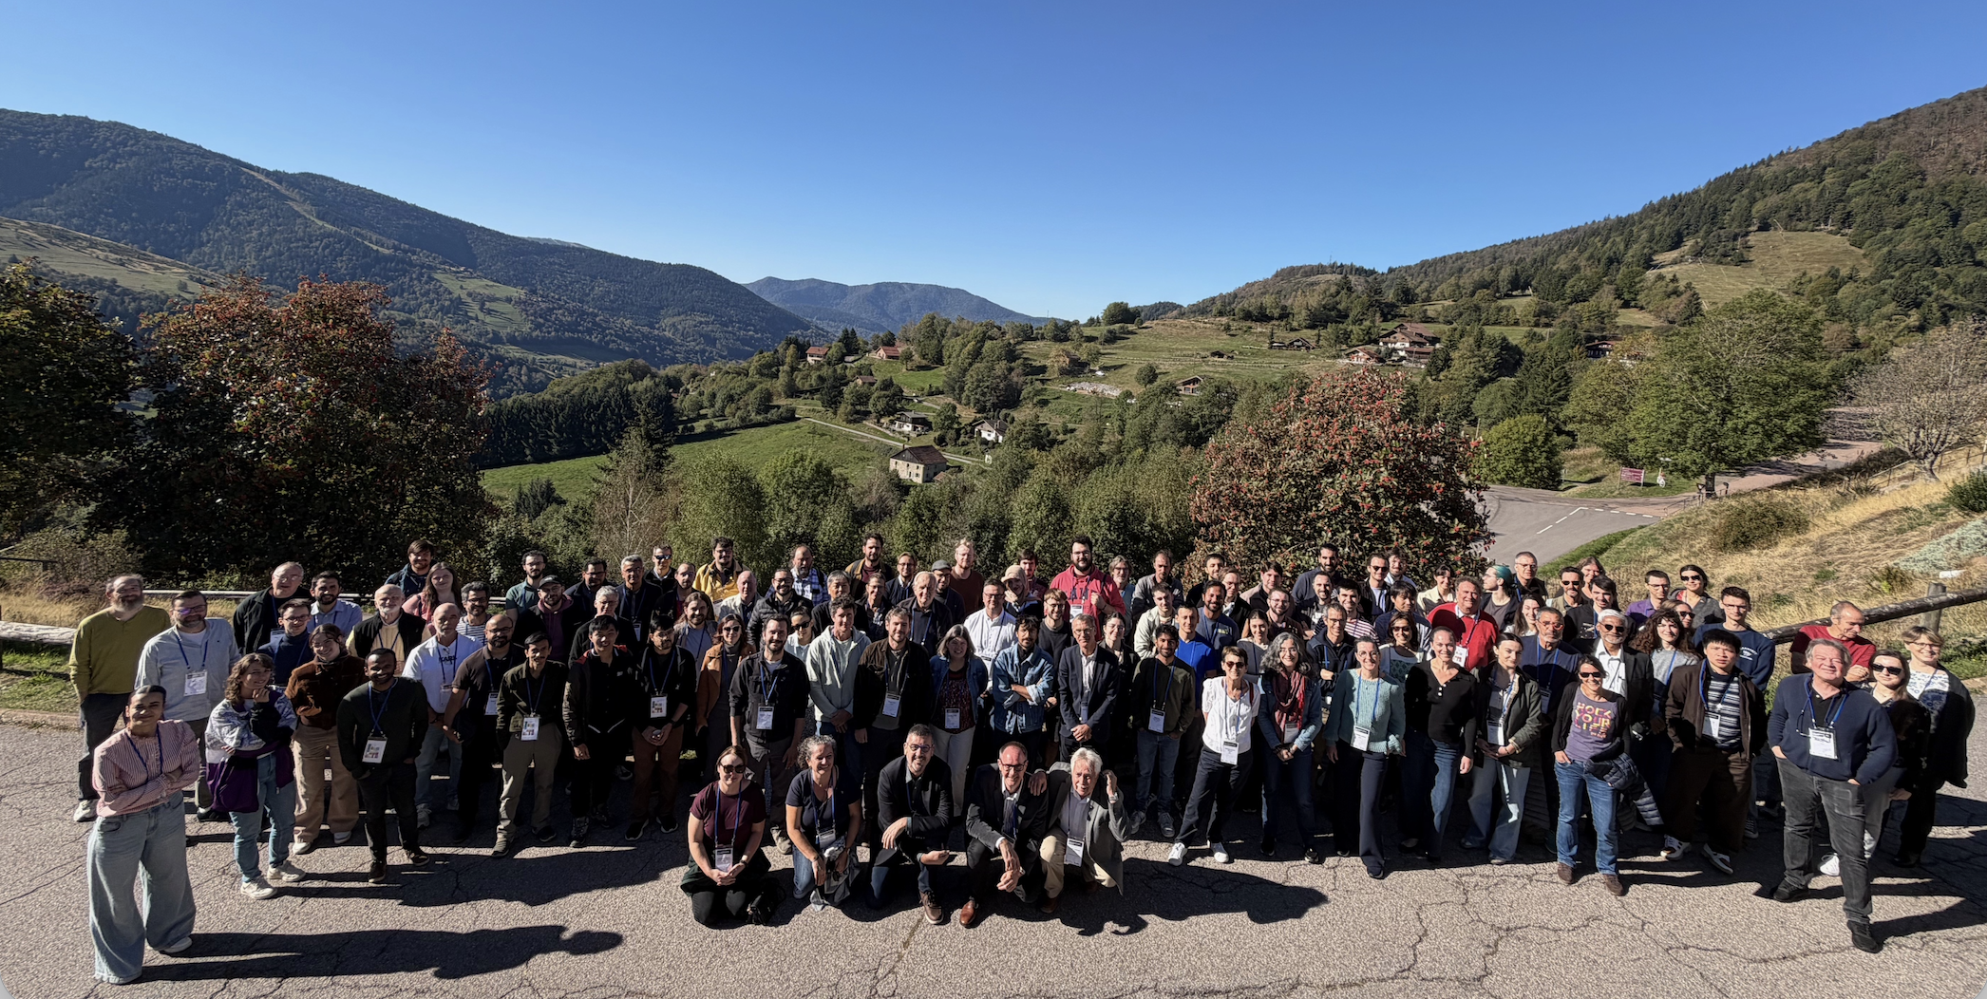
Very brief conclusion
2026 edition : “un grand cru”

Slide 2
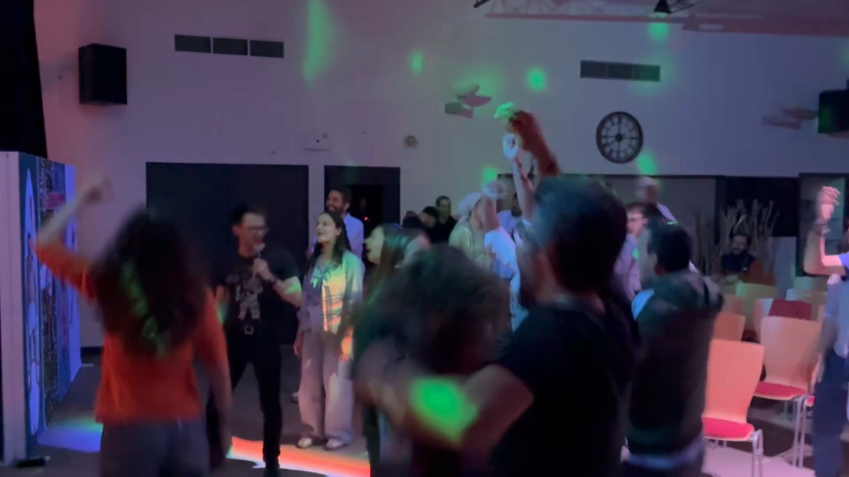

Slide 3
Statistics
Participation
107 participants (including 39 GANIL staff members)
29 early-career researchers
78 researchers
24 laboratories from 15 countries
Gender distribution
31 female
75 male
1 non-binary
Belgium 3
Canada 2
Finland 1
France 77
India 2
Italy 1
Japan 1
Poland 5
Portugal 1
Romania 1
South Korea 1
Spain 8
Sweeden 2
United States 1
Vietnam 1

Slide 4
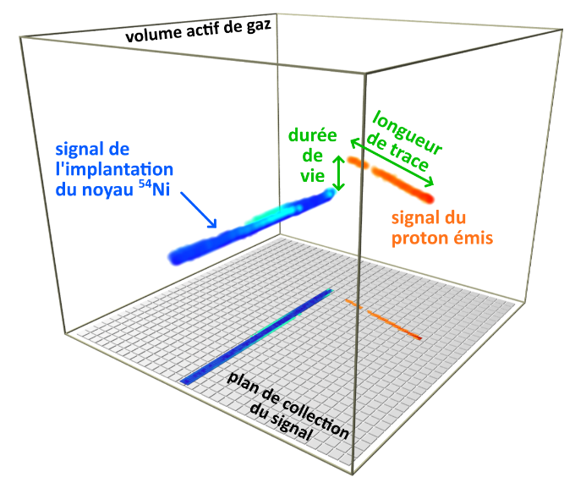
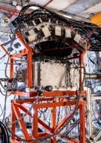
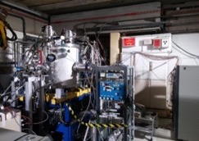
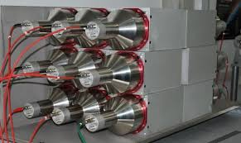
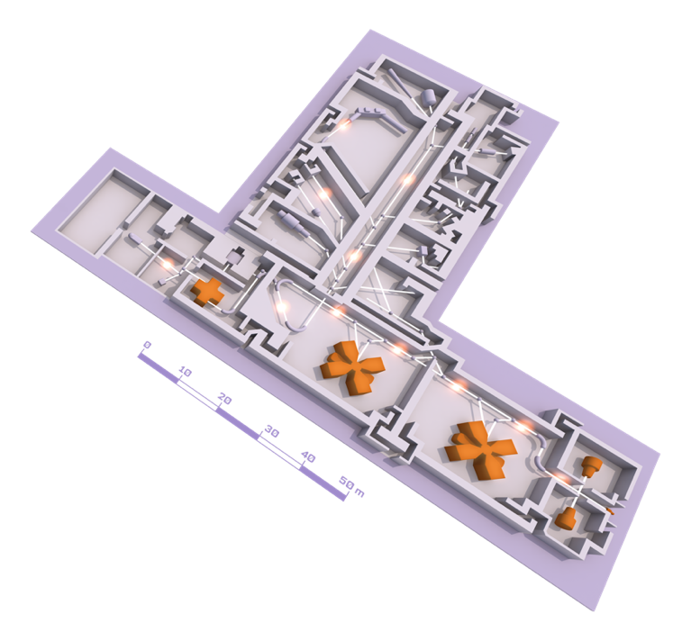
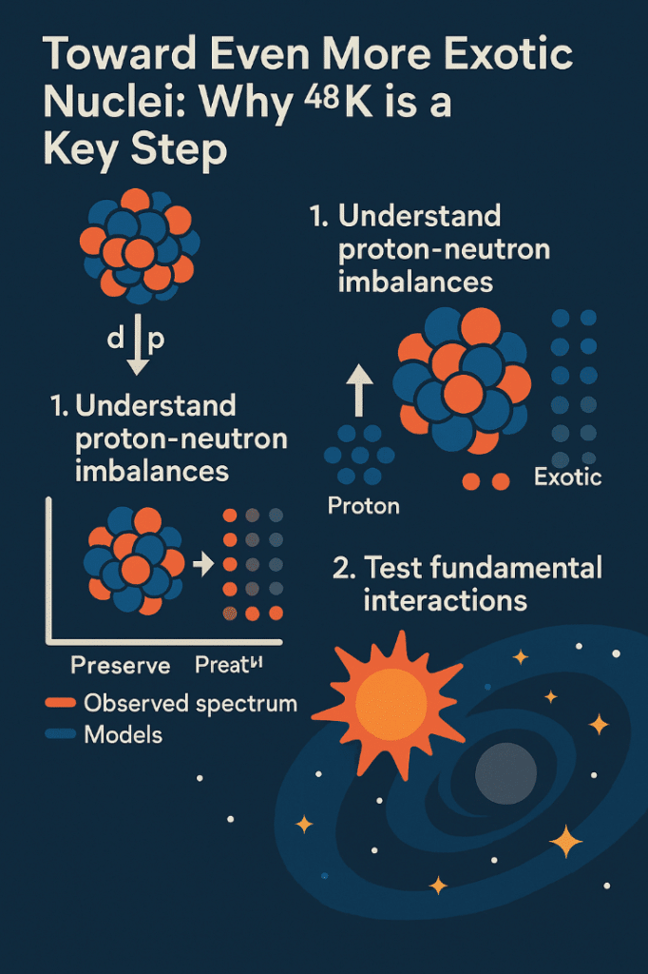
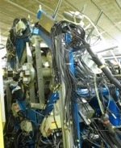

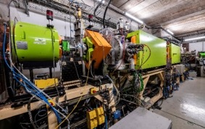

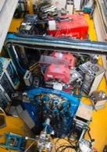
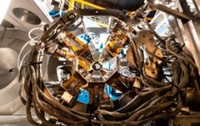
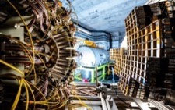
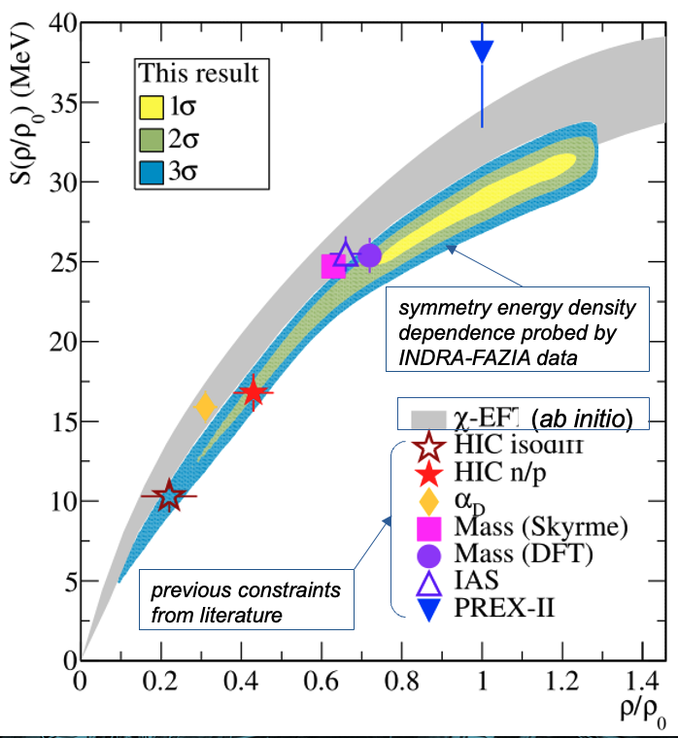
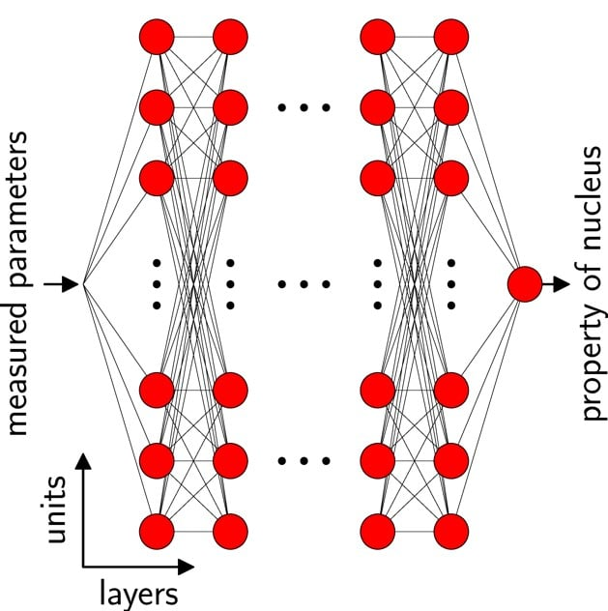
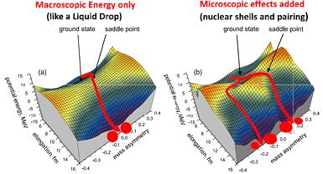
Cyclotron experiments still very competitive
5 cyclotrons
Stable beams: ¹²C à U
Energy : from < 1 MeV/u up to 95 MeV/u
SPIRAL1 radioactive ion beams
Up to 4 experiments in parallel
Nuclear structure, Nuclear astrophysics & Exotic radioactivity
MUGAST
EXOGAM
LISE SPECTROMETER
ACTAR TPC
Experimental rooms
TAS
Nuclear structure & Nuclear astrophysics
INDRA + FAZIA
New Spiral1 beams
EOS
AGATA
(2015-2021; 2029-2030)
VAMOS
SPIRAL1 GANIL CYCLOTRONS
Light nuclei nuclear structure
Fission
New stable beams : Th and W
²³⁵U under investigation
4

Slide 5
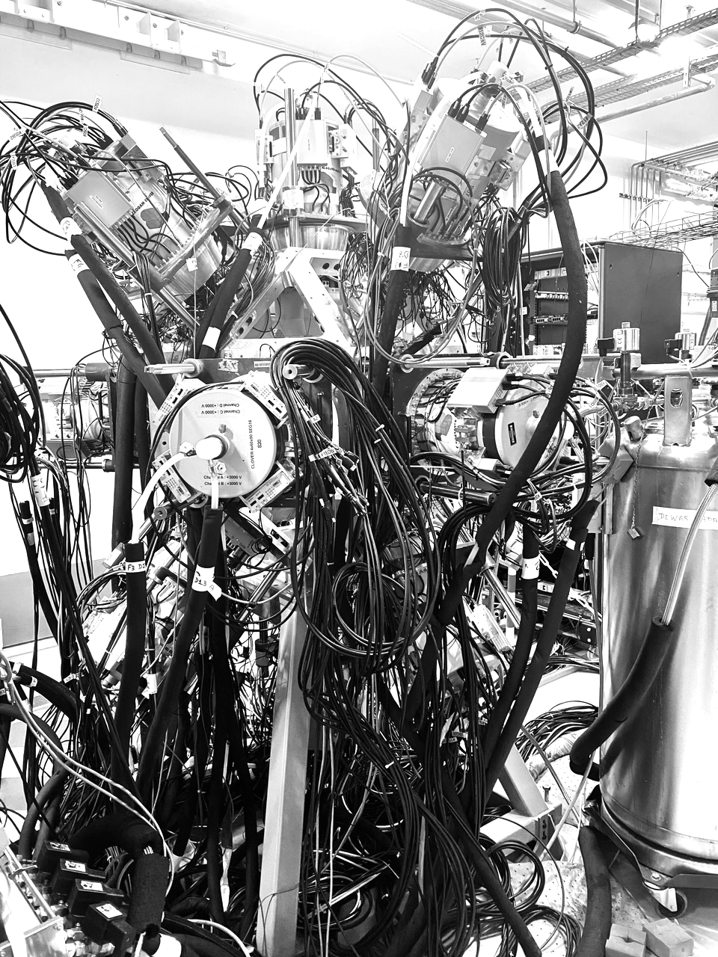
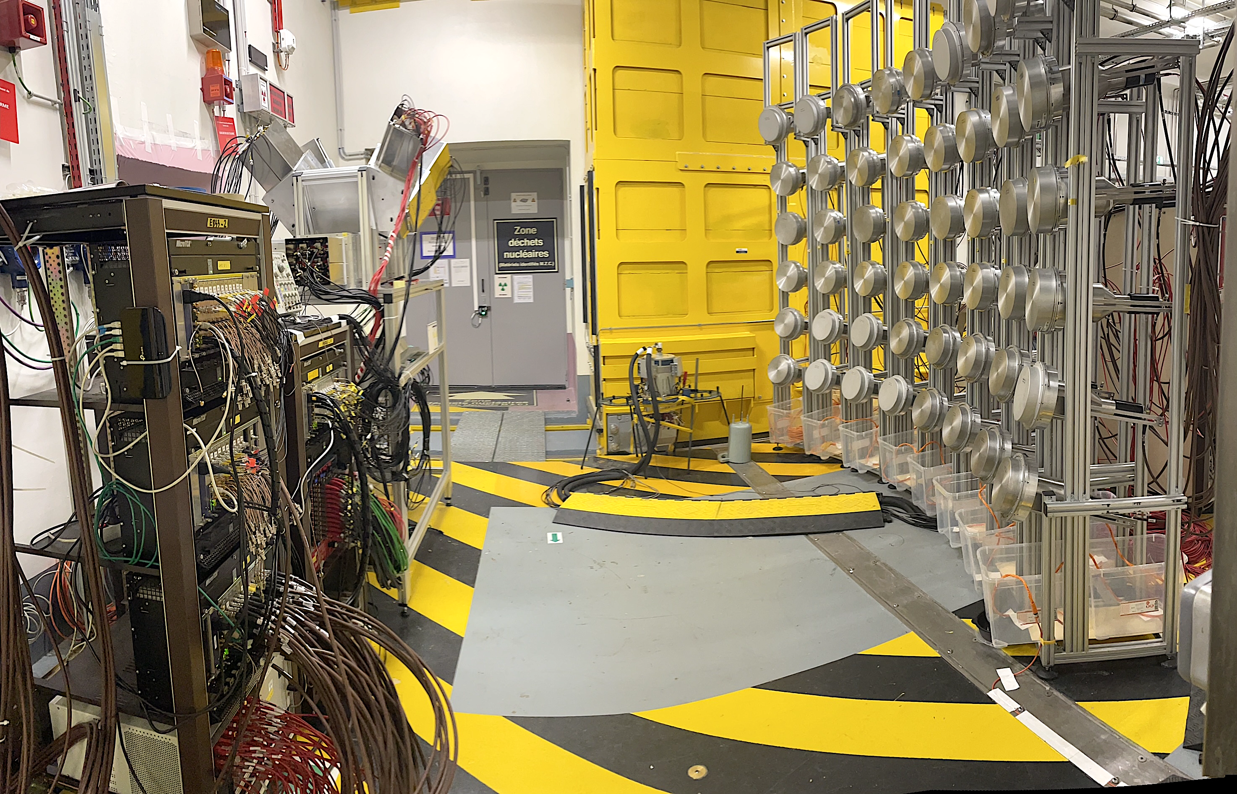
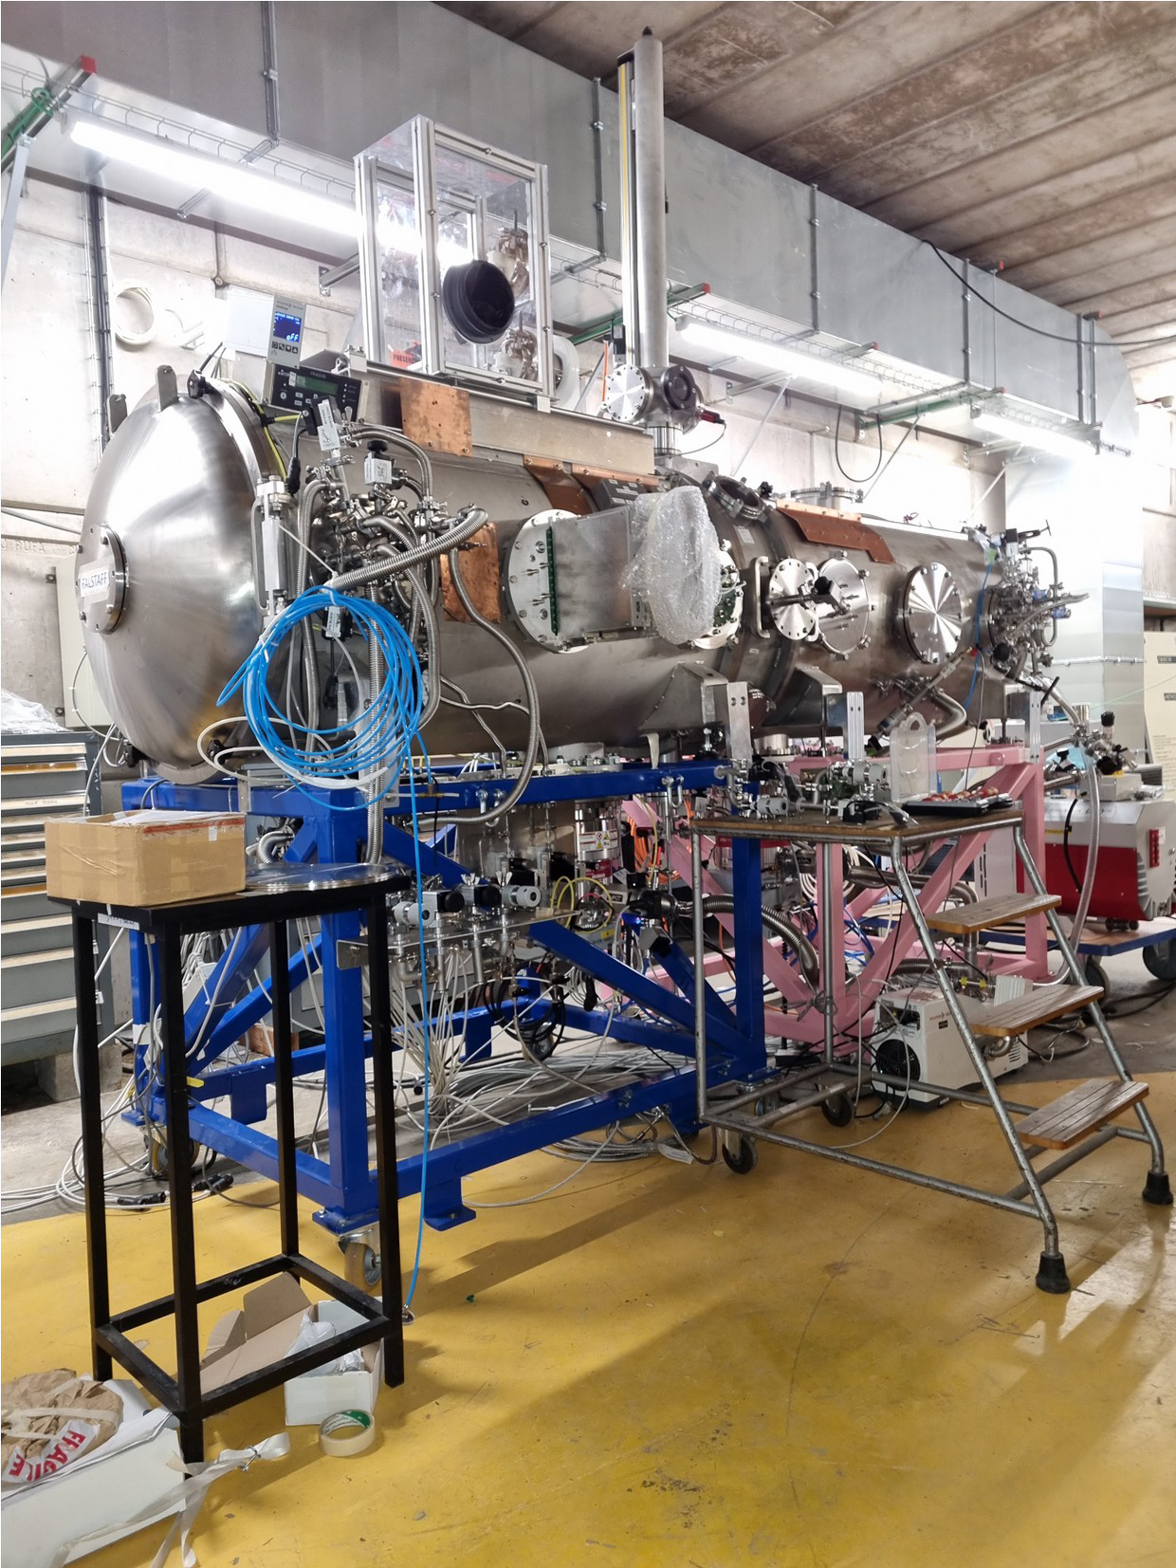
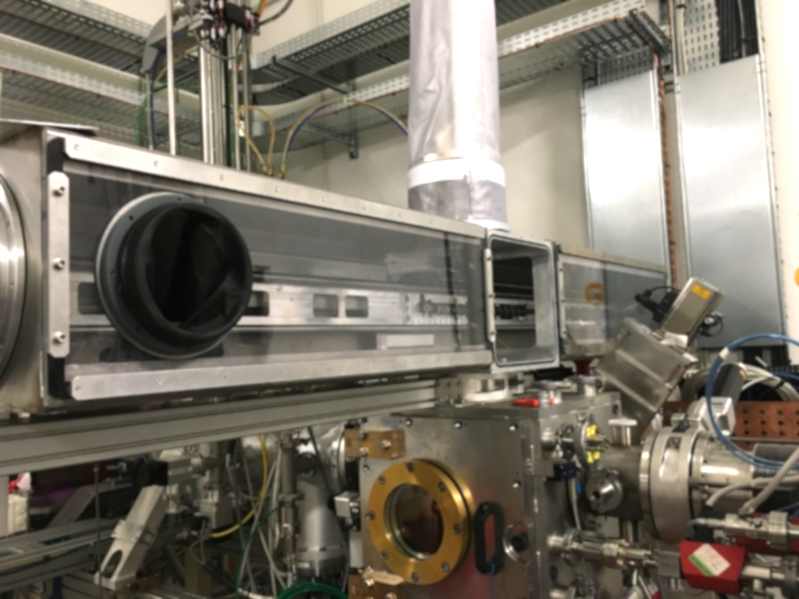
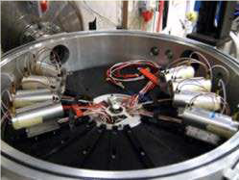
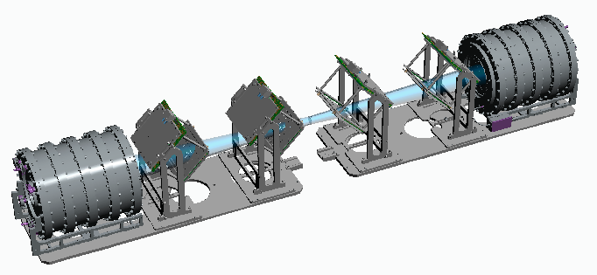
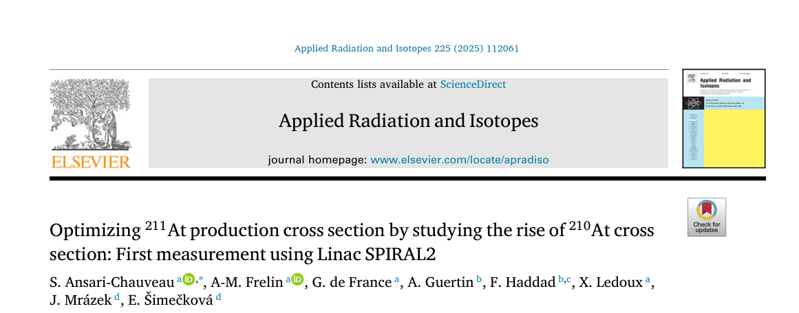
NFS a scientific programme in full expansion
Pygmy dipole resonance in ¹⁴⁰Ce using the (n,n’γ) reaction, Marine Vandebrouck et al
Light ions production studies with MEDLEY at the NFS facility, Diego Tarrio et al
(n,xn γ) reaction cross section measurements for nuclear energy, M. Kerveno et al
REPARE project: production of ²¹¹At for alphatherapy, Gilles de France et al
Shedding new light
on the structure of
⁵⁶Ni using (n,3n)
reaction at NFS,
E. Clement et al
REPARE
MEDLEY
²³⁵U fission fragment study with
FALSTAFF at NFS, D. Doré et al.
5

Slide 6
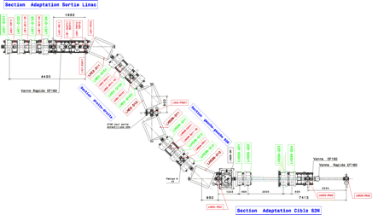
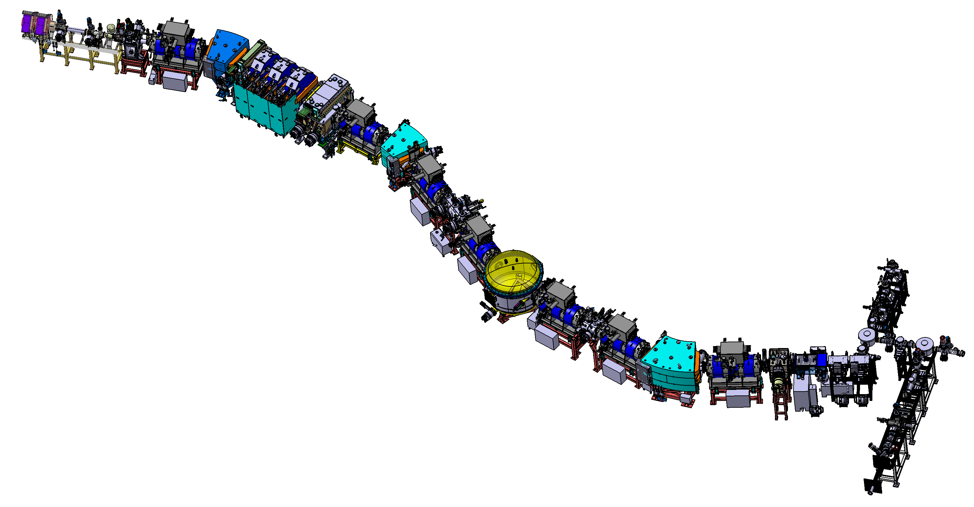
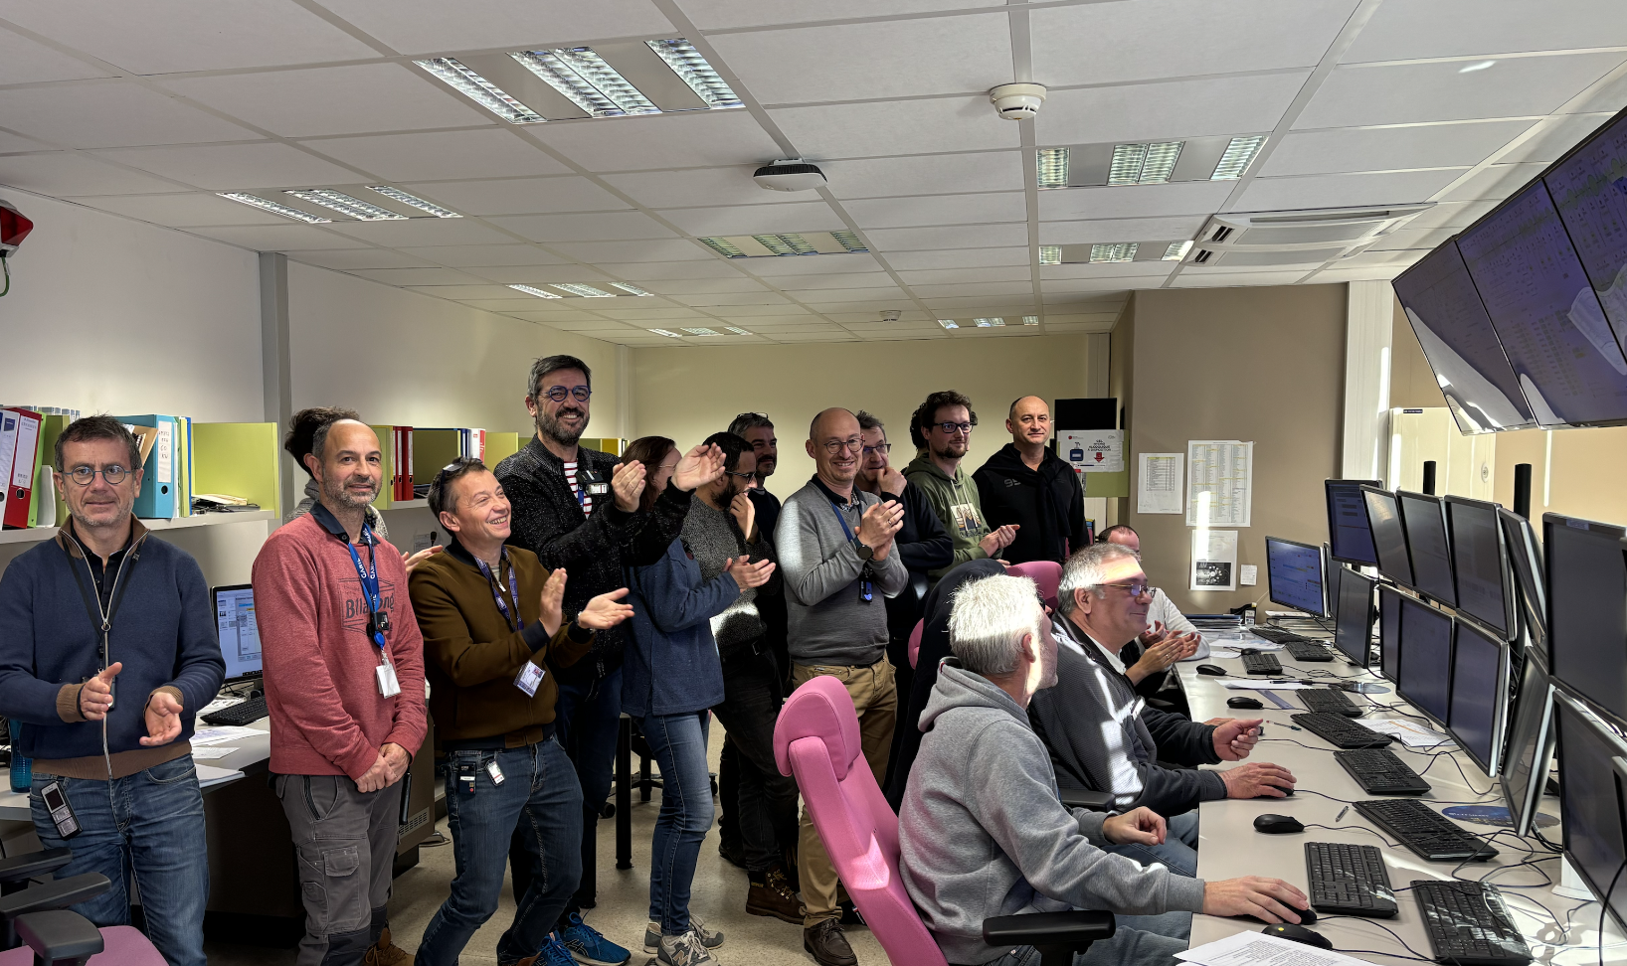
S³ commissioning optical commissioning soon
Expected end fall 2027
J6A
Accelerator & beam line tuning up to the target
J6B
Spectrometer optical commissioning with direct beam
Beam
J6C
Scientific commissioning, reactions at the target
Measure and optimise the rejection (case by case)
Estimate transmission
Detection systems : LEB / SIRIUS
LHE-S3N
Achromatic point
Mass separator
Target position
S³LEB
Primary beam dump
Momentum achromat
Final focal plane
Secondary beam dump
LINAC
S³
6

Slide 7






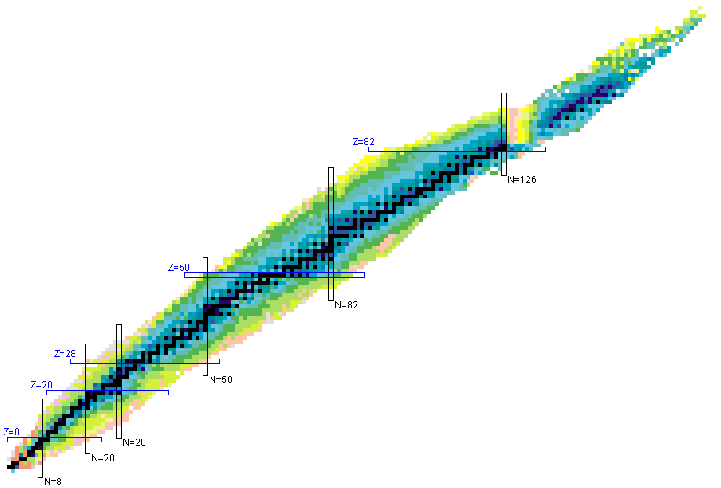
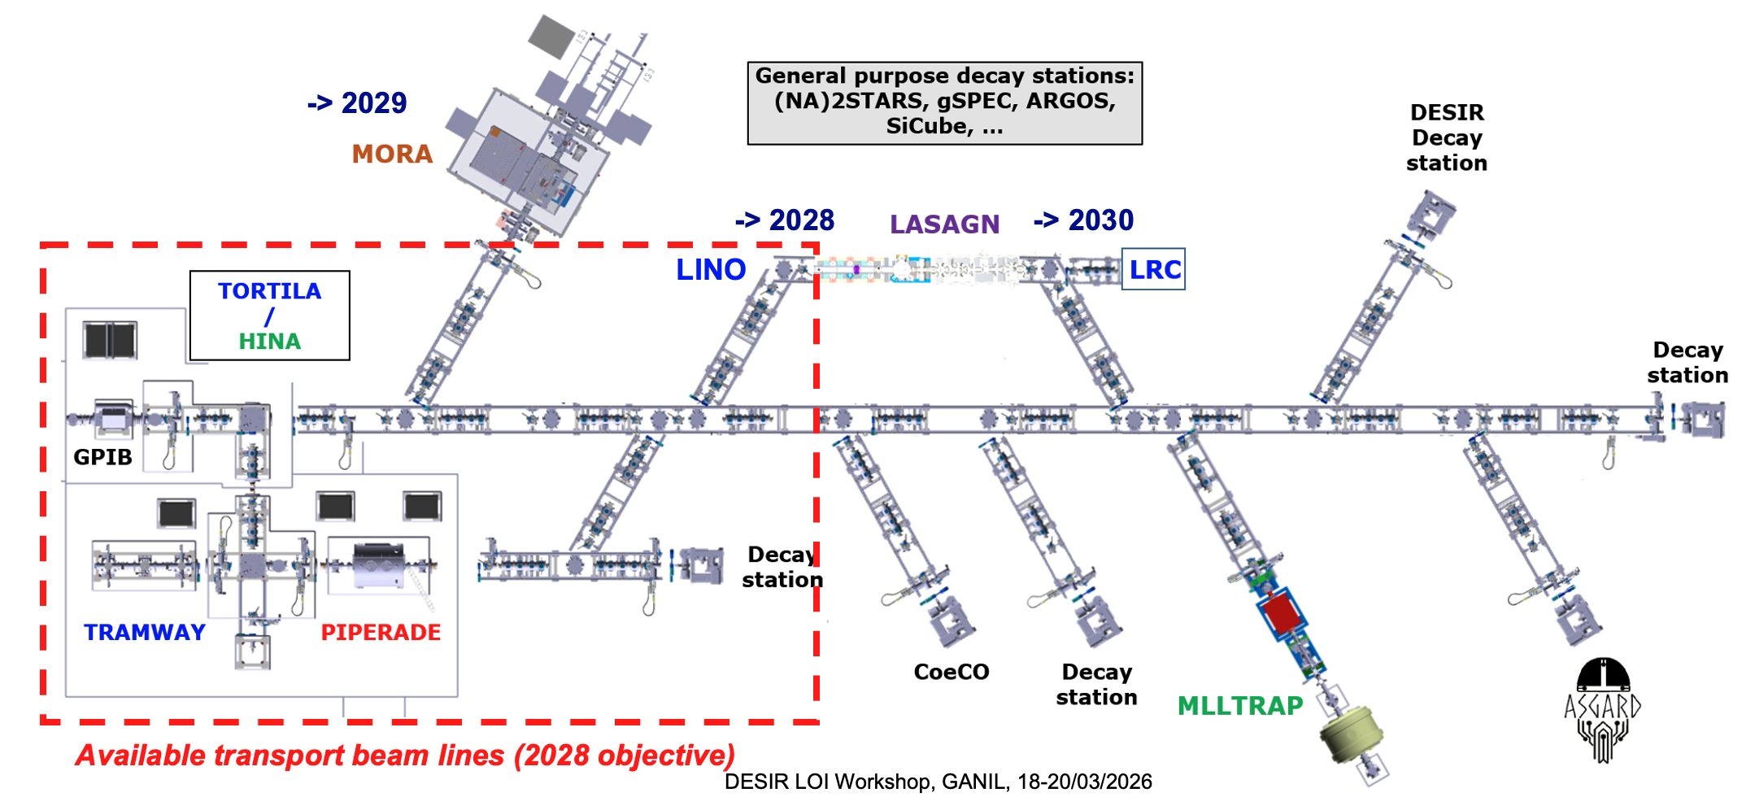
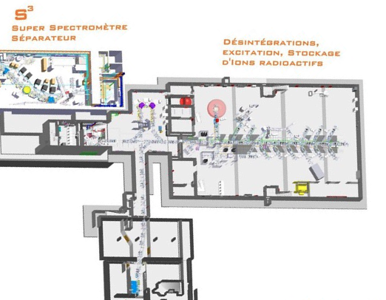

DESIR project enters in a new phase
Building acceptance 2026
Installation of beam lines & first setups ongoing
First experiments 2029
S³-LEB, SIRIUS
  Fusion-evaporation
  (Multi-)nucleon Transfer
S³-LEB
Beams from SPIRAL1 and S³
Important beam preparation and purification capabilities
High resolution and high precision experiments
Studies of fundamental properties of nuclei:
masses, lifetimes, decay modes, spin, quadrupolar moments…
Nucleosynthesis, Fundamental interactions, study of weak interaction
SPIRAL 1 Upgrade
  Beam & target fragmentation
Scientific aperture
Contribution to ESPPU
DESIR workshop March 2026 : 52 Letter of Intents
7

Slide 8
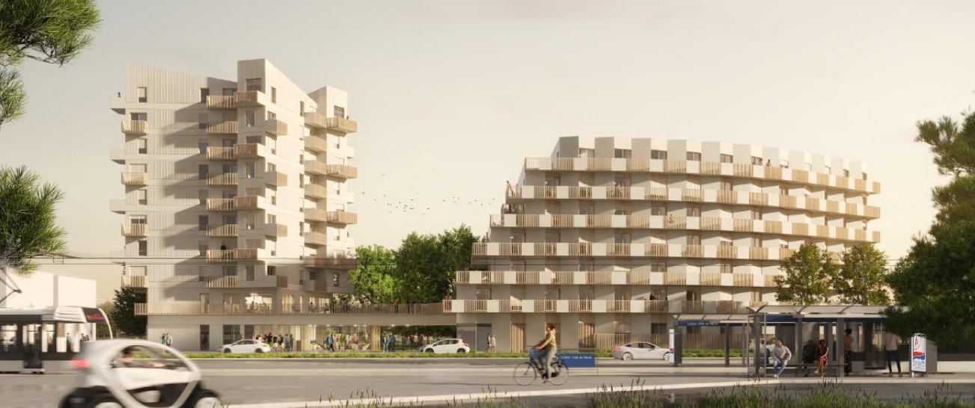
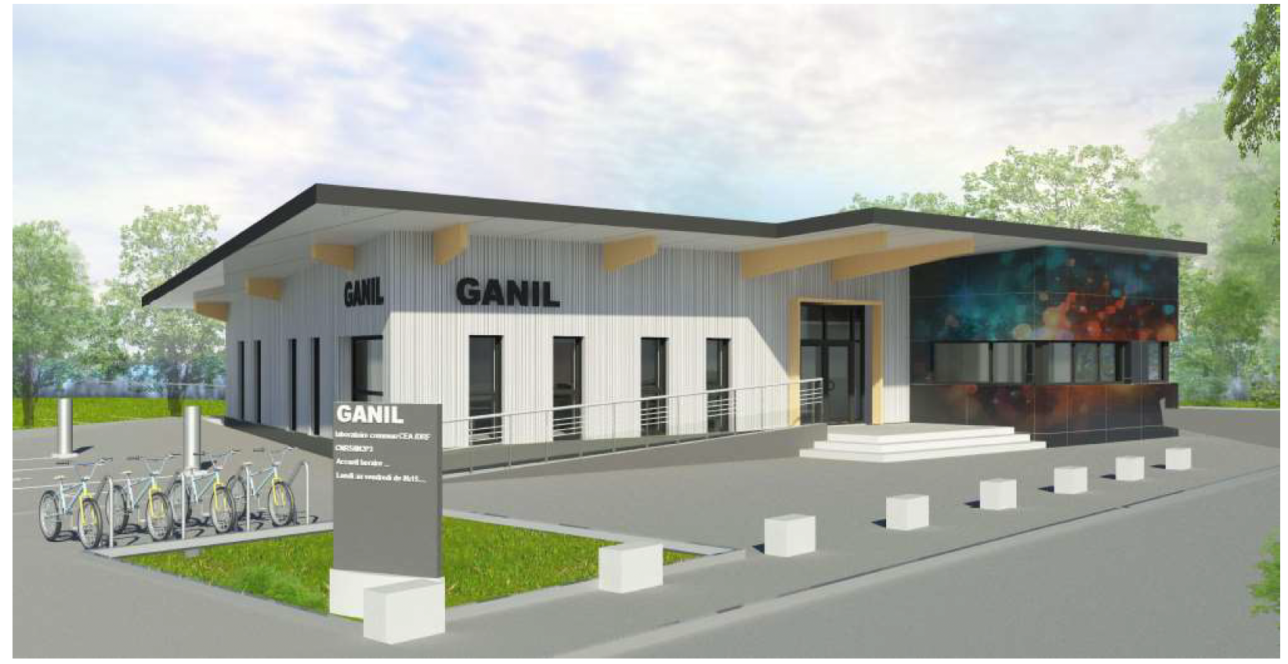
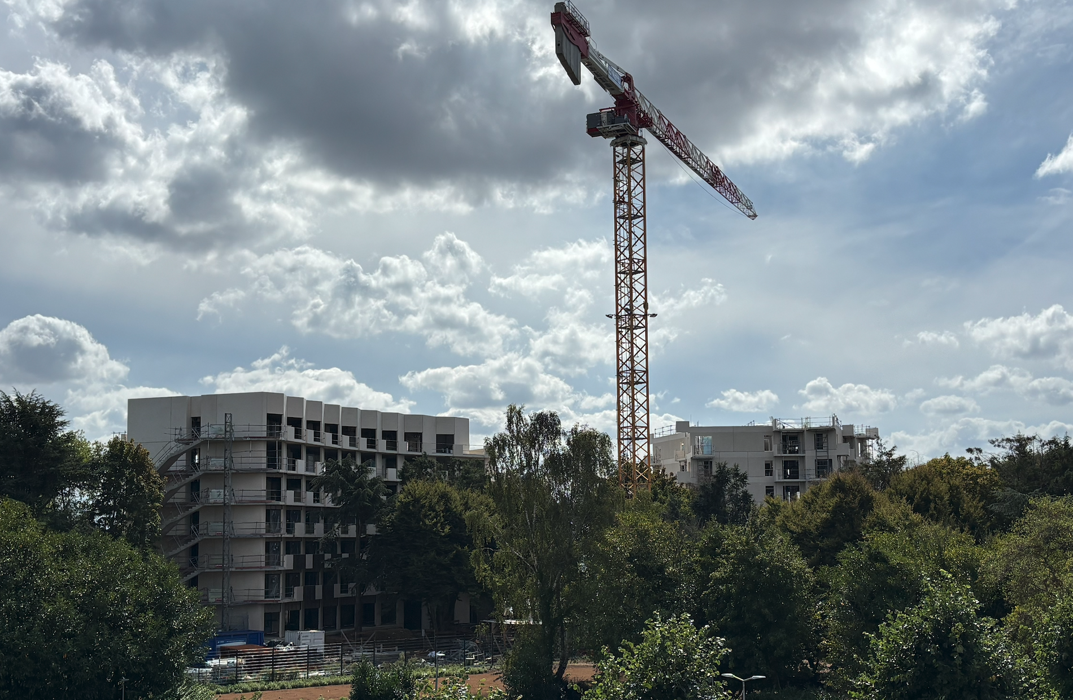
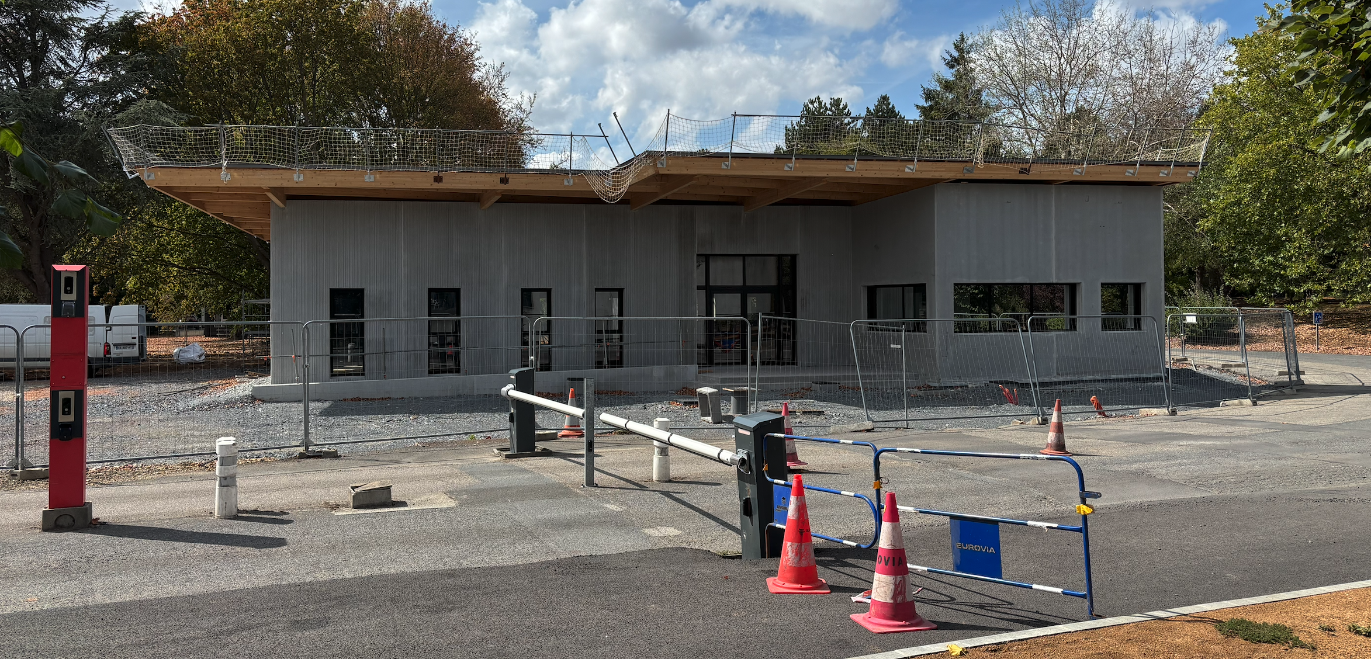
New standing for users (2027-2028)
Construction of a researchers’ residence and a student residence ongoing
New GANIL campus reception buiding
8

Slide 9
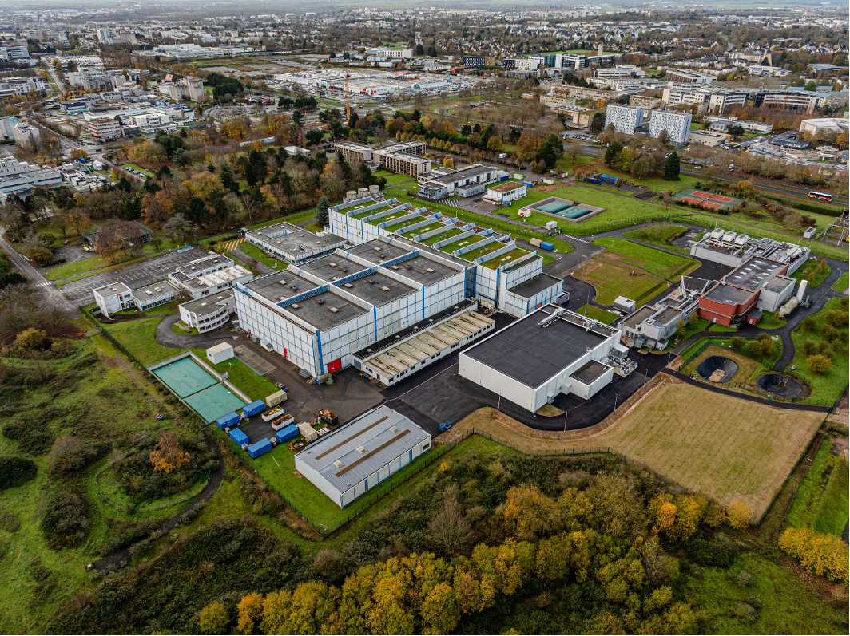
Thank you for supporting GANIL
Have a safe trip back

