Slide 1

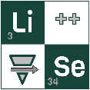

Search for New Isotopes at FRIB:
Recent Results and Future Opportunities
Oleg B. Tarasov
24th GANIL Colloque
September 21–25, 2026; Vosges Mountains, Bussang

Slide 2
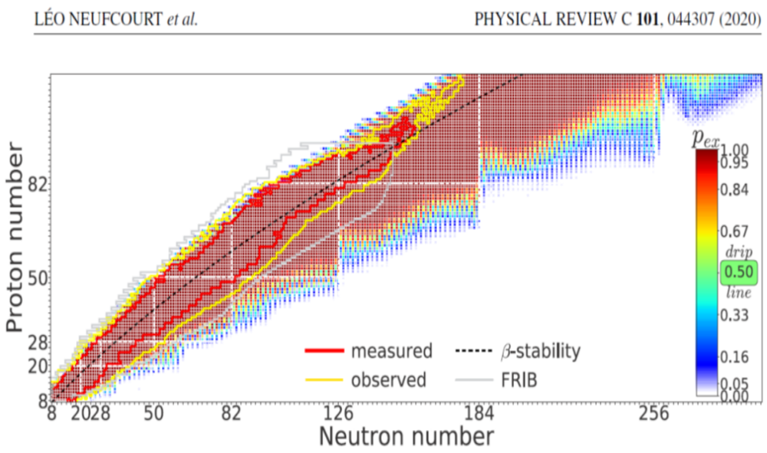
Terra incognita
The work by Neufcourt et al. showed how Bayesian model averaging can be used to quantify the landscape of nuclear existence by combining information from several models.
Only around 3000 have been experimentally observed
According to the Bayesian model averaging analysis, the number of particle-bound nuclei
with Z,N ≥ 8 and Z ≤119
  is 7708 ± 534 (>50% chance),
  and >10% chance of 10,000 isotopes
A vast region of the nuclear landscape remains terra incognita
200
Even if a nucleus is expected to exist,
the practical question is whether it can be produced at a measurable rate
EPAX2: empirical systematics
no nuclear masses,
no evaporation/de-excitation physics,
only fitted trends from existing data.

Slide 3
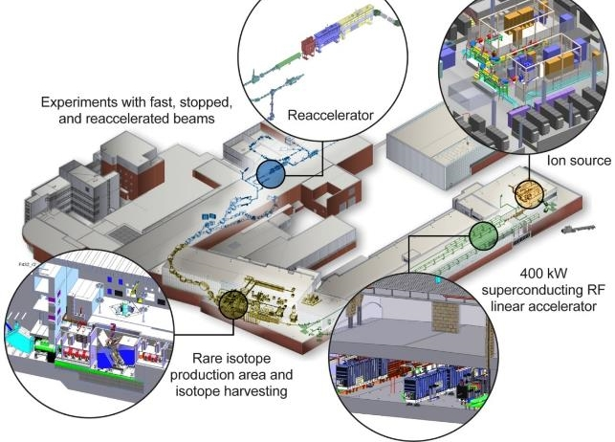
The Facility For Rare Isotope Beams
FRIB is designed for 400 kW beam power
  8 p𝜇A or 5 x 10¹³ ²³⁸U /s
  42 p𝜇A or 2.6 x 10¹⁴ ⁴⁸Ca /s
Operation at 20 kW now, power ramp-up underway, so PAC4 up to 45 kW
Range of beam energies provided for experiments
  Fast – 20 to 200 MeV/u
  Stopped – 10 kV
  Reaccelerated – 1.5-10 MeV/u
Started operation in May 2022
  More than 70 PAC approved experiments completed
  More than 650 Rare Isotope beams have been
  delivered to FRIB
Isotope harvesting capability (collection of otherwise unused isotopes for applications)
  3 experiment completed

Slide 4
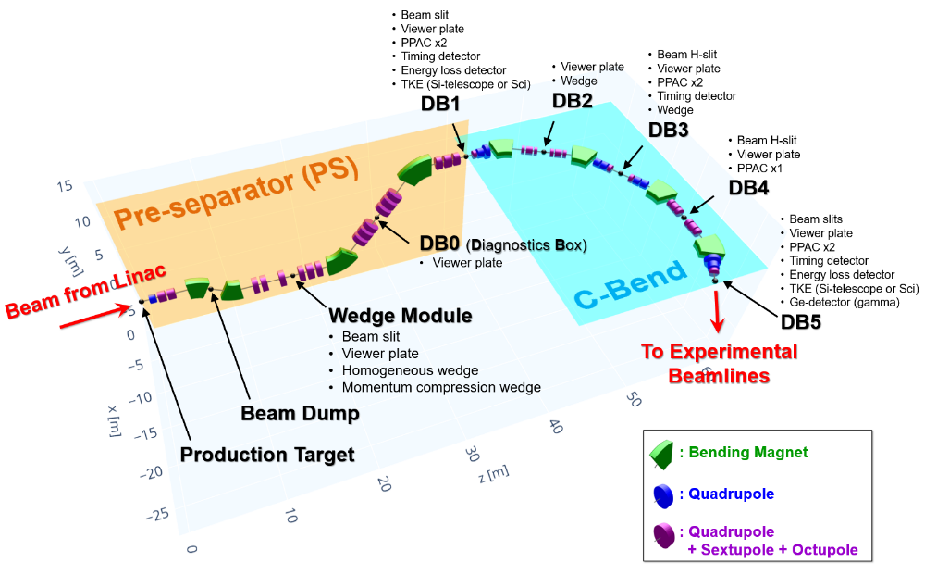
ARIS Fragment Separator
Multi-stage separation
  Reduces impurity rates for tracking at later stages
  First stage applies ~3x momentum compression (K3 mode) at vertical separation
    better matching to existing beam lines
  Horizontal stages can operate as
  one (CB1) or two (CB2) achromatic foci
    Single stage mode (CB1) offers
    higher resolving power
    but less acceptance
Remote handling of items in target/wedge area
M. Hausmann et al., NIMB 317 (2013) 349-353.
Design of the Advanced Rare Isotope Separator ARIS at FRIB
M. Portillo et al., NIMB 540 (2023) 168-173
Commissioning of the Advanced Rare Isotope Separator ARIS at FRIB

Slide 5

Published
“New” Isotopes

Slide 6
FRIB Beam Activities
FRIB primary beams for PAC4 Epoch3a call for proposals
2022
  Jan. – First primary beam transport through all separator stages
  May – First experiments at FDSi (⁴⁸Ca, ⁸²Se)
  H. L. Crawford et al., PRL 129 (2022) 212501
  T.J. Gray et al., PRL 130 (2023) 242501
  I. Cox et al., PRL 132 (2024) 152503
2023
  Jan. – Commissioning and experiment at ARIS with a high-Z intense beam (1.5 kW ¹⁹⁸Pt). First new isotopes
  O.B.T. et al., PRL 132 (2024) 072501
  July – 10 kW: 2 experiments
  Dec. – ²³⁸U 10.4 kW P.N.Ostroumov et al., PRAB 27 (2024) 060101
2024
  July – ⁸²Se 20 kW: new isotope search run
  O.B.T. et al., PRC 112 (2025) 034604
Beam | A | Z | Maximum Energy [MeV/u] | Intensity [pnA] | Beam Power [kW]
16O | 16 | 8 | 165 | 9470 | 25
18O | 18 | 8 | 165 | 8418 | 25
20Ne | 20 | 10 | 175 | 7143 | 25
22Ne | 22 | 10 | 175 | 6494 | 25
28Si | 28 | 14 | 255 | 3501 | 25
30Si | 30 | 14 | 255 | 3268 | 25
36Ar | 36 | 18 | 255 | 2723 | 25
40Ar | 40 | 18 | 255 | 2451 | 25
40Ca | 40 | 20 | 255 | 2451 | 25
48Ca | 48 | 20 | 240 | 2170 | 25
58Ni | 58 | 28 | 250 | 2414 | 35
64Ni | 64 | 28 | 235 | 2327 | 35
64Zn | 64 | 30 | 250 | 2188 | 35
70Zn | 70 | 30 | 230 | 2174 | 35
70Ge | 70 | 32 | 246 | 1742 | 30
76Ge | 76 | 32 | 228 | 1558 | 27
82Se | 82 | 34 | 227 | 1880 | 35
78Kr | 78 | 36 | 247 | 1817 | 35
86Kr | 86 | 36 | 228 | 1785 | 35
92Mo | 92 | 42 | 238 | 457 | 10
124Xe | 124 | 54 | 240 | 840 | 25
144Sm | 144 | 62 | 222 | 1095 | 35
192Os | 192 | 76 | 192 | 407 | 15
195Pt | 195 | 78 | 190 | 405 | 15
198Pt | 198 | 78 | 188 | 403 | 15
208Pb | 208 | 82 | 188 | 1023 | 40
209Bi | 209 | 83 | 188 | 891 | 35
232Th | 232 | 90 | 181 | 357 | 15
238U | 238 | 92 | 177 | 1068 | 45
238U | 238 | 92 | 193 | 435 | 20
https://frib.msu.edu/user-facilities/frib/beams

Slide 7
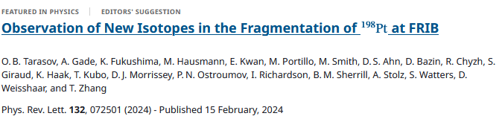
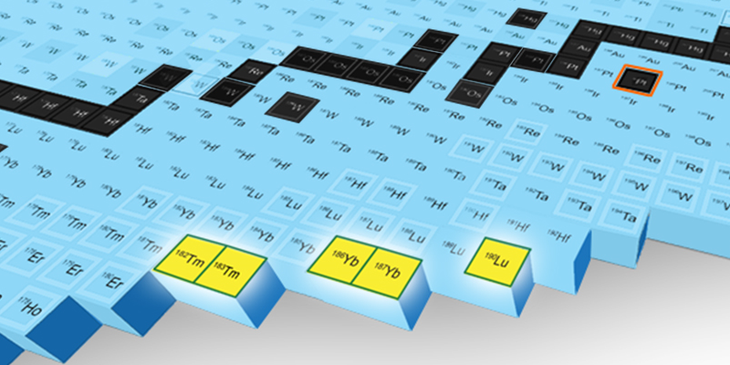
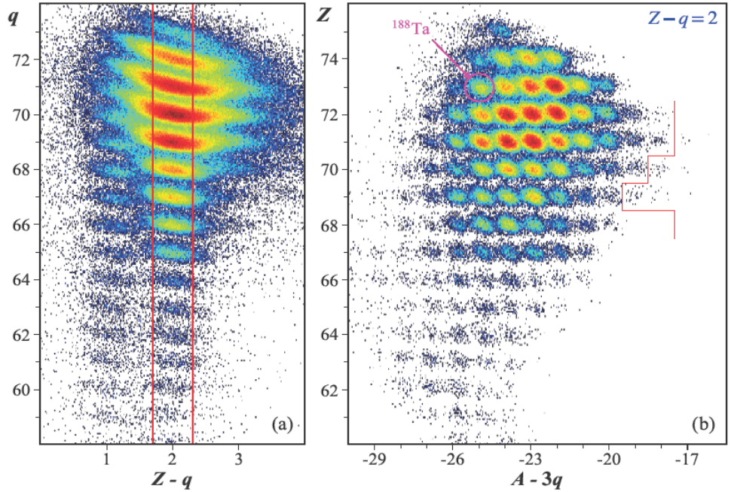
¹⁹⁸Pt (186 MeV/u) at FRIB
01/2023
Over the course of the experiment, five new isotopes, namely ¹⁸²Tm (29 events), ¹⁸³Tm (7), ¹⁸⁶Yb (27), ¹⁸⁷Yb (3), ¹⁹⁰Lu (5), were observed for the first time. One event was found to be consistent with ¹⁸⁴Tm, and another one was found to be consistent with ¹⁹¹Lu.
One-event cases are not claimed as observations of new isotope.
This intensity corresponds to only 1/270 of FRIB’s ultimate
primary-beam power.
This successful new isotope search was performed less than one year after FRIB operations began and demonstrates the discovery potential of the facility which will ultimately provide 400 kW of primary beam power.

Slide 8
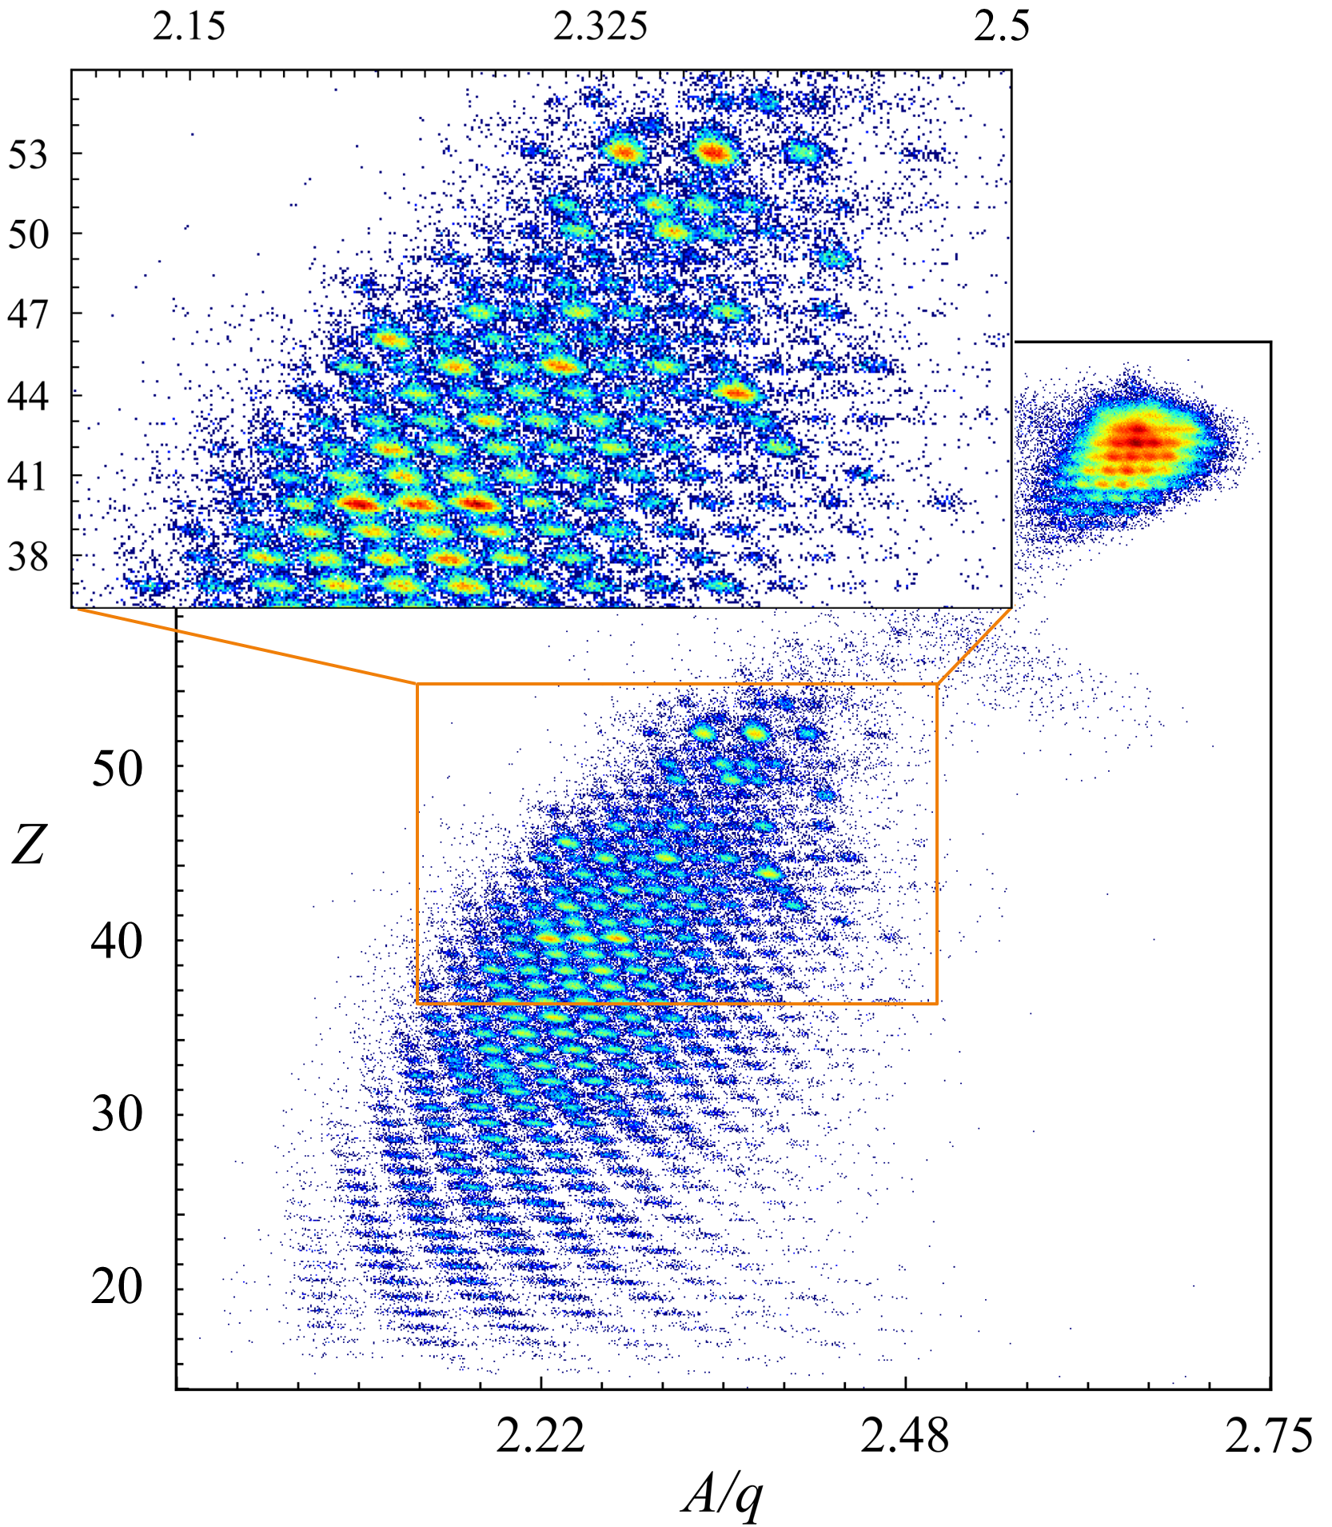
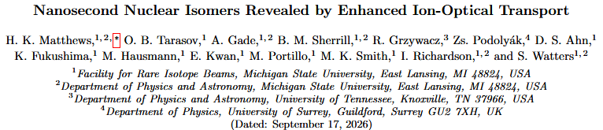
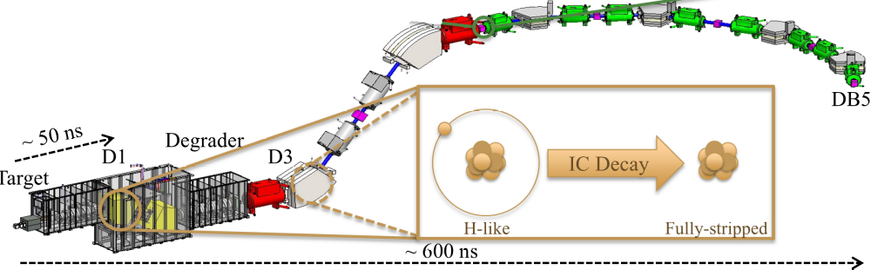
Nanosecond Isomer Map
PhD student: Holly Matthews
Enhanced transmission of certain nuclei is due to ns isomer decay in-flight
  Unexpectedly large yields of certain nuclei observed during rare-isotope beam purification
Effect explained by in-flight internal conversion changing ion charge states
  Charge-state change redirects isomers onto the separator trajectory
  Ion transport becomes sensitive to fast nuclear decay processes
Ion-optical transport established as a new probe for nuclear decay studies
  Isomer population for reaction mechanism studies
  PID tagging without gamma-detectors
submitted to PRL

Slide 9
e23607: ²³⁸U, 10 kW
12/2023

Slide 10
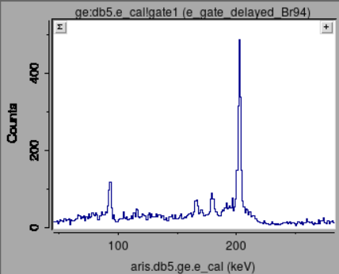
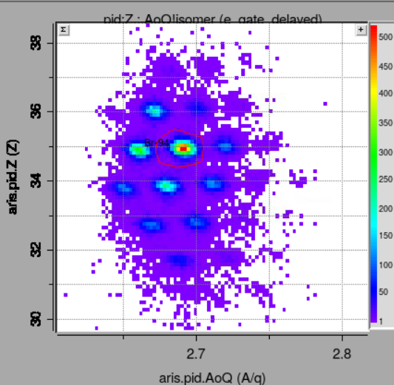
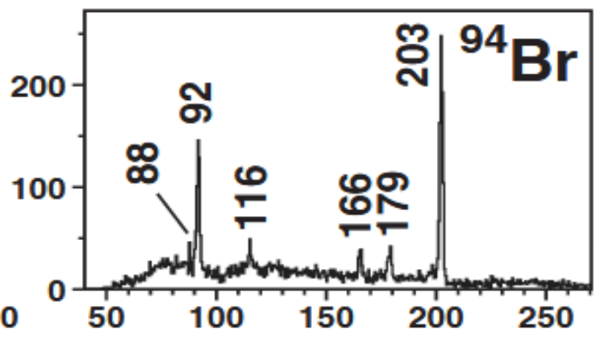
E23607 “Secondary beams from ²³⁸U” : Particle ID
²³⁸U 177 MeV/u, 10.4 kW
ARIS: 1 day (22-23 December 2023),
K3-CB2 optics
3 settings:
  isomer tagging
  new isotope regions – ⁹³As, ¹⁵²Cs
Particle ID was verified by the decay of known microsecond isomers (⁸⁸Br, ⁹⁴Br, ⁹⁸Y)
The production rates are in good agreement with the RIKEN results
e23607
Gated on delayed gamma
^{94m}Br

Slide 11
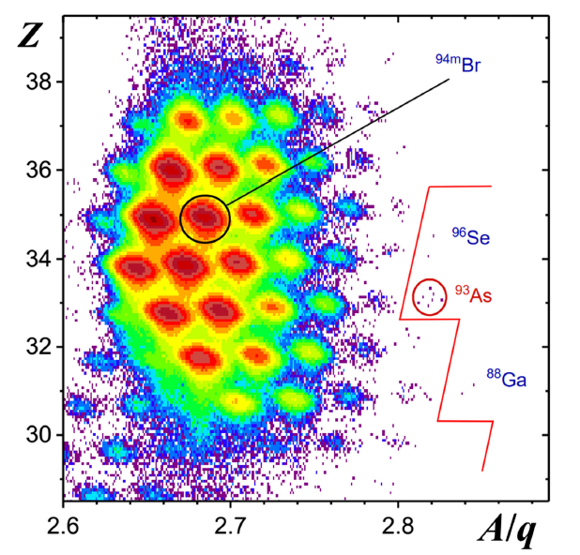
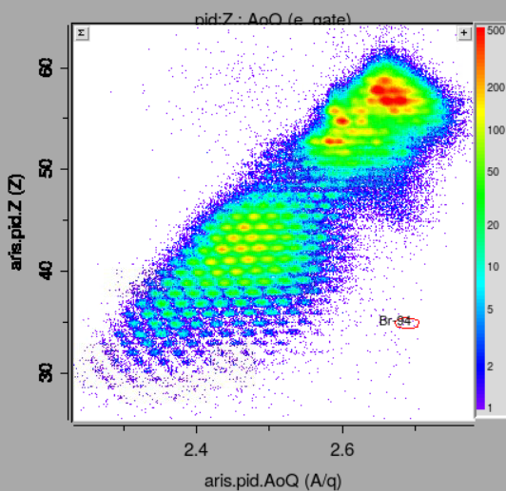
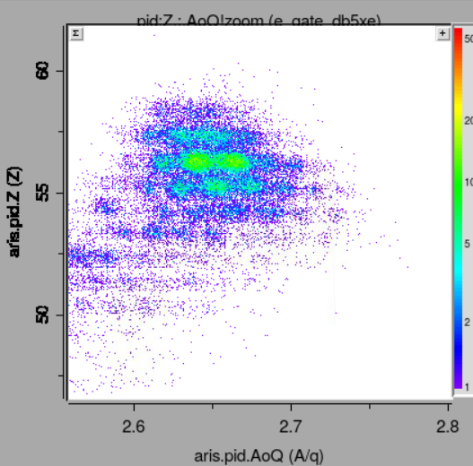
e23607 : Results
⁹³As - settings
¹⁵²Cs - settings
Over 300 fission fragments identified in all settings
In a 6-hour run with 10 kW at the Low-Z settings, three “new” isotopes were observed
⁸⁸Ga, ⁹³As, ⁹⁶Se
But “new” is only for a couple of months ..
before our submission participants of this experiment from RIKEN informed us, that..
Y. Shimizu et al.,
PHYSICAL REVIEW C 109, 044313 (2024)
received 19 December 2023
accepted 7 March 2024
published 8 April 2024
P. N. Ostroumov, O. B. T. et al.,
PHYSICAL REVIEW ACCELERATORS AND BEAMS 27, 060101 (2024)
Received 12 February 2024
Z-q=0

Slide 12
e24605: ⁸²Se, 20 kW
07/2024

Slide 13
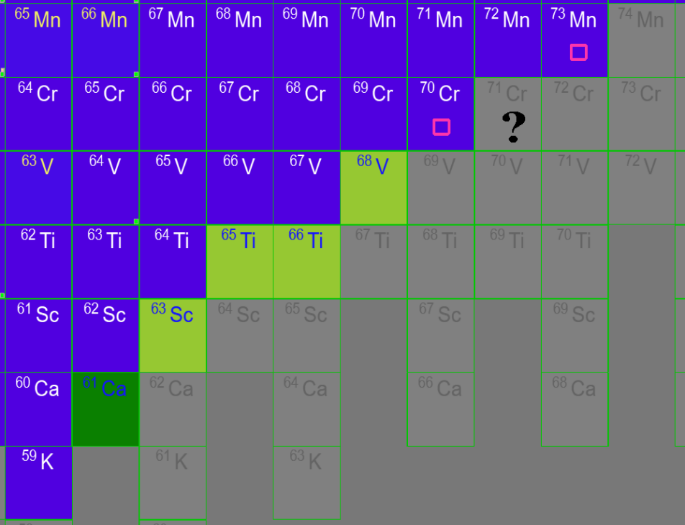
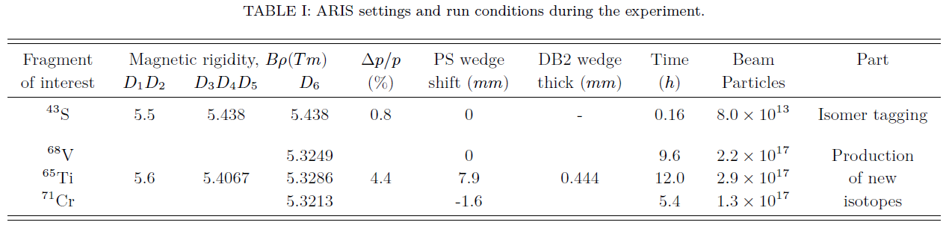
Exp. 24605 : new isotope search run with an ⁸²Se beam
⁸²Se 228 MeV/u, 20 kW
ARIS: July 2024, K3-CB2 optics
4 settings:
  Isomer tagging
  New isotope regions – ⁶⁵Ti, ⁶⁸V, ⁷¹Cr
Particle ID was verified by
    decay of ⁴³S microsecond isomer
    Calcium anomaly vs. A/q=3 line
    Even Z vs. A/q=2.5
New isotope search results
    30.9 h (6.5h with stack, 24.4h with Sci)
    4 new isotopes + 1 candidate
    ⁶³Sc (3), ⁶⁵Ti (2), ⁶⁶Ti (2), ⁶⁸V (4), and ⁶¹Ca (1)
    No events for ⁷¹Cr (0)
O.B.T. et al.,
PRC112, 034604 (2025)
Wedge shift:
Rapid switching to another FOI region

Slide 14
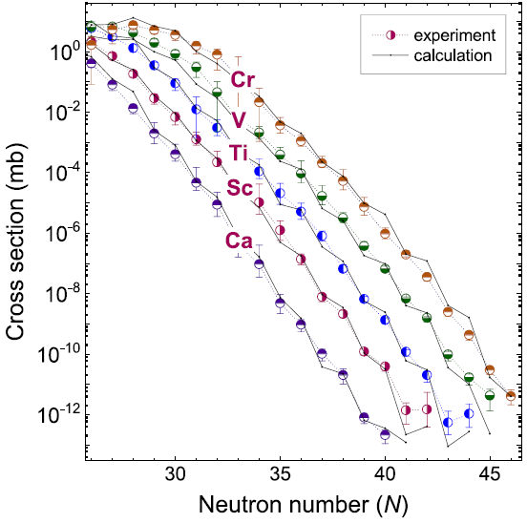
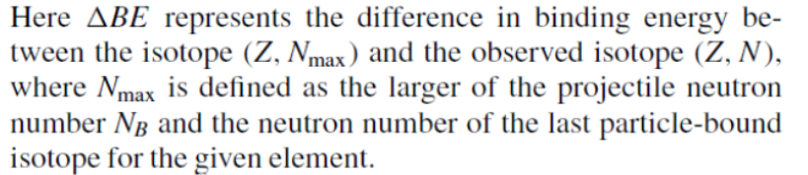
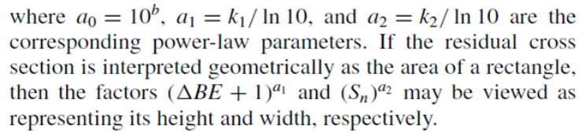
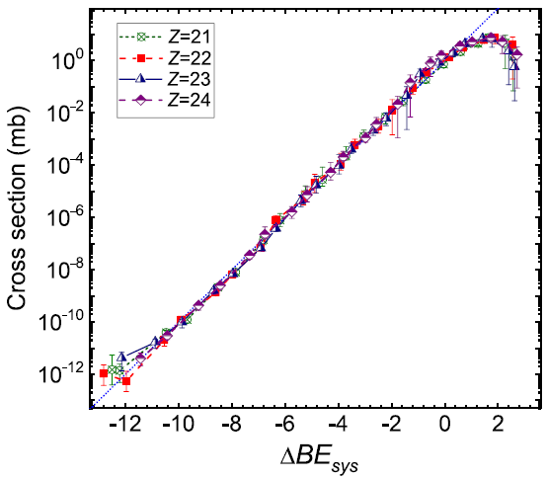
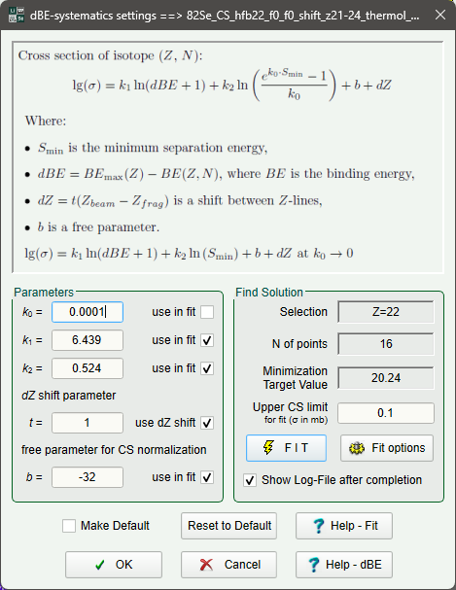
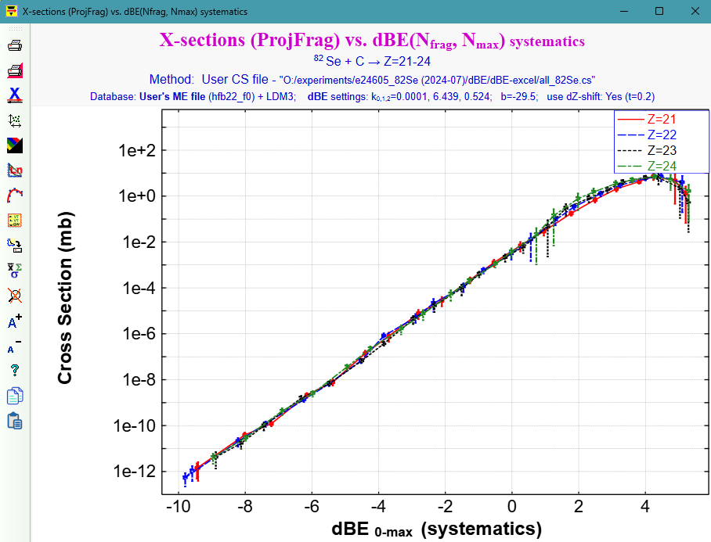
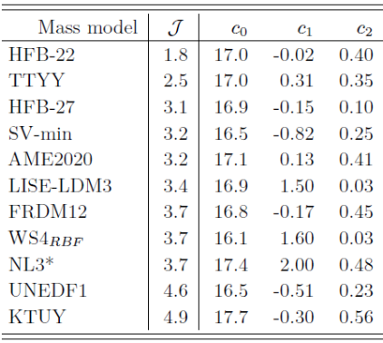

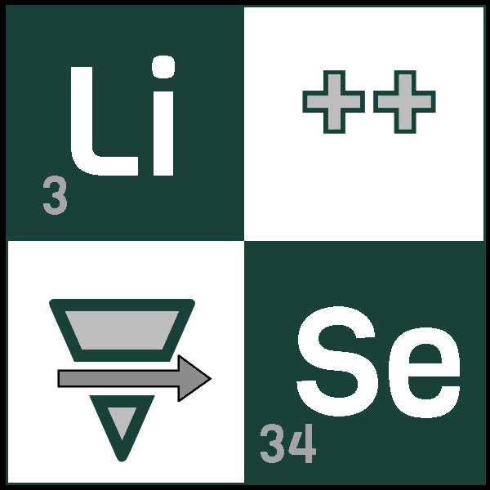
Insights into new-isotopes production
LISE⁺⁺ AA
New ΔBE-systematics
Geometric Interpretation
HFB22
See PRC 112, 034604 (2025) Appendix for math
ΔBE-systematics with built-in parameter fitting to experimental cross-section data in LISE⁺⁺
⁸²Se+C
HFB-22
More details next week at GANIL

Slide 15
Bayesian Model Averaging
(BMA)

Slide 16
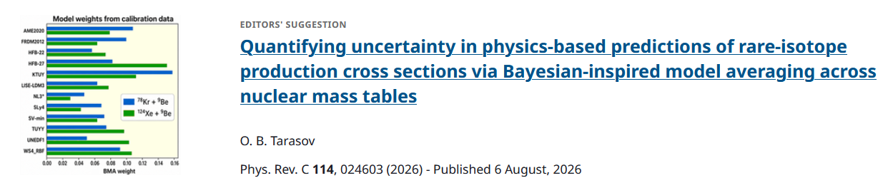
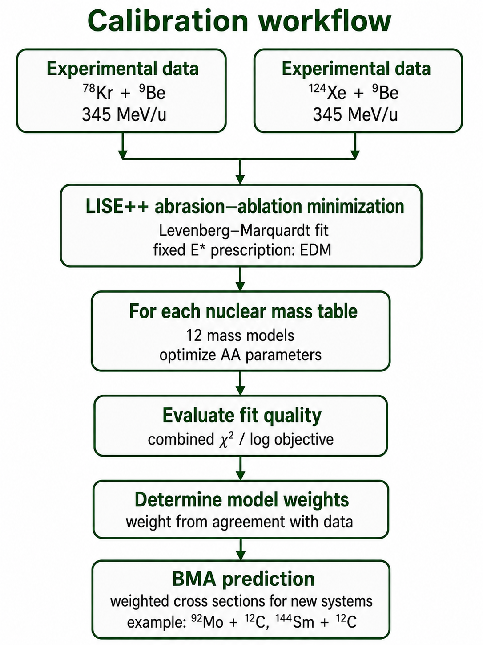
Uncertainty in physics-based predictions of rare-isotope production
Previous practice: choose best mass table
LISE⁺⁺ AA calculations were compared with data using different nuclear mass tables
For the ⁸²Se case, the best agreement was obtained with HFB-22 among 12 tested mass tables
But what about the other 11 models?
What uncertainty should be assigned to cross-section
predictions for more exotic nuclei?
Can the same approach be applied to neighboring beams?
More details next week at GANIL

Slide 17
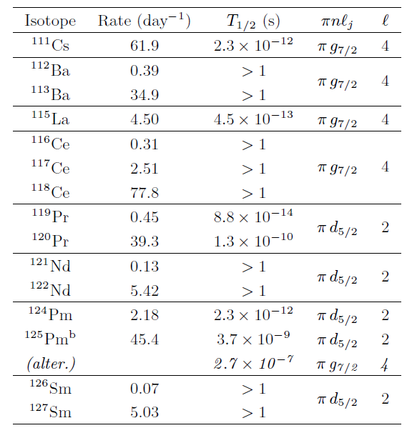
First experimental check of BMA-inspired predictions
Courtesy of M.Portillo
O.B.T., PRC 114, 024603 (2026)
Table.
Estimated production rates per day and
proton-radioactivity
half-lives for selected candidates populated
with the ¹⁴⁴Sm beam.
The manuscript was submitted to PRC on March 11, just before the ¹⁴⁴Sm experiment began on March 13. New isotopes were observed with preliminary production cross sections close to the BMA-inspired predictions and significantly below EPAX3.

Slide 18
Completed NI experiments —
analysis / publication preparation

Slide 19
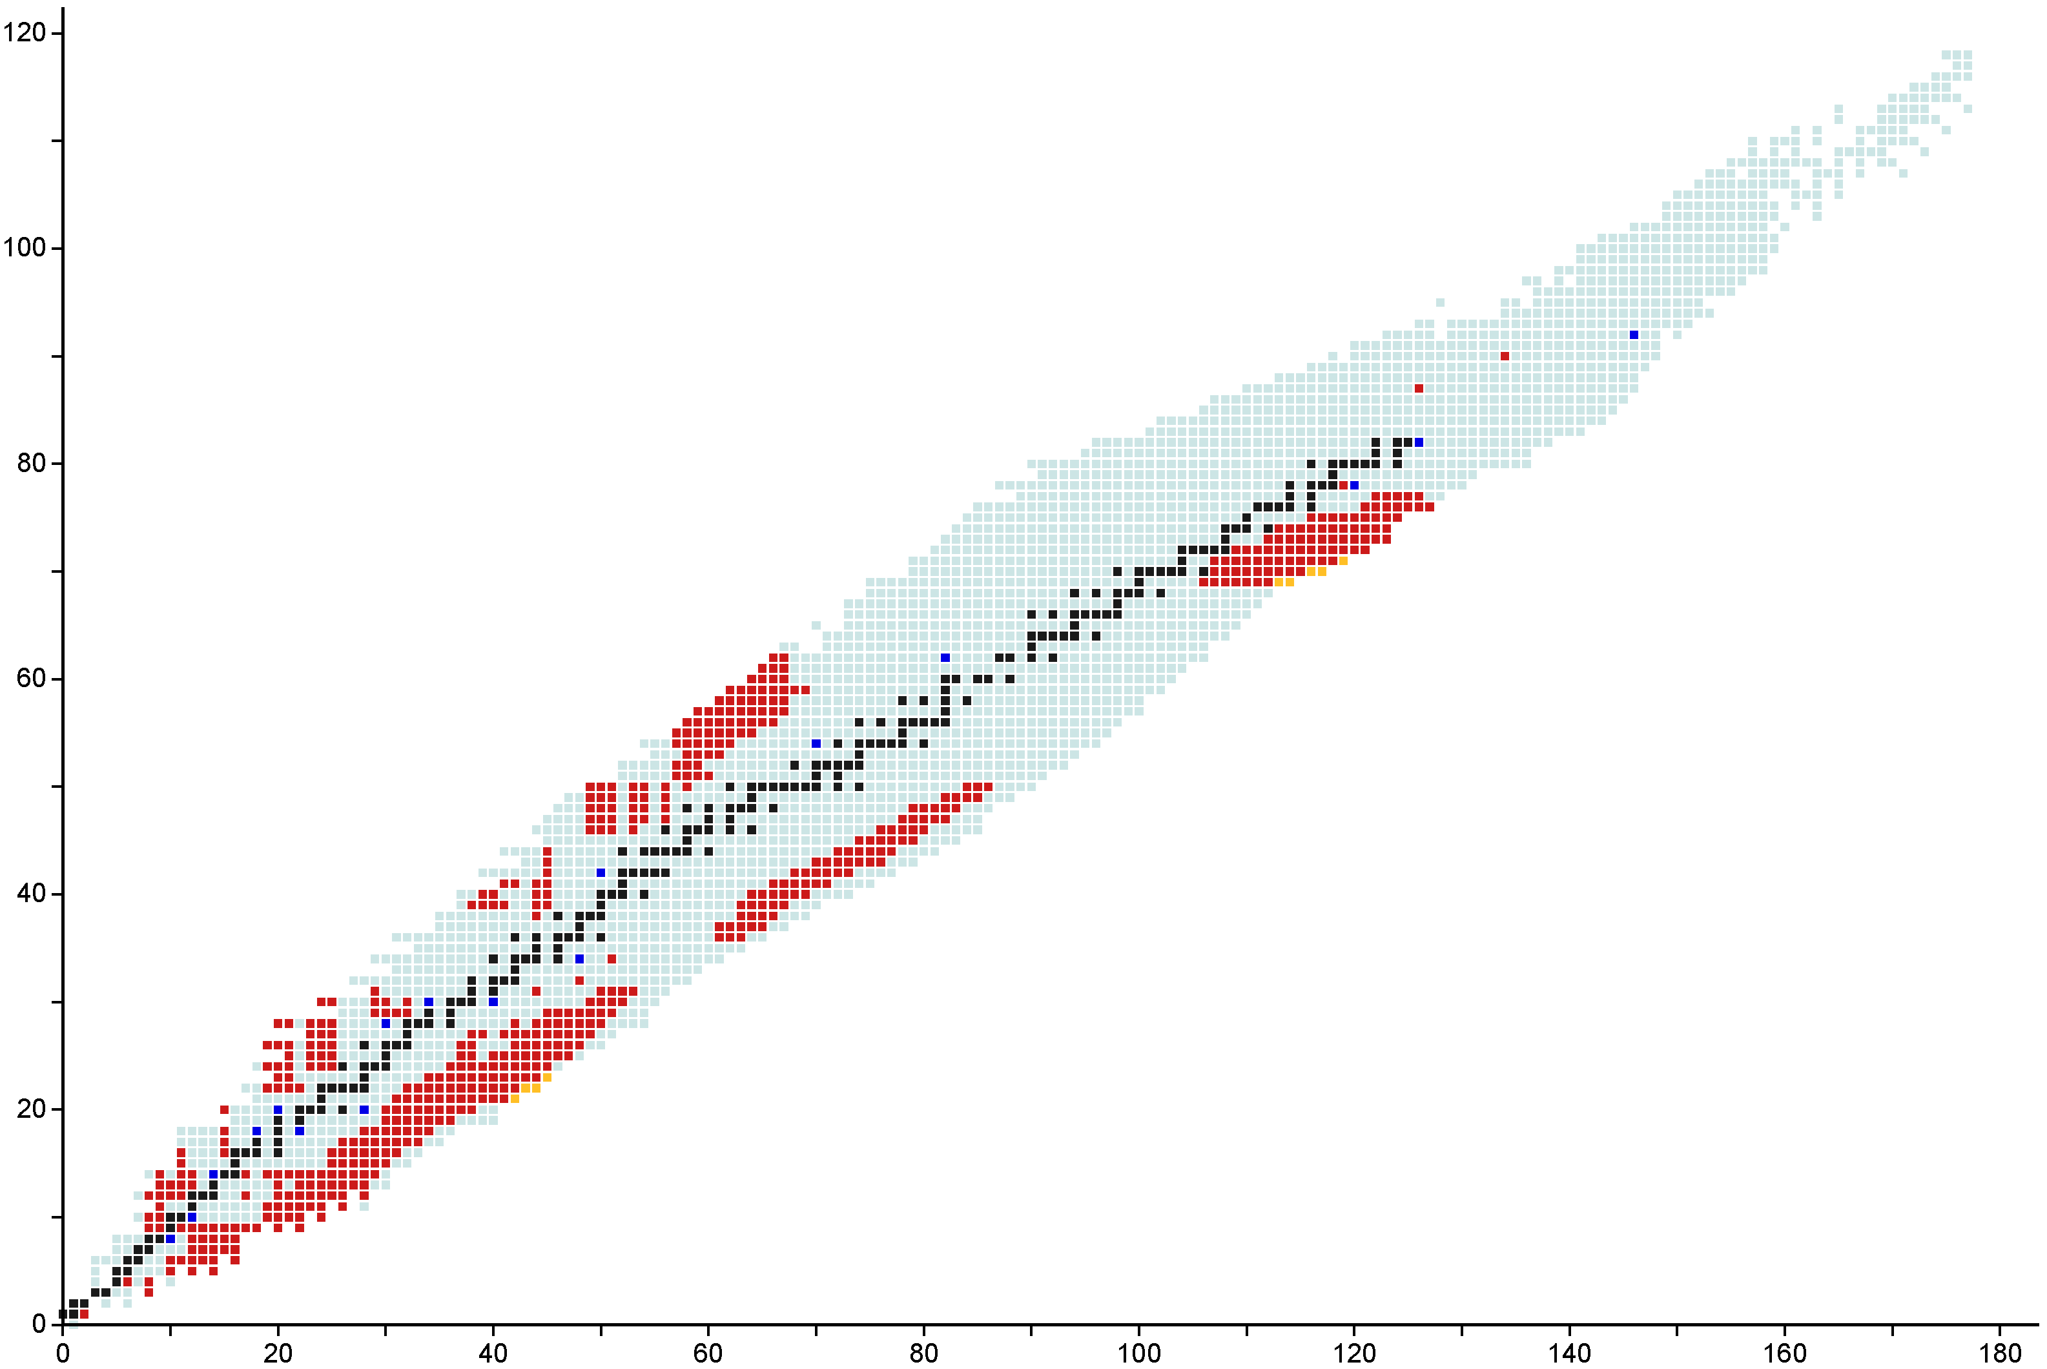
Completed NI experiments — analysis / publication preparation
04/2026
E21080
FDSi
Protons
07/2026
E23064
FDSi
03/2026
E23071
FDSi
²³⁸U
²⁰⁸Pb
¹⁴⁴Sm
^{182,183}Tm, ^{186,187}Yb, ¹⁹⁰Lu
Stable isotopes
Primary Beams
2024
E21069
E23055
FDSi
Observed isotopes
⁸²Se
Experiments at FRIB
Discovered at FRIB
Data Date: 2026-04-21
⁶³Sc, ^{65,66}Ti, ⁶⁸V
Neutrons

Slide 20
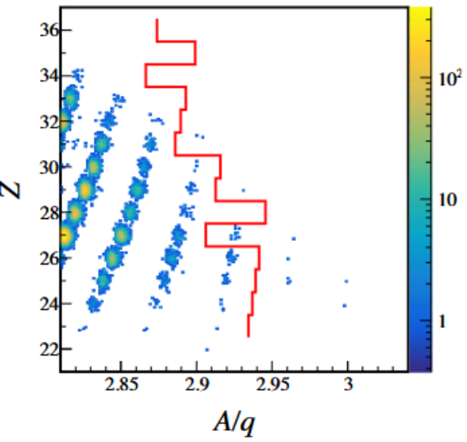
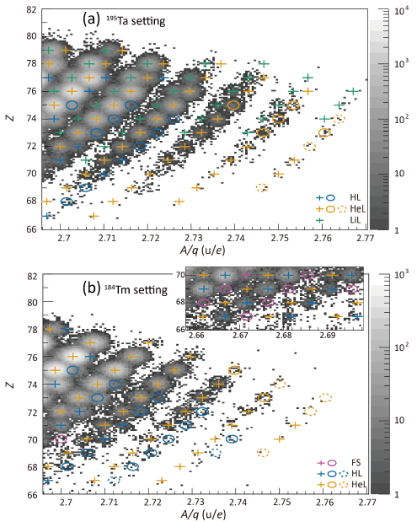
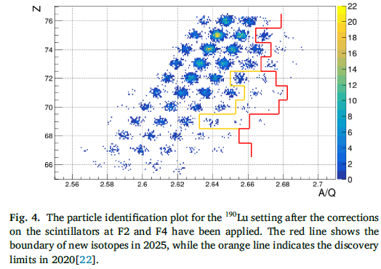
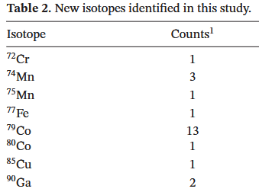
“New isotope” rush
Just before the Spring 2026 FRIB FDSi campaign
MDT in fall 2025
Prog. Theor. Exp. Phys. (2026) 061D01
Received: 29 December 2025
Published: 14 May 2026
Corrected and typeset: 16 June 2026
Prog.Theor. Exp. Phys. 2026, 033 (2026).
S.Pietri et al., Phys. Lett. B 880 (2026) 140729
Experiment done in April 2020
Received 13 March 2026;
Received in revised form 6 July 2026;
Accepted 6 July 2026
40 → 10 → 5 → 0

Slide 21
E21069, 23055: ⁸²Se, 20 kW
publication in preparation

Slide 22
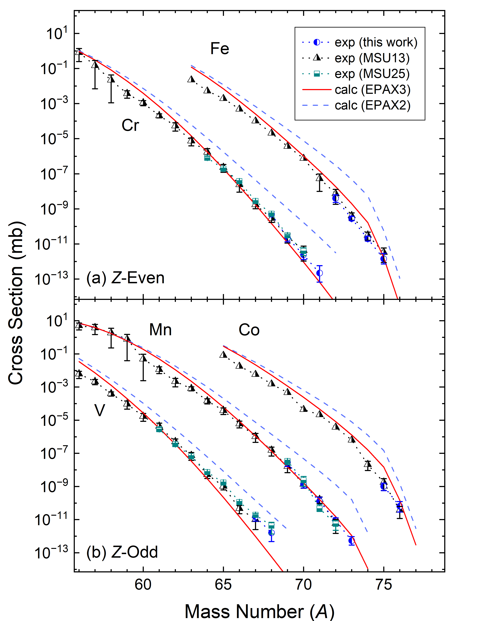
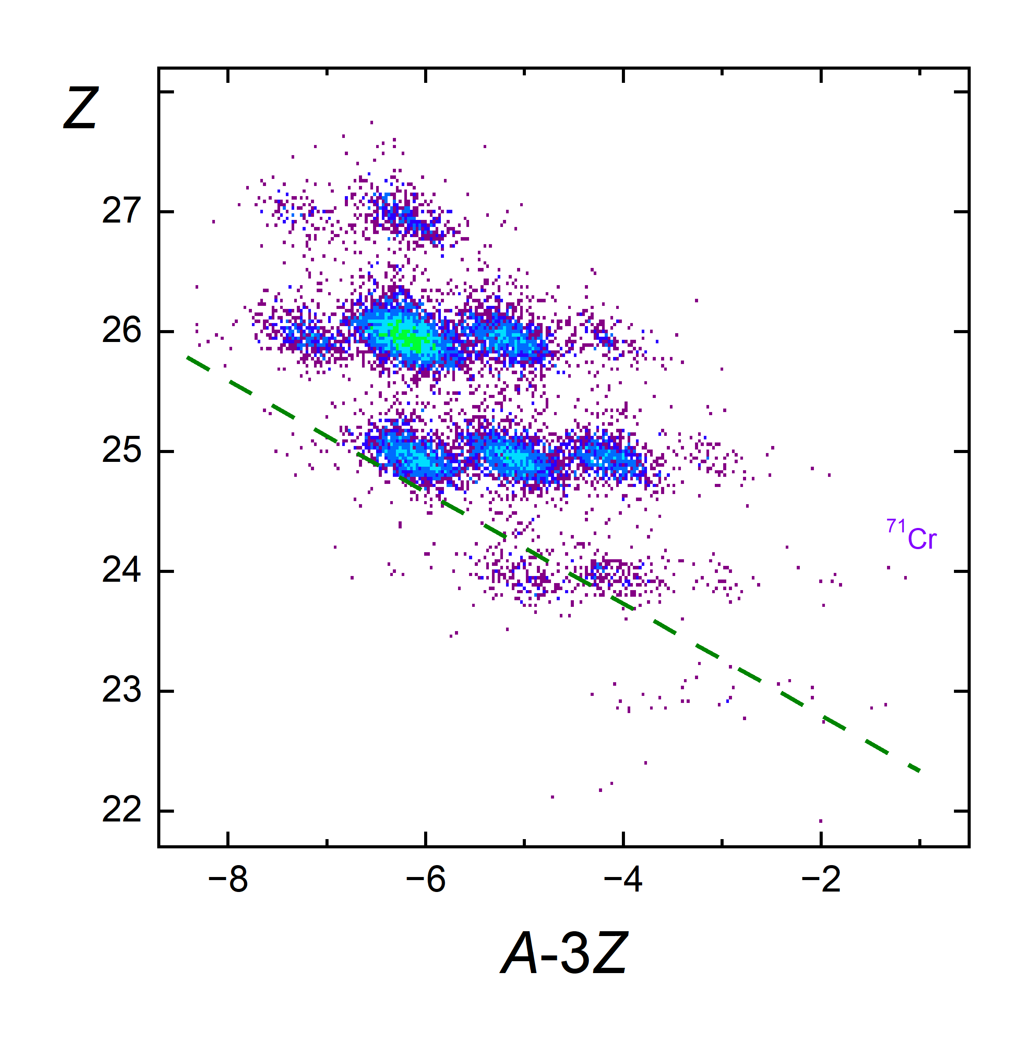
Observation of ⁷¹Cr
PhD student: Shane Watters
With ⁸²Se at 225 MeV/u on an 8 mm C target 2 events of ⁷¹Cr were observed in approximately 40 hours at 550 pnA
2 events meet all PID criteria and probability of misidentification is <10⁻⁸
⁷¹Cr is interesting because many models have it weakly bound or even unbound – stability is related to N=50 shell closure
@ ARIS
Preliminary

Slide 23
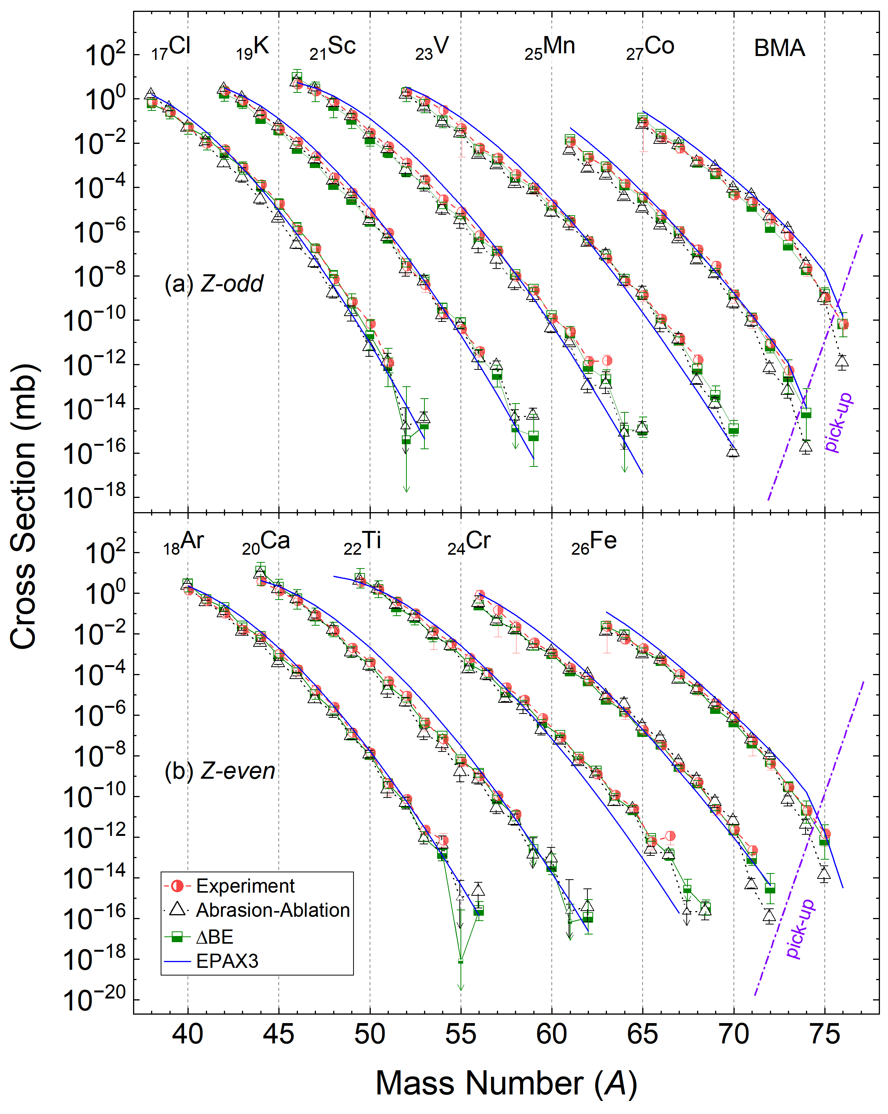
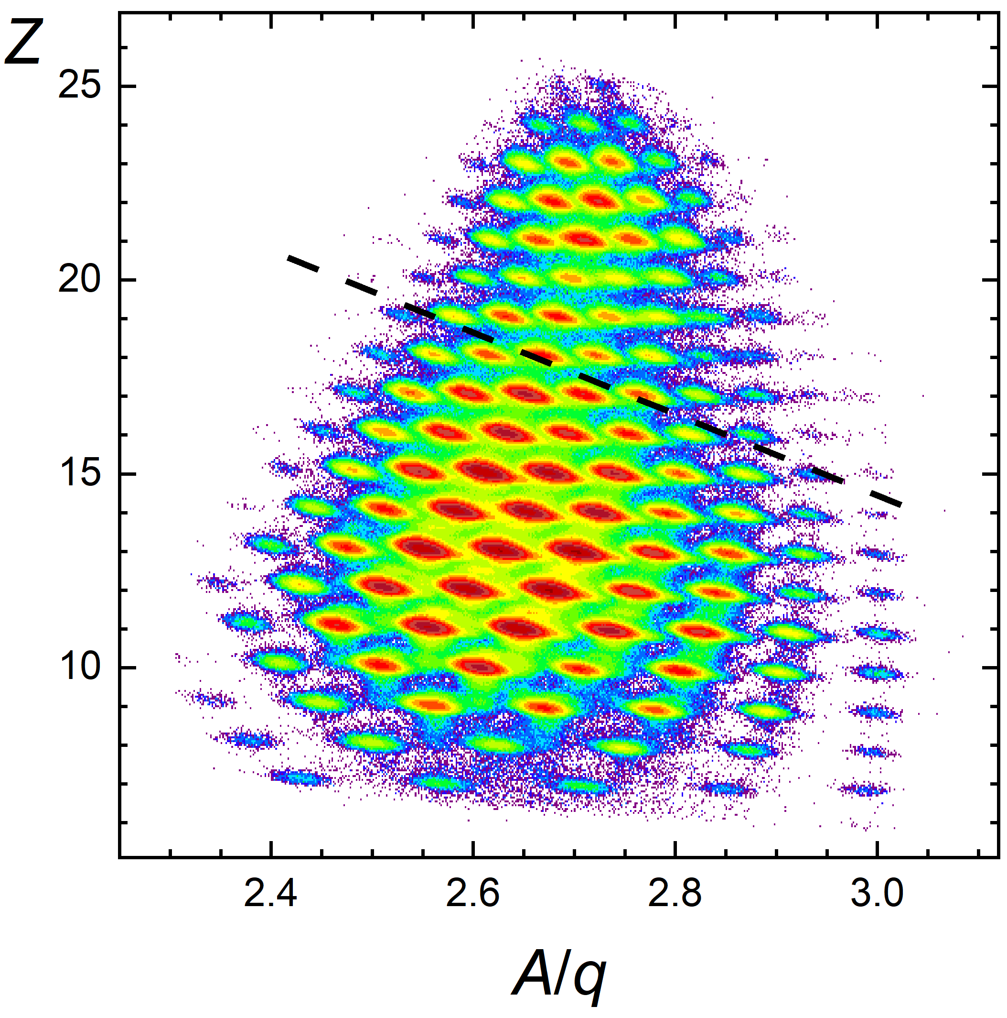
Production Cross Sections: Bayesian Model Averaging of AA and ΔBE
Production cross sections were analyzed using AA and ΔBE calculations with 11 nuclear mass tables
BMA distributions were obtained by combining the AA and ΔBE results using the derived model weights
The resulting uncertainties are important for planning future exploration of unknown regions of the nuclear chart
@ FDSi
PhD student: Shane Watters
More details, including ⁴⁶Si production, next week at GANIL

Slide 24
Spring 2026 FDSi Campaign

Slide 25
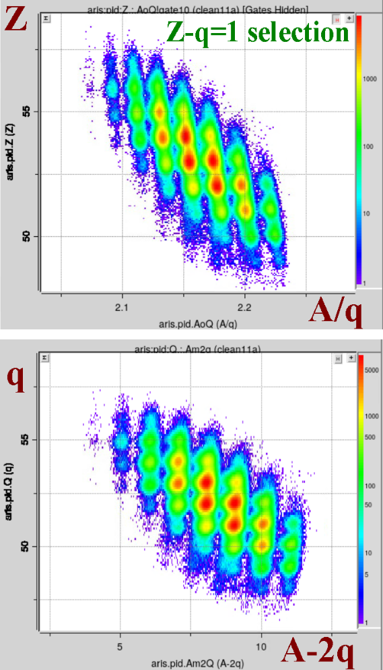

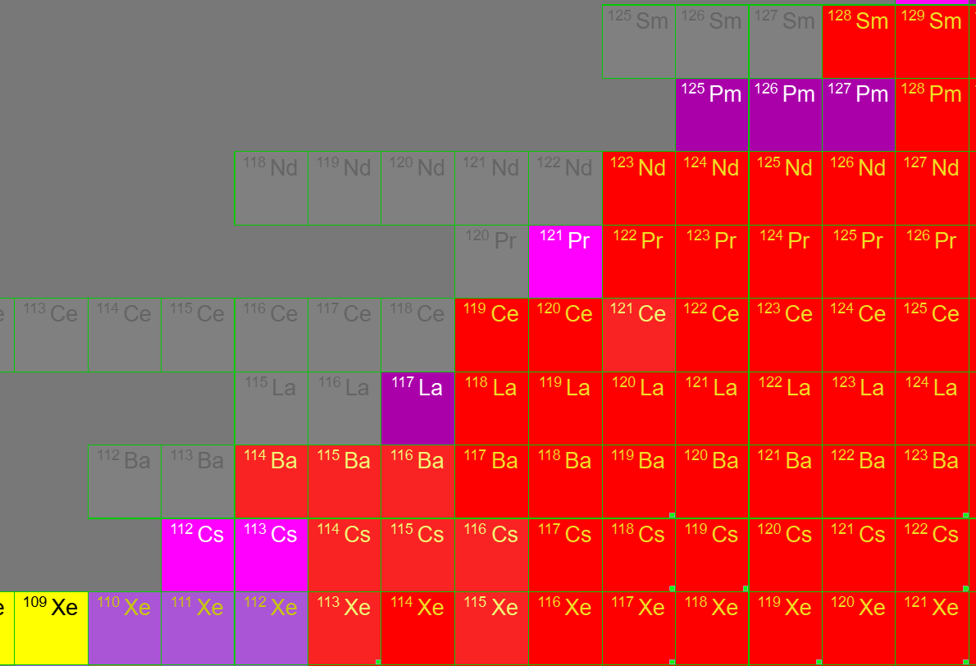
E23071: ¹⁴⁴Sm
The Study of Proton-Rich Isotopes Along the Proton Drip-Line above ¹⁰⁰Sn
Spokesperson: Seweryniak, Dariusz
Co-spokespersons: … ,Tarasov, Oleg
Completed: 03/16/2026
¹⁴⁴Sm(222 MeV/u, 20 kW) + C (3.5 mm)
PhD student: Holly Mathews
The A-Z-q PID method (using TKE) is essential to overcome charge-state ambiguities
  Charge-state selection: q=Z after the target, then q=Z-1 after each of the two wedges and two material layers
Experiment planning based on BMA predictions
  New isotopes were observed with preliminary production cross sections close to the BMA-inspired predictions and significantly below EPAX3 predictions
Successful search for new isotopes
  Highlights the facility’s discovery potential, which will continue to grow as the beam current increases
FRIB
RIKEN
Protons
Preliminary
FRIB has discovered at least 7 isotopes that were unknown at the time.

Slide 26
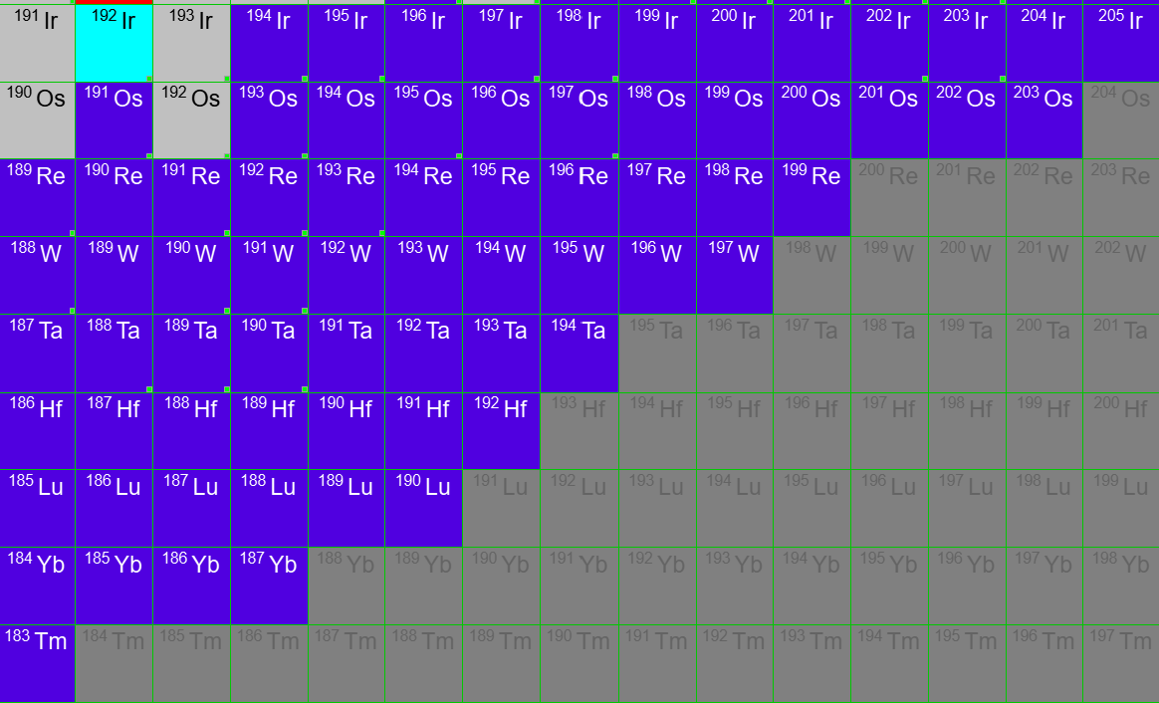
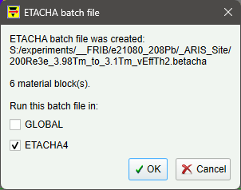
E21080: ²⁰⁸Pb
Decay spectroscopy in the vicinity of the N=126 shell closure
Spokesperson: Wu, Jin
Co-spokespersons: Estrade, Alfredo Tarasov, Oleg
Completed: 04/10/2026
²⁰⁸Pb(188 MeV/u, 20 kW) + C (3.5 mm)
PhD student: Daniel Kaloyanov
The A-Z-q PID method (using TKE) is essential to overcome charge-state ambiguities
  Initial charge-state selection (5 days): q=Z-2 after all materials
  Last day:
    q=Z-2 after the target
    then q=Z-3 after each of the two wedges
    and two material layers
  GLOBAL overpredicts
  the fully-stripped charge states
  Final charge-state selection established
  with ETACHA4
Preliminary
Call from LISE
output: CSV file, …
FRIB
GSI
RIKEN
FRIB has discovered at least 11 isotopes that were unknown at the time
More details next week at GANIL

Slide 27
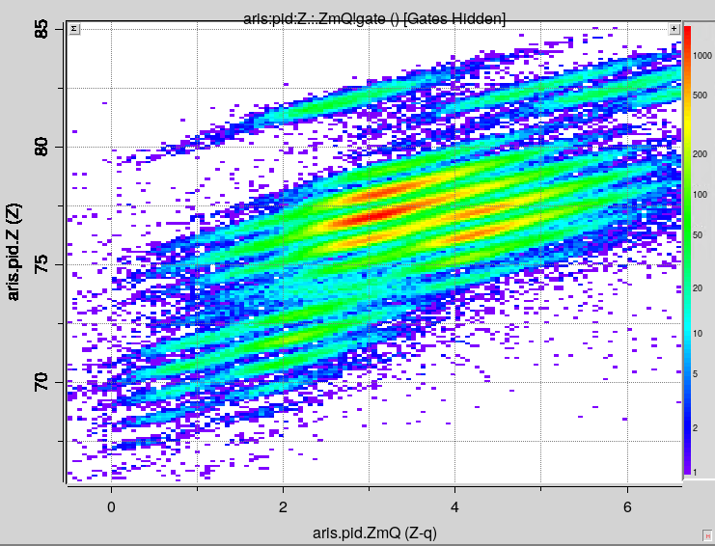
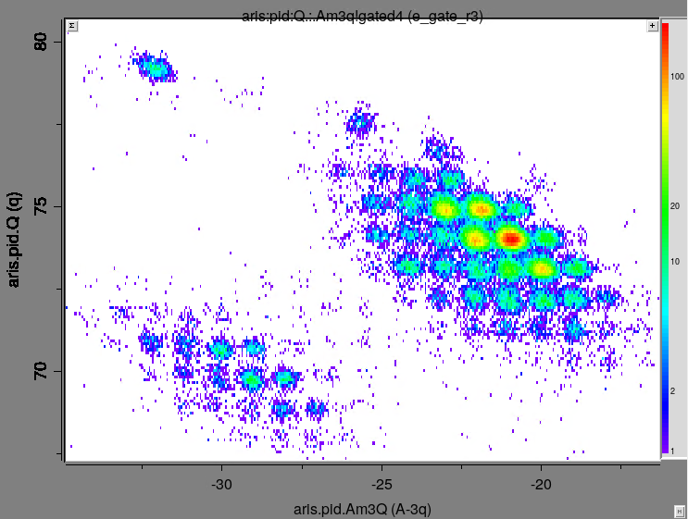
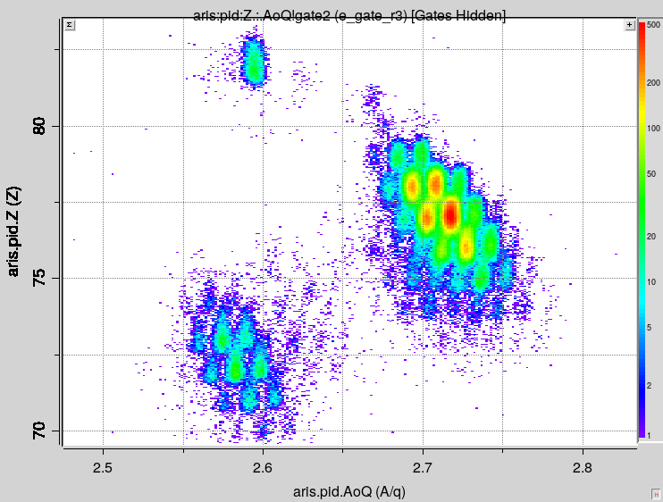
E21080: ²⁰⁸Pb → PID
σ(Z)=0.24
σ(q)=0.17
PhD student: Daniel Kaloyanov
σ(A-3q) = 0.15
Z-q=3 selection
Z
q
Z
Z-q
A-3q
A/q

Slide 28
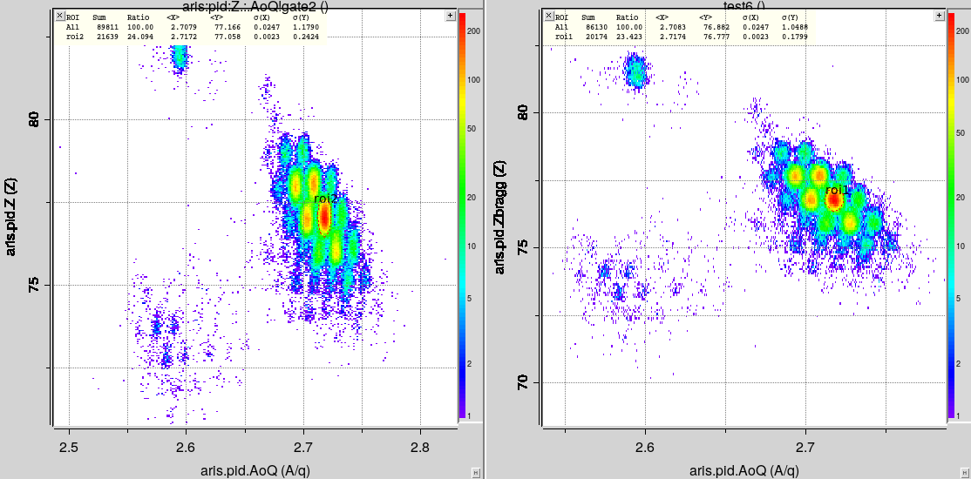
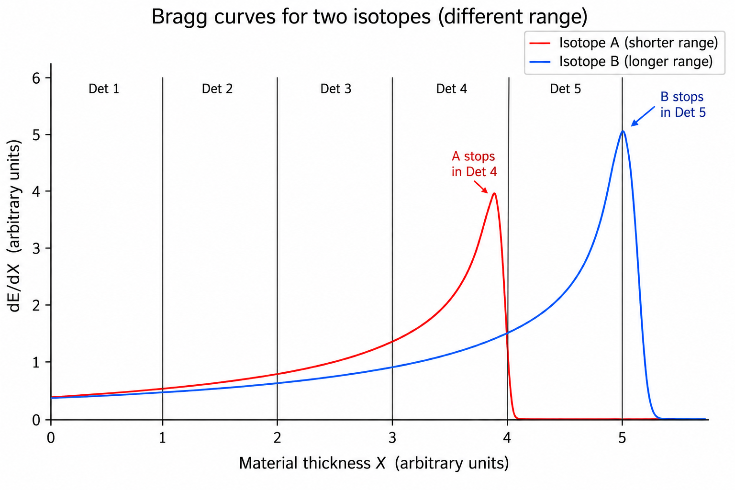
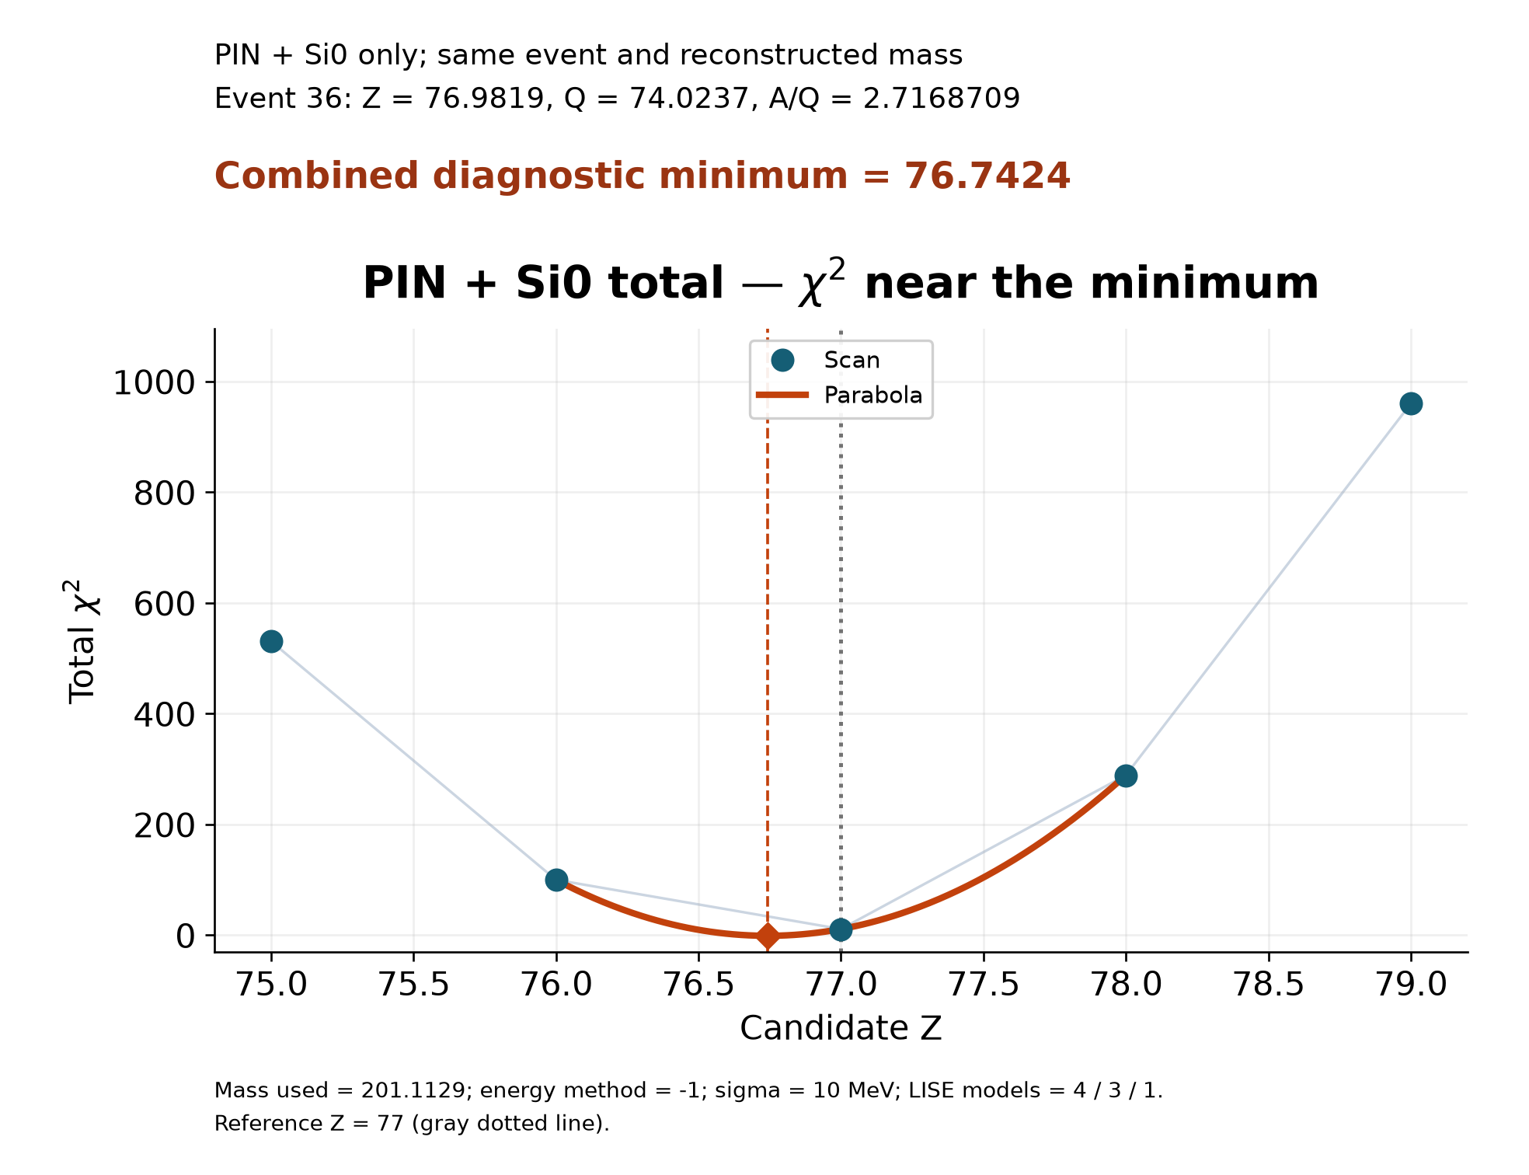
New component for PID : Z_{Bragg}
LISE⁺⁺ library integration with SpecTcl (FRIB DAQ)
  Charge state, energy loss, ranges, masses, etc.
The Si-telescope measures the energy-loss pattern through several detector layers and the implantation detector.
The complete profile contains more information than a single ΔE measurement: its amplitude, shape, range, and stopping position all depend on the ion and its entrance energy.
Two reconstruction
options
  Machine learning
  Constrained
  minimization
original
Z_{Bragg}
σ(Z)=0.24
σ(Z)=0.18
PhD student: Daniel Kaloyanov
More details next week at GANIL

Slide 29
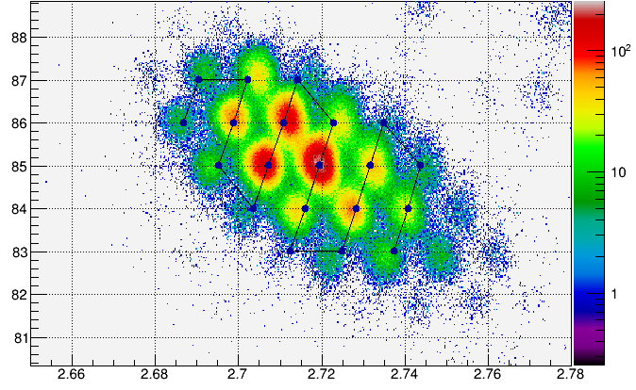
E23064 : ²³⁸U
Seniority Isomers and Single-Particle Evolution in ²¹⁸⁻²²²Pb Region: New Isotopes, Isomers, and Half Lives
Spokesperson: Allmond, Mitch
Co-spokespersons: … ,Tarasov, Oleg
Completed: 07/14/2026
²³⁸U(193 MeV/u, 20 kW) + C (2 mm)
Courtesy of Tim Gray
Z vs. A/q gated on Z-q=3
The A-Z-q PID method (using TKE) is essential to overcome charge-state ambiguities
  Charge-state selection
    q=Z-2 after the target
    then q=Z-3 after each of the two wedges
    and two material layers
The experiment with DEGAi(4pi)-XSiSi (first campaign of both configurations of FDSi) successfully separated multiple charge states in the neutron-rich Pb region (spanning Pb to Ac) — a major milestone for FDSi capabilities at FRIB.
Several new gamma-decaying isomers and several new isotopes have been discovered. Further, several new ground-state half-lives have been measured for the first time.

Slide 30
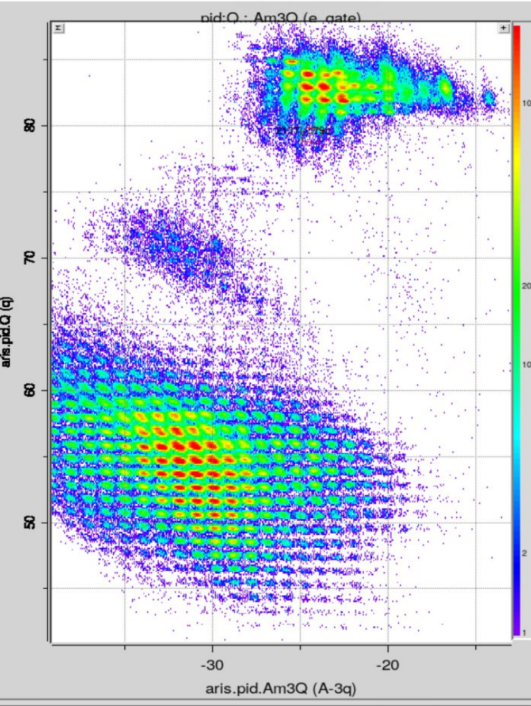

²³⁸U : Fragment Production in Materials
q
With reactions in the production target only, LISE⁺⁺ predicts essentially no fission fragments reaching DB5
²³⁸U → ²¹⁸Pb @ ARIS
When reactions in the wedges are included, the observed fission-like component can be reproduced
LISE⁺⁺ Power Deposition calculations are shown on the right
No primary target-fission products survive to DB5
The fission-like fragments observed at DB5 are produced in downstream materials
The dominant contribution comes from reactions in the second wedge
An important feature of next-generation high-intensity rare-isotope facilities
What is origin?
A – 3q
https://lise.frib.msu.edu/17/18_00_25_ReactionsInWedges.pdf
No primary fission products at DB5

Slide 31
Towards 400 MeV/u

Slide 32


FRIB Energy Upgrade (FRIB400)
400 MeV/nucleon for U and higher energies for lighter beams
FRIB400 will:
Enable significant gains in isotope yields, nearly doubling the reach of FRIB along the neutron dripline and bringing into reach more nuclei relevant for the r-process and neutron-star crust processes
Create dense nuclear matter of up to twice saturation density, critical for multi-messenger astrophysics
Provide up to two-orders-of-magnitude increase in luminosity for spectroscopy in key regions of the nuclear chart
Expand the scientific impact of harvested isotopes by increasing the available yield of many isotopes by 10 times
The FRIB400 project’s doubling of the energy available at FRIB would not only increase reaction rates by employing higher luminosities but also would enable new reaction mechanisms to be used 4.6 What Happens When Nuclei Collide?, 2023 LRP
Finally, a timely energy upgrade of the recently completed Facility for Rare Isotope Beams (FRIB400) offers a golden opportunity to use the collision of heavy ions to probe the equation of state in regions of critical importance for multi-messenger astronomy. Sidebar 5.2 Neutron Star Inspired Density Ladder, 2023 LRP
Space in the FRIB tunnel for the needed 11 cryomodules –
lends itself to staged implementation
FRIB400 Whitepaper (2023 update) linked from: frib.msu.edu/frib400

Slide 33

Impact of higher energy and target design to multi-step production
Upgrading FRIB to 400 MeV/u makes it possible to increase the production probability of neutron-rich isotopes in multi-step reactions by an order of magnitude
Target production research: Use a liquid lithium target to increase the multi-step factor
FRIB-2025
scaled from
I=20 kW
T= 1 day
dP/P = 4%
1 week run
⁶⁶Ca @ E200 ~ 1 event: C-target
⁶⁸Ca @ E400 ~ 1 event: C-target
⁷⁰Ca @ E400 ~ 1 event: Li-target

Slide 34

$${LISE}_{cute}^{++}$$

Slide 35

${LISE}_{cute}^{++}$ : from reaction mechanisms to experiment-ready predictions
Reliable prediction of rare-isotope production
  Fragmentation, Abrasion–Ablation and Abrasion–Fission
  Multi-step reactions, nucleon pickup
  Excitation-energy, evaporation, breakup and fission modeling
  Production cross-section systematics and mass-model dependence
Recent reaction-model developments
  Improved Abrasion–Ablation energy redistribution and de-excitation
  Abrasion thermalization treatment revisited and numerically validated
  Angular-momentum dependence introduced into de-excitation
  Improved treatment of secondary-reaction cross sections
  Continued development of cross-section minimization and uncertainty studies
Realistic modeling of the complete separator
  Optics, wedges, slits, charge states, multi-step reactions and material interactions
  Transmission, power deposition and prompt-radiation estimates
  Optimization based on the actual experimental configuration
Goal: not simply predict a production cross section — predict the beam that reaches the experiment

Slide 36

${LISE}_{cute}^{++}$ : toward automated and AI-assisted experiment design

Slide 37

${LISE}_{cute}^{++}$ : toward automated and AI-assisted experiment design
Automation: Silent Mode and batch processing
  Large sets of LISE files calculated automatically
  Command-line transmission, tuning, energy calculations,
  deposition and radiation studies
  Batch logging and reproducible calculation workflows
  Python/Excel post-processing for systematic rate studies
An expanding LISE⁺⁺ ecosystem
  ETACHA4 — non-equilibrium charge-state evolution
  GLOBAL — charge-state calculations and optimized transmission
  GEMINI⁺⁺ — statistical de-excitation
  IsomerAPI — isomer and γ-ray information
  Direct integration of these tools into experiment-planning workflows
  Beam dump, Prompt-radiation, Radiation residue utilities
AI-assisted development
    Accelerating implementation, testing, and
    validation of new physics models
  LISE⁺⁺ AI Planning Agent
    Assists users with experiment-planning workflows
    Uses LISE⁺⁺ documentation, expert guidance, and examples of validated tunes
  LISE⁺⁺ AI Safety Agent
    Evaluates proposed separator settings against device limits
    Checks power deposition, beam size, and beam-dump constraints
  Toward reliable AI-assisted experiment design and optimization
workflow • documentation • expert guidance • validated tunes
device limits • power •
beam size • beam dump

Slide 38

${LISE}_{cute}^{++}$ : toward automated and AI-assisted experiment design

Slide 39
Summary & Acknowledgements

Slide 40
Summary
FRIB has already demonstrated strong new-isotope discovery capability at only a fraction of its ultimate beam power
New isotopes have been observed with ¹⁹⁸Pt, ⁸²Se, and in the 2026 FDSi campaign with ¹⁴⁴Sm, ²⁰⁸Pb, and ²³⁸U beams
Reliable searches increasingly require sophisticated particle identification, including A–Z–q analysis, isomer tagging, charge-state modeling, and Z_{Bragg} reconstruction
Production-rate predictions far from stability require uncertainties: ΔBE systematics and Bayesian model averaging provide a path beyond a single “best” reaction model
Multi-step reactions in the target and secondary reactions in wedges and other beamline materials become increasingly important at high-intensity facilities
Higher beam power, FRIB400, and optimized multi-step production will significantly extend access toward the limits of nuclear existence
LISE⁺⁺ is evolving from a separator-design code into an integrated, automated and AI-assisted framework connecting reaction mechanisms, realistic beam transport, experiment planning, and data analysis

Slide 41
Team & Acknowledgements
Fragment Separation Department
Ahn, Deuk Soon
Dombos, Alexander
Hausmann, Marc
Kahl, Daid
Kwan, Elaine
Portillo, Mauricio
Sherrill, Bradley
Smith, Mallory
Steiner, Mathias
Tarasov, Oleg
Accelerator Physics Department
Wei, Jie
Ostroumov, Peter
Fukushima, Kei
……..
New Isotope Research Group
ADS
BMS
OBT
Kaloyanov, Daniel - grad
Matthews, Holly - grad Richardson, Isaiah - grad
Watters, Shane - grad
Ray, Arjun - undergr
Miltner, Hudson - undergr
Additional acknowledgements
Prof. A.Gade, FDSi Collaboration
IRL NPA (CNRS–MSU/FRIB) — collaboration and travel support
This material is based upon work supported by the U.S. Department of Energy, Office of Science, Office of Nuclear Physics and used resources of the Facility for Rare Isotope Beams (FRIB), which is a DOE Office of Science User Facility, operated by Michigan State University, under Award Number DE-SC0023633. This work was supported by the US National Science Foundation under Grant No. PHY-20-12040, 23-10078.

