Slide 1
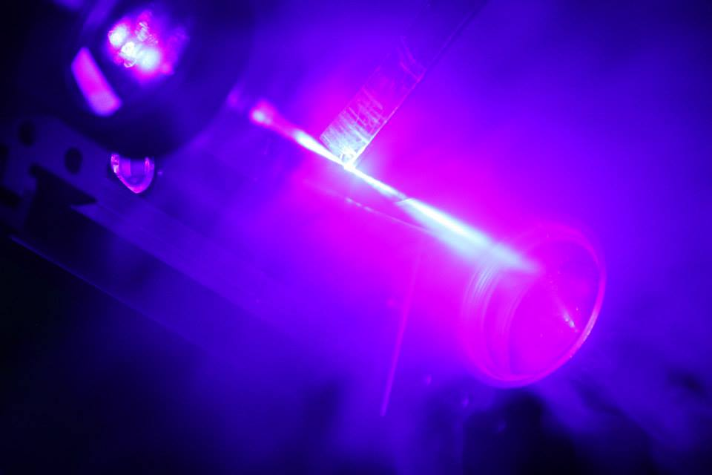
S³-Low Energy Branch: recent advances and future directions
Sarina Geldhof
on behalf of the S³LEB collaboration

Slide 2
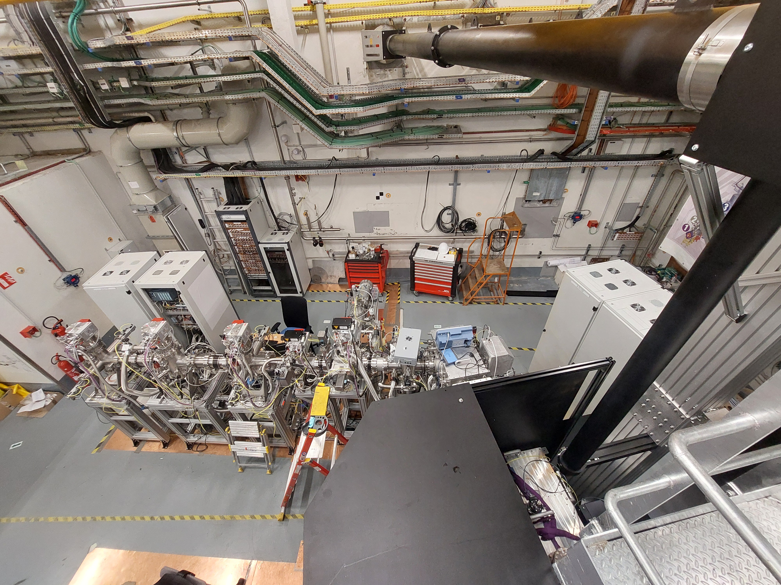
Outline
Technique and setup
S³LEB commissioning
Scientific programme
Ongoing projects
Conclusion and outlook

Slide 3
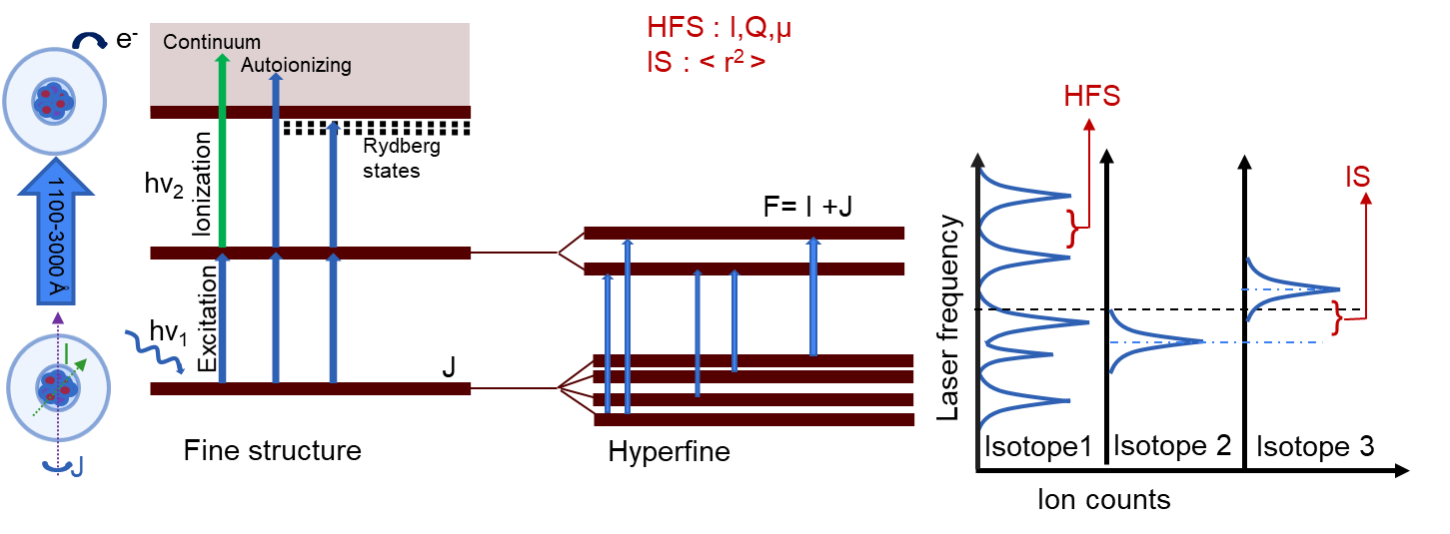

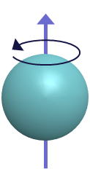
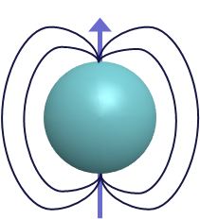
Resonant ionisation spectroscopy
Nuclear configuration/ shell model states
Isotope shifts
  Changes in rms charge radii
Hyperfine structures
  Nuclear spin
  Magnetic dipole moment
  Electric quadrupole moment
Identification of nuclear states
$ν_{F}=ν_{0}+Af\left(I,J,F\right)+Bg\left(I,J,F\right)$ $A=μ\frac{B_{e}}{\left|IJ\right|} B=eQ_{s}\left\langle \frac{∂^{2}V}{∂z^{2}}\right\rangle$
Static and dynamic deformation

Slide 4
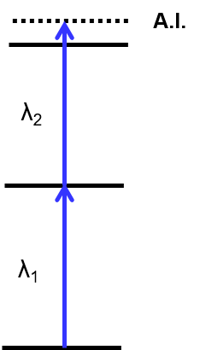
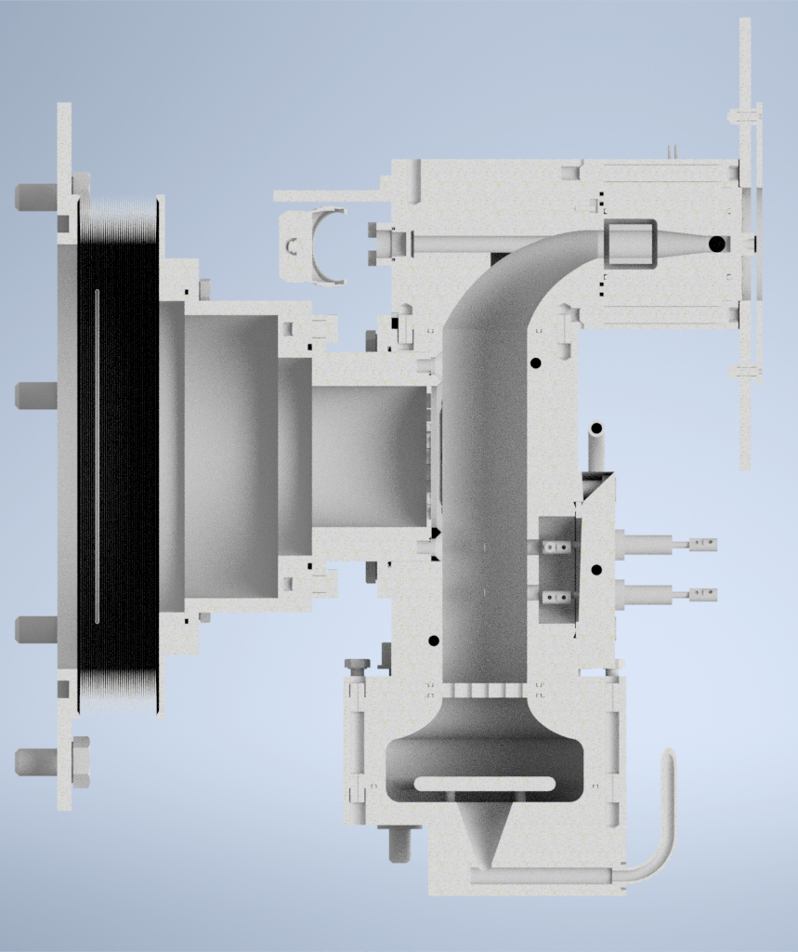
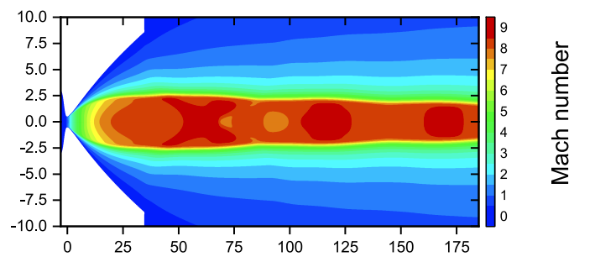
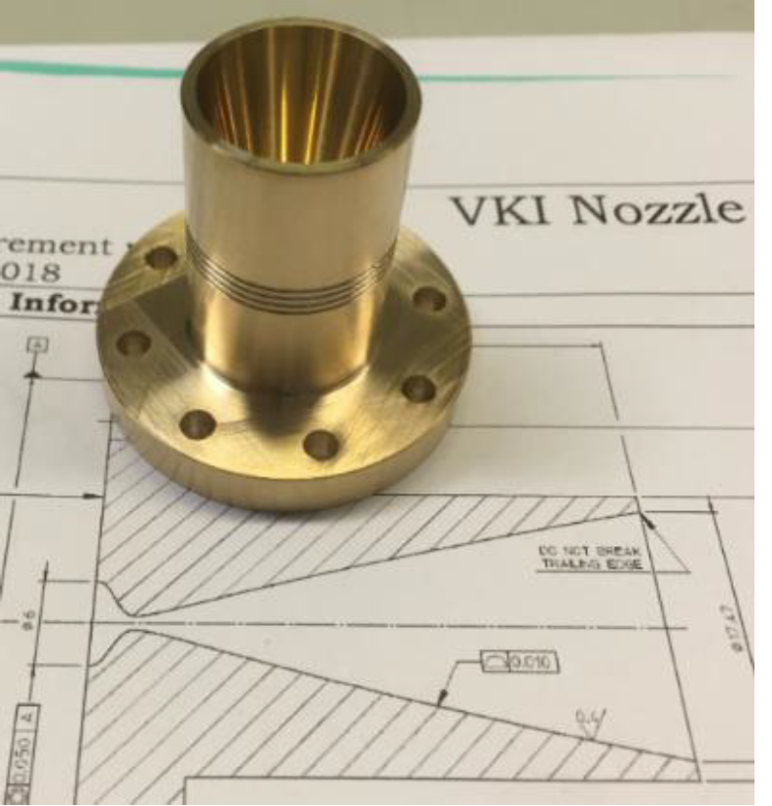
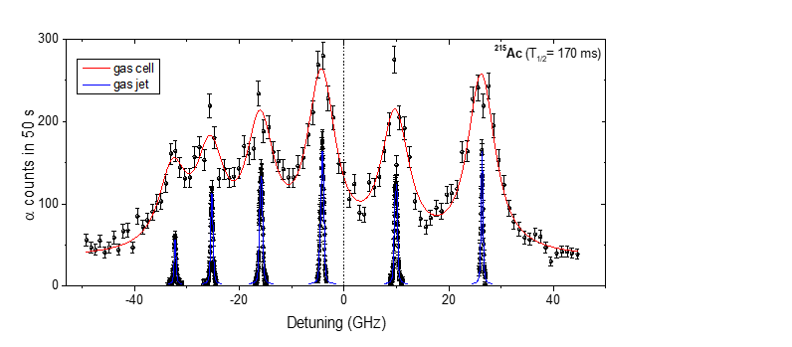
In gas cell / in gas jet spectroscopy
Gas jet laser probing
Gas cell
Broadening effects
Broadband laser (GHz)
Extraction time ~500 ms
de Laval Nozzle
Hypersonic gas jet : ρ ↘︎ T ↘︎
Narrowband laser (MHz)
Proof of principal @ LISOL
Gas cell laser probing
Decoupling of laser axis from spectrometer axis
Supersonic jet
S³ nuclei
Extraction by gas flow only
E< 1 MeV/u
Stopping, thermalization
and neutralization
Buffer gas at 100-500 mbar
Thin window
R. Ferrer, Nat. Comm. 8 (2017)

Slide 5
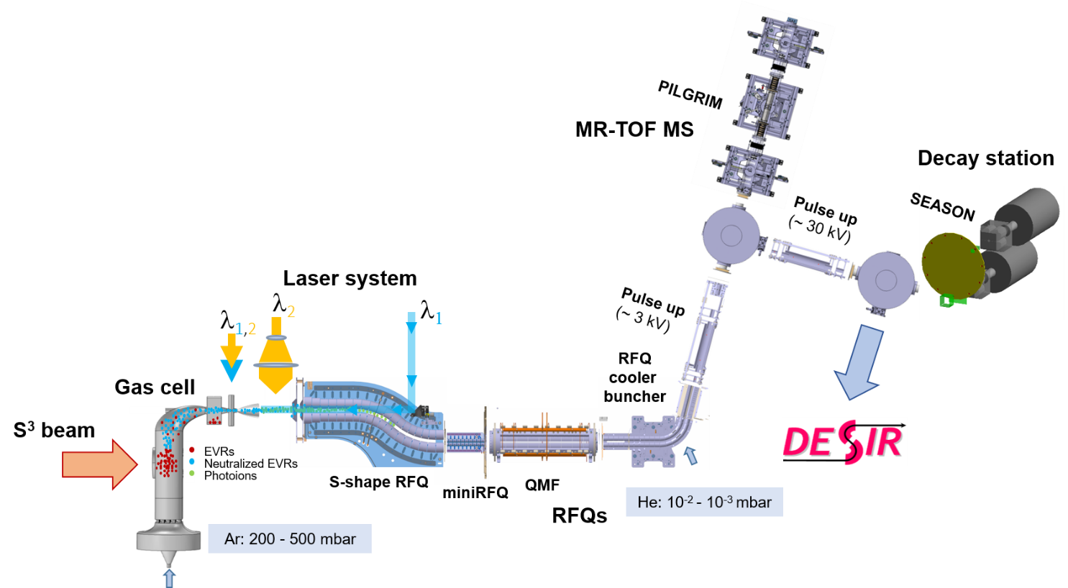
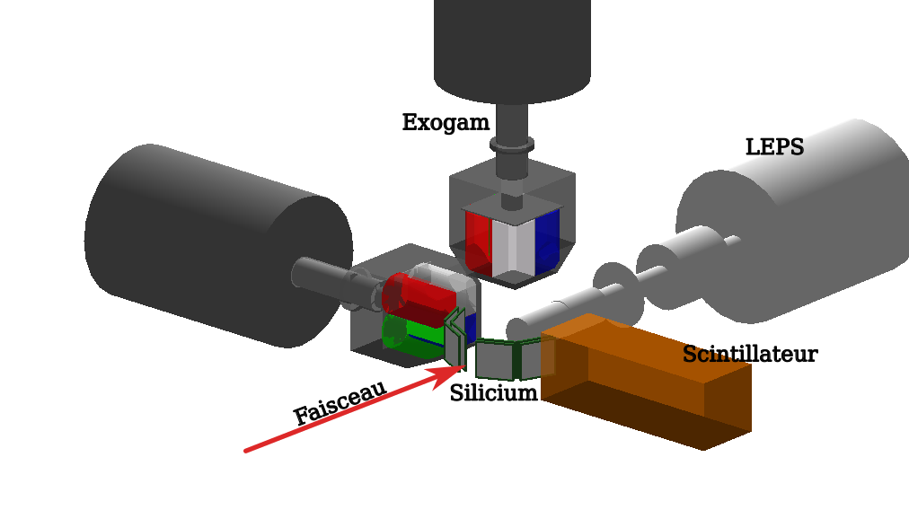
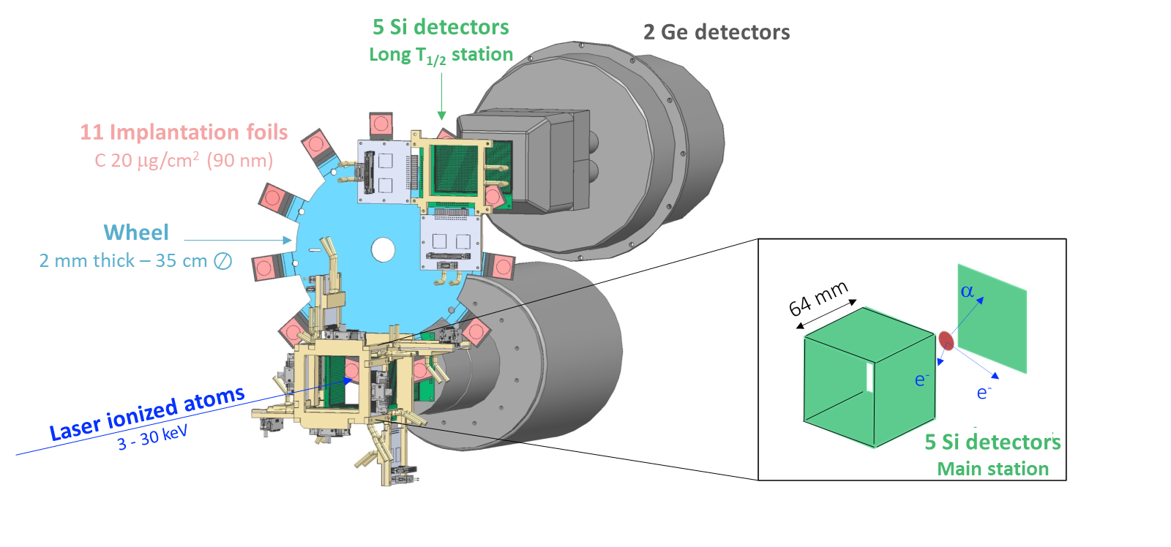
S³LEB
Laser spectroscopy on S³ products in a supersonic jet at intermediate resolution (~200 MHz)
Mass and decay spectroscopy measurements
IDEAS³
Low (or no)-background laser spectroscopy due to mass/decay-tagged counting
Low (or no)-background mass spectrometry and decay spectroscopy due to (very) selective ionisation
SEASON
A. Ajayakumar et al., NIMB 539 (2023)
J. Romans et al., Atoms 10 (2022)

Slide 6
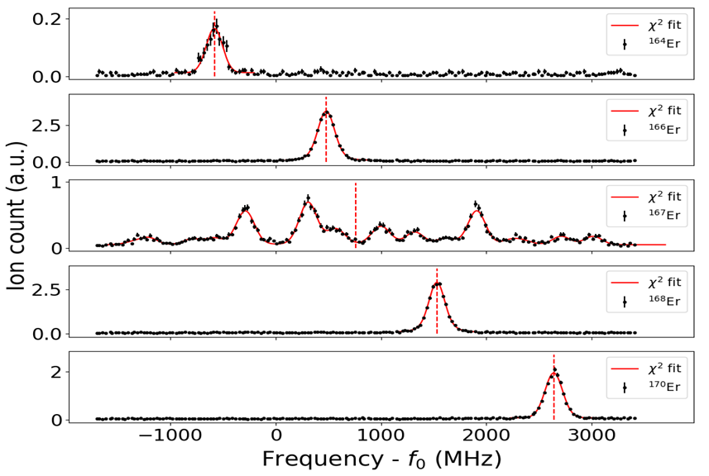
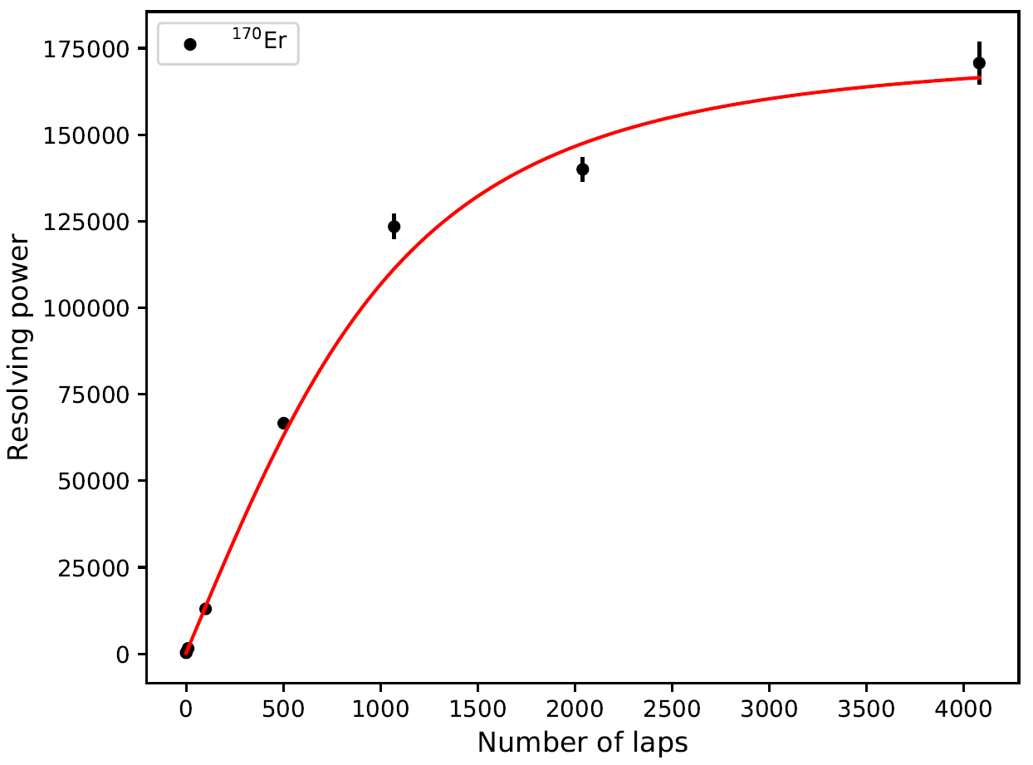
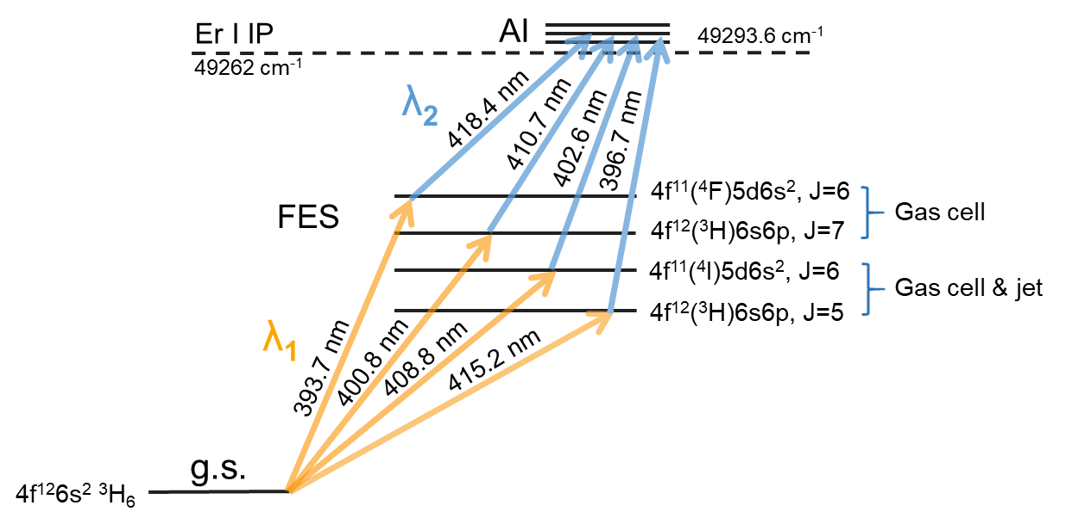
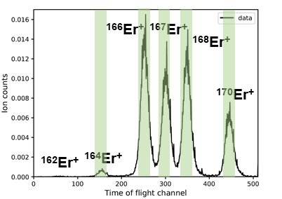
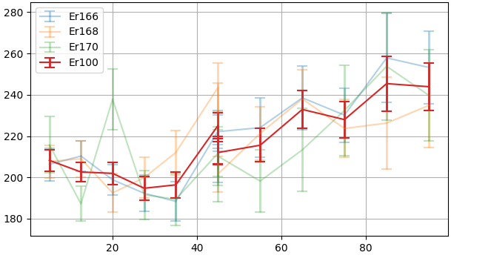
Offline commissioning LPC
Laser ionisation in the gas jet and mass separation with the PILGRIM MR-TOF-MS
Search for optimal laser-spectroscopy scheme for S³ commissioning with Er
R as a function of N_{laps}
PhD thesis W. Dong (IJCLab)
Systematic work to improve resolution by studying influence of:
Laser power and alignment
Background pressure
Gas cell position and temperature
Reached Mach 6-6.5 (~200 MHz FWHM), nozzle made for Mach 8
To be investigated further
FWHM (MHz)
Axial position in jet (mm)
PhD thesis F. Ivandikov (KU Leuven)

Slide 7
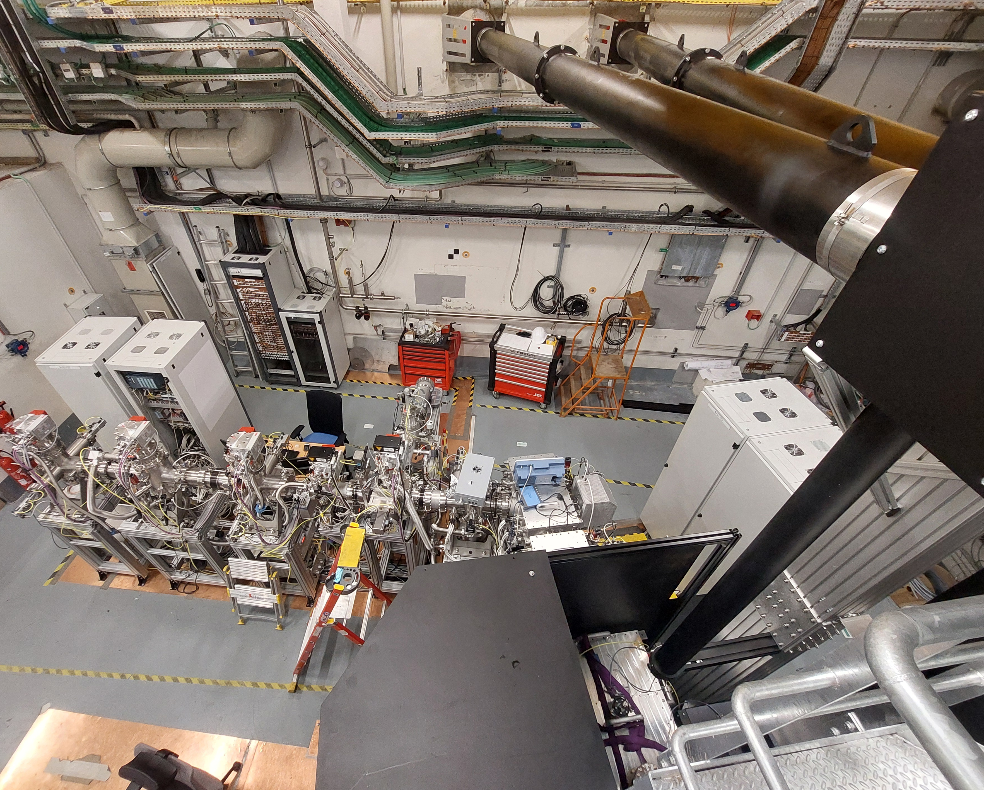
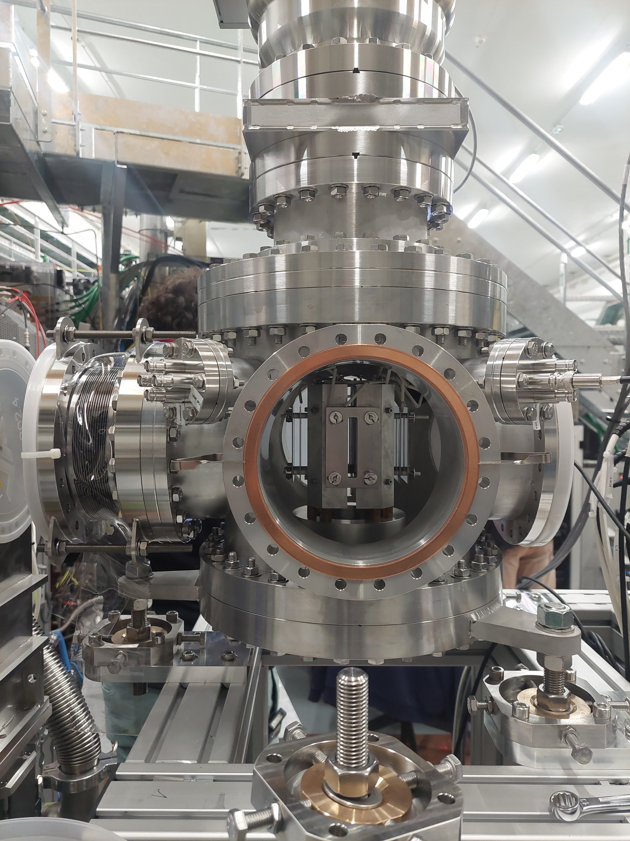
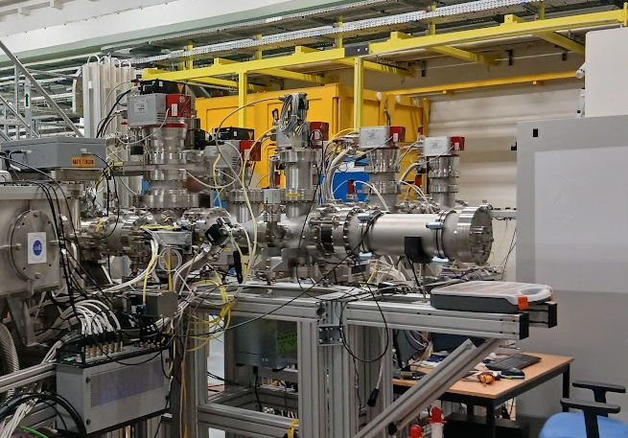
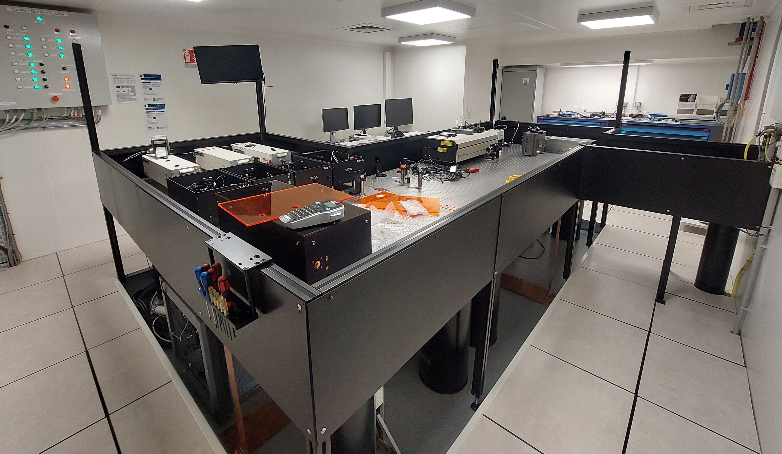
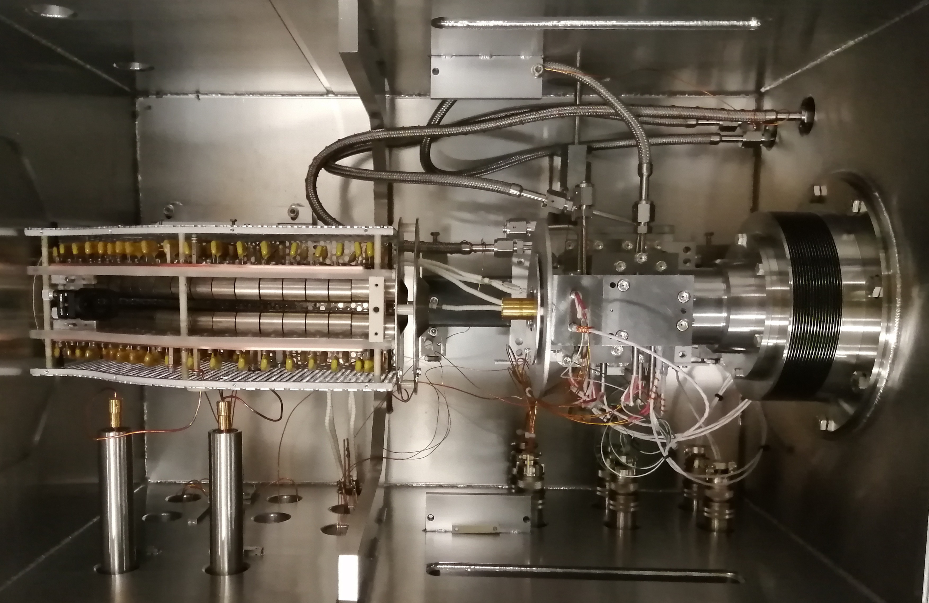
S³LEB restart at S³
2024: S³LEB moved to the focal plane of S³
  New laser room and laser transport set up
  90° bender and first part of beamline installed and tested to connect to PILGRIM and SEASON, DESIR,… in the future
  Transmission re-optimised with ¹³³Cs surface ion source
Connexion to DESIR still to be built

Slide 8
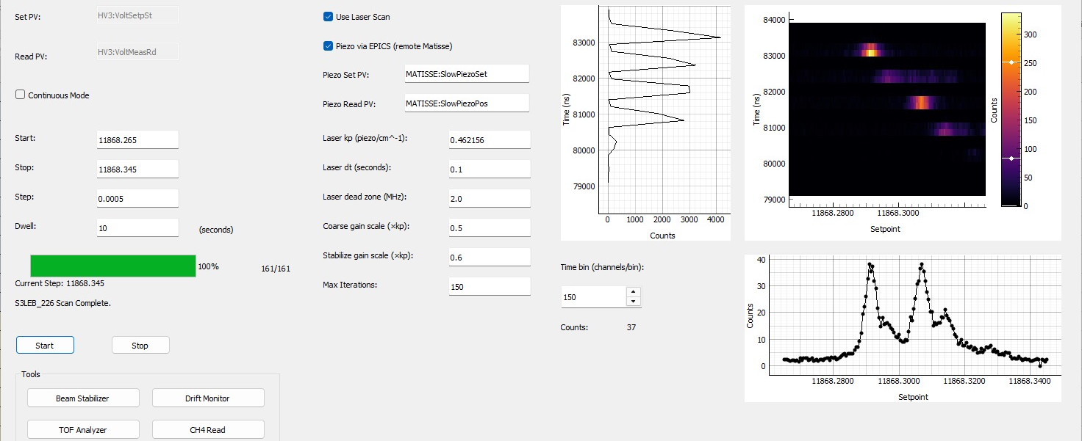
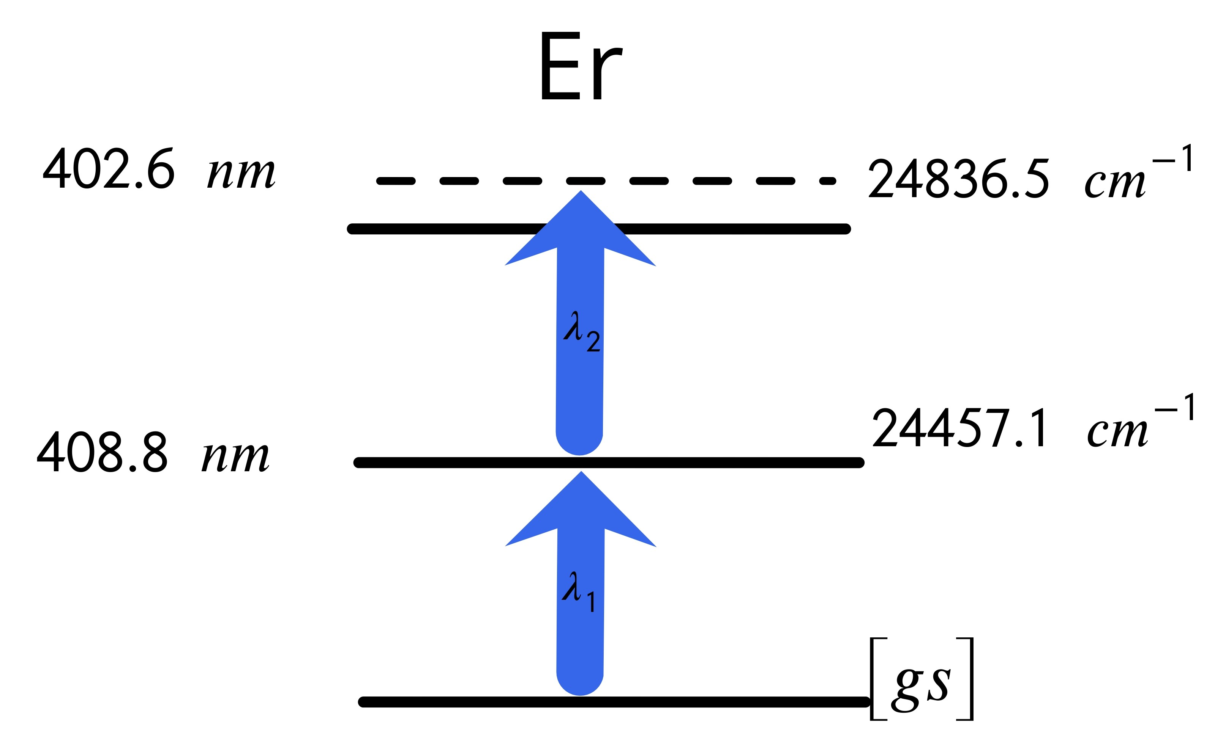
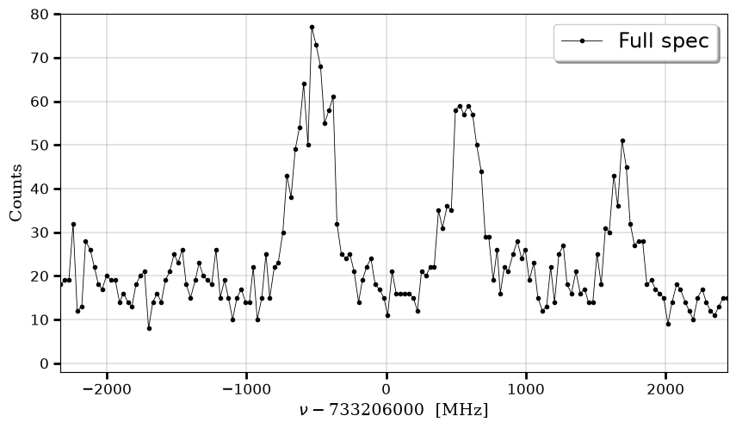
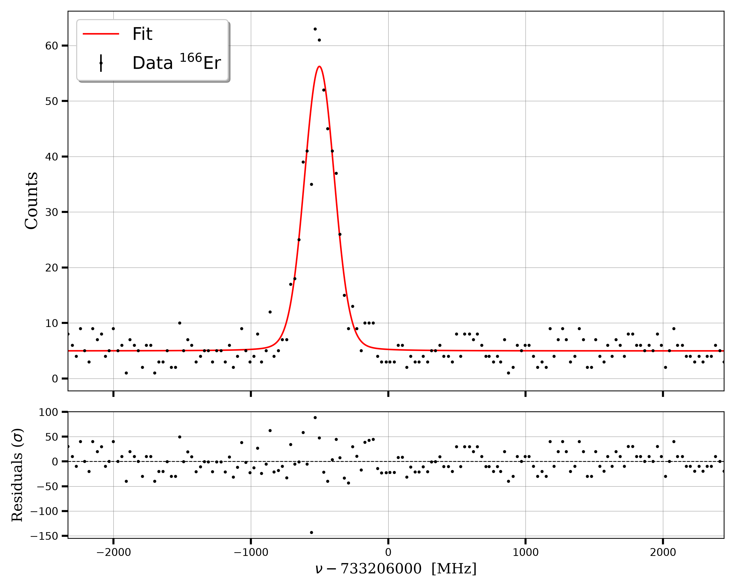
S³LEB restart at S³
Full control system implemented, including DAQ and laser scanning, using EPICS protocol and python interface
Tests to improve cooling and bunching performed
Re-optimisation of PILGRIM MR-TOF performed, and investigations ongoing to improve stability and time resolution
In-gas-jet spectroscopy re-established, with measurements of transitions in Er and Dy
Poster
S.V. Pineda
Poster
M. Brun
A.F. Lopez-Loaiza, M. Brun, et al., submitted to NIM. B
Talk A.F. Lopez-Loaiza

Slide 9
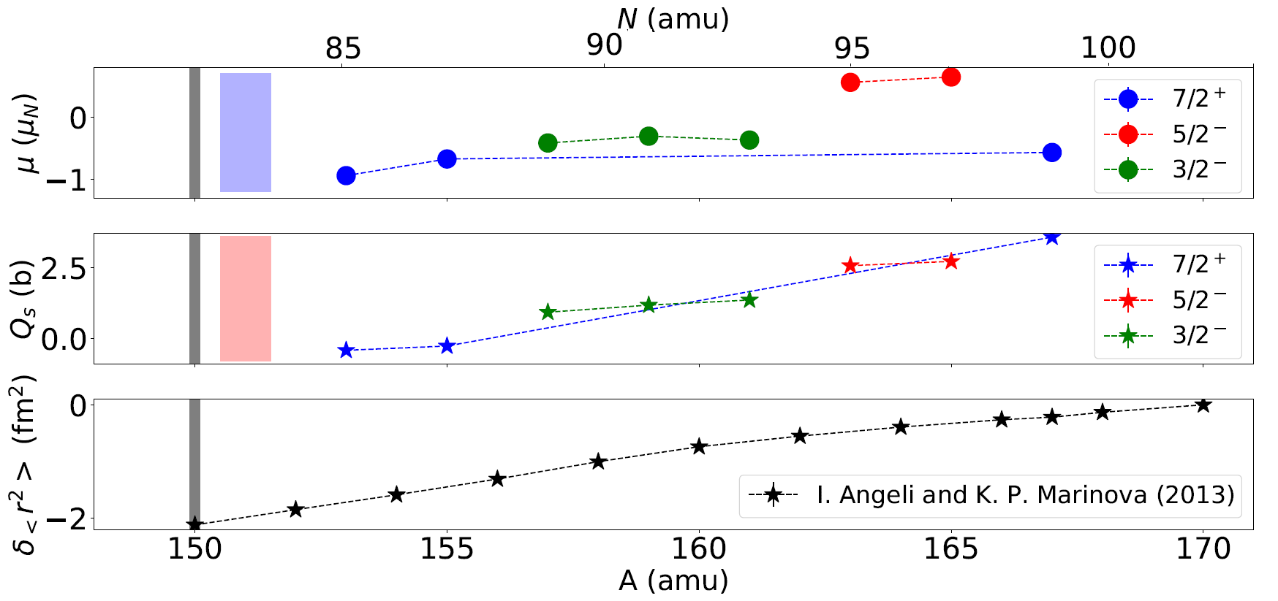
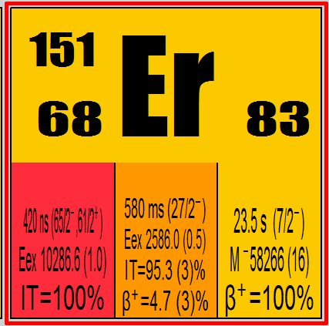
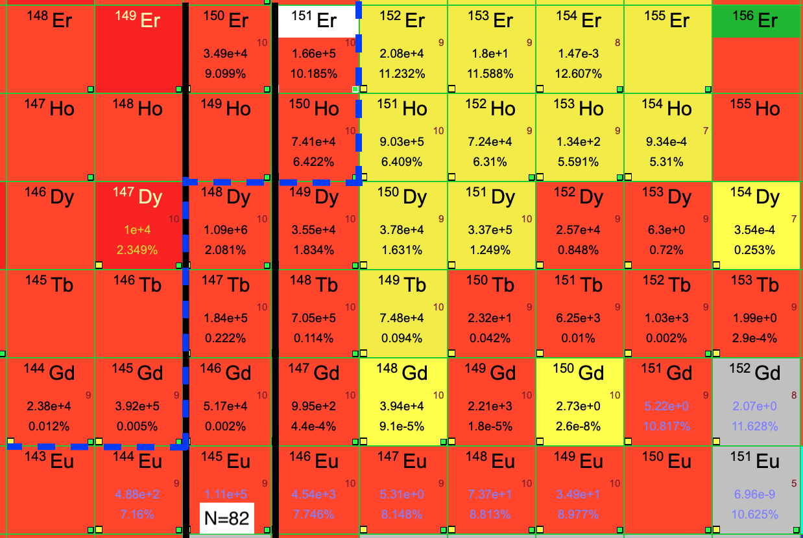
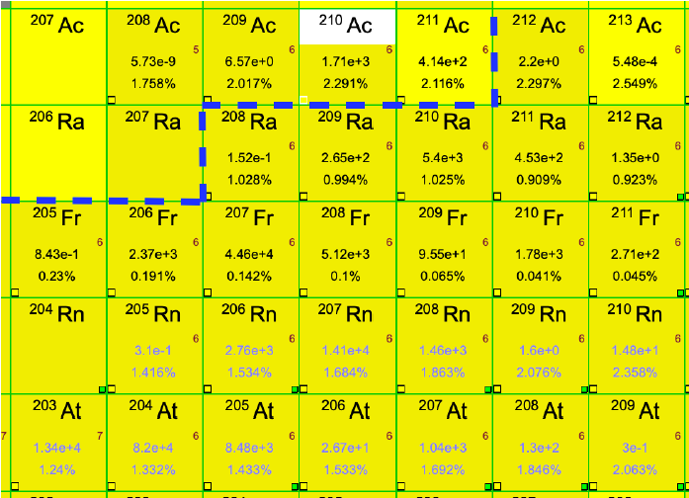
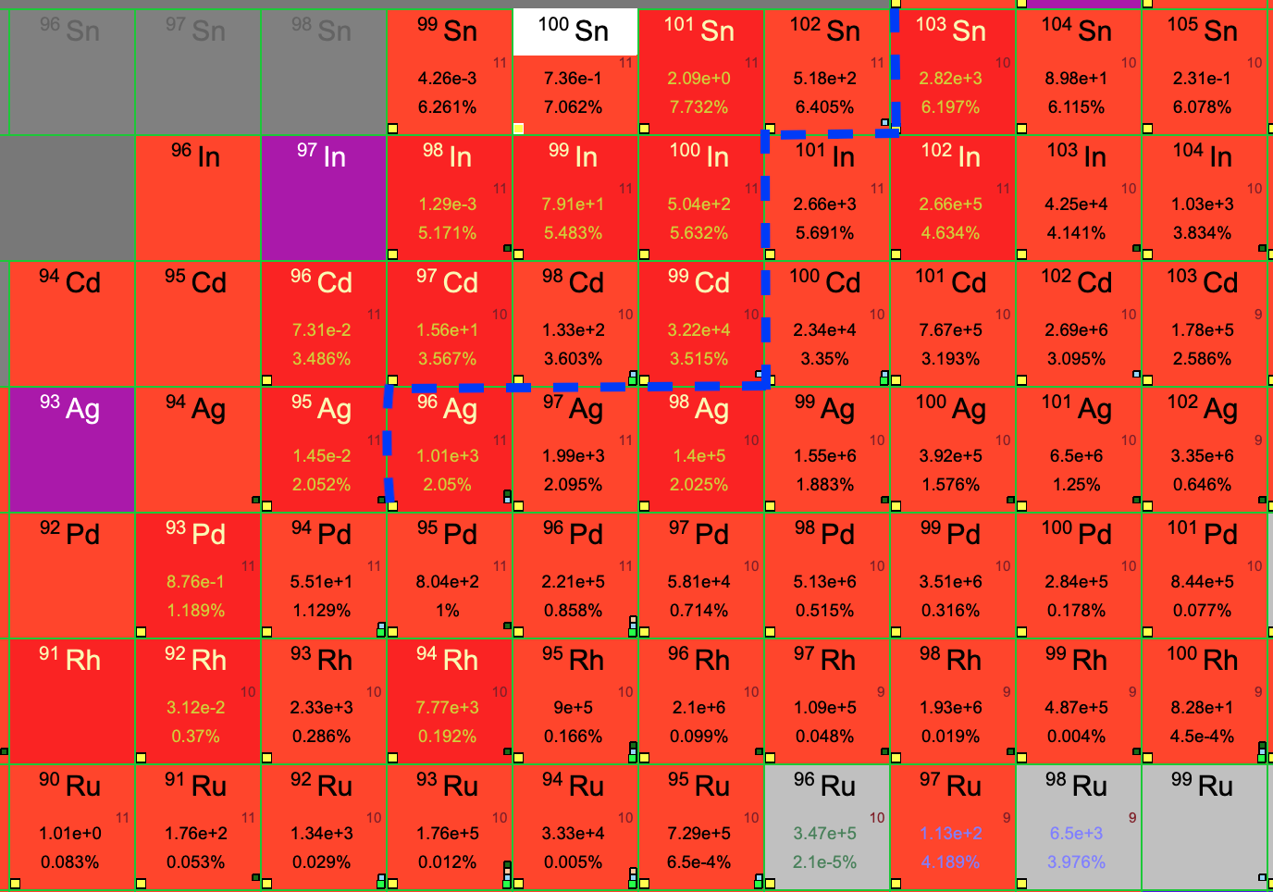
Online commissioning
Coming years: start physics commissioning of S³ with reaction
⁴⁰Ar + ¹¹⁶Sn, S³LEB will be the first setup used:
Focus on ¹¹⁶Sn(⁴⁰Ar, 4n)¹⁵¹Er
Opportunity to study the single-particle states and high-spin isomers
around the N = 82 shell closure
Further steps for LEB commissioning:
Asymmetric reactions ⁴⁰Ar + ¹⁷⁵Lu and ²⁰Ne + ¹⁹⁷Au, main goal Ac isotopes
⁵⁰Cr + ⁵⁸Ni to go towards N = Z nuclei
⁴⁰Ar + ¹¹⁶Sn
²⁰Ne + ¹⁹⁷Au
⁵⁰Cr + ⁵⁸Ni
N = Z
LISE++ simulations (courtesy H. Savajols)

Slide 10
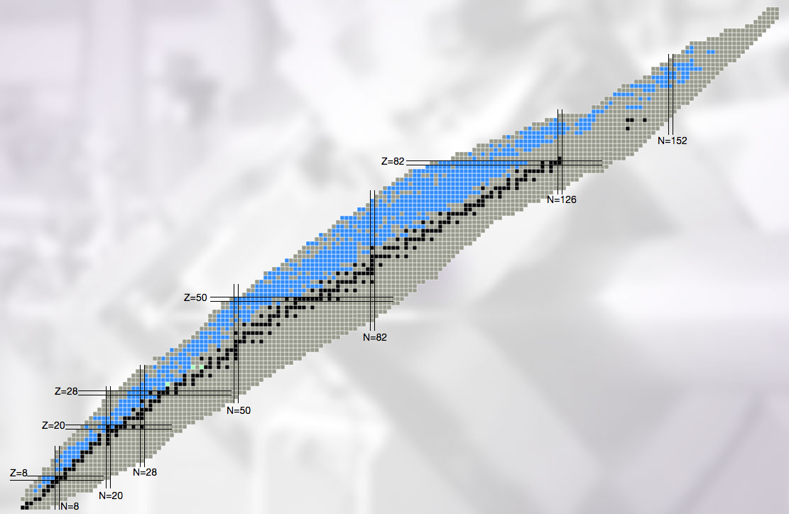
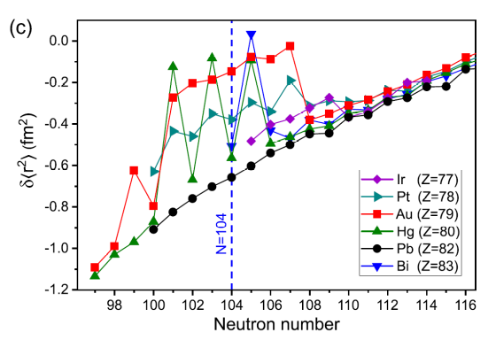
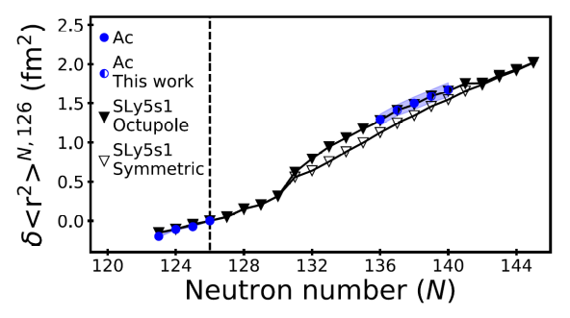
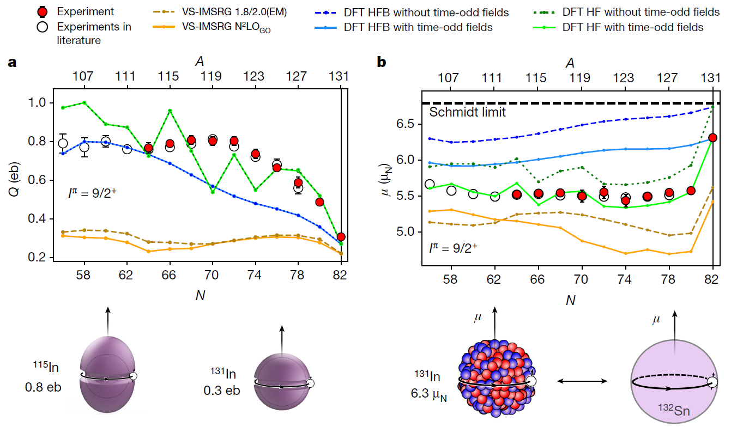
Scientific programme
After online commissioning, start of scientific programme: pre-proposals/Letters of Intent prepared for workshop back in 2018, re-discussed in 2022
Main focus:
Single-particle vs deformation
Octupole deformation
SHE structure (Fm, No, Lr)
Shape-coexistence
High-spin isomers
N = 82 shell closure
Exotic decay modes
J. Cubiss et al., Phys. Rev. Lett. 131 (2023)
E. Verstraelen et al.,
Phys. Rev. C 100 (2019)
N=Z / Symmetries
Shell evolution
Nucleosynthesis
A.R. Vernon et al., Nature 607 (2022)

Slide 11
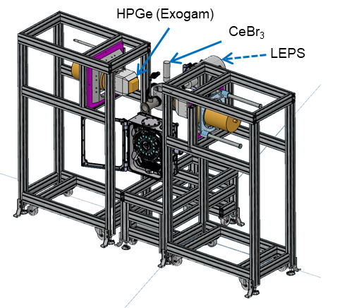
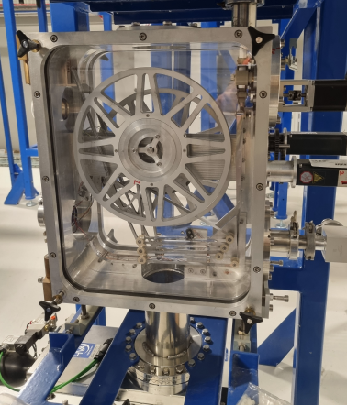

Ongoing projects
Talk M. Ragot
Several projects ongoing to improve/expand the setup:
Combine with decay spectroscopy → IDEAS³, SEASON, new setup for exotic decay channels?
Expand laser spectroscopy: resolution → RF, sensitivity → LRC
Improve gas cell extraction time and neutralisation → FRIENDS³
New paths: molecular spectroscopy
Poster
S. Bara
IDEAS³ (IDentification and DEcay Assisted by S³)
Identification station under construction at IJCLab
Decay spectroscopy tape station based on BEDO (ALTO)
Needed for characterisation of S³(LEB) beams
Multi-detection: gamma-ray, protons, β, X-ray
Courtesy L. Plagnol

Slide 12
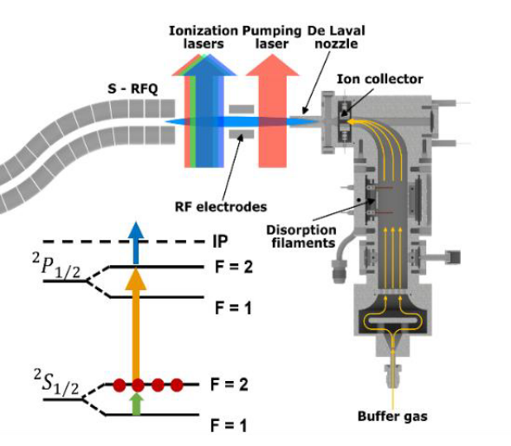


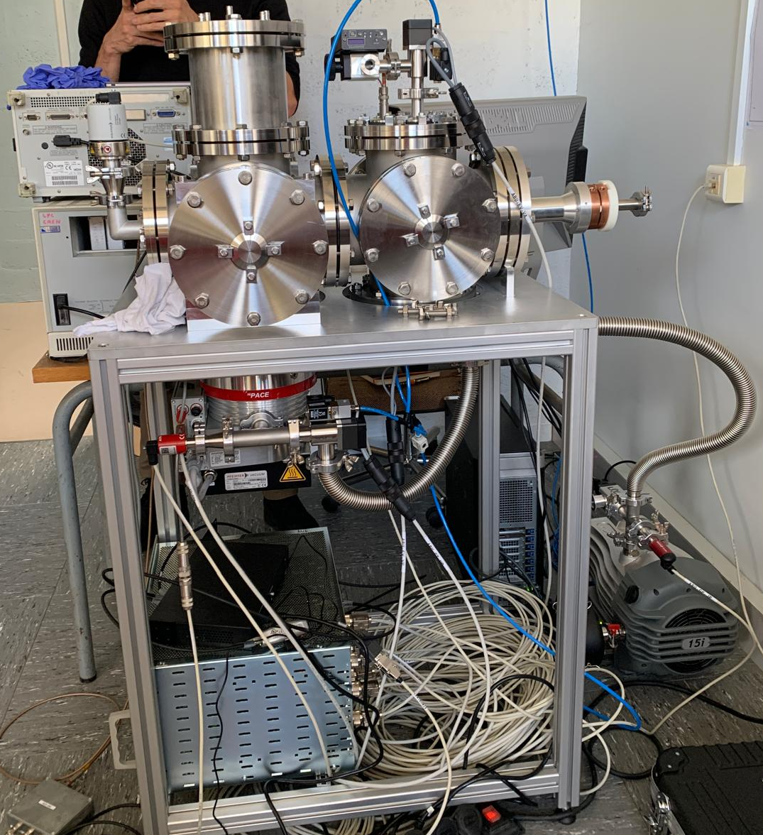
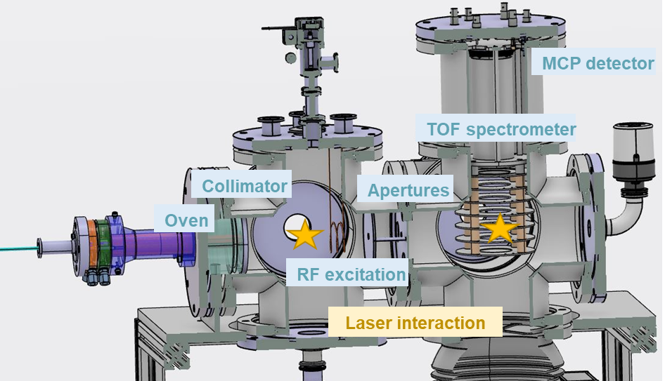
Ongoing projects
DRIL (Double Resonance Investigation on-Line)
Adapting the Laser Radiofrequency Double Resonance (LRDR) spectroscopy technique to S³LEB gas jet environment to measure magnetic octupole moment of radioactive nuclei
Talk A. Raggio
Courtesy A. de Roubin
First phase: new S³ Atomic Beam Unit with possibility to implement LRDR
Built at LPC, to be moved to AlTISA in the coming weeks for laser access

Slide 13
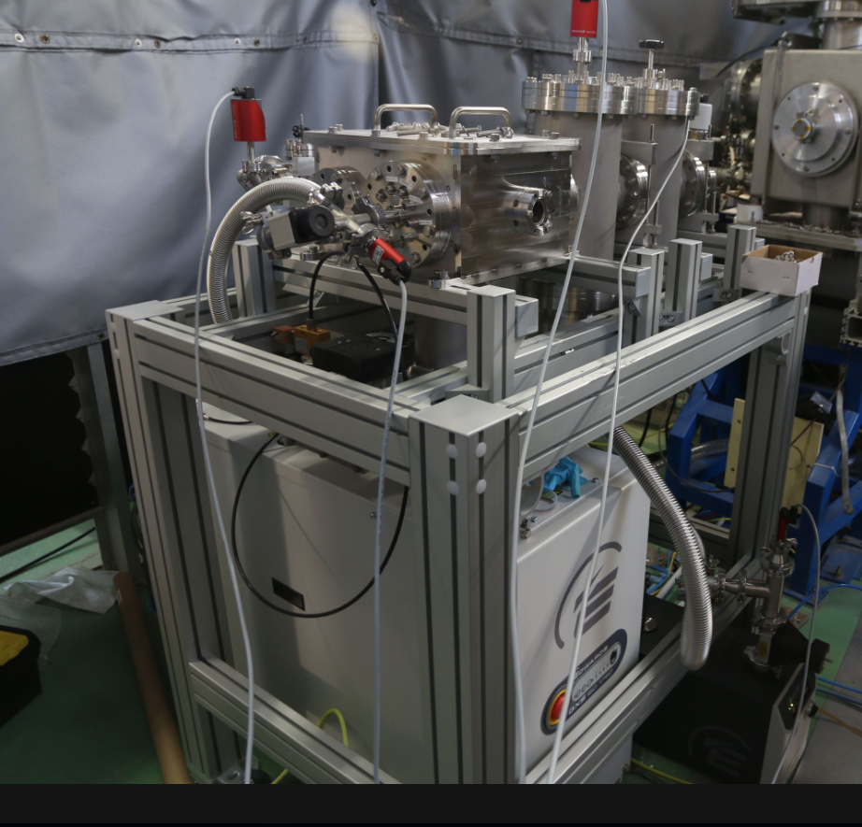
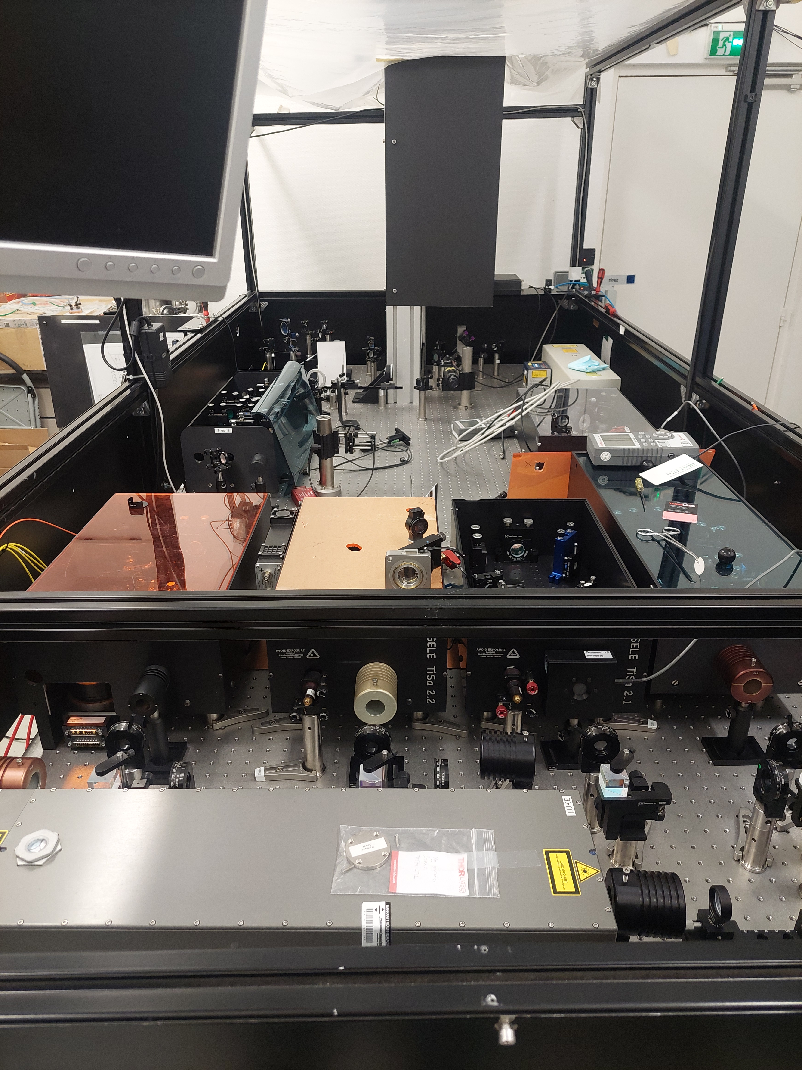
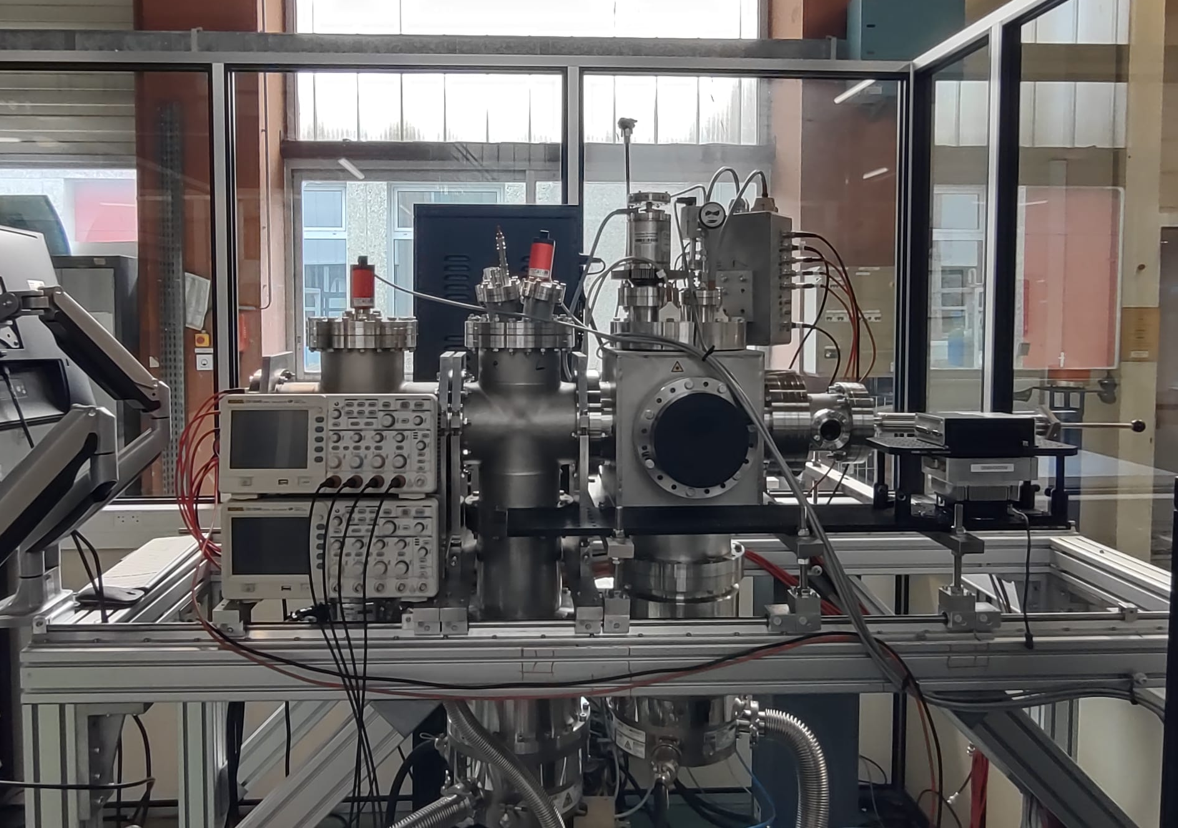
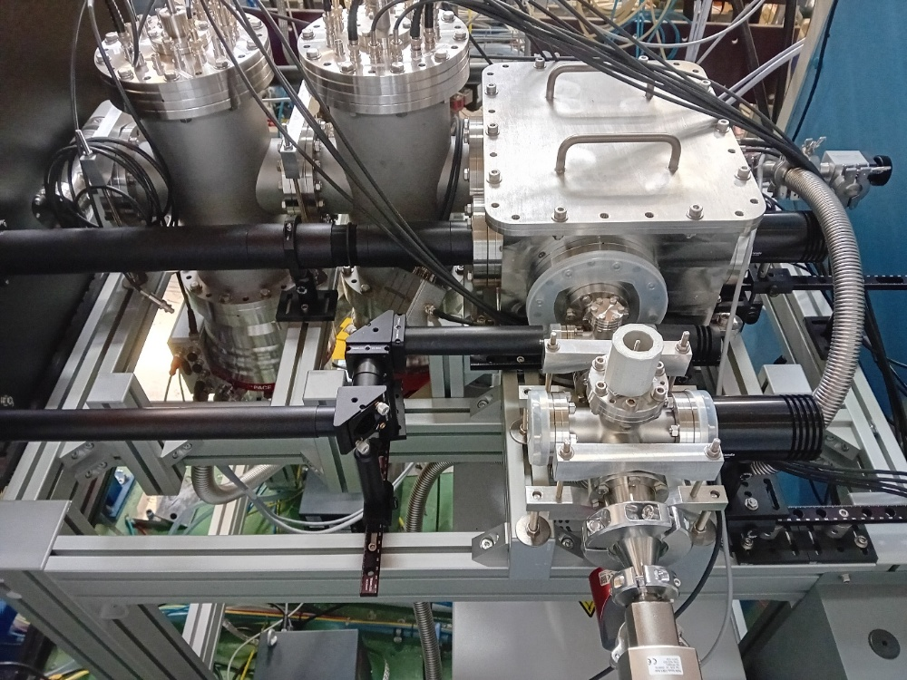
Ongoing projects
FRIENDS³ (Fast Radioactive Ion Extraction and Neutralisation Device for S³)
LRC (Laser resonance chromatography)
New offline research platform at GANIL
GISELE laser lab
Talk T. Stefan

Slide 14
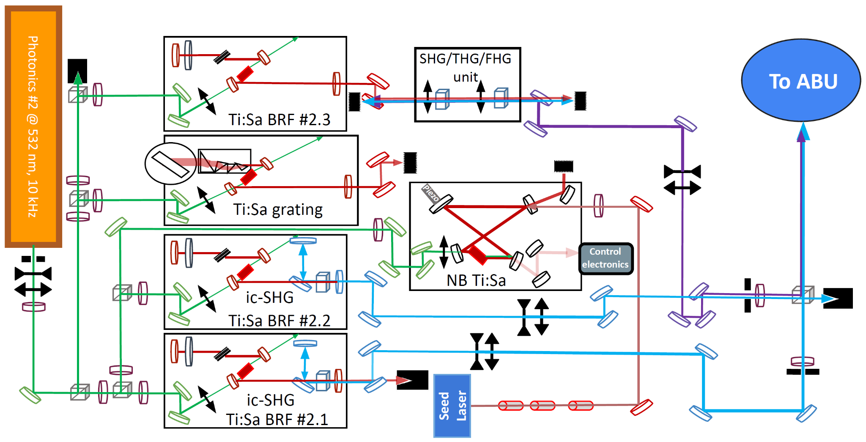

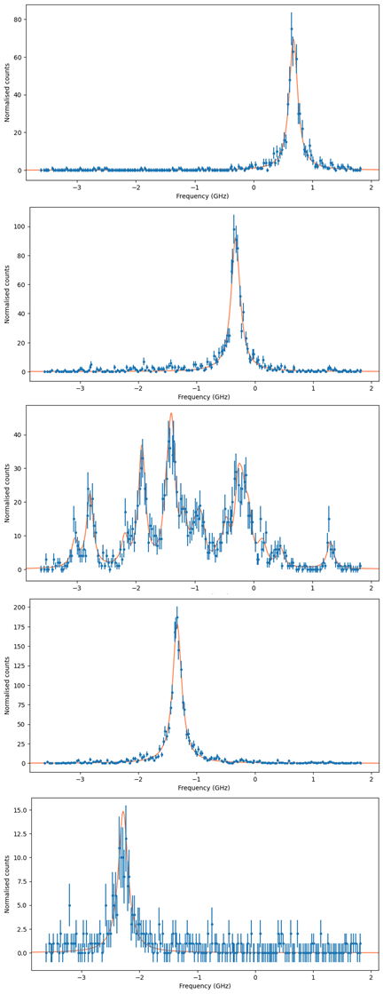
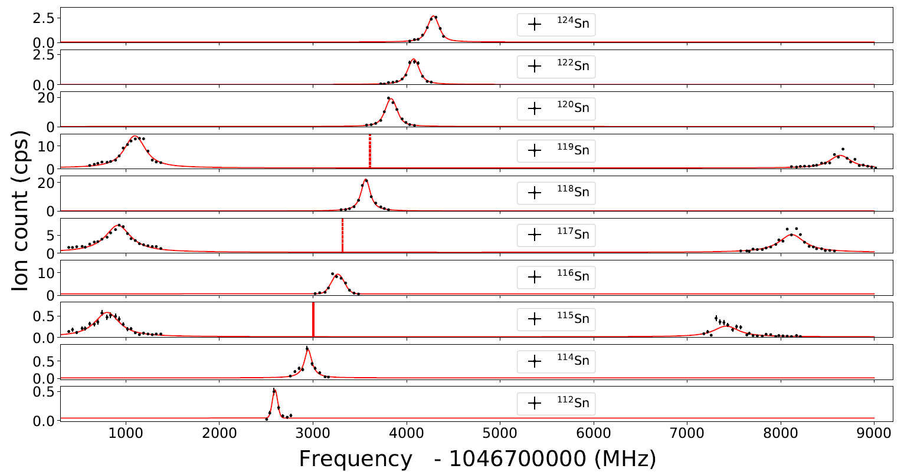
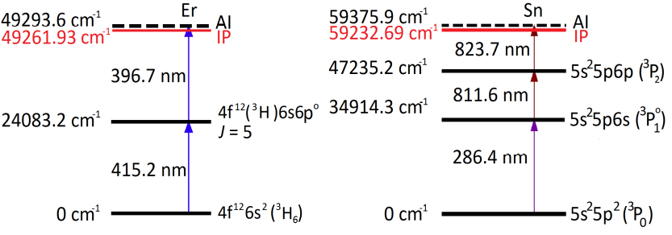
GISELE laser lab
Offline laser lab for training, developments, ionisation scheme testing and laser access for test benches
¹⁷⁰Er
A.I.
¹⁶⁸Er
418.4 nm
393.7 nm
¹⁶⁷Er
¹²⁴Sn
Er
¹²²Sn
¹²⁰Sn
PhD thesis A. Brizard
¹⁶⁶Er
¹¹⁹Sn
¹¹⁸Sn
¹¹⁷Sn
¹¹⁶Sn
¹¹⁵Sn
¹⁶⁴Er
¹¹⁴Sn
¹¹²Sn
J. Romans et al. NIM B 536 (2023)

Slide 15
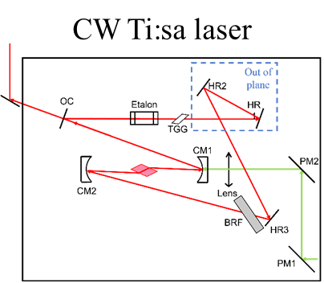



GISELE laser lab
Offline laser lab for training, developments, ionisation scheme testing and laser access for test bench(es)
Injection-Locked cavity: needs seed, diode limited in Δλ tuning range
Solution: home-built cw Ti:sa
(V. Sonnenschein’s design)
→ Scannable over a 9 GHz range with ~ 3 MHz linewidth
Proof-of-principle measurements with Dy spectroscopy
PhD work
V. Marchand
(IJCLab)
PRELIMINARY

Slide 16




Ongoing projects
FRIENDS³ (Fast Radioactive Ion Extraction and Neutralization Device for S³):
Reduce extraction time
Improve neutralisation efficiency
New electrical gas cell (based on JetRIS design) and offline test setup
Simulations of ion transport and electron cloud
Ideally both at
the same time
Gas cell
Electrodes
COMSOL flow/DC field
COMSOL plasma model
SIMION SDS model
Neutralisation
area
De Laval
nozzle
bRFQ
W. Dong et al., NIM B 579 (2026)
mRFQ
QMF
Lens
MCP
E. Morin et al., NIM B 573 (2026)

Slide 17








Ongoing projects
FRIENDS³: First laser ionisation results
Next: measurements with narrowband laser
Afterwards: neutralisation tests with an ionisation → neutralisation → reionisation scheme
Courtesy V. Marchand
and V. Manea
Mass scan using QMF
Water contamination ⇒ baking needed
$$\text{Er}\text{+} \text{+} 3×\text{H}\text{2}\text{O}$$
Ionisation
by laser
Reionisation
by laser
Er⁺ + 4$×$H₂O
Expand to a general offline setup for gas jet spectroscopy and study of gas-cell processes
E.g. Molecular spectroscopy, proof-of-principle performed at KU Leuven
Upgrades of test bench started
ThO spectroscopy in gas jet
Poster
A. Vicente
Courtesy R. Ferrer

Slide 18


Conclusion and outlook
SPIRAL2-S³ and S³LEB offer a promising new path for producing and studying low-energy beams of exotic nuclei
  Multi-instrument approach is key for combining strengths and maximizing output
Offline commissioning completed at LPC, successful restart at S³ focal plane
  First in-gas-jet spectroscopy and mass measurements demonstrated
  Approaching first experiments with radioactive beams
Setup continuously developing
  Laser systems and gas cell: future versions studied
  Mass spectrometer and decay spectroscopy stations: improvements foreseen
  New techniques: e.g. LRC, LRDR, molecular spectroscopy

Slide 19





Thank you for your attention!
GANIL:
A. Ajayakumar, A. Brizard, S. Damoy, P. Delahaye, H. Dinesan, C. Duguépéroux, S.K. Chinthakayala, P. Gangnant, J. Goupil, M. Laatiaoui, N. Lecesne, R. Leroy, A.F. Lopez-Loaiza, F. Lutton, A. Ortiz-Cortes, B. Osmond, J. Piot, H. Savajols, T. Stefan
LPC:
M. Brun, J.-F. Cam, X. Fléchard, C. Gautier, P. Lassegues, J. Lory , Y. Merrer, S.V. Pineda, H. de Préaumont, A. de Roubin, C. Vandamme
KU Leuven:
A. Claessens, T.E. Cocolios, R. Ferrer, R. de Groote, F. Ivandikov, J. Romans, P. Van den Bergh, P. Van Duppen
IJCLab:
W. Dong, P. Duchesne, S. Franchoo, L. Lalanne, V. Manea, V. Marchand, E. Morin,
L. Plagnol, O. Pochon, A. Vicente
JGU/GSI:
S. Raeder, D. Studer
JYU:
I.D. Moore, M. Reponen
IPHC:
E. Traykov
IRFU:
M. Authier, O. Cloué, A. Drouart, M. Ragot, E. Rey-Herme, D. Thisse,
M. Vandebrouck

Slide 20




Offline commissioning LPC
The scheme used for commissioning has no sensitivity to charge radii (tiny field shift factor)
Verify other transitions with known large isotope shifts (based on old spectroscopy work)
¹⁶⁴Er
¹⁶⁶Er
¹⁶⁷Er
$δν_{A^{′}A}=FδΛ_{A^{′}A}$+$M\frac{A^{′}−A}{A^{′}A}$
¹⁶⁸Er
¹⁷⁰Er
PhD thesis of W. Dong, IJClab

Slide 21




Offline commissioning LPC
PILGRIM: Multi-reflection time-of-flight mass spectrometer
Mass separation and measurements tested with
bunches from the S³LEB cooler-buncher
Resolving power > 100 000
DT1
DT2
MagneTOF mini
DT3
Pulse drift tube sections
3-keV beam from
cooler-buncher
Mirror electrodes
Time of flight separation in multiple revolutions
¹⁷⁰Er at 1000 laps
R as a function of N_{laps}
¹⁷⁰Er⁺
¹⁶⁶Er
¹⁶⁷Er
¹⁶⁸Er
¹⁷⁰Er
∆TOF_{FWHM} = 160 ns
TOF – acquisition offset (ns)
Courtesy P. Delahaye
PhD thesis P. Chauveau, GANIL
PhD thesis B.-M. Retailleau, GANIL
Master thesis Y. Balasmeh, LPC

Slide 22

Offline commissioning PILGRIM
Courtesy Pierre Delahaye

Slide 23


N=Z region
Electromagnetic moments & mean squared charge radii:
  Shell structure around N=Z=50 and evolution of N=50 shell closure
  Study of p-n pairing
  Evolution of deformation and odd-even staggering
Current injector and gas cell (A/Q = 3 & 500 ms)
A/Q = 3 & ‘Fast LEB’ (50 ms)
New injector (A/Q = 7) & ‘Fast LEB’ (50 ms)
A<80 → DESIR better suited

