Slide 1

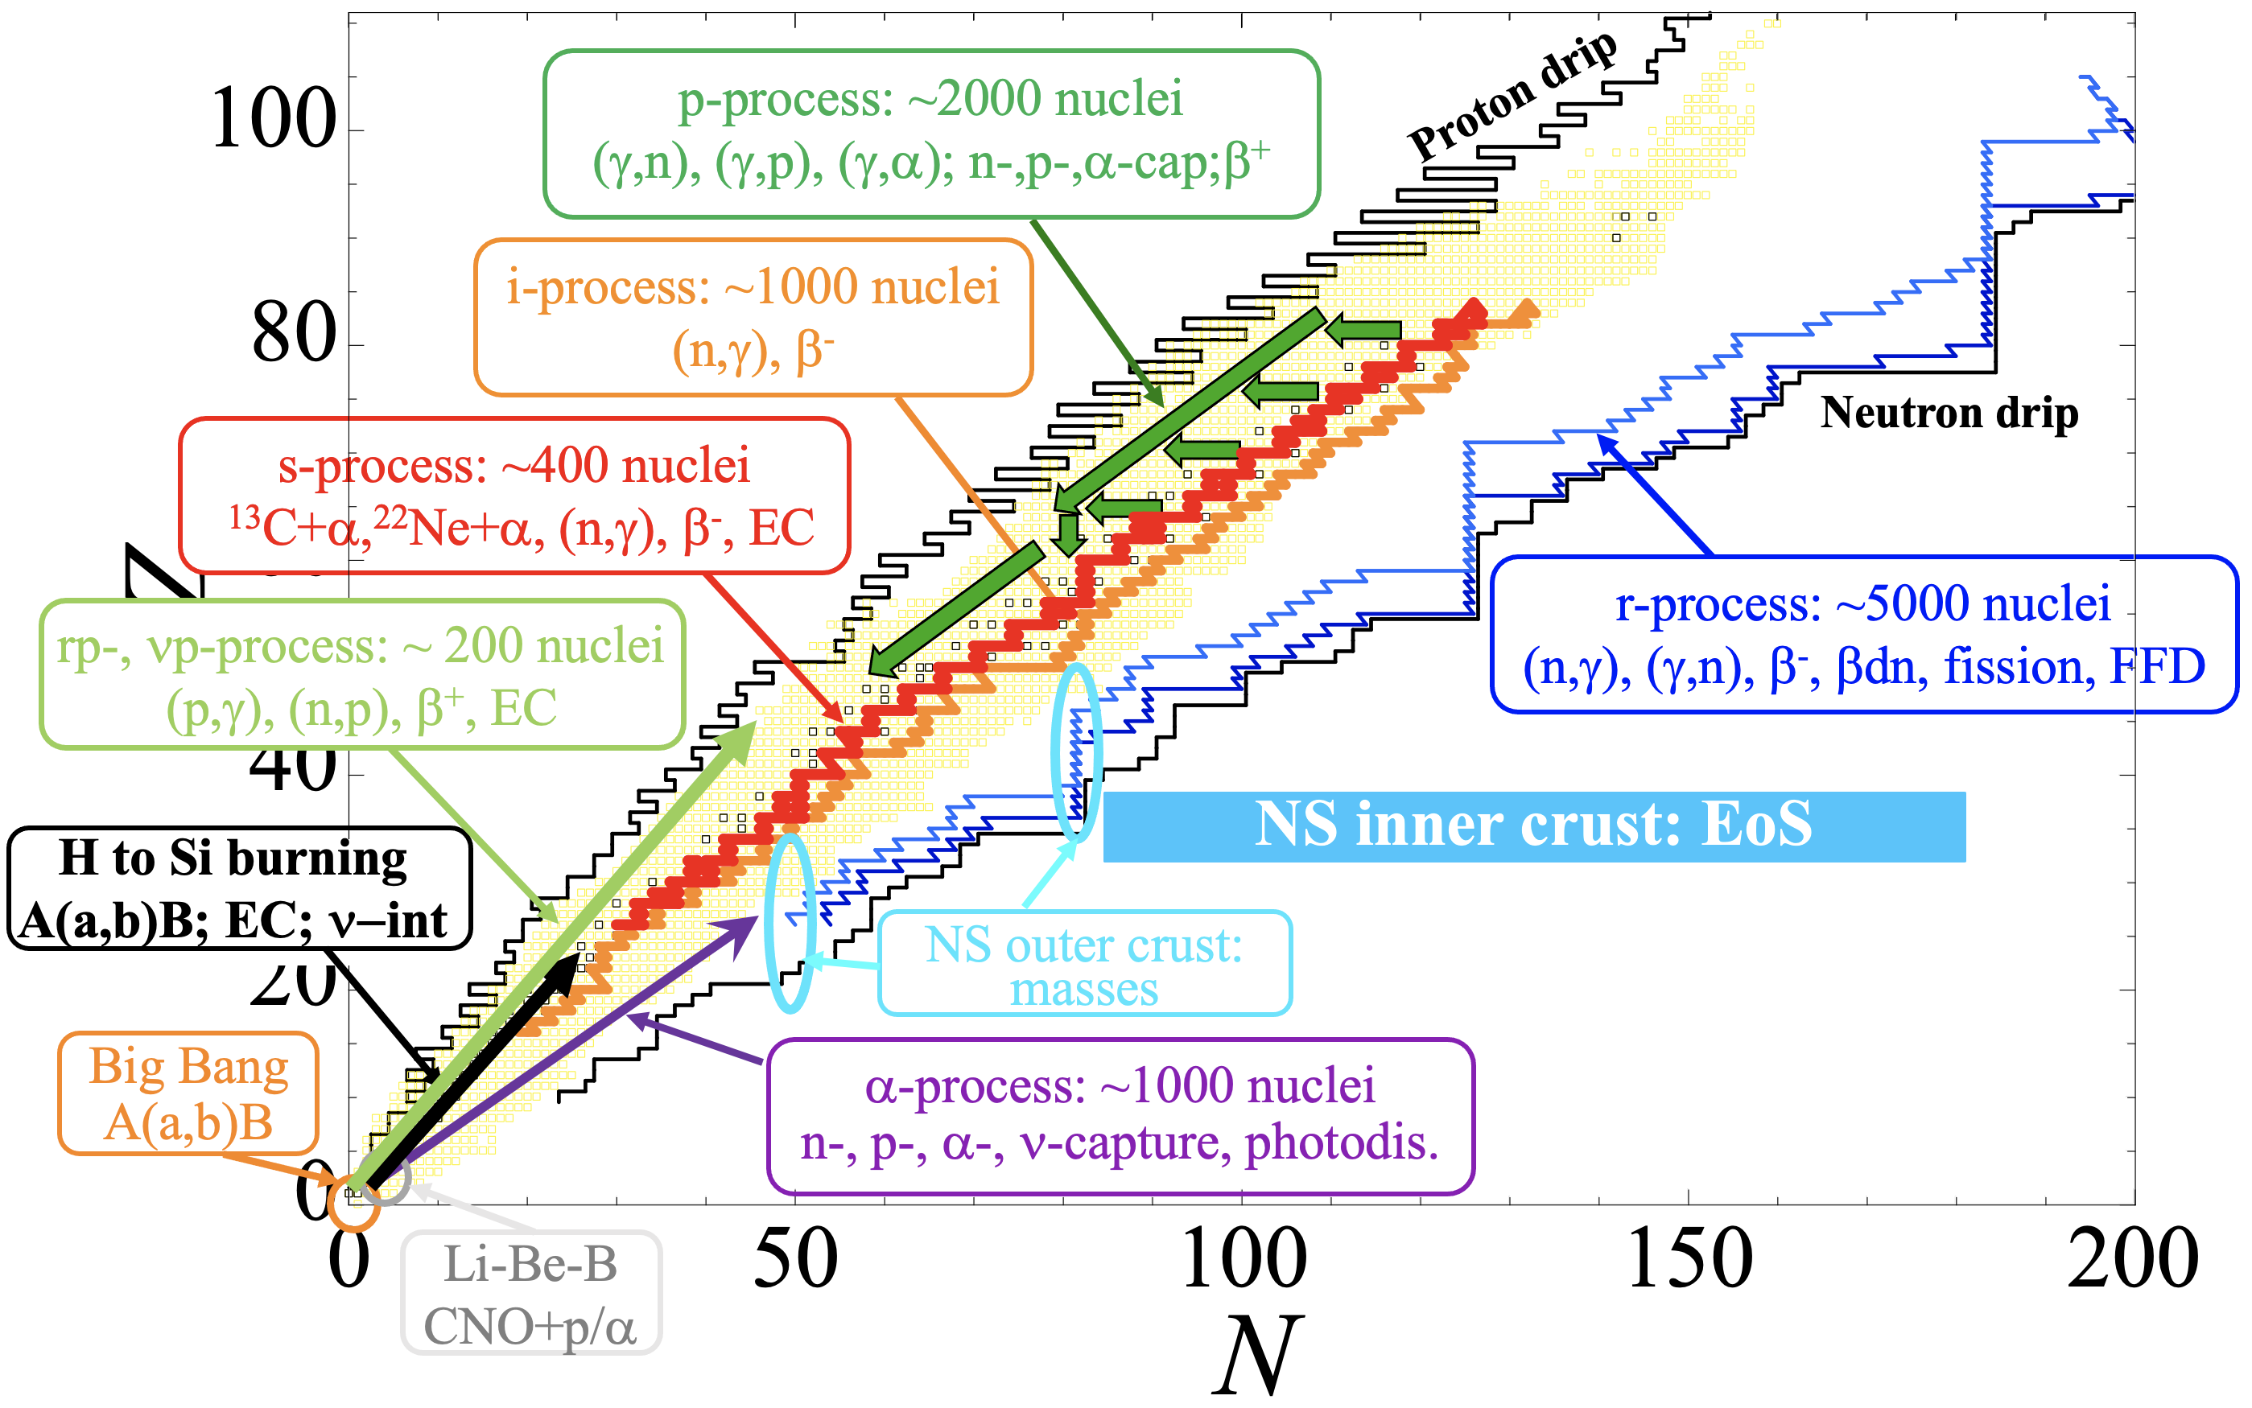
Theoretical nuclear uncertainties and
their impact on astrophysical predictions
S. Goriely (IAA-ULB)

Slide 2
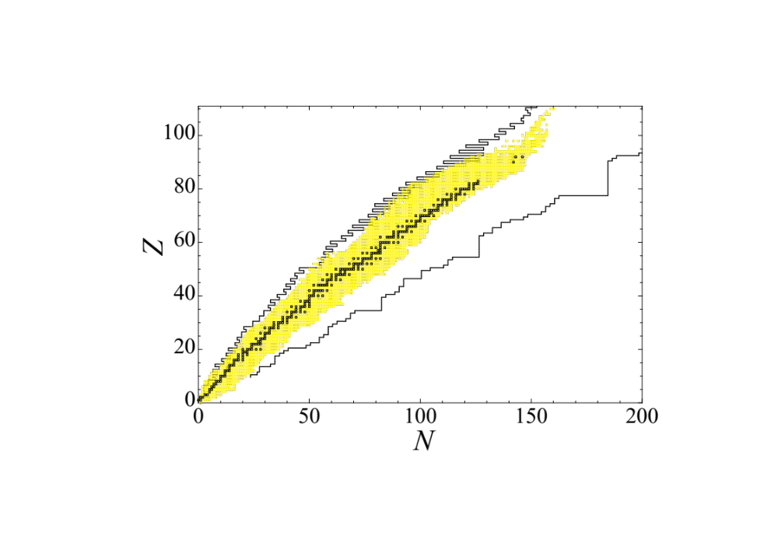
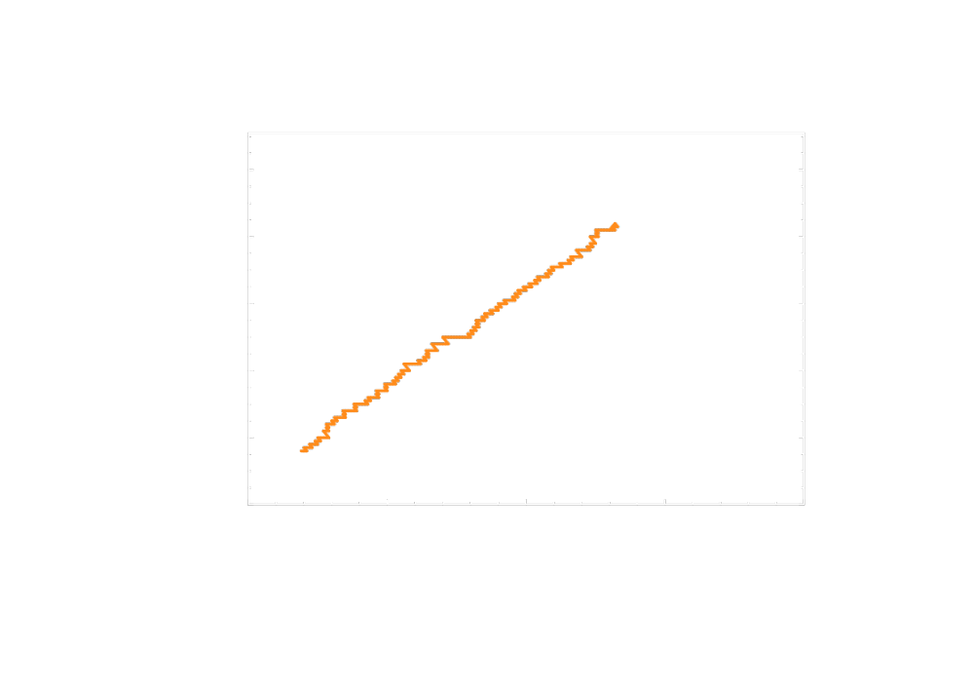
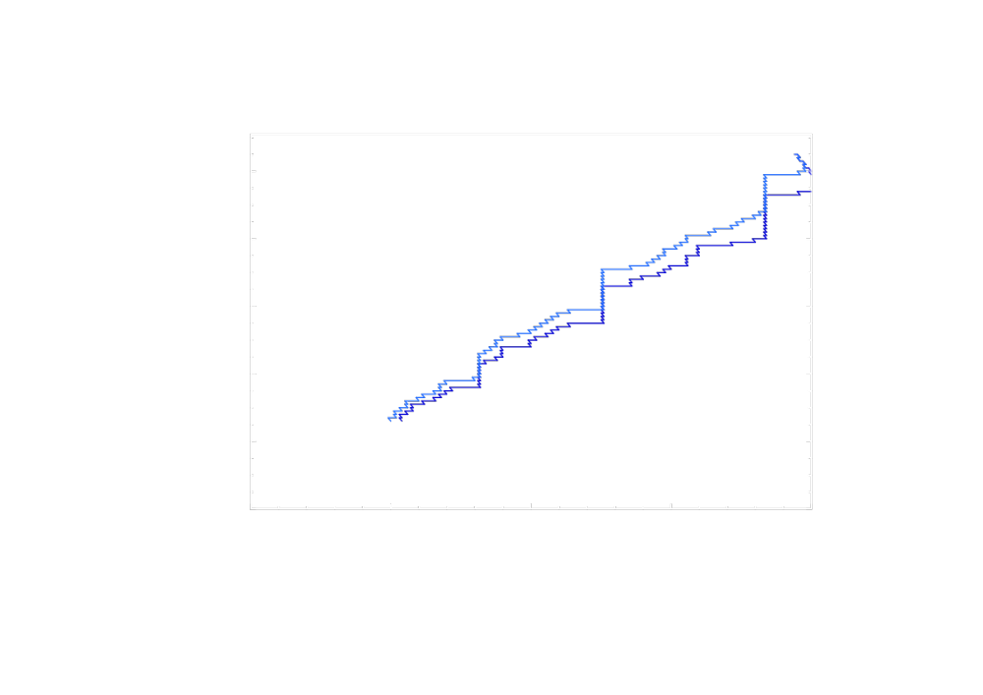
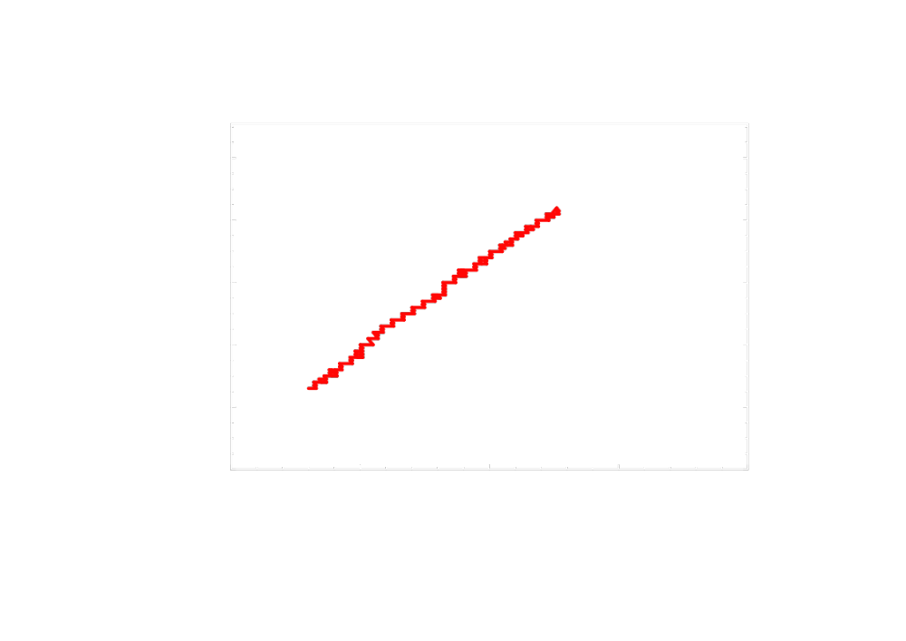

Nuclear Astrophysics: a field with high NP demands
p-process: ~2000 nuclei
(γ,n), (γ,p), (γ,α); n-,p-,α-cap;β⁺
Proton drip
i-process: ~1000 nuclei
(n,γ), β⁻
How do nuclear uncertainties affect astrophysics observables ?
How accurate should the NP predictions be ?
What needs to be measured ?
Neutron drip
s-process: ~400 nuclei
¹³C+α,²²Ne+α, (n,γ), β⁻, EC
... Nuclear theory to fill the gaps ...
r-process: ~5000 nuclei
(n,γ), (γ,n), β⁻, βdn, fission, FFD
rp-, νp-process: ~ 200 nuclei
(p,γ), (n,p), β⁺, EC
NS inner crust: EoS
H-Si burning / Novae
A(a,b)B; EC; ν−int
NS outer crust:
masses
Big Bang
A(a,b)B
α-process: ~1000 nuclei
n-, p-, α-, ν-capture, photodis.
UHECR: ~100 nuc
(γ,n), (γ,p), (γ,α)
Li-Be-B
CNO+p/α

Slide 3
Nucleosynthesis: a field with high demands in theoretical NP
p-process:
SNII, SNIa
~2000 nuclei: (γ,n), (γ,p), (γ,α); n-,p-,α-cap;β⁺
Proton drip
Neutron drip
r-process:
NSM, SNII ? Collapsar ?
~5000 nuclei: (n,γ), (γ,n), β, fission, FFD
i-process:
AGB stars, RAWD
~1000 nuclei: (n,γ), β⁻, fission

Slide 4
How do nuclear uncertainties affect astrophysics observables ?
For the last 60 years, nuclear astrophysicists have been trying to estimate the impact of theoretical nuclear physics uncertainties on astrophysical observables :
  Improve models and optimize model parameters for the various nuclear inputs entering reaction/decay rates
  Quantify uncertainties affecting the various inputs
  Estimate rates and propagate input uncertainties into rates
  Propagate the nuclear rate uncertainties into “realistic” astrophysical simulations and astronomical observables
  Identify the reaction/decay rates impacting the most observables for future (exp or theoretical) improvements
Note:
  Experimentalists always provide “uncertainties” (“error bars”)
  Theoretical NP uncertainties “discovered” in ~2020 in the nuclear astrophysics community
    Essentially no well-documented theoretical uncertainties
    Many confusing and incorrect approaches followed

Slide 5
Nuclear inputs to reaction and decay rates
Ground-state properties
(Masses, β₂, matter densities, spl, pairing…)
Nuclear Level Densities
(E-, J-, π-dep., collective enh., …)
Fission properties
(barriers, paths, mass, yields, …)
STRONG
ELECTROMAGNETIC
WEAK
Optical potential
(n-, p-, α-potential, def-dep)
γ-ray strength function
(E1, M1, def-dep, T-dep, PC)
β-strength function
(GT, FF, def-dep., PC)

Slide 6
Quantification of the MODEL uncertainties
Ground-state properties
(Masses, β₂, matter densities, spl, pairing…)
Skyrme vs Gogny
Nuclear Level Densities
(E-, J-, π-dep., collective enh., …)
Fission properties
(barriers, paths, mass, yields, …)
Stat vs Comb vs SM
Skyrme vs Gogny vs RMF
STRONG
ELECTROMAGNETIC
WEAK
Optical potential
(n-, p-, α-potential, def-dep)
γ-ray strength function
(E1, M1, def-dep, T-dep, PC)
β-strength function
(GT, FF, def-dep., PC)
WS vs BHF vs CEFT
QRPA: Skyrme vs Gogny vs RMF
Provided the different models reproduce as accurately as possible related observables
Notes:
many-body perturbation theory with state-of-the-art nuclear interactions from chiral effective field theory

Slide 7
Nuclear inputs to reaction and decay rates
Ground-state properties
(Masses, β₂, matter densities, spl, pairing…)
Mean-Field model
Nuclear Level Densities
(E-, J-, π-dep., collective enh., …)
Fission properties
(barriers, paths, mass, yields, …)
HFB+Comb
Mean-Field model
STRONG
ELECTROMAGNETIC
WEAK
Optical potential
(n-, p-, α-potential, def-dep)
γ-ray strength function
(E1, M1, def-dep, T-dep, PC)
β-strength function
(GT, FF, def-dep., PC)
Chiral EFT
HFB+QRPA
HFB+QRPA
Each model includes parameters that are adjusted on related experimental data

Slide 8
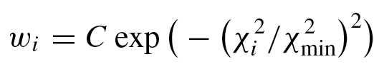
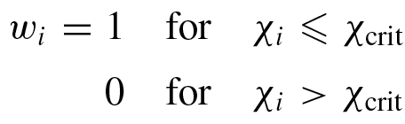
Quantification of the parameter uncertainties
(local variation of parameters in the vicinity of the optimum)
The Backward-Forward Monte Carlo method (e.g. Bauge et al. 2011) consists of the following steps:
  (i) Assessing the allowed range of variation in the vicinity of the local minimum for each of the model parameters.
  (ii) Sampling model-parameter sets using assessed parameter uncertainties
  (iii) (Backward MC step): Selecting those parameter sets from the sampled population using a likelihood function with respect to available experimental data
  (iv) (Forward MC step): Using selected sampled parameter sets to additionally calculate experimentally unknown data.
  (v) Deriving the first and second moments (the mean value and covariance) or maximum-to-minimum variation of the estimated observables
or
Notes:
The BFMC method relies on the sampling of model parameters and on the use of a generalized χ2 estimator to quantify the likelihood of each model calculation result respective to a given set of experimental constraints.
Note that both weighting functions are biased towards model predictions rather than experimental data
However, the UMC-B method would require an even larger numerical effort than with the above-mentioned weighting functions given by Eqs. (3 ) and (4 ). The reason is that the absolute χ2 value tends to be larger than the normalized quantity χ2/χ2min , so the weight calculated by Eq. (5 ) is smaller in the UMC-B. Therefore, a much larger set of sampled parameters is required to achieve convergence of the mean value and covariance calculations.

Slide 9
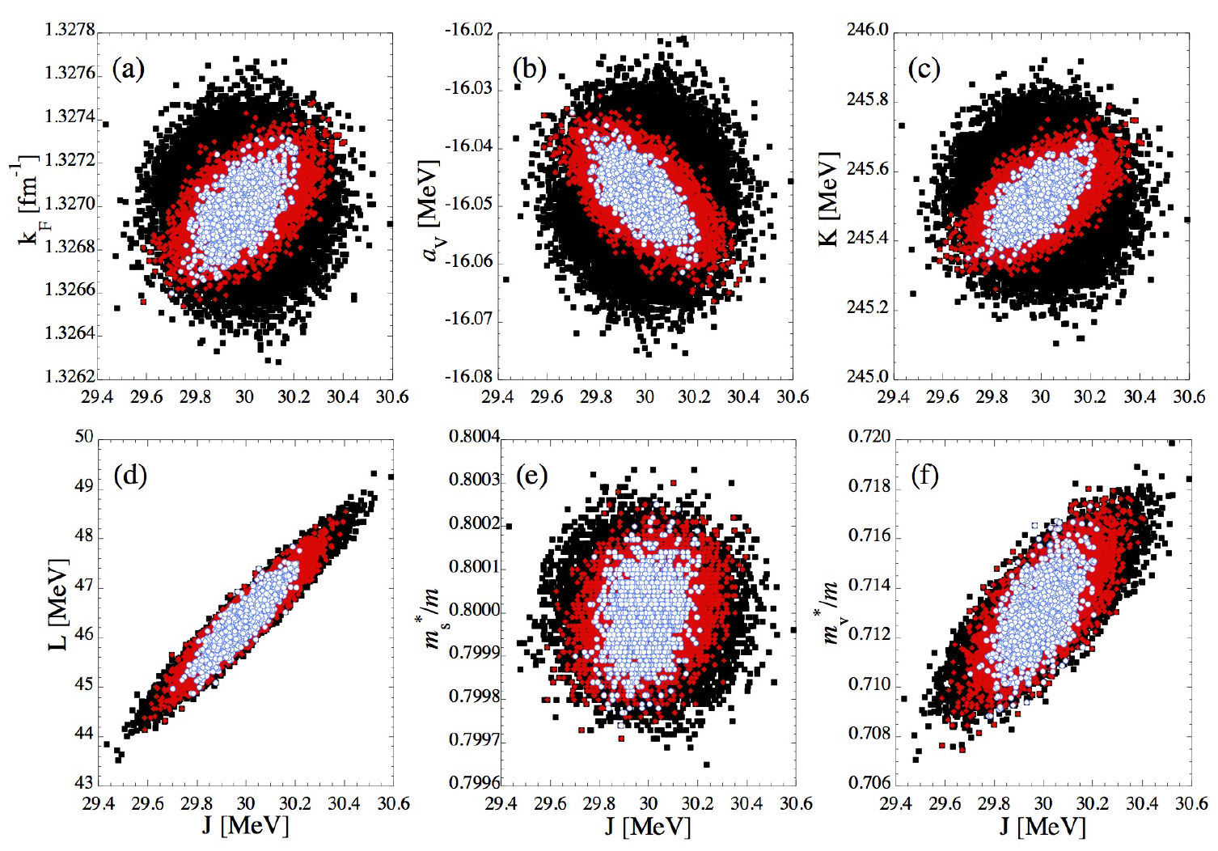
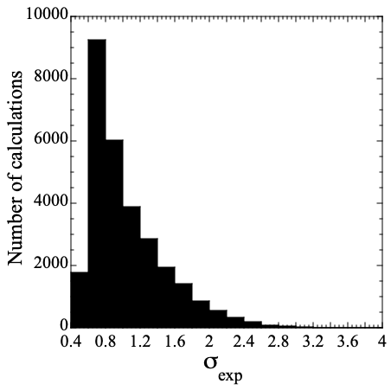
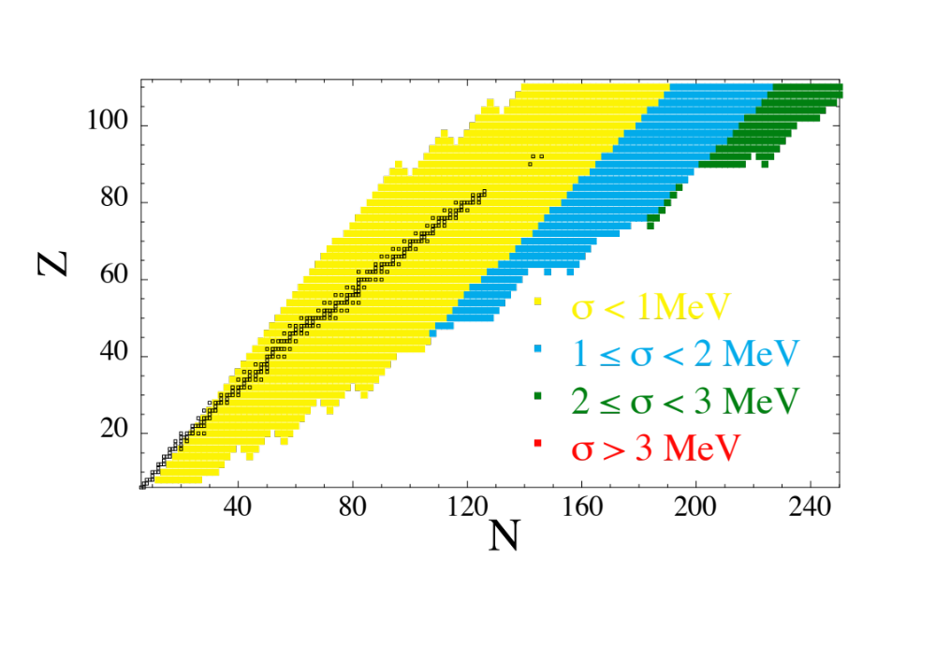
Quantification of theoretical parameter uncertainties
e.g. HFB-24 Masses : 21 Skyrme + pairing parameters → σ_{rms} ~ 0.55MeV (wrt AME2020)
(iii) Backward MC : build ~30’000 parameter sets
Correlated parameter variations
rms vs exp masses
  1770 σ < 0.6 MeV
  11000 σ < 0.8 MeV
Only parameter variations constrained by exp. data, e.g. s.t. σ_{rms} < 0.8 MeV
(iv) Forward MC :
HFB-24
Uncorrelated parameter variations among different nuclei
rms deviation
wrt
HFB24 minimum
Uncorrelated propagation of parameter uncertainties in astrophysical simulations

Slide 10
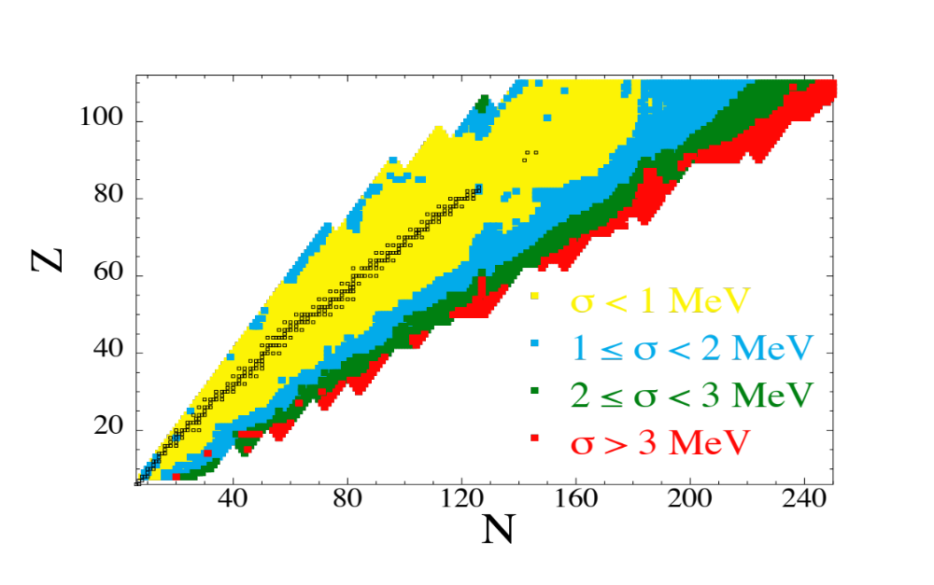
Quantification of theoretical mass uncertainties
Parameter uncertainties
Model uncertainties
e.g. on Masses (SG & Capote, 2014)
Parameter
(Statistical)
Model
(Systematic)
HFB24
HFB2-32
Model or parameter variations must be constrained by experimental data
Only parameter variations s.t. σ_{rms} < 0.8 MeV
Only mass models s.t. σ_{rms} < 0.8 MeV
~
~
Uncorrelated parameter variations among ≠ nuclei
Masses/rates variations correlated by the model

Slide 11

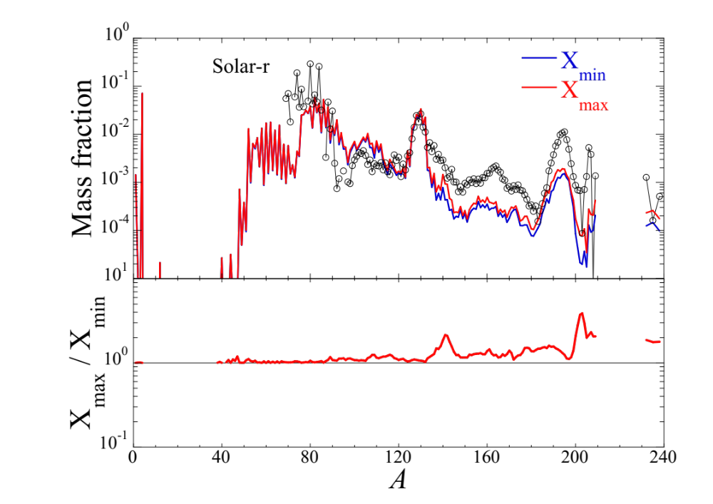
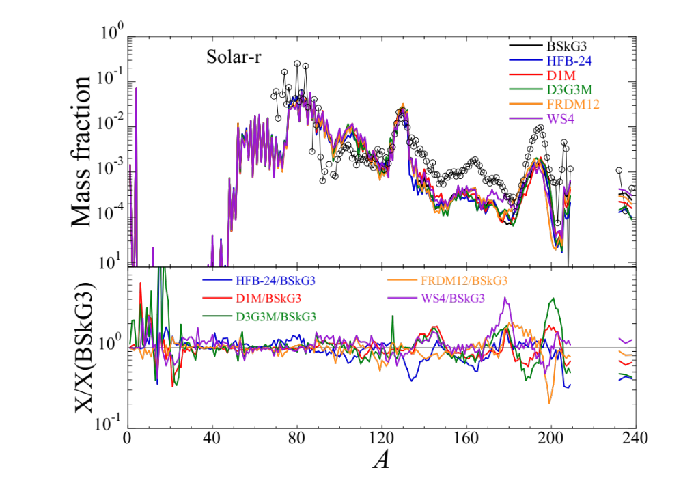
Propagation of Mass uncertainties into NSM simulations
Uncorrelated Parameter uncertainties
Correlated Model uncertainties
1.375-1.375M_{o} (358 traj)
1.375-1.375M_{o} (358 traj)
HFB-24
MC approach if uncorrelated uncertainties
Additional correlations may exist, e.g S_{n} and M
Parameters changes must be constrained by exp
MC approach not correct
Coherent model-correlated uncertainties
Each model is affected by parameter unc.
Parameter < Model uncertainties → need for improved models

Slide 12
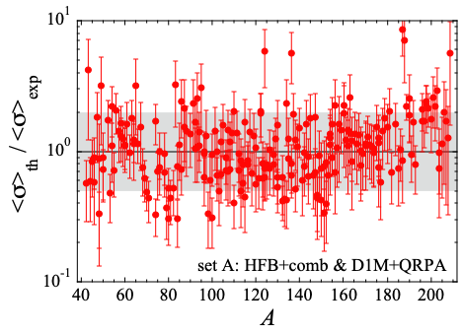
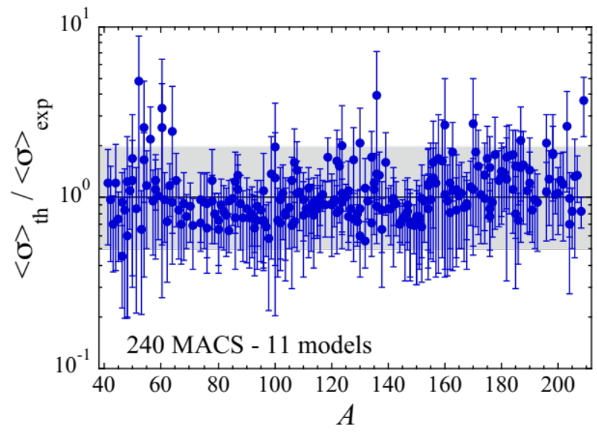
Quantification of (n,γ) uncertainties associated to NLD and PSF
Parameter uncertainties
Model uncertainties
Parameter
(Statistical)
Model
(Systematic)
Parameter or Model variations must be constrained by experimental data
BFMC method
NLD/PSF parameters s.t.
~240 (n,γ) MACS with f_{rms}≤ 2
Only NLD/PSF models s.t.
accurate description of exp data
~240 (n,γ) MACS with f_{rms}≤ 2

Slide 13
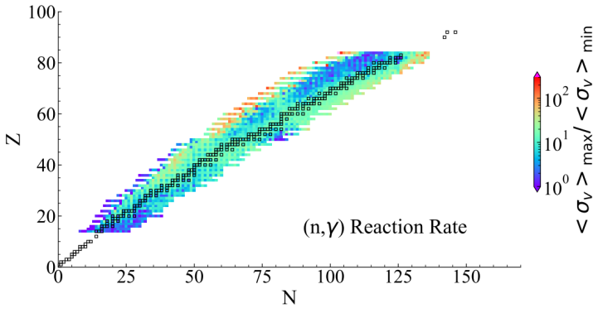
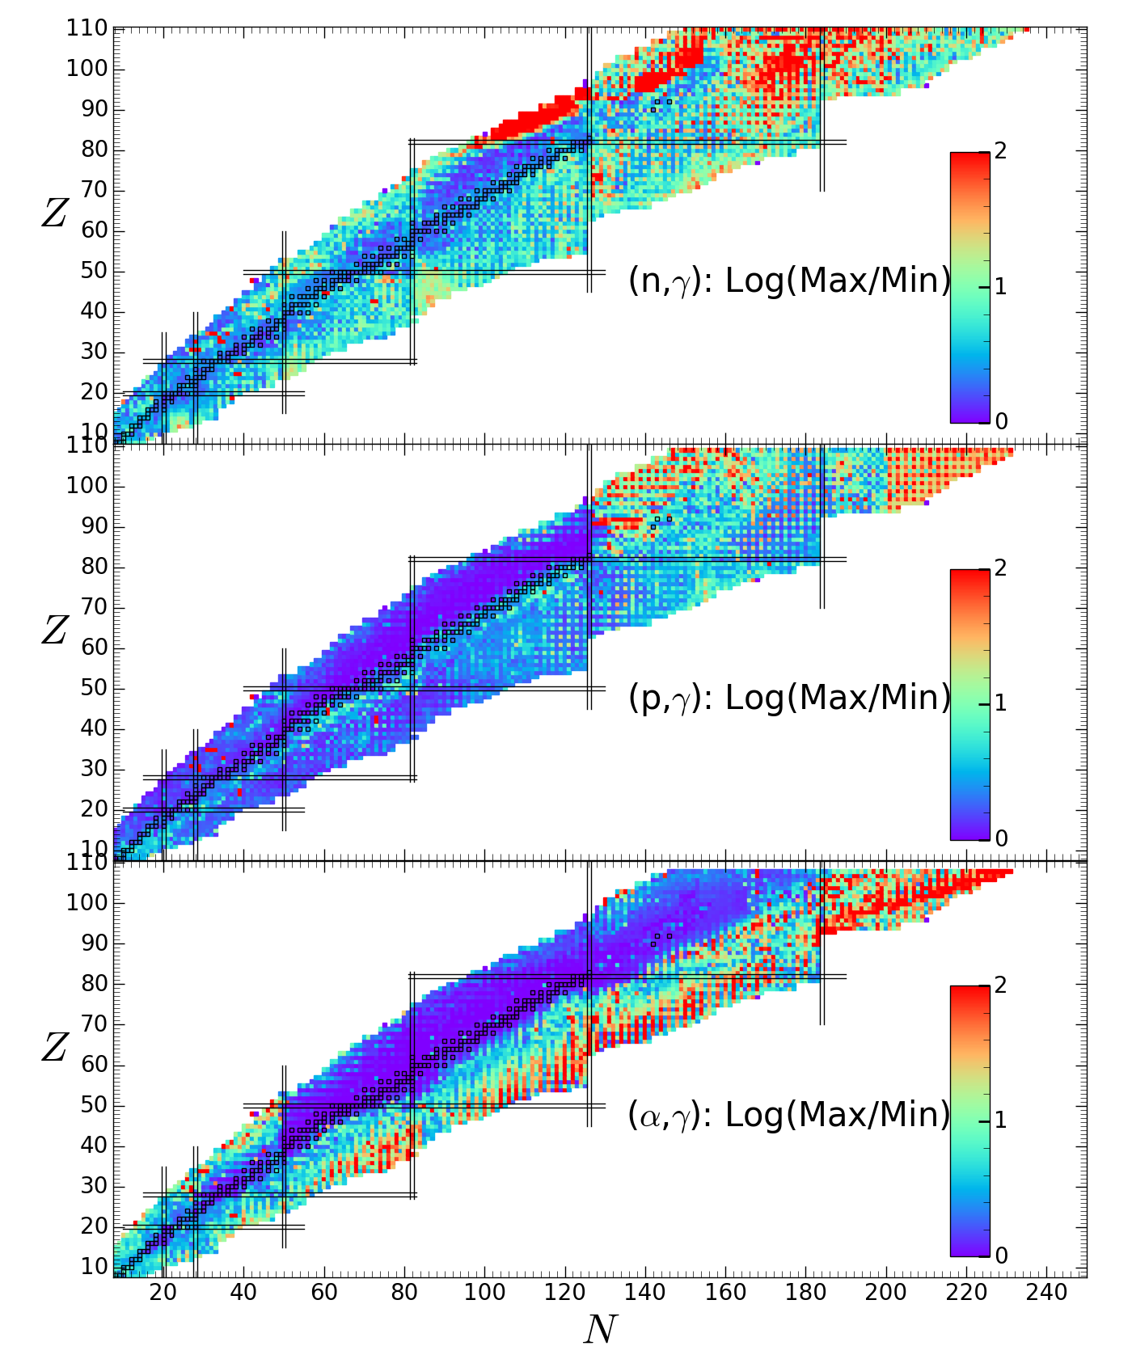
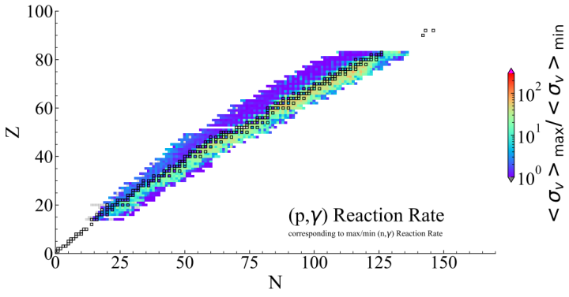
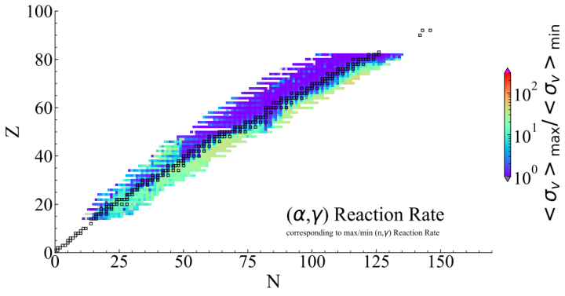
Impact of NLD/PSF uncertainties on unknown (n,γ), (p,γ), (α,γ) rates
<σ>_{max} / <σ>_{min}
“Uncorrelated” parameter uncertainties
“Correlated” model uncertainties
[... though (n,γ), (p,γ), (α,γ) are correlated ...]

Slide 14
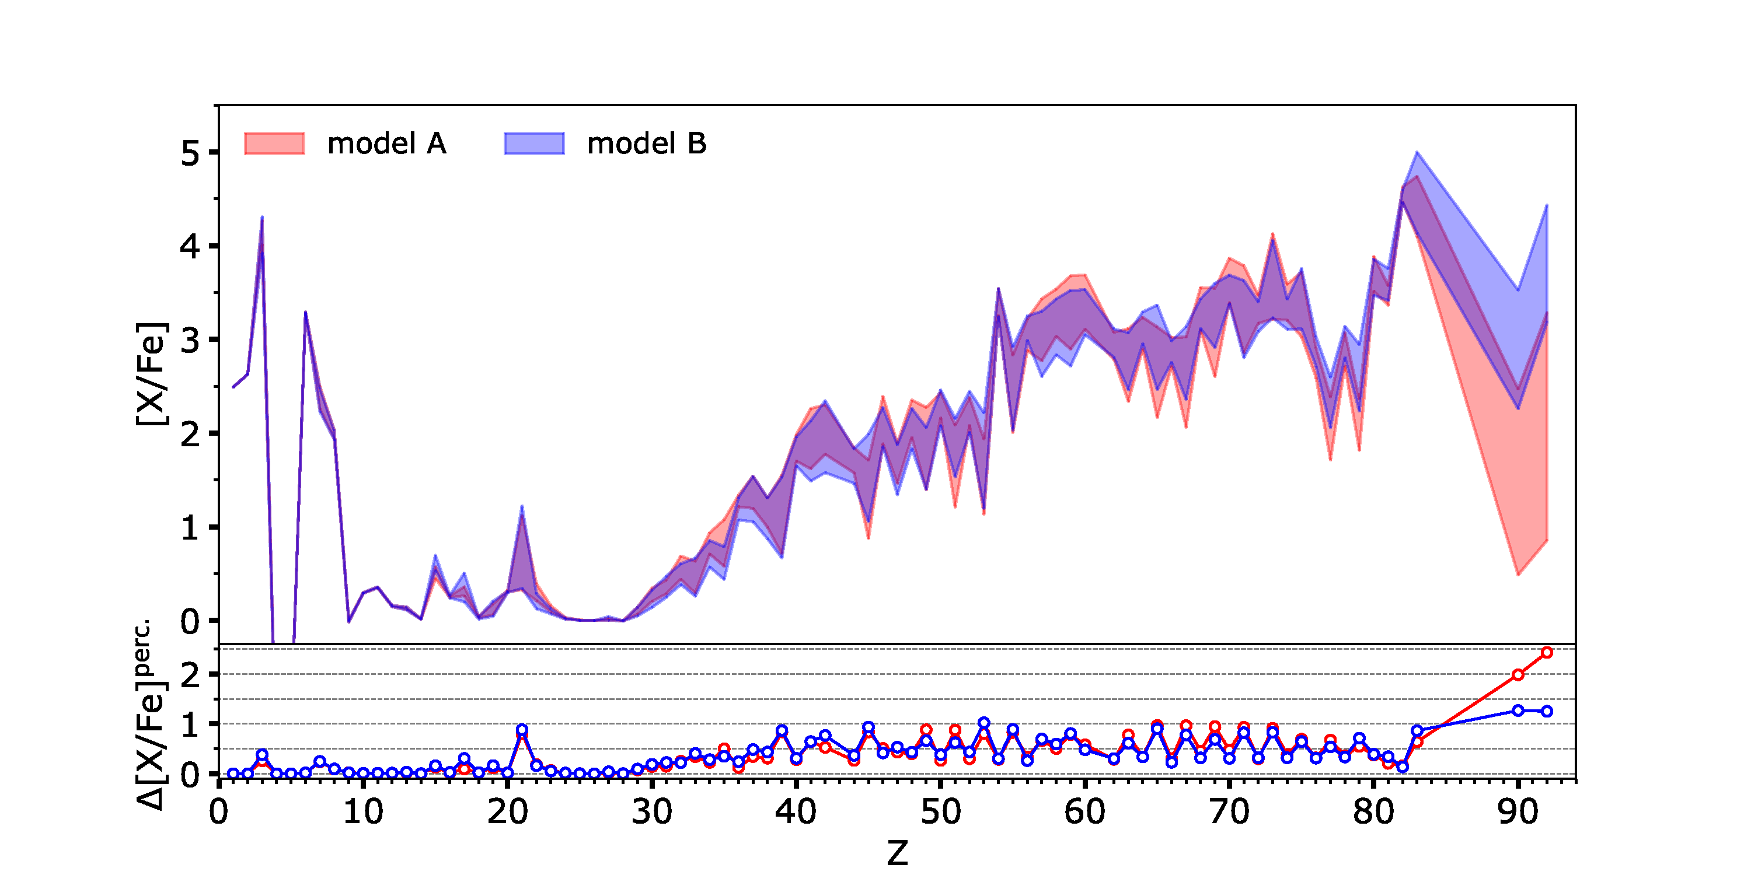
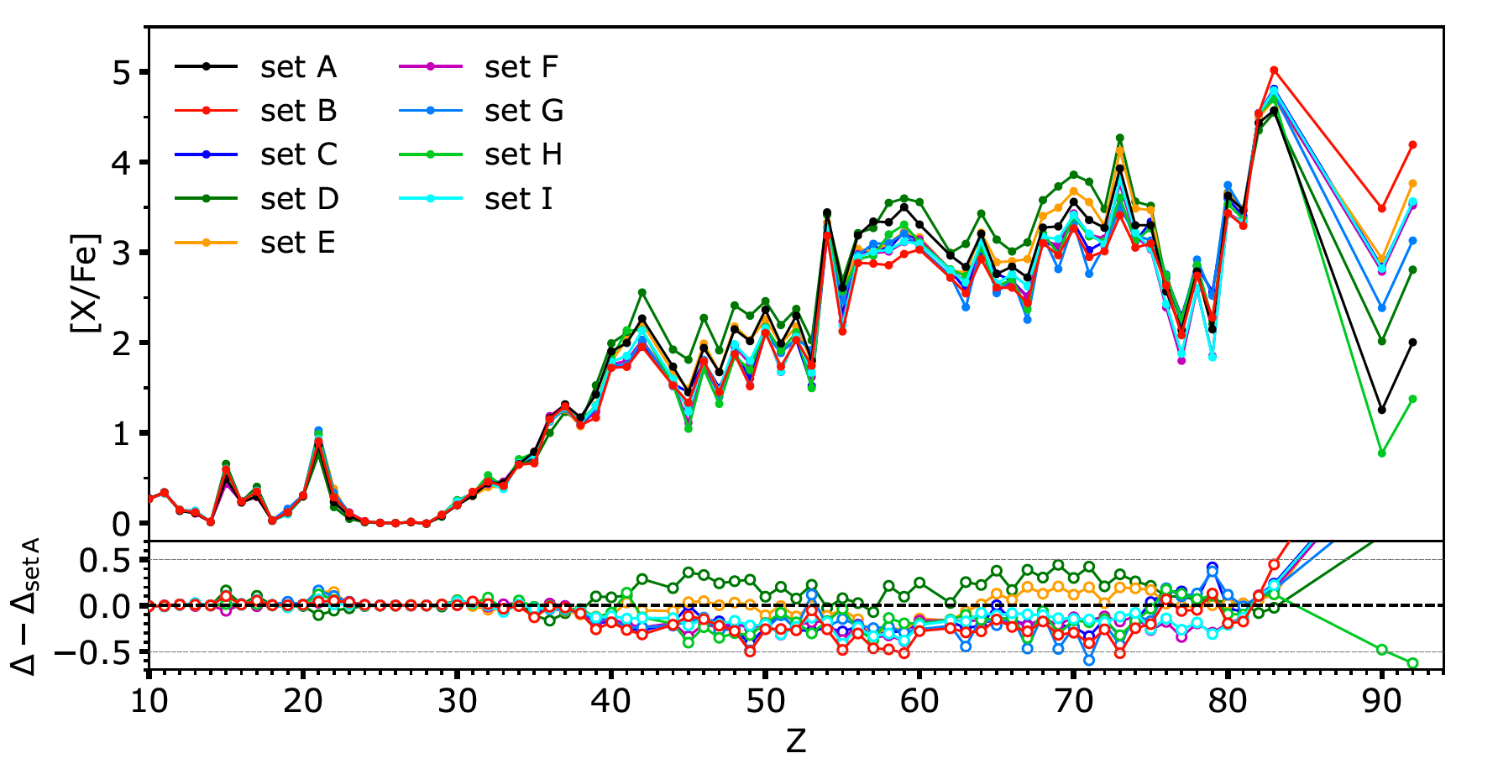
Impact of NLD/PSF on the i-process in low-Z low-M AGB stars
Surface abundances in a 1M_{o} [Fe/H]=-2.5 AGB star
(Martinet et al. 2024)
Uncorrelated Parameter uncertainties
Correlated Model uncertainties
Log X / X_{init}
Log X / X_{init}
Parameter and Model uncertainties have ~ the same impact in magnitude
Extraction of the reactions with the most impactful uncertainties

Slide 15
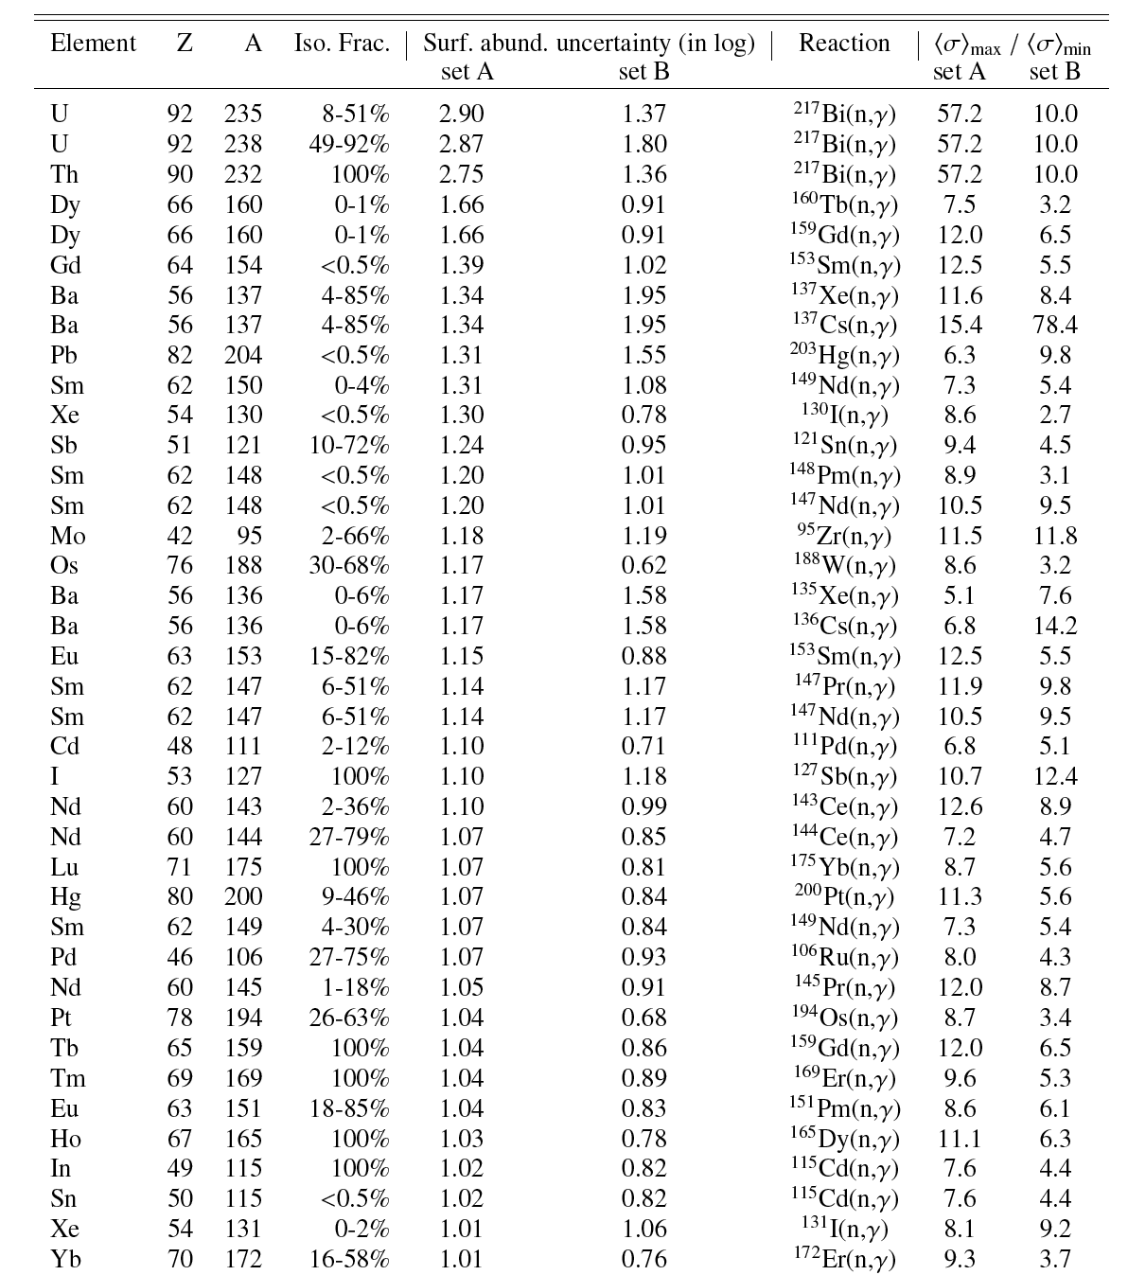
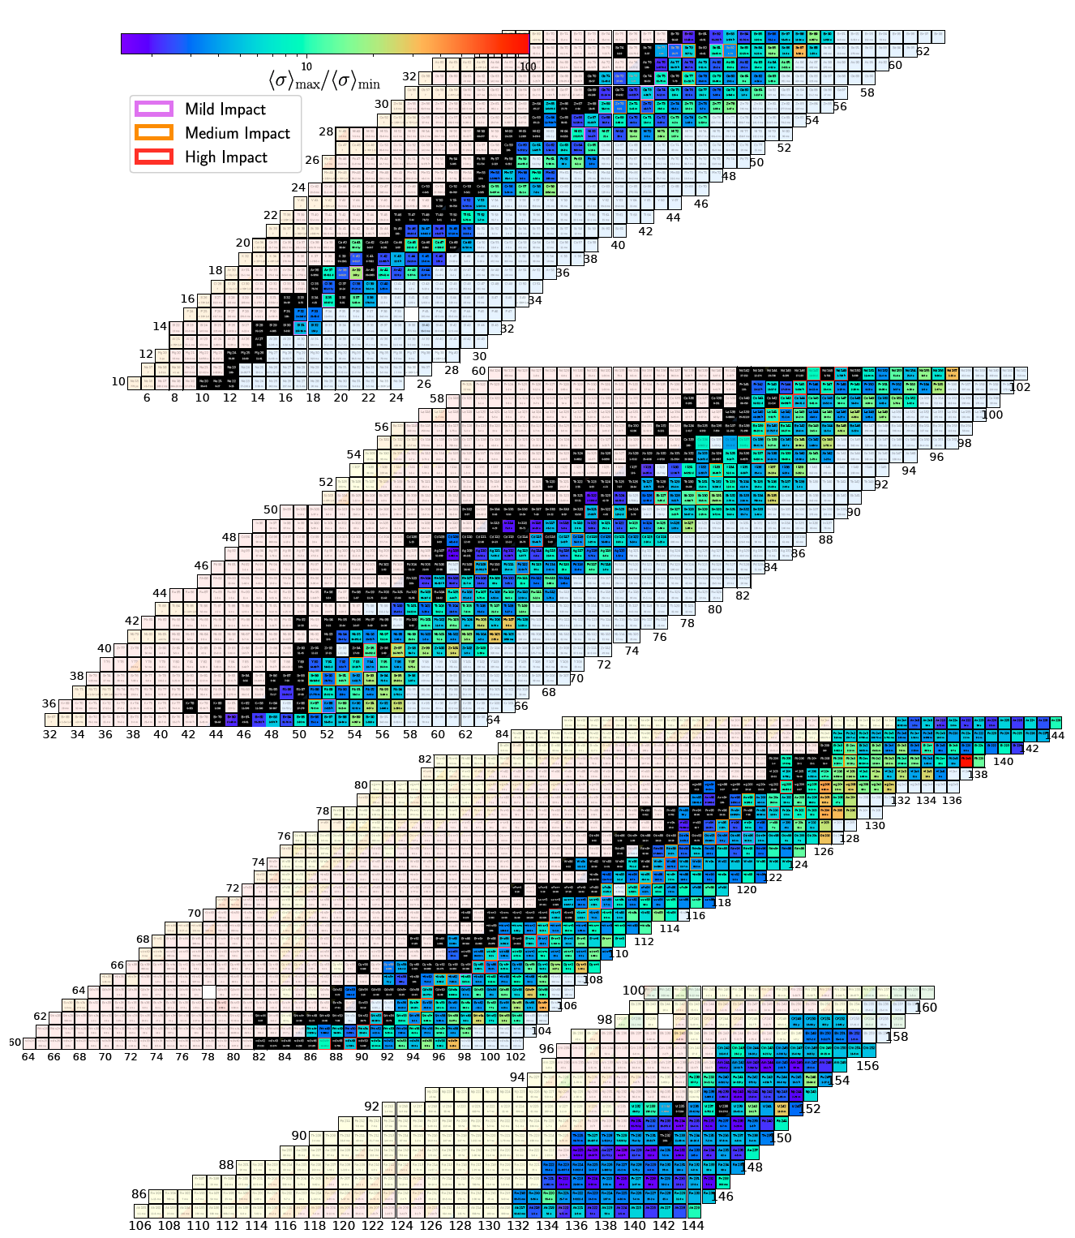
List of main (n,γ) uncertainty drivers for i-process
Martinet et al., A&A 684, A8 (2024)

Slide 16
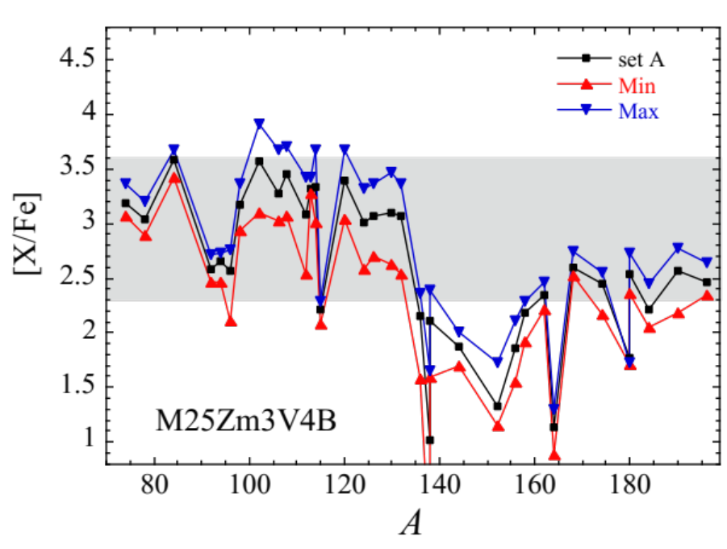
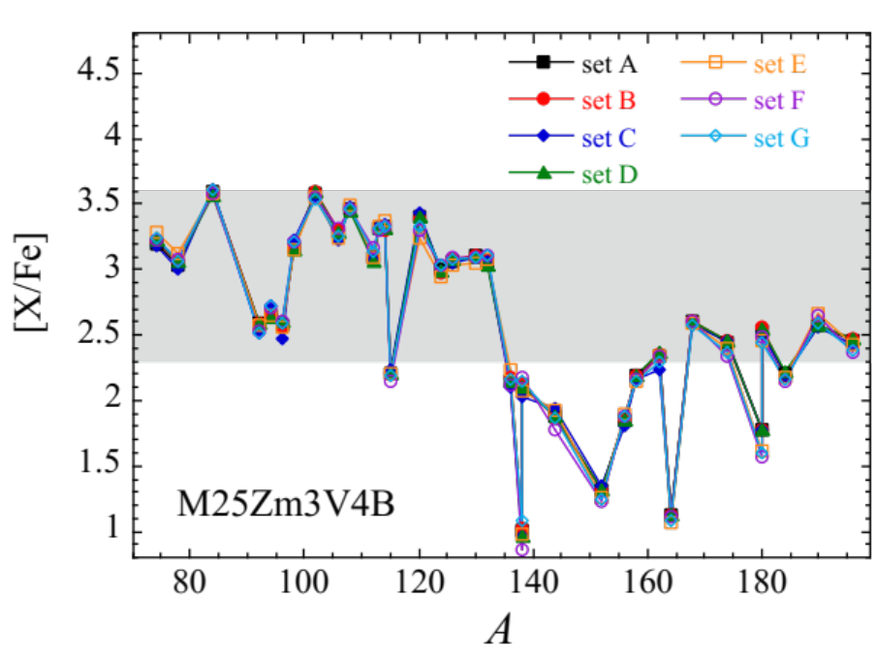
Impact of NLD/PSF uncertainties on the p-process nucleosynthesis
Overproduction of p-nuclei in the core of an exploding 25M_{o} Z=0.001 v/v_{c}=0.4 star
(Choplin et al. 2022)
Uncorrelated parameter uncertainties
Correlated model uncertainties
Highly dominated by (γ,n) parameter uncertainties
Parameter uncertainties >> Model uncertainties
Extraction of the reactions with the most impactful uncertainties

Slide 17
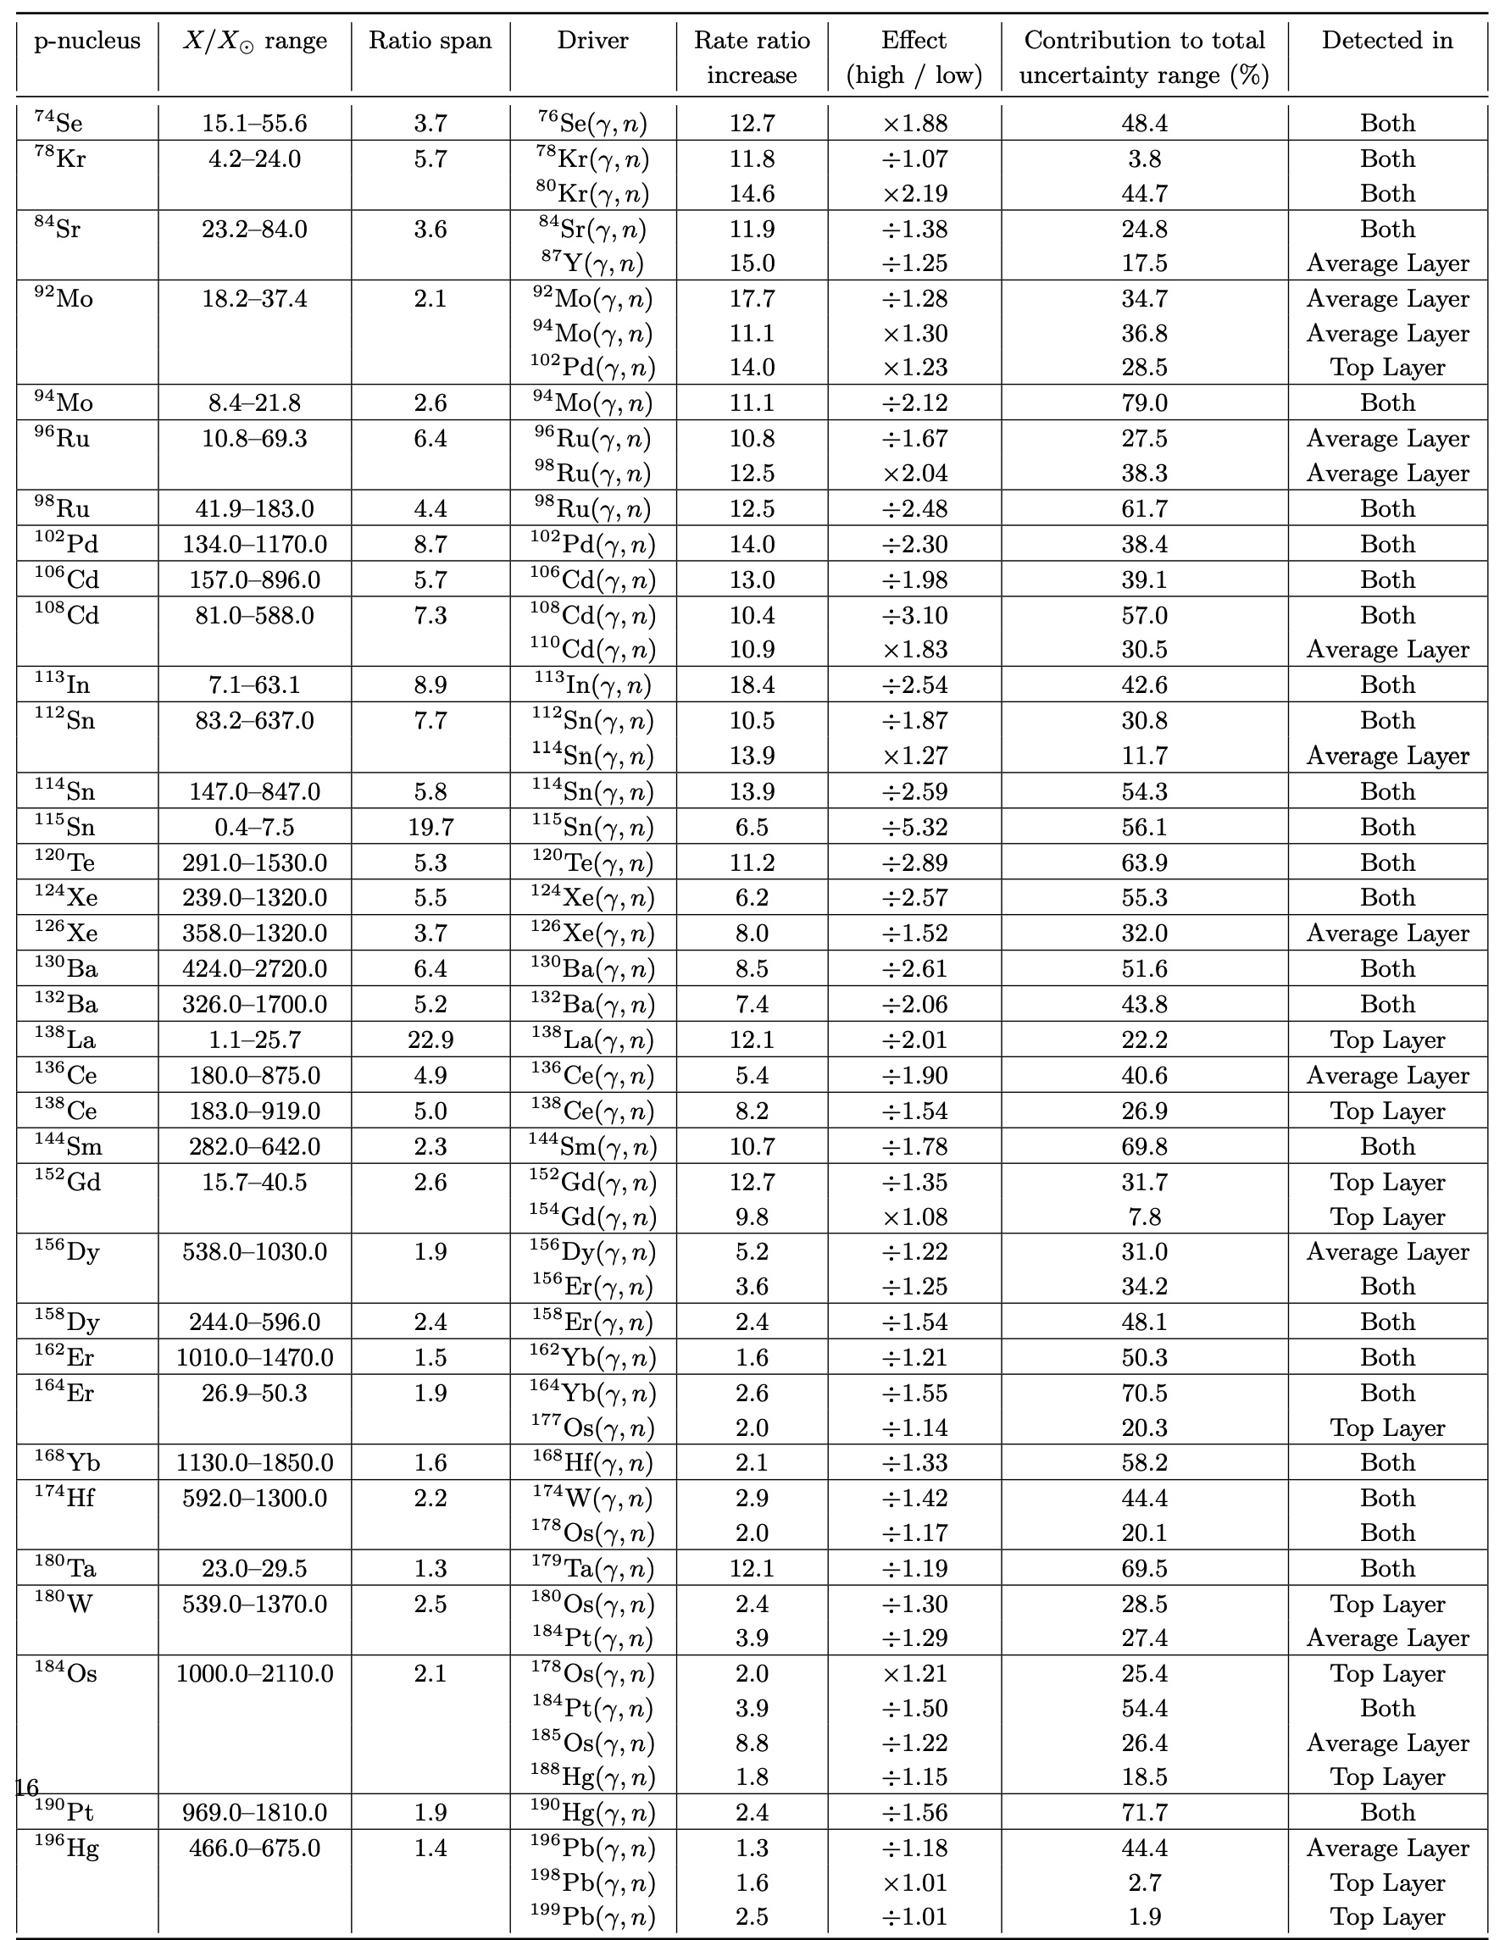
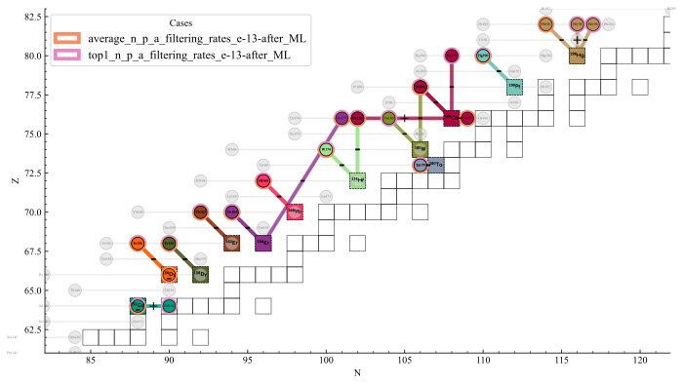
List of main (γ,n) uncertainty drivers for p-process
Main drivers:
Stable or close-to-stable targets
Photodisintegration of p-nuclei
Martinet et al., A&A 713, A49 (2026)

Slide 18
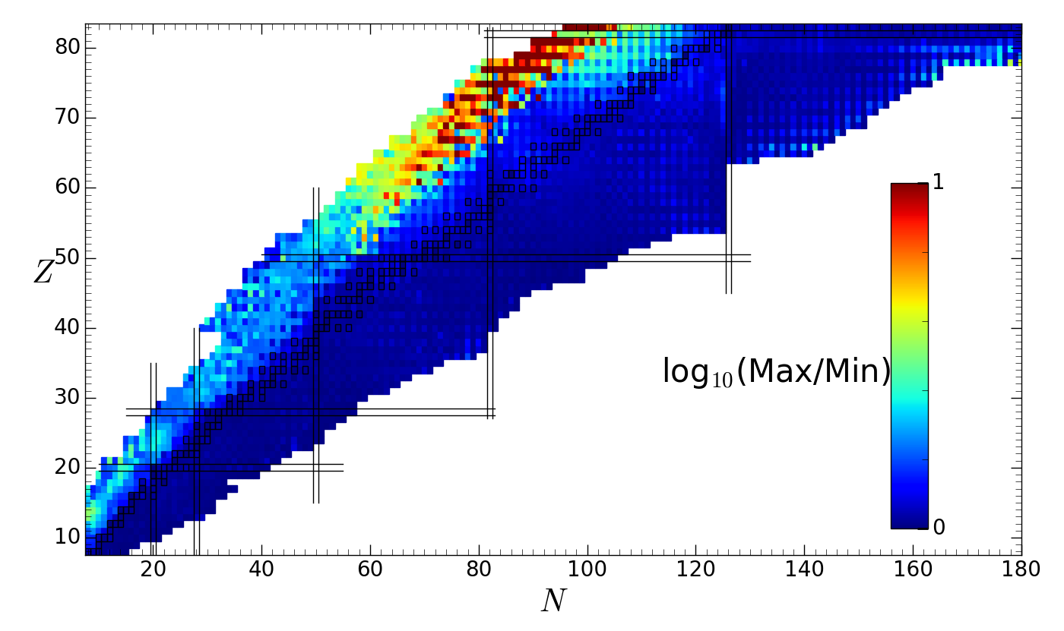
Quantification of (n,γ) uncertainties associated to n-OMP
Pruitt et al. (2023) uncertainties quantification of Koning & Delaroche OMP
120 sets of KD parameters adjusted on experimental OMP-related data
<σ>_{max} / <σ>_{min}
<σv>_{n,γ} T=10⁹K
Small impact of the OMP on the (n,γ) cross sections
KD OMP parameters have a relatively weak isospin (N-Z) dependence

Slide 19
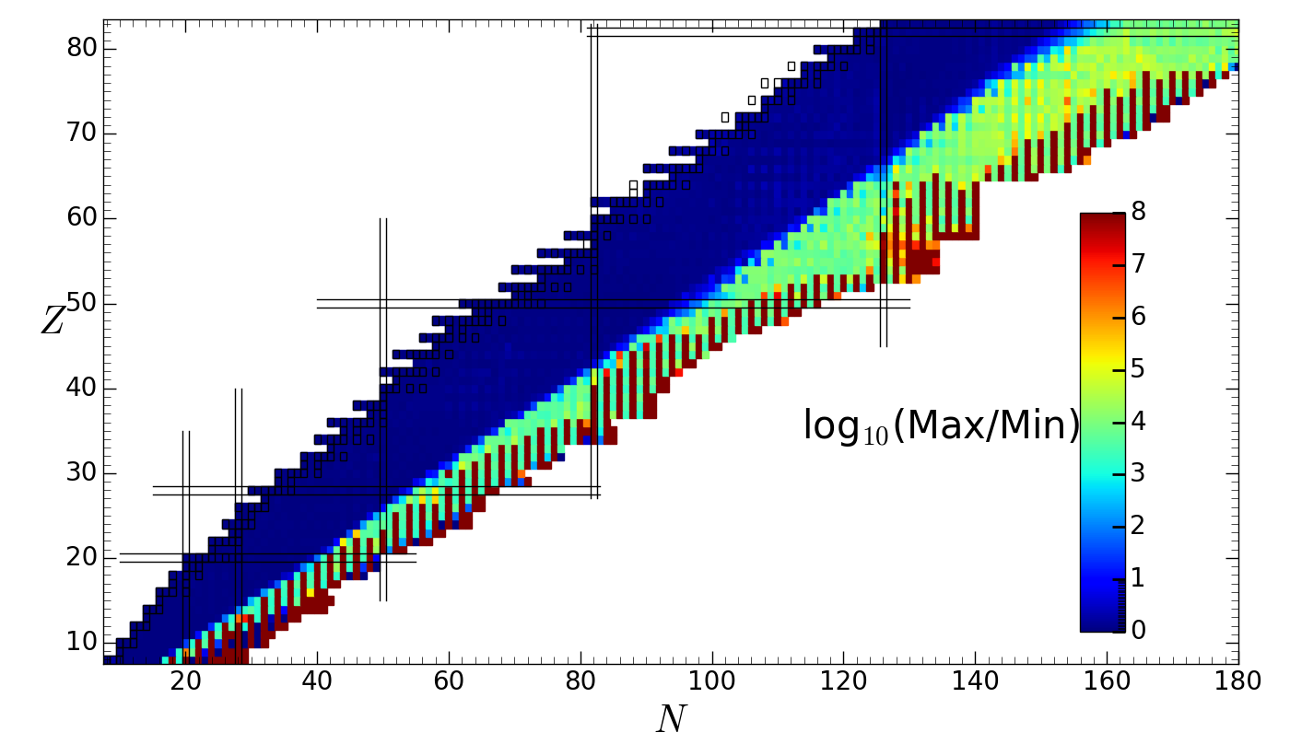
Quantification of (n,γ) uncertainties associated to n-OMP
Whitehead et al. (2021) microscopic OMP with uncertainties quantification
based on an analysis of 1800 isotopes with 12 ≤ A ≤ 242 and projectile energies E ≤ 150 MeV in the framework of many-body perturbation theory with nuclear interactions from chiral effective field theory.
→ global spherically equivalent WS-type form with uncertainty quantification
BFMC method further applied by Wang et al. (2026) using experimental (n,γ) MACS and neutron strengths S₀
171 sets of WLH parameters selected on experimental OMP-related data + MACS + S₀
<σv>_{n,γ} T=10⁹K
8 orders of magnitude !!
Huge impact of the OMP on the (n,γ) cross sections / rates

Slide 20
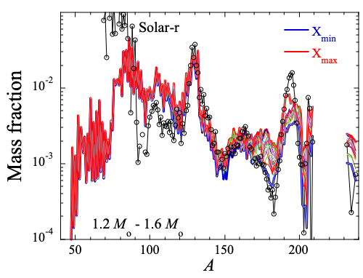
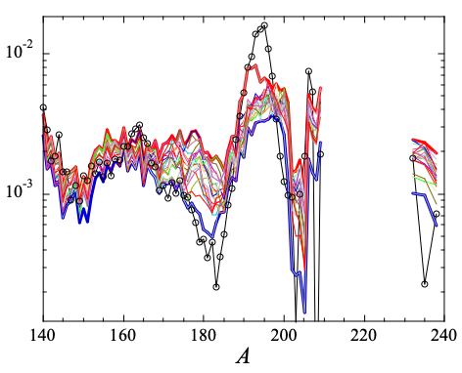
Impact of WLH OMP uncertainties on the r-process nucleosynthesis in NSM
<σ>_{max} / <σ>_{min}
r-process: 1.20 – 1.60 M_{o} NSM:1206 traj

Slide 21
Conclusions
Different types of theoretical uncertainties
  correlated model uncertainties
  uncorrelated parameter uncertainties for each model
Selection of nuclear models for astrophysics according to
  Their reliability, i.e. their physical robustness
    e.g. avoid extrapolation with “macroscopic” (or ML) models
  Their accuracy, i.e. capacity to reproduce experimental data
    e.g. SLO, GLO models of PSF should not be used

Slide 22
Conclusions
Different types of experimental NP impact
  Direct local impact : e.g. ⁷⁶Se(γ,n) on the p-production of ⁷⁴Se
  Direct regional impact : e.g. ²¹⁷Bi(n,γ) on the i-production of actinides
  Indirect global impact : new data to reduce parameter/model uncertainties
    A regularly-updated library of evaluated cross sections / rates
    in particular: n-, p-, α-captures, β±/EC/SF/α decay
    A regularly-updated library of evaluated input parameters
    in particular: M, R_{c}, β₂, J^{π}, B_{f}, D₀, S₀, <Γ_{γ}>, PSF, NLD, OMP, ...
  Direct global impact: improved theory guided by measurements, e.g.
    Mass: models towards “Shell Model” - “Ab-initio” predictions
    PSF: Systematic presence of PDR, upbend, scissors mode, ...
    NLD: Prediction of low-energy ρ(U,J,π)
    OMP: Systematics of the low-energy isovector imaginary potential
    Fission: ... so help me god !
... Still a lot of work ahead of us ...

Slide 23
THANK YOU
FOR
YOUR ATTENTION

