Slide 1

Population of
Pygmy Dipole Resonance States in Fusion–Fission Reactions
Adam Maj (IFJ PAN kraków)
and
N. kumar (Oslo), C. Schmitt (Strasbourg/kraków), M. Ciemała (Kraków)
and
S. Peru (Orsay), O. Litaize (cadarache)
and others

Slide 2
plan of the talk
PDR – what do we know
vamos++@PARIS – Fusion-fission experiment in ganil
Do we see gamma Decay of pdr states in Fusion-fission experiment?
follow up experiments
PARIS: status and plans (if time permits)
ConclusionS

Slide 3
PDR – what do we know

Slide 4
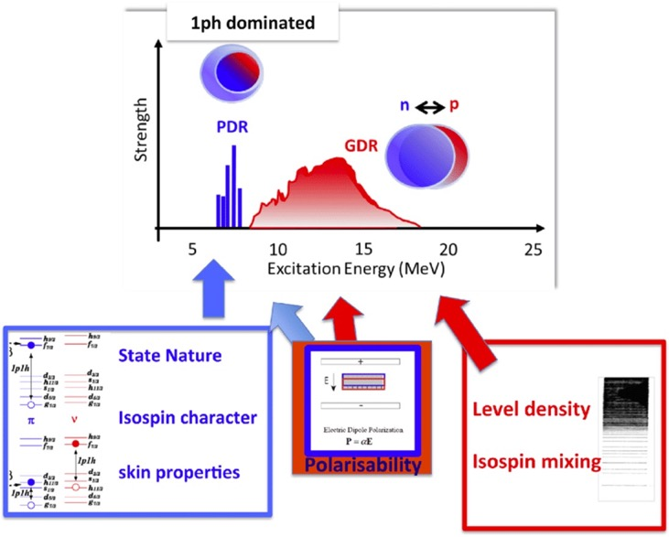
PDr states
E1 nuclear response
rich in physical information

Slide 5
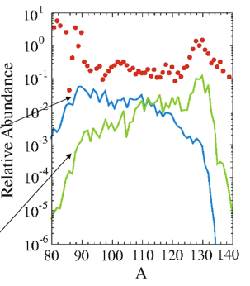
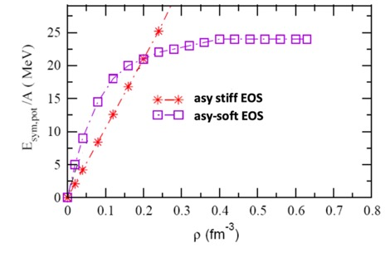
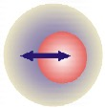
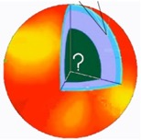
Interest in the pygmy resonance
Implications beyond nuclear
structure of the low-lying E1
strength:
Possible impact on the
r-process nucleosynthesis
related to determination of nuclear symmetry energy (n- rich matter)
can be used for neutron skin thickness determination (neutron stars)
r-process
exp
Theory
Symmetry term of EOS
Theory + Pygmy
S.Goriely, PLB, 436, 10 (1998)
0.16 normal condition
From
n-skin thickness
to
n-star radius
11

Slide 6
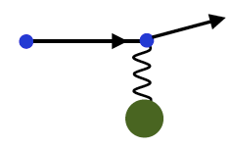
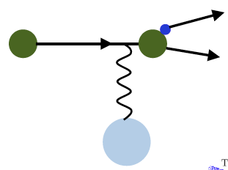
Coulomb versus nuclear excitation
(γ,γ’) real photons
on stable nuclei
Probing the entire nuclear volume
(p,p’) virtual photons
at E_{beam}> 200 MeV
on stable nuclei
Probing the entire nuclear volume
Work at Osaka RCNP
Coulomb excitation
with radioactive beams
virtual photons
Exotic nuclei
(α,α’γ) or (¹⁷O,¹⁷O’γ) and (p,p’γ)
Probing the nuclear surface mainly
– short range nuclear forces and low-energy of the collision

Slide 7
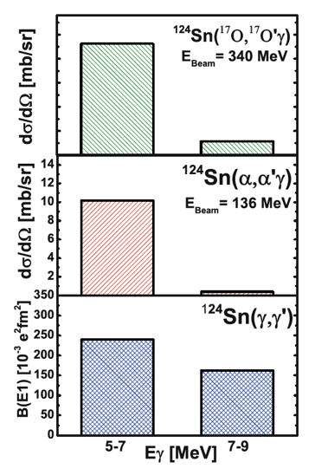
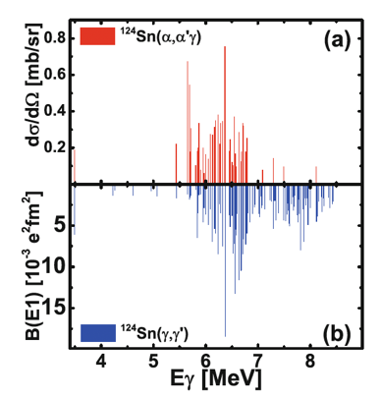
Work on ¹²⁴Sn with direct reactions
The EWSR
property of the
nuclear states
were extracted!!

Slide 8
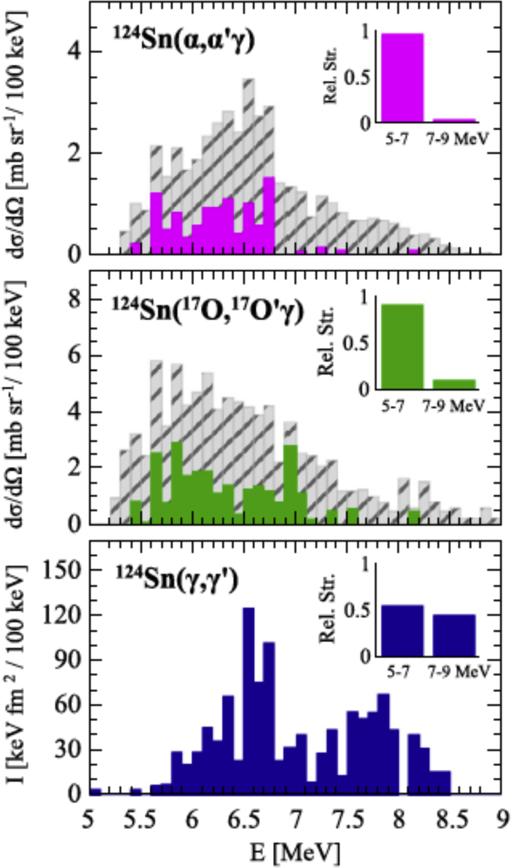
What have we learned using different probes?
Iso-scalar and iso-vector components
Similar response with α-particle
and ¹⁷O
Endres J., et al.
Phys. Rev. C, 85 (2012), 064331
Pellegri L., et al.
Phys. Lett. B, 738 (2014), 519
Govaert K., et al.
Phys. Rev. C, 57 (1998), 2229

Slide 9
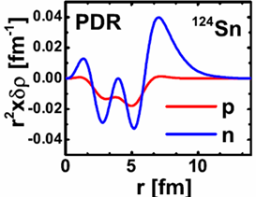
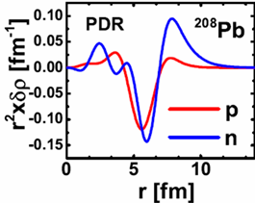
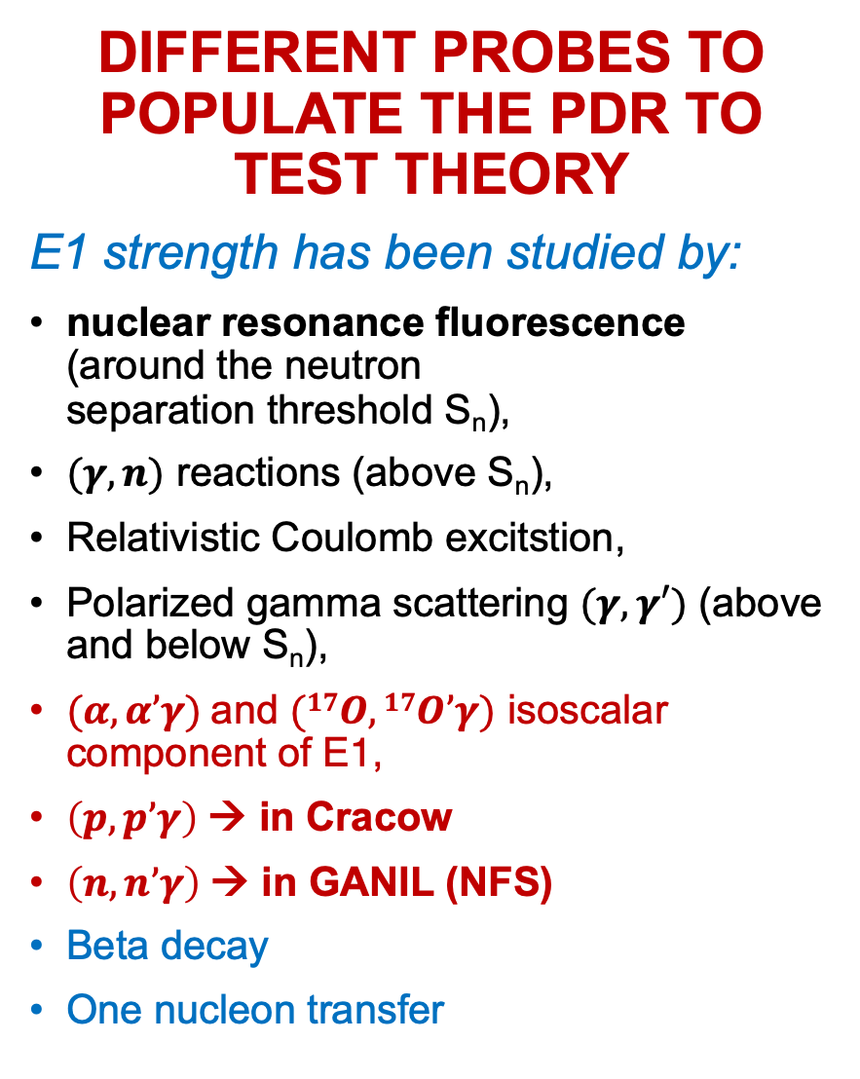
Different probes to populate the PDR to test theory
E1 strength has been studied by:
nuclear resonance fluorescence (around the neutron
separation threshold S_{n}),
$(γ,n)$ reactions (above S_{n}),
Relativistic Coulomb excitstion,
Polarized gamma scattering $(γ,γ′)$ (above and below S_{n}),
$(α,α’γ)$and $(17O,17O’γ)$ isoscalar component of E1,
$\left(p,p’γ\right)$→ in Cracow
$\left(n,n’γ\right)$→ in GANIL (NFS)
Beta decay
One nucleon transfer
Transition densities
Bracco, F.C.L. Crespi and
E.G. Lanza, EPJA(2015)51:99

Slide 10
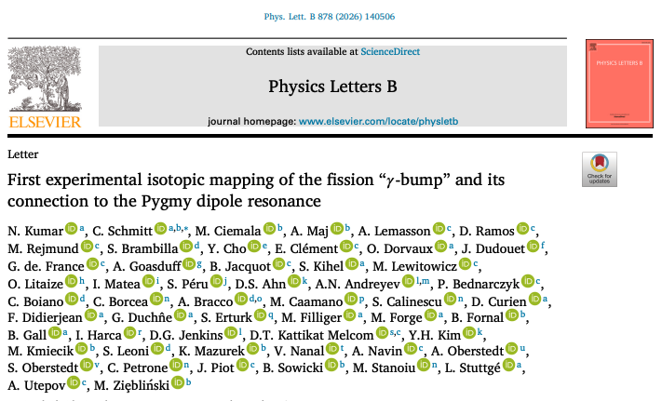
Can PDr states be populated in fission reactions?

Slide 11
vamos++@PARIS – Fusion-fission experiment in ganil

Slide 12
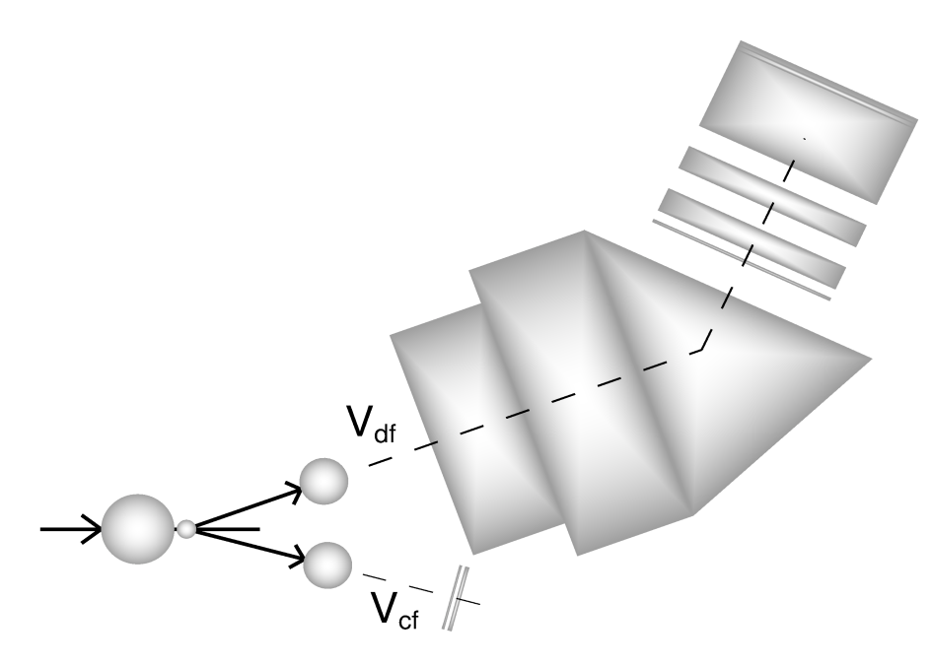
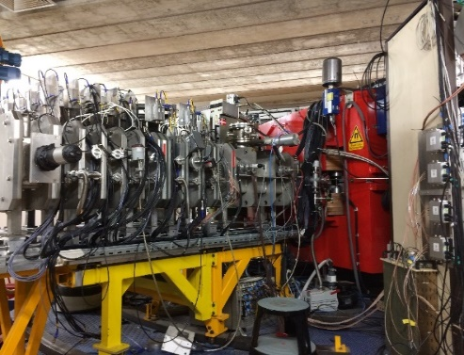

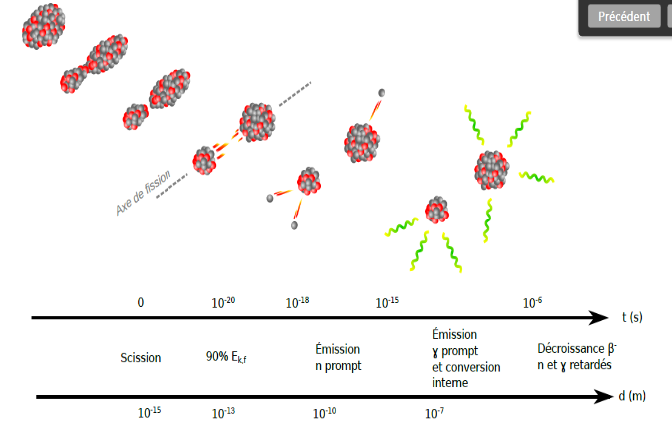
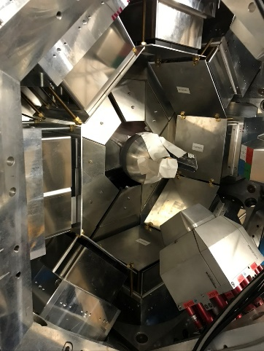
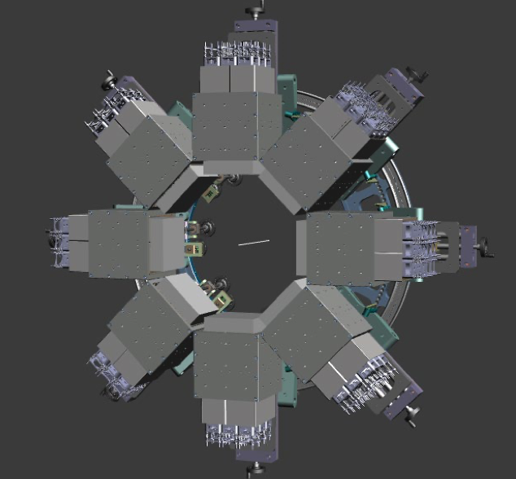
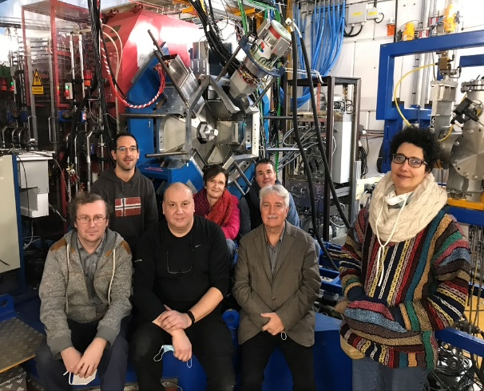
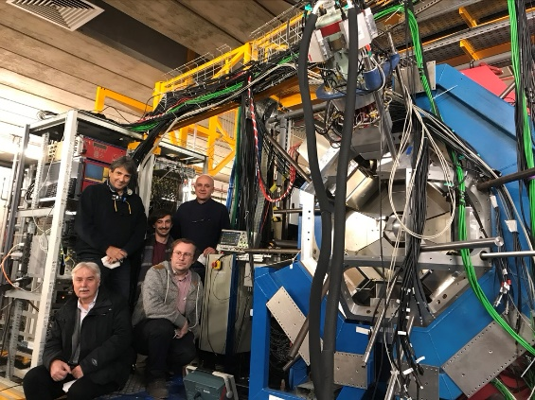
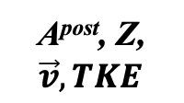
Experimental approach and Set Up at GANIL
Fusion-fission in inverse kinematics
A^{post}, Z,
$$\vec{v}, TKE$$
²³⁸U + ⁹Be →²⁴⁷Cm* (E*~ 43MeV)
^{(5.88MeV/u) (500μg/cm2)}
VAMOS++
γ
^{target}
Ff1
Ff2
γ
^{beam}
event
by
event
 Accurate Ff’s (A, Z, v, TKE)
 PFGS and properties (E_{γ}^{sum}, M_{γ} )
 Neutron multiplicity
PARIS
PFGS,
E_{γ}^{sum}, M_{γ} ,
M_{n,}
8 clusters
+ Exogam

Slide 13
PARIS array properties
Good energy resolution for low and high energy γ-rays
  35 keV @ 1.332 MeV
Excellent Time resolution (below ∼ 1 ns)
Measurement of gamma multiplicity from frontal LaBr₃ or CeBr₃
Large efficiency for high energy γ-rays (∼ 5% at 10 MeV for 8 clusters)
72 phoswiches in 8 clusters
72 LaBr3:Ce or CeBre 2”x2” crystals in 8 clusters
∼ 28 liters of NaI in 8 clusters
Previous use of PARIS in PFGS/PFNS:
E. Kozulin et al., Eur. Phys. J A 56 (2020) 6
E. Vardaci et al., Phys. Rev. C 101 (2020) 064612
L. Qi et al., Eur. Phys. J A 56 (2020) 98

Slide 14
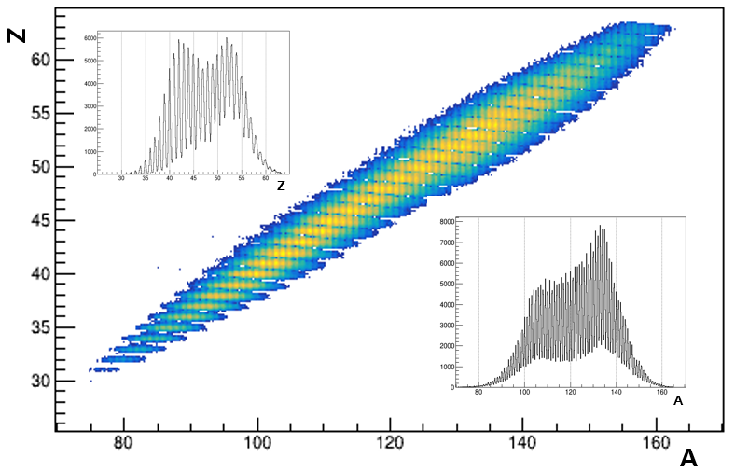
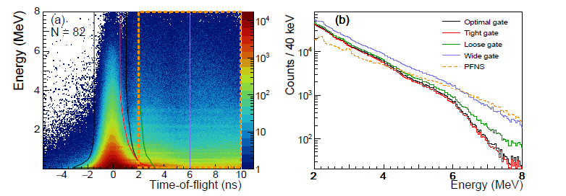
VAMOS++:
Ecellent A&Z resolution - in the present experiment it was 1/200 in mass and 1/68 in charge.
PARIS:
Excelent
neutron/γ discrimination

Slide 15

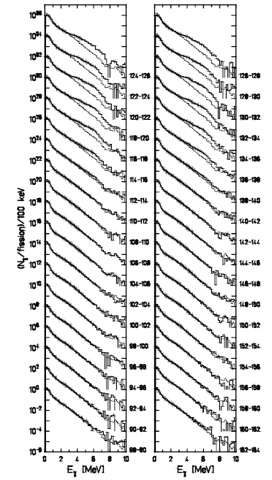
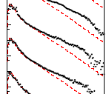


A singular phenomenon: The fission “ γ bump ”
1980’s: Evidence of an excess
of γ’s at high E_{γ} for some splits
2019 onwards: γ bump profile
²⁵²Cf (sf)
VAMOS++ + PARIS
HIGHER SENSIVITY
Francheteau et al., PRC (2025)
Early 2025: Heated debate about origin
Structural? Statistical?
Collective or Single-particle nature?
Due to n (N~68,82) and/or p (Z~40,50)?
Need of A and Z
identification of the emitter
Holtzel et al., Z Phys. (1996)

Slide 16
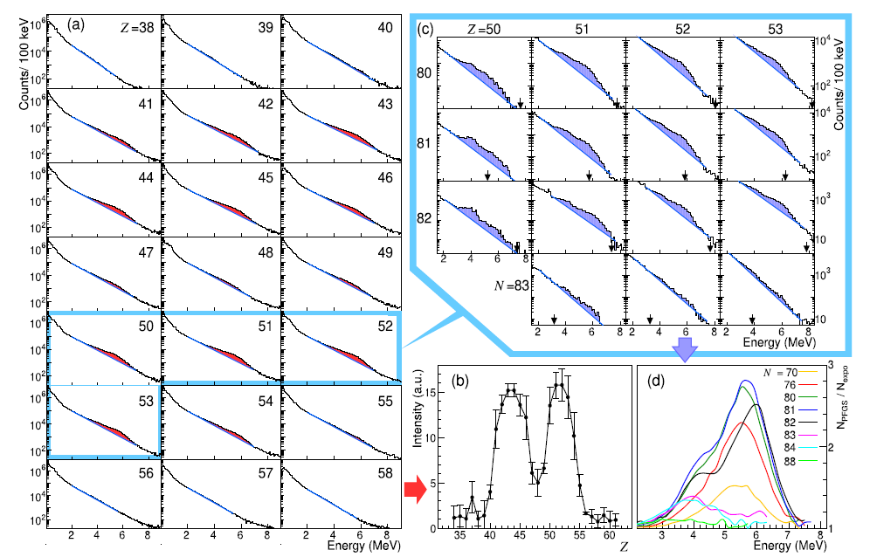

Isotopic mapping of the γ bump with PARIS@VAMOS++
The isotopic dependence of the 𝛾-bump was evidenced for the first
time in this work

Slide 17
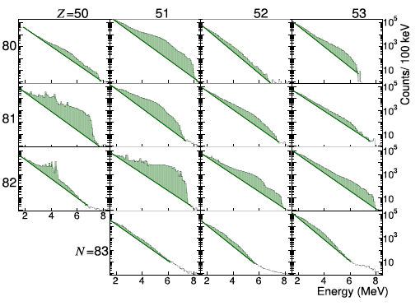
Experimental data and FIFRELIN code calculations
by Olivier Litaize with Sophie Péru microscopic NLD and GSF
FIFRELIN is a Monte Carlo code modelling the energetics of fission at scission, followed by the de-excitation of the about 500 produced fragments within the Hauser-Feshbach formalism. Model ingredients are taken from experiment and/or phenomenological models or microscopic theories (e.g. for NLD, GSF, internal conversion and neutron transmission coefficients, etc) depending on availability.
The FIFRELIN description of the overall trend with 𝑍 and 𝑁, concerning the presence or absence of a bump and its single- or double-humped profile, is rather remarkable.

Slide 18
Do we see gamma Decay of pdr states in Fusion-fission experiment?

Slide 19
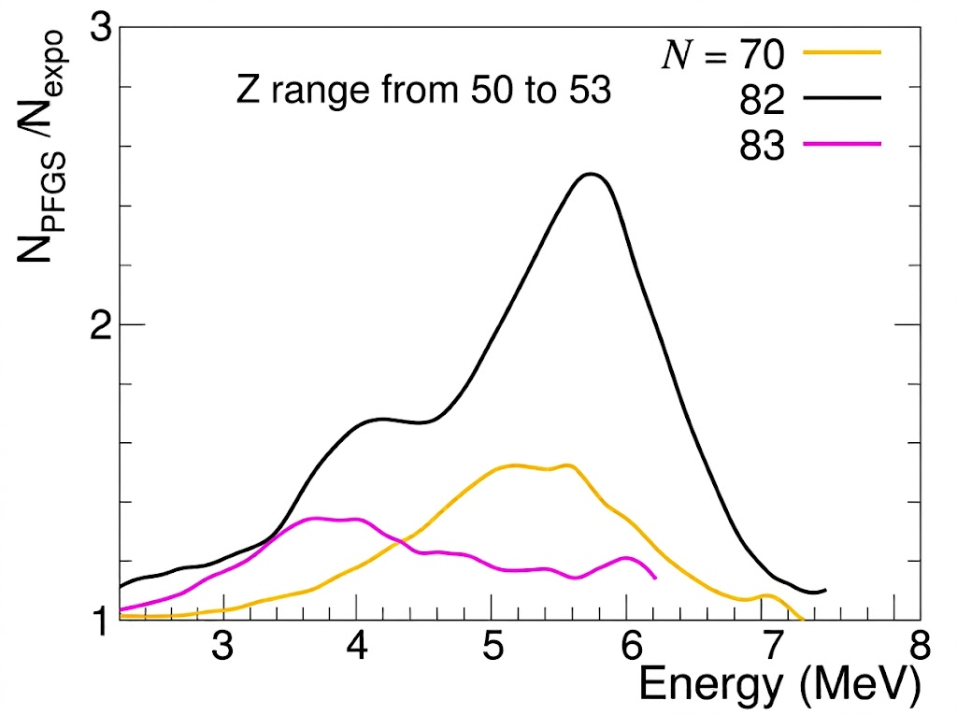
Observation: Striking similarity of the „bumps”
to Iso-scalar and iso-vector PDR states
Iso-scalar PDR component?
Iso-vector PDR component?
is this an evidence for Pygmy “strength” in fission?

Slide 20
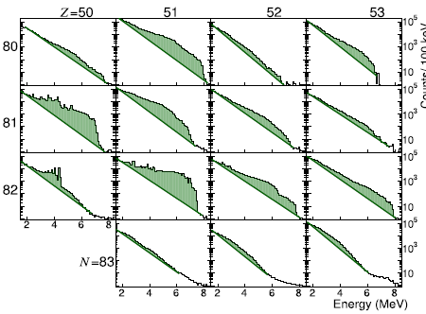
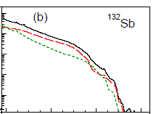

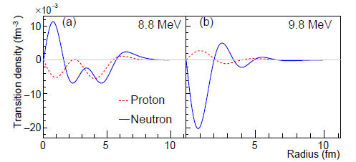



Origin of the γ bump in theoretical calculations
Dedicated fission-fragment deexcitation calculations with the FIFRELIN code using
microscopic nuclear level densities (D1M) and γ strength functions (D1M+QRPA)
with O. Litaize, S. Péru
Calculated PFGS
Fission populates states in the low-energy tail of the Giant Dipole Resonance between ~ 5 and 10 MeV
! PYGMY RESONANCE !
Total E1
M1
Fission and Soft/Giant Resonances
physics
Two-fold impact:
 Insight into the post-scission dynamics of the fragments
 Insight into the nature of « Pygmy states »
R
R
Calculations by S. Péru (2025)
 Main contribution due to the decay from E1 states
 Both IsoScalar (IS) and Isovector (IV) nature
 IS component enhanced at N~82 due to vibration
of the « stiff » neutron skin about the core
Neeraj Kumar, C.S, M. Ciemala, A. Maj, et al., accepted at Phys Lett B (2026)

Slide 21
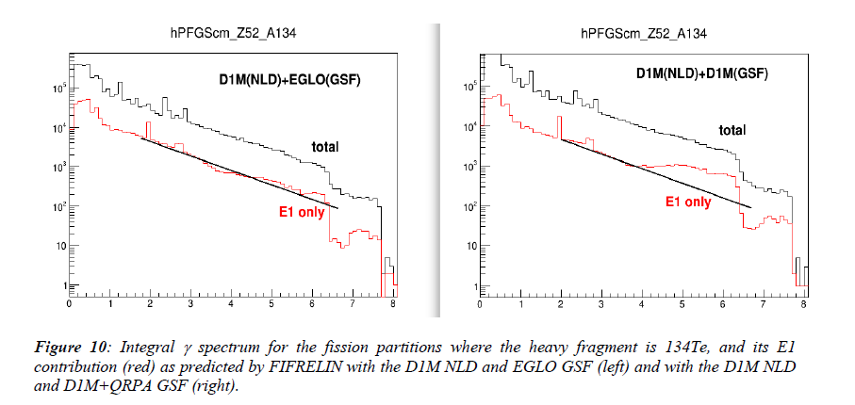
Are these bumps really PDR states?
If the ”bumps” correspond to PDR gamma-decay, then if we "remove" in the theory the PDR states, the bumps should disappear.
Calculations where the D1S+QRPA gamma strength was replaced with with a phenomenological "standard" gamma strength function, which does not account for the PDR but only for the GDR.
Full calculations
In the theory the bumps are indeed resulting from the PDR gamma-decay

Slide 22
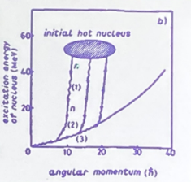
Why in some nuclei bump is stronG
and in another – weak or absent
Maybe due to population pathway?
If PDR state is built on a ground state, it will be fed preferentially from entry regions of low angular momentum, the cascades coming from higher angular moment will go to the yrast and will bypass PDR
entry region
PDR

Slide 23
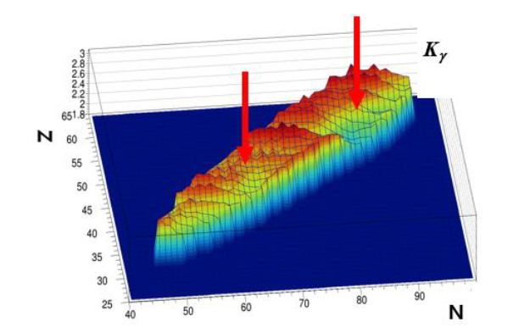
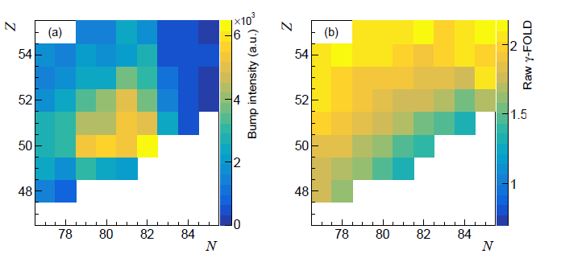
Can feeding mechanism explain the intensity of the PDR states?
γ fold in PARIS vs. (Z,N) in VAMOS++
Intensity of the γ-bump
γ-fold (multiplicity) ~ ang. mom.
Indeed, it seems to exist some correlation between the region of nuclei with high γ-bump intensity and with low angular momentum

Slide 24
We found quite strong hint, that the γ-bumps seen in many measured prompt fission gamma spectra (PFGS), are related to the γ-decay of PDR states populated in the fusion-fission reactions.
Hovever to proove this, more studies, for example of
angular distributions of the PFGS,
mechanisms of angular momentum and exitation energy sharing,
are needed.

Slide 25
follow up experiments

Slide 26
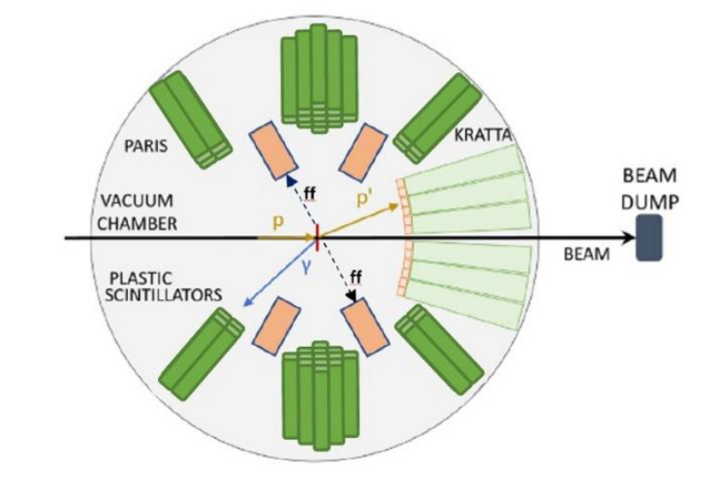
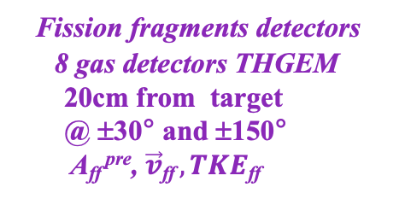
Next plans experiment at CCB IFJ PAN: Evolution of pFG emission with excitation energy
Event-by-event
E* - tagged fission of ²³²Th
Ff’s (A, TKE)
PFGS and PFNS
and…
PFGS Angular Distributions (+ maybe polarisations)!!
Inelastic scattering
p + ²³²Th → p’ + ²³²Th* (E* up to ~ 30MeV)
^{(160Mev) (400μg/cm2)}
^{p’}
^{n}
²³²Th
^{p}
^{γ}
Ff1
²³²Th*
Ff2
KRATTA
32 triple telescopes
40cm from target
from 6° to 18°
E_{p’} , ϑ_{p’}
Fission fragments detectors
8 gas detectors THGEM
20cm from target
@ ±30° and ±150°
A_{ff} ^{pre}, $\vec{v}\text{ff} , TKE$_{ff}
PARIS
42 phoswiches
27cm from target
@ ±45, 90, 135°
PFGS, E_{γ}^{sum}, M_{γ} ,
PFNS, M_{n}
Despite worse A and Z resolution as compared to VAMOS, we might establish multipolarities of the γ-bumps, proving that they are indeed PDR states
FISSION FRAGMENT DETECTOR

Slide 27
Posibly:
New VAMOS++&PARIS exoeriment in Ganil, but using more PARIS clusters at different angles, so that the measurements of Angular distributions of the claimed PDR states will be possible.

Slide 28

PARIS: status and plans

Slide 29
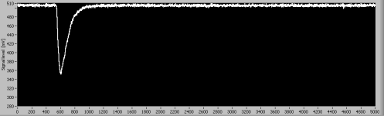
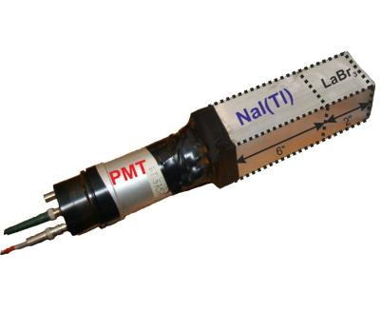
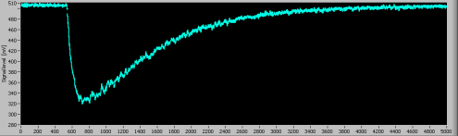
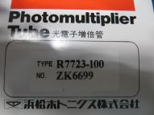
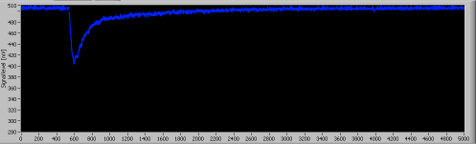
Phoswich tests
10 ns risetime
LaBr3 or CeBr3
Single pulses
HAMAMATSU
Mixed signal

Slide 30
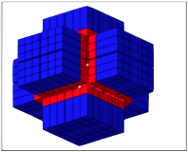
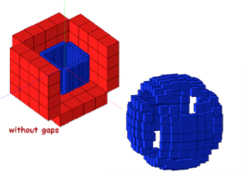
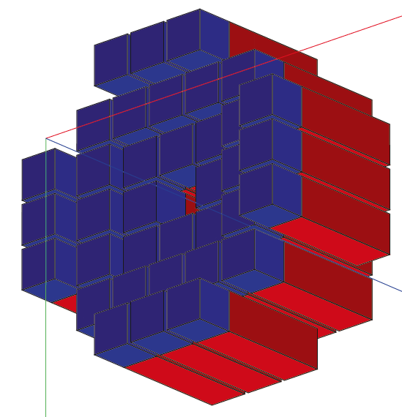
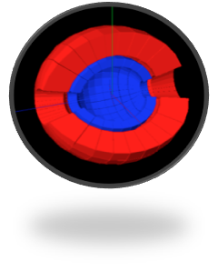
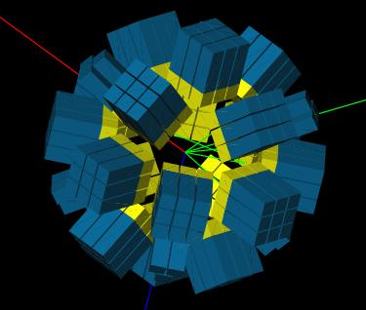
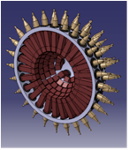
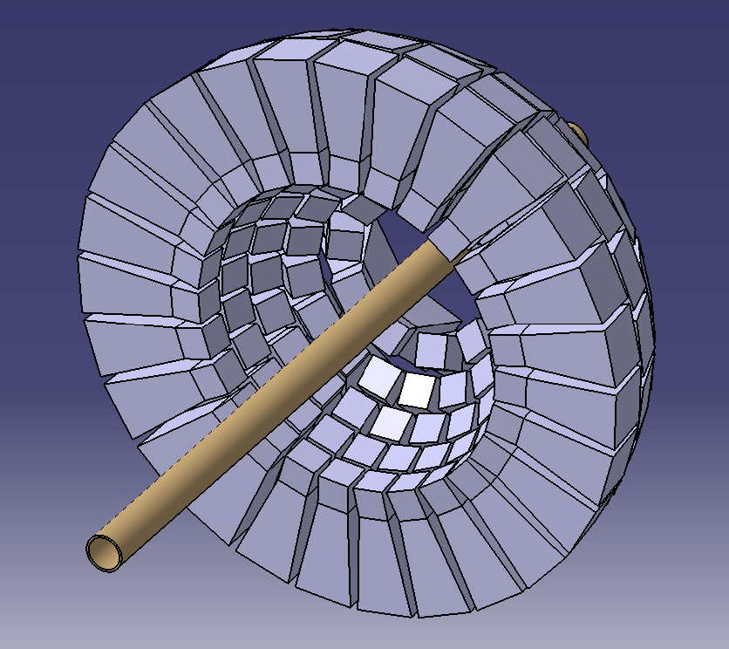

Several geometries studied
‘cubic’-like
‘Ideal’ - spherical
‘radial’-like
PARIS to be made of rectangular phoswiches
Arranged in clusters (9 phoswiches each)
This allows cubic, wall or semi-spherical geometry with 24 clusters (216 phoswiches)

Slide 31
Presently PARIS collaboration possesses 106 phoswich detectors - ≈ 12 clusters:
4 LaBr3_NaI clusters (produced by Saint Gobain)
6 CeBr3_NaI cluster (produced by Scionix)
1 mixed LaBr_NaI and CeBr3_NaI
Detectors are normally in the owners laboratories
(for example: 3 clusters are presently in IFJ PAN Krakow, 2 in Mumbai, rest in Orsay, Milano, …)
According to the MoU the partners should make them available for the experimental campaigns in the host laboratories: GANIL, IJCLaB Orsay, LNL Legnaro, IFJ PAN, Mumbai, …

Slide 32



PARIS@LEGNARO
200 mm
200 mm
200 mm
Displacements to access to the target
Stil ongoin work for the details of the mechanical coupling by
IJCLab Orsay (I. Matea, Ch. le Galliard), IFJ PAN Krakow (B. Sowicki, A. Maj, M. Ciemała),
LNL Legnaro (S. Pigliapoco, M. Rampazzo, J.J. Valiente-Dobon), Milano (F. Camera, G. Benzoni, B. Million)

Slide 33
List of LOIs for AGATA-PARIS setup in LNL Legnaro
Commissioning of the AGATA Zero-Degree Configuration at LNL
Spoke-persons: F. Crespi – S. Bottoni – B. Greaves – M. Ciemala
Search for Pygmy Dipole Resonance Built on Super-deformed ¹⁹⁴Hg
Spoke-persons: O. Wieland – M. Ciemala
Investigating the evolution of the low-lying iso-scalar strength in Sn isotopes using the AGATA and PARIS arrays
Spoke-persons: M. Markova – A. Giaz
Investigation of the Pygmy Dipole Resonance in ⁸⁸Sr, ⁹⁰Zr, ⁹⁴Zr and ⁹²Mo via Inelastic ¹⁷O Scattering
Spoke-persons: A. Giaz, I. Matea, M. Markova
The search for Jacobi shape transitions and related phenomena in hot rotating 92Mo nuclei …
Spoke-persons: M. Kmiecik, A. Maj – F. Camera
GDR feeding of Super-Deformed states in ¹⁴³Eu
Spoke-persons: F. Camera – M. Kmiecik
Linking the compound nucleus deformation with the low-energy isomeric structures of different deformations in ¹⁸⁸Pt …
Spoke-persons: M. Ciemala – F. Crespi
Study of the Photon and Neutron Decay of Giant Resonances in ²⁰⁸Pb, excited via ¹⁷O inelastic scattering
Spoke-persons: M. Kmiecik – F. Crespi
Excitation energy, spin and parity determination in ... The case of the identical bands of ¹⁵¹Tb and ¹⁵²Dy
Spoke-persons: J. Lyungvall – O. Dorvaux
Elucidating the mechanism of ¹²C(¹²C,𝛾) radiative capture
Spoke-person: D. Jenkins
Lifetime measurements of excited states in neutron-rich ¹⁸C and ¹⁶C isotopes: a test of the three-body forces
Spoke-persons: M. Ciemala – F.C.L. Crespi
Studies of the high-spin structure in nuclei close to ⁴⁰Ca, …
Spoke-persons: P. Bednarczyk – M. Matejska-Minda, A. Maj
Investigating the prompt γ-feeding of the fission isomer ^{237f}Pu with the recoil-shadow technique
Spoke-persons: C. Hiver - J. Wilson

Slide 34
ConclusionS
In an unique experiment in GANIL of coupling two state-of-art instruments, VAMOS++ and PARIS, a dataset for the PFGS together with isotopically identified fission fragments was collected.
Scanning of the "gamma-bump" for entire fission fragment production and identification of its emitters in Z and N in the model-independent way was achieved for the first time
For entry regions of fissions fragments with lower angular momenta (around Z = 50 and N = 82), we see intense high energy structures („γ-bumps”) in the gamma-ray spectrum which may be interpreted as originating from PDR γ-ray decay. The results agree remarkable well with the theoretical predictions using FIFRELIN code calculations with microscopic NLD and GSF.
This suggest, that the fission process can be another probe to populate and study Pygmy Dipole Resonance states, also in the exotic, difficult to reach otherwise, nuclei.
Further investigations of this phenomenon, using the PARIS array (which construction is constantly progressing) are planned.

Slide 35
Acknowledgements
to all Colleagues, co-authors of the PLB paper:
to VAMOS, PARIS and EXOGAM collaborations,
and to EURO-LABS support

Slide 36
backup slides

Slide 37
Prompt de-excitation of the fragments
after scission
Generation of E* and L in fission
Sharing at scission
 Depends on the dynamics of fission:
Depends on fundamental nuclear properties:
Nuclear level density
γ strength function
De-excitation of a fission fragment after scission
Complete
Fission
ExpEriments
Measurement of the properties of
the prompt neutrons and γ rays in
coincidence with fragment (A, Z)
Reconstruct the de-excitation path
Deduce the primary fragment E* and L

Slide 38


²³⁸U + ⁹Be →²⁴⁷Cm*
PARIS is at 90º in respect to the Velocity vector of detected fragment in VAMOS, while forward and backward in respect to the undetected fragment.
a) and b): PFGS for ¹³⁴Te in VAMOS++, in the low and higher E range.
Red and black refer to the spectrum defined as forward and backward, respectively. Blue arrows show transitions from ¹³⁴Te, while green points the region characteristic of the light partners.
c) and d): Same for ¹⁰⁴Mo in VAMOS++. Green arrows show transitions from ¹⁰⁴Mo.
Conclusion: Emission from heavy partner

Slide 39

N,Z gated properties – PFGS
Current VAMOS++ + PARIS setup cannot separate γ-rays originating from the two fission fragments.
Spectra labeled with charge Z include contributions from both the detected fragment (Z) and its complementary partner (ZFS​−Z).
Detected Z=52 contains γ-rays from partners Z=44, 42, 40 (from Cm, Pu, and U fission).
Detected Z=42 contains γ-rays from partners Z=54, 52, 50.
The "bump" intensity peak is distributed over a wider range of Z values on the light fragment side compared to the heavy fragment side.
The γ-bump originates primarily from the heavy fragments.

Slide 40


Energy resolution and Add back: PARIS
Energy resolution: ~30 keV around 1.2 MeV, ~50 keV around 2.7 MeV.
Addback: Summing of Energy deposits inside PARIS cluster
Cluster of phoswiches “advantage”

Slide 41


Promp gamma-ray: time measurement
Time betwen gamma and ion [ns]
Ion V [cm/ns]
Event by event ion velocity correction of ToF
ToF sigma for prompt gamma peak ~0.8 ns

Slide 42

N, Z, identification VAMOS++ spectrometer
The resolution achieved in the present experiment was 1/200 in mass and 1/68 in charge.
Detected post-neutron mass spectrum

Slide 43




Towards a complete measurement with PARIS@VAMOS++
γ fold in PARIS vs. (Z,N) in VAMOS++
²³⁸U + ⁹Be →²⁴⁷Cm*
P R E L I M I N A R Y
Fragment (Z,N) in VAMOS++
Prompt Fission γ Spectrum in PARIS
Available data set:
 ~ 500 PFGS (Z,N) tagged in VAMOS++
 M_{γ} , <E_{γ} >, E_{γ}^{sum}
 Exponential tail = f (NLD, T)
 Neutrons

Slide 44


