Slide 1

Study of stretched states at CCB
N.Cieplicka-Oryńczak¹, Y. Jaganathen⁹, B. Fornal¹, S. Leoni², M. Płoszajczak³, M. Ciemała¹, S. Ziliani², M. Kmiecik¹, A. Maj¹, J. Łukasik¹,
P. Pawłowski¹, B. Sowicki¹, B. Wasilewska¹, M. Ziębliński¹, C. Boiano², S. Brambilla², P. Bednarczyk¹, S. Bottoni², A. Bracco², I. Burducea⁵,
F. Camera², I. Ciepał¹, C. Clisu⁵, F.C.L. Crespi², K. Dhanmeher¹, N. Florea⁵, E. Gamba², J. Grębosz¹, M. N. Harakeh⁴, D. A. Iancu⁵, Ł.W. Iskra¹,
M. Krzysiek¹, P. Kulessa¹, N. Marginean⁵, R. Marginean⁵, I. Matea⁷, M. Matejska-Minda¹, K. Mazurek¹, B. Million², W. Parol¹, M. Sferrazza⁸, L. Stan⁵, B. Włoch¹, C. Schmitt¹, D. Duda¹, K. Gajewska¹, O. Wieland², G. Corbari², A. Giaz², E. van Rompu⁶, P.-A. Söderström¹⁰, A. Kuşoğlu¹⁰, S. R. Ban¹⁰, D. Balabanski¹⁰, K. Hadyńska-Klęk¹¹, A. Špaček¹¹, P. Dey¹¹, A. Krzysiek¹¹, G. Szymanek¹¹
¹IFJ PAN Kraków, Poland, ²Università degli Studi di Milano and INFN Sezione di Milano, Italy, ³GANIL, Caen, France, ⁴University of Groningen,
The Netherlands, ⁵IFIN-HH, Bucharest, Romania, ⁶KU Leuven, Belgium, ⁷Université Paris-Saclay, France, ⁸Université Libre de Bruxelles, Belgium, ⁹National Centre for Nuclear Research, Warsaw, Poland, ¹⁰ELI-NP, Bucharest, Romania, ¹¹Heavy Ion Laboratory, Warsaw, Poland

Slide 2
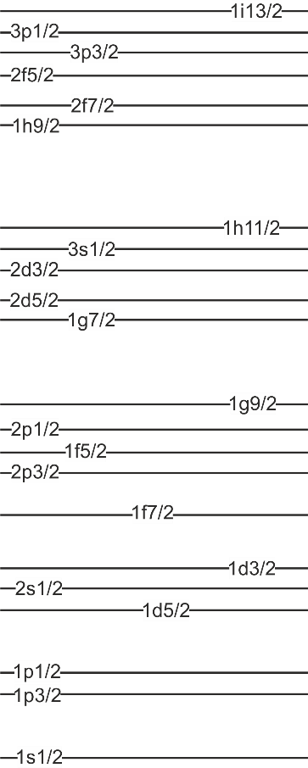
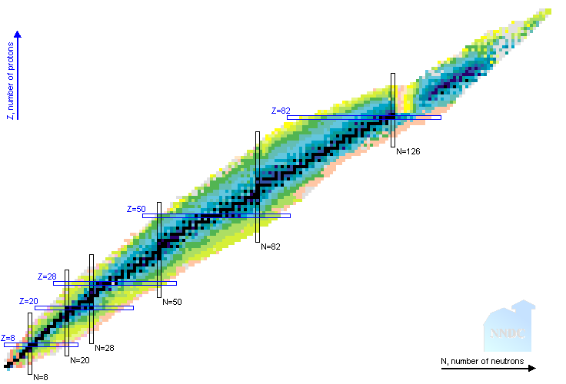
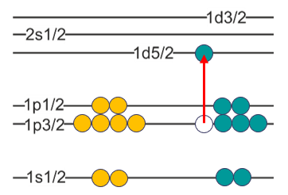
What is a „stretched” state?
Such states are dominated by a single particle-hole component
for which the excited particle and the residual hole couple to
the maximal possible spin value:
J_{max} = j_{p} (max) + j_{h} (max)
M12
REPORTED STRETCHED STATES
M10
J = 5/2 + 3/2 = 4
h_{11/2}  i_{13/2} M12 transitions
i_{13/2}  j_{15/2} M14 transitions
²⁰⁸Pb
M8
f_{7/2}  g_{9/2} M8 transitions
⁵²Cr, ⁵⁴Fe, ⁵⁶Fe, ⁵⁸Ni ⁶⁰Ni
M6
d_{5/2}  f_{7/2} M6 transitions
²⁴Mg, ²⁸Si
M4
PROTONS NEUTRONS
¹⁶O
p_{3/2}  d_{3/2} M4 transitions
¹¹B, ^{12,13,14}C, ^{14,15}N, ¹⁶O

Slide 3
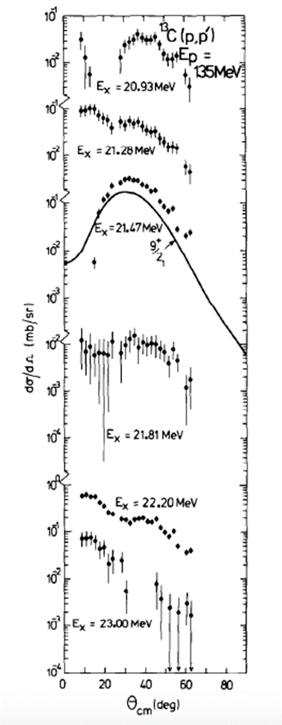
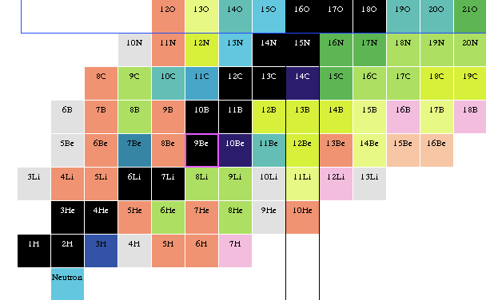
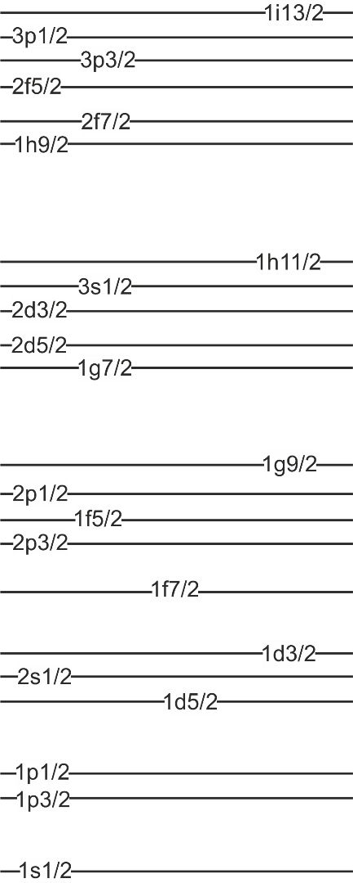
Stretched states in light nuclei – why are they interesting?
M4 STATES
IN CONTINUUM
In light nuclei reached by p_{3/2}  d_{5/2} M4 transitions
Populated in inelastic scattering of protons, electrons or pions (experiments in the 80’s)
UNBOUND STATES
PARTICLE
SEPARATION
ENERGY
¹⁶O
¹⁴N
¹⁵N
¹²C
¹³C
¹⁴C
¹¹B
BOUND STATES
ALMOST NO DATA ON
M4 RESONANCES DECAY!
PROTONS NEUTRONS
¹³C
CONFIGURATIONAL PURITY
ones of the simplest known
nuclear excitations
TESTING GROUND FOR THEORETICAL CALCULATIONS
properties of stretched states (decay patterns e.g.) used as
demanding test of state-of-the-art theory approaches
(Gamow Shell Model e.g.)
30°

Slide 4
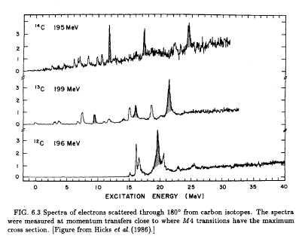
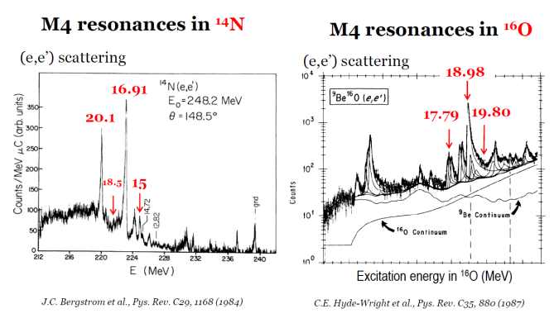
Stretched resonances – from previous works
¹³C is a perfect case to start:
strong M4 excitation
well isolated peak
quite easy preparation of target
INELASTIC ELECTRON SCATTERING EXPERIMENTS
¹⁴C
11.7
17.3
24.3
RADIOACTIVE
TARGET
21.47
¹³C
16.08
REPORTED STRETCHED STATES
In light nuclei reached by p_{3/2}  d_{3/2} M4 transitions
Populated in inelastic scattering of protons,
electrons or pions (experiments in the 80’s)
9.5
1d_{5/2}
¹²C
19.5
R.S. Hicks et al., PRC34, 1161(1986)
1p_{1/2}
¹⁶O
¹⁴N
¹²C
¹³C
¹⁴C
18.98
1p_{3/2}
¹⁴N
16.91
20.1
¹⁶O
17.79
19.80
J.C. Bergstrom et al.,
PRC29, 1168(1984)
1s_{1/2}
18.5
15.0
C.E. Hyde-Wright et al., PRC35, 880(1987)
1s_{1/2}
1p_{3/2}
1p_{1/2}
1d_{5/2}

Slide 5
Stretched resonances – from previous works
¹²C: the 19.5-MeV stretched M4 excitation is mixed with other multipolarities
INELASTIC ELECTRON SCATTERING EXPERIMENTS
¹⁴C
11.7
17.3
24.3
RADIOACTIVE
TARGET
21.47
¹³C
16.08
REPORTED STRETCHED STATES
In light nuclei reached by p_{3/2}  d_{3/2} M4 transitions
Populated in inelastic scattering of protons,
electrons or pions (experiments in the 80’s)
9.5
1d_{5/2}
¹²C
19.5
MORE COMPLEX CASE
R.S. Hicks et al., PRC34, 1161(1986)
1p_{1/2}
¹⁶O
¹⁴N
¹²C
¹³C
¹⁴C
18.98
1p_{3/2}
¹⁴N
16.91
20.1
¹⁶O
17.79
19.80
J.C. Bergstrom et al.,
PRC29, 1168(1984)
1s_{1/2}
18.5
15.0
C.E. Hyde-Wright et al., PRC35, 880(1987)
1s_{1/2}
1p_{3/2}
1p_{1/2}
1d_{5/2}

Slide 6
Stretched resonances – from previous works
¹⁴N has two strong M4 excitations, but the target is difficult to prepare…
Lithium amide: ⁷Li-¹⁴N-H₂ + (¹⁶O contamination)
INELASTIC ELECTRON SCATTERING EXPERIMENTS
¹⁴C
11.7
17.3
24.3
RADIOACTIVE
TARGET
21.47
¹³C
16.08
REPORTED STRETCHED STATES
In light nuclei reached by p_{3/2}  d_{3/2} M4 transitions
Populated in inelastic scattering of protons,
electrons or pions (experiments in the 80’s)
9.5
1d_{5/2}
¹²C
19.5
MORE COMPLEX CASE
R.S. Hicks et al., PRC34, 1161(1986)
1p_{1/2}
¹⁶O
¹⁴N
¹²C
¹³C
¹⁴C
18.98
1p_{3/2}
¹⁴N
16.91
20.1
¹⁶O
17.79
19.80
J.C. Bergstrom et al.,
PRC29, 1168(1984)
1s_{1/2}
18.5
15.0
C.E. Hyde-Wright et al., PRC35, 880(1987)
1s_{1/2}
1p_{3/2}
1p_{1/2}
1d_{5/2}

Slide 7
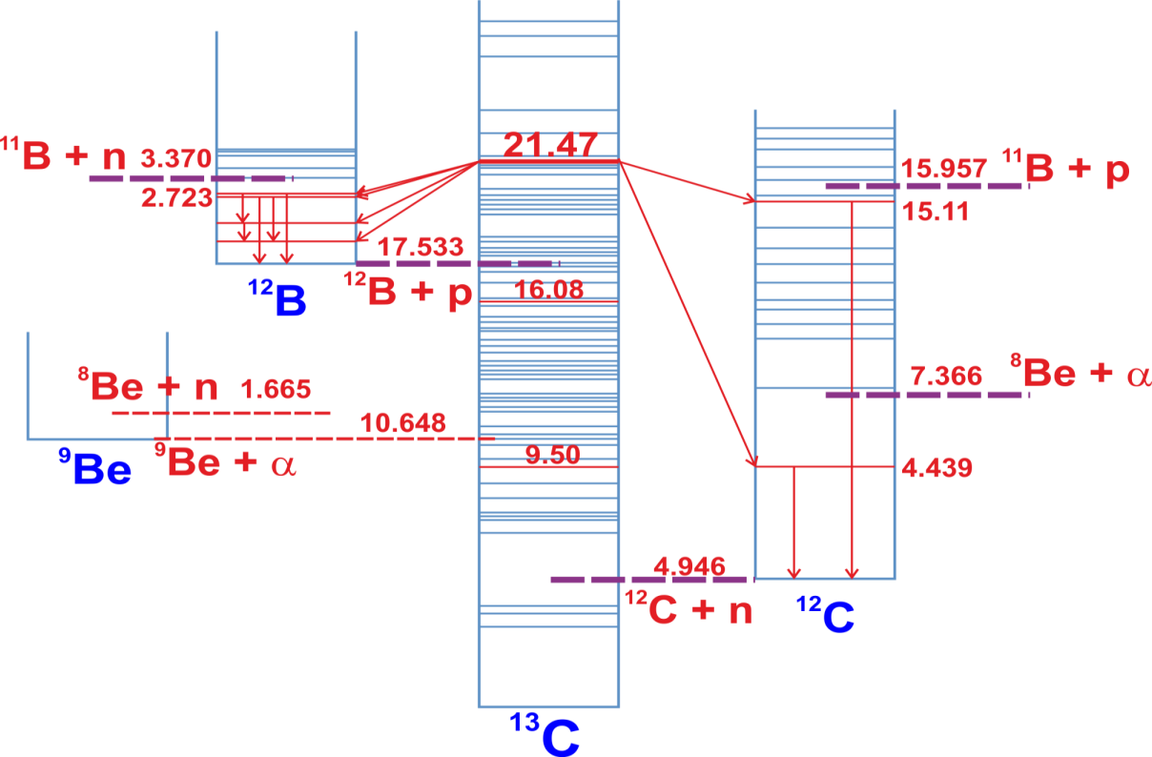
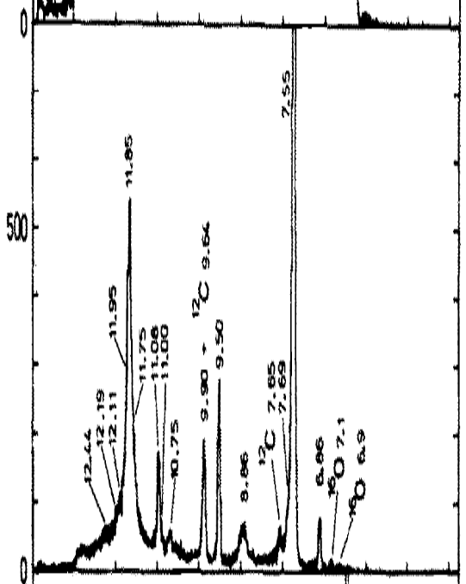
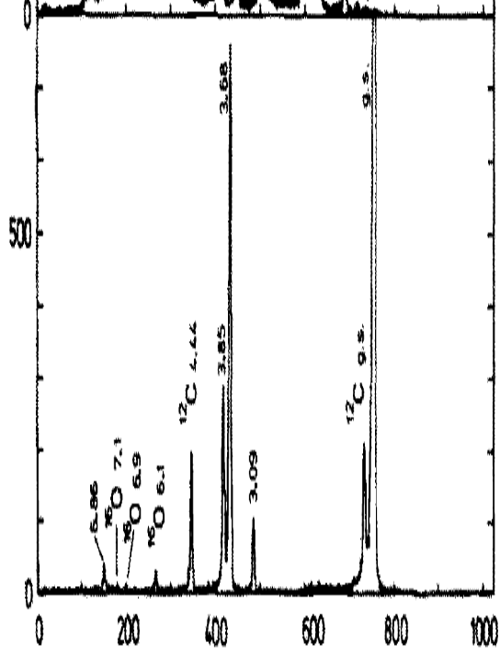
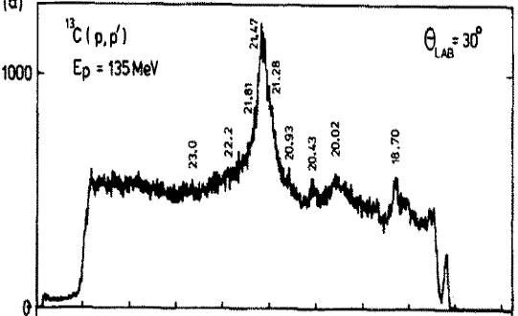
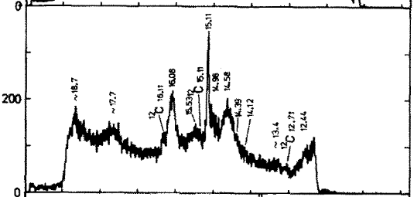
Previous studies of stretched states in ¹³C
and our experimental method
INELASTIC PROTON SCATTERING ON ¹³C
S.F. Collins et al., Nuc. Phys. A481, 494(1988)
(Indiana University Cyclotron Facility Magnetic Spectrograph)
E_{p} = 135 MeV
21.47
GATE ON SCATTERED PROTONS
Strongest expected γ rays: ¹²B: 953, 1668, 1674, 2723 keV
¹²C: 4439, 15110 keV
EXCITATION ENERGY [MeV]

Slide 8
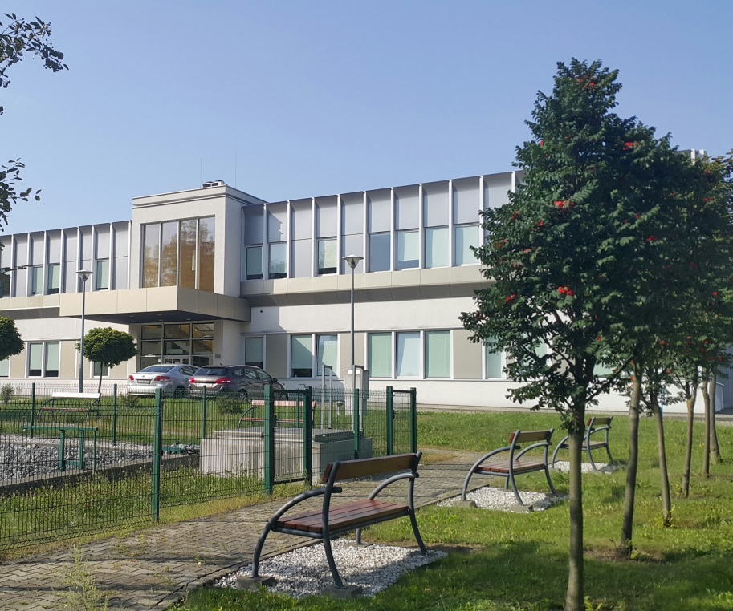
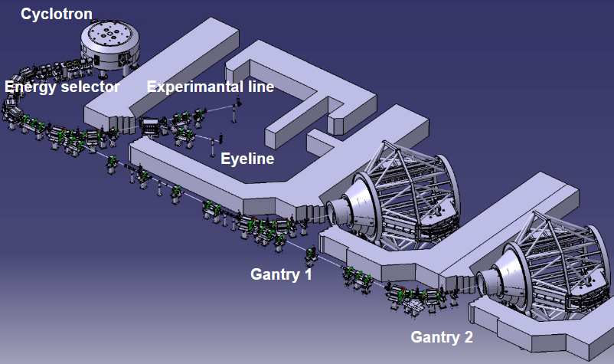

Experimental setup – Cyclotron Centre Bronowice (IFJ PAN, Kraków, Poland)
Proteus C-235

Slide 9
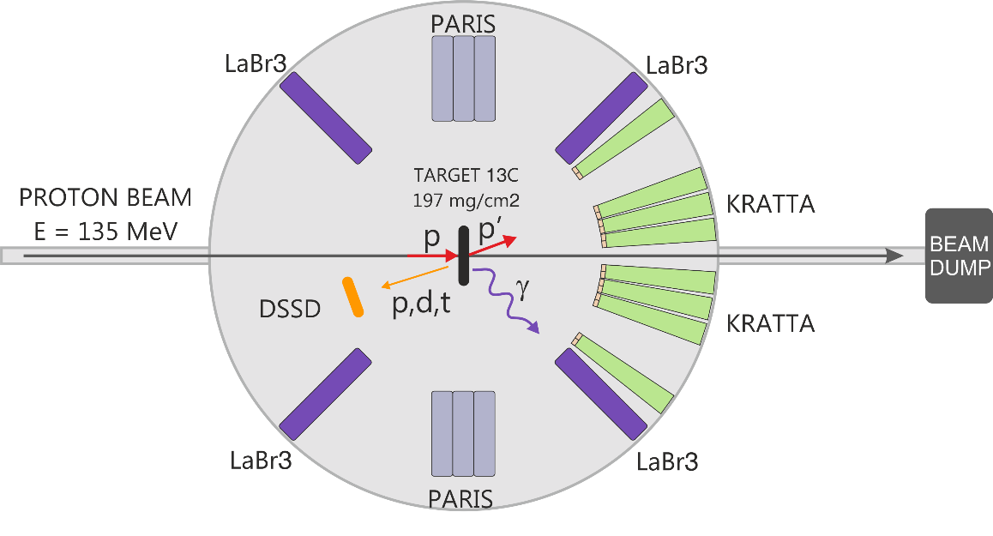
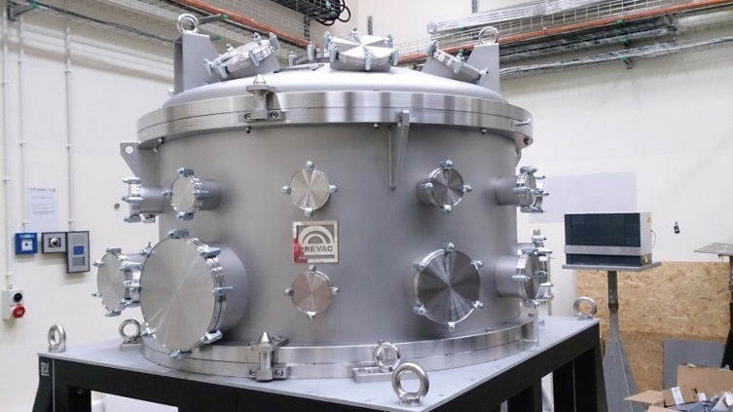
Experimental setup at CCB IFJ
1) Scattered protons measurement: KRATTA telescope array
2) γ-ray detection:
  four LaBr₃ detectors (3.5”x8”)
  two clusters of the PARIS scintillator array
3) Measurement of light charged particles produced in the reaction: a thick position-sensitive Si detector
Large vacuum scattering chamber at CCB

Slide 10
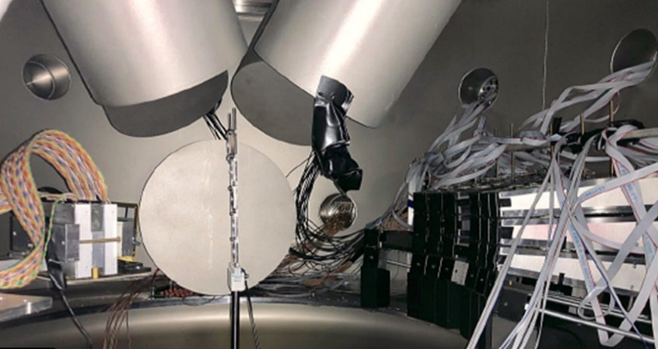
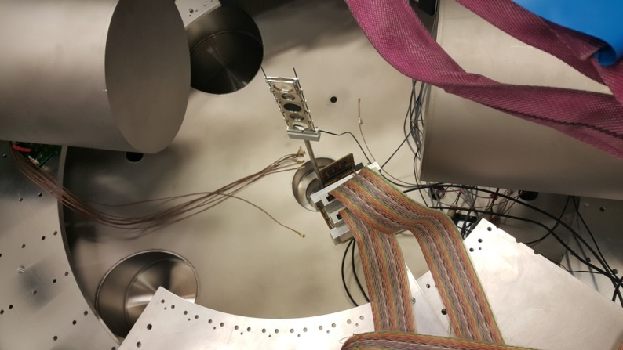
Experimental setup at CCB IFJ
LABR
LABR
PARIS
DSSD
KRATTA
PARIS
PARIS
1) Scattered protons measurement: KRATTA telescope array
2) γ-ray detection:
  four LaBr₃ detectors (3.5”x8”)
  two clusters of the PARIS scintillator array
3) Measurement of light charged particles produced in the reaction: a thick position-sensitive Si detector
DSSD
BEAM

Slide 11
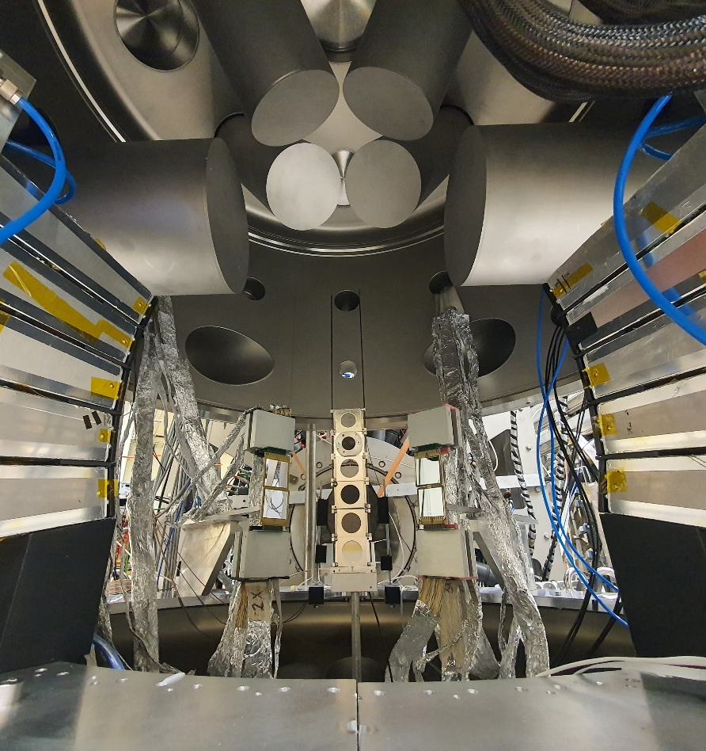
Experimental setup at CCB IFJ
LABR
PARIS
PARIS
DSSD
DSSD
◉
KRATTA
KRATTA
1) Scattered protons measurement: KRATTA telescope array
2) γ-ray detection:
  four LaBr₃ detectors (3.5”x8”)
  two clusters of the PARIS scintillator array
3) Measurement of light charged particles produced in the reaction: a thick position-sensitive Si detector

Slide 12
THE FIRST CASE: ¹³C
May 2019 – June 2020
Spokepersons: S. Leoni (Univ. of Milan and INFN Milan), B. Fornal (IFJ PAN), M. Ciemała (IFJ PAN)

Slide 13
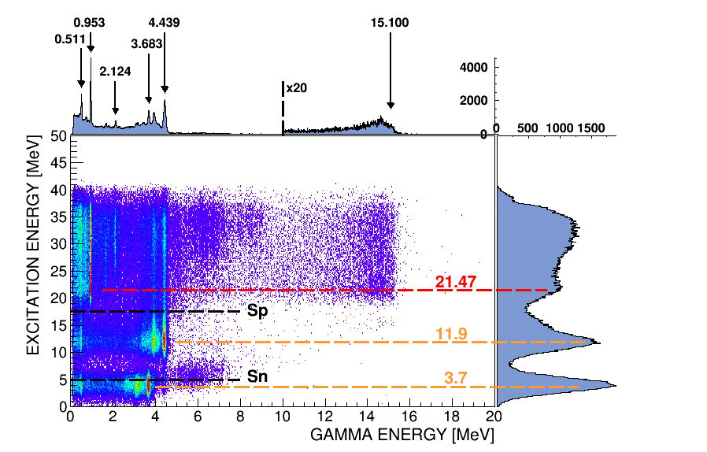
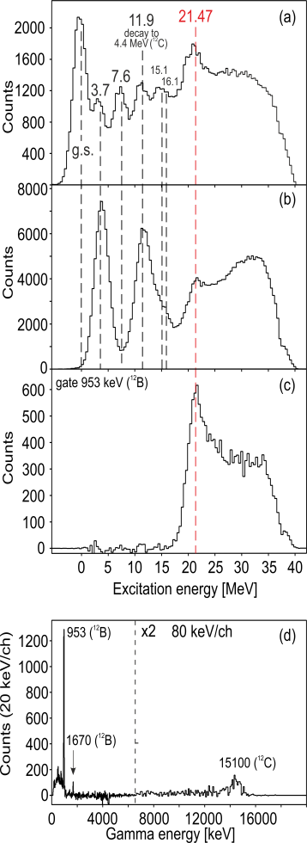
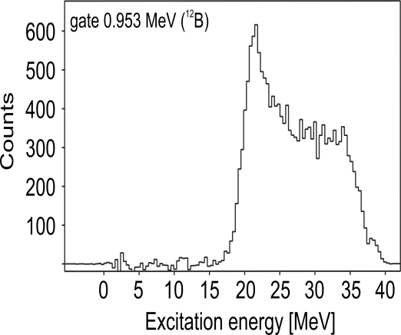
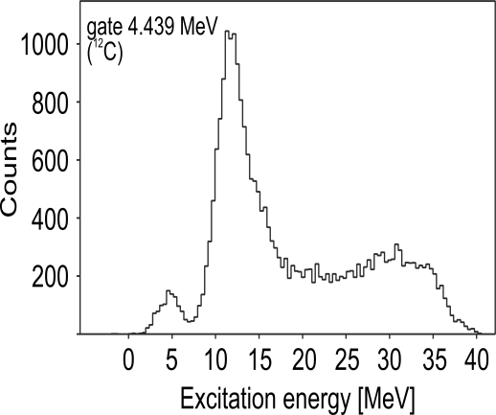
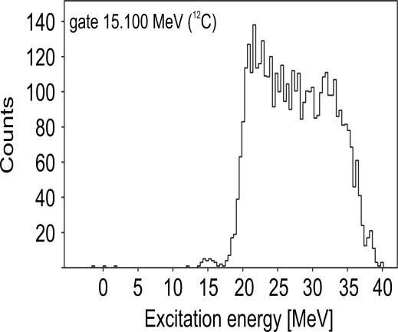
Experimental results: proton-gamma coincidence measurement
¹²B
¹²C
¹²C
GATE 953 keV
(¹²B)
GATE 21.47 MeV (¹³C)
21.47
GATE 4.4 MeV
(¹²C)
GATE 15.1 MeV
(¹²C)
21.47

Slide 14

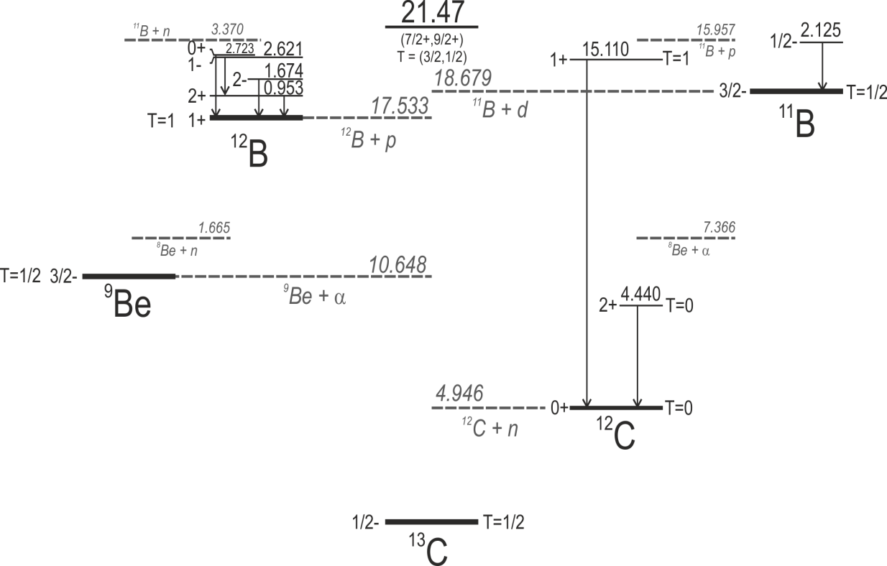
Experimental results: proton-gamma coincidence measurement
PROTON DECAY TO ¹²B
NEUTRON DECAY TO ¹²C
7(2)
24(5)
69(6)
Decay to ¹²B g.s. ?

Slide 15
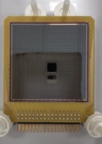
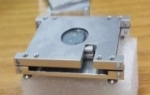
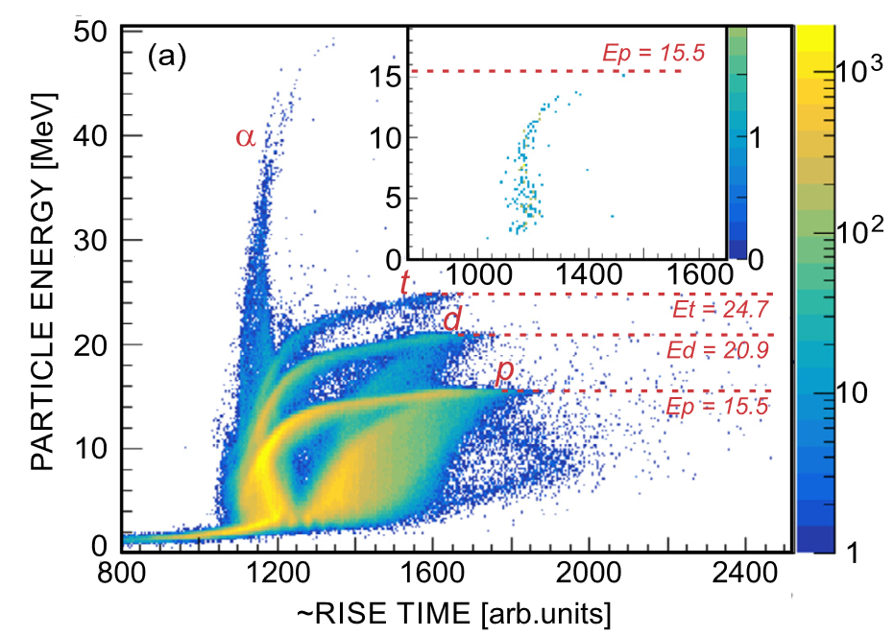
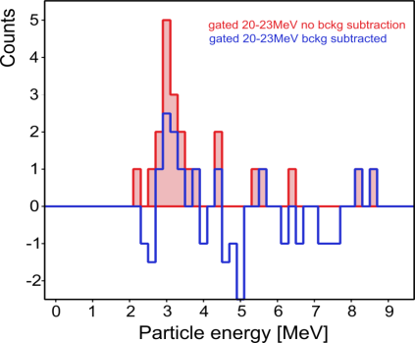
Experimental results: proton-particle coincidence measurement
TEST EXPERIMENT WITH THIN TARGET
FOR LOW-ENERGY PROTONS
¹³C target made of 10 foils in separate frames, total thickness 1 mg/cm²
Nicoleta Florea, Nicu Marginean IFIN-HH, Romania
DSSSD (Micron Semiconductor Ltd)
Active area: 50mm x 50mm
No. of strips: 32 (16 per side)
Thickness: 1.5 mm
LIGHT PARTICLE IDENTIFICATION
BASED ON ENERGY AND RISE TIME
PROTON DECAY TO ¹²B
NEUTRON DECAY TO ¹²C
7(2)
24(5)
69(6)
0-23
Decay to ¹²B g.s. ?
3.0 MeV
NO BACKGR. SUBTR.
WITH BACKGR. SUBTR.
Excit.Energy in ¹²B [MeV] | E_{proton} [MeV]
2.723 | 1.214
2.621 | 1.316
1.674 | 2.263
0.953 | 2.984
0.0 | 3.937

Slide 16
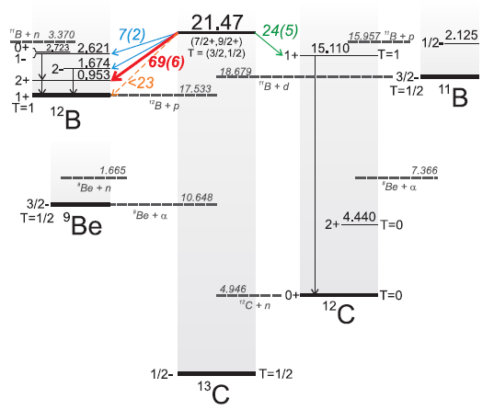
The first case: ¹³C
Experimental results on the decay
of the 21.47-MeV stretched state
Gamow Shell Model calculations
by Y. Jaganathen (IFJ PAN)
and M. Płoszajczak (GANIL)
The Gamow Shell Model is an open-quantum system extension of the traditional Shell Model, which provides:
a rigorous treatment of bound and unbound nuclear excitations, including coupling to a continuum of non-resonant particles
a fully consistent calculation of the resonance energy and width and their mutual relation
PROTON DECAY
NEUTRON DECAY
Fraction of the decay with gamma-ray emission from daughter nuclei: 46(10)%
FOR THE FIRST TIME GSM CALCULATIONS WERE PERFORMED FOR SUCH „HEAVY” SYSTEM

Slide 17
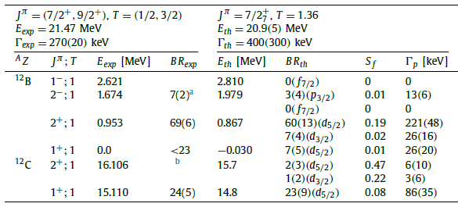
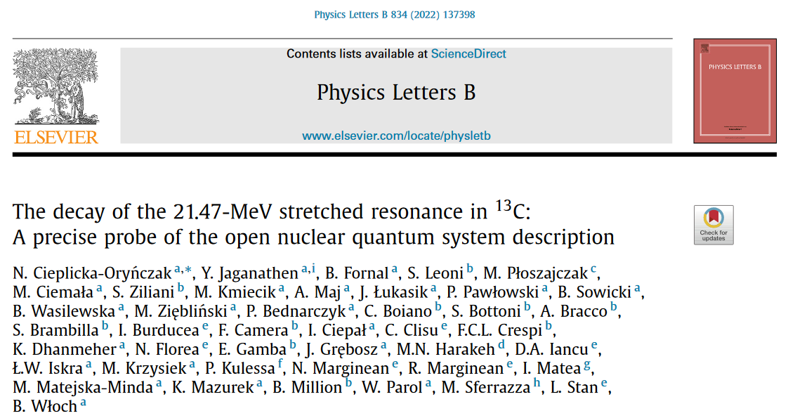
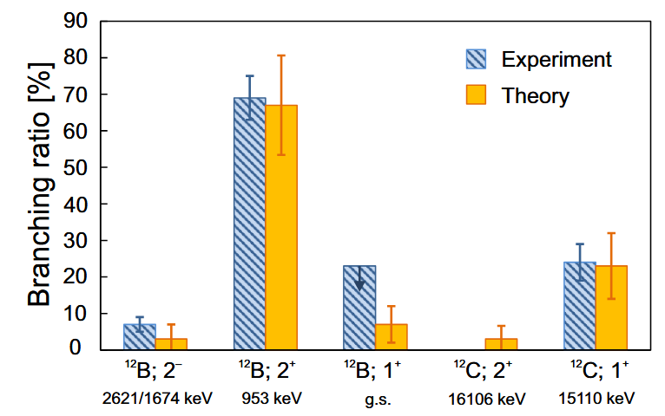
The first case: ¹³C
Experimental results on the decay
of the 21.47-MeV stretched state
Gamow Shell Model calculations
(by Y. Jaganathen (IFJ PAN)
and M. Płoszajczak (GANIL))
PROTON DECAY
NEUTRON DECAY
Fraction of the decay with gamma-ray emission from daughter nuclei: 46(10)%

Slide 18
¹⁶O CASE
December 2019 – March 2020
Spokepersons: S. Ziliani (Univ. of Milan and INFN Milan), N. Cieplicka-Oryńczak (IFJ PAN)

Slide 19
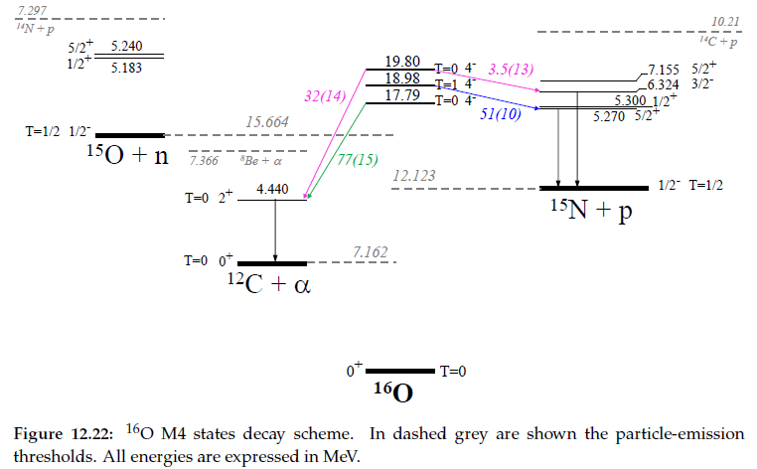
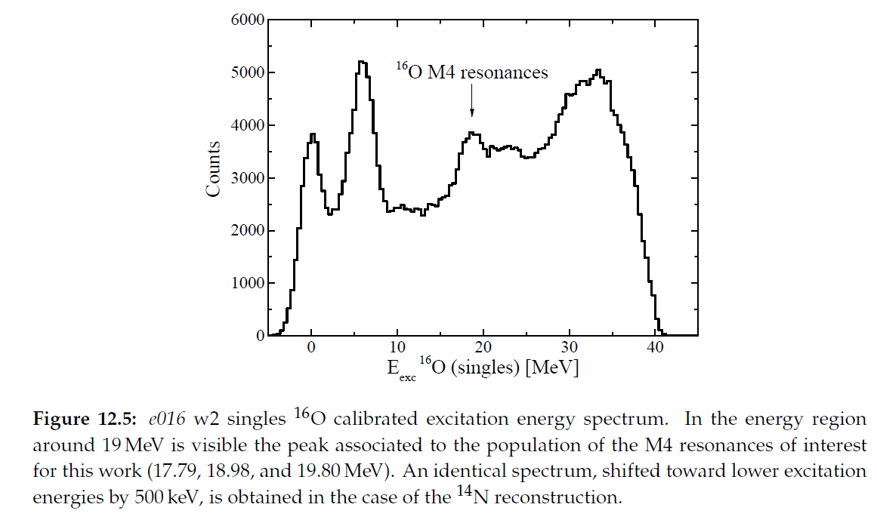
Stretched resonances in ¹⁶O
⁷Li-¹⁴N-H₂ + (¹⁶O contamination) target 160 mg/cm²
18.98
¹⁶O
17.79
19.80
POSSIBLE DECAY BRANCHES
C.E. Hyde-Wright et al., PRC35, 880(1987)
PRESENT (p,p’) EXPERIMENT
Strongest expected γ rays:
¹²C: 4439 keV
¹⁵N: 5269, 5298, 6322, 1885 keV
S.Ziliani, PhD thesis, University of Milan (2021)

Slide 20
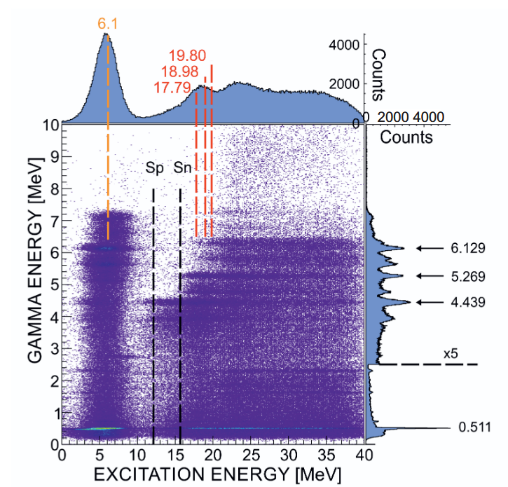
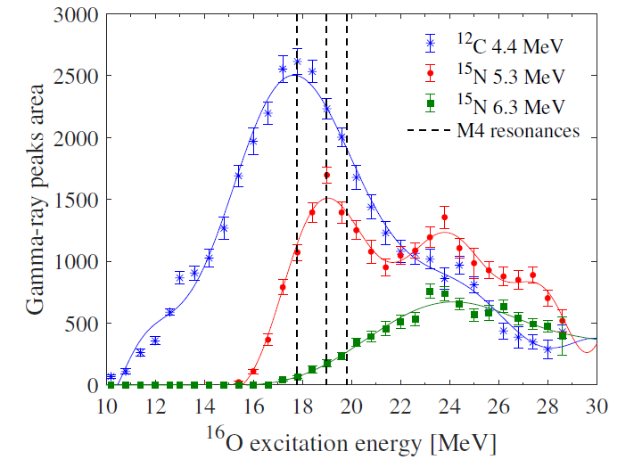
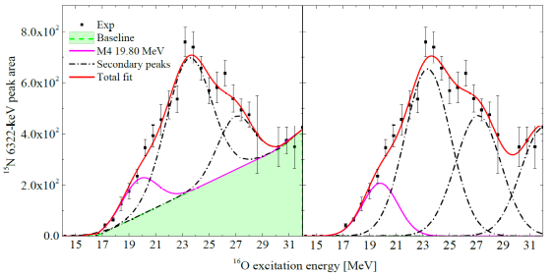
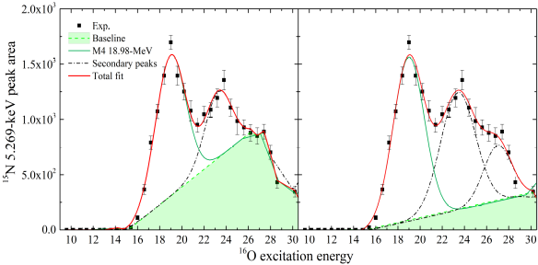
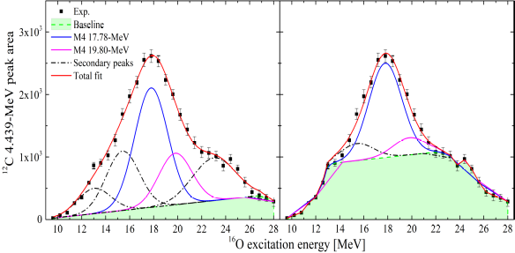
Stretched resonances in ¹⁶O
AREA SCANNING (600-keV-wide gates)
AREA OF GAMMA RAY PEAKS
AS FUNCTION OF EXCITATION ENERGY
EXTRACTION OF DECAY BRANCHINGS ASSOCIATED TO GAMMA EMISSION
S.Ziliani, PhD thesis, University of Milan (2021)

Slide 21
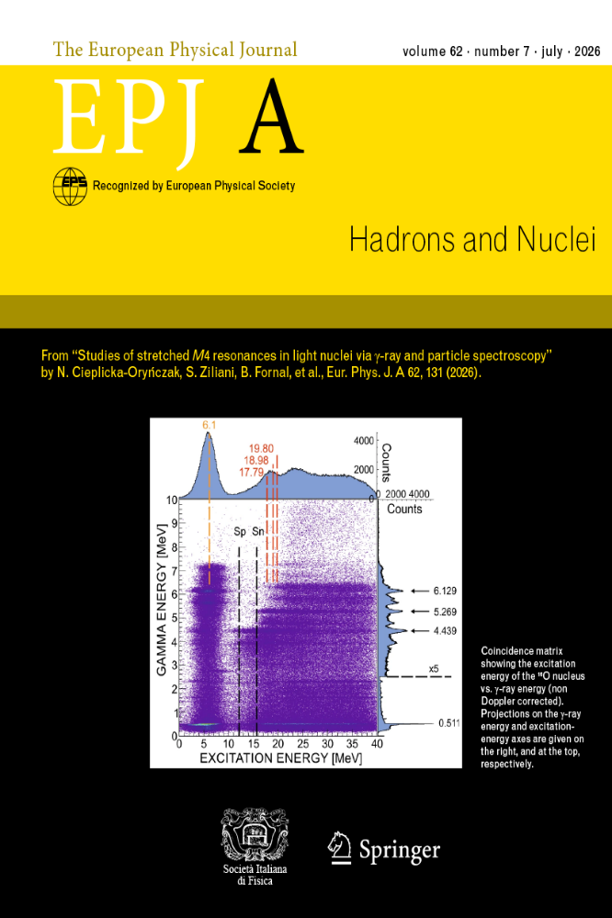
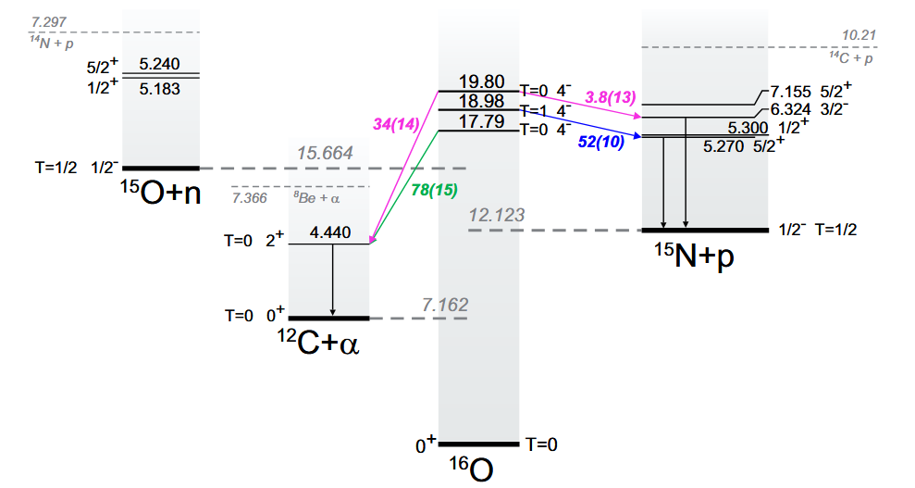
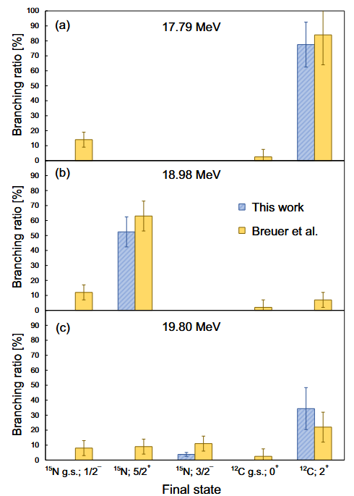
Branching ratios in ¹⁶O
RESULTS FROM PRESENT (p,p’) EXPERIMENT
COMPARISON OF BR WITH PREVIOUS
¹⁷O(d,t) AND ¹⁷O(3He,alpha) EXPERIMENTS
H. Breuer et al., Phys.Lett. 96B, 35 (1980)

Slide 22
Recent experiment: ¹²C
October 2024 – January 2025
Spokepersons: N. Cieplicka-Oryńczak (IFJ PAN), G. Corbari (Univ. of Milan and INFN Milan)

Slide 23
Study of M4 stretched configuration decay in ¹²C
¹⁶O
¹²C
¹³C
INELASTIC ELECTRON SCATTERING EXPERIMENTS
¹⁴C
11.7
17.3
24.3
RADIOACTIVE
TARGET
21.47
¹³C
16.08
comparison of cross sections measured in (π⁺,π⁺’) and (π⁻,π⁻’) experiments was interpreted as due to isospin mixing between two or more 4⁻ levels of T = 1 and
T = 0 character
a significant 2⁻ strength was found for the 19.4-MeV peak identified in the inelastic scattering of 398-MeV protons on the ¹²C target
9.5
19.6
Mixed with other
multipolarities - MORE COMPLEX CASE
¹²C
R.S. Hicks et al., PRC34, 1161(1986)
Decay data can help to resolve
the complicated energy spectrum in ¹²C at high excitation energies!
The 19.6-MeV state in ¹²C having strong single-particle-hole component partially overlaps with other states…

Slide 24
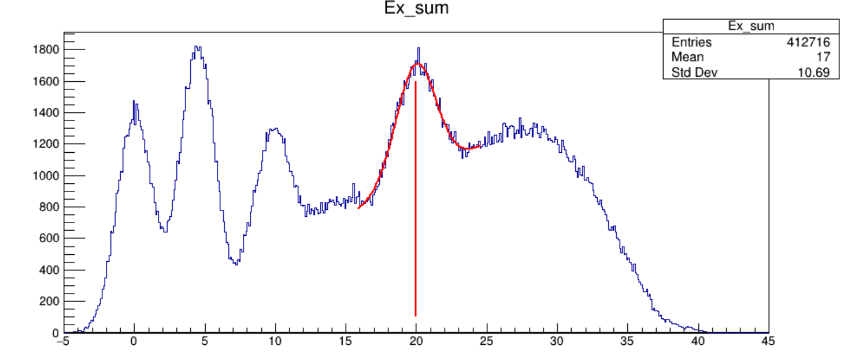
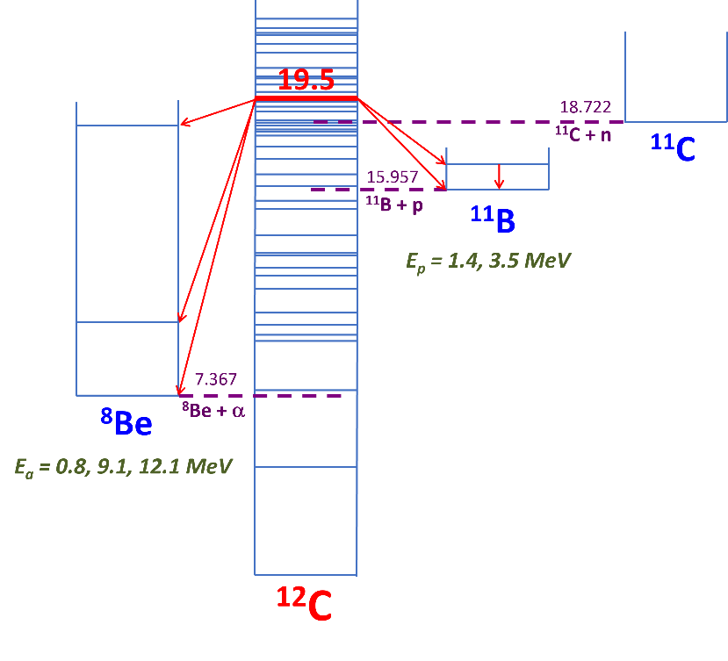
Experimental results: ¹²C population in (p,p’) reaction at 135 MeV
Excitation Energy from proton measurement
(150 mg/cm² target)
No gamma ray detection required („proton singles”)
The aim of the proposed experiment is to identify the decay of the 19.6-MeV
1p_{3/2} → 1d_{5/2} resonance in ¹²C
PROTON SINGLES
19.6
Counts
19.8
g.s.
4.4
9.6
15.1
Expected γ rays
¹¹B: 2124 keV
Excitation Energy [MeV]

Slide 25
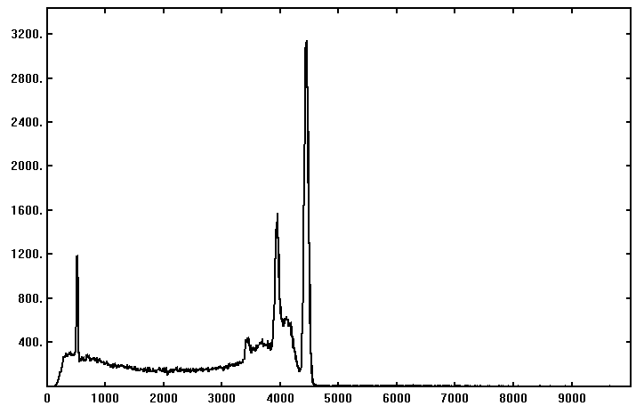
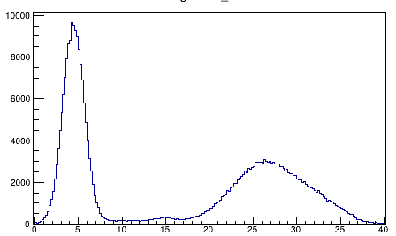
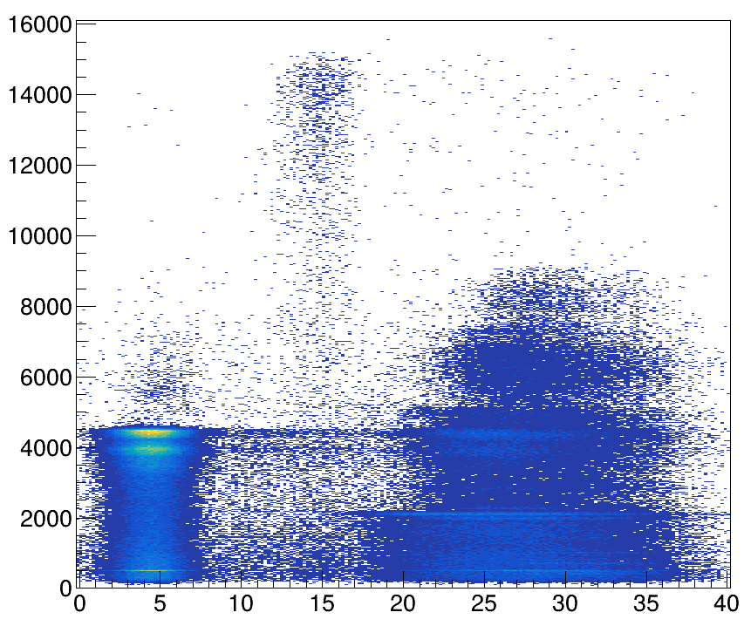
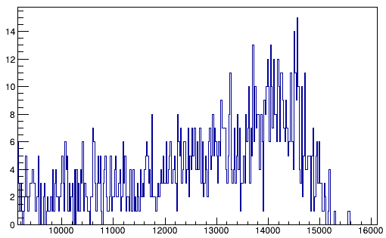

Proton-gamma coincidence measurement
4439 (¹²C)
Ex GATE < 10 MeV
Counts
1st EP
(¹²C)
Counts
4.4
15.1
511
2nd EP
(¹²C)
15100 (¹²C)
Gamma Energy [keV]
Gamma Energy [keV]
Sn
Sp
1st EP (¹²C)
4439 (¹²C)
2124 (¹¹B)
2000 (¹¹C)
718 (¹⁰B)
511
Excitation Energy [MeV]

Slide 26

Proton-gamma coincidence measurement
4439 (¹²C)
Ex GATE < 10 MeV
Counts
1st EP
(¹²C)
Counts
4.4
15.1
511
2nd EP
(¹²C)
15100 (¹²C)
Gamma Energy [keV]
Gamma Energy [keV]
Sn
Sp
511
2124 (¹¹B)
Ex GATE > 20 MeV
2000
(¹¹C)
718
(¹⁰B)
4439 (¹²C)
Counts
2297
(¹¹B)
4319
(¹¹C)
1st EP (¹²C)
1022
(¹⁰B)
4439 (¹²C)
2868
(¹⁰B)
4804
(¹¹C)
5019 (¹¹B)
2124 (¹¹B)
2804
(¹¹C)
EP
2000 (¹¹C)
5500, 6478, 6904, 7500 (¹¹C)
718 (¹⁰B)
511
Excitation Energy [MeV]
Gamma Energy [keV]

Slide 27


Proton-gamma coincidence measurement
19.6
2124
Counts
4.4
15.1
15100 (¹²C)
Gamma Energy [keV]
GAMMA GATE
2124 keV (¹¹B)
4439 (¹²C)
Counts
1st EP (¹²C)
2124 (¹¹B)
20.7(3)
2000 (¹¹C)
718 (¹⁰B)
511
Excitation Energy [MeV]
Excitation Energy [MeV]

Slide 28





Scattered proton – light charged particle coincidences
PRELIMINARY
Excitation Energy from proton measurement (150 mg/cm² target)
Statistics from one weekend only
PARTICLE IDENTIFICATION MATRICES
from ¹²C(p,p’) reaction (1 mg/cm2 target)
EXCITATION ENERGY - PARTICLE ENERGY MATRIX
from ¹²C(p,p’) reaction (1 mg/cm2 target)
^{DSSD 0}
^{DSSD 1}
16.0
Proton separation energy
Particle energy [a.u.]
7.4
Alpha decay
possible
Particle Energy [MeV]
^{DSSD 2}
^{DSSD 3}
triton
deuteron
Particle energy [a.u.]
proton
Excitation Energy [MeV]
Rise time [a.u.]
Rise time [a.u.]
The analysis is ongoing…

Slide 29
Summary
The first information on the decay branching of the 21.47-MeV stretched state in ¹³C nucleus was obtained from proton-gamma coincidence measurements.
Successful comparison with experiment in terms of state energy, width and decay branchings proves the high quality and precision of the GSM wave-function calculations.
This newly developed theoretical approach will be crucial in predicting structures in the continuum in other nuclei in this key region of nuclear chart.
Information on the branching ratios from the 17.8-, 19.0-, and 19.8-MeV stretched states in ¹⁶O was obtained.
The preliminary results of the ¹²C experiment provided information on
the proton-decay branch of the 19.6-MeV stretched resonance
… analysis will be continued!
Thank you for your attention!

Slide 30

Stretched M4 resonances in ¹⁴N
⁷Li-¹⁴N-H₂ + (¹⁶O contamination) target 160 mg/cm²
No γ decay from
2⁺ state in ¹⁰B
Strongest expected γ rays:
¹²C: 4439 keV
¹³C: 3089, 3684, 3853 keV
¹⁰B: 414, 718, 1021, 2868 keV
No γ decay from first
excited state in ¹³C
PERSPECTIVES
New thick target of ⁷Li-¹⁴N-H₂ (about 160 mg/cm²) without oxygen contamination
Similar experimental setup
QUALITATIVE INFORMATION ON DECAY BRANCHINGS ASSOCIATED TO GAMMA EMISSION
S.Ziliani, PhD thesis, University of Milan (2021)

Slide 31


Proton-gamma coincidence measurement
15.0(1)
GAMMA GATE
15100 keV (¹²C)
Counts
Counts
4.4
15.1
15100 (¹²C)
Excitation Energy [MeV]
Gamma Energy [keV]
4.5(1)
GAMMA GATE
4439 keV (¹²C)
Counts
1st EP (¹²C)
4439 (¹²C)
2124 (¹¹B)
2000 (¹¹C)
718 (¹⁰B)
511
Excitation Energy [MeV]
Excitation Energy [MeV]

Slide 32

Branching ratios in ¹⁶O
RESULTS FROM PRESENT (p,p’) EXPERIMENT
COMPARISON OF RELATIVE POPULATION
WITH PREVIOUS (p,p’) EXPERIMENT
R.S. Henderson et al., Aust.J.Phys.32,411(1979)
non „gamma-ray” fraction
„gamma-ray” fraction

Slide 33



Scattered protons measurement
J. Lukasik et al., NIM A709, 120(2013)
scattered protons
PROTON IDENTIFICATION MATRIX PD1-PD2
protons
PROJECTION ON PD2 AXIS
1) Scattered protons measurement: KRATTA telescope array
2) γ-ray detection:
  four LaBr₃ detectors (3.5”x8”)
  two clusters of the PARIS scintillator array
3) Measurement of light charged particles produced in the reaction: a thick position-sensitive Si detector
PROTON ENERGY SPECTRUM
IN PD2

Slide 34

KRATTA – excitation energy spectra
13C(p,p’) @ 135 MeV
REFERENCE
SPECTRUM
S.F.Collins et al., Nuc. Phys. A481,494(1988)
Counts
Excitation energy spectra measured at ~36° corresponding to the excitations in the ¹³C target nucleus measured as:
EXCITATION ENERGY[MeV]
21.5
PROTON SINGLES
(only scattered proton required)
SINGLES (only scattered proton required)
11.9
decay to
4.4 MeV (¹²C)
15.1
3.7
7.6
16.1
g.s.
EXCITATION ENERGY[MeV]
PROTON-GAMMA COINCIDENCES
COINCIDENCES (scattered proton and gamma ray required)
EXCITATION ENERGY[MeV]
EXCITATION ENERGY[MeV]

