Slide 1
First high resοlutiοn
in-gas-jet laser spectrοscοpy at S³-LEB
Andres F. Lopez-Loaiza
On behalf of S³-LEB team

Slide 2
Content
Resonance Ionization Spectroscopy (RIS) and S³-LEB setup.
ALTISA: new laser laboratory for S³.
high resolution spectroscopy of Dy:
    421nm .
    418nm .
Commissioning and characterization of MR-TOF-MS (PILGRIM).

Slide 3
Content
Resonance Ionization Spectroscopy (RIS) and S³-LEB setup.
ALTISA: new laser laboratory for S³.
high resolution spectroscopy of Dy:
    421nm .
    418nm .
Commissioning and characterization of MR-TOF-MS (PILGRIM).

Slide 4
Tunable
Pulsed $∼$ 10 kHz
Time sychronization
Spatial overlapping
Broadband $\sim$ GHz
Narrowband $\sim$ MHz
λ₂
λ₁
$$I,δ\left\langle r^{2}\right\rangle ,μ_{I},Q$$
$$δν_{i}^{A,A^{′}}=F_{i}λ\left(δ\left\langle r^{2}\right\rangle \right)+\frac{m^{A}{−m}^{A^{′}}}{m^{A}m^{A^{′}}}M_{i}$$
$$A=\frac{μ_{I}B_{j}(0)}{|\vec{J}||\vec{I}|}$$
$$B=eQ{\left(\frac{∂^{2}V_{ext}}{∂z^{2}}\right)}_{z=0}$$
[MHz]

Slide 5
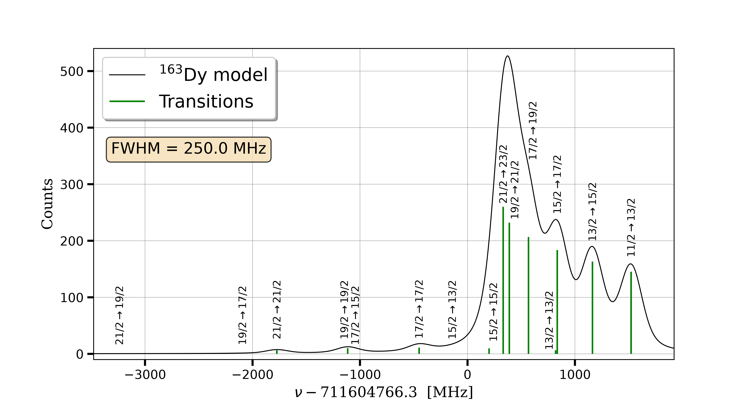
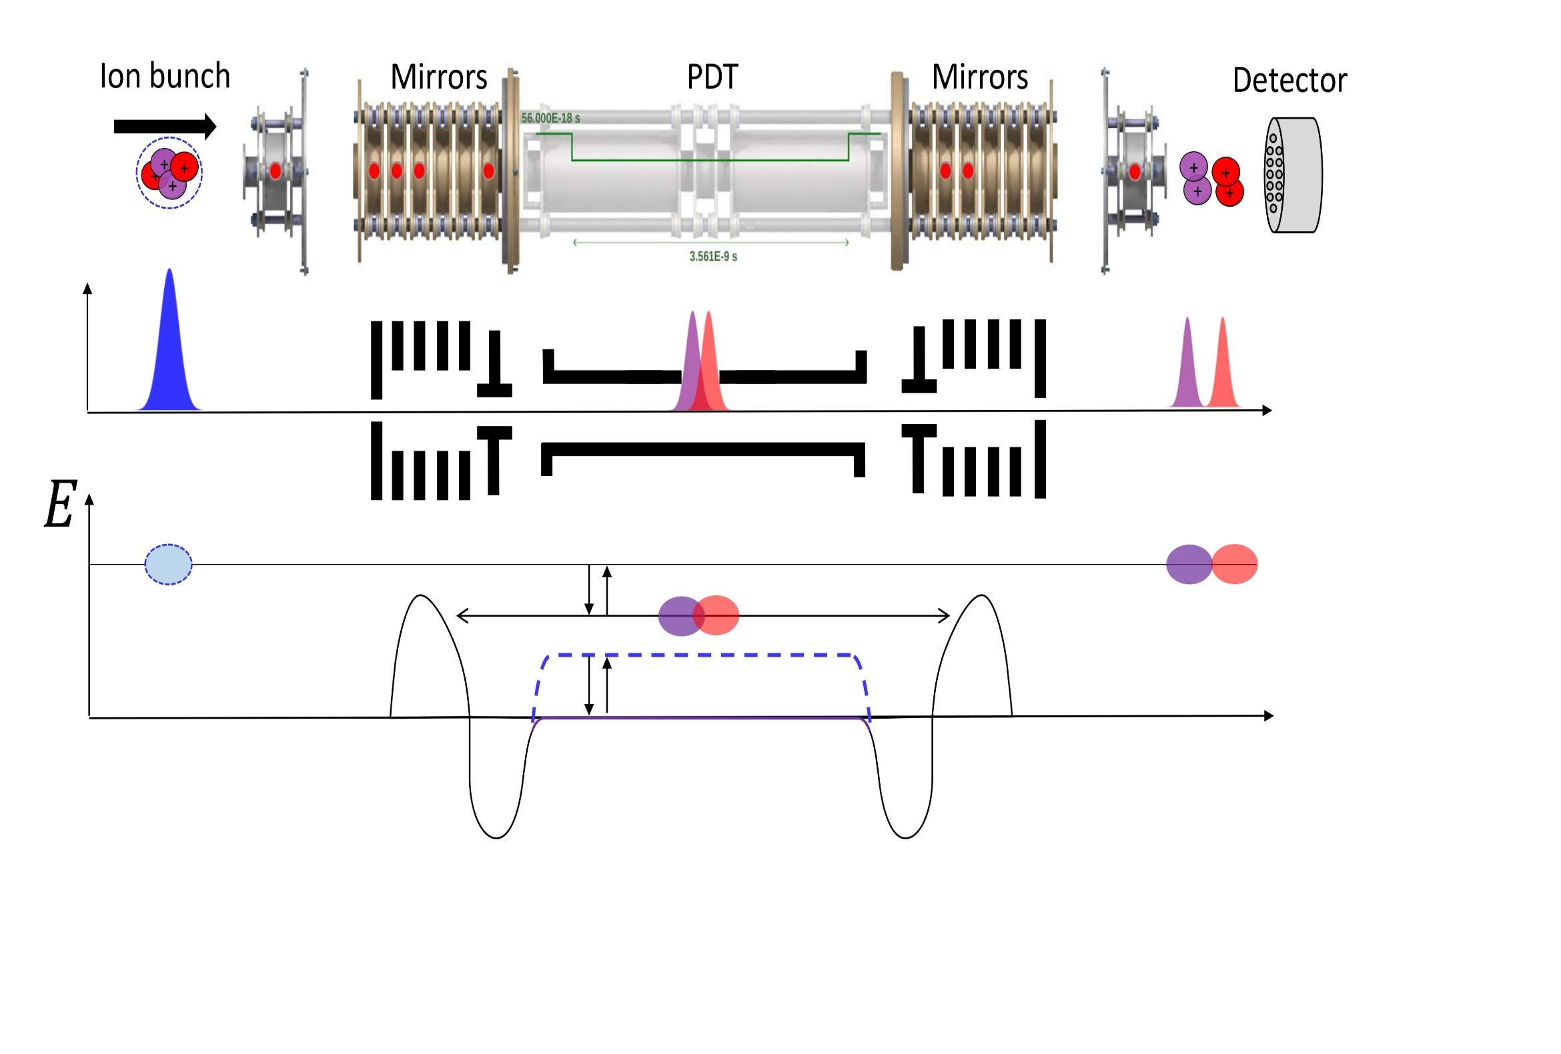
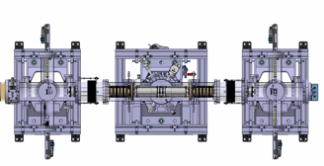
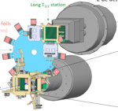

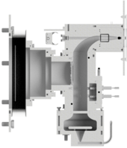
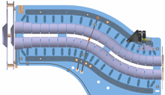
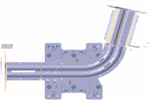

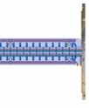

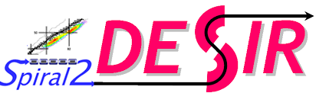
S³-LEB
MagneTOF
MR-TOF MS
Counts
PILGRIM
MCP_{inj}
SEASON
MCP 3
λ₁
λ₂
Pulse up
(~ 3 kV)
Laser system
Gas cell
RFQ
Cooler
Buncher
S-shape RFQ
miniRFQ
QMF
beam
He: 10⁻² - 10⁻³ mbar
RFQs
Ar: 200 - 500 mbar
MCP 1
MCP 2

Slide 6
Content
Resonance Ionization Spectroscopy (RIS) and S³-LEB setup.
ALTISA: new laser laboratory for S³.
high resolution spectroscopy of Dy:
    421nm .
    418nm .
Commissioning and characterization of MR-TOF-MS (PILGRIM).

Slide 7
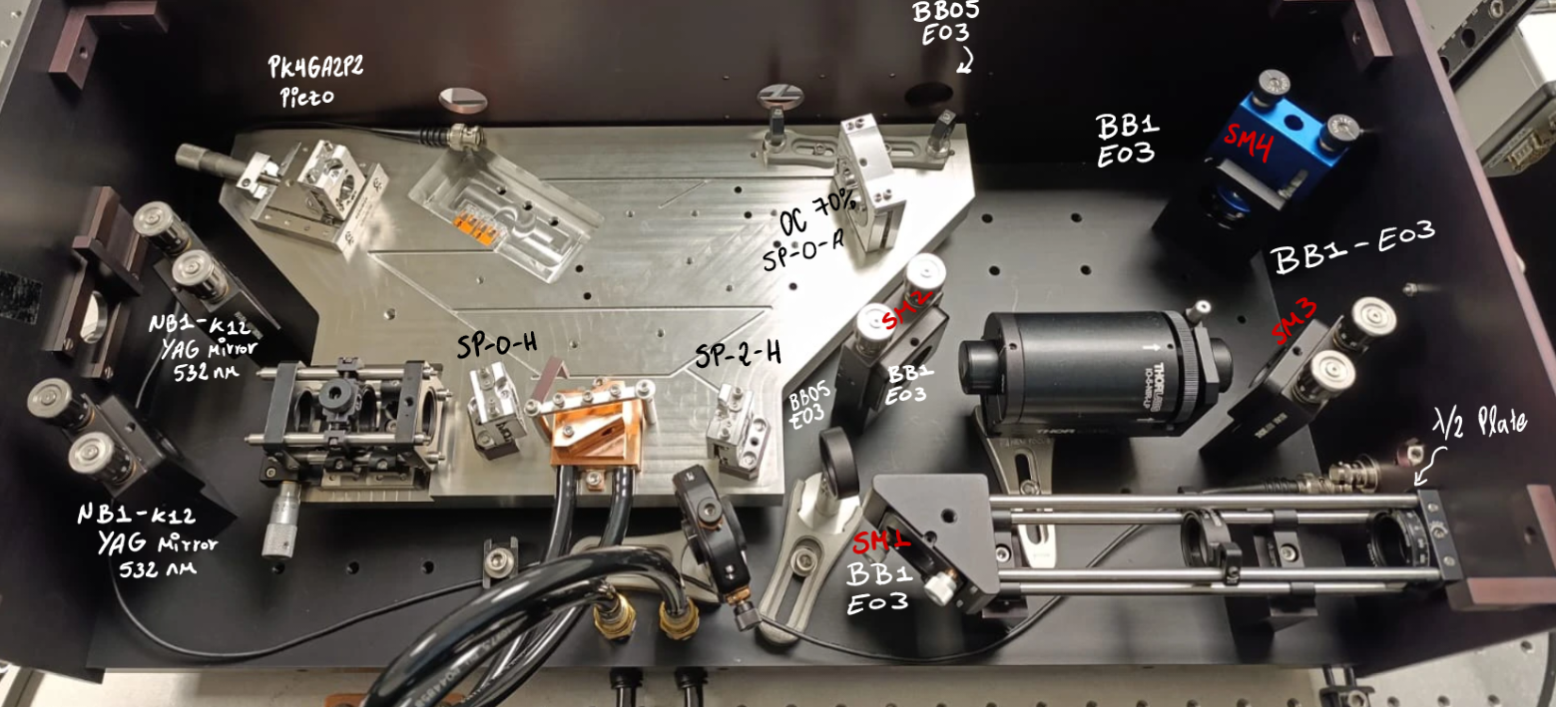


ALTISA
A new laser laboratory for S³LEB
$\sim 600$ mW
$\sim 60$ mW
@ M. Brun

Slide 8
Content
Resonance Ionization Spectroscopy (RIS) and S³-LEB setup.
ALTISA: new laser laboratory for S³.
high resolution spectroscopy of Dy:
    421nm .
    418nm .
Commissioning and characterization of MR-TOF-MS (PILGRIM).

Slide 9
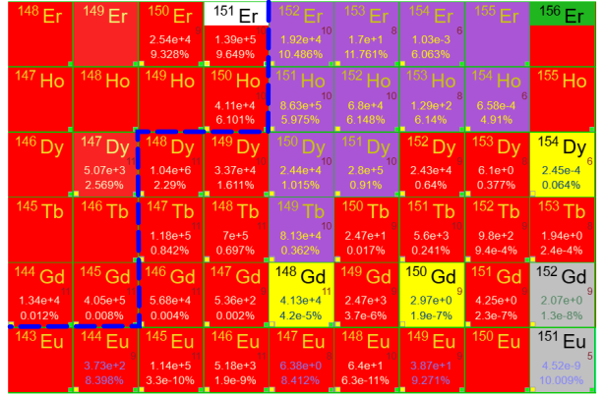
$${}_{18}^{40}{Ar}+{}_{50}^{116}{Sn}$$
$${}_{68}^{152}{{Er}_{84}}$$
Milestone of the first
S³ reaction
N=82 Shell Closure

Slide 10
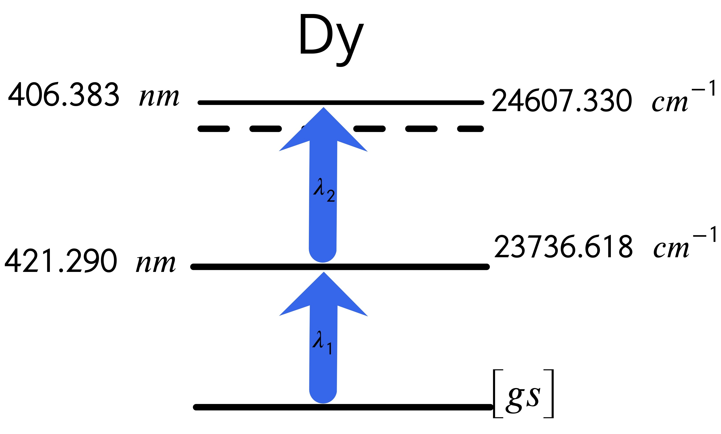
High resolution spectroscopy of Dy: 421nm
Dy 156
0.056 %
Dy 157
$$I=5/2^{ −}$$
Dy 158
0.095 %
Dy 159
$$I=5/2^{ −}$$
Dy 160
2.329 %
Dy 161
18.889%
$$I=5/2^{+}$$
Dy 162
25.47%
Dy 163
24.89%
$$I=5/2^{ −}$$
Dy 164
28.260%
$δν∼517$MHz/u
$FWHM∼110$MHz
A.F. Lopez-Loaiza. et al.
GANIL - GISELE 2025
$$A_{ik}≈2.8×{10}^{8}$$
Rel. Int = 16000

Slide 11
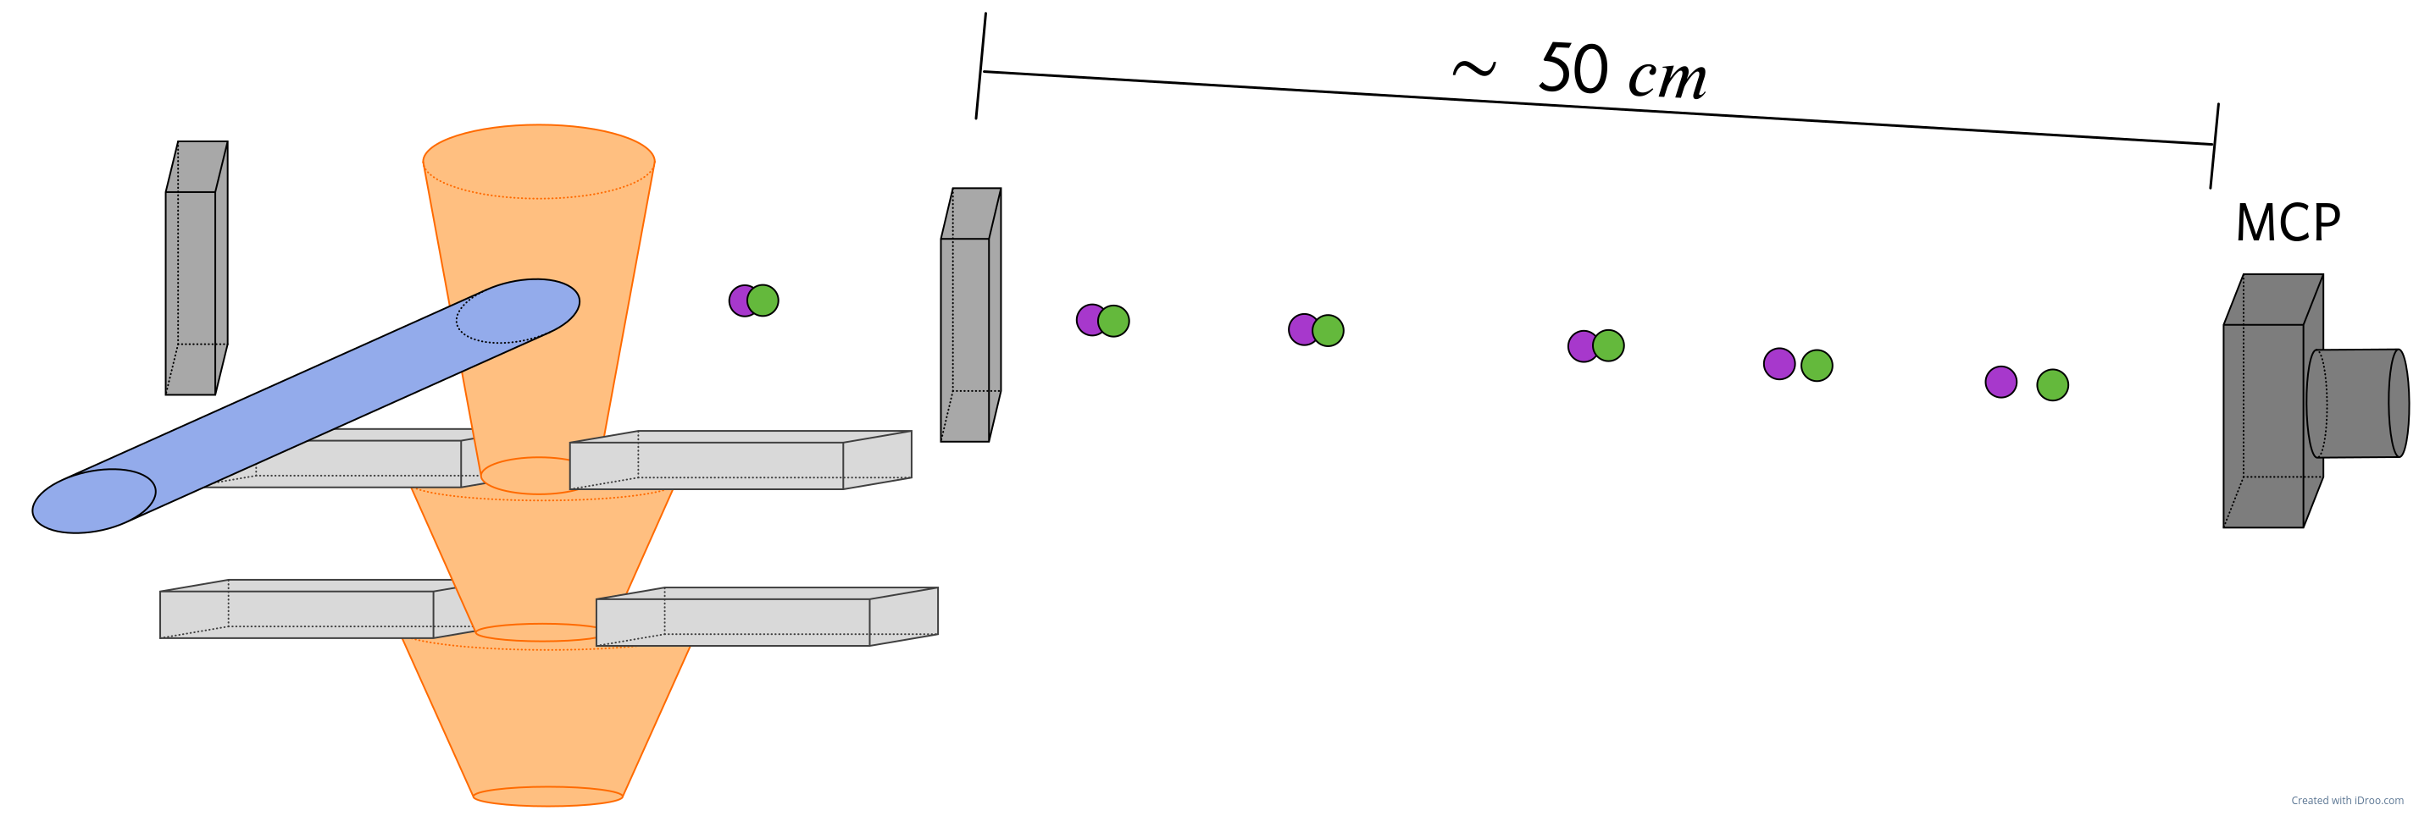
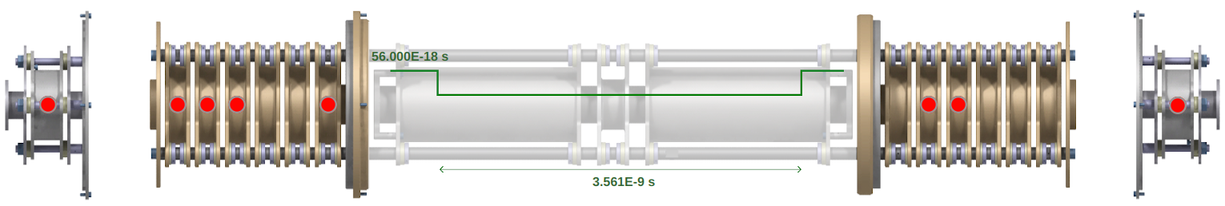
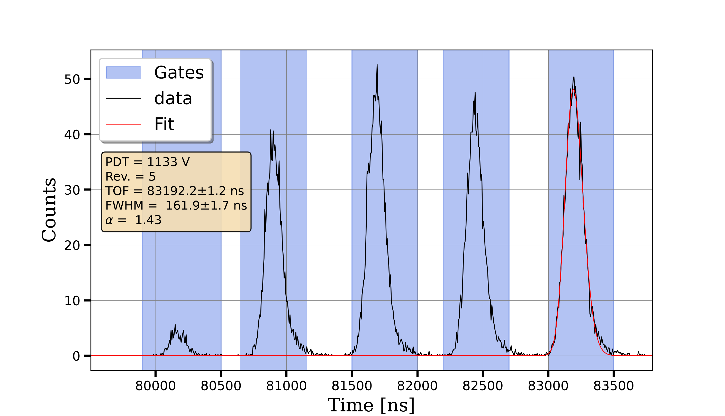
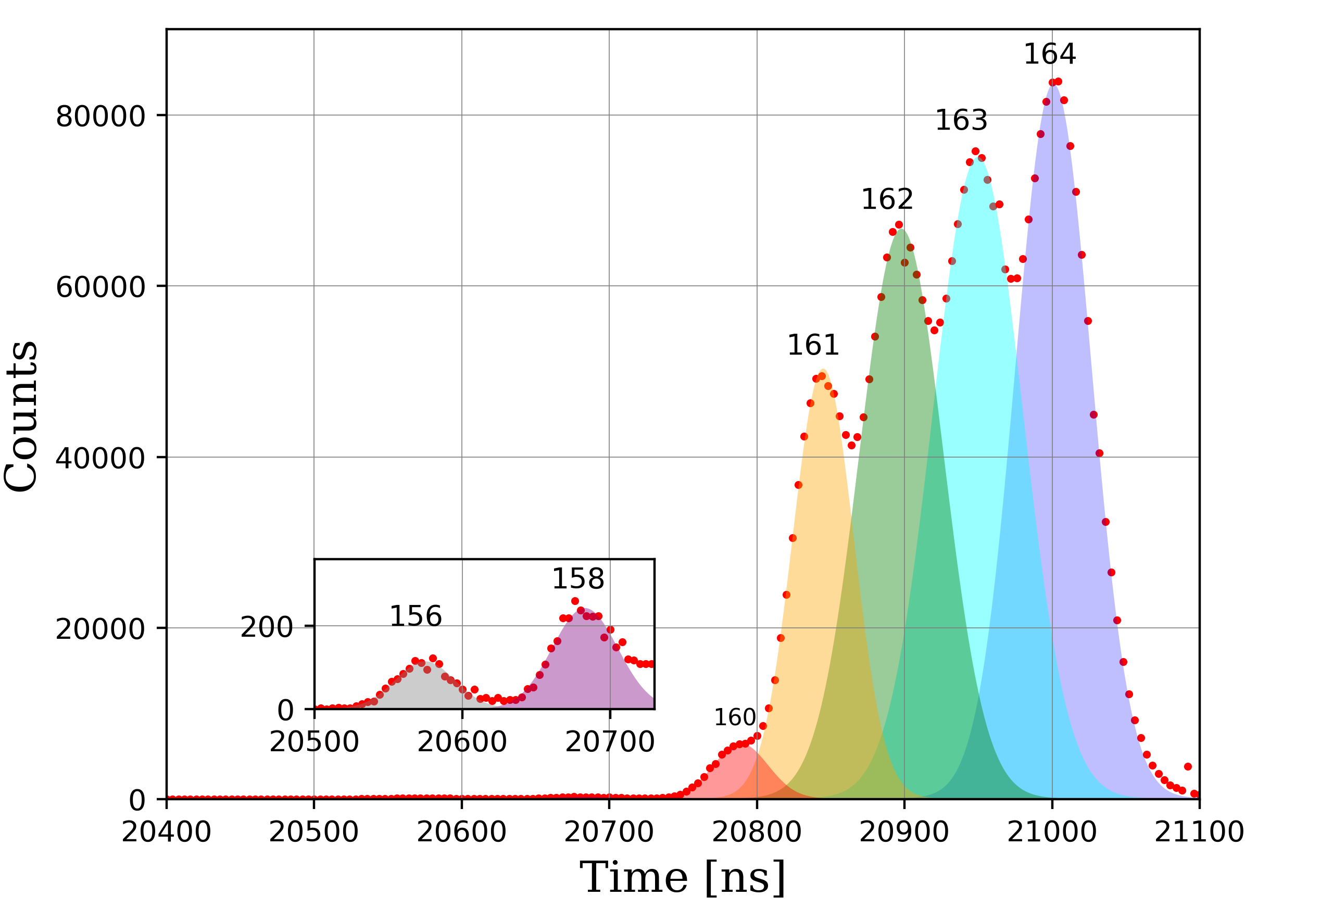
Time of Flight Resolution for Dy
S³-LEB: Gas-jet
GISELE: Atomic beam unit
MR-TOF-MS
PILGRIM
Linear
TOF separator
162
163
164
161
160

Slide 12
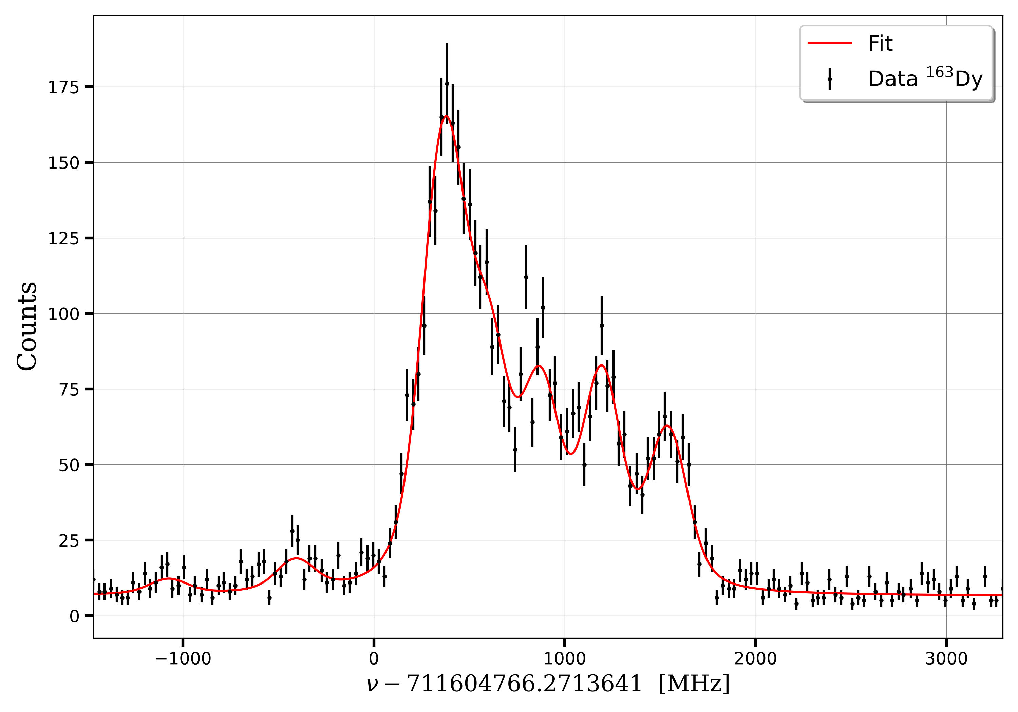
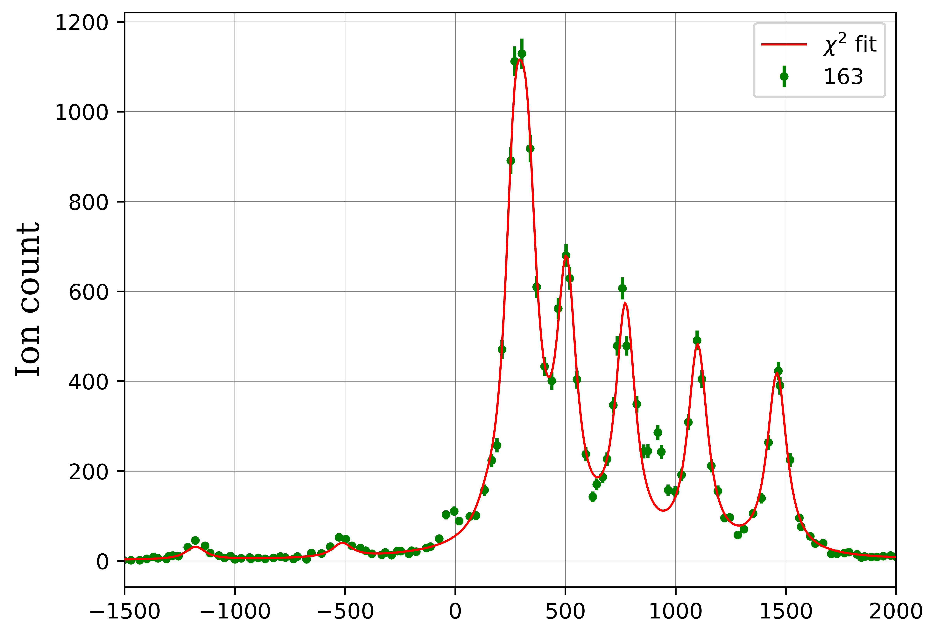
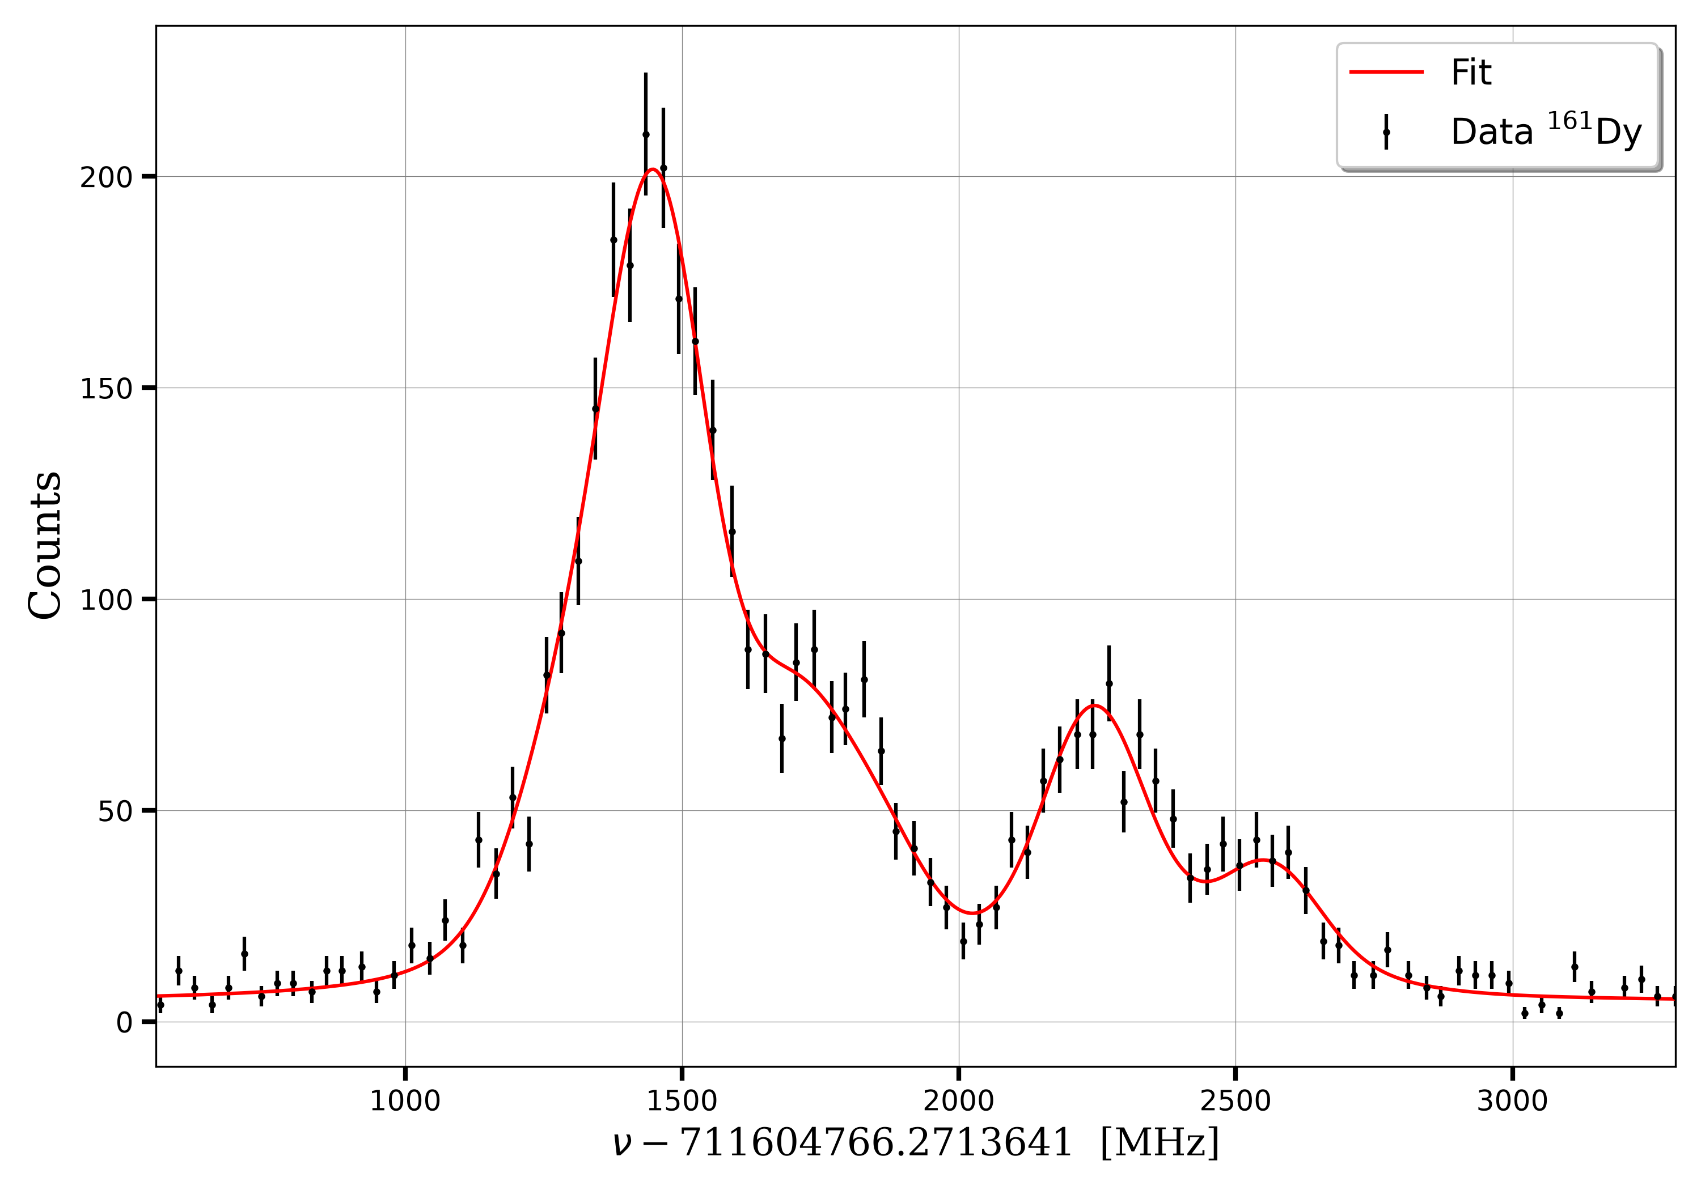
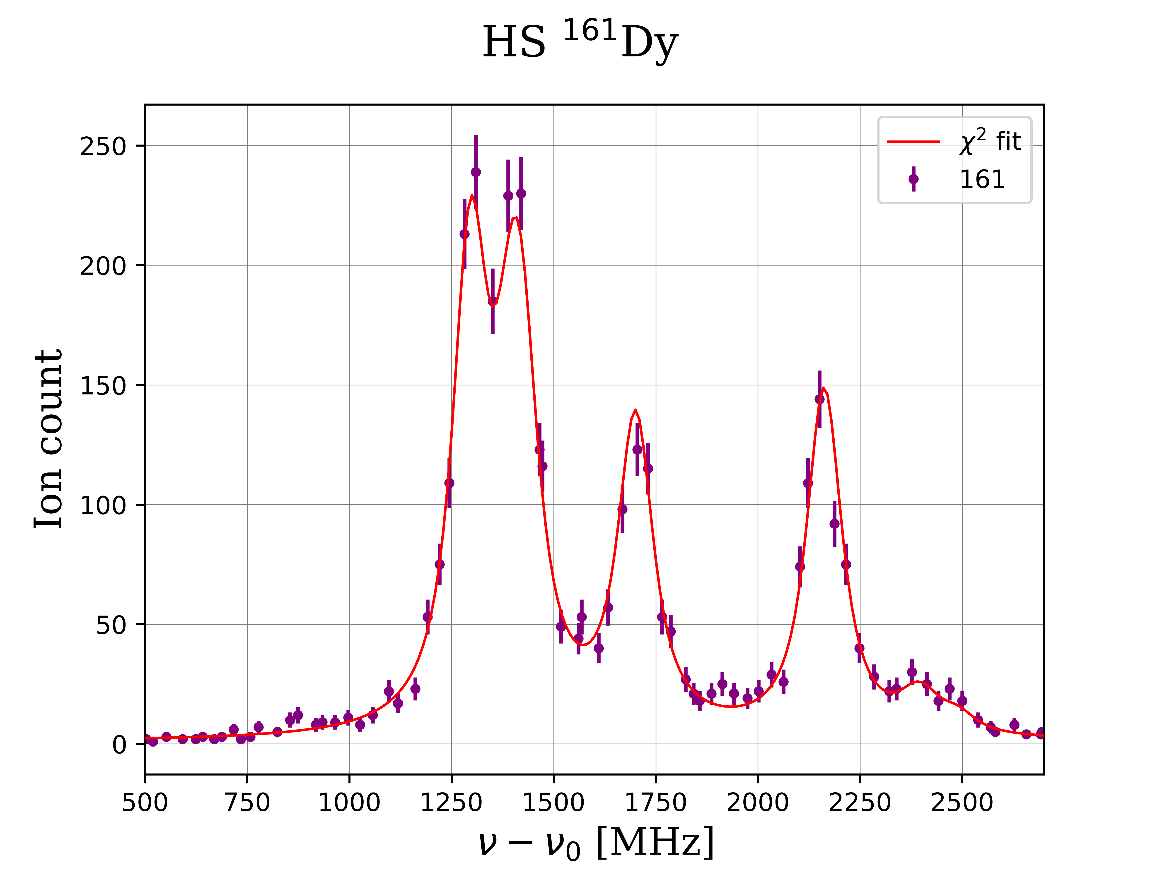
High resolution spectroscopy of Dy: 421nm
HFS
Preliminary
S³-LEB
¹⁶³Dy
¹⁶³Dy
GISELE
Gas-jet
Vacuum
¹⁶¹Dy
¹⁶¹Dy
@ SATLAS 2

Slide 13
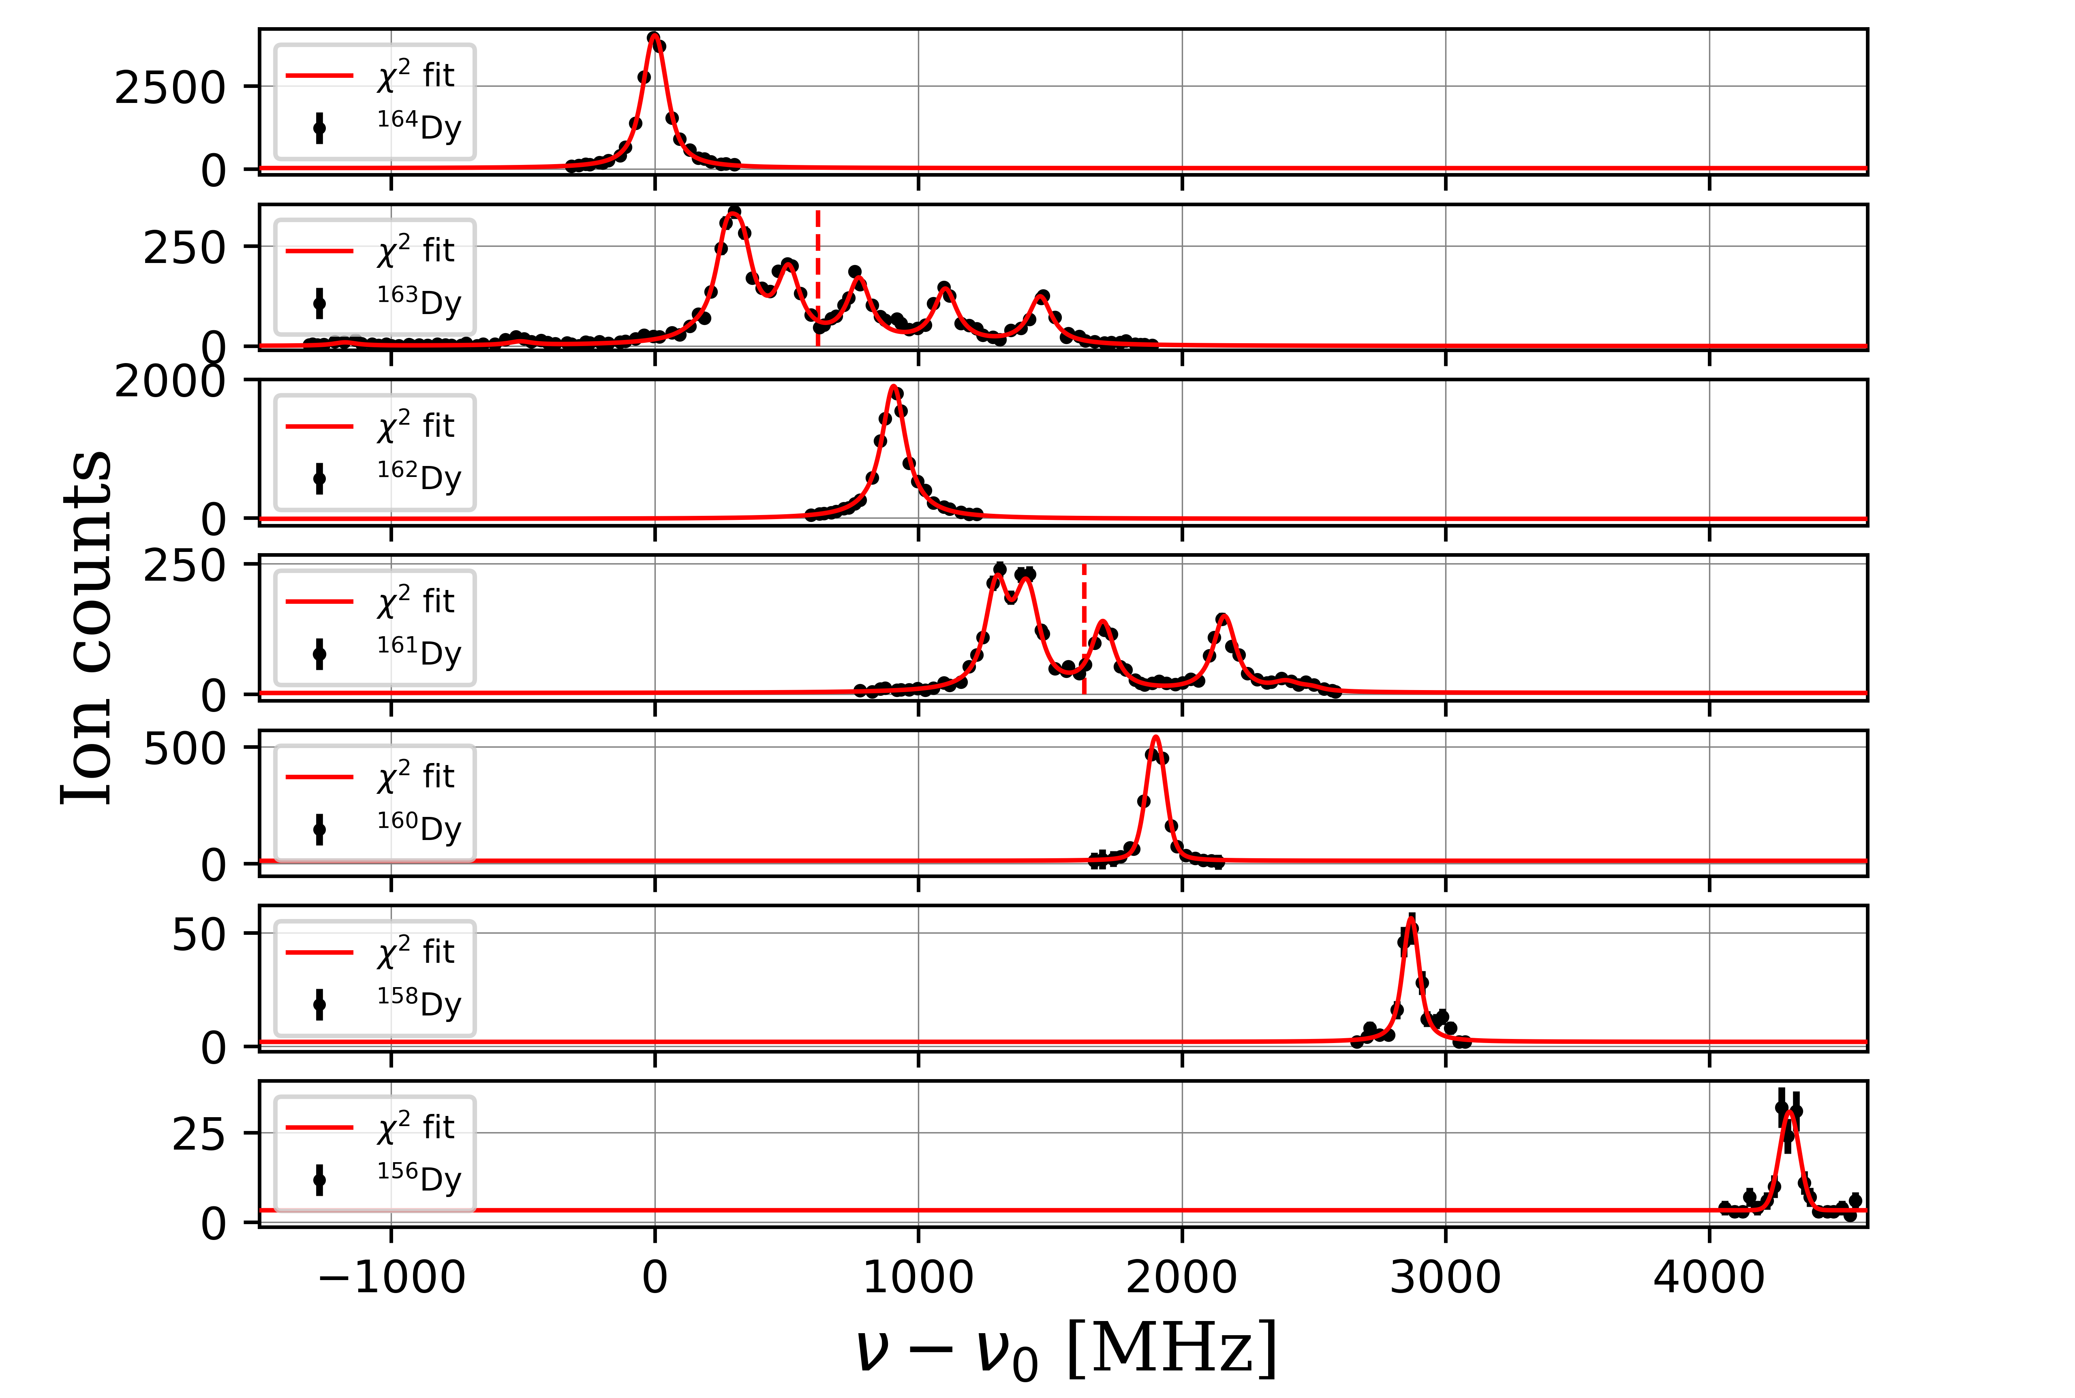
High resolution spectroscopy of Dy: 421nm
Preliminary
Isotope shift
$∼517$MHz/u

Slide 14
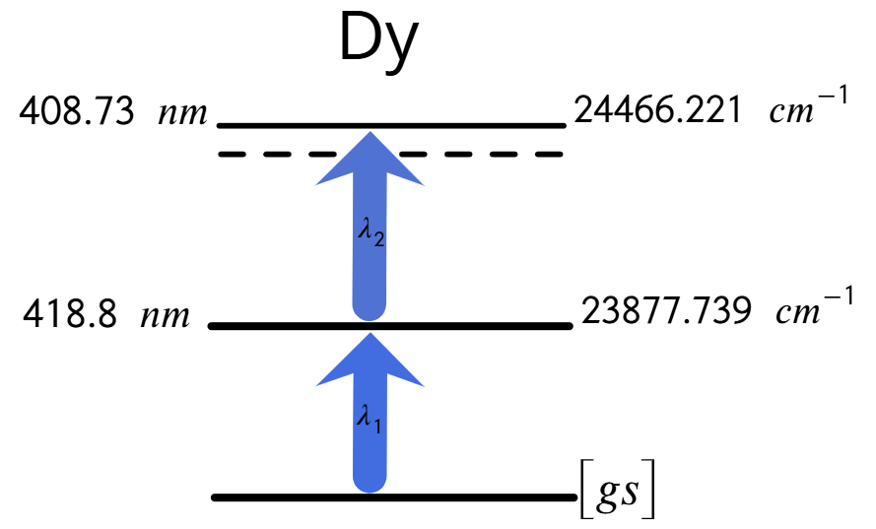
High resolution spectroscopy of Dy: 418nm
Dy 156
0.056 %
Dy 157
$$I=5/2^{ −}$$
Dy 158
0.095 %
Dy 159
$$I=5/2^{ −}$$
Dy 160
2.329 %
Dy 161
18.889%
$$I=5/2^{+}$$
Dy 162
25.47%
Dy 163
24.89%
$$I=5/2^{ −}$$
Dy 164
28.260%
$A$ and $B$ not reported
$$A_{ik}≈1.26×{10}^{8}$$
Rel. Int = 12000

Slide 15
High resolution spectroscopy of Dy: 418nm
Preliminary
Isotope shift
418nm transition
$$<$$
Isotope shift
421nm transition
$δν∼250$MHz/u
$δν∼517$MHz/u
Resolution of 220 MHz (FWHM)
$A$ and $B$ to be extracted

Slide 16
Content
Resonance Ionization Spectroscopy (RIS) and S³-LEB setup.
ALTISA: new laser laboratory for S³.
high resolution spectroscopy of Dy:
    421nm .
    418nm .
Commissioning and characterization of MR-TOF-MS (PILGRIM).

Slide 17
MR-TOF-MS: PILGRIM
R. Wolf et al. multi-reflection time-of-flight mass analyzers by use of an in-trap potential lift. 2011.

Slide 18
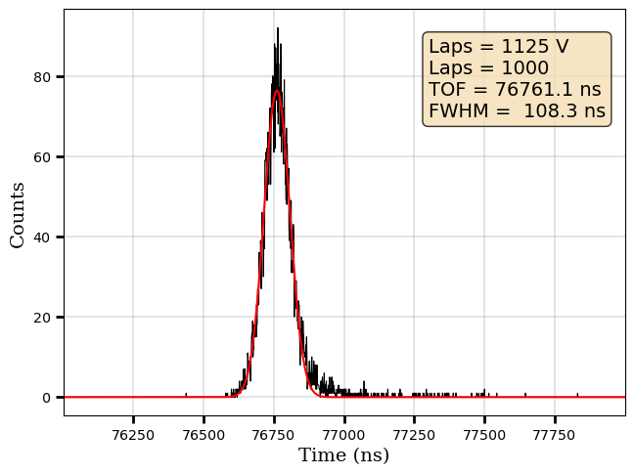
MR-TOF-MS: PILGRIM: PDT scan
PDT voltage [ V ]
PDT voltage [ V ]
TOF [ $μ$s ]
TOF [ $μ$s ]
$$R\sim 8×{10}^{4}$$
$$R\sim 1.5×{10}^{5}$$

Slide 19
PDT scan
Is the complete symmetric curve the optimal one?
M3=1819.7
M3=1819.8
M3=1819.9
M3=1820.0
M3=1820.5
M3=1820.9
Moving M3 was possible to reduce the asymmetry
@ S. Pineda

Slide 20
Mirror Sensitivity
$$α=\frac{ΔTOF [ns]}{ΔV [V]}$$
Mirrors | $α$ [ ns/V ]
M1 | 0.34(1)
M2 | 0.54(1)
M3 | -3.54(1)
M4 | -2.24(1)
M5 | -0.34(1)
LENTM | 0.35(1)

Slide 21
Power supplies fluctuations
Mirrors | $\frac{∆V}{V}=$ $\frac{σ}{V}$
M1 | $$3.5×{10}^{−6}$$
M2 | $$5.6×{10}^{−6}$$
M3 | $$2.9×{10}^{−6}$$
M4 | $$2.9×{10}^{−6}$$
M5 | $$3.3×{10}^{−6}$$
LENTM | $$3.5×{10}^{−6}$$
M3
$$α′=\frac{ \left(\frac{ΔTOF}{TOF}\right)}{\left(\frac{ΔV}{V}\right)}$$
$$ΔTOF≈19 ns$$

Slide 22
Fundamental Jittering
@ L. Canete
@ S. Pineda
@ S. Bara

Slide 23
Conclusions
A new laser laboratory is fully operational and connected to S³LEB hall.
LEB setup for laser spectroscopy is operational and the first high resolution in gas-jet measurements have been carried out.
Perspectives
high resolution spectroscopy of Dy: * 404.7nm
high resolution spectroscopy of Er: * 393nm
high resolution spectroscopy of Gd.
Thank you for your attention.

Slide 24
Backup

Slide 25
Beam expansion
$f_{1}=−13.7$ mm
$f_{2}=+150$ mm
$$\frac{f_{2}}{f_{1}}=10.95$$
5.2 cm
$d=4$ mm $⇒ d_{e}=43.8$ mm

Slide 26
Beam expansion
Lens 2
Lens 1

Slide 28
High resolution spectroscopy of Dy

Slide 29
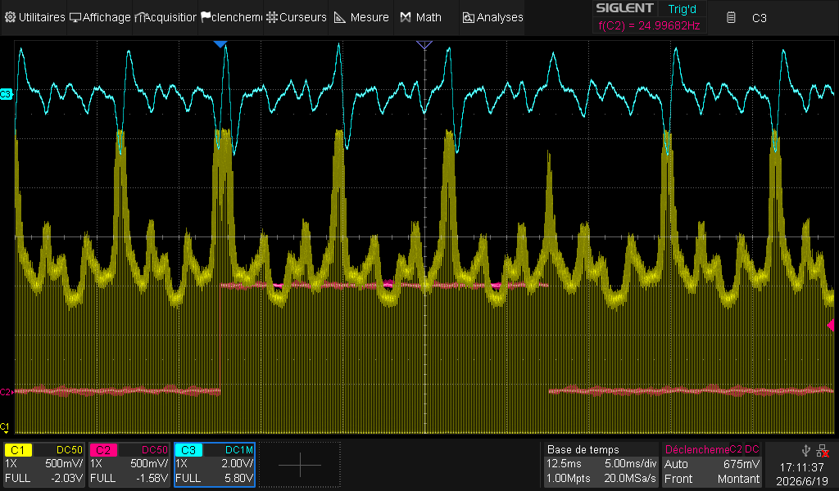
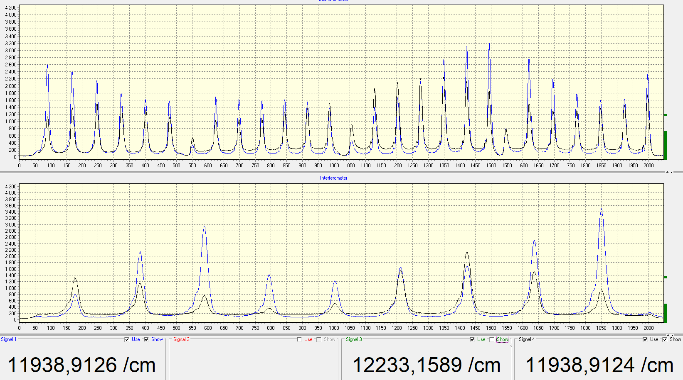
Locking Process of the narrowband laser
No-locking: 760mW
Locking: 1.35W
SHG: 60mW

Slide 30

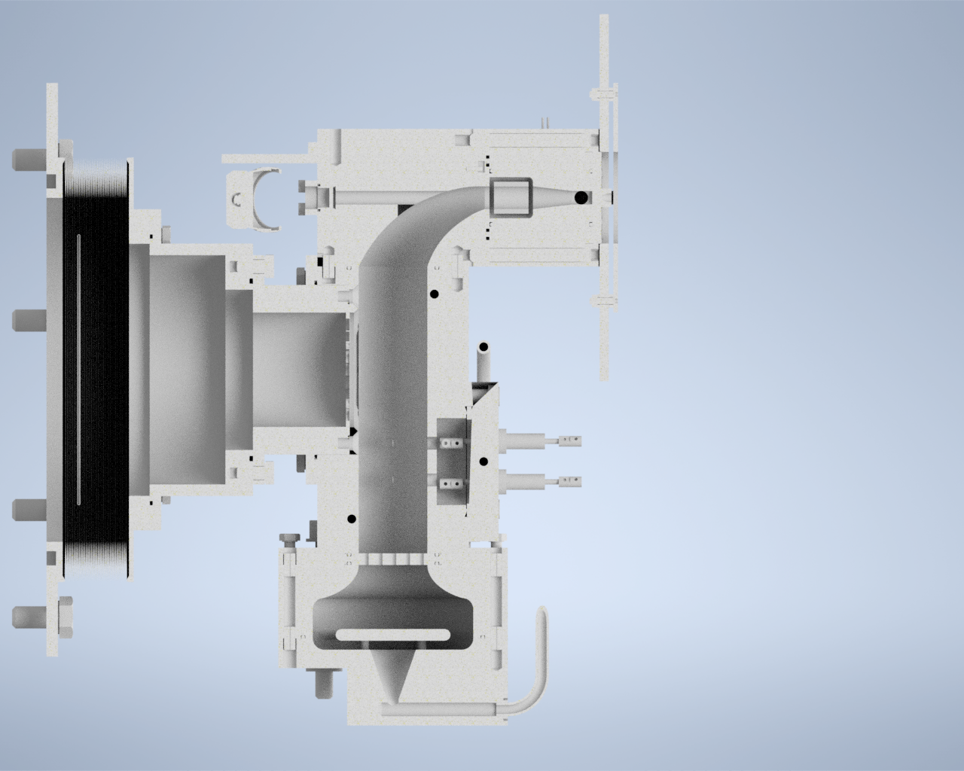
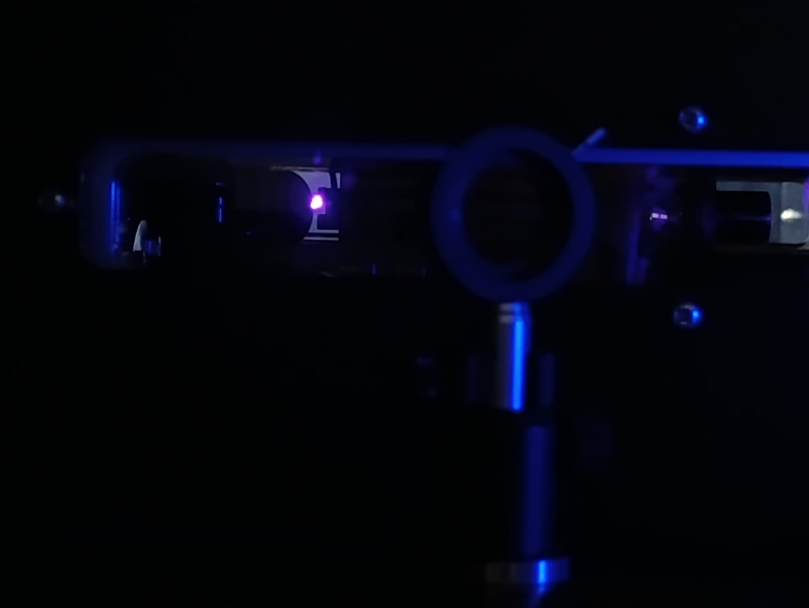


Alignment strategy for the anticollinear path
$4$ mm $\sim$
50.4mW
λ₁
λ₂
400mW
Supersonic jet
Nozzle
Gas jet laser probing

Slide 31
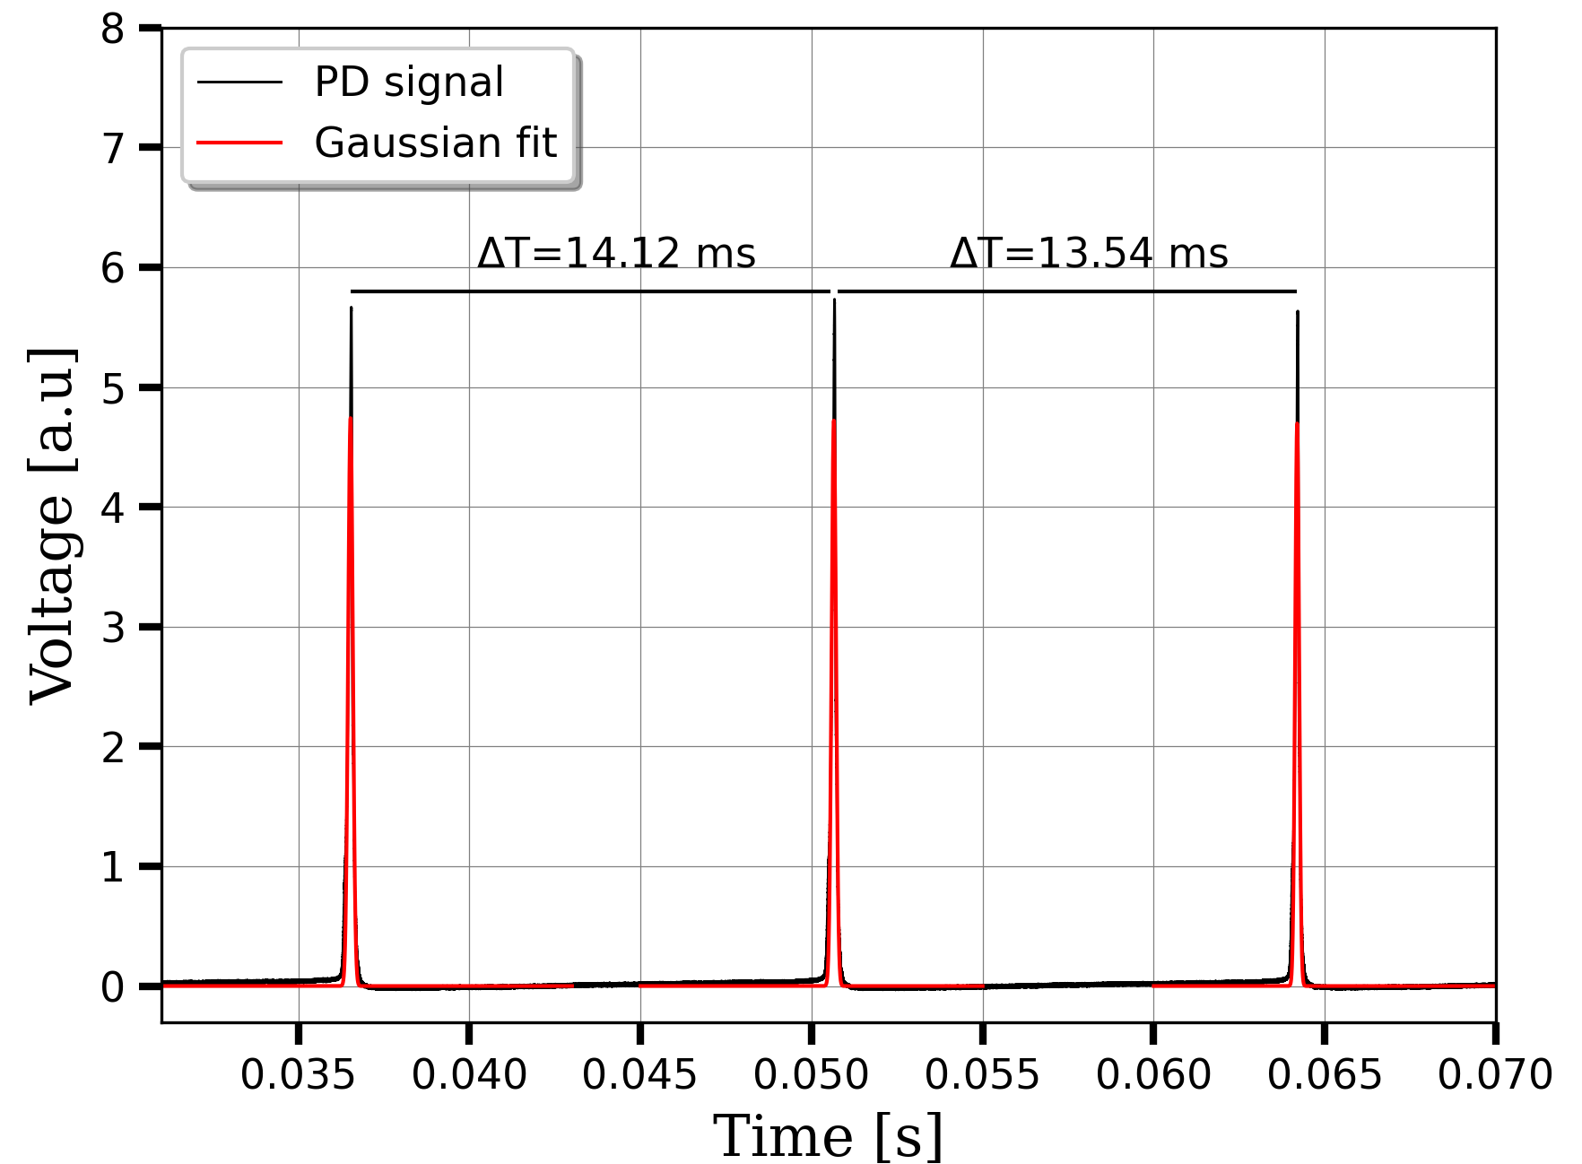
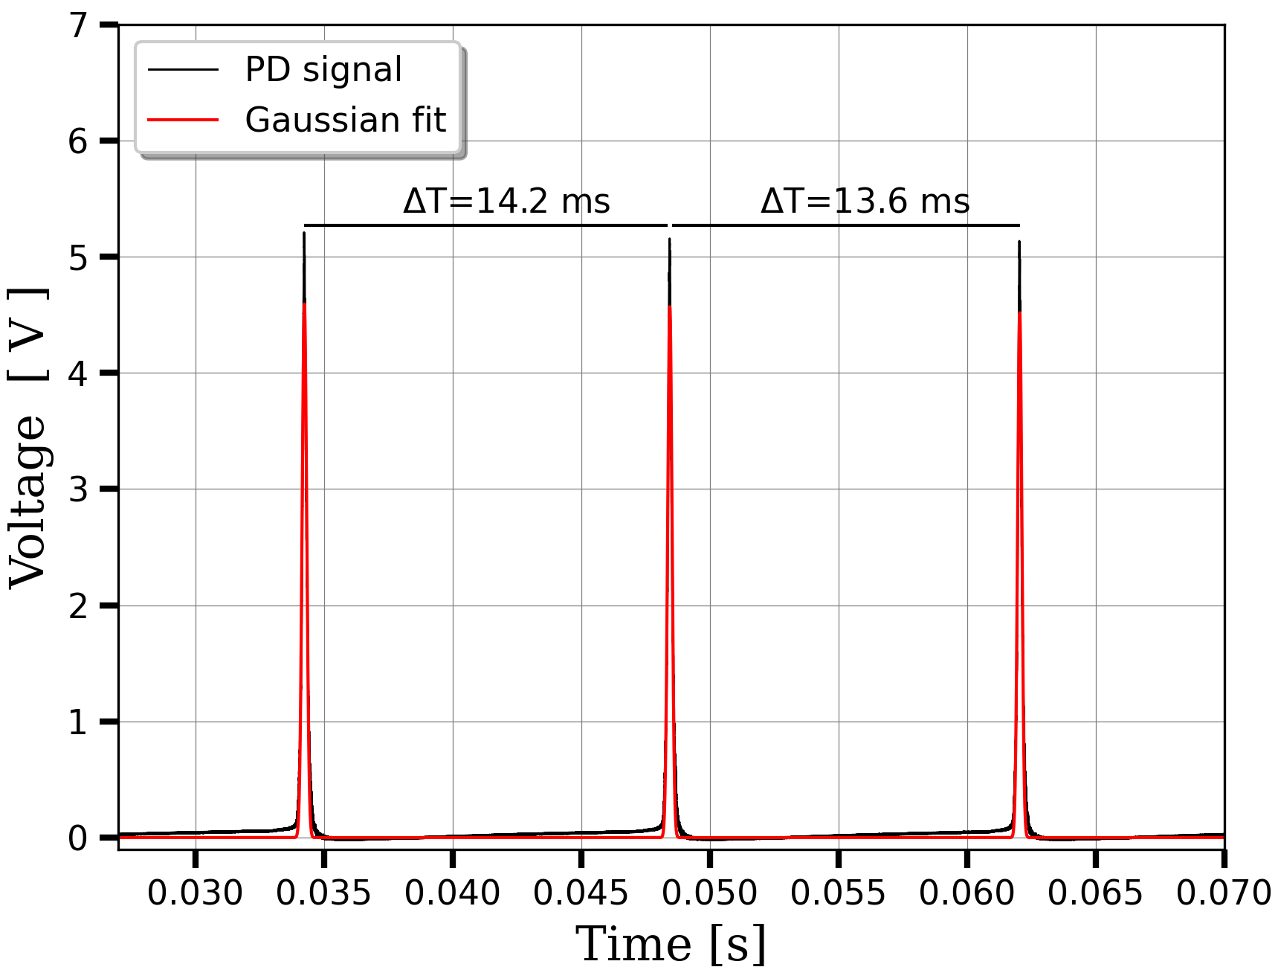

ILC characterization
Matisse transmission spectrum
ILC transmission spectrum
$$δν=11\left(1\right) MHz$$
$$δν=15\left(1\right) MHz$$

Slide 32
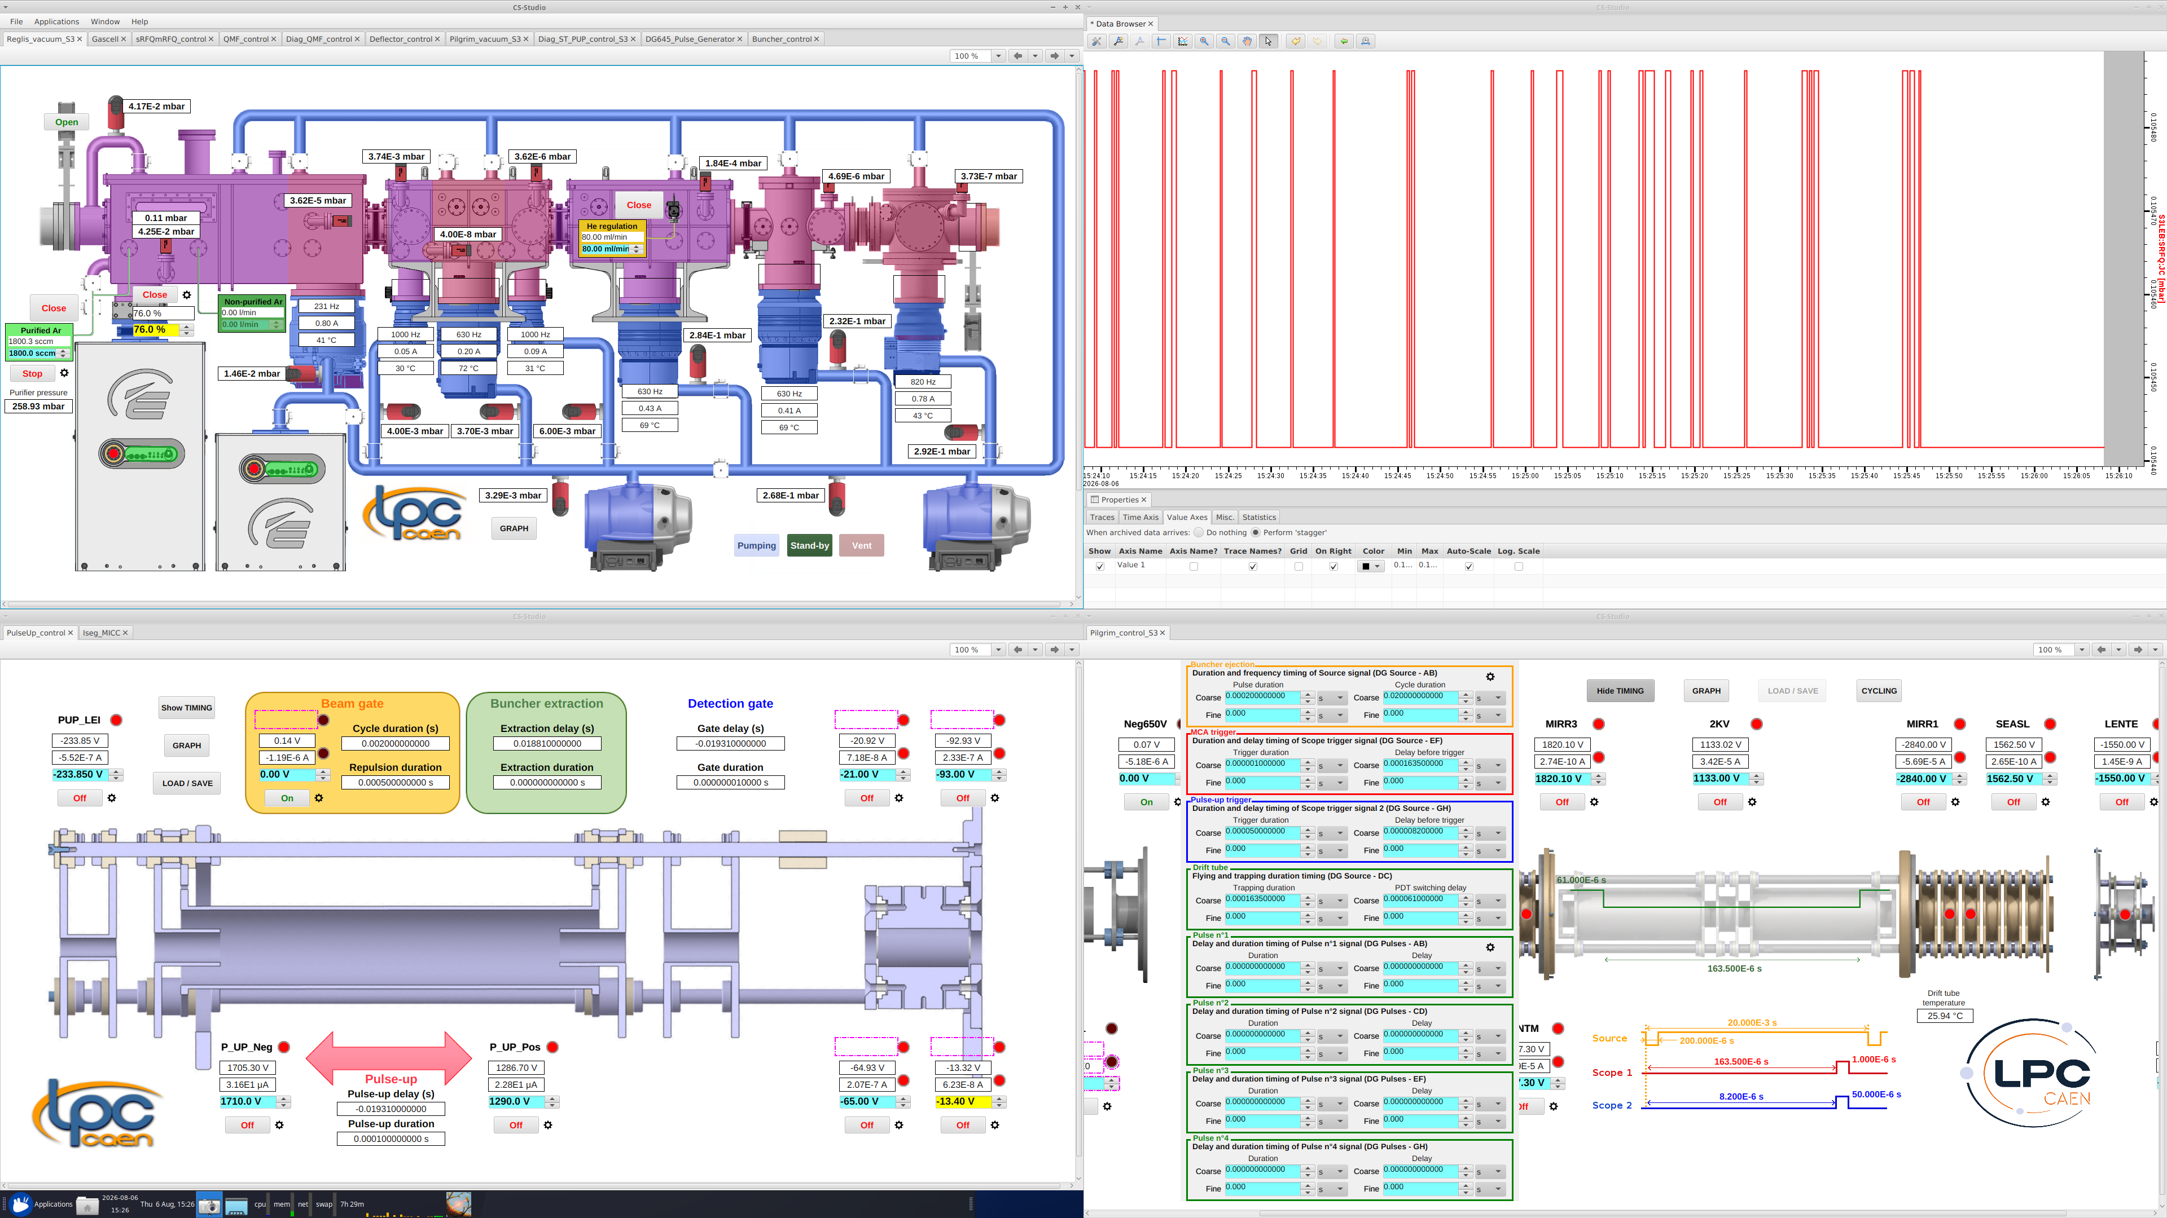
Pressure matching
$$\frac{P}{P_{0}}={\left[1+\left(\frac{γ−1}{2}\right)M^{2}\right]}^{−γ/(γ−1)}$$
$$M=8.11$$

Slide 33
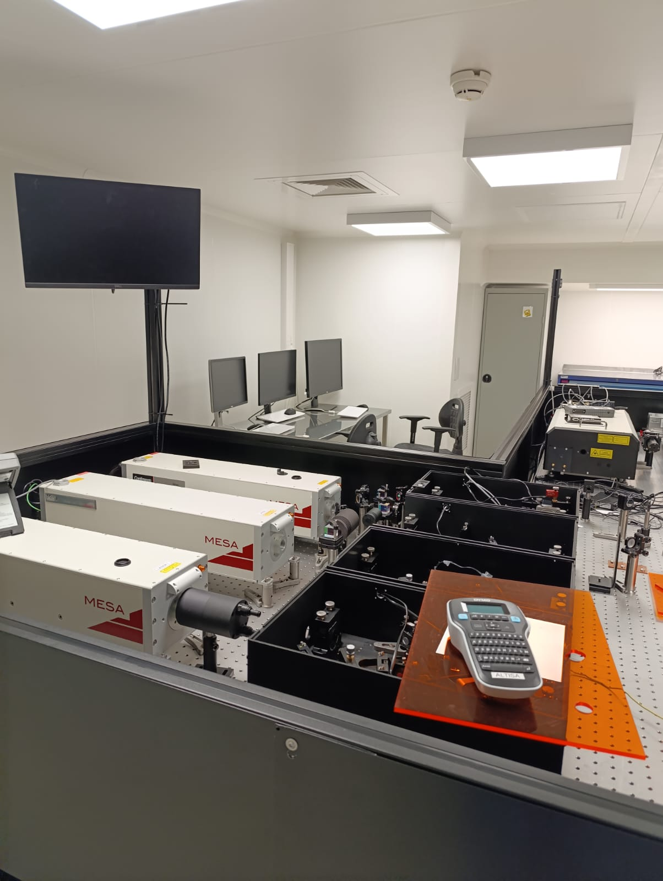
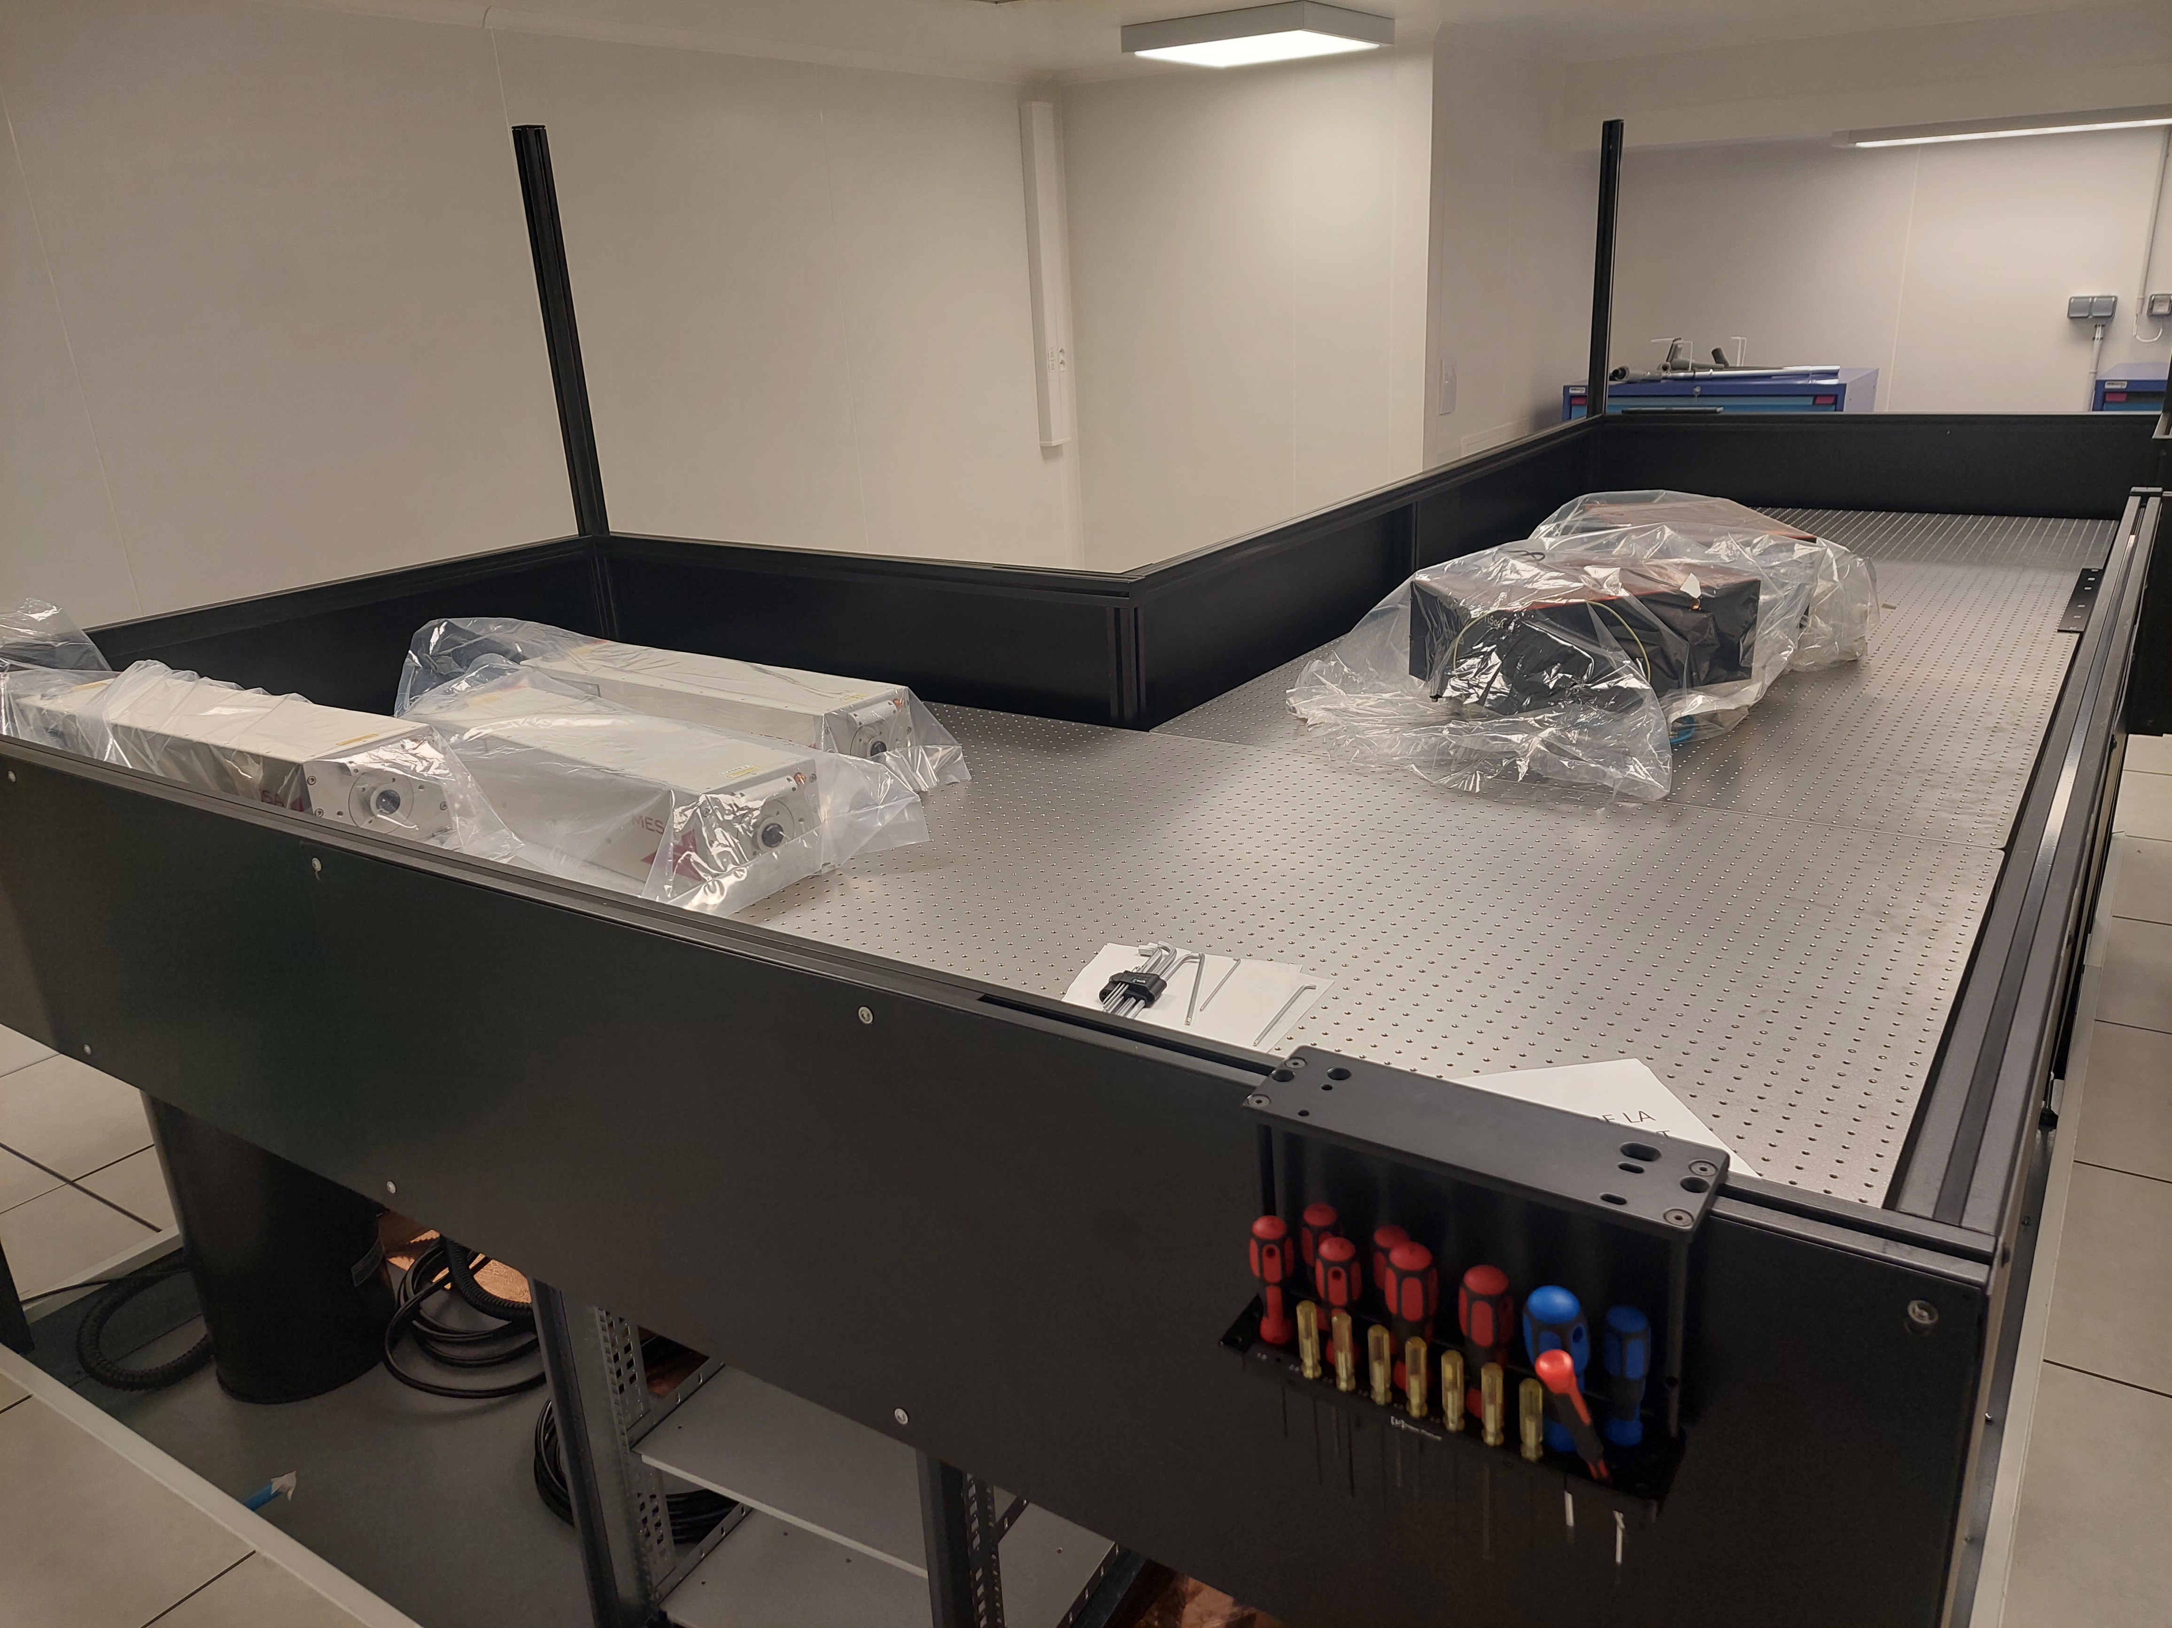
ALTISA

Slide 34
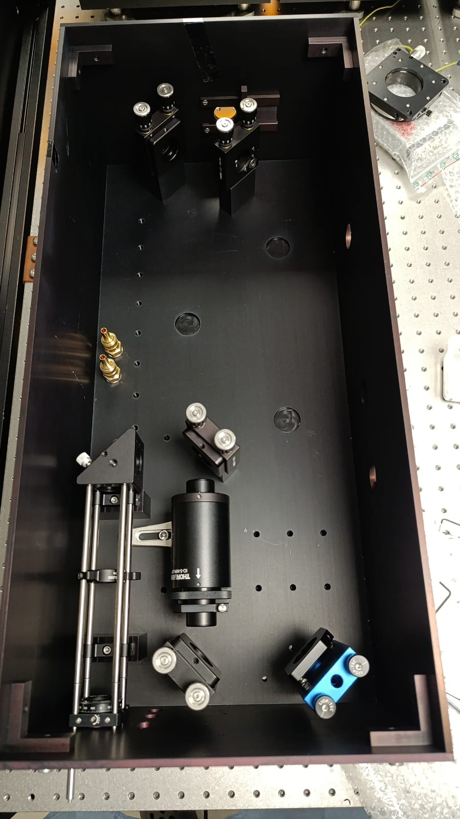
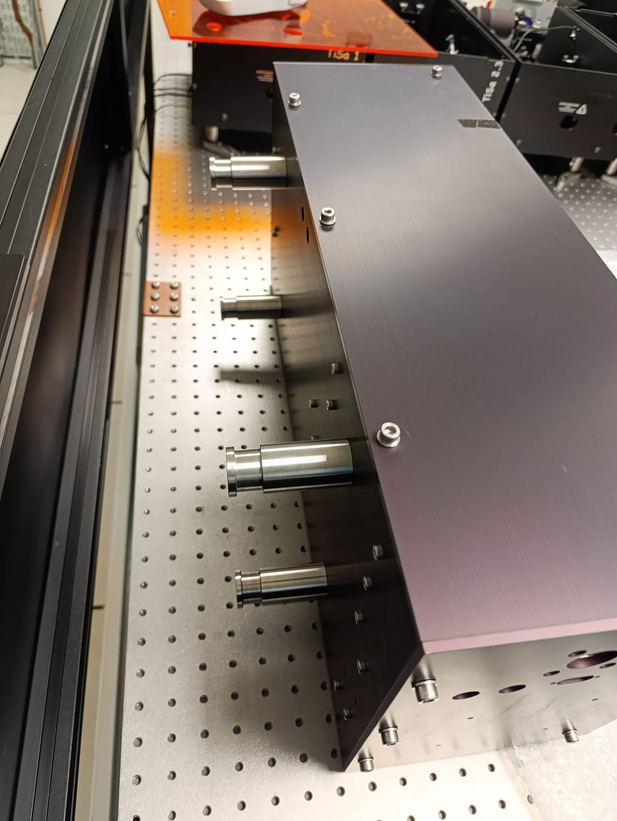
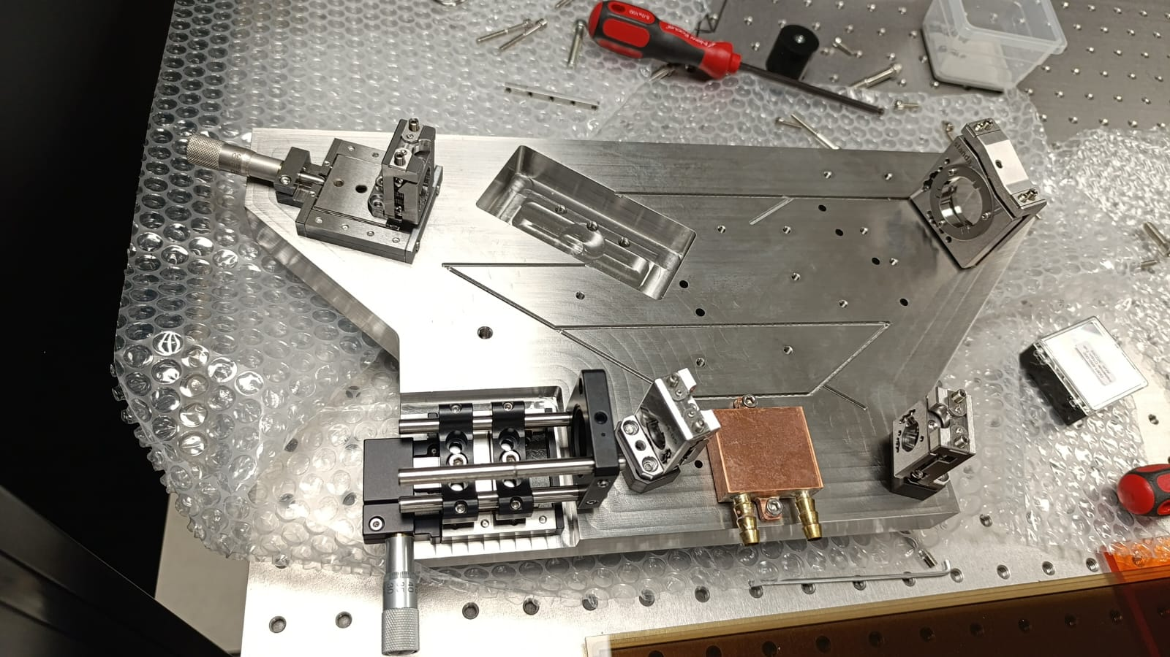
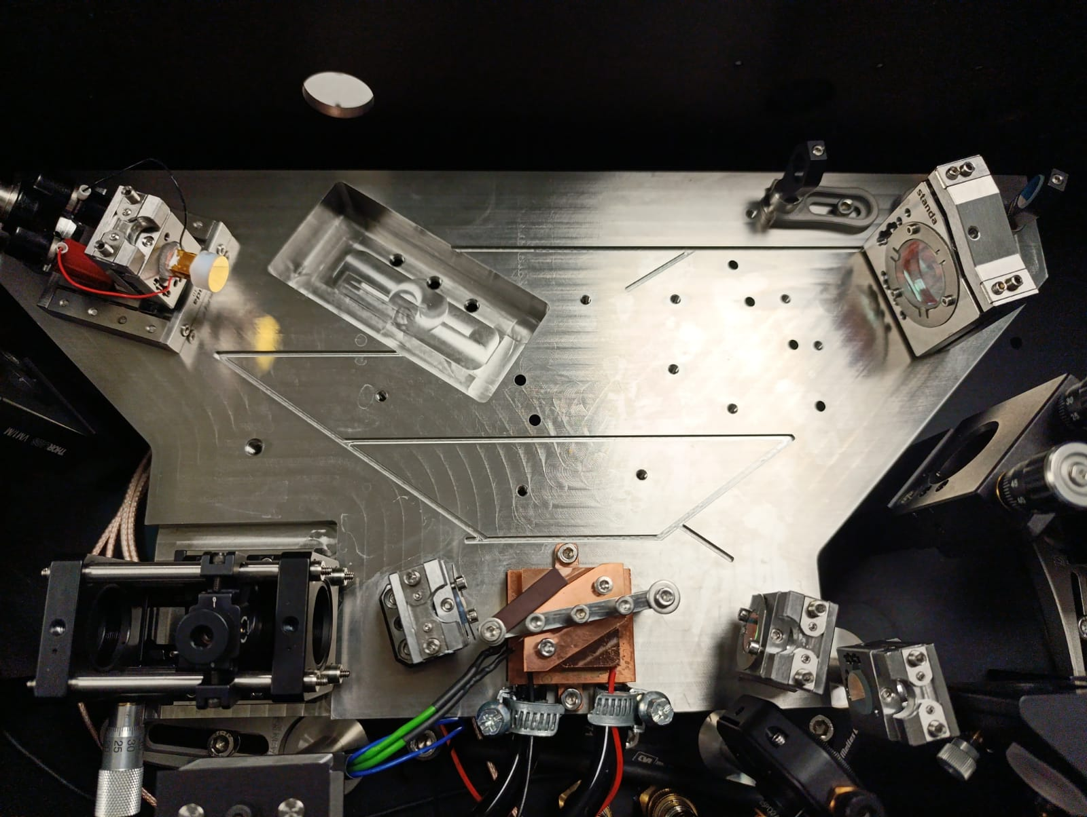
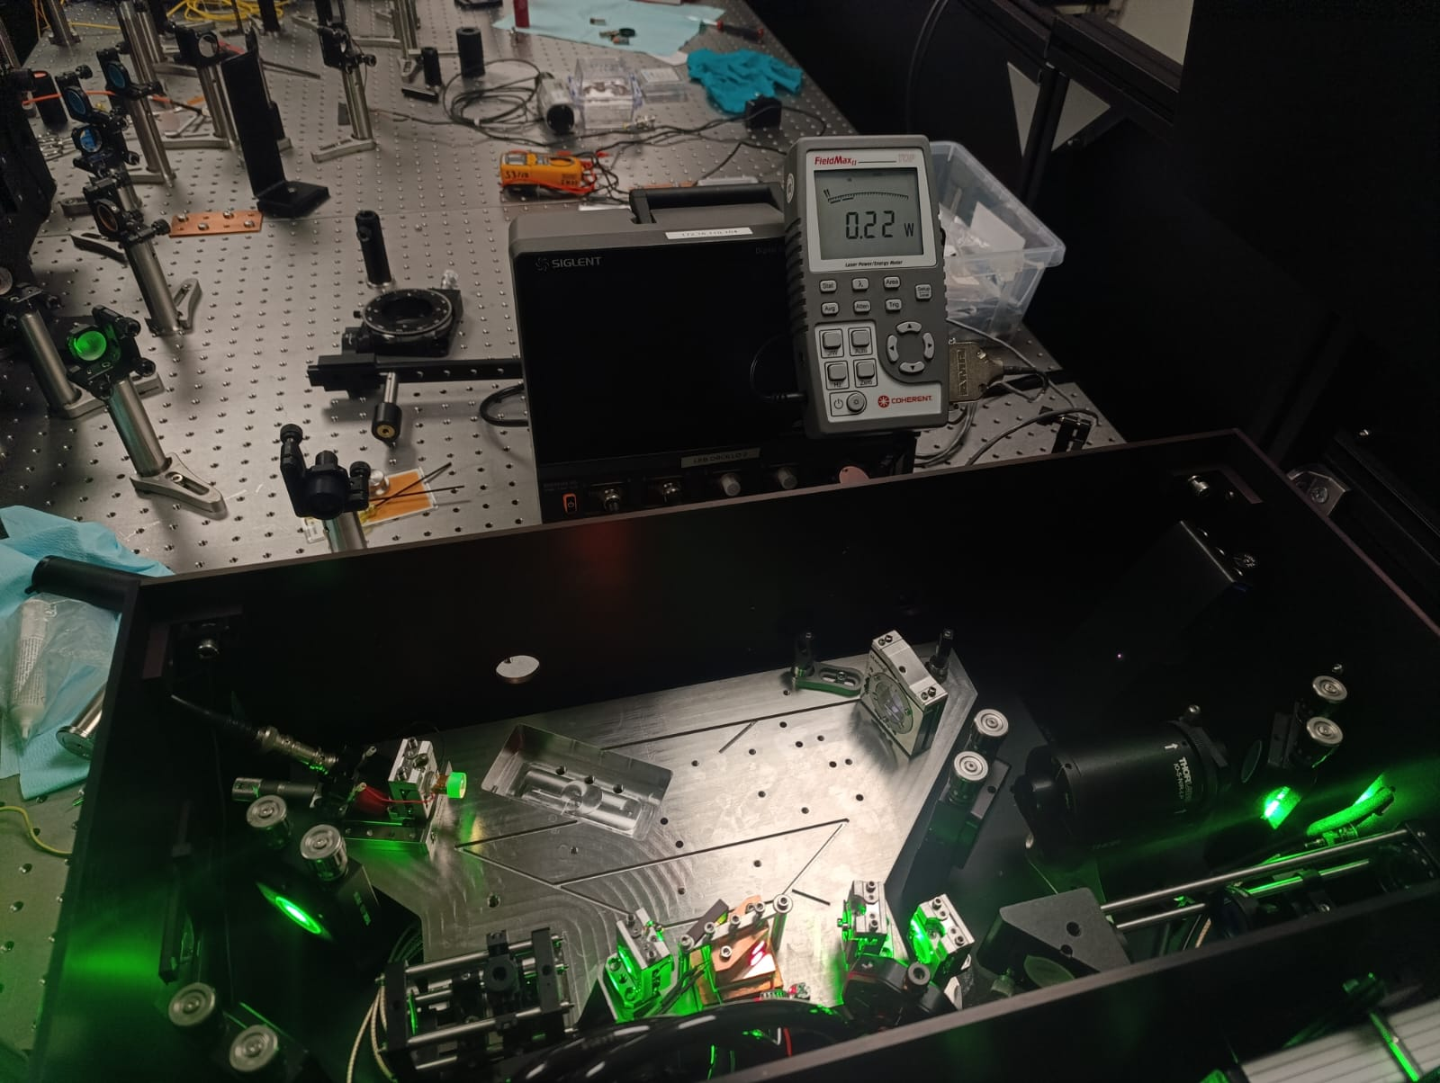
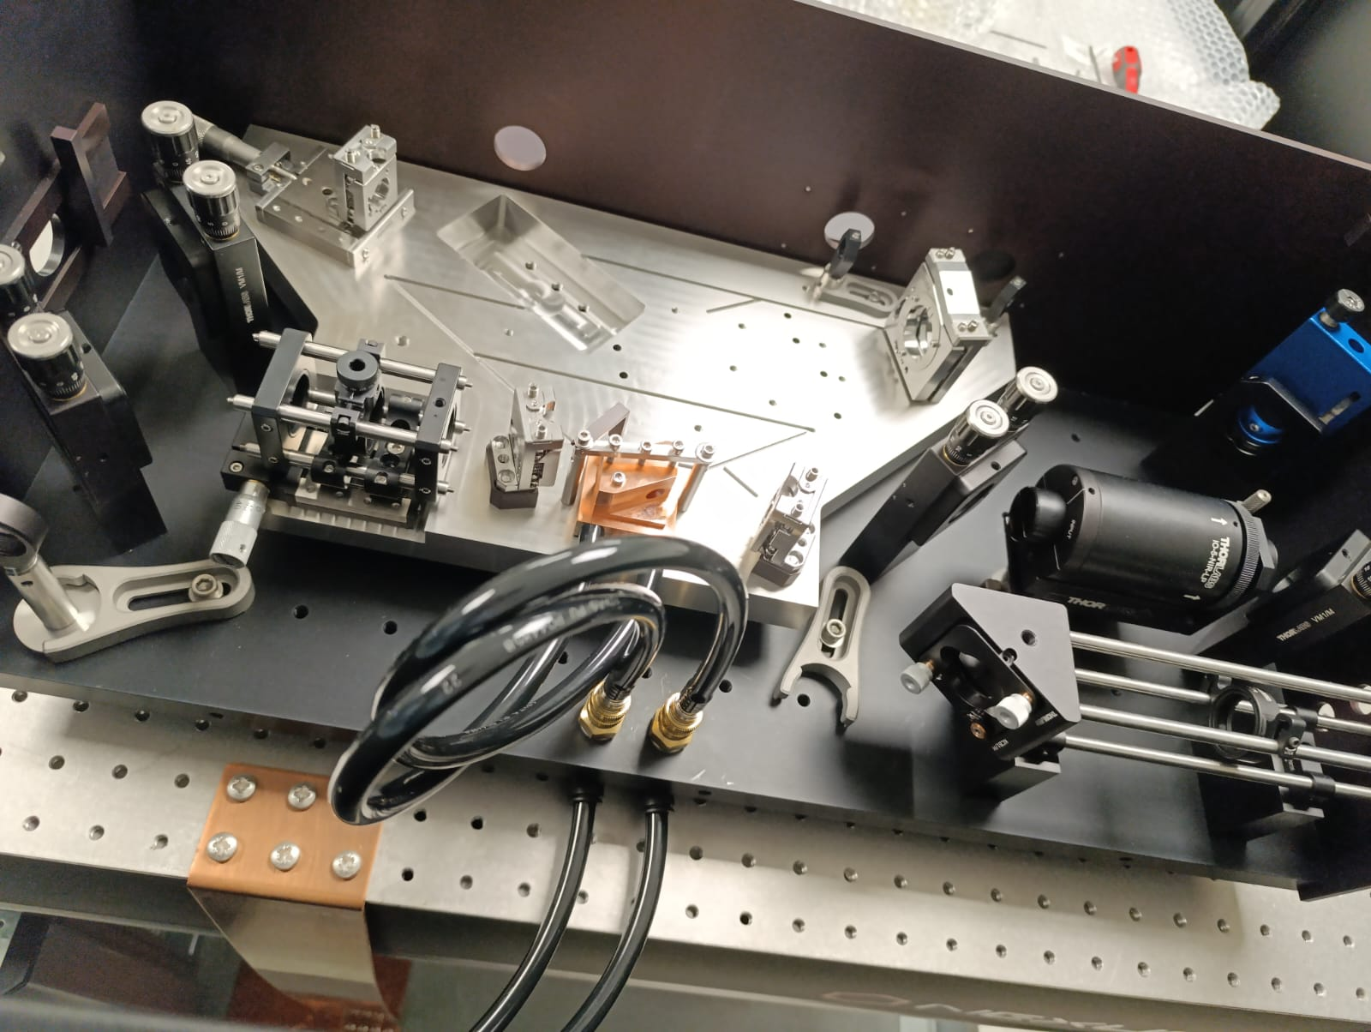
A new narrowband cavity for S³

Slide 35
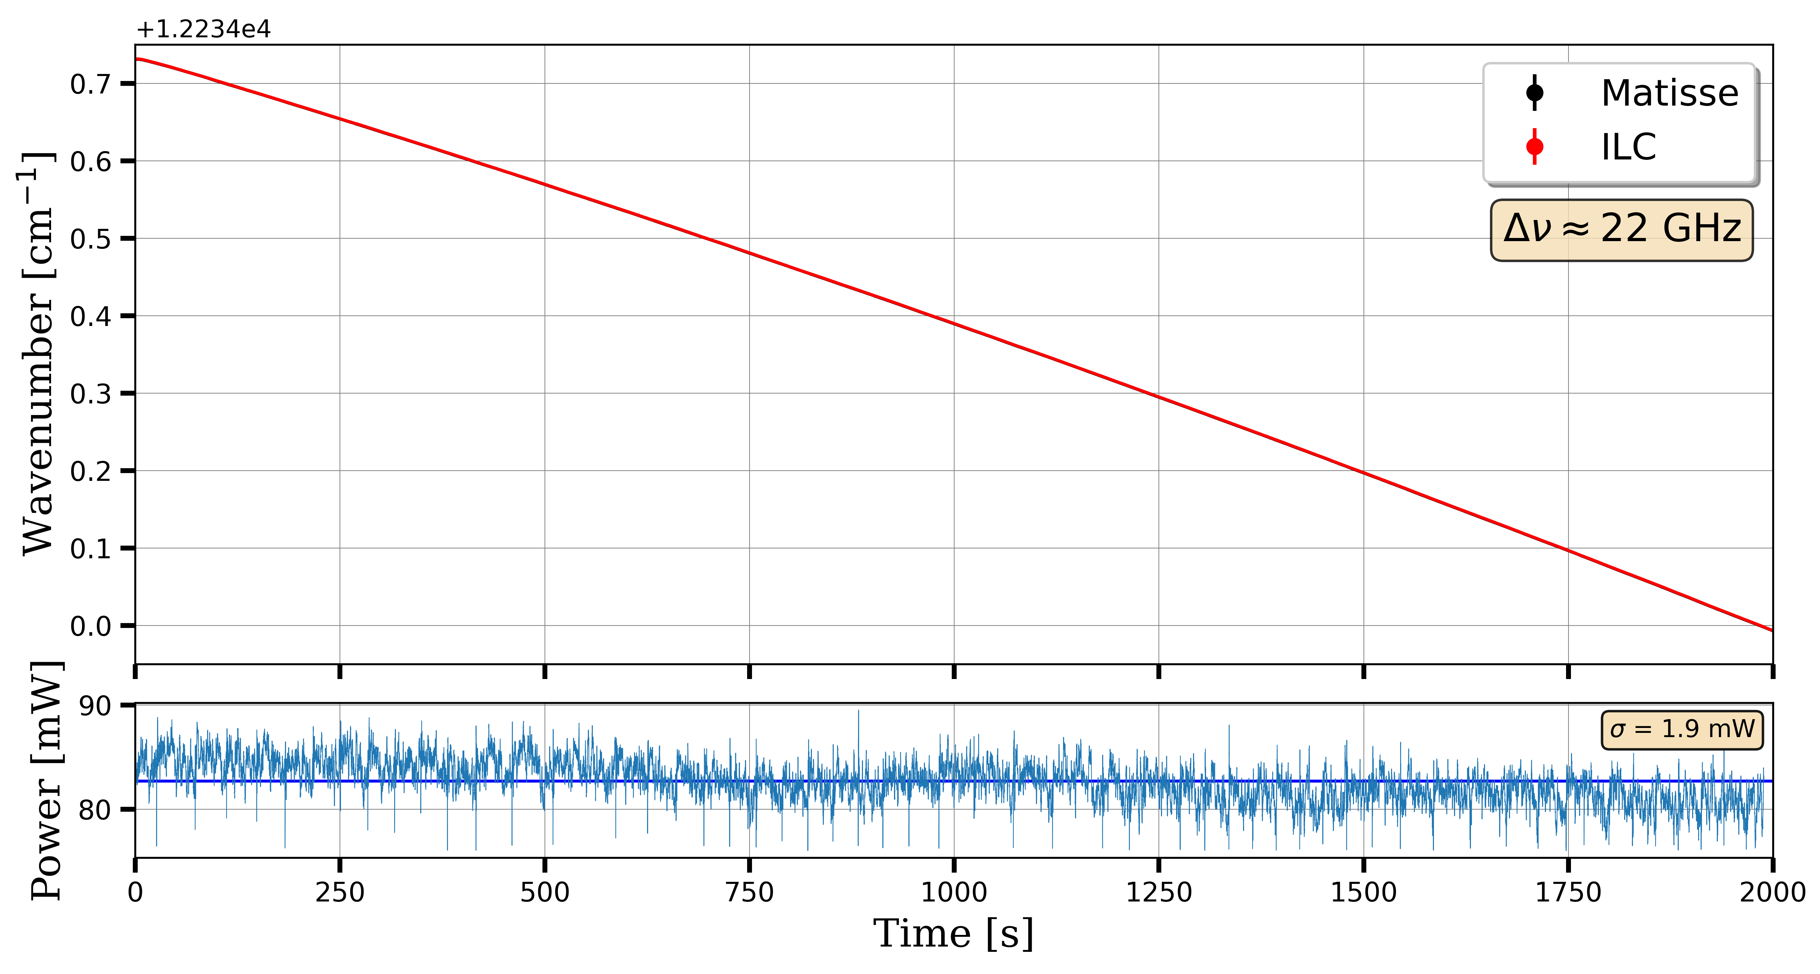
A new narrowband cavity for S³
Tunable
Pulsed $∼$ 10 kHz
Narrowband
$\sim$15(1) MHz

Slide 36
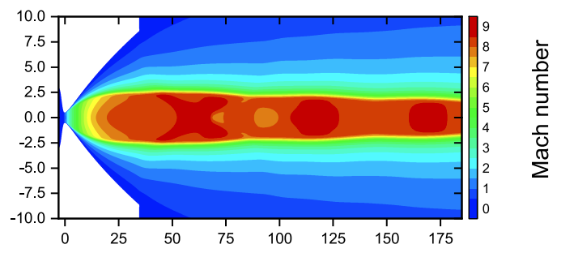
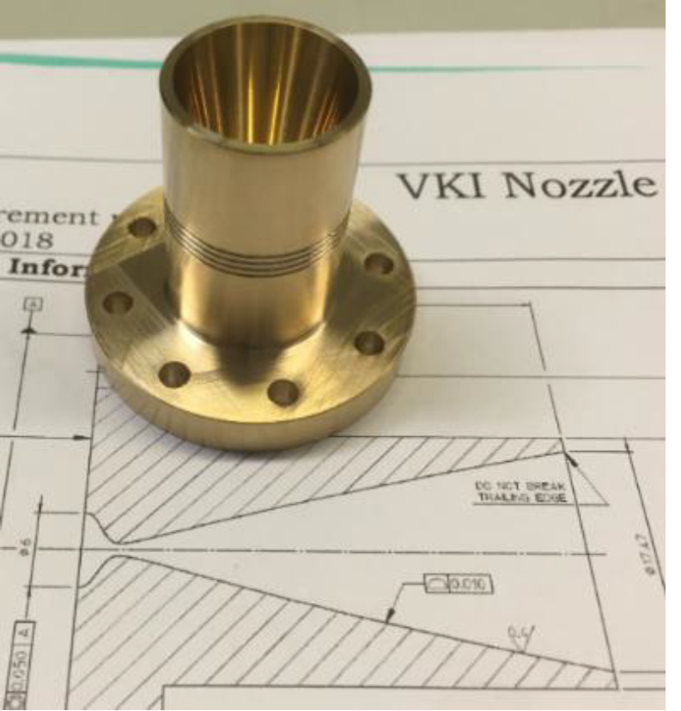
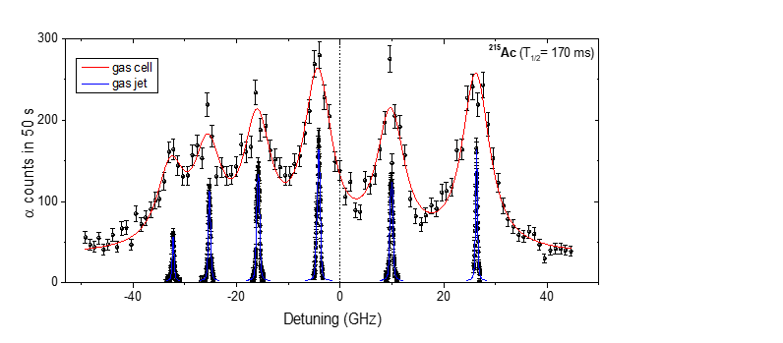
Gas jet laser probing
Gas cell
Broadening effects
Broadband laser (GHz)
Extraction time ~500 ms
de Laval Nozzle
Hypersonic gas jet : ρ ↘︎ T ↘︎
Narrowband laser (MHz)
Proof of principal @ LISOL
$\sim 6$cm
λ₁
Gas cell laser probing
λ₂
Ion collector
Supersonic jet
Extraction by gas flow only
+
+
+
+
$E<1$ MeV/u
Stopping, thermalization
and neutralization
Thin window
Ar buffer gas at 100-500 mbar
R. Ferrer, Nat. Comm. 8 (2017)

