Slide 1
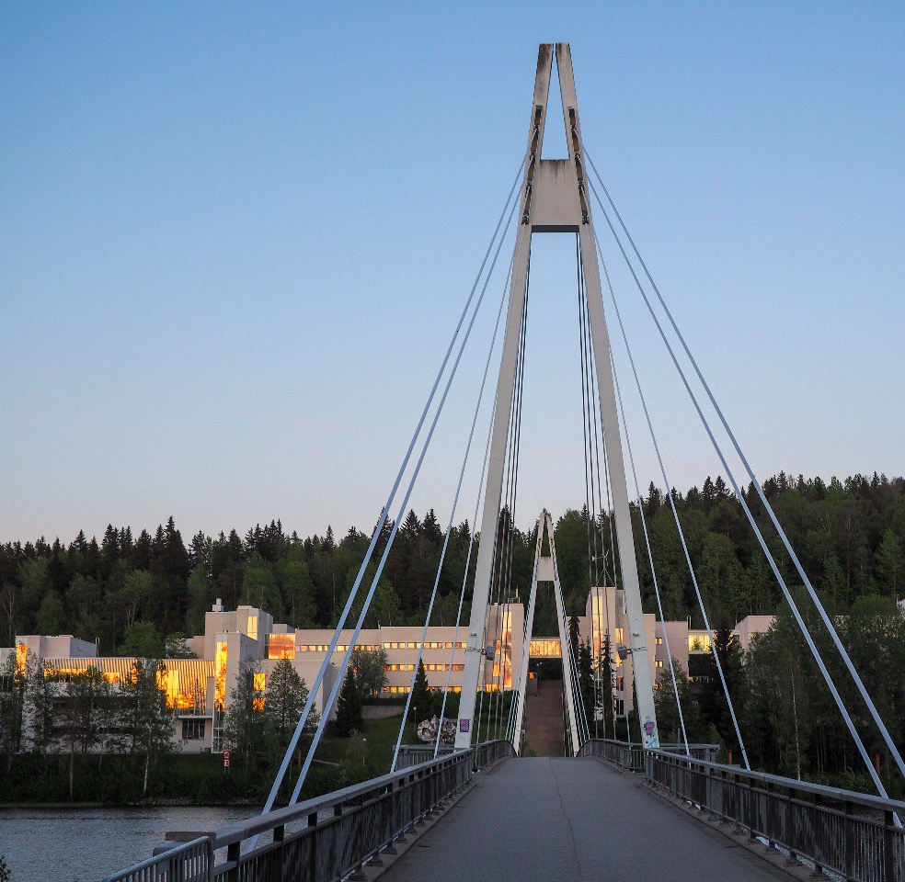
MR-ToF measurements of the exotic 94Ag
Ville Virtanen
ville.virtanen@ganil.fr
GANIL
GANIL Colloque 24.9.2026

Slide 2
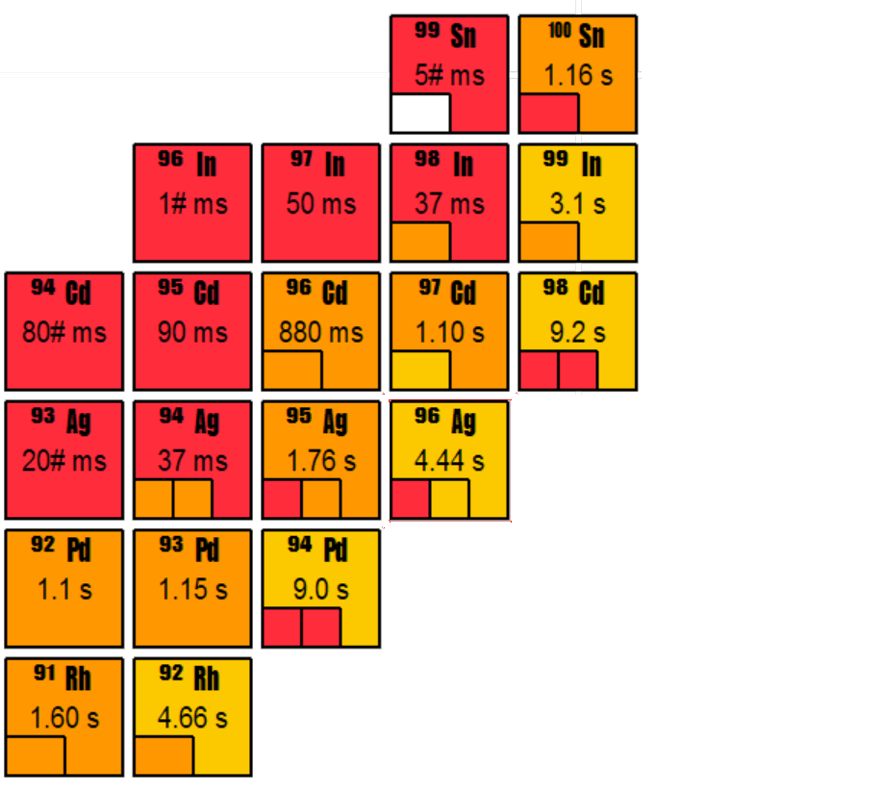
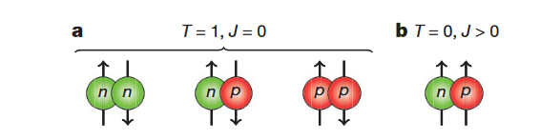
N=Z nuclei near proton-dripline
Study of pn-interaction facilitated by overlap of π and ν-states at N = Z.
Approach to doubly magic shell closure at 100Sn .
Astrophysical RP-process
Increased Coulomb interaction drives nuclei to undergo proton emission
dVpn formula here
Cederwall Nature volume 469, pages 68–71 (2011)

Slide 3
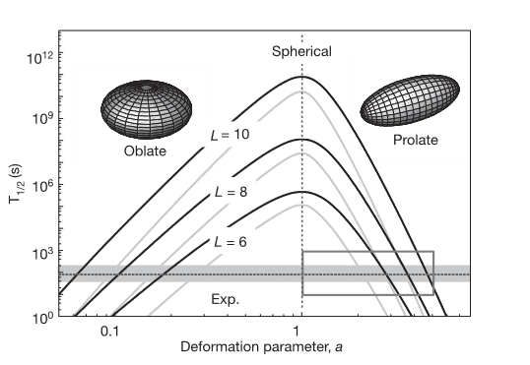
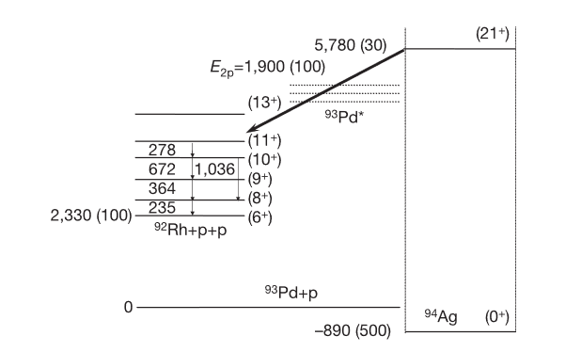
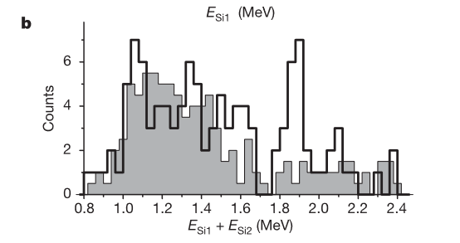
Two-proton radioactivity?
Why not 1p?
Deformation?
Mukha et al. vol 439 19 2006 doi:10.1038/nature04453

Slide 4
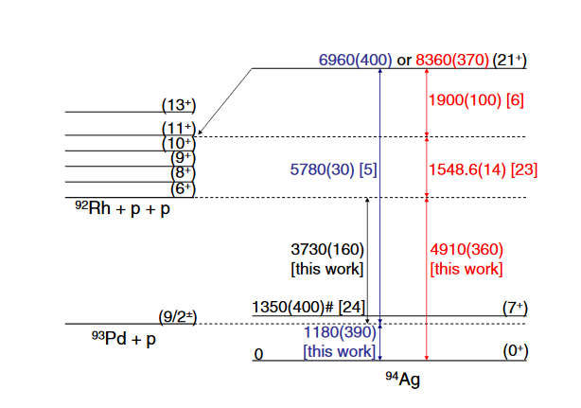
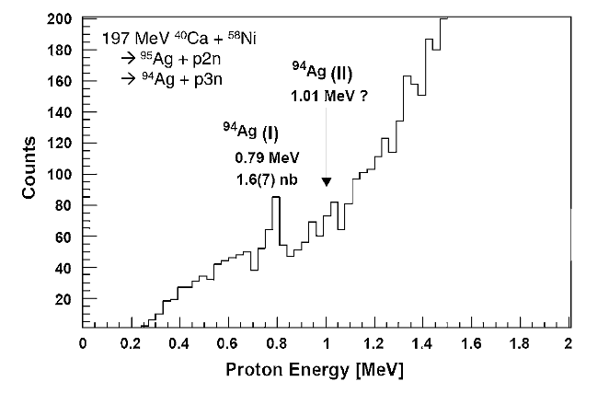

Two-proton radioactivity?
Subsequent study by Cerny et al. confirmed the 0.79 MeV proton, but saw no evidence for two-proton decay or the other 1.01 MeV single proton
$Q_{2p} \left(94Ag\right)= ∆\left(94Ag\right)−$ $∆$(92Rh) - 2$∆$(1H)
J. Cerny PRL 103, 152502 (2009)
A. Kankainen et al. PRL 101, 142503 (2008)

Slide 5
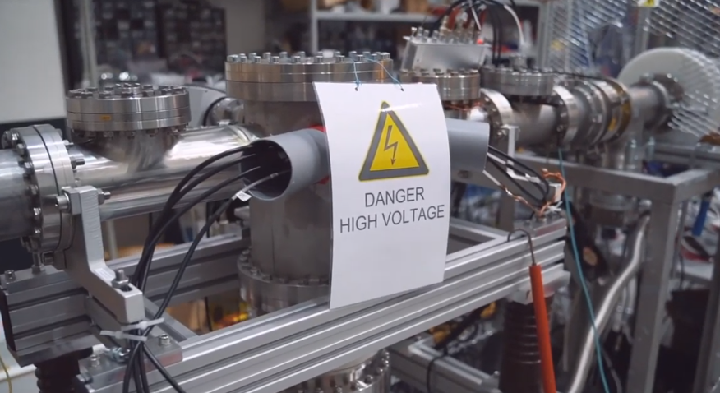
Methods

Slide 6
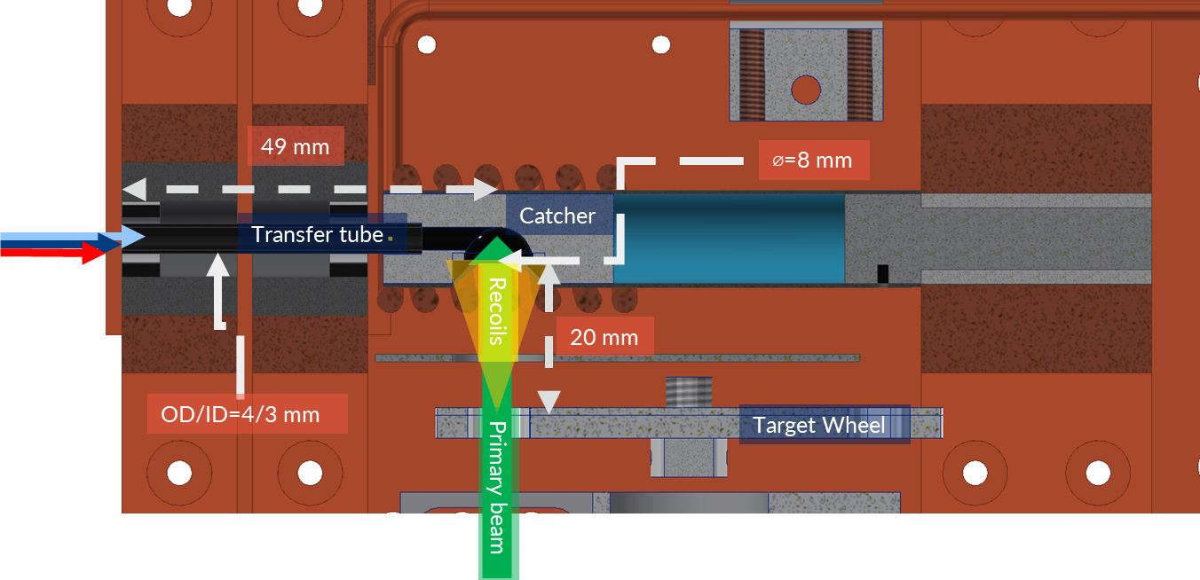
Inductively Heated Hot Cavity Cather Laser Ion Source
Typically: Gas cell. This time no buffer gas in chamber: reaction products caught in graphite catcher.
61 106.2cm⁻¹
~800 nm
λ₃
54213.60 cm⁻¹
6d ²D_{5/2}
421.214 nm
λ₂
30 472.71cm⁻¹
5p ²P_{3/2}
⁴⁰Ca(⁵⁸Ni,p3n) ⁹⁴Ag
328.162 nm
λ₁
A target ion source system for fusion-evaporation reactions
  Efficient: ~10 % for Ag, few % for Pd
  Fast: ~8 ms for Ag, < 1 s for Pd
0 cm⁻¹
5s ²S_{1/2}
Reponen, M. et al. Review of Scientific Instruments 86, 123501 (2015)

Slide 7
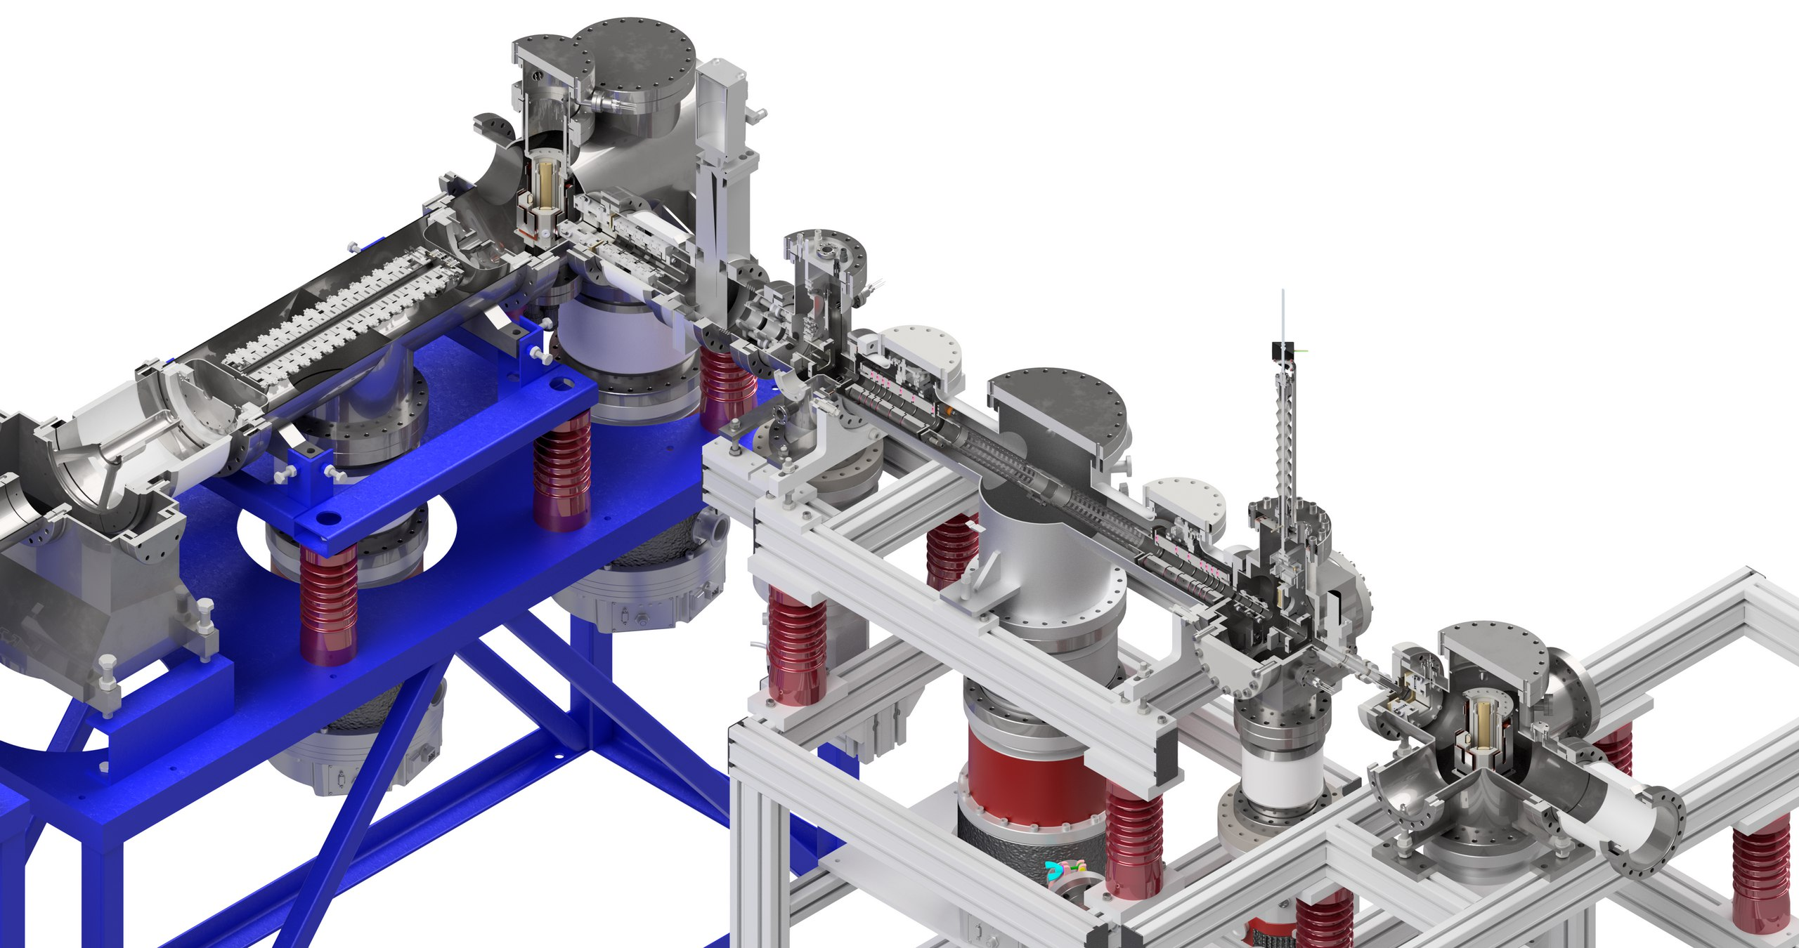
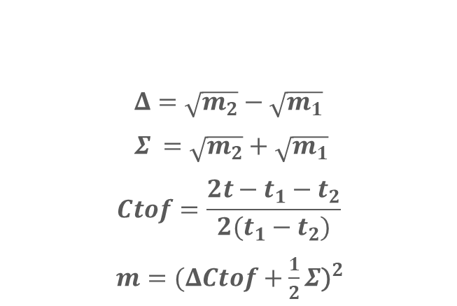
$$Δ=\sqrt{m_{2}}−\sqrt{m_{1}}$$
$Σ =\sqrt{m_{2}}+\sqrt{m_{1}}$
$$Ctof=\frac{2t−t_{1}−t_{2}}{2(t_{1}−t_{2})}$$
$m={(ΔCtof+\frac{1}{2}Σ\text{)}}^{2}$
Quadrupolar bender
Mini buncher
Injection chamber
RFQ cooler buncher
Main chamber
Extraction chamber
MagneToF,
Silicon detector,

Slide 8
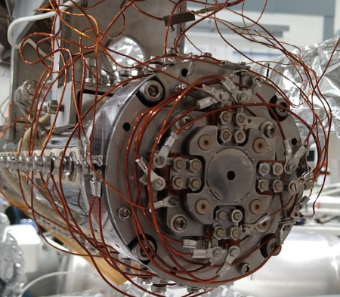
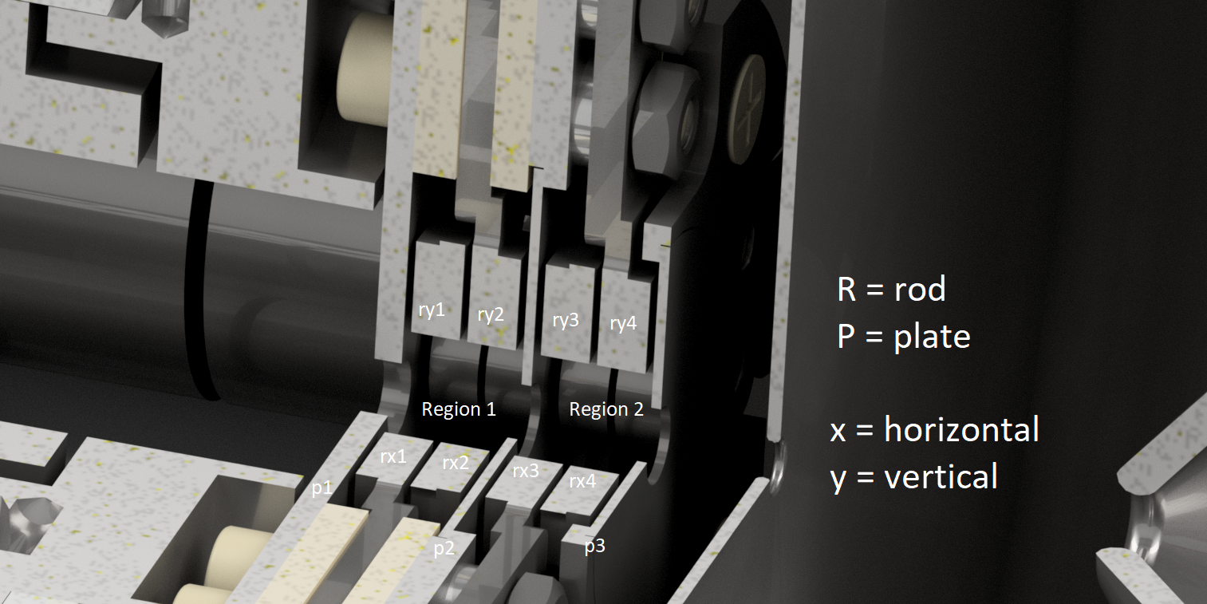
The Mini buncher
~22-72 ns bunches, ~10-20 eV energy spread,
R0 = 3.75 mm Typically 3 MHz 1kVpp. ~50 % transmission.
2e+5 -1e+6 ions per bunch
Notes:
A linear harmonic paul trap

Slide 9
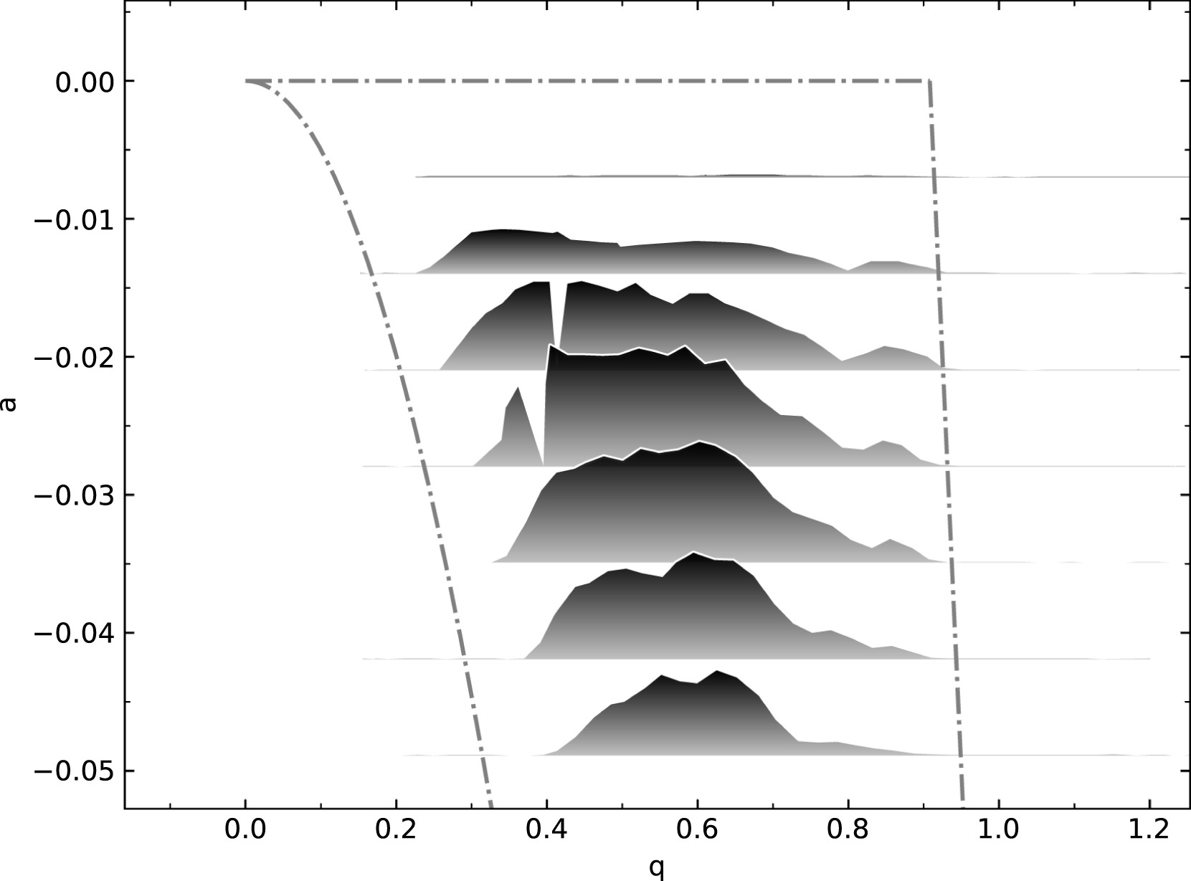
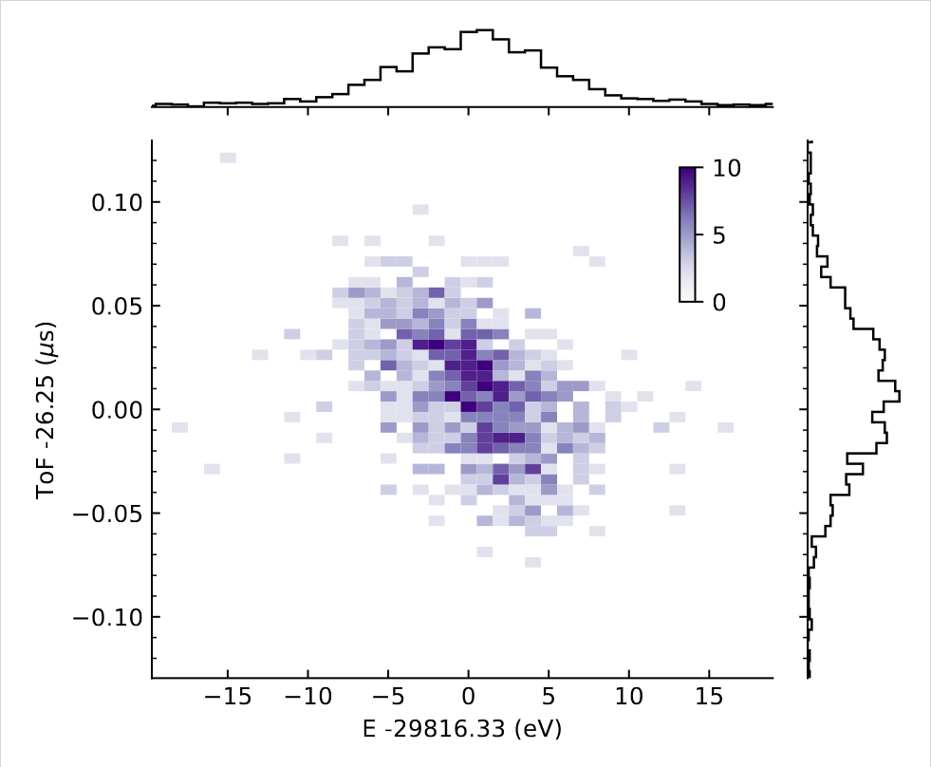
Virtanen, V. A. et al. Miniaturised cooler-buncher for reduction of longitudinal emittance at IGISOL.
NIM-A1072, 170186 (2025).

Slide 10
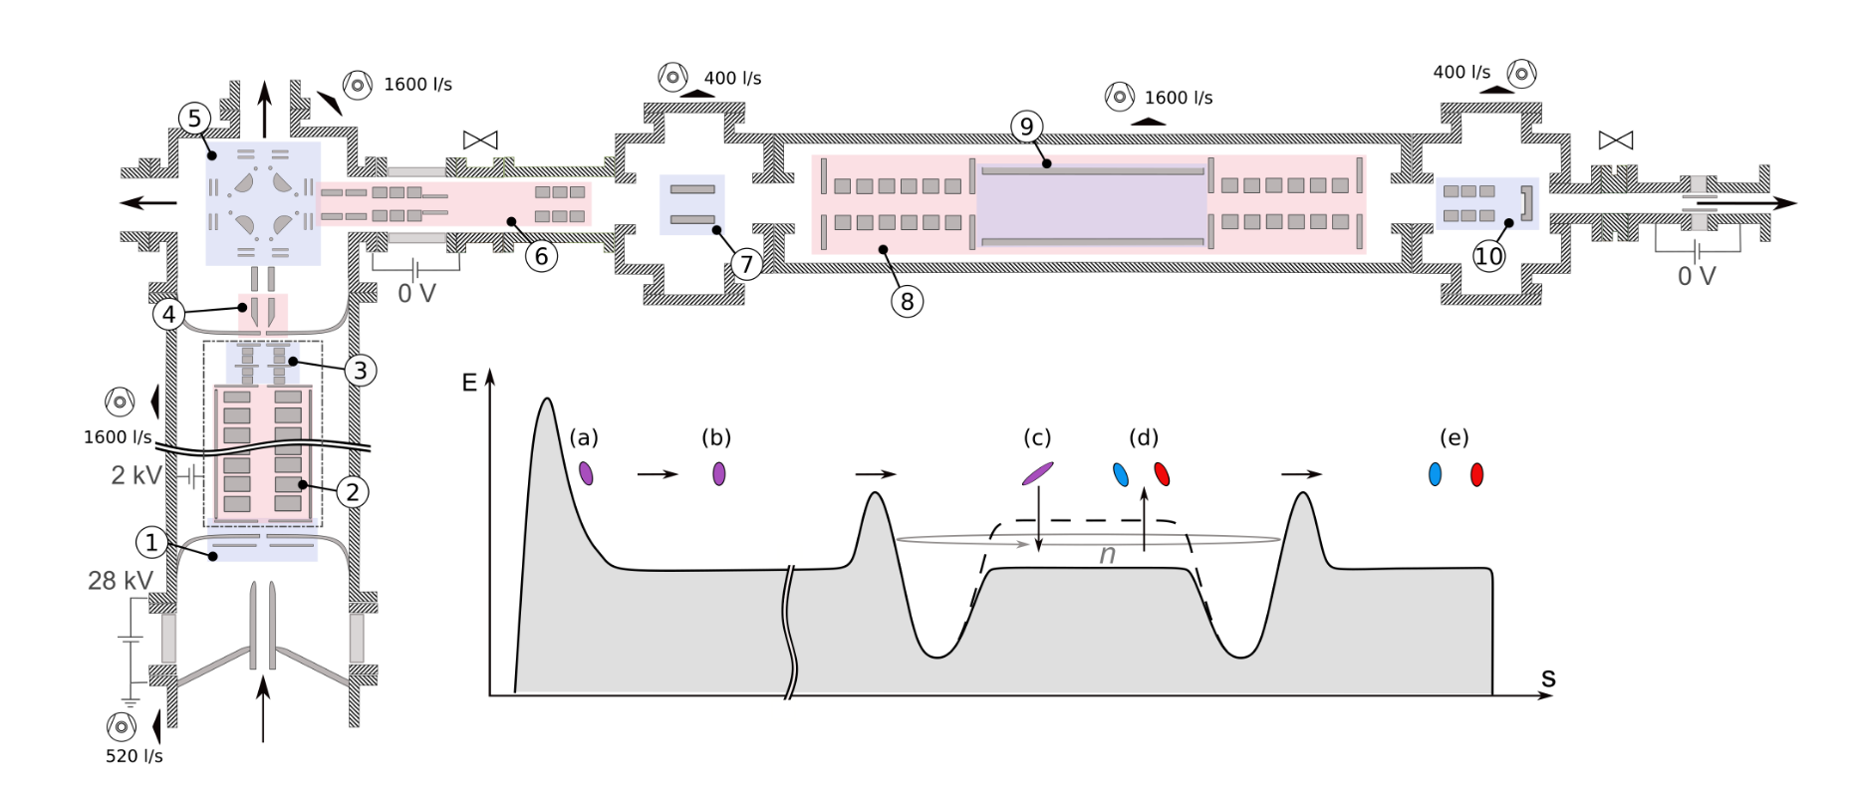

Slide 11
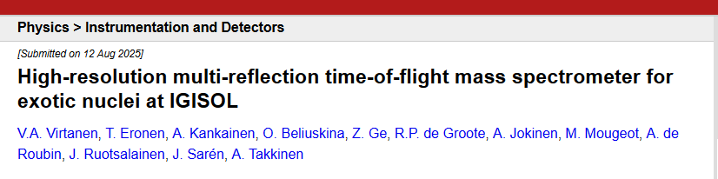
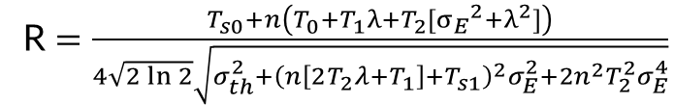


$$t=T_{s0}+T_{s1}\tilde{E}+n\left(T_{0}+T_{1}\tilde{E}+T_{2}{\tilde{E}}^{2}\right)$$
$$\left\langle t\right\rangle =T_{s0}+n\left(T_{0}+T_{1}λ+T_{2}[{σ_{E}}^{2}+λ^{2}]\right)$$
$$σ_{t}^{2}={\left(n\left[2T_{2}λ+T_{1}\right]+T_{s1}\right)}^{2}σ_{E}^{2}+2n^{2}T_{2}^{2}σ_{E}^{4}$$
R $=\frac{T_{s0}+n\left(T_{0}+T_{1}λ+T_{2}[{σ_{E}}^{2}+λ^{2}]\right)}{4\sqrt{2\ln{2}}\sqrt{σ_{th}^{2}{+\left(n\left[2T_{2}λ+T_{1}\right]+T_{s1}\right)}^{2}σ_{E}^{2}+2n^{2}T_{2}^{2}σ_{E}^{4}}}$
 | https://doi.org/10.48550/arXiv.2508.10048

Slide 12
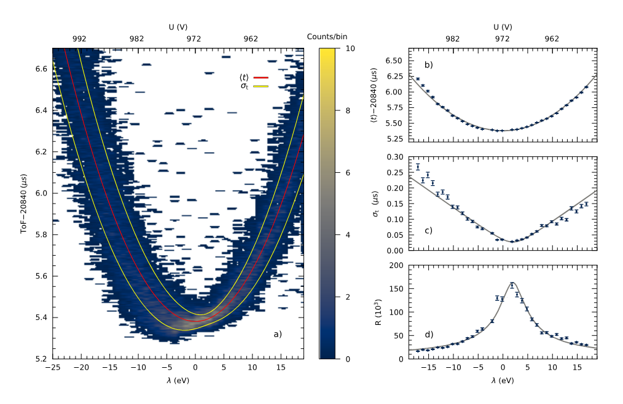
Changing trapping energy
Notes:
On the left hand side the measured ToF as function of the pulsed drift tube voltage.
The optimum marked with red, slightly defocusing setting (note the KE decreases to the right.
Right figure
Of course, such scans are even more interesting when performed On-line
Recently the first on-line separation of A = 107 was achieved using fission products produced with igisol fission ion guide

Slide 13
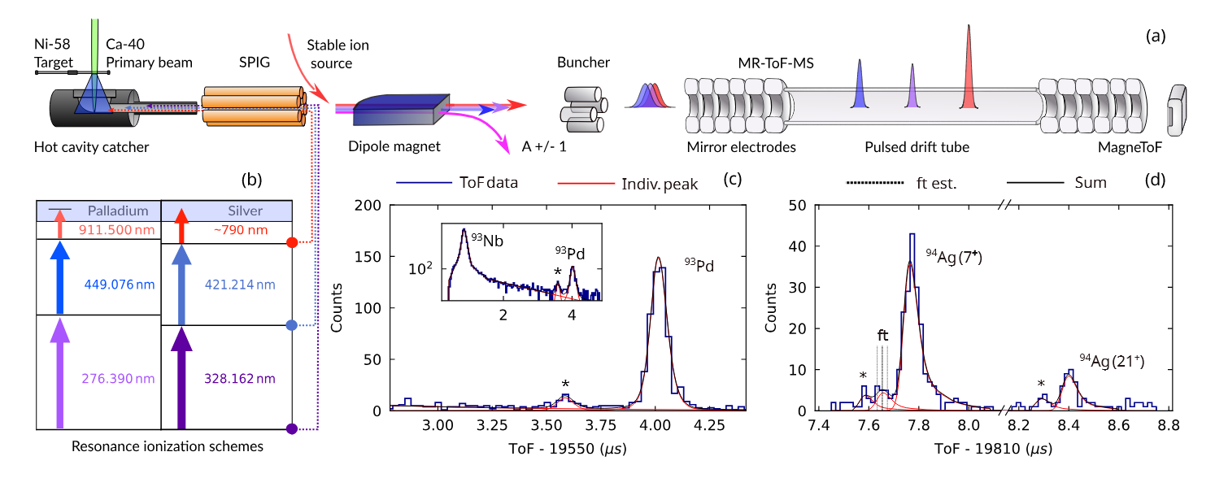
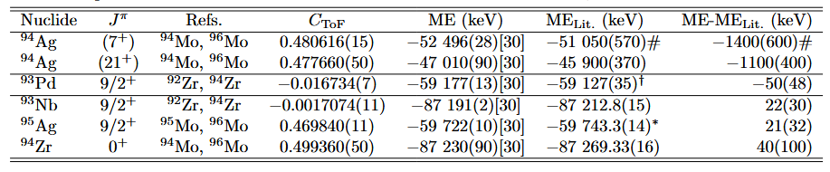
Submitted to Nat. Comm.

Slide 14
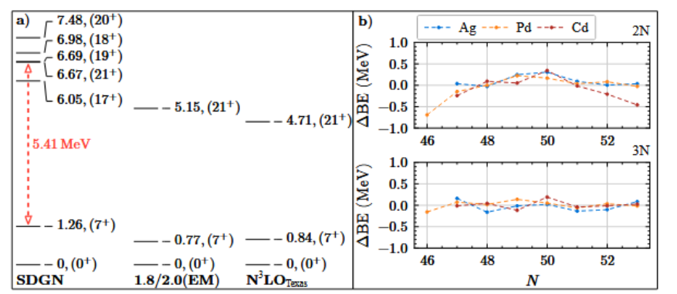
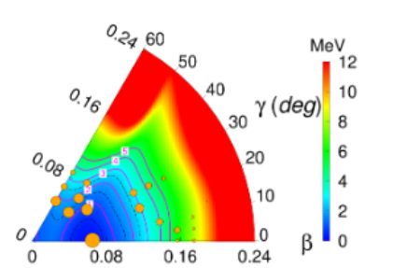
The LSSM calculations utilizing the SDGN effective interaction
reproduce the 5.49(10) MeV experimental (7+) and (21+) isomer energy difference in 94Ag (in red) within
experimental uncertainties, in addition to the the spin-gap isomerism of the (21+) state. VS-IMSRG
calculations with 1.8/2.0 (EM), and N3LOTexas chiral interactions produce a significantly lower excitation
energy for the (21+) state, and thus a smaller energy gap between it and the (7+) state.
Discrete Non-Orthogonal
Shell-Model (DNO-SM) formalism

Slide 15
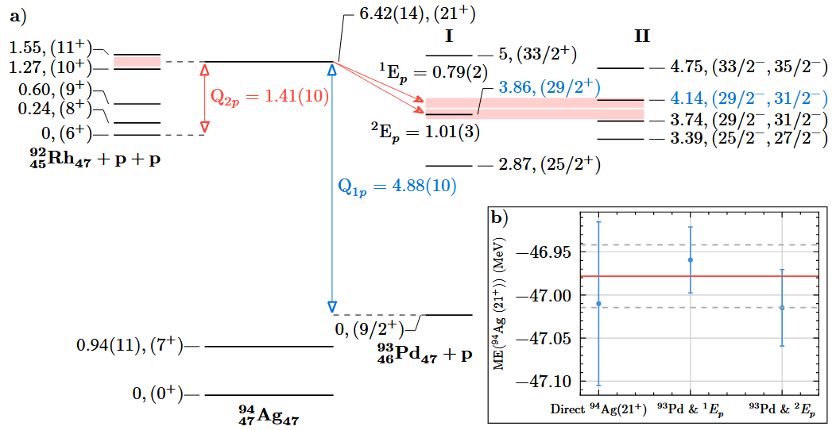
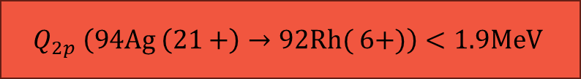
Results and conclusions
$$Q_{2p} \left(94Ag \left(21+\right)→92Rh( 6+)\right)<1.9MeV$$
Theory reproduces measured beta-decay half-life! Theory: 0.45(3) s
exp : 0.40(4) s

Slide 16
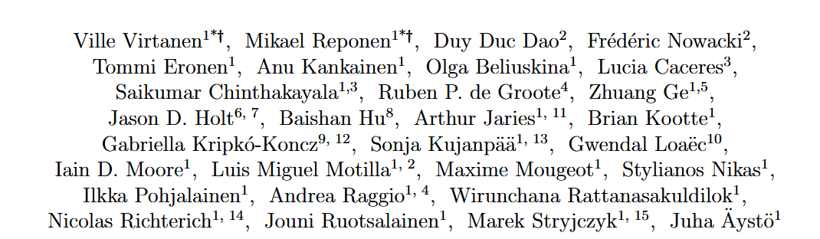


Thank you
This project has received funding from the European Union’s Horizon 2020 research and innovation programme under grant agreement No 771036 (ERC CoG MAIDEN).

