Slide 1
Laser Radiofrequency Double Resonance Spectroscopy in a Collimated
Supersonic Gas-jet Expansion
Andrea Raggio¹, Pierre Lassegues², Maylis Brun², Ruben de Groote¹, Antoine de Roubin², Rafael Ferrer Garcia¹, Harshithbabu¹ , Wout Saelens¹
¹ KU Leuven, Instituut voor Kern- en Stralingsfysica, B-3001 Leuven, Belgium
² Université de Caen Normandie, ENSICAEN, CNRS/IN2P3, LPC Caen UMR6534, F-14000 Caen, France
Colloque GANIL 21-25 September 2026

Slide 2
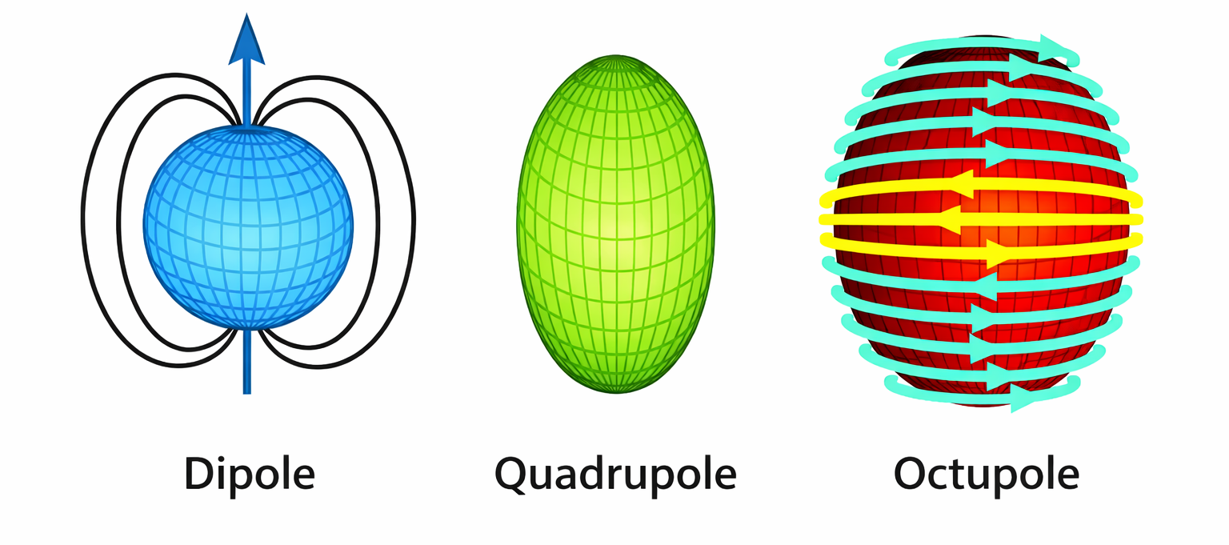
Electromagnetic moments
μ
Q
Ω
²⁰⁹Bi
I = 9/2
μ and Q extensively studied across the nuclear chart
^{Atomic G.S.}
^{J = 3/2}
Limited studies on Ω due to the sensitivity and resolution required
Mertzimekis, T. J., et. al NIM A 807 (2016): 56-60.
Li, Jiguang, et al Atoms 10.4 (2022): 132.

Slide 3
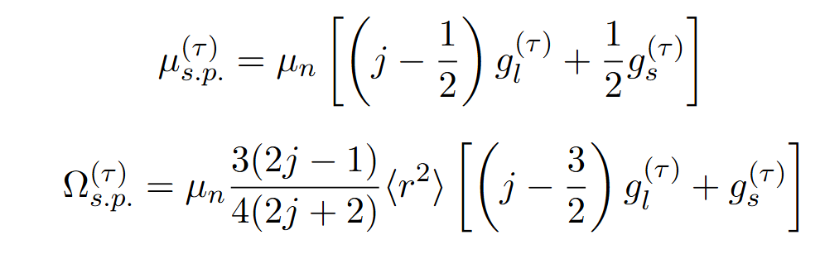
Magnetic nuclear moments
μ and Ω are linked to the same underlying magnetic degrees of freedom but probe them in different ways.
Hyperfine anomalies (HFA)
μ dipole strength
Ω higher order multipole sensitivity
HFA radial sensitivity
𝐴 ≈𝒦 𝑔𝐼 (1+𝜀)
Effects of nuclear magnetization distribution (Bohr–Weisskopf correction)
𝛥≡(𝐴⁽¹⁾/𝑔𝐼⁽¹⁾)/ (𝐴⁽²⁾/𝑔𝐼⁽²⁾)
No systematic investigation available across isotopic chains
Accessed through differential measurements (~0.1% variations)
Persson, J.R., At. Data Nucl. Data Tables 99 (2013) 62–68.
Büttgenbach, S., Hyperfine Interact. 20 (1984) 1–64.

Slide 4
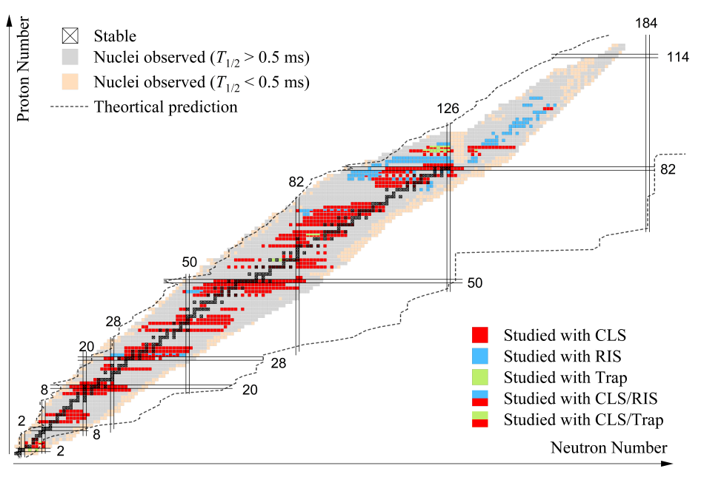

Conventional laser spectroscopy techniques
Methods used at RIB facilities:
  Environmental effects (temperature, pressure)
    CLS: ≈ 10-100 MHz
  Natural and power broadening
    Linewidth: ≈ 1 / state lifetime
    E1 lines ≈ 10 MHz
Resolution
Sensitivity
Yang, X. , et al Progress in Particle and Nuclear Physics 129 (2023): 104005

Slide 5
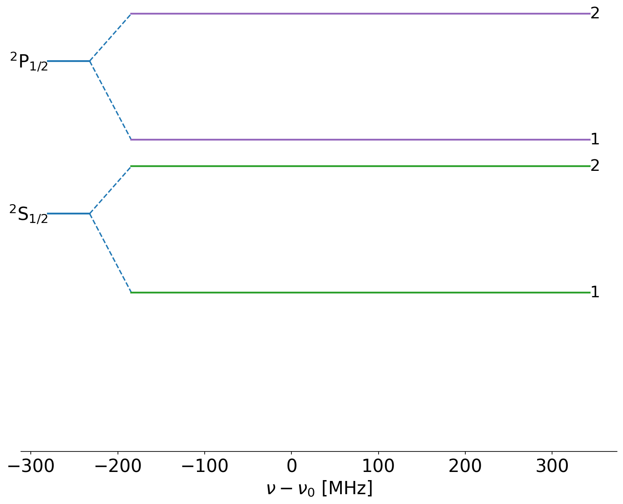
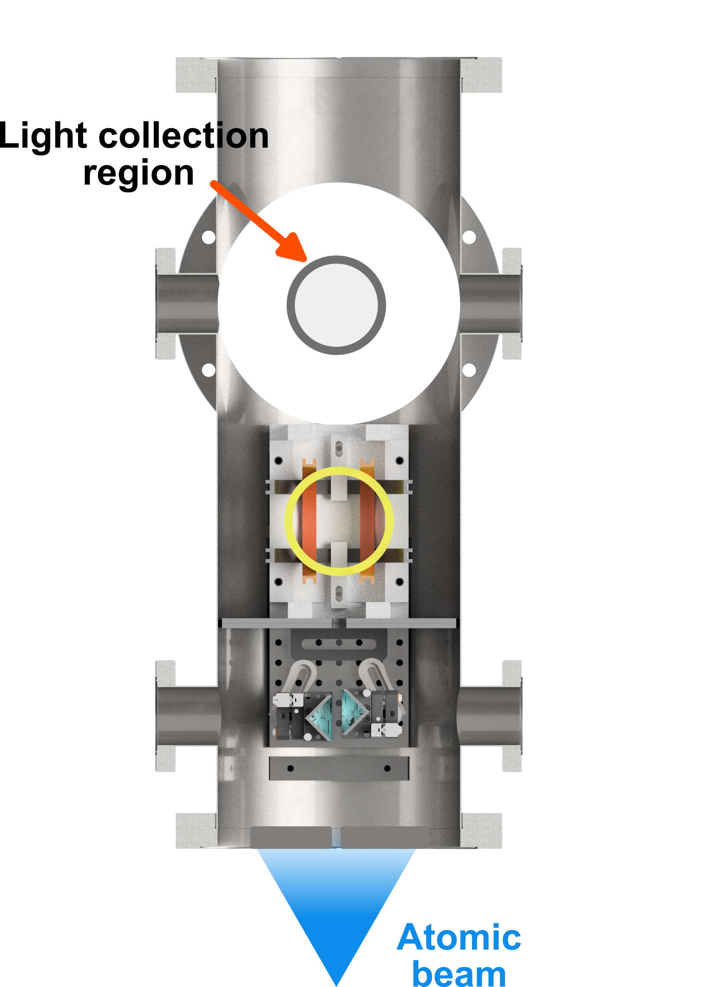
Laser RF Double Resonance spectroscopy

Slide 6
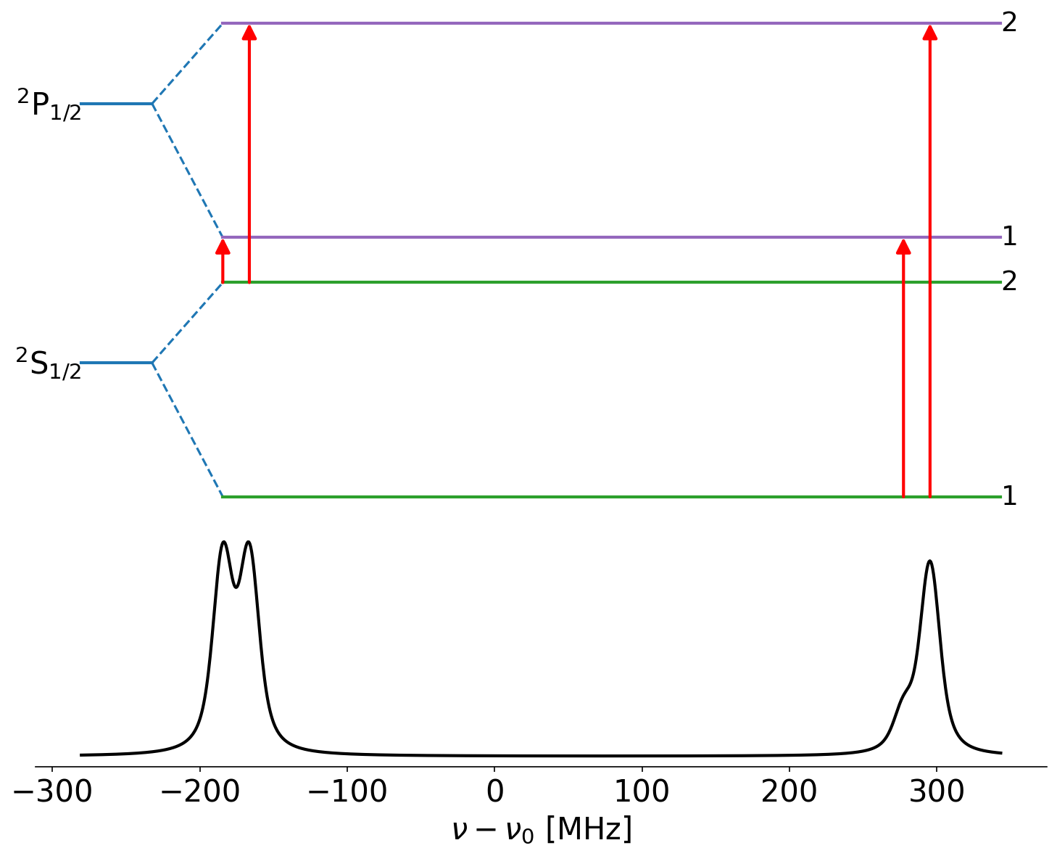
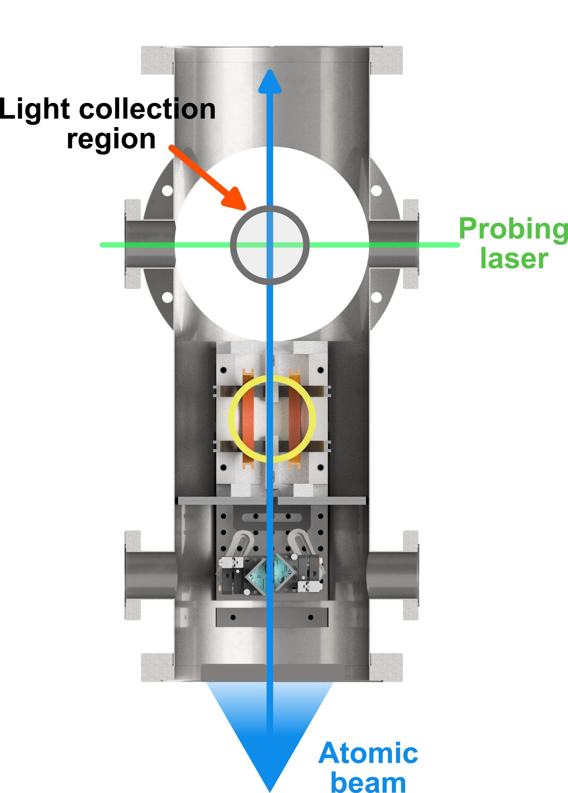
Laser RF Double Resonance spectroscopy

Slide 7
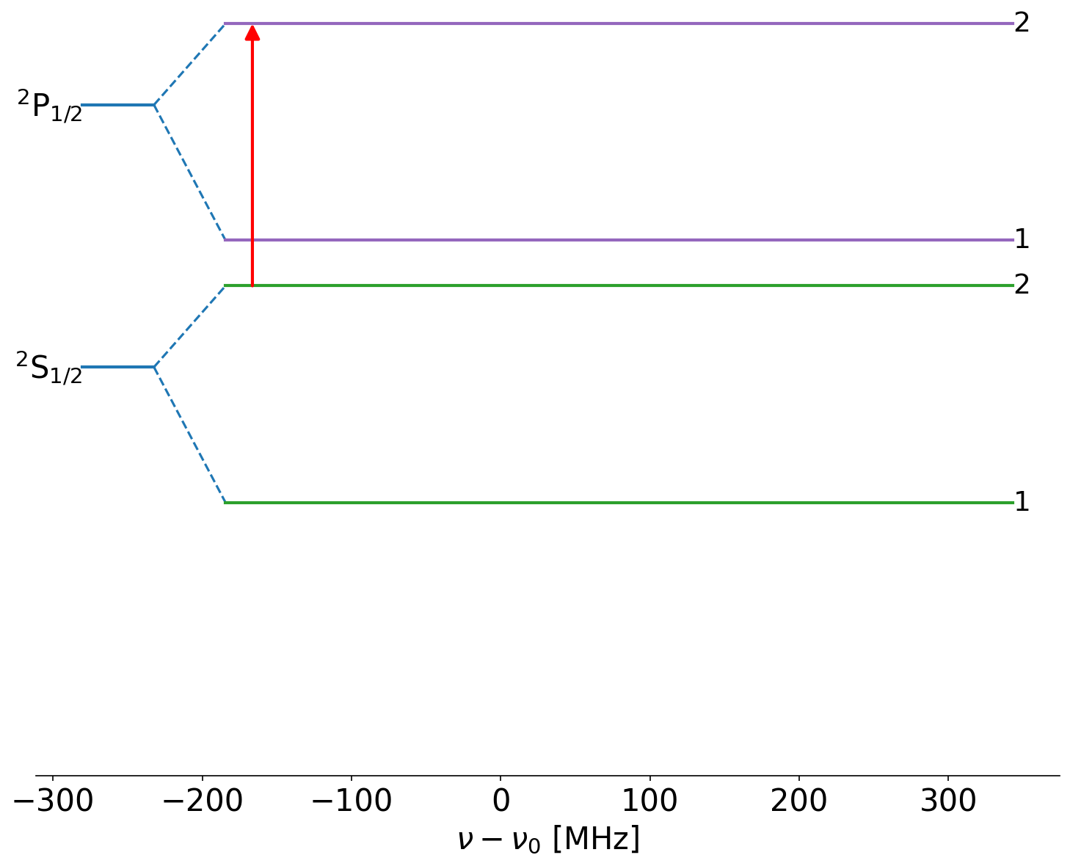
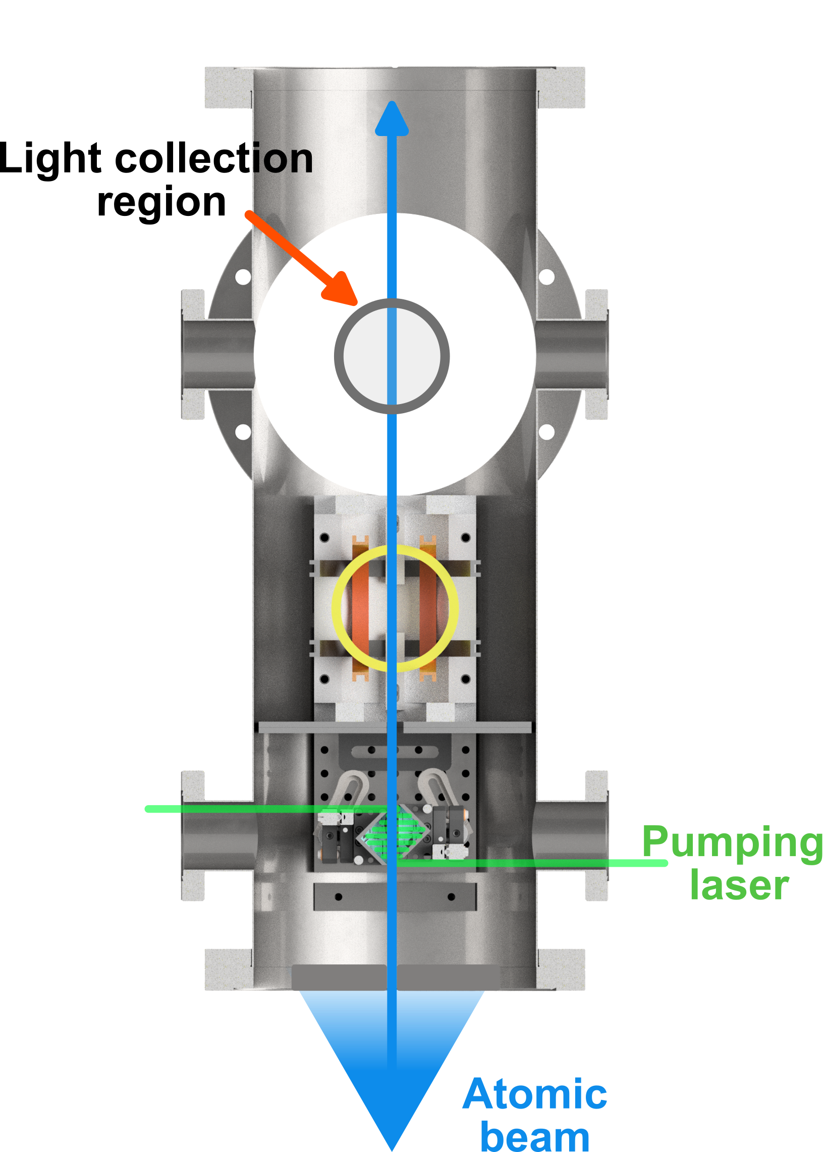
Laser RF Double Resonance spectroscopy

Slide 8
Laser RF Double Resonance spectroscopy

Slide 9
Laser RF Double Resonance spectroscopy

Slide 10
Laser RF Double Resonance spectroscopy

Slide 11
Laser RF Double Resonance spectroscopy

Slide 12
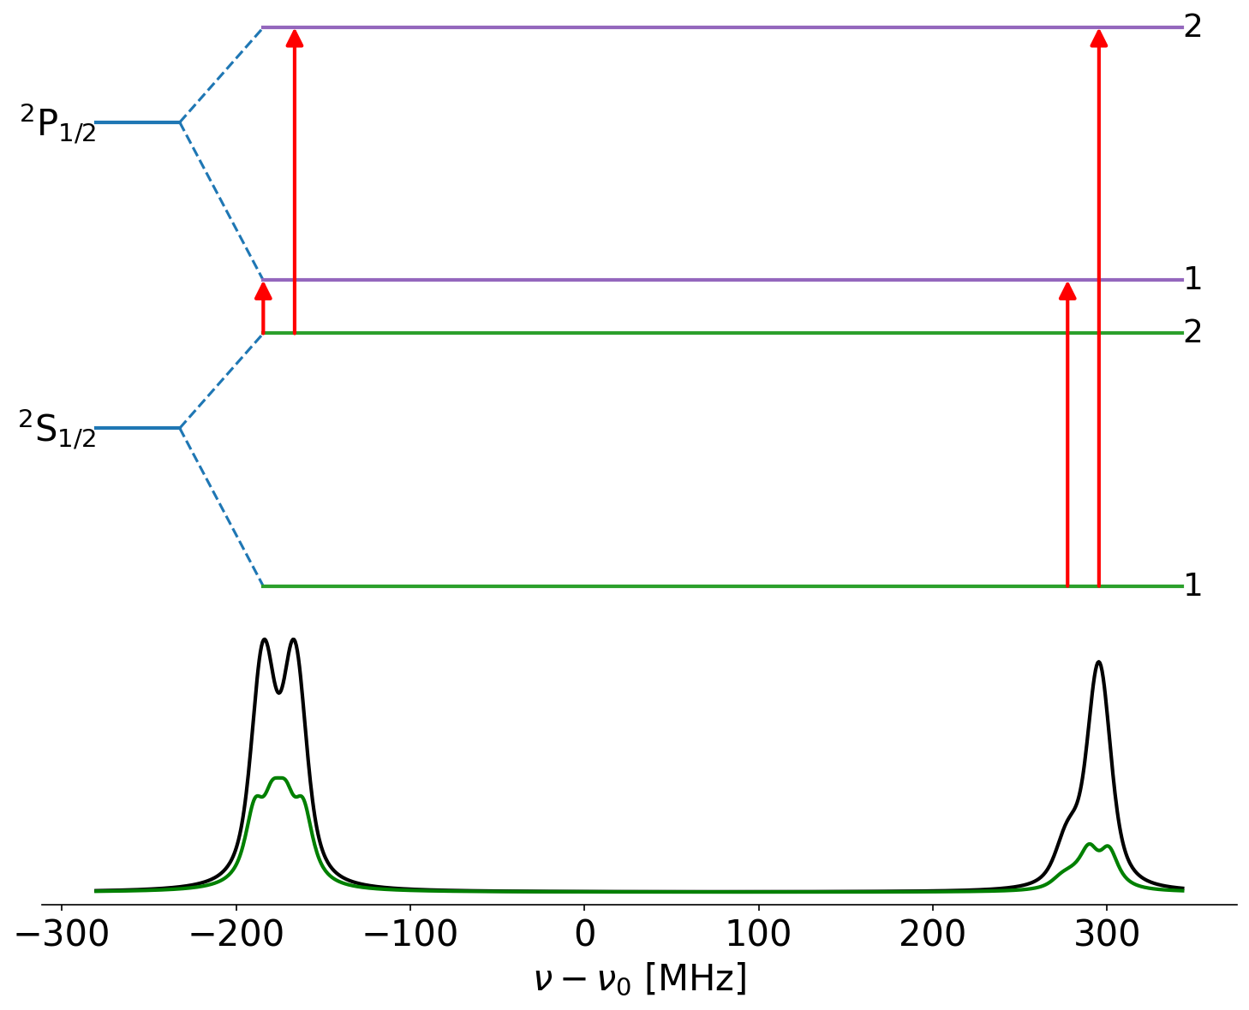
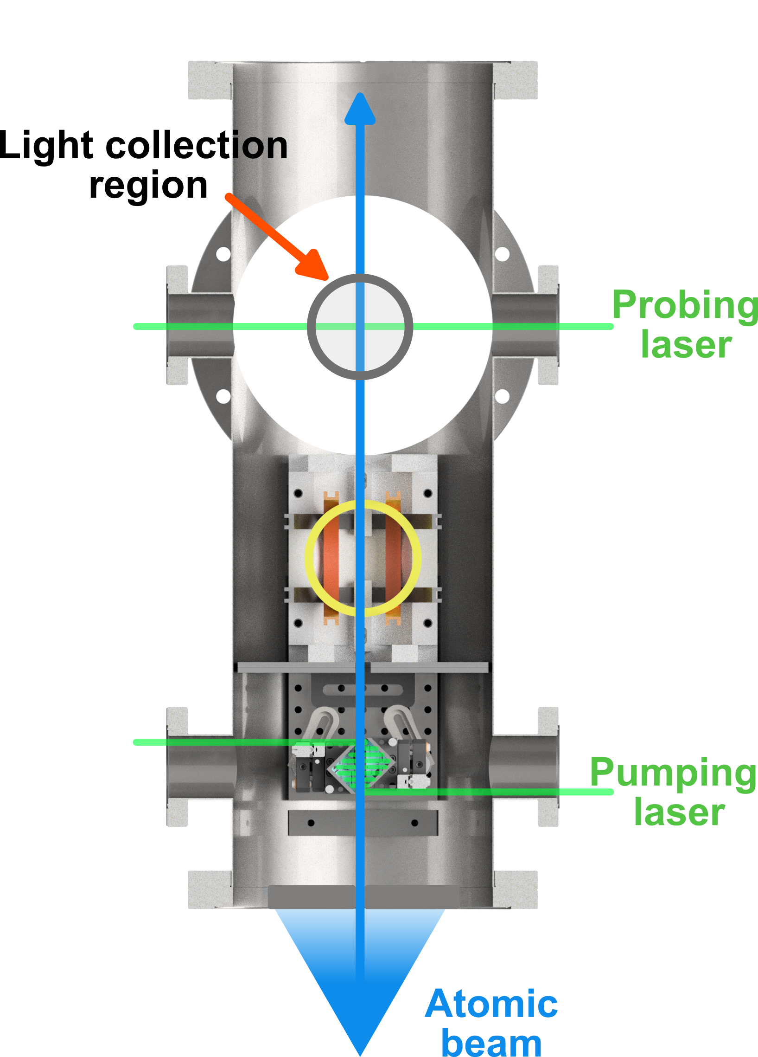
Laser RF Double Resonance spectroscopy

Slide 13
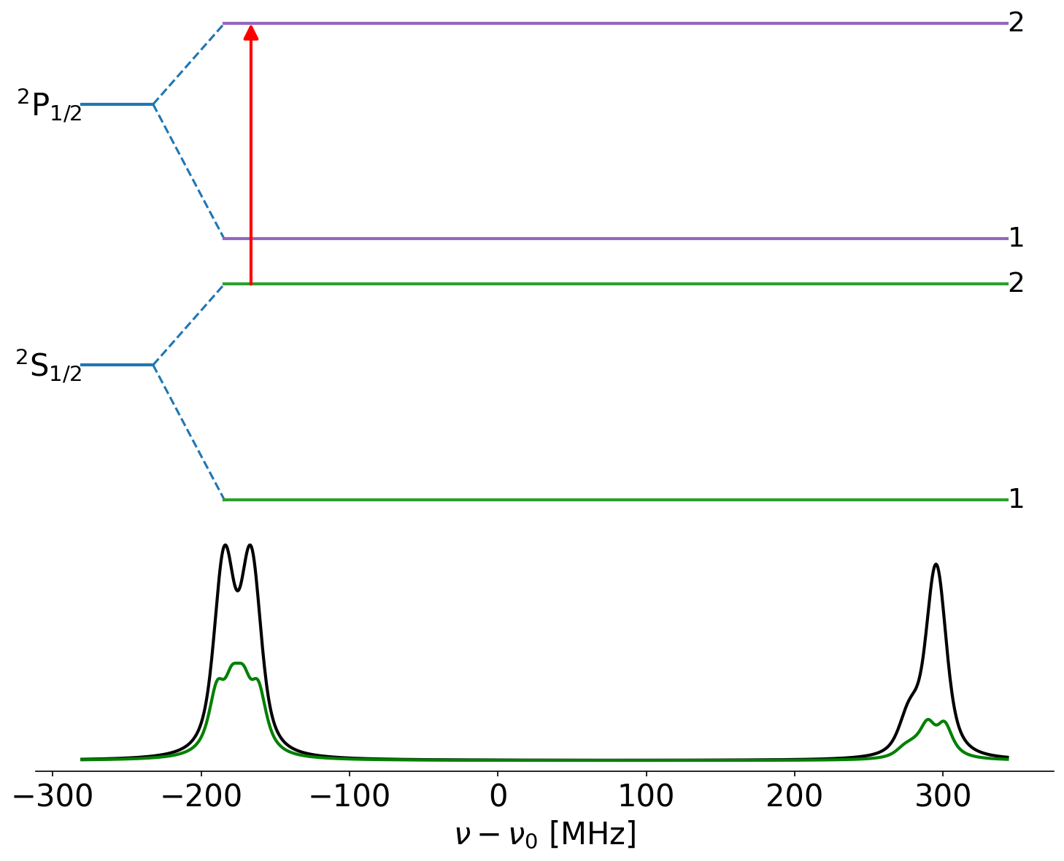
Laser RF Double Resonance spectroscopy

Slide 14
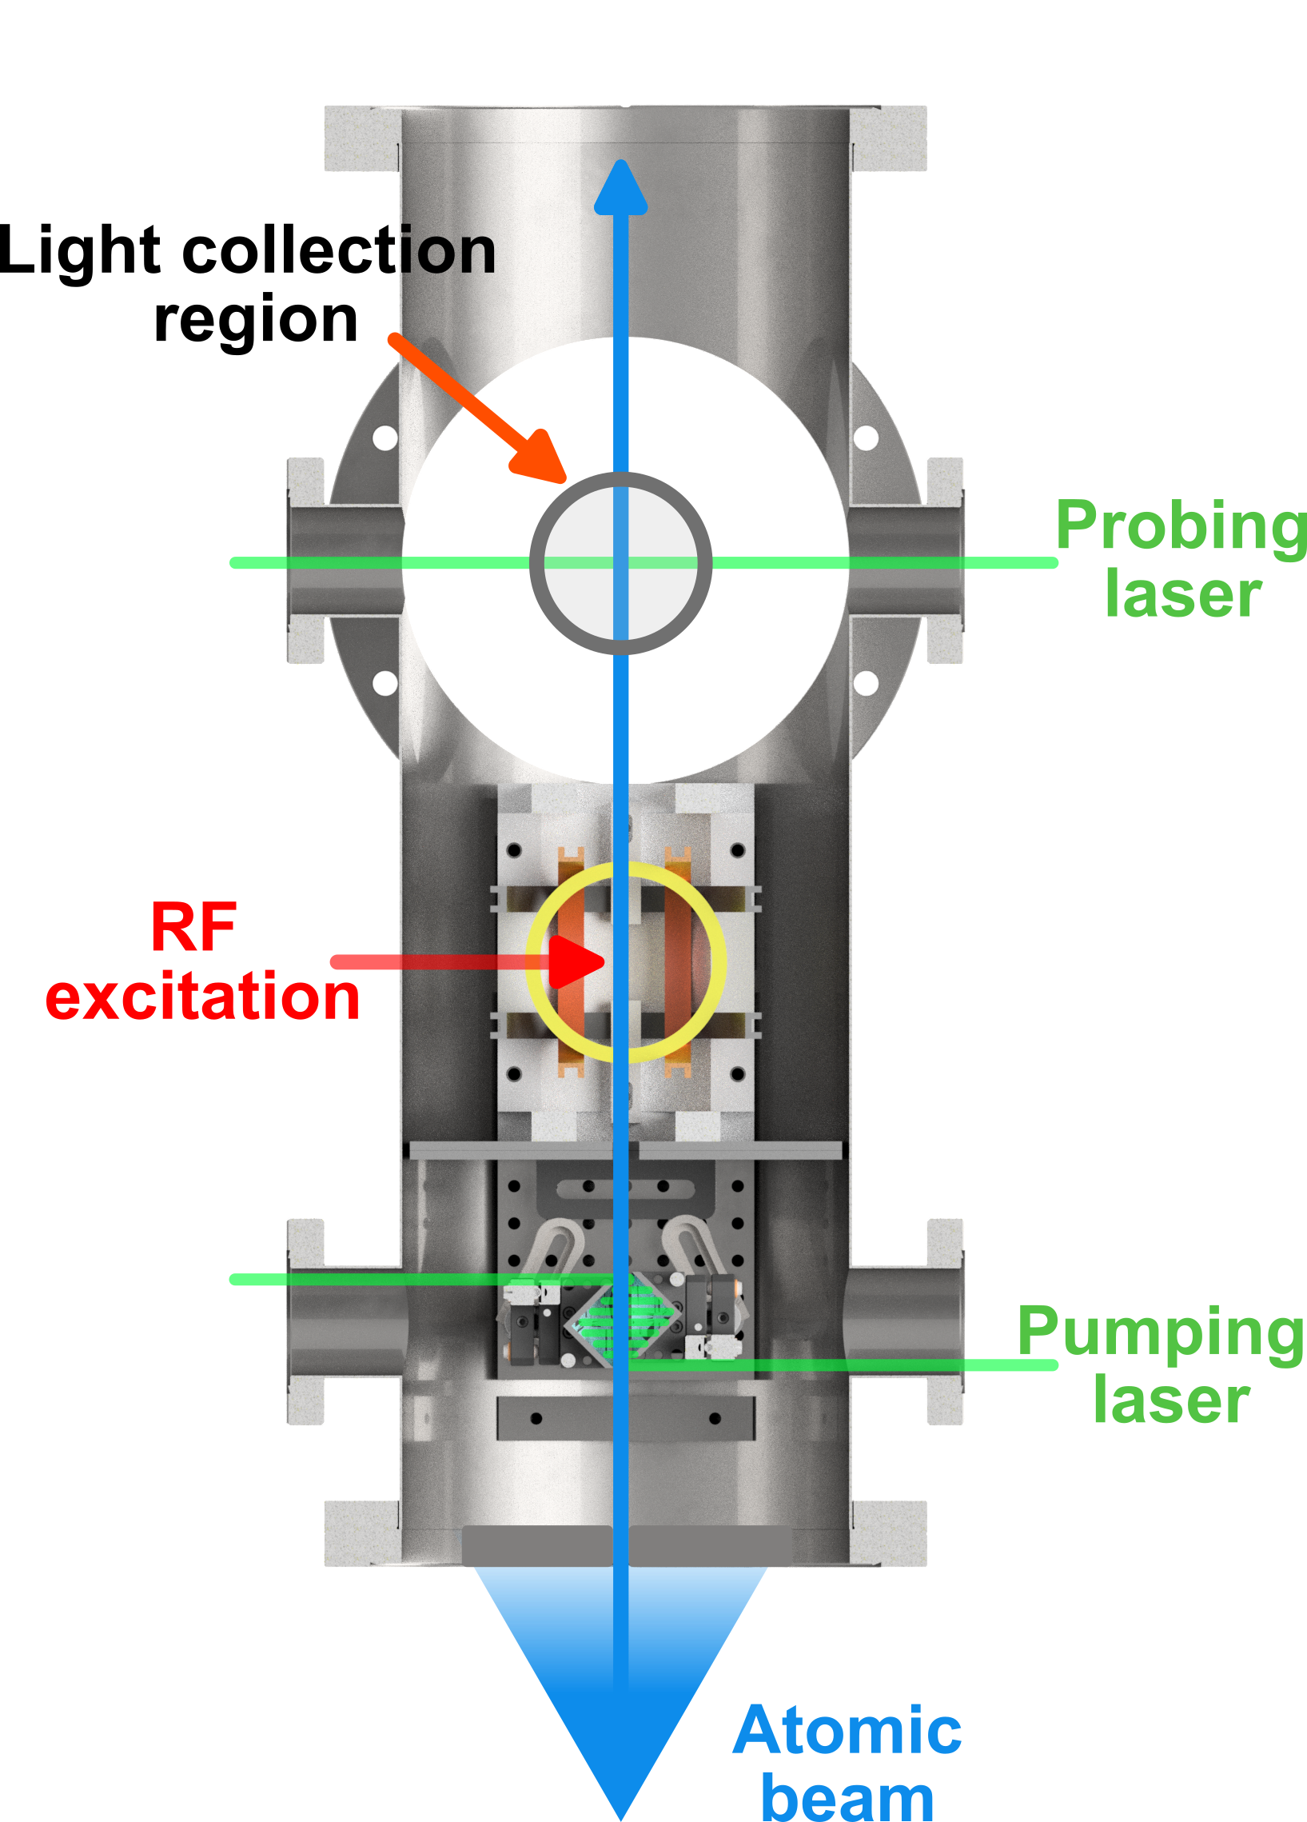
Laser RF Double Resonance spectroscopy

Slide 15
Laser RF Double Resonance spectroscopy

Slide 16
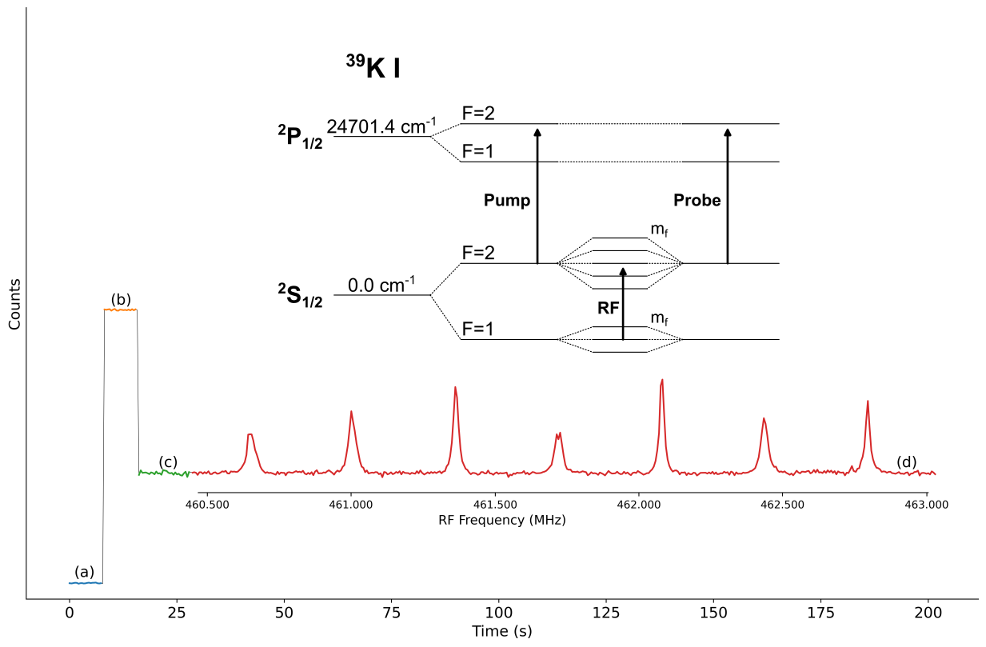
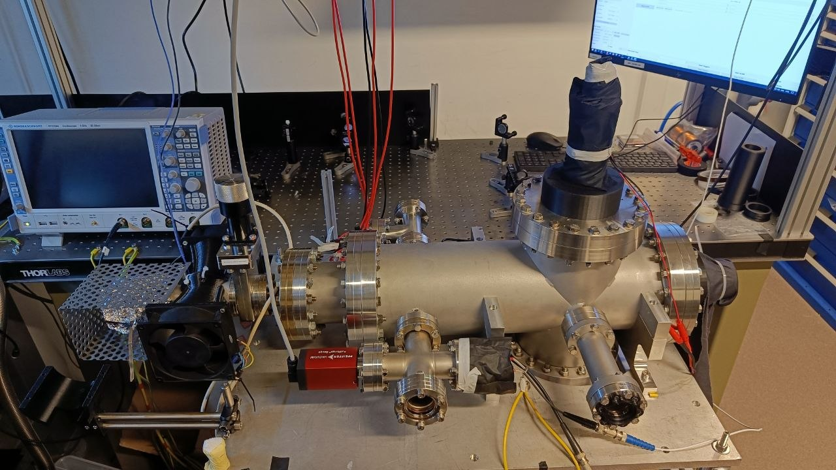
Implementation in Leuven ABU
No pump
RF in
Linewidth: ~20 KHz FWHM
Resolving the Zeeman splitting of the hyperfine levels
Pump in
Lasers off resonance
Allegrini, M. et al., Journal of Physical and Chemical Reference Data 51, no. 4 (2022).

Slide 17
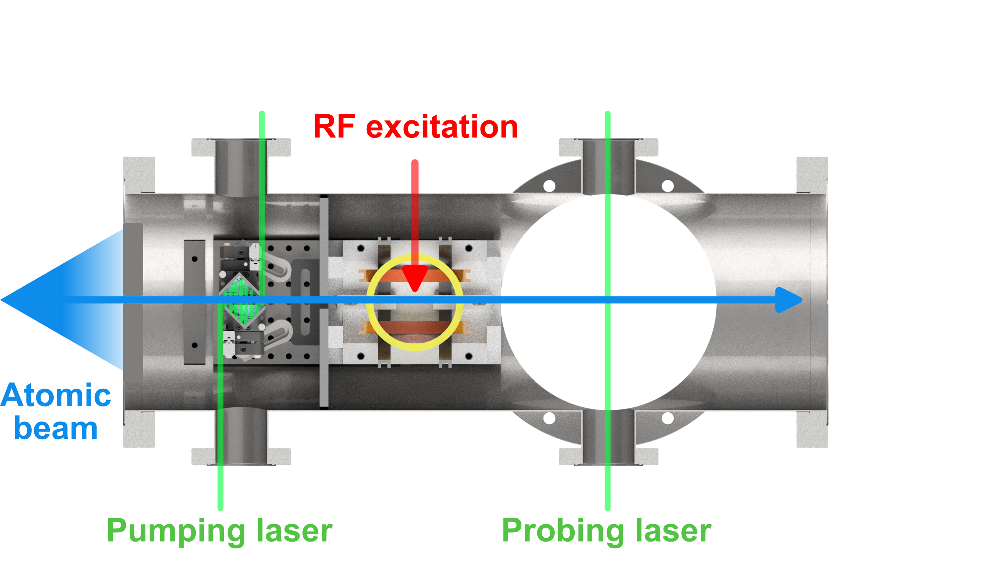
Limitations
Laser Radiofrequency Double Resonance
High resolution (kHz)
Low sensitivity
Not suitable for radioactive species
We need an efficient source of slow atoms in combination with the double resonance technique
Notes:
LRDR when applied in a atomic beam unit is not suitable for radioactive species.

Slide 18
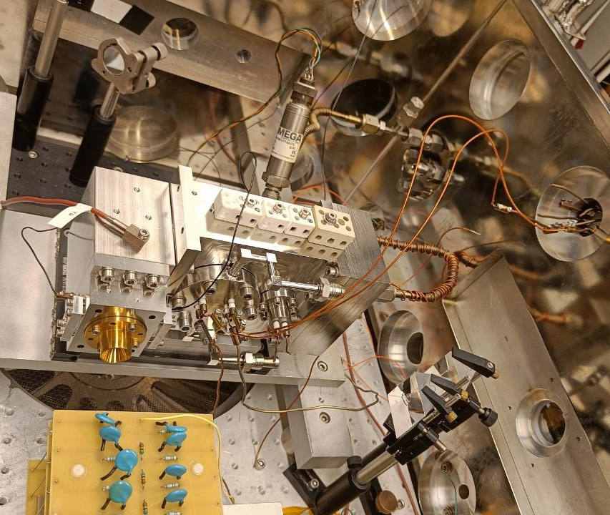
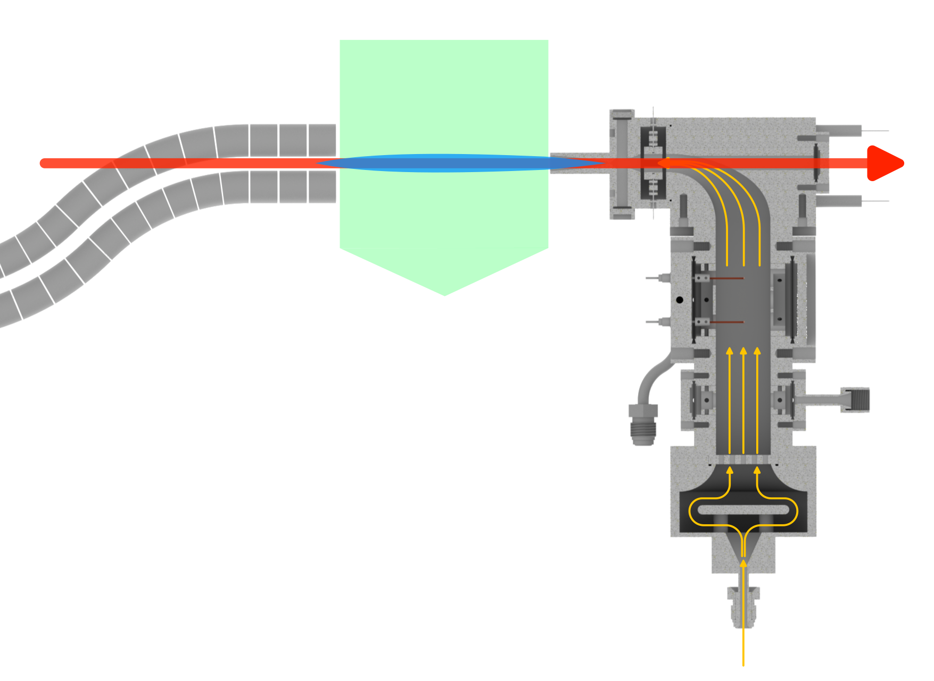
The IGLIS facility at KU Leuven
In Gas-jet Laser Ionization Spectroscopy
Medium resolution (100 MHz)
High sensitivity
λ₁
λ₂
To mass separator
Wide range of offline sources:
Alpha recoil, desorption filament, ablation targets…
The technique is already applied at online RIB facilities
Buffer gas
Ferrer, Rafael, et al. Nat. comm. 8.1 (2017): 14520.
Kudryavtsev, Yu, et al NIMB 376 (2016): 345-352.

Slide 19
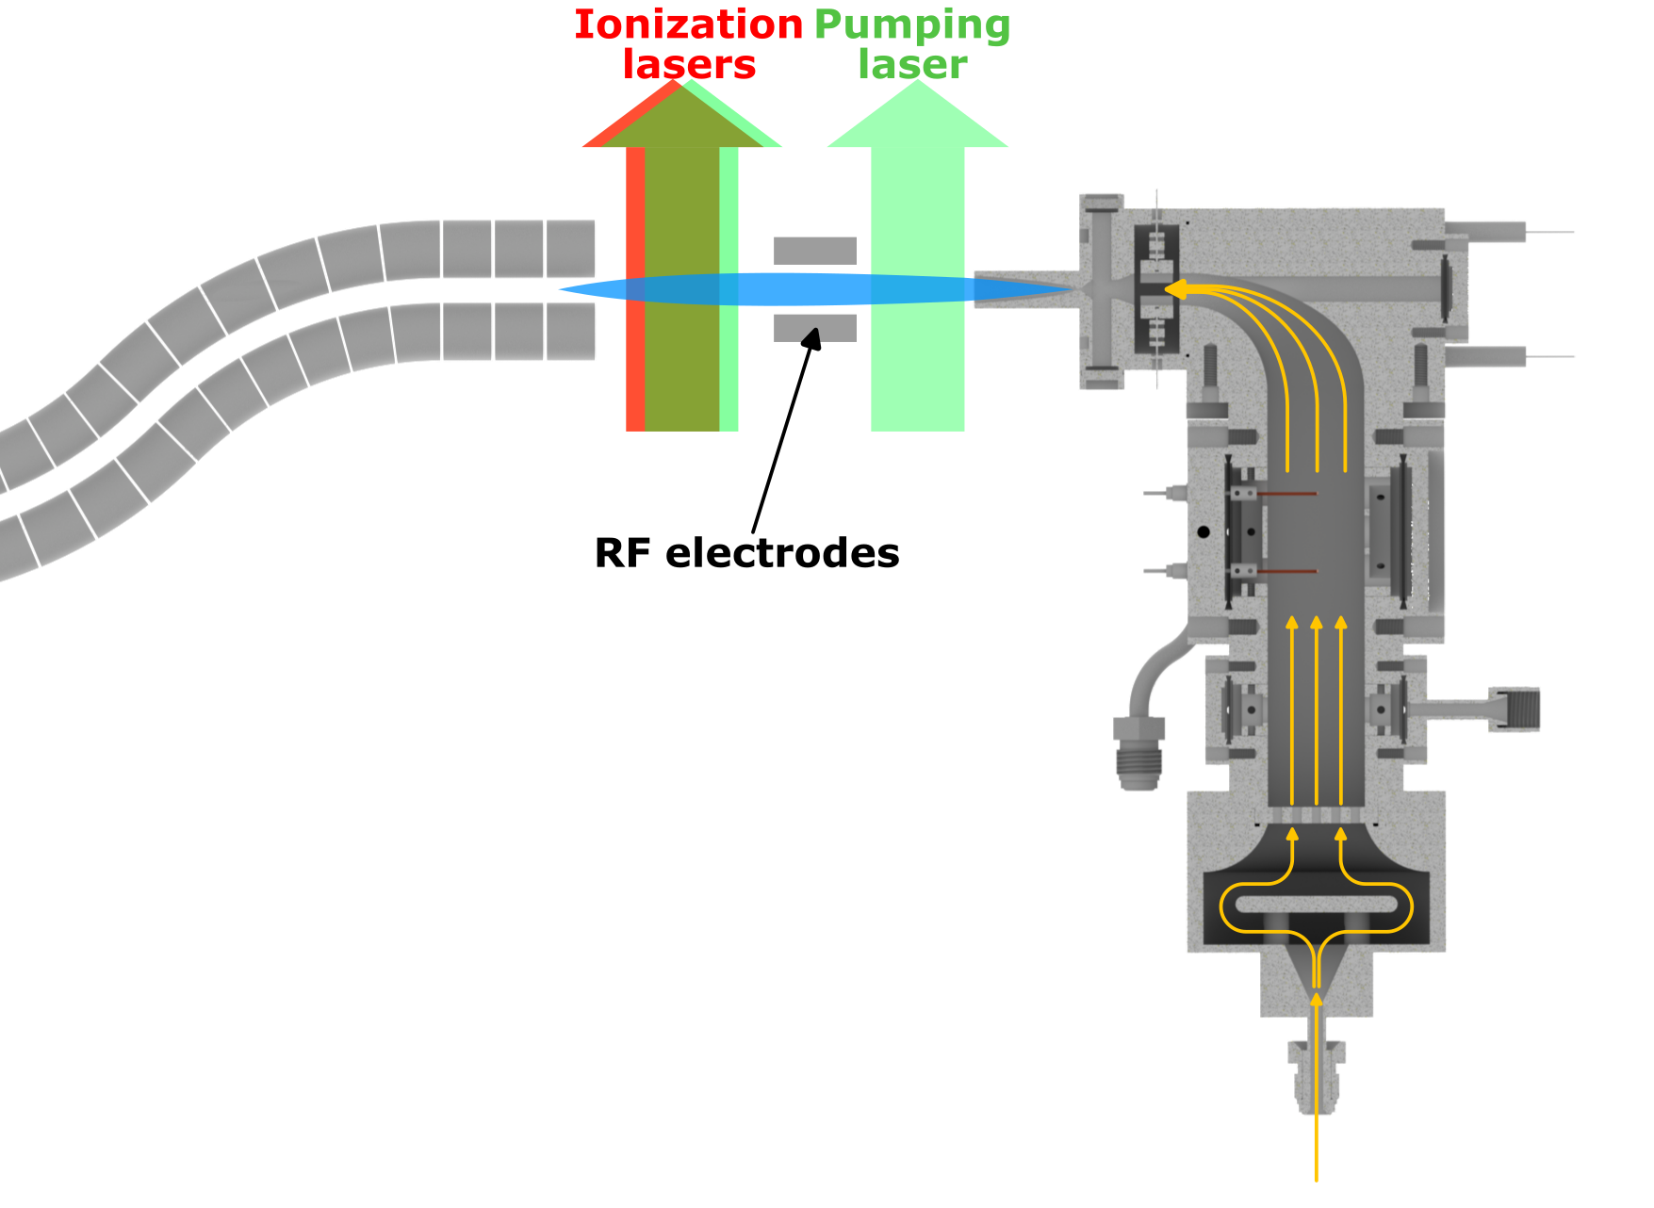
LRDR applied to IGLIS
Segment the gas-jet expansion into three region:
Pump, RF and Probing
High resolution
High sensitivity
Combination of LRDR precision with the sensitivity offered by multistep ionization schemes and mass separation
To mass separator
Minimal collisional rate within the gas-jet expansion
Variable length of the jet based on the de Laval nozzle in use
  From 60mm to 200mm (~120us to 400us ToF)
Buffer gas

Slide 20
Na I
41449.451 cm⁻¹
IP
355 nm
16956.17 cm⁻¹
589 nm
0.0 cm⁻¹
GS
Allegrini, M. et al., Journal of Physical and Chemical Reference Data 51, no. 4 (2022).

Slide 21
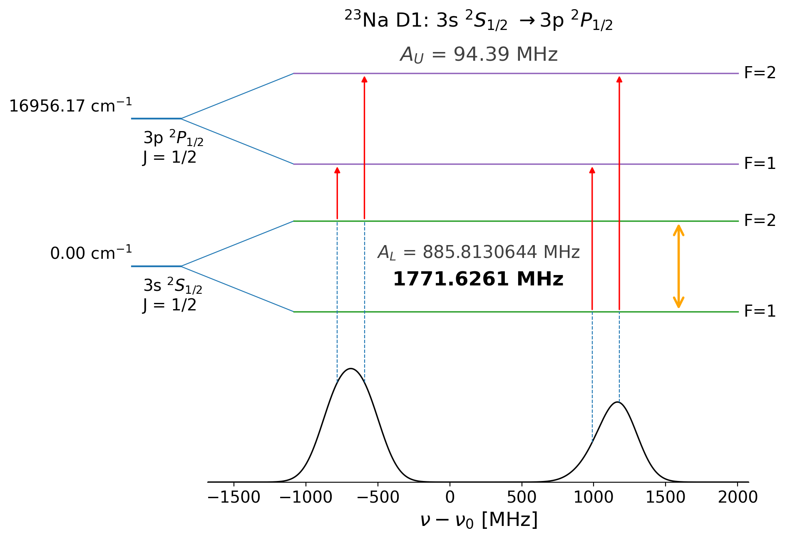
Na I
41449.451 cm⁻¹
IP
355 nm
16956.17 cm⁻¹
589 nm
0.0 cm⁻¹
GS
Allegrini, M. et al., Journal of Physical and Chemical Reference Data 51, no. 4 (2022).

Slide 22
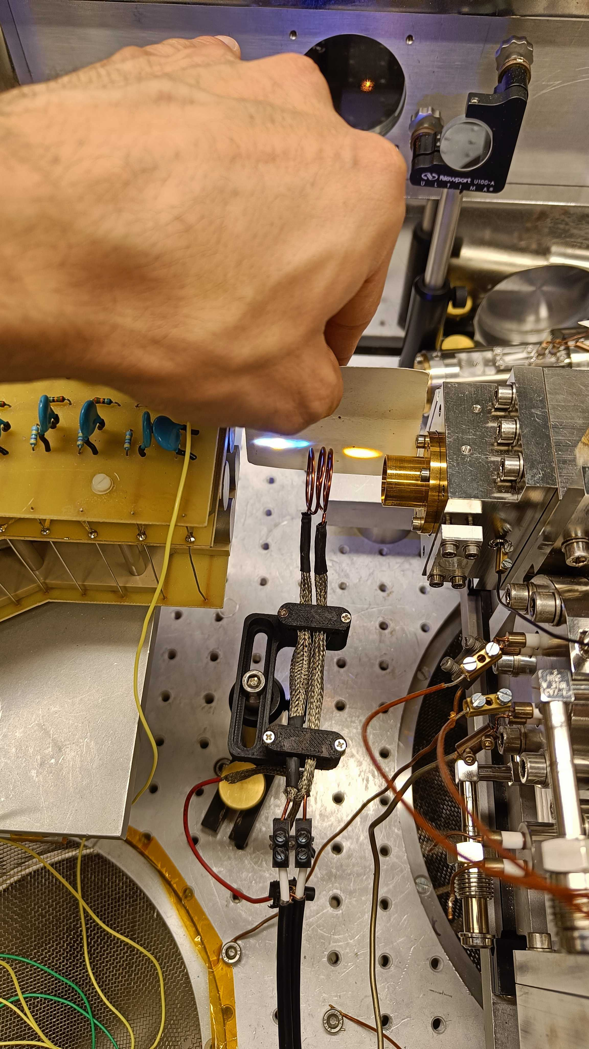
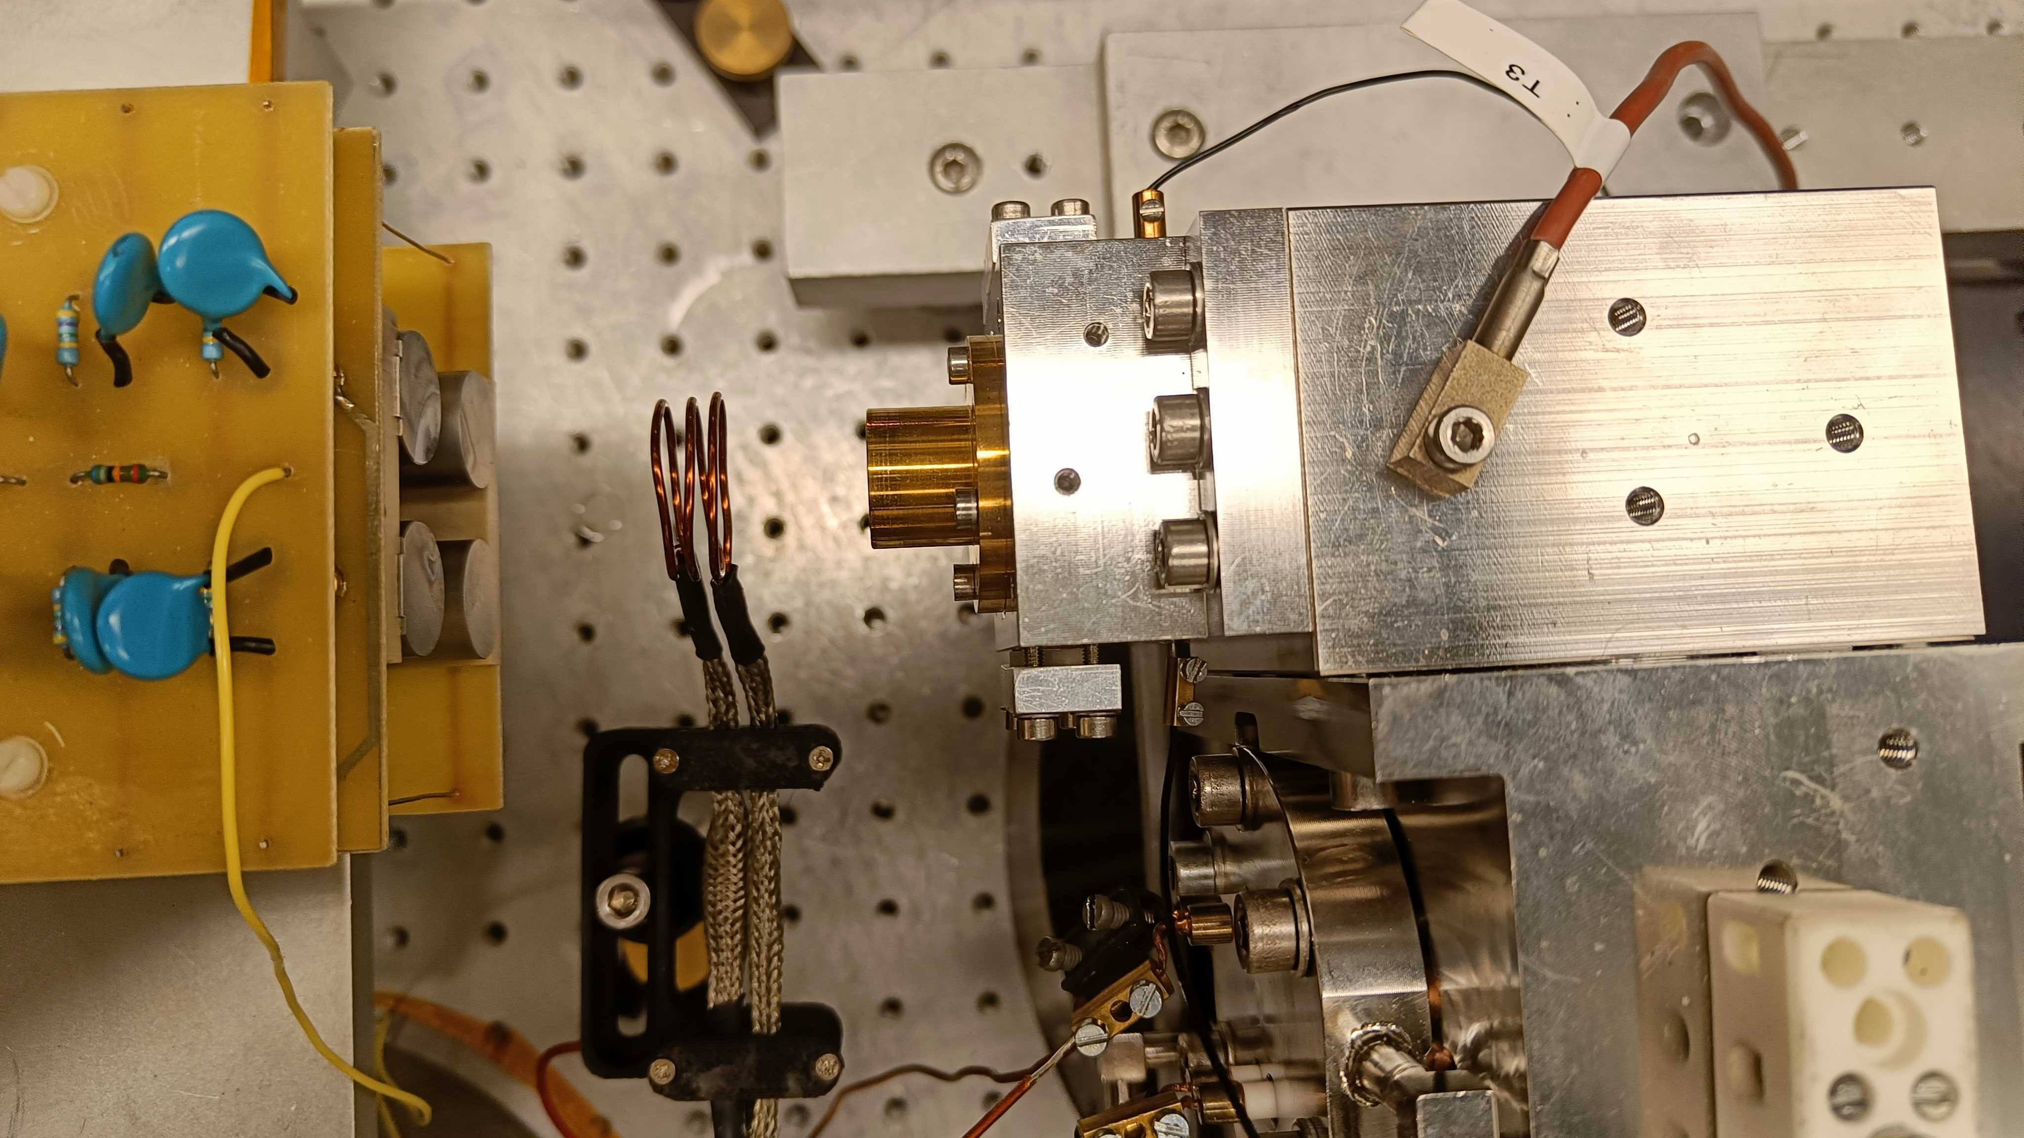
60mm jet and RF coil

Slide 23
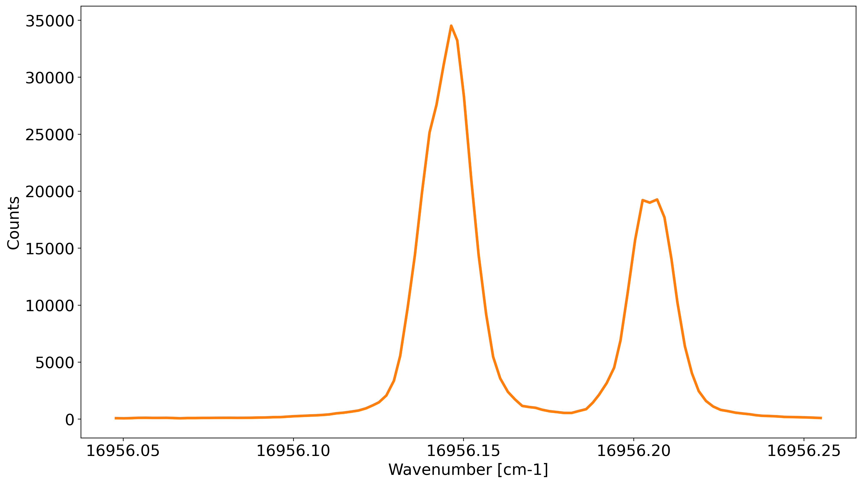
Laser Scan
No pump laser

Slide 24
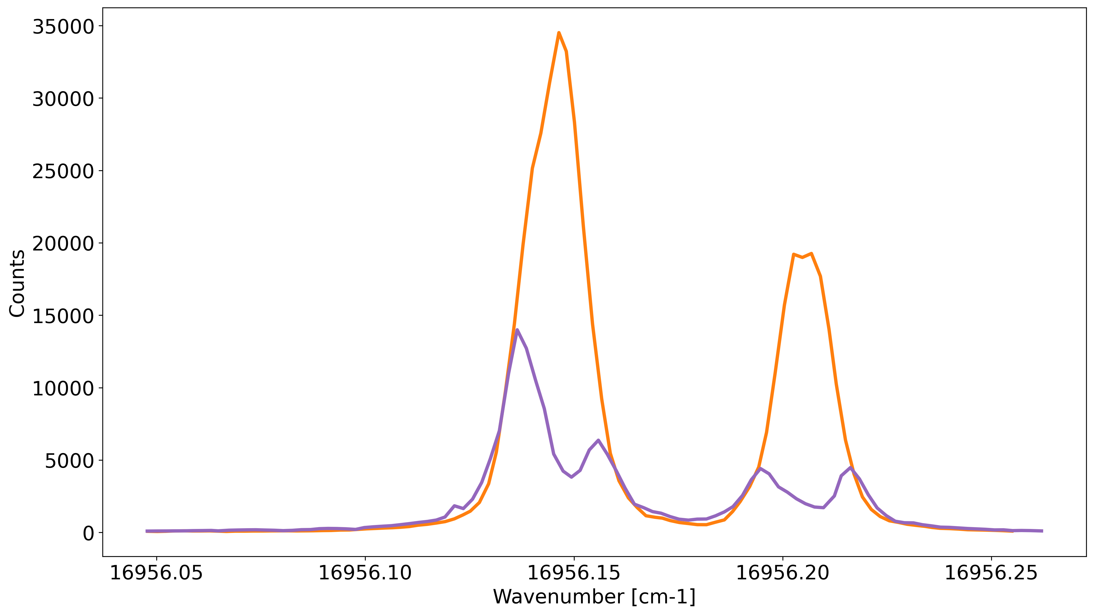
Pumping effect
~85% pumping reduction
~90% pumping reduction

Slide 25
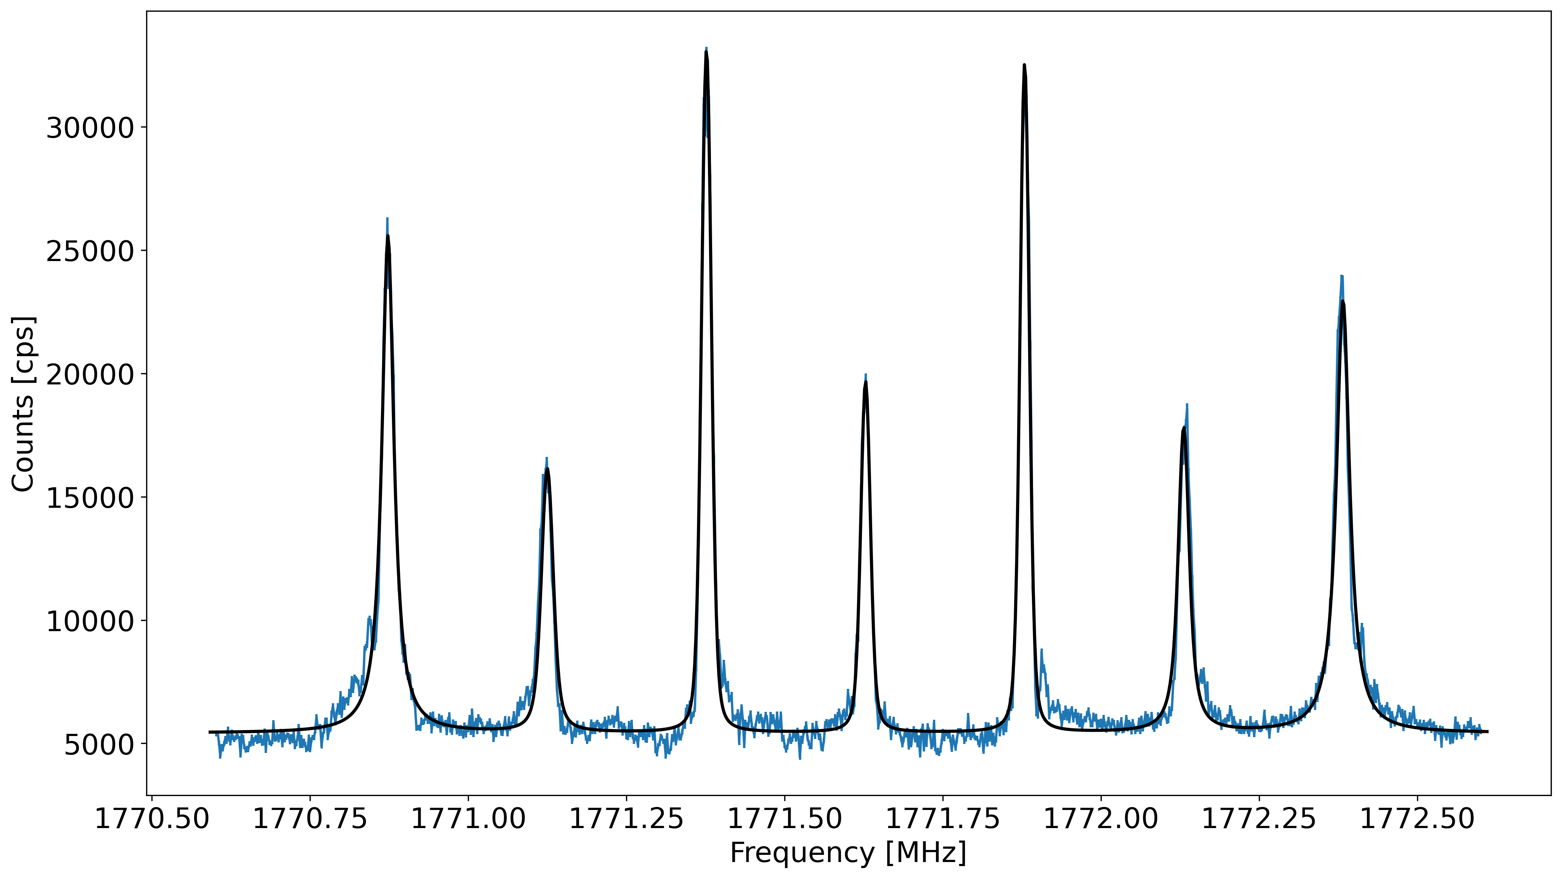
Radiofrequency excitation
Linewidth ~20KHz FWHM
Zeeman splitting due to environmental B field
Pump on

Slide 26
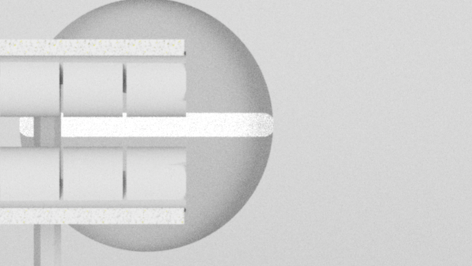
RF pulsing
20 mm
RF on
RF off
RF off
0
40
80
120
Time [us]

Slide 27
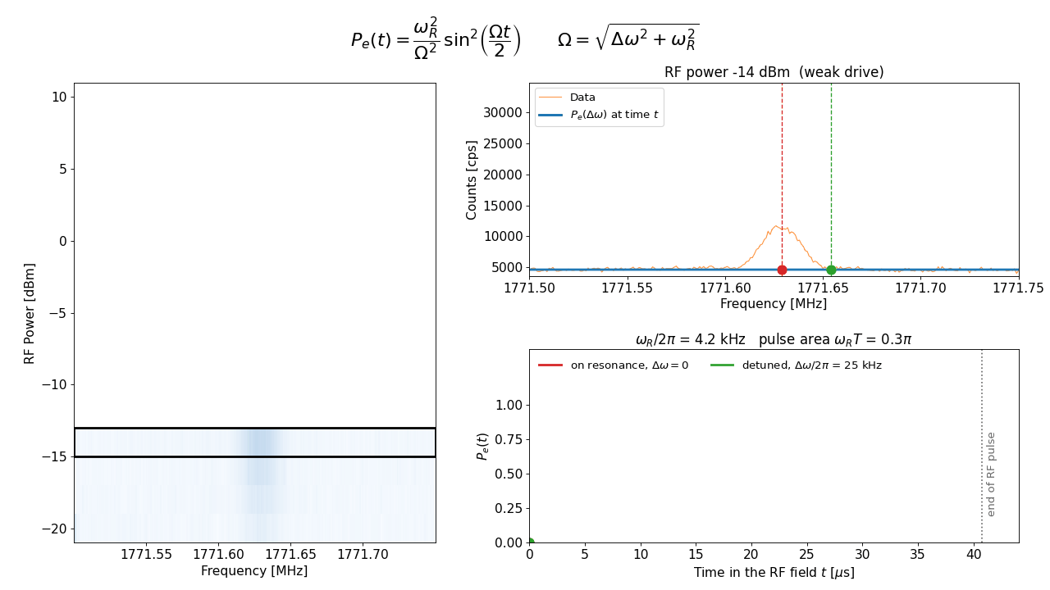
Rabi Excitation

Slide 28
Rabi Excitation

Slide 29
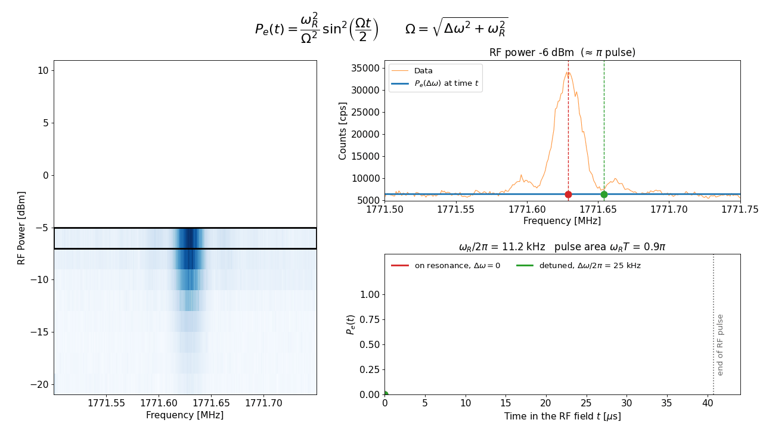
Rabi Excitation

Slide 30
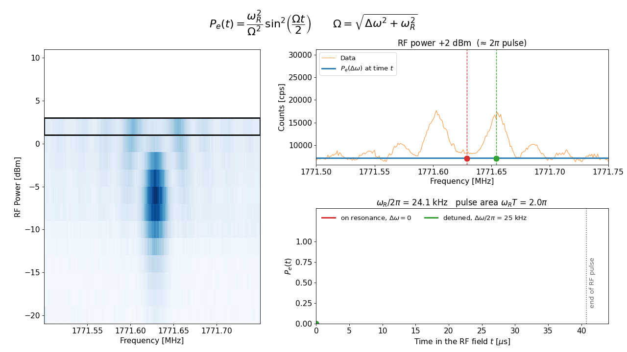
Rabi Excitation

Slide 31
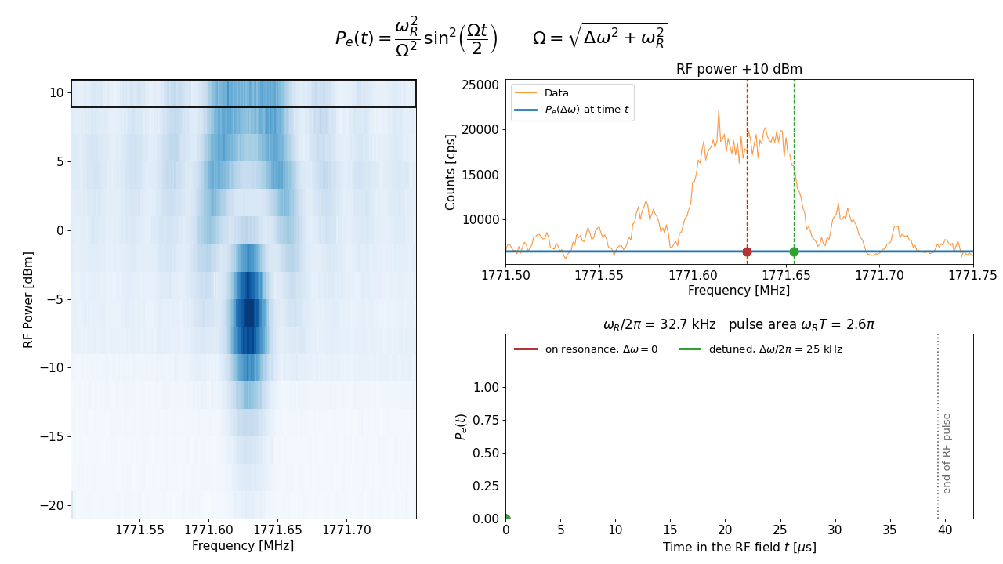
Rabi Excitation

Slide 32
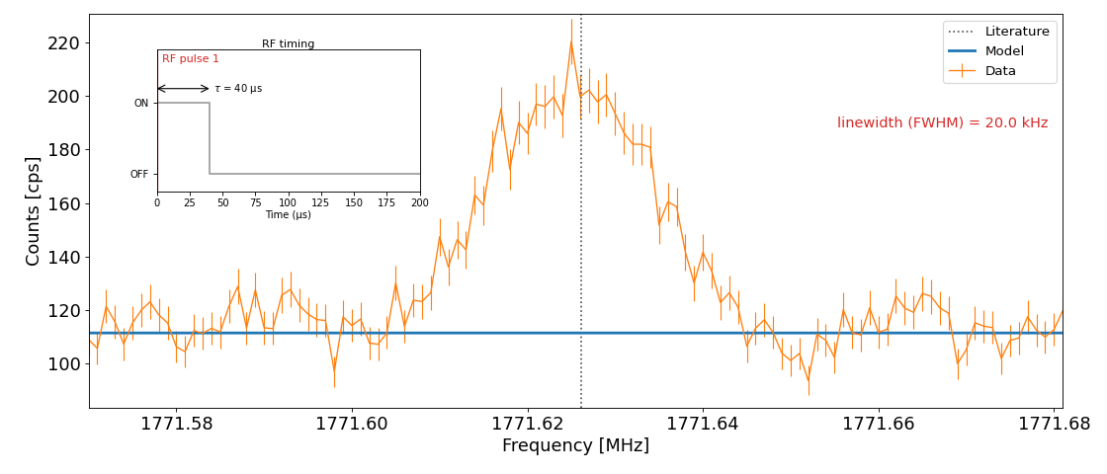
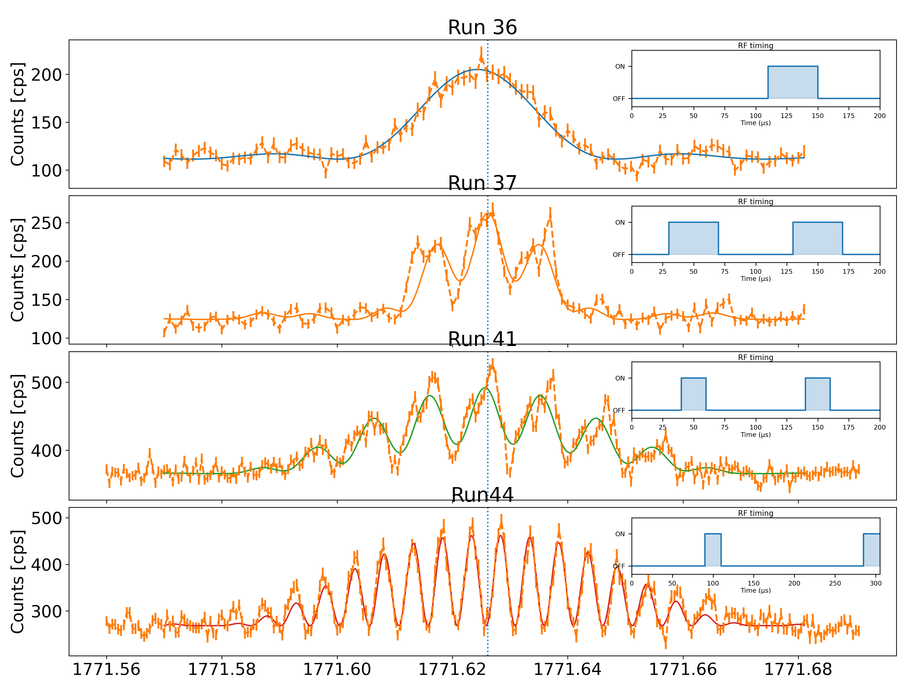
Coherence time and Ramsey excitation
180 mm jet with high stagnation de Laval nozzle
130 mm stripline electrode (~260 us)
1 pulse of 40us
~25kHz
2 pulses of 40us 60us separation
~16kHz
2 pulses of 20us 80us separation
~12.5kHz
2 pulses of 20us 200us separation
~5kHz

Slide 33
Coherence time and Ramsey excitation
180 mm jet with high stagnation de Laval nozzle
130 mm stripline electrode (~260 us)
1 pulse of 40us
~25kHz
2 pulses of 40us 60us separation
~16kHz
2 pulses of 20us 80us separation
~12.5kHz
2 pulses of 20us 200us separation
~5kHz

Slide 34
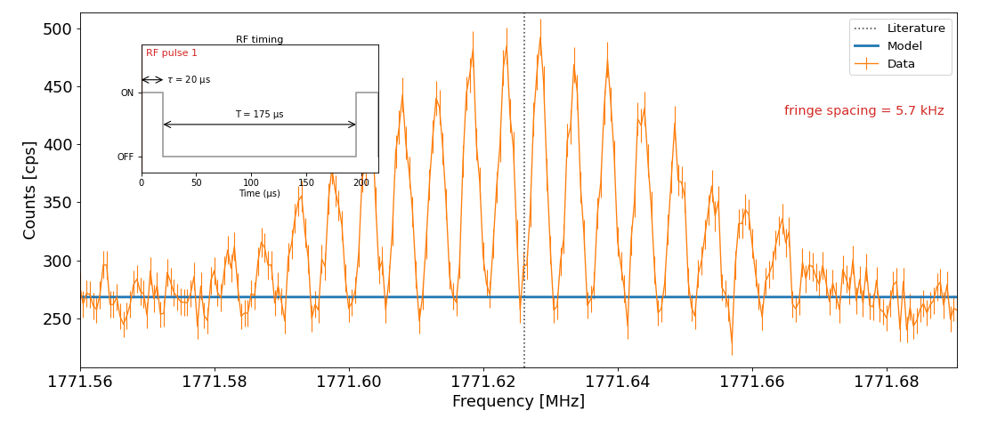
Coherence time and Ramsey excitation
180 mm jet with high stagnation de Laval nozzle
130 mm stripline electrode (~260 us)
1 pulse of 40us
~25kHz
2 pulses of 40us 60us separation
~16kHz
2 pulses of 20us 80us separation
~12.5kHz
2 pulses of 20us 200us separation
~5kHz

Slide 35
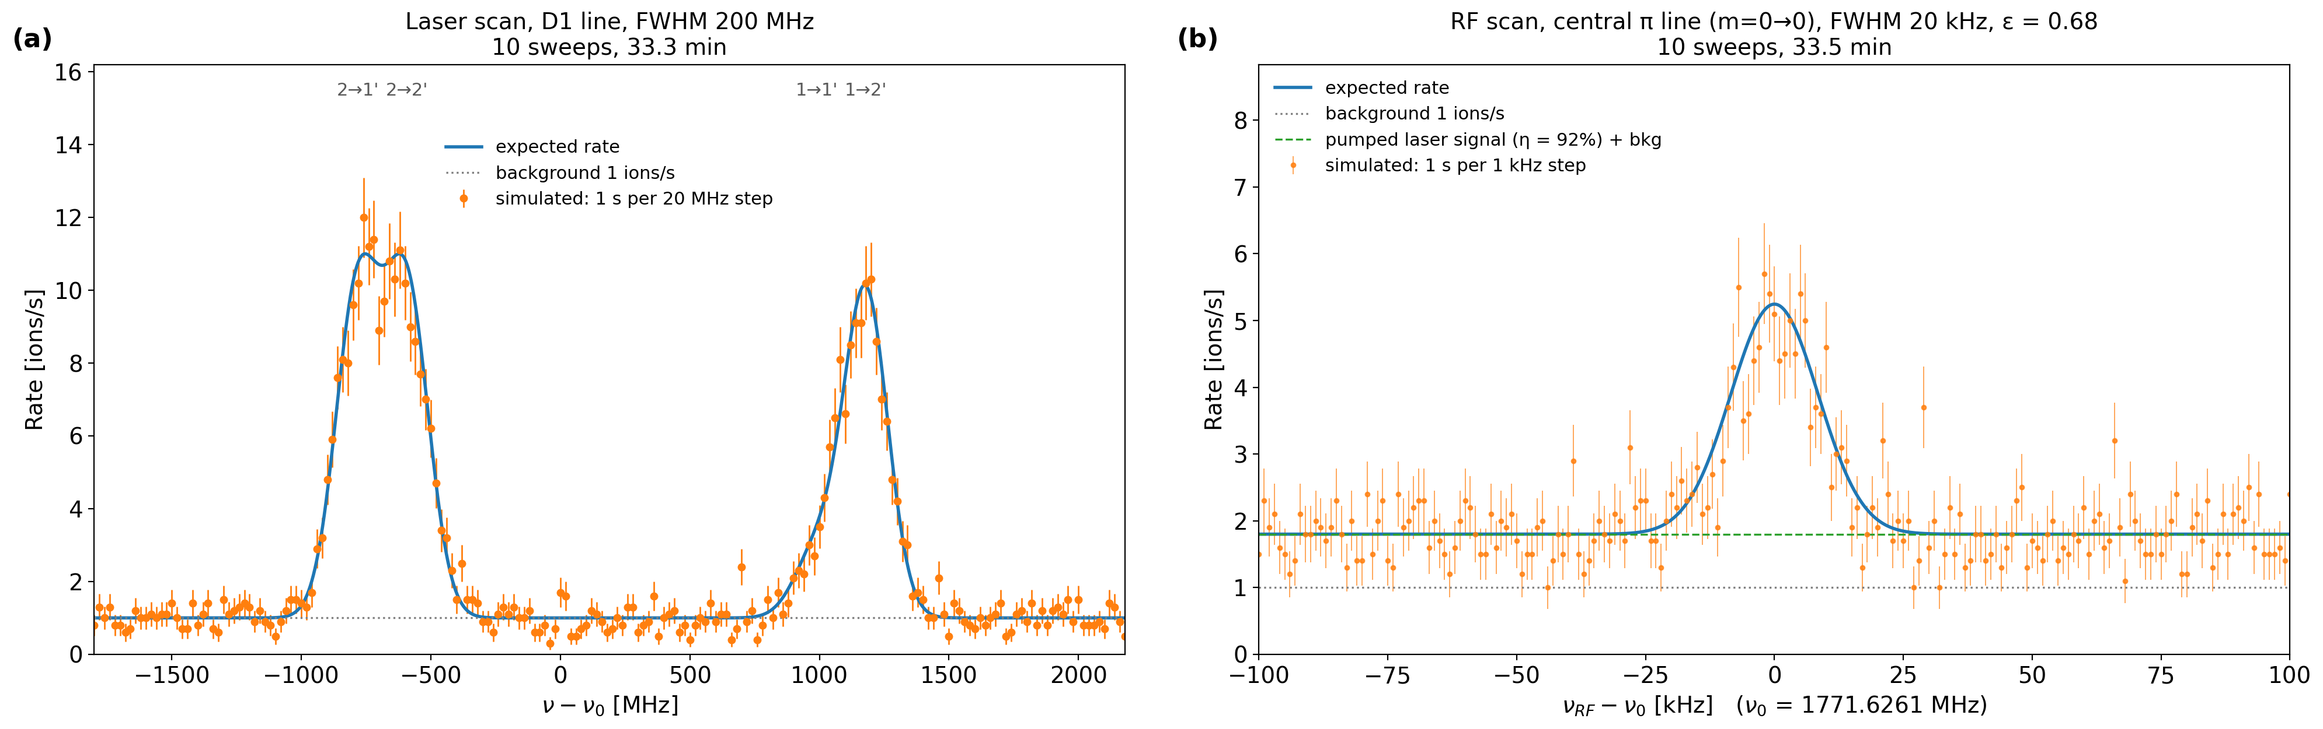
Comparison to high resolution in-gas jet spectroscopy
Simulated
10Hz resonant laser signal
1Hz detection background
Estimated from the measurements
90% pumping efficiency
60% RF repopulation efficiency

Slide 36
Comparison to high resolution in-gas jet spectroscopy
Simulated
10Hz resonant laser signal
1Hz detection background
Estimated from the measurements
90% pumping efficiency
60% RF repopulation efficiency

Slide 37
Conclusion
LRDR successfully implemented in a collimated
supersonic Gas-jet expansion
Compared to standard in-gas jet spectroscopy
High resolution ~1000 increase
High sensitivity ~0.5 in signal to noise *
Coherence time demonstrated across the length of the gas-jet
(minimized collisions in the supersonic expansion)
Further tests ongoing for the full characterization of the technique
Pathway to perform kHz resolution spectroscopy on RIB produced at S³-LEB
and systematically study higher order nuclear moments across isotopic chains

Slide 38




Nuclear Moments group and collaborators
Andrea Raggio
Ruben de Groote
Rafael Ferrer Garcia
Harshithbabu
Wout Saelens
Pierre Lassegues
Maylis Brun
Antoine de Roubin
Thank you for the attention!

Slide 39
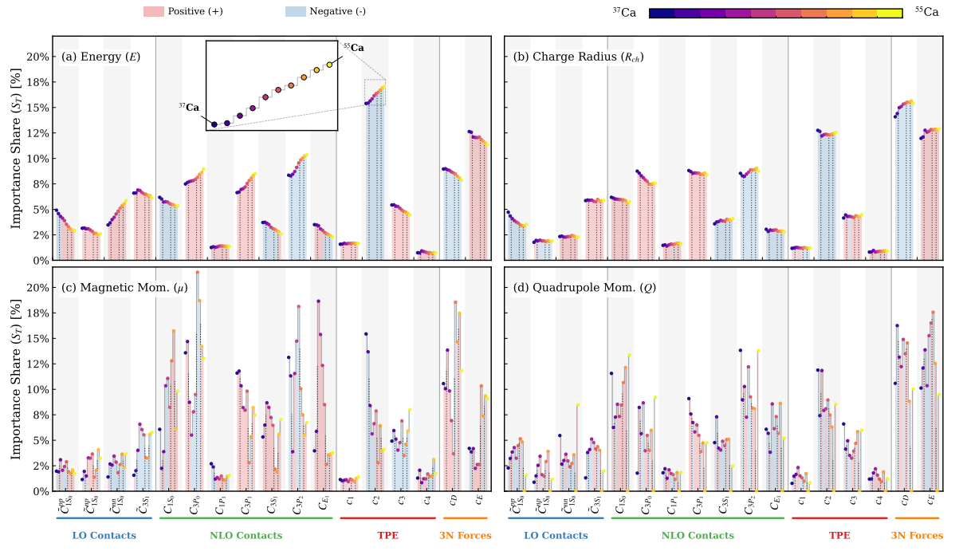
Electromagnetic moments
LEC contribution to bulk observable doesn’t carry isotope dependent importance
EM carry spin-isospin interaction information which changes with neutron numbers
Munoz, Jose M., et al. arXiv:2603.26905 (2026).
Notes:
what information does em moments provides, brief description of deformation of levels
Extensive measurements over the years favored by new facilities and techniques, study of evolution across isotopic chains, especially in deformed regions and across nuclear shell closures

Slide 40
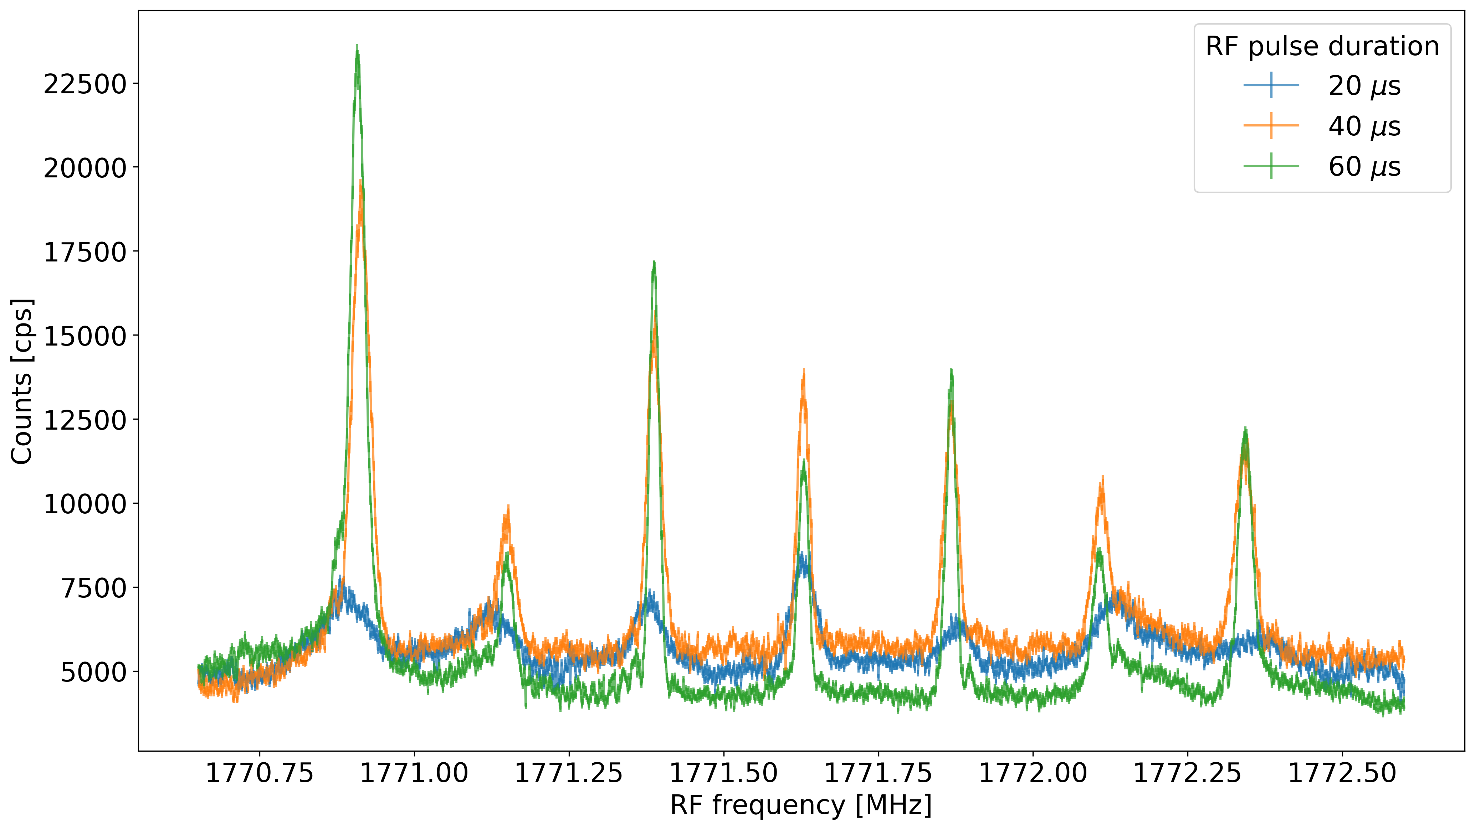
RF pulse duration
FWHM ~ 1/∆T

Slide 41
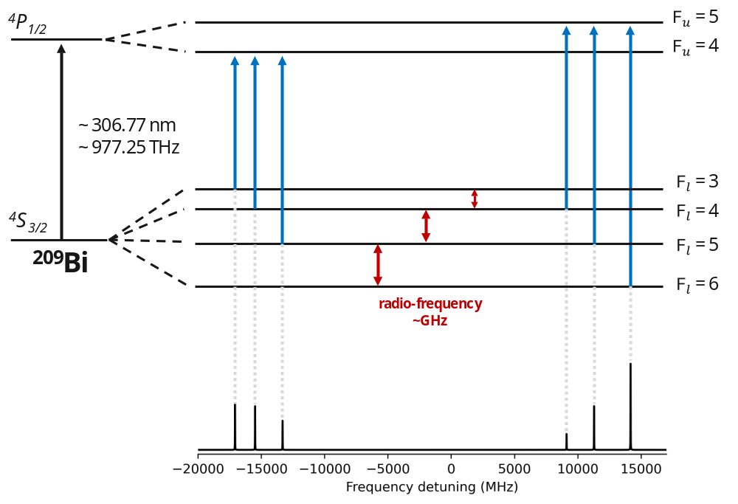
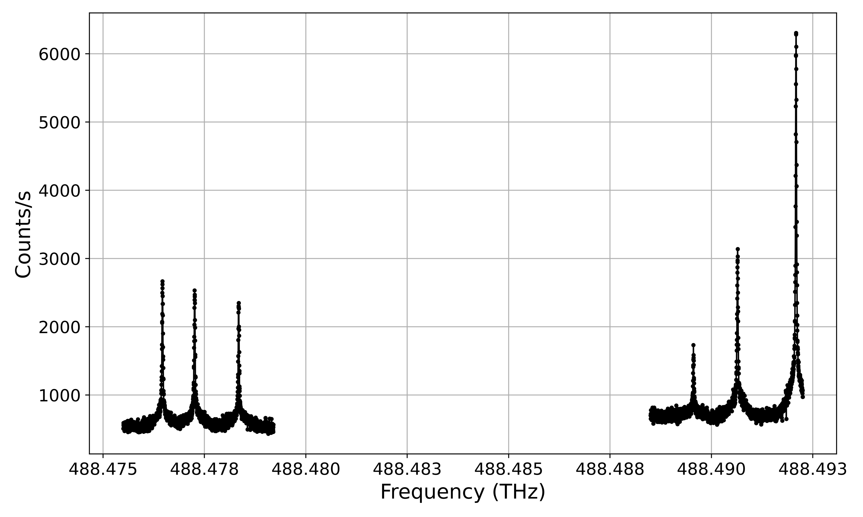
Fluorescence spectroscopy of ²⁰⁹Bi and hyperfine structure
Natural linewidth ~ 27 MHz
Measured FWHM ~ 30MHz
Standard laser spectroscopy
Measures the relative frequency separations between hfs transitions
Resolution limited, at best, by the natural linewidth
Laser - RF double resonance
Measures directly the spacing between two hfs levels within a single fine-structure state
Resolution set by the atom–RF field interaction time (→ much narrower)
Slide courtesy of A. Candiello

Slide 42
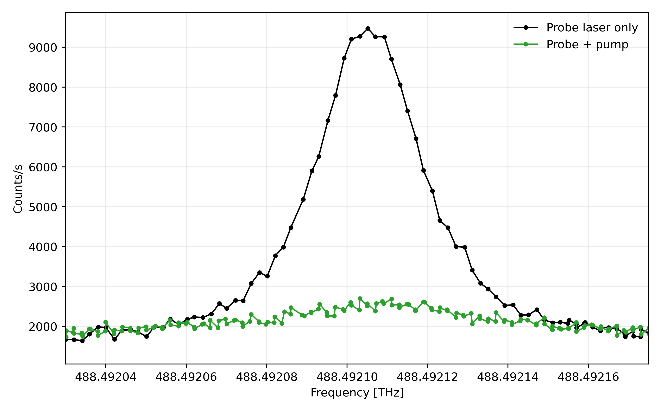
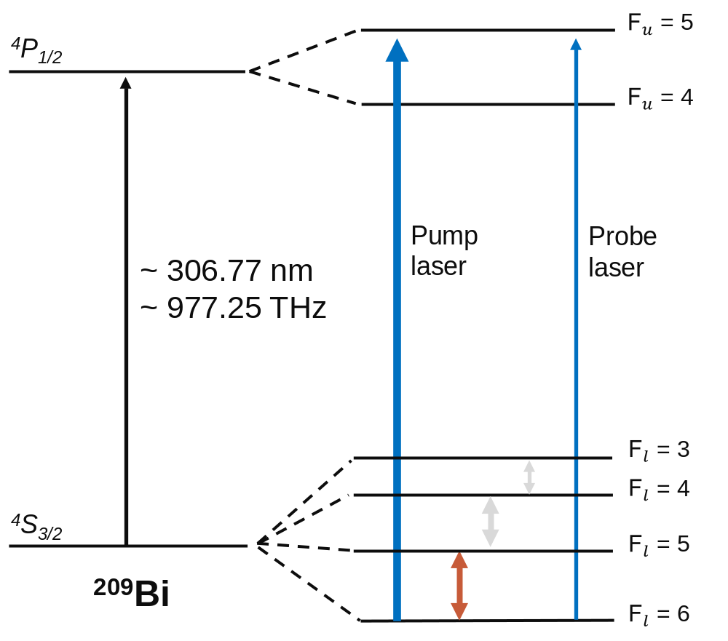
²⁰⁹Bi LRDR spectroscopy
LASER RESONANCE
Pumping effect
RF RESONANCE
Slide courtesy of A. Candiello

Slide 43
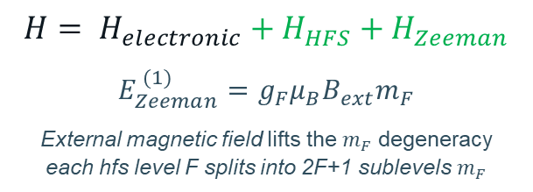
External magnetic field: Zeeman splitting of the hfs levels
Field dependence: each hfs interval splits into a fan of Δm = 0, ±1 components,
shifting ~ linearly with B
$$H= H_{electronic}+H_{HFS}+H_{Zeeman}$$
$${E_{Zeeman}^{ (1)}=g}_{F}μ_{B}B_{ext}m_{F}$$
External magnetic field lifts the $m_{F}$ degeneracy each hfs level F splits into 2F+1 sublevels $m_{F}$
Simulated RF spectra (ambient field, $B_{ext}=44 μT$): resolved Zeeman lines
The resolved Zeeman pattern is used to calibrate the magnetic field and to identify the $m_{F}=0→0$ transition, whose centroid is extrapolated to recover the field-free transition frequency
Slide courtesy of A. Candiello

Slide 44


²⁰⁹Bi: extraction of the field-free hyperfine centroid
Each RF scan is fitted to extract the $m_{F}=0→0$ centroid, which is extrapolated to $B=0$.
1- Resolved RF spectrum
2- Extract $m_{F}=0→0$centroid
${\text{m}}_{F}=0$ $→0$
Measured FWHM ~ 5.5 kHz
The same procedure is applied to each hyperfine gap to obtain the field-free transition frequencies:
$$ν_{3,4}, ν_{4,5}, ν_{5,6}$$
Slide courtesy of A. Candiello

Slide 45
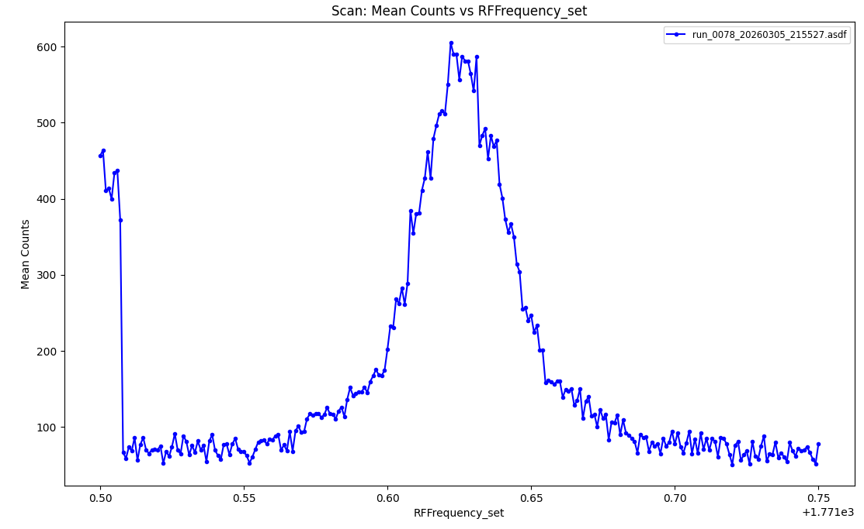
Field compensation
RF signal
Field ~0 on all 3 axis
RF Signal > RIS Signal
Lineshape is strongly affected by small field variations
RIS signal
30 us RF pulse

Slide 46
Field compensation
Field ~0 on all 3 axis
RF Signal > RIS Signal
Lineshape is strongly affected by small field variations
Non uniform background field

