Slide 1
News, group meeting ‘Particles’
IN2P3/UCBL/lab news:
M2 Internships: the group has put 4 offers online up to now (2 CMS, 1 COMET, 1 FCC). Foire aux theses held on Oct 23.
HCERES: Janv 21-23. Groupe Particules, Janv 21, 15h
Preparation of the Next IP2I Director Appointment
Search committee to be established by IN2P3 / UCBL
IP2I contacts:
Corinne Augier – Researchers
Bogna Kubik – Engineers / Technicians
Job announcement: imminent, Candidate presentations: early next year
Appointment process: validation by in2p3/UCBL and Lab Council in spring
Official end of Anne’s mandate: December 2026
R&D for future collider news:
Entretiens Annuels Projets (EAP) : T-MRPC date TBD, GRAM on Nov 4th, FCC in November 20th.
CEPC on hold: https://cerncourier.com/a/cepc-matures-but-approval-is-on-hold/
CMS news:
LHC Luminosity: the LHC made it: 123fb-1 (the goal for the year was 120)
LHC upgrade: BPOL12V chip problem (see next slide).
CMS spokesperson-elect: Anadi Canepa, start 1 January 2026 and ends on 31 August 2028.
Workshop CMS France, March 11-13 will be held in Lyon (IP2I+CC-in2p3).

Slide 2
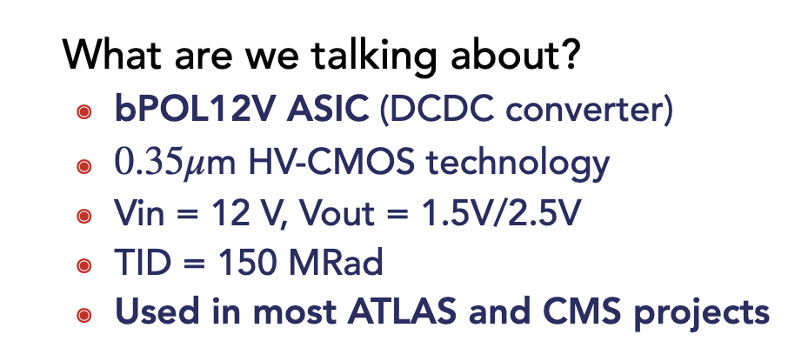

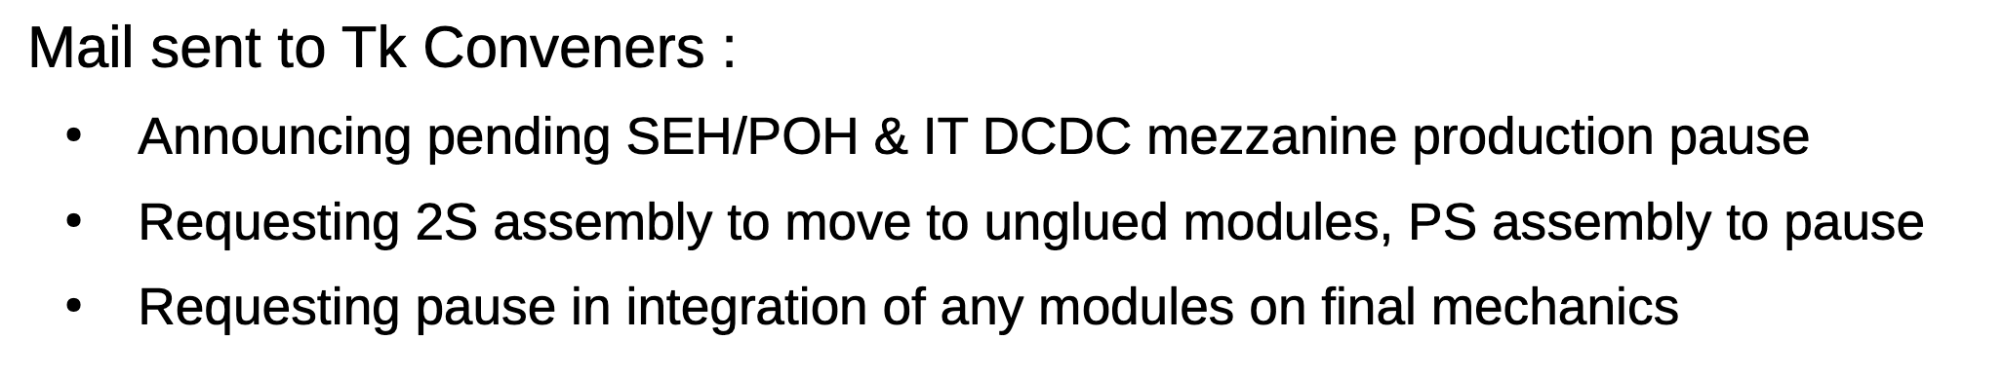
LHC bad news Bpol12V ASIC failure (DC DC converter)
There is a temperature effect
Turning-on has an effect
Dose has an effect
Particle type (and thus displacement damage) seems to have an effect
“Annealing“ seemed to have an effect, now this is being questioned
Solutions involving change of operational procedures
Looks pretty unlikely now
Solutions exploiting dose dependency
Effects acceptable for certain sub-detectors? Certain areas in the trackers?
Solutions involving passive components
Also getting unlikely
Addition of passive component(s) (capacitor, resistor)?
change of board layout required
Very difficult to fit more components onto OT hybrids
Solutions involving a new chip (not yet firmly excluded, but considered nearly impossible by ESE)
From the tracker project

Slide 3
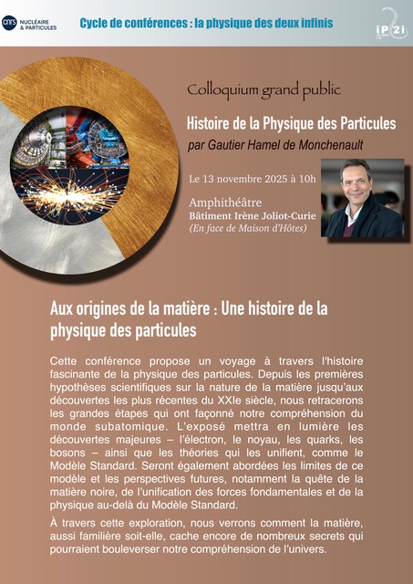
Upcoming (known) events and deadlines
❑ Nov 3-7: CMS Tracker week, CERN
❑ Nov 4: Entretien Annuel Projet: GRAM (zoom)
❑ Nov 4: PhD defense Elise Jourd’huy
❑ Nov 13: Colloquium on the history of particle physics by Gautier Hamel de Monchenault, amphithéâtre du bâtiment Irène Joliot-Curie → Bat neuf à coté maison d’hotes
❑ Nov 13: HDR Gaelle Boudoul
❑ Nov 17-21: Ecole de GIF on future colliders, Strasbourg
❑ Nov 20: Entretien Annuel Projet: FCC, CERN
❑ Nov 24-26: IRN Terascale, Montpellier
❑ Nov 26-28: FCC / DRD France workshop, Paris
❑ Nov 30 – Dec 6: JRJC, Côtes d’Armor
❑ Dec 4: PhD defense Ji-Eun Choi, Seoul (Korea)
❑ Dec 8-12: CMS week, Seoul (Korea)
❑ Jan 7-9: Linear Collider Facility at CERN workshop, CERN
❑ Jan 26-30: 9th FCC workshop, Munich
❑ Jan 21: HCERES, groupe Particules, 15h
❑ Jan 28-30: CMS Top Workshop, Oviedo (Spain)
❑ Feb 3-6: Prospectives techniques et Journées R&T, IP2I
❑ Feb 9-13: CMS week, CERN
❑ Mar 11-13: CMS France workshop, Lyon
❑ Mar 15-22: Moriond EW
❑ Mar 22-29: Moriond QCD

Slide 4
News on our activities (tour de table)

Slide 5
Back-up slides

Slide 6
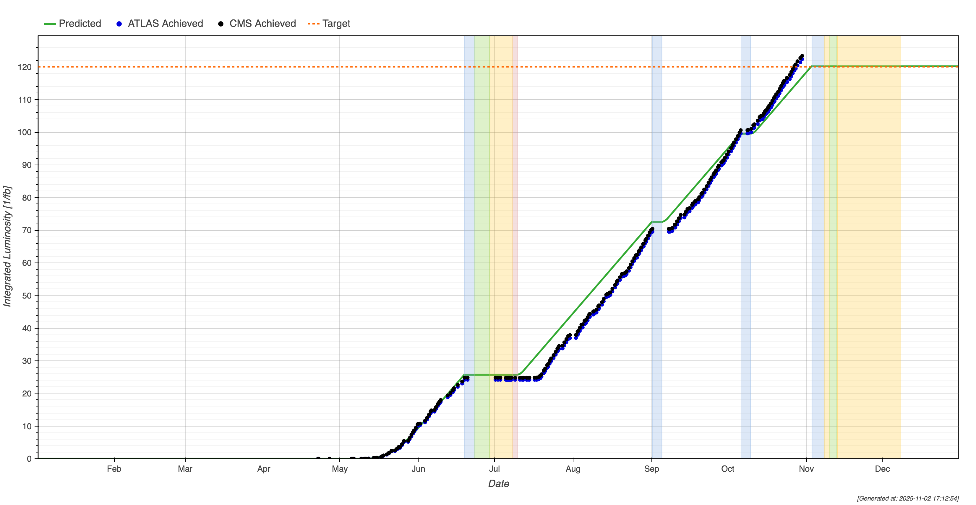
News, group meeting ‘Particles’
CMS news:
CMS spokesperson-elect:
Anadi Canepa (FNAL, USA): 849 votes (60.1%)
Markus Klute (KIT, Germany): 563 votes (39.9%)
Anadi Canepa is elected for the next Spokesperson term, which starts on 1 January 2026 and ends on 31 August 2028.
LHC GOOD NEWS : LHC made it !
123fb-1 (the goal for the year was 120)
Asymmetric Beams :
1.4e11 ppb (issue with RF fingers since July
Sector 6L2 next to Alice ).
1.8e11 ppb for beam 2 ( record! And ultimate goal for run3 )

Slide 7
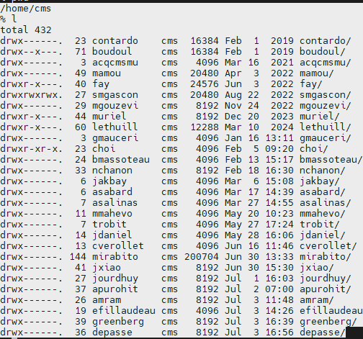
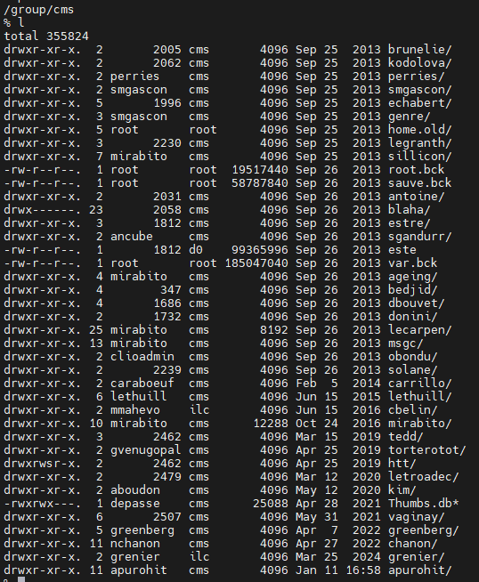
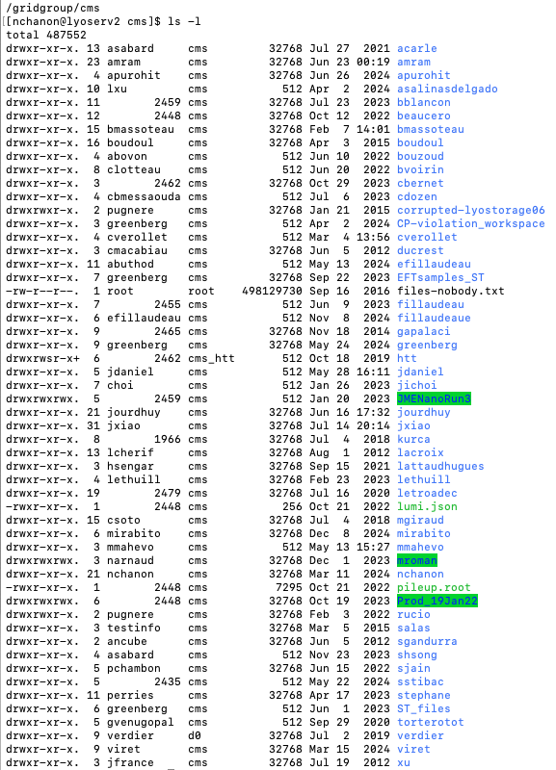
CMS IP2I Data cleaning

