Slide 1



July ##, 2026
Hierarchical CPSO Search for Extreme Mass Ratio Inspirals in Space Based Gravitational Wave Detector Data
Haocheng Hu (胡灏成) ¹ Yan Wang (王炎) ¹
Soumya D. Mohanty^{2,3}
^{1.} Huazhong University of Science and Technology
^{2.} University of Texas Rio Grande Valley
^{3.} Indian Institute of Technology (Hyderabad)
Notes:
Hello everyone. I’m Hu HaoCheng from Huazhong University of Science and Technology. It’s a great pleasure to be here at the National University of Singapore for this workshop.
My talk today is about CPSO Search for EMRI in space-based gravitational wave data. These works were done in collaboration with my advisor Wang Yan and collaborators including Prof. Mohanty.

Slide 2
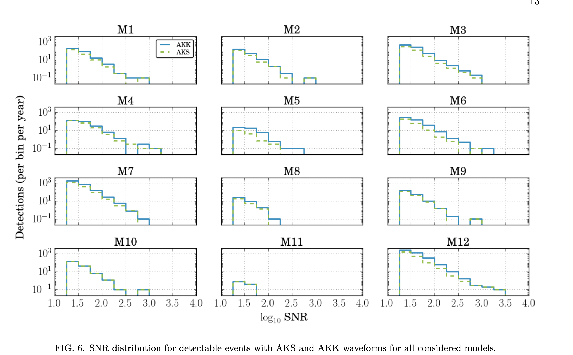
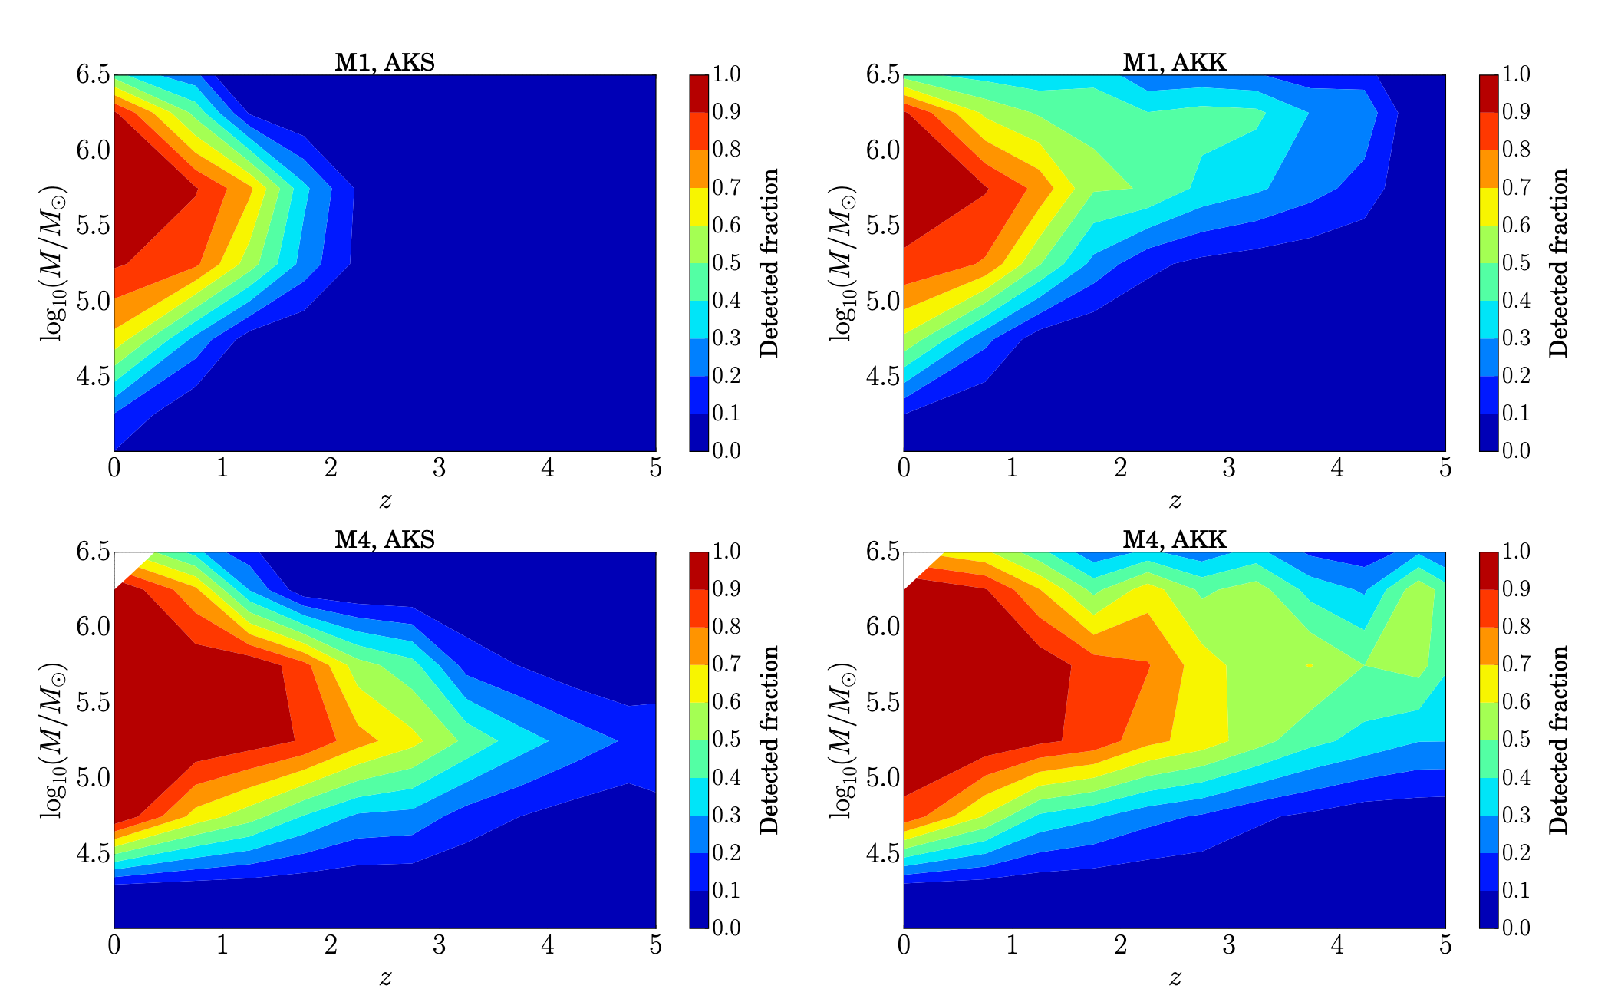
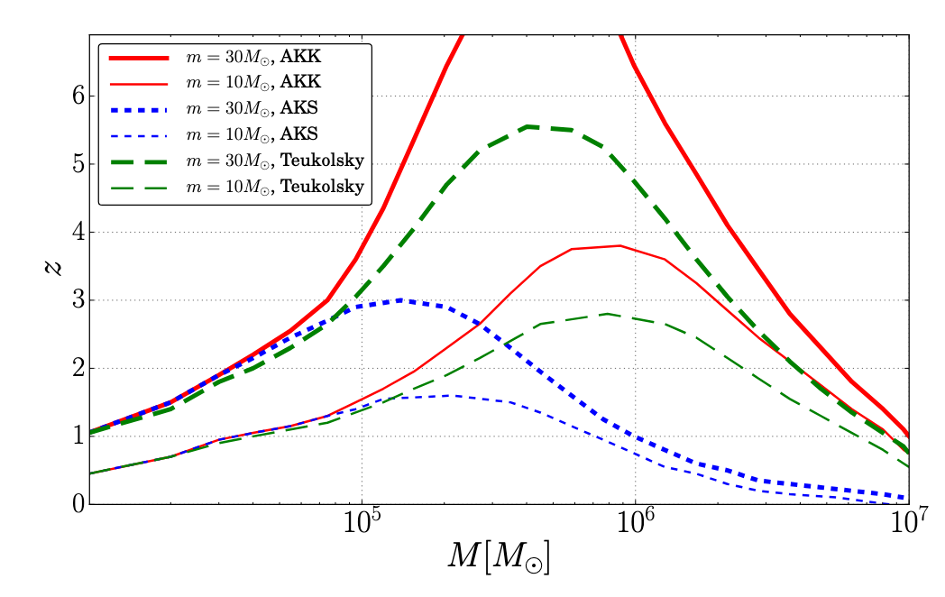
Detected EMRI Sources
Babak et al, PRD (2017) arXiv:1703.09722
Notes:
This page is about the parameter range we need to consider in EMRI.
You can see that most detected EMRI sources have low SNR

Slide 3
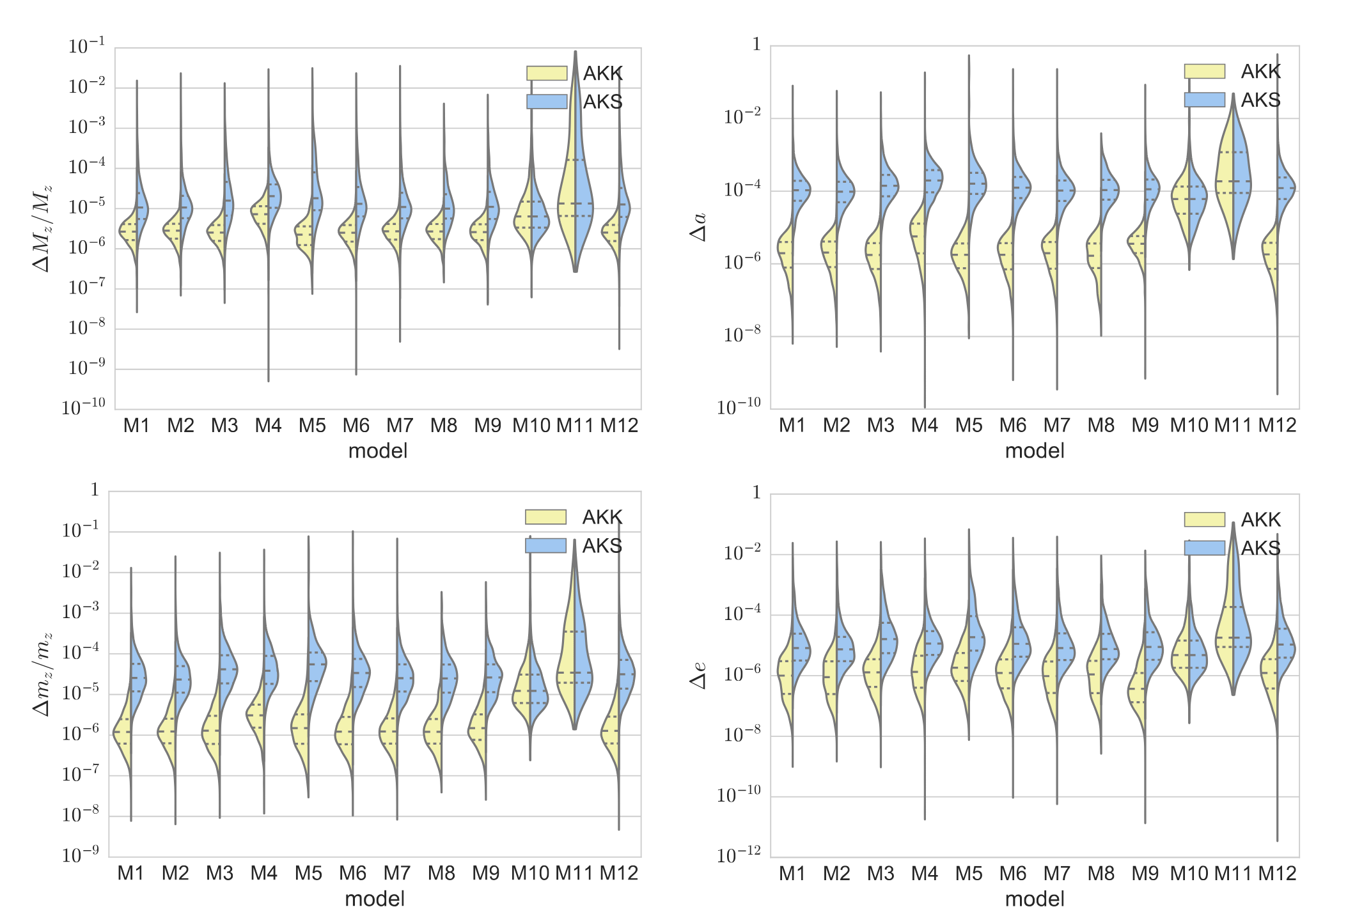
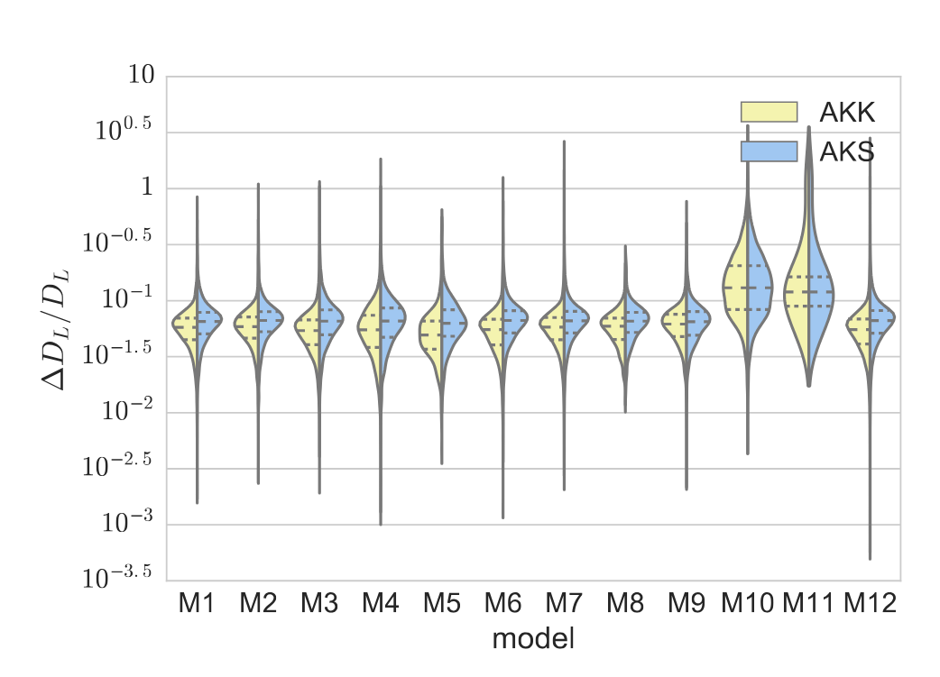
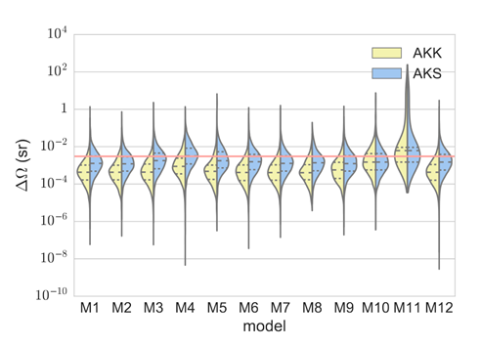
PE Accuracy for EMRI
Babak et al, PRD (2017) arXiv:1703.09722
Notes:
EMRI is sensitive to the intrinsic parameters. And it’s estimated accuracy for EMRI intrinsic parameters can reach the order of 10^-6（minus six of ten）.

Slide 4
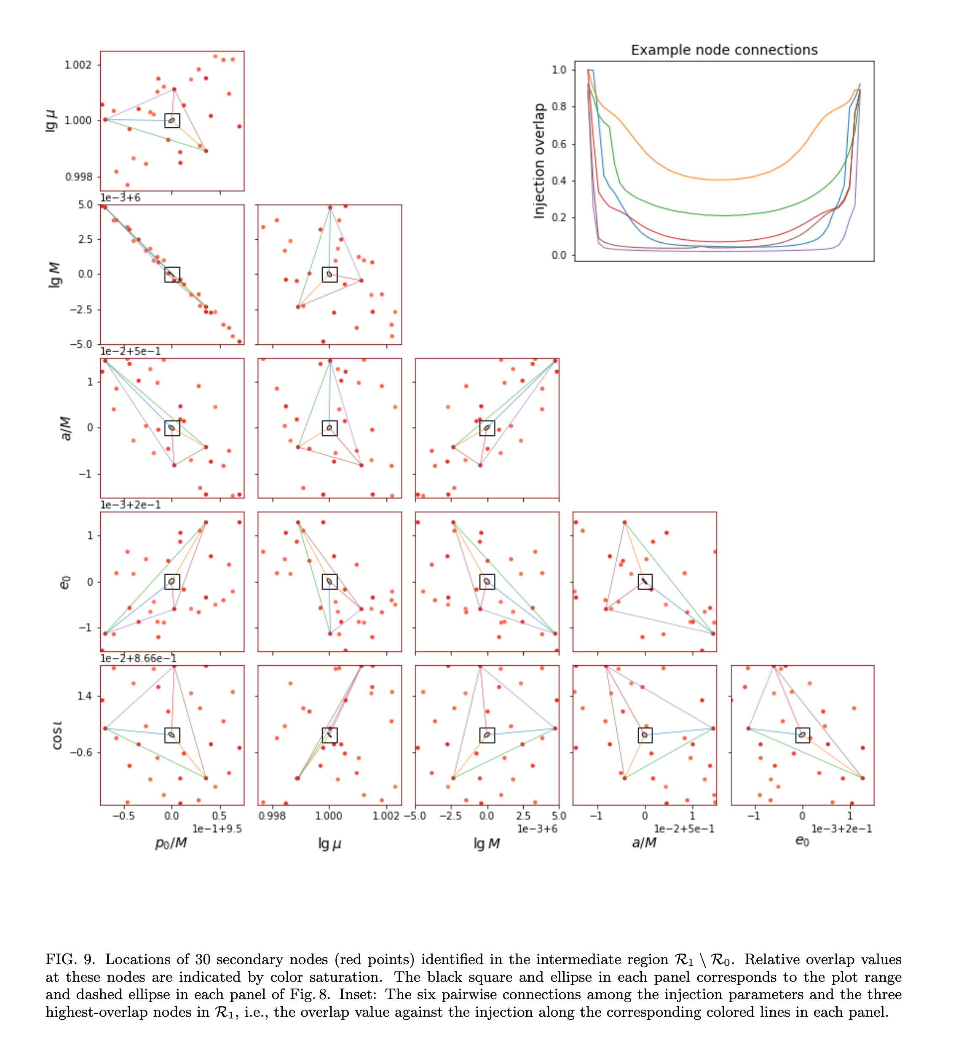
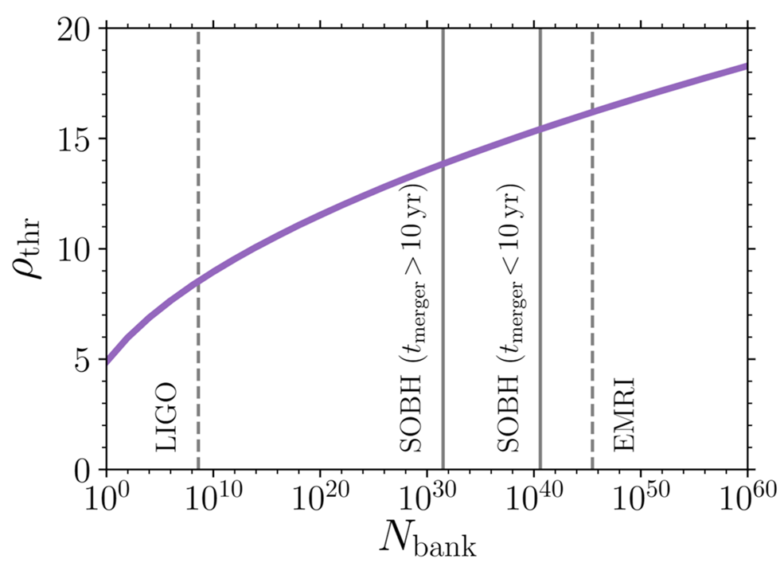
Challenges in Data Analysis
Chua et al, PRD(2022)
Moore et al, MNRAS (2019)
Notes:
As the right picture shows, for a trivial template bank, it is estimated that we need more than 10^40(forty of ten) templates.
Another major difficulty in EMRI data analysis is the multi-peak structure, which is mainly caused by the waveform’s multiple harmonics. The left picture also illustrates this.
It’s a natural idea that we need to compress the search region first, so this idea becomes a hireachical method

Slide 5
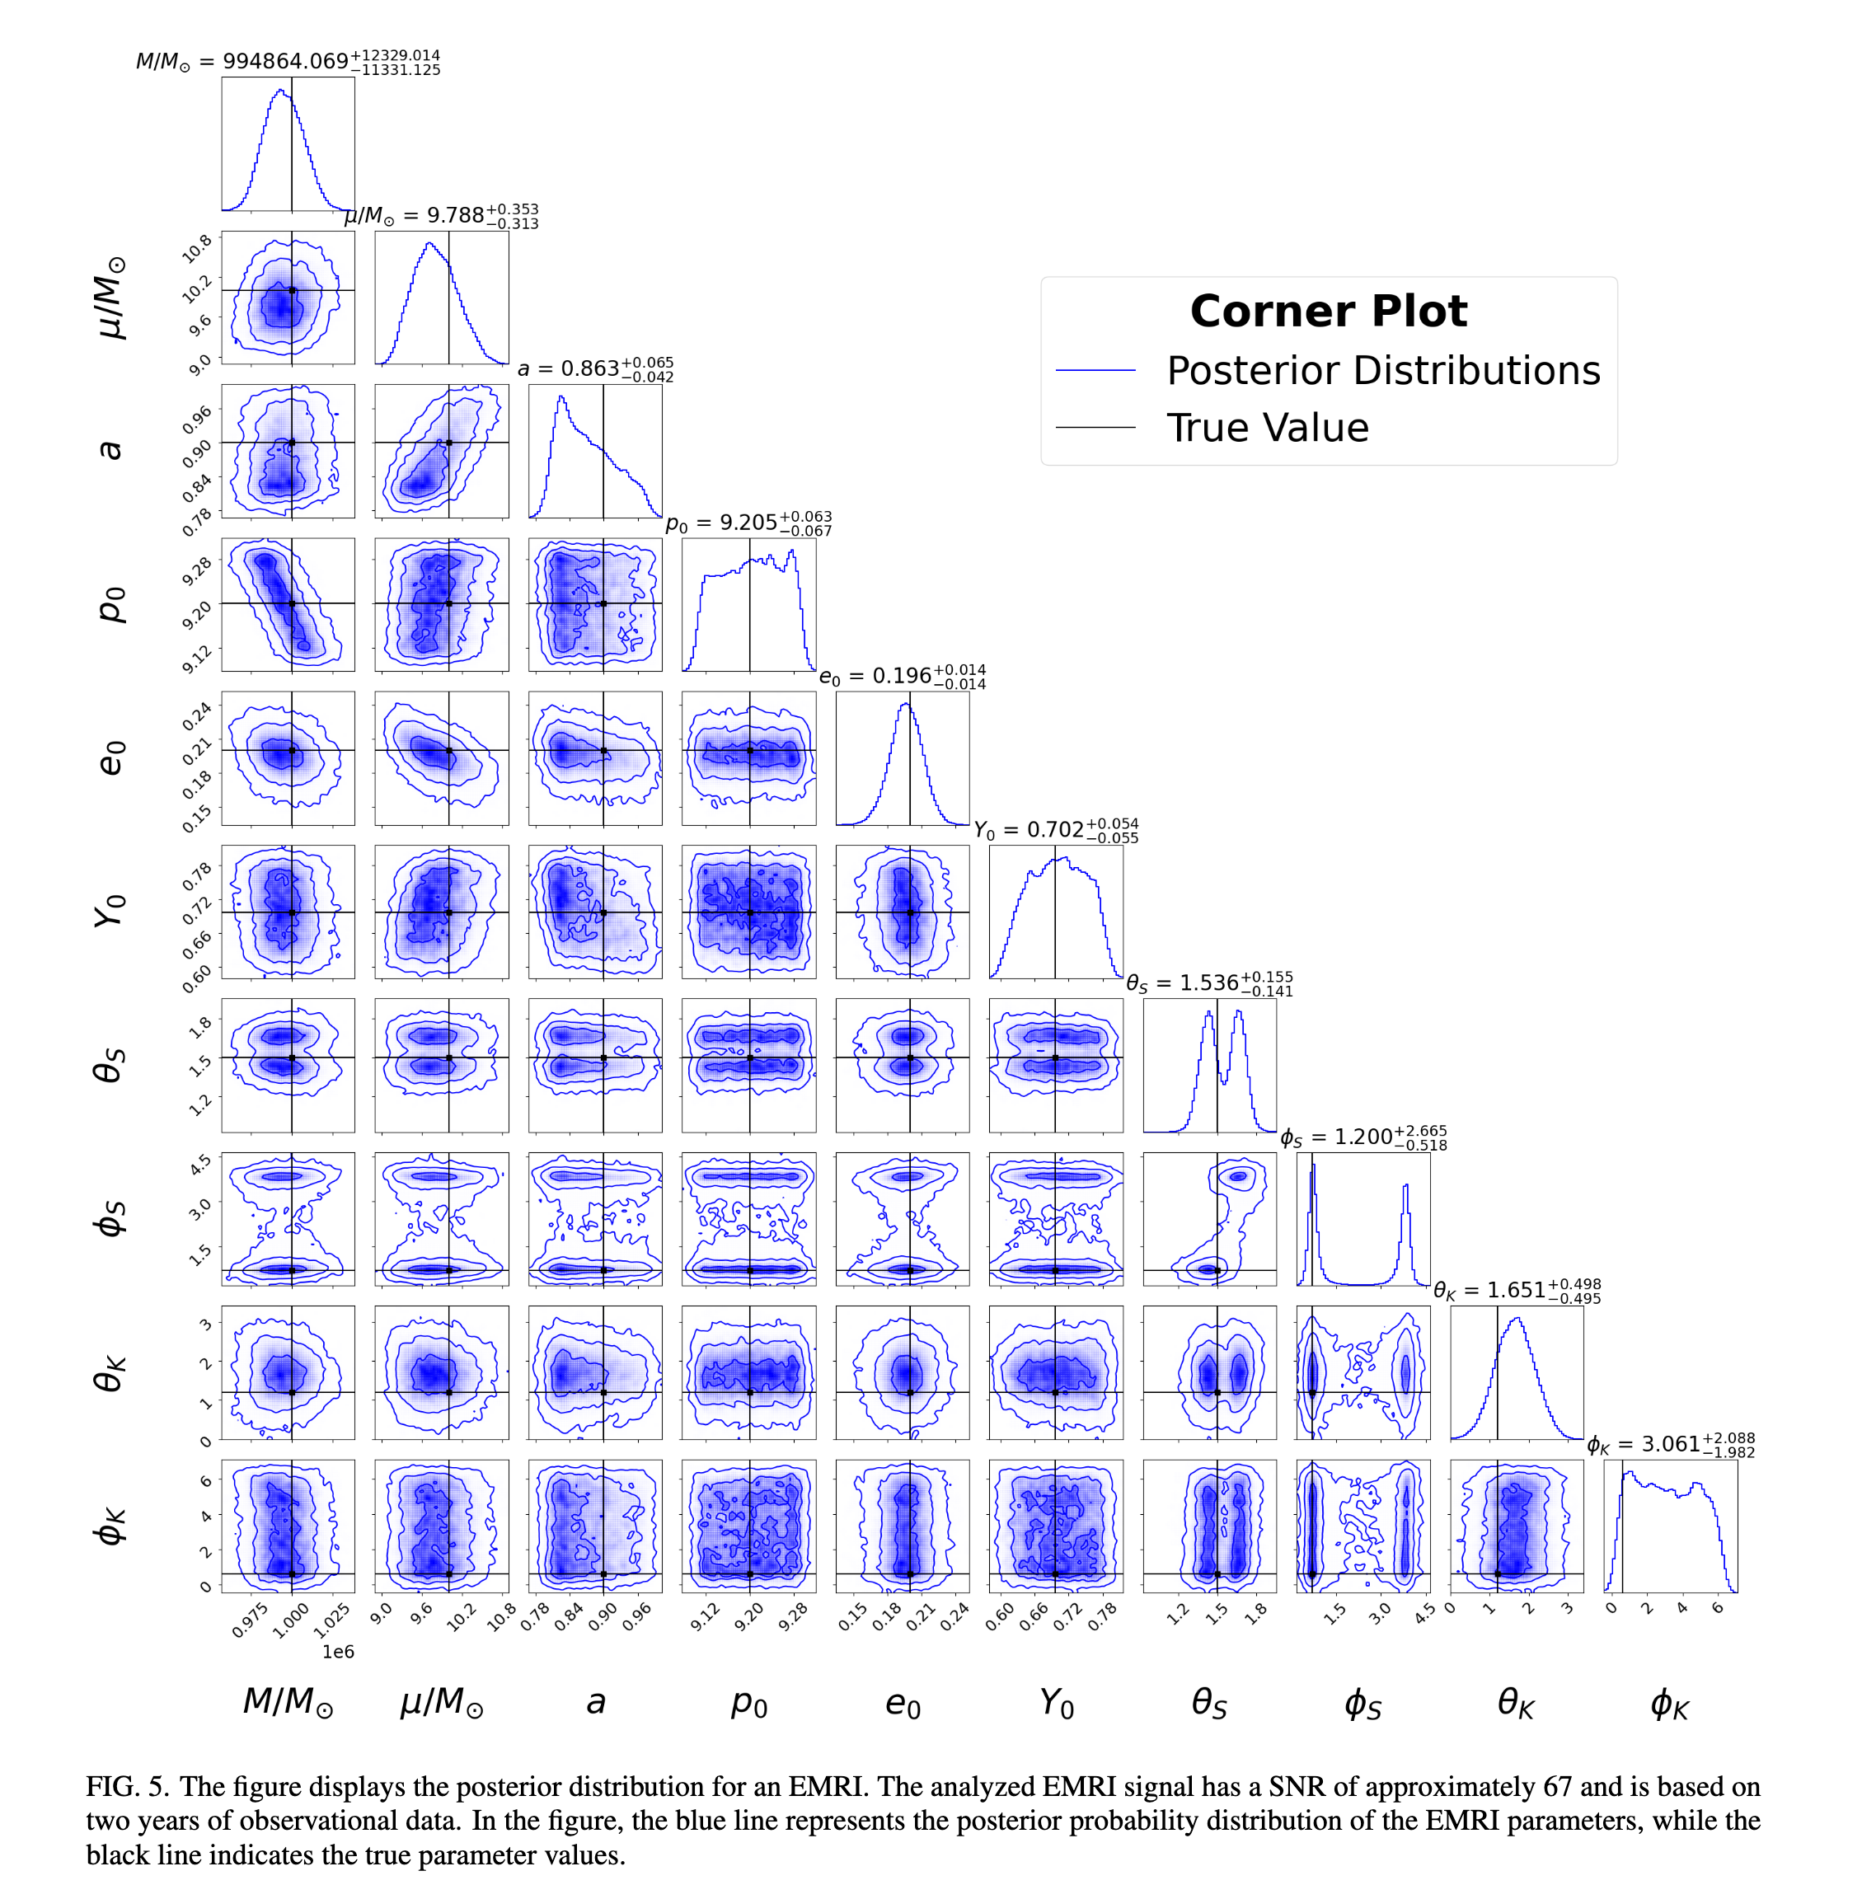
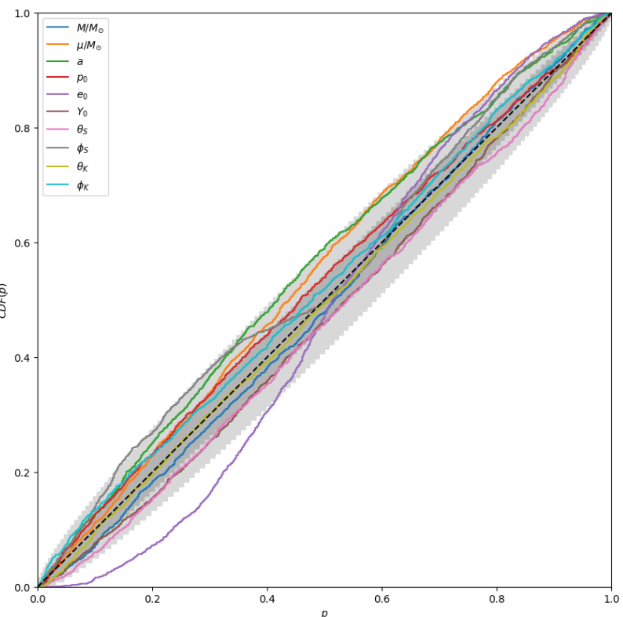
Normalizing Flow
Liang et al,
arXiv:2409.07957
Notes:
There are many ways to compress the search region.
For example, machine learning, what we discussed yesterday.

Slide 6
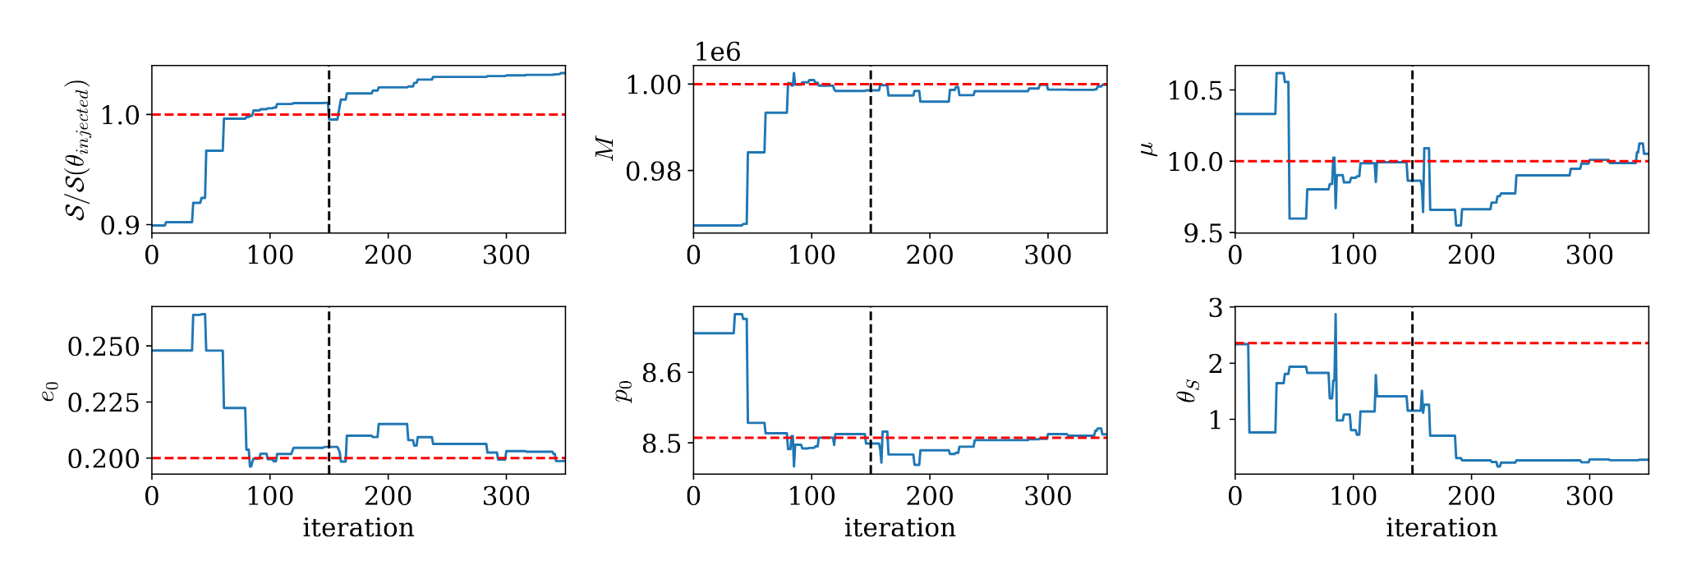
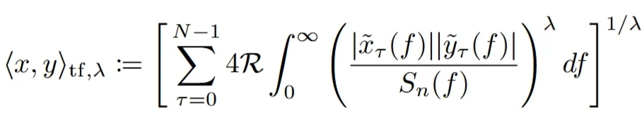
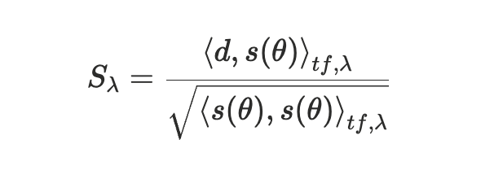
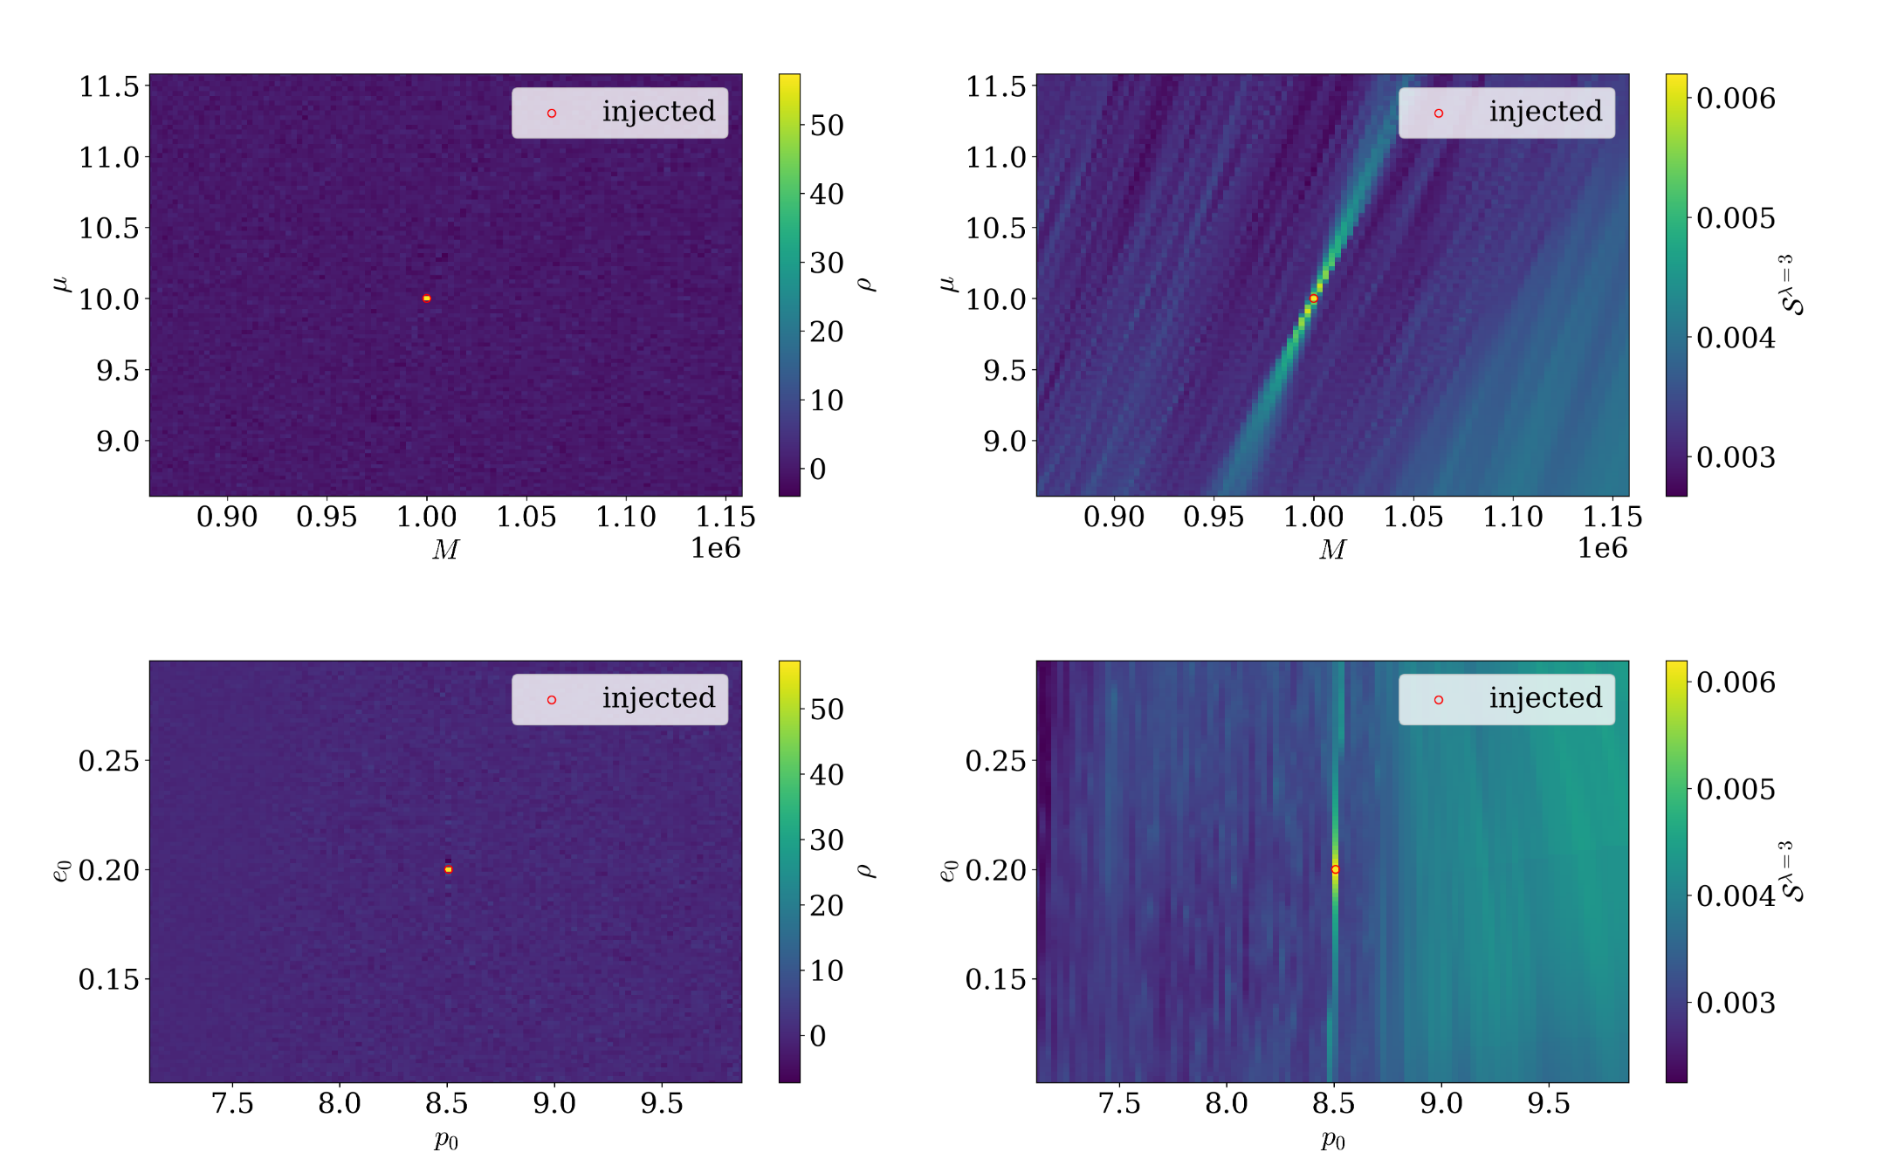
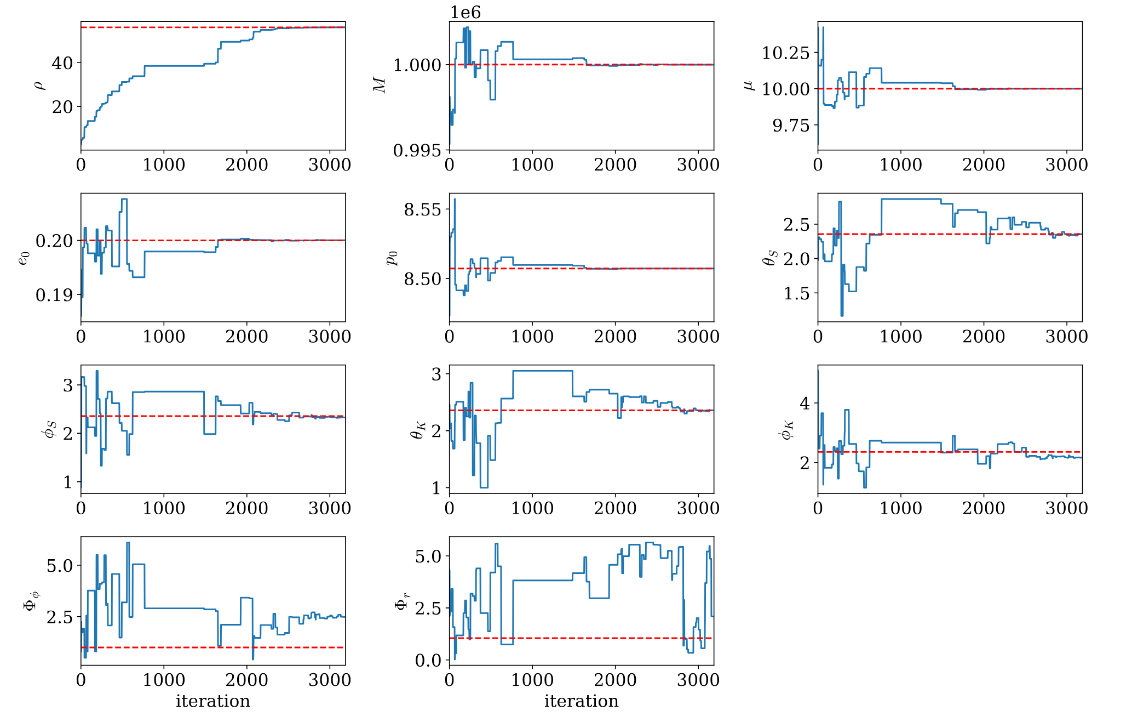
From identification to parameter estimation
Strub et al, arxiv:2505.17814
Notes:
Random search algorithm can also do this.
This page is about Stefan Strub’s work. He uses a hierarchical method and adopts a new detection statistic which finds the best parameters that match the power in each time-frequency “pixel”to help the search. Therefore, the statistic has the advantage of disregarding phase coherence between pixels while still enforcing frequency evolution coherence. This provides a wider primary mode in the search landscape for parameters {M, μ, p0, e0}.
He got good results: it converges within thousands of iterations and has good estimation accuracy for most parameters.

Slide 7
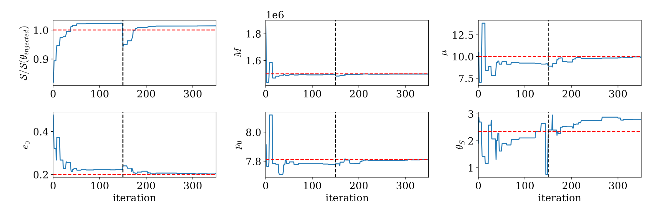
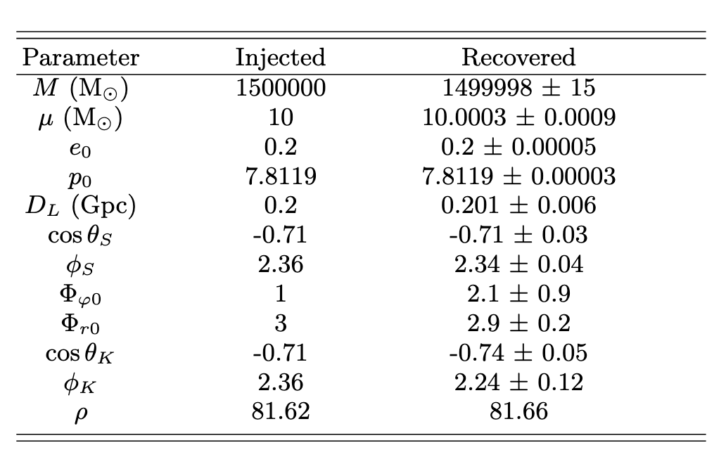
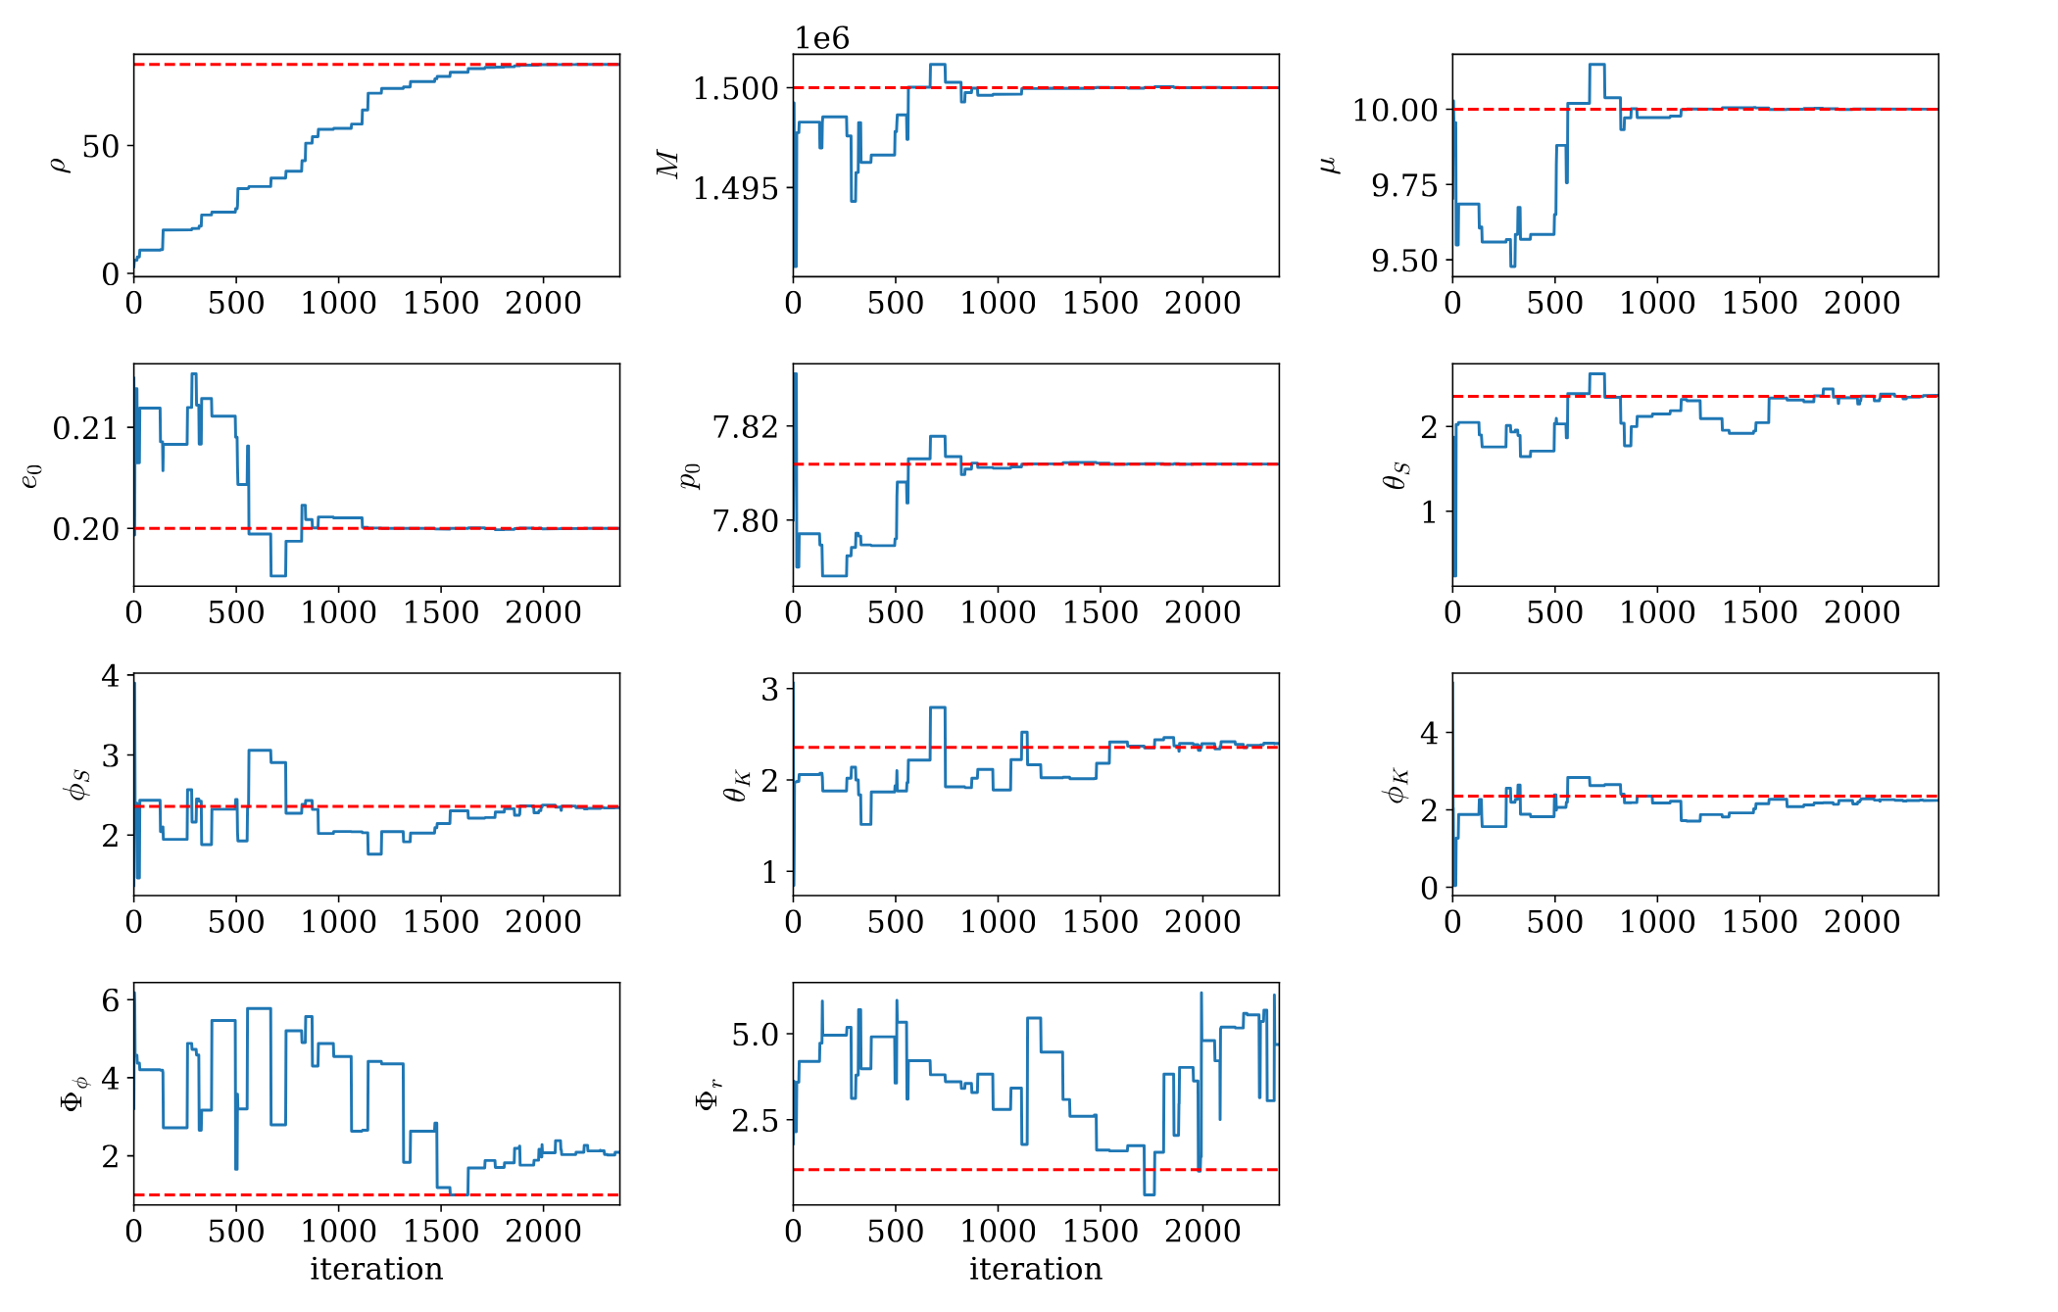
From identification to parameter estimation
Strub et al, arxiv:2505.17814

Slide 8
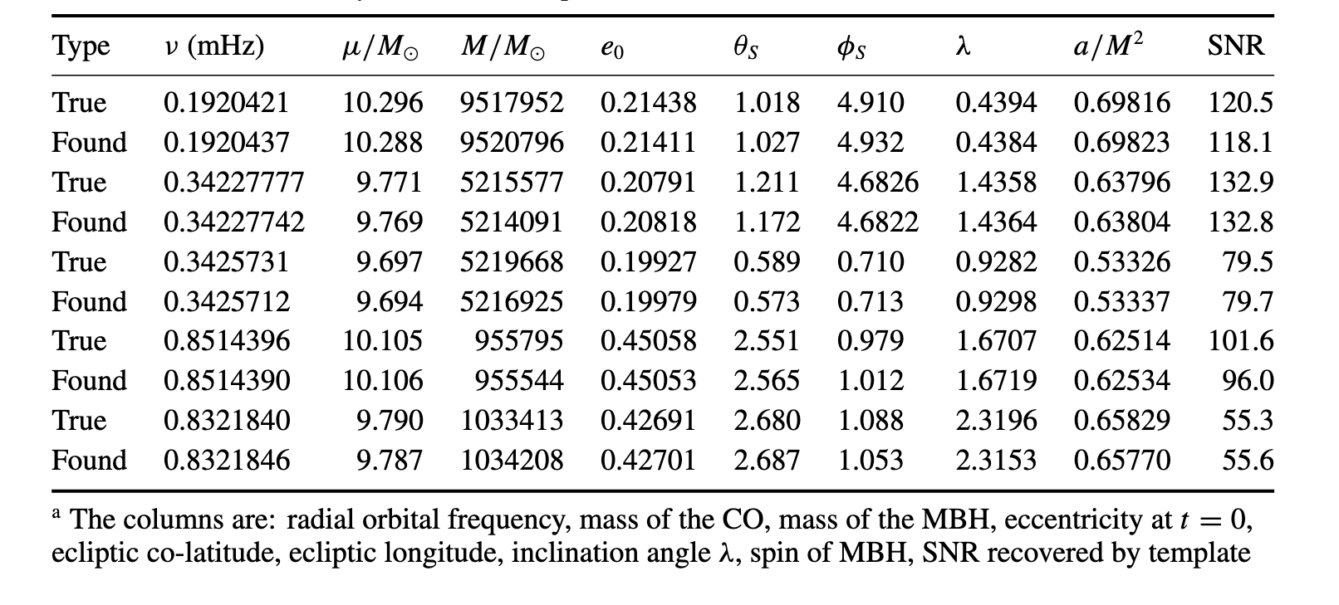
MCMC method in MLDC data
Babak et al,
Class. Quantum Grav.2009
Notes:
MLDC数据：MCMC方法

Slide 9
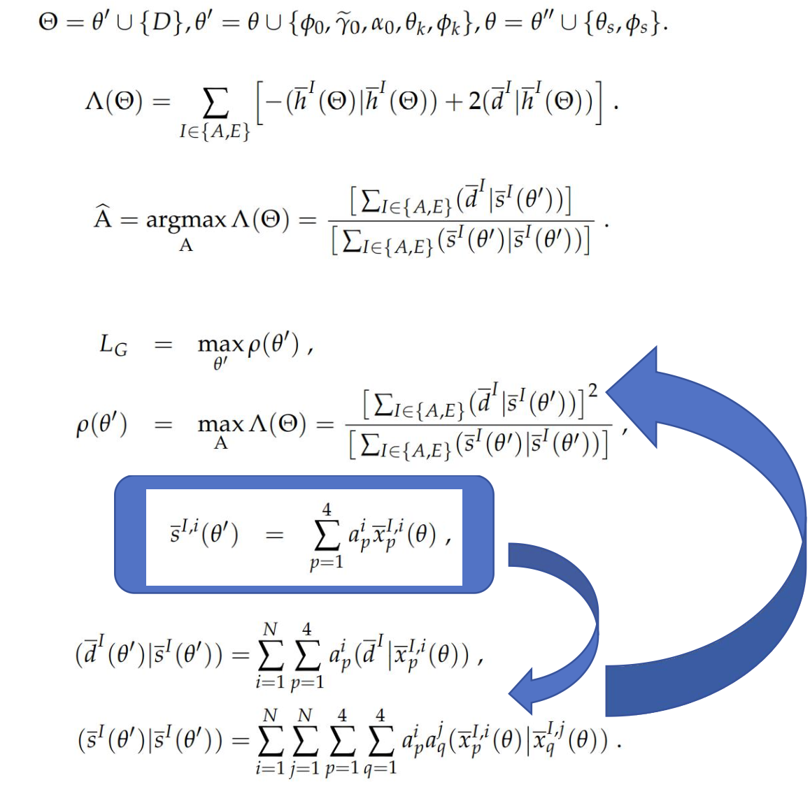
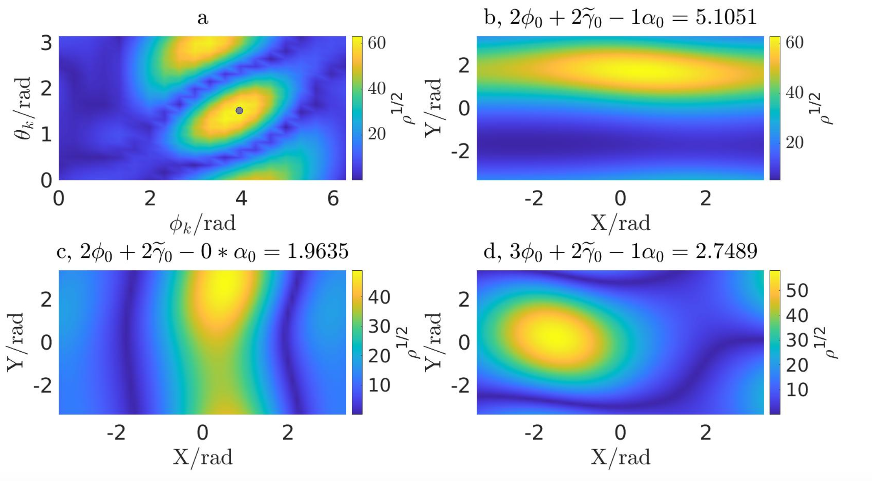
A Hierarchical Strategy for Searching Extreme Mass-Ratio Inspiral Signals Via Reduced Dimensionality Likelihood and Particle Swarm Optimization. Xiaobo Zou et.al, to be submitted to arXiv
Notes:
This page’s content comes from Zou Xiaobo. He originally planned to attend this workshop, but he couldn’t come for personal reasons. So he asked me to give a brief introduction to his work.
F-Statistic
We can write the signal as a_p^i about extrinsic parameters and x_p^i about intrinsic parameters for every mode of EMRI,and construct a F-stastic
In the field of gravitational waves, this is probably the first time it is used in PTA. The use of this statistic in PTA can directly achieve the purpose of dimension reduction, Because these coefficients about external parameters can be solved by analysis method. But for EMRI, because we have many modes, so it’s a little different. It has more than one peak, and has some structure.
So in every step, every particle, Zou applys many Fminsearch to get the result.

Slide 10
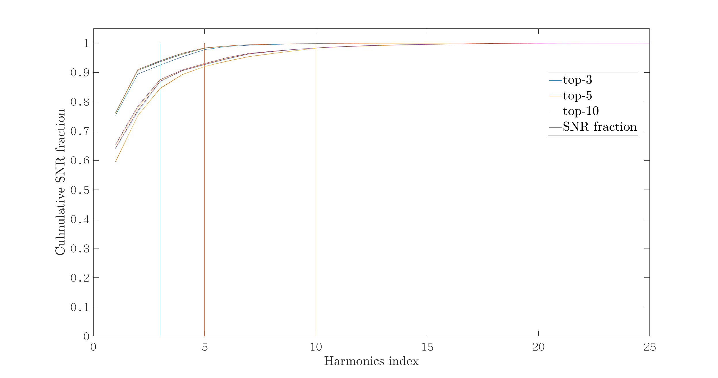
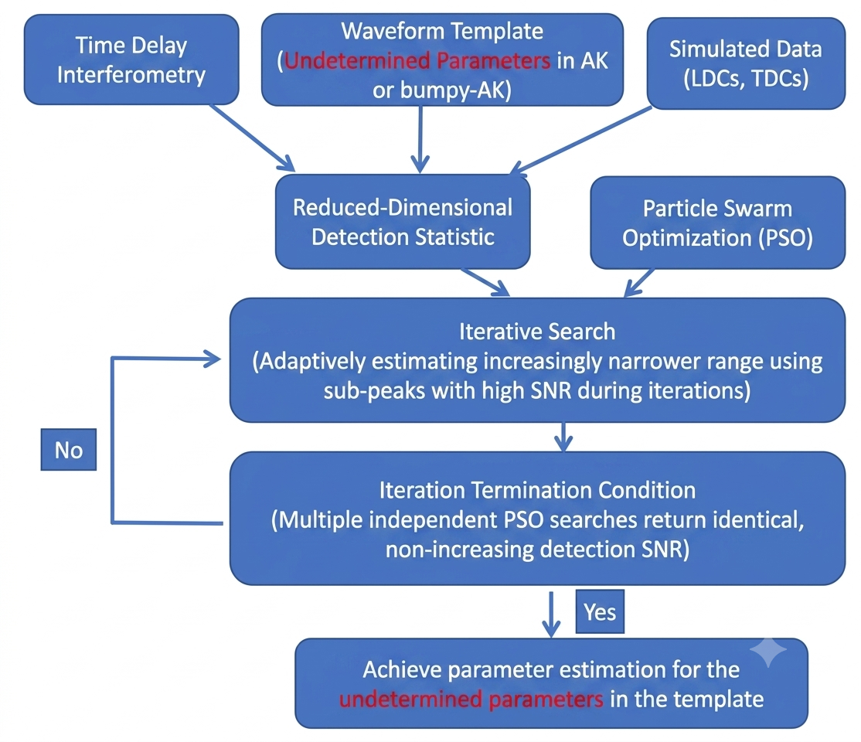
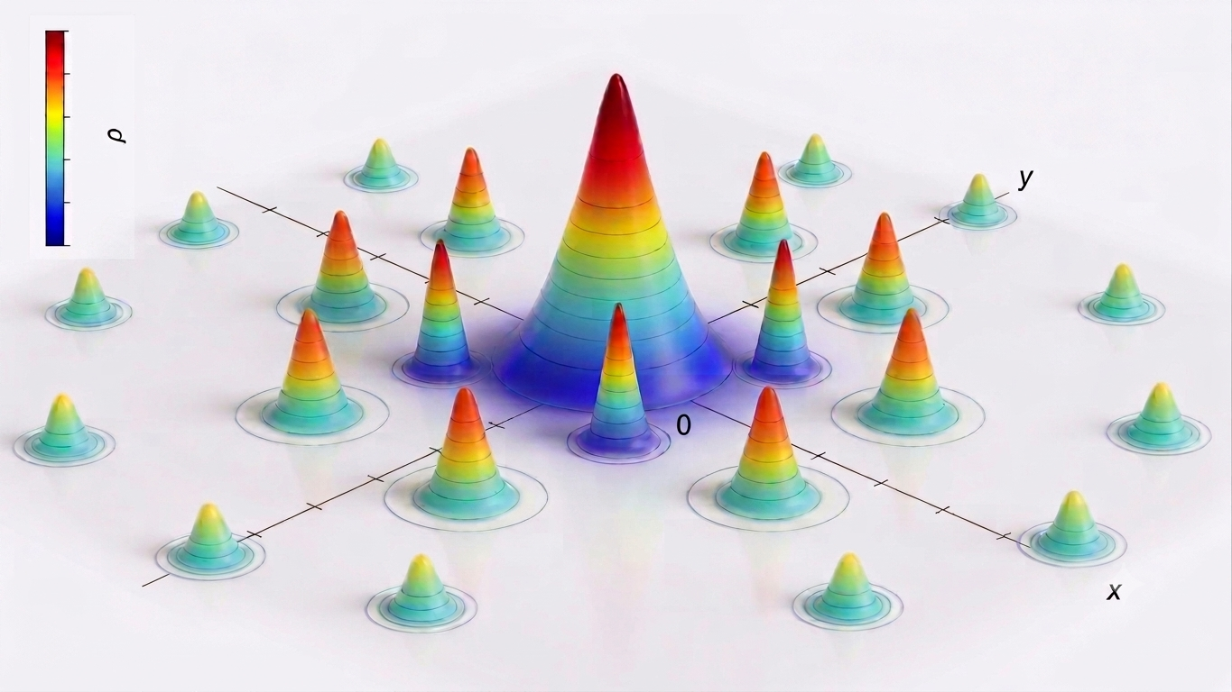
A Hierarchical Strategy for Searching Extreme Mass-Ratio Inspiral Signals Via Reduced Dimensionality Likelihood and Particle Swarm Optimization. Xiaobo Zou et.al, to be submitted to arXiv
1. The partial match of the harmonics leads to primary peak surrounded by secondary peaks.
2. Higher-SNR secondary peaks tend to cluster densely around the primary peak.
3. The hierarchical search collects high-SNR secondary peaks and iteratively refines the search region based on their clustering behavior.
4.Multiple independent PSO runs converging to the same SNR plateau identifies the primary peak, which is then used for parameter estimation.
Notes:
The key idea is that the secondary peaks tend to cluster densely around the primary peak. (Left picture)
It is hard to find the primary peak, but if we search many times and find many high-fitness secondary peaks, we can iteratively refine a smaller search region based on their clustering behavior until we find the primary peak. That is exactly what the flowchart in the middle describes.

Slide 11
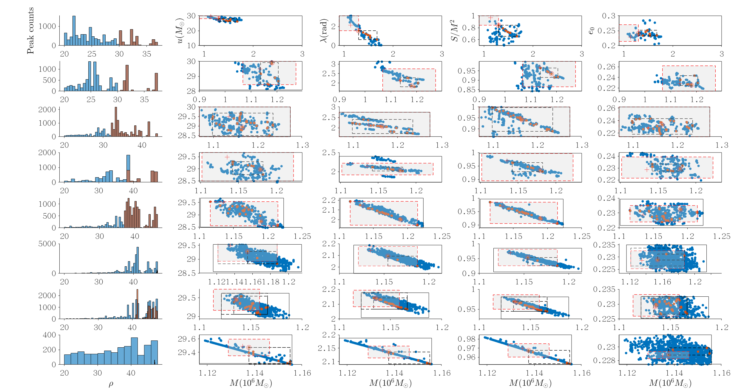
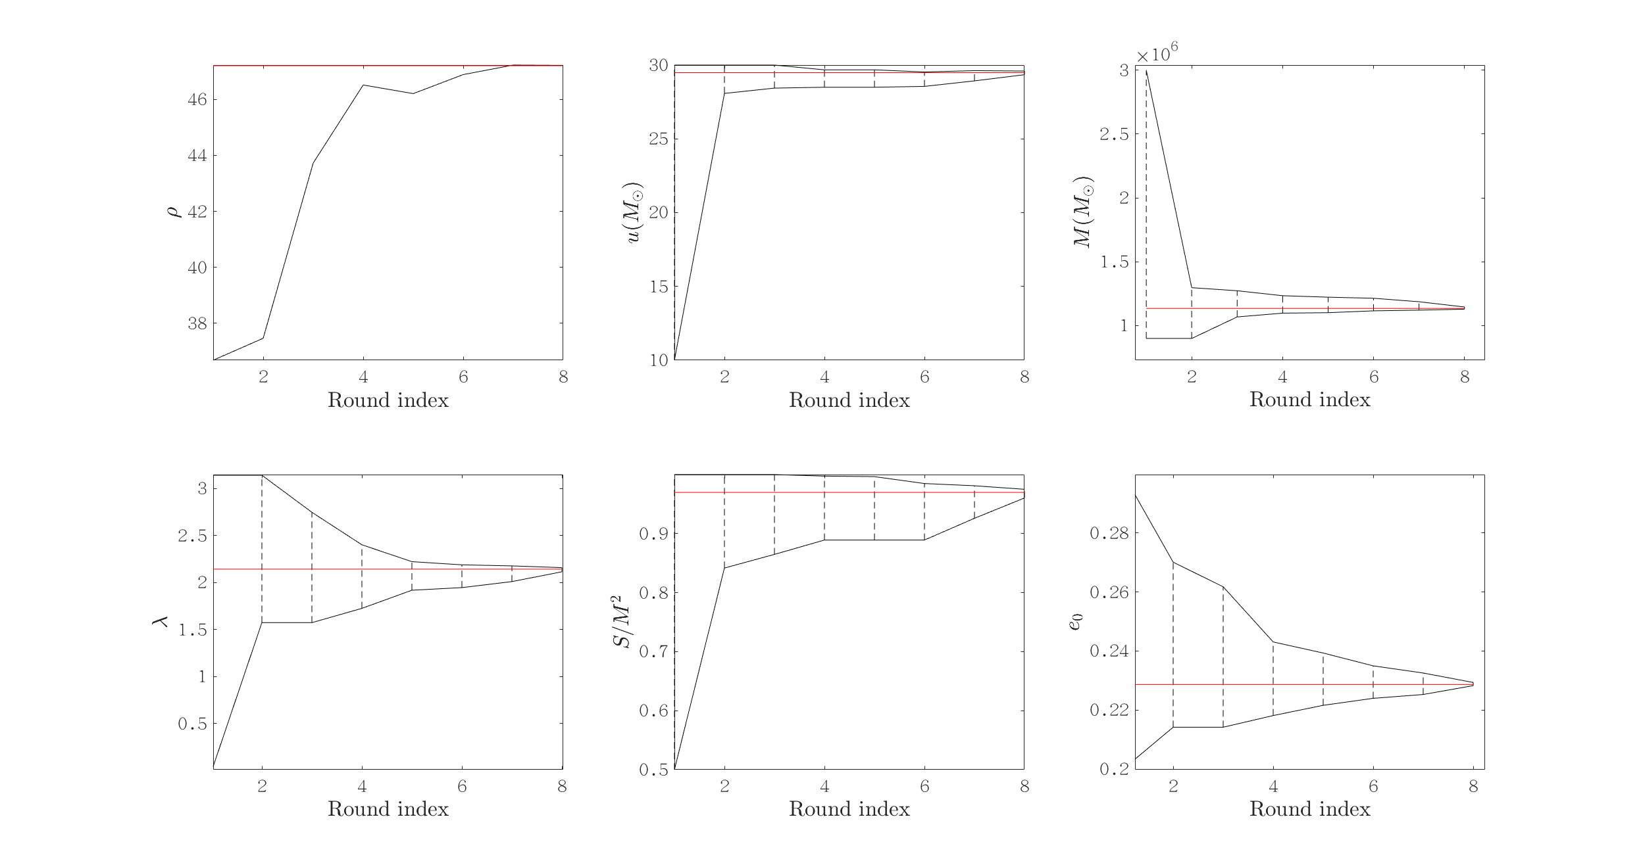
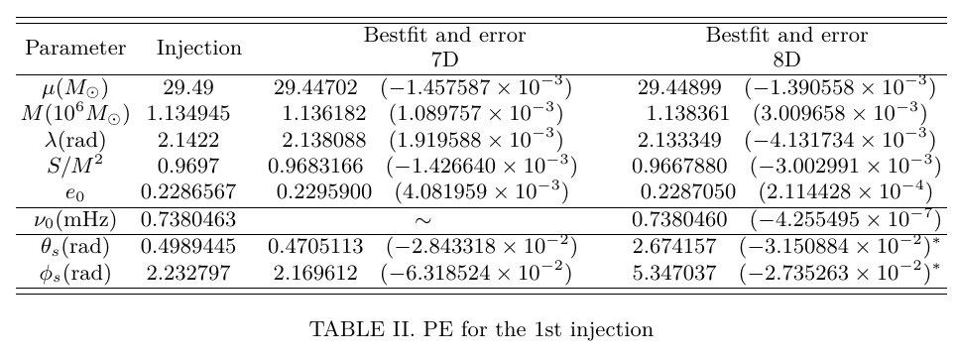
A Hierarchical Strategy for Searching Extreme Mass-Ratio Inspiral Signals Via Reduced Dimensionality Likelihood and Particle Swarm Optimization.
Notes:
it can converge to the true value from a broad prior spanning one or two orders of magnitude.

Slide 12
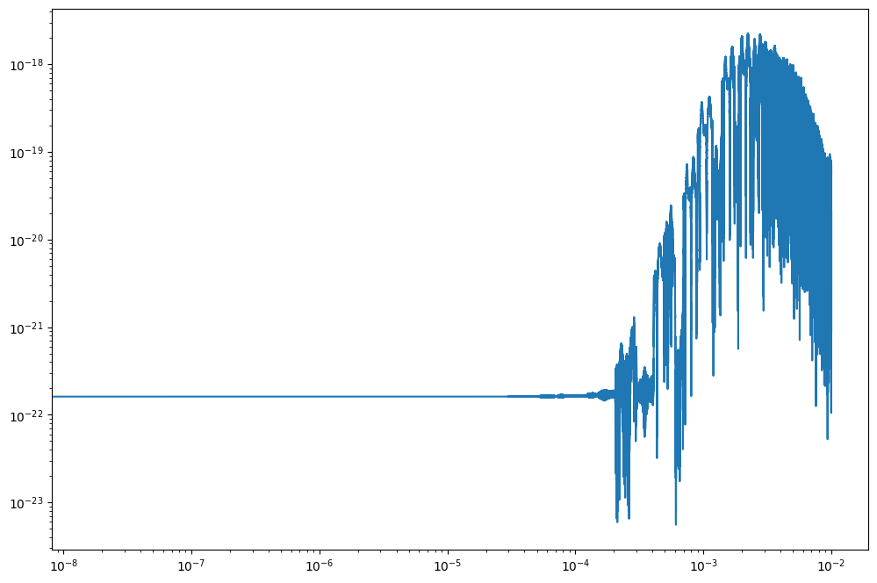
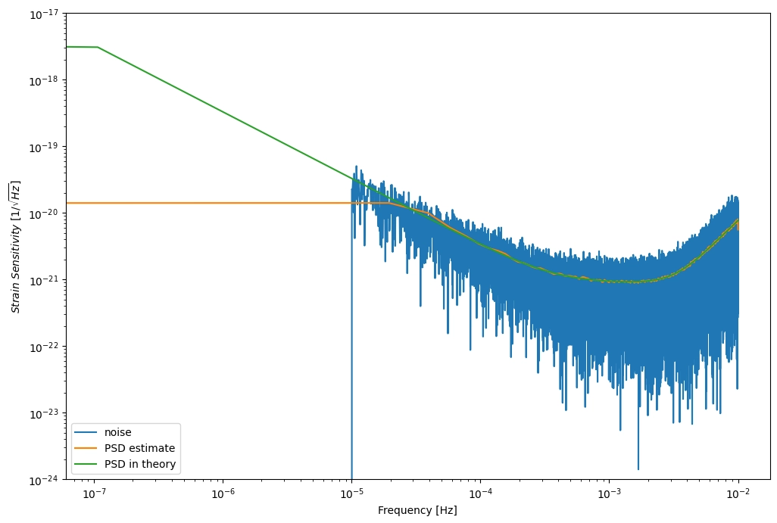
Method: Data Generation
FastEMRIWaveform (FEW) to obtain the gravitational wave signal,
FastLISAResponse to include the LISA response and produce the TDI A channel data,
LISAanalysistools package to generate noise.
Notes:
I use the FastEMRIWaveform package (few) to obtain the gravitational wave signal and the FastLISAResponse package to include the LISA response and produce the TDI A channel data.
I use the PSD from LISAanalysistools package to generate noise.

Slide 13
Method: Pipeline
Step1: Argmax($S_{λ}$)
Step1: Argmax(𝐒_𝝀)
Ranges from prior to $\{M (1 ± 10\%), μ(1 ± 10\%), p0 (1 ± 1\%),, e0(1 ± 10\%),\}$
Ranges from prior to {𝑀 (1 ± 10%), 𝜇(1 ± 10%), 𝑝0 (1 ± 1%),, 𝑒0(1 ± 10%),}
Step3: Argmax(LLR)
Ranges to $\{D_{L} \left(1 ± 10\%\right),θ \left(1 ± 10\%\right), φ\left(1 ± 10\%\right), θ_{S}\left(1 ± 10\%\right),φ_{S}\left(1 ± 10\%\right), Φ_{r},Φ_{φ}\}$
Ranges to {𝐷_𝐿 (1 ± 10%),𝜃 (1 ± 10%), 𝜙(1 ± 10%), 𝜃_𝑆 (1 ± 10%),𝜙_𝑆 (1 ± 10%), Φ_𝑟,Φ_𝜙}
Local optimization
Step2:Argmax(LLR)
Ranges to $\{{M \left(1 ± 1\%\right),p0 (1 ±0.1\%),D}_{L} \left(1 ±20\%\right)\}$
Ranges to {〖𝑀 (1 ± 1%),𝑝0 (1 ±0.1%),𝐷〗_𝐿 (1 ±20%)}
Notes:
This is my pipeline
It is just a simple hireachical method, and nothing new

Slide 14
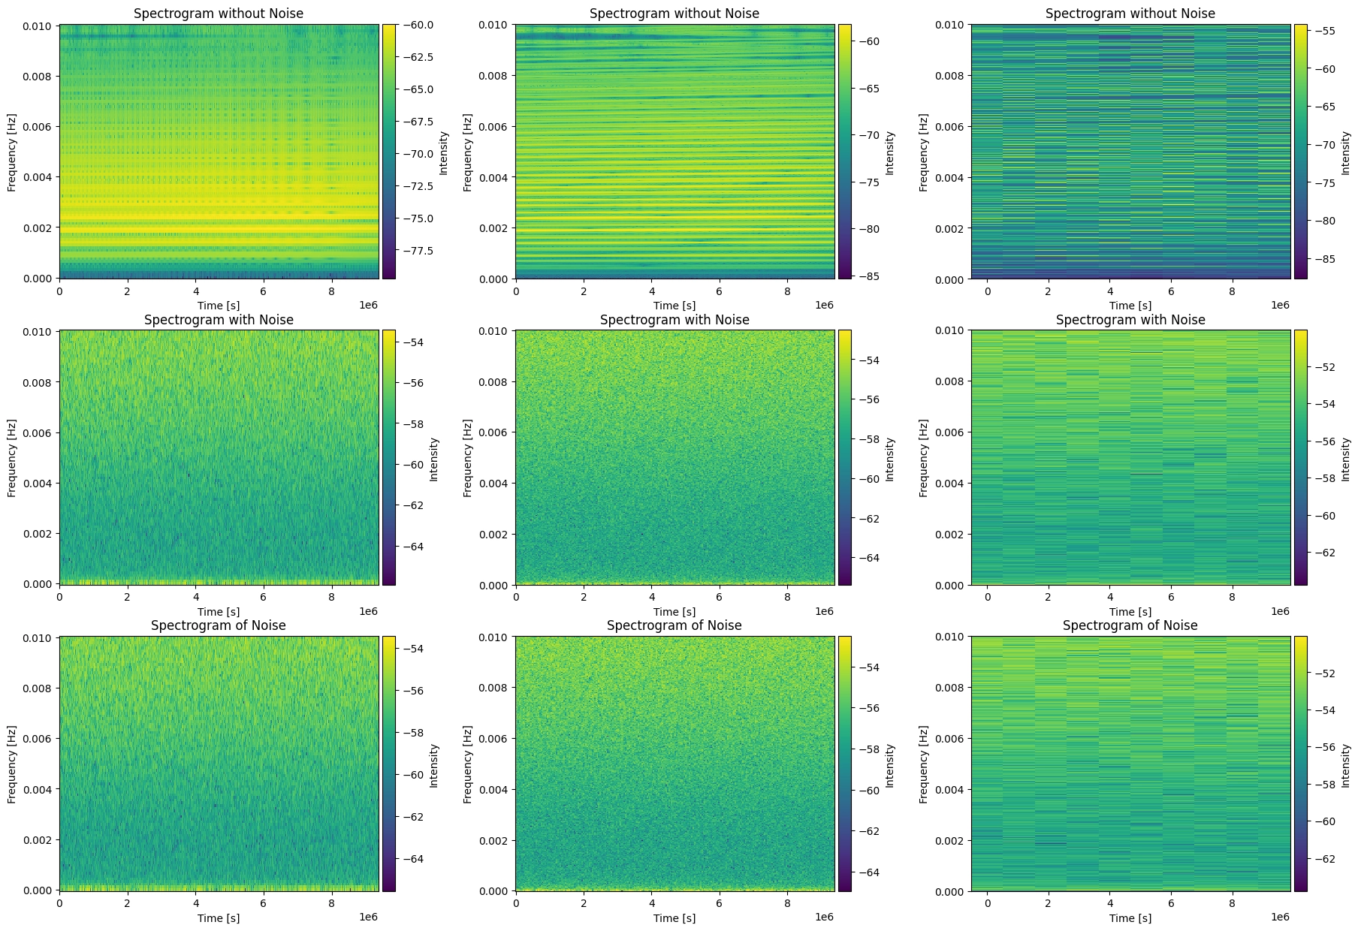
Detection statistic: $S_{λ}$
Method
Define inner product:
Define a statistic:
Notes:
I choose the S_lambda statistic defined in Strub’s research. because it has a advantage don’t need to handle a big number of modes.
To compute the statistic, we need to divide the data into several bins and have the short-time Fourier transform.
So there’s a problem about the size of bin. Different bin sizes have different effects: smaller bins increase noise impact, while larger bins make it easier to ignore frequency evolution coherence in a bin.
As the right picture shows.
The left part shows that the signal is overwhelmed in the noise,
As the right part, maybe you can find some different between the upper part and the lower part.

Slide 15
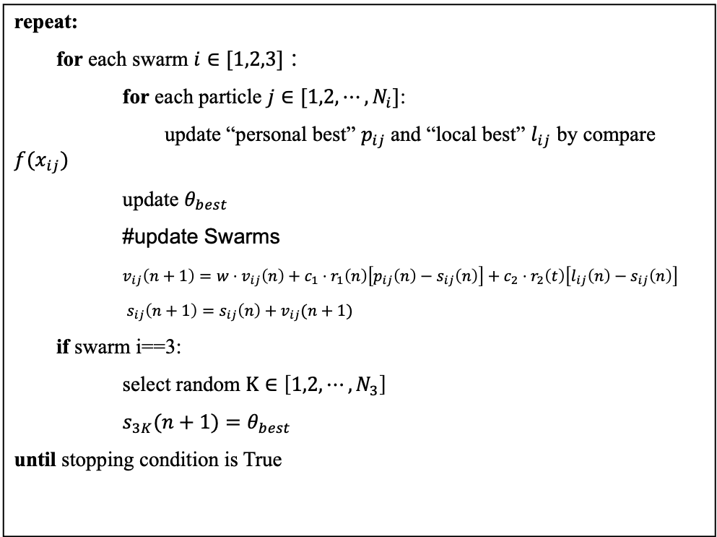
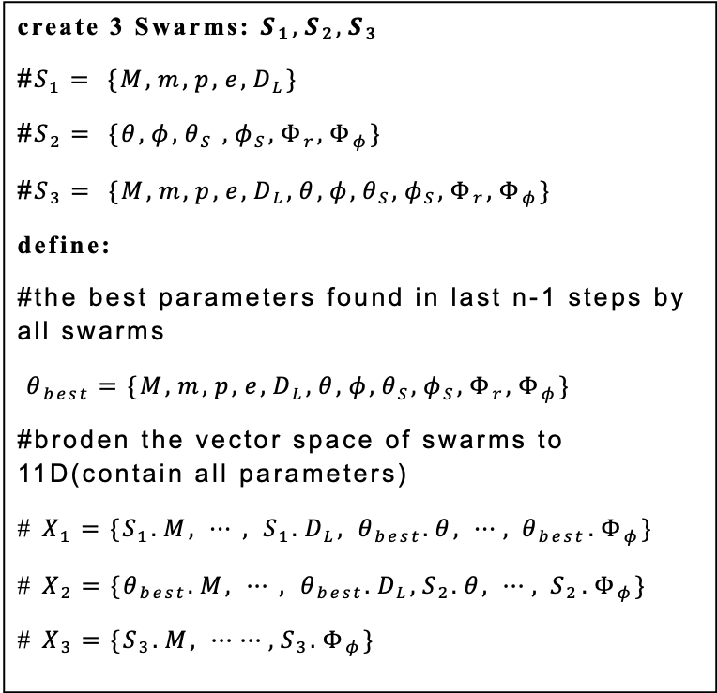
Cooperative particle swarm optimizer(CPSO)
Method
create 3 Swarms: $S_{1},S_{2},S_{3}$
#$S_{1}= \{M, m, p, e, D_{L}\}$
#$S_{2}= \{θ, φ, θ_{S} , φ_{S}, Φ_{r}, Φ_{φ}\}$
#$S_{3}= \{M, m, p, e, D_{L}, θ, φ, θ_{S}, φ_{S}, Φ_{r}, Φ_{φ}\}$
define:
#the best parameters found in last n-1 steps by all swarms
$θ_{best}=\{M,m,p, e, D_{L}, θ, φ, θ_{S}, φ_{S}, Φ_{r}, Φ_{φ}\}$
#broden the vector space of swarms to 11D(contain all parameters)
# $X_{1}=\{S_{1}.M, ⋯, S_{1}.D_{L}, θ_{best}.θ, ⋯,{ θ}_{best}.Φ_{φ}\}$
# $X_{2}=\{θ_{best}.M, ⋯, θ_{best}.D_{L},S_{2}.θ, ⋯,{ S}_{2}.Φ_{φ}\}$
# $X_{3}=\{S_{3}.M, ⋯⋯,S_{3}.Φ_{φ}\}$
repeat:
for each swarm $i∈[1,2,3]$：
for each particle $j∈[1,2,⋯,N_{i}]$:
update “personal best” $p_{ij}$and “local best” $l_{ij}$ by compare $f(x_{ij})$
update $θ_{best}$
#update Swarms
$v_{ij}\left(n+1\right)=w⋅v_{ij}\left(n\right)+c_{1}⋅r_{1}\left(n\right)\left[p_{ij}\left(n\right)−s_{ij}\left(n\right)\right]+c_{2}⋅r_{2}\left(t\right)\left[l_{ij}\left(n\right)−s_{ij}\left(n\right)\right]$
$s_{ij}\left(n+1\right)=s_{ij}\left(n\right)+v_{ij}(n+1)$
if swarm i==3:
select random $K∈\left[1,2,⋯, N_{3}\right]$
$s_{3K}(n+1)=θ_{best}$
until stopping condition is True
Notes:
The second one is a cooperative particle swarm optimizer(CPSO), which employs cooperative behavior to significantly improve the performance of the original PSO. It uses multiple swarms to cooperatively optimize different components of the solution vector. Applications of CPSO on several benchmark optimization problems show marked improvement over traditional PSO, especially in high-dimensional problems.
There are two small differences between my CPSO and the original literature. I choose the components of the solution based on physics knowledge rather than average division; the swarms are divided into three types: one searches intrinsic parameters, another searches extrinsic parameters, and the last searches all parameters so it can help swarms 1 and 2 escape suboptimal traps.
I also use a local best instead of a global best in CPSO, which has been proved to be useful in traditional PSO.

Slide 16
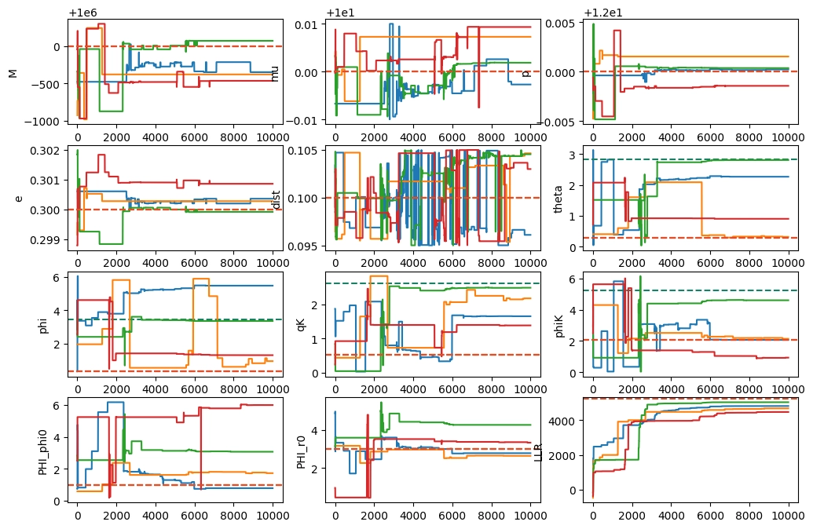
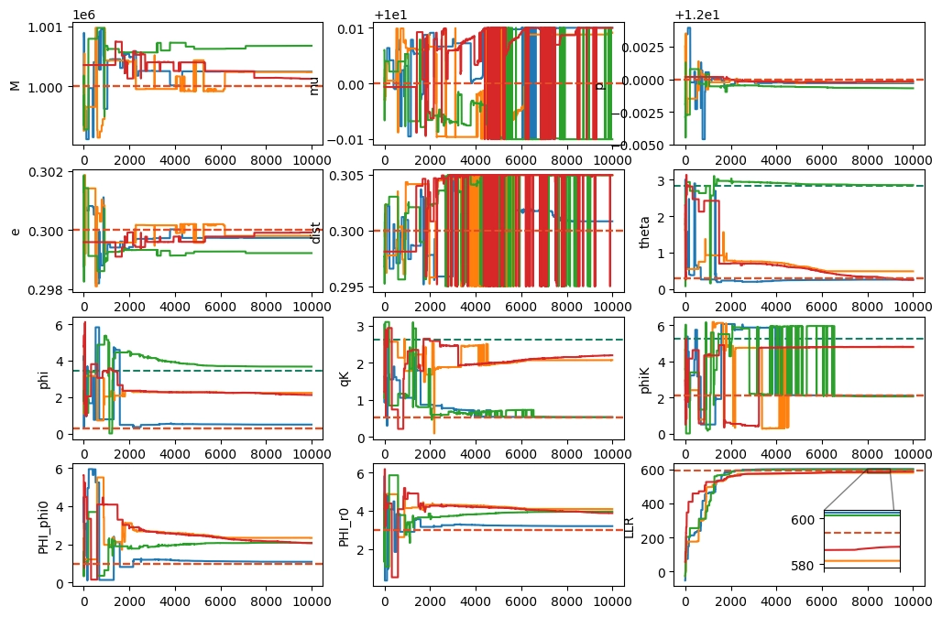
Comparison: CPSO & PSO
PSO
CPSO

Slide 17
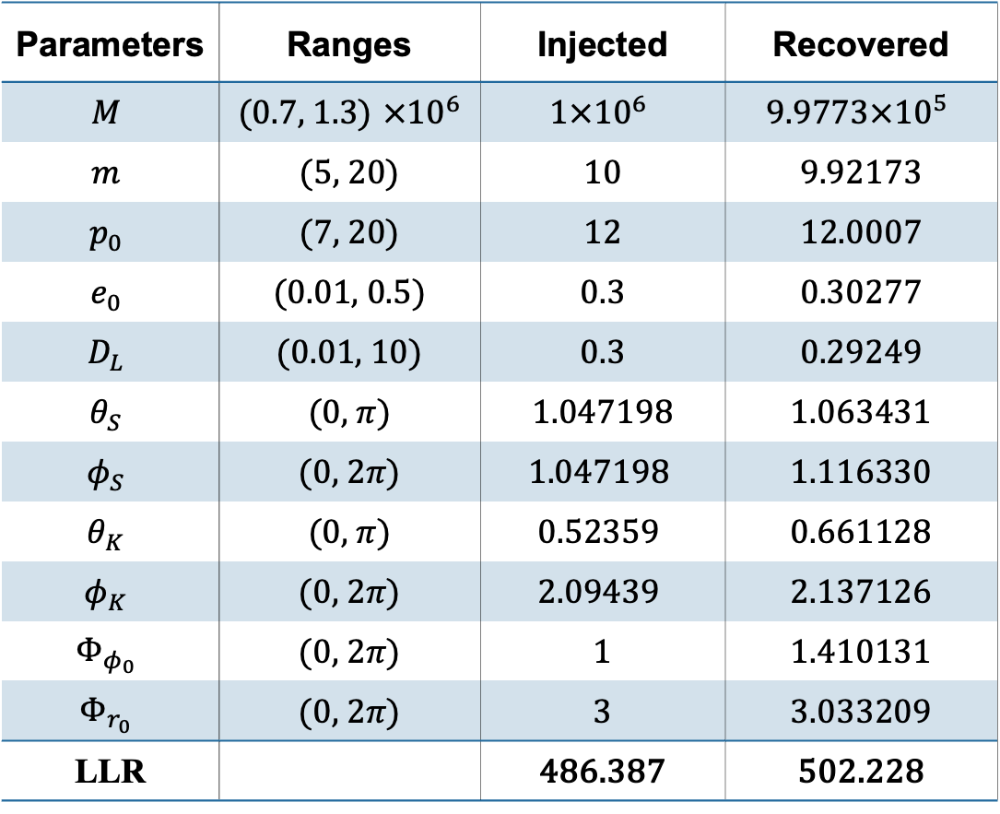
Case1: (SNR~30)
Parameters | Ranges | Injected | Recovered
$$M$$ | ($0.7$, 1.3) $×{10}^{6}$ | $$1×{10}^{6}$$ | $$\text{9.9773}×{10}^{5}$$
$$m$$ | (5, 20) | 10 | 9.92173
$$p_{0}$$ | (7, 20) | 12 | 12.0007
$$e_{0}$$ | (0.01, 0.5) | 0.3 | 0.30277
$$D_{L}$$ | (0.01, 10) | 0.3 | 0.29249
$$θ_{S}$$ | (0, $π$) | $1.04719$8 | 1.063431
$$φ_{S}$$ | (0, $2π$) | $$1.047198$$ | 1.116330
$$θ_{K}$$ | (0, $π$) | $$0.52359$$ | 0.661128
$$φ_{K}$$ | (0, $2π$) | $$2.09439$$ | 2.137126
$$Φ_{φ_{0}}$$ | (0, $2π$) | 1 | 1.410131
$$Φ_{r_{0}}$$ | (0, $2π$) | 3 | 3.033209
LLR |  | 486.387 | 502.228
Notes:
This is my final result for Case 1. It is a source with SNR around 30.

Slide 18
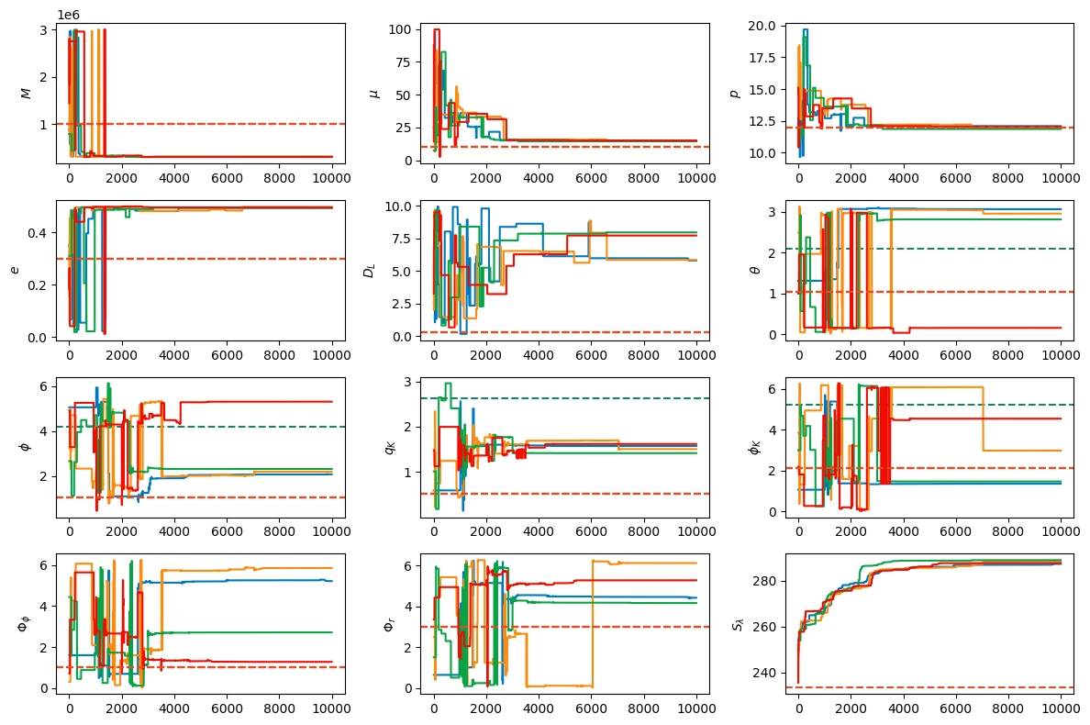
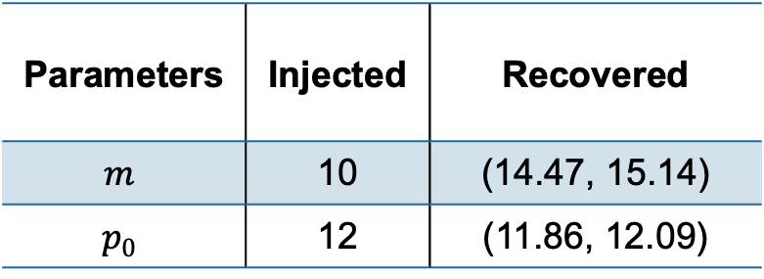
Case1:
Step 0: Limit the semi-latus rectum
Parameters | Injected | Recovered
$$m$$ | 10 | (14.47, 15.14)
$$p_{0}$$ | 12 | (11.86, 12.09)

Slide 19
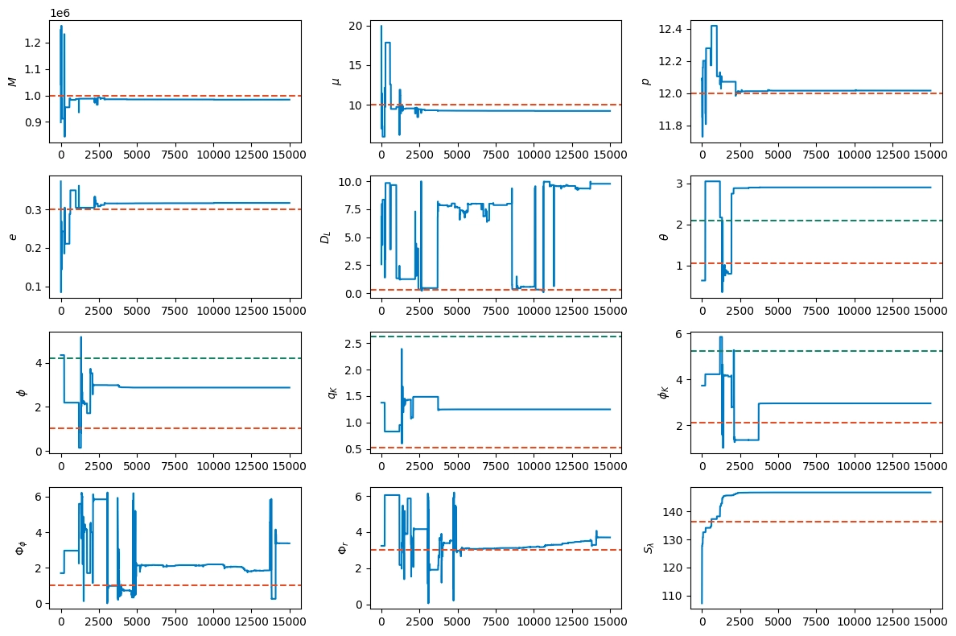
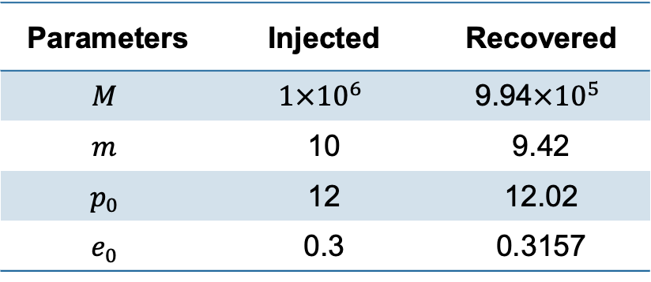
Case1: (SNR~30)
Step 1: intrinsic parameters
Parameters | Injected | Recovered
$$M$$ | $$1×{10}^{6}$$ | $$\text{9.9}\text{4}×{10}^{5}$$
$$m$$ | 10 | 9.42
$$p_{0}$$ | 12 | 12.02
$$e_{0}$$ | 0.3 | 0.3157
Notes:
.

Slide 20
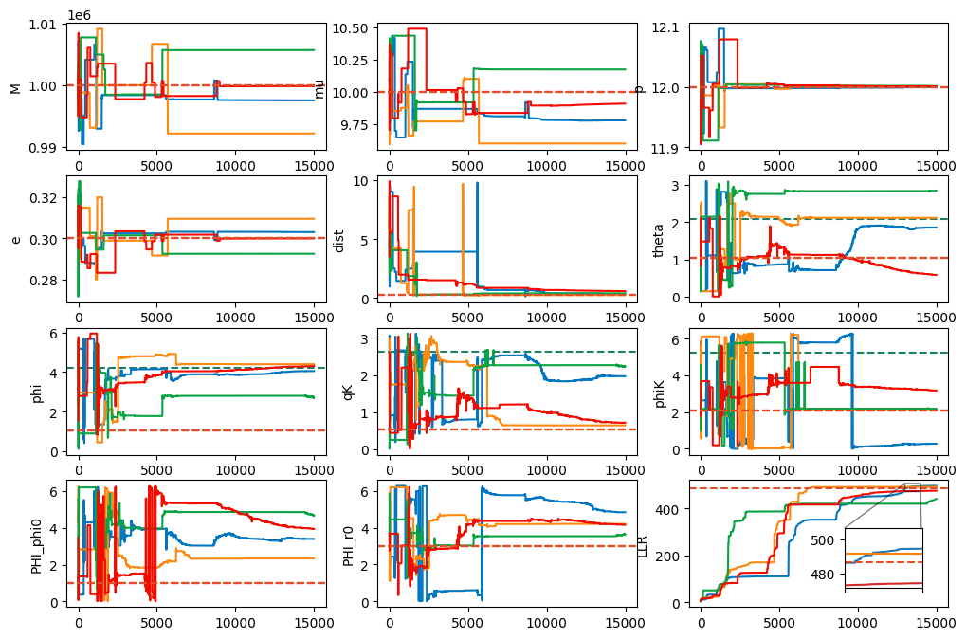
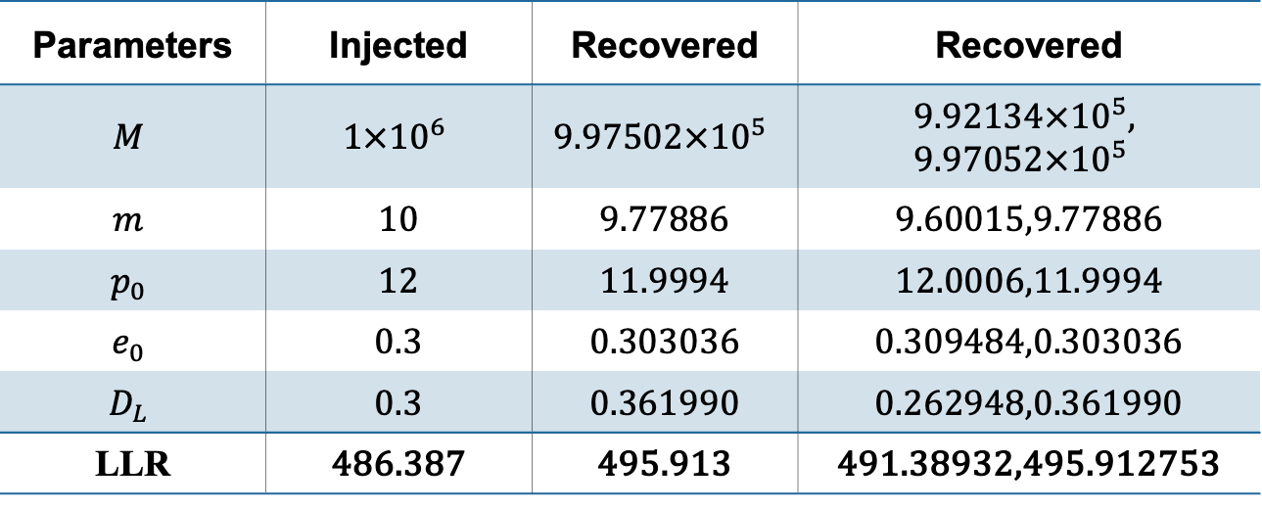
Case1: (SNR~30)
Step 2: distance and more accurate estimation
Parameters | Injected | Recovered | Recovered
$$M$$ | $$1×{10}^{6}$$ | $$\text{9.97}\text{502}×{10}^{5}$$ | $$\text{9.9}\text{2134}×{10}^{5}\text{, 9.97052}×{10}^{5}$$
$$m$$ | 10 | 9.77886 | 9.60015,9.77886
$$p_{0}$$ | 12 | 11.9994 | 12.0006,11.9994
$$e_{0}$$ | 0.3 | 0.303036 | 0.309484,0.303036
$$D_{L}$$ | 0.3 | 0.361990 | 0.262948,0.361990
LLR | 486.387 | 495.913 | 491.38932,495.912753

Slide 21
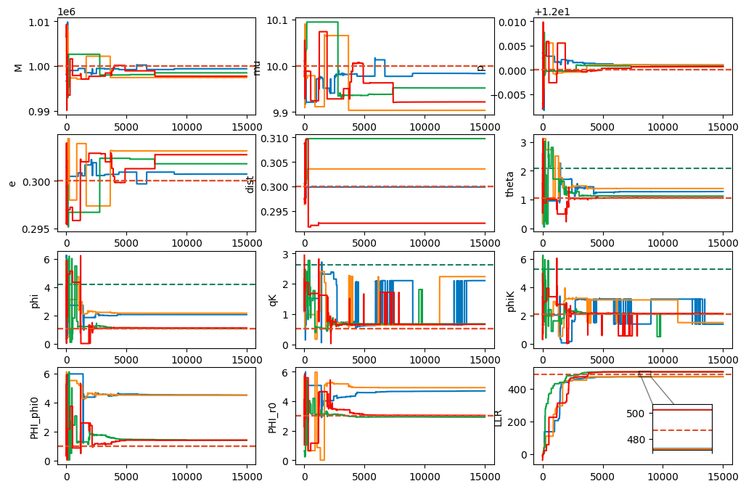
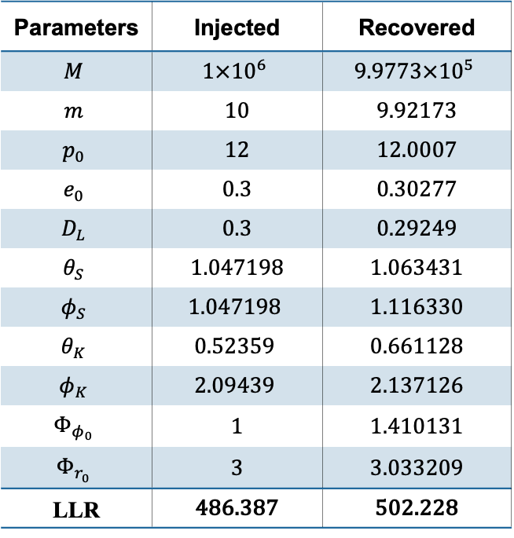
Case1: (SNR~30)
Step 3:
Parameters | Injected | Recovered
$$M$$ | $$1×{10}^{6}$$ | $$\text{9.9773}×{10}^{5}$$
$$m$$ | 10 | 9.92173
$$p_{0}$$ | 12 | 12.0007
$$e_{0}$$ | 0.3 | 0.30277
$$D_{L}$$ | 0.3 | 0.29249
$$θ_{S}$$ | $1.04719$8 | 1.063431
$$φ_{S}$$ | $$1.047198$$ | 1.116330
$$θ_{K}$$ | $$0.52359$$ | 0.661128
$$φ_{K}$$ | $$2.09439$$ | 2.137126
$$Φ_{φ_{0}}$$ | 1 | 1.410131
$$Φ_{r_{0}}$$ | 3 | 3.033209
LLR | 486.387 | 502.228

Slide 22
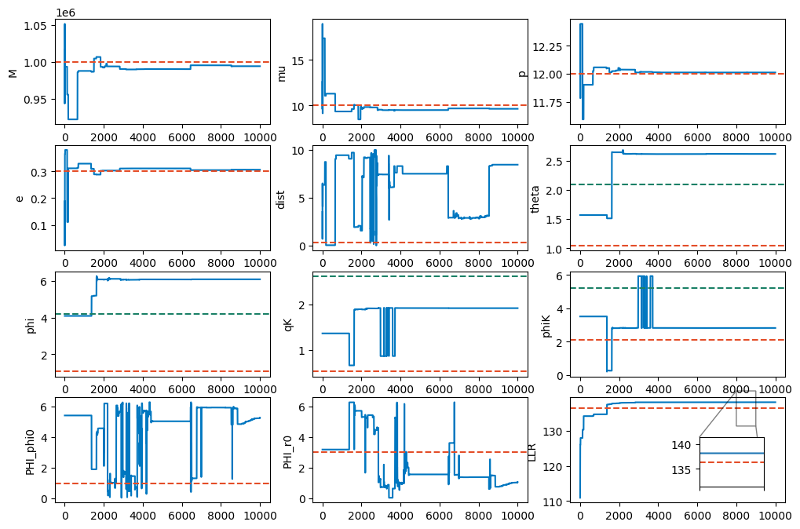
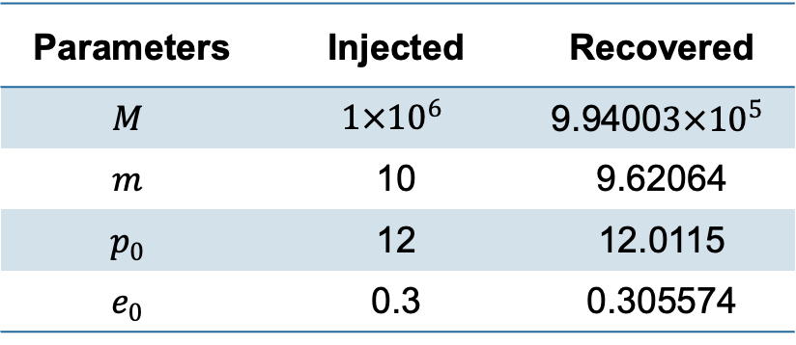
Case1:
Step 2:
Parameters | Injected | Recovered
$$M$$ | $$1×{10}^{6}$$ | $$\text{9.9}\text{400}3×{10}^{5}$$
$$m$$ | 10 | 9.62064
$$p_{0}$$ | 12 | 12.0115
$$e_{0}$$ | 0.3 | 0.305574

Slide 23
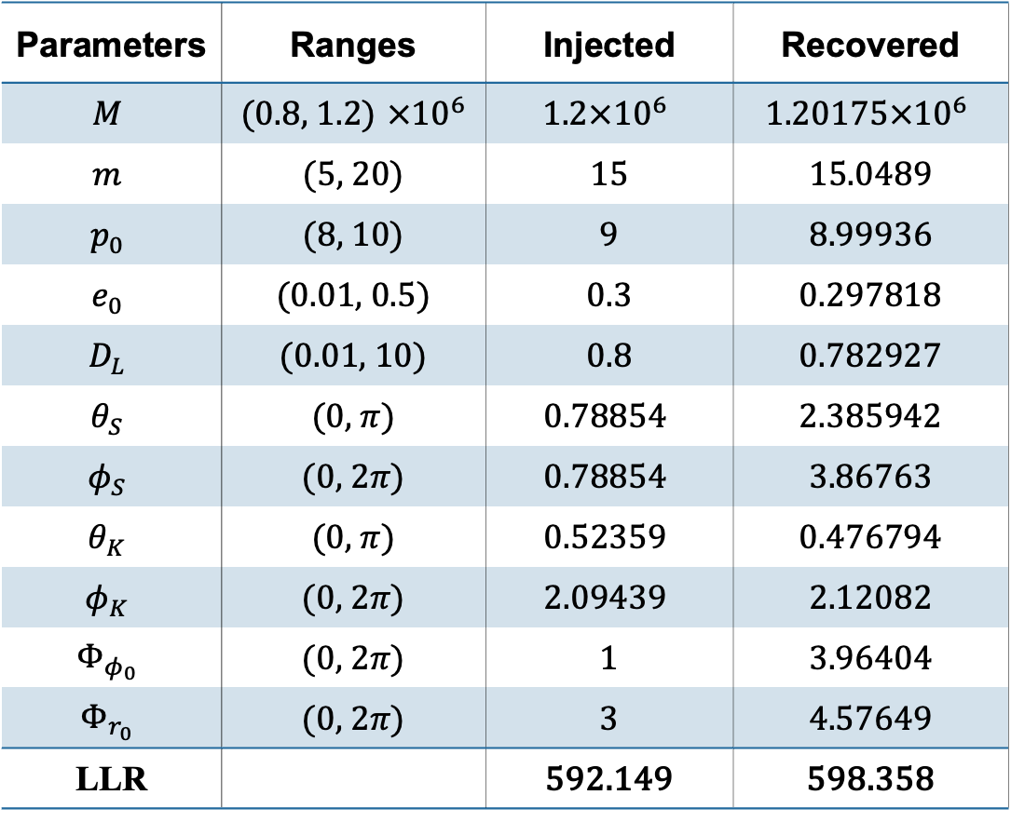
Case2: (SNR~30)
Parameters | Ranges | Injected | Recovered
$$M$$ | ($0.8$, 1.2) $×{10}^{6}$ | $$1.2×{10}^{6}$$ | $$\text{1.}\text{20175}×{10}^{6}$$
$$m$$ | (5, 20) | 15 | 15.0489
$$p_{0}$$ | (8, 10) | 9 | 8.99936
$$e_{0}$$ | (0.01, 0.5) | 0.3 | 0.297818
$$D_{L}$$ | (0.01, 10) | 0.8 | 0.782927
$$θ_{S}$$ | (0, $π$) | $$0.78854$$ | 2.385942
$$φ_{S}$$ | (0, $2π$) | $$0.78854$$ | 3.86763
$$θ_{K}$$ | (0, $π$) | $$0.52359$$ | 0.476794
$$φ_{K}$$ | (0, $2π$) | $$2.09439$$ | 2.12082
$$Φ_{φ_{0}}$$ | (0, $2π$) | 1 | 3.96404
$$Φ_{r_{0}}$$ | (0, $2π$) | 3 | 4.57649
LLR |  | 592.149 | 598.358

Slide 24
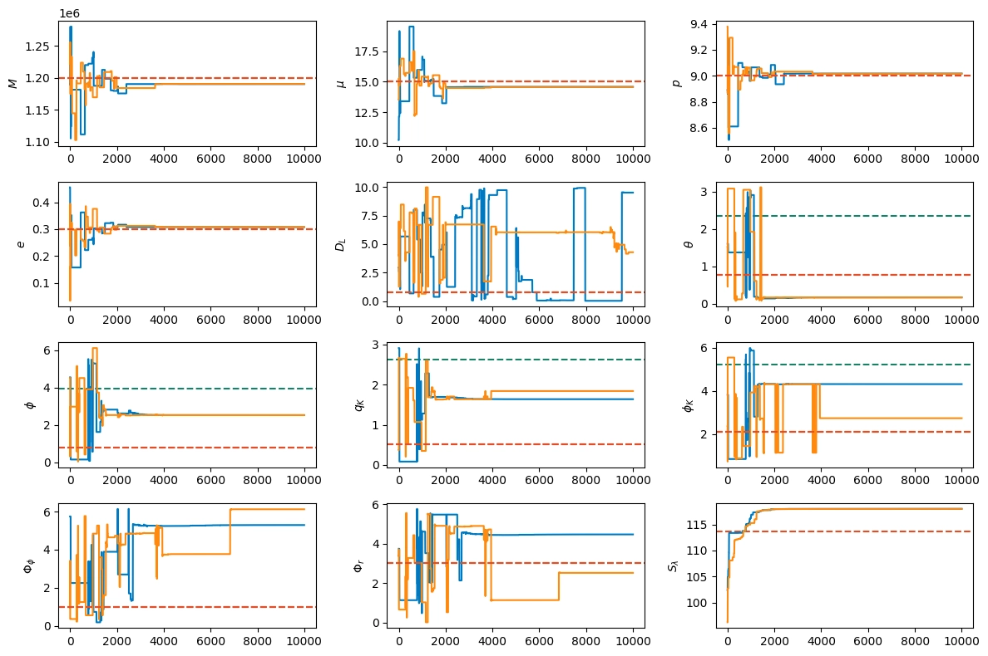
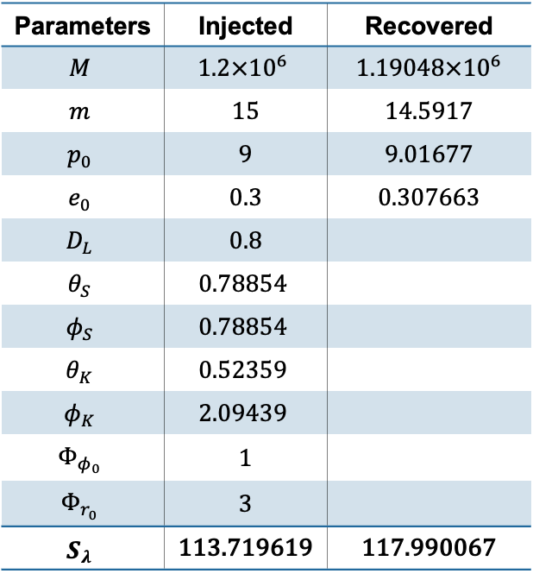
Case2: (SNR~30)
step 1:
Parameters | Injected | Recovered
$$M$$ | $$1.2×{10}^{6}$$ | 1.19048$×{10}^{6}$
$$m$$ | 15 | 14.5917
$$p_{0}$$ | 9 | 9.01677
$$e_{0}$$ | 0.3 | 0.307663
$$D_{L}$$ | 0.8
$$θ_{S}$$ | $$0.78854$$
$$φ_{S}$$ | $$0.78854$$
$$θ_{K}$$ | $$0.52359$$
$$φ_{K}$$ | $$2.09439$$
$$Φ_{φ_{0}}$$ | 1
$$Φ_{r_{0}}$$ | 3
$$S_{λ}$$ | 113.719619 | 117.990067
Notes:
Prior:
M:(1.1, 1.3)*1e6 m:(5, 20)
p0:(8.5, 9.5) e0:(0.01,0.5)
DL:(0.01,10)

Slide 25
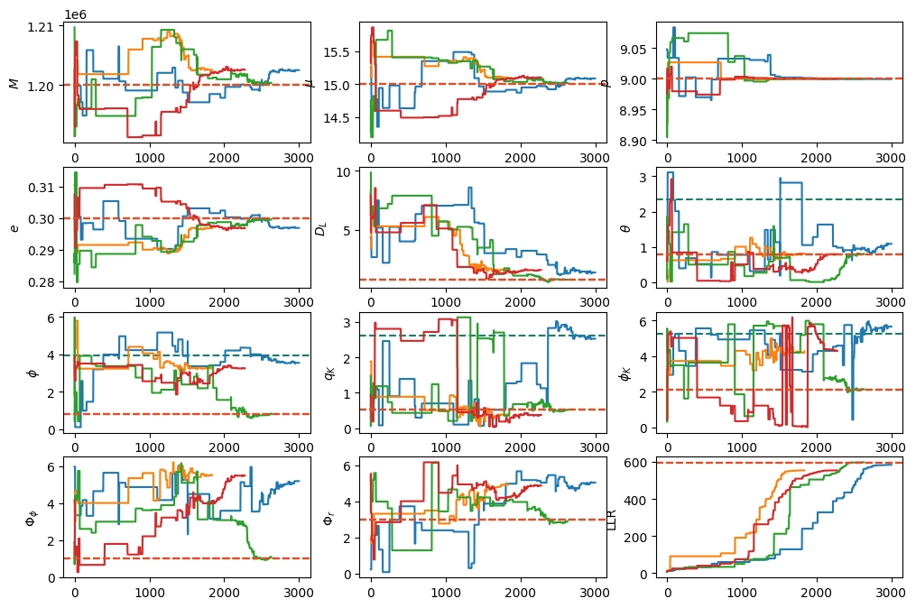
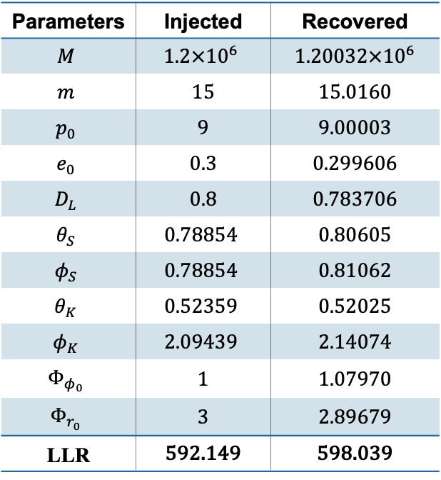
Case2: (SNR~30)
step 2:
Parameters | Injected | Recovered
$$M$$ | $$1.2×{10}^{6}$$ | 1.20032$×{10}^{6}$
$$m$$ | 15 | 15.0160
$$p_{0}$$ | 9 | 9.00003
$$e_{0}$$ | 0.3 | 0.299606
$$D_{L}$$ | 0.8 | 0.783706
$$θ_{S}$$ | $$0.78854$$ | 0.80605
$$φ_{S}$$ | $$0.78854$$ | 0.81062
$$θ_{K}$$ | $$0.52359$$ | 0.52025
$$φ_{K}$$ | $$2.09439$$ | 2.14074
$$Φ_{φ_{0}}$$ | 1 | 1.07970
$$Φ_{r_{0}}$$ | 3 | 2.89679
LLR | 592.149 | 598.039
Notes:
Prior:
M:(1.19, 1.21)*1e6 m:(14, 16)
p0:(8.9, 9.1) e0:(0.01,0.5)
DL:(0.01,10)

Slide 26


Case2: (SNR~30)
step 3:
Parameters | Injected | Recovered
$$M$$ | $$1.2×{10}^{6}$$ | 1.20175$×{10}^{6}$
$$m$$ | 15 | 15.0489
$$p_{0}$$ | 9 | 8.99936
$$e_{0}$$ | 0.3 | 0.297818
$$D_{L}$$ | 0.8 | 0.782927
$$θ_{S}$$ | $$0.78854$$ | 2.385942
$$φ_{S}$$ | $$0.78854$$ | 3.86763
$$θ_{K}$$ | $$0.52359$$ | 0.476794
$$φ_{K}$$ | $$2.09439$$ | 2.12082
$$Φ_{φ_{0}}$$ | 1 | 3.96404
$$Φ_{r_{0}}$$ | 3 | 4.57649
LLR | 592.149 | 598.358
Notes:
Note that：
It’s better than step2 ( LLR is larger：598.3>598.1)
Or it’s worse than step2 (parameters is further from injection value)
Prior:
M:(1.19, 1.21)*1e6 m:(14, 16)
p0:(8.9, 9.1) e0:(0.01,0.5)
DL:(0.78,0.82)

Slide 27


Case2: Another noise(SNR~30)
step 3:
Parameters | Injected | Recovered
$$M$$ | $$1.2×{10}^{6}$$ | 1.19986$×{10}^{6}$
$$m$$ | 15 | 14.9901
$$p_{0}$$ | 9 | 8.99994
$$e_{0}$$ | 0.3 | 0.300163
$$D_{L}$$ | 0.8 | 0.790004
$$θ_{S}$$ | $$0.78854$$ | 0.680574
$$φ_{S}$$ | $$0.78854$$ | 0.639392
$$θ_{K}$$ | $$0.52359$$ | 0.405101
$$φ_{K}$$ | $$2.09439$$ | 2.05806
$$Φ_{φ_{0}}$$ | 1 | 0.88664
$$Φ_{r_{0}}$$ | 3 | 3.11122
LLR | 708.367 | 720.688
Notes:
Prior:
M:(1.19, 1.21)*1e6 m:(14, 16)
p0:(8.9, 9.1) e0:(0.01,0.5)
DL:(0.78,0.82)

Slide 28


Supplement: Case3(SNR~90)
Step 1:
Parameters | Injected | Recovered
$$M$$ | $$1×{10}^{6}$$ | 9.9484$×{10}^{5}$
$$m$$ | 10 | 9.6951
$$p_{0}$$ | 12 | 12.0002
$$e_{0}$$ | 0.3 | 0.306185
$$D_{L}$$ | 0.1
$$θ_{S}$$ | $$1.04719$$
$$φ_{S}$$ | $$1.04719$$
$$θ_{K}$$ | $$0.523599$$
$$φ_{K}$$ | $$2.09440$$
$$Φ_{φ_{0}}$$ | 1
$$Φ_{r_{0}}$$ | 3
$$S_{λ}$$ | 531.236 | 534.395
Notes:
Prior:
M:(0.5, 2)*1e6 m:(5, 20)
p0:(11, 13) e0:(0.01,0.5)
DL:(0.01,10)

Slide 29


Supplement: AE channel (SNR~30)
step 2:
Parameters | Injected | Recovered
$$M$$ | $$1×{10}^{6}$$ | 1.00085$×{10}^{6}$
$$m$$ | 10 | 10.0016
$$p_{0}$$ | 12 | 11.99908
$$e_{0}$$ | 0.3 | 0.299016
$$D_{L}$$ | 0.5 | 0.42487
$$θ_{S}$$ | $$1.04719$$ | 0.949525
$$φ_{S}$$ | $$1.04719$$ | 1.041247
$$θ_{K}$$ | $$0.52359$$
$$φ_{K}$$ | $$2.09439$$
$$Φ_{φ_{0}}$$ | 1
$$Φ_{r_{0}}$$ | 3
LLR | 344.143 | 366.321
Notes:
Previously I only used the A-channel TDI. Some results from my classmates on massive black hole binaries indicate that using both AE channels can help with the degeneracy of distance and some angles. So I tried it, and although it does not immediately solve the secondary peak problem, it improves accuracy.
It is still hard to distinguish these secondary peaks from the primary peak.

Slide 30


Supplement: Kerr(SNR~30)
step 2:
Parameters | Injected | Recovered
$$M$$ | $$1×{10}^{6}$$ | 1.0199$×{10}^{6}$
$$m$$ | 10 | 10.0427
a | 0.95 | 0.95056
$$p_{0}$$ | 12 | 11.9952
$$e_{0}$$ | 0.3 | 0.298319
$$D_{L}$$ | 0.3 | 0.2517
$$θ_{S}$$ | $$1.04719$$ | 0.98126
$$φ_{S}$$ | $$1.04719$$ | 1.08859
$$θ_{K}$$ | $$0.52359$$ | 0.63269
$$φ_{K}$$ | $$2.09439$$ | 2.33082
$$Φ_{φ_{0}}$$ | 1 | 1.04573
$$Φ_{r_{0}}$$ | 3 | 3.152537
LLR | 399.647 | 406.368

Slide 31
Thank you

Slide 32

Non-local best
In some situation (Right picture and Case2Step2/3), a Non-local best can be better than the true value, and we don’t find any better result around true value.
Notes:
Orange: Set prior to the local best found by PSO
Prior:
intrinsic: central on the value found by PSO, cover the injection value (1.5* distance of two value)
extrinsic: central on the value found by PSO, $±0.3$
Blue: Set prior to the injection value
Prior:
intrinsic: central on the injection value, $±5σ$
extrinsic: central on the value found by PSO, $±0.3$
对于固定注入信号，存在参数具有差异但匹配度极高的模版（overlap > 0.9）,反映在后验分布（或参数空间上一般的探测统计量的分布）上就对应了主峰或次峰
考虑入噪音的随机性，这两个峰的高度（包括高度差）就是随机变量，以对数似然比为例，这个随机变量的方差值为信噪比，那么相对（对数似然比）值为信噪比倒数，
如果主峰和次峰统计量值过于接近（比如我报告时说的1%），这个差距就存在被噪音抹平的可能性，
所以在低信噪比的情况下就必须要解决是否可分辨（比如更换统计量是否有效），如何分辨这些极为接近的次级峰的问题

