Slide 1





T-SDHCAL
I.Laktineh
IP2I, Lyon, France
for the T-SDHCAL groups
IP2I, SJTU, CIEMAT, VUB, Yonsei

Slide 2
Outline
SDHCAL
Short description
Summary of the most important results
Further improvements on energy reconstruction
T-SDHCAL
Why timing is useful?
How to achieve it
Future developments

Slide 3
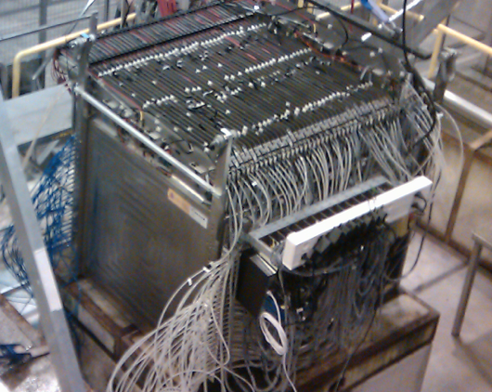
48 layers (-6λ_{I})
1 cm X 1 cm granularity
3-threshold, 500000 channels
Power-Pulsed
Triggerless DAQ system
Self-supporting mechanical structure
Completed in 2011 and tested in 2012
Published: JINST 10 (2015) P10039

Slide 4
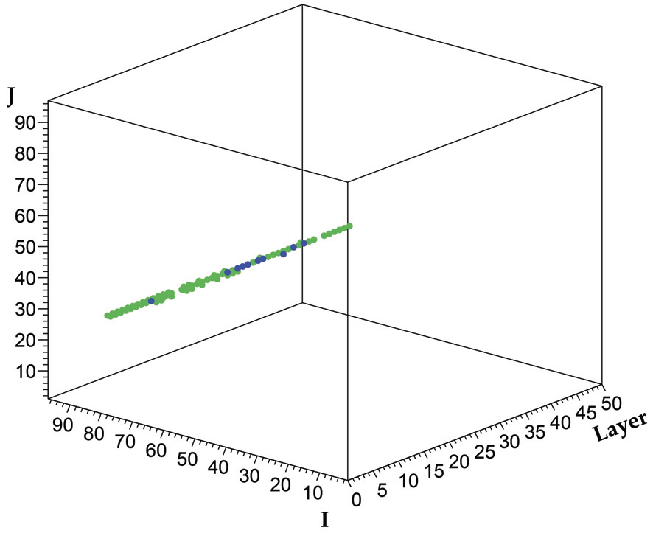
SDHCAL prototype was exposed to beam particles
at CERN PS, SPS in 2012, 2015, 2017 and 2018

Slide 5
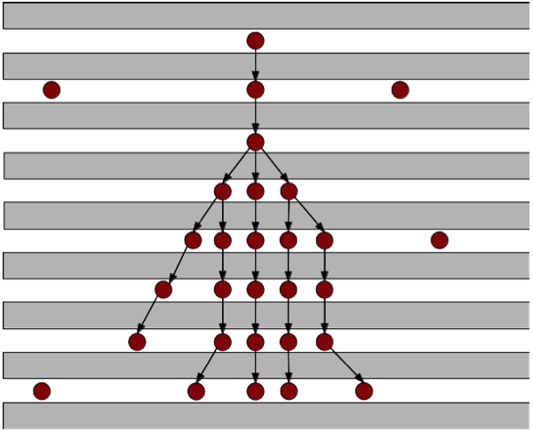
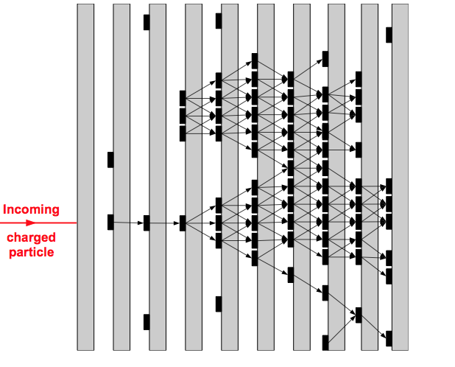
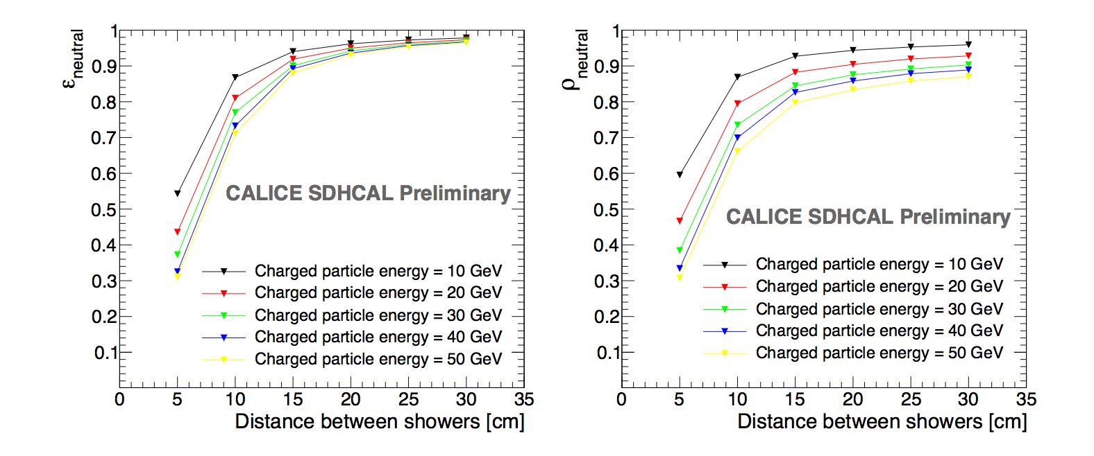
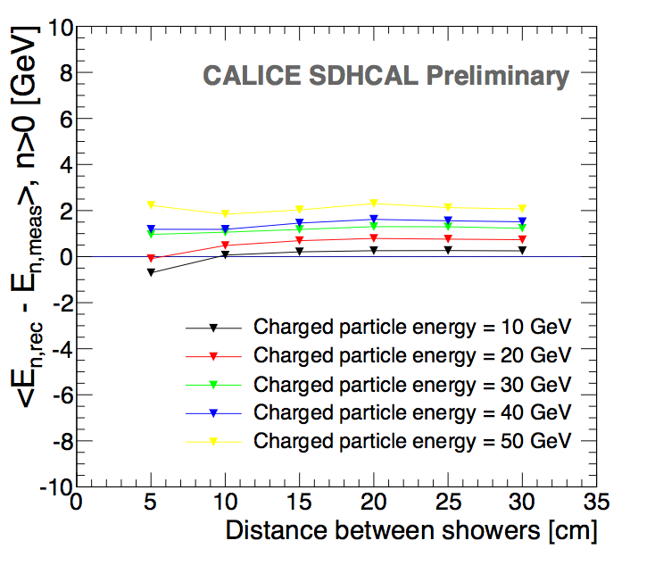
SDHCAL high granularity is important for PFA
It helps to optimize the connection of hits belonging to the same shower by using first the topology and then the energy information
April algorithms:
It connect hits and then their clusters using distance and orientation information
then correct using tracker information (momentum)
Efficiency
ΔE
Purity
1 neutral of 10 GeV
1 neutral of 10 GeV
1 neutral of 10 GeV
CALICE note CAN054

Slide 6
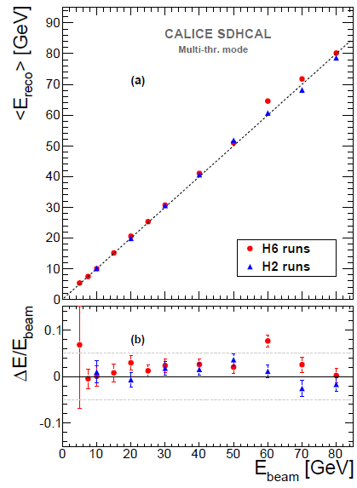
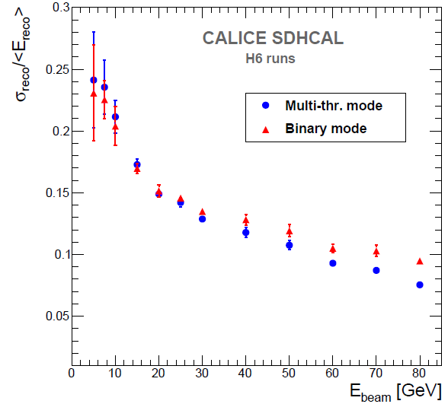
Energy reconstruction
N₁= Nb. of pads with first threshold <signal < second threshold
N₂ = Nb. of pads with second threshold <signal < third threshold
N₃ = Nb. of pads with signal> third threshold
E_{rec =} α (N_{tot}) N₁ + β (N_{tot}) N₂ + γ (N_{tot}) N₃
N_{tot} = N₁ + N₂ + N₃
α , β , γ are quadratic functions of
They are computed by minimizing :
χ²= (E_{beam}-E_{rec})²/E_{beam}
Only a few energy points with small amount of data were used for this minimisation
JINST 11 (2016) P04001

Slide 7
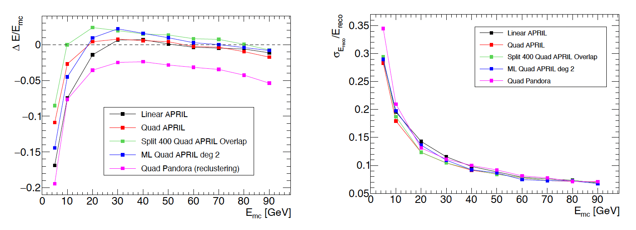
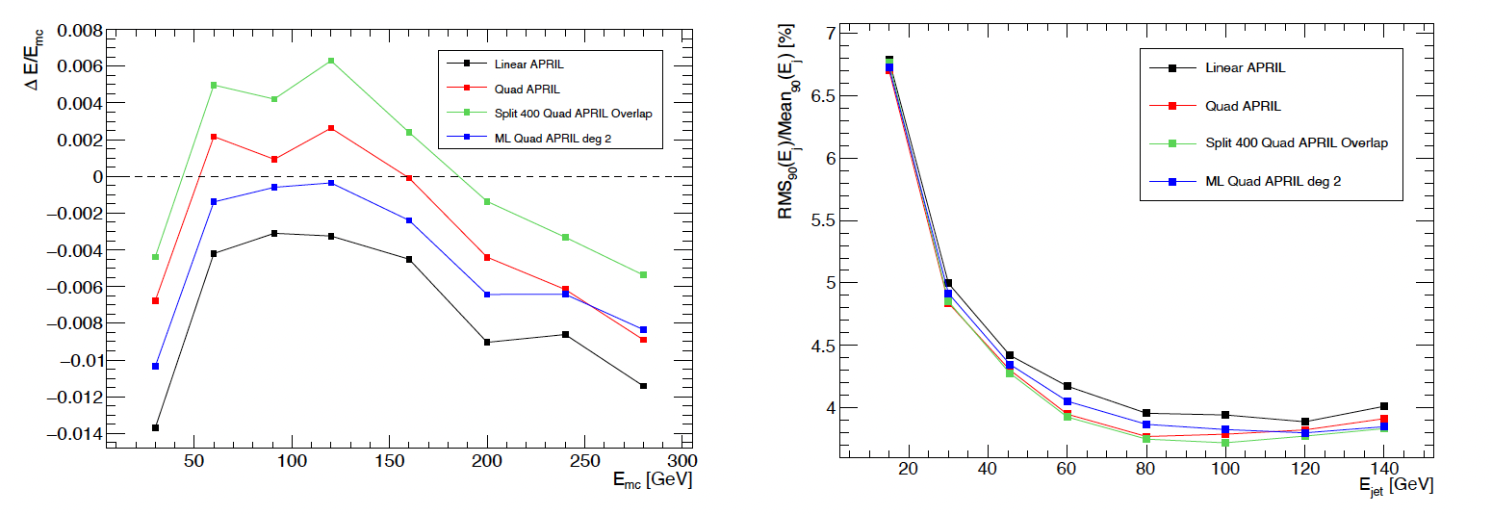
Improvements are obtained by using two sets of parameters for low and high “energy” regions
K⁰_{L}@SDHCAL
Jets with SDHCAL
T. Pasquier

Slide 8
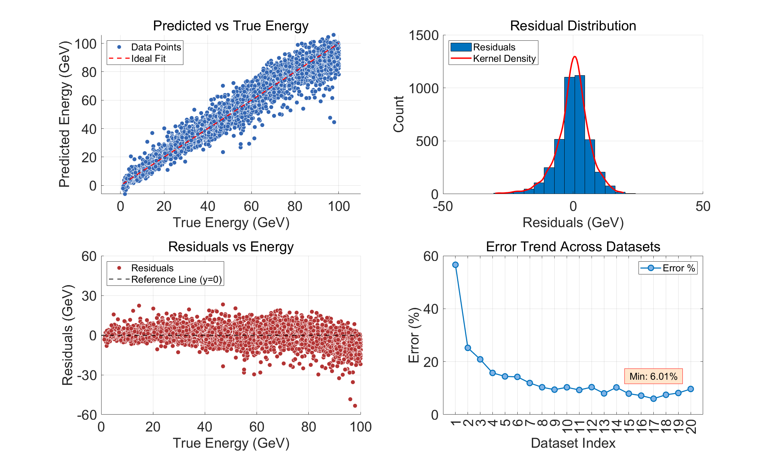
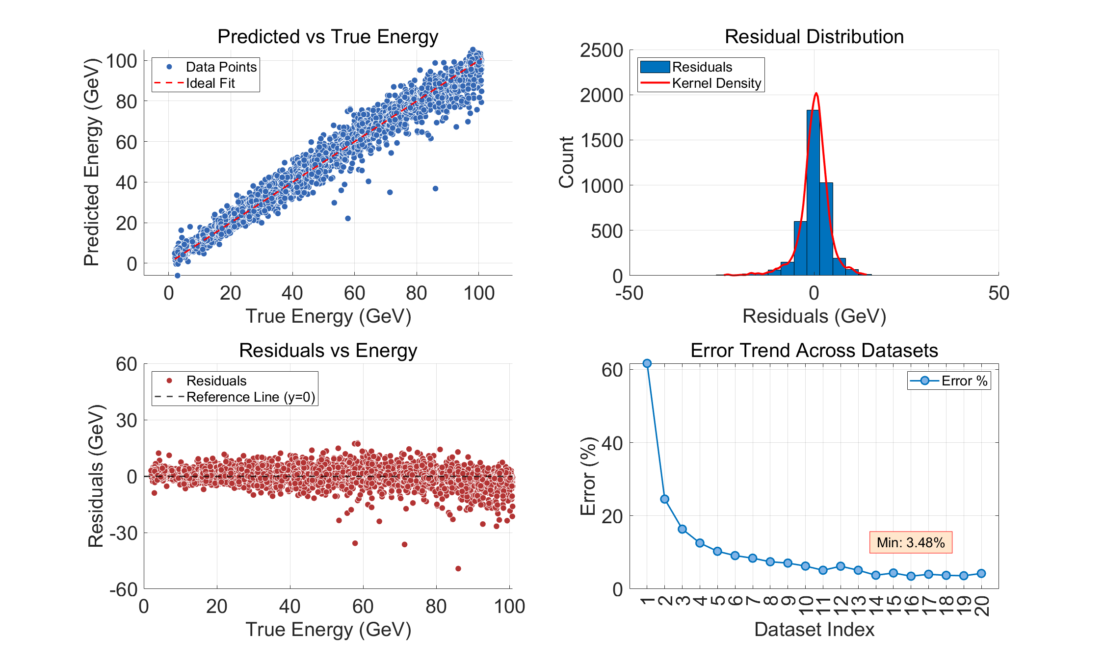
Using GNN to reconstruct the energy is also useful and in particular if you know the nature of the particle : proton, pion…
Pions
Protons
Y. Tan

Slide 9
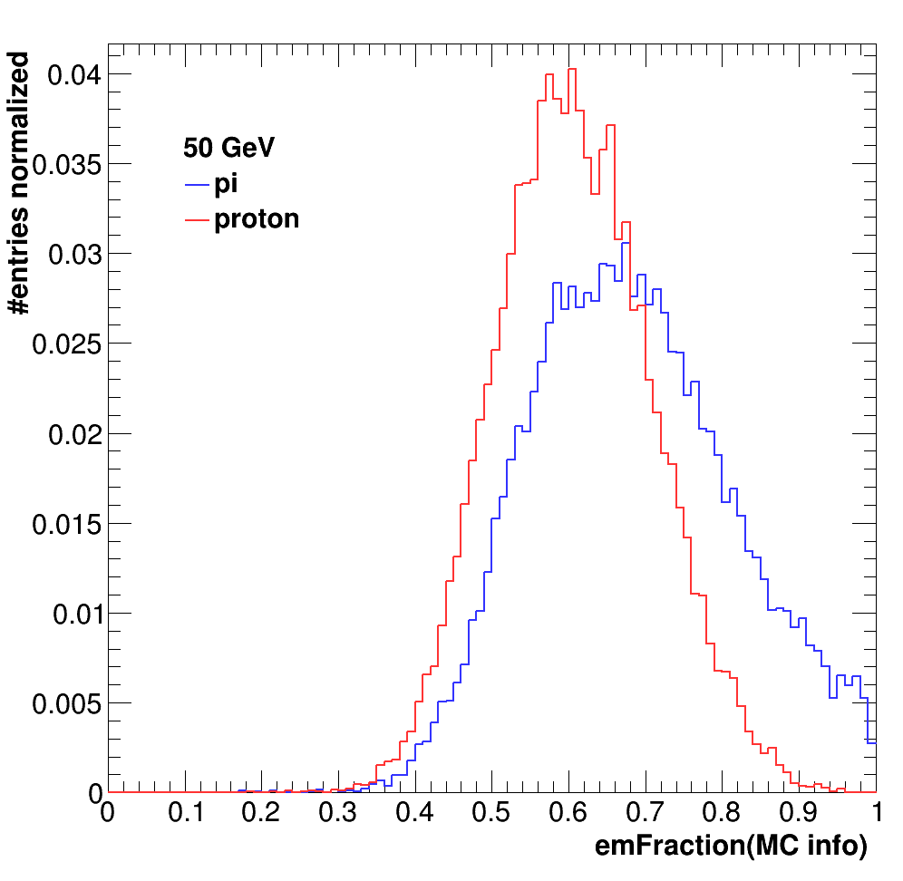
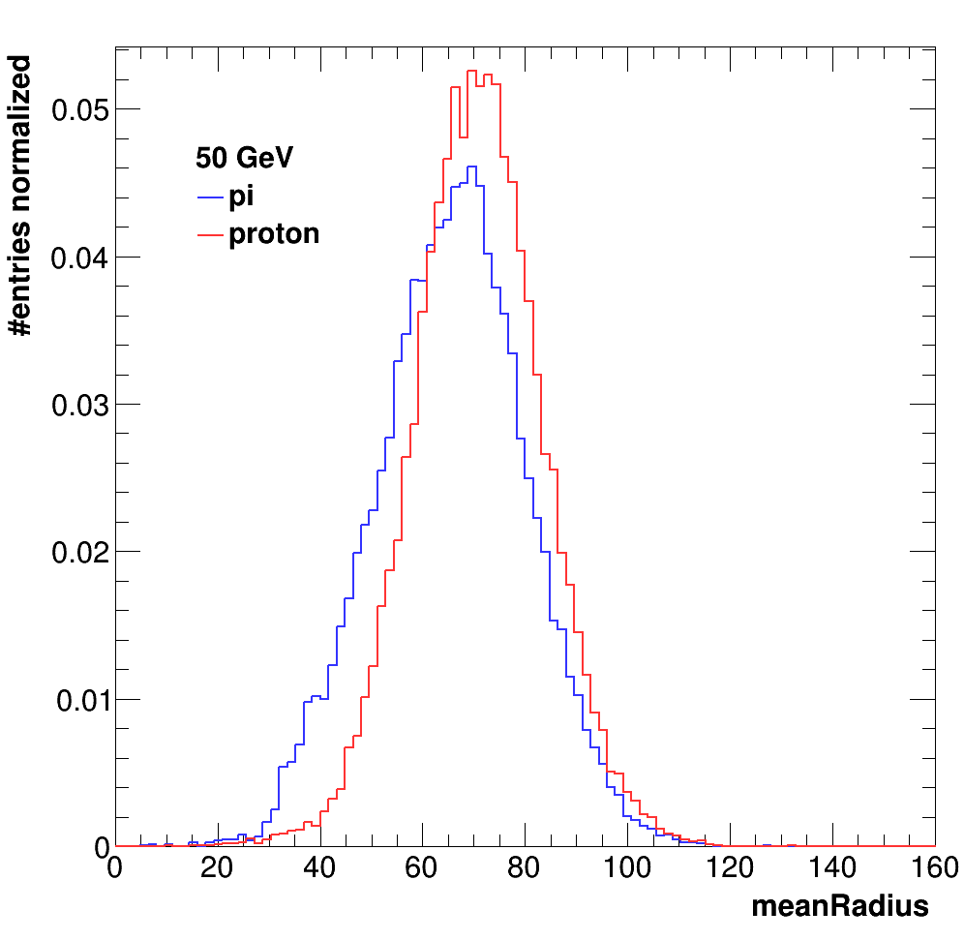
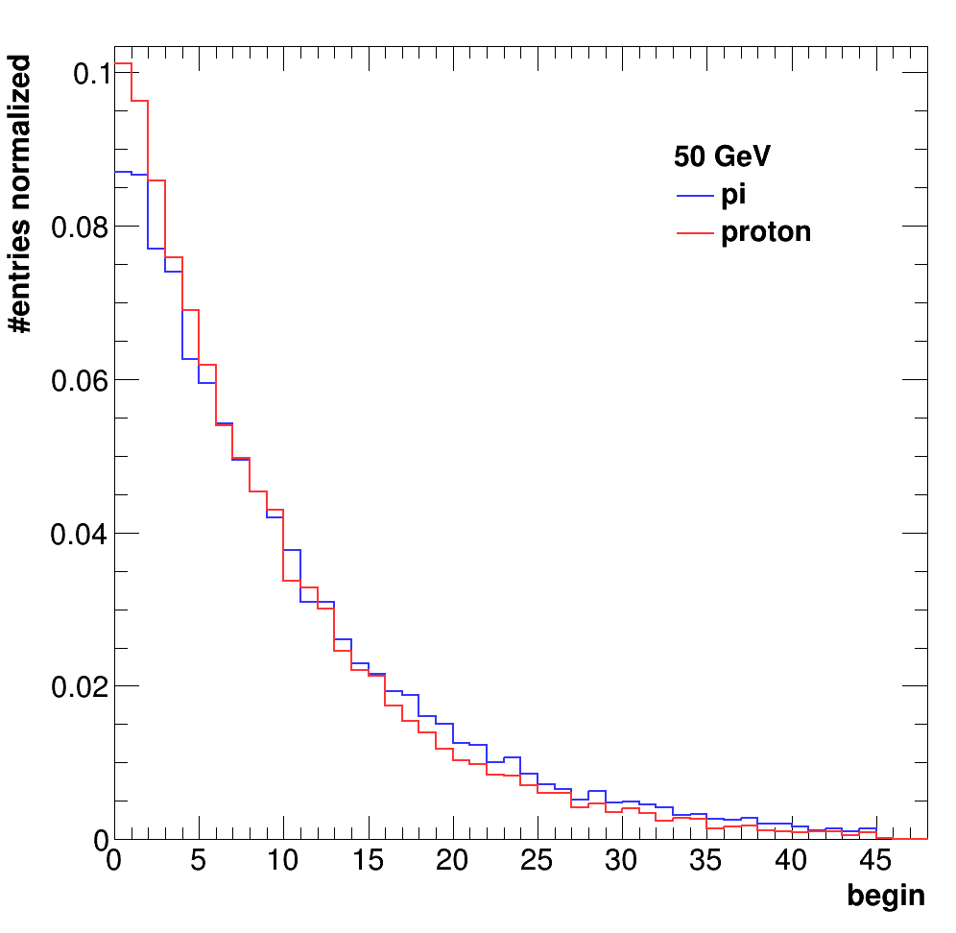
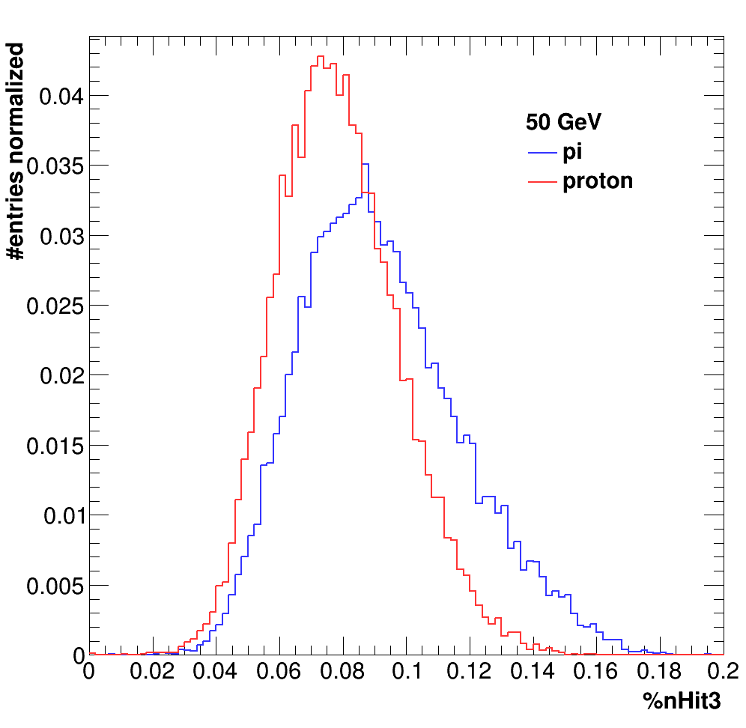
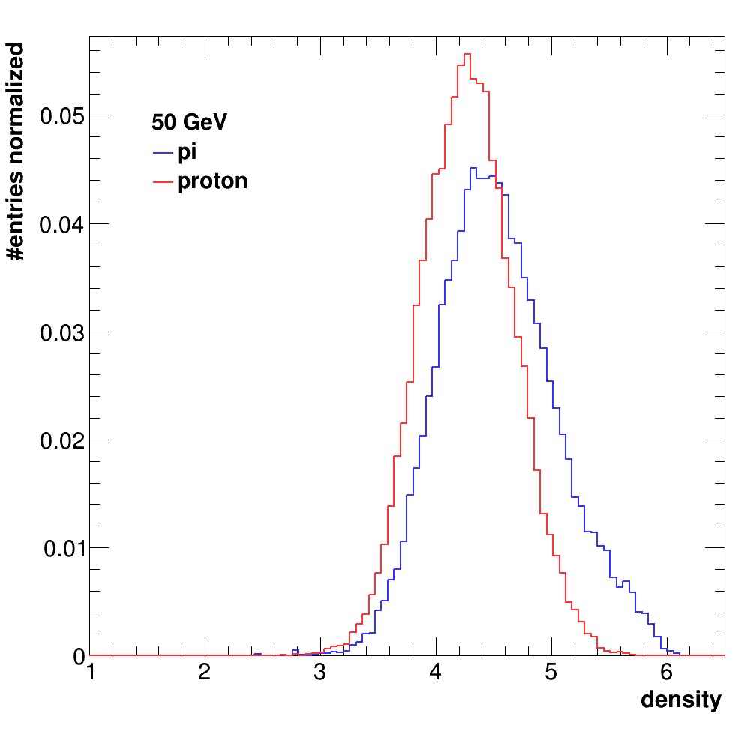
Proton-Pion separation
The energy reconstruction method was applied to hadron events.
No distinction was made between pions and protons or others.
Hadronic showers of pions and protons are not identical.
Simulation
Better construction can be made if one can identify the nature f the hadron.
Simulation
Simulation
Simulation
Simulation

Slide 10
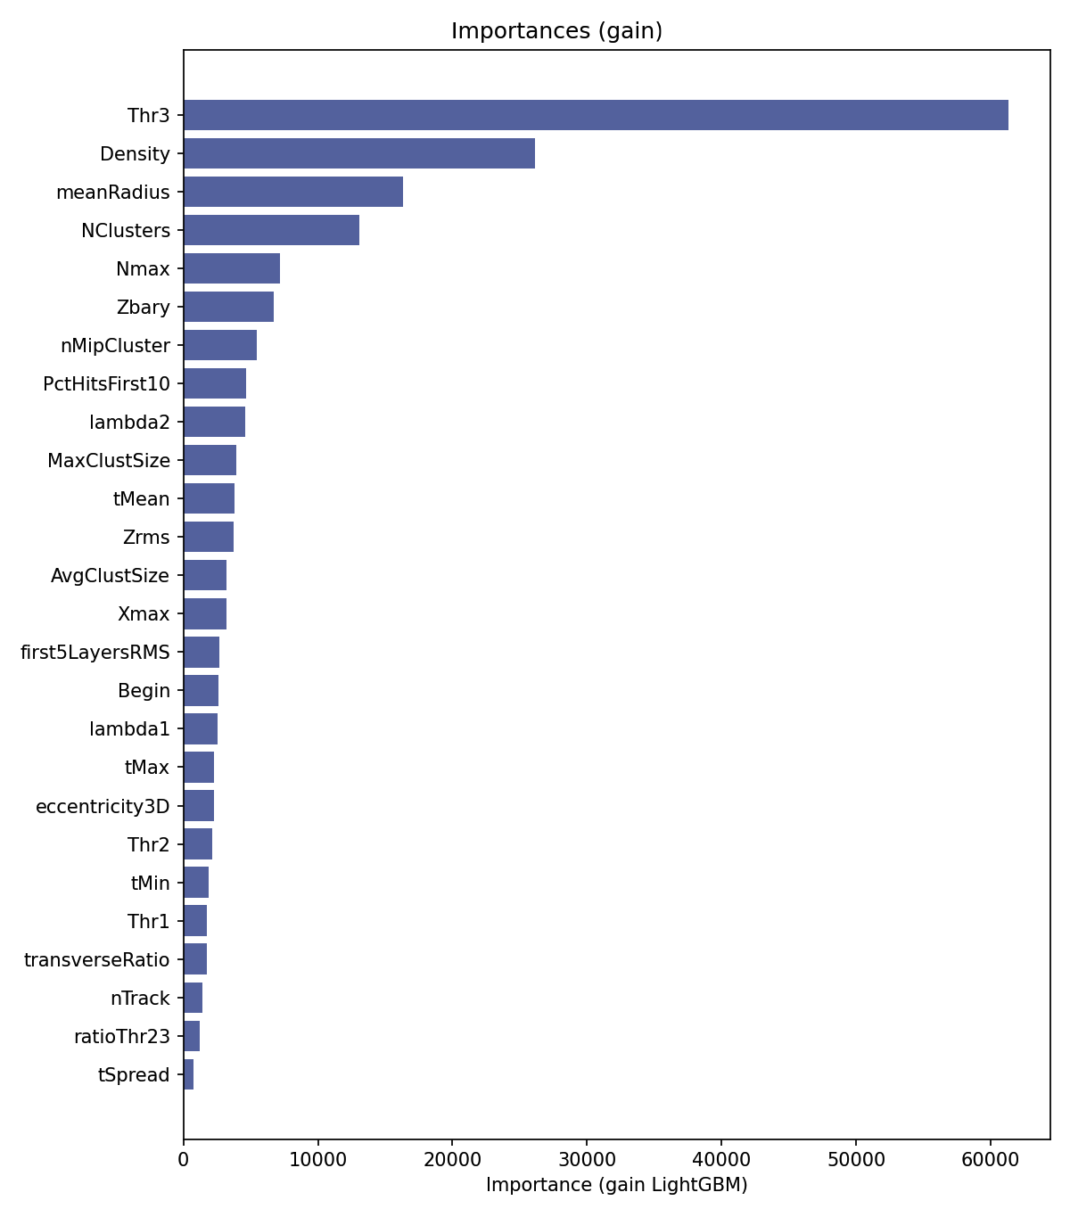
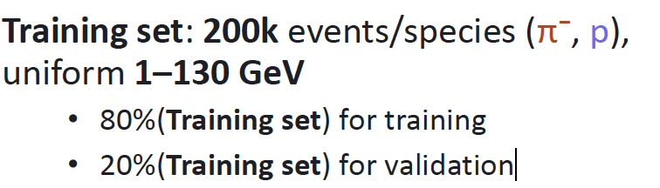
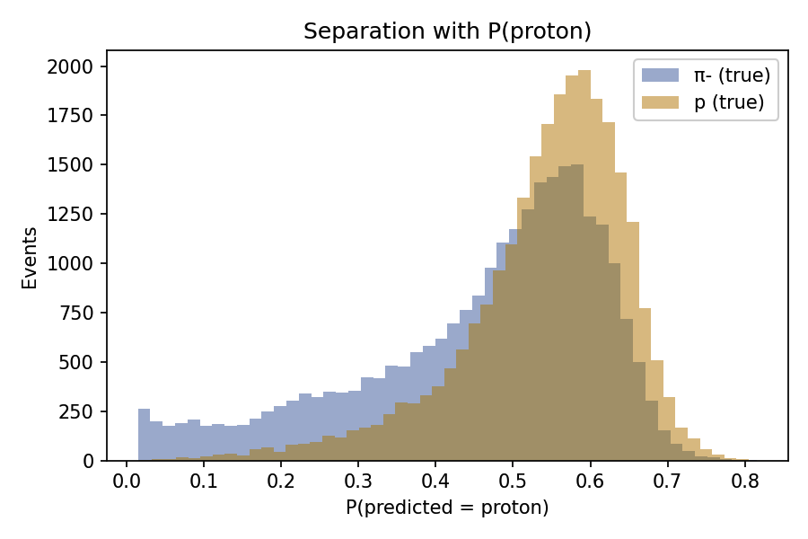
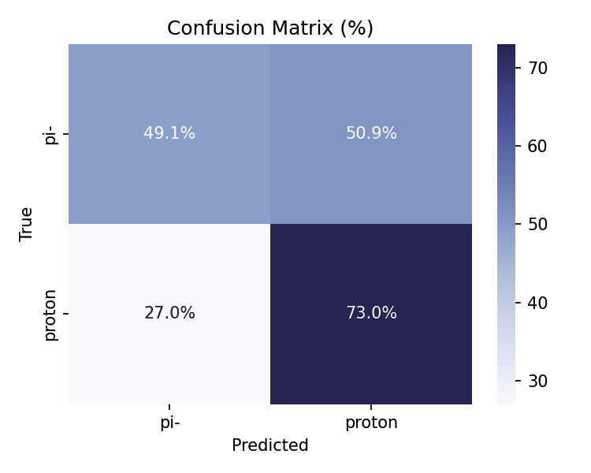
Proton-Pion separation
M. Idir
Next step is to use GNN to identify separate proton from pions and then use the same technique to estimate the energy

Slide 11
SDHCAL → T-SDHCAL
Circular Collider requirements:
Continuous readout
Active cooling
High rate capabilities

Slide 12
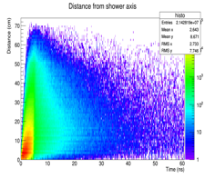
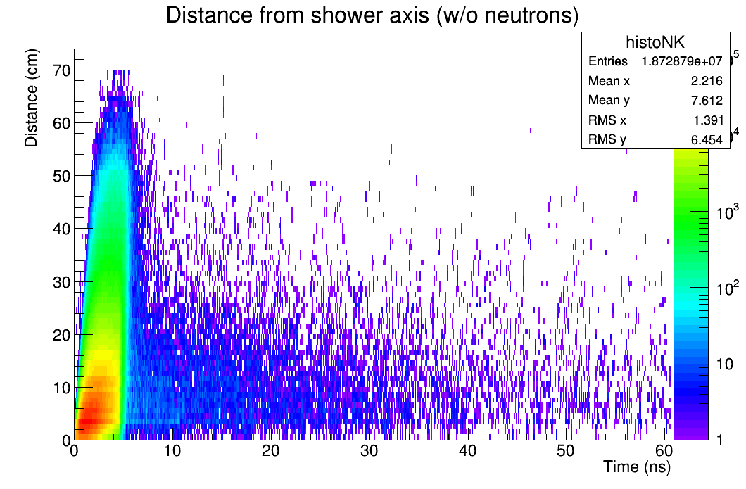
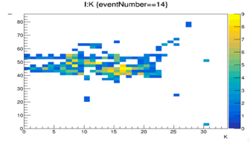
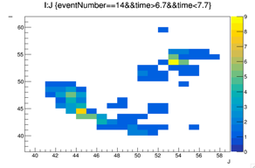
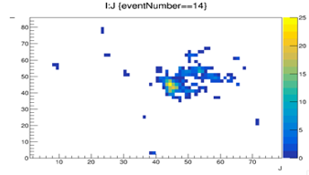
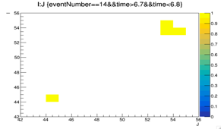
Timing is an important factor to identify delayed neutrons → better reconstruct their energy
Timing can help to separate close-by showers and reduce the confusion for a better PFA application. Example: pi-(20 GeV), K-(10 GeV) separated by 15 cm.
1 ns resolution
Y
Y
Z
X
100 ps resolution
Y
Y
X
X

Slide 13
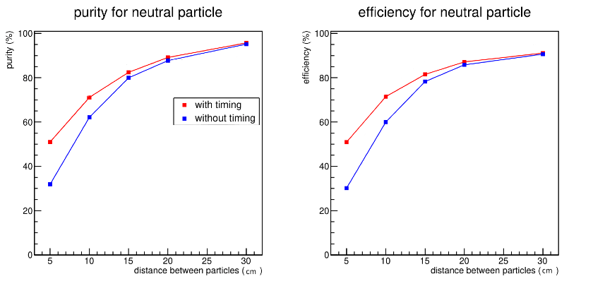
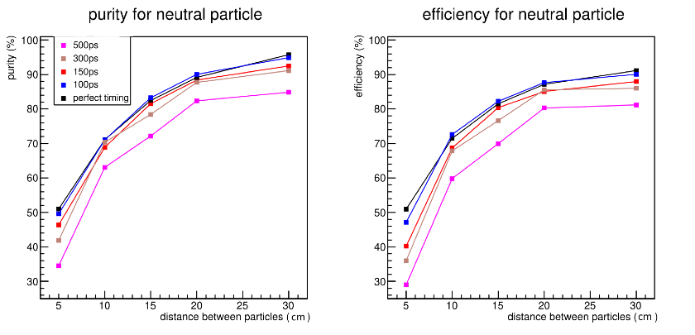
Including time information to separate hadronic showers ( 10 GeV neutral particle from 30 GeV charged particle) using techniques similar to ARBOR’s ones.

Slide 14
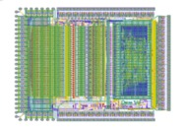
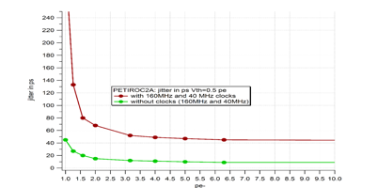
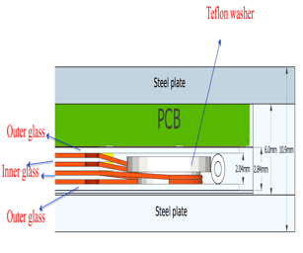
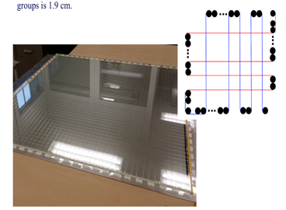
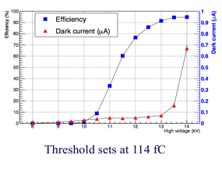
How to achieve an excellent time resolution:
An ASIC with a fast preamplifier, precise discriminator and excellent TDC
is needed
→PETIROC 32-channel, high bandwidth preamp (GBWP> 10 GHz), <3 mW/ch, dual time and charge measurement (Q>50 fC)
jitter < 20 ps rms @ Q>0.3 pC
→ Go to CALOROC after
A fast-time DETECTOR
Multigap RPC is an excellent candidate.
4-5 gaps of 250 µm each can provide 100 ps time resolution

Slide 15
First step towards transforming SDHCAL into T-SDHCAL
W. Wu
Front-End Electronics for MRPC readout with high timing resolution
The system includes a front-end board (FEB), a detector interface card (DIF) and a data acquisition system(DAQ) based on ZCU102.
Test System and Setup
Some noise was observed because of external power lines but fixed with a new iteration

Slide 16
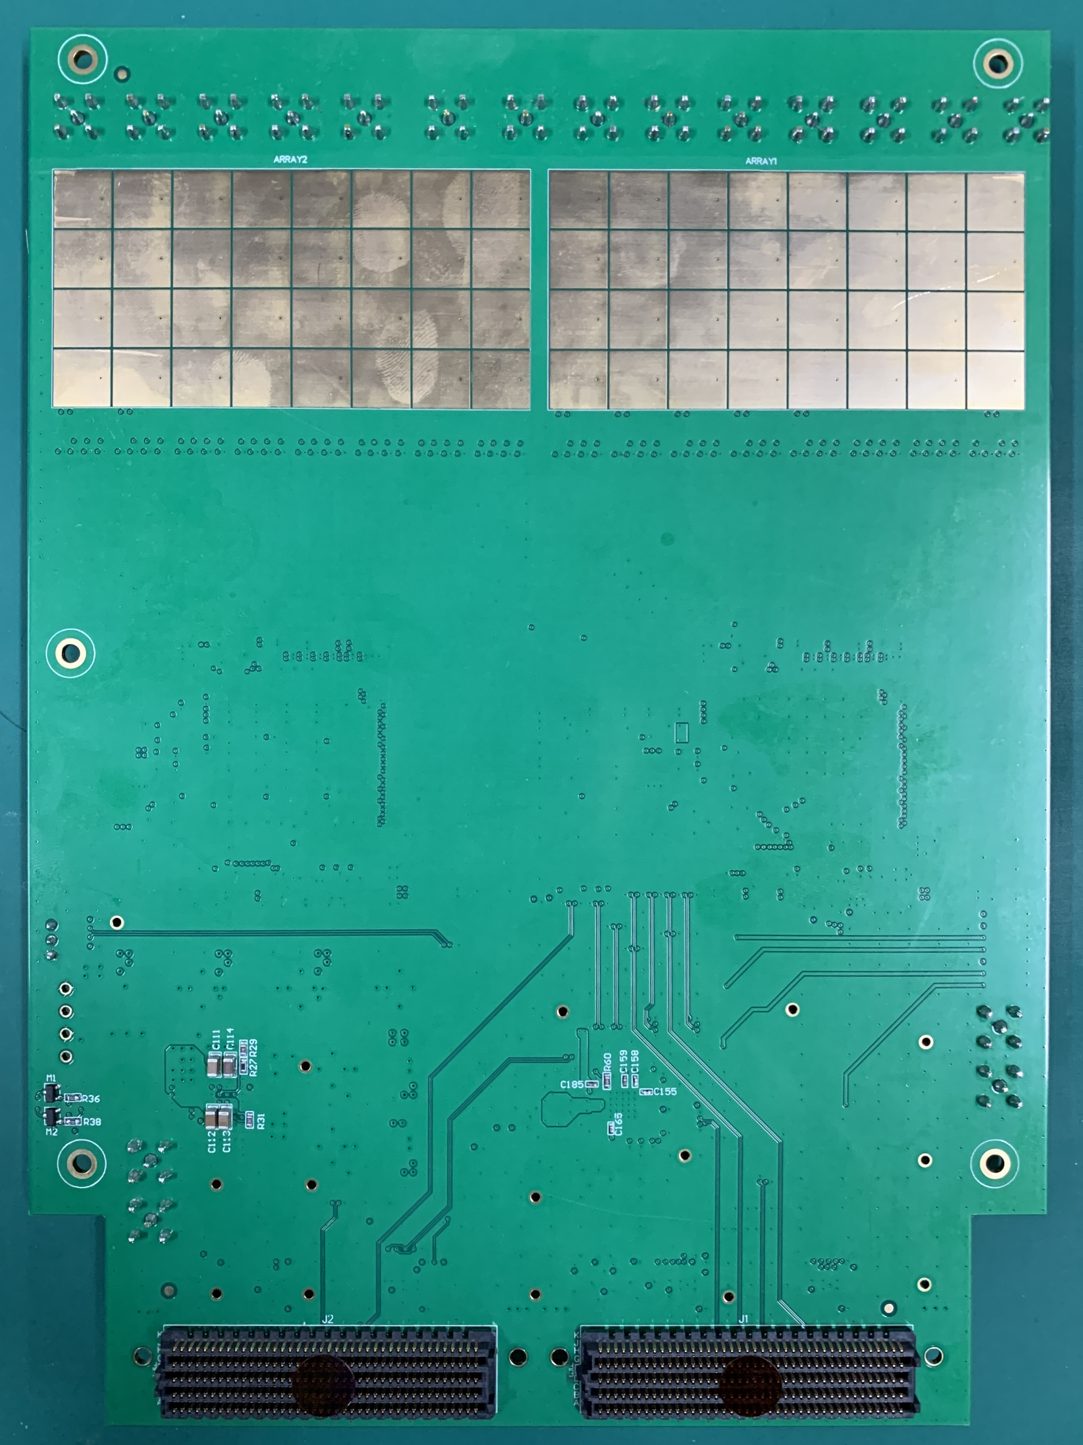
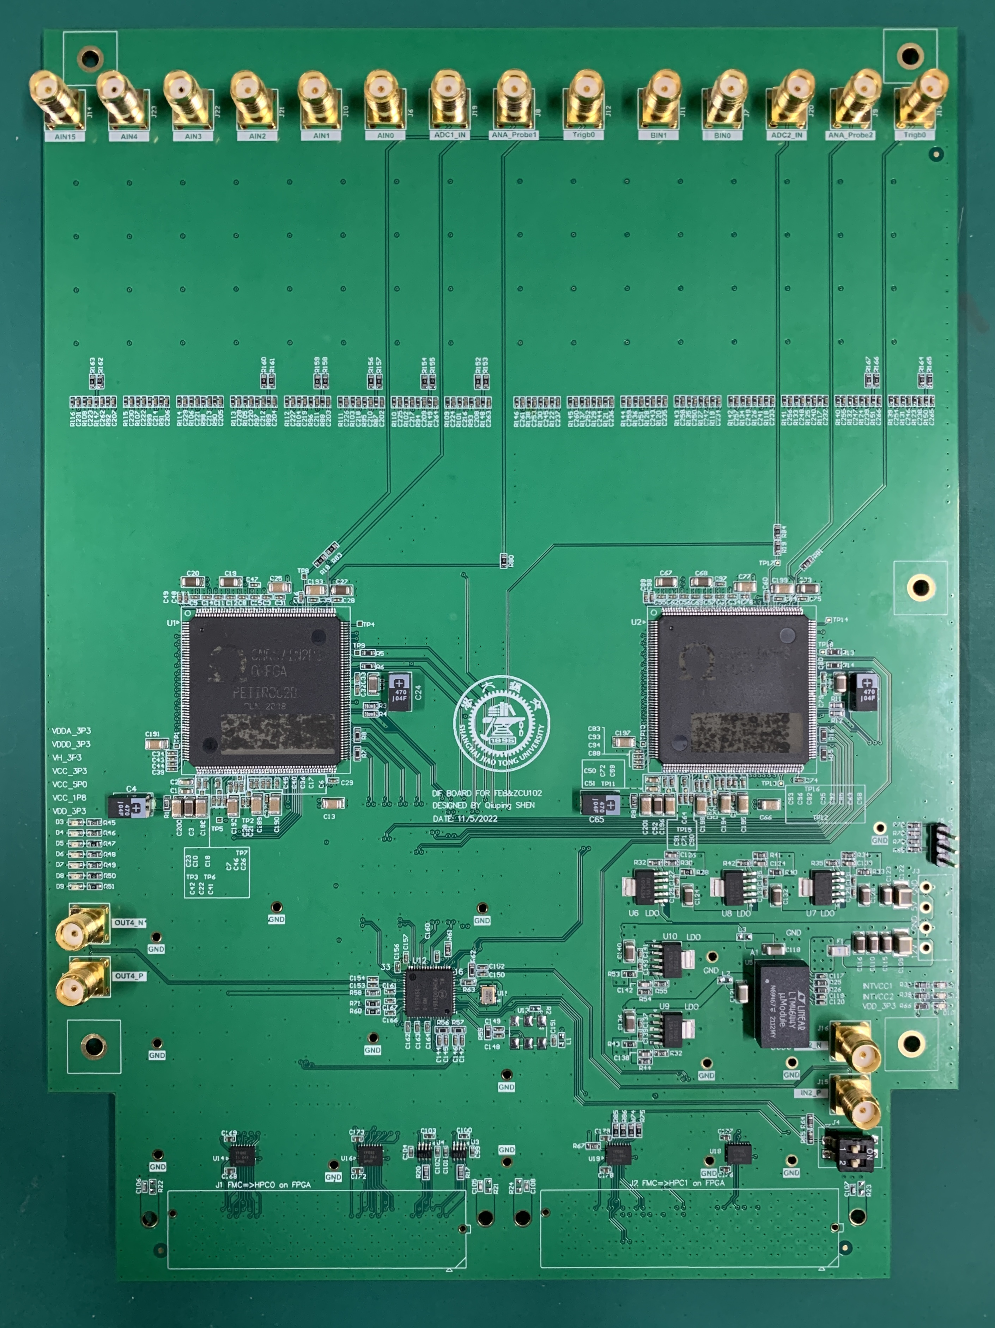
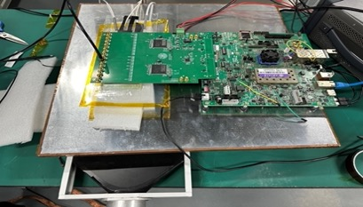
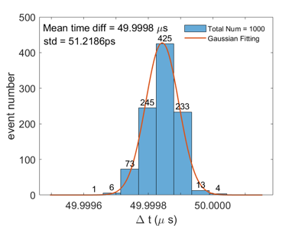
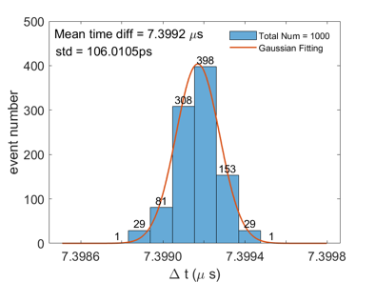
σ_{t} = 36 ps
σ_{t} = 75 ps
Electronics only

Slide 17
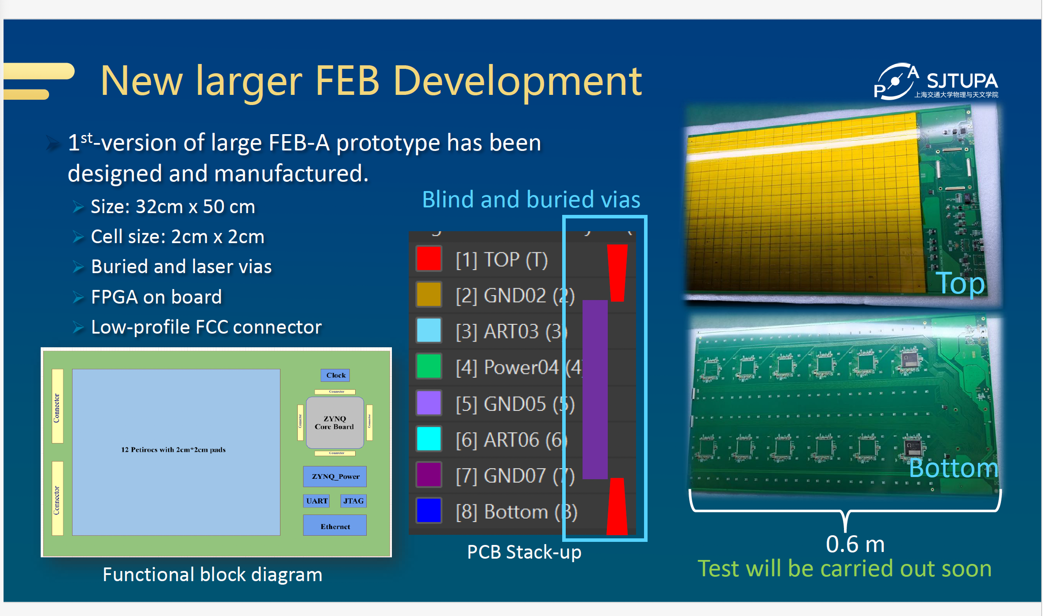

Slide 18
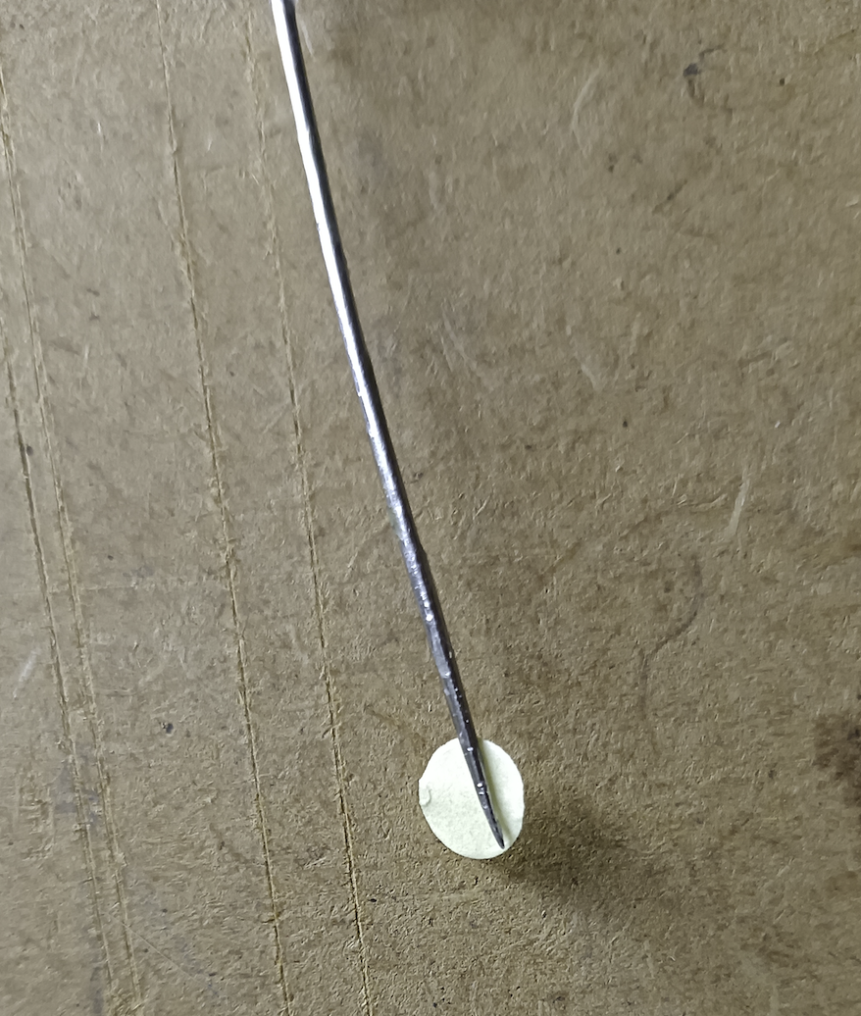
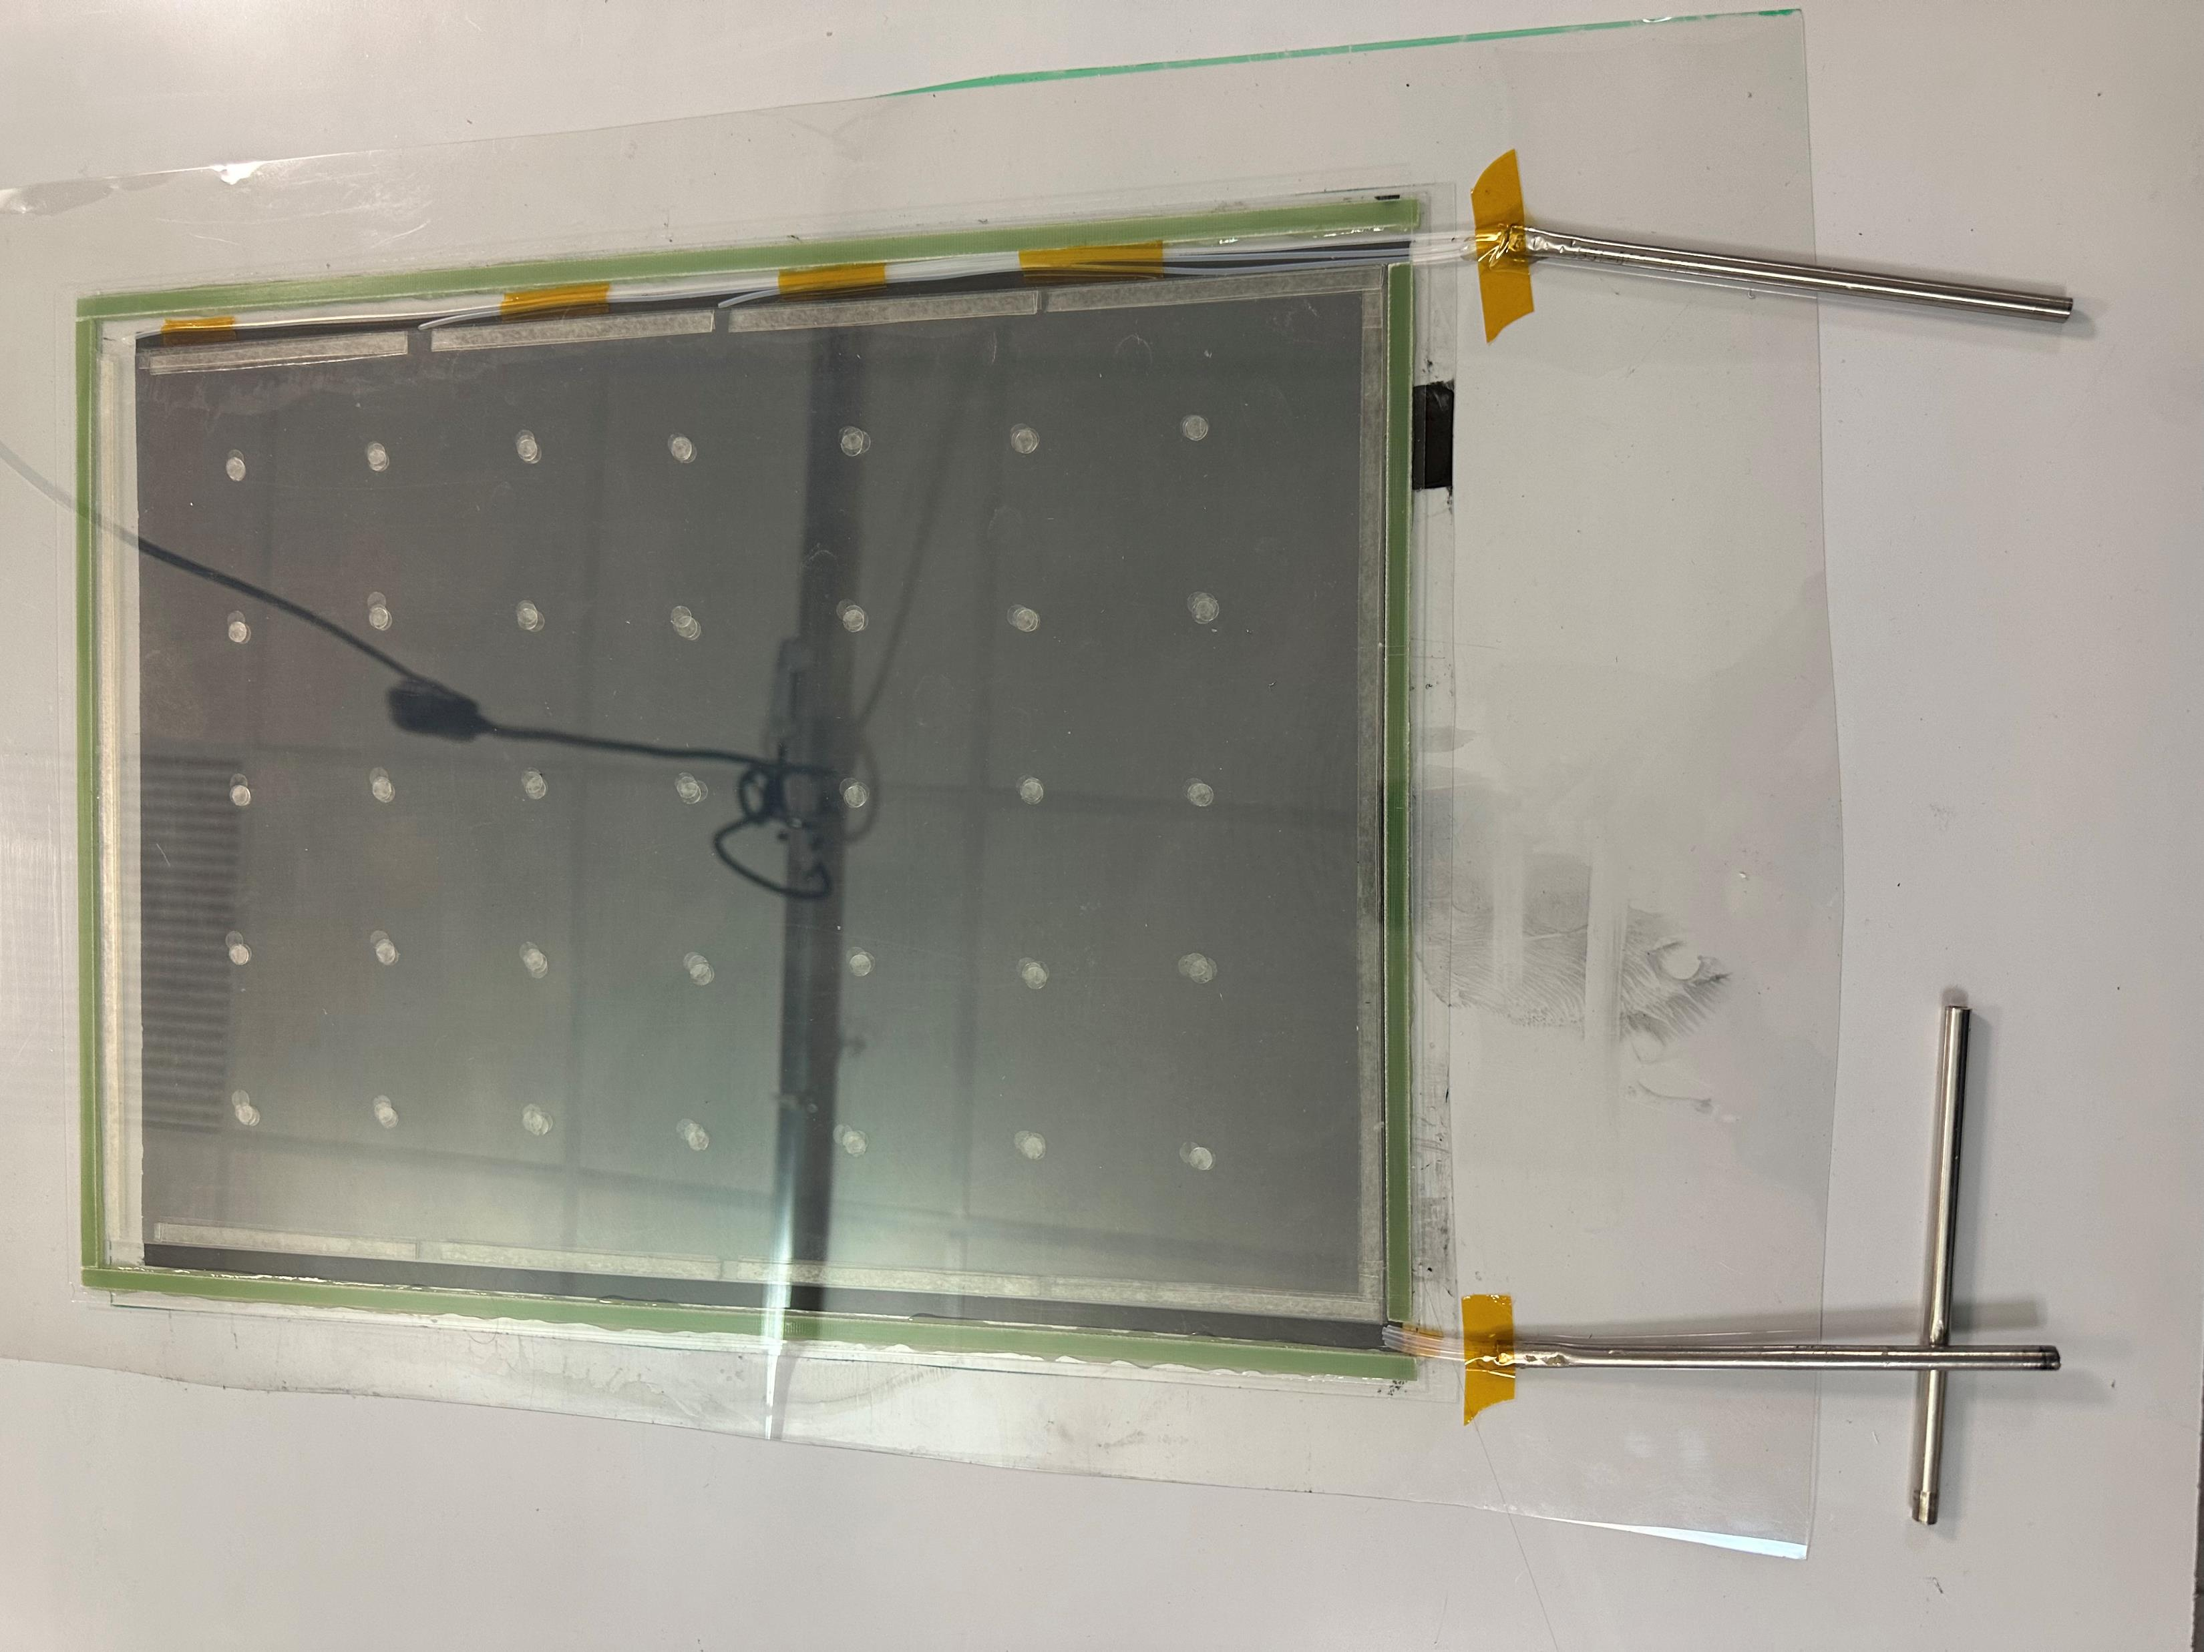
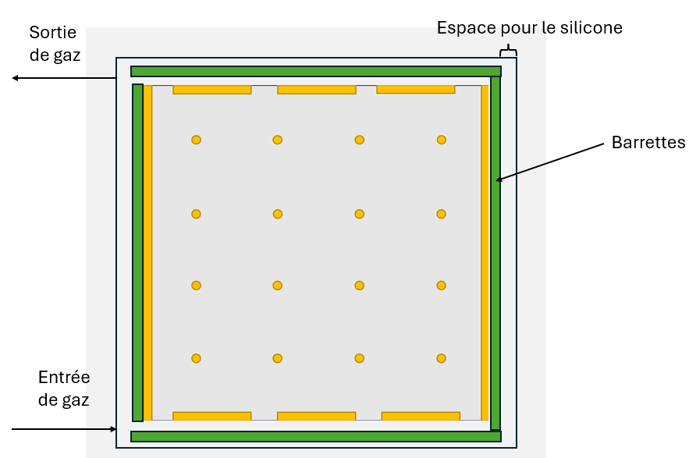
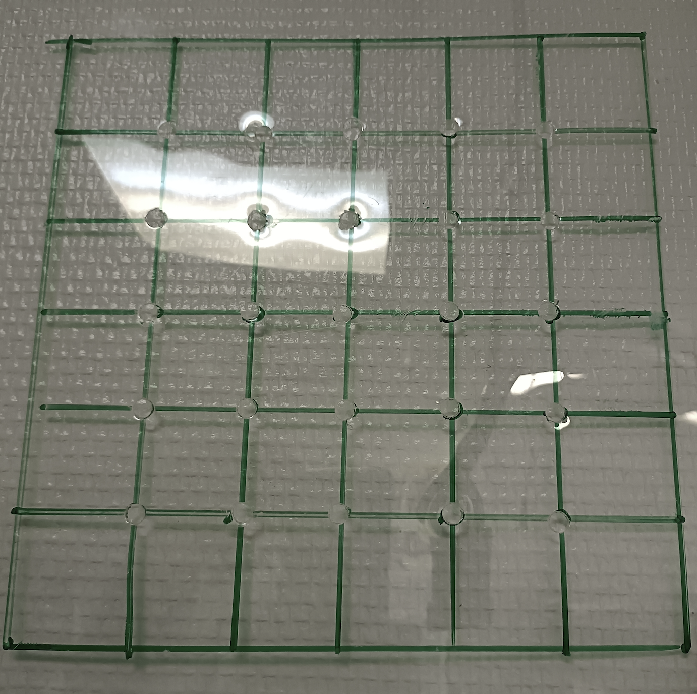
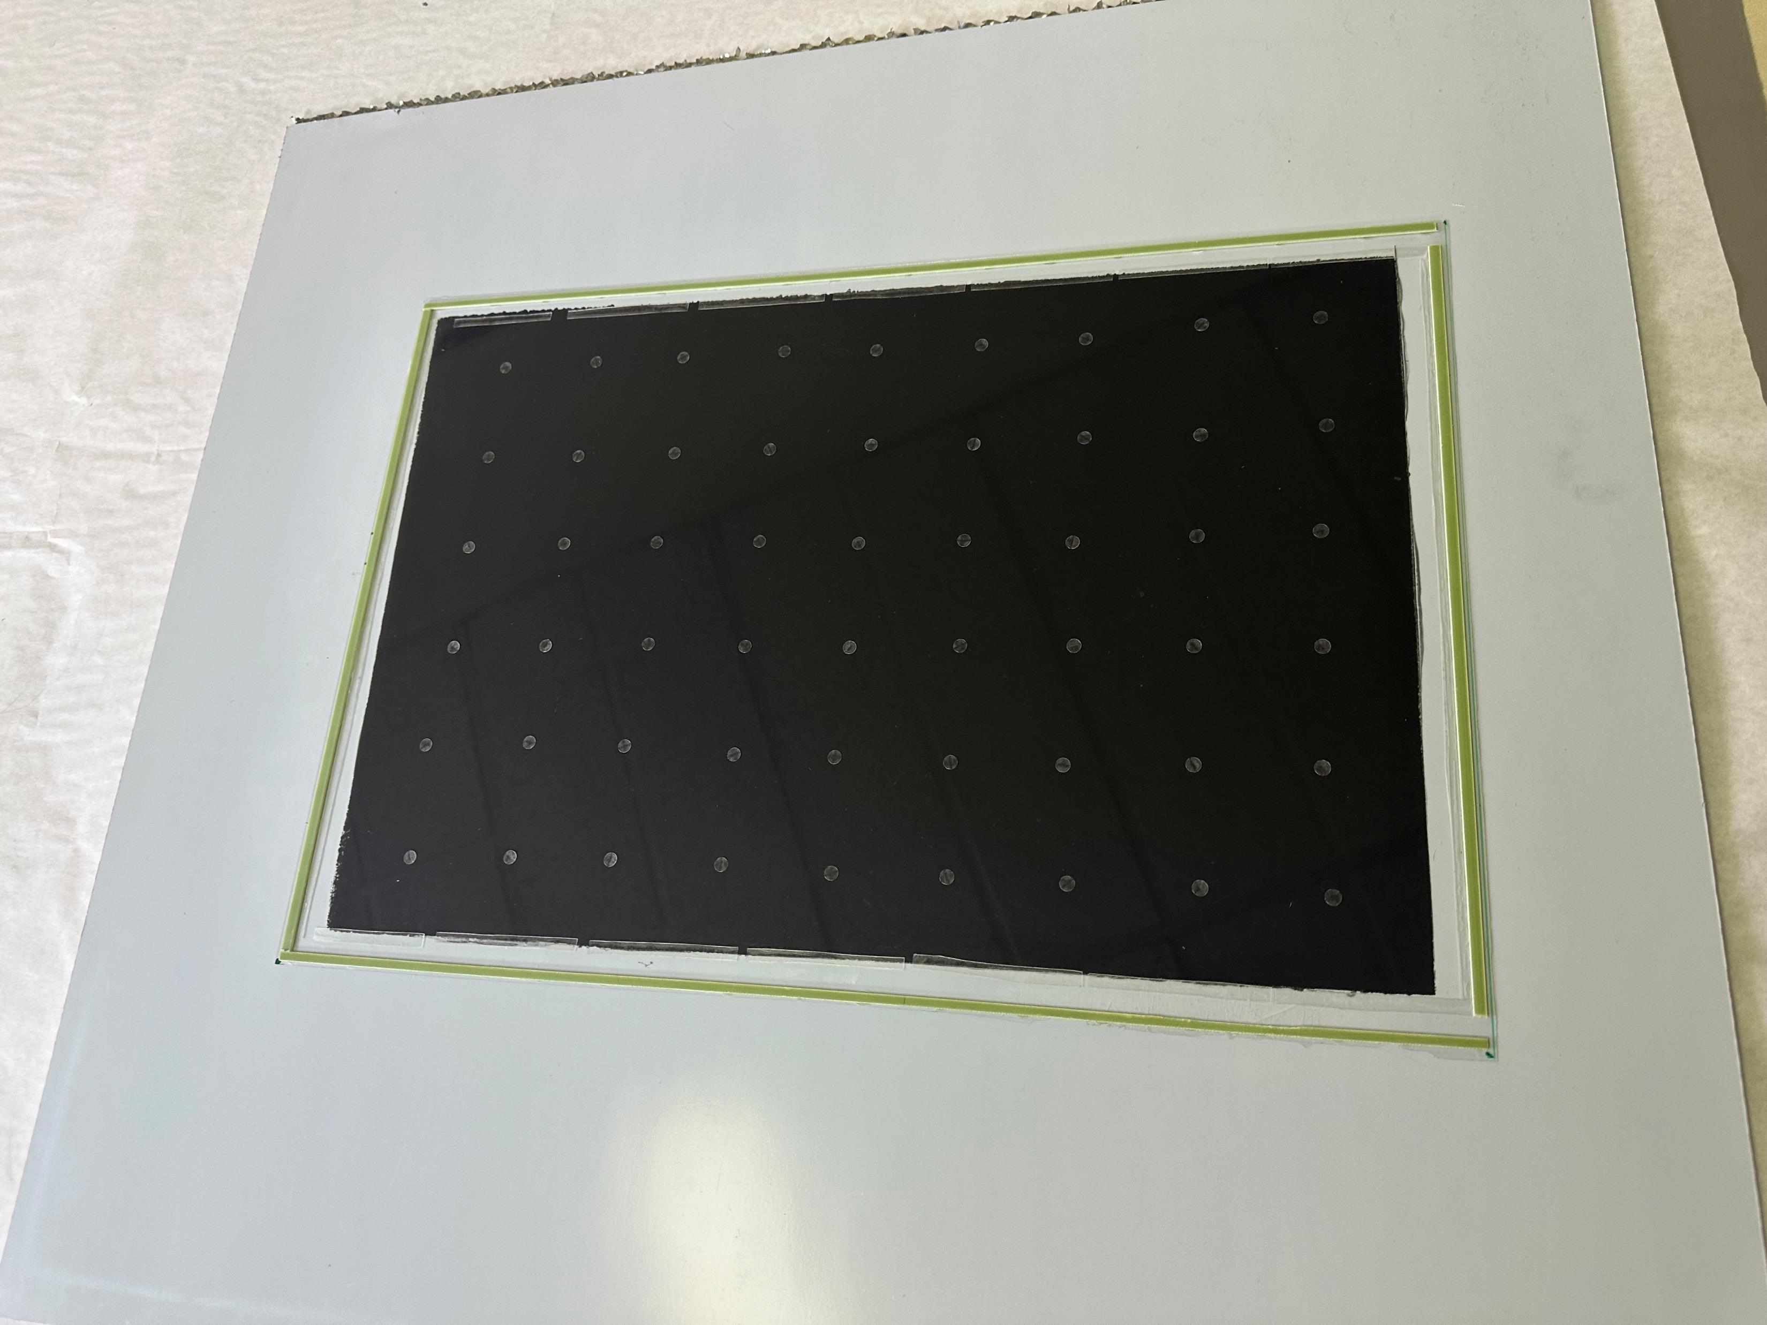
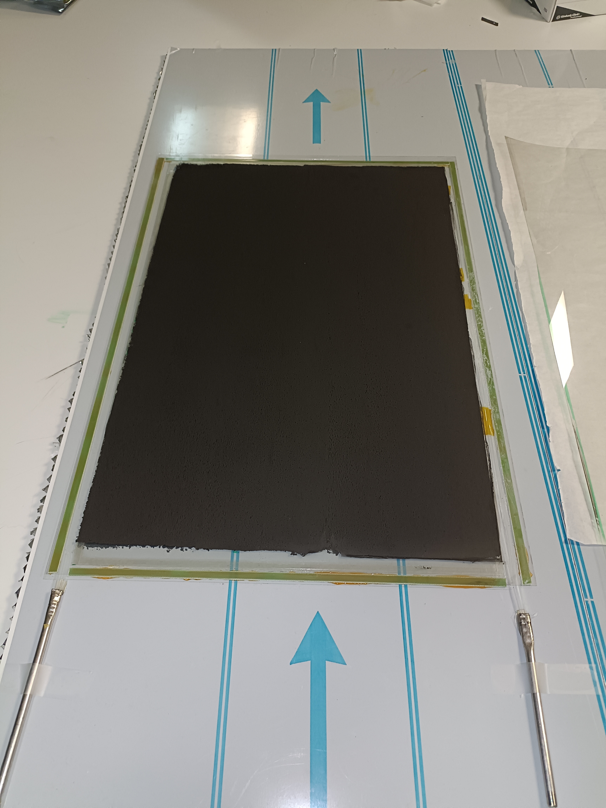
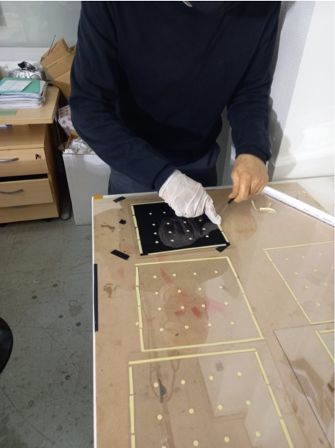
New and easy way of construction MRPC
Using mylar foil and double-face tape to produce spacers of the required height
Protection paper to be taken off
Several gaps put one over the the other
Gas outlet
Silicone filling area
Grid for spacer positioning
Outer frame
Anode (last plate with coating)
Spacers are placed
Gas inlet
4-gap RPC
Inner frame
Glass thickness: 280 µm
Gas gap: 220 µm

Slide 19
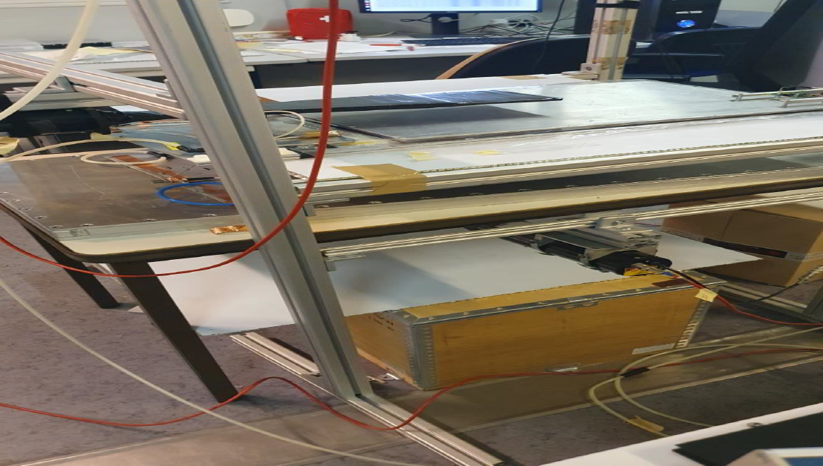
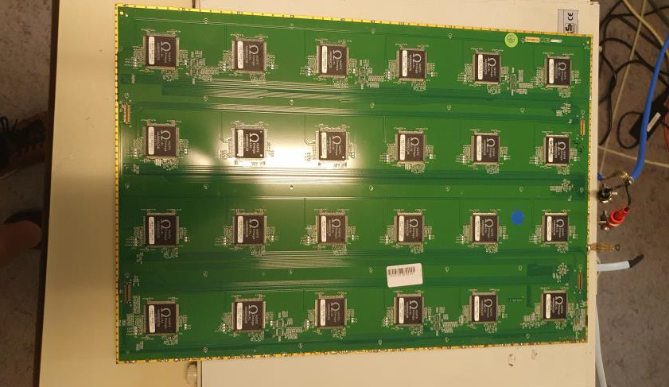
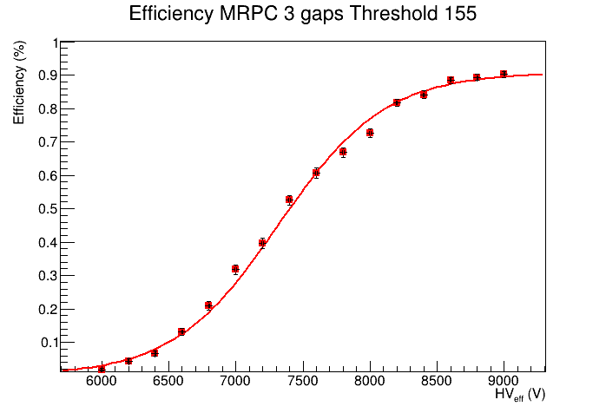





MRPC of 3, 4 and 5 gaps of 50 cm X 33 cm were built using home made spacers of 220 µm height and glass plates of 330 µm
Homogeneity studied thanks to 1 cm x 1 cm pickup pads with HR ASICs from SDHCAL electronics. 3 cm pitch leads to better homogeneity and lower noise than 5 cm pitch.
5 cm pitch
3 cm pitch
Next step is to use a customized version of the
spacers produced by a a company in Taiwan
at our request

Slide 20



Towards eco-friendly gases
M. Verzeroli (CERN-IP2I) , have produced a few MRPC using the same method at CERN and is testing them with CAEN Desktop Digitizer v1730 to assess their timing performance in an independent way using standard gas mixture and new eco-friendly gases
M. Verzeroli et al, NIMA 1078 (2025) 170591

Slide 21





Plans in the near future
Large MRPC
Large ASU
New ASIC
Caloroc D? 64ch in 65 nm TSCM
and a TDC providing 12 ps time resolution
We intend to use the present SDHCAL to test the new system in the context of a hadronic shower
→ Very useful for hadronic shower models in Geant4
We also need
New cassette design
Cooling system embedded in the cassette
DAQ system capable of communicating with both SDHCAL and T-SDHCAL electronics
Some of these could be common to others and collaboration is welcome

Slide 22
Summary
SDHCAL concept with its high granularity provides an excellent tool not only to apply PFA by separating nearby showers but also to measure their energy.
Different techniques were used to measure hadronic shower energy
excellent linearity and very good resolution are obtained
The exploitation of the hadronic shower shape thanks to the high granularity is an excellent asset to identify particles and then better measure their energy.
In the future SDHCAL will exploit precise time information using MRPC. The time information will improve on energy reconstruction by separating delayed neutrons contribution and better estimating it.

Slide 23



SDHCAL High-granularity impact
Hough Transform is an example to extract tracks within hadronic showers and to use them to control the calorimeter in situ
ρ_{xz} = z sin(θ) + x cos(θ)
Excellent agreement with efficiency/multiplicity results obtained with cosmic and beam-muons. Excellent agreement data/MC

Slide 24



Two hadronic shower separation
10 GeV neutral and 10 (30 GeV) charged pion.

Slide 25


Timing could be an important factor to identify delayed neutrons and better reconstruct their energy

Slide 26

Gas system
Gas recycling is necessary to reduce cost :
-Goal: reduce the gas consumption to reduce the cost.
-Gas renewal of 5-10% rather than 100%
-Conceived by the CERN gas group

Slide 27


SDHCAL Simulation
IP2I
Up to 20% improvment is expected

Slide 28



4 units of SDHCAL-MM
1m x 1m each were produced, tested in a
muon beam
CNRS-LAPP

Slide 29
The 4 units of SDHCAL-MM were then inserted in the SDHCAL-RPC prototype replacing the RPC units #10, 20, 35 and 50
Additional development with Resistive Micromegas has started to render the SDHCAL-Micromegas more robust against discharges that may happen in the core of the shower.
Similar activities with Thick GEM replacing MM were also initiated.

Slide 30


JINST 15 (2020) P10009
Electron and muon rejection > 99%

Slide 31

New version of PETIROC front-end board
SJTU
Yongqi Tan
Improving power rail design
Better isolation between sensitive analog signals and digital signals
Its power rails have been tested and verified.
Si5345 – used to generate clocks for Petiroc
Output clocks have been successfully tested
Time resolution of about 40 ps measured

Slide 32





SDHCAL prototype construction
10500 64-ch ASIC were tested and calibrated using a
dedicated (ASICs layout : 93% ).
310 PCBs were produced, cabled and tested.
They were assembled by sets of six to make 1m² ASUs
170 DIF, 20 DCC were built and tested.
50 detectors were built and assembled with
their electronics into cassettes.
Self-supporting mechanical structure.
DAQ system using both USB and HTML protocol
was developed and used.
Full assembly took place at CERN.

