Slide 1
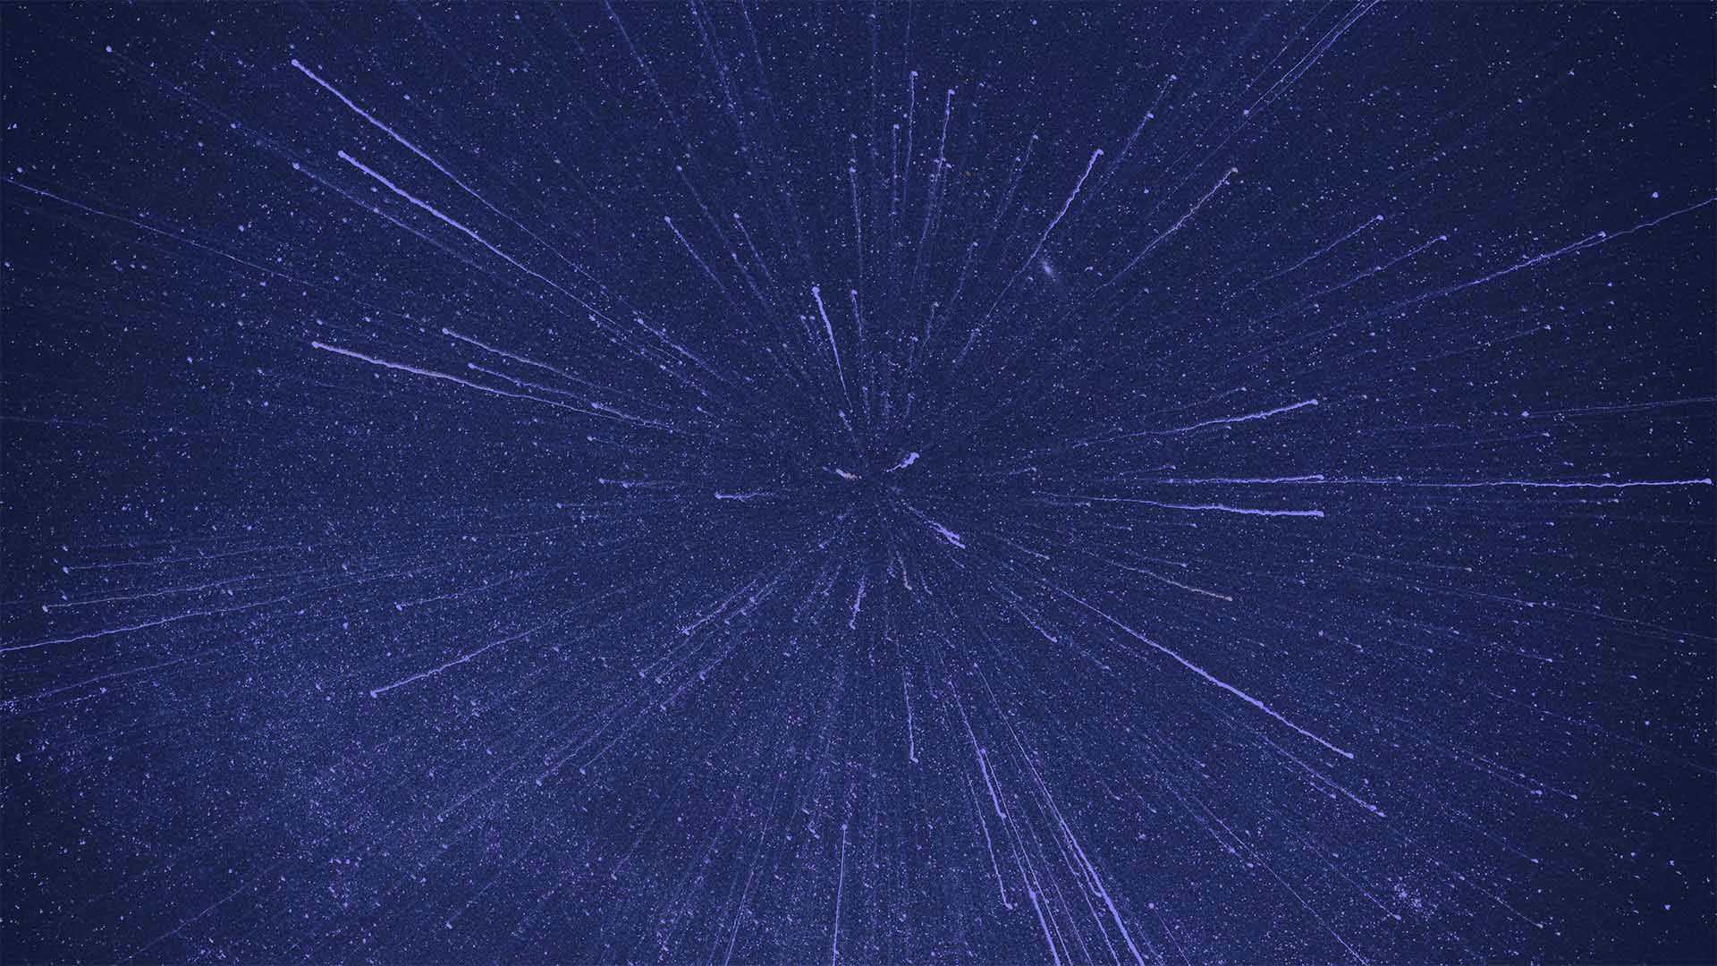


5th FCC France workshop, Paris, 26-28 November 2025
MANTA DRD3 project
D. Contardo (IP2I)

Slide 2

Framework of the MANTA project in DRD3*
conveners J. Baudot, M. Deveaux, A. Maire
5 French institutes out of 18, 5 institutes also participating to the OCTOPUS DRD3 project
 | Institute (in random order) | City | Country | Contact person
1 | IP2I | Lyon | France | Didier Contardo
2 | University Bergamo | Bergamo | Italy | Gianluca Traversi
3 | University Barcelona | Barcelone | Spain | Raimon Casanova Mohr
4 | Instituto de Fisica Corpuscular | Valencia | Spain | Carlos Marinas
5 | Instituto Galego de Física de Altas Enerxías | Santiago | Spain | Abraham Gallas
6 | University and INFN Pisa | Pisa | Italy | Francesco Forti
7 | Marietta Blau Institute for particle Physics (MBI) | Vienna | Austria | Thomas Bergauer
8 | University Pavia | Pavia | Italy | Lodovico Ratti
9 | Universität Bonn | Bonn | Germany | Bernhard Ketzer
10 | University Münster | Münster | Germany | Denise Moreira de Godoy
11 | GSI | Darmstadt | Germany | Michael Deveaux
12 | Stanford Linear Acceleartor Center | Menlo Park | USA | Catarina Vernieri
13 | IPHC | Strasbourg | France | Jerome Baudot, Antonin Maire
14 | IRFU | Saclay | France | Fabrice Guilloux
15 | LPNHE | Paris | France | Giovanni Calderini
16 | University Pusan | Busan | South Korea | Sanghoon Lim
17 | LPSC | Grenoble | France | Rachid Guernane
18 | Deutsches Elektronen Synchrotron | Hamburg | Germany | Simon Spannagel
* MANTA is part of the IN2P3 MP GRAM as OCTOPUS, see presentation of A. Besson

Slide 3
Framework of the MANTA project in DRD3*
conveners J. Baudot, M. Deveaux, A. Maire
5 French institutes out of 18, 5 institutes also participating to the OCTOPUS DRD3 project
 | Institute (in random order) | City | Country | Contact person
1 | IP2I | Lyon | France | Didier Contardo
2 | University Bergamo | Bergamo | Italy | Gianluca Traversi
3 | University Barcelona | Barcelone | Spain | Raimon Casanova Mohr
4 | Instituto de Fisica Corpuscular | Valencia | Spain | Carlos Marinas
5 | Instituto Galego de Física de Altas Enerxías | Santiago | Spain | Abraham Gallas
6 | University and INFN Pisa | Pisa | Italy | Francesco Forti
7 | Marietta Blau Institute for particle Physics (MBI) | Vienna | Austria | Thomas Bergauer
8 | University Pavia | Pavia | Italy | Lodovico Ratti
9 | Universität Bonn | Bonn | Germany | Bernhard Ketzer
10 | University Münster | Münster | Germany | Denise Moreira de Godoy
11 | GSI | Darmstadt | Germany | Michael Deveaux
12 | Stanford Linear Acceleartor Center | Menlo Park | USA | Catarina Vernieri
13 | IPHC | Strasbourg | France | Jerome Baudot, Antonin Maire
14 | IRFU | Saclay | France | Fabrice Guilloux
15 | LPNHE | Paris | France | Giovanni Calderini
16 | University Pusan | Busan | South Korea | Sanghoon Lim
17 | LPSC | Grenoble | France | Rachid Guernane
18 | Deutsches Elektronen Synchrotron | Hamburg | Germany | Simon Spannagel
MANTA is a generic & configurable TPSCo 65nm MCMOS design towards tracking applications
ALICE-3 (7 inst.), LHCb-2 (1 inst.), BELLE-2 (4 inst.), CBM (2 inst.), FCC-ee (4 inst.)
* MANTA is part of the IN2P3 MP GRAM as OCTOPUS, see presentation of A. Besson

Slide 4
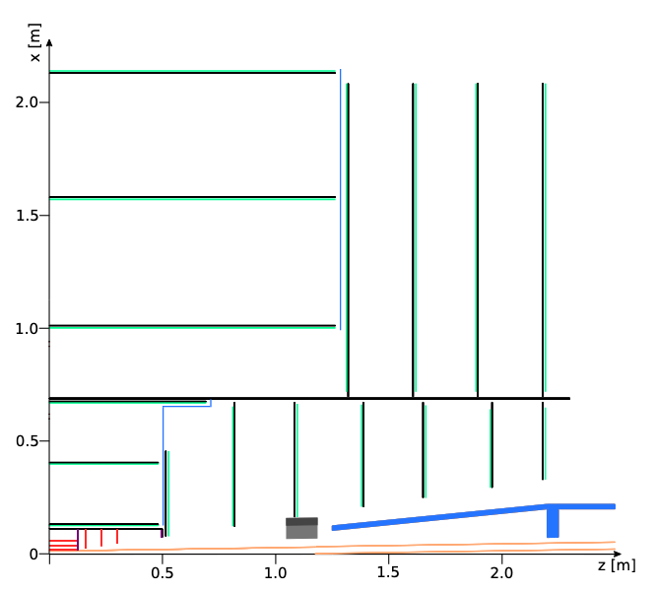
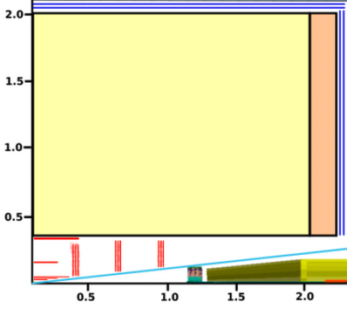

OCTOPUS & MANTA are up for all FCC-ee detector concepts
FCC-ee CLD Full Si Trk
IDEA-ALLEGRO Si/DCH
ILD FCC-ee adapted Si/TPC*
Outer Tracker, Wrapper Layers 2 layers/disks w/ ToF
FST
DCH
TPC
Intermediate Tracker, Lumical
Vertex Detector, Lumical
OCTOPUS & MANTA sensors have close specs for IT (possibly applicable to Lumical)
eg both VD & IT require equal transverse & longitudinal precision, slightly released for IT as well as the rates
CT, OT & WL have largely relaxed contraints for longitudinal precision (pitch) & rates to reduce power density
MANTA can investigate ToF integrated in OT/WL/IT sensors (possibly Lumical & Si-W Calo)
* otpion copying CLD VD and intermediate tracker

Slide 5
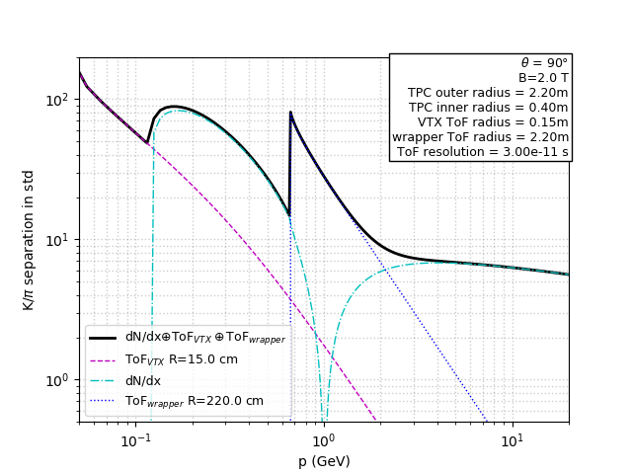
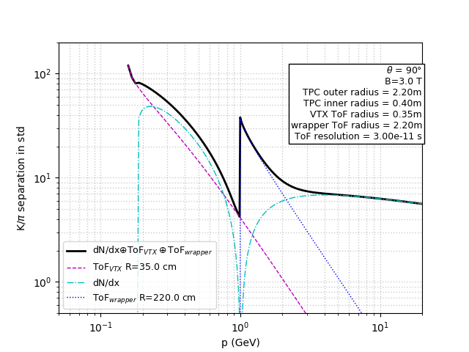
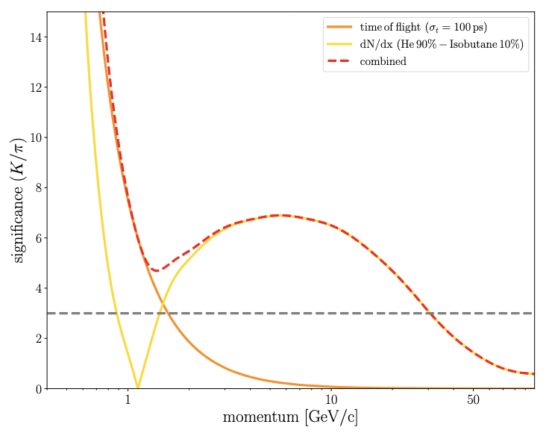
Time of Flight motivation for PID at FCC-ee
flavour tagging in Higgs decays to c/s quarks & extensive flavour program at Z-pole
A ToF measurement w/ ≃ 100 ps precision* at 2 m covers Gas Detectors blind spot (left)
ex. IDEA DCH
R. Aleksan
2T B-field
3T B-field
≃ 30 ps at 15 cm would extend range below the GD radius cut-off (middle)
at B = 3T ToF must be at < 2 m to avoid radius cut-off, or be completed w/ an ≃ 30 ps layer at 35 cm (right)
EoI “Toward MCMOS TOF tracking layers for a detector at FCC-ee”, IP2I-IRFU contribution to ESPP 2025
* within reach of current sensors at small pitch, precision can be relaxed to ≃ 140 ps for power with 2 redundant layers

Slide 6
Time of Flight other motivations at FCC-ee
mass and lifetime determination of new massive particles
correlation of vertex position to collision energy
A precision of ≲ 50 ps would be sufficient for mass estimate if the collision t₀ is undefined*
A direct measurement of t₀ close to the IP w/ ≃ 10 ps precision could allow:
reaching asymptotic mass precision if coupled with a track ToF also at 10 ps
correcting collision energy according to the vertex position
very challenging for sensor timing precision & electronics power consumption**
See also
P. Schwemling for precision timing with LFoundry process w/ and w/o sensor gain (LGAD-like)
A. Besson for APICS/ CASSIA work at IPHC on sensors w/ gain to reduce FE power consumption and improve timing precision (w/ higher S/N)
* the collision smearing is 36 ps
** t₀ precision can benefit from number of tracks at the vertex, ToF from the number of layers at large radii (possibly in a Si/W ECAL)

Slide 7
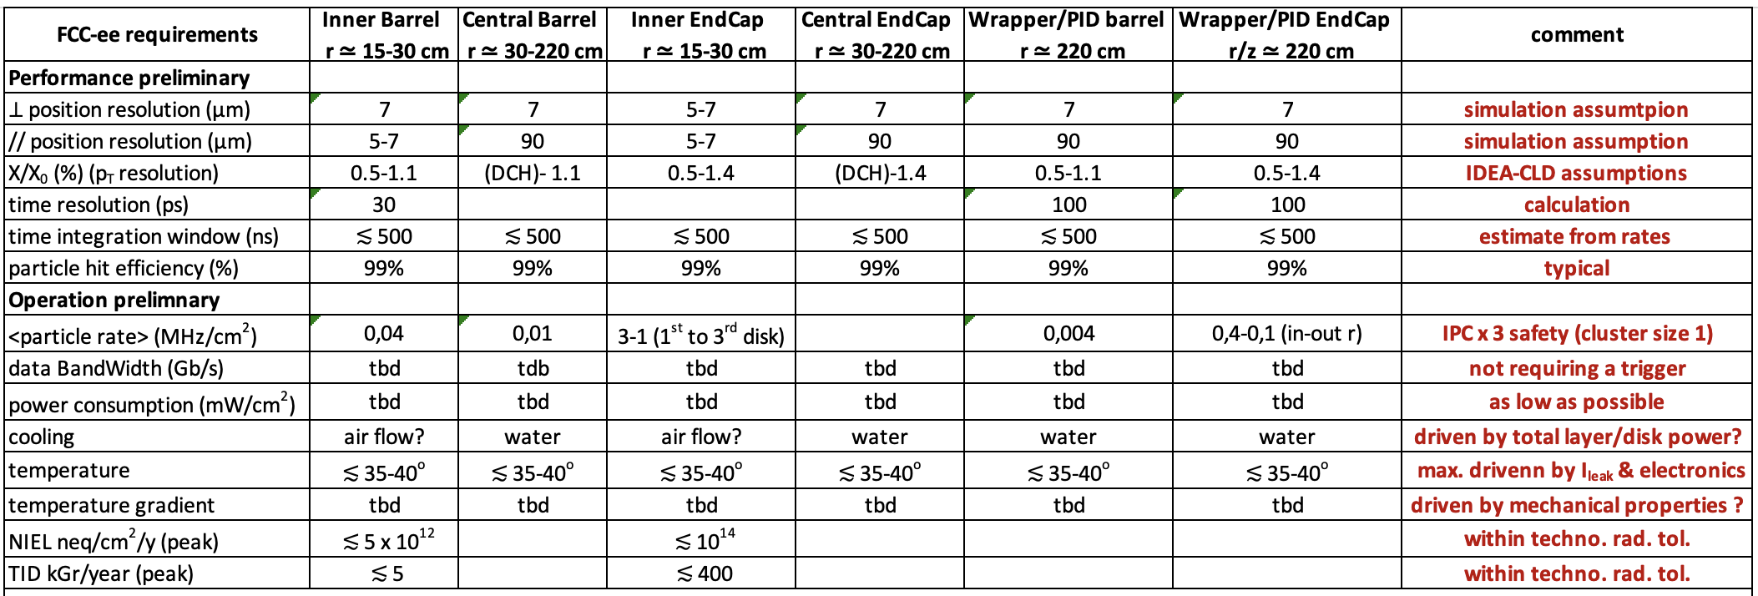
MANTA specifications for FCC-ee
initial requirements based on current state of simulations

Slide 8
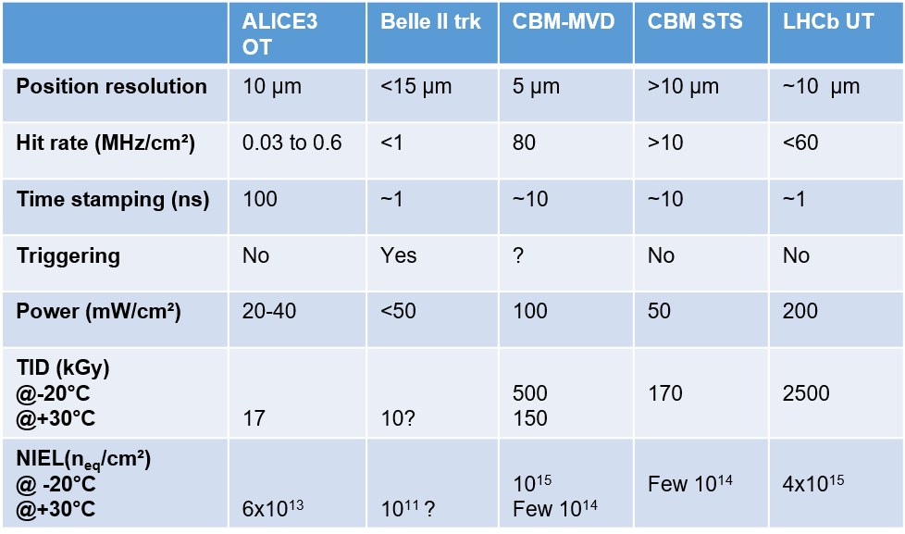
Common plausible overall MANTA specifications
Specification | Min. | Max.
Spatial resolution | ~ 5 µm | ~ 10 µm
Hit rate | <1 MHz/cm² | ~100 MHz/cm²
Time stamping | 1 ns (~30 ps PiD) | 100 ns
Power | 20 mW/cm² | 200 mW/cm²
Rad. Hard. | Marginal | ~4x10¹⁵ + 2.5 MGy
Sensor size | Reticle size, flat
Powering | Serial powering
Readout | Master/Slave
M.Deveaux DRD3 week
on-chip tuning

Slide 9
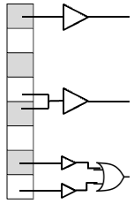
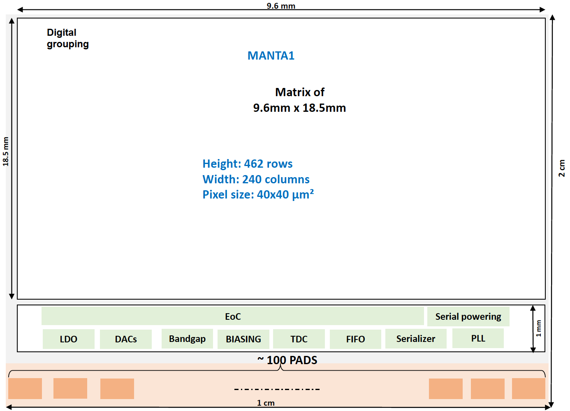
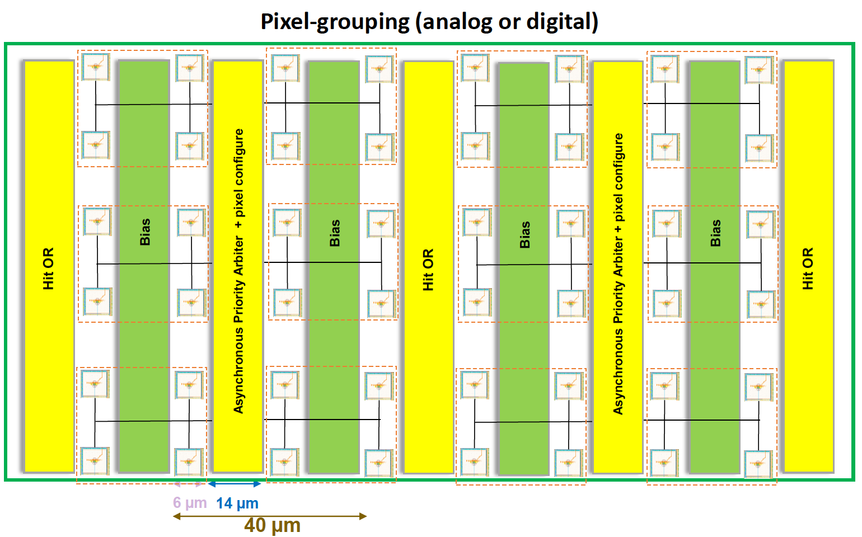
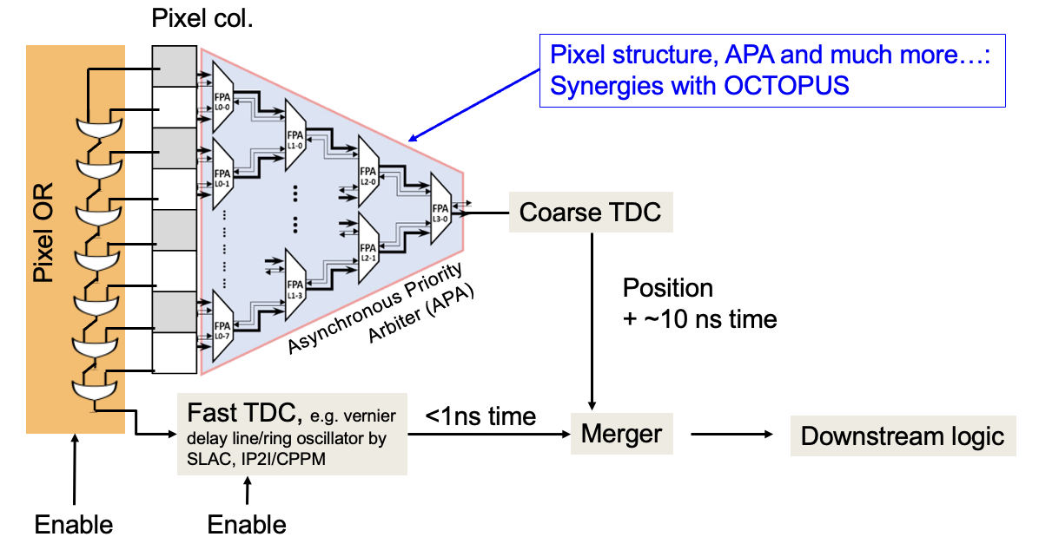
Readout architecture for MANTA
Asynchronous Priority Arbiter* for high bandwidth capability
fine timing “pixel or” line toward TDC at End of Column
analog stage based
on DPTS (CERN IP) w/ tunable current
pitch tbd
diodes
pixels grouping tbd
pixel matrix
APA synergy with OCTOPUS
footprint issue
floor plan
EoC synchronous or asynchronous synergy with OCOTPUS
ongoing investigation of options / simulations and of design work sharing
* no clock in matrix to reduce power consumption

Slide 10
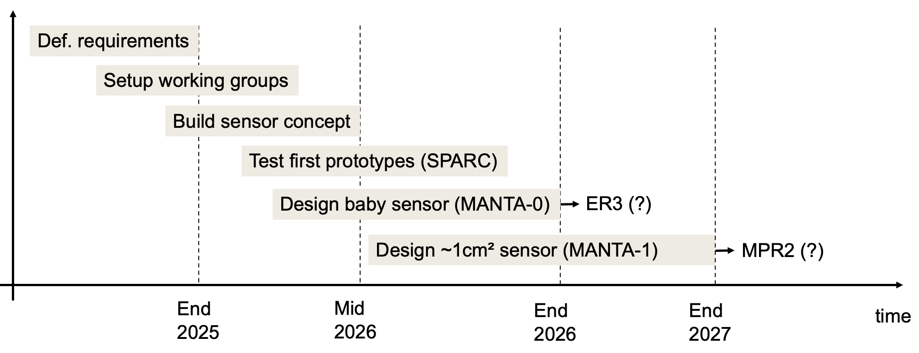
Tentative planning - drivers
readiness for common MPR2 with OCTOPUS, access to IPs and foundry provided by DRD7
possibility of intermediate “chiplets”* in ALICE ER3, availability of personale and funding
M.Deveaux DRD3 week
* 15 x 15 mm² area for test of specific IP blocks

Slide 11
Ancillary activities
Simulation work see presentations of J. Daniel and G. Boudoul
full sim of physics plus background as a function of r/𝜂 with realistic sensor description
provide input rates for OCTOPUS and MANTA architecture design
full sim study of different layers/disks configurations
assess X/X₀ impact of TL and overall tracking performance as a function of r/ 𝜂
Study tracker mechanical structure and services at IP2I (G. Boudoul)
evaluate impact of power consumption on X/X₀ introduced by active cooling
propose a mechanical design with low X/X₀ based on large bent sensors

Slide 12
Additional material

Slide 13
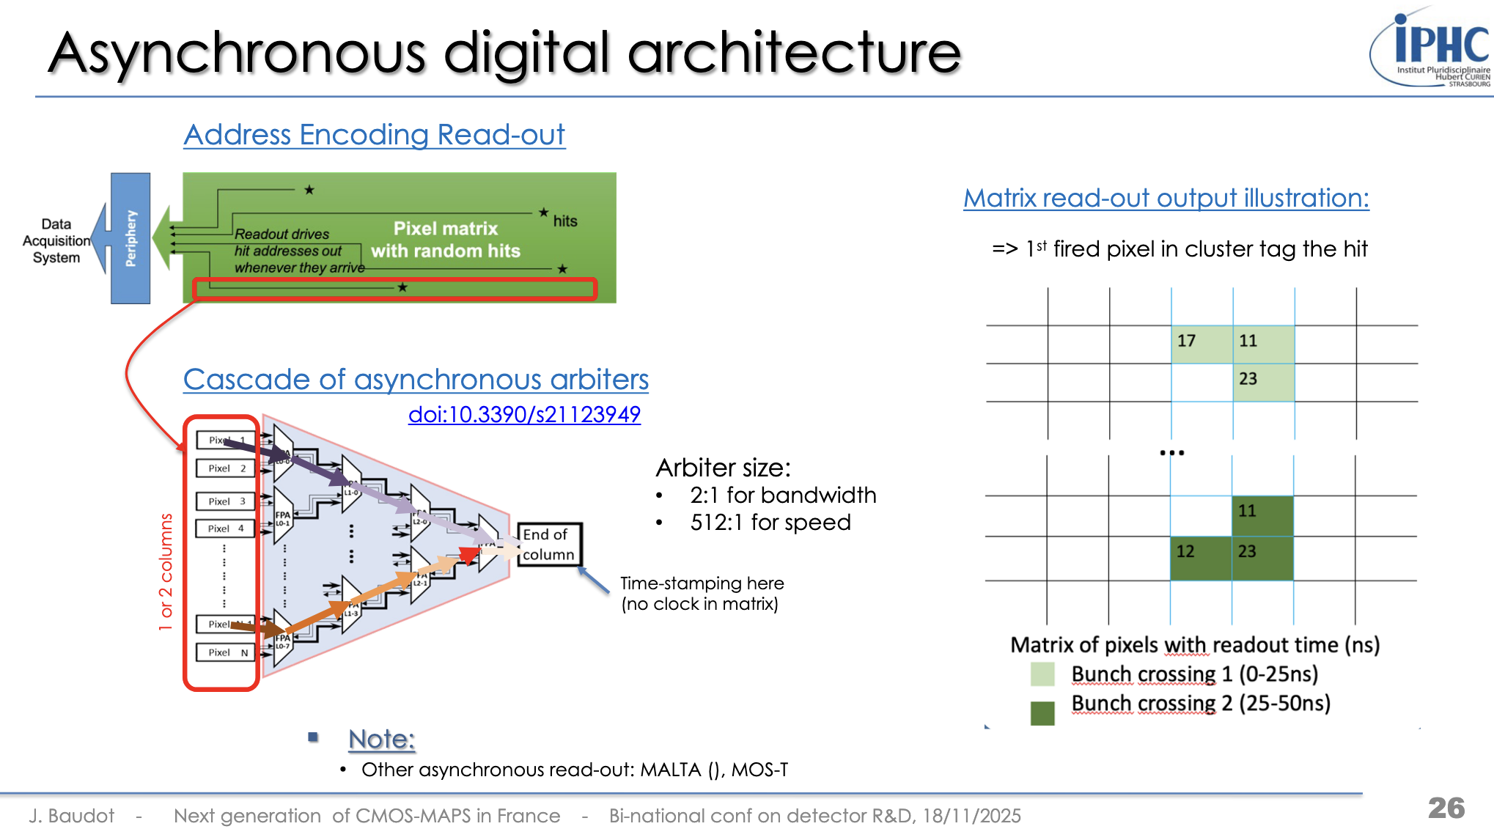
https://indico.in2p3.fr/event/36110/contributions/162263/attachments/97945/150918/maps-binatconf-20251118.pdf

Slide 14
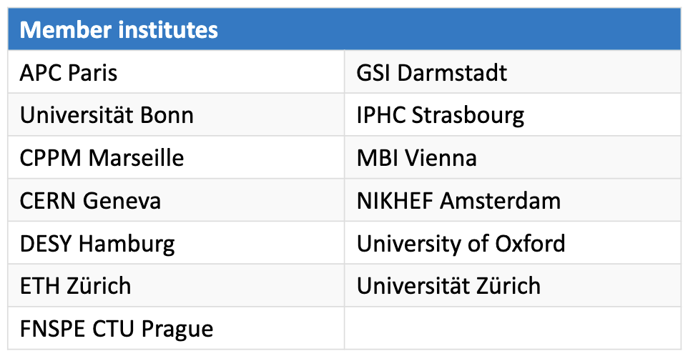
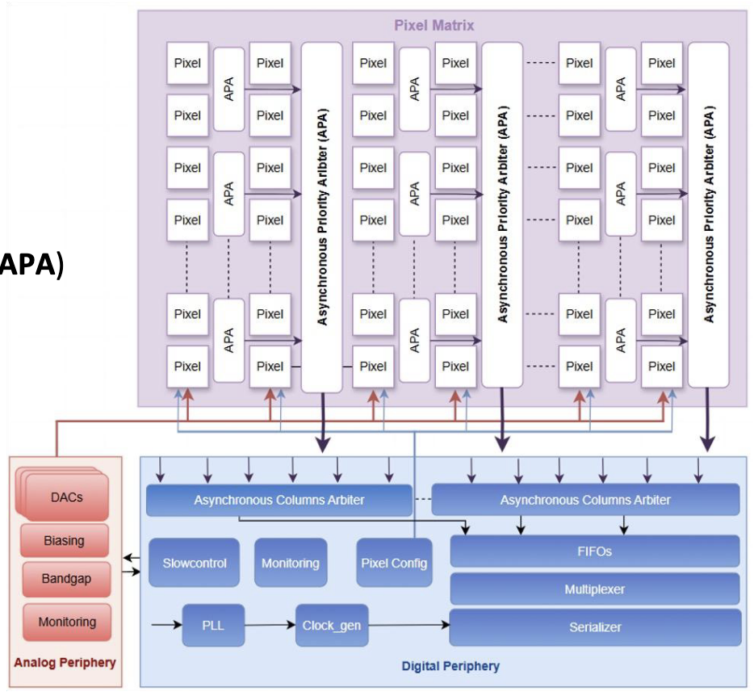
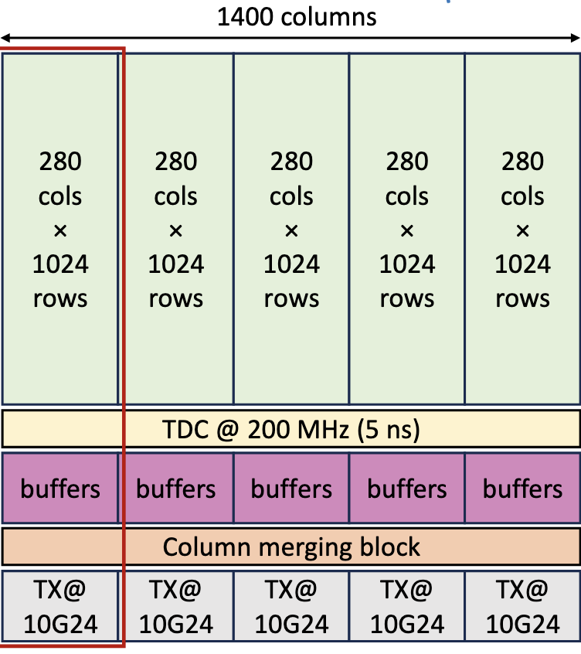
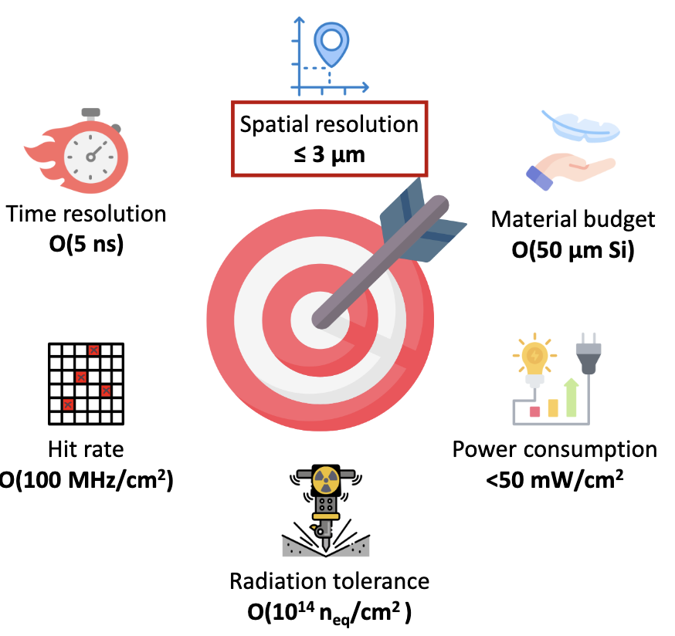
https://indico.cern.ch/event/1581713/contributions/6763825/attachments/3170095/5636931/Russo_OCTOPUS_WG1.pdf
OCTOPUS
diode pitch 20 μm, sensor “n-cross” (IPHC) alternative to “modified w/ gap” (ALICE ITS3) design
rise & fallling edges time stamping 5 ns (200 MHz) provinding ToT for charge sharing

