Slide 1
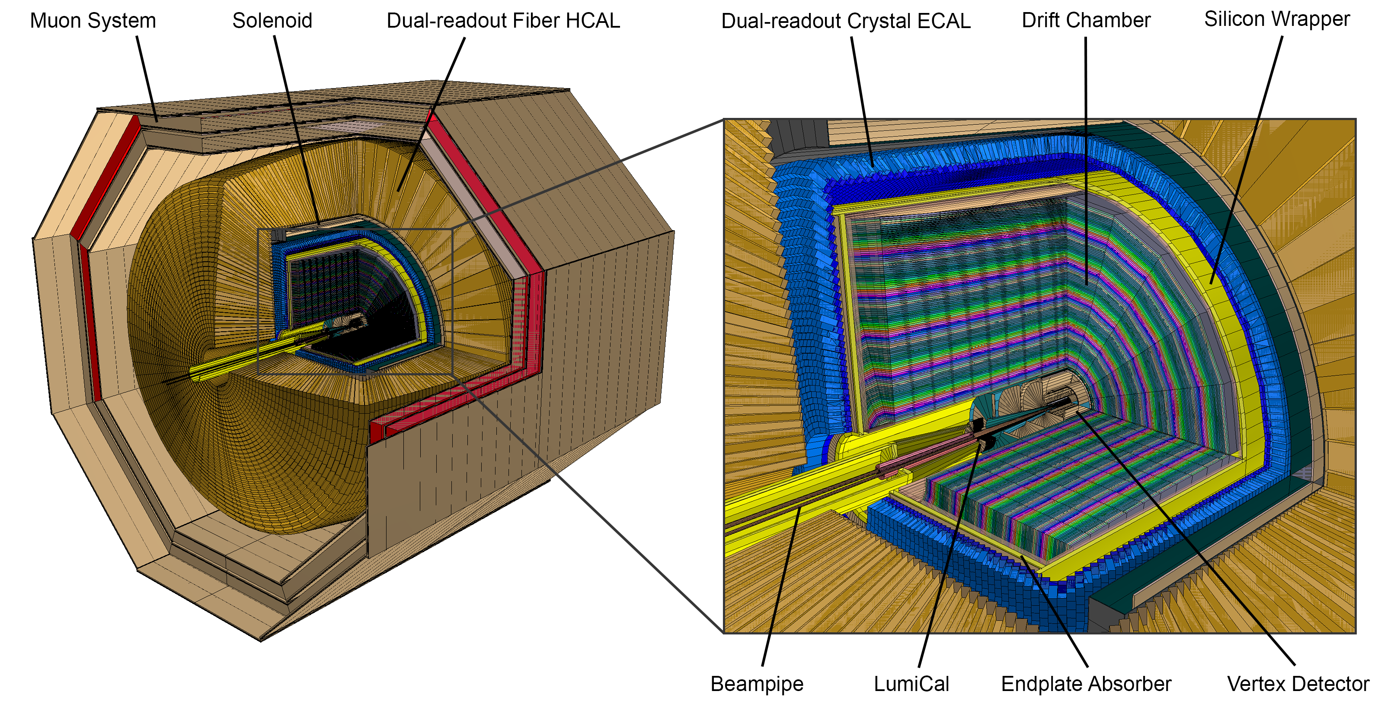



The Innovative Detector for E+e- Accelerator (IDEA) Detector Concept
IDEA detector concept
arXiv:2502.21223
Suzanne GASCON-SHOTKIN
5th FCC/DRD Workshop
APC/LPNHE Paris
27 novembre 2025
Notes:
Add simulation, 2502.21223

Slide 2
The Innovative Detector for E+e- Accelerator (IDEA) Detector Concept
Yoke + Muon chambers
R = 460-570 cm
Dual-Readout hcal:
R = 280-460 cm
IDEA detector concept
Superconducting solenoid coil:
3 T, R ∼ 2.5-2.8 m
DR crystal ecal: ~ 22 X0
R = 215-250 cm
Outer Silicon wrapper:
R = 200-215 cm
Drift Chamber: 112 layers
4 m long, R = 35-200 cm
Vertex:
5 MAPS layers
R = 1.37-31.5 cm
ID0080 Preparation of Time of Flight and tracking layers in a FCC-ee detector (portee par Gaelle Boudoul à l'IP2I)
ID0101 Development of an ultra-light drift chamber with PID capabilities for the IDEA detector (portee par Gabriel Charles à l'IJCLAB)
ID0110 A segmented crystal dual-readout electromagnetic calorimeter for FCC-ee (portee par Suzanne Gascon à l'IP2I)
Beam pipe: R∼1.0 cm
S. GASCON-SHOTKIN 5th FCC/DRD France Workshop APC/LPNHE Paris 27/11/2025
Notes:
ID0080 Preparation of Time of Flight and tracking layers in a FCC-ee detector (portee par Gaelle Boudoul a l'IP2I)
ID0101 Development of an ultra-light drift chamber with PID capabilities for the IDEA detector (portee par Gabriel Charles a l'IJCLAB)
ID0110 A segmented crystal dual-readout electromagnetic calorimeter for FCC-ee (portee par Suzanne Gascon a l'IP2I)

Slide 3
The Innovative Detector for E+e- Accelerator (IDEA) Detector Concept
Yoke + Muon chambers
R = 460-570 cm
Strengths
Precise trackers (μ-RWELL), possibility of identifying long lived particles
DR fiber hcal:
R = 280-460 cm
IDEA detector concept
Excellent jet energy resolution σ(E)/E ≃ 30/√E ⊕ 1%
Superconducting solenoid coil:
3 T, R ∼ 2.5-2.8 m
Up to 50K at 2 T, light/compact
DR crystal ecal: ~ 22 X0
R = 215-250 cm
Excellent energy resolution σ(E)/E ≃ 3%/√E ⊕ 1%
Outer Silicon wrapper:
R = 200-215 cm
Excellent momentum resolution, very little material, outstanding PID: π-K separation:>3 σ up to>20-25 GeV, 1.6(5)% total X/X₀ barrel(endcaps)
Drift Chamber: 112 layers
4 m long, R = 35-200 cm
Vertex:
5 MAPS layers
R = 1.37-31.5 cm
Very good space resolution,
excellent secondary and tertiary vertices identification
Beam pipe: R∼1.0 cm
Full simulation ready!
S. GASCON-SHOTKIN 5th FCC/DRD France Workshop APC/LPNHE Paris 27/11/2025
Notes:
Add simulation, strong points

Slide 4
The Innovative Detector for E+e- Accelerator (IDEA) Detector Concept
Yoke + Muon chambers
R = 460-570 cm
‘Weakness’: Need personpower (esp for digitization/reconstruction)
Dual-Readout hcal:
R = 280-460 cm
Superconducting solenoid coil:
3 T, R ∼ 2.5-2.8 m
IDEA detector concept
DR crystal ecal: ~ 22 X0
R = 215-250 cm
in progress (SiPM, readout, combined ECAL+HCAL), in progress
Outer Silicon wrapper:
R = 200-215 cm
Drift Chamber: 112 layers
4 m long, R = 35-200 cm
Vertex:
5 MAPS layers
R = 1.37-31.5 cm
in progress (IP, cluster counting, ML, Genfit framework)
Beam pipe: R∼1.0 cm
In progress: MLPF
S. GASCON-SHOTKIN 5th FCC/DRD France Workshop APC/LPNHE Paris 27/11/2025

Slide 5
The Innovative Detector for E+e- Accelerator (IDEA) Detector Concept
Physics performance
Drift Chamber: K/π separation in fast sim
HCAL impact on Higgs couplings
Vertex: IP resolution, rmin = 11.7 mm, and 5 μm
resolution in outer vertex
barrels and disks
IDEA detector concept
Silicon Wrapper: Relative mass resolution on
HNL as a function of its
flight distance
S. GASCON-SHOTKIN 5th FCC/DRD France Workshop APC/LPNHE Paris 27/11/2025
Notes:
Add simulation

Slide 6
Acknowledgements
Remerciements: R. Aleksan, E. Auffray-Hillemanns, D. Contardo, C. Dujardin, S. Eno, P. Giacomelli, C. Morel, A. Ilg, M.T. Lucchini, D. Yvon, P. Azzi, S. Moneta , W. Chong…
S. GASCON-SHOTKIN 5th FCC/DRD France Workshop APC/LPNHE Paris 27/11/2025
6

Slide 7

Improving the DR concept with a crystal or crystal-fiber ECAL: Readout with SiPMs
M.T, Lucchini IAS2021, Jan 2021
S. GASCON-SHOTKIN 4th FCC/DRD France Workshop IPHC Strasbourg 24/11/2023
7

