Slide 1

FCC-SEED Vertex detector project
Jeremy Andrea,
IPHC, CNRS, CERN
On behalf of the FCC-SEED project

Slide 2
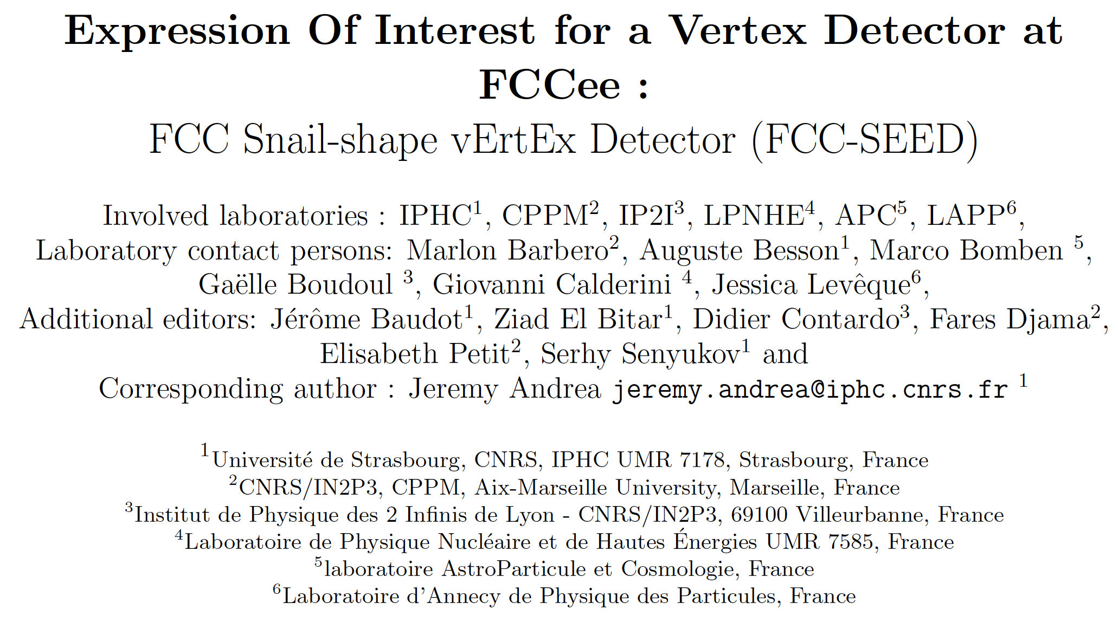
FCC-SEED
A vertex detector concept for FCCee
General Expression of Interests, not yet attached to a specific detector concept
2

Slide 3
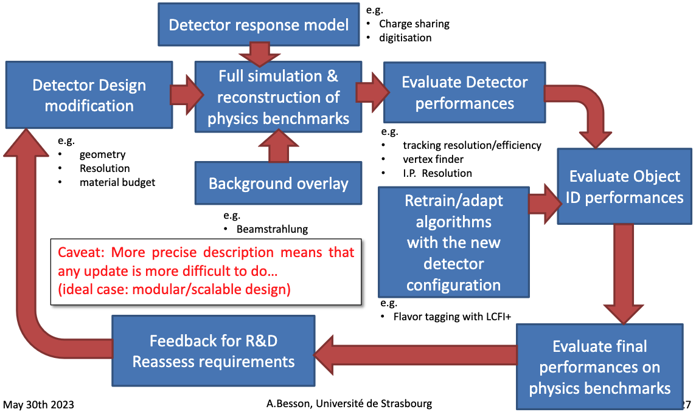
FCC-SEED : setting up the program
Goals for mechanics and integration: work toward a robust vertex concepts for FCCee in the coming ~5 years.
Main topics to be worked on :
Master curved sensor fabrication and testing,
Explore mechanical options, type of material, stress and cooling, etc…
Design a full mechanical geometry, to be tested in full simulation,
Iterative process !
Curved sensor, 3 steps identified :
Step 1 : functional single curved Mimosis,
Step 2 : ”Super-Mimosis”,
Step 3 : demonstrator of a full layer 1.
A.Besson

Slide 4
Existing concepts and FCC seed

Slide 5
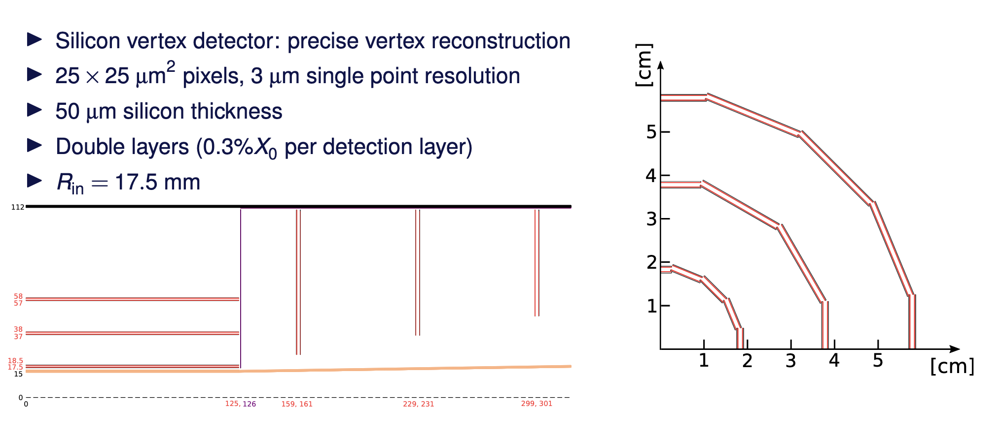

CLD vertex detector
Slide taken from A.Sailer, link.
y
$$θ$$
x
1srt layer radius reduced to 13 mm in latest design
Based on regular “flat” sensors.

Slide 6
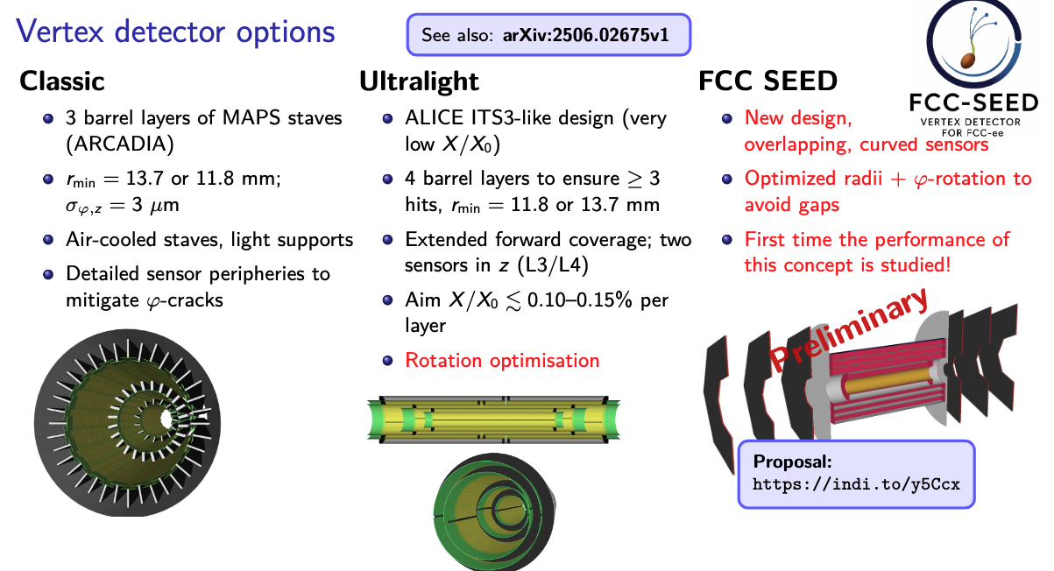
Other existing concepts for vertex detectors
Slide taken from Armin Ilg, Mohamed Ahmed link
Based on regular “flat” sensors.

Slide 7
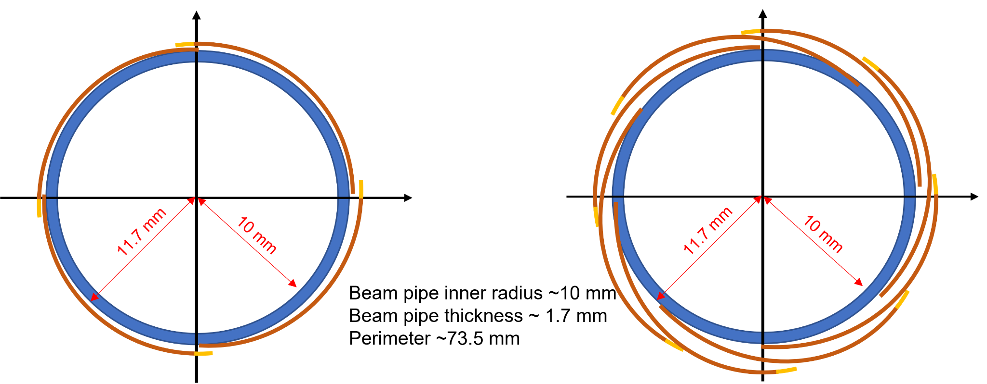
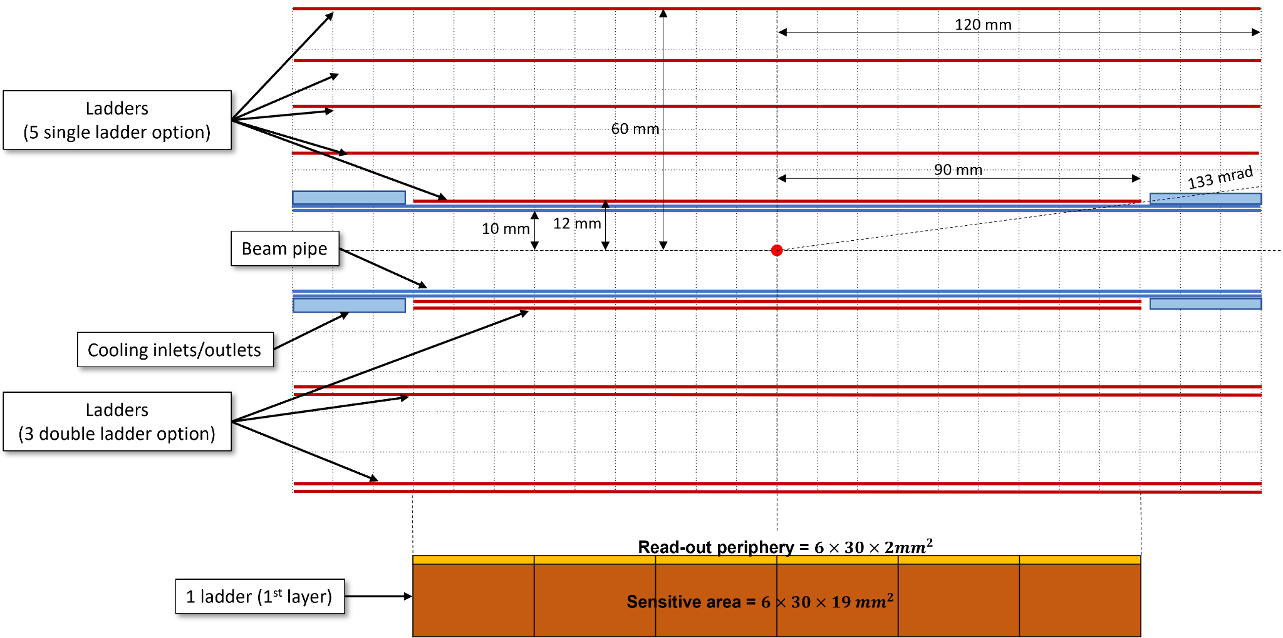
FCC-SEED : geometry concept
Option 1 : single layers
Option 2 : double layers
Based on large size curved sensors (DRD8)
Smallest possible radius, first hits as close as possible to the collision point,
Minimization of the material budget.
Geometry under study
Snail-like shape, slight sensor overlap,
Allow for a full r-phi coverage.
Options to be explored :
Possibility of stitching,
Double sided vs single sided layers,
Layers radius and numbers,
Cooling options.
Coherent developments of sensors, mechanic, integration and simulation.
Option 1
Option 2

Slide 8
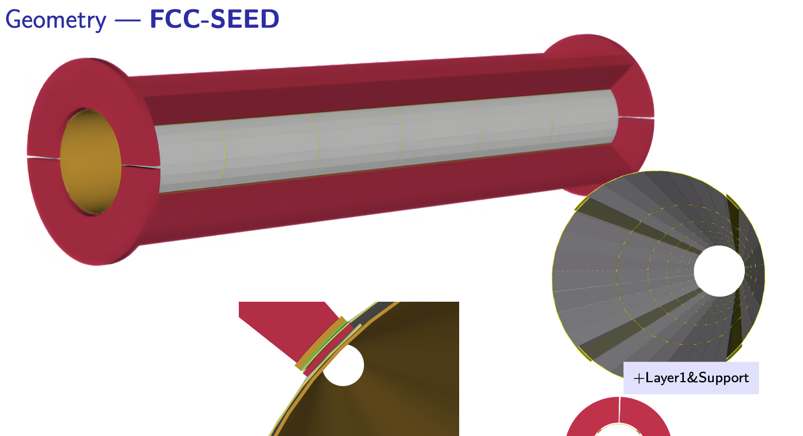
Implementation of the FCC-SEED barrel geometry
Slide taken from Armin Ilg, Mohamed Ahmed link
Mechanical studies ongoing to
Design lighter mechanical supports,
Study assembly and integration,
Design the overall interface with MDI,
Design the cooling system (with air),
Test different material for the supports,
Etc…
Very significant design work, but requires mechanical realisations : prototyping !

Slide 9
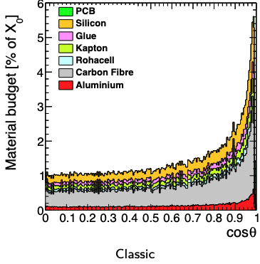
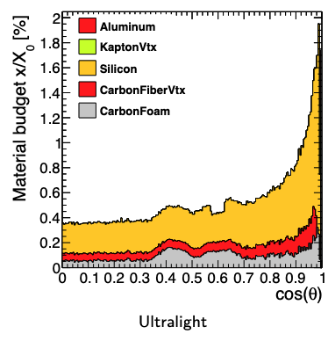
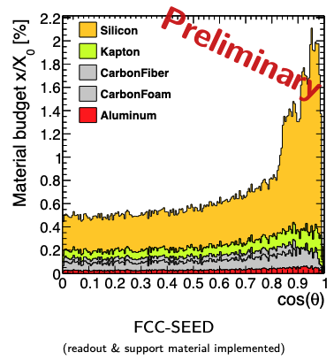
Comparisons of material budgets
Armin Ilg, Mohamed Ahmed link
Only the FCC-SEED Barrel is new,
endcaps from CLD detector !

Slide 10
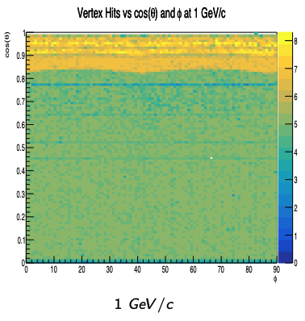
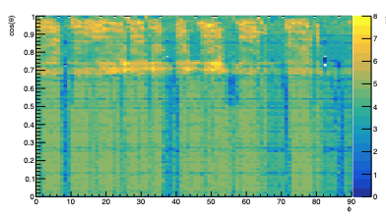
Hit distribution and acceptance coverage
Armin Ilg, Mohamed Ahmed link
Ultralight
FCC-SEED
FCC-SEED shows an hit acceptance, with a large majority of tracks having 5 hits in the Vertex detector

Slide 11
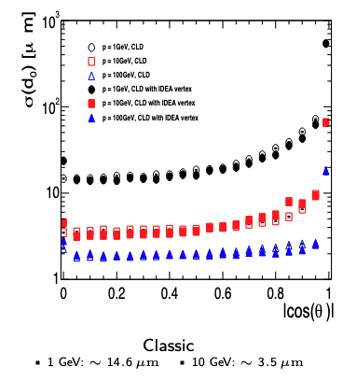
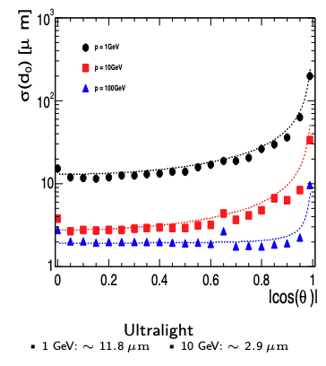
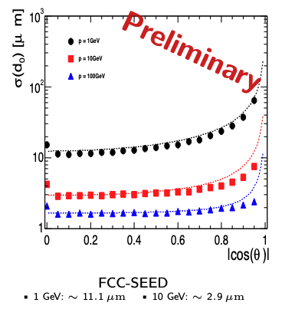

$d_{0}$ resolutions
Armin Ilg, Mohamed Ahmed link
Despite slightly higher material budget, best performance observed for FCC-Seed => almost always 5 hits per tracks.

Slide 12
R&D and prototyping toward FCC-SEED
The FCC-SEED geometry, for the barrel region, relies on curved sensor.
Required gain in know-how and expertise :
Methodology and setup to bend sensors,
To what radius, and with what width, can we bend sensors without breaking?
Does the bending modify sensor performances?
Design and tests methods for installation on mechanical supports,
How the cooling can be performed (air flow, heat dissipation vs air temperature and flow),
Etc… etc…
Bending sensors : method inspired from Alice ITS3, bending setup installed and commissioned.
Plan :
Use Mimosis chips for curved sensor tests,
Mimosis 2.0 are good candidates for practicing bending,
Functional versions Mimosis 1 or 2.1 are good candidates for bend sensor testing with particles => lab and test beam,
Readout inherited from Mimosis, new flex (connection to the chip) has been designed and produced.

Slide 13
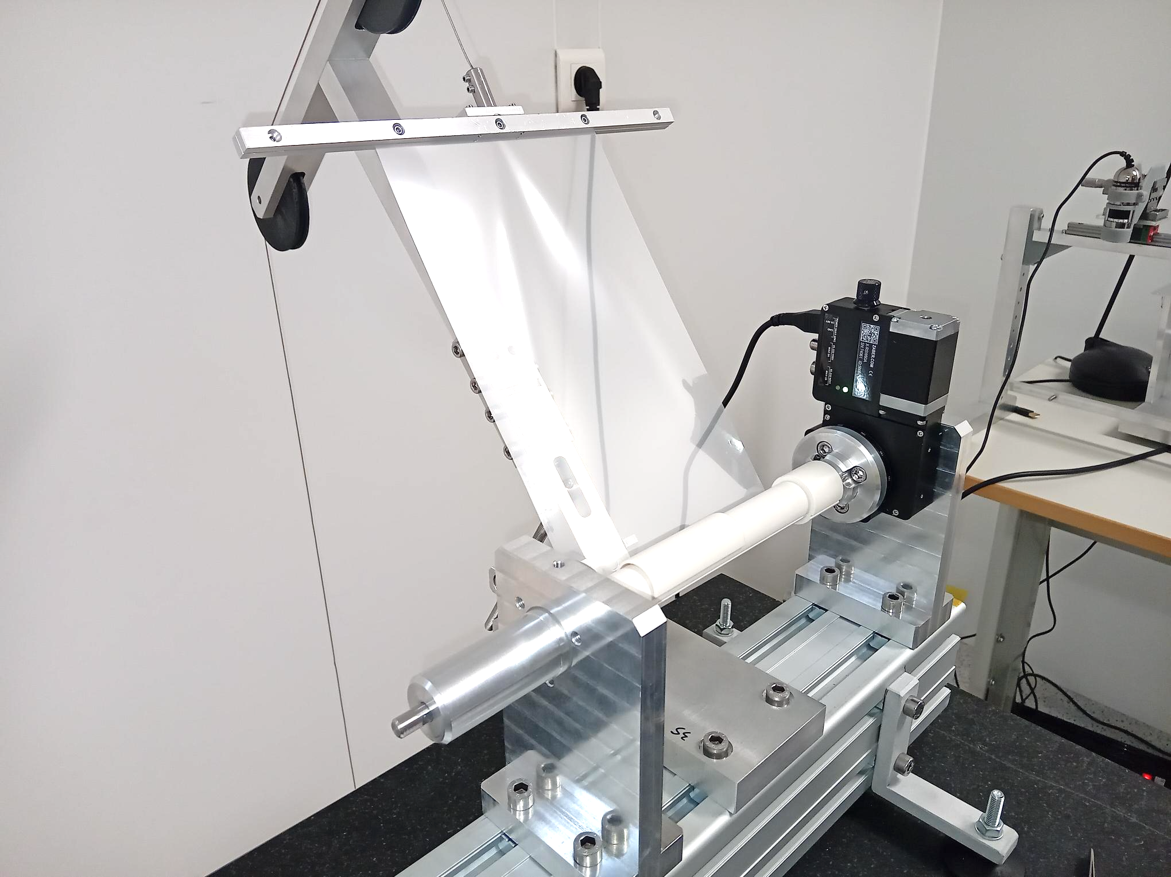
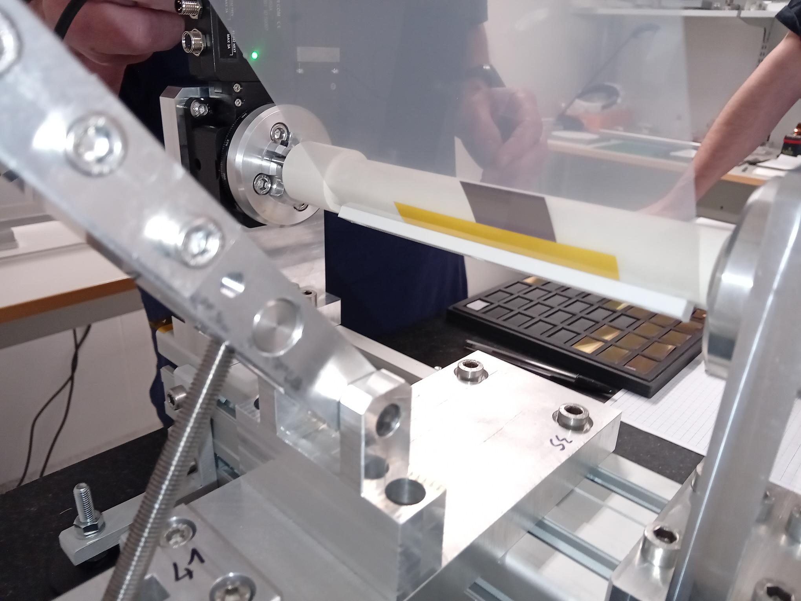
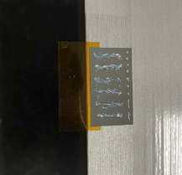

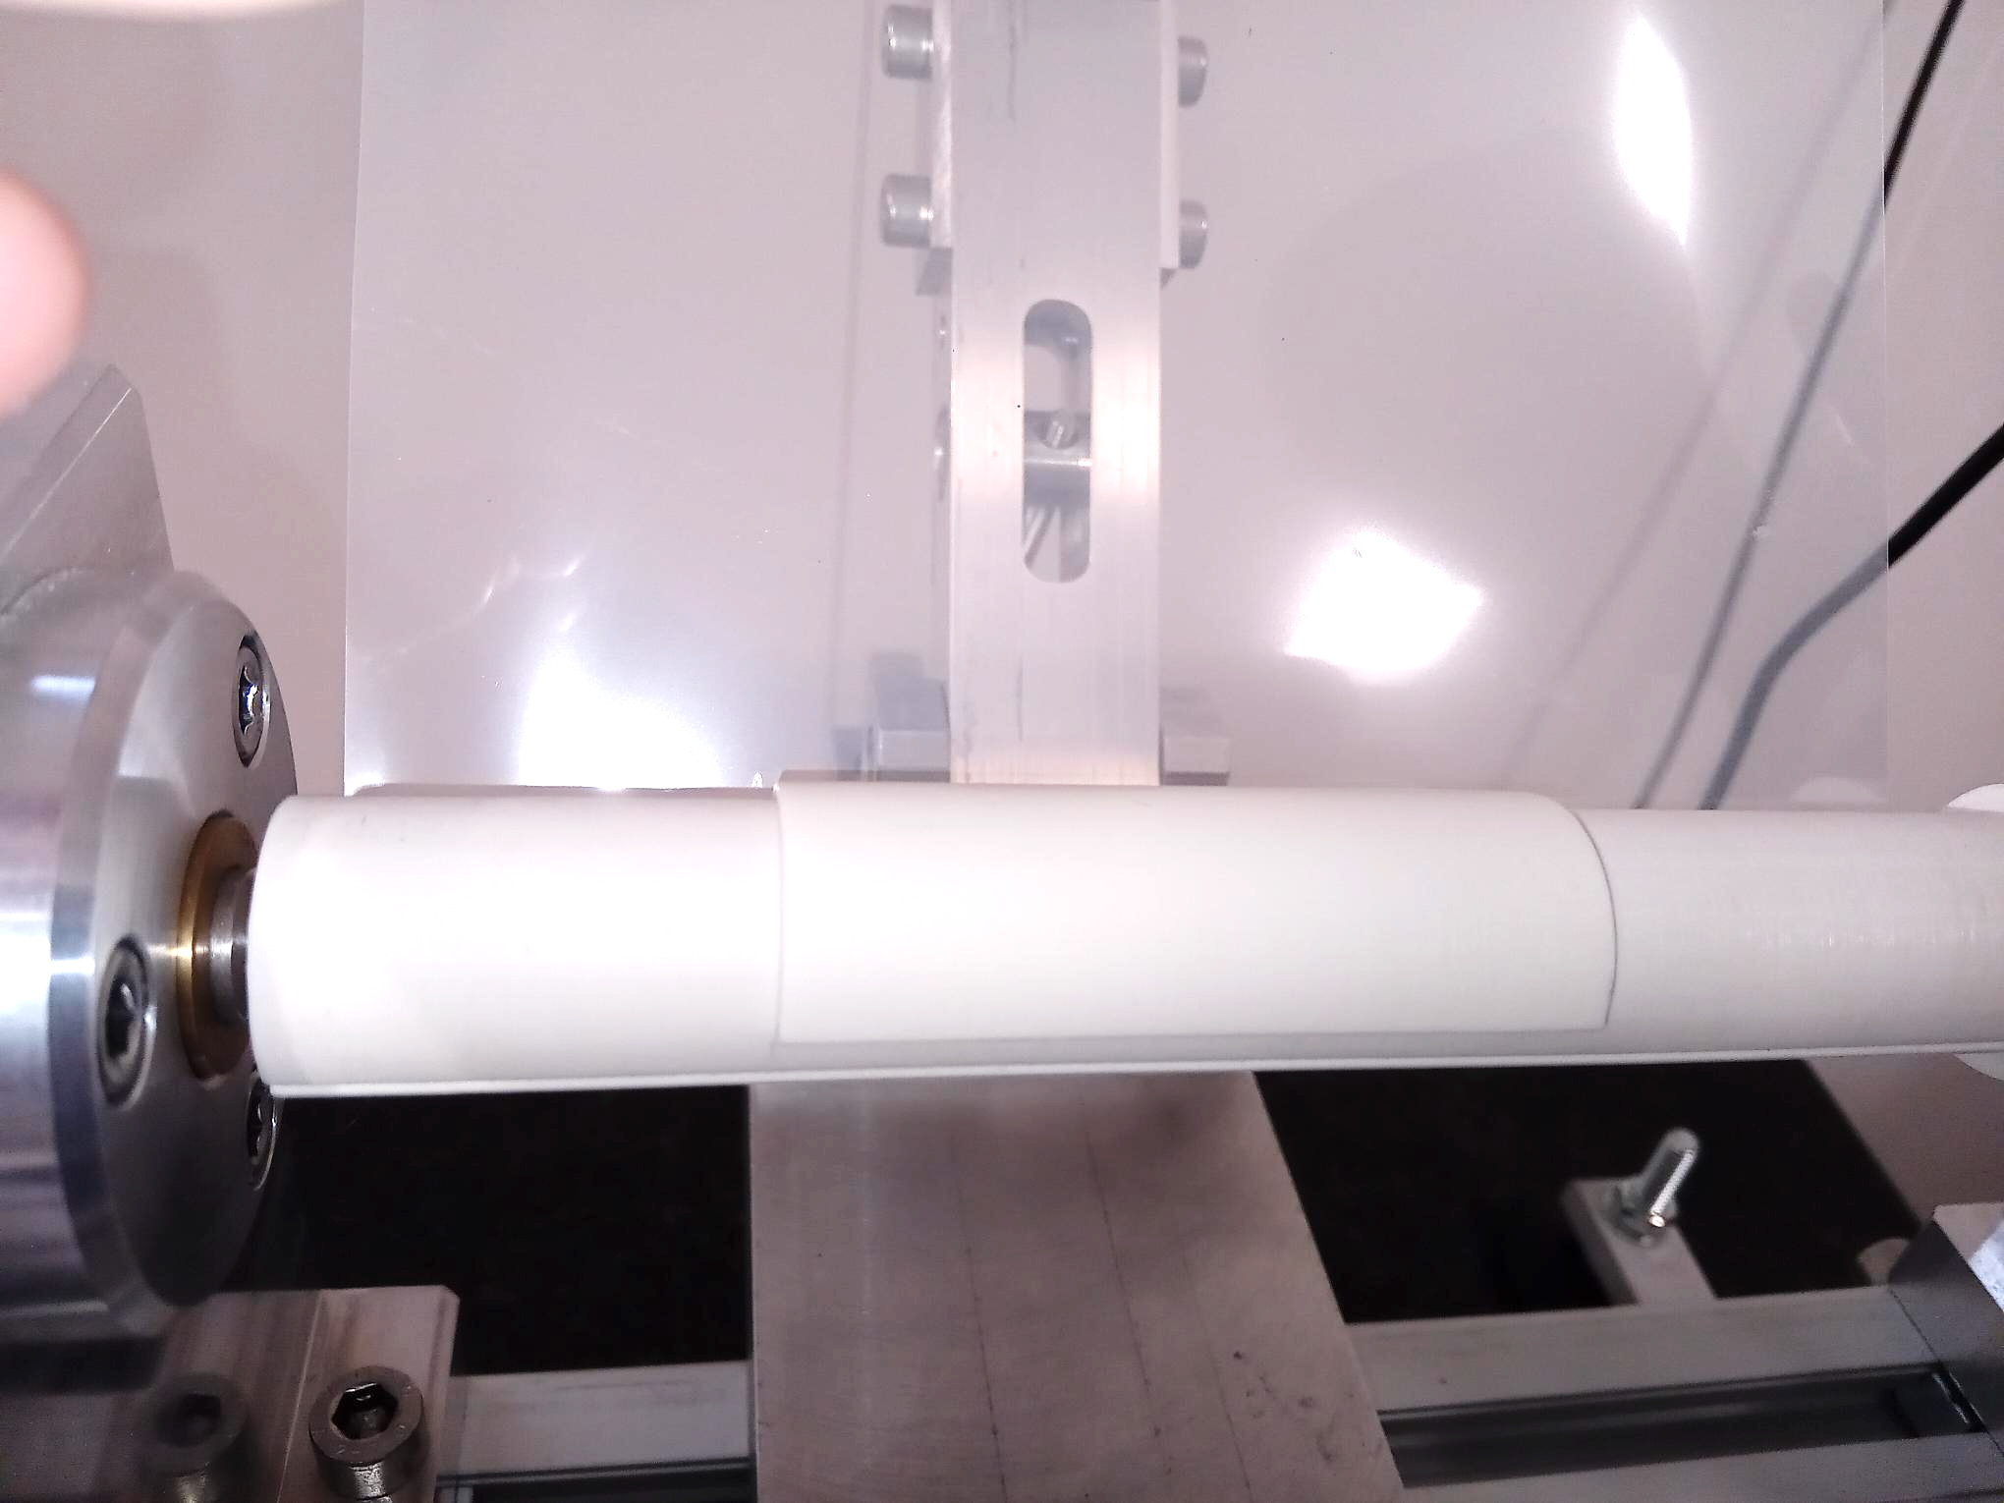
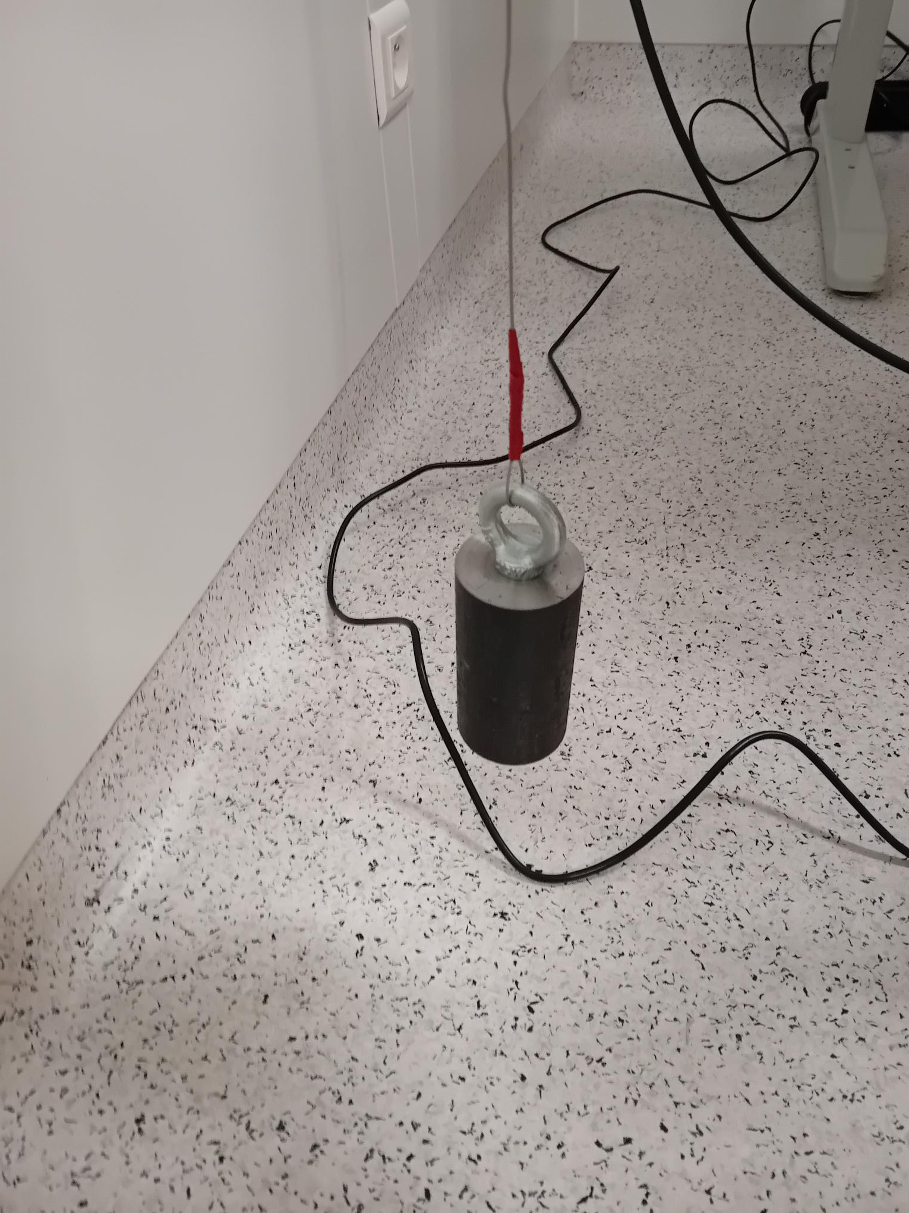
Sensor Bending
Millar foil
Sensor
Sensor support
Mandrell
counterweight

Slide 14
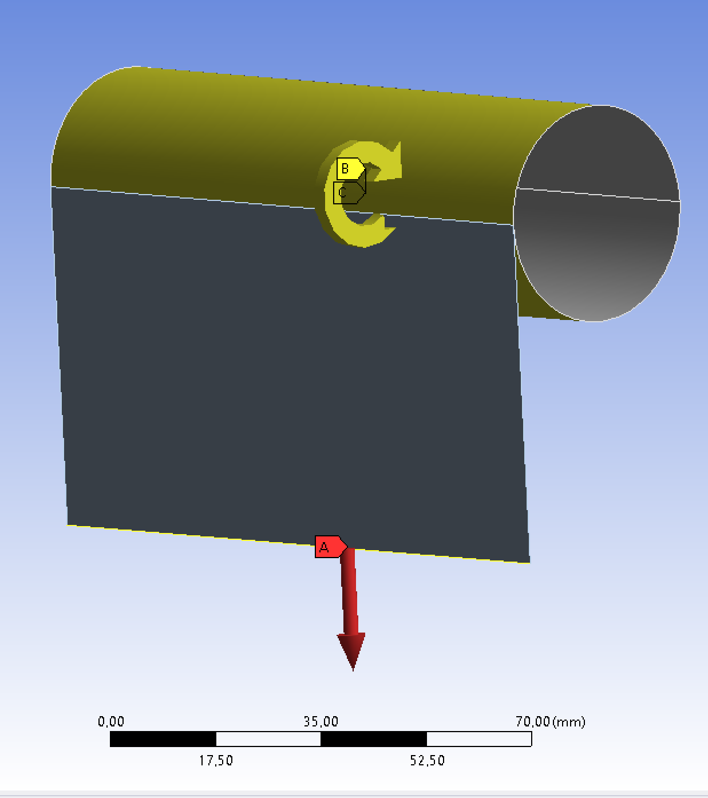
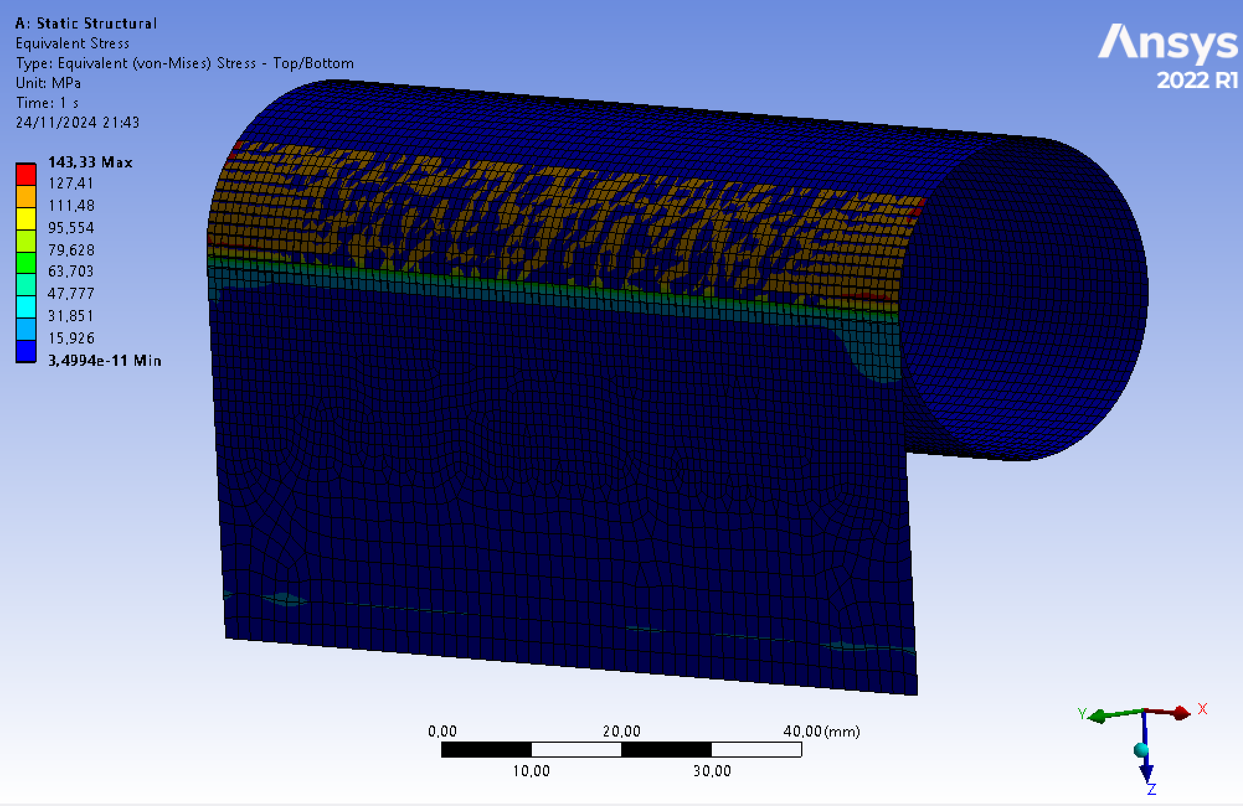
Mecanical simulations
Preliminary
Goal : simulate the bending of a silicon sensor, to determine the breaking points vs thickness and inner radius.
Start with the modelling of a simple leaf of silicon, but mechanical characteristics of chips might be different :
Simulation of a complete chips might be difficult,
Considering measuring the mechanical characteristic of Mimosis and feed the simulation with the results.
Preliminary studies with ANSYS being performed, but much more work is needed.
More simulations (thermo-fluidic) related to thermal aspects are also required.
Preliminary

Slide 15
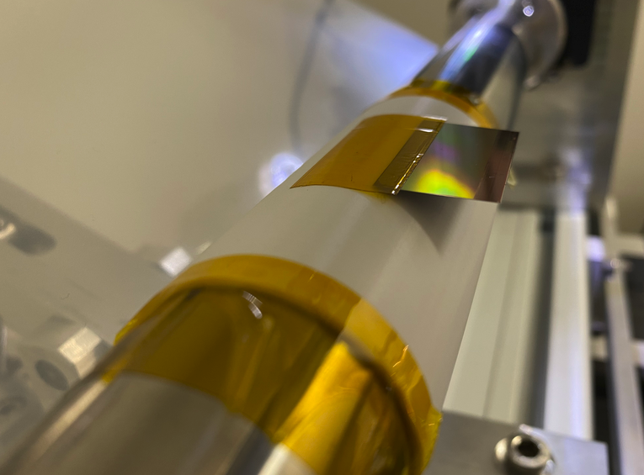
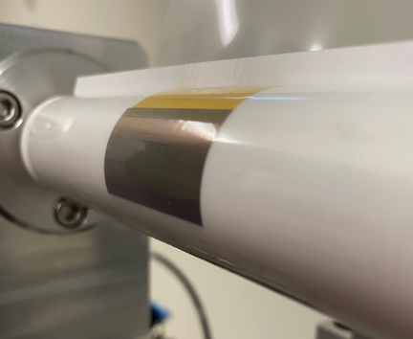
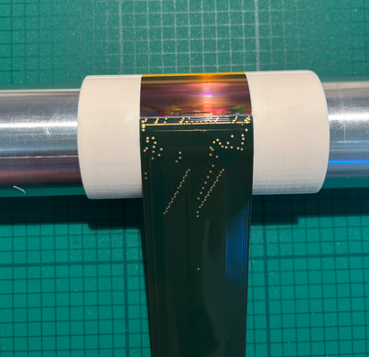
Toward functional bend Mimosis
Several tests were performed, with different glue viscosities and glue doses.
Methodology for bending and connecting sensors are defined and tested.
Ready to glue and wire-bond a functional Mimosis for lab and beam tests (CYRCé then DESY).
Sensor covered with Kapton foil,
after rolling the Millar foil
Curved sensor glued on it support, ready for bonding
Sensor taping on the mandrel

Slide 16
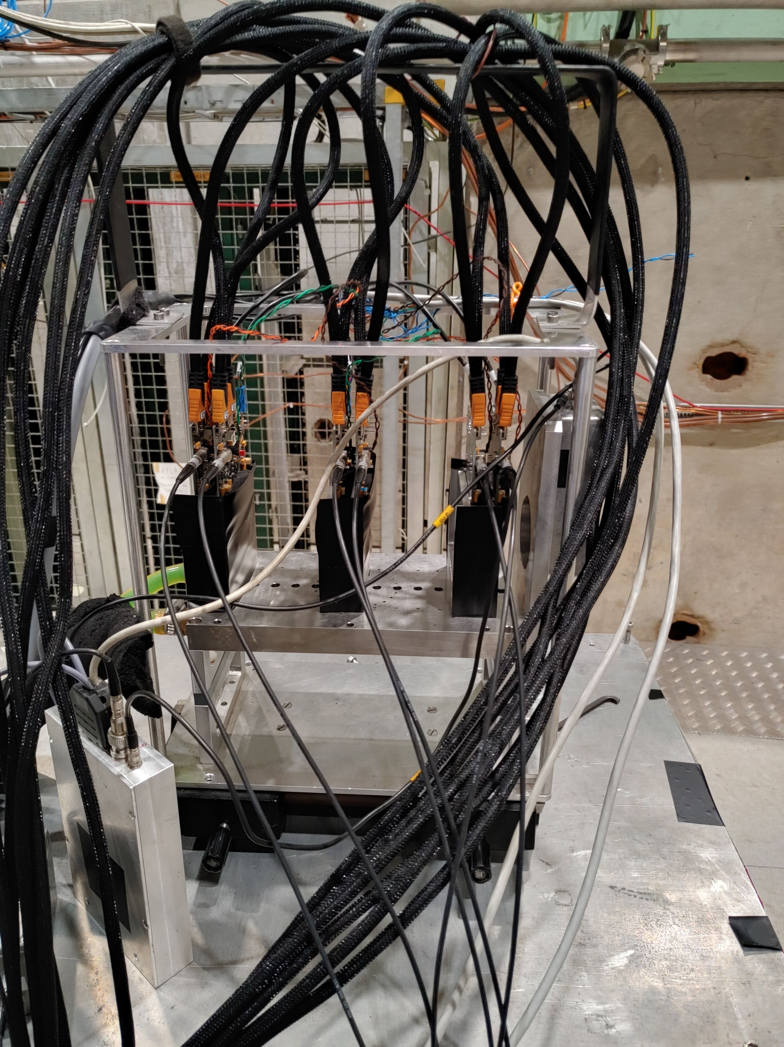
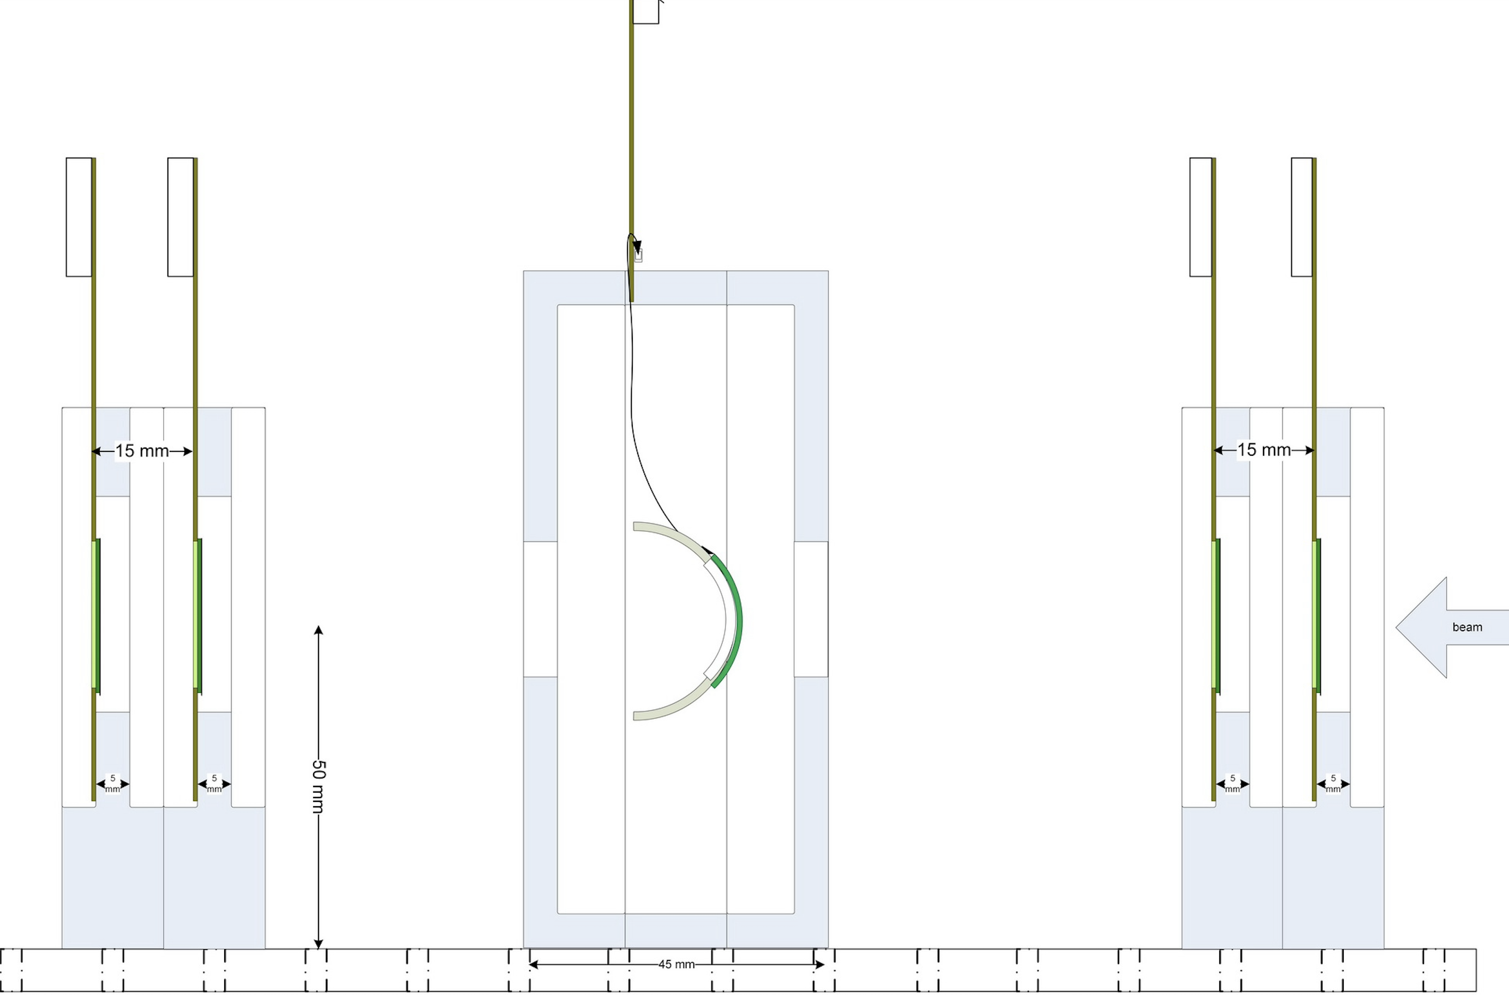
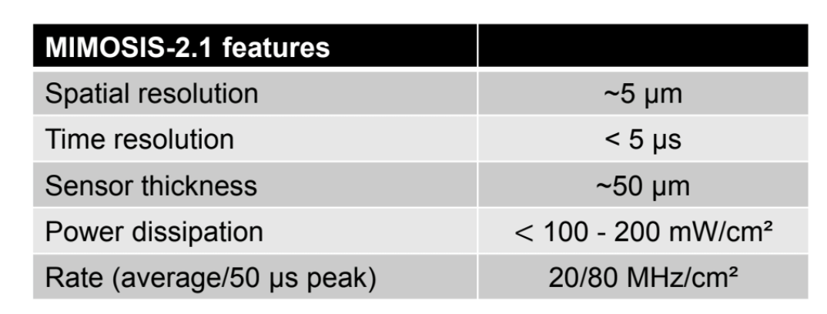
Beam test preparation
Testing with beams to be performed with a Mimosis-based telescope.
Two layers with two Mimosis sensors each, sandwiching the Detector Under Test (DUT).
Synchronisation “for free”, uses same DAQ and software.
Prior to test at DESY, testing of the sensors and telescope at the local IPHC cyclotron.
Curved Mimosis supports and test box designed and fabricated.
Reference planes
2 Mimosis per layer
scintillator
Location of the DUT

Slide 17
Long road ahead…
FCC-SEED is a new vertex concept for FCCee based on curved sensor and original design
Coherent approach : plan to study coherently chip designs, mechanics, cooling and integration,
Generic : can be ported/adapted to any detector concepts.
First simulations show a competitive performance.
While chip designs happens, use existing chips (Mimosis) for mechanical and integration studies.
Curved single Mimosis, with test-beam targeted in spring 2026,
Curved Mimosis Ladder by the end of 2026. Requires developments on mechanic, flex and DAQ,
Demonstrator of a first layer 1 in 2027.
In parallel, work on overall design and mechanical prototyping
Test of materials : carbon foam, peek, 3D printed composite,
Test bench for air cooling,
Design of vertex detector mechanical supports and rooting of services, including assembly procedures,
Optimise geometry based on performance in fullsimulation.
Goal : demonstrate relevance, performance and feasibility of FCC-SEED by 2028.

