Slide 1
Evolution of WLCG Data & Storage Management
Outcome of Amsterdam Jamboree
Andrea Sciabà
Réunion des sites LCG-France
24-25 June, CPPM Marseille

Slide 2
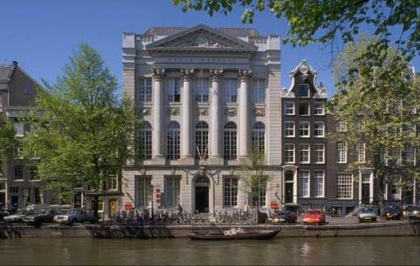
Introduction
Held in Amsterdam
Two and a half days
100 attendees
30 presentations
http://indico.cern.ch/event/92416
  Check for details on the talks and the attached documents

Slide 3
Goals
Challenges
  Performance and scalability for analysis
  Long term sustainability of current solutions
  Keep up with technological advances
  Look at similar solutions
The goal is to have a better solution by 2013
  Focus on analysis and user access to data
  Based on available tools as far as possible
    And try to avoid HEP-only solutions
  More “network-centric”
    cloud of storage
  Less complexity, more focused use cases

Slide 4
Technical areas
Use tape just as backup archive
Allow remote data access
Look into P2P technologies
“Global home directory”
Address catalogue consistency
Revisit authorisation mechanisms
  Quotas, ACLs, ...
Virtualisation, multicore

Slide 5
Agenda
Day 1: Setting the scenario
Day 2: Review of existing technologies and potential solutions
Day 3: summary, agreement on demonstrators and prototypes, plan and timeline

Slide 6
The “strawman” model
Some past assumptions do not hold anymore
  “Network will be a bottleneck, disk will be scarce, need to send jobs to the data, ...”
Key features
  Tape is a true archival system
    e.g. “stage” from a remote site’s disk rather than from tape
  Transparent (also remote) data access
    More efficient use of networks
  More CPU-efficient data access (also remote)
  Less deterministic system (= more flexible and responsive)
    P2P to be seriously investigated
Notes:
“Network is a bottleneck” implied to design sites as “walled cities” with two entrances: the CE and the SE.
Today, some sites have comparable WAN and LAN connectivity.
Transparent remote data access possible via xrootd.
Tape: copying from another site’s disk can be better than from one’s tape backend.
Some experiments stage from tape even if they have abundant disk.
Less structured transfers between T1’s and T2’s.

Slide 7
Networks and tape storage
LHCOPN fine today but limited to T0-T1, T1-T1 flows
  Flows are larger than expected
  T1-T2, T2-T2 becoming significant
Need to study patterns, design an architecture and build it
  If not done, network will do become a problem
HSM are not really used as such
  Data are explicitly pre-staged
  Users are often forbidden to access tape
Introduce the notion of file-set?
  More efficient dataset placement on disk and tape
Use disks for archive?
  Focus on cost and power efficiency, not performance
Would clustered storage be more operationally efficient?
Notes:
Moving to P2P; expectations becoming unrealistic.
File-sets would make more efficient dataset placement on disk and tape and better support production workflows.
Would avoid to have to setup tape families; files could be spread over different disk servers to balance the load.
Demonstrator on economical, operational feasibility of disk archives; prove workflow simplification.
Clustered storage is supposed to be easier to operate independently of its size.

Slide 8
Data access and transfer
Various well known issues
  Heterogeneity of storage and data access protocols
    need fine tuning for CPU efficiency
  Authorization depends on system
Desiderata
  A transparent, efficient, fault tolerant data access layer
  Reliable data transfer and popularity-aware dataset replication
  Global namespace
  Transparent caching
Use UNIX paradigm?
The focus should be on a common data access layer
Efficient usage of network, meltdown avoidance, sustainable operations are also a concern
Use sparse access to objects and events rather than scheduled dataset transfers depending on the case
Notes:
Intelligent defaults (which replica to read, which SE to write on) + possibility to specify.

Slide 9
Namespaces, catalogues, quotas
Need for global namespaces: hierarchical (directories) and flat (GUIDs)
Catalogue: should be simple and consistent with storage
  LFC and AliEN File Catalogue meet the requirements
  Lack of consistency is a serious issue
ACLs: should be global (and no backdoors), support DNs and VOMS groups
  And quotas, too
Quotas still missing but should be easy to implement on top of catalogue
Notes:
Now ACLs are defined in central catalogue, SRM and SE!

Slide 10
Multicore and global namespaces
Problems with current way to use multicore CPUs (one job per core)
  Increasing memory needs
  Increasing independent readers/writers to disk
  Increasing number of incoherent jobs competing for resources
Must learn how to use all cores by a single job
  Will provide many opportunities for optimization
Global namespace
  Look for viable implementations
Notes:
Optimizations:
Job becomes “memory-rich”
Coordinated I/O
Reduced external connections
Local output merging

Slide 11
Second Day

Slide 12
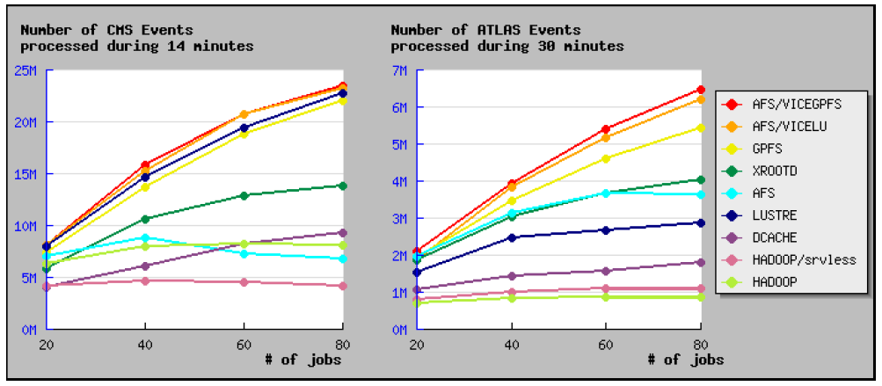
File system tests and summary of IEEE MSST symposium
HEPIX storage WG is benchmarking several storage systems against CMS (serial access) and ATLAS (random access) applications
  AFS, GPFS, Lustre, xrootd, dCache, Hadoop
  Metrics are events/s, MB/s
Results “today” (work in progress)
  GPFS excellent (but expensive)
  AFS VICE/GPFS, AFS VICE/Lustre excellent
Highlights from discussions at IEEE MSST at Lake Tahoe
  HEP DM too complex, unreliable, not standard, not reusable, expensive to manage
  Should use standard protocols and building blocks
  NFS 4.1 very attractive
  SSDs not yet ready for production
Notes:
CMS does serial access, ATLAS does random access.
AFS VICE/Lustre allows to remove servers without a visible interruption and it is free.
Performance is sensitive to caching client-side.
Plan to add NFS 4.1 and use updated applications.
Use standard protocols and building blocks.

Slide 13
NFS 4.1 and xrootd
NFS 4.1 is very attractive
  Good for high latency, full security, standard protocol, pNFS scalable, industry support, available in OS, funded by EMI, simple migration path (for dCache)...
xrootd is a well established solution for HEP use cases
  Well integrated with ROOT
  Catalogue consistency by definition
  Seamless data access via LAN and WAN
  Strongly plug-in based
Support is best effort by experts
Protocol partially coupled with implementation?
Notes:
P2P-like internal file discovery
Authorization UNIX-like, simple shared secret, GSI, Kerberos, VOMS

Slide 14
FTS and the file catalogues
FTS limitations
  The channel concept is becoming insufficient for any-to-any transfers: abandon it?
  Easy to overload the storage:
  FTS server depends on the link: use message queues to submit anywhere?
  Have the system choosing the source site?
  Allow to restart partial transfers?
LFC: main issue is consistency (for any catalogue)
  Solve it using a messaging system between the catalogues and the SEs?
AliEN File Catalogue
  Provides a UNIX-like global namespace with quotas
  Includes a powerful metadata catalogue
A comparison between LFC and AliEN FC is missing
Notes:
Abandon channels?
Use MQ to submit anywhere?
Add GUIDs to SE catalogue to remove need for local file catalogue.
AlienFC supports various authentication systems (X.509, ssh, user/password, job tokens) and file collections.

Slide 15
CDN and SRM
Investigate Content Distribution Networks
  Network of disk caches where files are read from
  Use Distributed Hash Tables for cache resolution
  CoralCDN is a popular CDN, but there is no security
SRM problems
  Protocol development was rushed
  Overly complex space management
  Incoherent implementations
  Addresses both DM and data access
SRM future a subset of it?
  Drop data access

Slide 16
ROOT and ARC
Smart caching makes access via WAN possible and efficient
  The TTreeCache reduces by a factor 10000 the number of network transactions
  A cache on the local disk (or a proxy) would further improve performance
Optimizing also for multicore machines
In ARC, the CE can cache files
  Can schedule dataset transfers on demand
File location in caches stored in a global index using Bloom filters
  But with the probability of some cache misses
Notes:
All T2 storage is used as a cache and is accessed as a local file system

Slide 17
xrootd at KIT and StoRM/GPFS/TSM at CNAF
KIT is a successful example of integrating xrootd with a tape system
  Scalability, load balancing, high availability
  Also integrated with BestMAN SRM and GridFTP
CNAF has completely moved to GPFS for storage
  StoRM for SRM, GridFTP, TSM for tape, xrootd for ALICE
  GPFS complex but extremely powerful
  Performance most satisfactory
Notes:
Xrootd at KIT could even implement the Strawman model, by looking for a file at another site instead of from tape when it is not on disk.
Alice is very happy with it.
With GPFS, recalls from tape reaching 500 MB/s (80% of tape drive nominal rate).

Slide 18
HDFS at Tier-2’s
The filesystem component of Hadoop
  Strong points are fault tolerance, scalability and easy management
  Aggregates the WN disks
Integrated with BestMAN SRM, GridFTP, xrootd, FUSE
No security
Notes:
Blocks automatically replicate.
All data is checksummed on read.
Easy to add/remove nodes.
Incredibly fast metadata server.
FUSE used to have a filesystem-like interface.

Slide 19
Conclusion
What now?
  Define demonstrators and corresponding metrics for success
  Define a plan including resource needs, milestones
  Track progress (Twiki, GDB meetings)
  Conclusions by end of 2010

Slide 20
Demonstrators
ATLAS Tier-3’s: use local storage as cache via xrootd
Use CoralCDN for a proxy network, using HTTP via ROOT
PanDA dynamic data placement: trigger on-demand replication to Tier-2’s and/or queue jobs where data are
  Study an algorithm to make the optimal choice
Use xrootd redirector layered on other SEs
ARC caching
Use messaging for catalogue-SE synchronization
Compared study on catalogues
Proxy caches in ROOT
NFS 4.1
…
Notes:
For Coral, use ROOT with HTTP as access protocol

