Slide 1



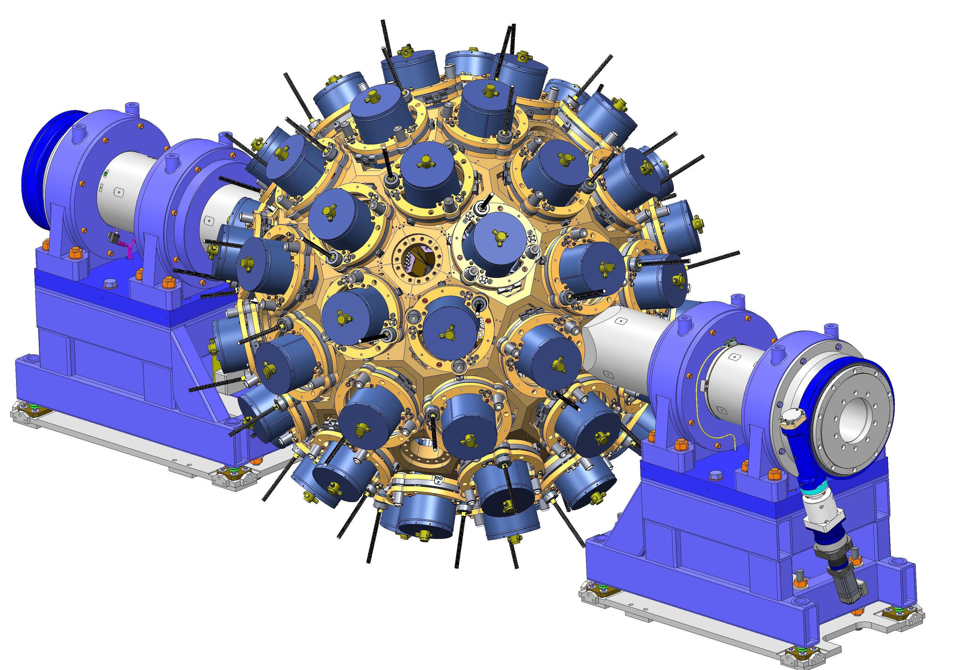

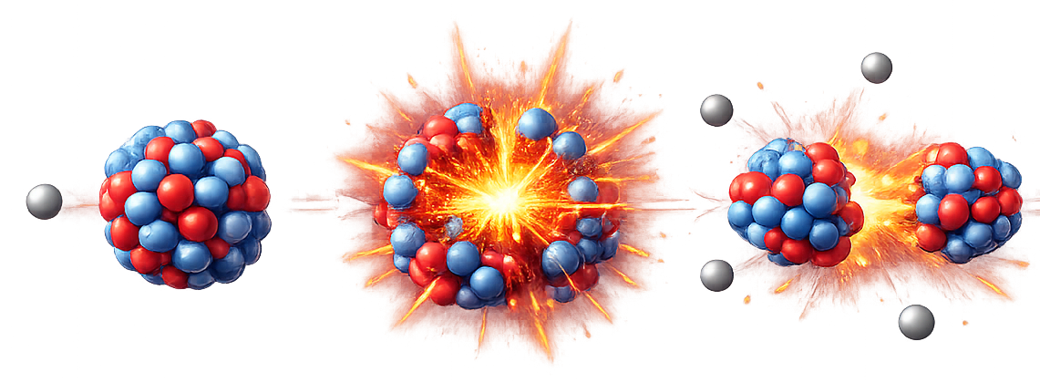
Data Challenge: Scientific introduction Jérémie Dudouet (IP2I Lyon, CNRS)
Adrien Matta (LPC Caen, CNRS)

Slide 2
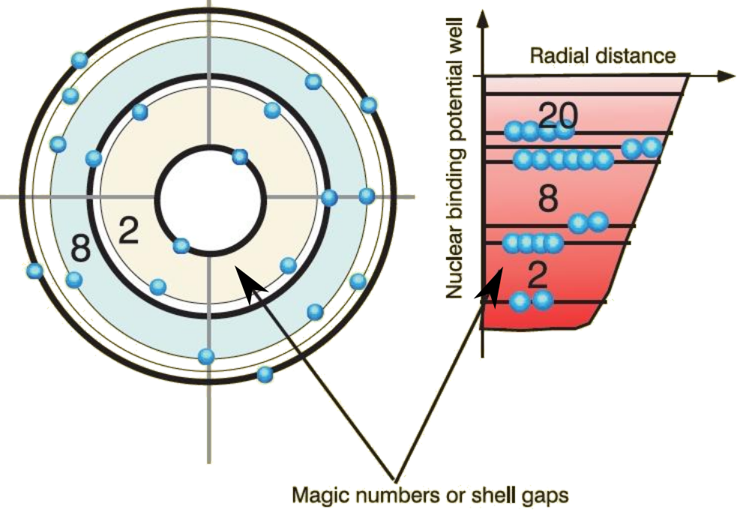
Scientific context: fundamentals of nuclear structure
Stable nuclei nuclear chart
Origins of our understanding of the atomic nucleus
Nucleons are organized in shells
Nucleons organized in nuclear shells
Electrons organized in electronic shells

Slide 3
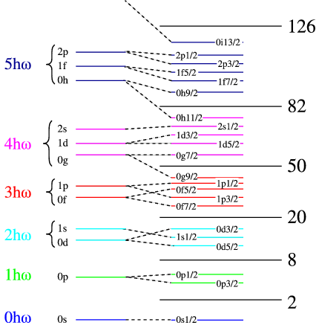
Scientific context: fundamentals of nuclear structure
Stable nuclei nuclear chart
Origins of our understanding of the atomic nucleus
Nucleons are organized in shells
Evidence of magic numbers

Slide 4
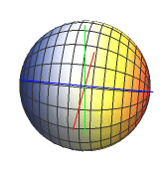
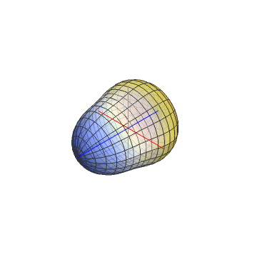
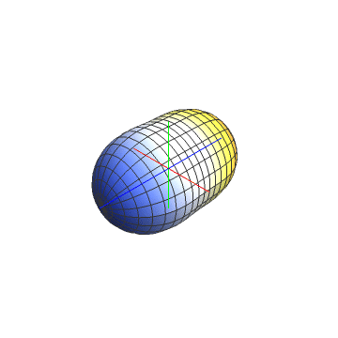
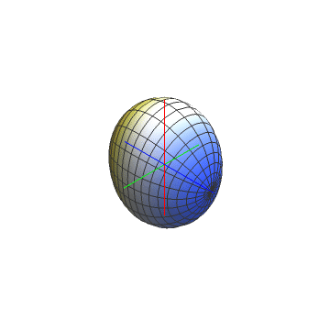
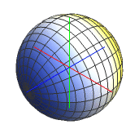
Scientific context: fundamentals of nuclear structure
Exotic nuclei
p–n imbalance can enhance certain phenomena:
Emergence of collective motion
Modification of shell structure / magic numbers
Shape transitions

Slide 5
Scientific context: how to probe nuclear structure
Excitation energy populates different excited-state configurations

Slide 6
Scientific context: how to probe nuclear structure
Excitation energy populates different excited-state configurations

Slide 7
Scientific context: how to probe nuclear structure
Excitation energy populates different excited-state configurations

Slide 8
Scientific context: how to probe nuclear structure
Excitation energy populates different excited-state configurations

Slide 9
Scientific context: how to probe nuclear structure
Excitation energy populates different excited-state configurations

Slide 10
Scientific context: how to probe nuclear structure
Excitation energy populates different excited-state configurations

Slide 11
Scientific context: how to probe nuclear structure
Excitation energy populates different excited-state configurations
De-excitation to the ground state via γ-ray emission
Experimental access to the internal structure of the nucleus through γ-ray spectroscopy

Slide 12
Scientific context: building a level scheme: the “nuclear ID card”

Slide 13
Scientific context: the fission process
Fission is the most efficient way to produce neutron-rich nuclei
✅ Advantage:
Broad population of neutron-rich fission fragments ➥ large-scale, systematic γ-ray spectroscopy.
⚠️ Drawback:
Very complex mixture ➥ requires advanced analysis tools
≈ 800 nuclei produced simultaneously

Slide 14
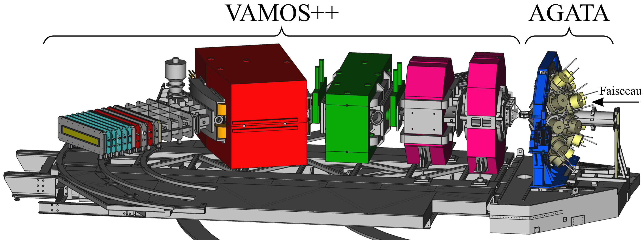
How to make γ-ray spectroscopy of fission fragments ?
With fragment identification: AGATA + VAMOS
Without fragment identification: EXILL
Advantage:
Isotopic identification ➥ very clean spectra, simple analysis
Drawback:
Complicated detection system / pre-analysis
Limited statistics / multiplicities
Advantage:
Datasets with huge statistics
4π solid angle → high multiplicities
Simple detection system
Drawback:
Complicated γ-ray analysis
Cannot be applied on unknown nuclei

Slide 15
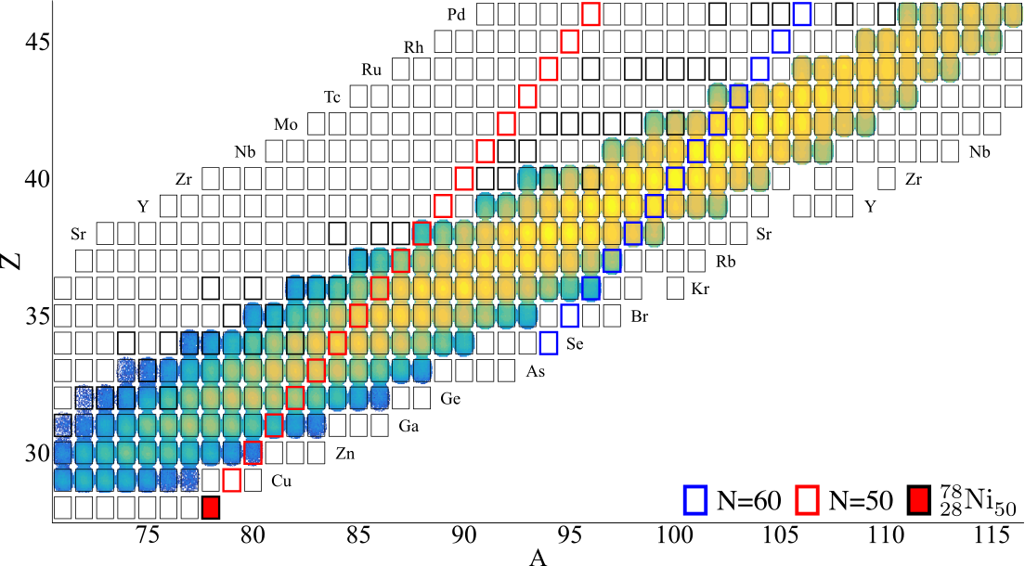
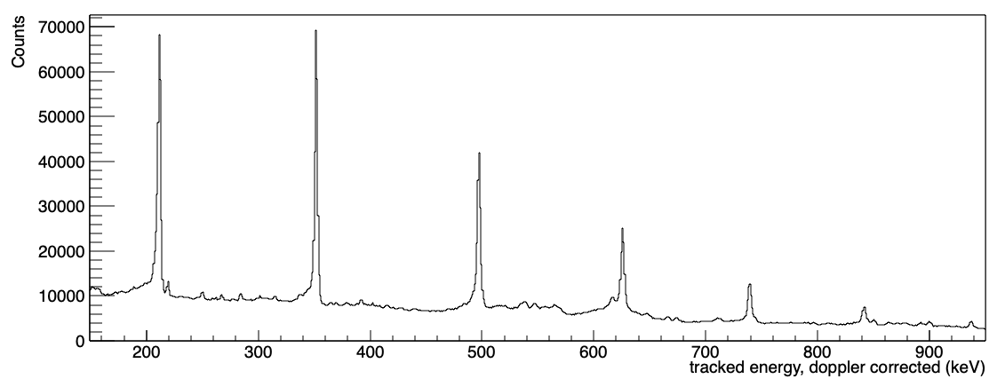
How to make γ-ray spectroscopy of fission fragments ?
With fragment identification: AGATA + VAMOS
Isotopic identification
Advantage:
Isotopic identification ➥ very clean spectra, simple analysis
Drawback:
Complicated detection system / pre-analysis
Limited statistics / multiplicities
2⁺
4⁺
¹⁰⁰Zr gated spectrum
6⁺
8⁺
10⁺
12⁺

Slide 16
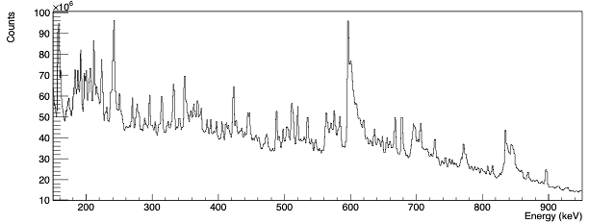
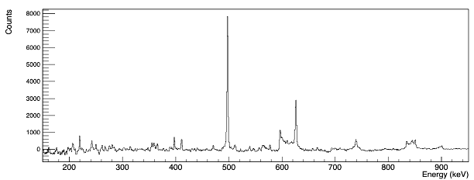
How to make γ-ray spectroscopy of fission fragments ?
Without fragment identification: EXILL
No isotopic identification
Advantage:
Datasets with huge statistics
4π solid angle → high multiplicities
Simple detection system
Drawback:
Complicated γ-ray analysis
Cannot be applied on unknown nuclei
2⁺
4⁺
6⁺
(2⁺ & 4⁺) gated spectrum
Gate 1
Gate 2
8⁺
10⁺
12⁺

Slide 17
Principle of the Data Challenge
Two realistic datasets have been simulated (new physics has been added)
Dataset AGATA
Dataset EXILL
Simulation of an AGATA + VAMOS experiment
Z and A of the emitting fragment are known
Dataset limited to multiplicity 1
Goals:
Calibrate and analyse the data
Produce multiplicity 1 spectra
Simulation of an EXILL experiment
No identification of the emitting nucleus
High-multiplicity data
Goals:
Calibrate and analyse the data
Produce gamma-gamma matrices
Common objective
Cooperation between the two experiments to be able to reconstruct level schemes
AGATA teams will identify the first transitions
EXILL teams will search for coincident γ rays
→ Together, we reconstruct new level schemes

Slide 18
Principle of the Data Challenge
Main tasks for the week
Use GitLab collaboratively
Work with forks and feature branches
Use issues and merge requests effectively
Keep discussions and decisions traceable
Build automated pipelines
Snakemake for reproducible analysis workflows
GitLab CI for builds, tests, and quality checks
Describe methods and outputs
Produce clear metadata for datasets and results
Document code and analysis choices
Team up and deliver
Align on shared goals and milestones
Split tasks and assign owners
Share progress, blockers, and results daily

Slide 19
Principle of the Data Challenge
Team composition
Dataset AGATA
Dataset EXILL
Issue Saber
Commit Claymore
Víctor Martínez Nouvilas
Sandipan Dawn
Francisca Filipa Pereira Barbosa Afonso
Krzysztof Solak
Juan Francisco Gonzalez Linares
Juan Fuentes Lois
Vskchintamani Sai Sisir Chandrachud Malladi
Elias Arnqvist
Keon Hee Kim
Merge Dagger
Fork Gladius
Piotr Garczyński
Natalia Thomas
Sebastián Gómez García
Isaac ZEGHNI
Lou Dienis
Konstantina Palli
Yuma Ohsawa
Francesco Esposito
Francisco Geraldes Barba

