Slide 1
EPICS control-system architecture
20 JAVA SWING GUI
35 Phoebus GUI
JAVA server
Alarms / Archiving
Archiving RDB
ORM java
Alarms RDB
Channel Access
Eth
Accelerator
Tuning Parameters
17 VME IOC
16k EPICS records
Devices configuration
48 Linux IOC
74k EPICS records
15 Archive Engines
Wiring
Gateway
Modbus TCP/RTU
Modbus TCP
~ 2000 Devices / ~ 90 PLC

Slide 2
EPICS control-system infrastructure
36 Linux Station
2 Linux Virtual machines / proxmox hypervisor
CentOs 7 Linux distribution – preparing switch to Ubuntu next year
EPICS 3.14.12.2
Phoebus 4.7.2 – update to 5.0.2 for Ubuntu
Archive engine : 4.6.10 – preparing switch to Archive appliance 2.2.1
Asyn/Modbus driver
Alarm monitoring: Ganil solution
JAVA 8 – SWING
postgreSQL RDB
MVME 5500 VME CPU / VxWorks 6.9.4.11
ICV I/O cards (150, 108/179, 196, 714)

Slide 3
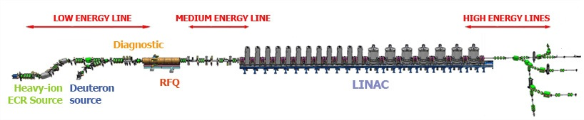
IOC
  I/O or specific HW treatment => 17 VME IOC
  ex : LLRF, beam monitoring (position, losses)
  Modbus/TCP devices and archiving => 48 Linux IOC
  ex: Power converter, Beam profiler, slits
Each machine section has its batch of IOC :
  Sources
  Low - Medium - High energy lines
  RFQ - LINAC
Low Energy Lines
RFQ
Medium Energy line
LINAC
High Energy lines
3 VME IOC - 11 LINUX IOC
1 VME IOC
3 Linux IOC
2 VME IOC - 3 LINUX IOC
10 VME IOC - 24 LINUX IOC
1 VME IOC – 7 LINUX IOC
Heavy-Ion Source
Deuteron Source

Slide 4
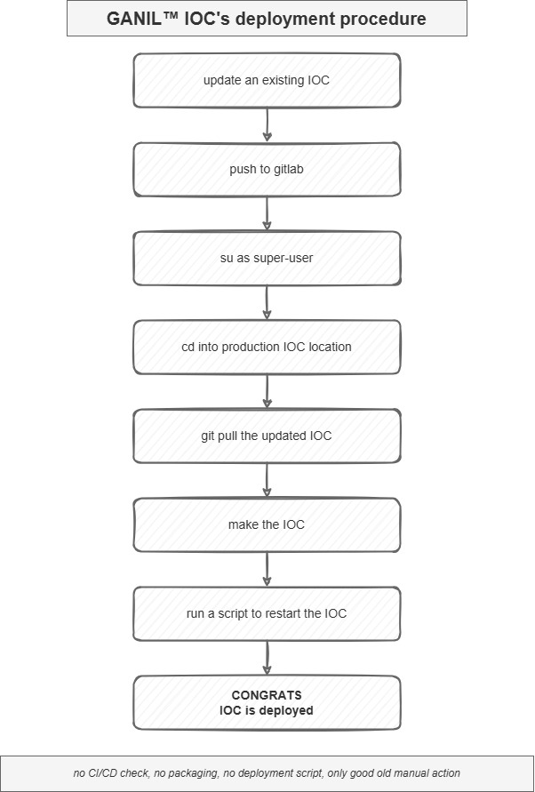
IOC Deployment

Slide 5
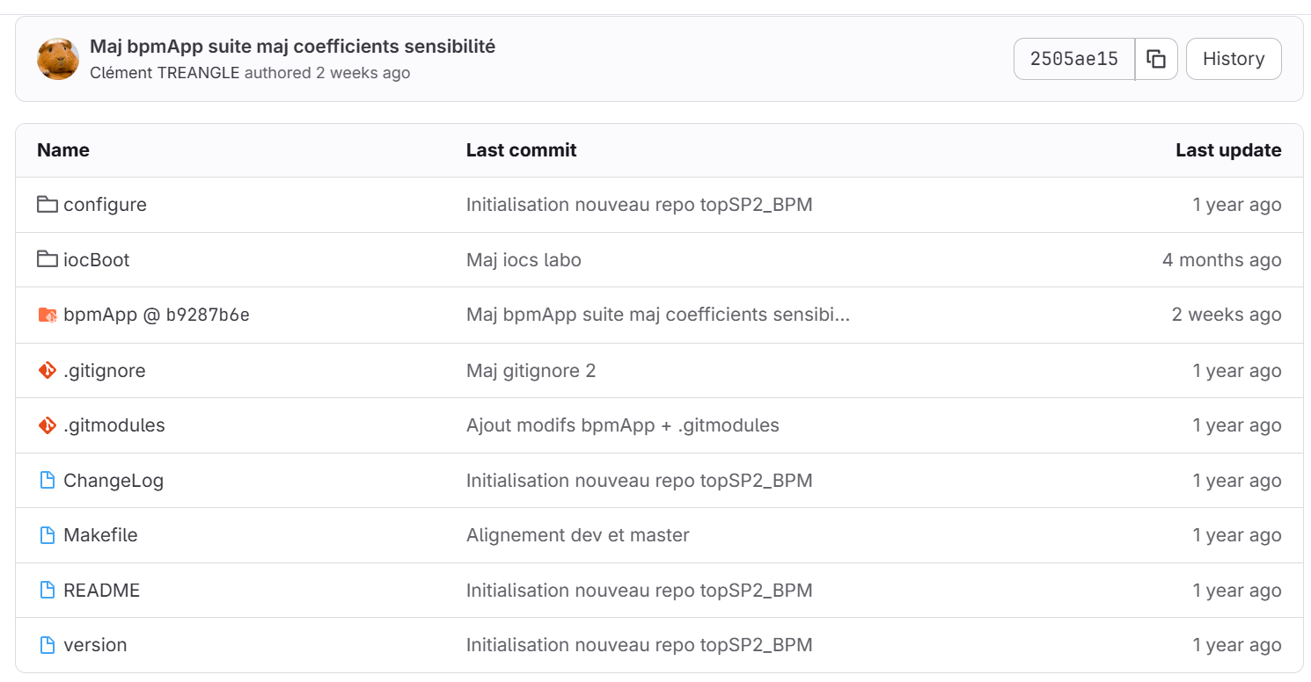
EPICS top overview (1)

Slide 6
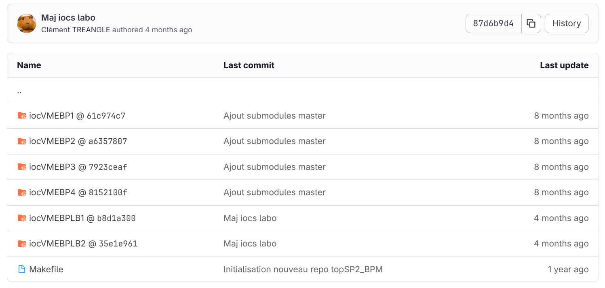
EPICS top overview (2)

